Slide 1
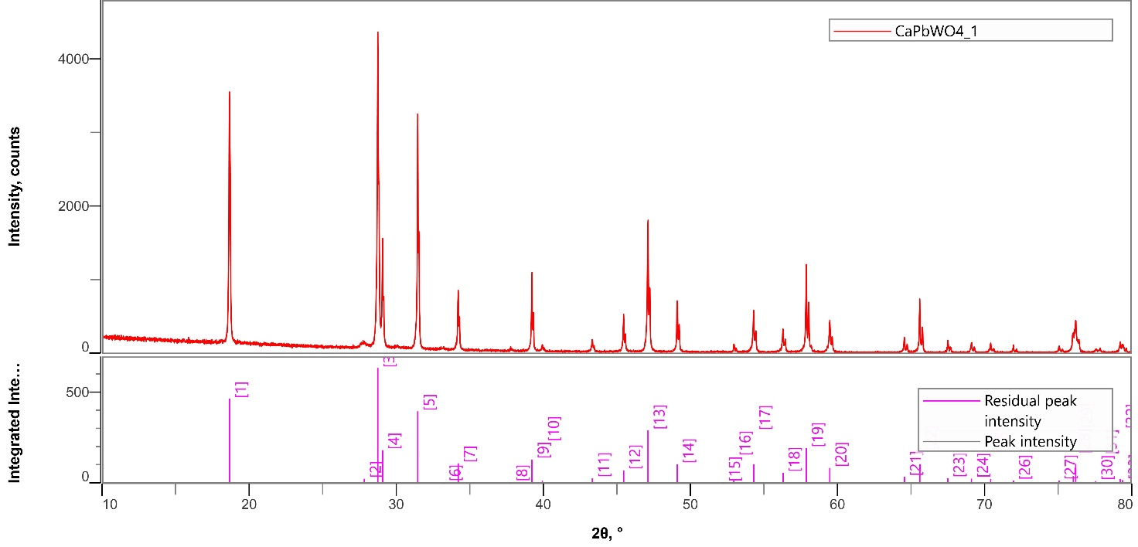
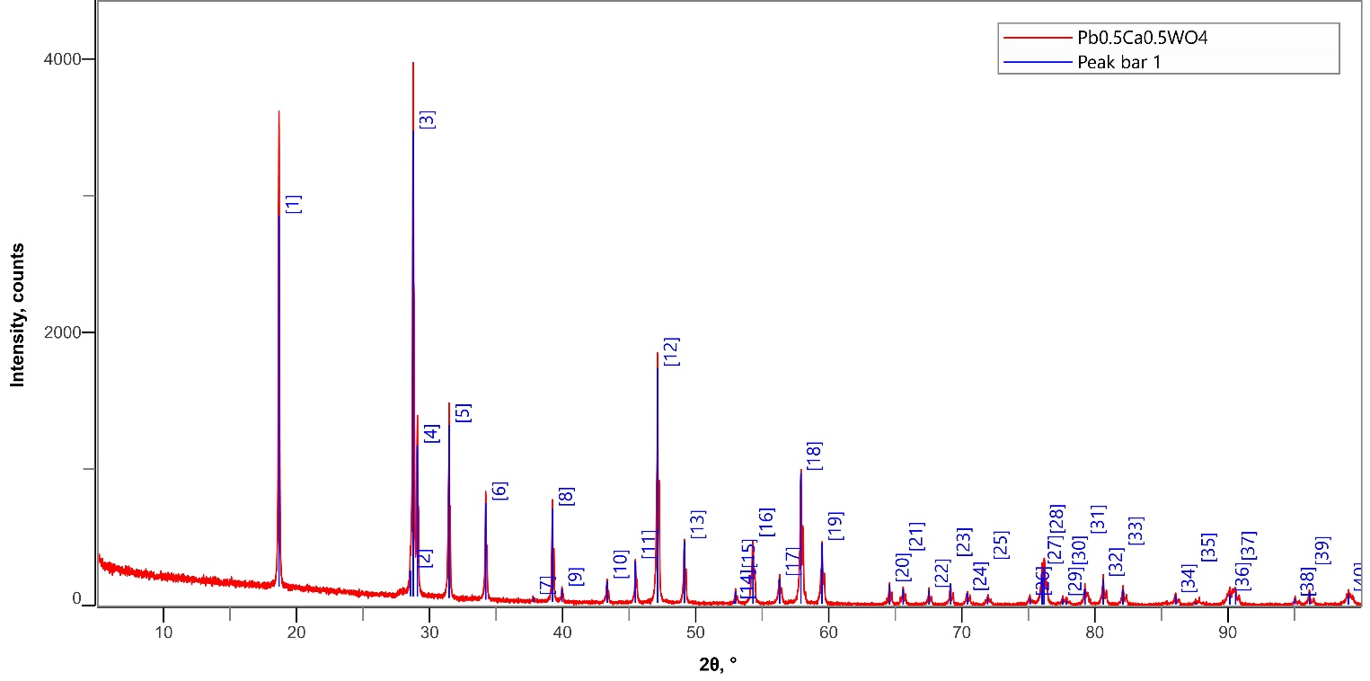
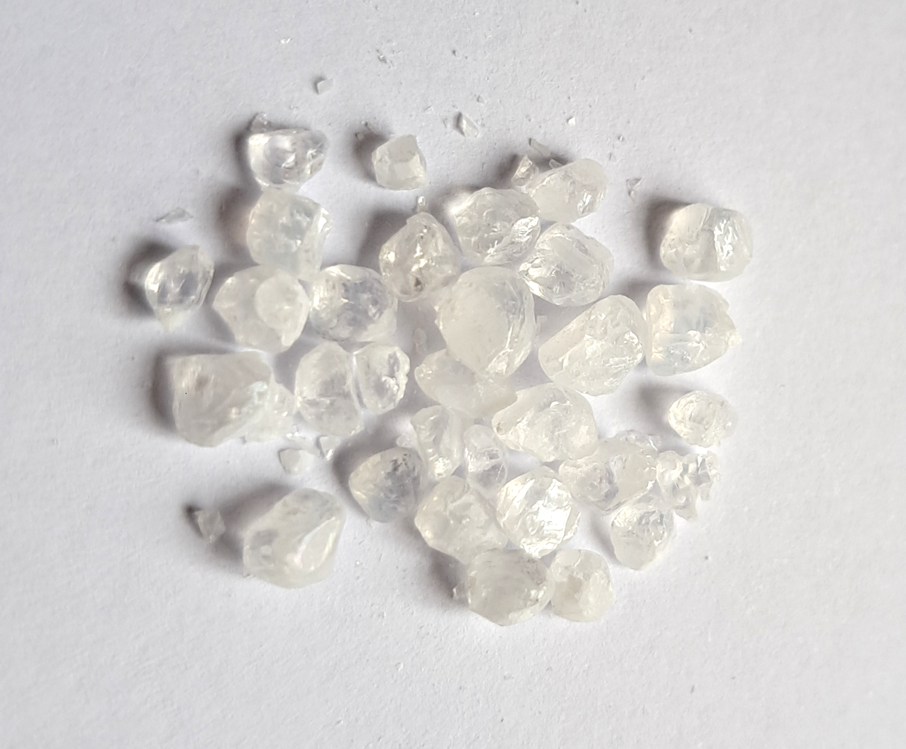
Ca_{x}Pb_{1-x}WO₄ grains (first attempt of production)
Mixed Ca_{x}Pb_{1-x}WO₄ grains were produced by the flux method
(as well as ZnWO₄ and CaWO₄ grains before):
CaCO₃+PbO+WO₃ (in stoichiometric proportions)+Na₂WO₄ (flux)
The yield of the grains is very low at the moment, they are "sticked"
in the flux volume.
According to XRD powder analysis the grains have the crystal lattice
of sheelite (CaWO₄) type.
Real stoichiometric composition of the grains (chemical analysis):
Ca_{0.7}Pb_{0.3}WO₄
Ca_{0.5}Pb_{0.5}WO₄
Nominal composition | Real composition
Ca_{0.7}Pb_{0.3}WO₄ | Ca_{0.75}Pb_{0.25}WO₄ (ensemble of grains)
Ca_{0.5}Pb_{0.5}WO₄ | Ca_{0.75}Pb_{0.25}WO₄ (small grain)
 | Ca_{0.92}Pb_{0.08}WO₄ (medium grain)
 | Ca_{0.91}Pb_{0.09}WO₄ (big grain)

Slide 2
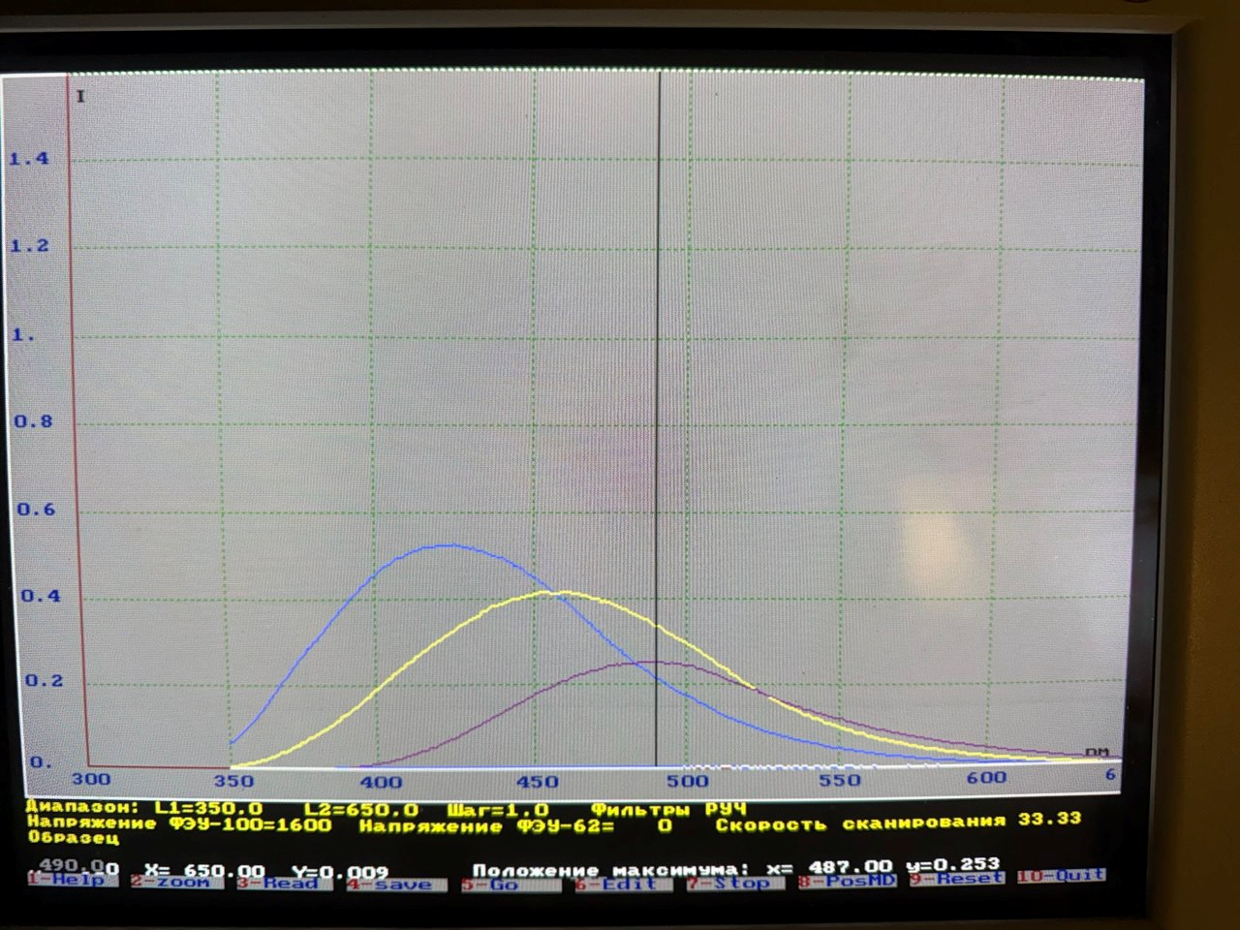
Luminescent properties*
X-ray excited luminescence
Photo-excited luminescence
CaWO₄ grains
Ca_{0.5}Pb_{0.5}WO₄ grains
Intensity, abs.un.
ZnWO₄ grains
Excitation
λ_{em}=440 nm
Emission
λ_{ex}=300 nm
Wavelength, nm
Decay curves under photo-excitation
λ_{ex}=266 nm, λ_{em}=430 nm
τ~5 µs
λ_{ex}=266 nm,
λ_{em}=410 nm
*All luminescent measurements were done using the ensemble of the grains

Slide 3
Brief summary
At the moment, the desired Ca_{0.5}Pb_{0.5}WO₄ composition is not achieved, the highest content of Pb in the grains is 0.25. Is it due to the physical-chemical limits for the solubility? If yes, is Ca_{0.75}Pb_{0.25}WO₄ composition is “acceptable” for GRAiNITA?
What is the bulk density of the mixed grains? For experimental study a sufficient amount (~30-50 cm³) is required.
The real chemical composition changes from one grain to another. How this fact will affect on the uniformity of the scintillation performance? If we have some small amount of the grains in the next future, we can check the light yield for each grain using Am²⁴¹ source as we have done before for ZnWO₄ grains.
The technology for the mixed grains production should and can be ☺ improved to increase the yield, optimize the chemical composition uniformity, etc.

