Slide 1
PSD test at ALTO
p bunches
Bunch length: 2 ns
Easy to switch from a p energy value to another (1h?) and better to go from higher to lower energy
Minimal possible current O(10pA) but beam is instable and no beam control works at this low level of current
If I=30 pA ➔ we have 0.4 p in each bunch ➔ we do not need to work in transmission ➔ no need for a gold layer and a vacuum chamber
We do not need to go through a PAC, we can use commissioning time or industrial activity time, in both cases half-day of time machine is available
We probably need 2 half-days: the first one to set the beam and the second one for the tests
Next slot in October. Otherwise, hopefully in November or end of January
Tables to place the detector at the right position are available, the electronics can be placed on a bench next to the detector. Remote desktop to the acquisition PC from the control room

Slide 2
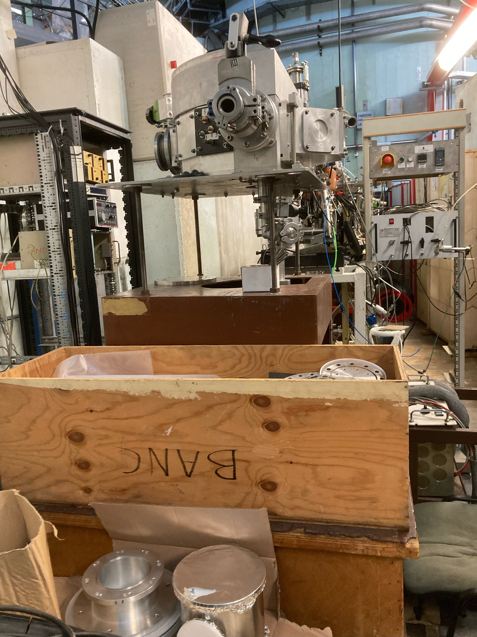
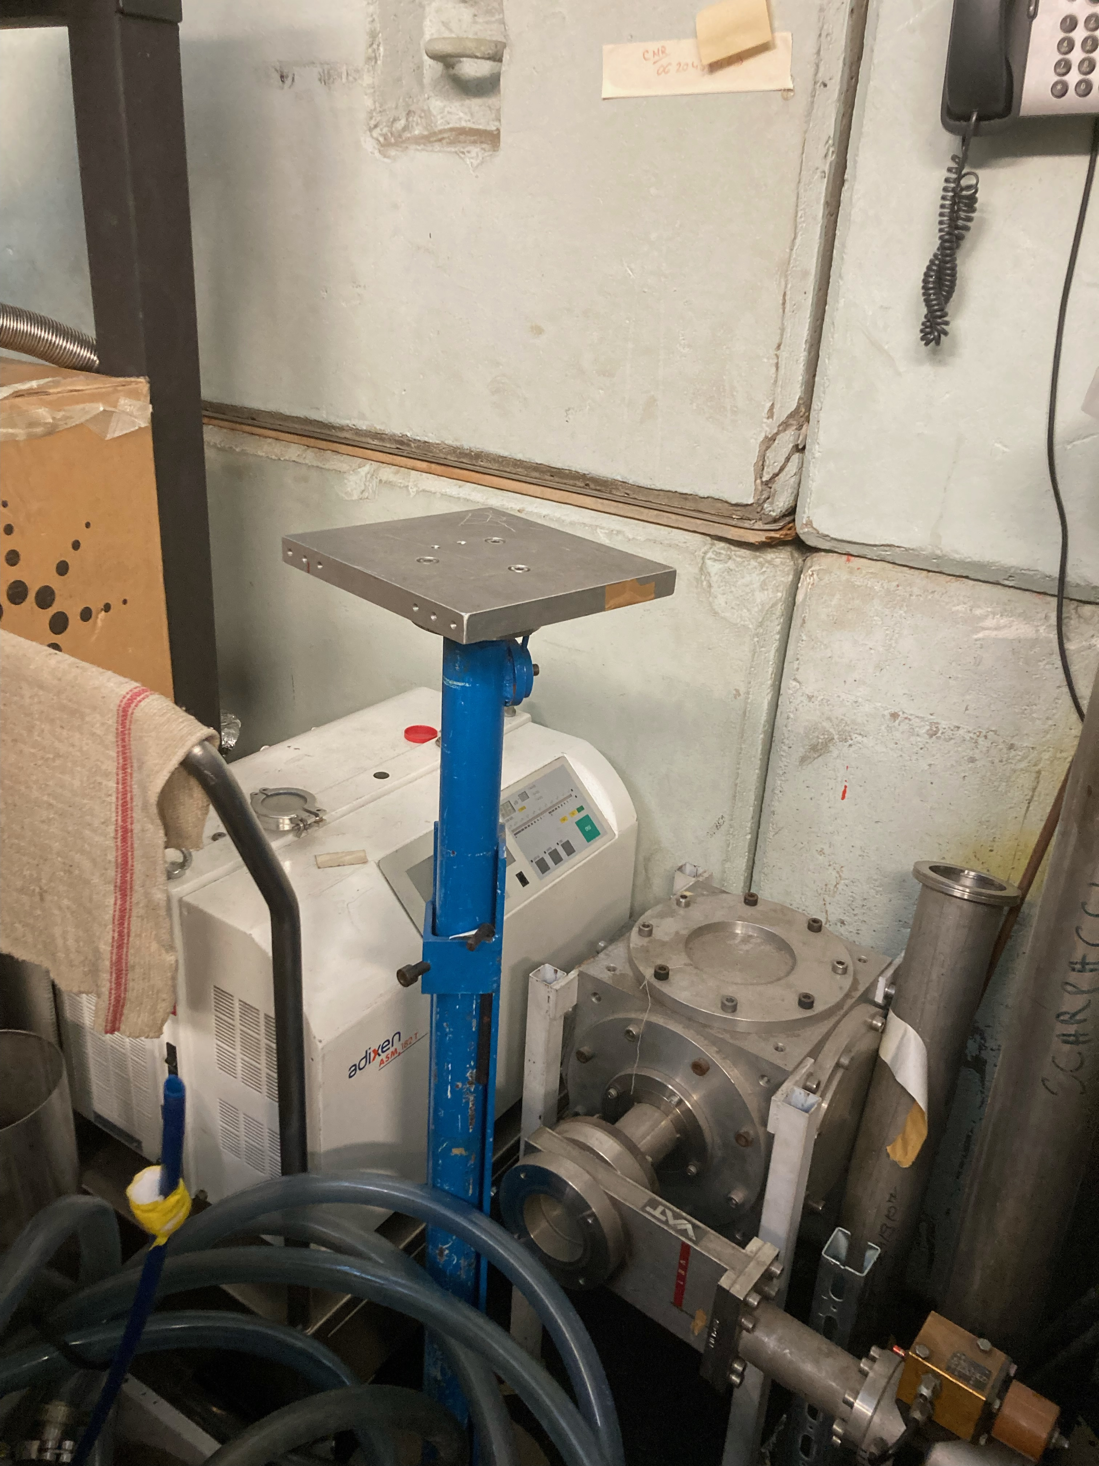
Test beam preparation @ ALTO
First industrial test on Feb 27th, 28th. We need higher p energy → to be confirmed that ALTO can approach 20 - 25 MeV
4 mm of plastic to reduce the beam energy from 25 to 15 MeV.
The beam will be always on, a faraday cage will be used to block the beam and access the test room
Experiment in the 410 test-beam room
Beam at ～1.6m from soil
Several height-adjustable tables are available (20x20, 60x20)
  → we need a support for the PMT to be fixed on the table
The TRG signal will be provided by the machine , 2 ns NIM signal
8 BNC cables available from the beam room to the control room
Need to minimize the material in front the crystal
  → Use of tedlar for light tightness

