Slide 1
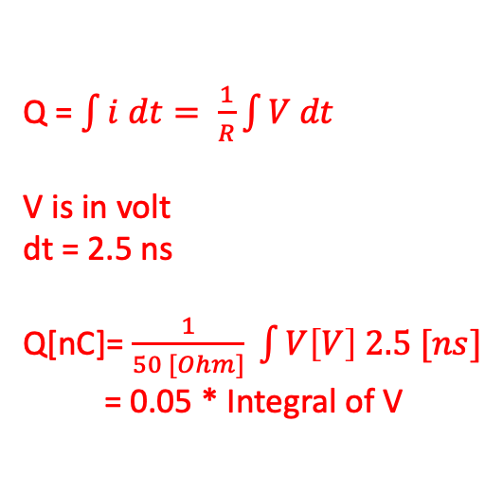
Decay time constant estimation for ZnWO₄
Acquisition of 10k WFs → mean WF production → exponential fit
Selection of the WFs used to produce de mean WF by the charge → small Q events are pure Cherenkov
Q = $\int{i dt}= \frac{1}{R}\int{V dt}$
V is in volt
dt = 2.5 ns
Q[nC]= $\frac{1}{50 [Ohm]} \int{V\left[V\right] 2.5 [ns]}$
= 0.05 * Integral of V

Slide 2
Q<3000
(Q<150 nC)
Q>3000
(Q>150 nC)
Q<8000
(Q<400 nC)
Q>8000
(Q>400 nC)

Slide 4
Selection of the WFs used to produce de mean WF by the charge → small Q events, big Vmax are pure Cherenkov
Q>5000
(Q>250 nC)
V<150mV
Q<5000
(Q<250 nC)
V>150mV

Slide 5
GRAIN | tau |  | Scale |  | tau*scale | %
1 | 0,077 | 8,70E-04 | 25,9 | 0,19 | 1,9943 | 0,21
2 | 0,908 | 0,009 | 18,73 | 0,09 | 17,00684 | 1,79
3 | 5,69 | 0,07 | 13,96 | 0,08 | 79,4324 | 8,36
4 | 25,33 | 0,035 | 33,63 | 0,08 | 851,8479 | 89,64

