Slide 1
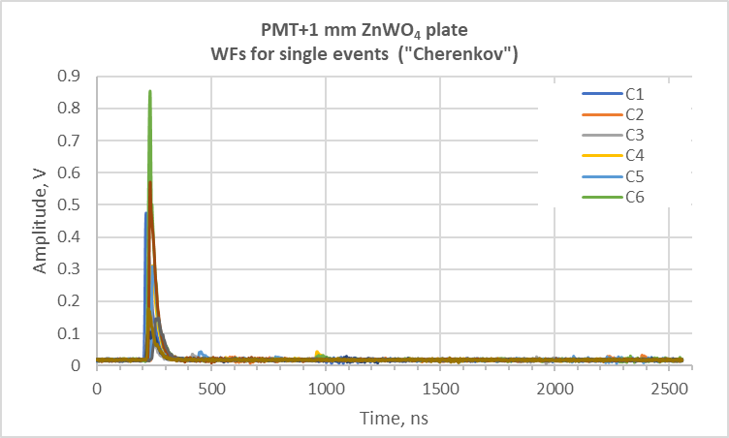
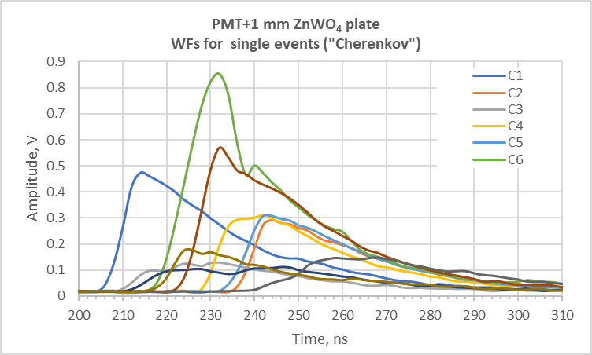
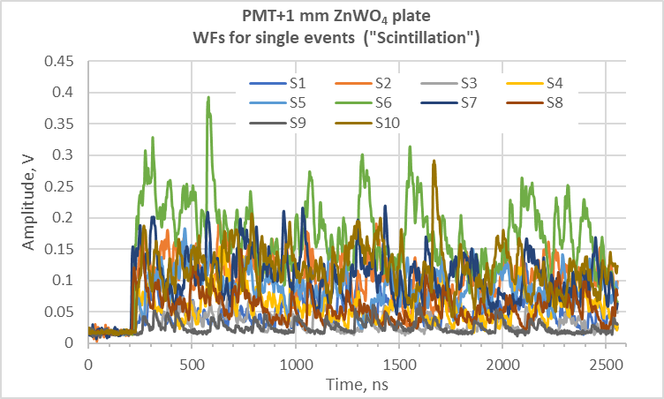
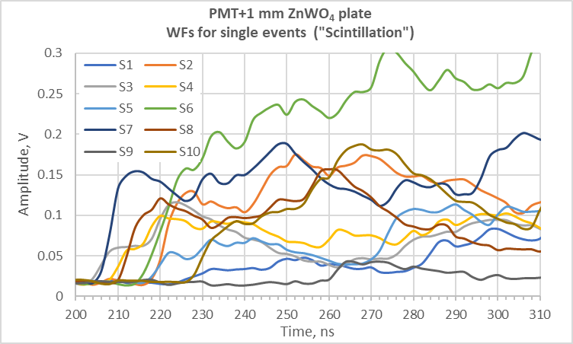
1 mm ZnWO₄ plate coupled to the PMT
?
Zoom in
Zoom in
?
Two main types of the registered pulses:
Cherenkov light from the PMT glass
Scintillation light from the ZnWO₄ plate

Slide 2
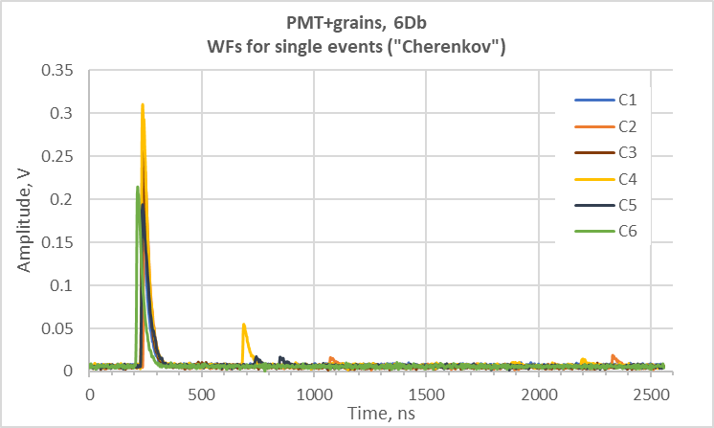
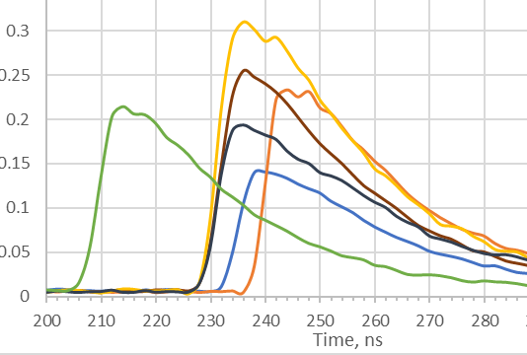
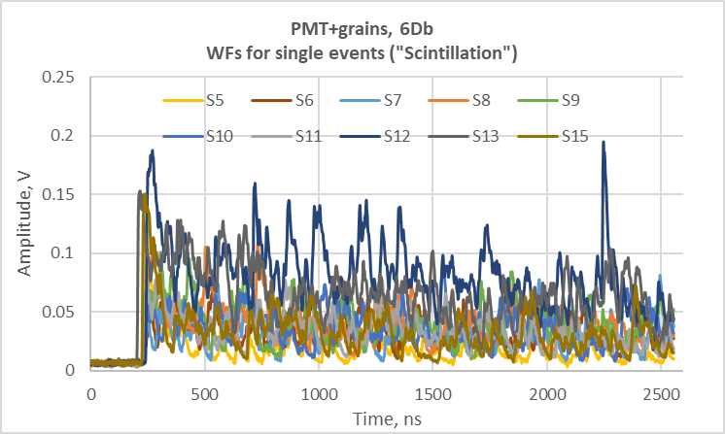
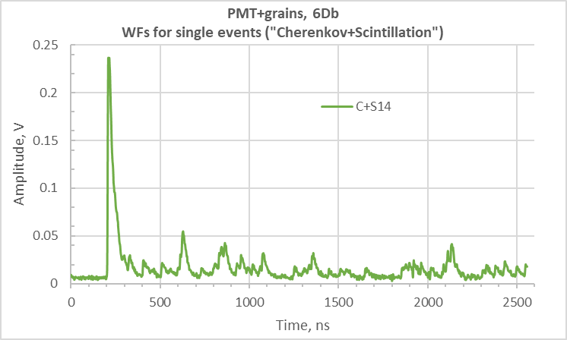
1 mm ZnWO₄ grains coupled to the PMT
?
?
Three main types of the registered pulses:
Cherenkov light from the PMT glass
Scintillation light from the ZnWO₄ plate
Cherenkov+scintillation light from the grains

Slide 3
Comments and conclusion
The previous fitting of the averaged waveforms performed by Giulia should not be impacted by the presence of Cerenkov light
or observed trigger shifting since the contribution of the short time component is very small in comparison
with the main scintillation component (0.21% vs 91.5% for the plate and 0.55% vs 91.3% for the grains).
To clear up the effect of Cerenkov light or trigger shifting , now we are trying to analyze 10 000 individual WFs registered
for separate events. Perhaps, after the “pulse-shape selection”, it will be possible to exclude the Cherenkov pulses/the pulses
with a weird trigger and generate the “clean” averaged waveform for further analysis.

