Slide 1
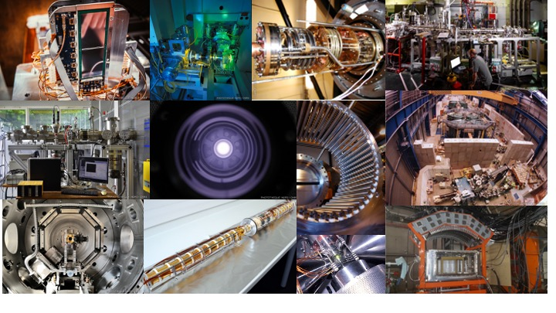
ISOL-France
WORKSHOP VII
April 3-4 2025
https://isolfrance.in2p3.fr/

Slide 2


Welcome
Thanks to:
Nuclear Pole of IJCLab, GDR Resanet and GANIL for financial support
Valérie Brouillard, Emilie Bonnardel and the Events team of IJCLab for the organization

Slide 3
Welcome
Scope and program
Session 1. Status of Facilities and Beams
Session 2. Decay Spectroscopy
Session 3. Mass Measurements and Traps
Session 4. Fundamental Interactions
Session 5. Laser Spectroscopy
Discussion :
  Certain questions prepared in advance
  Other questions - don’t hesitate to intervene
Slides on Indico or to ISOL-France bureau
No Badge, please introduce yourself when asking a question

Slide 4
Welcome
ISOL-France website

Slide 5
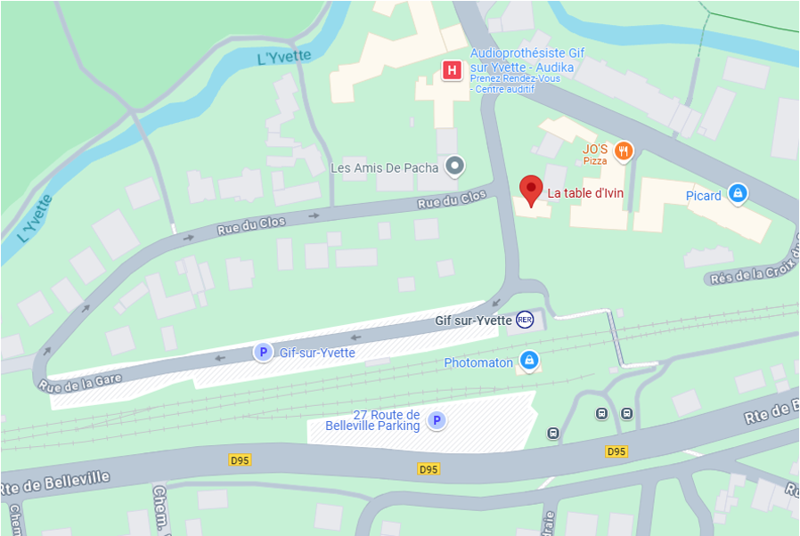
Welcome
Coffee breaks in front of the meeting room
Welcome coffee/tea also next morning in front of the meeting room
Buffet-style lunches will be organized in the building 102 (across the street)
Photo today after lunch break
Dinner will take place at the restaurant « La Table d’Ivin »
Very close to the RER B station « Gif sur Yvette »
Check your menu choices on the Evento

Slide 6
Discussion : Facilities and Beams
• Timeline S3 and DESIR :
  Equipment arrival at GANIL?
  Start of the facilities?
  First experiments? Participation commissioning experiments.

Slide 7
Discussion : Facilities and Beams
• Timeline S3 and DESIR :
  Equipment arrival at GANIL?
  Start of the facilities?
  First experiments? Participation commissioning experiments.
• Human resources :
  Status of position opening for DESIR? PhD, post-doc?
  Positions to come in the context of S3 and DESIR? CRCN, MC, CPJ?
  How and when will/can the responsibility for an equipment be transferred to GANIL? (e.g. : operation of HRS, GPIB...)?

Slide 8
Discussion : Facilities and Beams
• Timeline S3 and DESIR :
  Equipment arrival at GANIL?
  Start of the facilities?
  First experiments? Participation commissioning experiments.
• Human resources :
  Status of position opening for DESIR? PhD, post-doc?
  Positions to come in the context of S3 and DESIR? CRCN, MC, CPJ?
  How and when will/can the responsibility for an equipment be transferred to GANIL? (e.g. : operation of HRS, GPIB...)?
• Organisation of GANIL as a « user facility » :
  administrative implications
  organization of long-term missions

Slide 9
Discussion : Facilities and Beams
• Timeline S3 and DESIR :
  Equipment arrival at GANIL?
  Start of the facilities?
  First experiments? Participation commissioning experiments.
• Human resources :
  Status of position opening for DESIR? PhD, post-doc?
  Positions to come in the context of S3 and DESIR? CRCN, MC, CPJ?
  How and when will/can the responsibility for an equipment be transferred to GANIL? (e.g. : operation of HRS, GPIB...)?
• Organisation of GANIL as a « user facility » :
  administrative implications
  organization of long-term missions
SPIRAL1 open questions :
  Laser ion source
  Batch mode
  MNT

Slide 10

Discussion - Conclusion
National Events
  Could we better coordinate ?
  Common workshop S³ - DESIR - ISOL-France ?
Common DAQ @GANIL ?
  several tools under development or upgrade
  common data format?
  DAQ = GANIL responsibility or user’s ?
  GANIL’s network access ? Data management plan ?
  ISOL-France community needs ?
  -> Survey to come to consult the community
new COMET
NARVAL/DCOD
AGATA DAQBox
NUMEXO
ISOL-France : budget ?
  Ask for recurring budget from in2p3 ?
PERIF
  New PERIF 2025 : S.Lecanuet @IJCLab
  New Agreement : simpler and more flexible

Slide 11
Conclusion of the WS
How to facilitate the access of our facilities to international/national collaborators ?
  need send a request to the GUEC for new & more flexible procedures
  administration, access, long term stays, pays and reimbursements etc.
  ➭ upcoming survey to gather the needs of the community
ID Station and Decay Station for DESIR
  need for a PI : point for our next Strategy Meeting (new recruits at CEA/CNRS etc.)

