Slide 1
ISOL France 2025
News from ALTO-LEB experiments
Emile Cantacuzène
3rd year PhD
Under the supervision of David Verney
April 2025
IJCLab – Nuclear pole - Team FIIRST

Slide 2
Outline
I. Structure above the neutron threshold at ALTO
a. The ALTO facility
b. Beta-delayed neutron emission : state of the art
II. Experiment : TETRA2023
a. Experimental setup
b. New method for beta-delayed neutron spectroscopy
c. Beta-delayed two-neutron emission of ${}_{}^{84}{Ga}$
III. Experiment : MONSTER2025
a. Experimental setup and challenges
b. Preliminary analysis

Slide 3
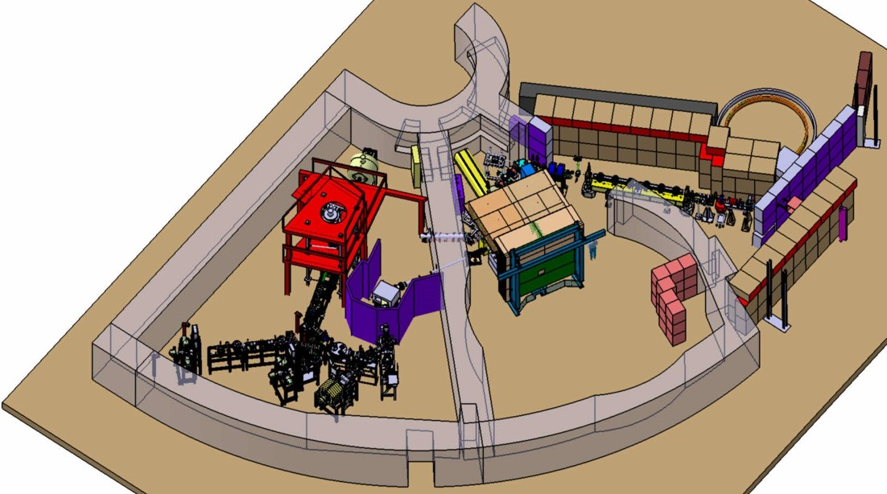
The ALTO facility
ALTO Low Energy Branch : An ISOL facility
I. Structure above the neutron threshold at ALTO
1

Slide 4
The ALTO facility
ALTO Low Energy Branch : An ISOL facility
- Electron linear accelerator
- 50 MeV energy
- 10 μA current
I. Structure above the neutron threshold at ALTO
1

Slide 5
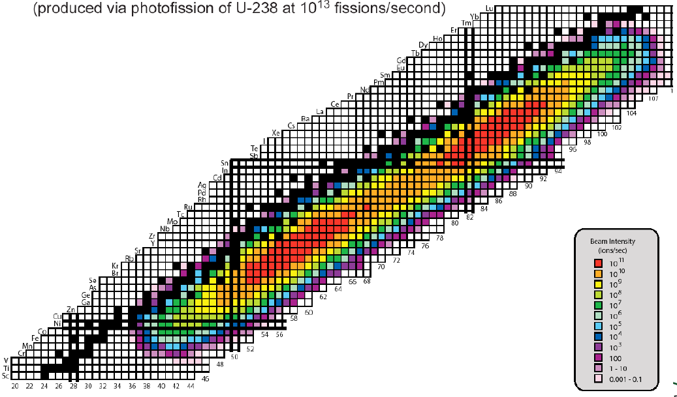
The ALTO facility
ALTO Low Energy Branch : An ISOL facility
- Electron linear accelerator
- 50 MeV energy
- 10 μA current
- Thick UCx target
- Photofission
- Heated up to 2000 °C
No contribution in neutron deficient isotopes
I. Structure above the neutron threshold at ALTO
1

Slide 6
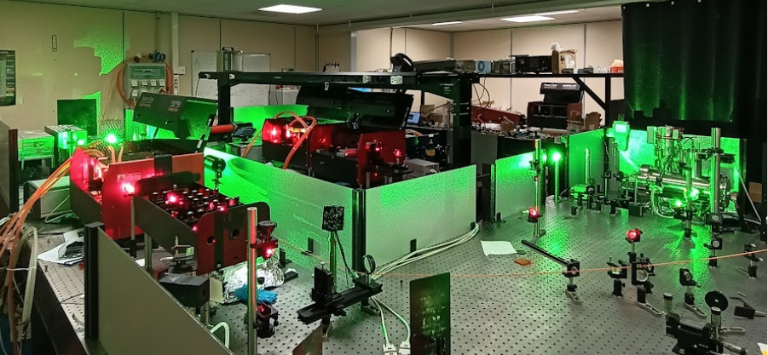
The ALTO facility
ALTO Low Energy Branch : An ISOL facility
- Electron linear accelerator
- 50 MeV energy
- 10 μA current
- Thick UCx target
- Photofission
- Heated up to 2000 °C
- Laser ionization
- Selection in Z
I. Structure above the neutron threshold at ALTO
1

Slide 7
The ALTO facility
ALTO Low Energy Branch : An ISOL facility
- Electron linear accelerator
- 50 MeV energy
- 10 μA current
- Thick UCx target
- Photofission
- Heated up to 2000 °C
- Laser ionization
- Selection in Z
- Mass separation
- Selection in A
I. Structure above the neutron threshold at ALTO
1

Slide 8
The ALTO facility
ALTO Low Energy Branch : An ISOL facility
- Electron linear accelerator
- 50 MeV energy
- 10 μA current
- Thick UCx target
- Photofission
- Heated up to 2000 °C
- Laser ionization
- Selection in Z
- Mass separation
- Selection in A
- Beta-decay stations
- Conversion electrons (COeCO)
- Gamma spectroscopy (BEDO)
- Neutron emission (TETRA)
2 last experiments (Nov 2023, Feb 2025) : Bringin neutron energy aspect at ALTO!
I. Structure above the neutron threshold at ALTO
1

Slide 9
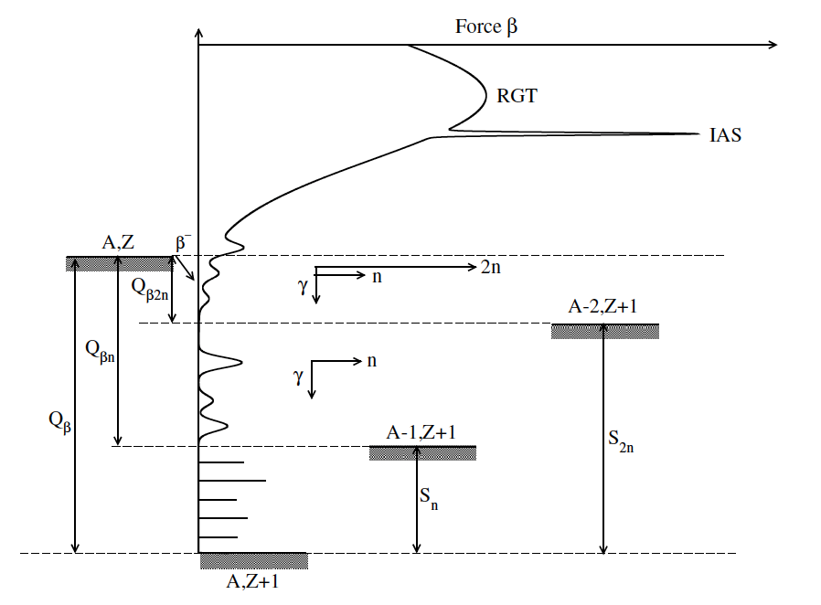
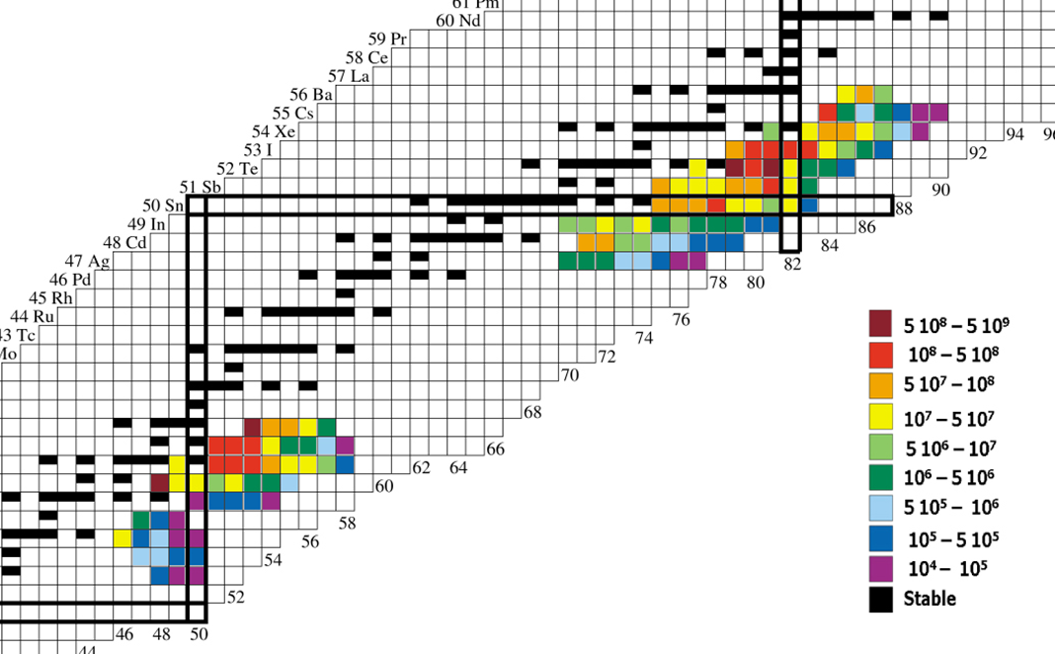
Beta-delayed neutron emission : state of the art
General overview
$${}_{}^{132}{Sn}$$
$${}_{}^{78}{Ni}$$
Fission fragments produced at ALTO
(measured in 2006 with hot ion plasma source)
$Q_{β−n}=Q_{β}−S_{n}$
$P_{n}$: Probability for the daughter nucleus to emit at least one neutron after the beta decay
$Q_{β−n}=Q_{β}−S_{n}$
$P_{n}$: Probability for the daughter nucleus to emit at least one neutron after the beta decay
: Available energy for neutrons
: Available energy for neutrons
Cf. Roberts et al. (1939)
I. Structure above the neutron threshold at ALTO
2

Slide 10
Outline
I. Structure above the neutron threshold at ALTO
a. The ALTO facility
b. Beta-delayed neutron emission : state of the art
II. Experiment : TETRA2023
a. Experimental setup
b. New method for beta-delayed neutron spectroscopy
c. Beta-delayed two-neutron emission of ${}_{}^{84}{Ga}$
III. Experiment : MONSTER2025
a. Experimental setup and challenges
b. Preliminary analysis

Slide 11
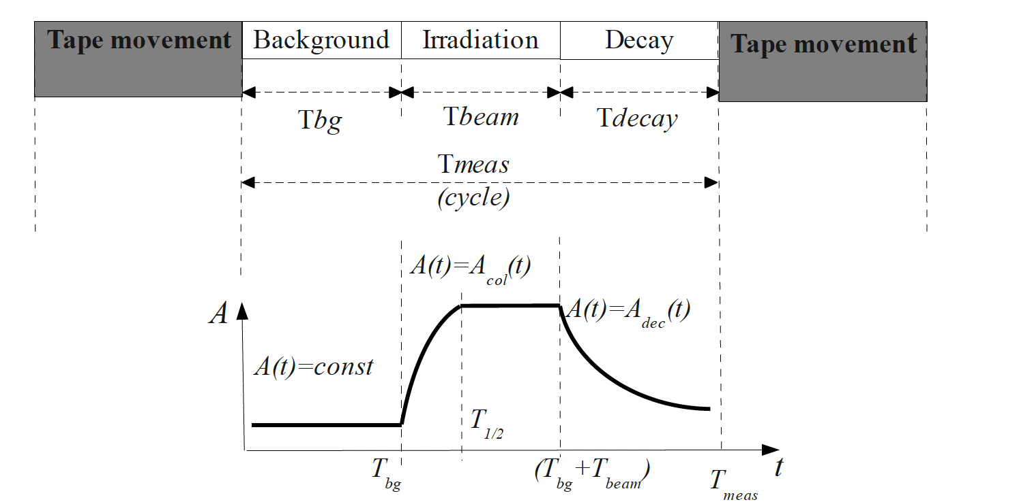
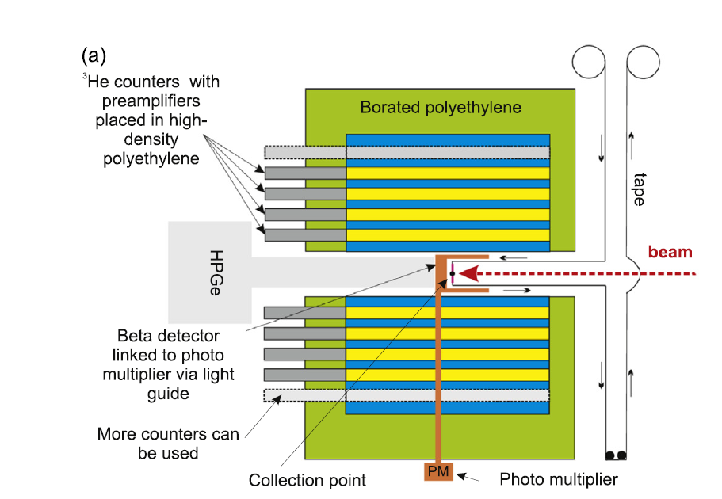
Experimental setup
Collection – Decay cycles
A neutron long-counter setup
Cf. Testov et al. Nuclear Instruments and Methods in Physics Research A 815 (2016)
II. Experiment : TETRA2023
3

Slide 12
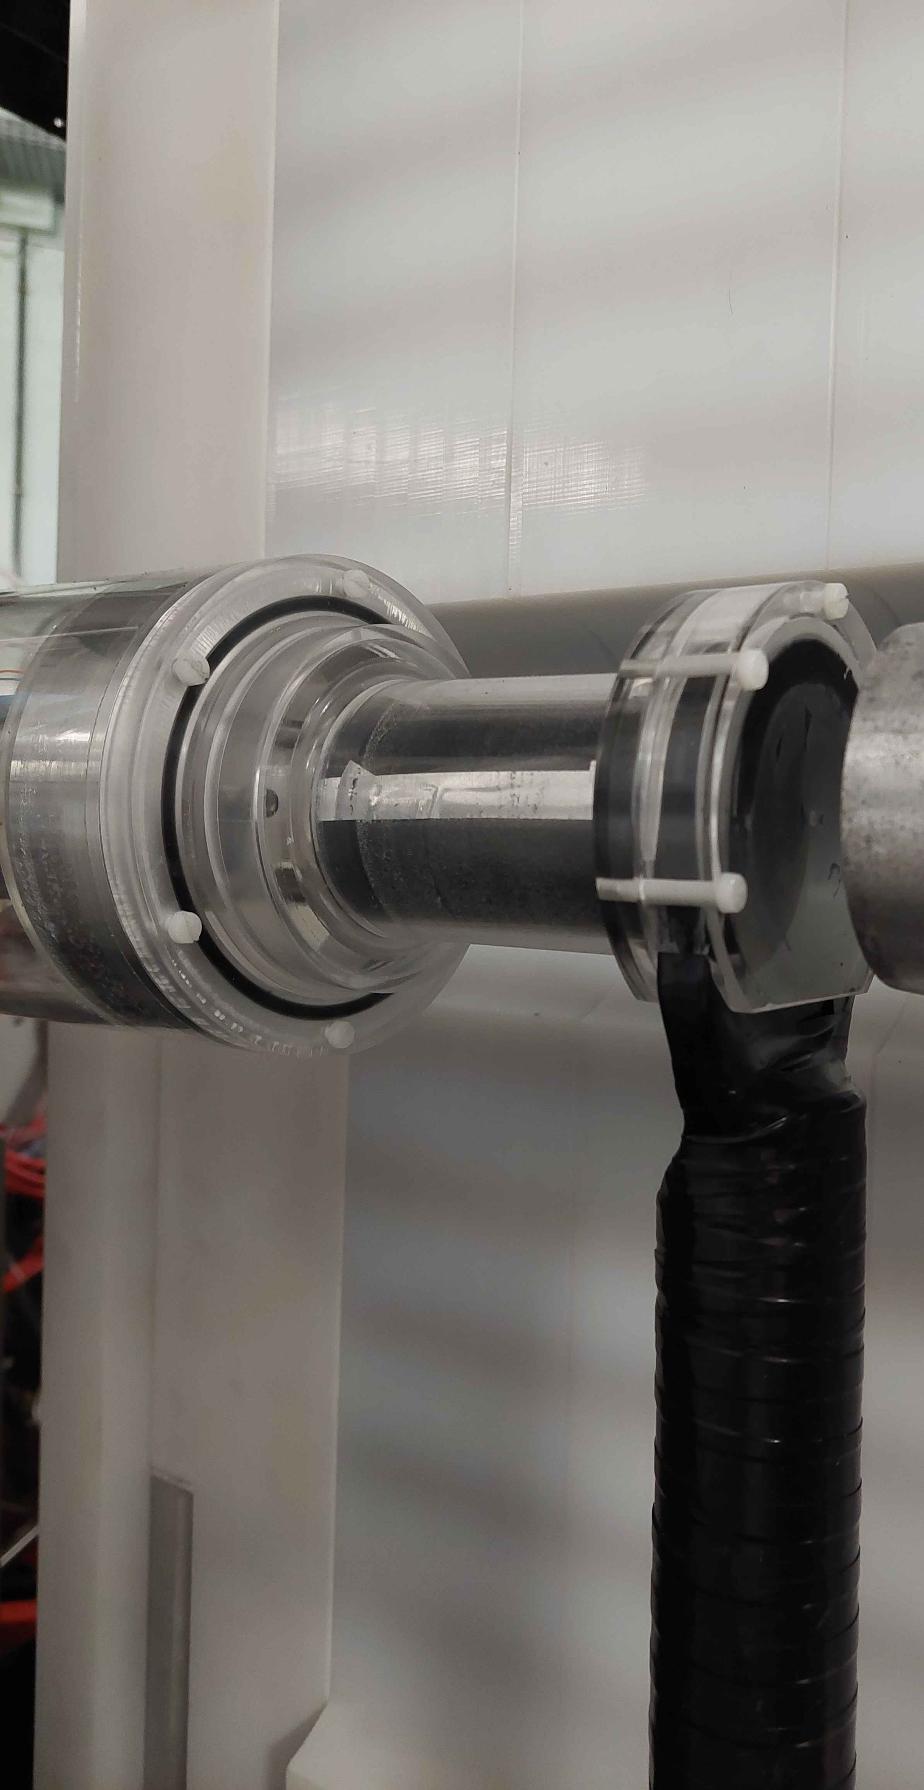
Experimental setup
Collection – Decay cycles
A neutron long-counter setup
4π-β plastic scintillator
Detection of β-electrons
Around 70% efficiency
Cf. Testov et al. Nuclear Instruments and Methods in Physics Research A 815 (2016)
II. Experiment : TETRA2023
3

Slide 13
Experimental setup
Collection – Decay cycles
A neutron long-counter setup
4π-β plastic scintillator
Detection of β-electrons
Around 70% efficiency
HPGe detector
Detection of γ rays
0.66% efficiency @ 964.1 keV
Cf. Testov et al. Nuclear Instruments and Methods in Physics Research A 815 (2016)
II. Experiment : TETRA2023
3

Slide 14
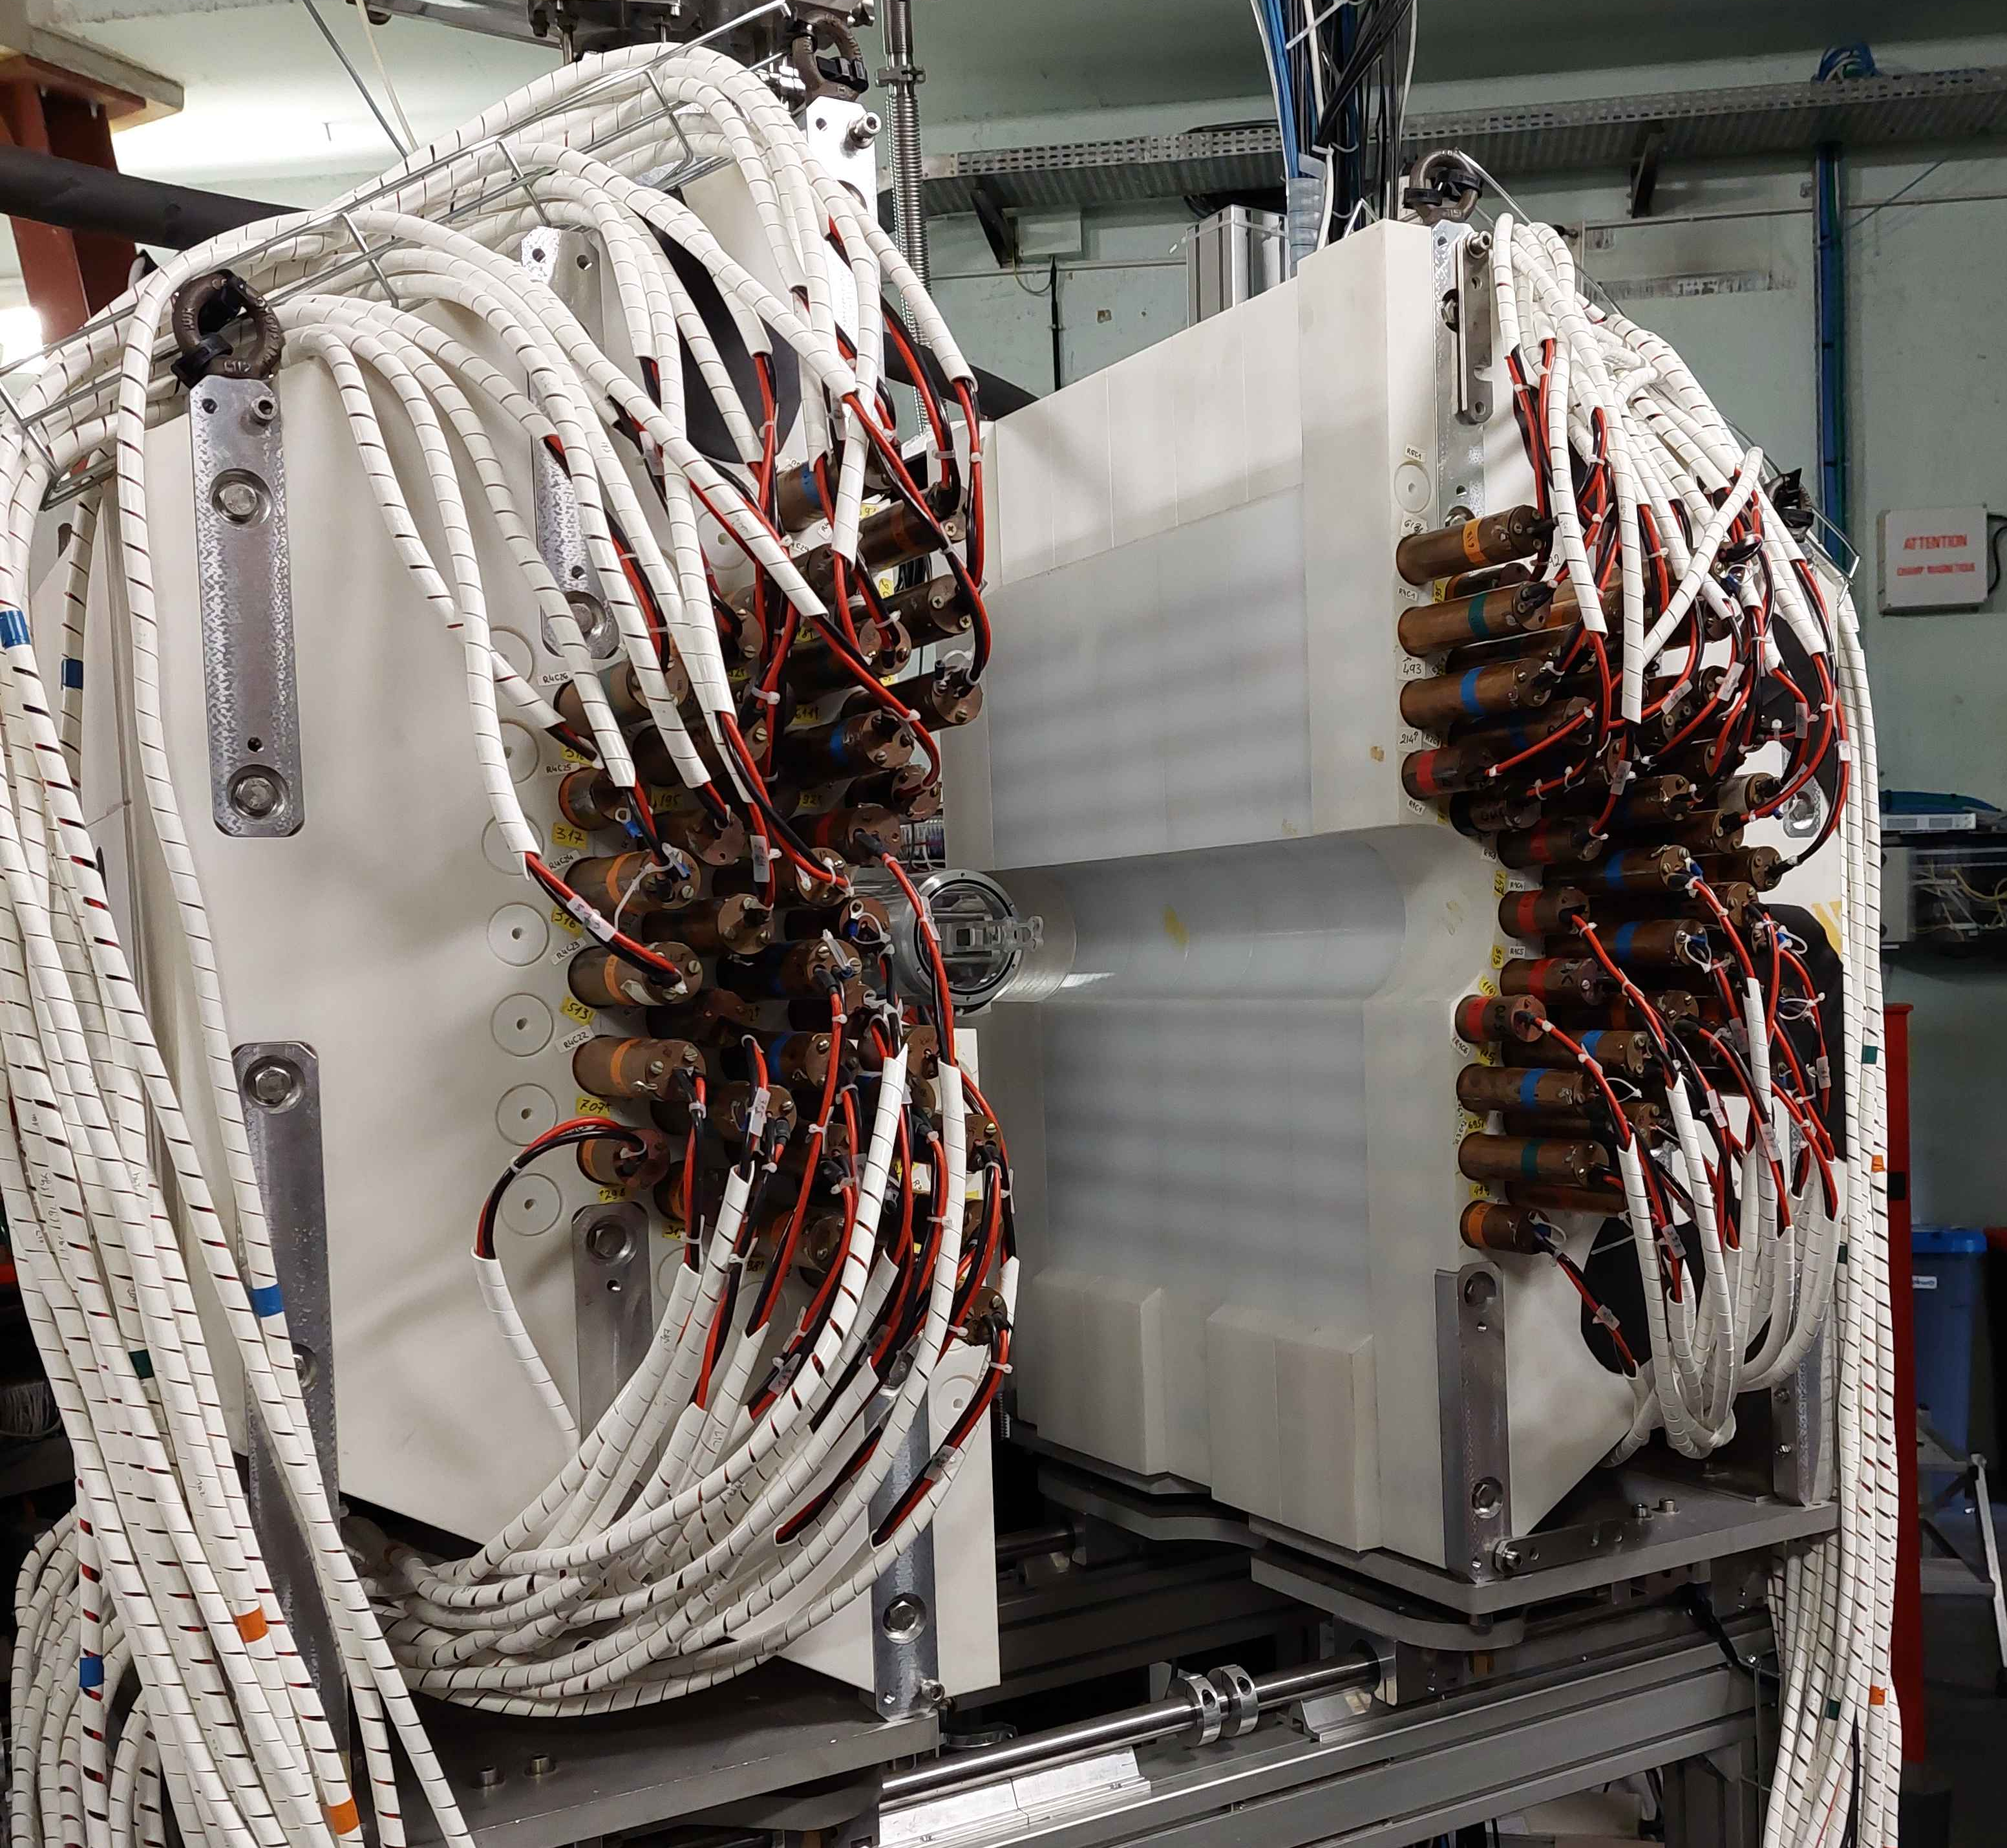
Experimental setup
Collection – Decay cycles
A neutron long-counter setup
4π-β plastic scintillator
Detection of β-electrons
Around 70% efficiency
HPGe detector
Detection of γ rays
0.66% efficiency @ 964.1 keV
Slow neutron counter TETRA
- Detection of neutrons
No energy information
Around 50% efficiency
Cf. Testov et al. Nuclear Instruments and Methods in Physics Research A 815 (2016)
II. Experiment : TETRA2023
3

Slide 15
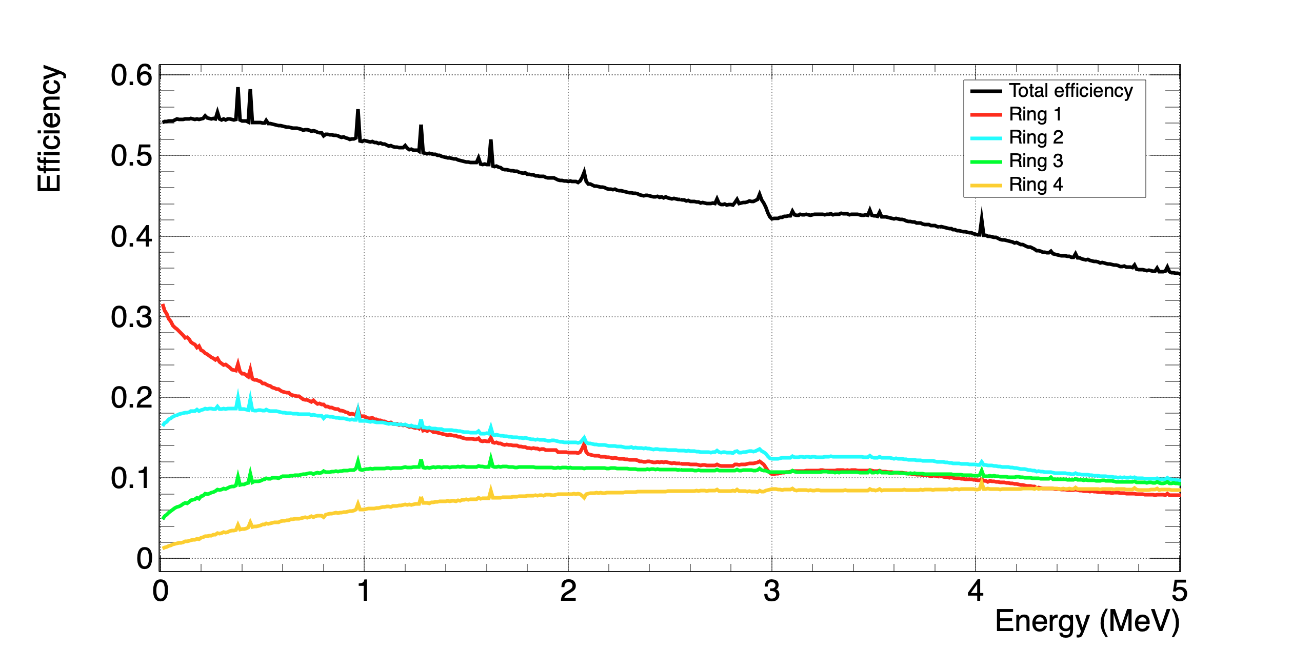
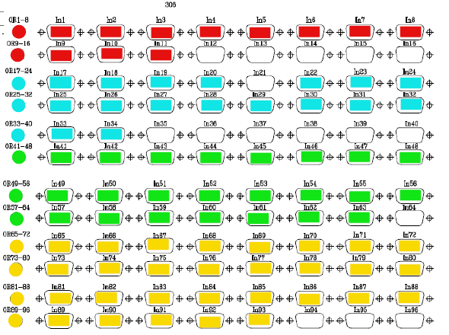
New method for beta-delayed neutron spectroscopy
Principle of the method
Efficiency as a function of mean neutron energy
MCNP simulation :
- 80 cells arranged in 4 rings
- Thermal neutron physics
- Realistic pressure in cells (around 2bars)
- 99% ${}_{}^{3}{He}$ and 1% CO₂ mixture
Neutron penetration increases with energy
Counts per ring available with TETRA segmented electronic
II. Experiment : TETRA2023
4

Slide 16
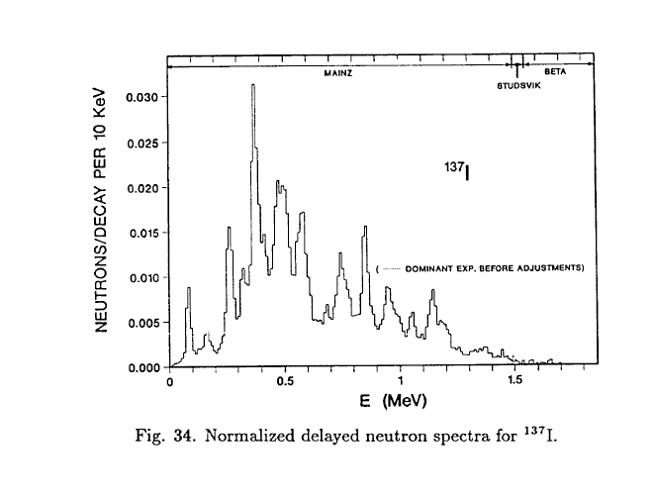
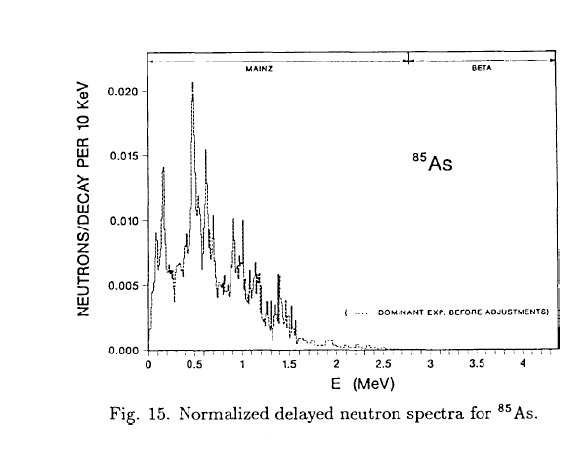
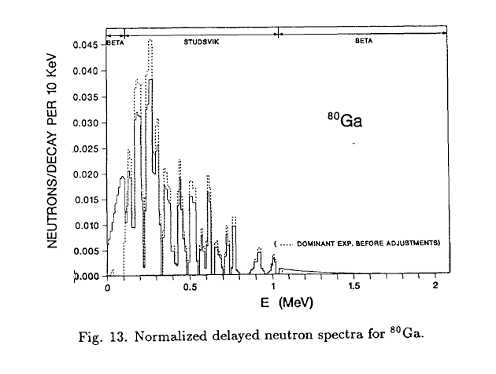
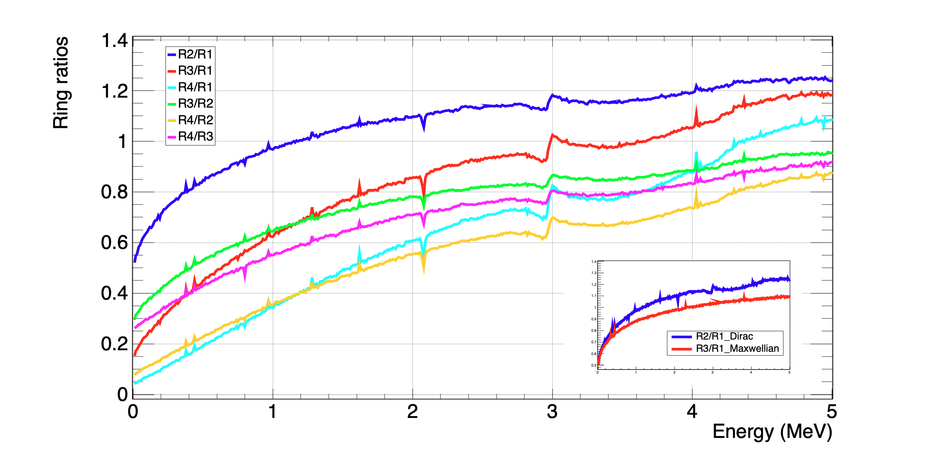
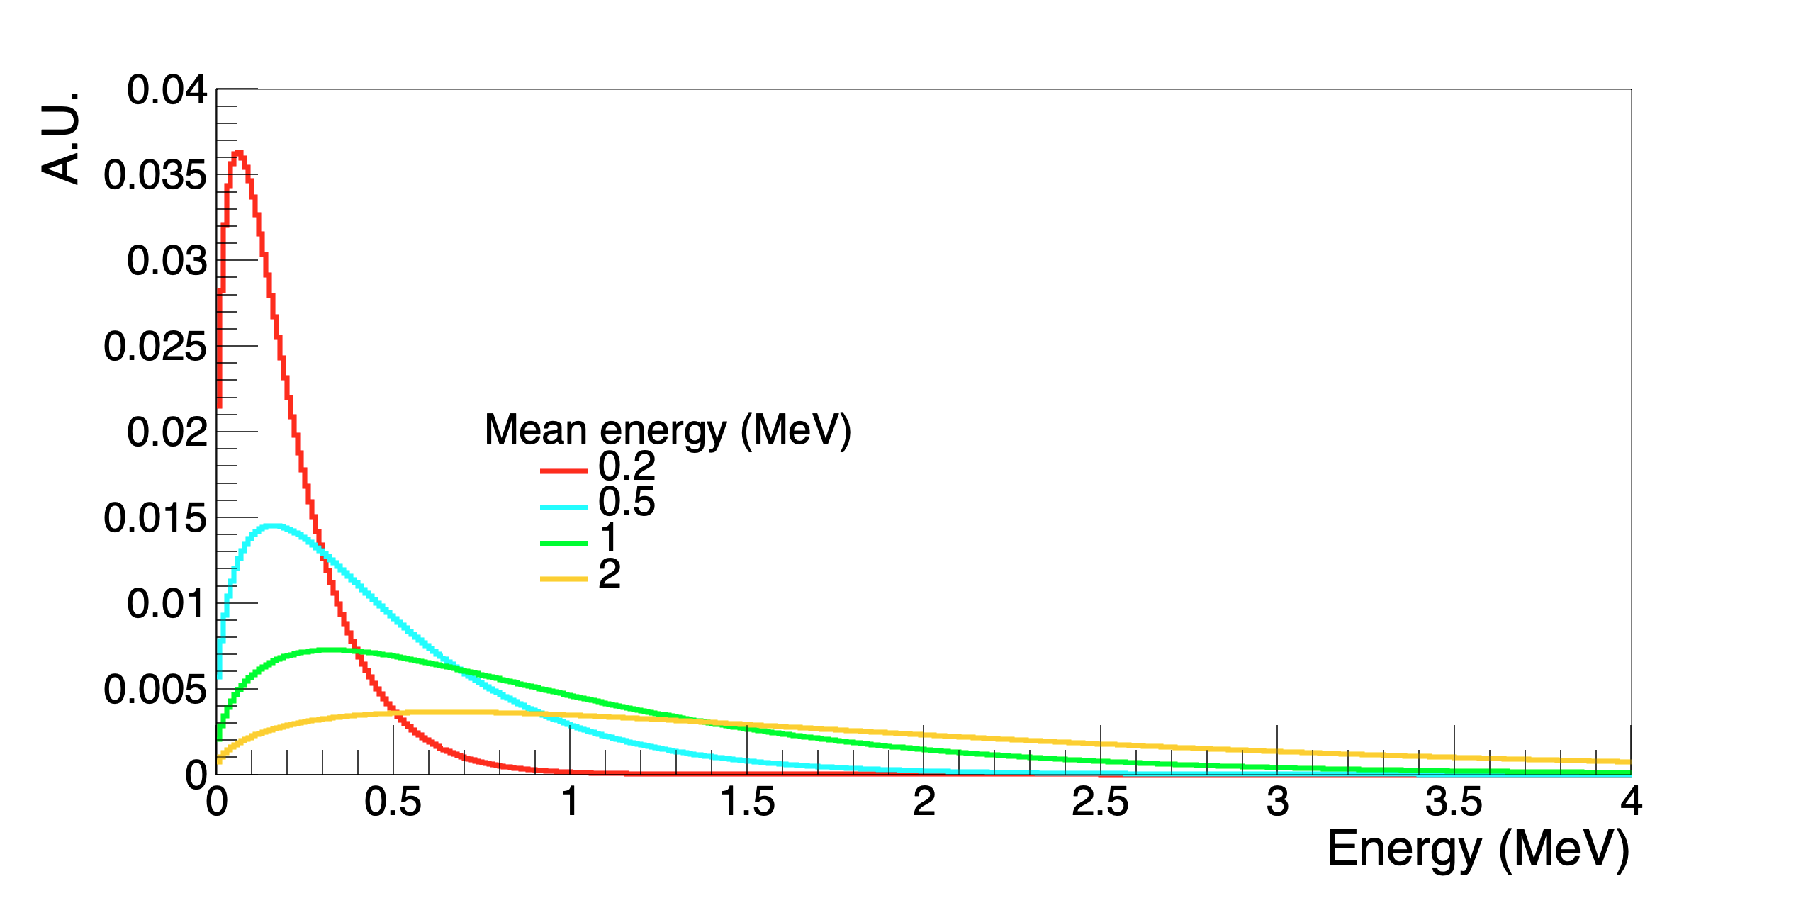
New method for beta-delayed neutron spectroscopy
Ring-ratios method
Ring-ratios as a function of mean neutron energy
f$\left(E\right)∝\sqrt{E}e^{−\frac{E}{T}}$
$$\overline{E}=\frac{3T}{2}$$
Mean energy prediction depends on shape of primary distribution
Cf. "Evaluation and Application of Delayed Neutron Precursor Data" Michaele Clarice Brady
Predictions of mean neutron energy using ring-ratios method
II. Experiment : TETRA2023
5

Slide 17
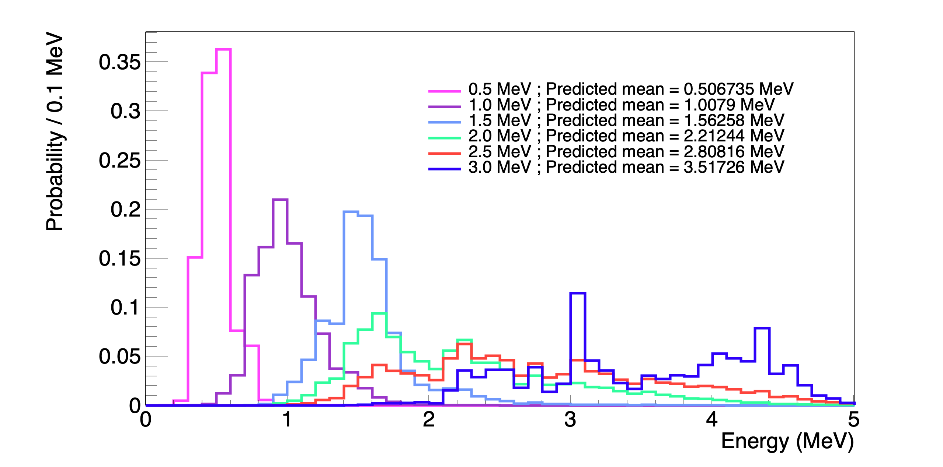
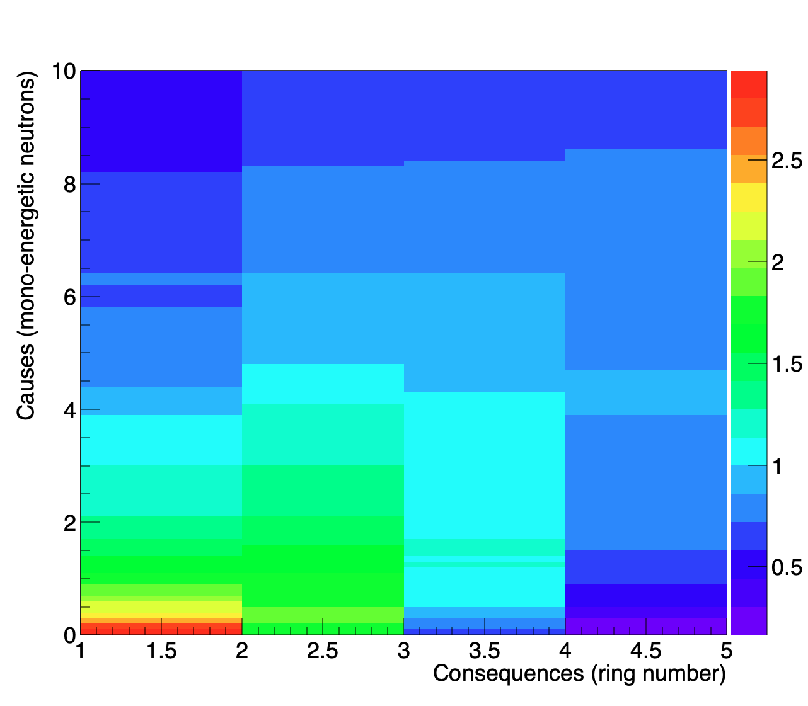
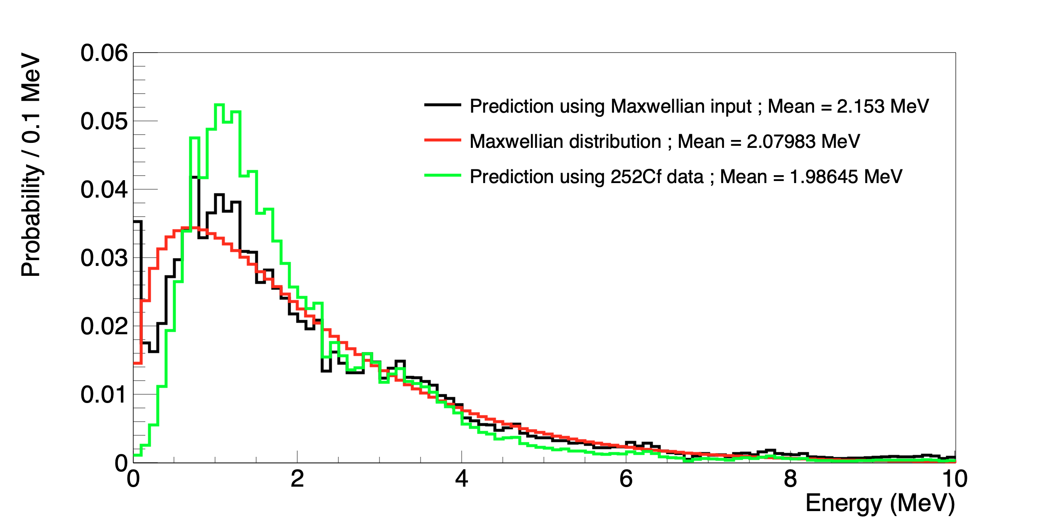
New method for beta-delayed neutron spectroscopy
Iterative Bayesian unfolding method
Relates folded distribution to real one
Uncertainty increases with mean energy !
Predictions for simulated mono-energetic distributions
Predictions for simulated neutron spectra
Prediction from data with ²⁵²Cf source
II. Experiment : TETRA2023
6

Slide 18
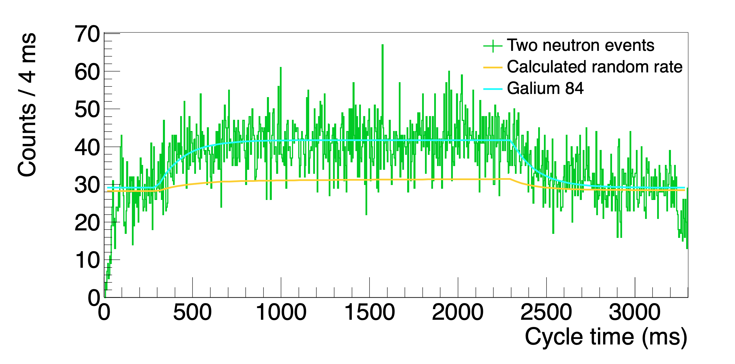
Beta-delayed two-neutron emission of ${}_{}^{84}{Ga}$
β-2n branching ratio
β-decay
${}_{}^{84}{Ga}$
2n-emission
2+
$$P2n=1.6±0.2\%$$
1348 keV
S2n
0+
S1n
${}_{}^{82}{Ge}$
${}_{}^{83}{Ge}$
1219.5 keV (${}_{}^{83}{Ge}$ → ${}_{}^{83}{As}$ )
1348 keV (${}_{}^{84}{Ga}$ → ${}_{}^{82}{Ge}$ )
${}_{}^{84}{Ge}$
1455 keV (${}_{}^{84}{As}$ → ${}_{}^{84}{Se}$)
1381 keV (${}_{}^{83}{As}$ → ${}_{}^{83}{Se}$ )
A high feeding of the 2+ state in the beta-2n channel
At odds with a statistical decay picture !
Interpretation under discussion
Can be compared to another measurement made at BRIKEN Cf. Yokoyama et al. PRC 108 (2023)
II. Experiment : TETRA2023
7

Slide 19
Outline
I. Structure above the neutron threshold at ALTO
a. The ALTO facility
b. Beta-delayed neutron emission : state of the art
II. Experiment : TETRA2023
a. Experimental setup
b. New method for beta-delayed neutron spectroscopy
c. Beta-delayed two-neutron emission of ${}_{}^{84}{Ga}$
III. Experiment : MONSTER2025
a. Experimental setup and challenges
b. Preliminary analysis

Slide 20
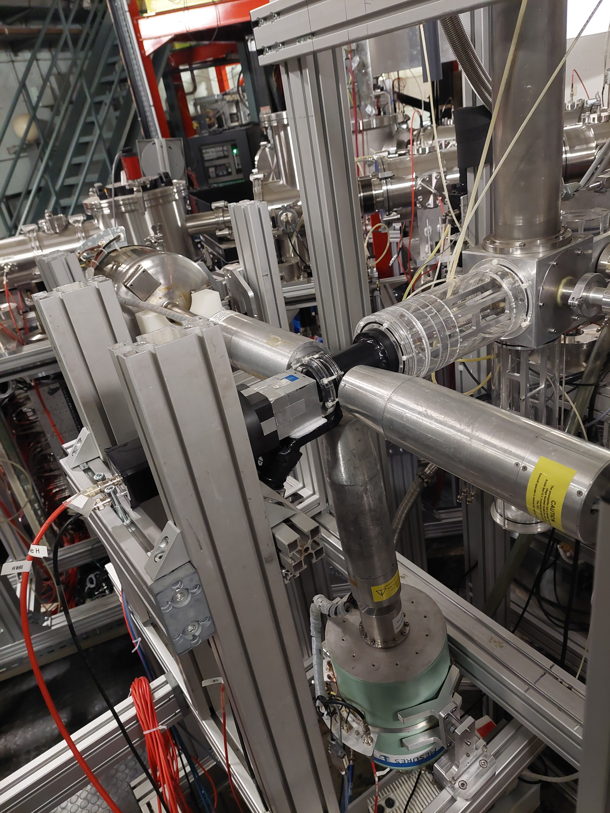
Experimental setup and challenges
A beta-delayed neutron-gamma spectroscopy setup
BEDO :
Collection – Decay cycles
4π-β plastic scintillator
3 HPGe detectors
1 LaBr
III. Experiment : MONSTER2025
8

Slide 21
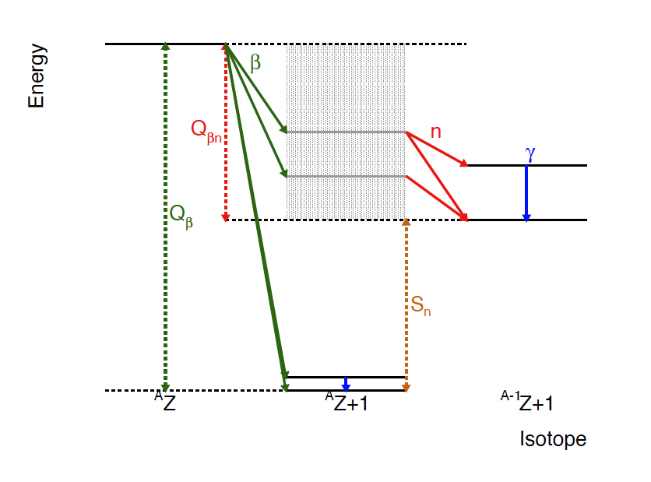
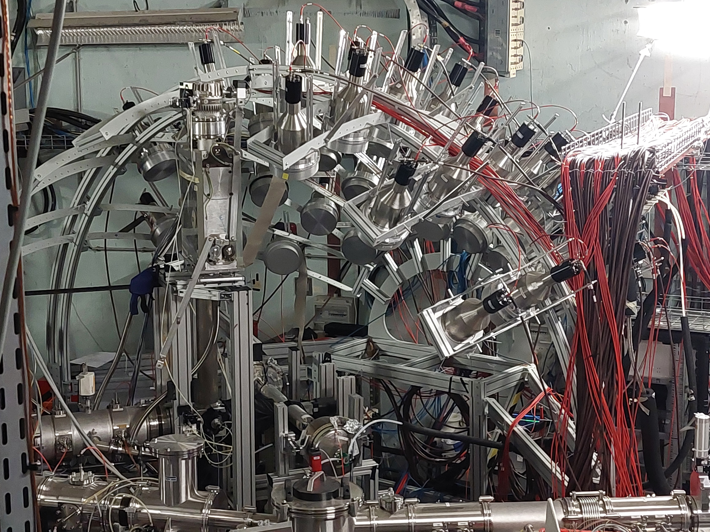
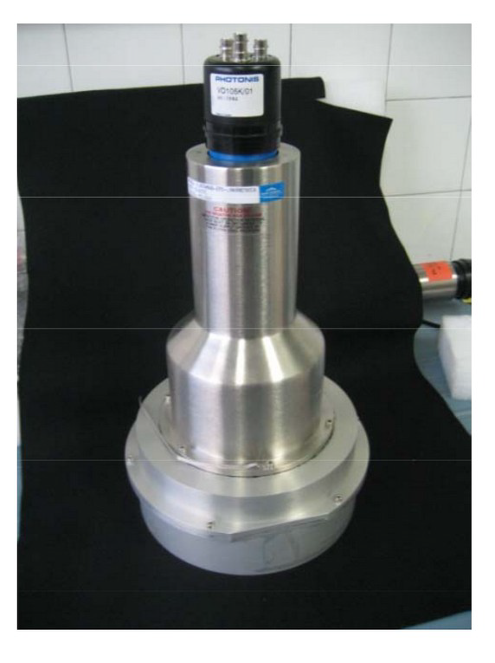
Experimental setup and challenges
Two experiments planned
83,84Ga doorway states
81Zn ground-state spin
A beta-delayed neutron-gamma spectroscopy setup
BEDO :
Collection – Decay cycles
4π-β plastic scintillator
3 HPGe detectors
1 LaBr
MONSTER :
39 liquid scintillators (EJ301) @ 1.5m
Beta-neutron-gamma coincidences
Beam collection point
III. Experiment : MONSTER2025
9

Slide 22
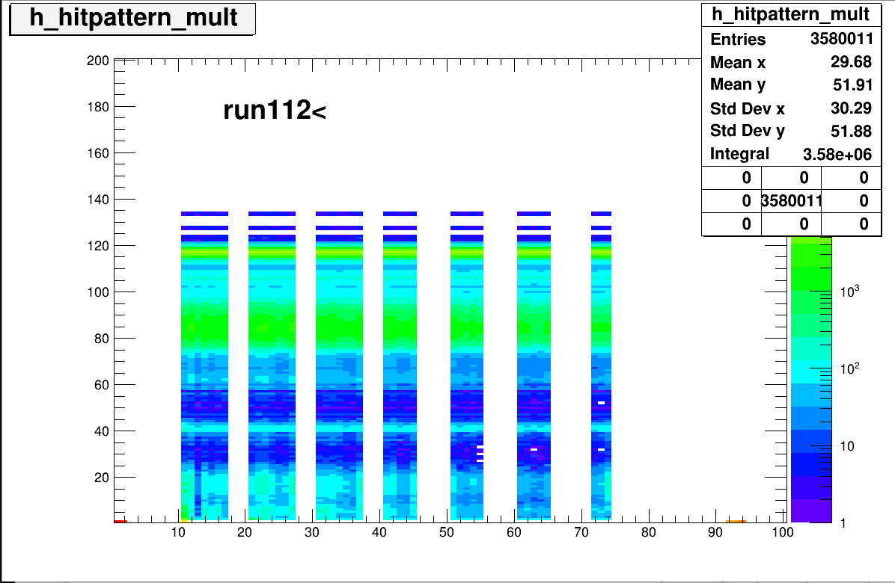
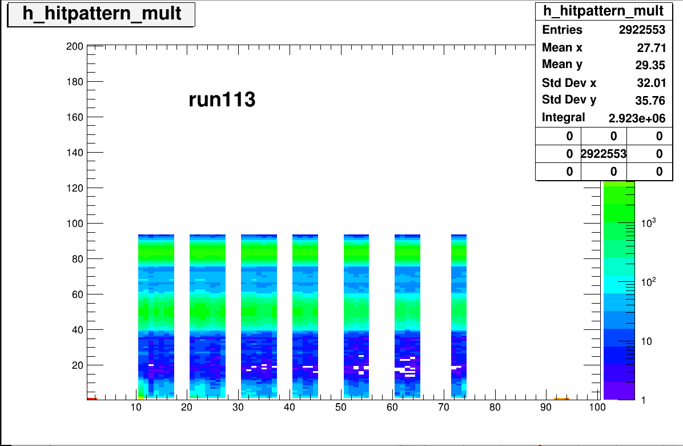
Experimental setup and challenges
Challenges
Production :
Setup :
Production difficulties (flood in October 2024)
Weird high multiplicity noise in MONSTER cells, linked to LINAC
Not enough production for 81Zn and 83,84Ga
Switch to 82Ga and 96Rb
Total acquisition time :
96Rb : 19h
82Ga : 13h
Overall very low statistics
Multiplicity dependant on LINAC intensity
Can get rid of with multiplicity cut but induces a dead time
III. Experiment : MONSTER2025
10

Slide 23
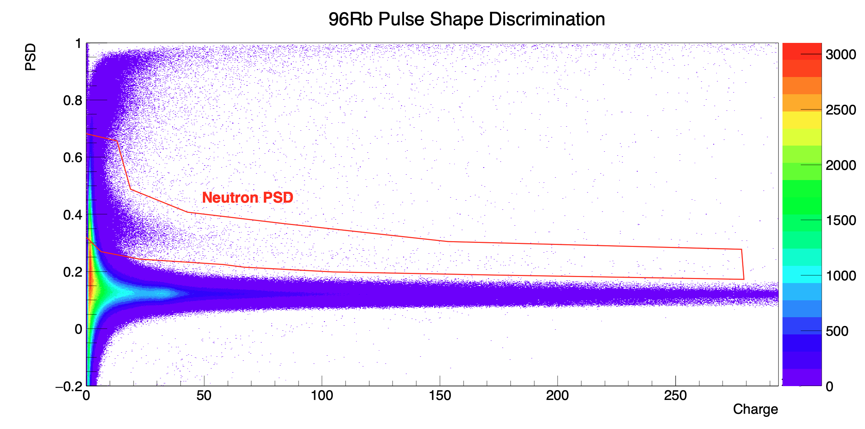
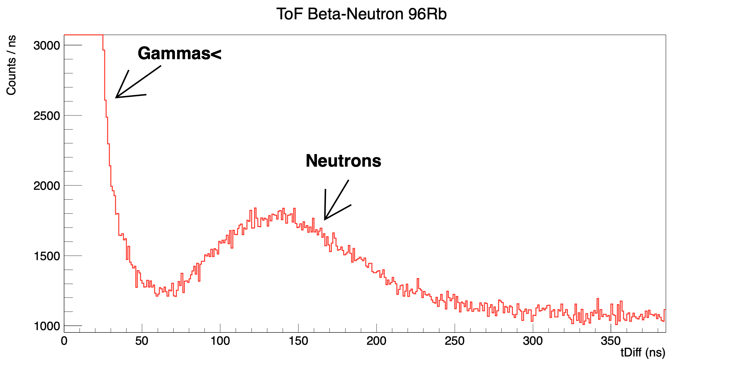
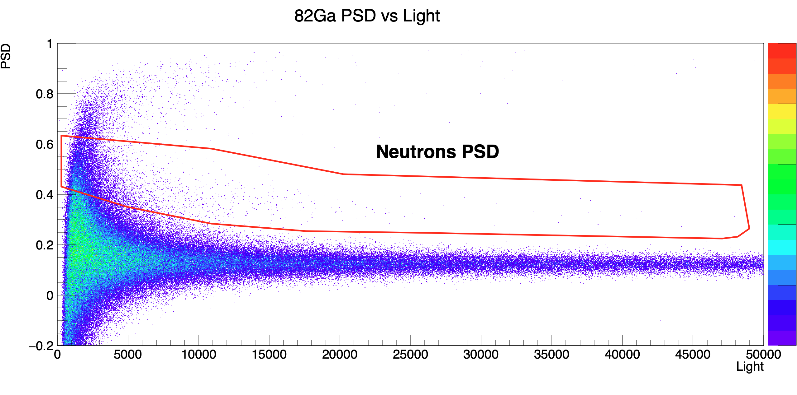
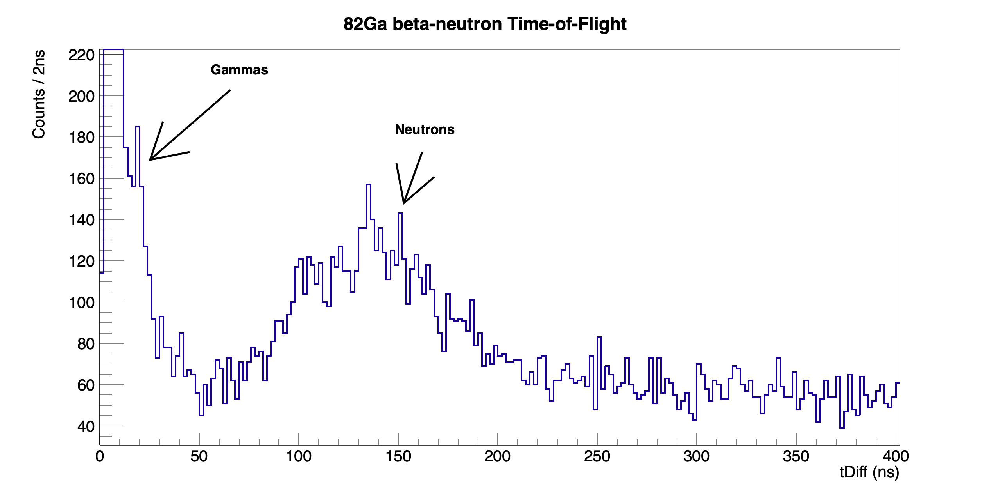
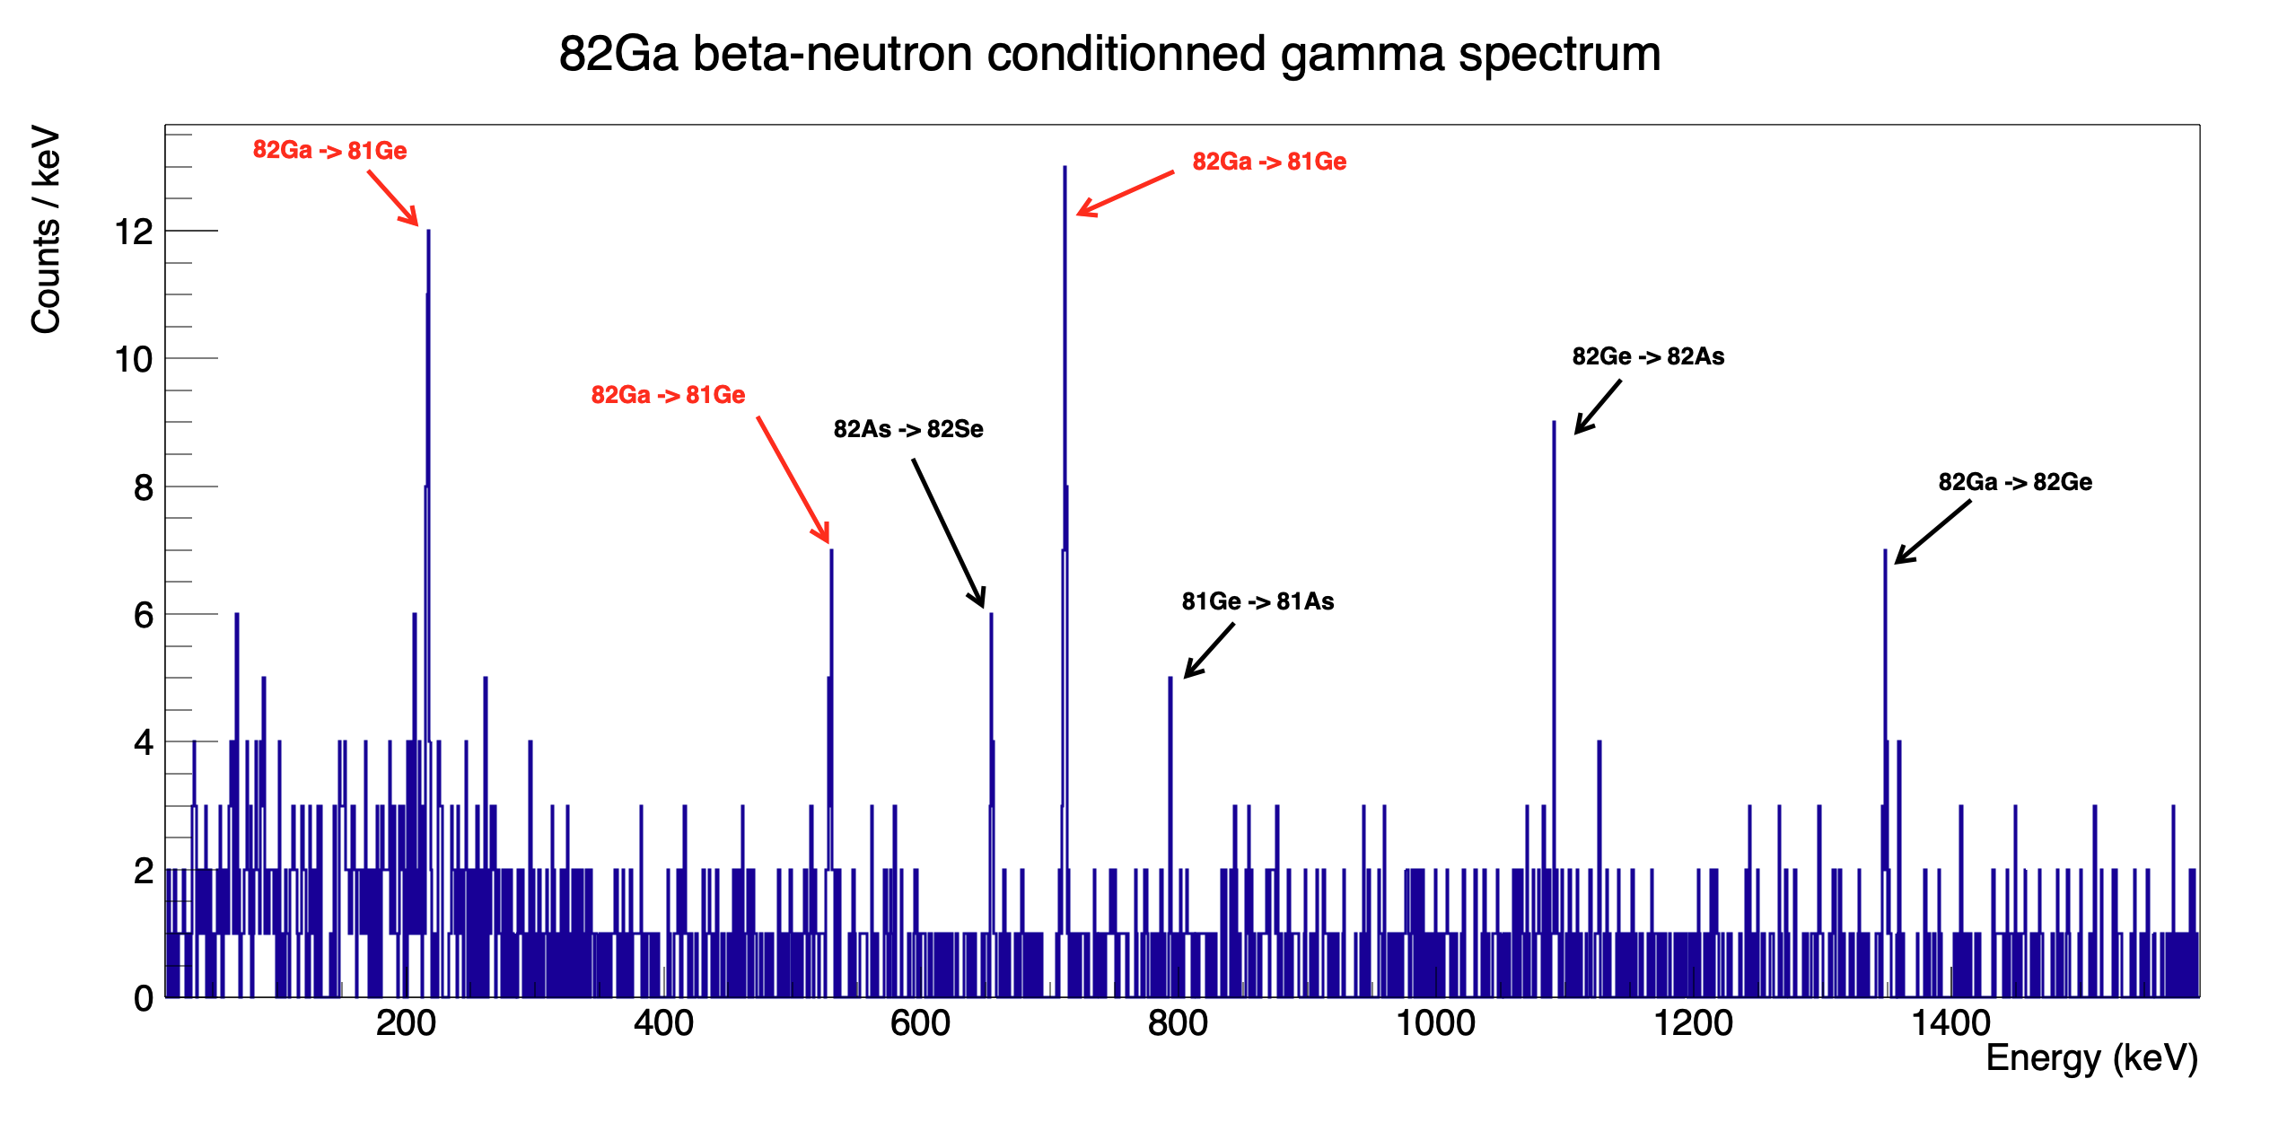
Preliminary analysis
⁹⁶Rb
Maybe enough statistics for a neutron energy spectrum
⁸²Ga
Enough to measure mean neutron energy and test TETRA method !
III. Experiment : MONSTER2025
11

Slide 24
Conclusion
Development of a new method to measure mean neutron energy using a slow neutron counter.
First prediction of the mean neutron energy of ${}_{}^{82}{Ga}$.
Measurement of the absolute branching ratio of the ${}_{}^{84}{Ga}$beta-2n branch and P2n.
First results from MONSTER2025 experiment at ALTO
MONSTER will be back……
Conclusion
12

Slide 25
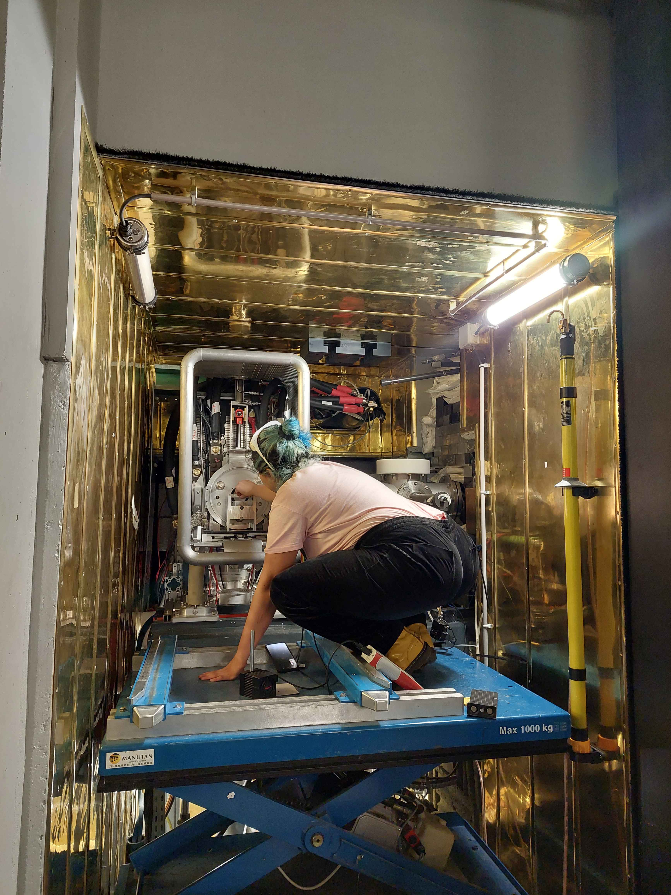
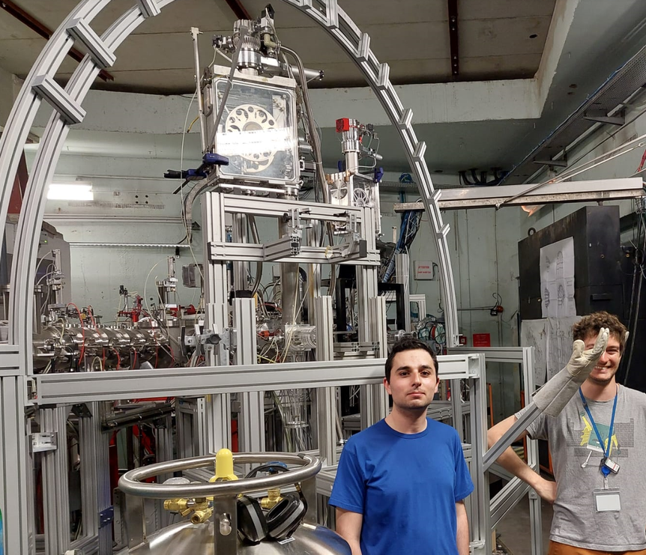
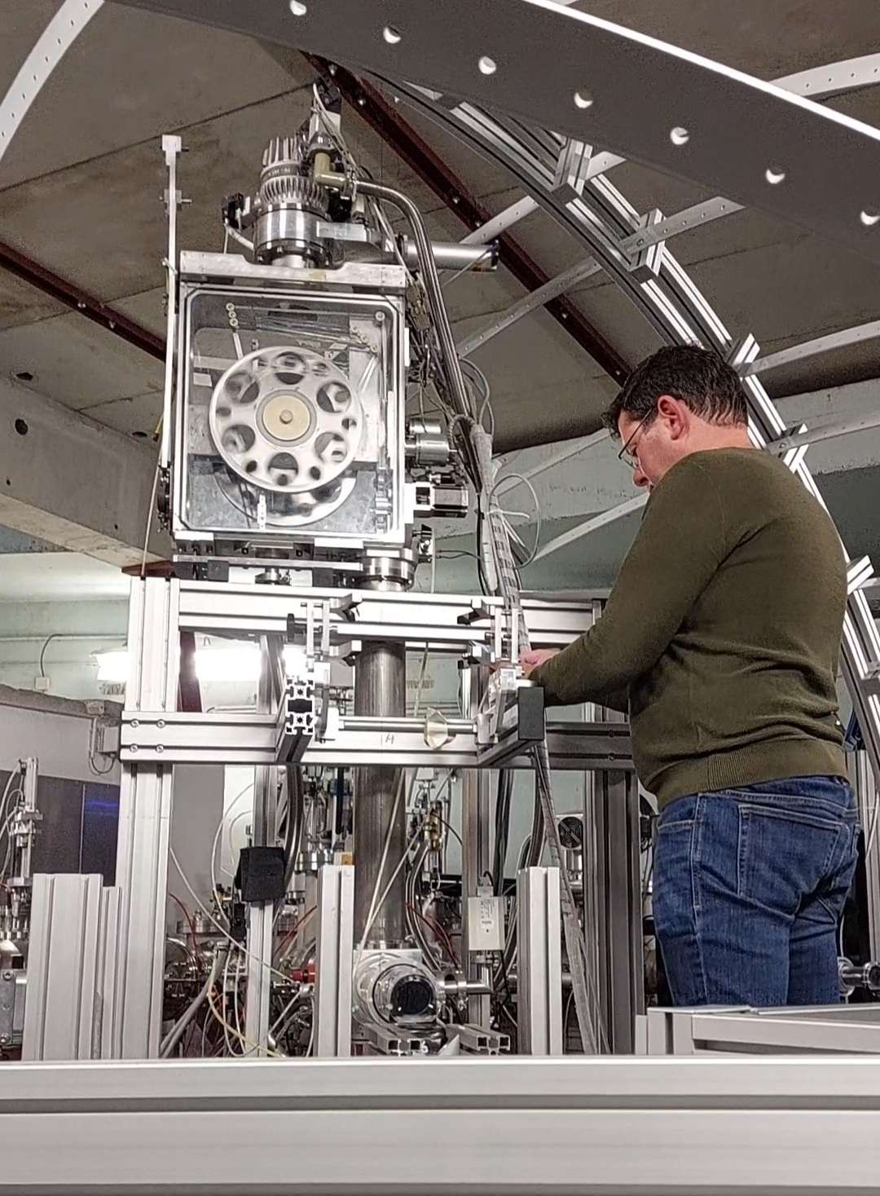
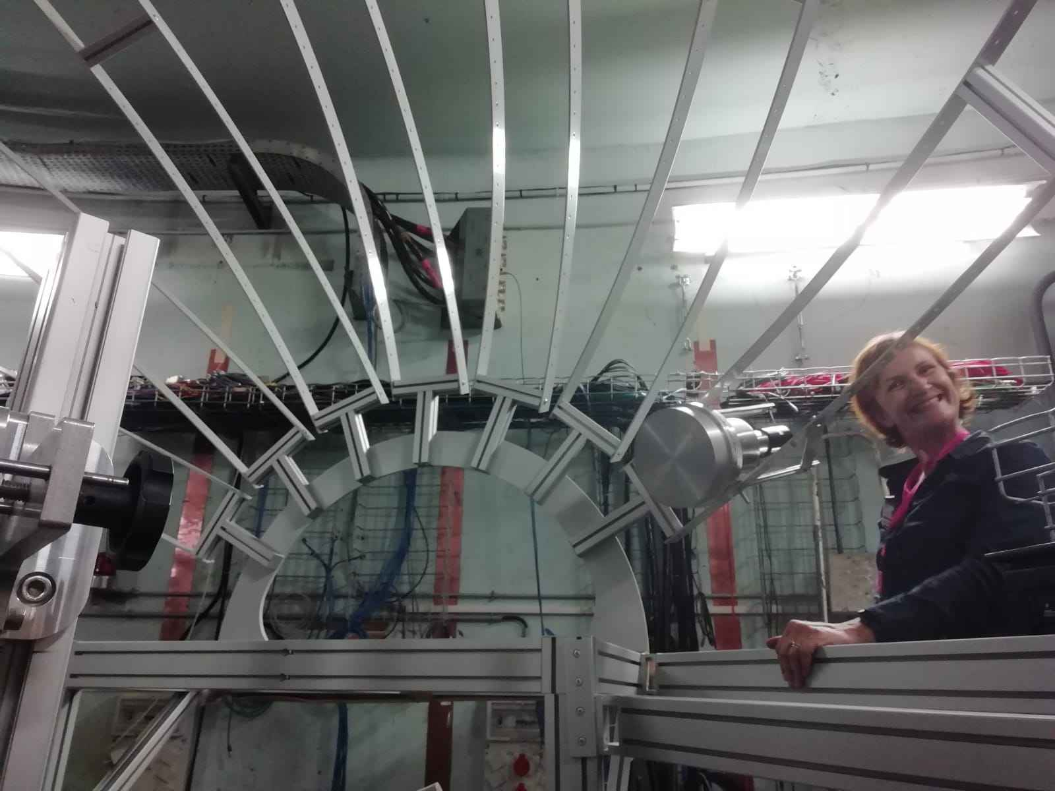
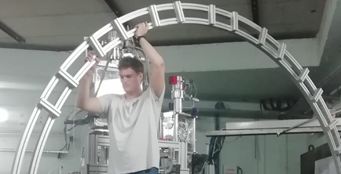
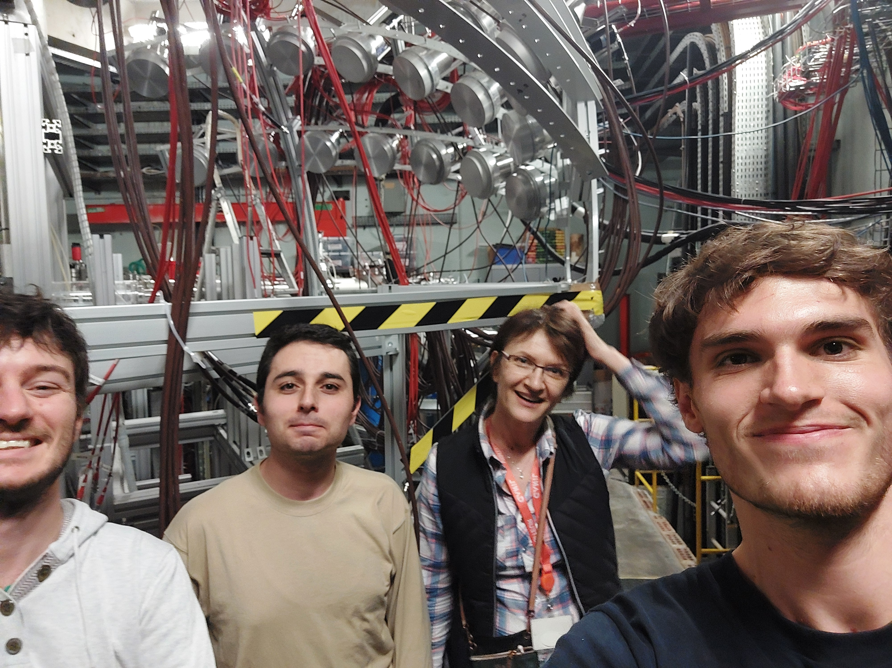
Thank you !

Slide 26
Backup
Formula
$D= \sqrt{{{(R}_{1}^{exp}−R_{1}^{Maxw})}^{2}+…+{{(R}_{6}^{exp}−R_{6}^{Maxw})}^{2}}$

Slide 27
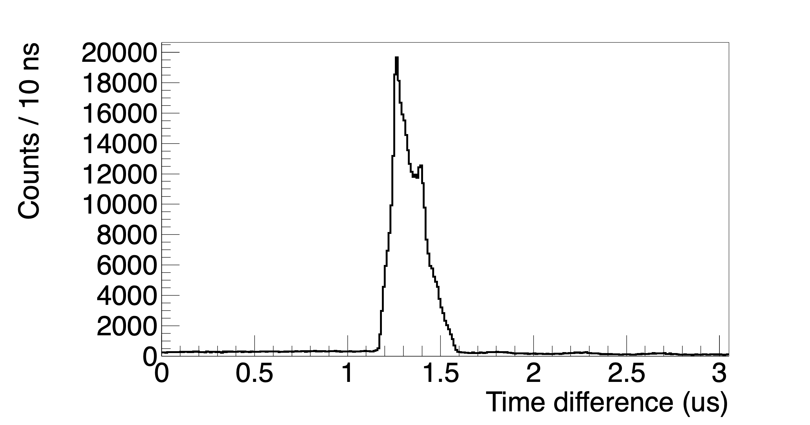
Calibration isotope : ${}_{}^{82}{Ga}$
4πβ efficiency
Single and β conditionned γ spectra
Energy (keV) | 216.6 | 530.4 | 711.4 | 867.2 | 1348.5
4πβ efficiency (%) | 66.8 | 74.9 | 71.3 | 76.2 | 76.5
$${\overline{ε}}_{β}=73.1±0.1 \%$$

Slide 28
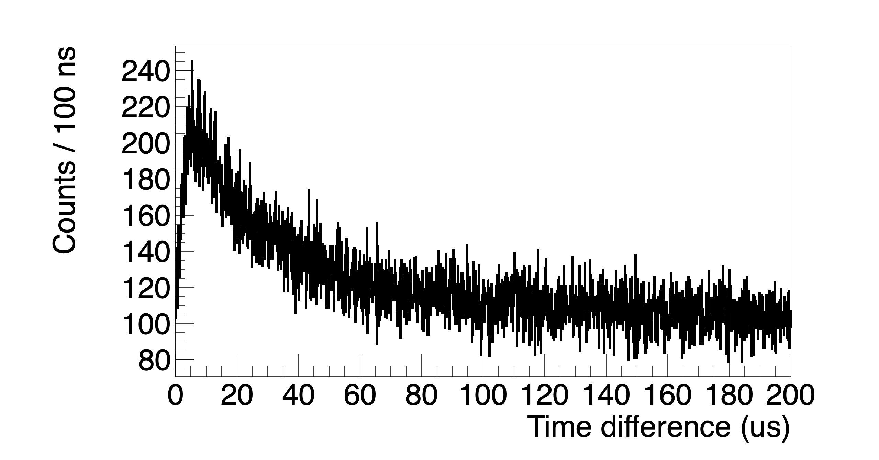
Calibration isotope : ${}_{}^{82}{Ga}$
TETRA efficiency
Single and neutron conditionned γ spectra
Energy (keV) | 216.6 | 530.4 | 711.4
TETRA efficiency (%) | 51.5 | 55.6 | 55.5
$${\overline{ε}}_{n}=54.2±0.1 \%$$

Slide 29
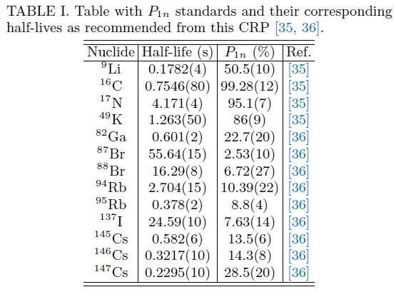
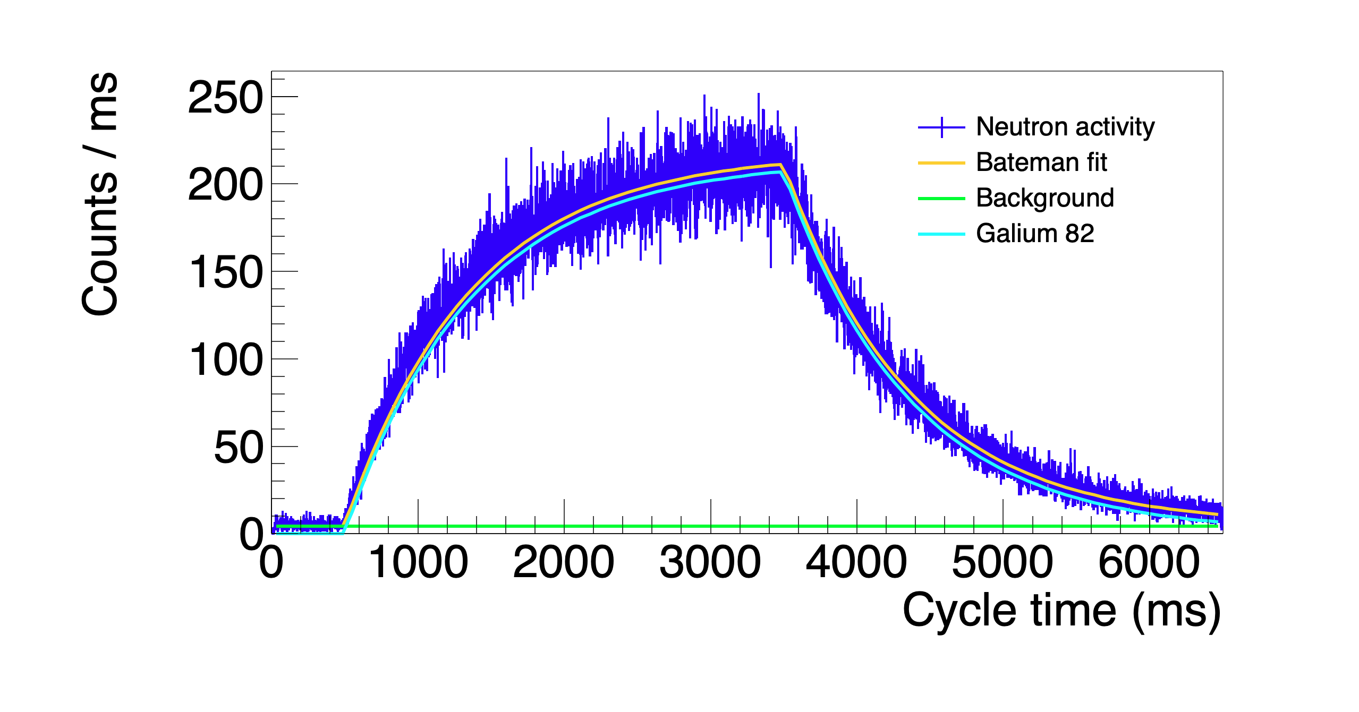
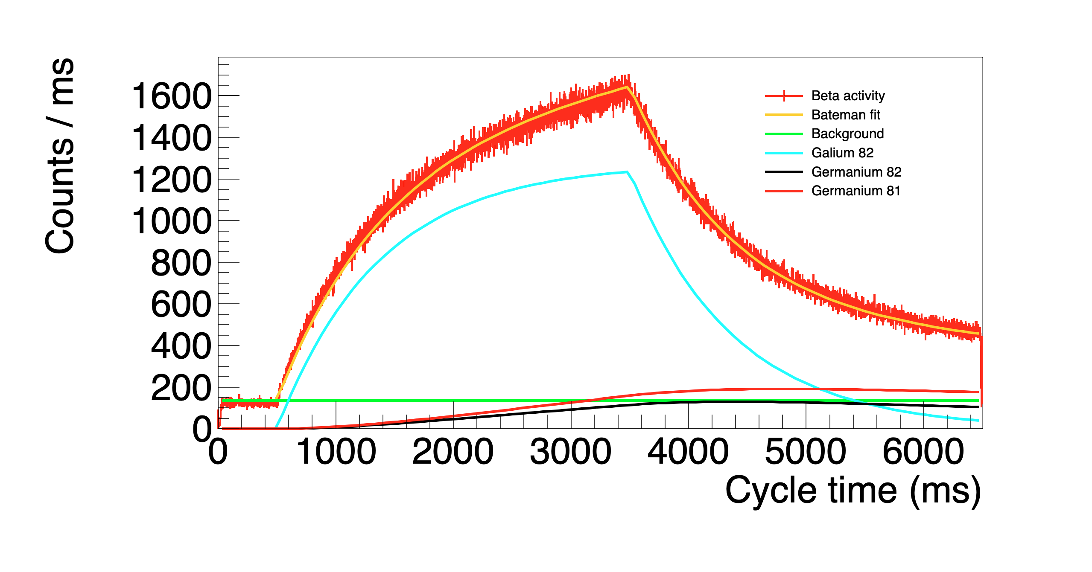
Beta-delayed two-neutron emission of ${}_{}^{84}{Ga}$
Cf. Liang et al. Nuclear Data Sheets 168 (2020)
Calibration isotope : ${}_{}^{82}{Ga}$
$${}_{}^{82}{Ga}$$
β
β-1n
$$Q_{β−n}=5.290 MeV$$
$${}_{}^{82}{Ge}$$
$${}_{}^{81}{Ge}$$
β
β
$$T_{\frac{1}{2}}=599 ms$$
$${}_{}^{82}{As}$$
$${}_{}^{81}{As}$$
$$P_{n}=P_{1n}=22.6±0.1 \%$$
$${\overline{ε}}_{β}=73.1±0.1 \%$$
$${\overline{ε}}_{n}=54.2±0.1 \%$$
500 cycles
500 cycles
${}_{}^{82}{Ga}$β activity curve
${}_{}^{82}{Ga}$neutron activity curve

Slide 30
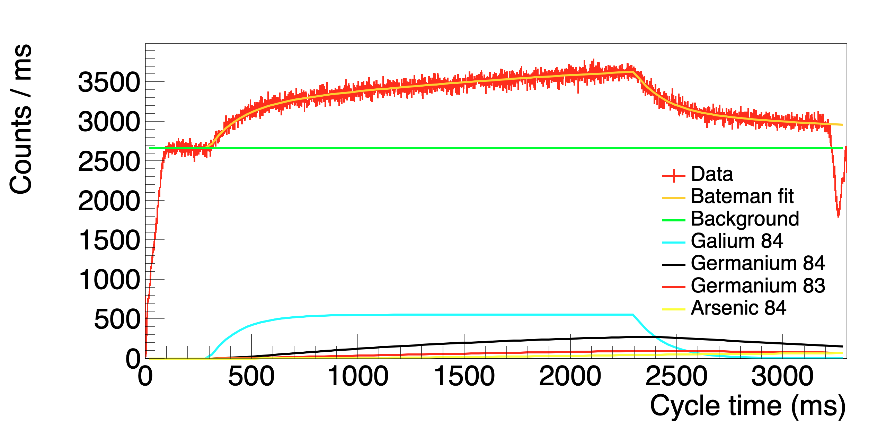
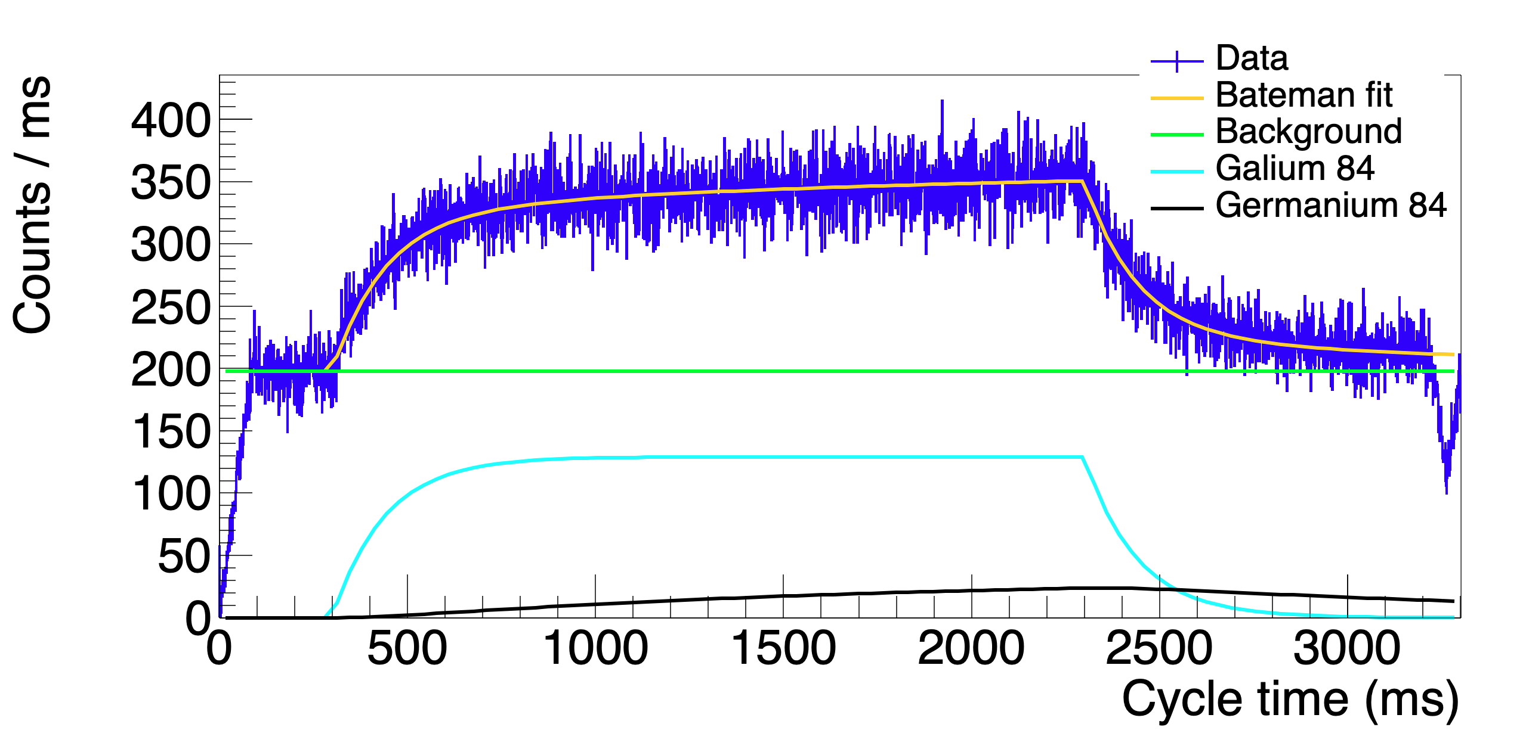
${}_{}^{84}{Ga}$
N_{β}(${}_{}^{84}{Ga}$) | 1107000 (1000)
N_{n}(${}_{}^{84}{Ga}$) | 258100 (500)
Bateman fits
$${}_{}^{84}{Ga}$$
β-2n
β
β-1n
$${}_{}^{84}{Ge}$$
$${}_{}^{83}{Ge}$$
$${}_{}^{82}{Ge}$$
$$Q_{β−1n}=8.811 MeV$$
β
β
$${}_{}^{84}{As}$$
$${}_{}^{83}{As}$$
$$T_{\frac{1}{2}}=97.1 ms$$
$$<n>∗=35.2±1.4\%$$
$${}_{}^{84}{Se}$$
β
20880 cycles
$$\overline{R}=1.51±0.06$$
20880 cycles
$${\overline{ε}}_{n}=48. 5±2. 3\%$$
${}_{}^{84}{Ga}$β activity curve
${}_{}^{84}{Ga}$neutron activity curve
Beta-delayed 2-neutron emission of ${}_{}^{84}{Ga}$ - Results
11

Slide 31
${}_{}^{84}{Ga}$
Two neutron events
N_{2n}(${}_{}^{84}{Ga}$) | 5540 (70)
$$Q_{β−2n}=5.179 MeV$$
20880 cycles
$$P2n=1.6±0.2\%$$
$$P_{n}=P_{1n}+P_{2n}=34.4±1.4 \%$$
${}_{}^{84}{Ga}$2-neutron activity curve
Cf. Jonson et al. CERN (1981)
Beta-delayed 2-neutron emission of ${}_{}^{84}{Ga}$ - Results
12

Slide 32
${}_{}^{84}{Ga}$
$P_{1n}=\frac{N_{1n}}{N_{β}}×\frac{ε_{β}}{ε_{n}}$
$R≡\frac{ε_{β}}{ε_{n}}$
Efficiency ratio
Single, β conditionned and neutron conditionned γ spectra
Energy (keV) | 247.7 | 1046
R | 1.56 | 1.45
$$\overline{R}=1.51±0.06$$

Slide 33
${}_{}^{84}{Ga}$
$P_{2n}=\frac{N_{2n}}{N_{β}}×\frac{ε_{β}}{ε_{n}^{2}}$
$$\frac{S_{(x+y)cond}}{S_{xcond}}=ε_{y}$$
TETRA efficiency
β-neutron conditionned γ spectra
Energy (keV) | 247.7 | 1046
TETRA efficiency (%) | 50.4 | 46.6
$${\overline{ε}}_{n}=48. 5±2. 3\%$$

Slide 34
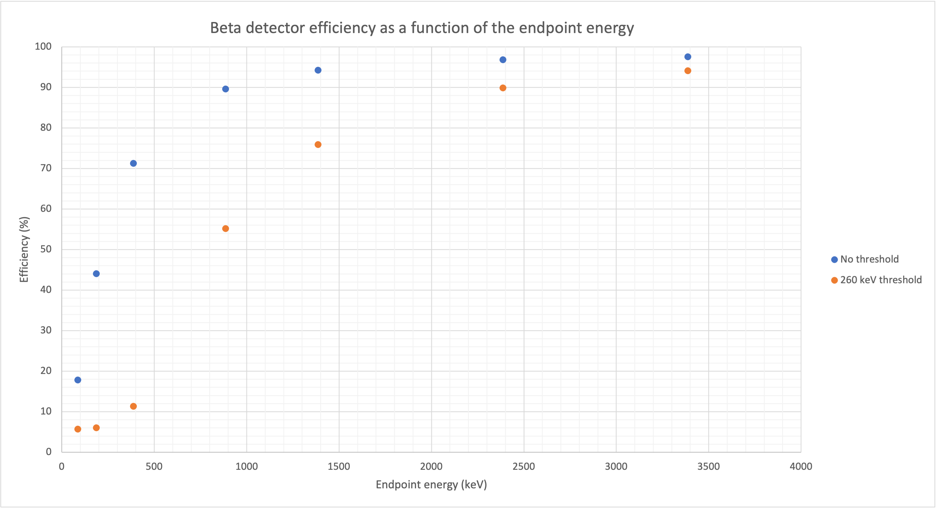
Backup
Beta detector simulations

Slide 35
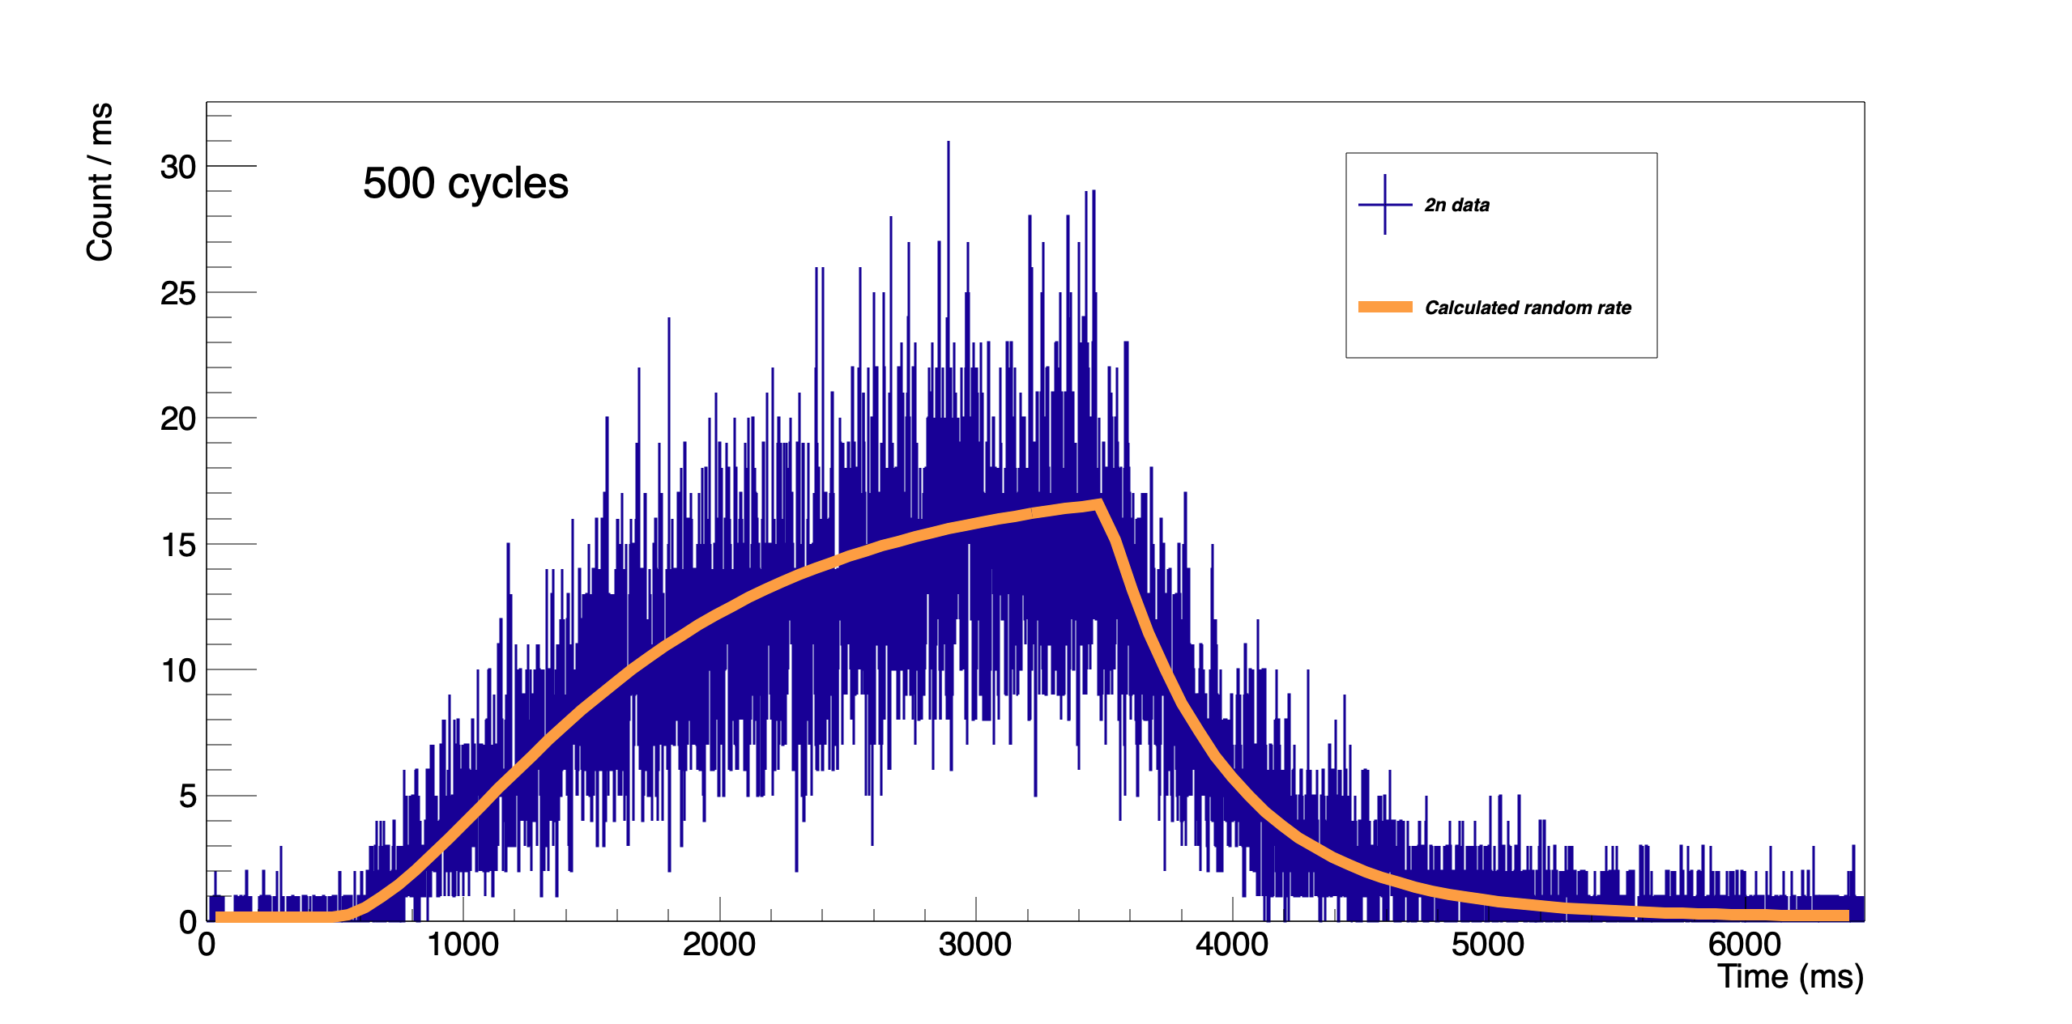
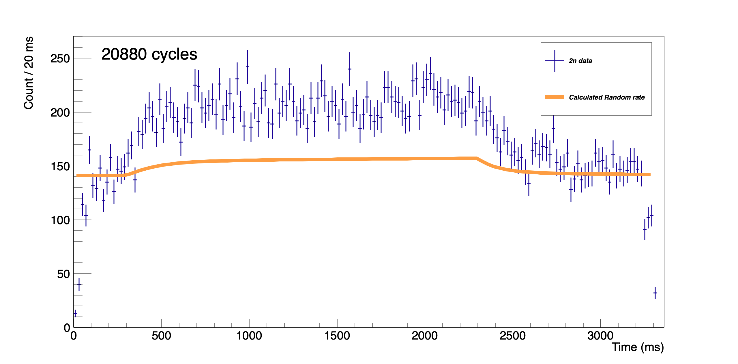
Backup
2n background
Sources of 2-n background
Fortuitous counting (grows with counting rate)
Natural background (constant)
$λ_{rand 2n}^{}=λ_{1n}^{2}θe^{−λ_{1}θ}$

Slide 36
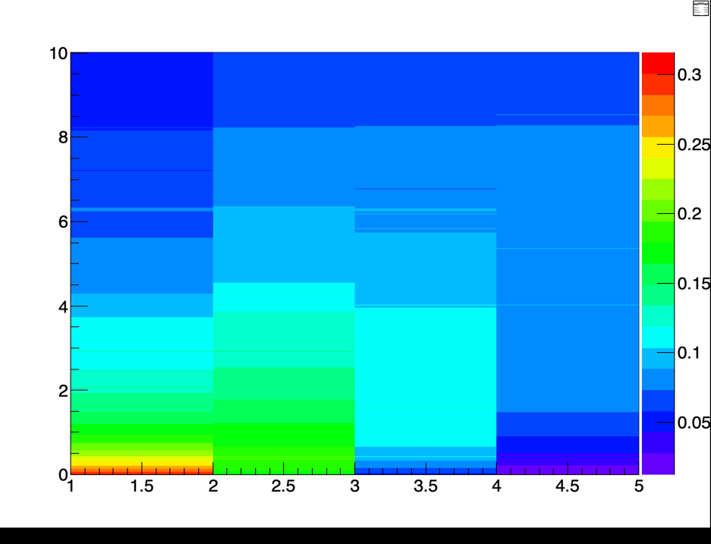
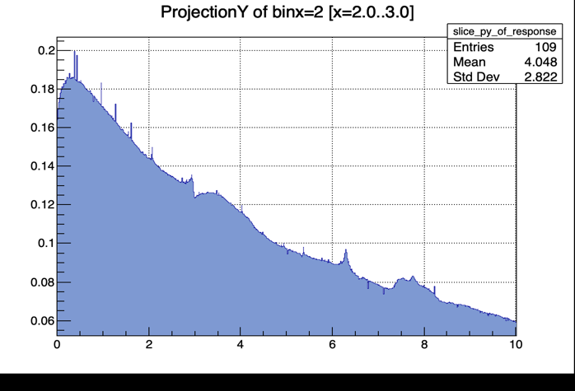
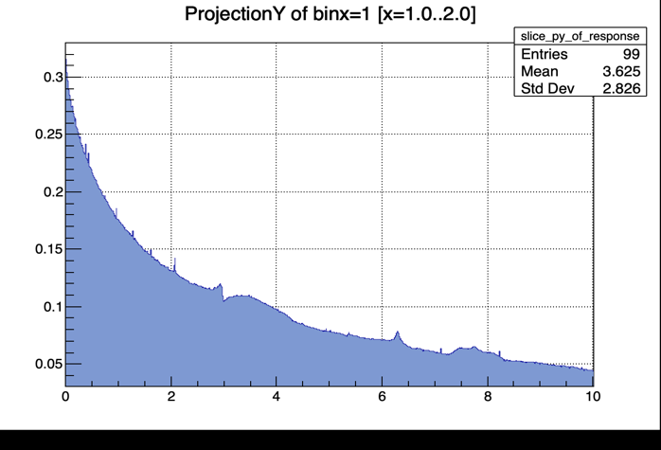
Backup
Bayesian unfolding method

Slide 37
Beta-delayed neutron emission : state of the art
Statistical models and « Pandemonium effect »
Peak structure cannot be explained with gross theory of beta-decay
Cf. Takahashi and Yamada Prog. Theor. Phys. 41 (1969)
I. Structure above the neutron threshold at ALTO
3

Slide 38
Beta-delayed neutron emission : state of the art
Statistical models and « Pandemonium effect »
Hardy : No structure, only statistical fluctuations
Pandemonium effect : Overestimation of feeding the levels under Sn
Cf. Hardy et al. Nuc. Phys. A305 (1977)
Peak structure cannot be explained with gross theory of beta-decay
Cf. Takahashi and Yamada Prog. Theor. Phys. 41 (1969)
I. Structure above the neutron threshold at ALTO
3

Slide 39
Beta-delayed neutron emission : state of the art
Statistical models and « Pandemonium effect »
Hardy : No structure, only statistical fluctuations
Pandemonium effect : Overestimation of feeding the levels under Sn
Cf. Hardy et al. Nuc. Phys. A305 (1977)
Peak structure cannot be explained with gross theory of beta-decay
Cf. Takahashi and Yamada Prog. Theor. Phys. 41 (1969)
BUT
Bad Pn and half lives predictions for medium mass nuclei.
No explanation for feeding of excited states instead of ground-state in the residue nuclei.
Cf. De Oliveira PhD thesis (1980)
I. Structure above the neutron threshold at ALTO
3

Slide 40
Beta-delayed neutron emission : state of the art
Structure and microscopic approaches
Evidence of structure in the beta-strength fuction near Sn.
Nowadays QRPA for beta strength function (microscopic)
Hauser-Feshbach models for neutron emission (statistical)
SF
BSF
CP
Cf. Minato et al. PRC 104 (2021)
Cf. Heidemann et al. PRC 108 (2023)
Cf. Xu et al. PRL 133 (2024)
New approach for neutron emission : doorway states !
I. Structure above the neutron threshold at ALTO
4

