Slide 1
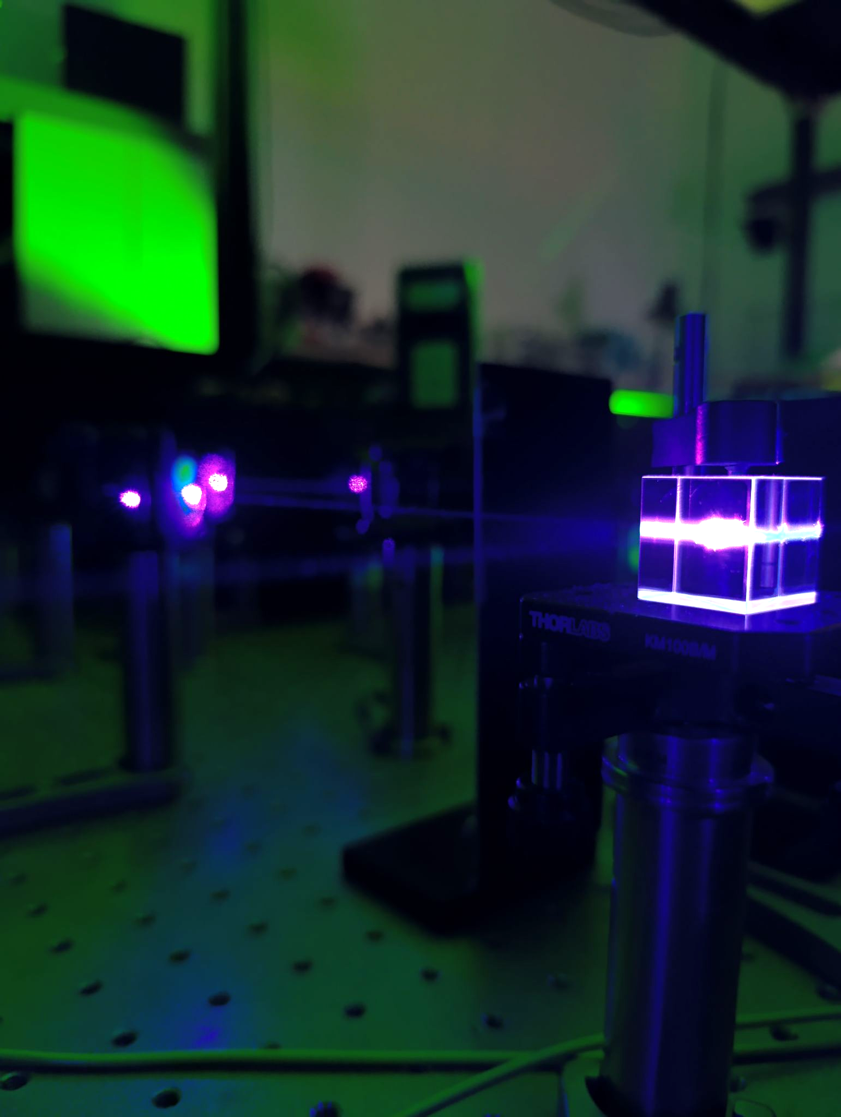
GISELE laboratory at GANIL
Andres Felipe Lopez
04/04/2025

Slide 2
Outline
GISELE Setup.
Characterization of the laser systems.
Results on Dy.

Slide 3
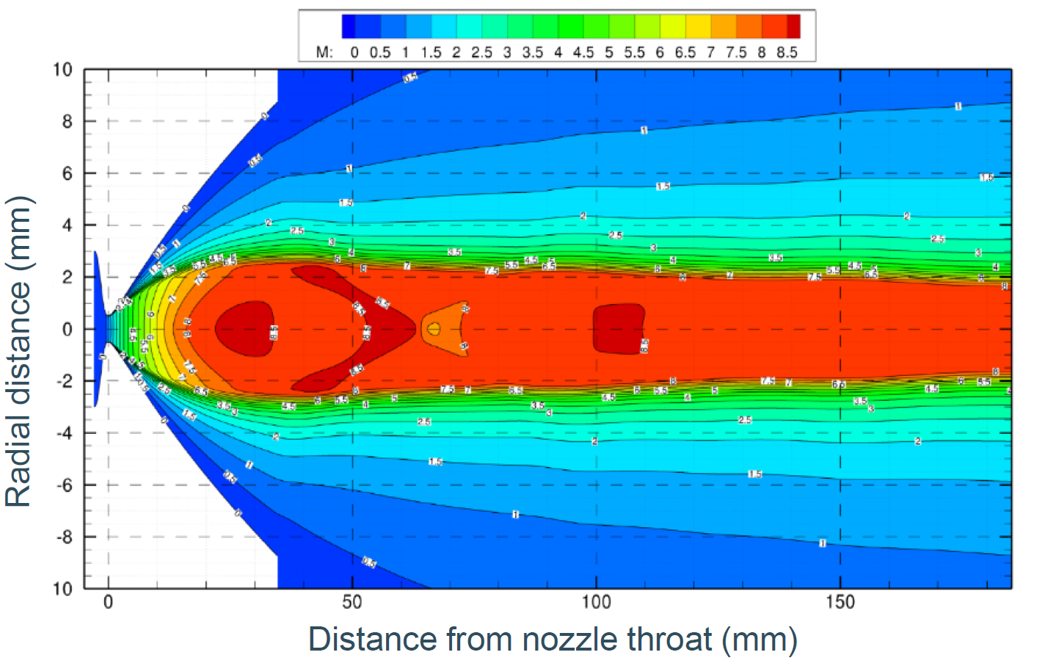
S3-LEB
Collision broadening
Doppler effect
Power broadening
Gas Cell
Broadband Spectroscopy
Gas-jet
ρ ↘︎ T ↘
Narrowband Spectroscopy
Broad-linewidth $δν∼$ few GHz
Narrow-linewidth $δν∼$ tens MHz
Pulsed $∼$ 10 kHz
Tunable
Laser 2
Laser 1
Notes:
Maybe add the broadening effects

Slide 4
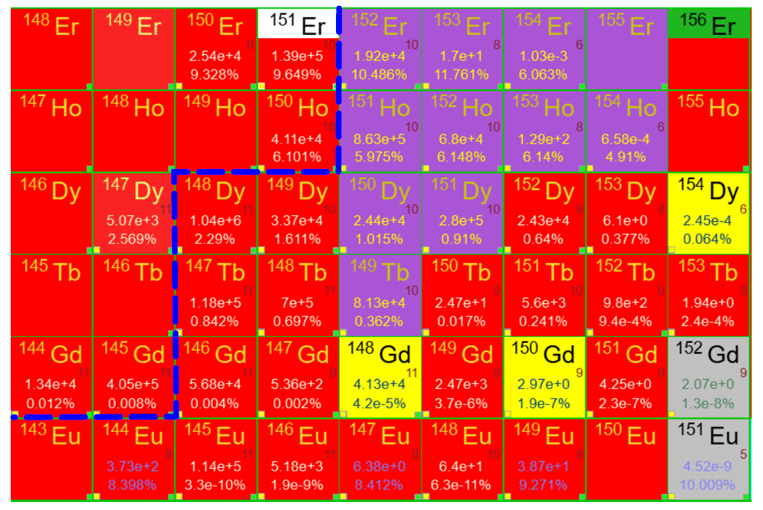
Elements of interest 1st experiment S3LEB
Extensively studied

Slide 5
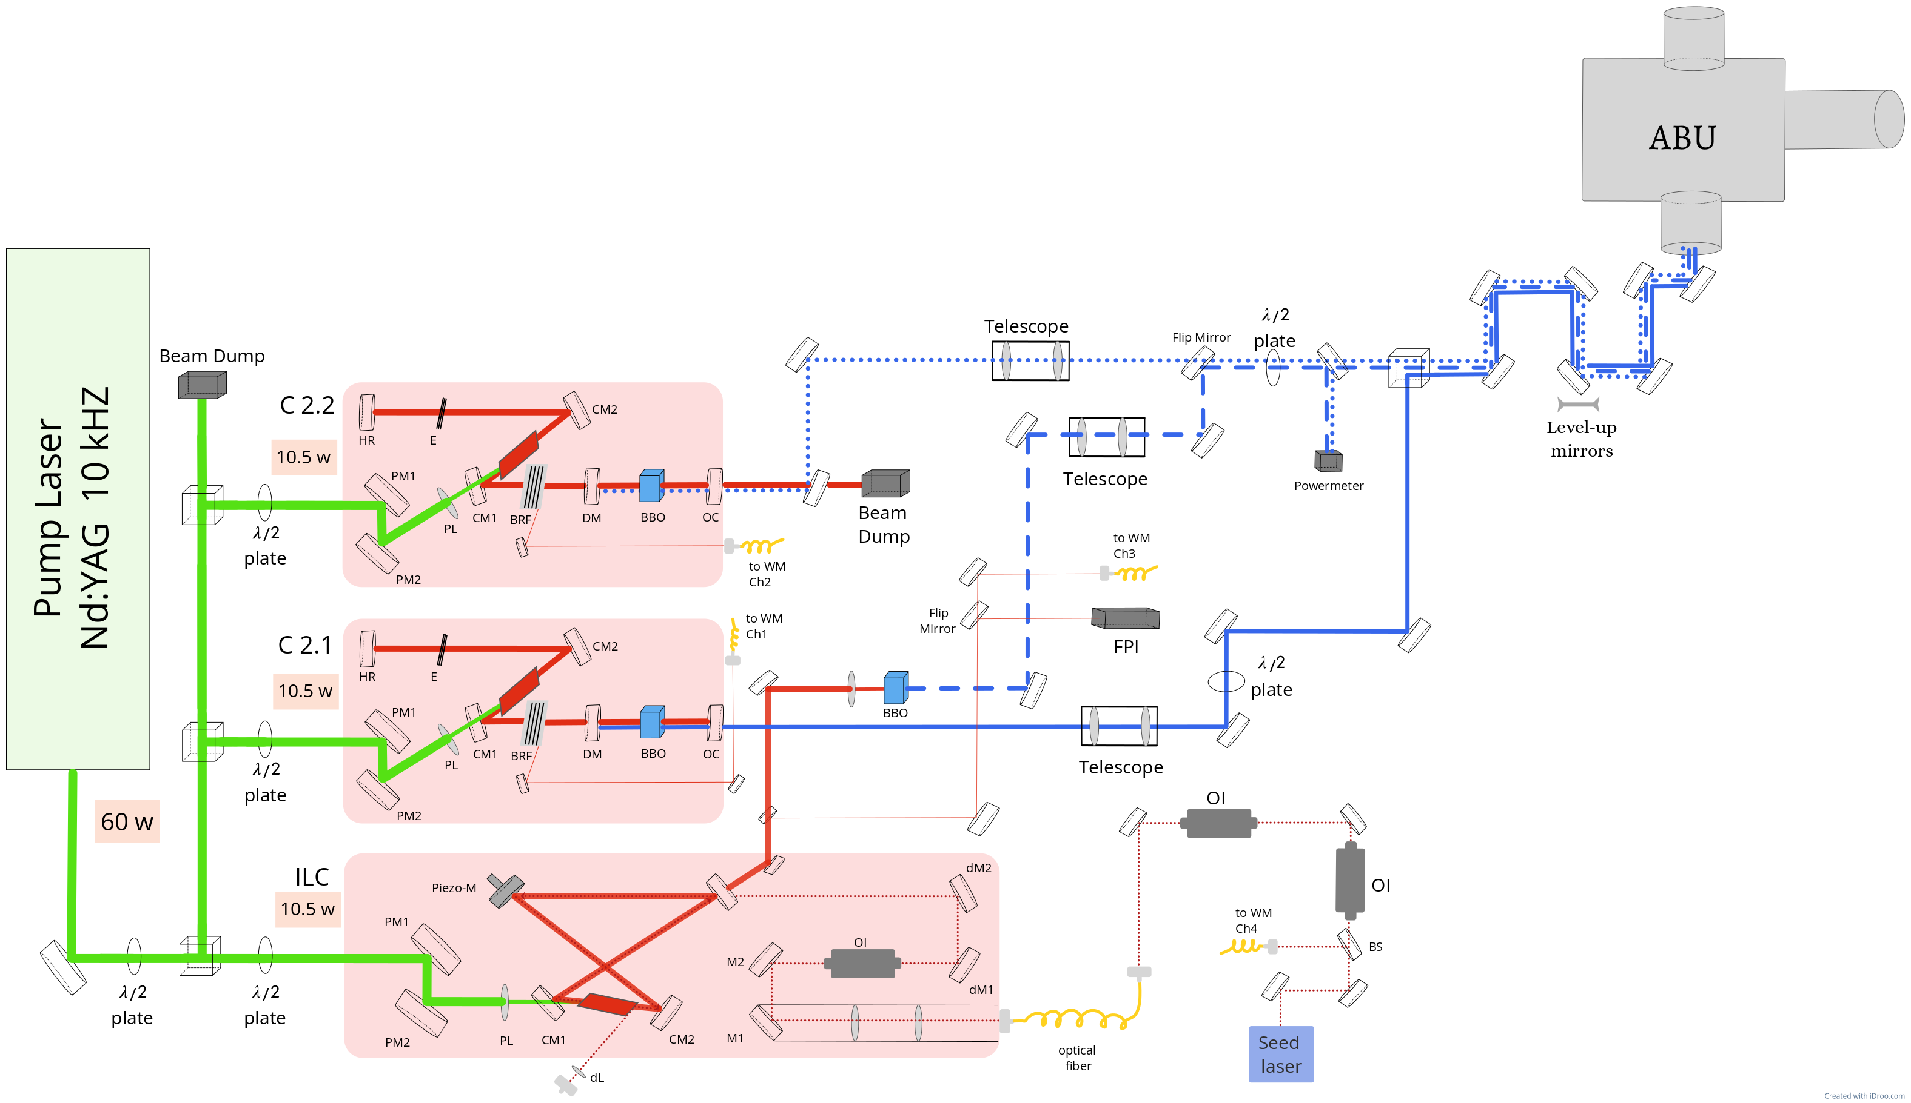
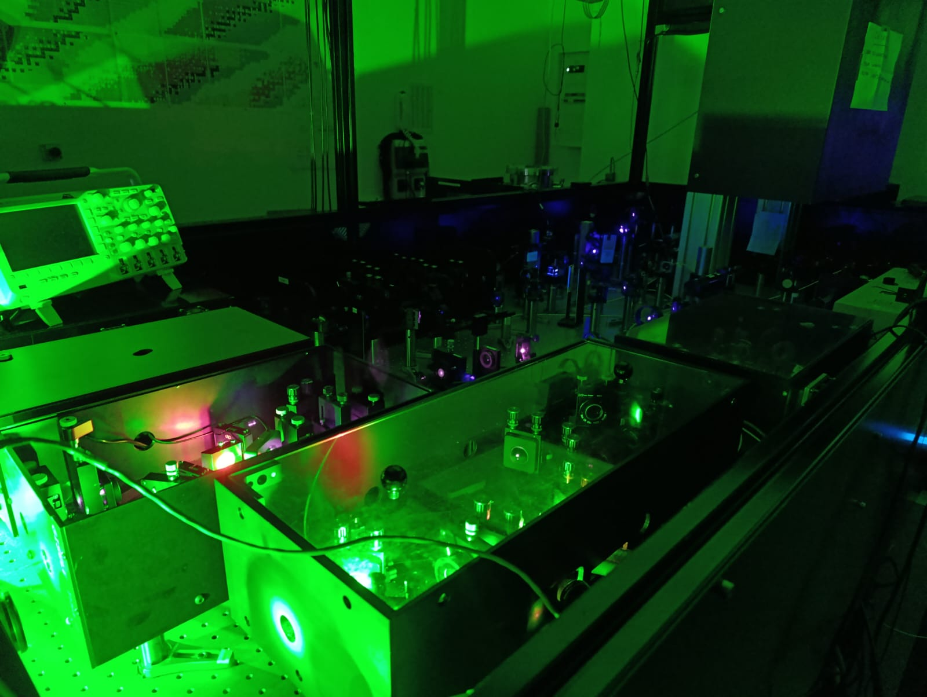
GISELE

Slide 6
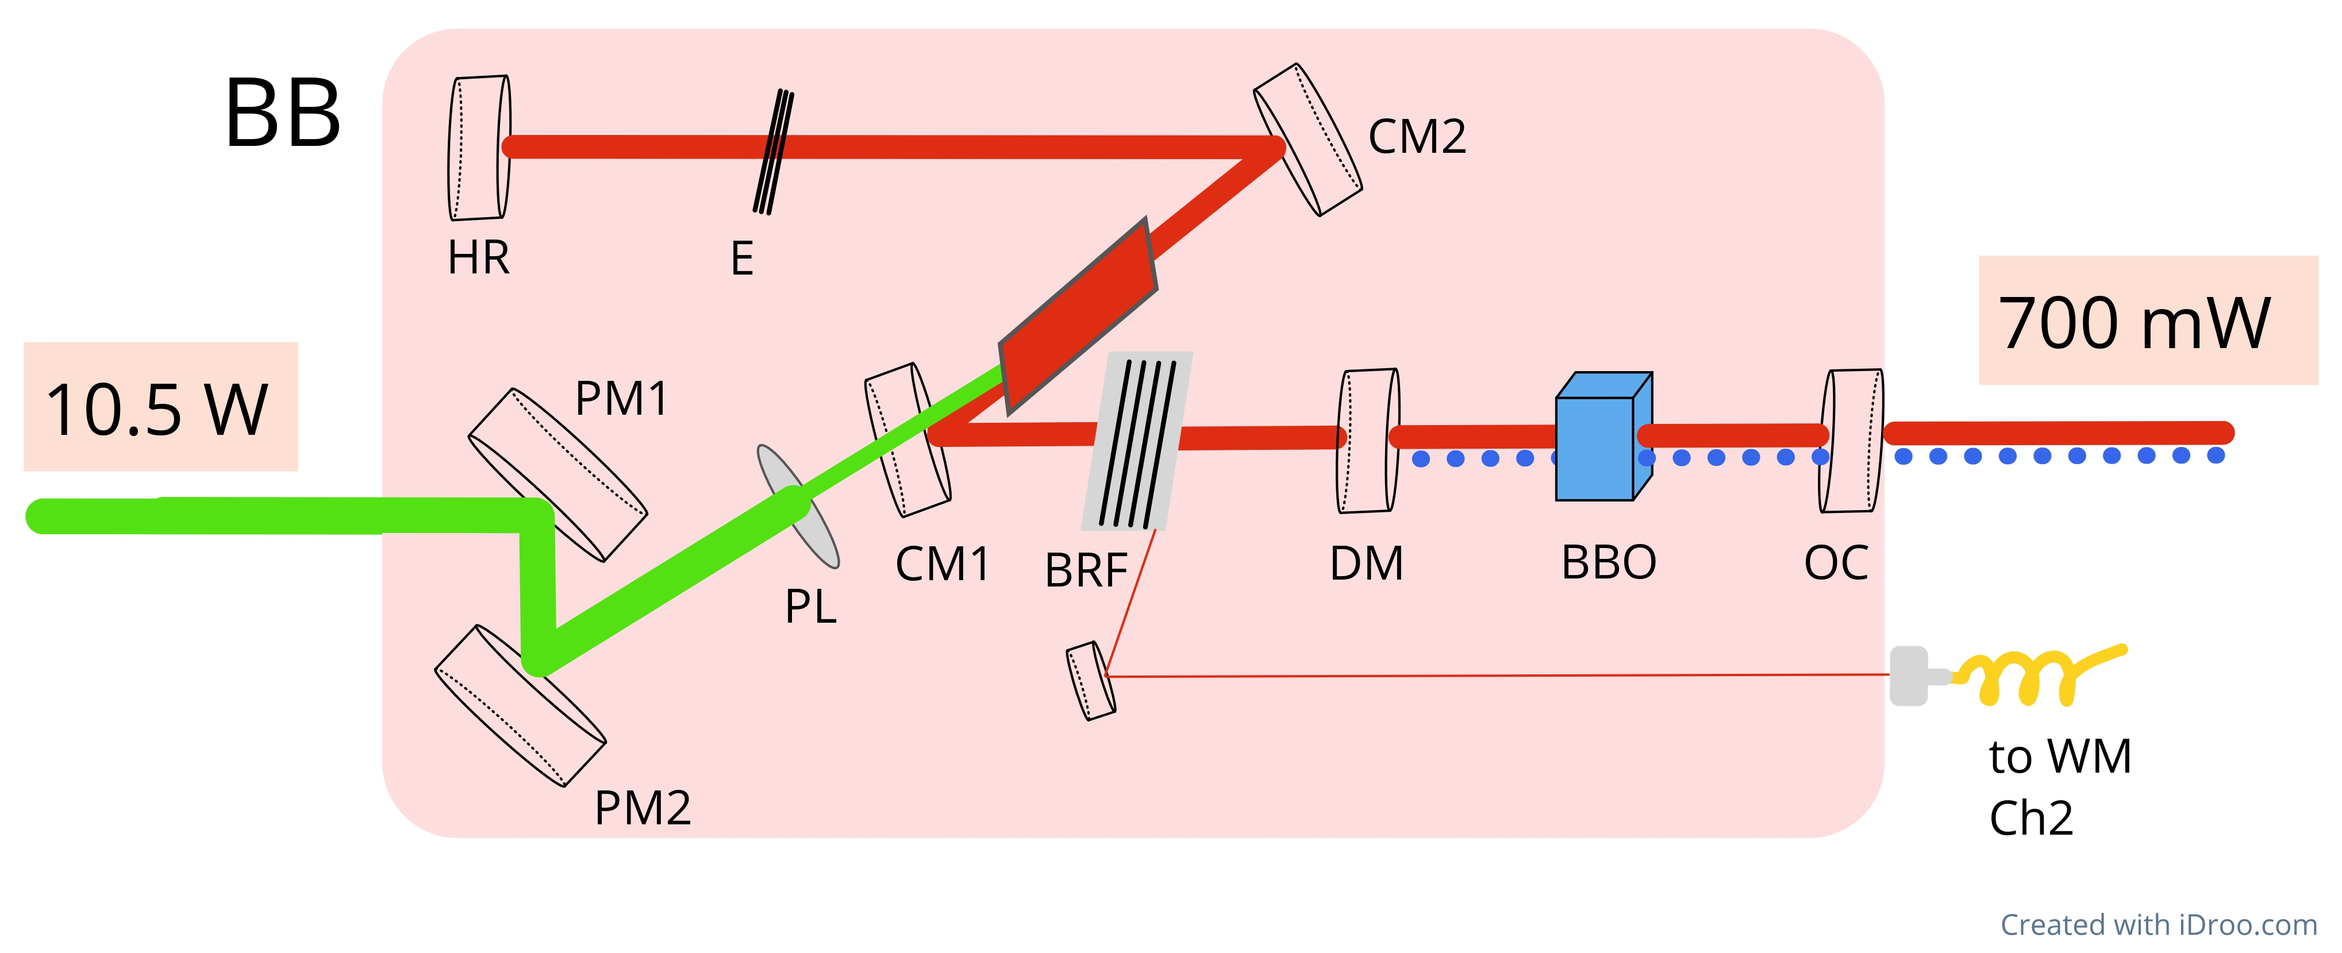
Single etalon broadband cavities
BIBO

Slide 7
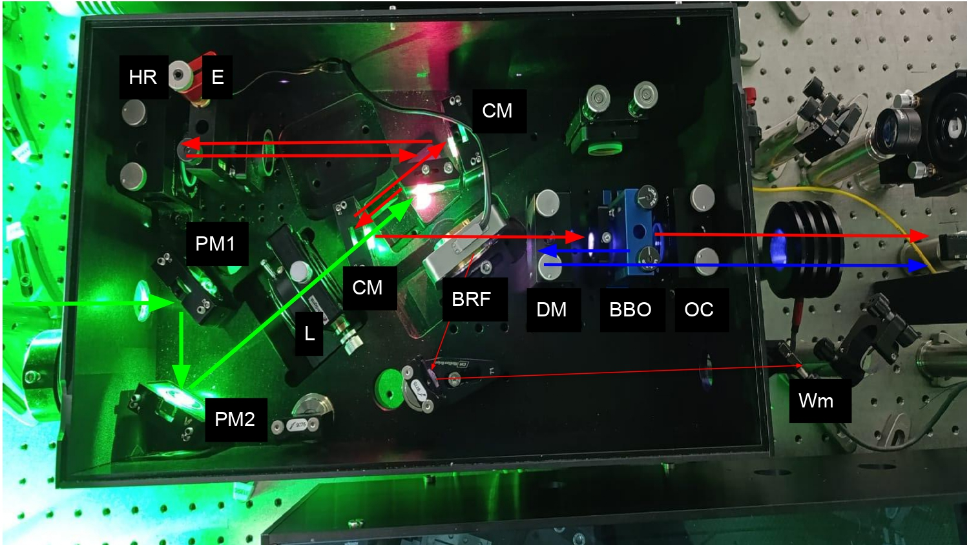
Single etalon broadband cavities
1st Step 2nd Step

Slide 8
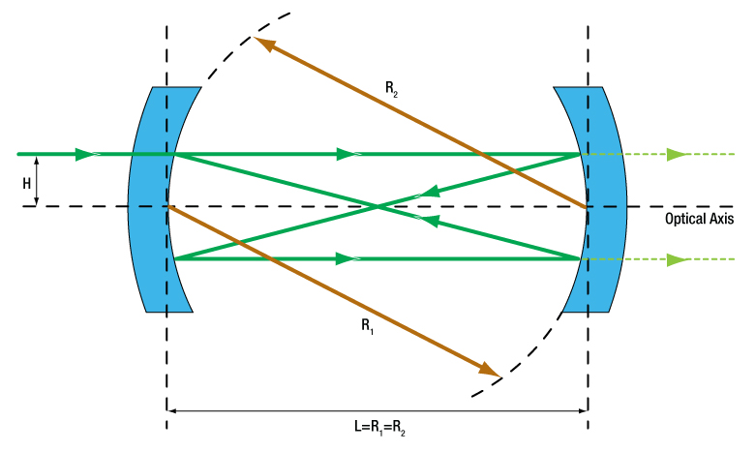
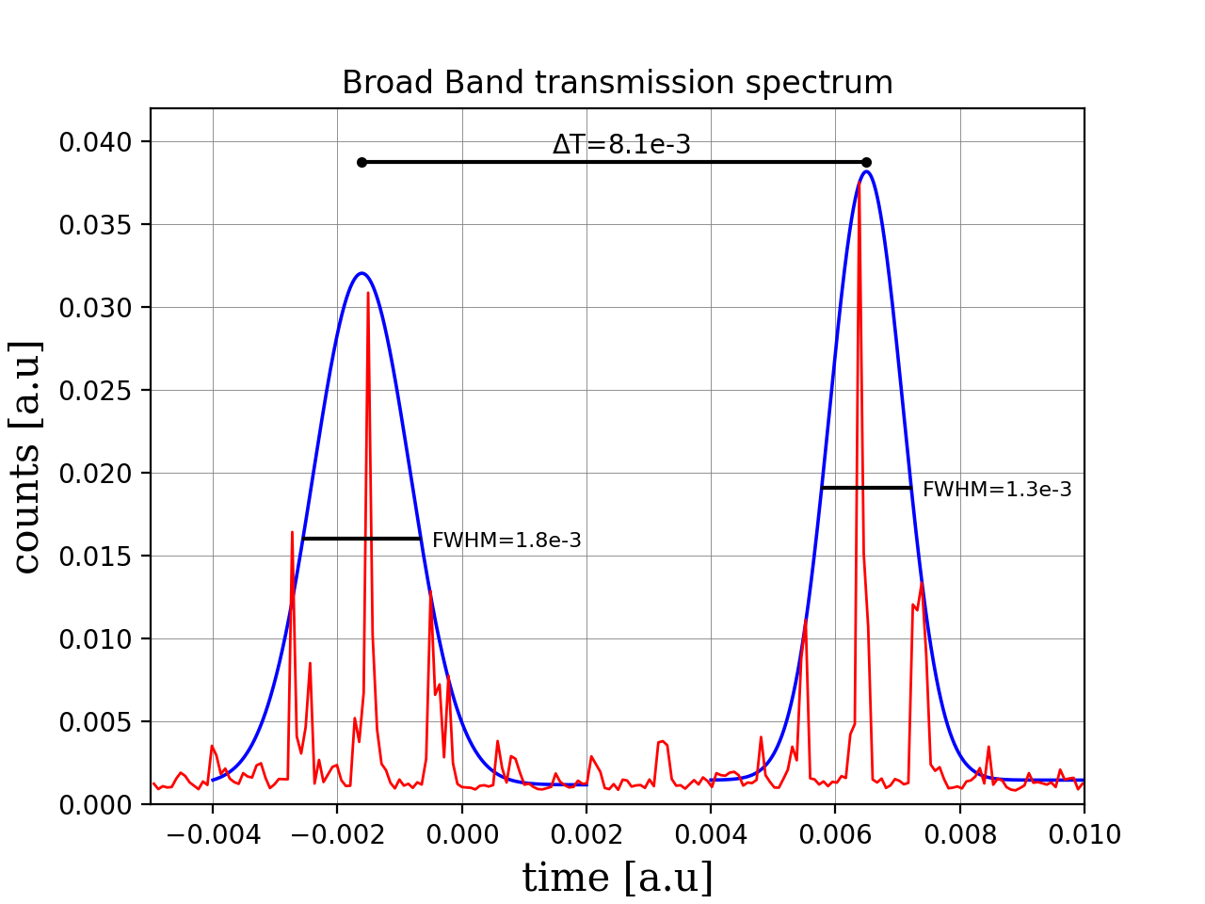
Characterization Broadband cavity
FPI
$$L$$
Broadband Cavity linewidth
$$L=q\left(\frac{λ}{2}\right)$$
$$δν_{FWHM}= \frac{δt_{FWHM}}{ΔT} ⋅FSR$$
Constructive interference
$$δν=3.16 GHz$$

Slide 9
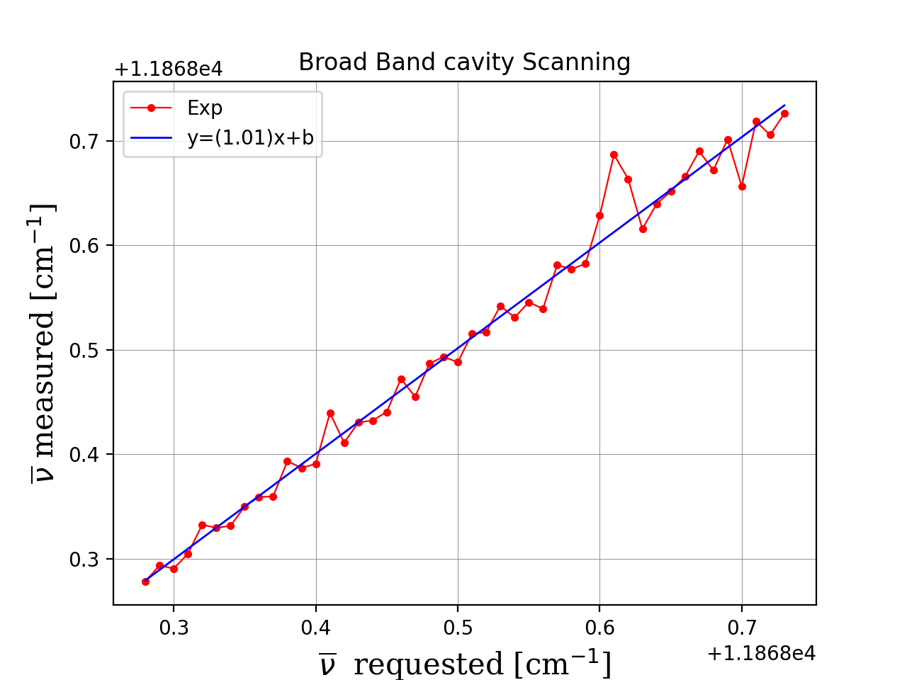
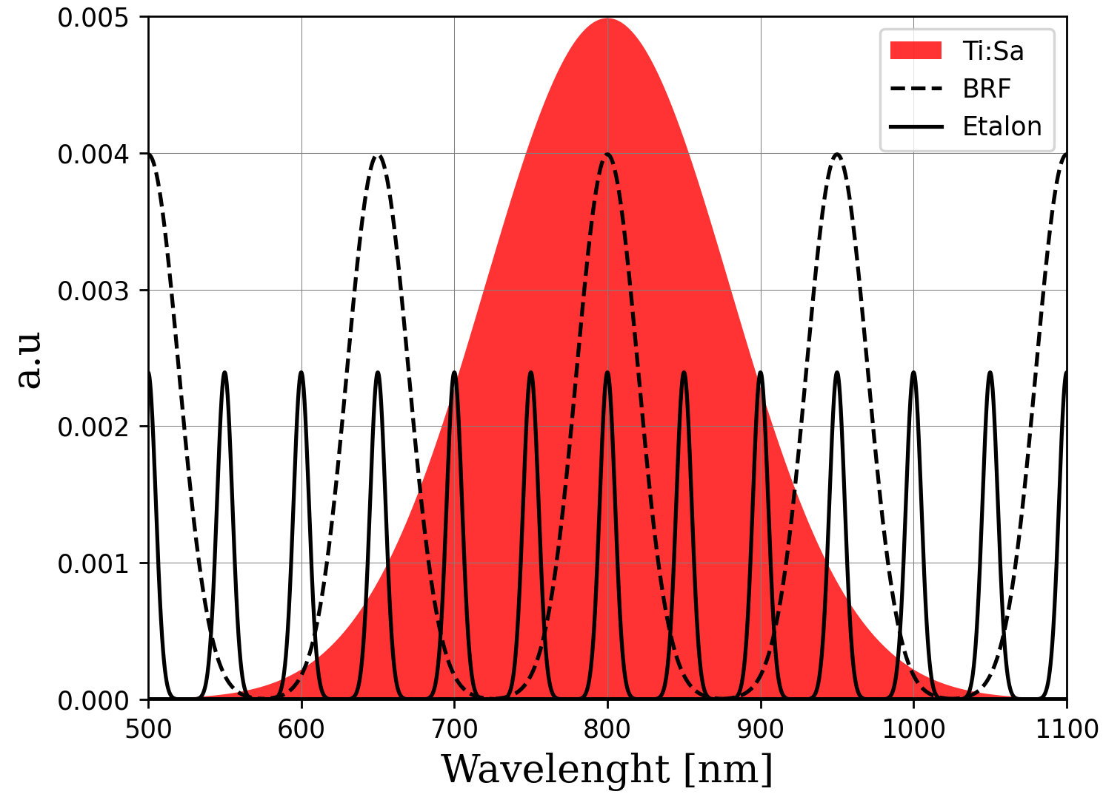
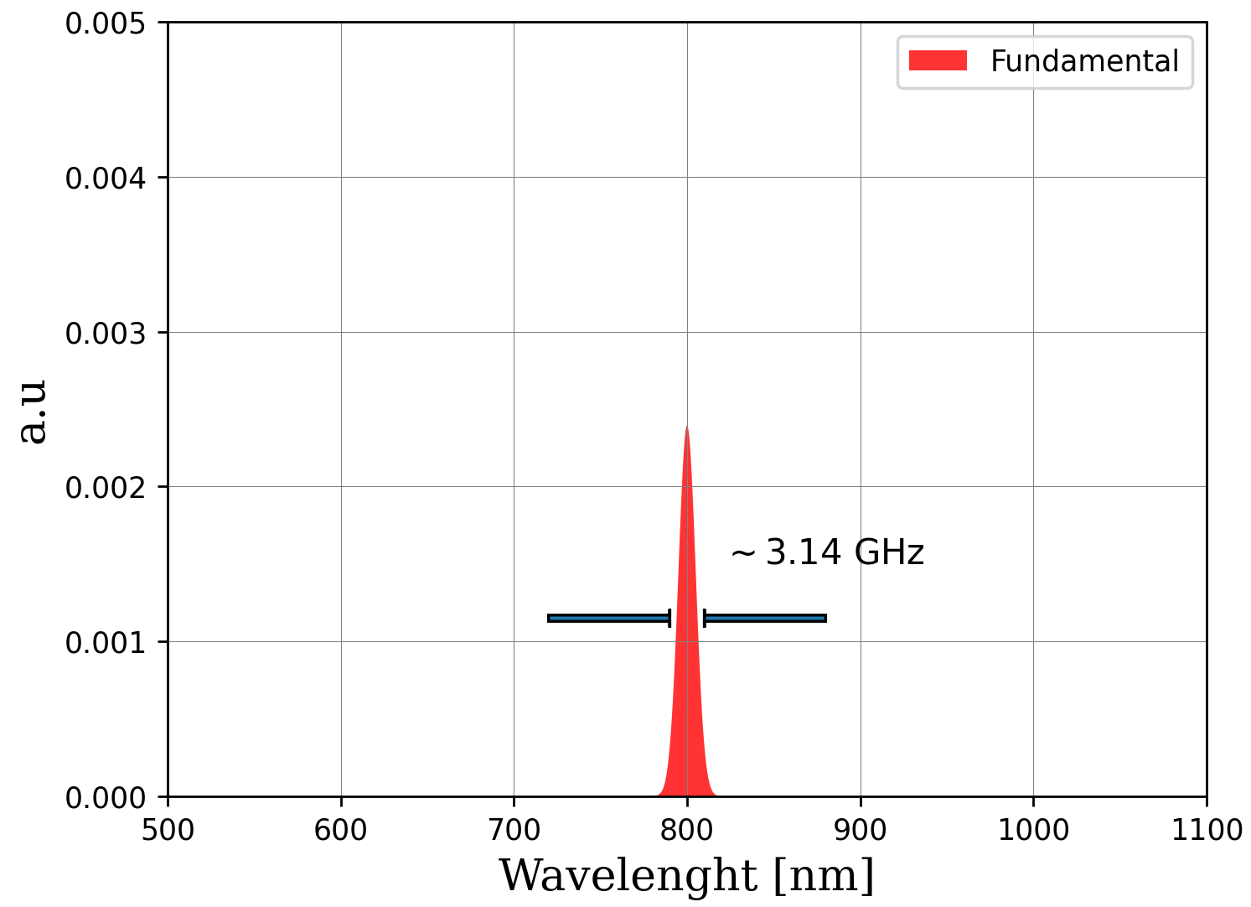
Characterization Broadband cavity
Broadband scanning routine
$δν=13.5$ GHz

Slide 10
Narrowband Injection-locked Ti:Sa cavity
Mainz design
$$L ∝ λ_{seed}$$

Slide 11
Narrowband Injection-locked Ti:Sa cavity
Mainz design
$$L ∝ λ_{seed}$$
Will be replaced by
the CW-cavity

Slide 12
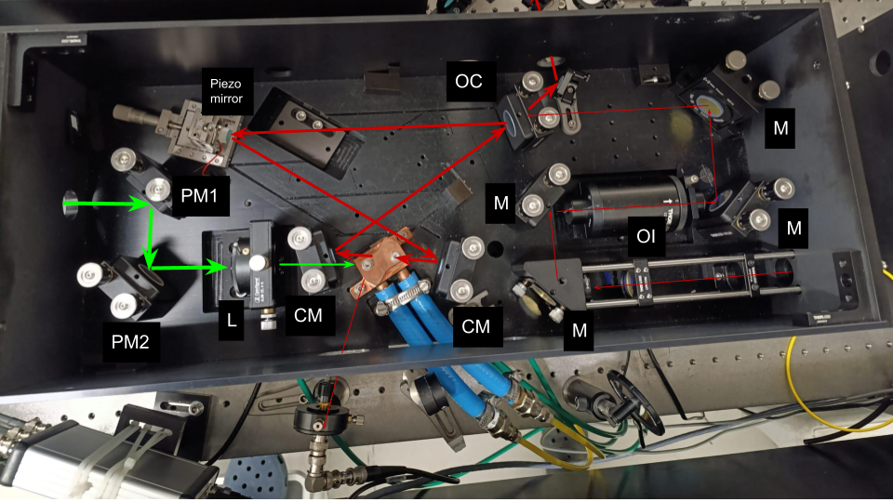
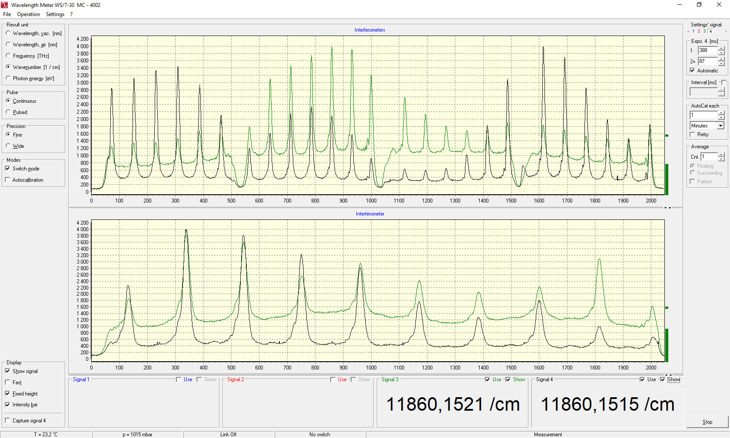
Injection-locked Ti:Sa cavity
Wavemeter readout
Injection-locked laser
Seeding Diode laser

Slide 13
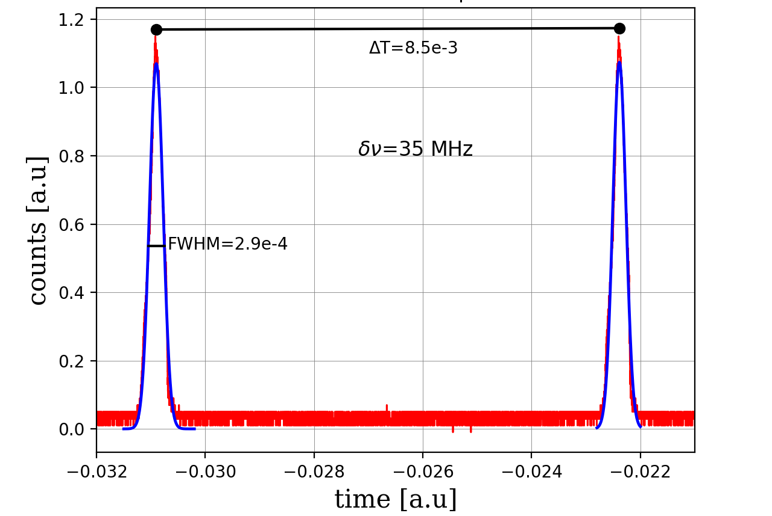
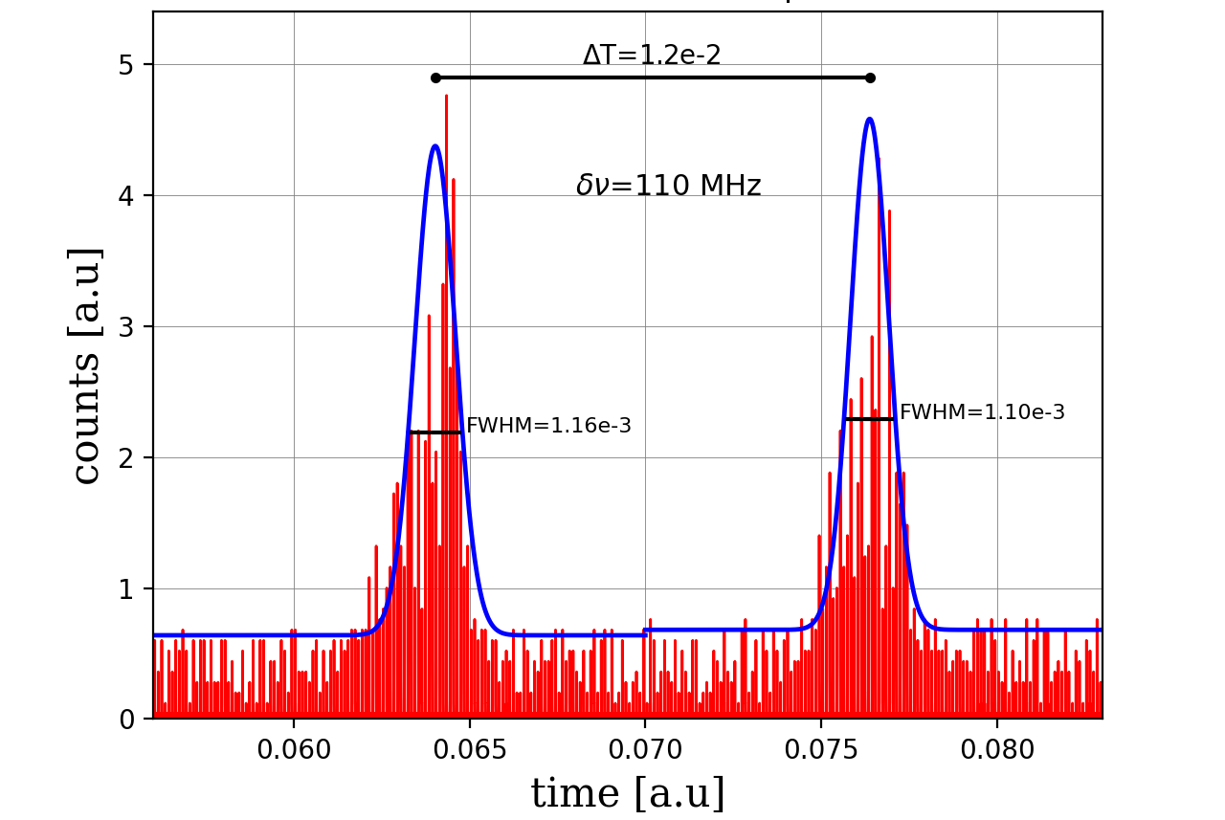
Characterization
Preliminary
Diode linewidth
Narrowband linewidth
$$δν=35 MHz$$
$$δν=40−110 MHz$$

Slide 14
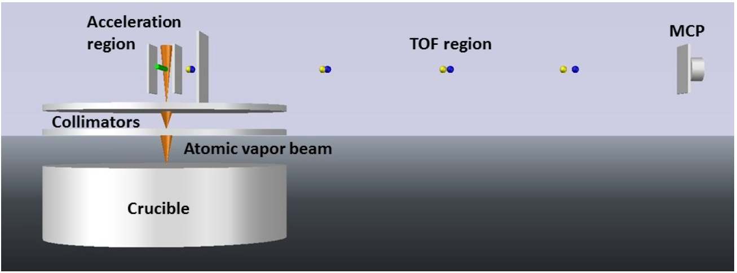
ABU – Atomic Beam Unit

Slide 15
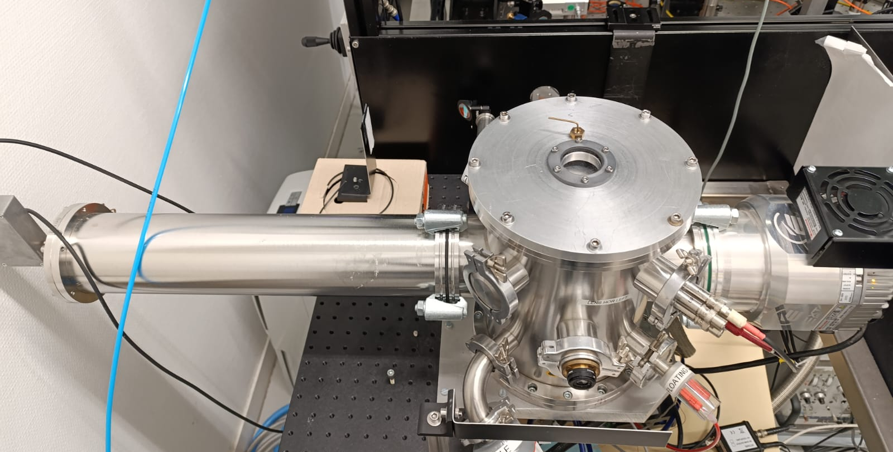
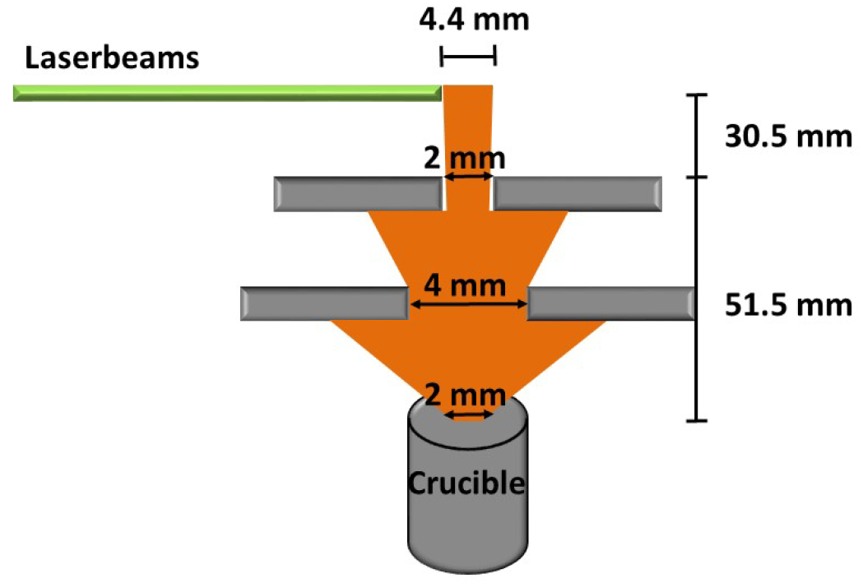
ABU – Atomic Beam Unit

Slide 16
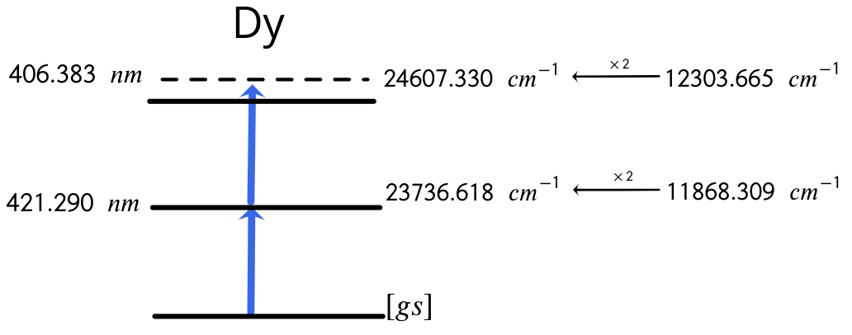
Off-line test on stable Dy

Slide 17
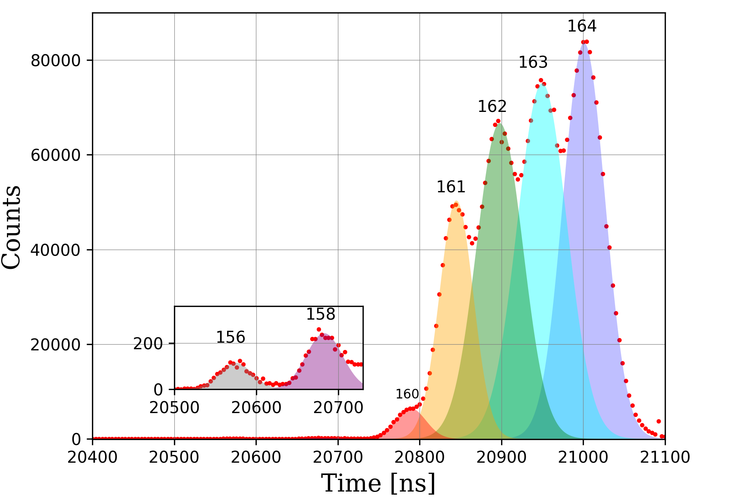
Broadband ionization on Dy
Preliminary
Isotope | Abundance
164 | 28.26 %
163 | 24.89 %
162 | 25.48 %
161 | 18.89 %
160 | 2.33 %
158 | 0.095 %
156 | 0.056 %
ToF Spectrum

Slide 18
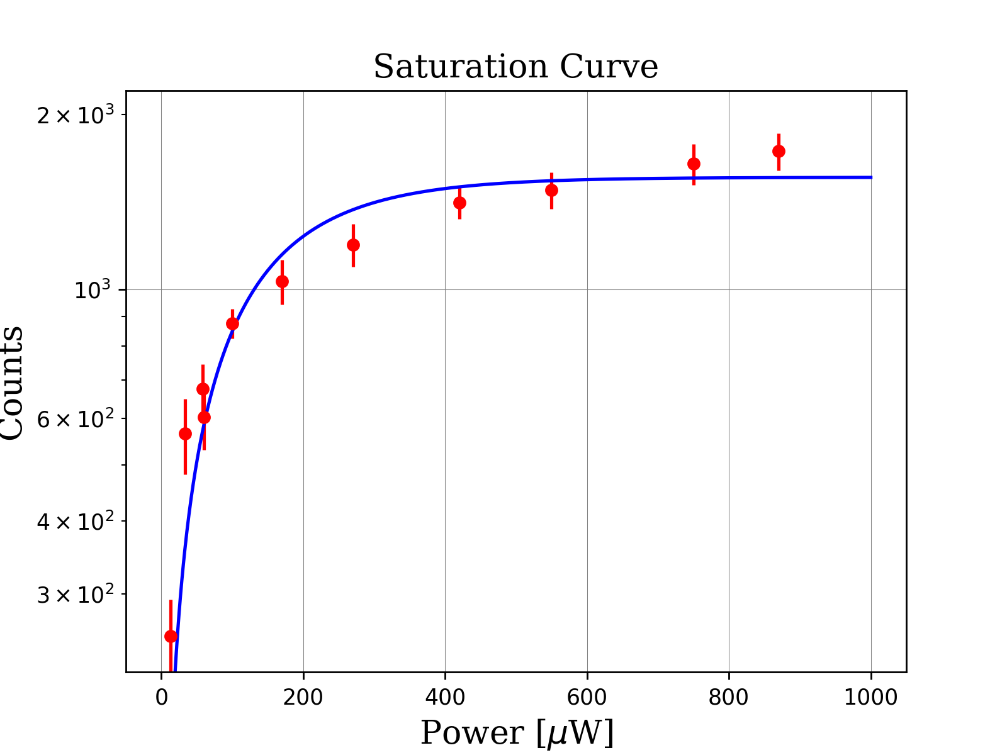
Narrowband spectroscopy on Dy
Preliminary
$$N=N_{0}(1 − e^{−E/E_{sat}})$$
$$N_{0}$$ | 1560.36 counts
$$E_{sat}$$ | 127.52 $μ$W

Slide 19
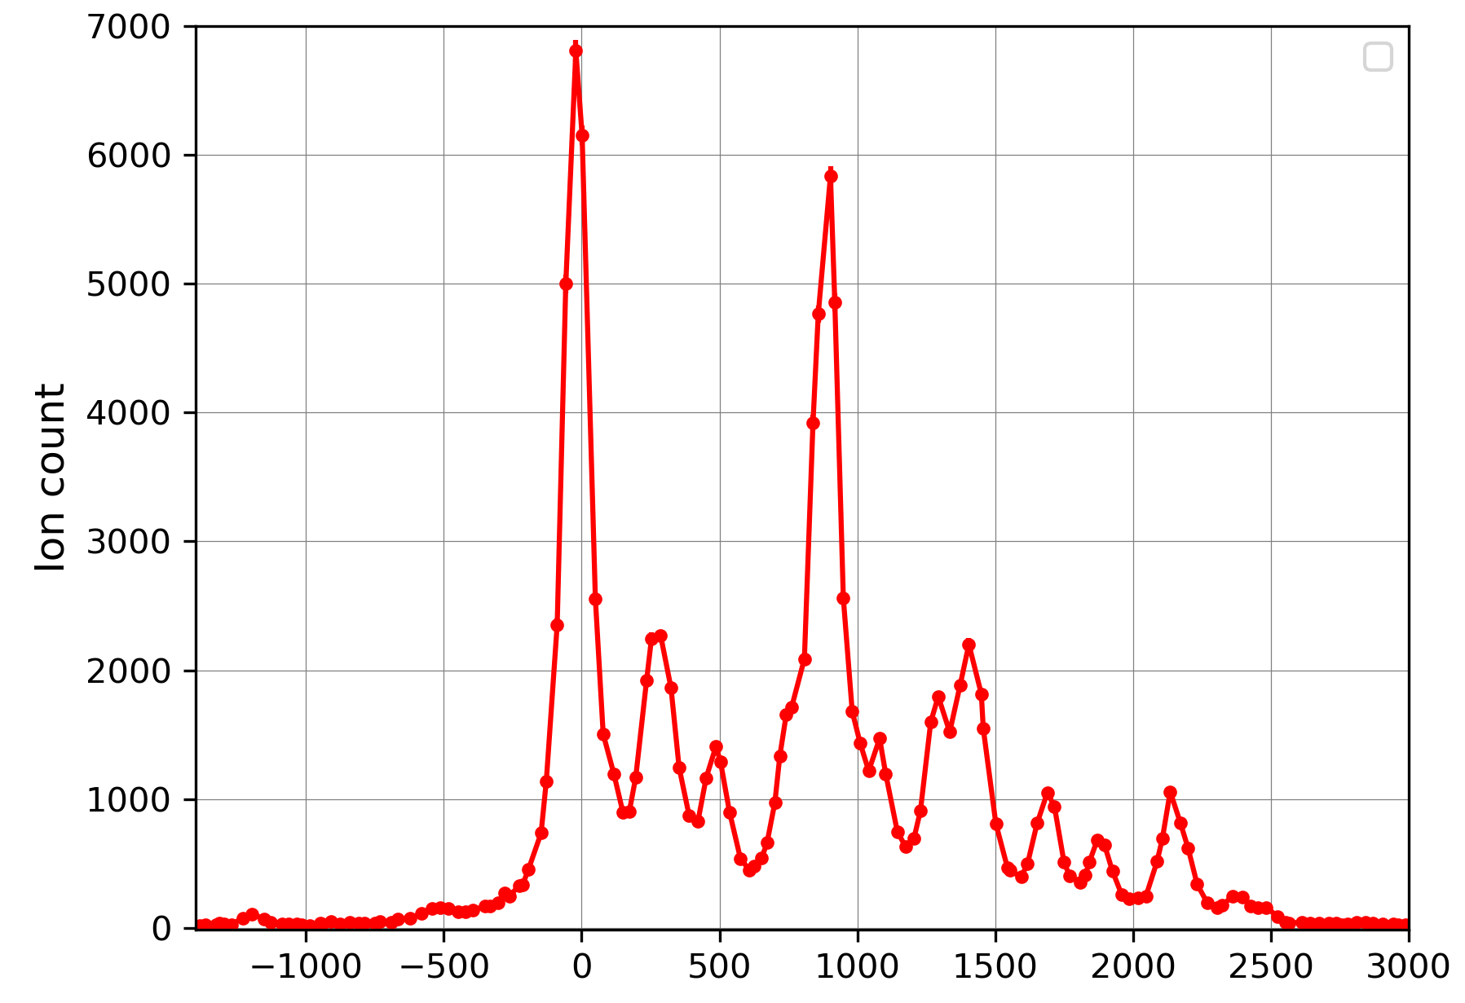
Narrowband spectroscopy on Dy
Preliminary
Narrowband Scan
ToF Spectrum
$ν−ν_{0}$ [MHz]

Slide 20
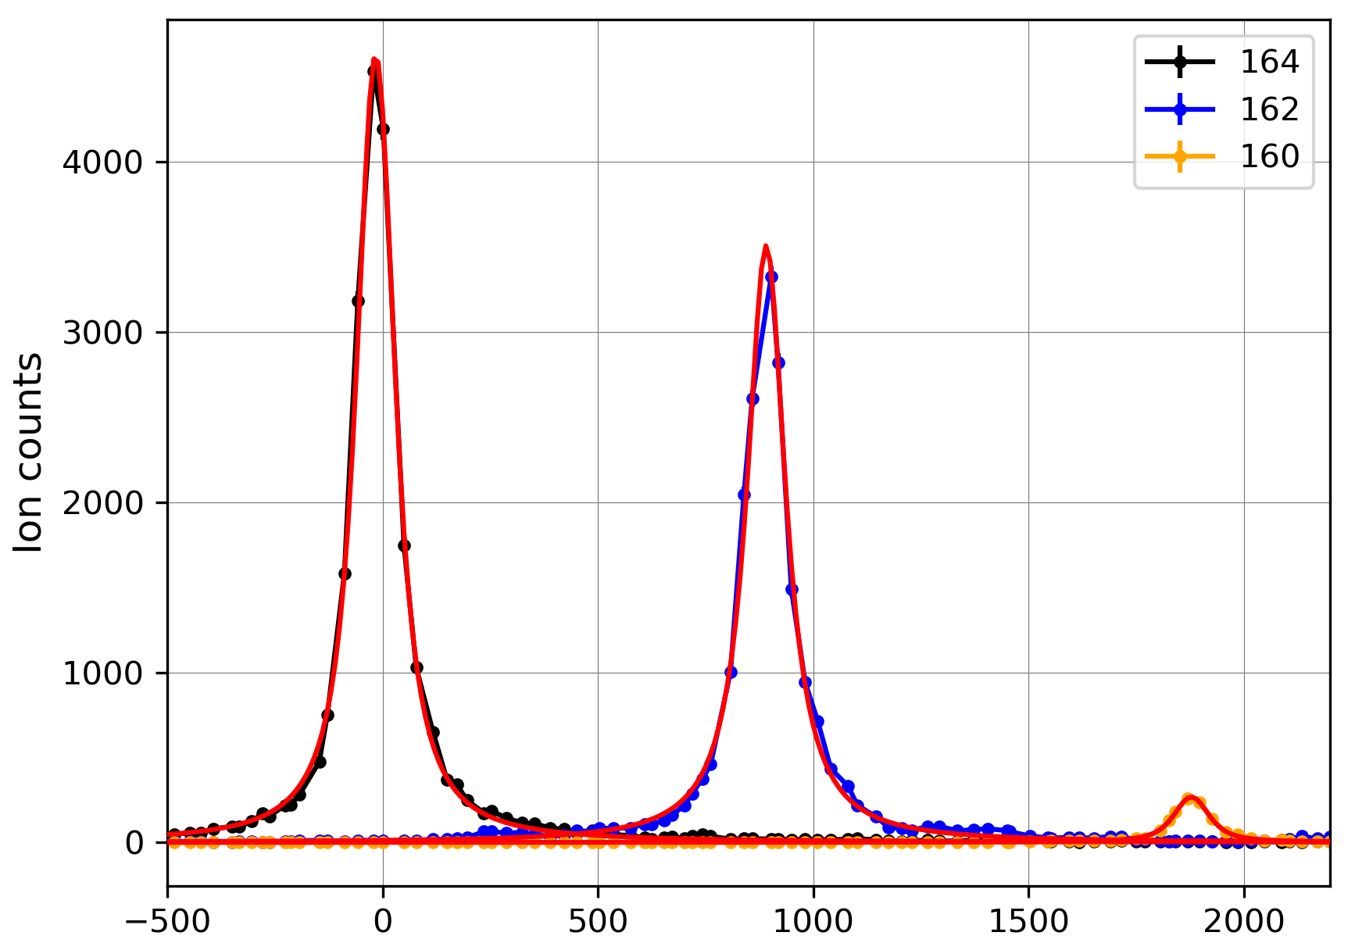
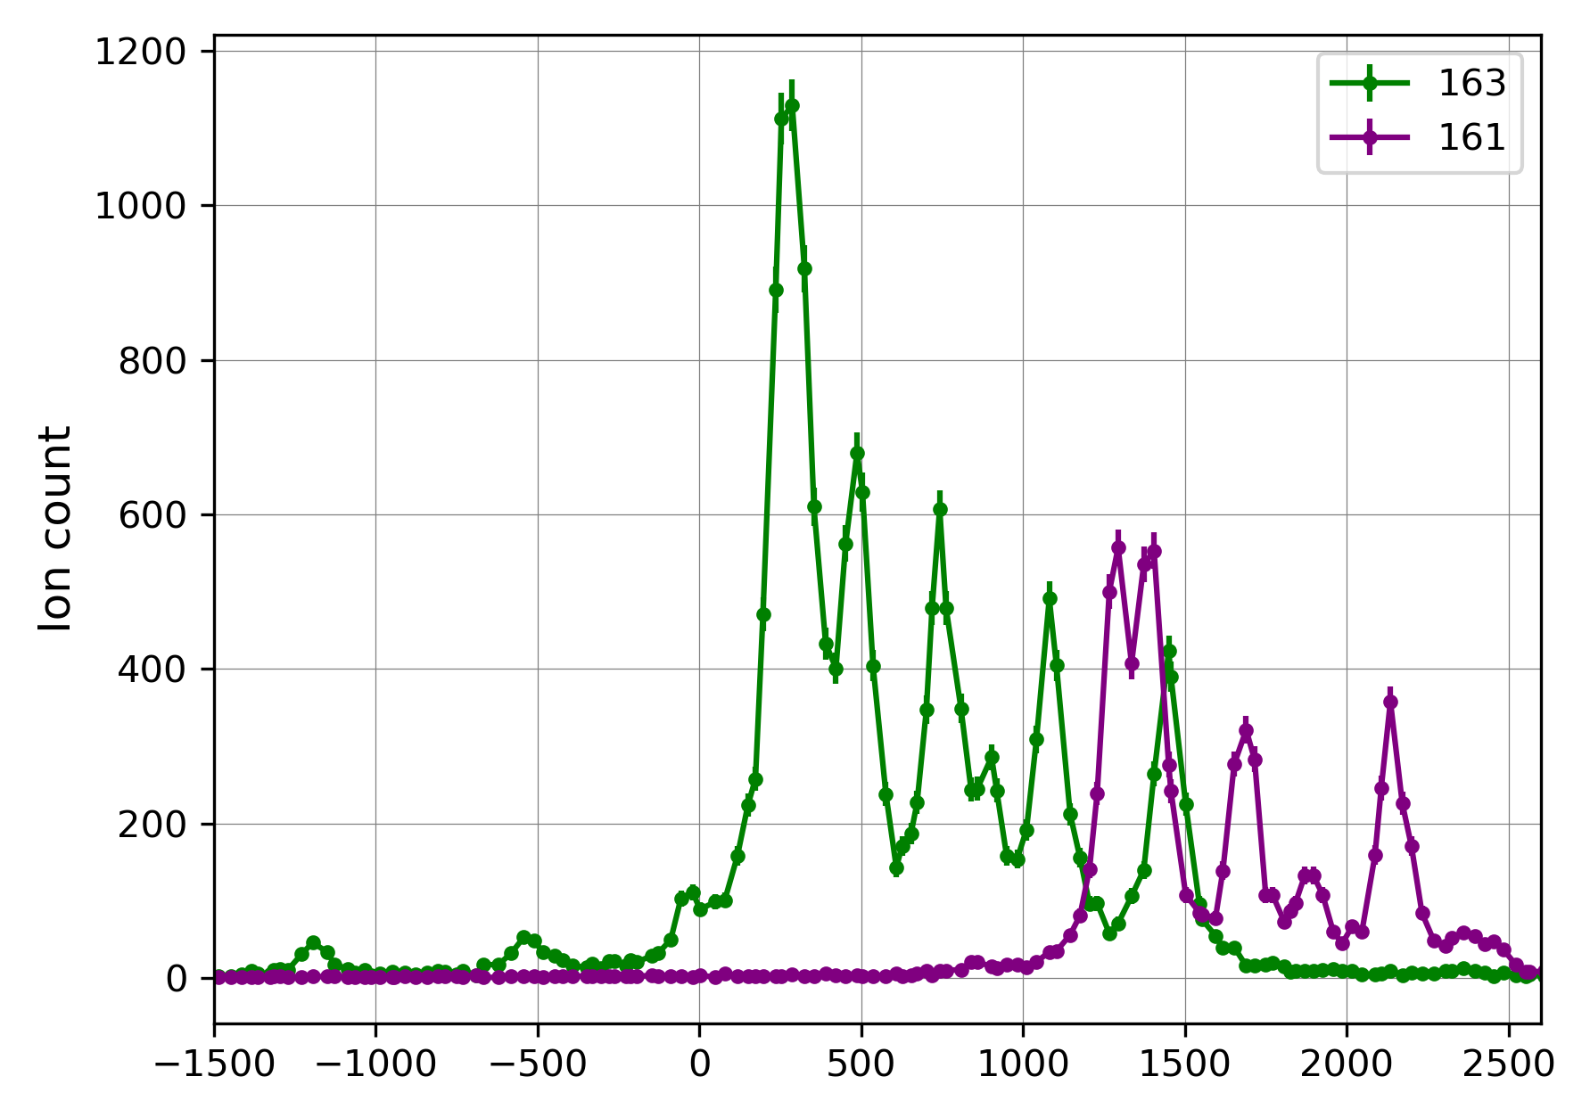
Narrowband spectroscopy on Dy
Preliminary
Narrowband Scan
Narrowband Scan
$ν−ν_{0}$ [MHz]
$ν−ν_{0}$ [MHz]

Slide 21
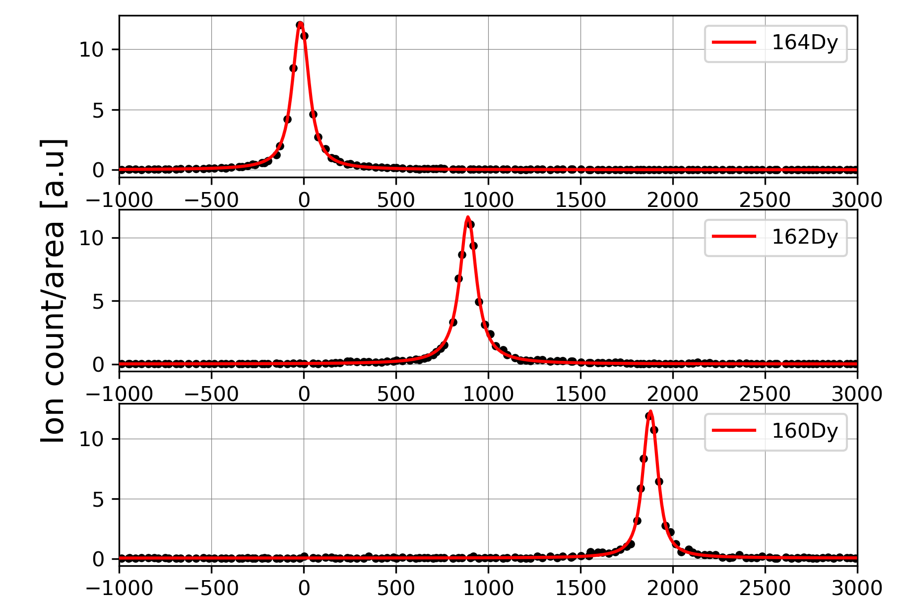
Isotope shift on Dy
Preliminary
Transition | $δν_{164−162}$ [MHz] | $δν_{164−160}$ [MHz]
421.291 nm (prev. Work 2013) | 913.2(8) | 1895(2)
421.291 nm (this work) | 906.8(7) | 1893(2)
$ν−ν_{0}$ [MHz]

Slide 22
Conclusions and Perspectives
After a complete restructuration of the lab, GISELE offline laboratory is again fully operational.
The first test on stable Dy was succesfully carried out at GISELE.
Future studies on Gd and Ho will be performed as paving the route of S3LEB experiments.
New laser room at S3LEB will be commissioned in the following months.

Slide 23
Thank you!

Slide 24
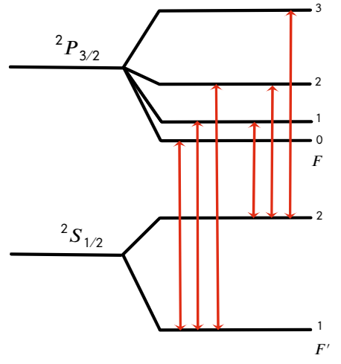
Narrowband spectroscopy on Dy
Preliminary

Slide 25
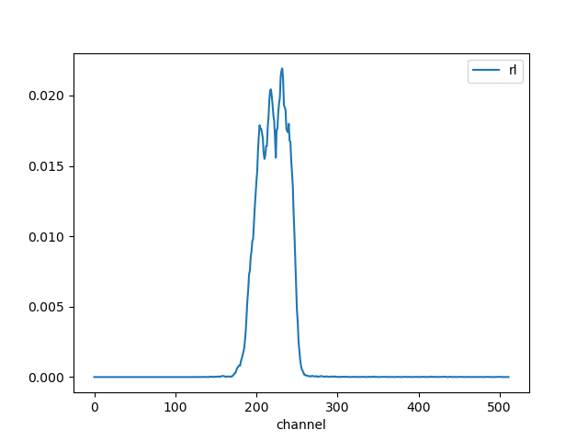
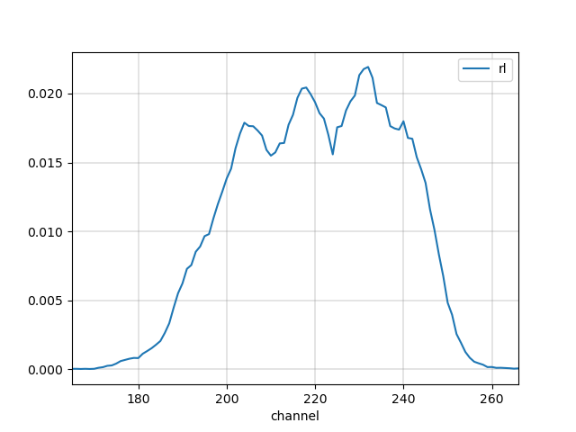

Slide 26
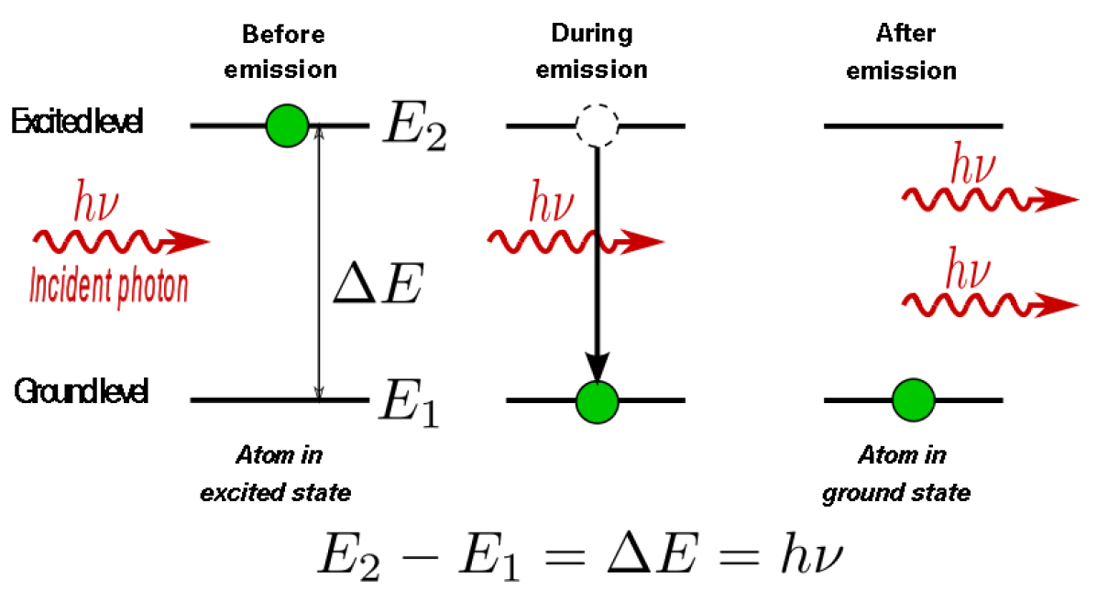

Slide 27
Laser Spectroscopy for Nuclear Structure put it S3LEB Gas cell, what you can do and a list of what you need, tunable laser, high power-pulsed, broadband, narrowband

