Slide 1


Recent results from RADRIS/JetRIS
Alexandre Brizard
Workshop ISOL-France VII, 2025

Slide 2
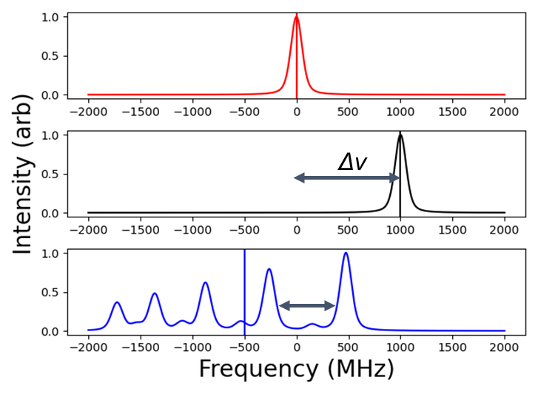


Resonance Ionisation Spectroscopy
Isotope shift
Hyperfine structure
Ionization potential
$$E_{IP}$$
Excited state
$$E_{0}$$
Ground state

Slide 3
A stroll through laser spectroscopy at GSI
RADRIS
  Results from beamtime 2024
  Latest technical developments
  Goals for beamtime 2025
JetRIS
  Latest changes of the setup
  Preliminary results from beamtime 2025
  Further developments

Slide 4
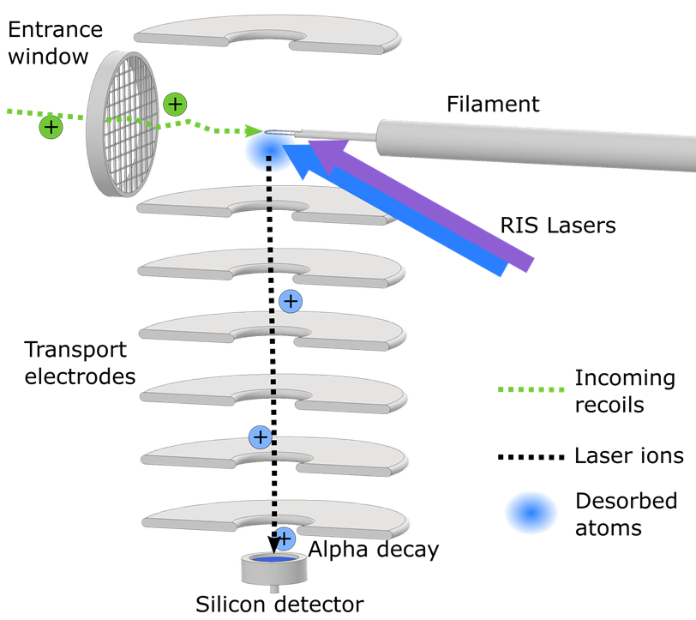
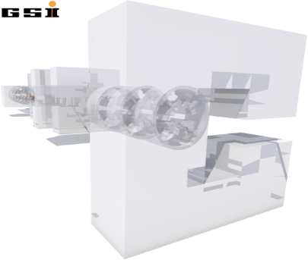
RADRIS
90mbar Ar
buffer gas

Slide 5

Beamtime 2024
${}_{ }^{52}{Cr+{}_{ }^{107}{Ag →}}{}_{ }^{γpxn}{Lu}$
Production
  Direct production of Lu and Yb
  Tm and Er in the decay chain

Slide 6




RIS on ¹⁵²⁻¹⁵⁴Tm
28169.0 ${cm}^{−1}$
Preliminary
25745.117 cm⁻¹
25656.019 ${cm}^{−1}$
25717.197 cm⁻¹
25717.197 ${cm}^{−1}$
25656.019 cm⁻¹
25745.117 ${cm}^{−1}$
4f¹³6s² J₀=7/2
4f¹³6s² J₀=7/2
Analysis by K. van Beek

Slide 7
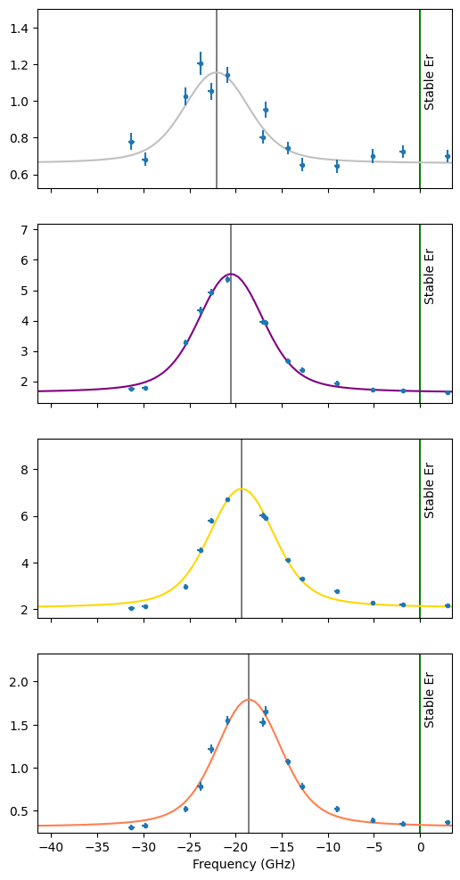
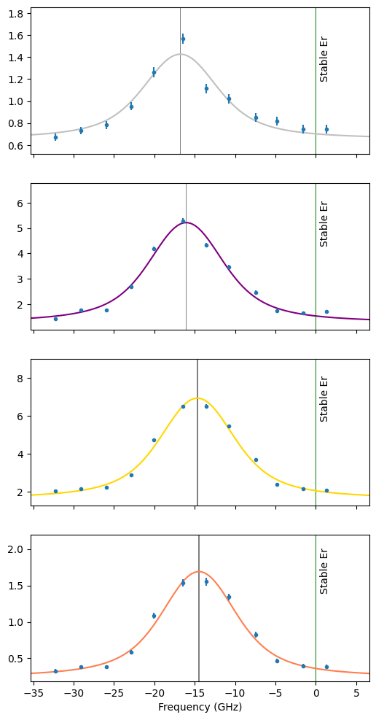
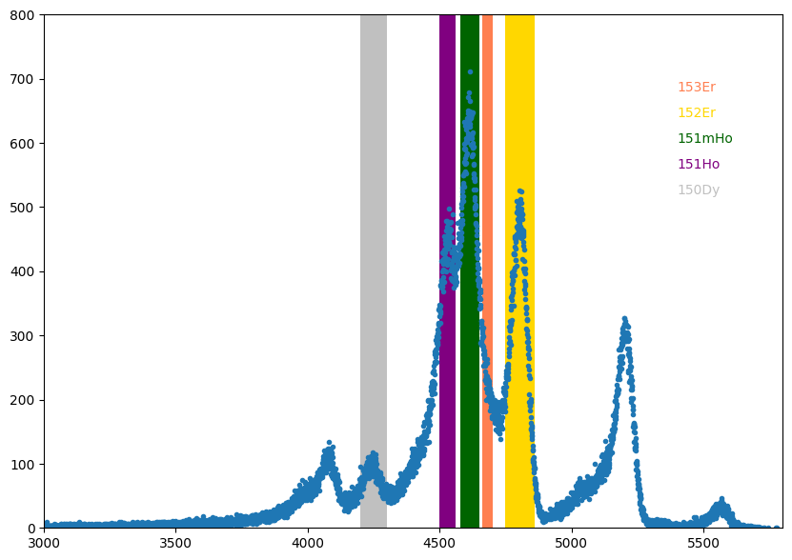

RIS on ¹⁵⁰⁻¹⁵³Er
ν₀ = 21701.885 cm⁻¹
ν₀ = 25392.779 cm⁻¹
28169.0 ${cm}^{−1}$
Preliminary
25392.779 cm⁻¹
21701.885 cm⁻¹
4f¹²6s² J₀=6

Slide 8
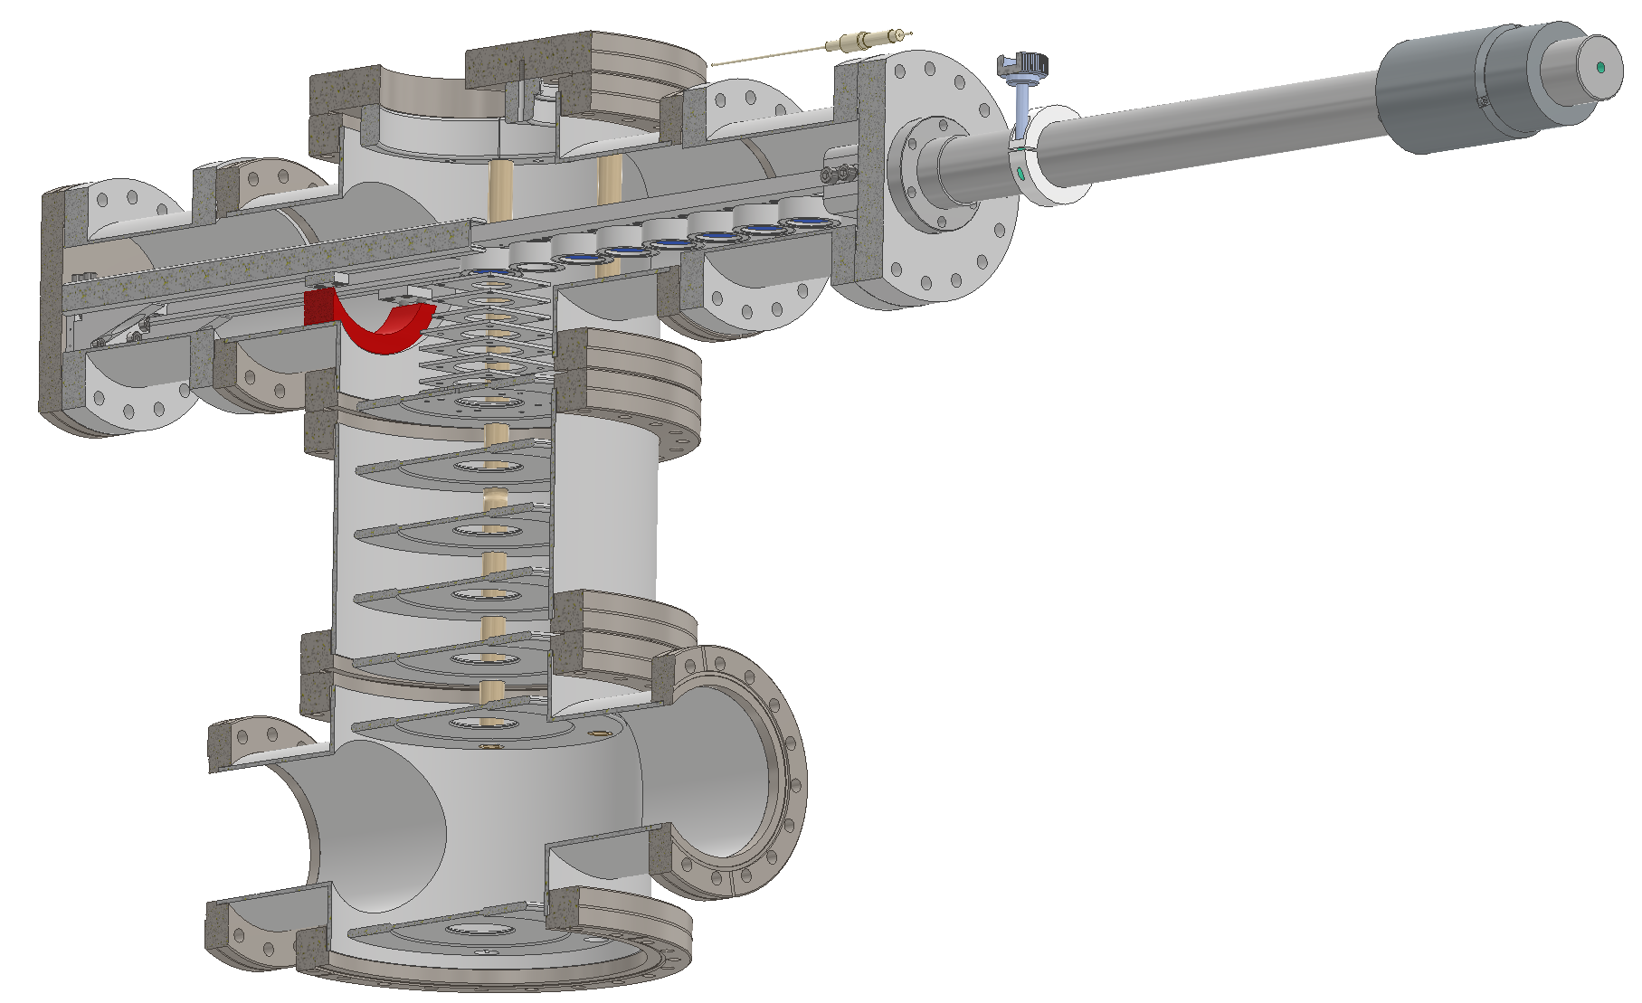
The 8 detectors setup
Access to longer lived isotopes
Multi detector configuration already tested with three detectors on a rotating wheel
Commissioning in June 2025

Slide 9











Goals for beamtime 2025
“Long lived” ²⁴⁶Cf
Good case for testing the new 8 detectors setup
Paving the way for measuring isotope shift in californium isotopes
$${}_{ }^{254}{No}$$
Production
$$51.2s$$
$$90\%$$
$${}_{ }^{250}{Fm}$$
Breeding on filament
$$30min$$
$$>90\%$$
$${}_{ }^{246}{Cf}$$
Spectroscopy &
detection
$$35.7h$$
$$100\%$$
$${}_{ }^{242}{Cm}$$
$$162.86d$$

Slide 10

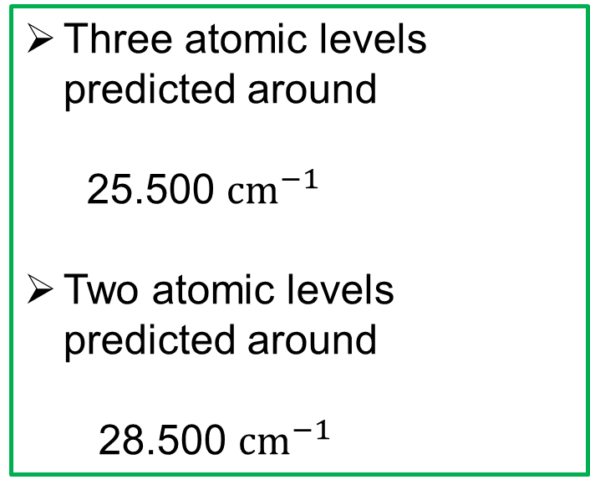






Goals for beamtime 2025
Level search in mendelevium
$${}_{ }^{254}{No}$$
Three atomic levels predicted around
25.500 ${cm}^{−1}$
Two atomic levels predicted around
28.500 ${cm}^{−1}$
Production
$$51.2s$$
$$10\%$$
$${}_{ }^{254}{Md}$$
Spectroscopy
$$10min$$
$${}_{ }^{254}{Fm}$$
Detection
$$3.2h$$
$$100\%$$
$$α$$

Slide 11
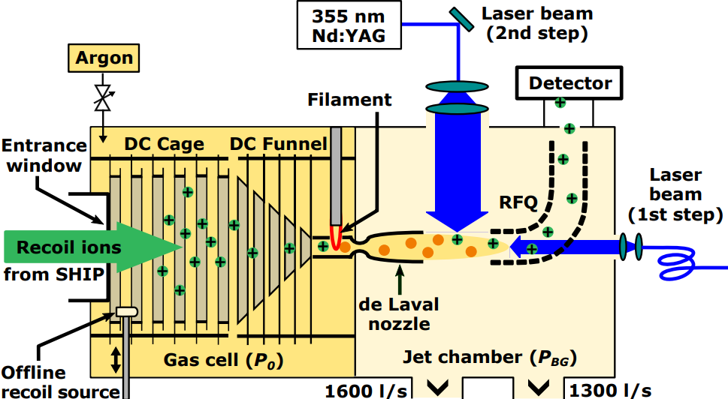
JetRIS

Slide 12
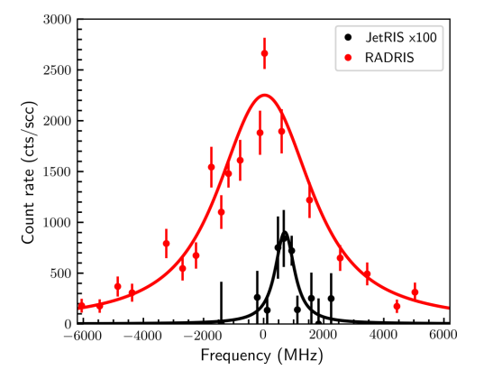
Online characterisation in 2022
²⁵⁴No measurement (high yield of 2 to 3 ions per second entering the cell)
Transport efficiency of 0.24%, with an overall efficiency of 0.01% (two orders of magnitude lower than RADRIS)
FWHM of about 770 MHz, five times better than RADRIS with 3900 MHz
Without power broadening, FWHM expected to be about 200 MHz
J. Lantis et all, Phys. Rev. Research 6, 023318 (2024)

Slide 13
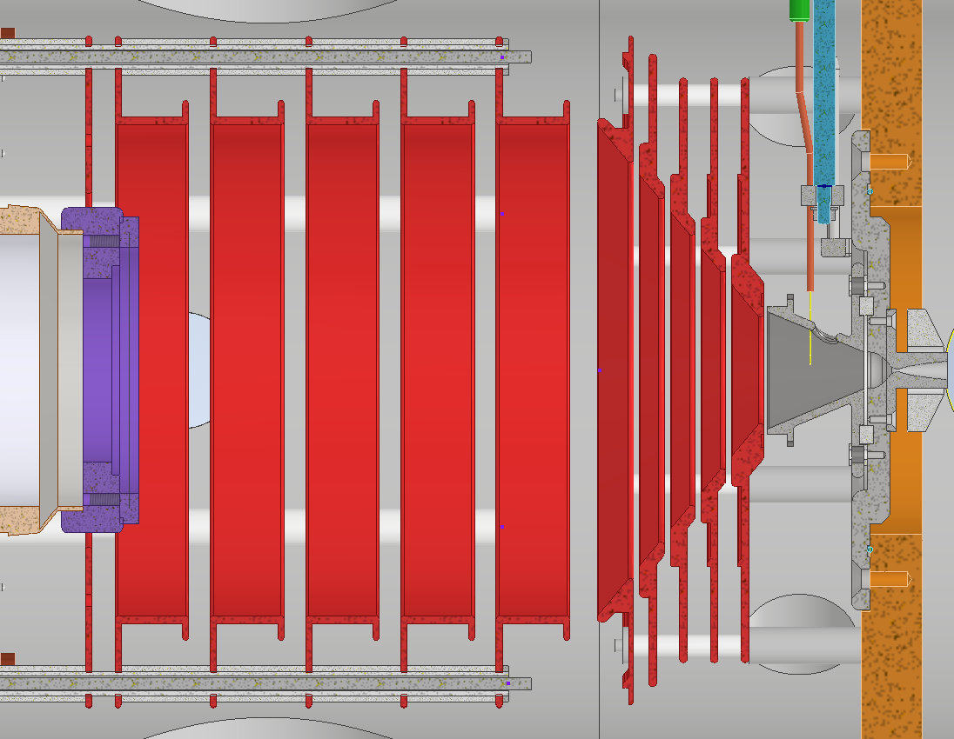
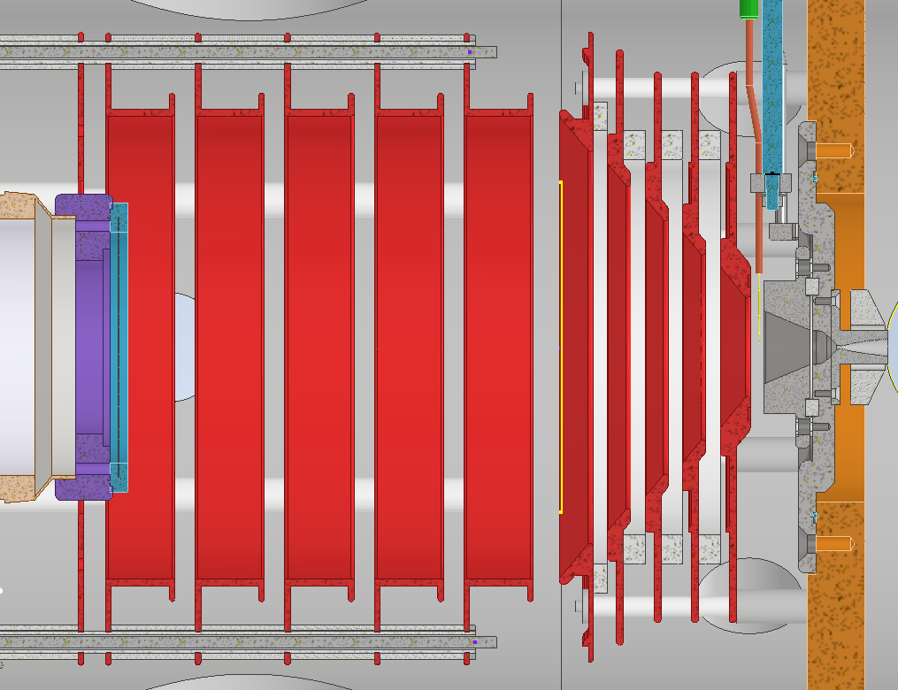
New design
In a collaboration with KU Leuven, a new design was proposed following COMSOL simulation of the gas cell by F. Ivandikov
Filament in front of the channel guiding the flow to the nozzle for better collection
Conical channel (prior tests)
Free filament (new prototype)

Slide 14
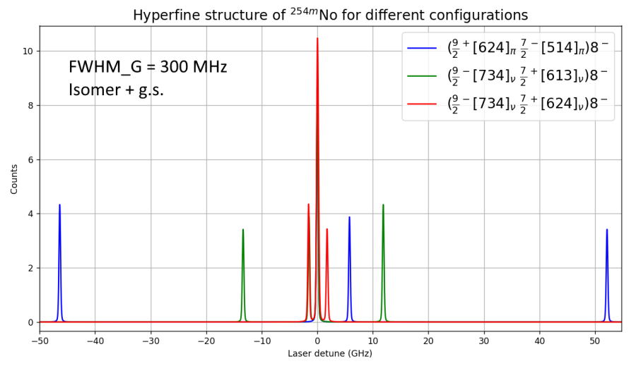
Beamtime 2024 goal
²⁵⁴No K=8⁻ isomer
Rather high yield, about 1/3 of the ²⁵⁴No
Short lifetime ~250 ms, out of RADRIS range
Two quasiparticles state configuration unknown
R.D. Herzberg et all, Phys. Scr. T125, 73 (2006)

Slide 15
Beamtime results
Efficiency improvement, to be analysed quantitatively !
Spectrum of ²⁵⁴No and its isomer !
PRELIMINARY

Slide 16
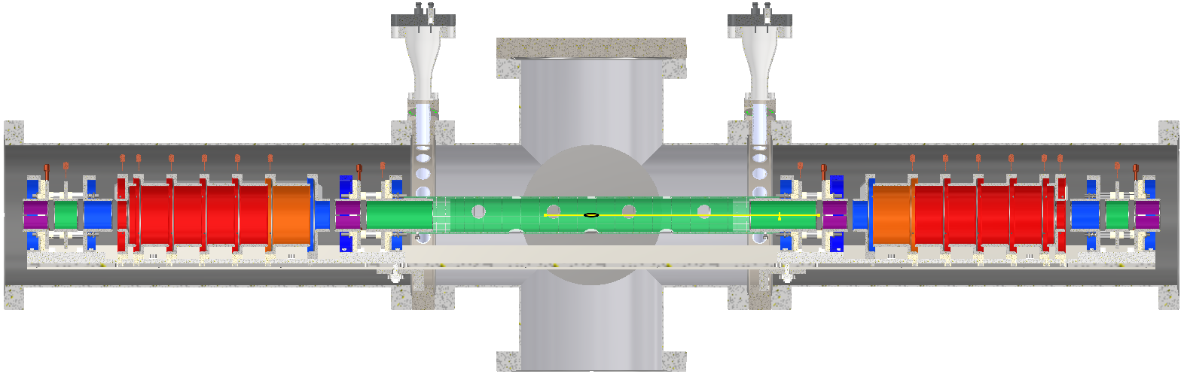
Further developments
Working on improving the efficiency
  New filament holder design to prevent updrift
  New simulations on the gas cell design
Implementation of an MR-ToF-MS
    No decay limitation (beta, long lived nuclei…)
    Possible mass measurement
  Tested offline in the University of Mainz
  Soon coupled to the bunching section, then to JetRIS

Slide 17













Thank you for your attention
GSI Darmstadt
B. Andelic, M. Block, F. Giacoppo, O. Kaleja, T. Kieck, A. Mistry, S. Raeder, M. Gutierrez-Torres, J. Warbinek
TU Darmstadt
Kenneth van Beek, A. Mistry, Th. Walther
Universität Mainz
A. Arya, S. Berndt, Ch. E. Düllmann, R. Hasse, B. Jana, M. Kaja, E. Kim, M. Laatiaoui, J. Lantis, T. Niemeier, E. Romero Romero, M. Stemmler, K. Wendt
KU Leuven
A. Claessens, R. Ferrer, F. Ivandikov, J. Romans, P. Van Duppen
HIM Mainz
P. Chhetri, St. Nothhelfer, D. Münzberg, E. Rickert, D. Studer, J. Weyrich
GANIL
A. Brizard, P. Chauveau, S. Geldhof, N. Lecesne, V. Manea, A. De Roubin, H. Savajols
CEA Saclay
E. Rey-Herme, M. Vandebrouck
Jyväskylä
I. Moore, A. Raggio
This Marie Sklodowska-Curie Action (MSCA) Innovative Training Network (ITN) receives funding from the European Union H2020 Framework Programme under grant agreement no. 861198.

Slide 18
A stroll through laser spectroscopy at GSI
RADRIS
  Results from beamtime 2024
  Latest technical developments
  Goals for beamtime 2025
JetRIS
  Latest changes of the setup
  Preliminary results from beamtime 2025
  Further developments

