Slide 1
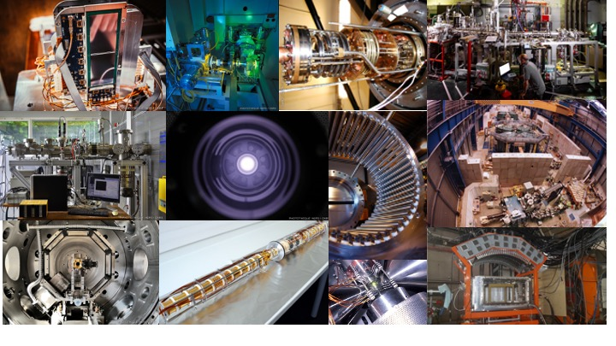
ISOL-France
WORKSHOP VII
April 3-4 2025
https://isolfrance.in2p3.fr/

Slide 2
Discussion : Facilities and Beams
• Timeline S3 and DESIR :
  Equipment arrival at GANIL?
  Start of the facilities?
  First experiments? Participation commissioning experiments.

Slide 3
Discussion : Facilities and Beams
• Timeline S3 and DESIR :
  Equipment arrival at GANIL?
  Start of the facilities?
  First experiments? Participation commissioning experiments.
• Human resources :
  Status of position opening for DESIR? PhD, post-doc?
  Positions to come in the context of S3 and DESIR? CRCN, MC, CPJ?
  How and when will/can the responsibility for an equipment be transferred to GANIL? (e.g. : operation of HRS, GPIB...)?

Slide 4
Discussion : Facilities and Beams
• Timeline S3 and DESIR :
  Equipment arrival at GANIL?
  Start of the facilities?
  First experiments? Participation commissioning experiments.
• Human resources :
  Status of position opening for DESIR? PhD, post-doc?
  Positions to come in the context of S3 and DESIR? CRCN, MC, CPJ?
  How and when will/can the responsibility for an equipment be transferred to GANIL? (e.g. : operation of HRS, GPIB...)?
• Organisation of GANIL as a « user facility » :
  administrative implications
  organization of long-term missions

Slide 5
Discussion : Facilities and Beams
• Timeline S3 and DESIR :
  Equipment arrival at GANIL?
  Start of the facilities?
  First experiments? Participation commissioning experiments.
• Human resources :
  Status of position opening for DESIR? PhD, post-doc?
  Positions to come in the context of S3 and DESIR? CRCN, MC, CPJ?
  How and when will/can the responsibility for an equipment be transferred to GANIL? (e.g. : operation of HRS, GPIB...)?
• Organisation of GANIL as a « user facility » :
  administrative implications
  organization of long-term missions
SPIRAL1 open questions :
  Laser ion source
  Batch mode
  MNT

Slide 6

Discussion - Conclusion
National Events
  Could we better coordinate ?
  Common workshop S³ - DESIR - ISOL-France ?
Common DAQ @GANIL ?
  several tools under development or upgrade
  common data format?
  DAQ = GANIL responsibility or user’s ?
  GANIL’s network access ? Data management plan ?
  ISOL-France community needs ?
new COMET
NARVAL/DCOD
AGATA DAQBox
NUMEXO
ISOL-France : budget ?
  Ask for recurring budget from in2p3 ?
PERIF
  New PERIF 2025 : S.Lecanuet @IJCLab
  New Agreement : simpler and more flexible

