Slide 1


Status of DESIR
Bertram Blank
LP2i Bordeaux
ISOL-France meeting, 03-04/04/2025

Slide 2


• • • DESIR at GANIL
« Decay , Excitation and Storage of Radioactive Ions »
Exotic decay modes Shape, size, structure of the nucleus Mass, correlations
A new GANIL users facility
Study of the fundamental properties of atomic nuclei and underlying forces
With a high precision using ultra-pure samples of radioactive ions manipulated at very low energy
Taking advantage of the various RIBs production methods
In complementarity to S³(-LEB) and other GANIL installations

Slide 3
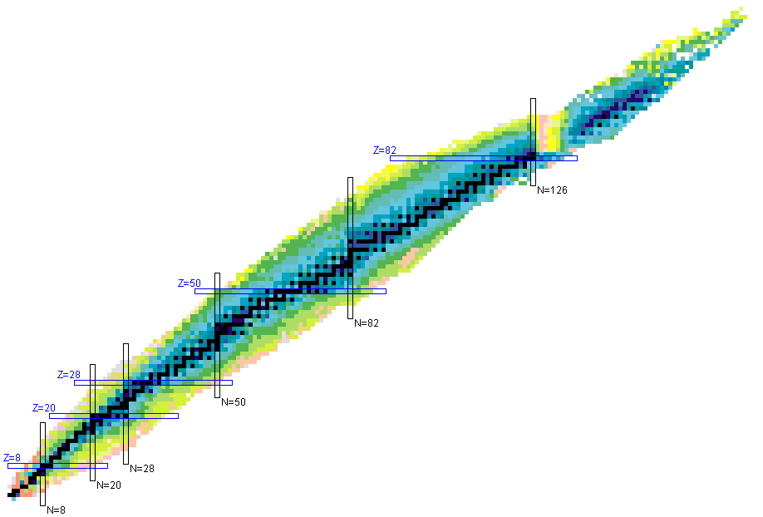
• • • DESIR scientific programme
Tests of Standard Model
    Super-allowed 0+ -> 0+ and mirror transitions
Research of exotic currents in weak interaction
  Angular correlation measurements β-ν (a_{βν})
  Beta-shape measurements
Test of time reversal violation
  β-ν correlation with polarized nuclei
N=Z and neutron-deficient nuclei
    π-ν interaction, isospin symmetry
    Binding energy, structure, deformation
    Astrophysical processes
Light nuclei
    Radioactive decay modes
    Nuclear structure
Heavy and super-heavy nuclei
    Shell structure
    deformation
    spectroscopy
Observables
Magnetic and quadrupole moments
Nuclear radius δ<r²>
g factor, spin-parity J^{π}
Mass
A_{βν}, A_{β} & D
T_{1/2} , I_{β,} E*, J^{π}
Gamow-Teller strength S(GT)
Emission Probabilities
…..
  Collinear laser spectroscopy: LUMIERE
  Use of traps:
  DETRAP
  Decay spectroscopy:
  BESTIOL

Slide 4
• • • DESIR scientific programme
Workshop DESIR: February/March 2024:100 participants, 22 instituts (15 from foreign countries)
Workshop LUMIERE: 2 July 2024 (25 participants)
Workshop BESTIOL: 16 December 2024 (48 participants)
Workshop DETRAP: 6 May 2025
Letters of intent: end of 2025
Proposals: 2026

Slide 5
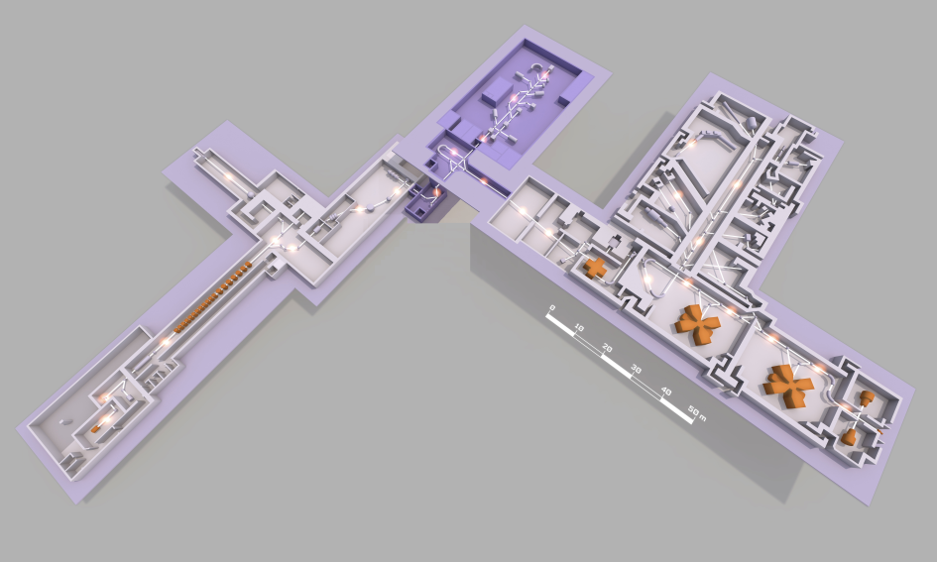

• • • GANIL in 2030
DESIR
SPIRAL2-Phase1
2027
S³
GANIL
2030
2024
NEWGAIN
SPIRAL1
CYREN
Two installations at GANIL:
cyclotrons with SPIRAL1 and SPIRAL2 with S3-LEB

Slide 6
• • •
DESIR Building

Slide 7
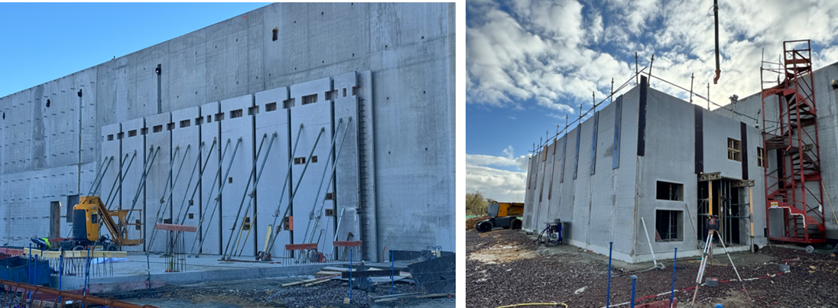
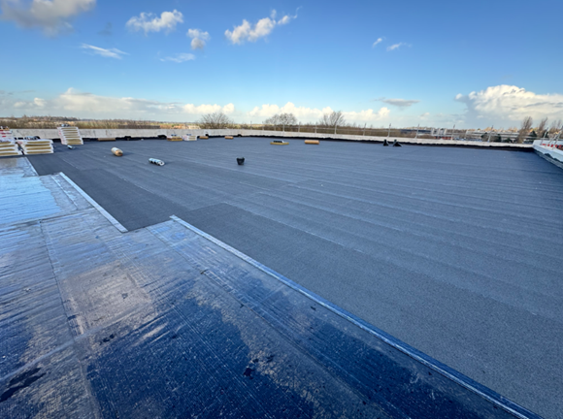
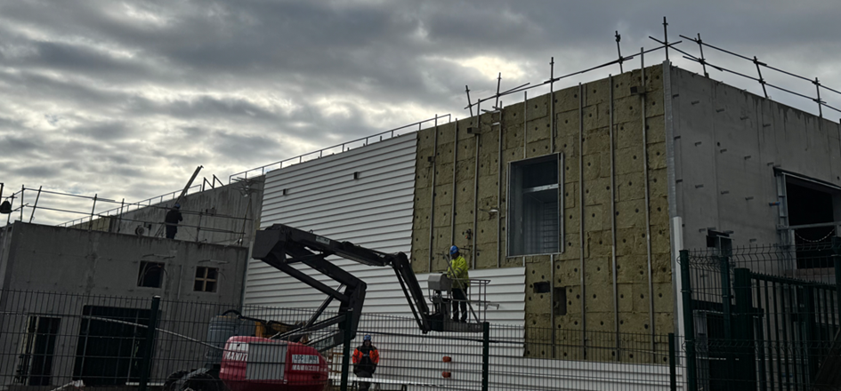
• • • DESIR building
Laser cabin
thermal
isolation
roof

Slide 8
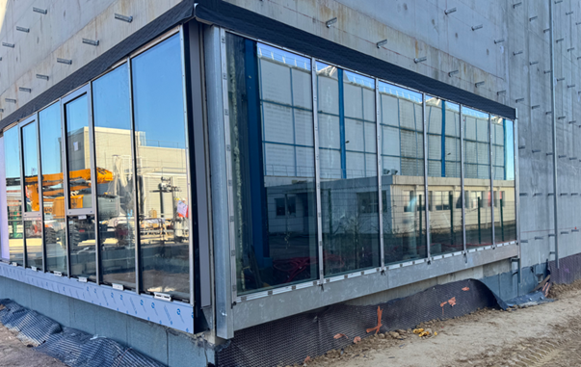
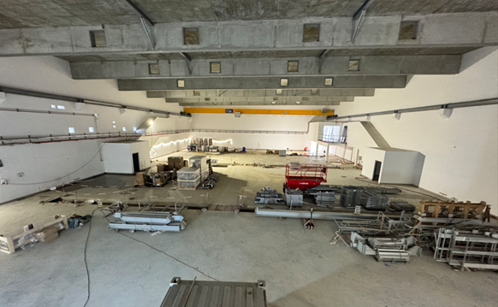
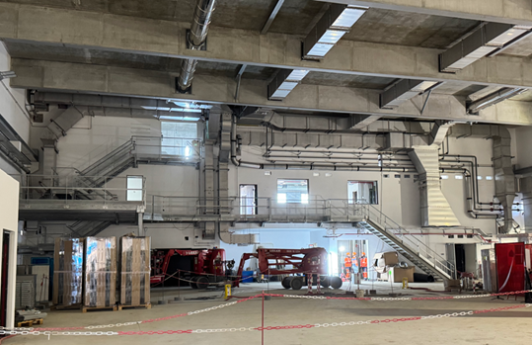
• • • DESIR building
inside the
DESIR hall
outside view of the DESIR hall
Building delivery:
05/09/2025
access to the
DESIR hall

Slide 9
• • •
DESIR beam lines

Slide 10
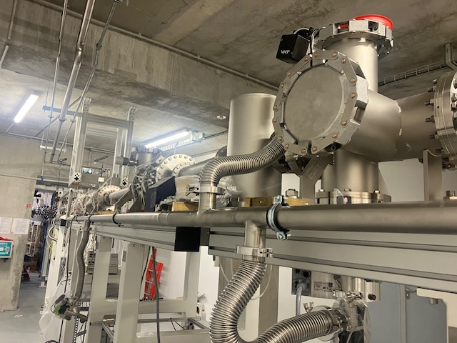
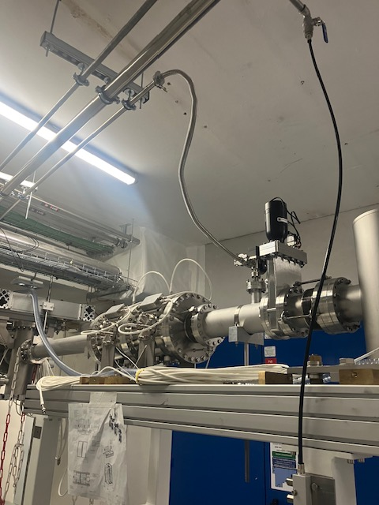
• • • DESIR beam lines: prototype section LT
LT beam line in
Salle à pillier
outside view of the DESIR hall
Ongoing work:
Electrical connection work complete
Tests of ISEG crates
Profiler control unit testing
PLC programming
Application for authorization to connect sections 1 and 2 in progress
Design: IJCLab
Mounting: GANIL
Building delivery:
05/09/2025
➔ Objective: sections 1 and 2 ready for beam testing by end 2025

Slide 11
• • •
Beam Preparation: HRS

Slide 12
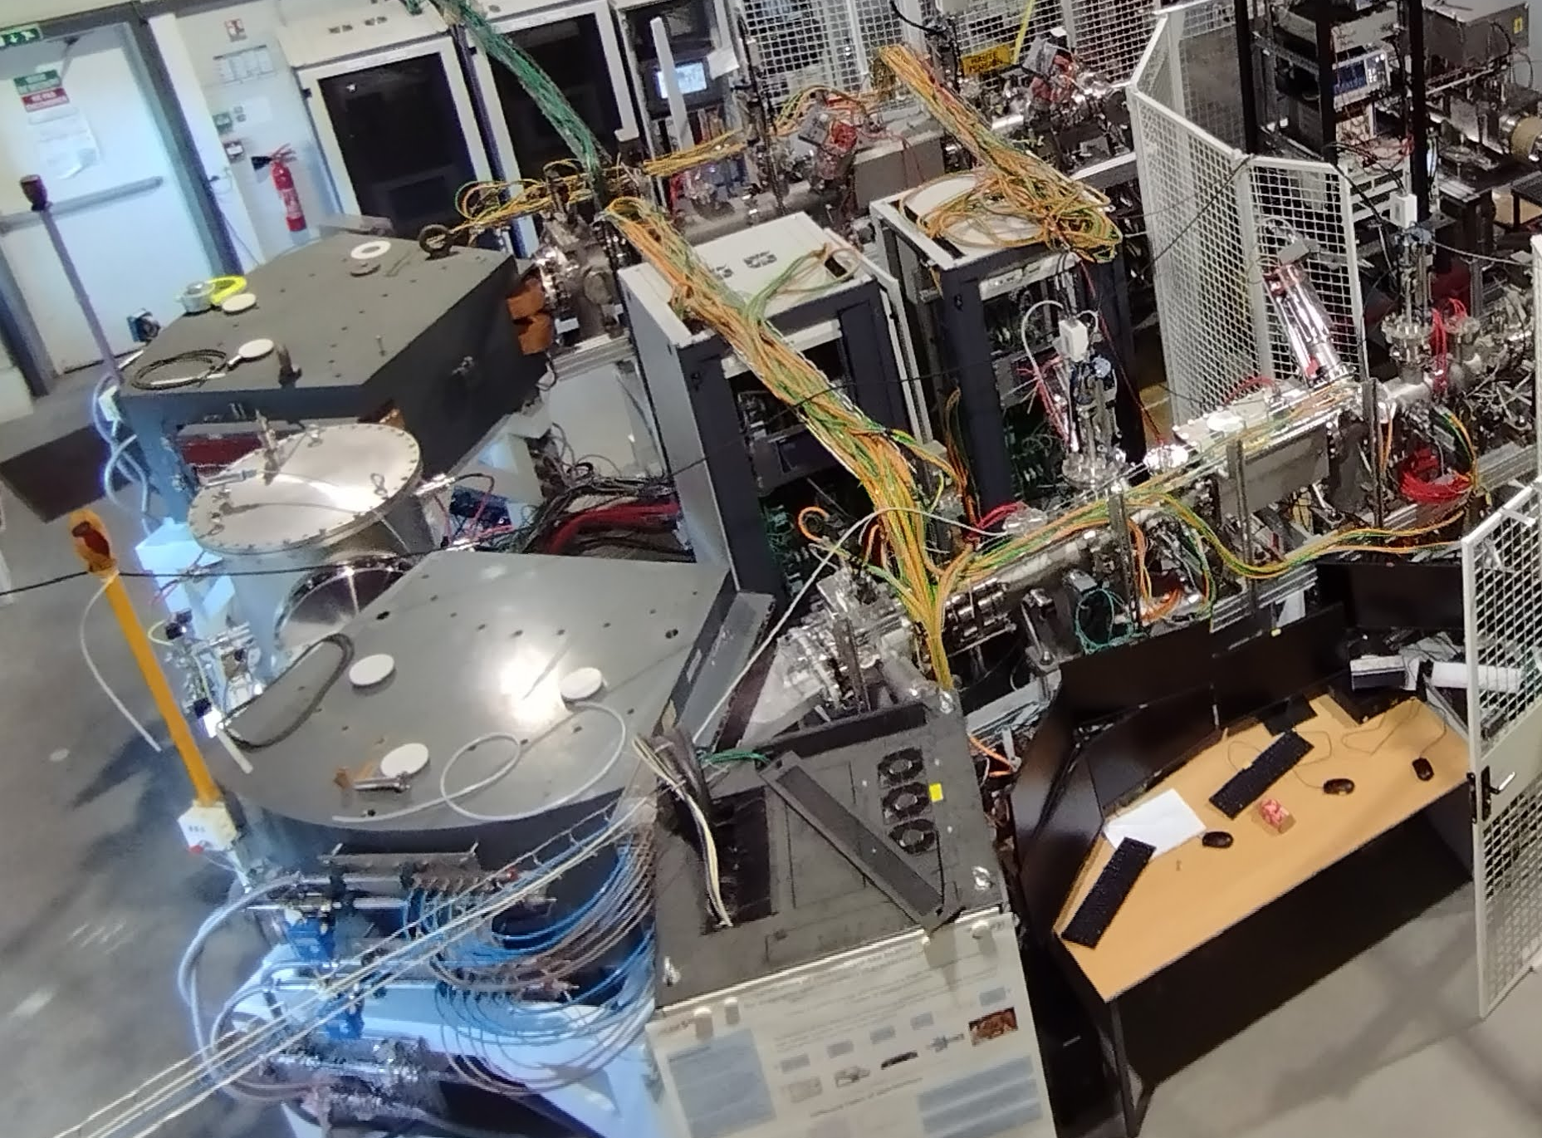
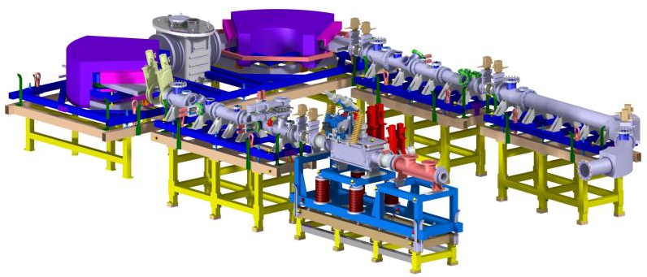

• • • Beam purification: High-resolution separator HRS
Configuration: MQ-MQ-FS-FQ-D-M-D-FQ-FS-MQ-MQ
M/ΔM =20 000 @ 3π mm.mrad / 30keV
T. Kurtukian Nieto et al., NIMB 317 (2013) 284
J. Michaud et al., LP2iB & IJCLab

Slide 13
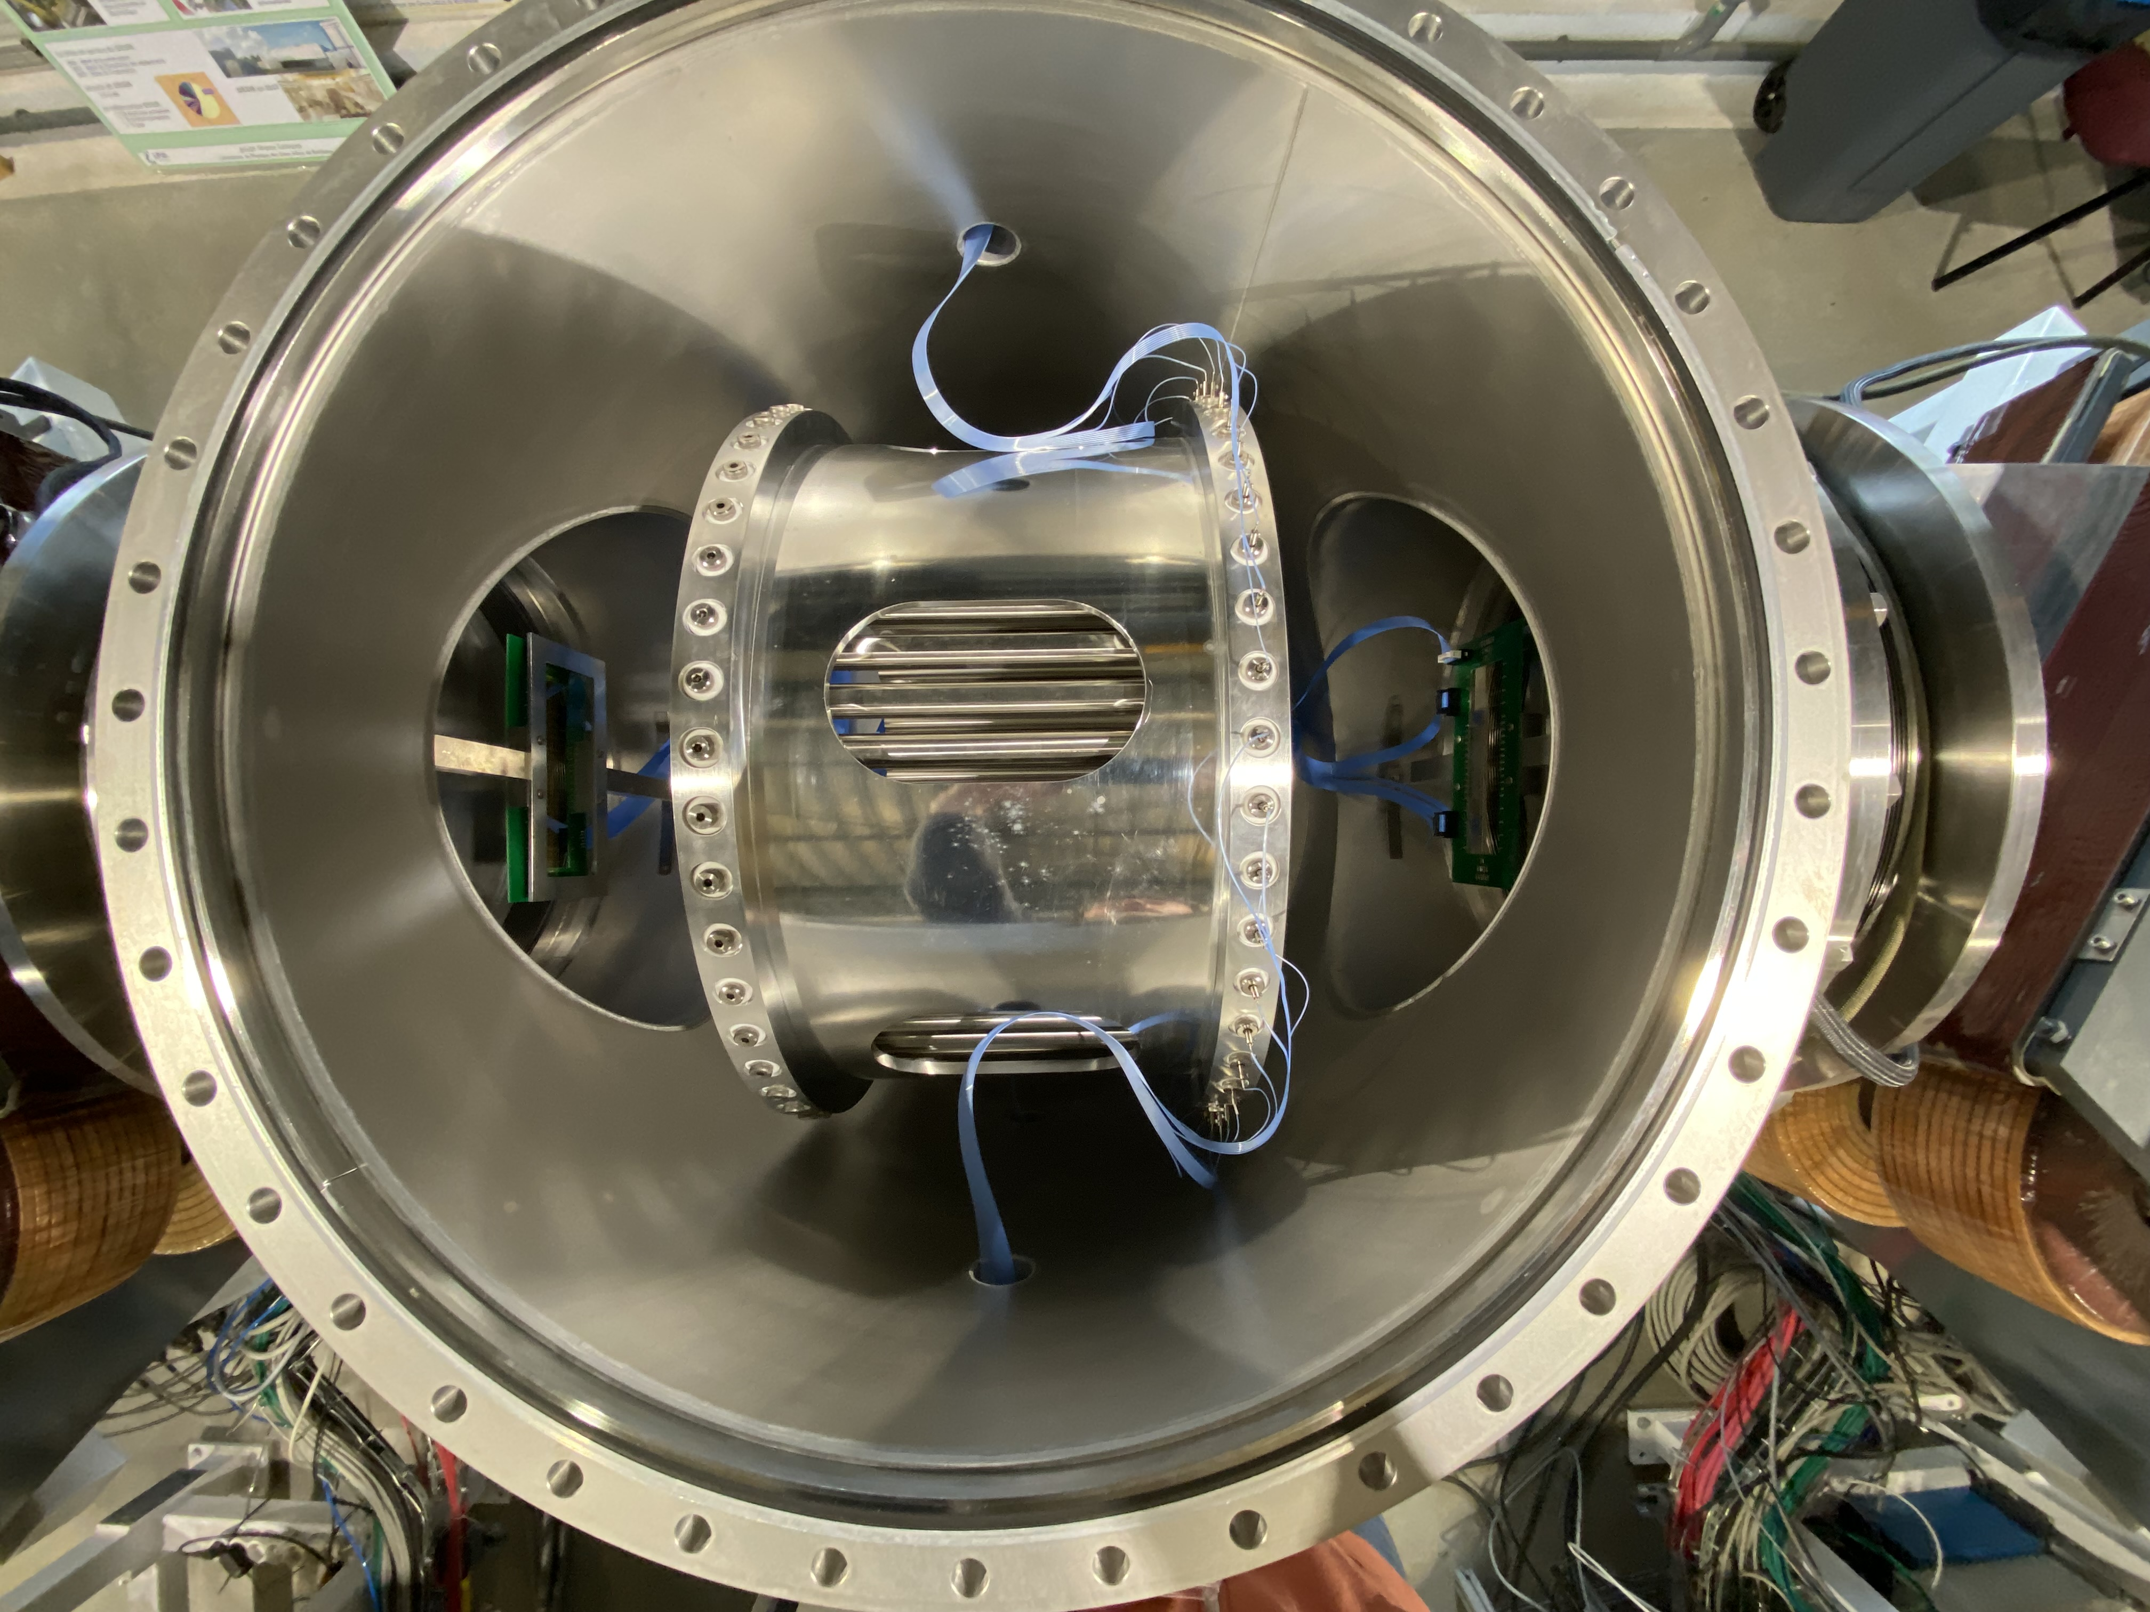
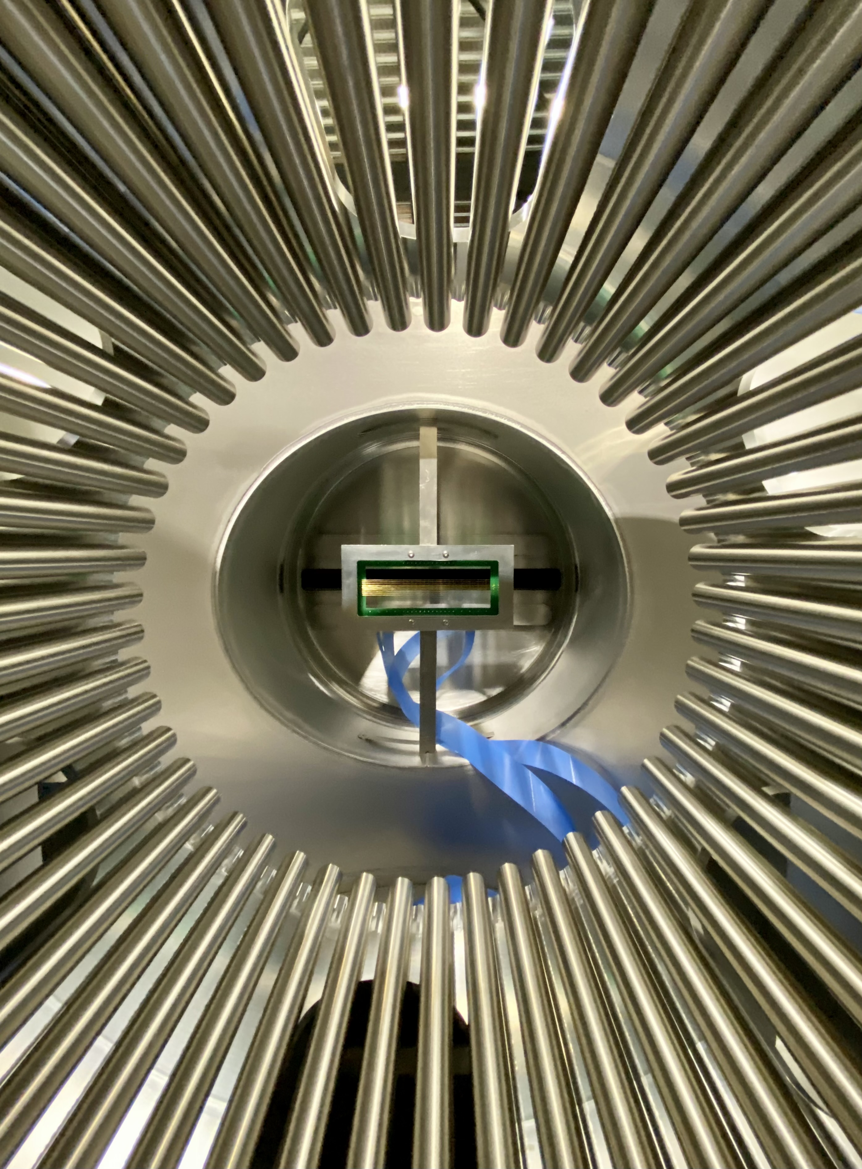
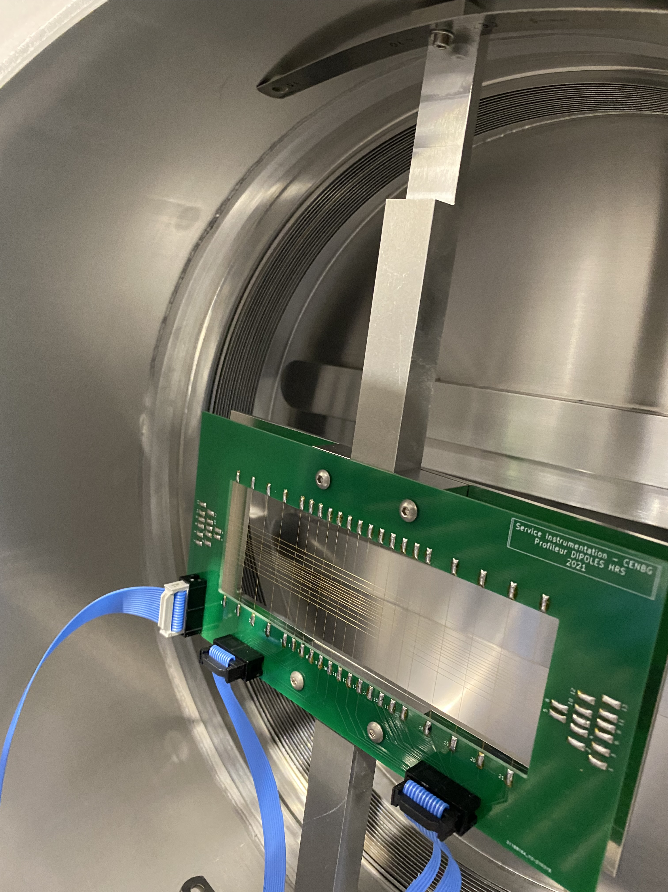
• • • DESIR HRS: Removal of profilers
Dismounting of profilers before and after the multipole ➔ improved transmission: 60% ➔95%
Top view Side view Axial view
A. Balana & L. Daudin, LP2iB

Slide 14
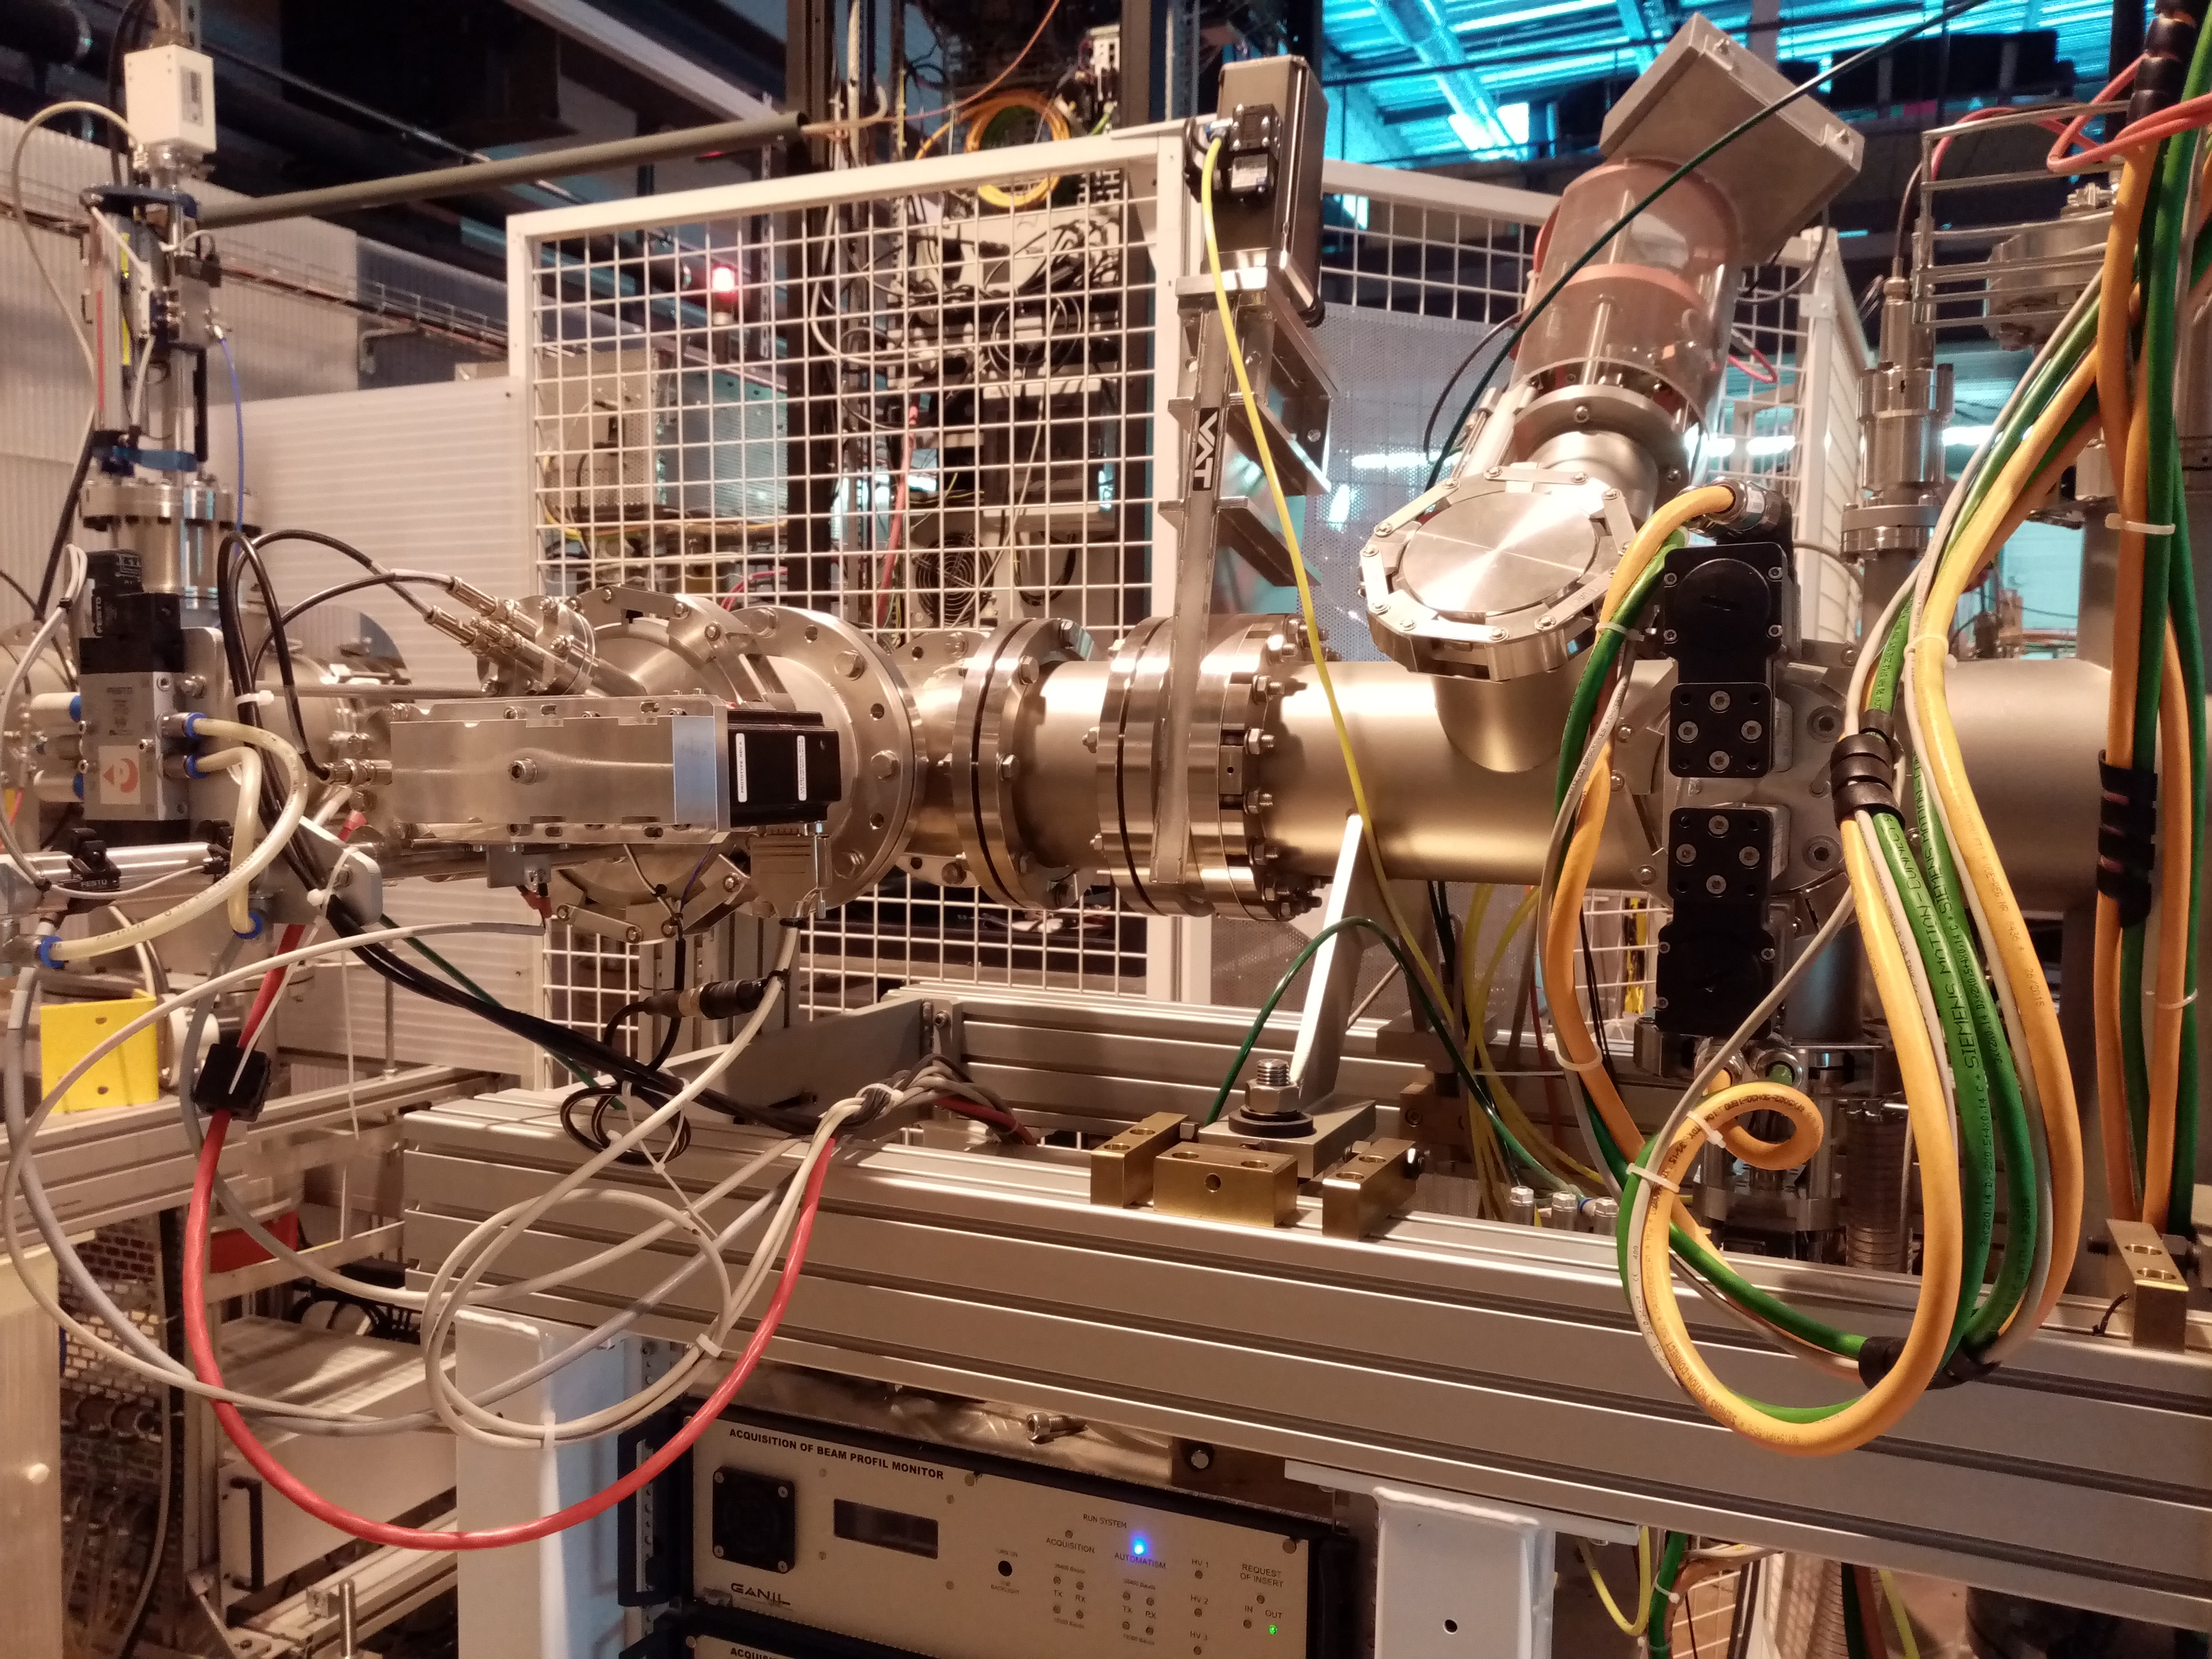
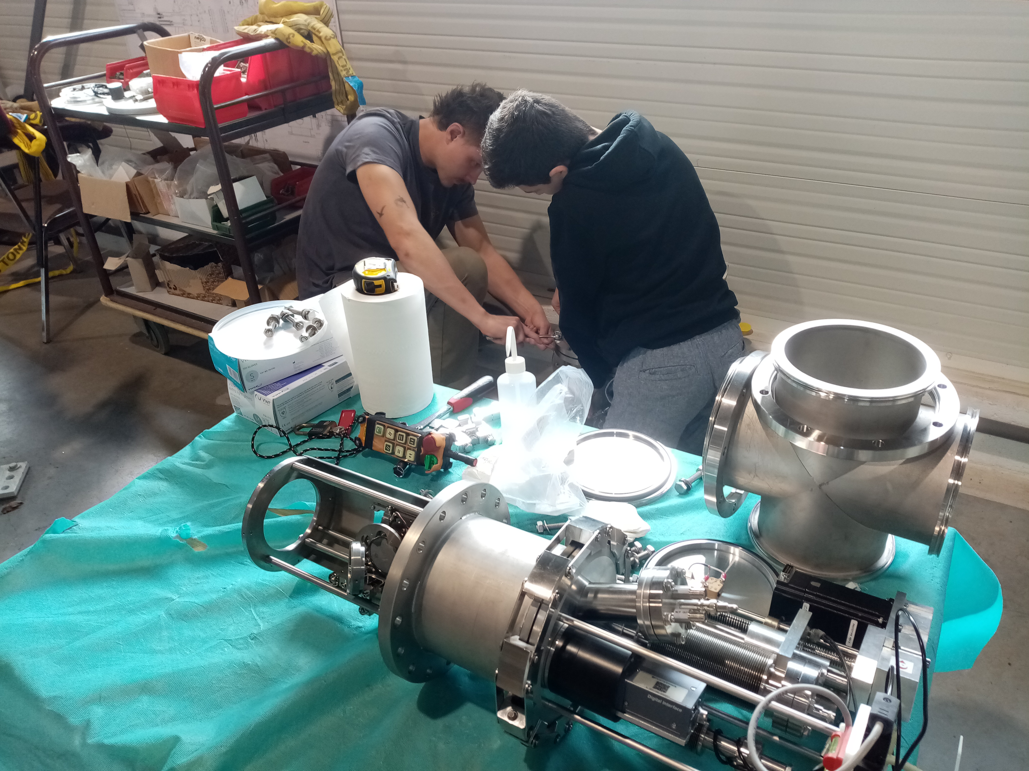
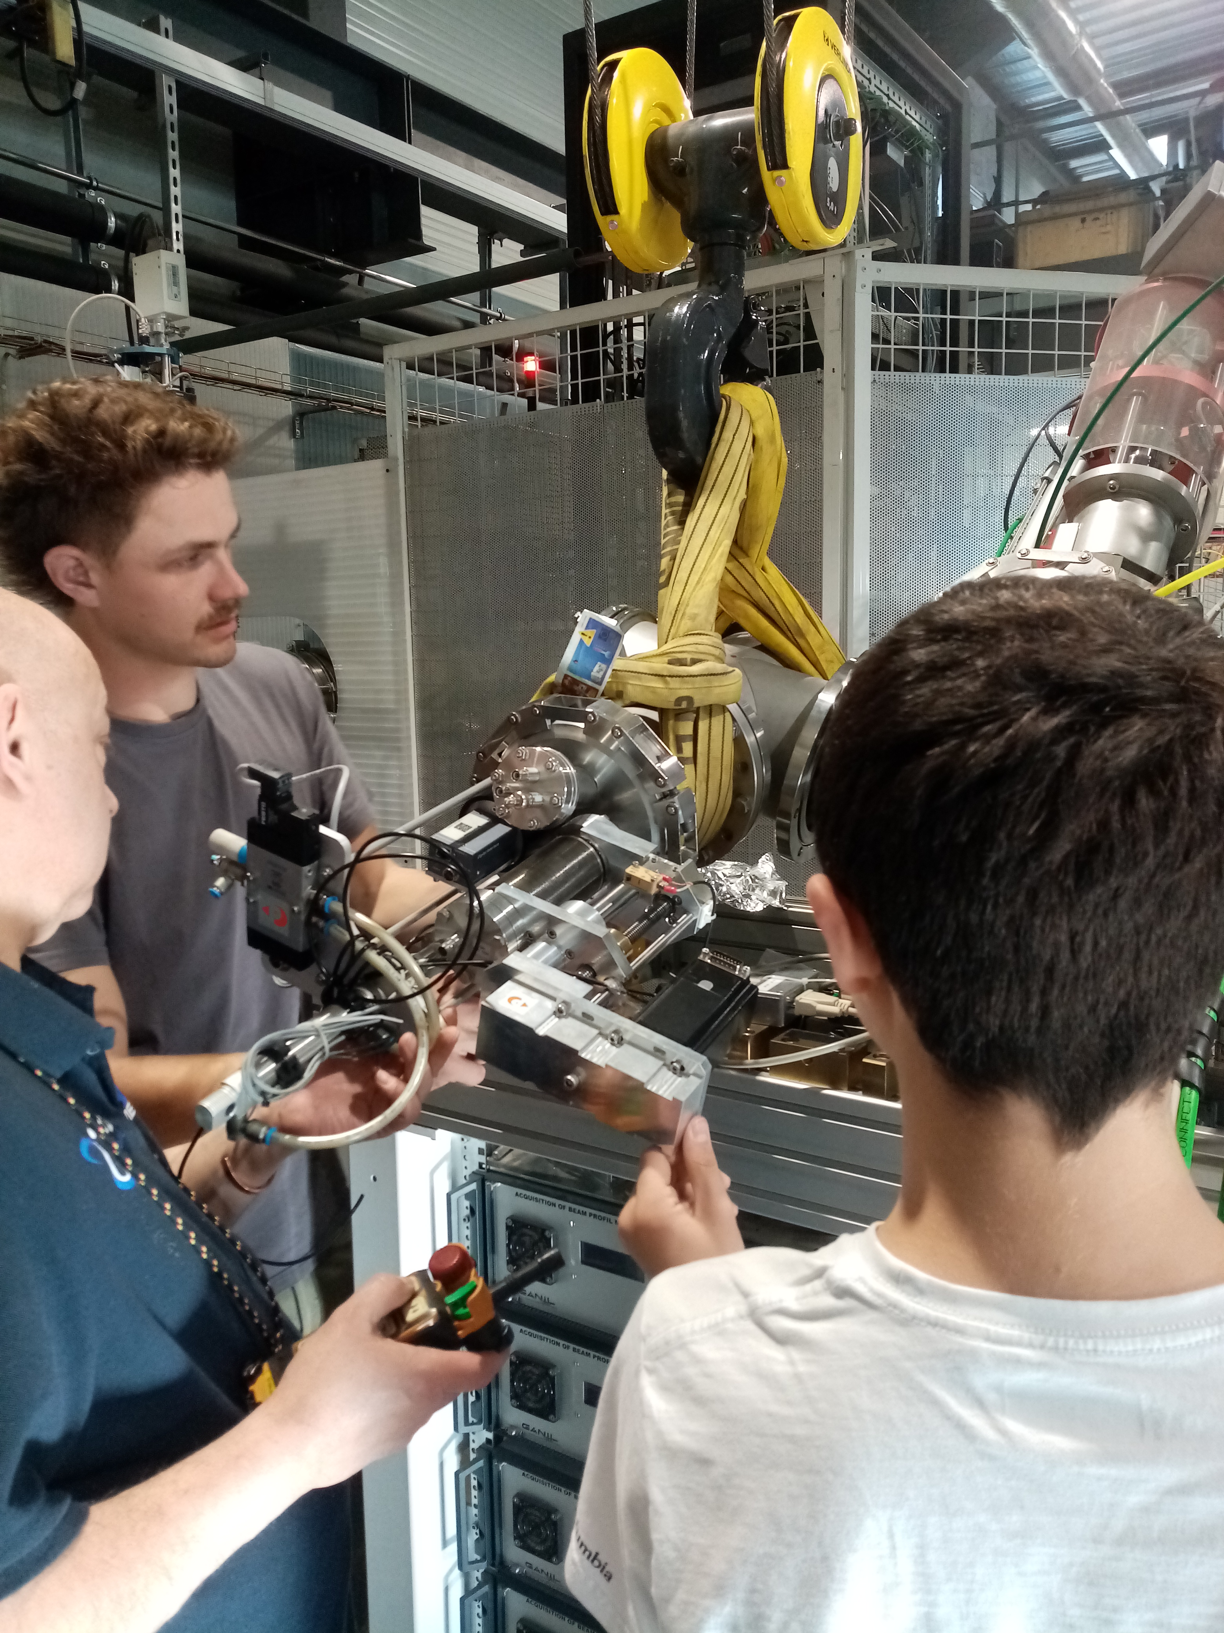
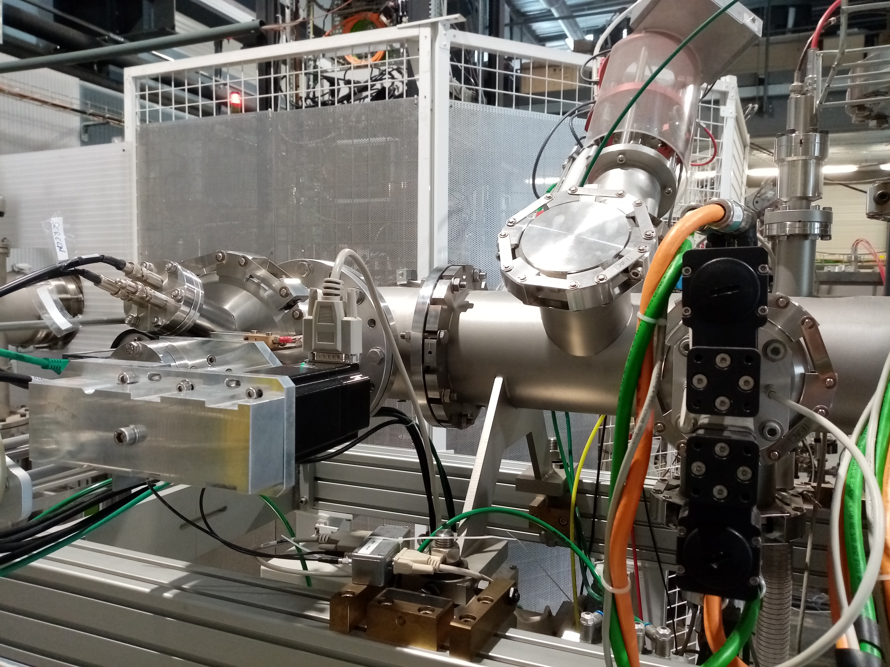
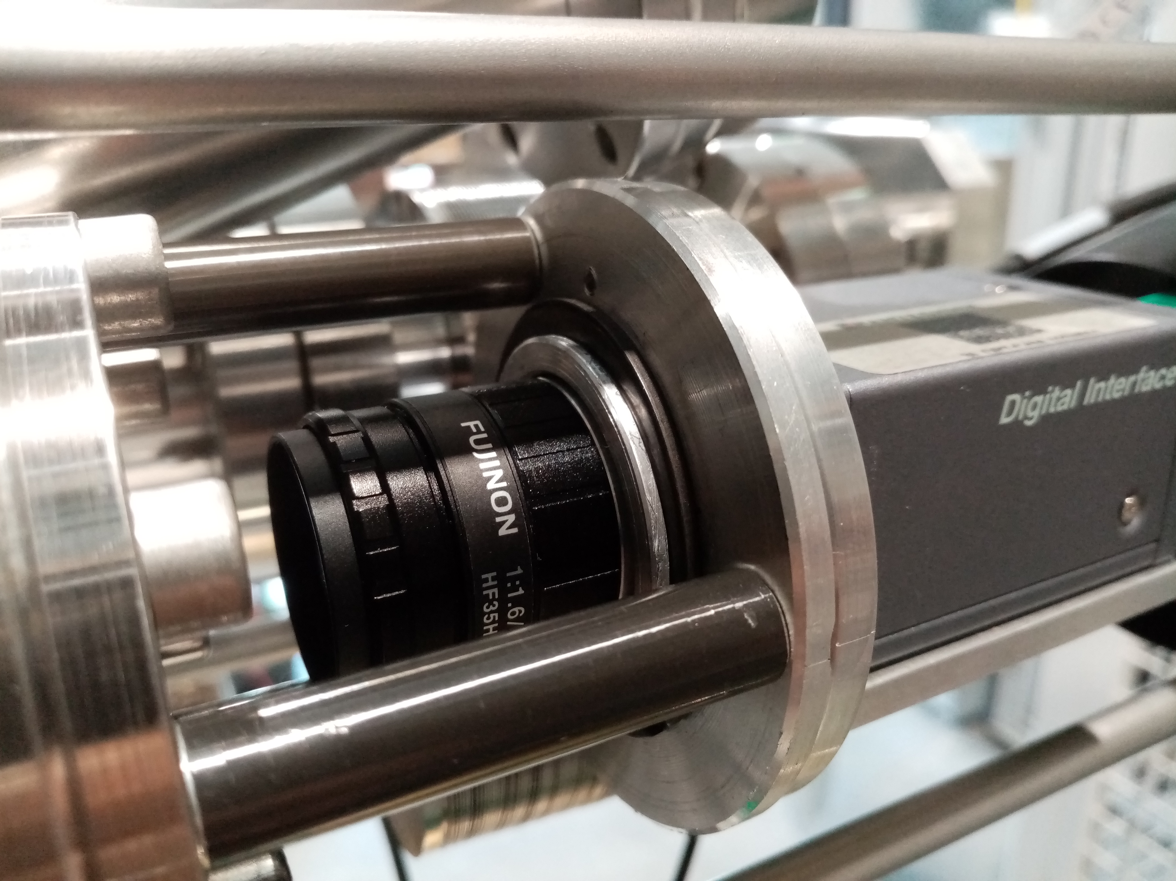
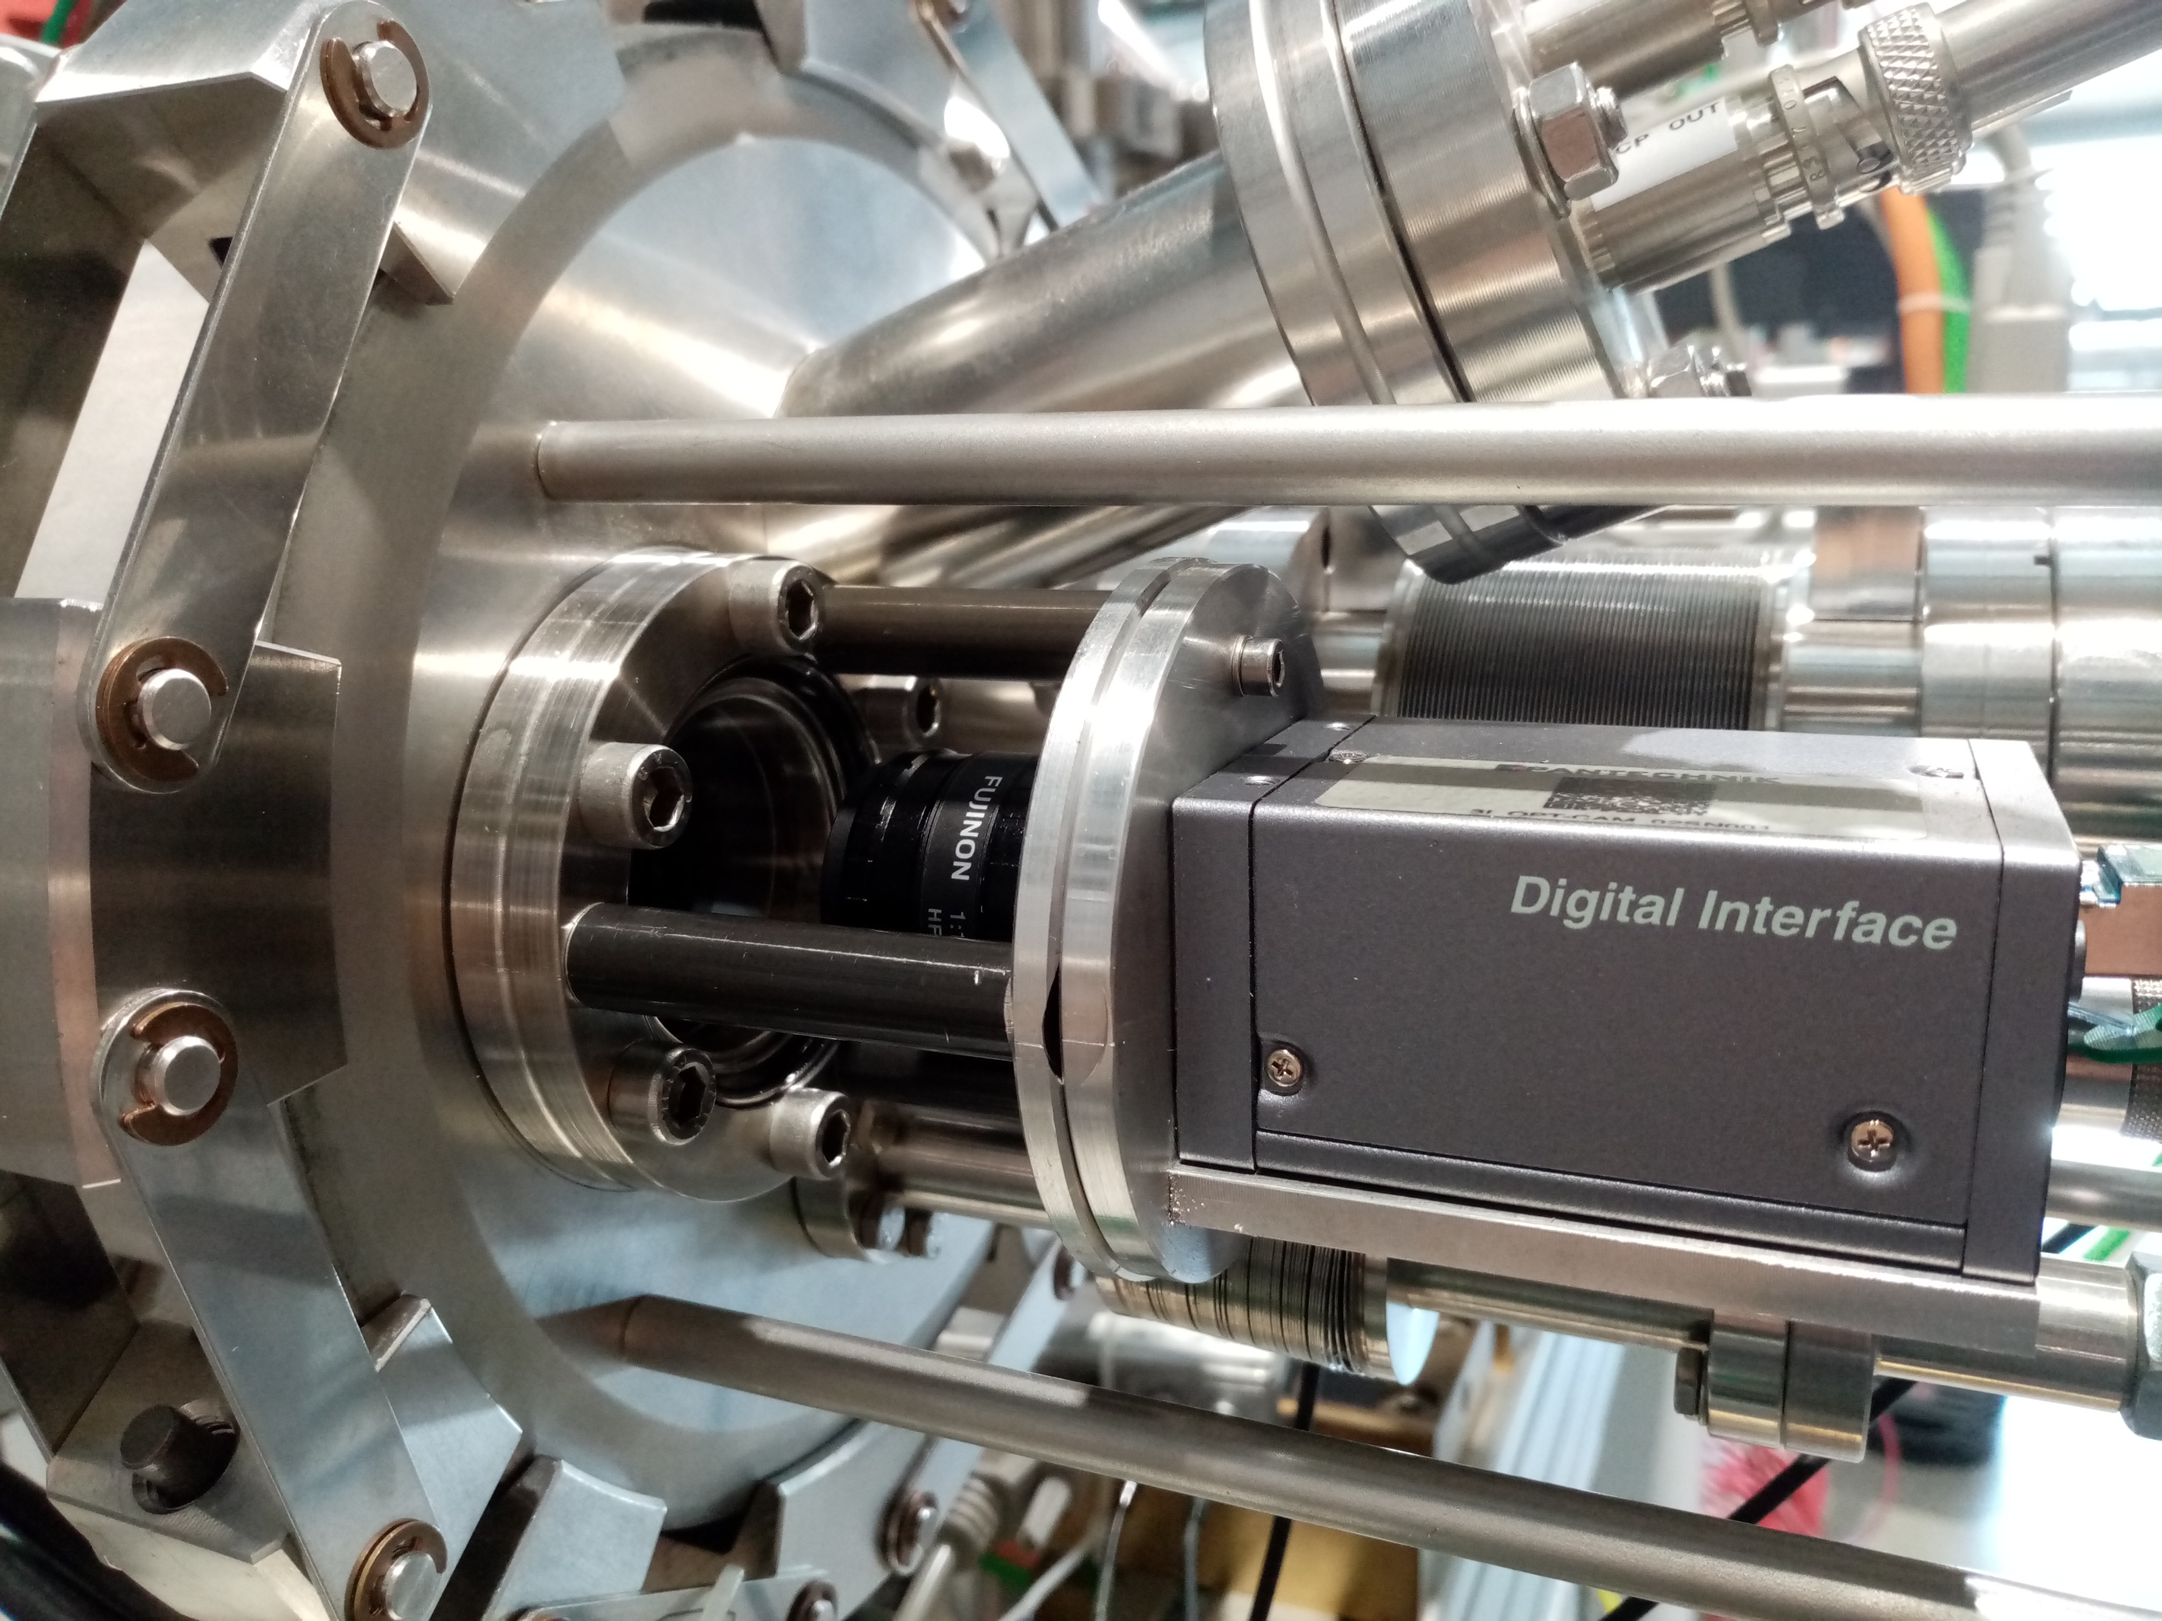
• • • DESIR HRS: Optimisation of emittance-meter – removal of valve
Camera support

Slide 15
• • •
Progress with experimental equipment
See talks by
Julien Pépin
Gautier Guinard
Pierre Delahaye
Romain Garreau
Anaïs Lépine
Simon Lechner
Louis-Alexanre Lalanne

Slide 16
• • •
Installation of experimental equipment

Slide 17


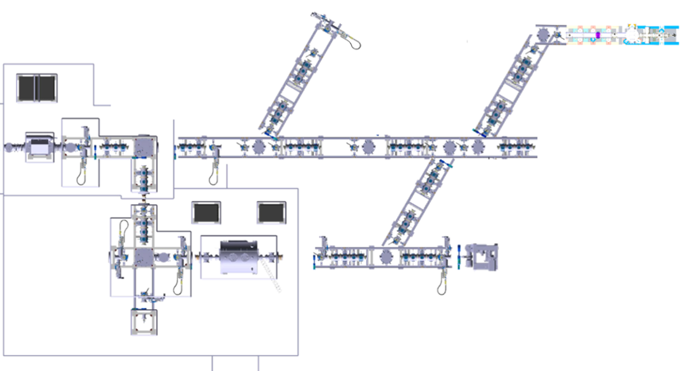


• • • Experimental equipment: time line
S2 - 2026: GPIB + PIPERADE + fluorescence laser line (LINO)
LINO
Beams
Id. Station
GPIB
Diag. box
PIPERADE

Slide 18
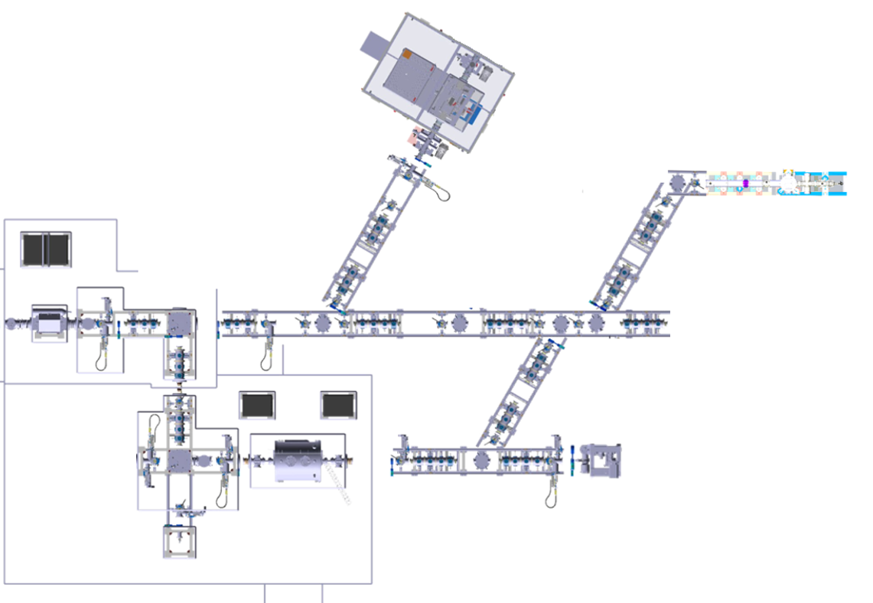

• • • Experimental equipment: time line
S1 - 2027: MORA cooler-buncher (RFQ)
RFQ (MORA)
LINO
Beams
Id. Station
GPIB
Diag. box
PIPERADE

Slide 19
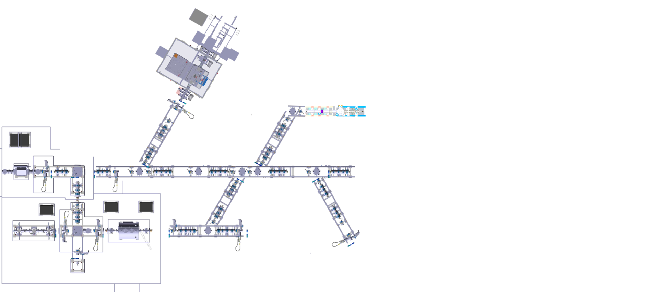

• • • Experimental equipment: time line
2028: MORA completed, MR-ToF-MS, decay stations
2028: RIBs available
MORA
LINO
Beams
Id. Station
GPIB
Decay station
MR-ToF-MS
PIPERADE
Decay station

Slide 20
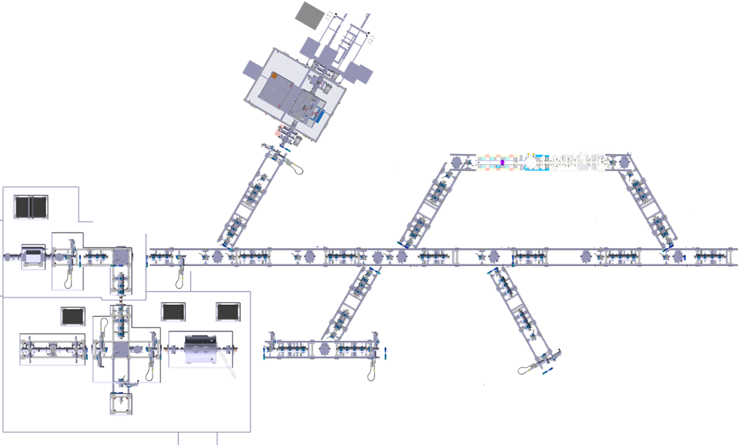













• • • Experimental equipment: time line
2029: collinear laser spectroscopy (LASAGN) completed, MLLTrap
MORA
LASAGN
HINA
Id. /Decay
Station
Beams
GPIB
Decay station
MR-ToF-MS
PIPERADE
(NA)2STARS
MLLTRAP

Slide 21
• • • DESIR project schedule
2012… 2015… 2018 2019 2020 2021 2022 2023 2024 2025 2026 2027 2028 2029
Décret
(09/03/2025)
Autorisations administratives
MSNR (ASN et AE)
Autorisation de modification INB 113
DAM
Enquête Publique
Autorisation de mise en service
DMES
Décision ASN
Bâtiment et infrastructures
Etudes et consultation des entreprises
Construction
PC
Réception
Procédés
(PRO-F,, -E, -SE,
-SYS, -SNC)
Conception, fabrication et qualification technique
Installation / mise en service
Grp. 1-3
Grp. 4-6
FAISCEAU
Périmètre base

Slide 22







• • •
Thanks for your attention

Slide 23
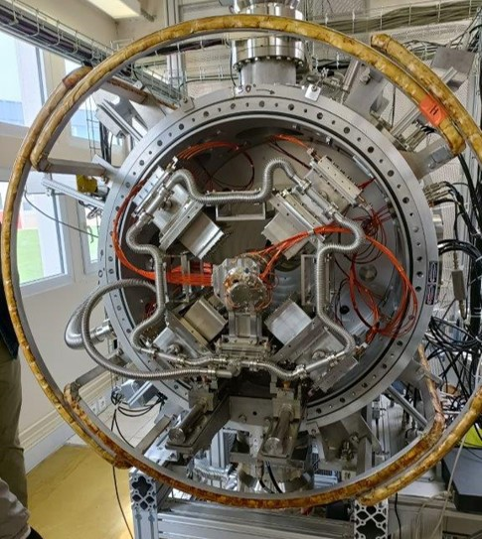
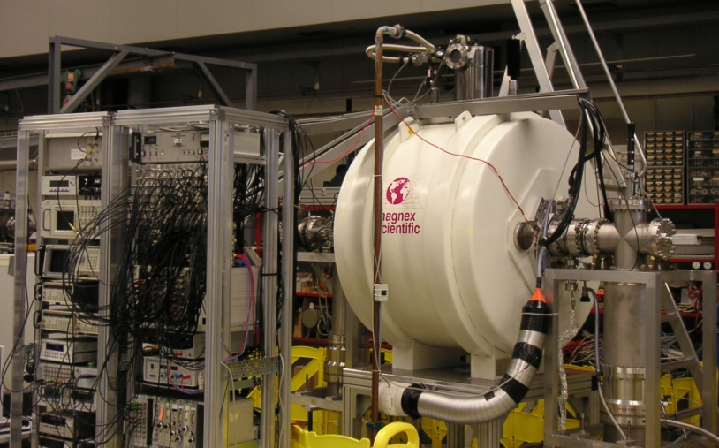



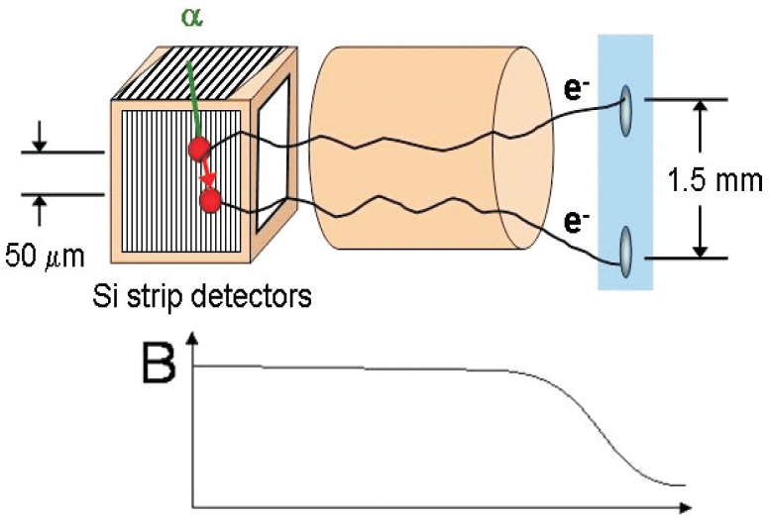
• • • The DE_{sir}TRAP_{ping} facility
MORA
MLLTrap
P. Delahaye, GANIL, L. Hayen, X. Fléchard, LPC Caen
P. Thirolf, LMU Munich – E. Minaya Ramirez, IJClab
RFQ-CB associated with a Paul trap
-> β-ν angular correlation coefficient
-> D correlation with laser polarized beams
Double Penning trap
-> high precision mass measurements
-> in-trap decay
e⁻ pixel
detector
E. Minaya-Ramires et al., NIM B 463 (2020) 315
P. Chauveau et al., NIMB 463 (2020) 371
P. Delahaye et al., Hyperfine Interaction 240 (2019) 63
Nuclear structure & Decay properties
  shell evolution, deformation
  (super-) heavy nuclei decay spectroscopy
Commissioning at ALTO (IJCLab)
Fundamental interaction physics
  exotic currents, CVC, V_{ud}, CP-violation
Commissioning at JYFL

Slide 24
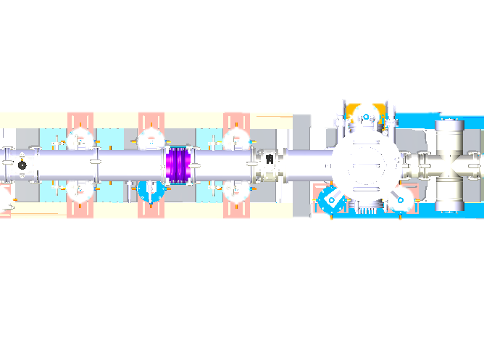
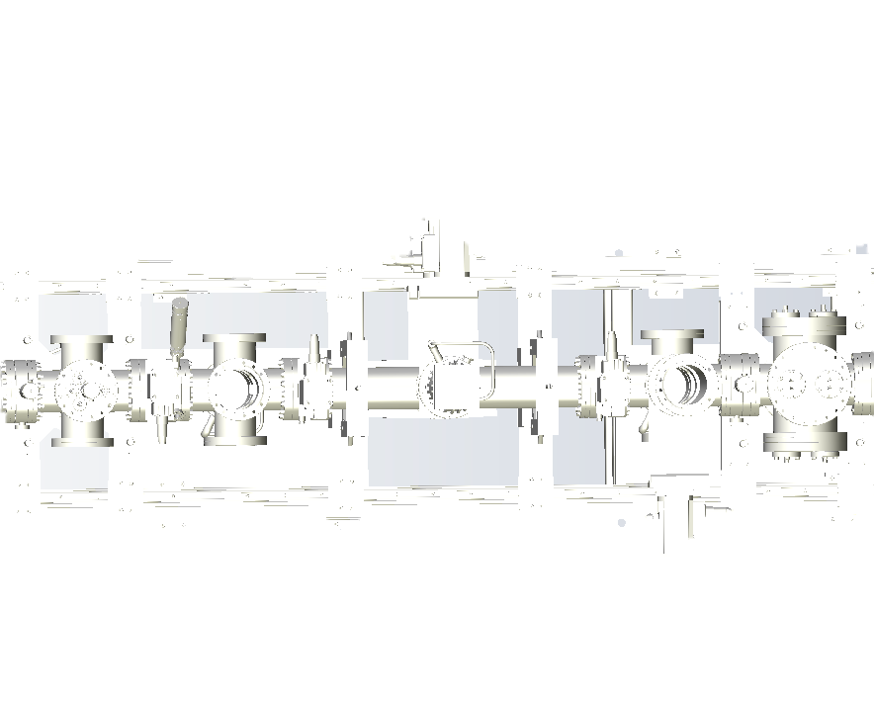
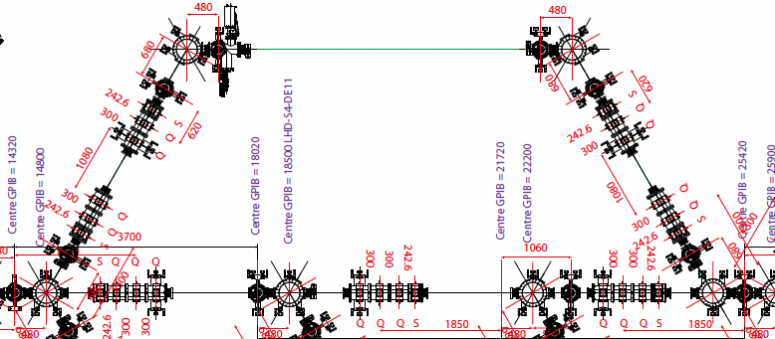
• • • The LUMIERE facility
Laser Utilization for Measurement and Ionization of Exotic Radioactive Elements
LASAGN (L. Lalanne, IPHC)
Collinear laser spectroscopy (CRIS like)
  -> hyperfine structure (magnetic and quadrupole moments, mean square charge radii)
LINO commissioned at ALTO, IJCLab, D. Yordanov et al.
LINO
MT, FC
IR
DP
IU
CRIS

Slide 25
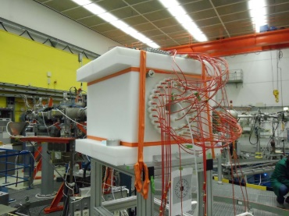
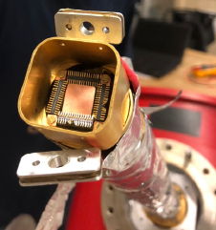
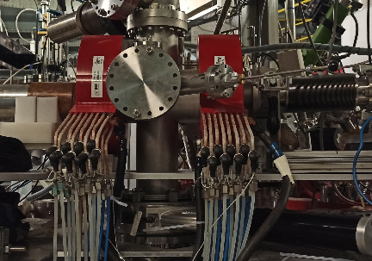
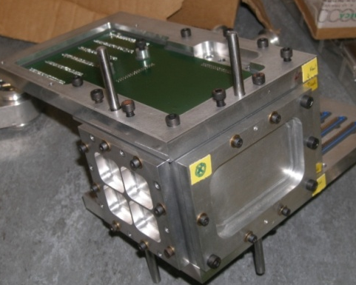
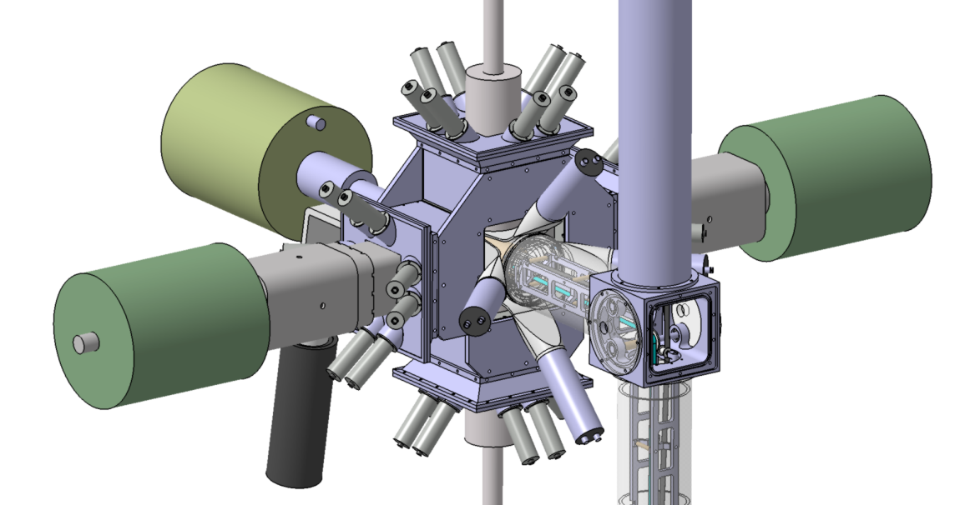
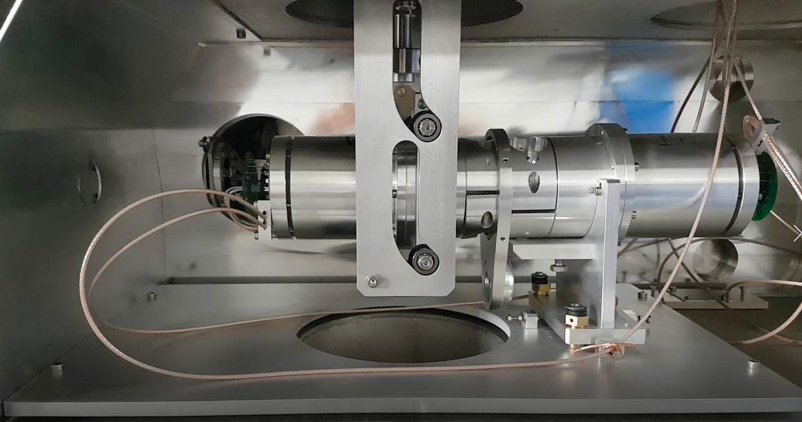
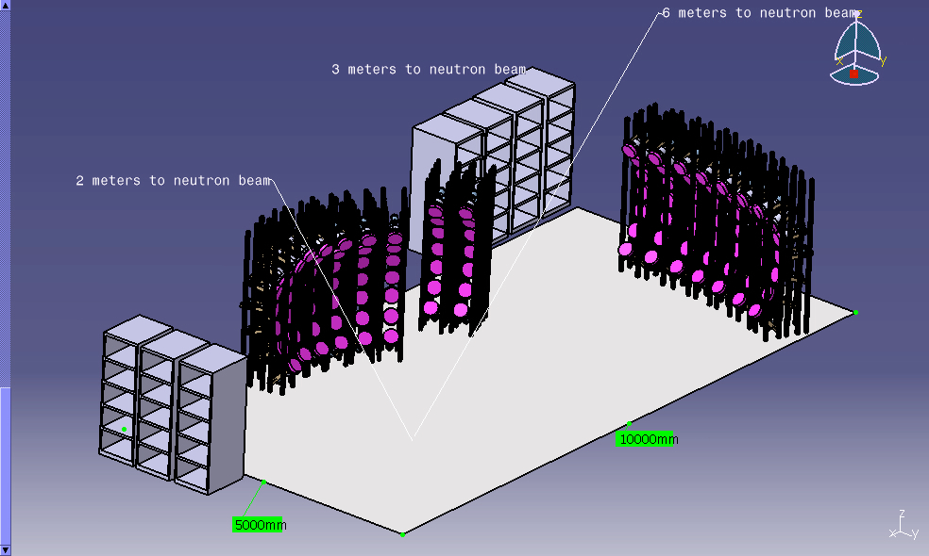
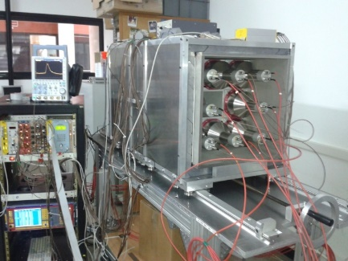

• • • The BESTIOL facility
BEta decay STudies at the SPIRAL2 IsOL facilty
Beam cooling and purification using PIPERADE for (trap-assisted) decay spectroscopy
-> High-precision measurements with ultra-pure samples for
fundamental interaction, nuclear structure, nuclear astrophysics etc
β-γ decay stations (BEDO, …)
total absorption spectrometers (DTAS)
neutron detection arrays (BELEN, MONSTER, …)
electron and proton detection (COeCO, SiCube, b-STILED
recoil detection (ASGARD)
for
CVC, V_{ud}
beta shapes
lifetimes, P_{(2)n}
exotic decays (β-2p, cluster emission)
Gamow-Teller strength
BELEN
ASGARD
SiCube
COeCO
BEDO
b-STILED
MONSTER
DTAS

Slide 26
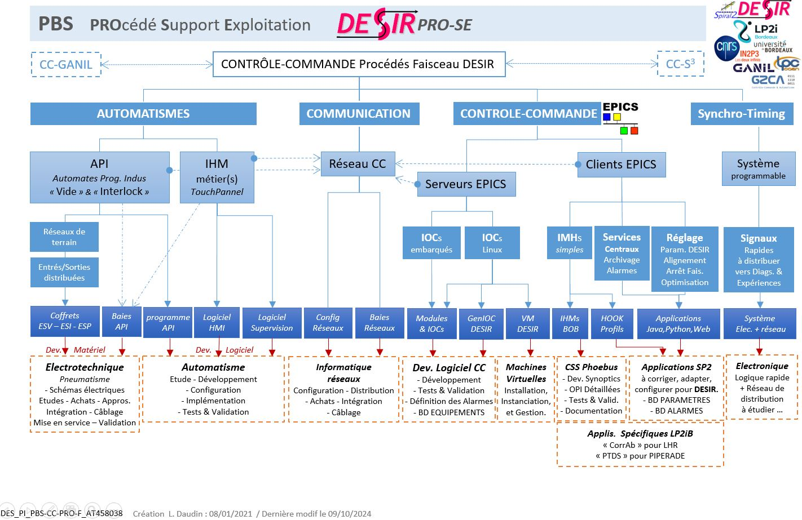
• • • DESIR C/C
L. Daudin et al.

Slide 27
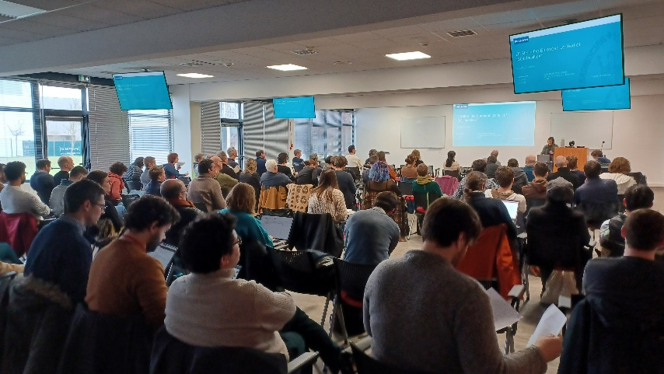
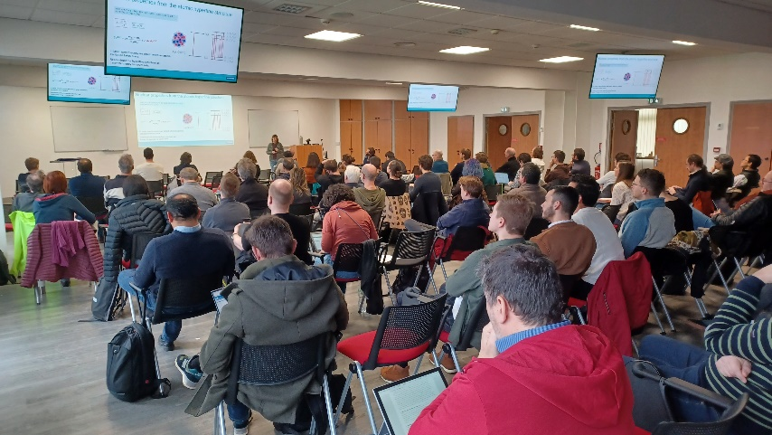
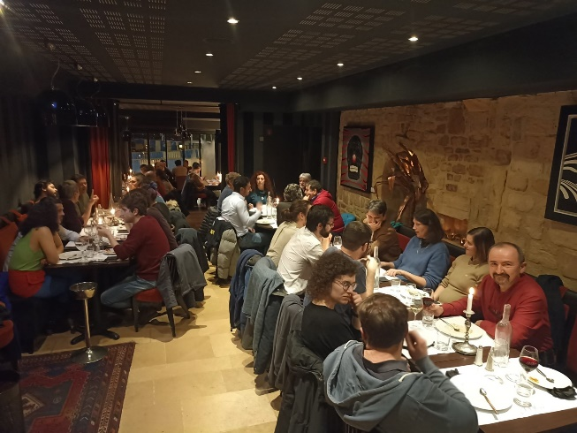
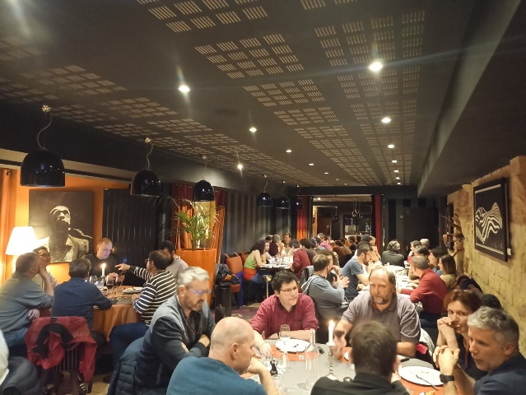
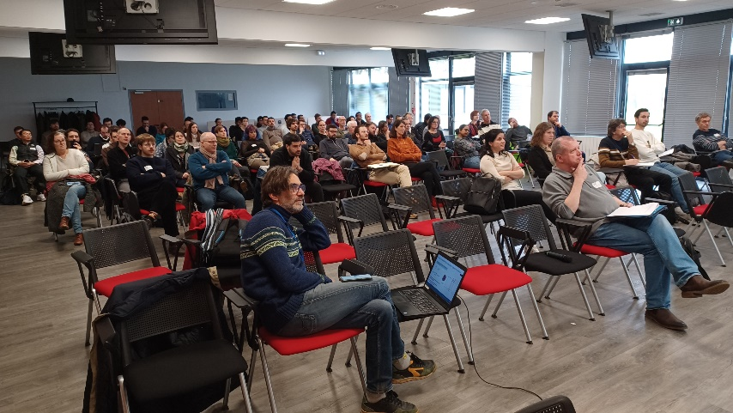
• • • Physics workshops to prepare DESIR: Feb/Mars 2024
more than 100 participants, 22 institutes, 15 foreign
Schedule overview:
Tuesday, 27/02/2024:
14:00 - 17:00: DESIR infrastructure, beam lines, purification equipment
17:30 - 18:30: Visit of the DESIR construction site
Wednesday, 28/02/2024
9:00 - 12:30: BESTIOL physics (including 30 min break)
14:00 - 15:30: DETRAP physics
15:30 - 16:00: Pause
16:00 - 17:30: LUMIERE physics
Thursday, 29/02/2024
9:00 - 12:30: DETRAP physics (including 30 min break)
14:00 - 15:30: LUMIERE physics
15:30 - 16:00: Pause
16:00 - 17:30: BESTIOL physics
20:00: Workshop dinner
Friday, 01/03/2024
9:00 - 10:30: LUMIERE physics
10:30 - 11:00: Break
11:00 - 12:30: Conclusions

Slide 28
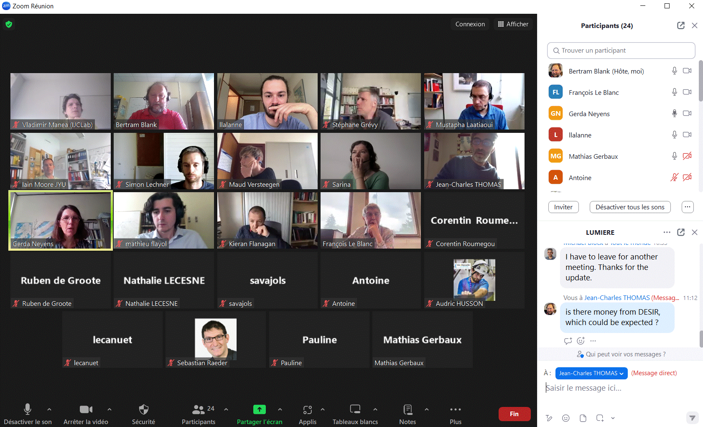
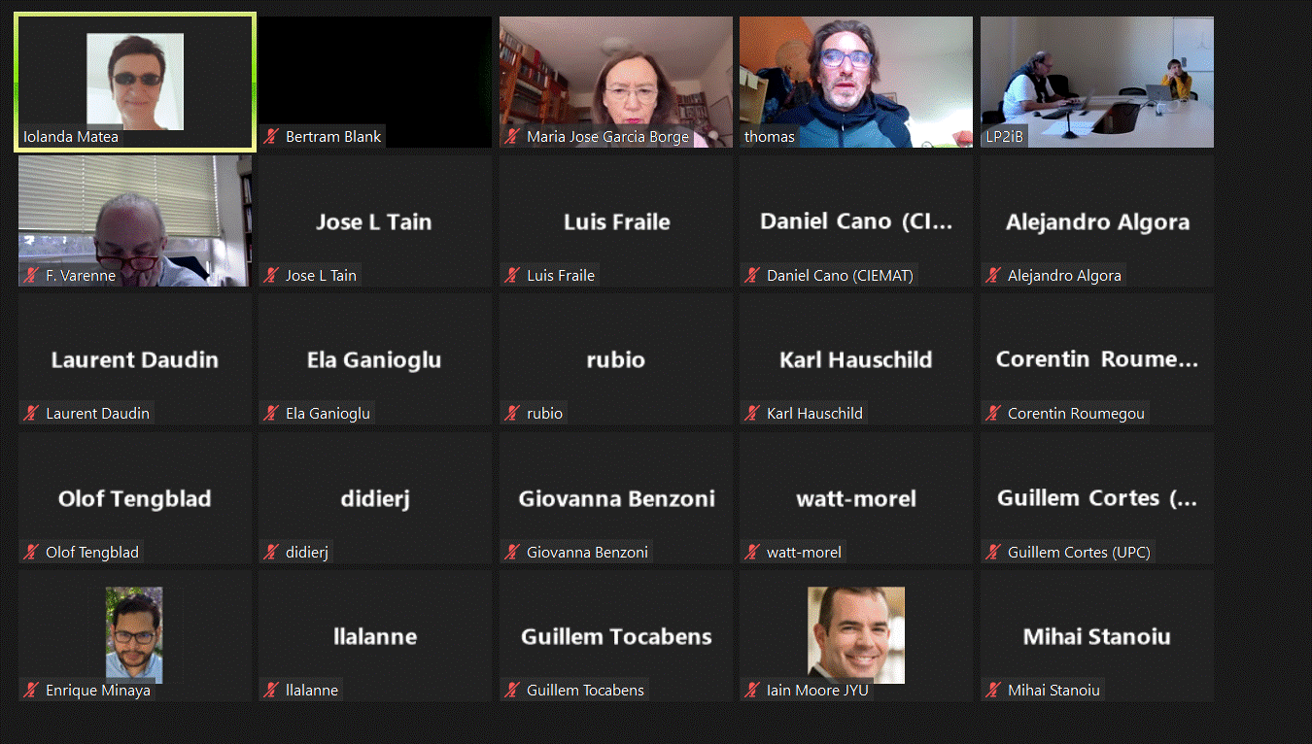
• • • Technical workshops to prepare DESIR
LUMIERE workshop: 2 July 2024: 25 participants
Layout of LUMIERE facility
Implication of human resources
Financial contributions
LUMIERE Schedule
BESTIOL workshop: 16 December 2024: 48 participants
Technical characteristic of different setups
Readiness of setups
Installation schedule
DETRAP workshop: 6 May 2025
Technical characteristic of different setups
Readiness of setups
Installation schedule
Letters of Intent: Fall 2025
Day-one proposals: 2026

Slide 29
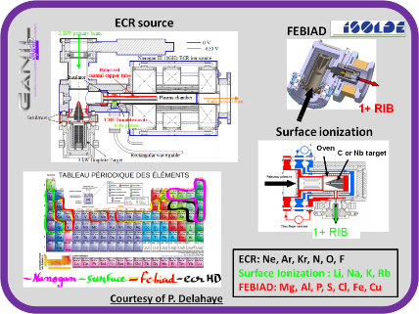
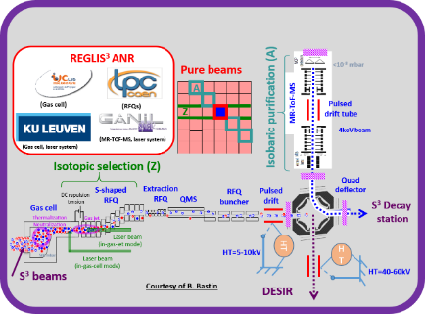
• • • Production of exotic nuclei
S³
S³
  S3-LEB:
  Fusion-evaporation
  SPIRAL1: Fragmentation
  SPIRAL2:
  Fission
SPIRAL1

Slide 30
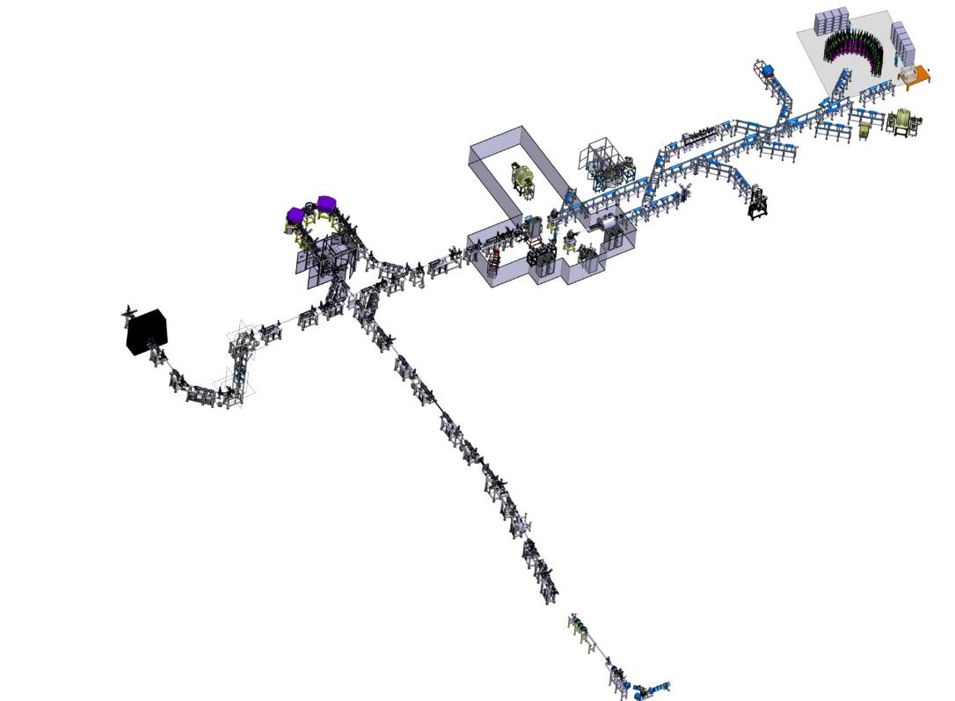








• • • Transport beam lines
1+ ions, < 60 keV, < 80 π.mm.mrad – fully electrostatic
Test bench
DESIR Hall
Ph. Alfaurt, LP2iB
SP1 -> DESIR beam line
Junction beam lines from SPIRAL1 and S3-LEB to the DESIR Hall: ~100 m
Installation starting by the end of 2025
Example: 45° deflector assembly
Upper part
Insertion
Pole assembly
Internal part
Base assembly
V. Watt-Morel, GANIL
SPIRAL1
L. Perrot et al., IJCLab

Slide 31





• • • Beam preparation and purification
RFQ Cooler
High Resolution Separator HRS
RFQ-Cooler Buncher
GPIB
Mass separation/beam purification:
$\frac{M_{0}}{ΔM}=\sim 20 000$
$\frac{M_{0}}{ΔM}=\sim 200 00$0
$\frac{M_{0}}{ΔM}≤{10}^{5}$
$\frac{M_{0}}{ΔM}≈{10}^{6}−{10}^{7}$
RFQ+HRS
Double Penning Trap
MR-ToF
Piperade
$1^{st}$ trap
Piperade
2nd trap
Beam preparation:
Cooling and bunching
Accumulation trap
Mass measurements:
Mass precision: 10⁻⁸ – 10⁻⁹
GPIB
Piperade
2nd trap
MR-ToF
Piperade
2nd trap

Slide 32





• • • Beam purification
RFQ + HRS
M/ΔM =20,000 @
3π mm.mrad / 30keV
GPIB + PIPERADE
  10⁵ ions/bunch, 2-20 Hz M/ΔM = 10⁵
Commissioning at LP2iB
Commissioning at LP2iB
Installation and commissioning: 2026-2027
MR-ToF-MS for mass measurements and beam purification: 2026-2028
Refurbishment
at LPC Caen

Slide 33



• • • Beam purification: RFQ SHIRaC
SHIRaC : Construction and test @ LPC Caen
6 m
Beam
5m
Beam
1,5 m
SHIRaC
RF: 2.1-4.9 MHz; V_{pp}: 8kV
Emittence: ~3π mm.mrad
ΔE ~eV
Transmission ~70 % for 1eµA beam
HT platform 60 kV
RF Electrical Field: 500V/m
…presently refurbished at LPC
(according to RFQ cooler of SPES)
R. Boussaid et al., PRCST 18 (2015) 072802

Slide 34
• • • Beam purification: High-resolution separator HRS
Configuration: MQ-MQ-FS-FQ-D-M-D-FQ-FS-MQ-MQ
M/ΔM =20 000 @ 3π mm.mrad / 30keV
T. Kurtukian Nieto et al., NIMB 317 (2013) 284
J. Michaud et al., LP2iB & IJCLab

Slide 35




• • • High-resolution separator 2nd order correction measurements
¹³³Cs: 1mm x 1mm
-> Shifted left -0,2G
-> Shifted right +0,2G
Beam can be scanned with the dipoles through end slits to obtain a precise beam profile
Corrected
Not corrected
Overcorrected
48-rod
multipole
J. Michaud et al., NIMB 541 (2023) 161
J. Michaud et al., LP2iB & IJCLab

Slide 36


• • • High-resolution separator HRS: emittance figures
Experimental measurements correspond to simulations
To-do list:
shaping of exit (1st dipole) and entrance (2nd dipole) poles
➔ fixed hexapole corrections
optimising of 3rd and higher orders
implementation of automatic higher-order corrections
NMR measurement reliability improvement
2nd order aberrations can be observed with the emittance-meter
Order 3: Not by eye, but a computer could
Image analysis software under development
(A. Balana)
J. Michaud et al., NIMB 541 (2023) 161
J. Michaud et al., LP2iB & IJCLab

Slide 37





• • • Beam preparation: General purpose ion buncher GPIB
To-do list:
- Magnetof for energy dispersion (avoid efficiency issues)
- Transverse emittance measurements in bunching mode
- RF phase dependence for the bunches
- Bunching mode to be investigated in detail (energy vs time dispersion)
- Space charge effects
- coupling to HRS ?
Emittance:
$3 π$.mm.mrad at 30 keV
Continuous mode:
Transmission for K⁺ ions is routinely over 75 %
Careful optical tuning yields transmission >90 %
Bunching mode:
100 % transmission up to 10⁶ ions/bunch
$∼$ 50 % transmission with 10⁸ ions/bunch
Energy and time dispersion:
Energy dispersion measurement currently limited by detection
system (< 6 eV) ➔ Magnetof
Minimum time dispersion currently down to $≈$ 250 ns (FWHM) at 3 keV
M. Gerbaux, C. Roumegou et al., LP2iB
M. Gerbaux et al., NIMA 1046 (2023) 167631

Slide 38








• • • Beam purification: PIPERADE
accuracy: $\frac{Δm}{m}≈{9.5×10}^{−10}$
precision: $\frac{δm}{m}≈{3×10}^{−9}$
7T
$$ν_{c}=\frac{φ_{c}+ 2πn}{2πt}=\frac{qB}{2πm}$$
PI-ICR
accuracy: $\frac{Δm}{m} ∗5$
precision: $\frac{δm}{m} ∗40$
purification trap accumulation & measurement trap
P. Ascher et al., NIMA1019 (2021) 165857
P. Ascher, M. Flayol, D. Atanasov,
E. Rey-herme, G. Guignard et al., LP2iB

Slide 39








• • • PIPERADE: Mass measurement of ⁴¹K with ToF-ICR
$${}_{}^{39}{K^{+}}$$
$${}_{}^{41}{K^{+}}$$
$${}_{}^{39}{K^{+}}$$
$$ν_{c}= \frac{qB}{2πm}$$
measured with ³⁹K as reference
ToF-ICR of 1 s
P. Ascher, M. Flayol, D. Atanasov,
E. Rey-herme, G. Guignard et al., LP2iB

Slide 40
• • • PIPERADE: PI-ICR
To-do list:
January 2025: diaphragm change for a smaller diameter hole
(reduction of gas leaking from PT to MT)
before moving to DESIR:
  systematic studies of ToF-ICR, impact of field imperfections
  (anharmonicities of E-field and fluctuations of B-field) on mass precision,
  mass-dependent errors, ion-ion interaction
  PI-ICR mass measurement and systematic studies
  (imperfections E/B fields + image distortion + extraction optimisation)
  PI-ICR cleaning: installation of an iris to select the ion of interest
  Buffer gas cooling technique: limits in terms of trapping times and
  investigation vs number of ions
if AC not OK at DESIR: pressure/temp stabilisation system to implement
commissioning at DESIR: all systematics to study again

