Slide 1
The current status of S³LEB at GANIL
Nathalie Lecesne for the S³ collaboration

Slide 2
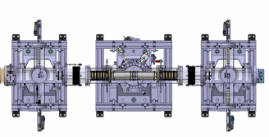
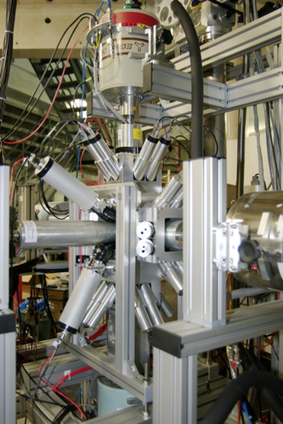
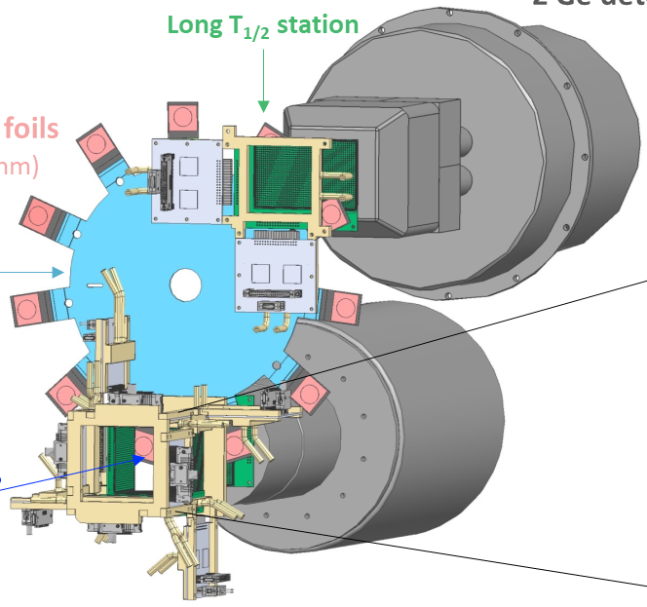
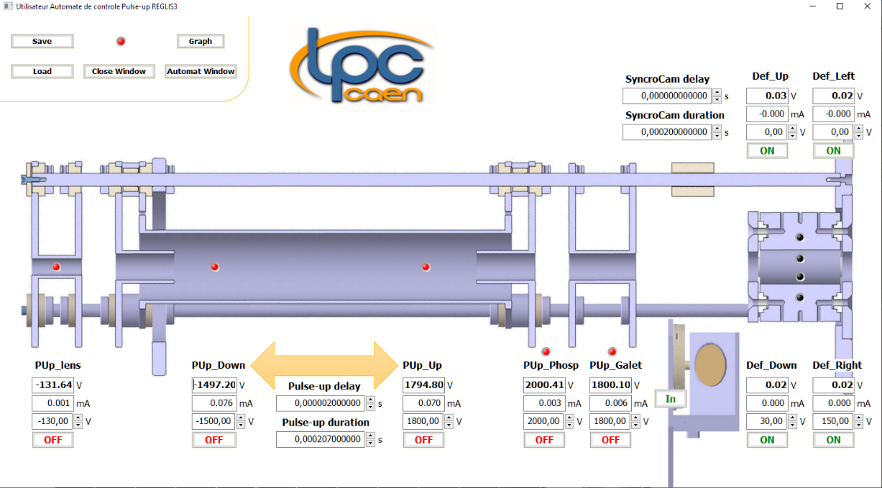
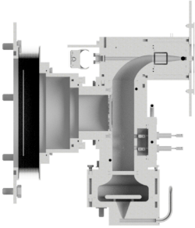
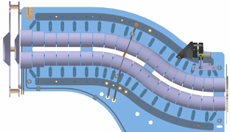
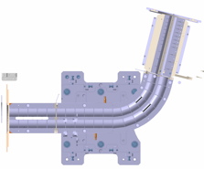
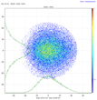
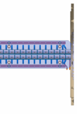
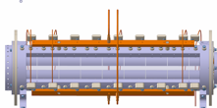







S³ LEB – S³ Low Energy Branch
Laser spectroscopy on S³ products in a supersonic jet (200Mhz)
  Mass and decay spectroscopy measurements
PILGRIM
Not to scale
MR-TOF MS
  Low (or no)-background laser spectroscopy due to mass/decay-tagged counting
  Low (or no)-background mass-spectrometry and decay spectroscopy due to (very) selective ionization
SEASON
IDEAS³
90° bender
Pulse up
(~ 3 kV)
Laser system
λ₁
λ₂
Gas cell
RFQ
Cooler
Buncher
S³ beam
S-shape RFQ
miniRFQ
QMF
He: 10⁻² - 10⁻³ mbar
RFQs
Ar: 200 - 500 mbar
R. Ferrer et al., Nucl. Instr. Meth. B 317, 570-581 (2013)
J. Romans, et al., Atoms 10, 21 (2022)
A. Ajayakumar et al., NIMB 539, 102-107 (2023)

Slide 3
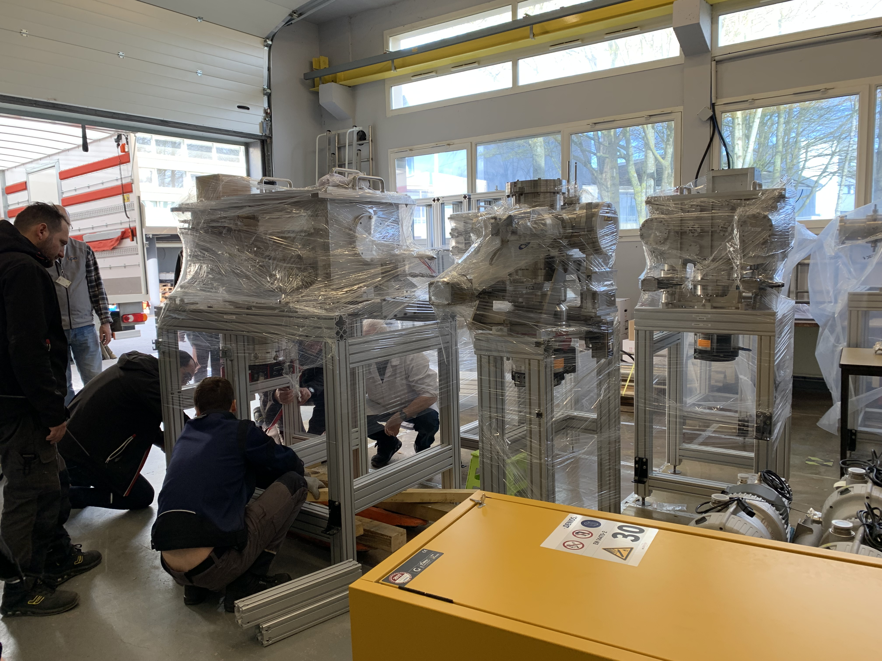
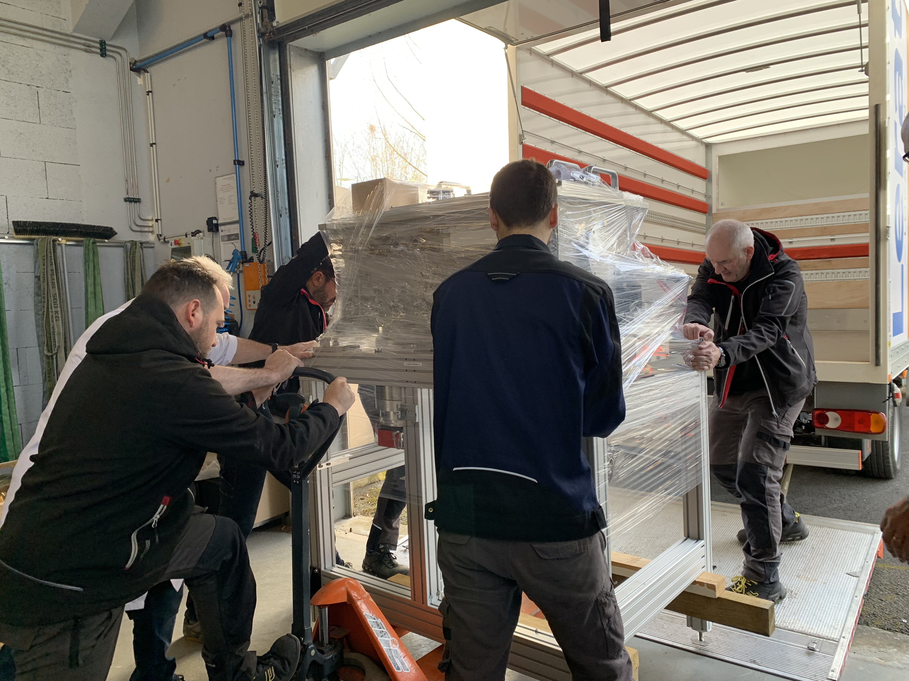
S3-LEB moving
From Sarina last ISOLFRANCE WS
After 10 years of construction, testing and commissioning at LPC Caen, moving of S3-LEB to S³ in March 2024
Around one week to decable, dismount, pack S3-LEB, 2 days to move

Slide 4
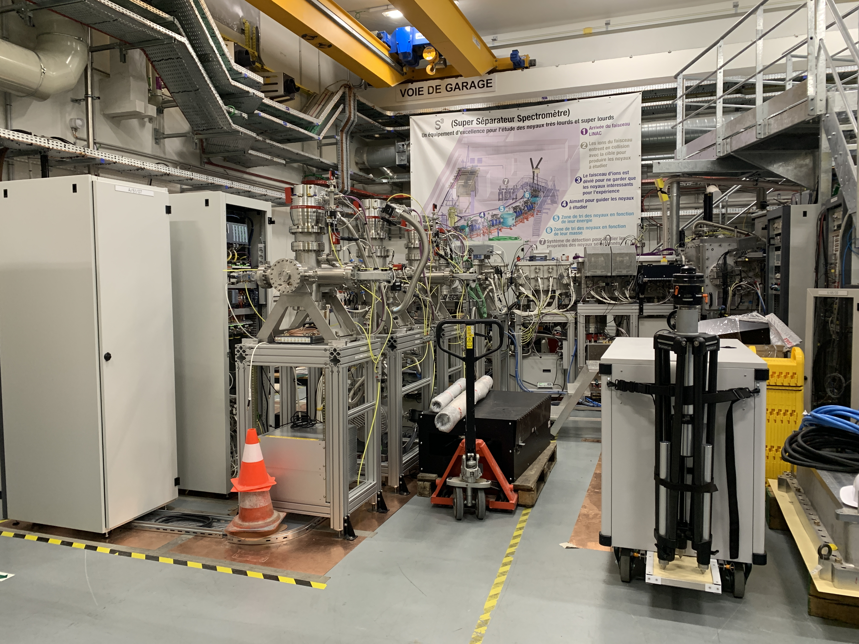
S³ LEB – Today

Slide 5
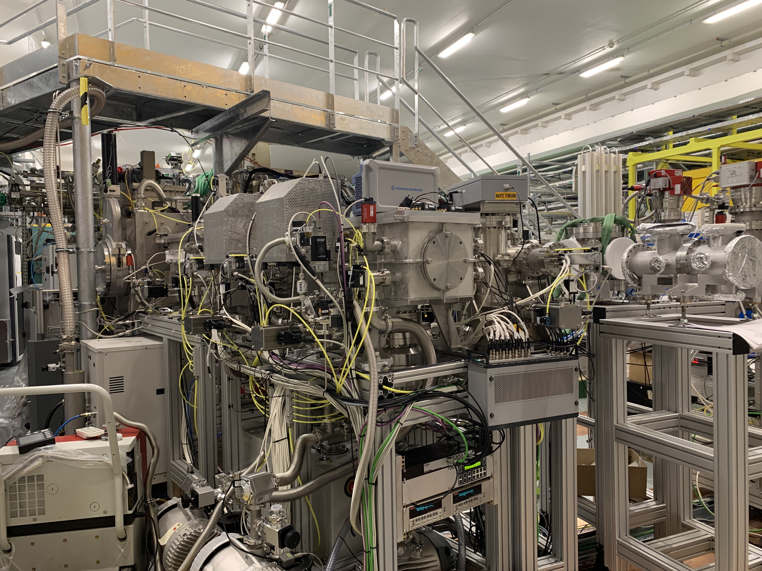
S³ LEB – REGLIS
REGLIS ready for off-line commissioning
  REGLIS started with thermoionic source
  Gas injection operational
  Transmission through RFQs to the buncher 50%
  Filament to be prepared with Er
MCP
Pulse up
(~ 3 kV)
Thermoionic source
Gas cell
RFQ
Cooler
Buncher
S-shape RFQ
miniRFQ
QMF
He: 10⁻² - 10⁻³ mbar
RFQs
Ar: 200 - 500 mbar

Slide 6
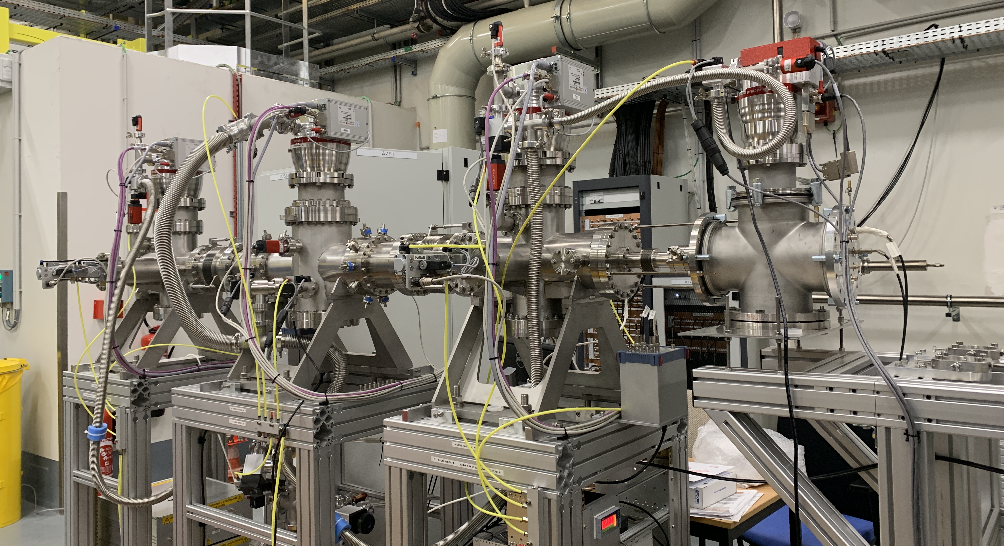
S³ LEB – REGLIS
PILGRIM ready for off-line commissioning
  Cs ion source installed
  Fastcomtec acquisition system for the Magnetof
  In preparation: voltage stabilization (low pass filter tested at LPC, safety under construction)

Slide 7
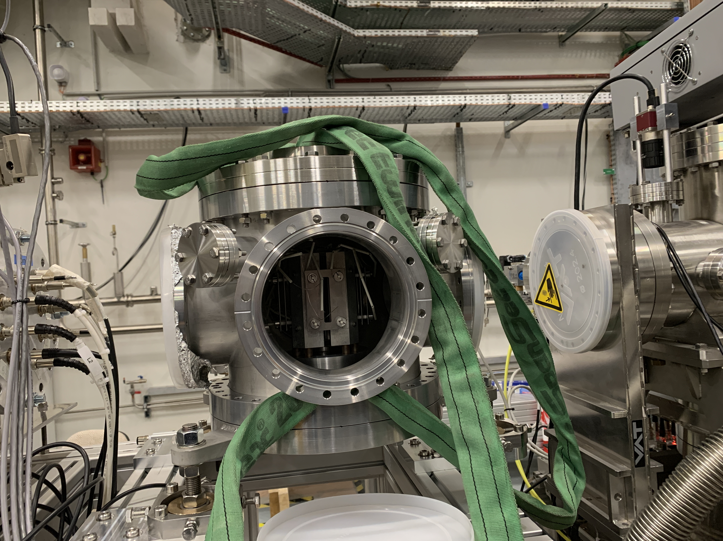
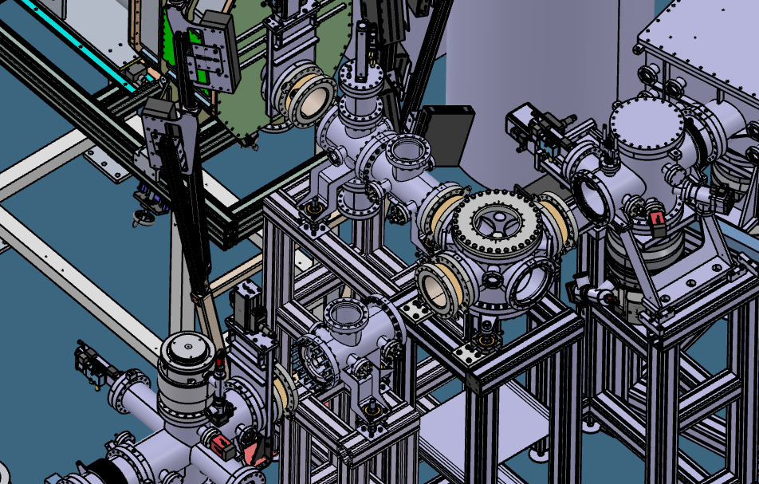
S³ LEB – 90° bender and connection lines
  90° Bender installed and aligned
  Vacuum + CC + PS to be installed
  Connection lines should be ready in May
  To be tested: 90° bender at 3kV
    If OK => 3KV RF Amplifiers, if not OK => 4kV power supplies

Slide 8
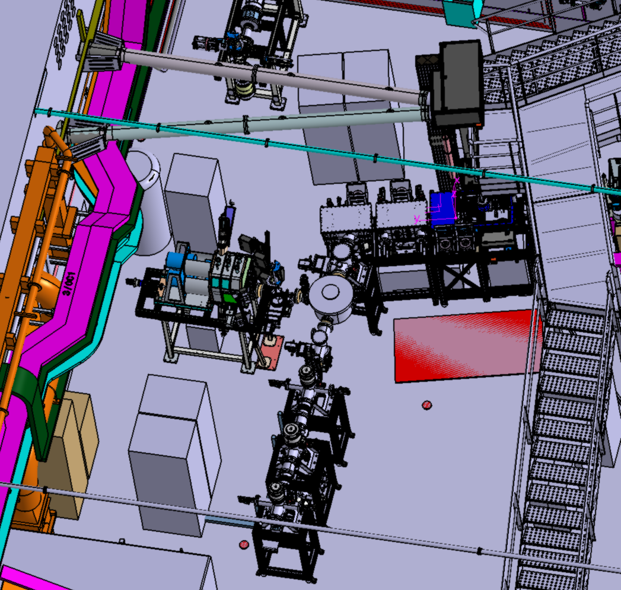
S³ LEB – Laser beam transport
  Installation of post and boxes in May
  Laser safety in the S³ room to be finalized for ”Expert mode”
  Short term: S³ room closed for none laser experts ?

Slide 9
S³ LEB – Toward on-line commissioning
Test of the complete new S³LEB line
  With Er laser ionized up to PILGRIM
  Test of the different configuration of the 90° bender
  Improvement of the in gas jet spectroscopy resolution (=> M=8)
  Test of the Si detectors
  Efficiency measurement with ²²³Ra
Entrance window
  Test of the connection between S³ and S³LEB with the 3µm Ti entrance window
  Development of thin entrance windows on the test bench
Exhaust system
  Implementation of the delay line
  on the roof of S³
λ₁
λ₂

Slide 10
S³ LEB – Planning

Slide 11
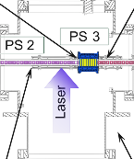
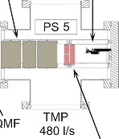


S³ LEB – What’s next
New ABU for ALTISA with RF exitation
  Under study at LPCCaen
  Further implementation of RF spectroscopy in S³LEB gas jet
New dye laser room
  Room above ALTISA to be refurbished
  Laser and chemical safety discussions
Related projects
  FRIENDS3
  SEASON
  IDEAS3
  OCS : On-line Chromatography Set-up
  Connection to DESIR and room 51
$≈$80 cm
$≈$60 cm
OCS
λ₁
λ₂

Slide 12














S³LEB collaboration
GANIL:
Anjali Ajayakumar; Dieter Ackermann; Alexandre Brizard; Sai Kumar Chinthakayala; Pierre Delahaye; Patrice Gangnant; Sarina Geldhof; Johan Goupil; Mustapha Laatiaoui; Nathalie Lecesne; Renan Leroy; Andres Lopez; Franck Lutton; Alejandro Ortiz-Cortes; Benoit Osmond; Julien Piot; Hervé Savajols
LPC:
Jean-François Cam; Hugues de Préaumont; Antoine de Roubin; Xavier Fléchard;
Clément Gautier; Julien Lory ; Yvan Merrer; Skyy Pinada; Christophe Vandamme
IJCLab:
Wenling Dong; Patricia Duchesne; Serge Franchoo; Vladimir Manea; Valentin Marchand; Elodie Morin;
Olivier Pochon
KU Leuven:
Arno Claessens; Thomas Cocolios; Rafael Ferrer; Mark Huyse; Fedor Ivandikov; Yuri Kudriavtsev;
Jekabs Romans; Paul Van den Bergh; Piet Van Duppen
JGU:
Sebastian Raeder; Dominik Studer; Klaus Wendt
JYU:
Iain David Moore; Michael Reponen; Juha Uusitalo
IPHC:
Emil Traykov
IRFU:
Martial Authier; Olivier Cloue; Antoine Drouard; Thomas Goigoux; Mathilde Ragot;
Emmanuel Rey-Herme; Damien Thisse; Marine Vandebrouck

Slide 13
Merci pour votre attention

Slide 14
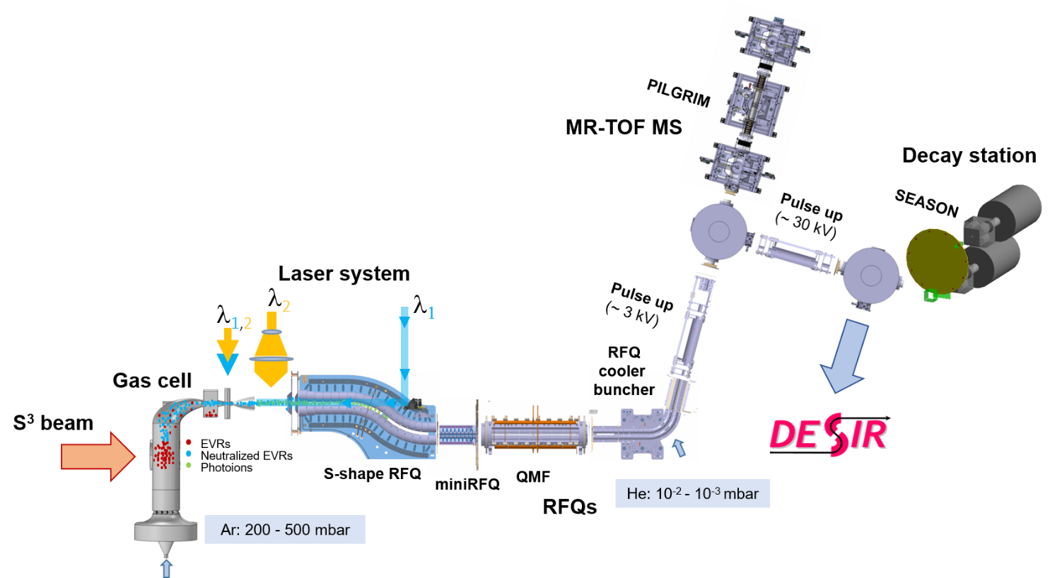
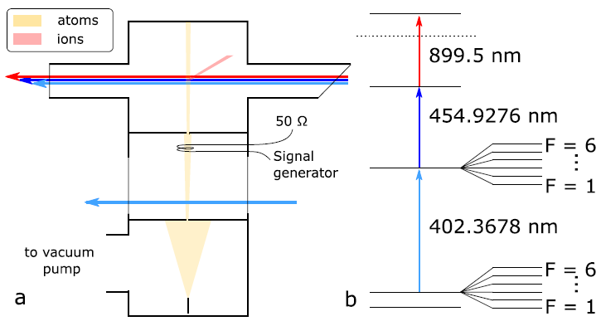
Ongoing projects: S³ABU
Extraction spectrometer
TOF detector
RF spectroscopy at S³LEB
Extraction of nuclear core properties depends on the available laser ionization scheme (technical limitations)
Proposed idea: combining RF spectroscopy with laser ionization spectroscopy at S³LEB
Improve the accuracy of hyperfine structure measurements by three orders of magnitude!
Interesting in the region of N = Z nuclei
Such precision makes it possible to extract the octupole magnetic moment of the nucleus
Information on the polarization of the nucleus, better description of the wave functions of nucleons
Testing the experimental method with ²⁰⁹Bi
Project in collaboration with R.P. de Groote (KU Leuven)
S³ABU: Design of the new S³ laser room Atomic Beam Unit by LPC Caen
Will include the possibility to implement the new RF spectroscopy method
SIMION Simulations of the optics by N. Rousseaux
Design started, machining in spring 2025, by LPC
Aperture
Laser interaction zone
RF excitation
Aperture
Oven
R.P. de Groote et al., PLB 827, 136930 (2022)

Slide 15
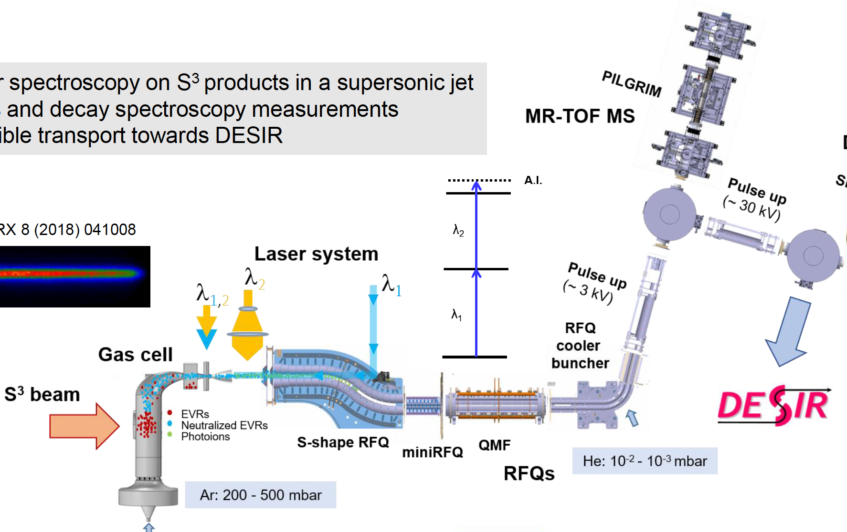
Online Chromatography Setup (OCS)
First phase: Integration behind Q-deflector @ S3-LEB
$≈$80 cm
$≈$60 cm
Compact setup (≈ 80 cm length)
Inauguration in parasetic mode (²¹⁴Ac⁺)
OCS

Slide 16
S³ LEB – S³ Low Energy Branch
PILGRIM
Not to scale
MR-TOF MS
SEASON
IDEAS³
90° bender
Pulse up
(~ 3 kV)
Laser system
λ₁
λ₂
Gas cell
RFQ
Cooler
Buncher
S³ beam
S-shape RFQ
miniRFQ
QMF
He: 10⁻² - 10⁻³ mbar
RFQs
Ar: 200 - 500 mbar

Slide 17
S³ LEB – S³ Low Energy Branch
$≈$80 cm
$≈$60 cm
OCS
λ₁
λ₂

Slide 18
S³ LEB – S³ Low Energy Branch
Not to scale
MCP
Pulse up
(~ 3 kV)
Thermoionic source
Gas cell
RFQ
Cooler
Buncher
S-shape RFQ
miniRFQ
QMF
He: 10⁻² - 10⁻³ mbar
RFQs
Ar: 200 - 500 mbar

