Slide 1



Super Separator Spectrometer
ISOL FRANCE 03/04/2025
H. Savajols (SM), A. Drouart (DSM), M. Authier (TM), G. Sénécal (GTC)
on behalf of the S³ project & collaboration

Slide 2

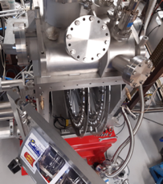

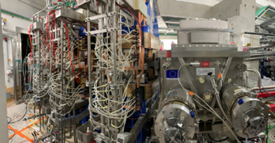
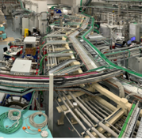
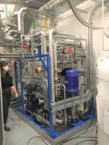
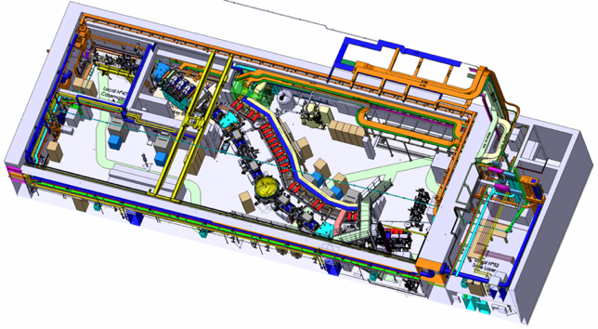

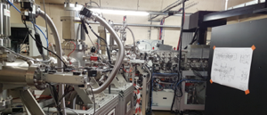
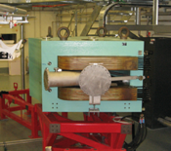





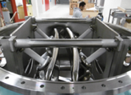
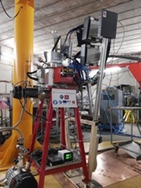
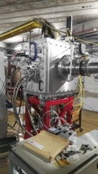
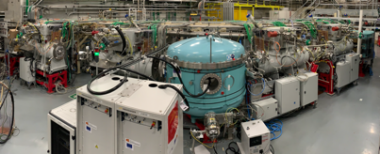




Super Separator Spectrometer
Open RT magnet & beam dump & Movable fingers
Lot C68, Cooling system, Laser room …
Dispersive zone
Infra / Interface
Target system
High power rotating targets
LEB @ LPC & GISELE Laser Lab
LEB
3 × M-dipoles
Large H & V gaps
DSSD, SSD, FEE/BEE, DAQ & Diagbox
SMT, PSS, Coldbox & LTC
E-Dipole
SIRIUS
SC Multipoles
20 cm gap & +/- 300 kV
Open slit in the anode
High selectivity > 10¹³ - High efficiency 50 % - In flight mass separation = 500
Versatility & unique instrumentation (SIRIUS – LEB)

Slide 3
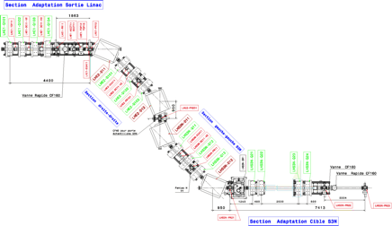
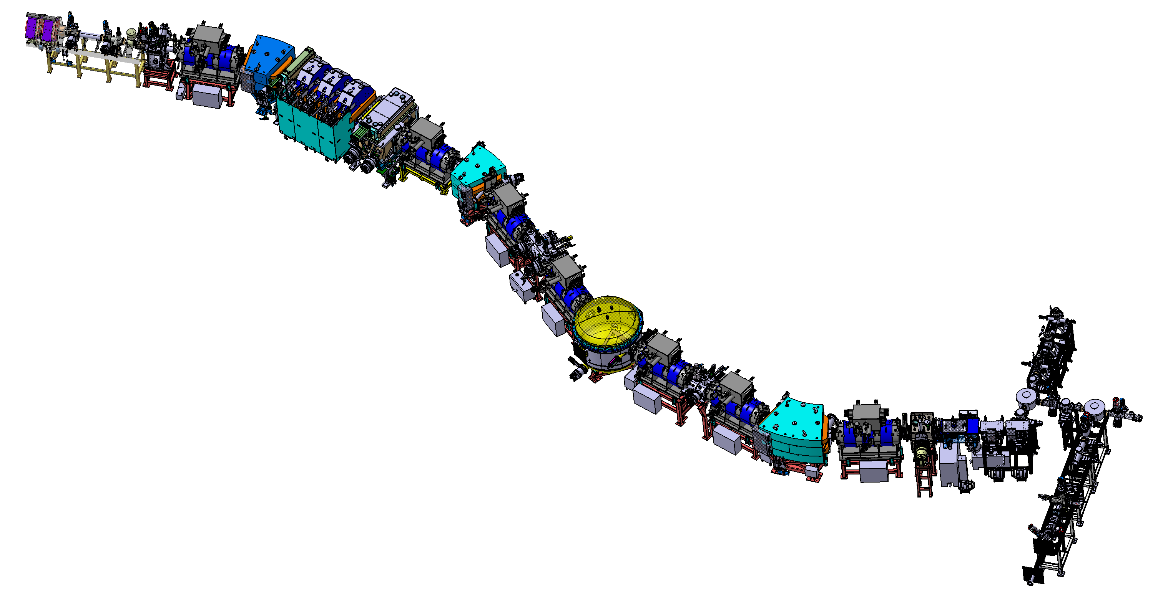
J6x : commissioning milestones
J6A
Accelerator & beam line tuning up to the target
J6B
Spectrometer optical commissioning with direct beam
Beam
J6C
Scientific commissioning, reactions at the target
Measure and optimise the rejection (case by case)
Estimate transmission
Detection systems : LEB / SIRIUS
LHE-S3N
Achromatic point
Mass separator
Target position
S³LEB
Primary beam dump
Momentum achromat
Final focal plane
Secondary beam dump
LINAC
S³

Slide 4

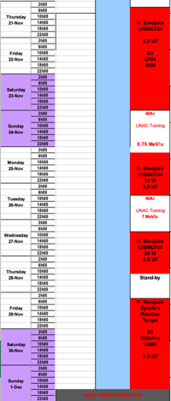
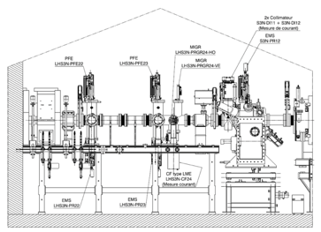
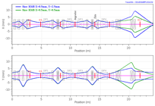
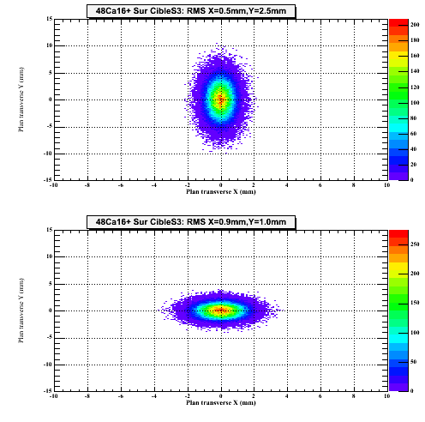
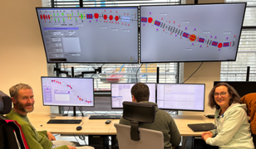
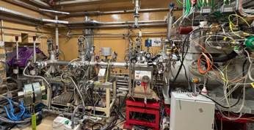
Milestone J6A: Beam optimisation on target
  LHS3N accelerator beam line tuning up to LHS3N-CF24
  Beam spot optimisation on the target (S3N-CF12)
  LINAC beam synchronisation / target wheel
  Direct ⁴⁰Ar beam ; E = 0.73 - 5 MeV/u (6 p𝛍A)
NOVEMBER 2024

Slide 5
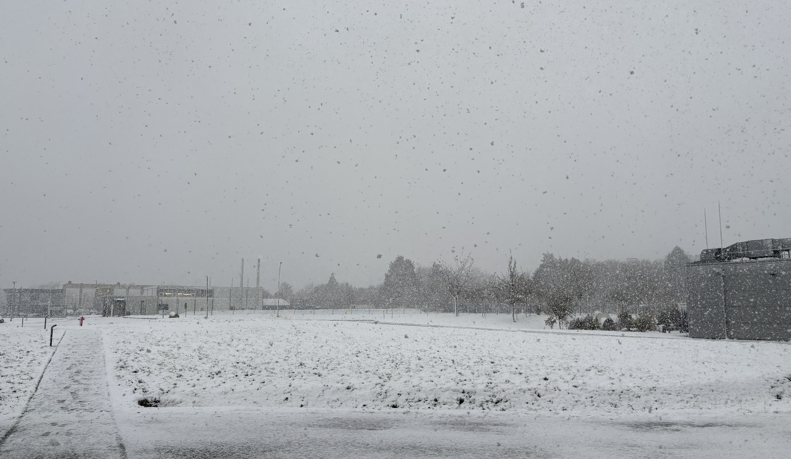
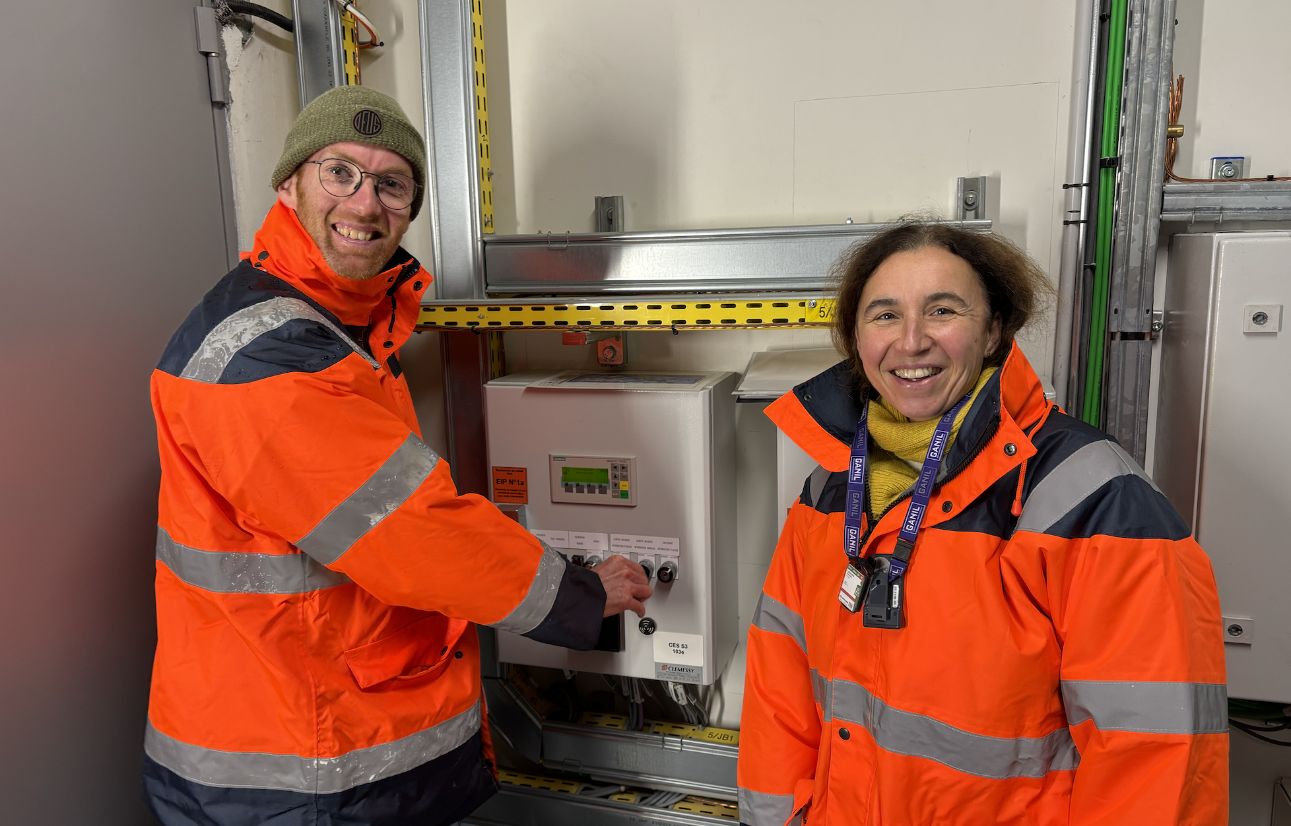
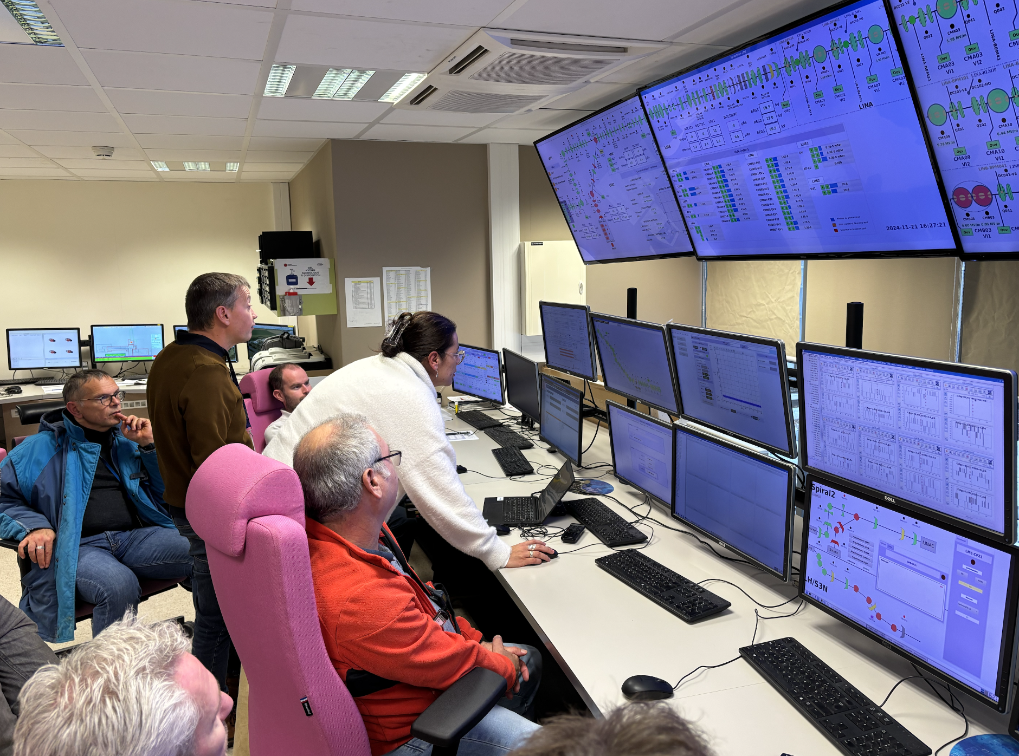
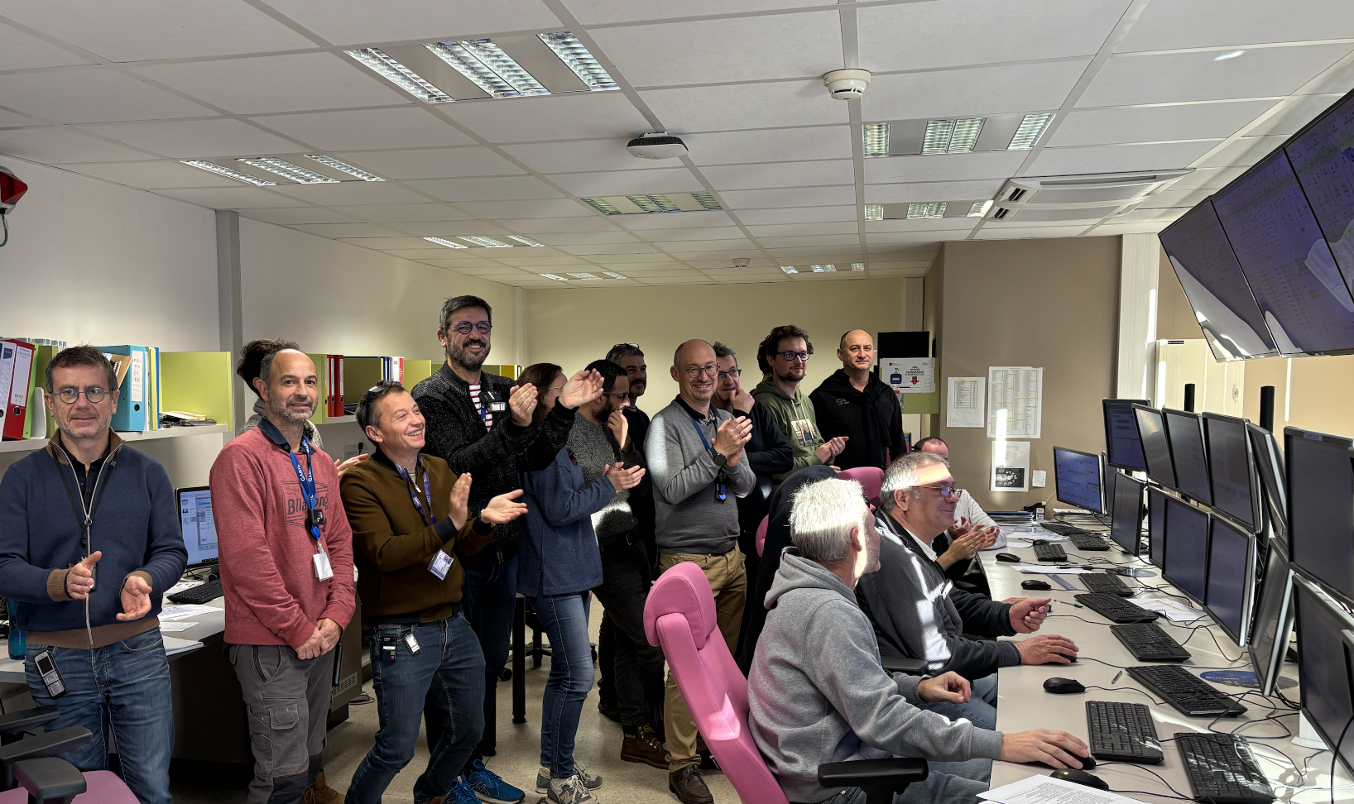

21 November: First S³ commissioning milestone achieved, with snow ...
On your marks …
Get set …
Go !
First high intensity beam at S³ : 80 μAe (5,7 pμA, 3,6.10¹³ pps, 1,14 kW)
M. Grasso (Journée projets IN2P3)

Slide 6
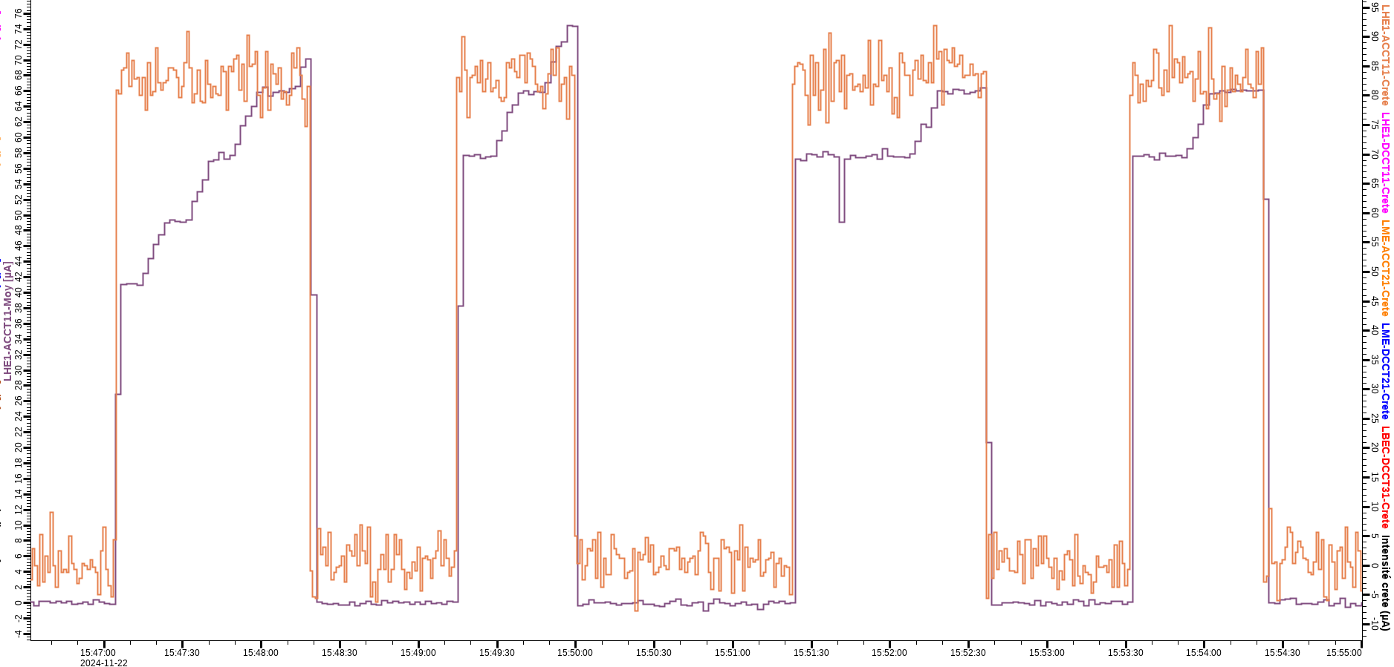
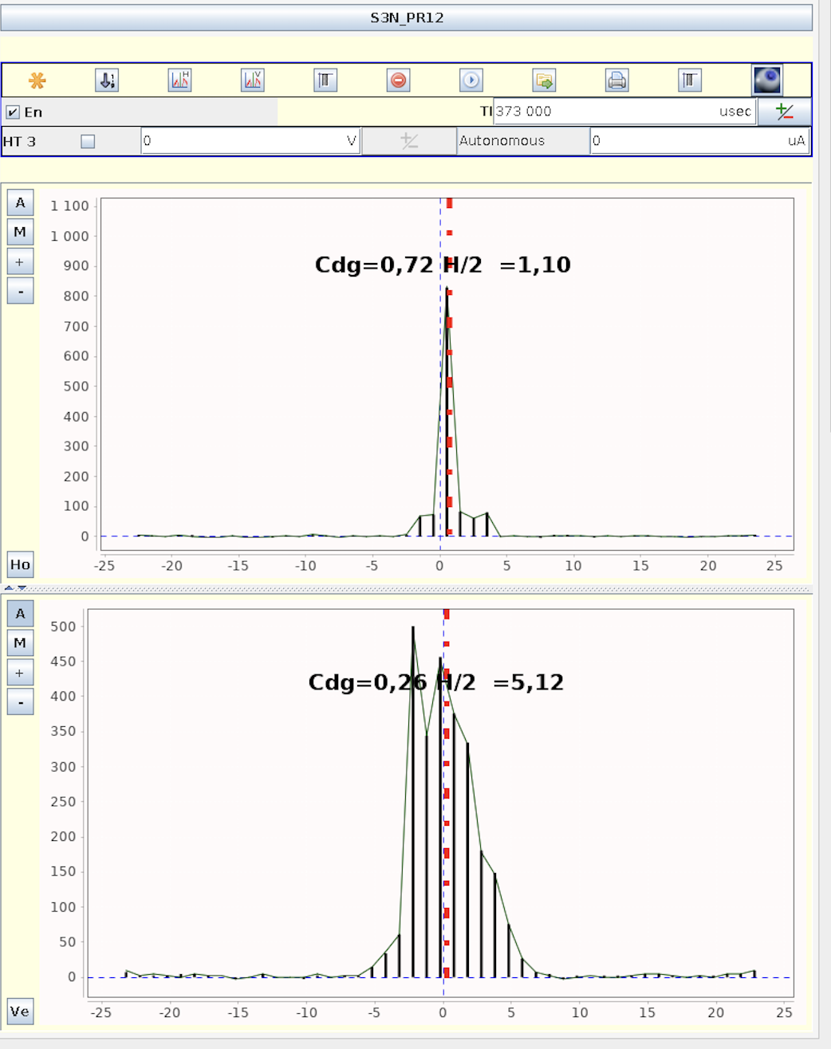
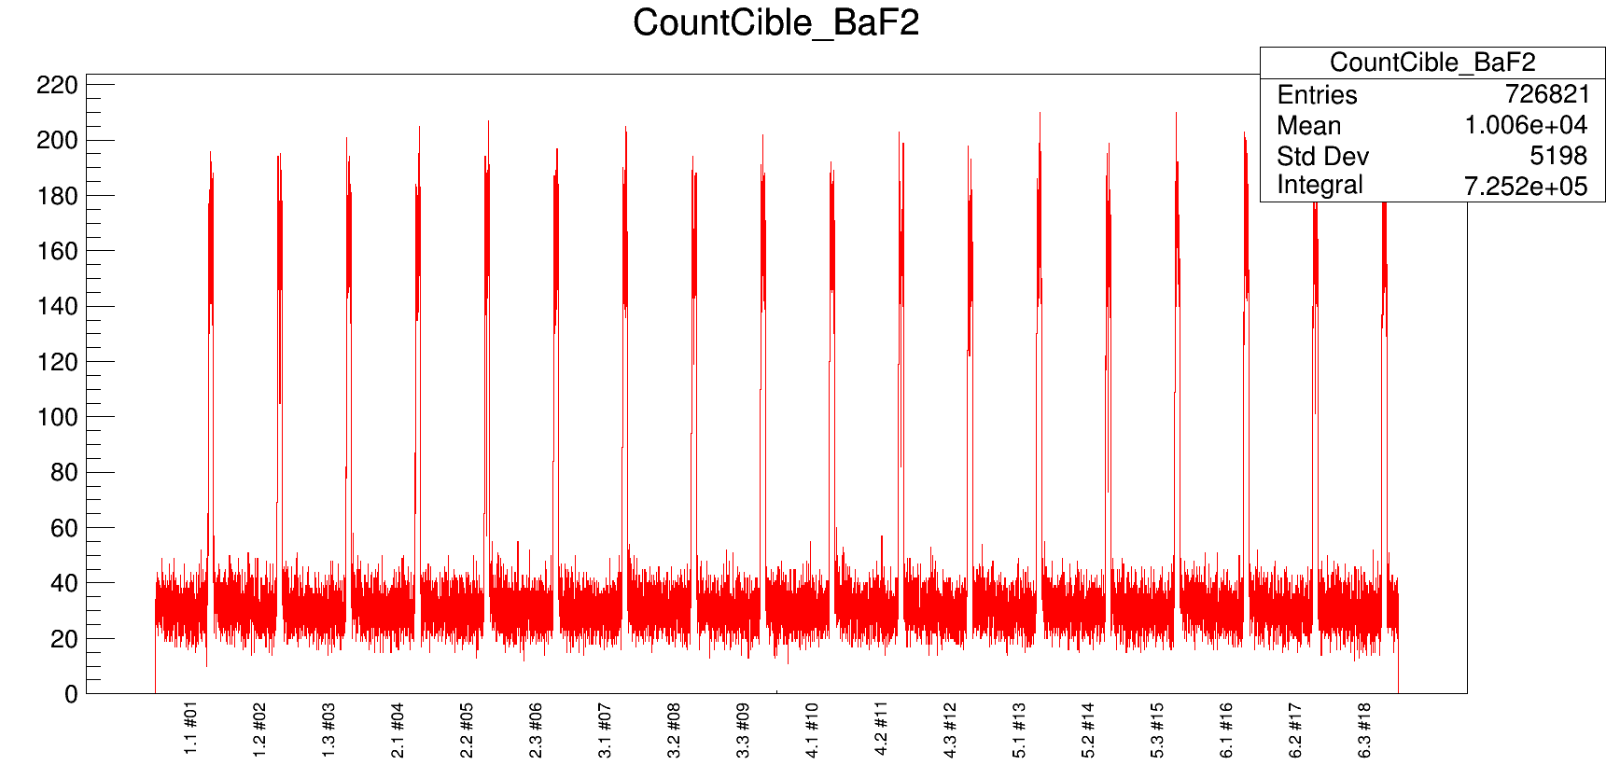
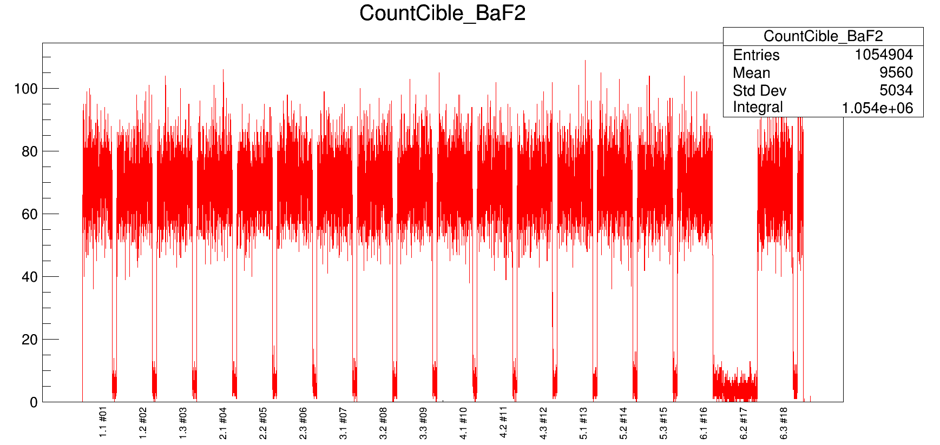
Milestone J6A: First results
⁴⁰Ar¹⁴⁺ beam at the the source (10 p𝜇A – 6,2.10¹³ pps)
Beam intensity at S³ 80 μAe (5,7 pμA, 3,6.10¹³ pps, 1,14 kW)
A/Q<3
A/Q<6
Beam intensity at the exit of the LINAC (orange curve)
Beam intensity at S³ (Bleue curve)
Horizontal beam spot X : 1,1 mm (FWHM)
Vertical beam spot Y : 5,12 mm (FWHM)
Beam time structure control by the target rotation
Without control of the LINAC time structure
Irradiation of target frames
With LINAC structure time control
Irradiation of targets only

Slide 7
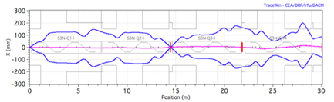
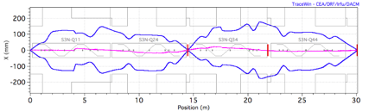
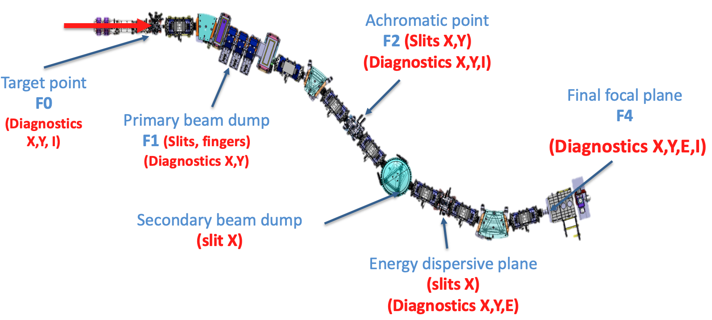
Next step: Jalon J6B planned to start end 2025
Spectrometer optical commissioning
  Direct and stripped beam up to the focal plane
  Progressive tuning of the elements (MA+ MS)
  Tools : diagnostics along the spectrometer + additional diagnostics at the focal plane (SIRIUS & LEB can be connected but not used)
  ➔ Beam ⁴⁰Ar ; E = 0.73 - 5 MeV/u and intensity of 30 W
Prerequisites
Beam on target : commissioning de of LHE-S³ with validation of the beam characteristics at the target point (Done J6A)
Commissioning of individual elements (magnets, power supplies, control-command, diagnostics…)
Alignments of magnets, slits and diagnostics Safety systems must be operational

Slide 8
To be done by the next milestone J6B
Target station : use of stripper foils (ok)
Room temperature magnets (3 magnetic dipoles & open multipole triplet)
  → final power-up tests in 2025
Electric dipole (chamber, electrodes and 300kV power supplies installed, HV feedthroughs delivered)
  → Conditioning at 260 kV (+/-130 kV) for ⁴⁰Ar¹⁴⁺ at 0,73 MeV/u (B𝜌 = 0.35 Tm et E𝜌 = 4.17 MV)
SMT, PSS & Cryogenics (7 PSS & 7 SMT & cold box + cryogenic line)
  → Full cryogenic-system qualification (ok)
  → Cold mass alignment of all SMT
  → All SMT in final position, tested and connected (PSS)
Beam dump (2 chambers, translation mechanisms, fingers and shielding delivered)
  → Not required for J6B

Slide 9



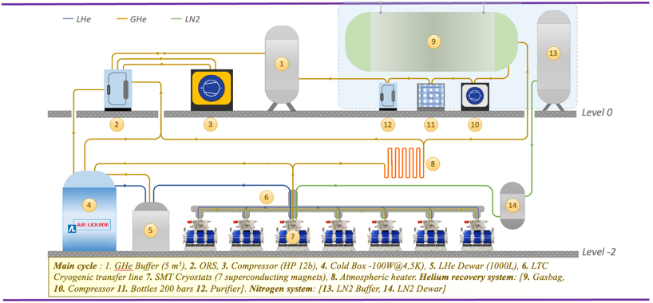
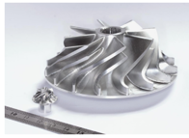
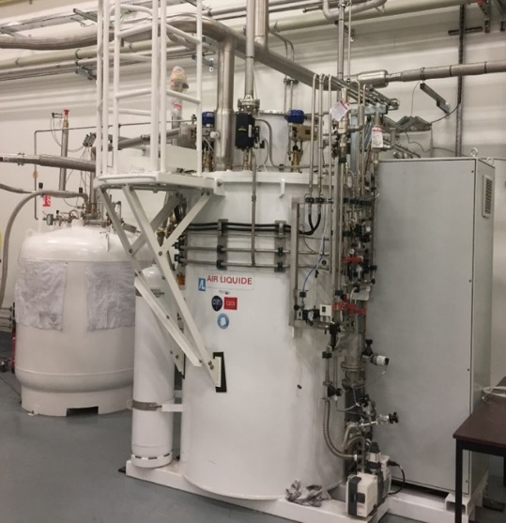
Cryogenics
Cold box capability 100 W
7 SMT = 35 W
Cryoline < 60 W
Cold box turbine issues May 2022 – September 2023 (4 crashes)
No SC magnets tests between May 2022 and end 2023!
Cold box eventually worked end 2023 but non satisfactory cool-down sequence end 2023:
  2 new Cryoline branches installed and requested optimization (Taconis problem, thermal losses…)
  Efficiency of the cold box (60%) : fixed by Air Liquide beginning 2024
Status end 2024
Efficiency of the cold box back to optimum / no failure
Global cryogenic tests including 6 SMT in their final position connected :
  Cryoline LN2 test : OK
  Cryoline LHe test (budget < 60 W)
  ➔ The Cryoline is qualified, optimizations pending to maximise the efficiency of the system

Slide 10
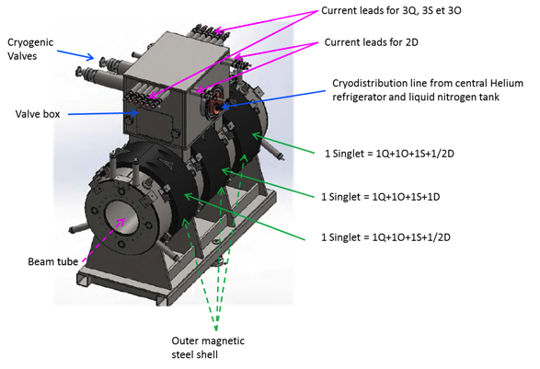
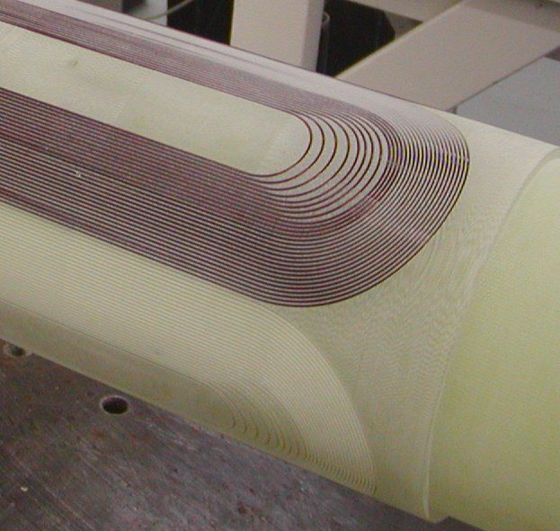
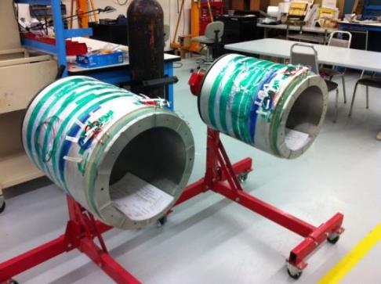
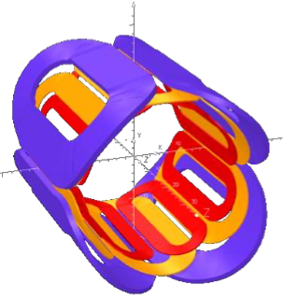
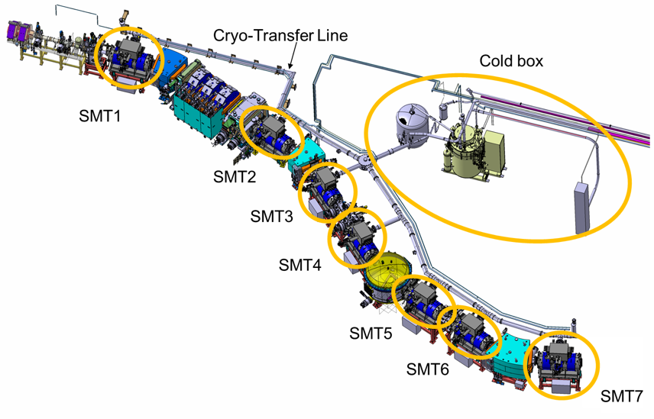
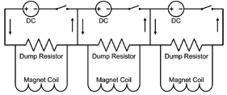
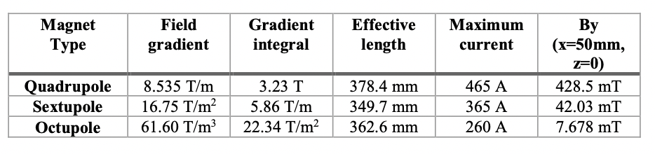
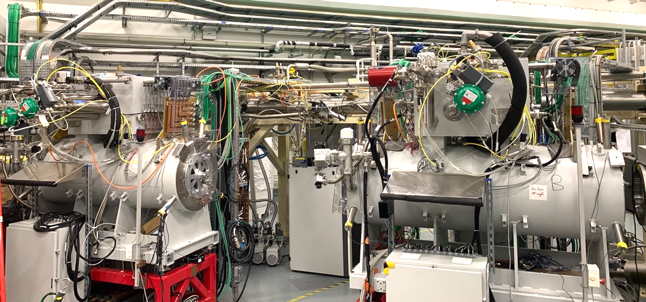
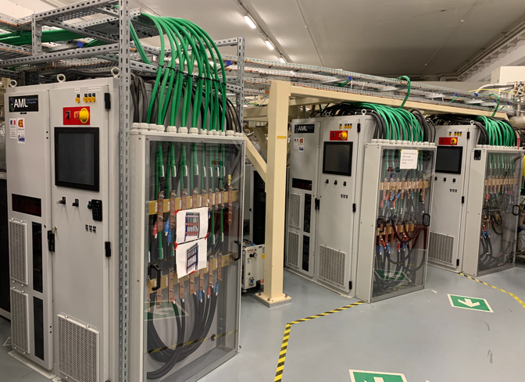



Superconducting Multipole Triplet (SMT)
Useful diameter 336 mm
7 SMT on the line
SMT: 11 coils @ 4K (NbTi)
3 singlets/SMT
Singlet: superimposed quadrupole, sextupole and octupole fields, plus a dipole steerer
One cryostat & cryogenic instrumentation
Common leads
PSS connected to SMT

Slide 11
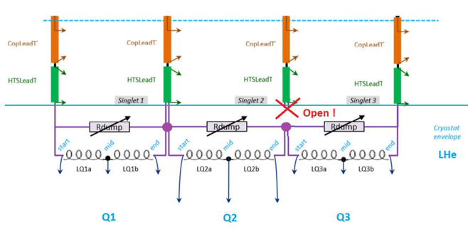
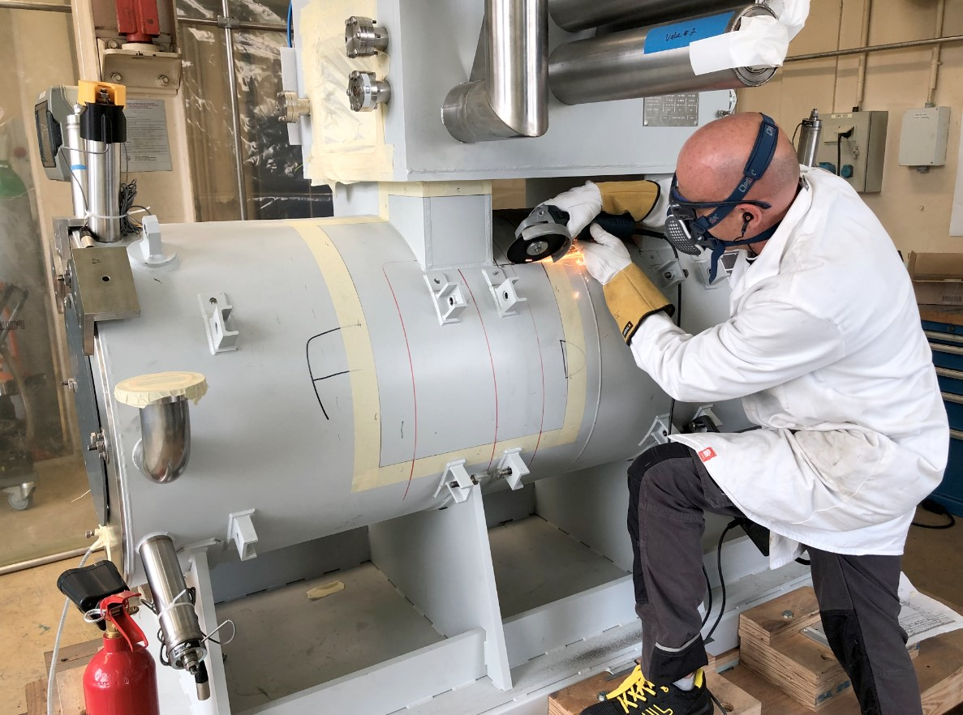
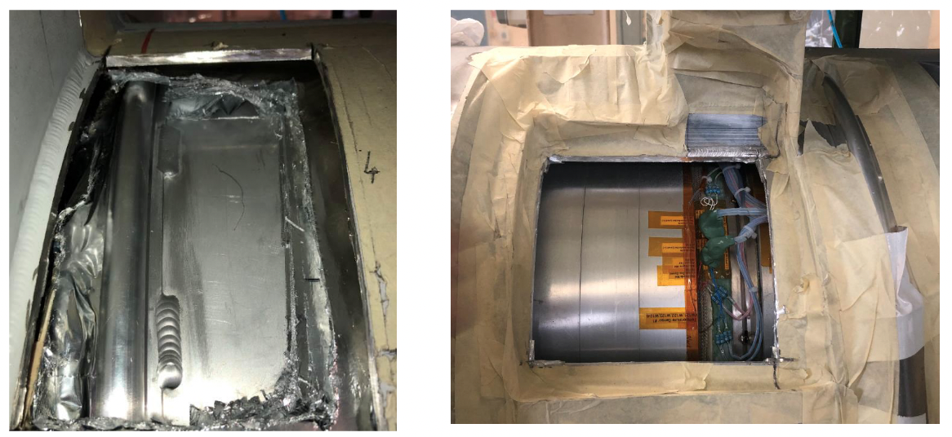
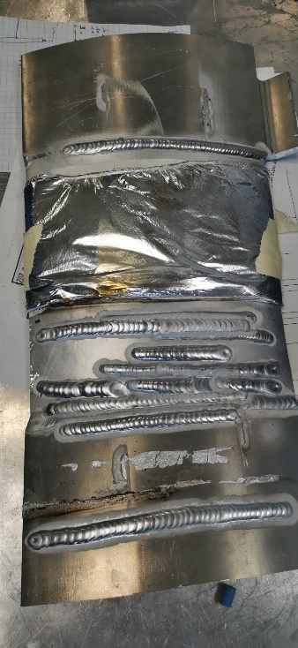
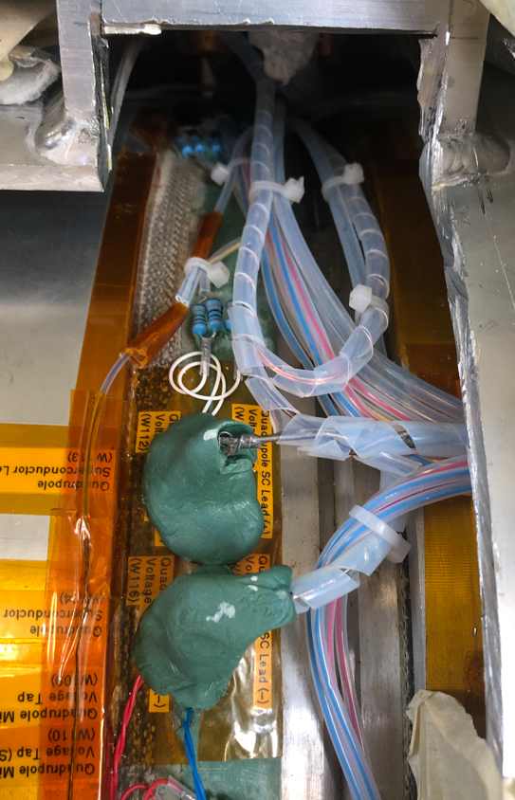
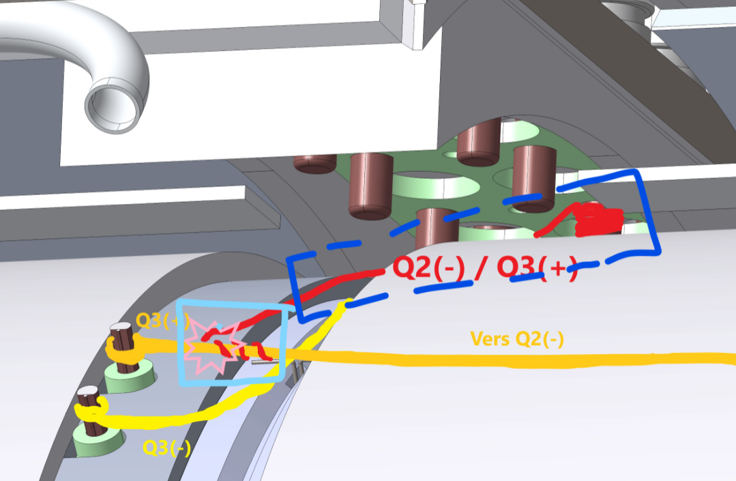
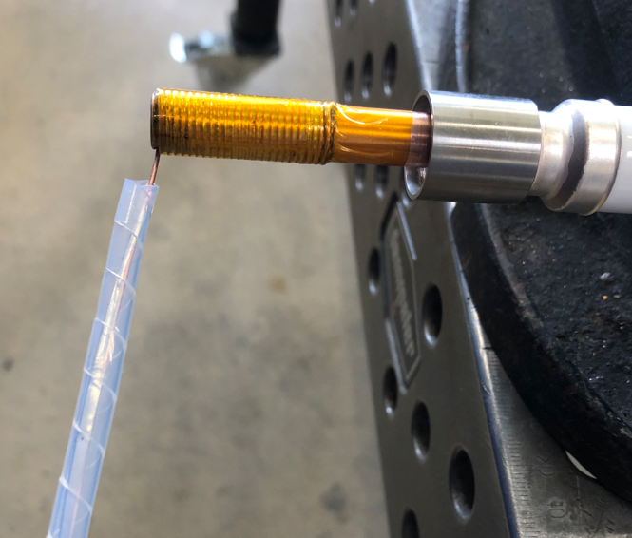
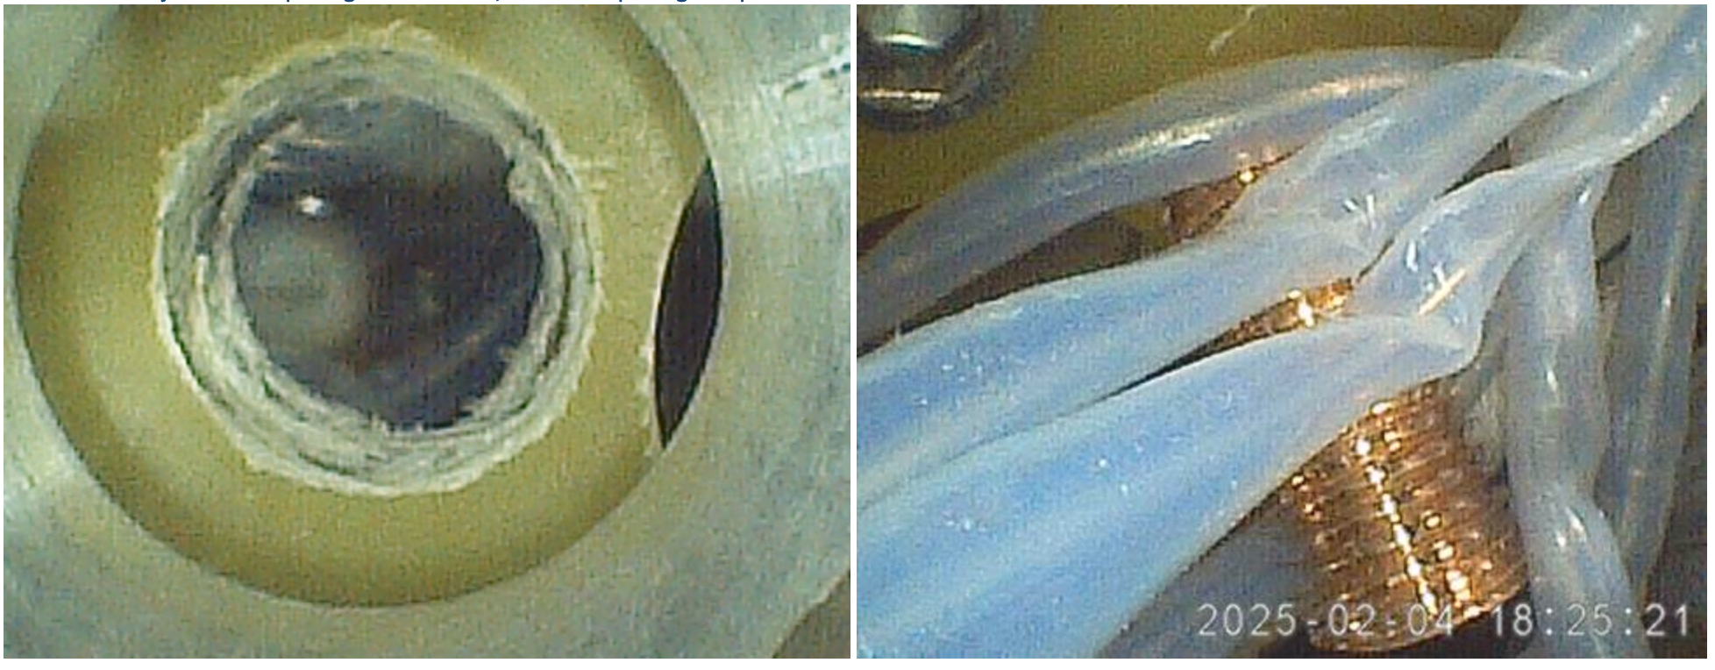
Superconducting Multipole Triplet (SMT)
All 7 SMT's delivered
SMT1-2-3-4-5-7 tested
SMT5: current limitation at 250-300 A (Qpoles) + vacuum leak
SMT6: current lead (ADI) between quadrupoles Q2/Q3 is non-functional
(broken connexion inside the cryostat or coil issue !)
SMT6 diagnostic/repair ongoing

Slide 12



Superconducting Multipole Triplet (SMT)
SMT main breakdown diagnostic
Manufacturing of current leads inside the cryostat are not identical
Some are much shorter !
Some do not have a LTS lined cable !
➔ The He level in the cryostat is too low
➔ Poor thermalisation (verified by temperature measurements) inducing current limitation and possibly breaking of the LTS after a quench
New sensors to be installed in the cryostat to regulate the He level to 120%.
Technical solution validated by cryogenic experts
This new sensors will be implemented first in the SMT6
for the next cool down sequence and to be deployed on
the SMTs if necessary

Slide 13




Superconducting Multipole Triplet (SMT)
HTS
HTS current leads delamination issues (thermal cycles)
➔ New design proposed by Irfu/CEA
Old design
New design
REBCO tapes
➔ New HTS will be first implemented into the SMT5 for tests and validation
(SMT5 is partially open to repair a vacuum leak – alumina to be replaced)
➔ Replacement of all HTS to be scheduled in the future (major maintenance phase)
LTS protection system
➔ Wiring modifications to add a protection of vulnerable connection zones (ISDAQ/PSS)
➔ Modification ongoing

Slide 14


Superconducting Multipole Triplet (SMT)
SMT6
SMT5
All SMT installed in the spectro line end of June 2025
(including SMT5 and SMT6)
➔ start of the cool down sequence with final tests

Slide 15









Superconducting Multipole Triplet (SMT)
Cold mass alignment
➜ Difficult task as different tools are needed for space issues
2 SMT aligned at +/- 0.3 mm
3 different alignment systems
3D mapper (ANL/GANIL)
Thin mapper
External mapper (GANIL/Irfu)
Under construction & to be tested

Slide 16






Ongoing : C. Joly and J.F. Yaniche Bat106 (IJCLAB)
F. Esnault (GANIL)
Electric dipole
Chamber, Ti electrodes & 300 kV power-supplies
Conditioning status:
Anode up to + 120 kV without too many micro discharges (MD)
Cathode up to – 142 kV with numerous MD
Anode & Cathode +/- 85 kV
Safety requirements (no one in the room)
→ Improvement of the conditioning software
→ Conditioning up to +/- 130 kV (one week in April, every week-end with the help of the accelerator operators when GANIL is in operation)

Slide 17

Commissioning plan
Milestone J6b : Spectrometer optical commissioning
  Direct and stripped beam up to the focal plane
  Progressive tuning of the elements (MA+ MS)
Block 1 : Spectrometer optical commissioning
Block 2 (Converging Mode) : LEB
Reaction 1: asymmetric reaction ⁴⁰Ar + ¹¹⁶Sn to produce erbium (N=82)
Block 3 (Coverging mode) : SIRIUS
Reaction 2: asymmetric reaction ⁴⁰Ar + ¹⁷⁴Yb to produce known actinides
Reaction 3: asymmetric reaction ⁴⁰Ar + ¹⁸⁰Hf to produce thorium (N=126)
Block 4 (Converging mode) : LEB
Reaction 4: asymmetric reaction ⁴⁰Ar + ¹⁷⁵Lu to produce actinium (N=126)
Reaction 5: symmetric reaction ⁵⁰Cr + ⁵⁸Ni to produce N = Z nuclei
Reaction 6: very asymmetric reaction ²⁰Ne + ¹⁹⁷Au to produce actinium (N=126)
Block 5 (Converging/ High Resolution modes) : SIRIUS
Reaction 7: very asymmetric reaction ²²Ne + ²⁰⁶Pb to produce thorium
Reaction 8: repeat asymmetric reaction ⁴⁰Ar + ¹¹⁶Sn to produce ¹⁵¹⁻¹⁵²Er
Reaction 9: repeat asymmetric reaction ⁴⁰Ar + ¹⁷⁴Yb
Reaction 10: ⁴⁰Ar + ²⁰⁹Bi to populate mendelevium isotopes ²⁴⁴⁻²⁴⁷Md

Slide 18




