Slide 1
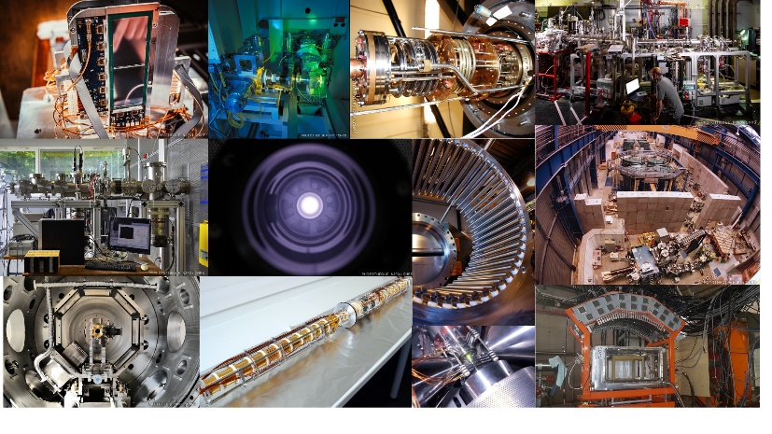
Workshop on R&D for new ISOL beams at SPIRAL 1 and ALTO
P. Delahaye on behalf of M. Dubois, E. Minaya Ramirez, P. Jardin, P. Chauveau and many others

Slide 2
Table of content
General feedback to SCIPAC – 3 slides Enrique & Mickaël
Physics interests
DESIR and SPIRAL 1 beams: slides B. Blank
ALTO: slide D. Verney
Developments of beams – slides P. Chauveau and P. Jardin as examples
Open questions
Laser ionisation at SPIRAL 1
Batch mode at SPIRAL 1
MNT at ALTO and SPIRAL 1

Slide 3
Table of content
General feedback to SCIPAC – 3 slides Enrique & Mickaël
Physics interests
DESIR and SPIRAL 1 beams: slides B. Blank
ALTO: slide D. Verney
Developments of beams – slides P. Chauveau and P. Jardin as examples
Open questions
Laser ionisation at SPIRAL 1
Batch mode at SPIRAL 1
MNT at ALTO and SPIRAL 1
Not a full summary! Just slides picked up here and there
Please see web site for more information https://indico.in2p3.fr/event/34404/

Slide 4
Table of content
General feedback to SCIPAC – 3 slides Enrique & Mickaël
Physics interests
DESIR and SPIRAL 1 beams: slides B. Blank
ALTO: slide D. Verney
Developments of beams – slides P. Chauveau and P. Jardin as examples
Open questions
Laser ionisation at SPIRAL 1
Batch mode at SPIRAL 1
MNT at ALTO and SPIRAL 1

Slide 5
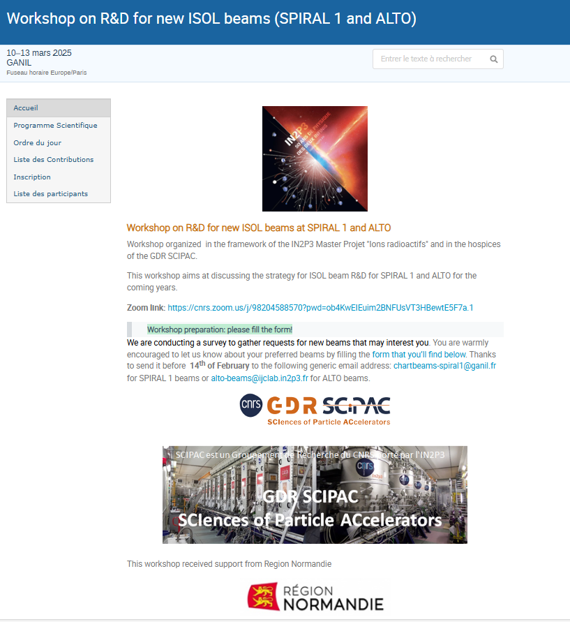
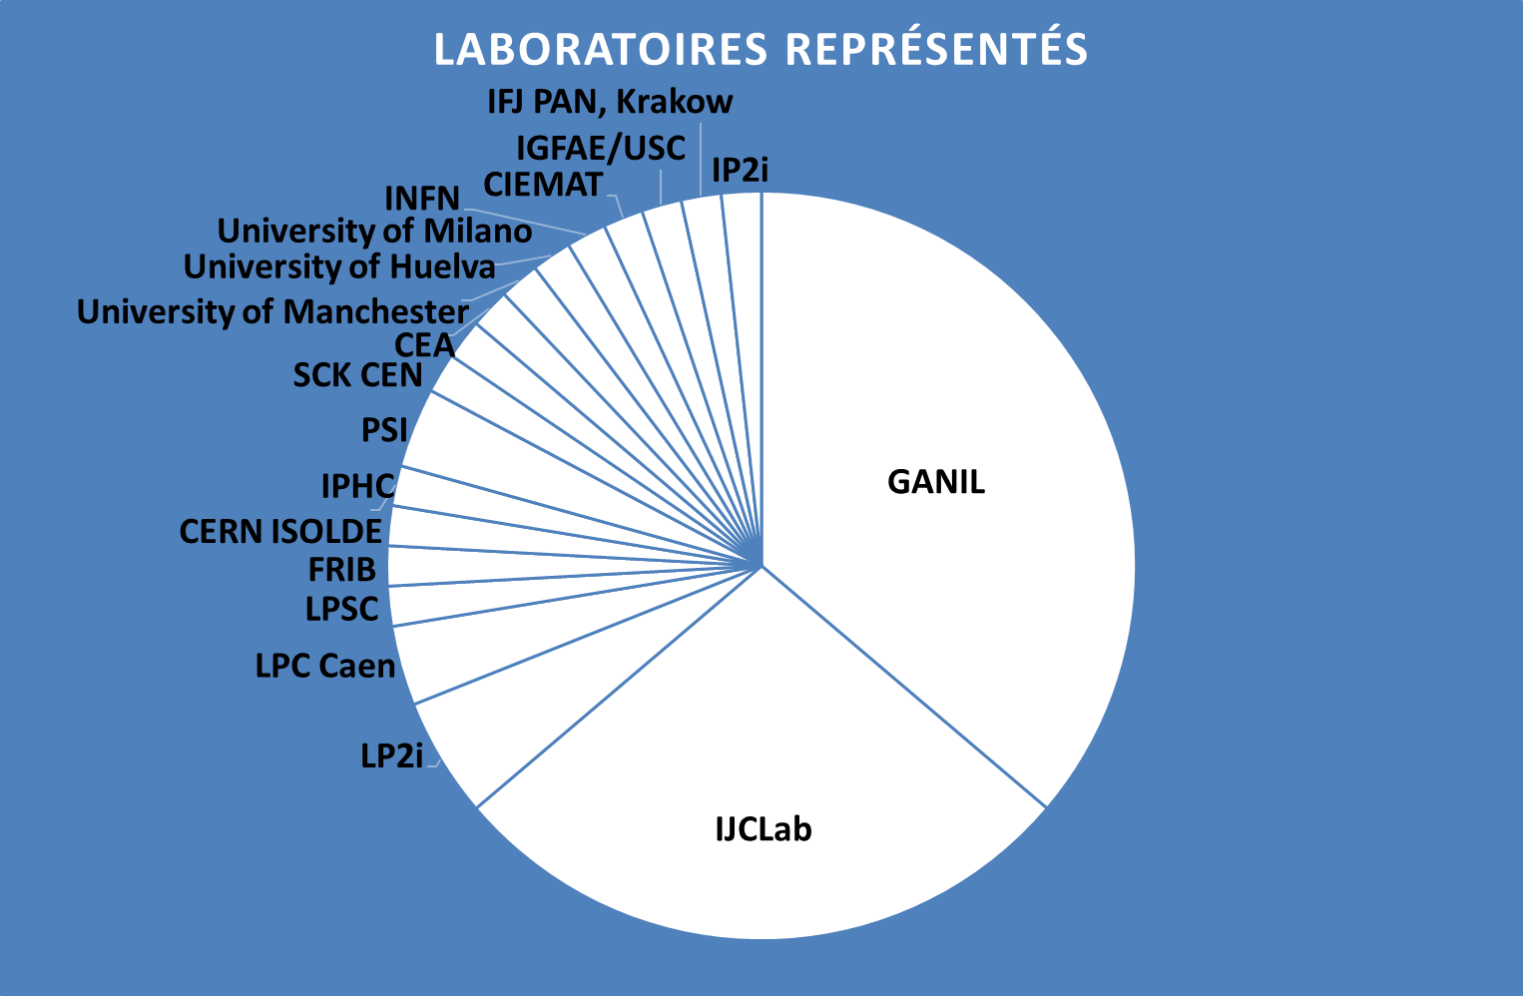
Workshop
https://indico.in2p3.fr/event/34404/overview
Workshop on R&D strategy for radioactive beams :
Common GANIL-SPIRAL1 / IJCLab-ALTO
In the framework of the “Master Projets Ions Radioactifs”
2 guests : Batch Mode (FRIB) – Laser ion source (ISOLDE)
64 participants (Researchers and engineers) (50% zoom - 50% at Caen)
All presentations are online
About 20 beam development requests received

Slide 6
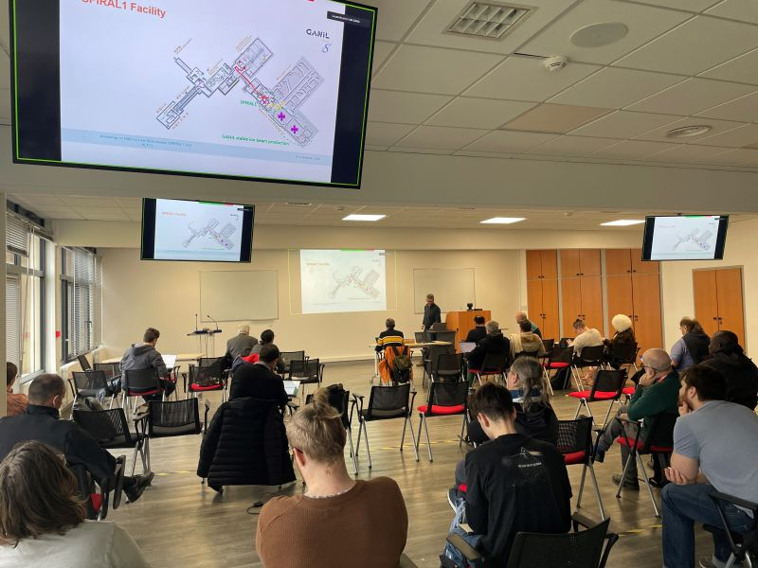
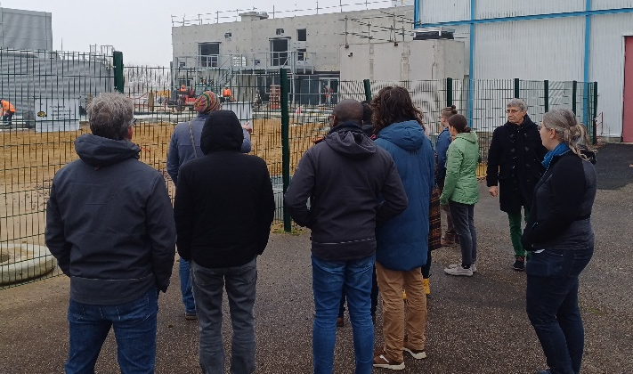
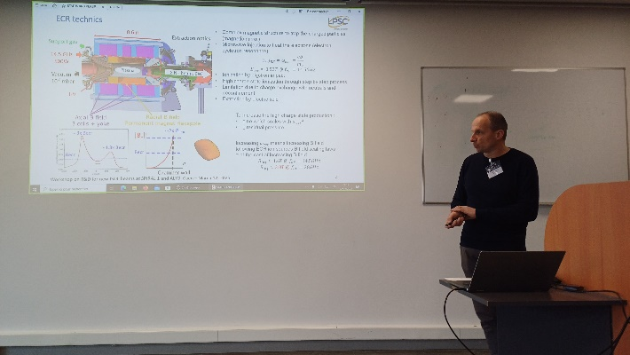
Workshop
Objectives
Collecting requests for beam development in the following context:
AGATA coming back at GANIL in 2029-2031
Start-up of the DESIR experimental hall
ALTO developments
Bring the protagonists together (Platform – Users)
Bring beam users together with beam R&D protagonists
Help identifying priority cases on both sites in the short and medium term
Support shared visions
Strategic discussions on platform investments
Comparison of user objectives with R&D in progress, or to be carried out

Slide 7
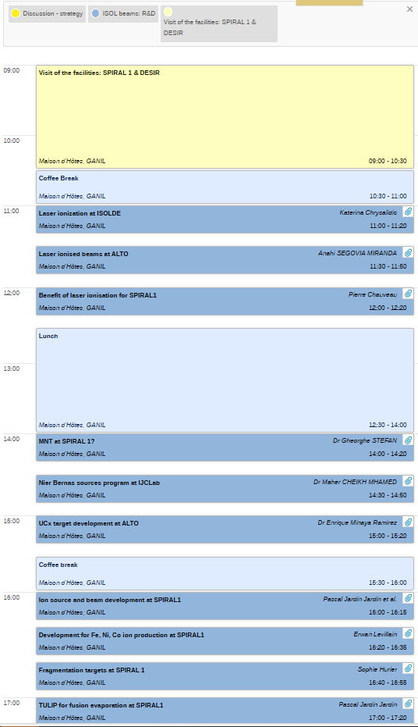
Workshop
Presentations
The first afternoon was devoted to the needs of the scientific community and platform operations.
Many presentations were given on R&D associated with the production of new beams (targets, sources, lasers, batch mode, etc.).
Discussions
Numerous discussions on ion beam purification and on the availability of national facilities for nuclear physics experiments.
Outcome
Good discussions and constructive exchanges between the protagonists of the radioactive ion beams R&D.
Bringing together beam users and beam R&D protagonists in one place is a very positive point.
Lots of information to process on the R&D directions for the coming years.
A synthesis and an analysis work is needed to define a common short- and medium-term strategy for both sites.

Slide 8
Table of content
General feedback to SCIPAC – 3 slides Enrique & Mickaël
Physics interests
DESIR and SPIRAL 1 beams: slides B. Blank
ALTO: slide D. Verney
Developments of beams – slides P. Chauveau and P. Jardin as examples
Open questions
Laser ionisation at SPIRAL 1
Batch mode at SPIRAL 1
MNT at ALTO and SPIRAL 1

Slide 9
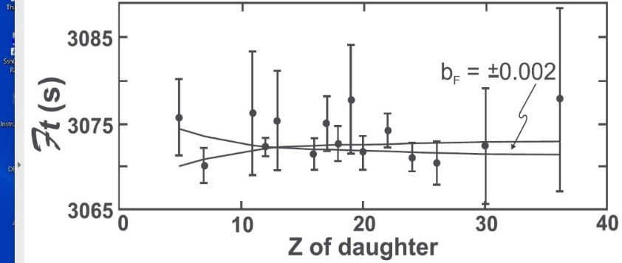
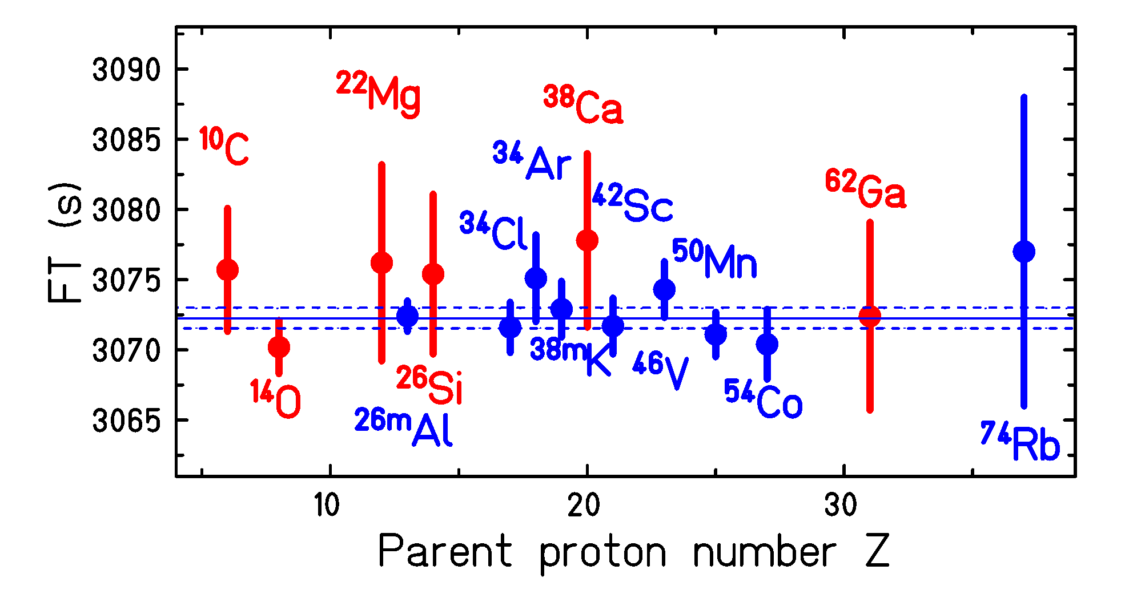
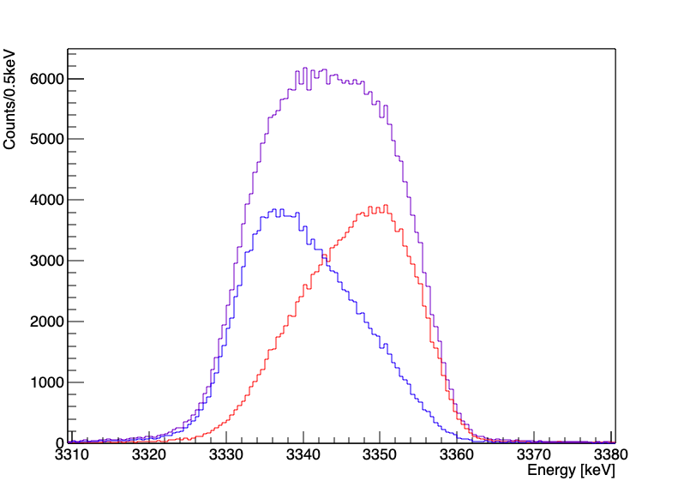
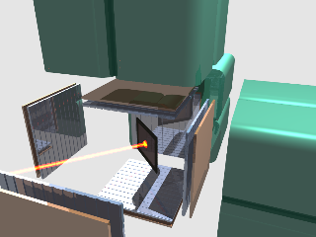
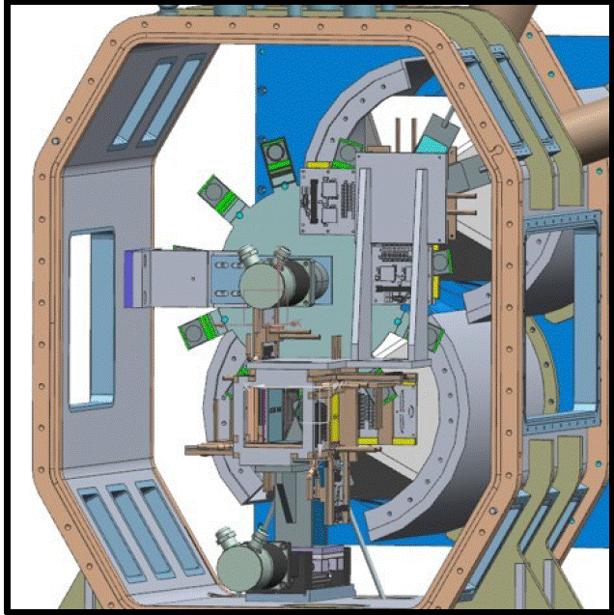
• • • Beam requests
BESTIOL:
Weak-interaction studies:
BR of 0+ - 0+ transitions to search for scalar interactions (Fierz term)
¹⁰C, ¹⁴O (I = 100 - 1000 pps) ➔ CO molecules?
high purity absolutely required
BR and Q_{EC} of heavy 0+ - 0+ emitters to extent CVC test
⁷⁰Br and ⁷⁴Rb (I = 1000pps) ➔ TULIP
high purity absolutely required
Search for exotic weak-interaction couplings with βp emitters
⁸Li (I > 100pps), ²⁰Mg (I = 1000pps), ³²Ar (100pps) ➔ WISArD-like
high purity absolutely required
β-recoil measurement for weak-interaction studies
^{10,11}C, ¹³N, ¹⁸F, ¹⁹Ne (I = 10⁶ pps)
high purity requied
β-delayed multi-proton emission
Search for p-p correlations, isospin mixing, astrophysical interest
²²Al, ²³Si, ²⁶P, ²⁷S, ³¹Ar, ³⁵Ca, ⁴³Cr (I = 1 – 10 pps) ➔ SEASON, Silicon-Cube
high purity required

Slide 10
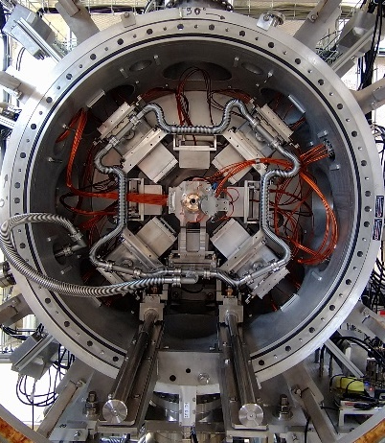
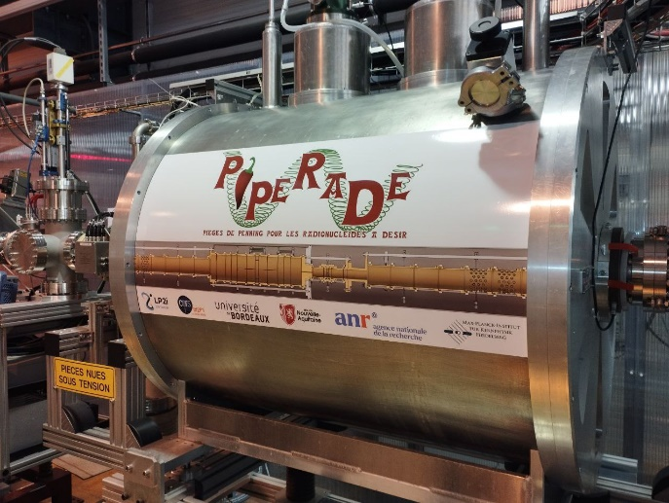
• • • Beam requests
DETRAP:
Search for CP violation with MORA
²³Mg, ³⁹Ca (I > 10⁷ pps)
high purity absolutely required
Mass measurements of N ≈ Z nuclei from Ag to Sn
n-p pairing, astrophysics
^{94,95}Ag, ^{96,97}Cd, ^{98,99}In, ¹⁰⁰Sn (I> 0.1 pps)
high purity is required
Mass measurements of light n-rich nuclei in the N=28 and N=16 regions
mass models, shell gaps, β-decaying isomers
⁴⁰⁻⁴⁷Cl, ^{49,50}Ar, ³⁷⁻⁴²P and ²³⁻²⁴O, ²⁴⁻²⁵F et ²⁰⁻²¹N (I > 0.1 pps)
high purity is required
LUMIERE
LASAGN: Laser spectroscopy at GANIL
spin, magnetic dipole, electric quadrupole moments, root mean square
charge radii
¹⁴⁻²²O, ³¹⁻⁴⁵Cl, ²⁸⁻³⁸P, ⁵⁸⁻⁶⁴Zn, ⁸²⁻⁹⁰Zr (I = 1000 pps, later I = 1 pps)
reasonable purity
→

Slide 11
• • • Beams mentioned during DESIR workshop, Feburary/March 2024
LUMIERE:
Agi Koszorus | O,F,P,S,Cl | no CLS performed
Louis Lalanne | O13 - O24 | Cl31 - Cl48
Antoine de Roubin | Au, Hg, Pt chains
Simon Lechner | Mg20, Sc51-54, Ga60-62, Ga83-85 Sr73-76, Sr101,102, Cd97-99, Cd131,132, Ba114-119, Ba149, 151, Yb149-151
Mustapha Laatiaoui | Lr255, Rf257 | Lu175-6 | Ac208, V44, Sc50
BESTIOL:
Sonja Orrigo | Ni78 region | N=82 region | Sn100 region
Guillem Tocabens | In98 - In105 | Cc99 - Cd103 | Ag94 - Ag102
James Cubiss | Ir165 - Ir180
Bernadette Rebeiro | C10, O14, Ne18, S30, Ti42, Cr46, Fe50, N54, As66, Br70
Jérôme Giovinazzo | Al22, Si23, P26, S27, Ar31, Ca35, Ti39, cr43, Fe46, Kr69
Georgi Georgiev | Y81, Nb83,87, Zr84,86, Tc92, Rh94, Pd94,95, Ag94,96, Cd98, In98
Leendert Hayen | C11, Ne19

Slide 12
• • • Beams mentioned during DESIR workshop, Feburary/March 2024
DETRAP:
Antoine de Roubin | Tm146, Lu150, Lu151
Enrique Minaya Ramirez | Rf257 | Sg260, Sg261
Emmanuel Rey-herme | Fm245-252
Hervé Savajols | Zn58, Ga61, Ge62, As65, Se66, Y78, Zr79, Nb82, Nb83, Tc86, Rh91
 | Sb chain, In98-99, Sn101, Ag94, Ph90, N=Z, Ba112, Ba114
Zhuang Ge | N=Z nuclei from Tc - Rh
Luis Miguel Motilla | Mg23, Ca39

Slide 13
• • • Beams mentioned LUMIERE and BESTIOL workshops
LUMIERE, July 2, 2024
Louis Lalanne | Cl chain, P chain?
BESTIOL, December 16, 2024
Muriel Fallot | N=82 nuclei, around Ni78, around Sn100
Leendert Hayen | C11, N13, F18, Ne19

Slide 14
Table of content
General feedback to SCIPAC – 3 slides Enrique & Mickaël
Physics interests
DESIR and SPIRAL 1 beams: slides B. Blank
ALTO: slide D. Verney
Developments of beams – slides P. Chauveau and P. Jardin as examples
Open questions
Laser ionisation at SPIRAL 1
Batch mode at SPIRAL 1
MNT at ALTO and SPIRAL 1

Slide 15
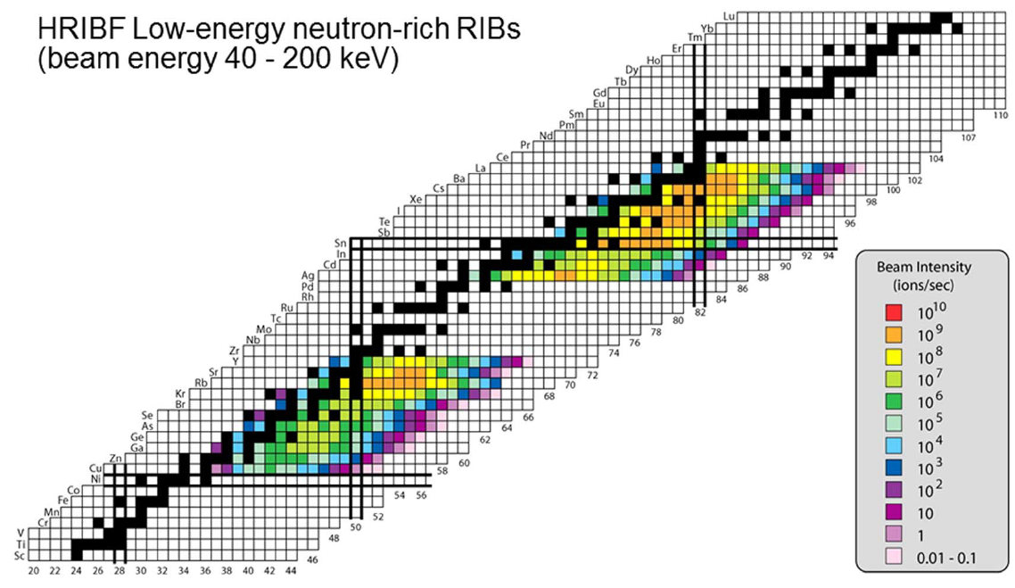
conclusions
requested developments :
laser ionized Zn (scheme already developed) Ge and Cd (scheme to be developed) with suppression of surface ionized Ga and In
more complicated : negative Br (1-) ions ; molecular As ions ?
surface ionized but we don’t care
surface ionized
→ structure nearby and above the neutron separation threshold
→ E0 strength measurement and the investigation of shape coexistence
surface ionized but we don’t care
surface ionized
fission fragments are badly needed at GANIL
it would be fantastic to have them available for DESIR
it is the necessary condition to pursue this program there

Slide 16
Table of content
General feedback to SCIPAC – 3 slides Enrique & Mickaël
Physics interests
DESIR and SPIRAL 1 beams: slides B. Blank
ALTO: slide D. Verney
Developments of beams – slides P. Chauveau and P. Jardin as examples
Open questions
Laser ionisation at SPIRAL 1
Batch mode at SPIRAL 1
MNT at ALTO and SPIRAL 1

Slide 17
HRS estimates (mass measurement)
P. Chauveau: on the necessity of a laser ion source at SPIRAL 1
Requirements
I > 0.1pps
Cont/IOI <10%
Comments
Most isotopes are very exotic, feasibility to be studied (N,O,F,P isotopes)
^{46,47}Cl and ^{49,50}Ar probably not feasible (in-target production in pps)
Isotopes in the N=Z=50 region are all laser-ionizable and heavily contaminated before the HRS
Contamination rates after HRS should be 0 but very model dependant

Slide 18
Example of R&D discussed
P. Jardin: TULIP development

Slide 19
Example of R&D discussed
P. Jardin: TULIP development

Slide 20
Table of content
General feedback to SCIPAC – 3 slides Enrique & Mickaël
Physics interests
DESIR and SPIRAL 1 beams: slides B. Blank
ALTO: slide D. Verney
Developments of beams – slides P. Chauveau and P. Jardin as examples
Open questions
Laser ionisation at SPIRAL 1
Batch mode at SPIRAL 1
MNT at ALTO and SPIRAL 1

Slide 21
Laser ionisation and batch mode at SPIRAL1
Laser ionization – discussion with expert from ISOLDE C. Chrysalidis
DESIR purification scheme with HRS and PIPERADE makes the case rather weak…
But experience shows that it is not unusual to underestimate a contamination problem
At SPIRAL 1 solid state lasers would have to be used, as stressed by expert Implementation of barracks on top of CIME
neutron exposition and general mechanical stability to be assessed
Rough estimate resources : 2 M€, 2 engineers or 1 engineer + 1 technician
Planning: ? > 5 years from now
Batch mode – discussion with expert from FRIB A. Villari
Difficulties to implement immediately at SPIRAL 1
No identification mean like MR ToF MS for long half – lifes
Collaboration with radiochemists is to be set up
So far only radioactive gas like ⁸⁵Kr seems immediately feasible
A detailed feasibility study is to be made for each requested beam
FRIB and ISOLDE are ready to help

Slide 22
MNT at ALTO and SPIRAL1
At ALTO R&D with Nier Bernas source – talk Maher Cheikh Mhamed
At SPIRAL1 TULIP like TISS – preliminary study Iulian Stefan
And also:
Testing MNTs in D2, refurbishing of second cave of SPIRAL 1, fission fragments at SPIRAL1…

Slide 23
Thanks a lot for your attention
It was not an exhaustive summary
Please see web site for more information https://indico.in2p3.fr/event/34404/
Feedback is being organized
Many beams, some easy, some not, a priority list will be required
Welcoming questions

