Slide 1
Cosmic-ray astronomy at the highest energies
Ground- and space-based detection principles,
recent highlights and future projects
Jonathan Biteau – Journée SFP Astropart. & MM – 2025.03.20

Slide 2
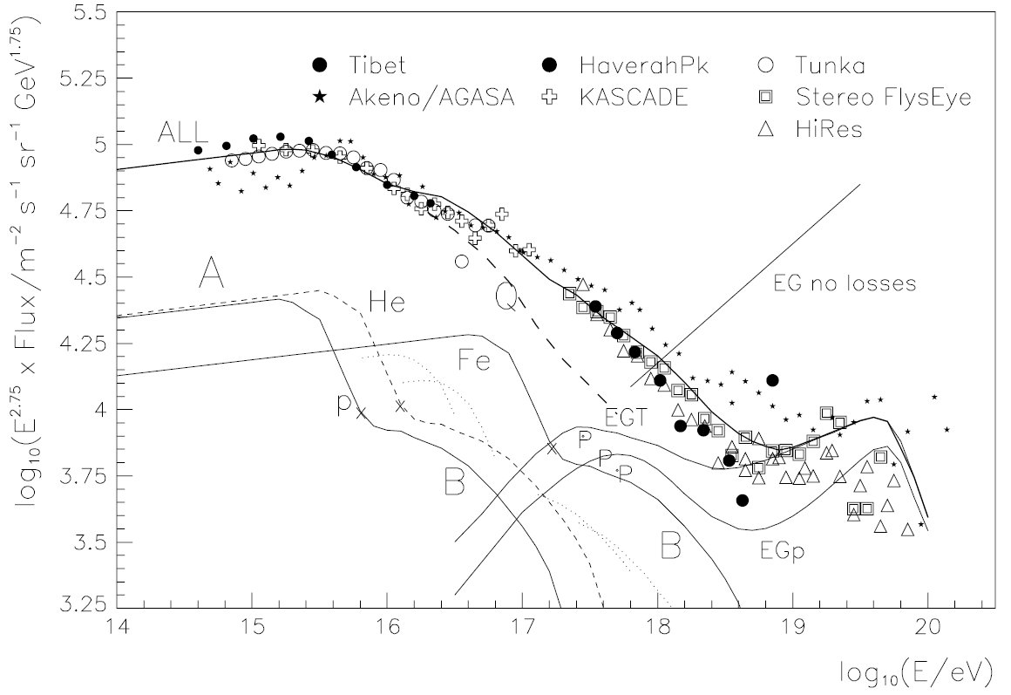
From Hillas, 20 years ago… pre Pierre Auger Observatory era
Component A
fully ionized H, He, … , Fe with a slope ɣ ~ 2.7 up to R_{A} ~ 3 PV
Component B
Something still has to be added to the ‘KASCADE’ component ‘A’
M. Hillas (2005)
Component C
H only ~ dip of Berezinsky+ ‘04
H and He (no heavier nuclei)
H, He, …, Fe ~ mix of Allard+ ‘06
Credit: Hillas, Topical Review in J. Phys. G: Nucl. Part. Phys. 31 (2005)
‹#›

Slide 3
From Hillas, 20 years ago… pre Pierre Auger Observatory era
Component A
fully ionized H, He, … , Fe with a slope ɣ ~ 2.7 up to R_{A} ~ 3 PV
Component B
Something still has to be added to the ‘KASCADE’ component ‘A’
M. Hillas (2005)
Component C
H only ~ dip of Berezinsky+ ‘04
H and He (no heavier nuclei)
H, He, …, Fe ~ mix of Allard+ ‘06
Credit: Hillas, Topical Review in J. Phys. G: Nucl. Part. Phys. 31 (2005)
‹#›

Slide 4
From Hillas, 20 years ago… pre Pierre Auger Observatory era
Component A
fully ionized H, He, … , Fe with a slope ɣ ~ 2.7 up to R_{A} ~ 3 PV
Component B
Something still has to be added to the ‘KASCADE’ component ‘A’
M. Hillas (2005)
Component C
H only ~ dip of Berezinsky+ ‘04
H and He (no heavier nuclei)
H, He, …, Fe ~ mix of Allard+ ‘06
O(10 evts km⁻² yr⁻¹)
Credit: Hillas, Topical Review in J. Phys. G: Nucl. Part. Phys. 31 (2005)
‹#›

Slide 5
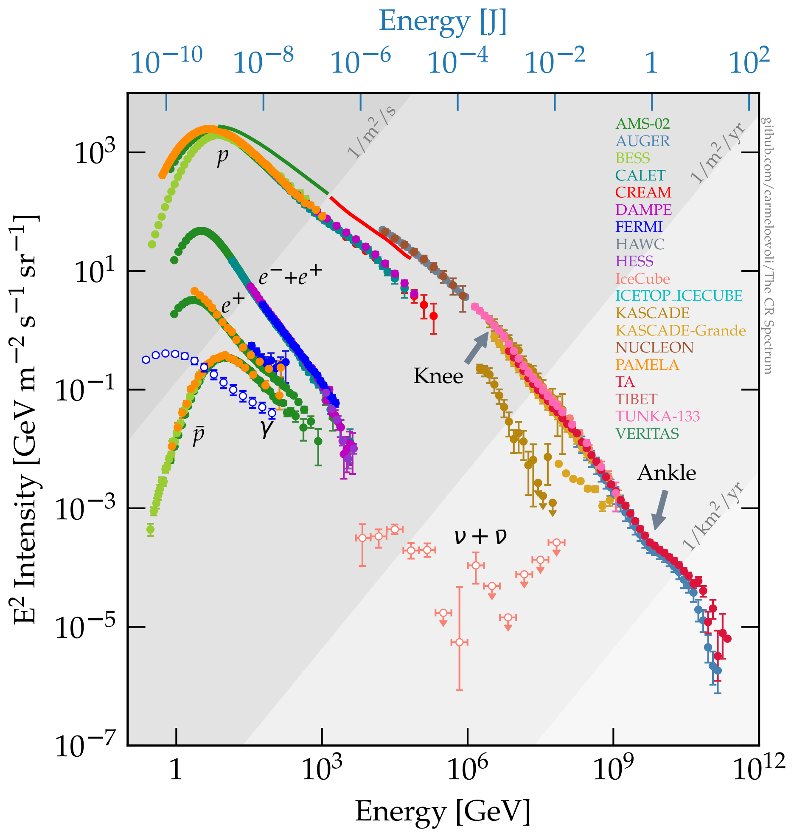
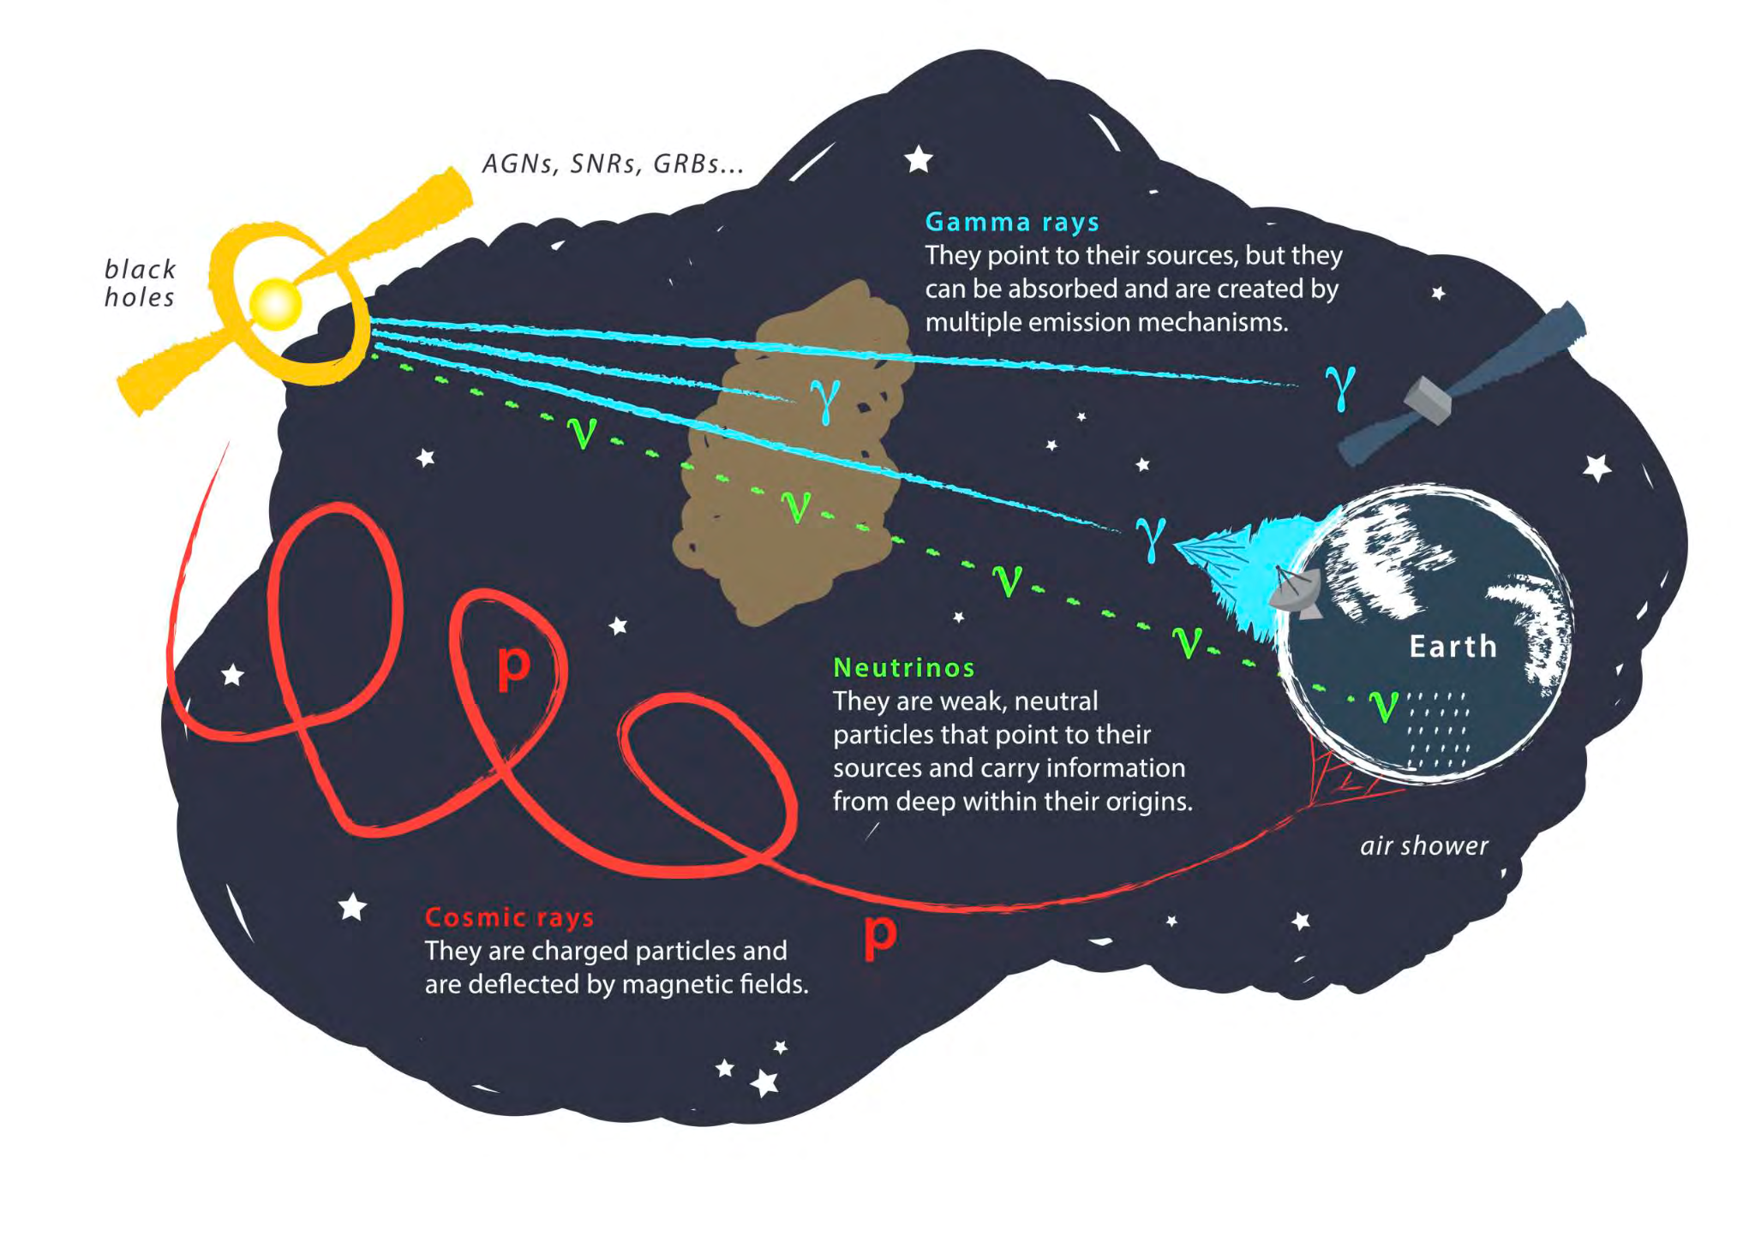
Today’s picture: all astroparticles
, nucleus
Credit: C. Evoli
Credit: M. Ahlers & F. Halzen
‹#›

Slide 6
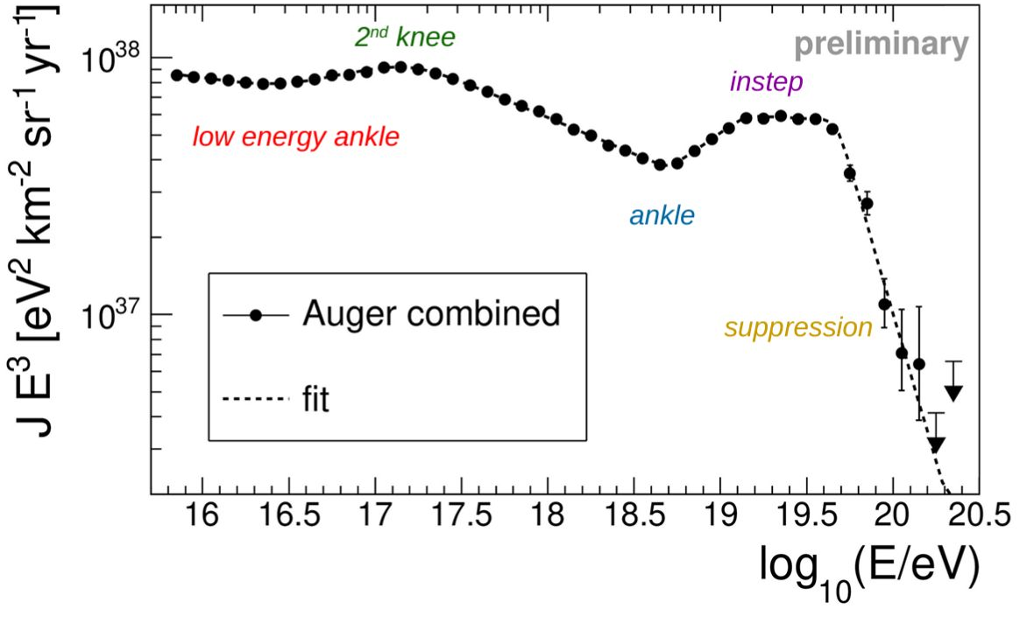
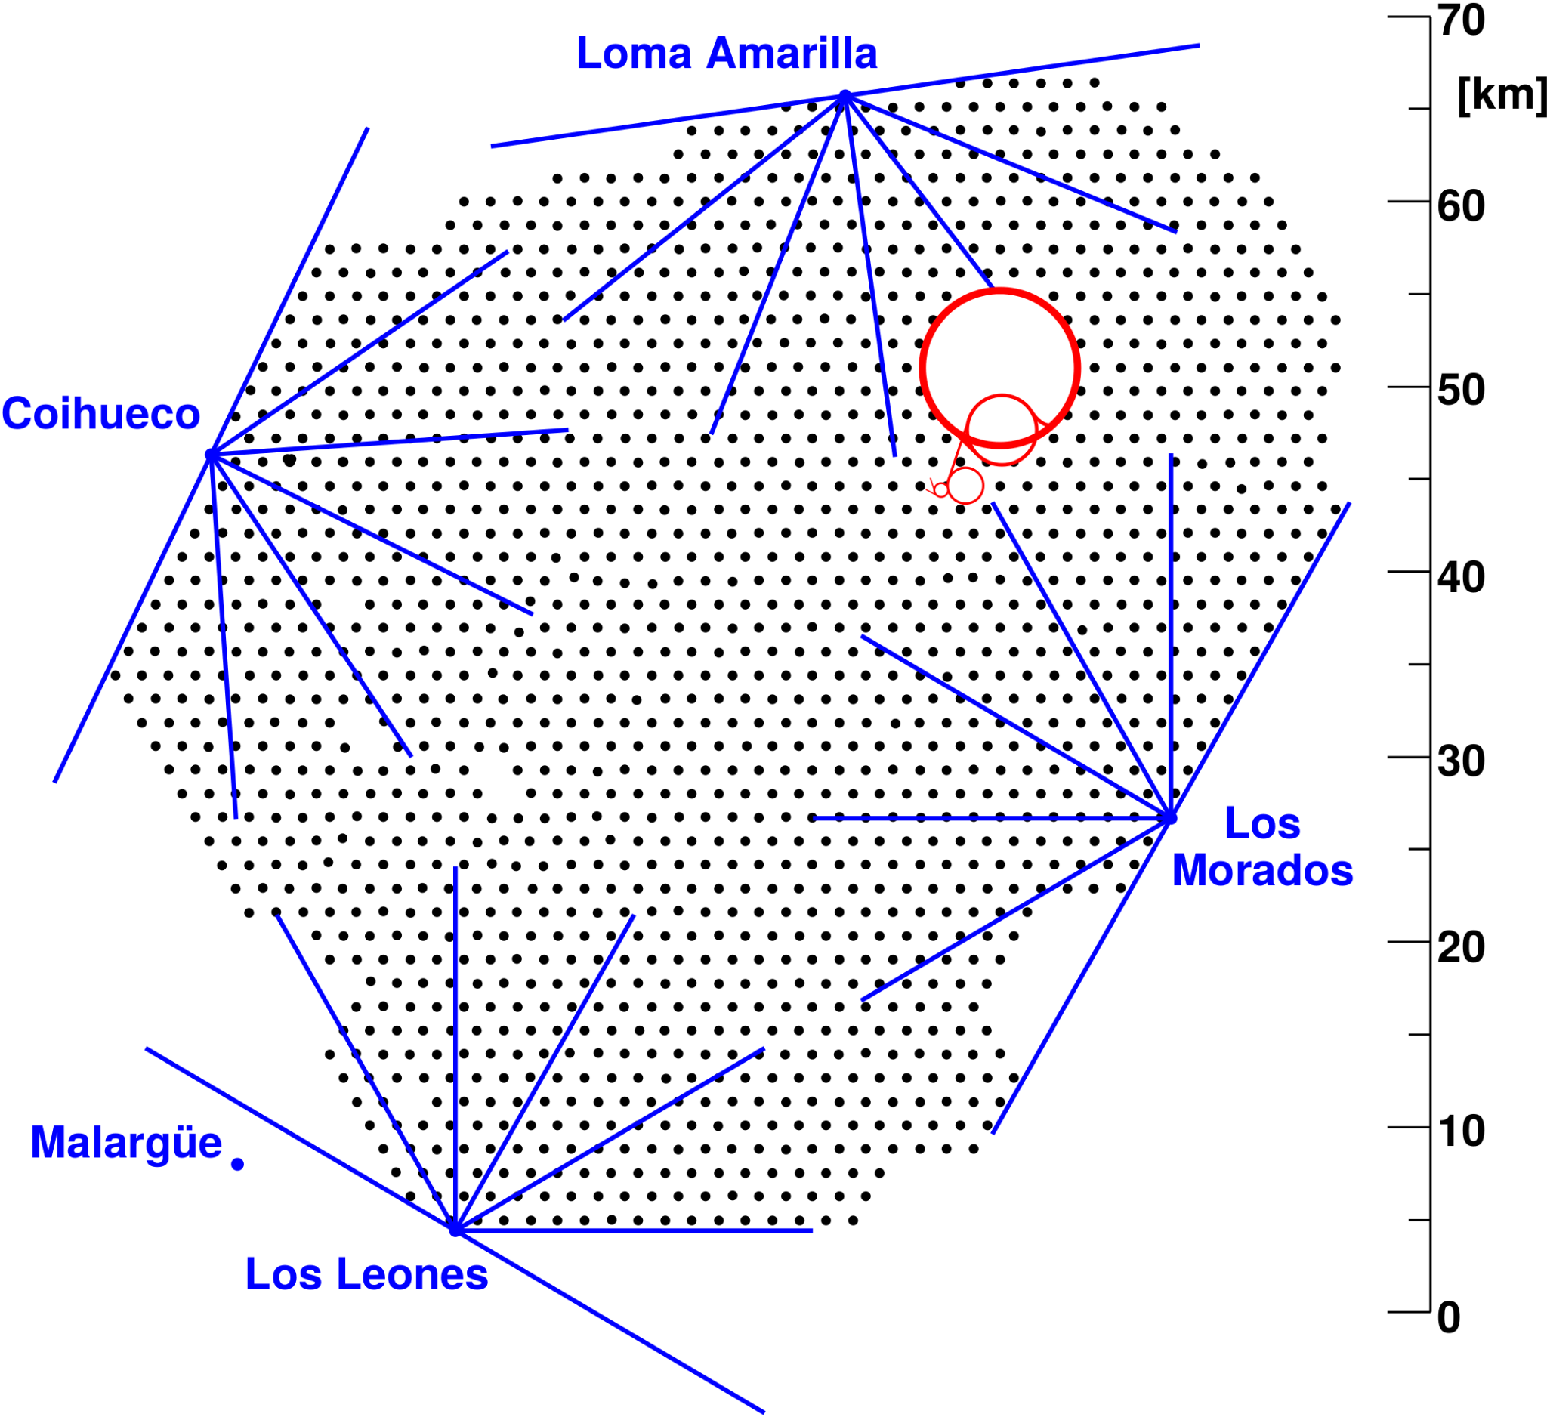
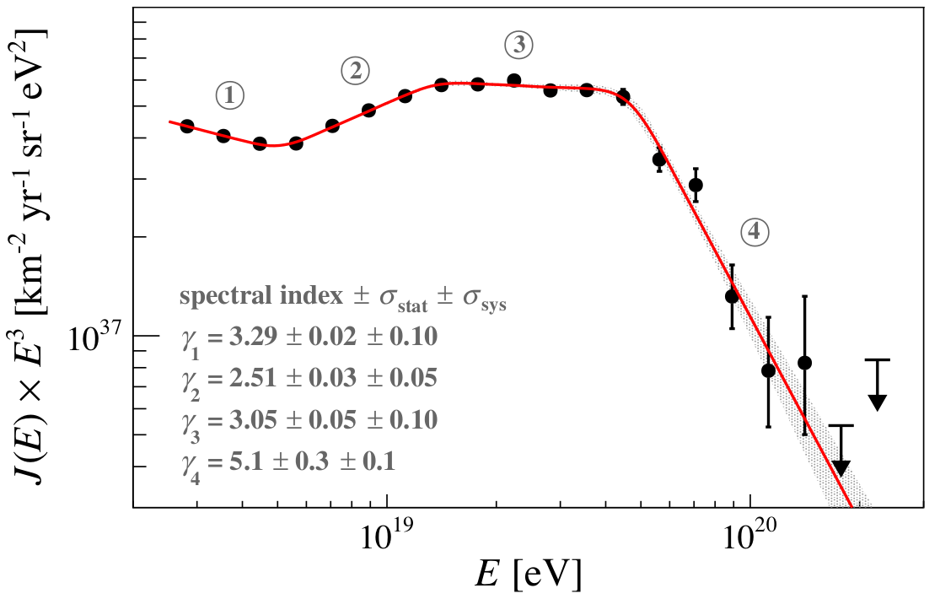
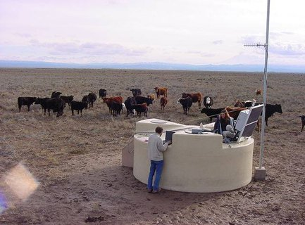
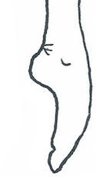
Today’s picture: cosmic rays at the highest E
Auger Coll; PRD ‘20, PRL ‘20,
EPJC ‘21, PoS(ICRC2023) by Brichetto
Credit: J. Cham
& D. Whiteson
Ankle
~5 EeV
Instep
~10 EeV
Toe
~40 EeV
30% precision
5% precision
1% precision
Auger, PRL (2020)
‹#›

Slide 7
I. Spectrum & nuclear composition
How to measure them, where do we stand, why does it matter
II. Anisotropy searches at the highest E
Why do we try, what do we see, the sources within reach?
III. The extragalactic cosmic-ray background
Next observational and phenomenological frontiers

Slide 8
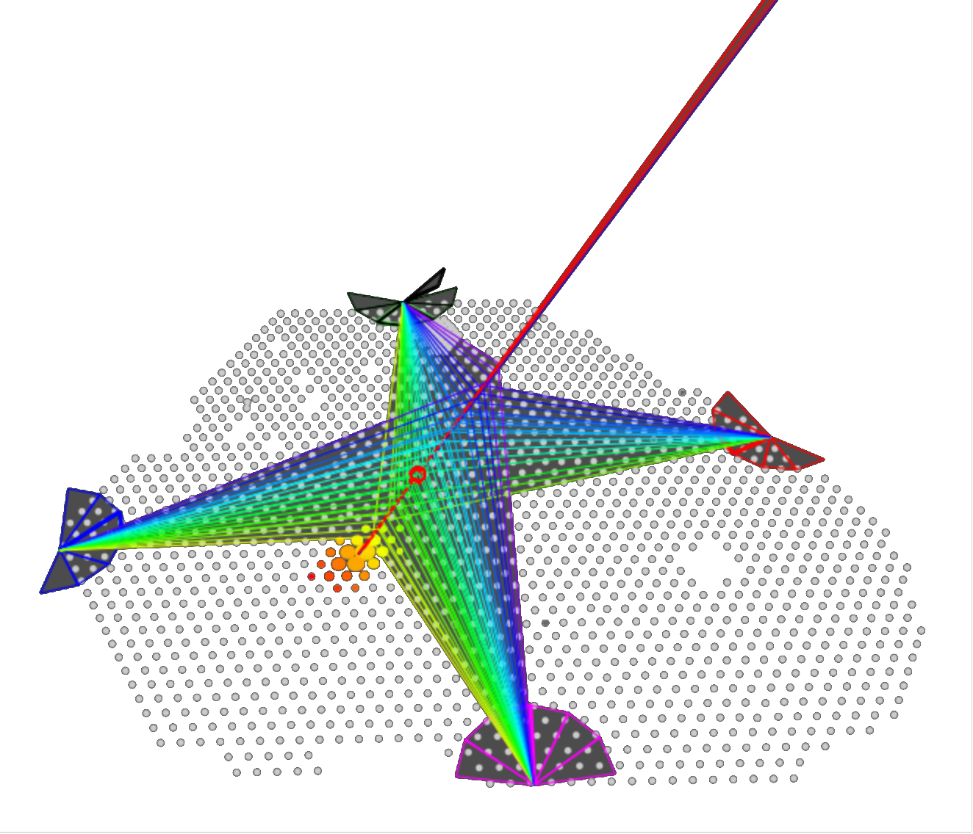
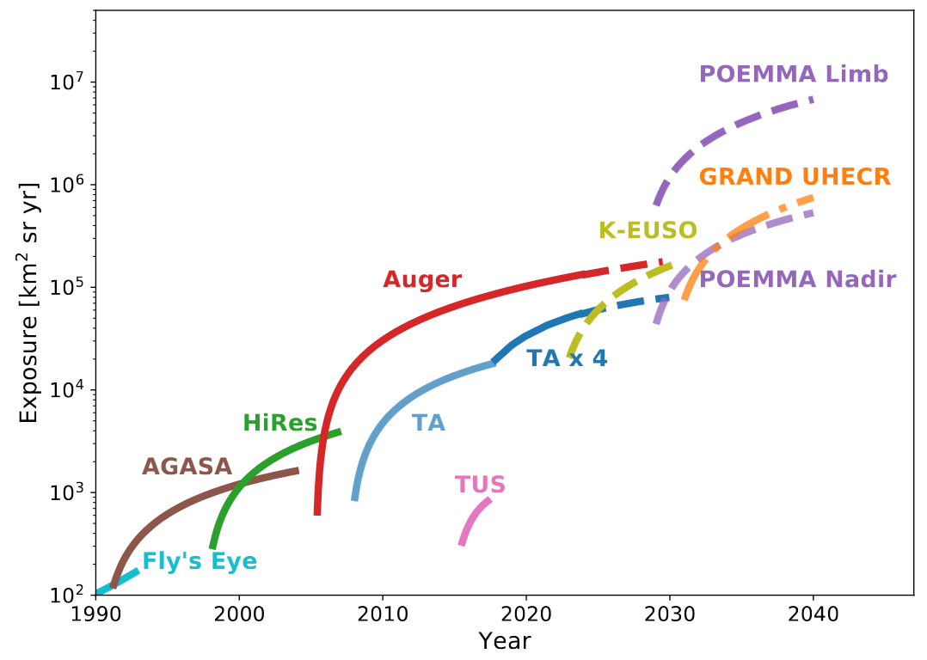
Detection principles
Shower particle sampling: water Cherenkov (Č) or plastic scintillator
Luminescence (calorimetric): fluorescence (isotropic) rather than Č
Radio emission: ~100 MHz pulse driven by geomagnetic effect
→ key quantity: Exposure = A_{eff} × Ω × T
Auger Phase 1 (2004-2021) ~80,000 km² yr sr, i.e. ~150k at E > 5 EeV
Example
Particle sampling and fluorescence
measurement for the highest E
hybrid event seen at the
Pierre Auger Observatory
Pierre Auger Observatory
→ 40-70 × AGASA, HiRES
→ 8 × Telescope Array (TA)
Alves Batista+ Front.Astron.Space ‘19
Auger Coll., ApJS 2023
‹#›

Slide 9
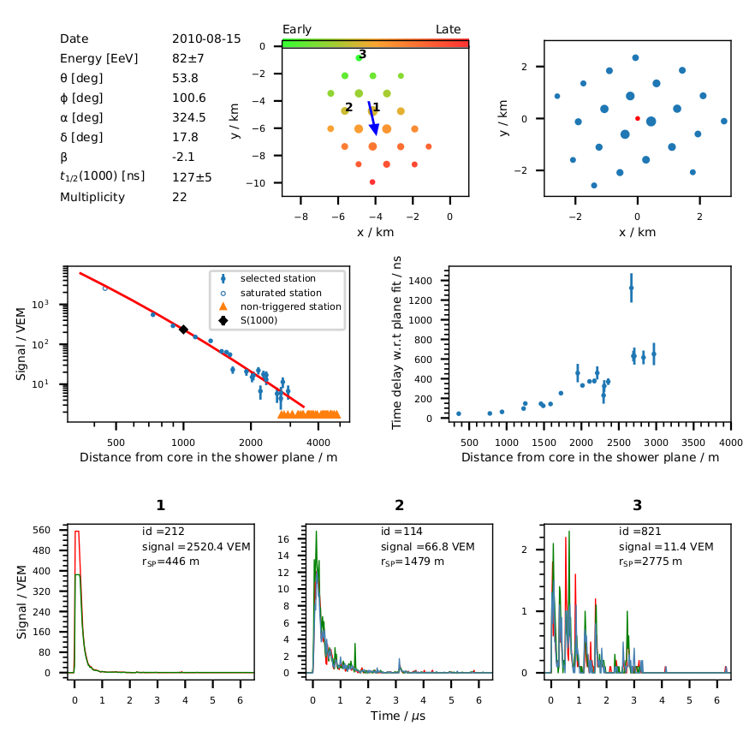
Event reconstruction: surface detector (SD)
Above the ankle:
ΔE/E < 15%
Δθ ~ 1°
Auger Coll., ApJS 2023
‹#›

Slide 10
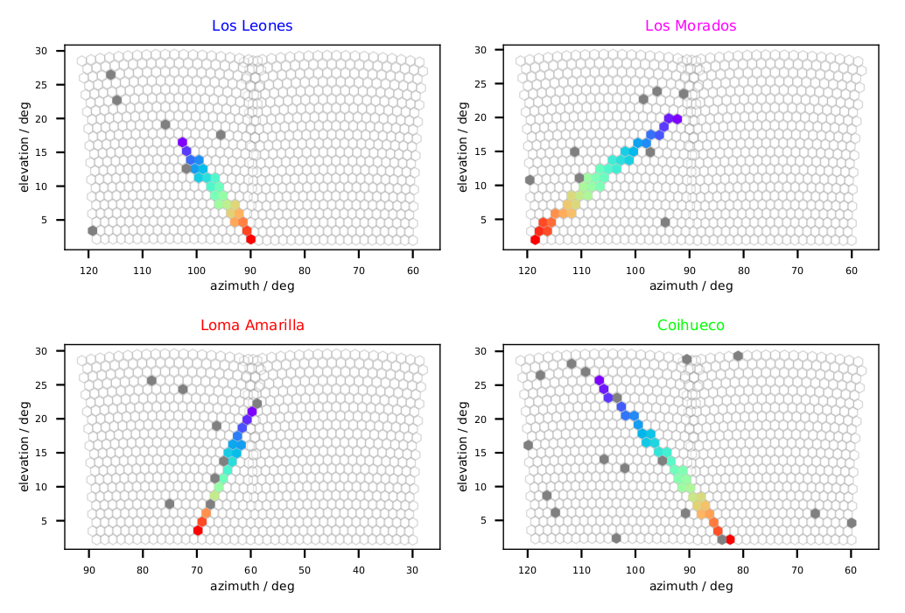
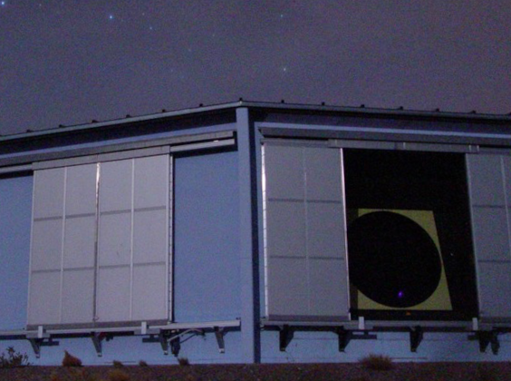
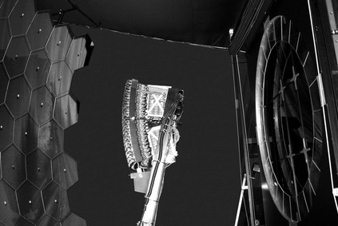
Event reconstruction: fluorescence detector (FD)
Auger Coll., ApJS 2023
‹#›

Slide 11
Cosmic-ray spectrum at the highest energies
Energy estimation
at the Pierre Auger Observatory
Data-driven: cross-calibration of SD signal with FD calorimetry
Energy estimation
at the Telescope Array
Monte-Carlo based + data-driven correction
E_{max}(TA) = 244 ± 29 EeV ↔ E_{max}(SD) ≃ 150 ± 20 EeV
E_{max}(SD) = 166 ± 13 EeV
= 26.6 ± 2.1 J (!)
E_{max}(SD/FD) = 82 ± 7 EeV
Auger Coll., PRD/PRL ‘20
TA, Science (2023)
‹#›

Slide 12
Cosmic-ray spectrum at the highest energies
Energy estimation
at the Pierre Auger Observatory
Data-driven: cross-calibration of SD signal with FD calorimetry
Energy estimation
at the Telescope Array
Monte-Carlo based + data-driven correction
E_{max}(TA) = 244 ± 29 EeV ↔ E_{max}(SD) ≃ 150 ± 20 EeV
E_{max}(SD) = 166 ± 13 EeV
= 26.6 ± 2.1 J (!)
E_{max}(SD/FD) = 82 ± 7 EeV
Auger Coll., PRD/PRL ‘20
TA, Science (2023)
‹#›

Slide 13
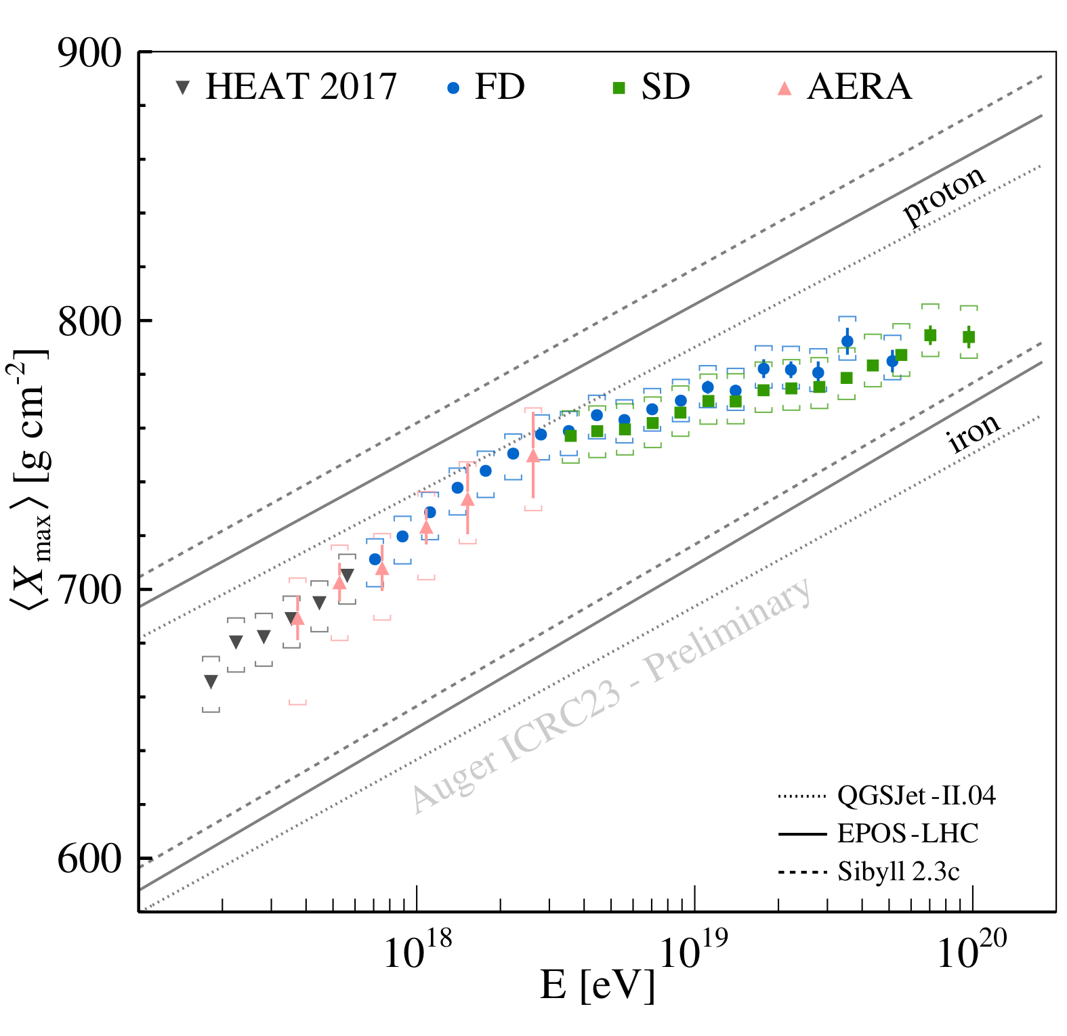
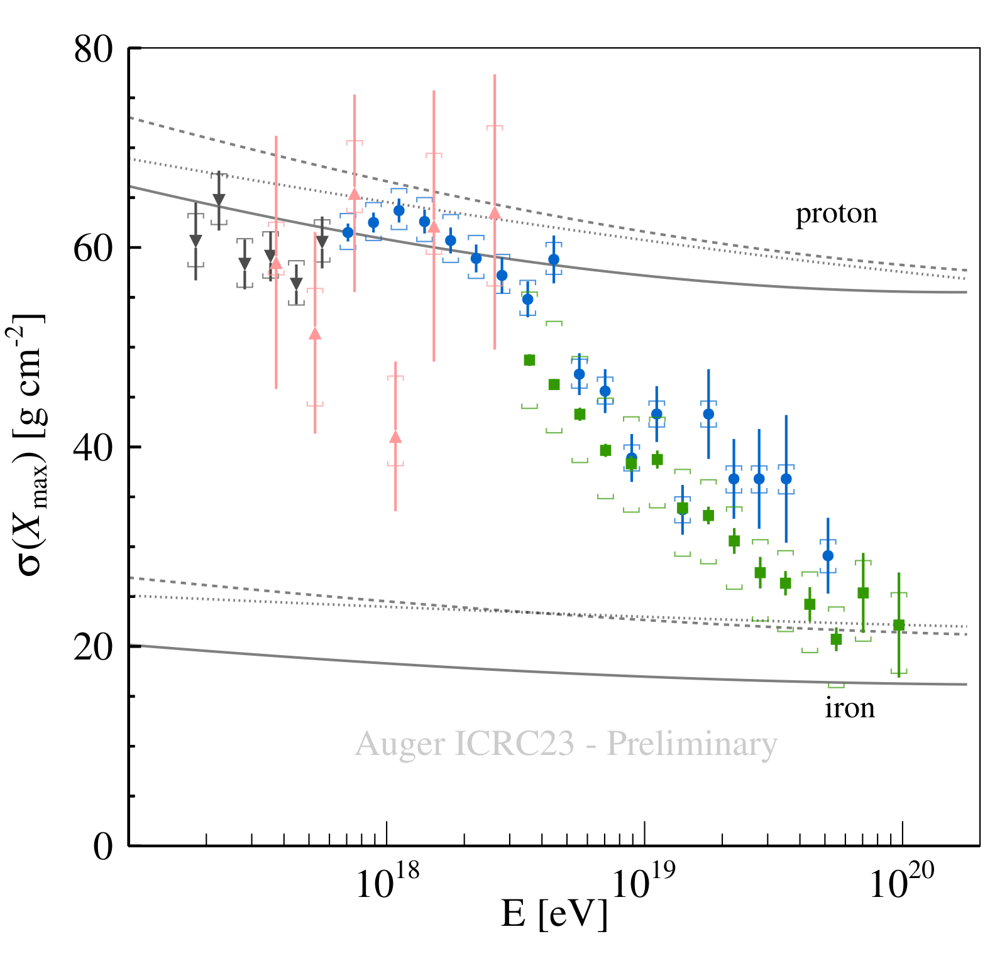
Shower slant depth: a proxy for
Independent measurements of X_{max} ∝ ln (E / A) at the Pierre Auger Observatory
High Elevation Auger Telescopes (low E) Auger Engineering Radio Array (Auger Coll., PRD/PRL ‘24)
Fluorescence Detector Surface Detector (DNN)
Auger Coll., PoS(ICRC23) by Salamida
‹#›

Slide 14
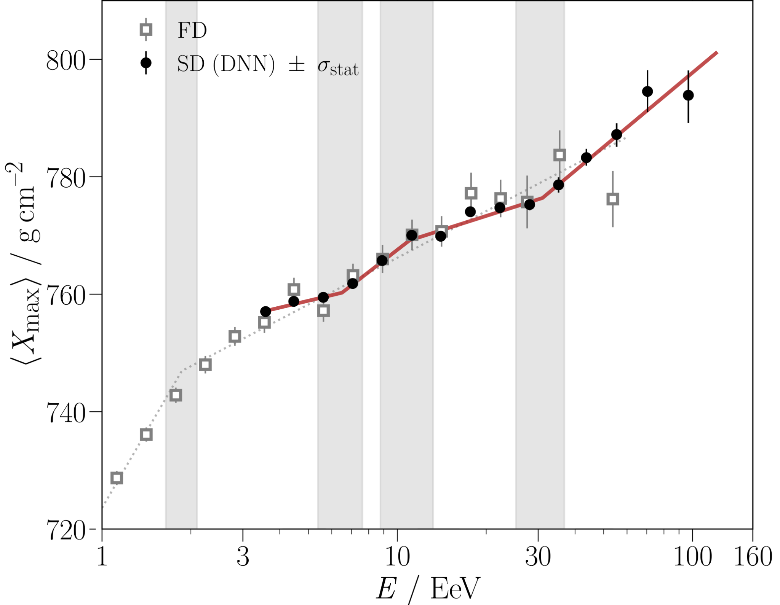
Shower slant depth: a proxy for
Independent measurements of X_{max} at the Pierre Auger Observatory
High Elevation Auger Telescopes (low E) Auger Engineering Radio Array
Fluorescence Detector Surface Detector (DNN)
Auger Coll., PRD/PRL ‘25
Auger Coll., PoS(ICRC23) by Salamida
‹#›

Slide 15
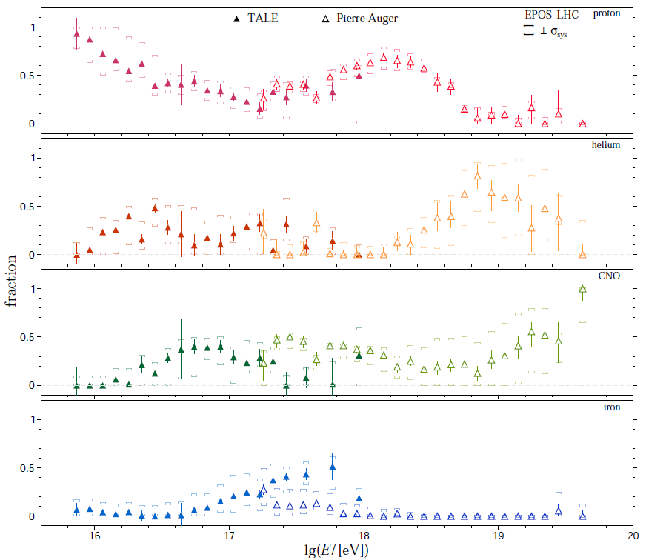
Today’s picture on
some H
little He
some CNO
little Fe
Credit: Coleman+,
Astropart. Phys. ‘22
‹#›

Slide 16
Today’s picture on
little H
some He
some CNO
little Fe
Credit: Coleman+,
Astropart. Phys. ‘22
‹#›

Slide 17
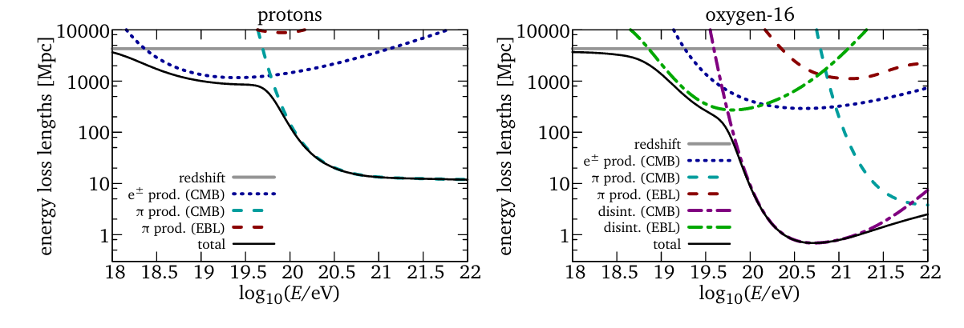
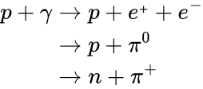
Composition impact on energy loss length
Credit: Aloisio ‘17
‹#›

Slide 18
Composition impact on energy loss length
Credit: Aloisio ‘17
MM channel: 𝜈 - CR
‹#›

Slide 19
I. Spectrum & nuclear composition
How to measure them, where do we stand, why does it matter
II. Anisotropy searches at the highest E
Why do we try, what do we see, the sources within reach?
III. The extragalactic cosmic-ray background
Next observational and phenomenological frontiers

Slide 20
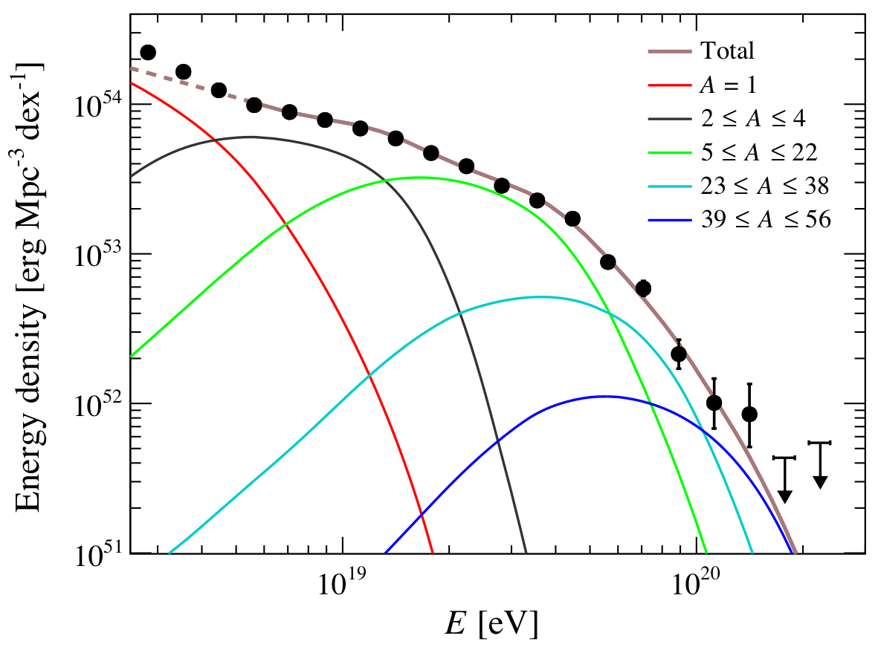
Combining observables to search for UHECR origins
ankle
instep
toe
Fit of synthetic model of source population
to spectrum and composition data
Spectral and composition observables integrated over the sphere
→ constrain energy injection rate & composition at escape from the sources
Ankle at > 5 EeV marks the transition to a purely extragalactic origin,
with the onset of He nuclei
Observed spectral features: instep at 10-15 EeV, toe at 40-50 EeV
→ markers of ~Peters cycle (acceleration up to E_{max}(Z) ~ Z × 5 EeV)
→ hard nuclear emission at sources (dN/dE ∝ E^{±1} vs E⁻², explained e.g. by escape
from magnetized region within the sources)
→ reservoir of heavy elements? Accelerated material with heavy nuclei,
that is little H and He with respect to the interstellar medium.
Anisotropy observables
→ break down the flux (and composition) vs arrival direction: pinpoint sources?
if cosmic magnetism does not prevent it!
Auger, PRD/PRL ‘20
Energy injection rate
Composition at the sources
vs
Luce, Marafico, JB+ ApJ ’22 & Marafico, JB+, ApJ ‘24
‹#›

Slide 21
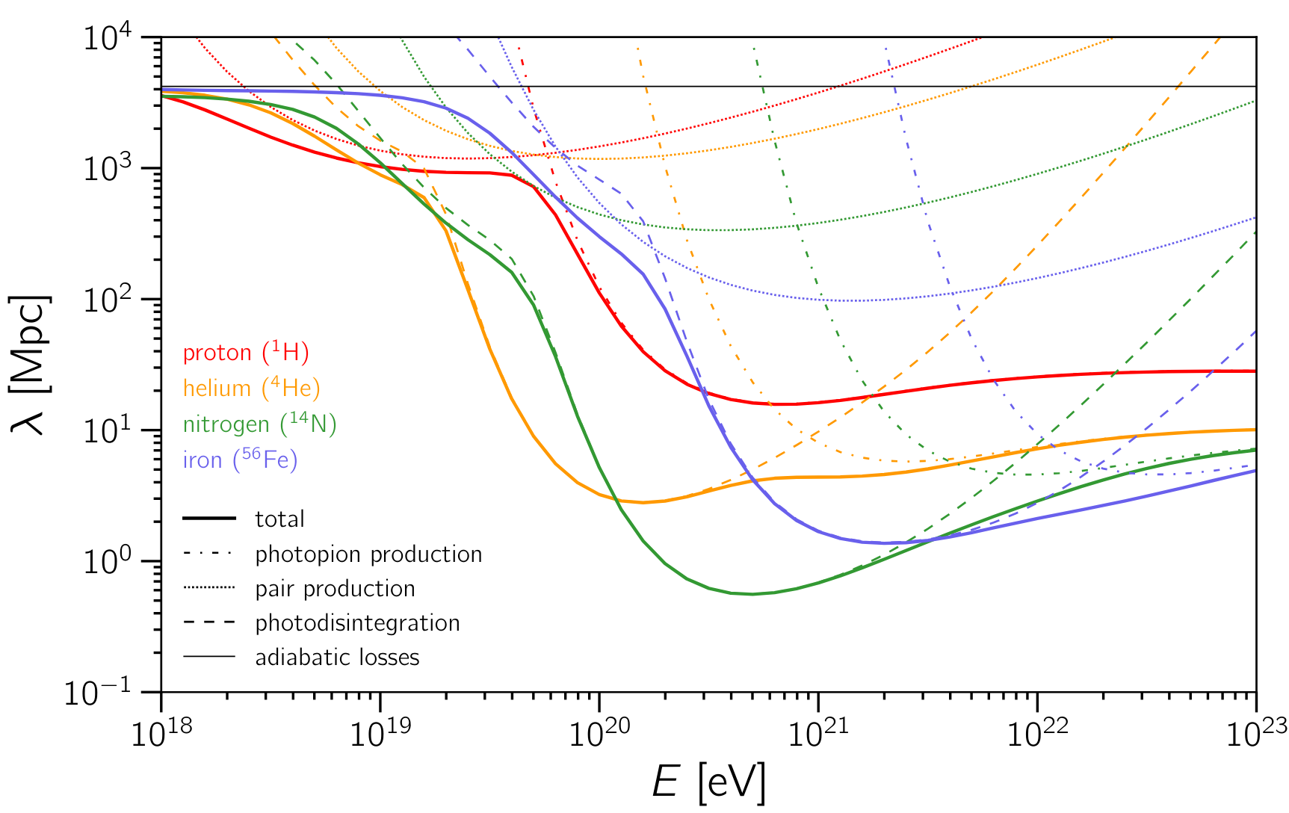
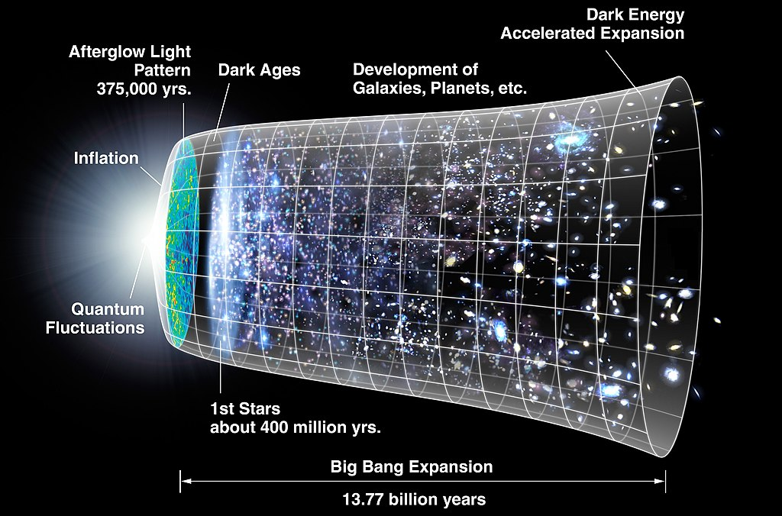
UHECR propagation on extragalactic scales
For nuclei:
Addazi+, PrPNP ‘22, see also Allard, JCAP ‘06
D_{L} ~ 1 Gpc
or z ~ 0.2
D_{L} ~ 1 Gpc
or D_{T} ~ 2.5 Gyr
‹#›

Slide 22
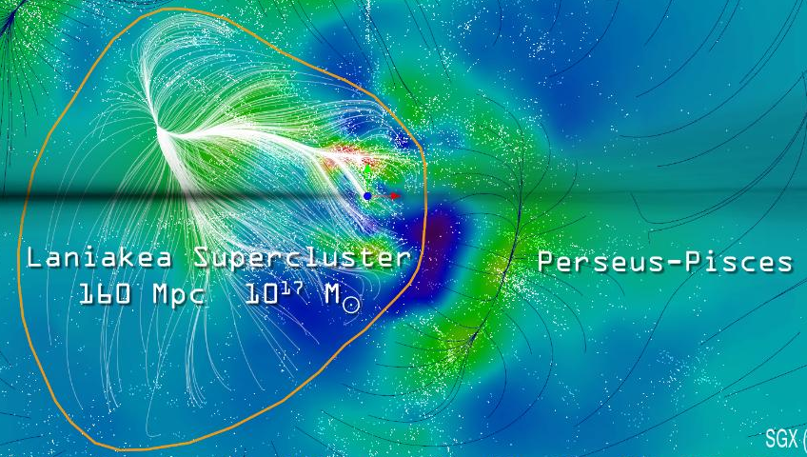
UHECR propagation on extragalactic scales
For nuclei:
Addazi+, PrPNP ‘22, see also Allard, JCAP ‘06
D_{L} ~ 150 Mpc
or z ~ 0.03
Credit: Tully+, Nature ‘14
‹#›

Slide 23
UHECR propagation on extragalactic scales
For nuclei:
Addazi+, PrPNP ‘22, see also Allard, JCAP ‘06
Credit: McCall+, MNRAS ‘14
D_{L} ~ 15 Mpc
‹#›

Slide 24
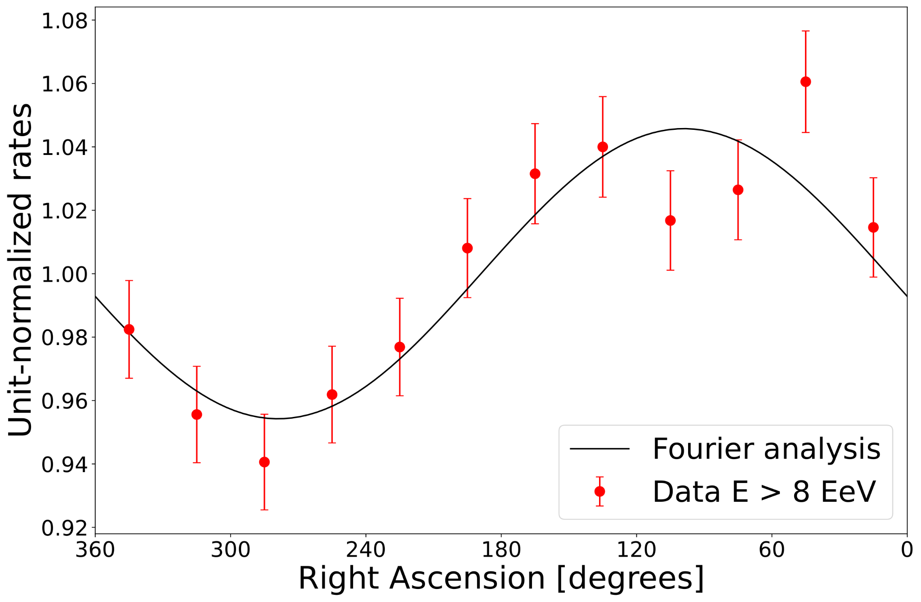
Arrival-direction modulation on large angular scales
Modulation of the event rate as a function of R.A.
or of the difference between events from East and West
Exposure of the array nearly uniform in right ascension
→ modulation = robust observable for the phase and amplitude
of the first spherical harmonic (equatorial component of the dipole)
Auger, ApJ ‘24
‹#›

Slide 25
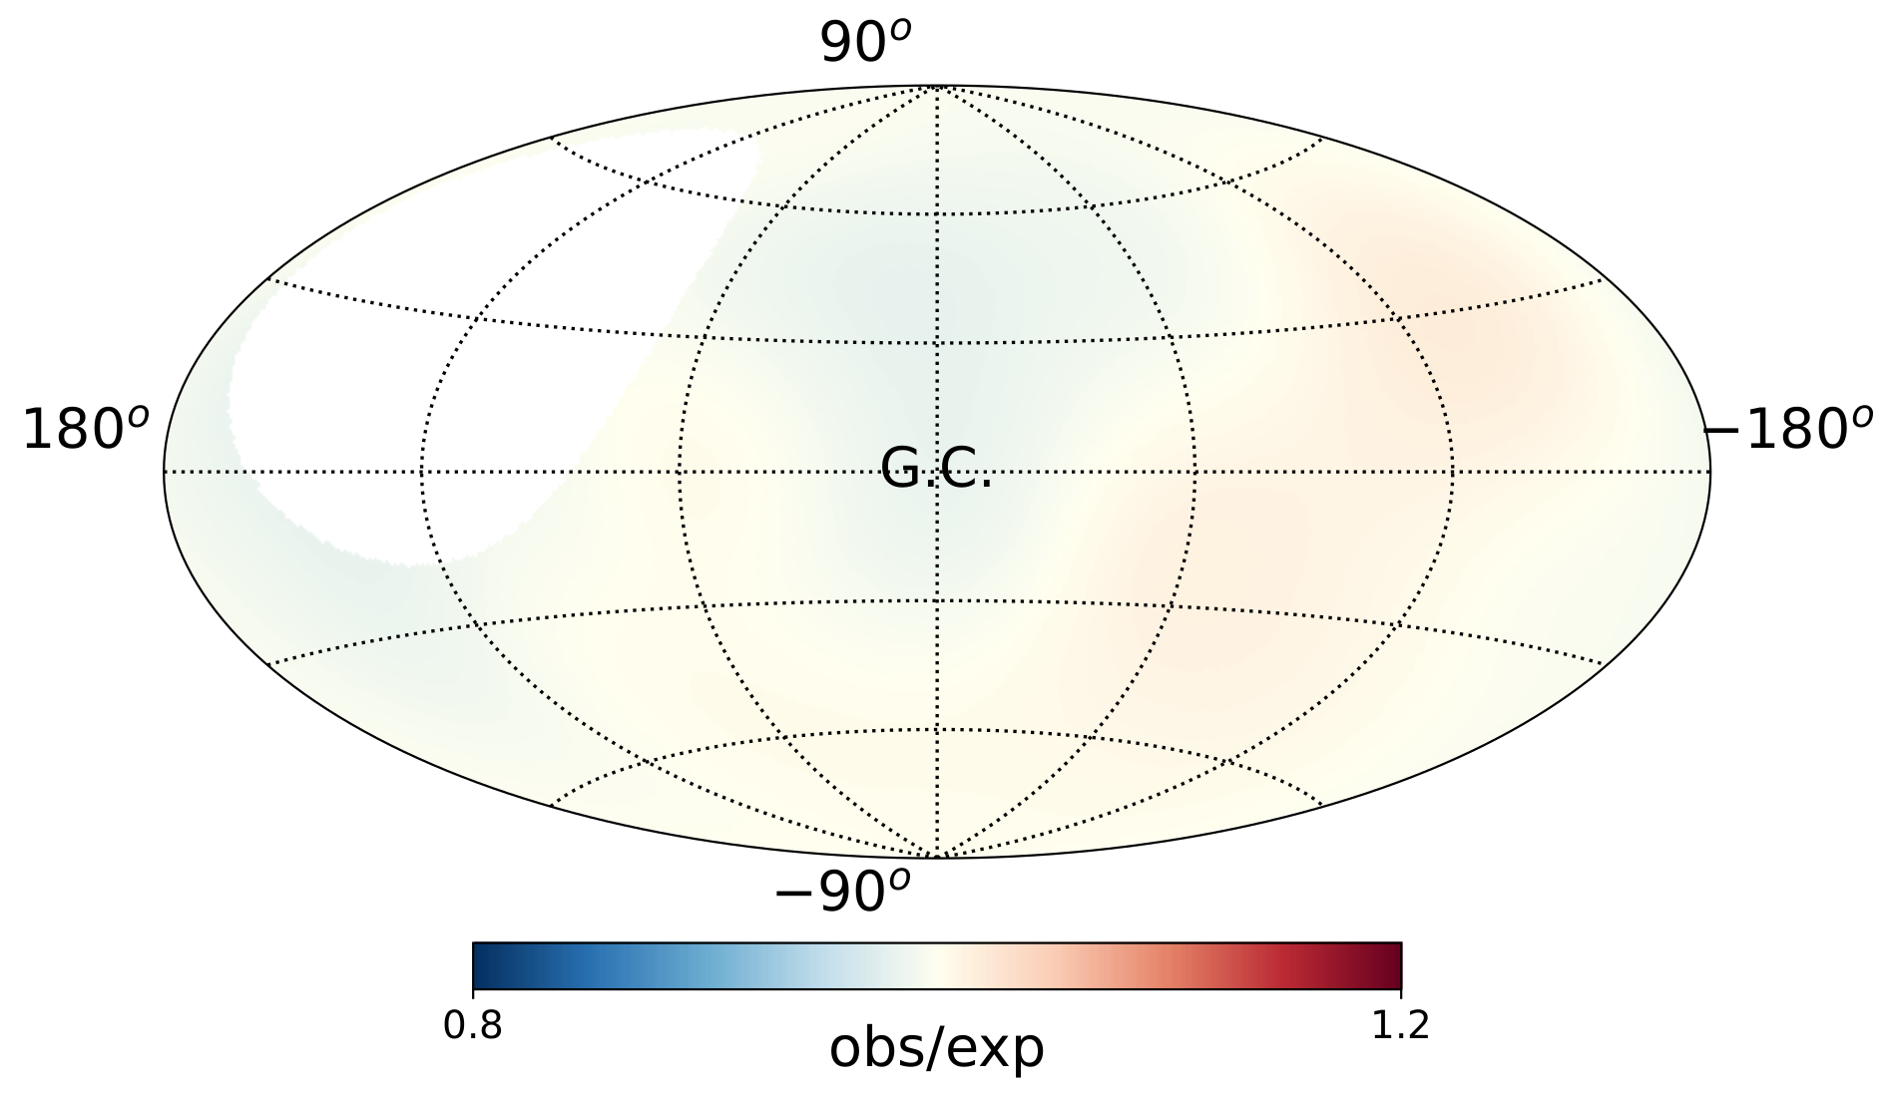
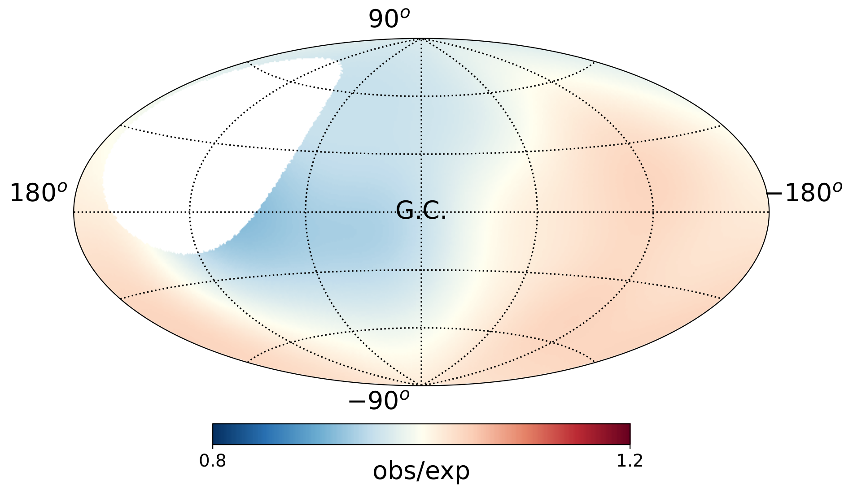
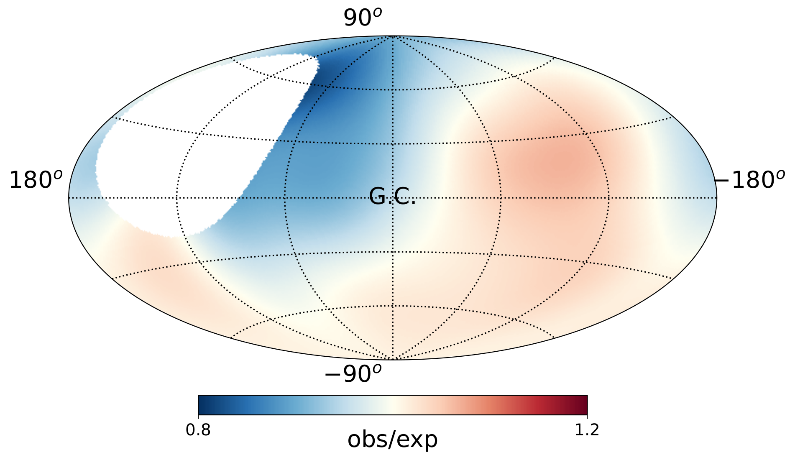
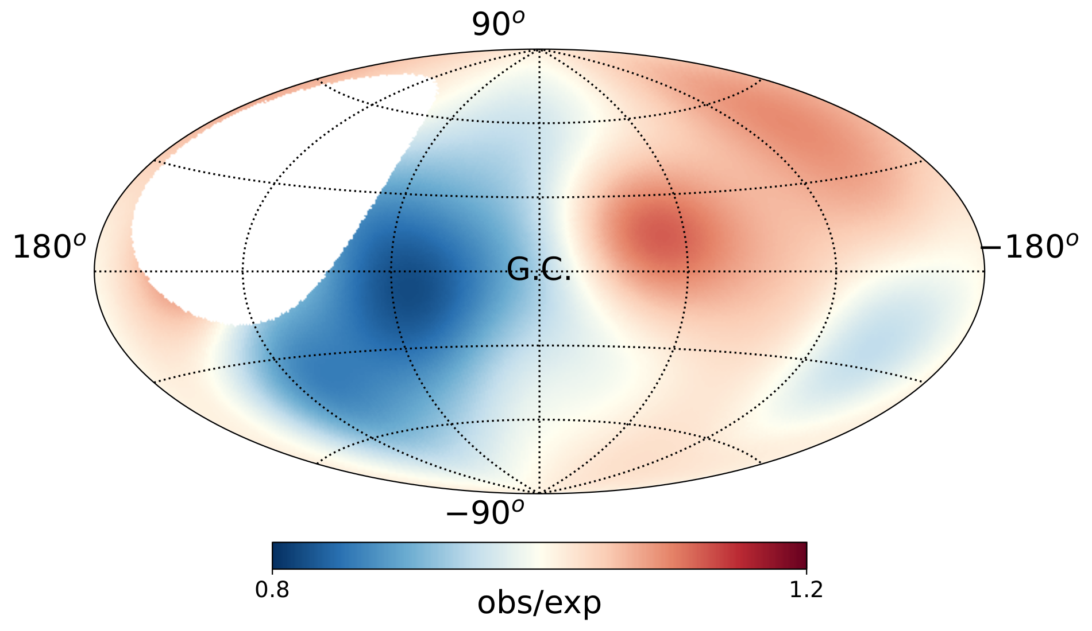
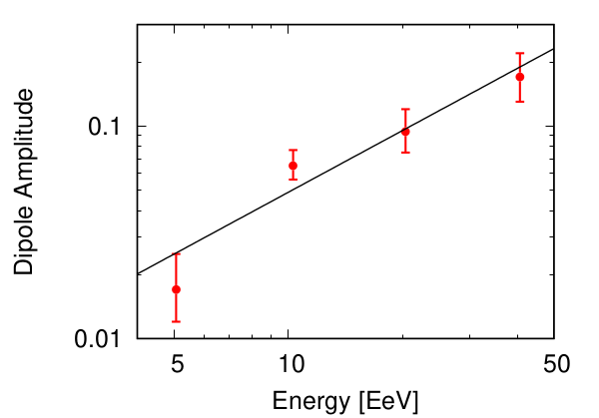
Observed arrival directions from the ankle to the toe
4-8 EeV
8-16 EeV
16-32 EeV
>32 EeV
observed / mean
observed / mean
observed / mean
observed / mean
Modulation in R.A. >8 EeV
significant at 6.8σ
well modeled by a dipole
~ 115° away from the Galactic center, in line with extragalactic distribution of luminous matter within
~100 Mpc
Auger Coll., ApJ ‘24/ ‘20 / ‘18, Science ‘17
‹#›

Slide 26
Observed arrival directions from the ankle to the toe
4-8 EeV
8-16 EeV
16-32 EeV
>32 EeV
observed / mean
observed / mean
observed / mean
observed / mean
observed / mean
Modulation in R.A. >8 EeV
significant at 6.8σ
well modeled by a dipole
~ 115° away from the Galactic center, in line with extragalactic distribution of luminous matter within
~100 Mpc
Auger Coll., ApJ ‘24/ ‘20 / ‘18, Science ‘17
‹#›

Slide 27
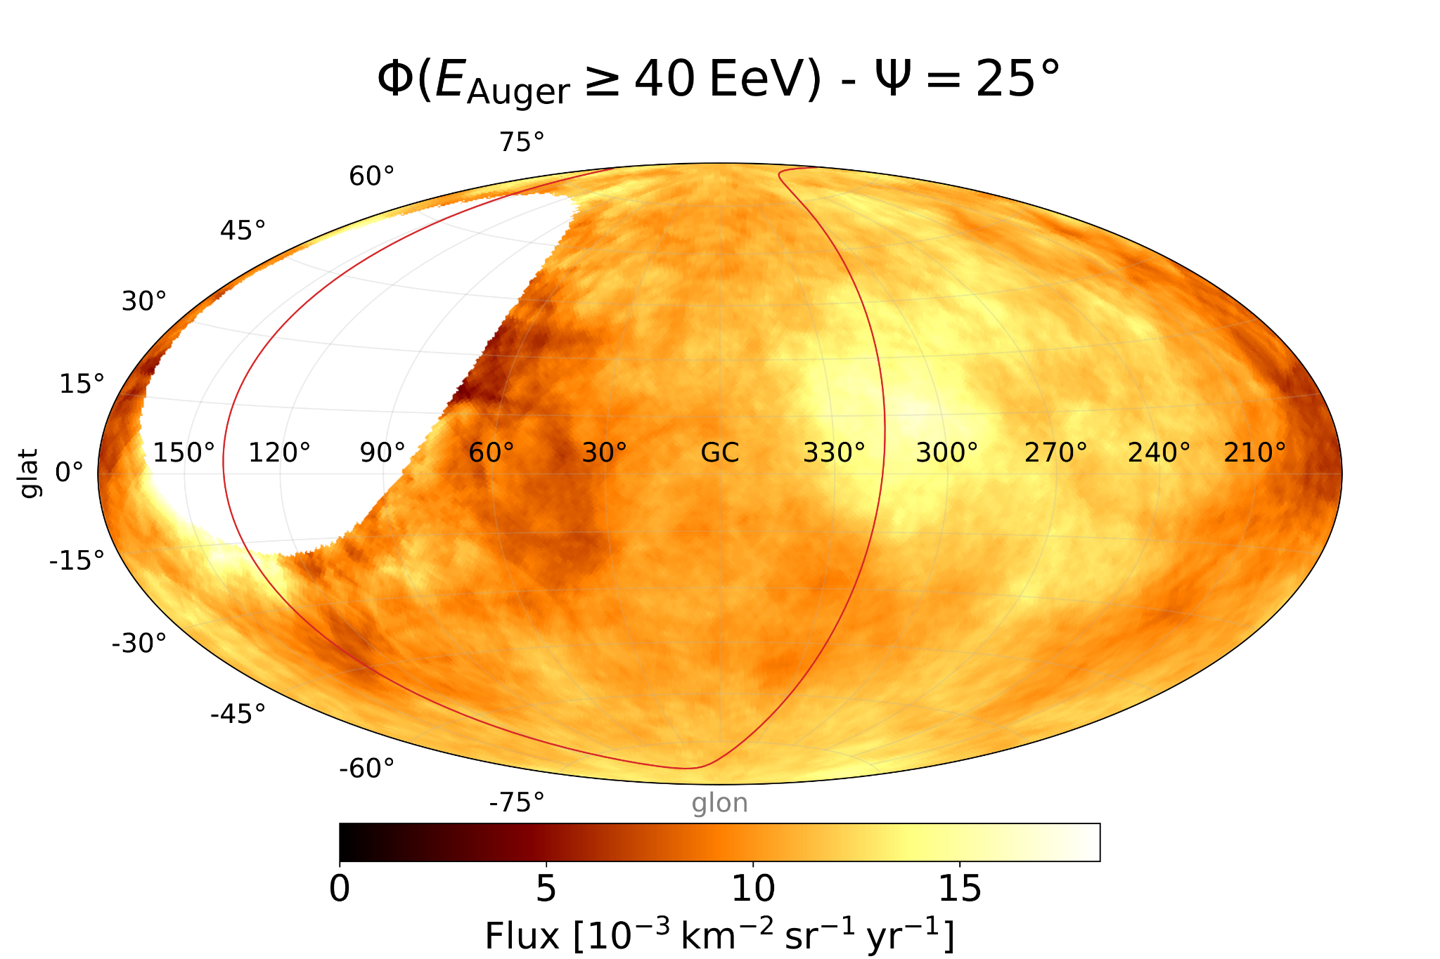
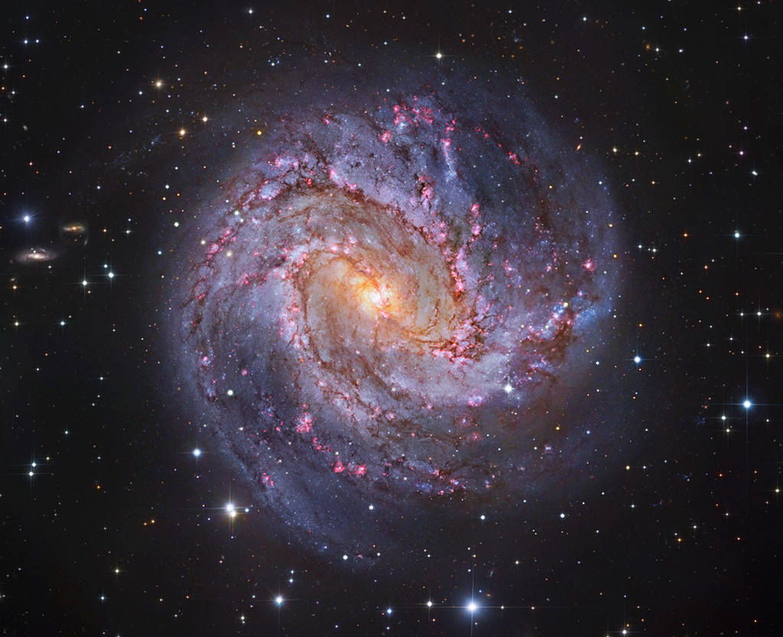
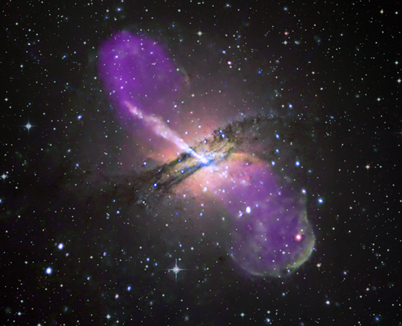
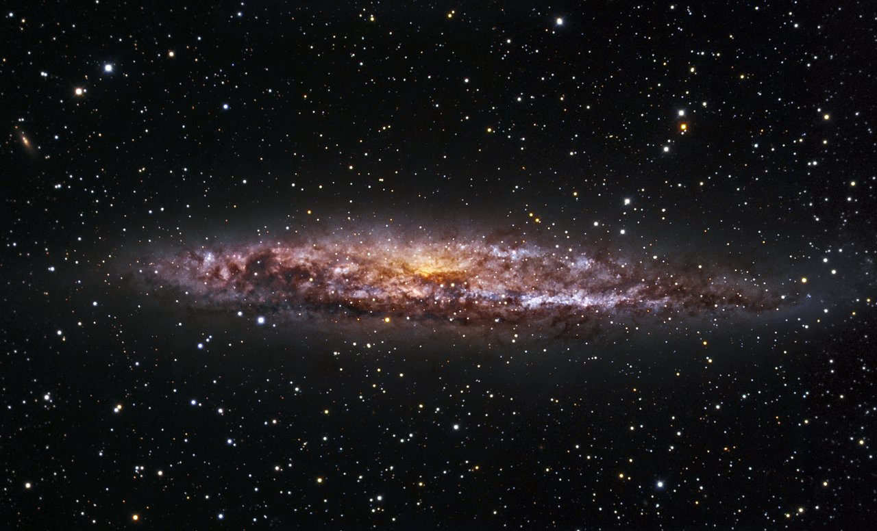
Status of anisotropies in the toe region
>32 EeV
> 10^19.5 eV
Arrival directions of events > 32 EeV up to Dec. 2020
~ 4σ excess in model-independent analysis (Centaurus region),
dataset publicly available at
observed / mean
Auger coll.,
ApJ ‘22
Credit: McCall+, MNRAS ‘14
Centaurus region
M83
Cen A
NGC 4945
Auger obs.
blind spot
‹#›

Slide 28
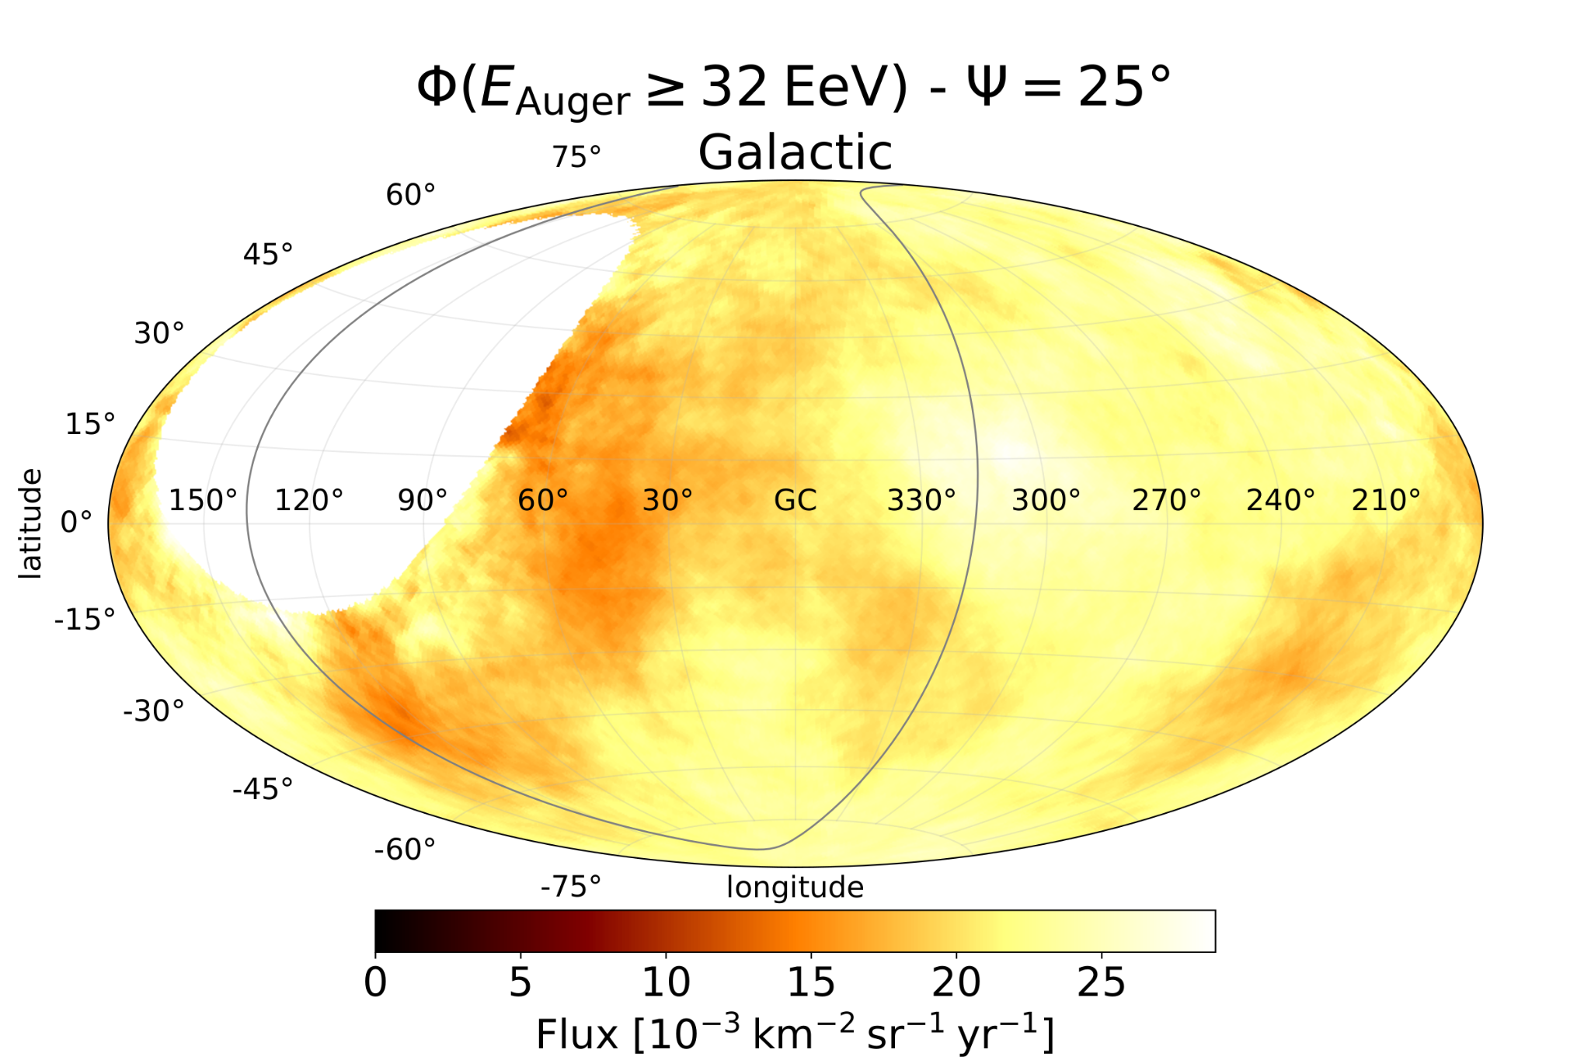
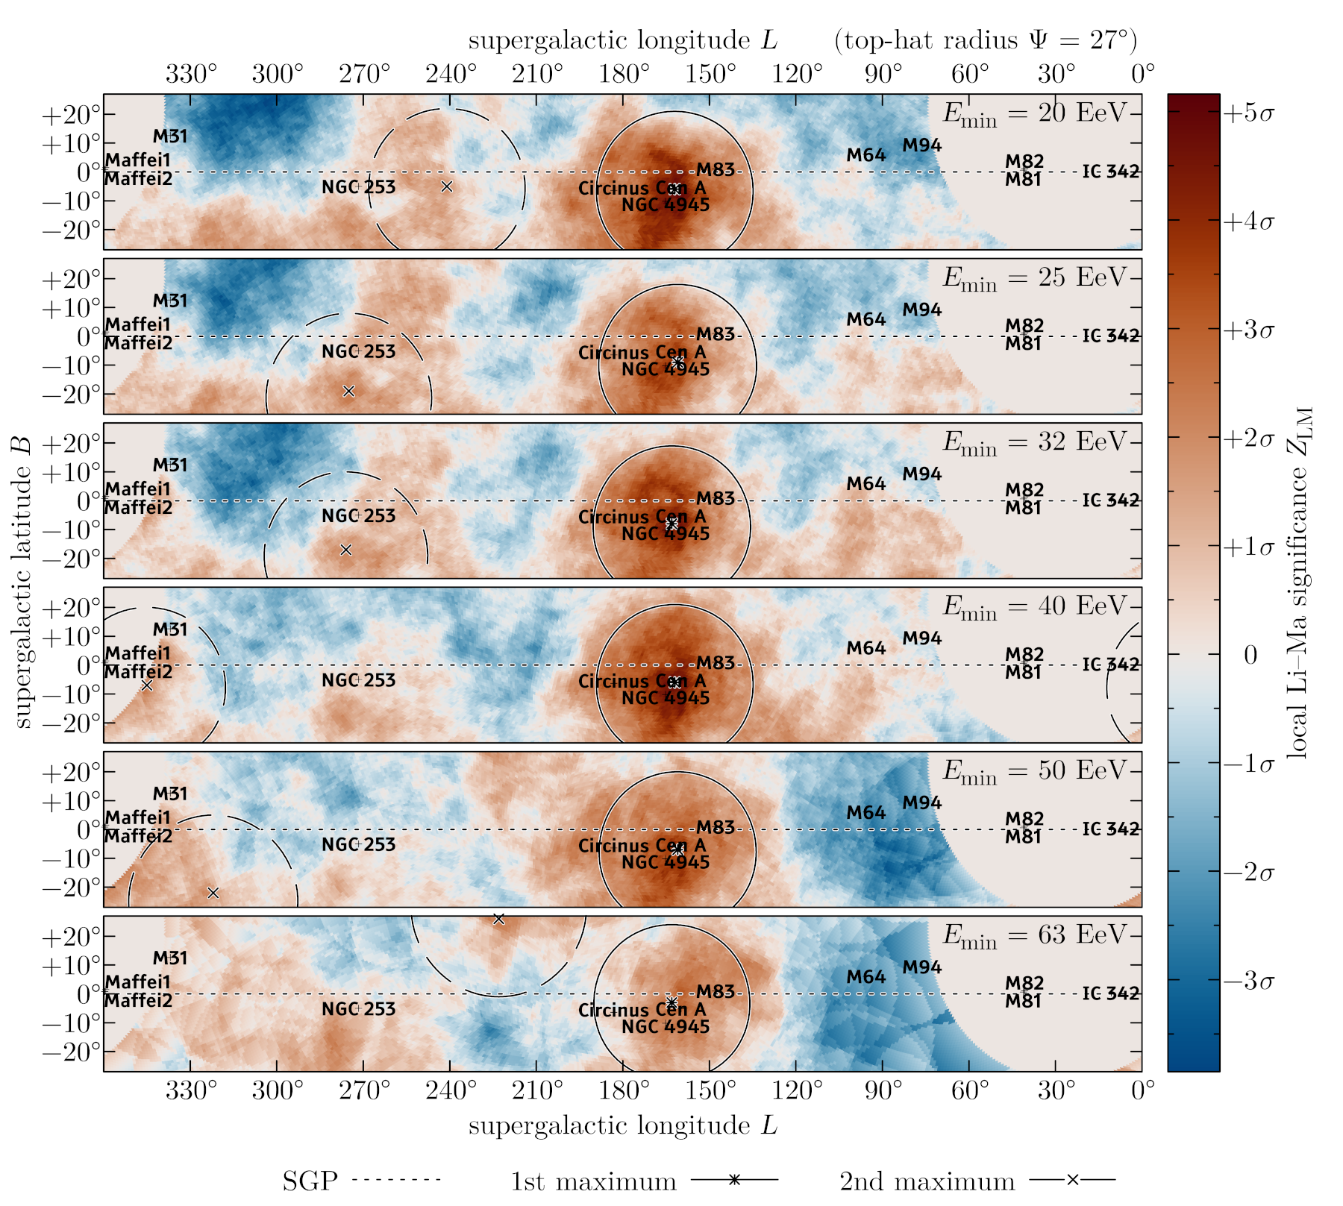
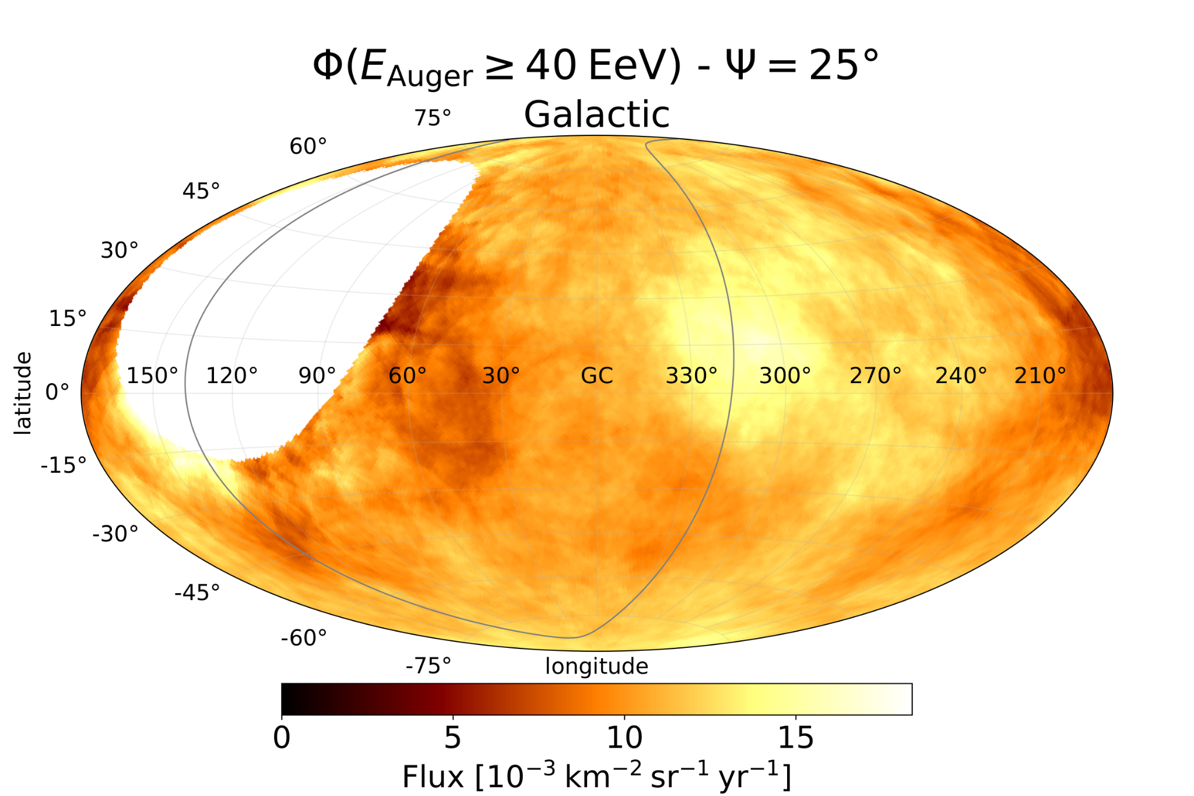
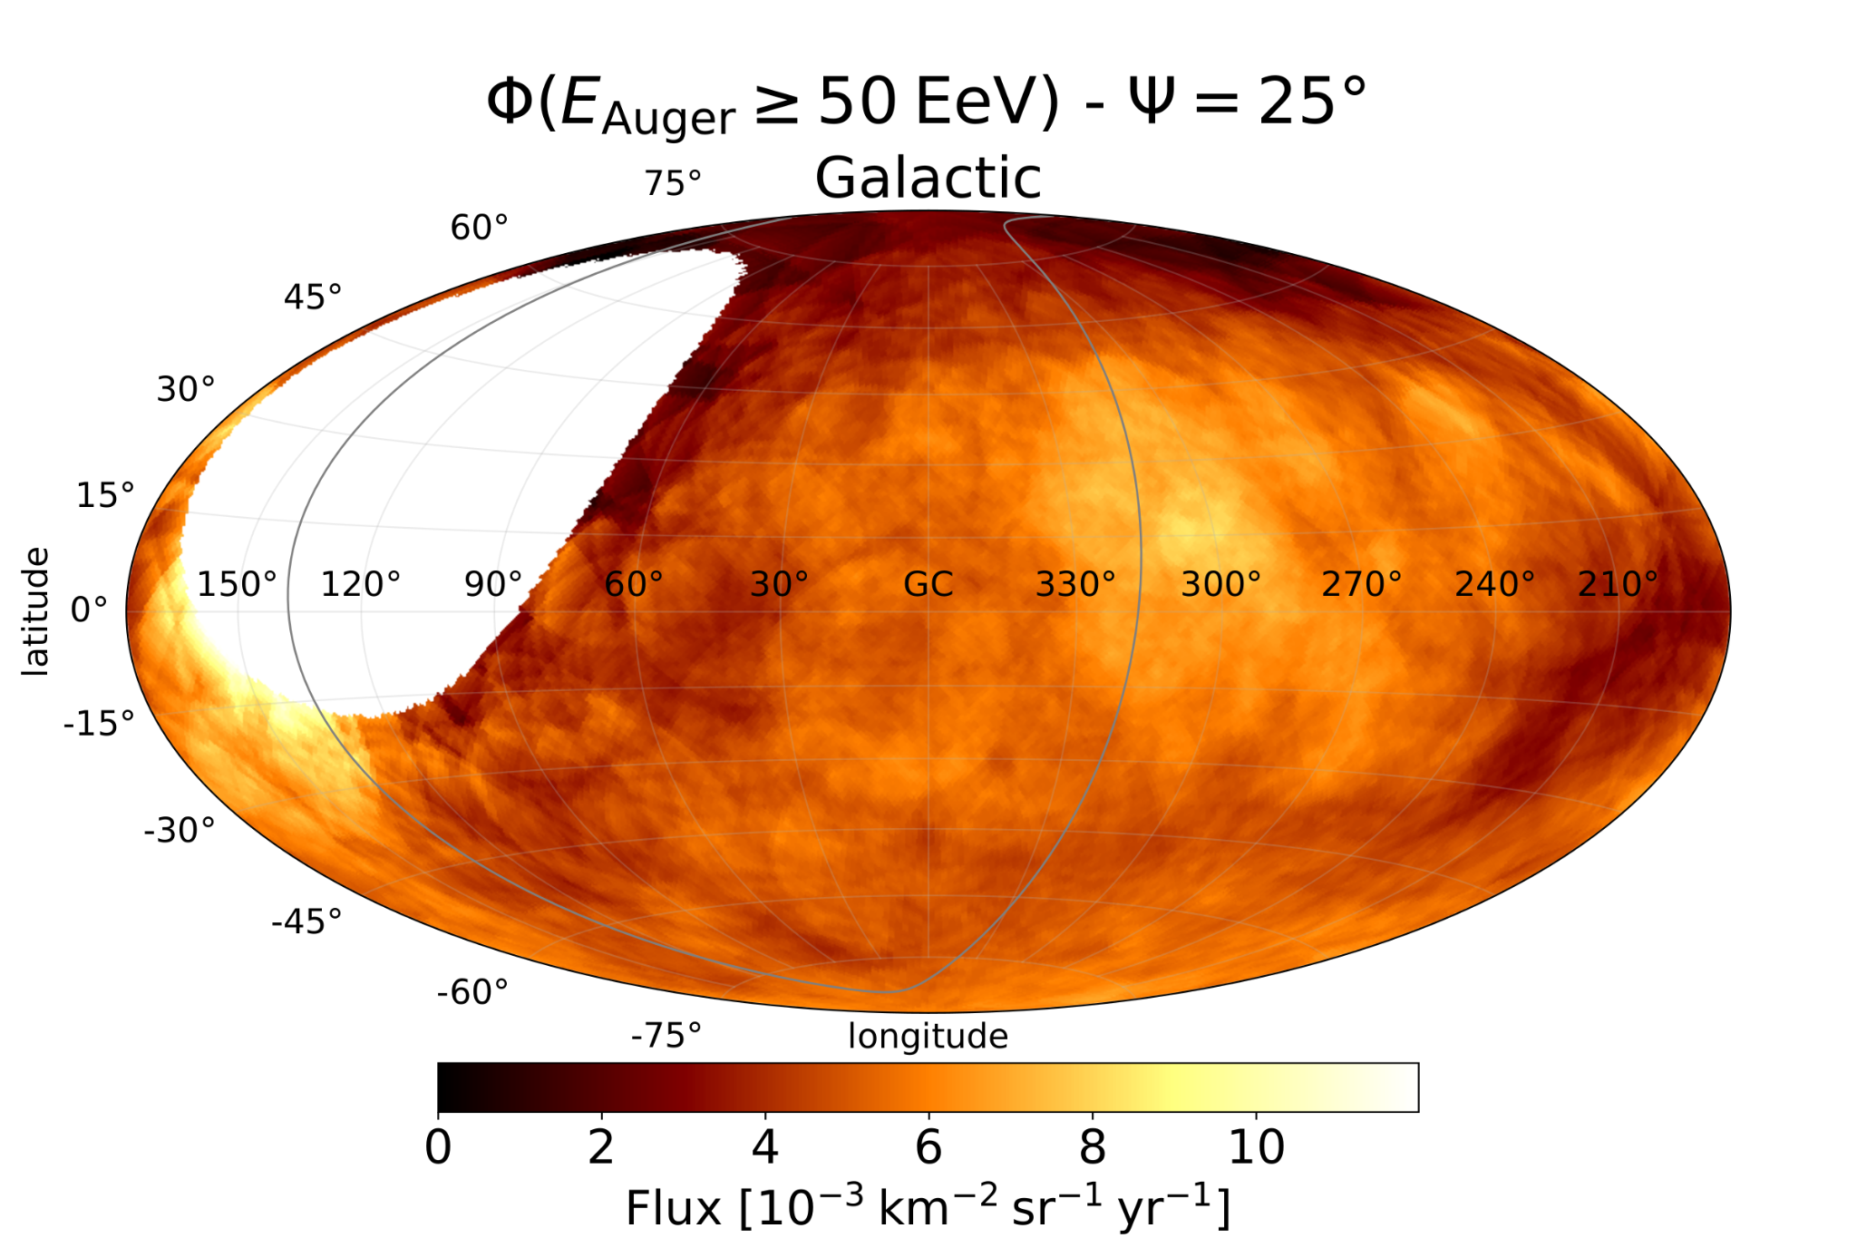
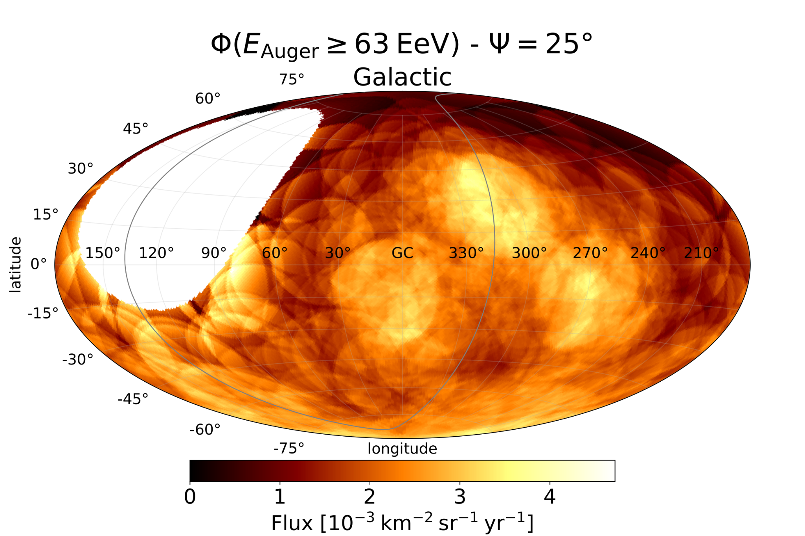
Status of anisotropies in the toe region
>32 EeV
> 10^19.5 eV
log₁₀ E/eV > 19.5: ~3000 evts
Auger Coll., accepted in ApJ
(arXiv:2407.06874)
observed / mean
Auger Coll., ApJ ‘24
log₁₀ E/eV > 19.6: ~1500 evts
log₁₀ E/eV > 19.7: ~700 evts
log₁₀ E/eV > 19.8: ~300 evts
Auger Coll., ApJ ‘22
‹#›

Slide 29
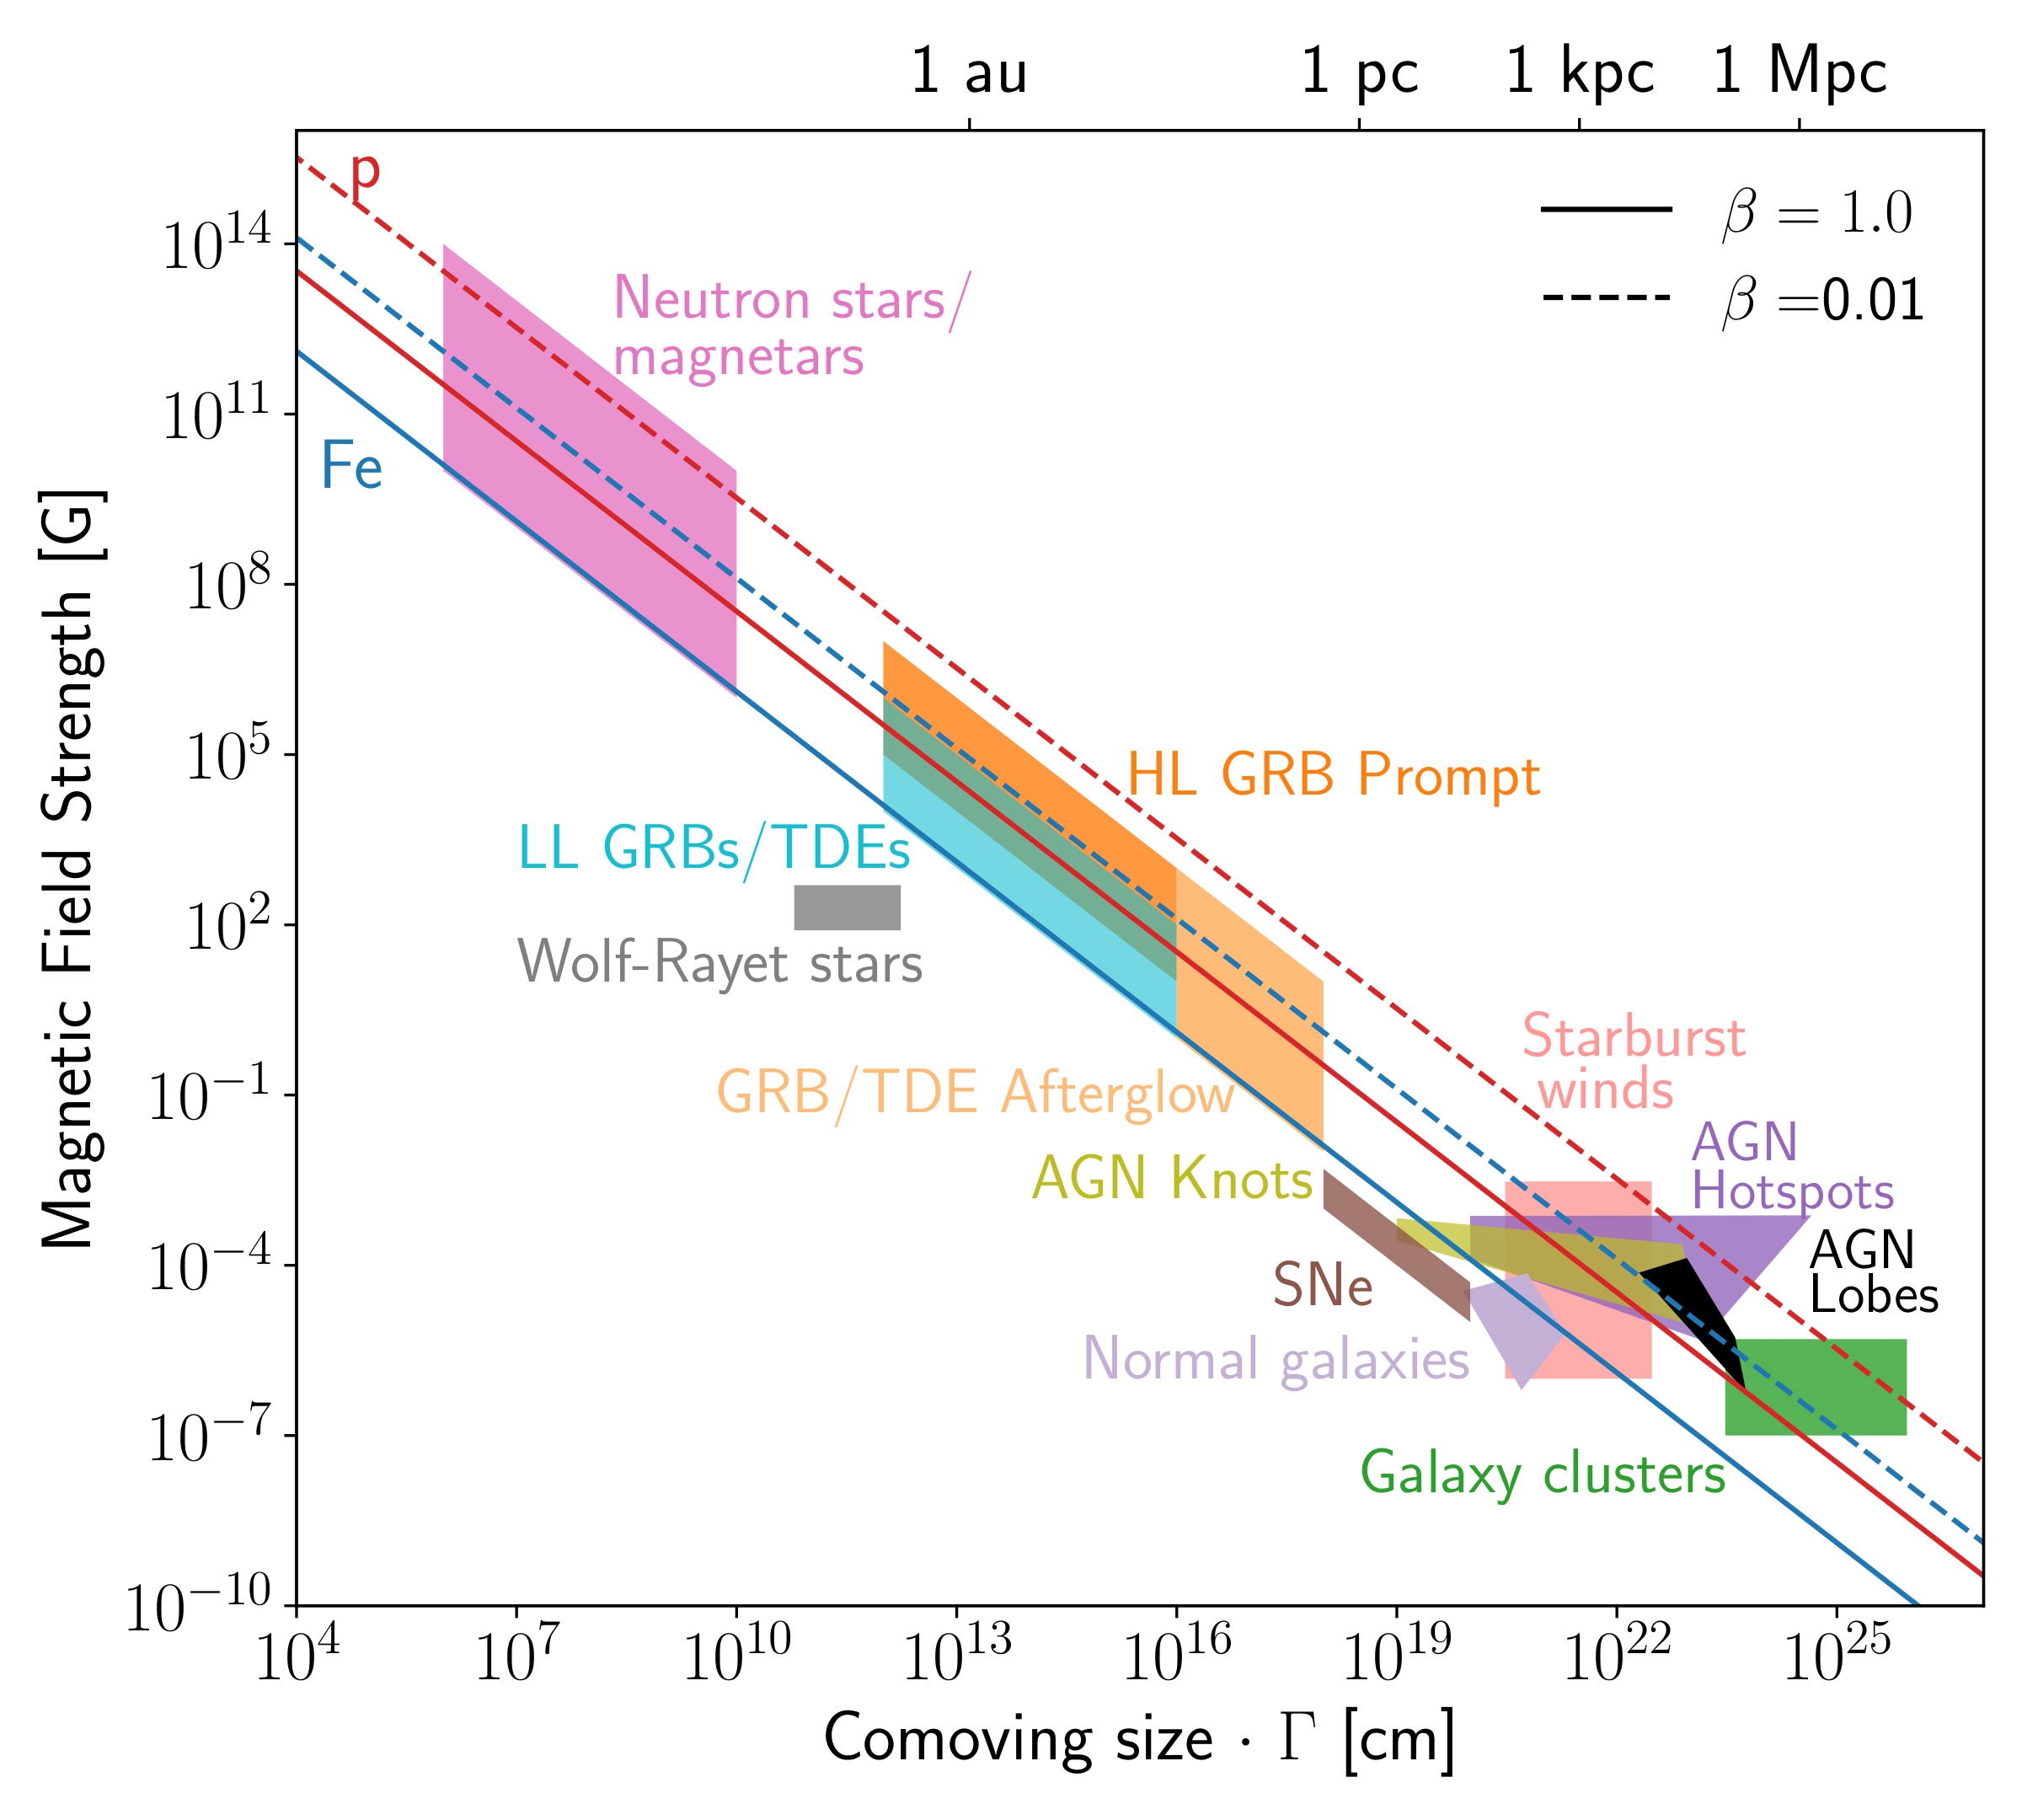
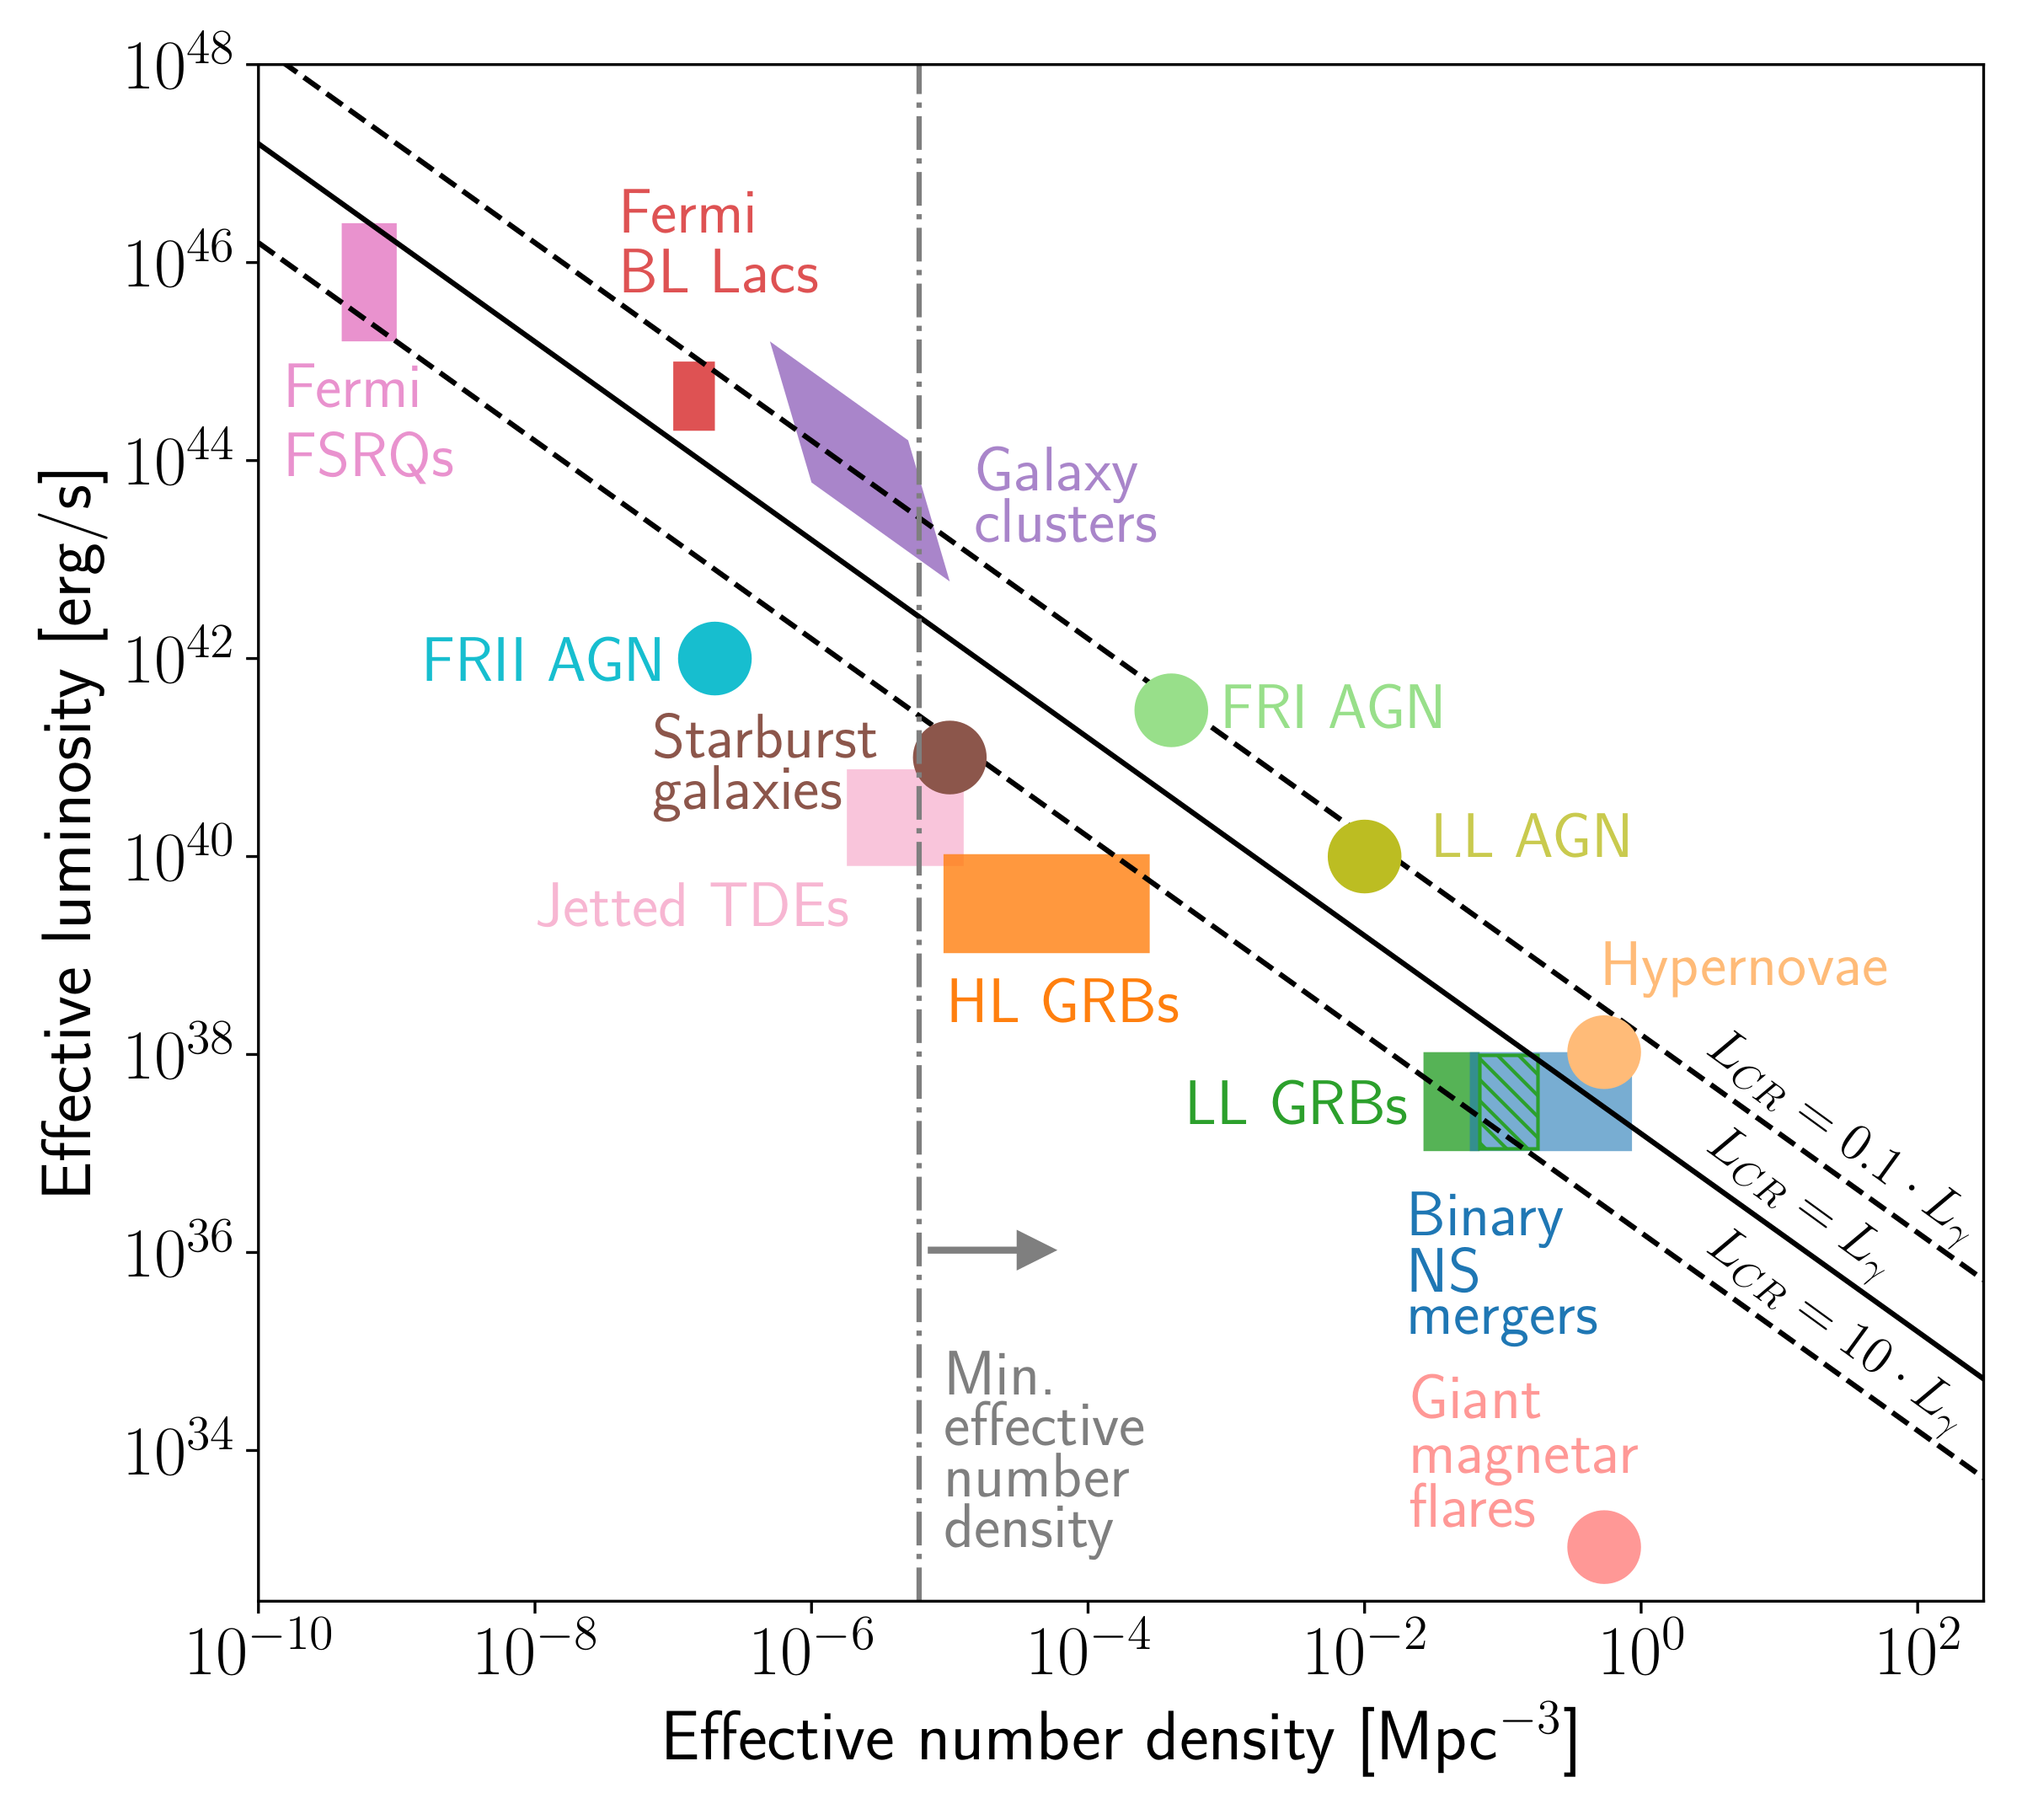
Which sources to explain the Centaurus region excess?
Hillas: only the highest-energy
Confinement, i.e. large B-field, size, and shock velocity:
B ⨯ ( r ⨯ Γ ) ⨯ β_{shock} > E / Ze
Arrival directions: only the numerous
No significant self-clustering above flux suppression:
number density > 10⁻⁵ / Mpc³ (if deflections < 30°)
Gamma-ray bursts
(GRB)
AGN
Active galactic nuclei
(AGN)
GRB
Alves Batista+, Front.Astron.Space Sci. ‘19
‹#›

Slide 30
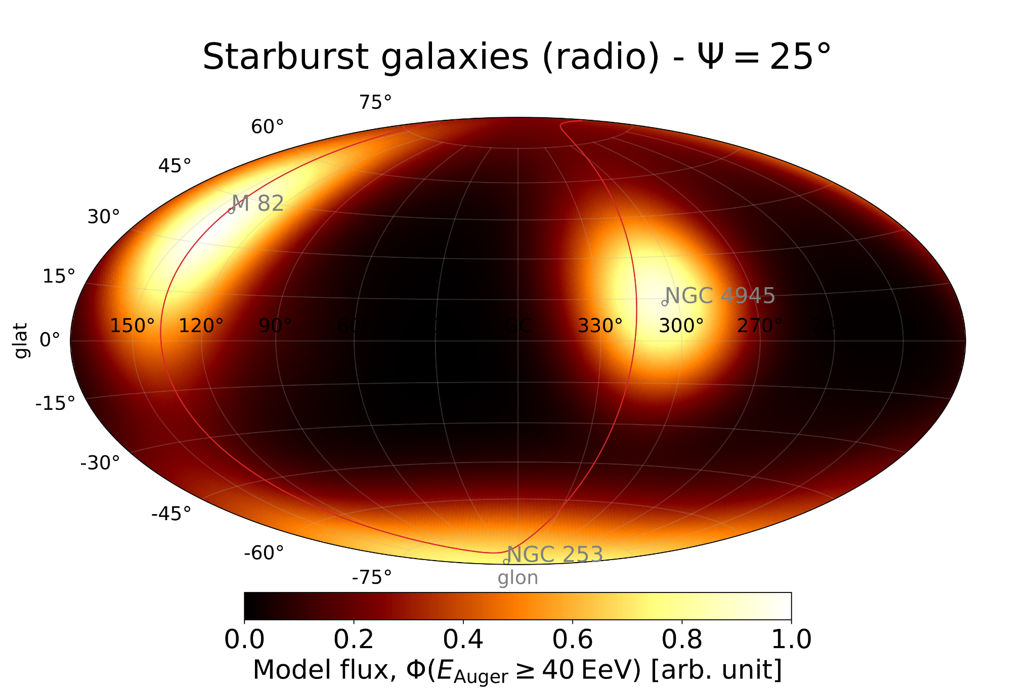
Status of anisotropies in the toe region
Arrival directions of events > 32 EeV up to Dec. 2020: best template model
~ 3.8σ exclusion of isotropy with 10% XS from 44 brightest star-forming galaxies < 150 Mpc (Auger, ApJ ‘22, ApJL ‘18)
~ 4.6σ exclusion when including Northern complementary data (Auger Coll. + Telescope Array Coll., PoS(ICRC2023) by Caccianiga)
Auger coll., ApJ ‘22
‹#›

Slide 31
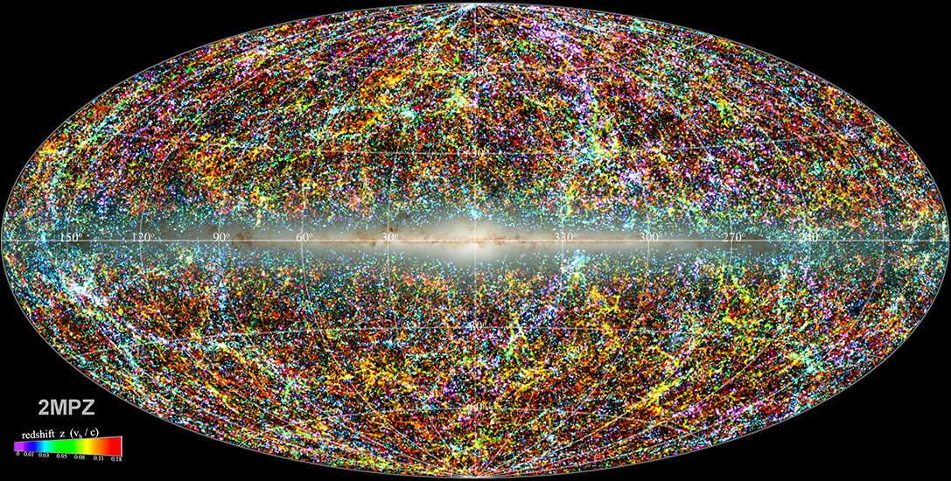
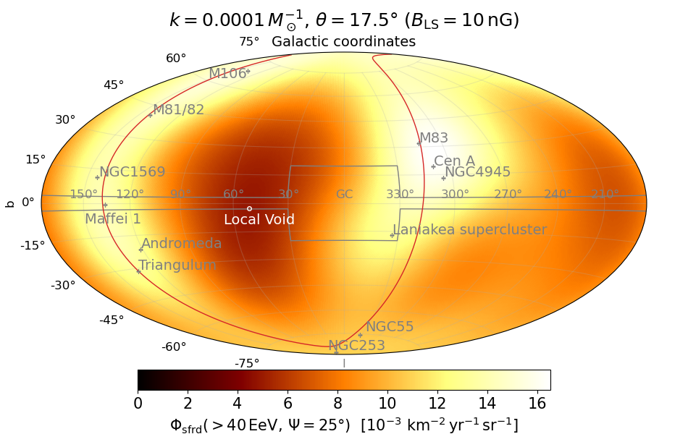
Mapping out star formation in the CR horizon
( 2MASS Photometric z catalog ⋂ WISE ) ✖ HyperLEDA (JB, ApJS ‘21)
Catalog of 400k galaxies out to d_{max} = 350 Mpc
Distances: 50 / 50 photometric / spectroscopic (cosmic distance ladder)
Completeness in stellar mass: 50% at d_{max} (× 2 wrt 2MRS)
Credit: JB
44 SFGs
XS~10%
MM channel: IR - GW - CR
Credits: 2MPZ, Bilicki & Jarret ‘14
Marafico, JB+ ‘24
JB ‘21 ⊂ 2MPZ
~400k galaxies
400k SFGs
XS~100%?
‹#›

Slide 32
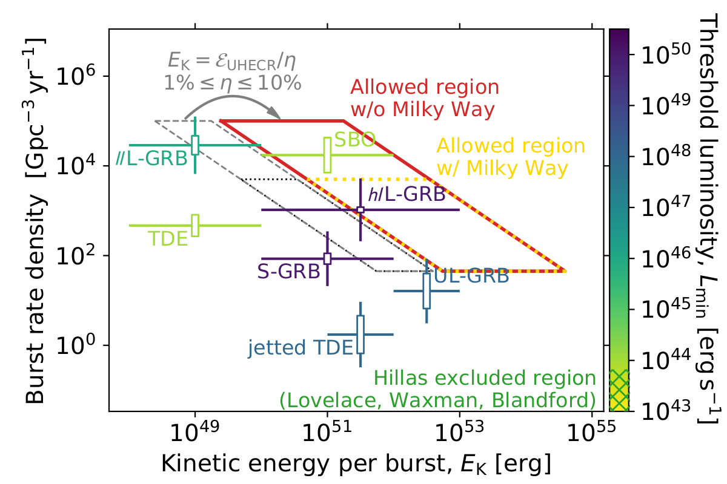
Candidate ultra-high-energy sources
X-ray transient rate: TDE, Short GRB, Long GRB
in line with models of particle acceleration at mildly relativistic internal shocks (Globus, Allard, Mochkovitch, Parizot, MNRAS 2015)
Auger + TA data
Credits: L. Caccianiga for Auger & TA
UHECR Model ≈ UHECR Data
Δθ(hotspot_{model}, hotspot_{data}) < 40°
Best-match transient scenario
Credits: Marafico, JB+ ‘24
MM channel
X-rays - CR
Marafico, JB, Condorelli, Deligny, Bregeon, ApJ ‘24
‹#›

Slide 33
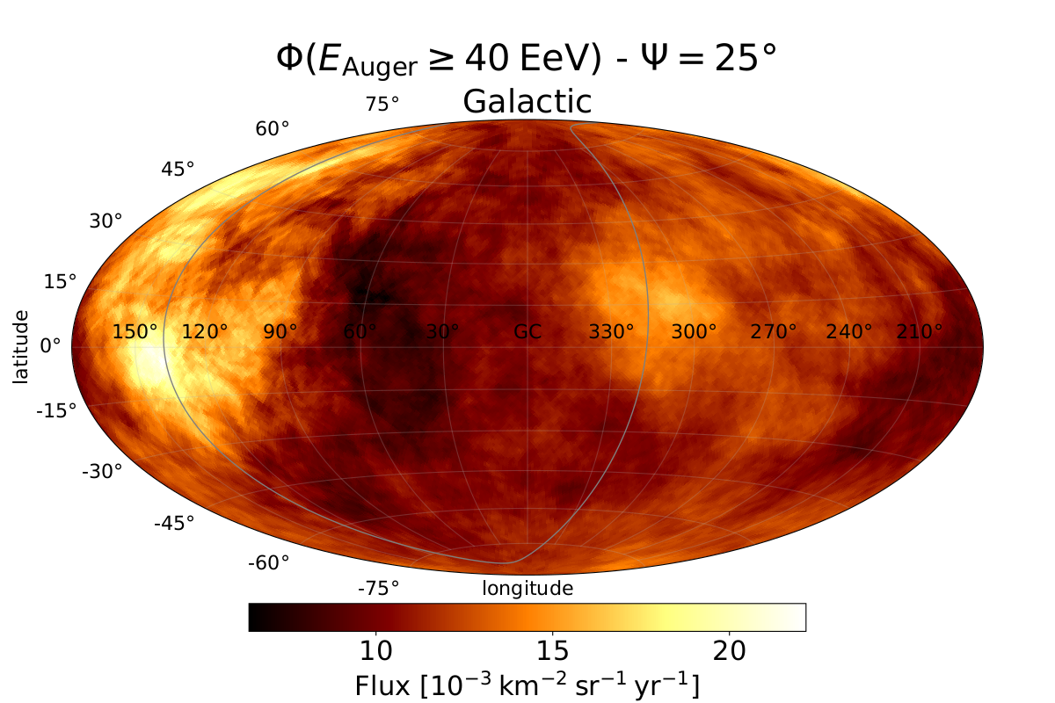
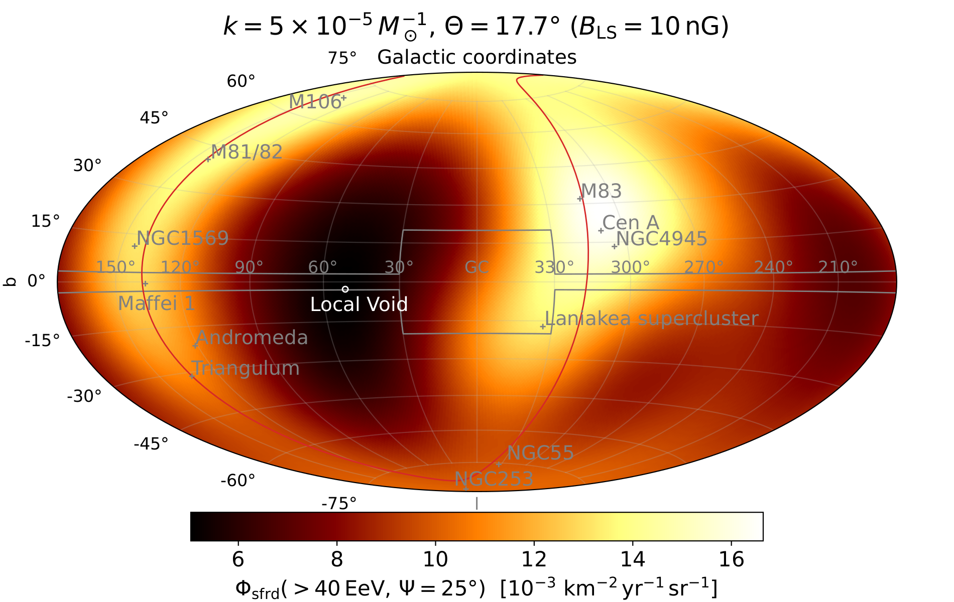
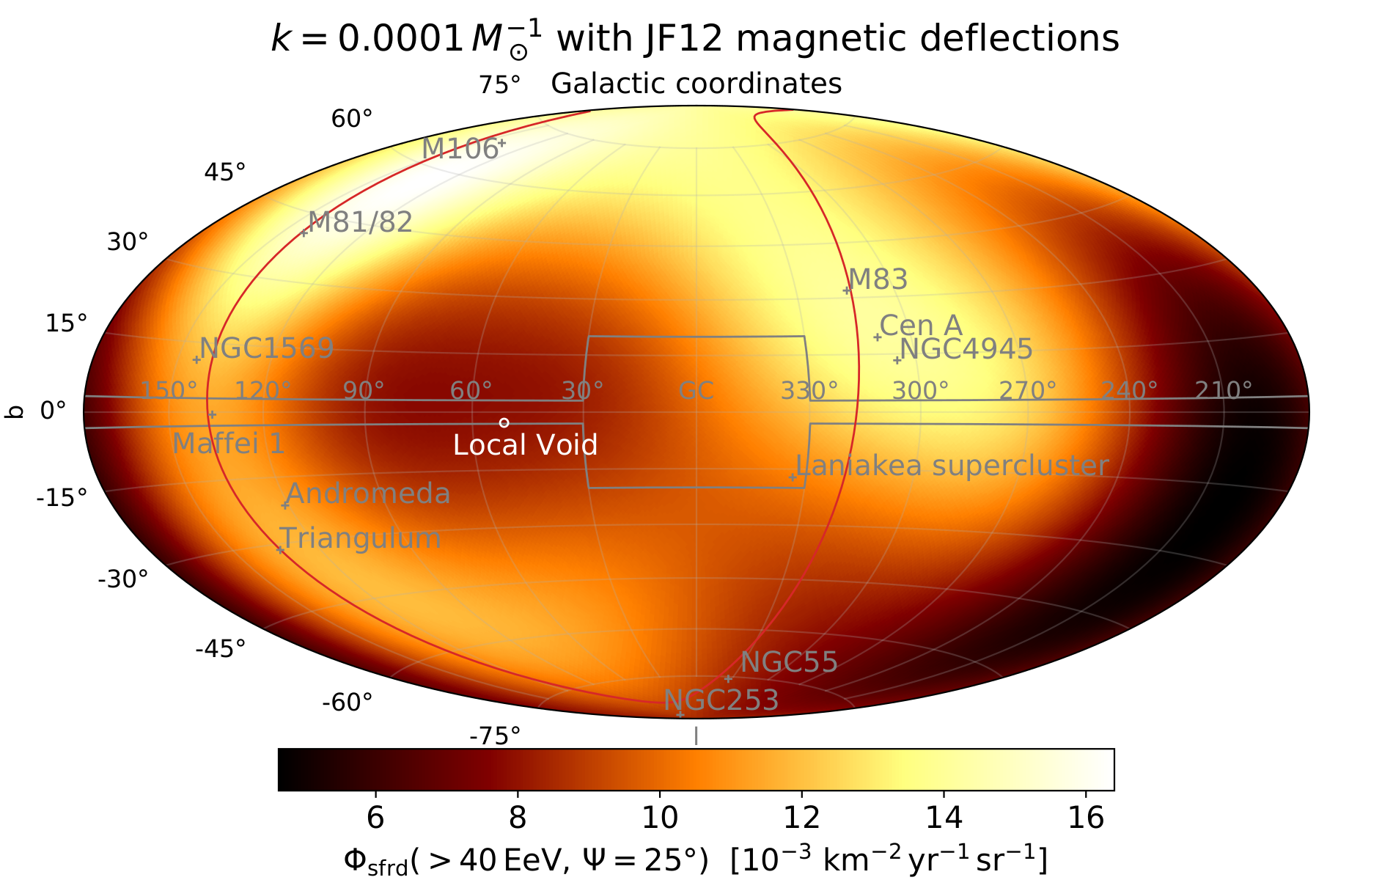
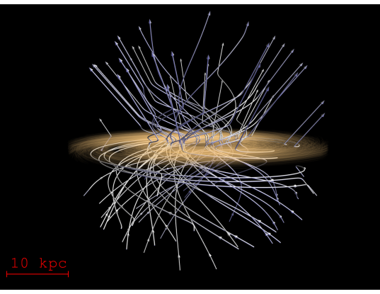
Impact of magnetic fields?
Elephant in the room: cosmic magnetic fields
Impact of B field in voids, sheets, filaments, clusters
→ order-of-magnitude estimates (e.g. Condorelli, JB, Adam, ApJ ‘23)
Impact of B field of the Milky Way
→ models still incomplete (e.g. Jansson & Farrar, ApJ ‘12 vs
Korochkin, Semikoz, Tinyakov, A&A '25)
→ no study able to jointly model the dipole > 8 EeV and
excesses > 40 EeV (see Allard, Aublin, Baret, Parizot, A&A ‘22 & ‘24)
Auger + TA data
Credits: L. Caccianiga for Auger & TA
MM channel: radio - CR
Regular B_{Milky Way}
Jansson & Farrar ‘12
Best-match transient scenario
Credits: Marafico, JB+ ‘24
‹#›

Slide 34
I. Spectrum & nuclear composition
How to measure them, where do we stand, why does it matter
II. Anisotropy searches at the highest E
Why do we try, what do we see, the sources within reach?
III. The extragalactic cosmic-ray background
Next observational and phenomenological frontiers

Slide 35
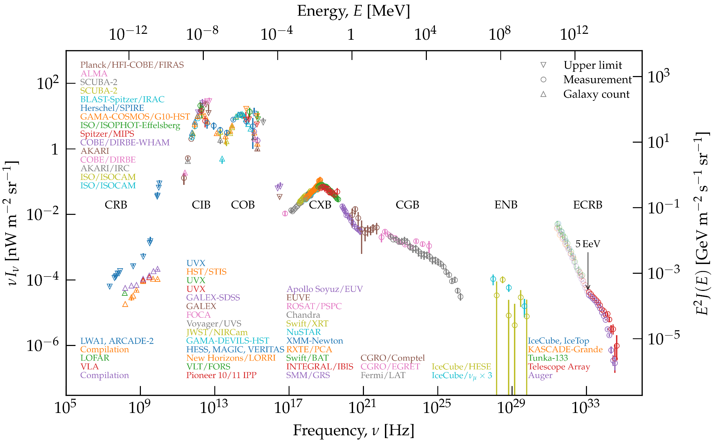
The extragalactic background from radio λ to ultra-high E
CR > 100 PeV
Radio signal
→ GRAND
E ~ 0.1-1 EeV
Fluo. signal
→ K-EUSO
E > 50 EeV
→ (POEMMA?)
Part. sampling
→ AugerPrime
E ~ 0.1-100 EeV
→ (GCOS?)
‹#›

Slide 36
The extragalactic background from radio λ to ultra-high E
MM synergies
Radio
B-fields
→ SKAO
O, X-rays
Transients
→ LSST
→ SVOM
IR (GW)
Galaxy
mapping
→ Euclid
𝛎 > 100 PeV
Smoking gun
→ KM3Net
→ GRAND
CR > 100 PeV
Radio signal
→ GRAND
E ~ 0.1-1 EeV
Fluo. signal
→ K-EUSO
E > 50 EeV
→ (POEMMA?)
Part. sampling
→ AugerPrime
E ~ 0.1-100 EeV
→ (GCOS?)
‹#›

Slide 37
The multi-messenger extragalactic spectrum
How to constrain the populations of hadronic emitters and the mechanisms at play in hadronic accelerators?
→ likely from what we learned about the populations of photon emitters .
‹#›

Slide 38
Model for the particles of the extragalactic spectrum?
?
‹#›

Slide 39
Model for the multi-messenger extragalactic spectrum
Ingredients
Refined photon model
Refined 3D catalog of baryonic matter
3D to 4D: ℝ³ + time
→ transients
?
‹#›

Slide 40
Backup

Slide 41
Clarification on energetics
Common in literature
apparent local rate ✕ isotropic-equivalent energy (beaming corrected - often based on gamma-ray flux)
This work
true local rate (beaming corrected) x true energies (based on expected kinetic energies)
Credits: review by Cano+ ‘17, adapted from Margutti+ ‘13, ‘14
‹#›
Jonathan Biteau

Slide 42
What remains: the multi-messenger extragalactic spectrum
?
Pulsar timing arrays
LIGO/Virgo
SKA
SphereX
Future MeV satellite(s)?
CTA
KM3Net
Auger
Future: Einstein Telescope
+ Fermi-LAT
+ IceCube
‹#›
Jonathan Biteau

Slide 43
Spline fit of the multi-messenger extragalactic spectrum
‹#›

Slide 44
The UHECR Background
Credits: Tsunesada+ ‘21
matched E-scales
Credits: Tinyakov+ ‘21
‹#›

Slide 45
Some landmarks in Auger anisotropy studies
Auger, Science 2007
Auger (incl. JB), Science 2017
First steps: hint
20 out of 27 evts within 3°
of nearby galaxies → ~3σ
10 evts in particular clustered
in the Centaurus region
Maturity: discovery
6σ dipolar-like flux
In line with nearby
galaxy stellar mass
distribution (2MRS)
~ 27 evts ≥ 57 EeV
~ 32,000 evts ≥ 8 EeV
Revival: a trail?
4σ evidence for ~10% excess from nearby
starbursts (23 brightest)
Now 4.5σ
Auger, JCAP ‘24
Auger, ApJL 2018, led by JB
Alves Batista+ (incl. JB) ‘19
~ 900 evts ≥ 39 EeV
‹#›

Slide 46
Status of the TA hotspots
Auger + TA data
Credits: L. Caccianiga for Auger & TA
Auger Coll., accepted in ApJ
(arXiv:2407.06874)
‹#›

Slide 47
Continuous losses of protons: p-ɣ on the CMB
Credit: Aloisio ‘17
c/H₀
Threshold for π photoproduction
2m_{p} m_{π} / 4ϵ ~ 50 EeV x (λ / 1 mm)
Note: p @ 50 EeV → unobserved
Center of mass
(50 EeV x 1 meV)^{½} ~ 0.2 GeV
Neutron = proton in the IGM
ɣcτ ~ 10 kpc x (E / 1 EeV)
‹#›

Slide 48
Escape spectrum: neutrons
Luce, Marafico, JB+ ApJ ’22
Biehl+ A&A ‘18

Slide 49
Catastrophic losses of nuclei: photo-erosion/disintegration
Credit: Aloisio ‘17
Photo-erosion driven by
ϵ_{ɣ}’ ~ 10 MeV: giant dipole resonance
→λ_{ɣ} ~ 0.5 mm (CMB) for E_{X}/A ~ 2 EeV
ϵ_{ɣ}’ ~ 30 MeV: quasi-deuteron process
ϵ_{ɣ}’ > 150 MeV: baryon resonance
→λ_{ɣ} ~ 30 µm (CIB) for E_{X}/A ~ 2 EeV
Lower energy nuclei and protons
→ with Lorentz boost nearly conserved
‹#›

Slide 50
Cosmic web: volume filling fraction
Clusters
Filaments
Sheets
Voids
200 Mpc
l = 10 Mpc
w = 1 Mpc
Credit: Oei+ A&A ‘22
Credit: Hackstein+ MNRAS ‘18 (Cosmic V-web constrained sim. / CLUES)
‹#›

Slide 51
Magnetic fields and where to find them
Cluster: B ~ 1-10 µG
e.g. Bonafede+ ‘10
Filament: B ~ 10-100 nG
Vernstrom+ ‘21, Carretti+ ‘22
Sheet: B?
Void: B < 10 pG
Jedamzik & Saveliev ‘19,
Vazza+ ‘17
200 Mpc
Our location:
The Local Sheet
Assume turbulent B field filling the Local Group with λ ~ λ_{clusters} and
B_{rms} to be determined
McCall ‘14
Credit: Hackstein+ 2018 (Cosmic V-web constrained sim. / CLUES)
‹#›
Jonathan Biteau

Slide 52
Validation: do we grasp all M★ and SFR?
1D visualization vs d out to 350 Mpc (vs 135 Mpc in Karachentsev+ 2018)
→ Full-sky plateau beyond 100 Mpc matches deep-field observations (Driver+ 2018)
→ Northern matches Southern hemisphere beyond 100 Mpc: negligible N/S dipole ~ isotropic regime
3D visualization out to 350 Mpc (see interactive figures of the Local Superclusters, Local Clusters and Local Sheet)
→ Good agreement with V-web from Cosmicflows (Hoffman+ 2017, Dupuy +2019) on supercluster scales
Local Group
Local Sheet
Virgo cluster
Laniakea supercluster
‹#›

Slide 53
EeV cosmic rays in the cosmic web
Condorelli, JB, Adam, ApJ ‘23
Voids: B < 10 pG
Too low to have a sizeable impact within cosmic-ray horizon
(see Pierre Auger Collab. ‘24)
The Local Sheet: B ~ B_{filaments}?
Translucent, w/ angular spread θ_{obs, UHECR} ~ Δθ_{Local Sheet}
Time spread → d_{min} = extent of B_{Local Sheet} ~ few Mpc
Galaxy filaments: B ~ 10-100 nG
Translucent to UHE nuclei
No need for specific treatment
Galaxy clusters: B ~ 1-10 µG
Calorimeters for UHE nuclei
translucent
opaque
Condorelli, JB, Adam, ApJ ‘23
‹#›

Slide 54
Starbursts host more frequent stellar explosions…
Marafico, JB+, ApJ ‘24
Why would UHECR sources be transient?
Hillas-Lovelace-Waxman: high-luminosity sources
Composition: H/He-poor material from (high-mass) stars
Minimum distance: for an observer in a large-scale B-field
Source with burst rate λ invisible:
B = 0
B > 0
2d_{min}
Source
Credit: S. Marafico
UHECR burst
‹#›

Slide 55
Contrast in the Centaurus region
Marafico, JB, Condorelli, Deligny, Bregeon, ApJ (in press) 2024
Auger + TA data
Credits: L. Caccianiga for Auger & TA
Best-match transient scenario
Credits: Marafico, JB+ ‘24
‹#›
Jonathan Biteau

Slide 56
Candidate ultra-high-energy sources
Marafico, JB, Condorelli, Deligny, Bregeon, ApJ (in press) 2024
Solution with at least 1 Northern & Southern hotspot found for
Local Sheet B_{rms} = 0.5 - 20 nG
Auger + TA data
Credits: L. Caccianiga for Auger & TA
UHECR Model ≈ UHECR Data
Δθ(hotspot_{model}, hotspot_{data}) < 40°
Best-match transient scenario
Credits: Marafico, JB+ ‘24
‹#›
Jonathan Biteau

Slide 57
Conclusions
Marafico, JB, Condorelli, Deligny, Bregeon, ApJ (in press) 2024
Local Sheet B_{rms} = 0.5 - 20 nG
Whether LOFAR could already probe such a field or whether SKAO could reveal it remains TBD
Transient rate = 50 - 30,000 Gpc⁻³ yr⁻¹
The only stellar-sized transients that satisfy both Hillas’ and our criteria are long gamma-ray bursts
arXiv:2405.17179
‹#›
Jonathan Biteau

Slide 58
Transient model of UHECR sky
Marafico, JB, Condorelli, Deligny, Bregeon, ApJ ‘24
Spectral & composition model (see also Luce+ ApJ ‘22)
Increasing value of burst rate per star-formation unit k, for a given B-field in the Local Sheet
‹#›

Slide 59
Observations in the Local Volume
Aim for volume limited sample to d < 11 Mpc or v_{LG} < 600 km/s
Distances based on usual cosmic-ladder estimates (supernovae,
Cepheids, Tully-Fisher, Faber-Jackson) + tip of the red giant branch
→ avoid biases induced by peculiar motion, distance uncertainty: 5-25%
Information available from Karachentsev+ 2018
• M★: stellar mass from K band (1022/1029)
• T: de Vaucouleurs’ morphology (1028/1029), special attention to dwarfs
• M(HI): atomic hydrogen mass, tracing gas (819/1029)
• SFR(FUV): mostly based on GALEX observations (647/1029)
• SFR(Hα): from literature & dedicated surveys (470/1029)
Main sequence of galaxies in the Local Volume?
SFR-M* branch occupied by Irregular (Irr.) and Spiral (S.) galaxies
Karachentsev+ 2013
Equatorial coordinates
Small Magellanic Cloud
(ESO/VISTA VMC)
Antennae: NGC4038/4039
(ESA/Hubble)
Messier 83
(ESO)
‹#›

Slide 60
Main sequence in the Local Volume
SFR tracers in the Local Volume
• Hα: 5-10 Myrs timescale, fraction of ionizing photons from young massive stars absorbed before being reprocessed into Hα
• FUV: 100-300 Myrs timescale, fraction of FUV photons from OB stars absorbed, often combined with total IR to estimate SFR
→ both corrected for extinction, i.e. escape from the galaxy
3 SFR-M★ branches
→ E-S0: linear (ꞵ = 1.0-1.1 ± 0.10), i.e. no active star formation
→ S: sub-linear (ꞵ = 0.81-0.69 ± 0.07), active star formation >10 Myrs ago
→ Irr: super-linear (ꞵ = 1.22 ± 0.04), active star formation <10 Myrs ago
Fit results with best morphological divide
• KS-test p-value for Gaussian residuals ~ 5%,
4σ outliers → hidden variables (metallicity, environment)
• SFR dispersion of S: 0.24 dex (FUV-Hα), 0.34 dex (M*-Hα)
J. Biteau – CTA-SFR – 2022.04.06
‹#›

Slide 61
Exploiting the HyperLEDA database
Limitations of GLADE / MANGROVE
Mix of overlapping catalogs: risk of duplicate entries, possibly direction-dependent flux limit
Fully exploiting distance databases
Local Volume (1k gal., d < 11 Mpc, Karachentsev+ 2018) and HyperLEDA (5M gal., Makarov+ 2014)
Distance revision: cosmic ladder > spectro-z > photo-z
Cosmic-ladder distances for ~1k nearby objects, spectro-z x 4 → 200k/400k within 350 Mpc
Stellar mass estimates
K-band for Local Volume, W1-band otherwise, with M*/L = 0.6 (M⊙/L⊙), i.e. Chabrier IMF
Association results
• 671,593 / 743,480 HyperLEDA
pairings (others = 2MASS
objects not in HyperLEDA)
• 361 duplicates removed
• 1,387 excluded entries:
- dubious duplicates removed
- jetted AGN from HyperLEDA
‹#›

Slide 62
Incompleteness with increasing distance
Mass function
Full-sky, including clones in the ZoA and weights as a function of galactic latitude
Best-fit double Schechter from GAMA-field observations (Wright+ 2017) scaled to observed integral, accounting for local overdensity
Low-mass end: (luminosity function) ✕ (fraction of observable objects above 2MPZ sensitivity limit, provided distances)
Completeness
From integral of (GAMA mass function) ✕ M* above 2MPZ sensitivity limit: weights = completeness(d) ✕ completeness(b) ∈ [0.26,1]
→ probed volume from 140 Mpc (2MRS) to 350 Mpc (2MPZ) at similar completeness: ✕ 2.6 (distance), ✕ 18 (volume)
→ further increase by ✕ 4 (distance) to be expected if full WISE x SuperCOSMOS potential exploited
‹#›

Slide 63
Incompleteness in the Zone of Avoidance
Estimated based on galaxy counts in 100-300 Mpc (nearly isotropic distribution)
Equal area galactic latitude bins in inner and outer plane regions (|l|=30°)
Cosmic variance estimated from bin-to-bin fluctuations at l > 45°
Corrections
Empirical Gaussian(sin b) fit used to infer galaxy weights:
re-weighting sufficient in outer plane, insufficient in inner plane
ZoA cut placed at ~50% incompleteness: l = 3° / 20° for outer / inner plane
galaxy cloning (as in Lavaux & Hudson’s 2M++ 2011) in ZoA region
Bilicki+ 2013
galaxy
cloning
‹#›

