Slide 1
Calibration system radioassay

Slide 2
The elements to be assayed
Guide tubes used for the source circulation around/along the TPC:
2 tubes will be present in DarkSide20k
Each tube is ~25m long and made of several segments (11)
Characteristics of the tubes: 50.8 mm outer diameter, 1.6 mm thickness
Metric weight of the tube: 2 kg/m
Flanges + gasket used to assemble the segments of tubes:
Flange used (by pair) in 8 locations/tube → 16 flanges used in total
A gasket is used in between each pair for leak tightness → 8 gaskets used in total
Weight is 0.403 kg/unit for the flanges → 6.448 kg/total
Weight is 0.018 kg/unit for the gaskets → 0.144 kg/total
Flanges + gasket used for the exit of the tubes from the cryostat:
Single flange used for each exit of the vessel → 4 flanges used in total
A gasket is used for each exit → 4 gaskets used in total
Weight is 2.611 kg/unit for the flanges → 10.444 kg/total
Weight is 0.062 kg/unit for the gaskets → 0.248 kg/total

Slide 3
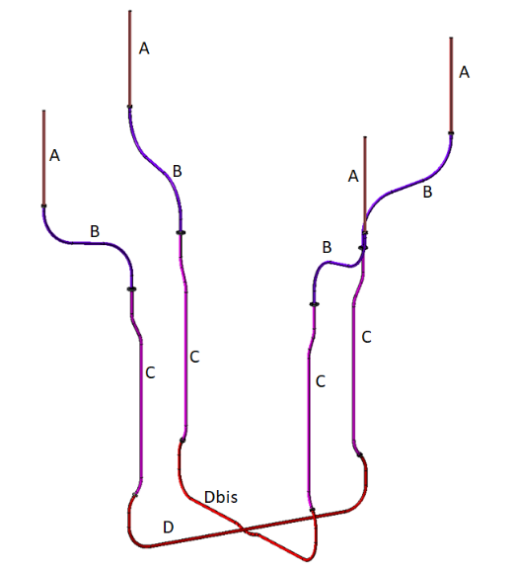
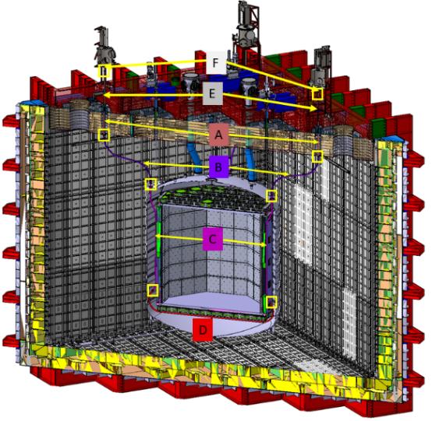
Guide tubes
Divided in several segments. Locations indicated in the captures of the official CAD.
The tubes will be purchased in segments of 5-6 m from which we will cut the needed length before bending.
For radio assay we plan to cut a sample from one segment. If 10 cm is ok, we would go for that. The weight would be 200 g.
Dimensions: 100 mm long, OD: 50.8 mm, thickness 1.6 mm.

Slide 4
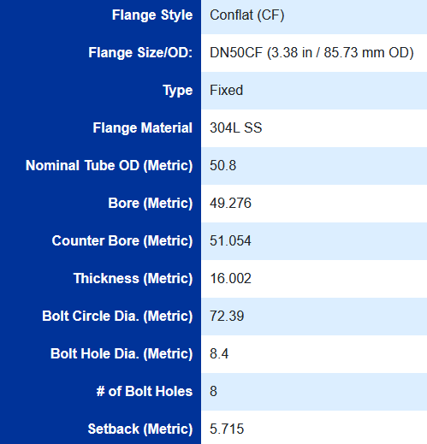
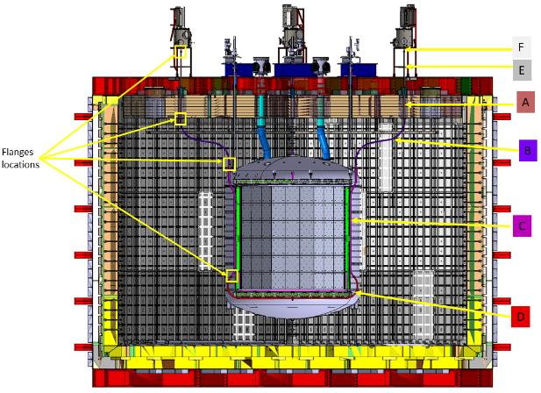
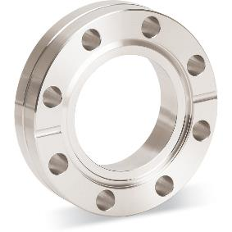
Flanges for segments assembly
They will be located at these 4 locations (+ symetry).
A spare flange is available for radio assay. Dimensions given on this slide.
Weight: 403g.

Slide 5
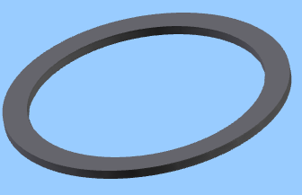
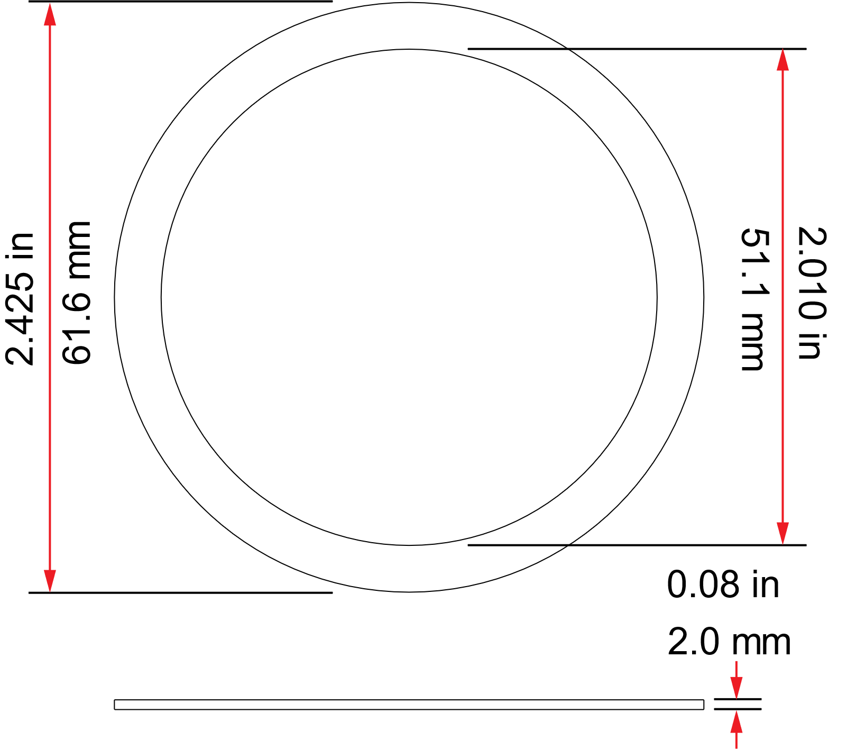
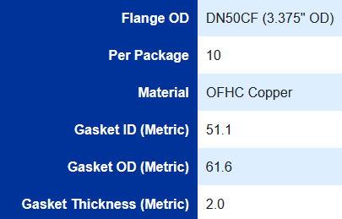
Gaskets for flanges for segments assembly
Same location as the flanges
A spare gasket is available for radio assay. Dimensions given on this slide.
Weight: 18g.

Slide 6
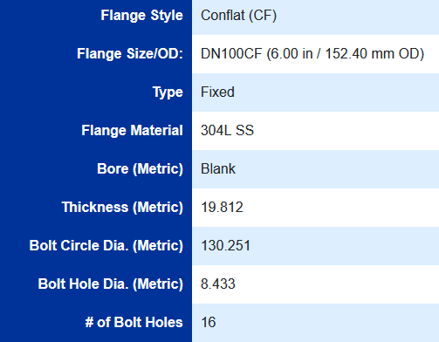
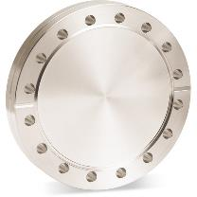
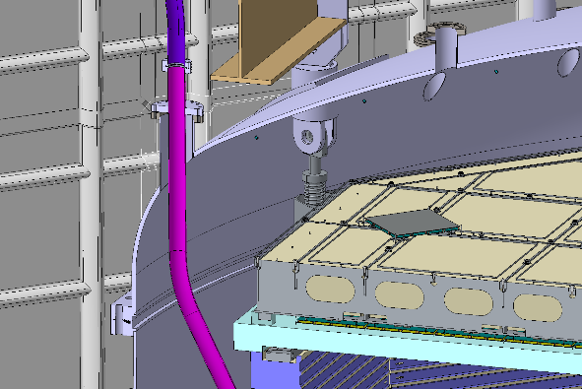
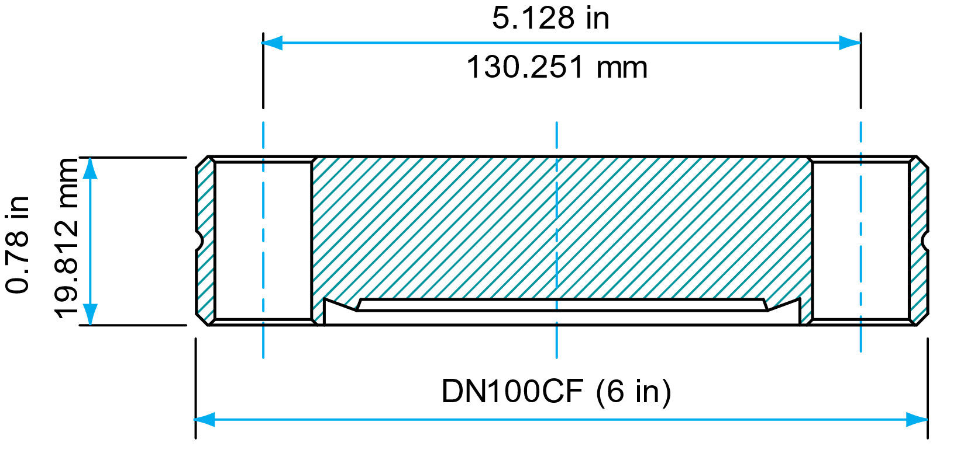
Flanges for vessel exit
NB: these flanges will be machined to let the guide tube go through
So their weight will be lower than the blank flanges (2.611 kg)… hard to estimate. Maybe 2/3 of the unit weight: 1.74 kg.
They are located on top the chimney to exit the vessel
A spare flange is available for radio assay. Dimensions given on this slide.
Weight: 2.611 kg.

Slide 7
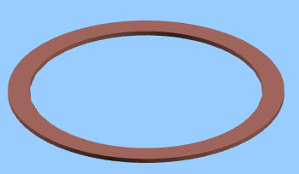
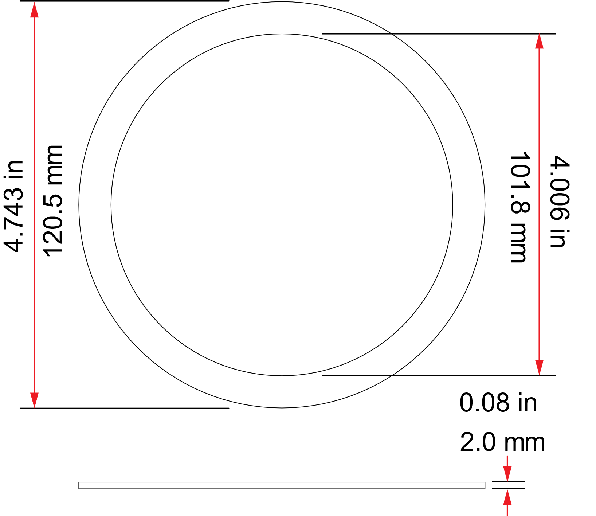
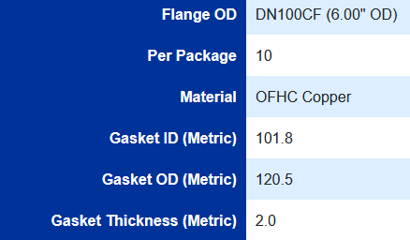
Gaskets for flanges for vessel exit
Same location as the flanges
A spare gasket is available for radio assay. Dimensions given on this slide.
Weight: 62 g.

