Slide 1
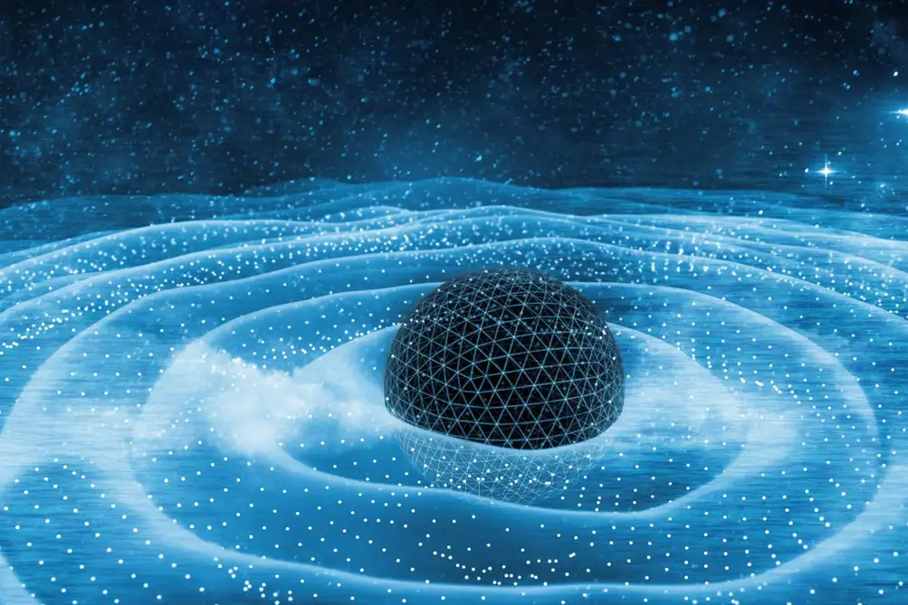
Overview of Work Group 4: Low-energy high-precision experiments bridging Quantum and Gravity
Catalina Curceanu, INFN-LNF, Italy
Matteo Fadel, ETH Zurich, Switzerland
Bridging high and low energies in search of quantum gravity - 2025 Cost Action CA23130 First Annual Conference
7-11 July 2025, Paris

Slide 2
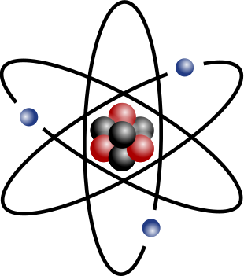
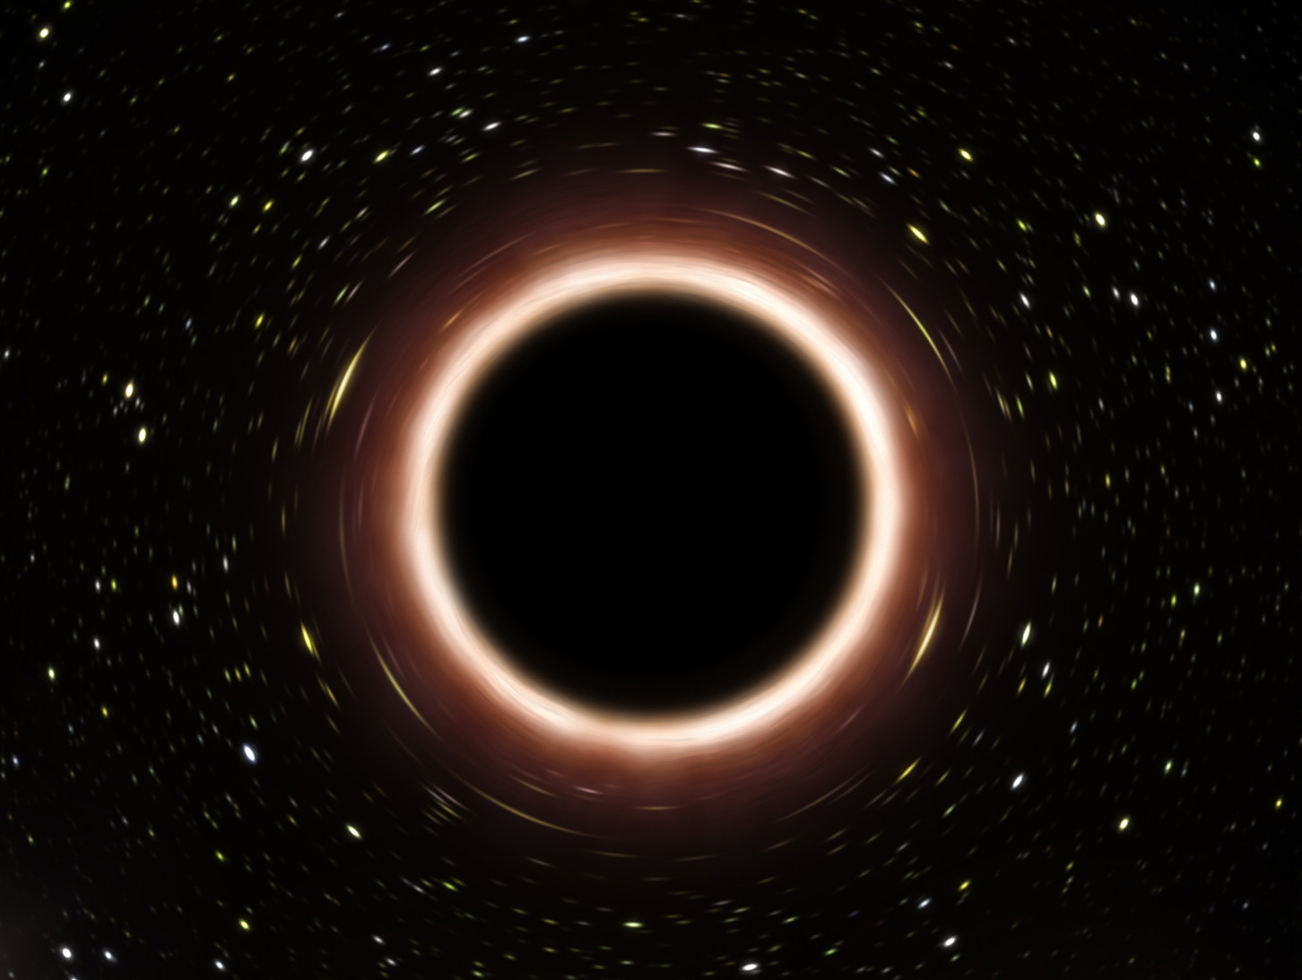
Quantum gravity?
?
Einstein’s field equations
Schrödinger’s equation

Slide 3
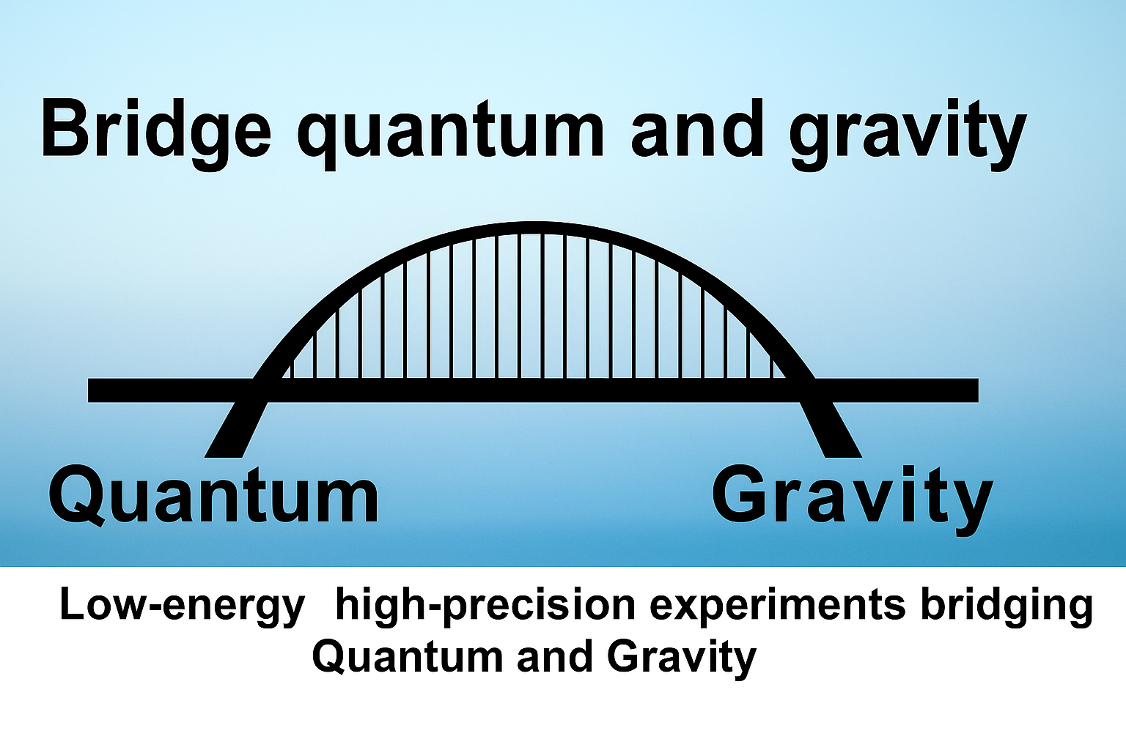
Which are the type of experiments ay low-energy investigate the relation between Quantum and Gravity?
Getty Images/iStockphoto Source: iStockphoto

Slide 4
Experimental approaches to test QG
high-energy
accelerators
gamma-rays
WG 2
gravitational waves
compact objects
neutrinos
cosmic rays
black-hole physics
………

Slide 5
Experimental approaches to test QG
low-energy
precision spectroscopy
underground experiments
atomic clocks
WG 4
levitated particles
many-body quantum systems
double-slit exp.
torsion balances
solid-state devices

Slide 6
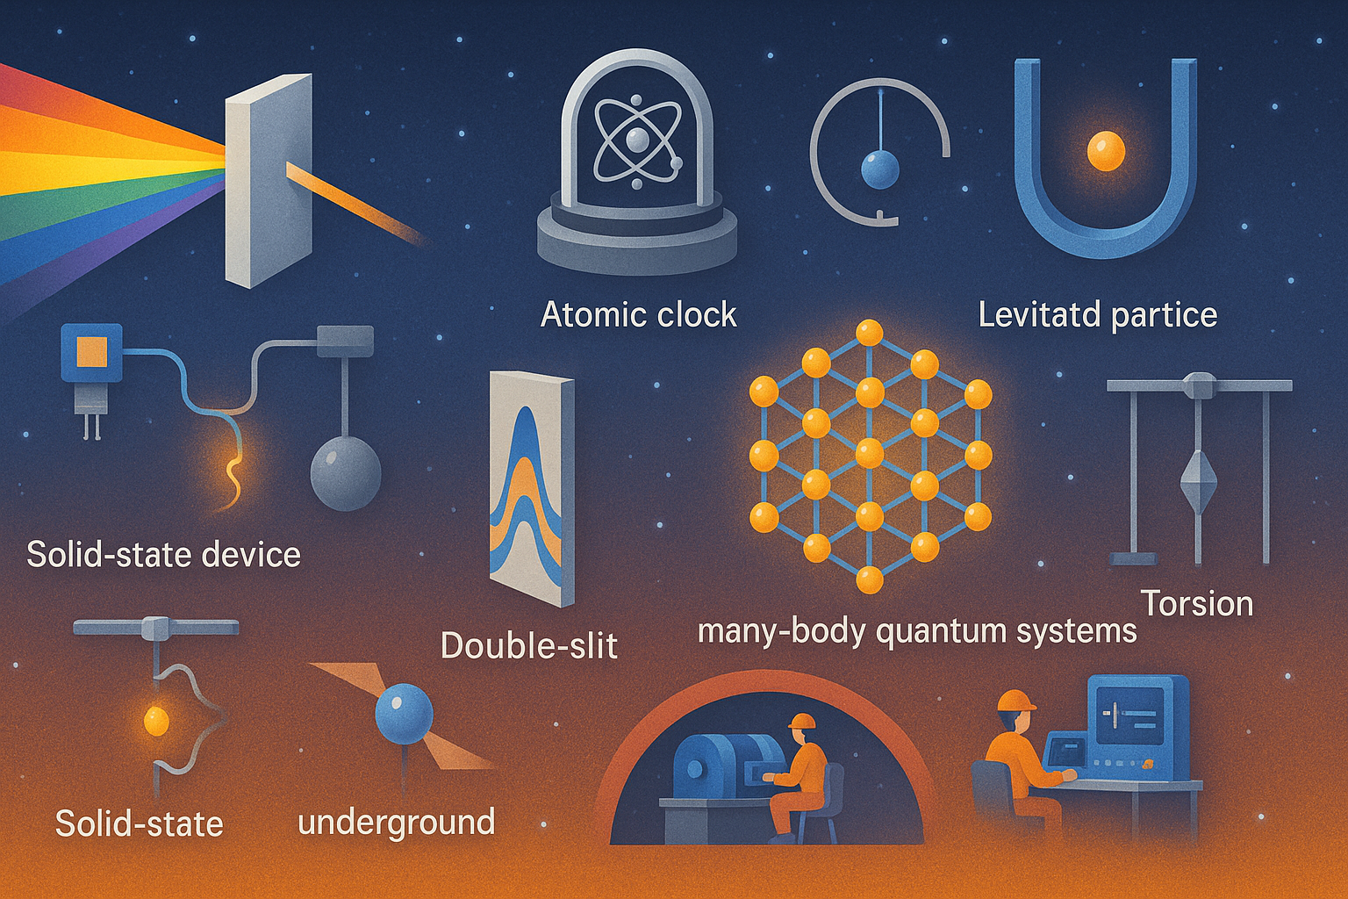

Slide 7
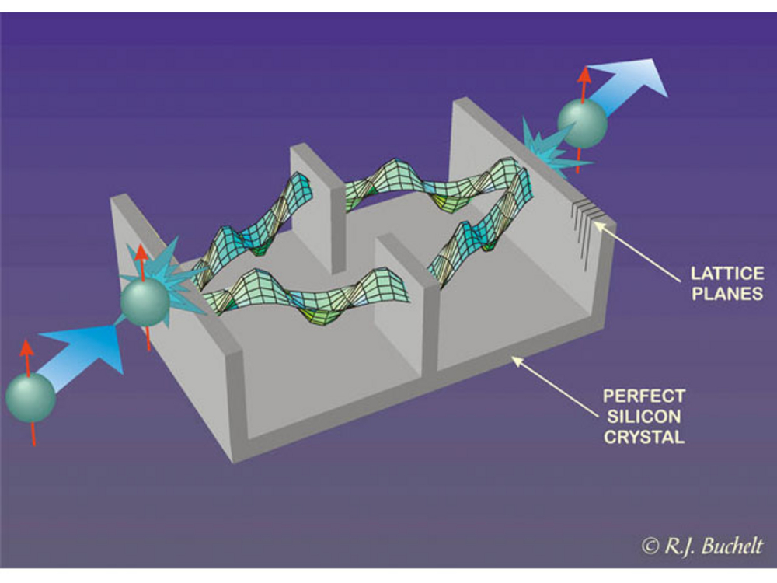
Experiments with quantum systems!
neutron interferometry

Slide 8
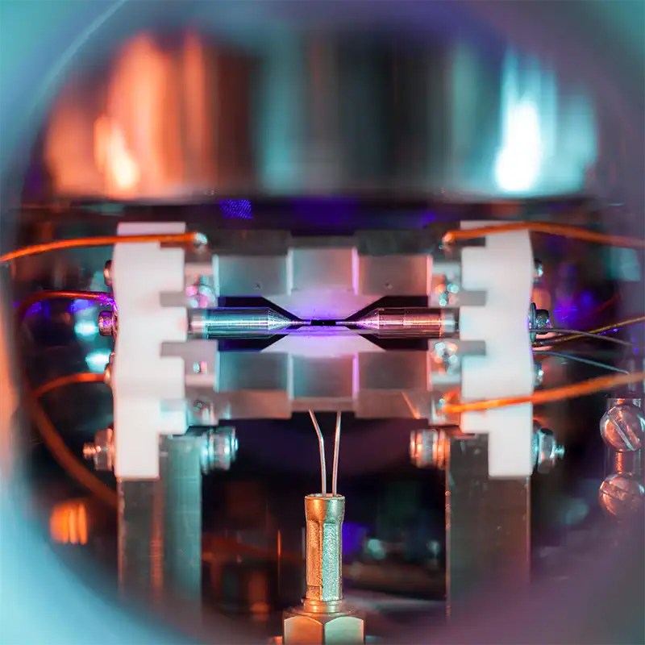
Experiments with quantum systems!
An ion trap in an ultra-high vacuum vessel. In the centre of the picture, as small bright dot is visible – a single trapped ⁸⁸Sr⁺ ion.
(Overall 1st in the EPSRC 2018 Science Photography Competition; crop slightly changed here.) Image by David Nadlinger/University of Oxford
single trapped ion

Slide 9
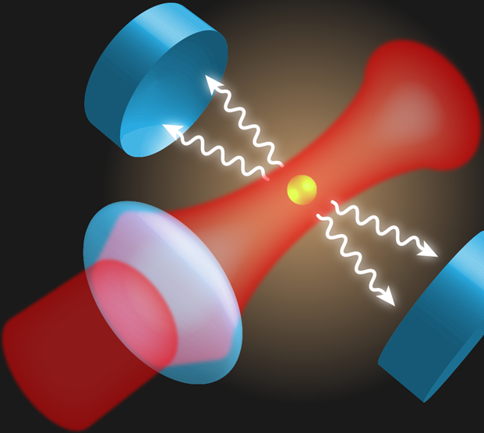
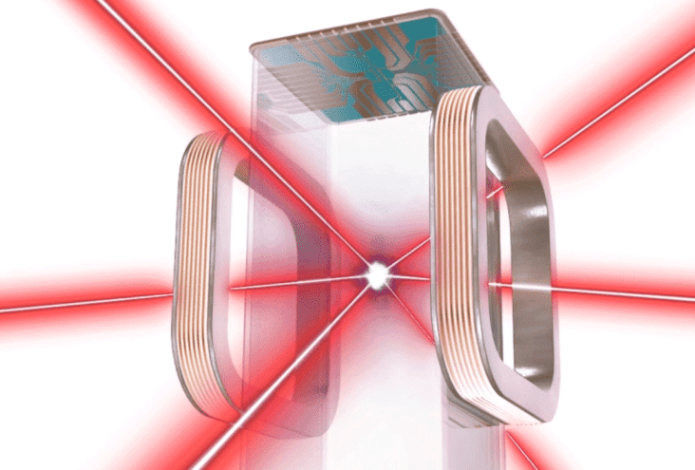
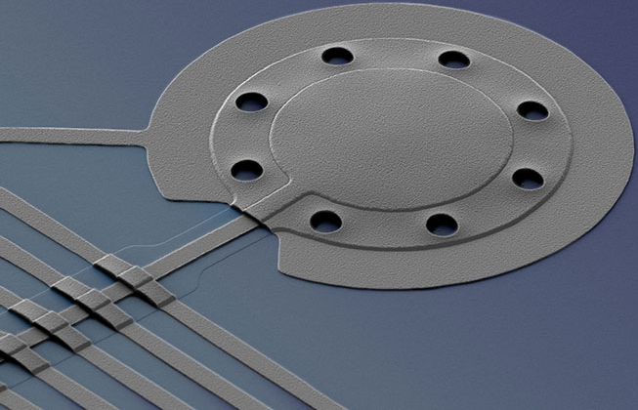
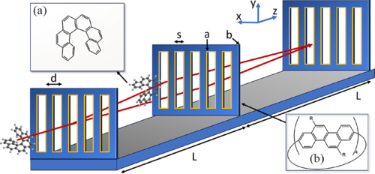
Not only single particles or atoms
Bose-Einstein condensates (10²-10⁵ atoms)
levitated particles (10⁷-10¹⁰ atoms)
molecule interferometry (10³ atoms)
nano-mechanical oscillators (10⁷-10¹⁷ atoms)

Slide 10
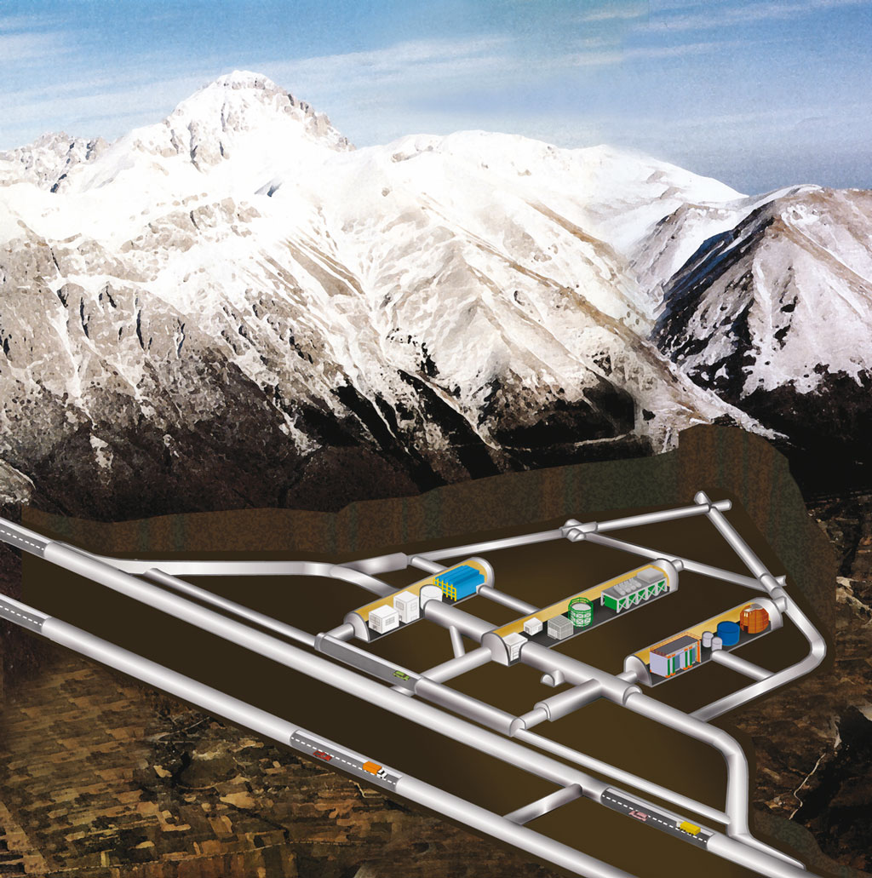
Experiments underground
Extreme precision experiments in underground laboratories – also relationship between DM and QG
Gran Sasso

Slide 11
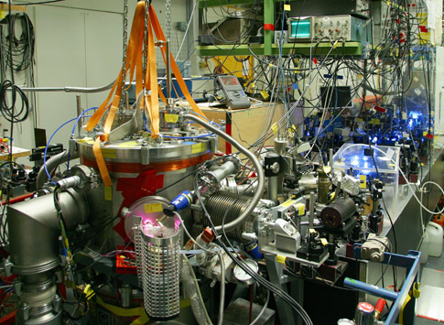
Precision Spectroscopy
Status: Among the most mature approaches.
Focus: Measuring tiny shifts in atomic and molecular energy levels (e.g., hydrogen spectroscopy, antihydrogen spectroscopy).
Quantum Gravity Connection: Tests of Lorentz invariance, limits on spacetime discreteness, and searching for effects predicted by quantum gravity models (like Planck-scale modifications).
Example: Hydrogen 1S–2S transition measured at the 10⁻¹⁵ relative uncertainty; no deviation from QED so far.
The 1S-2S hydrogen lab in 2010
http://www2.mpq.mpg.de/~haensch/1s2s/1s2s.html

Slide 12
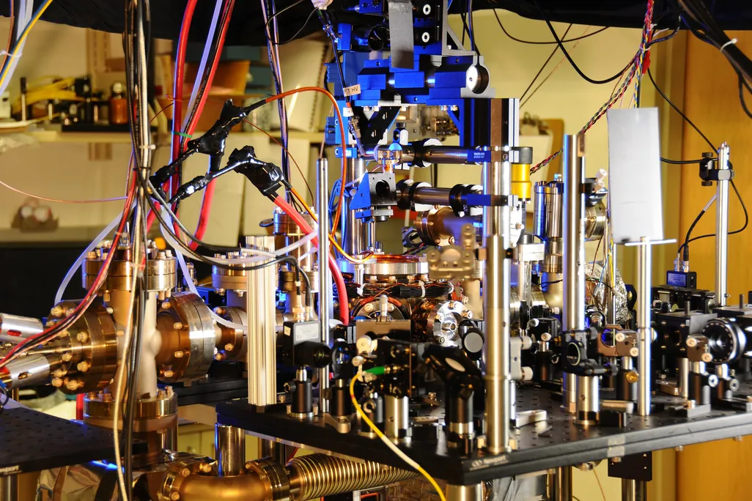
Atomic Clocks
Status: World-leading precision in time measurement.
Focus: Testing time dilation, gravitational redshift, and potential time-varying constants.
Quantum Gravity Connection: Constraining models of temporal decoherence, searching for Planck-scale noise.
Example: achieving stability at ~10⁻¹⁸; no evidence yet of quantum gravity noise.
This is an atomic clock that uses the predictable frequency of ytterbium atoms absorbing and emitting light to tell time. A new experiment paired a ytterbium-based atomic clock with two others that used aluminum and strontium atoms, respectively, to create an even more accurate measure of time. Burrus / NIST

Slide 13
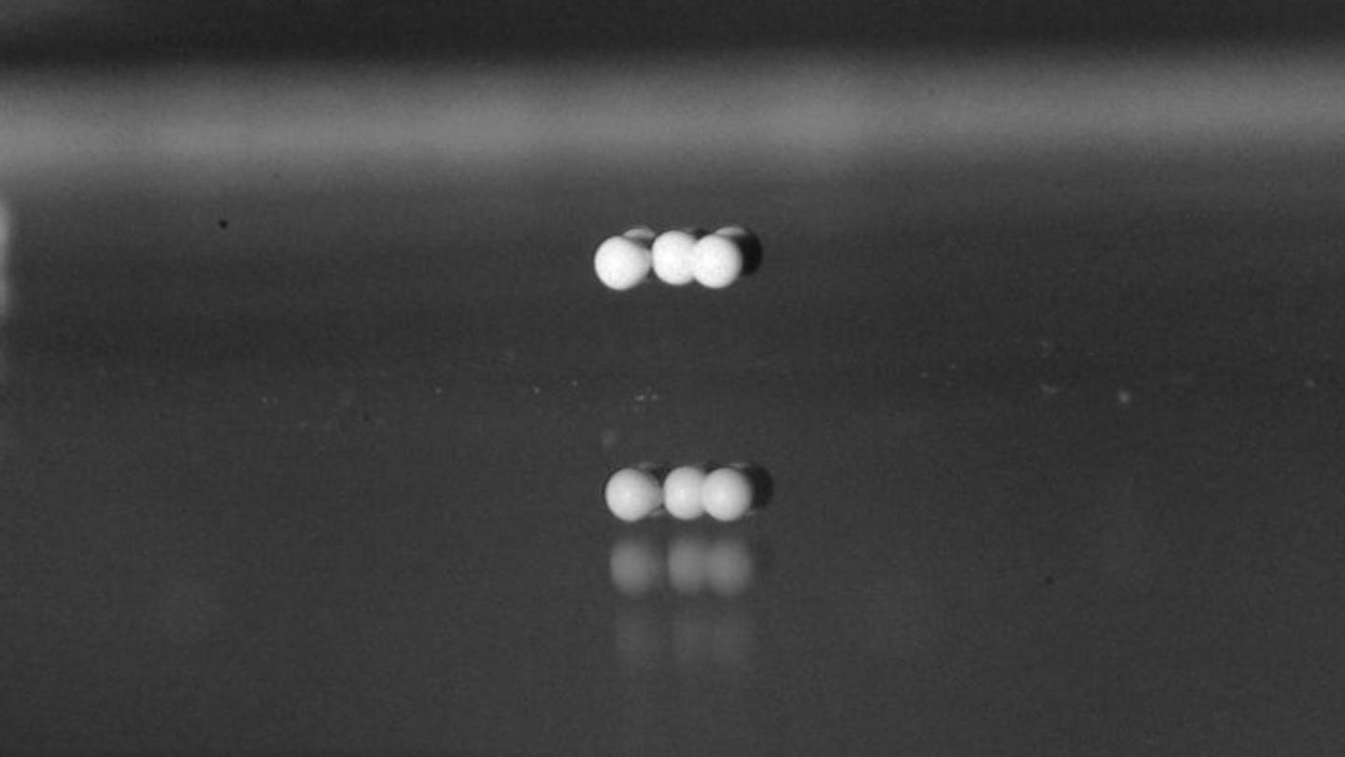
Levitated Particles
Status: Rapidly developing field.
Focus: Controlling the motion of optically or magnetically levitated nanoparticles in ultra-high vacuum.
Quantum Gravity Connection: Proposals to detect minimal length scales or spacetime fluctuations, probe wavefunction collapse…..
Example: Experiments have reached the quantum ground state of motion; searches for gravitational decoherence ongoing.
Univ.of Chicago and the University of Bath scientists revealed new insights about how materials cluster together in the absence of gravity. Courtesy of Melody Lim

Slide 14
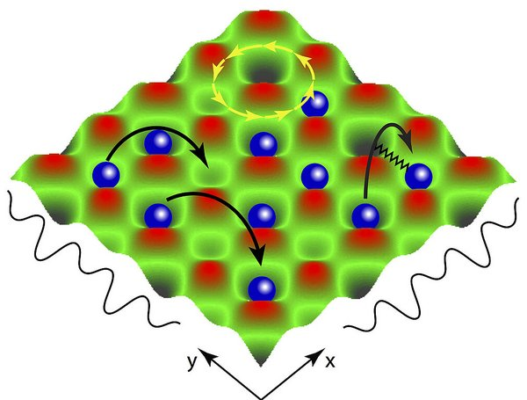
Many-Body Quantum Systems
Status: Emerging.
Focus: Entanglement and coherence in ultracold atoms and condensed matter.
Quantum Gravity Connection: Studying whether gravitational interactions can entangle spatially separated masses (testing models like semiclassical gravity vs. quantized gravity).
Example: Early experiments with Bose-Einstein condensates coupled to massive objects.
https://www.pks.mpg.de/nqd

Slide 15
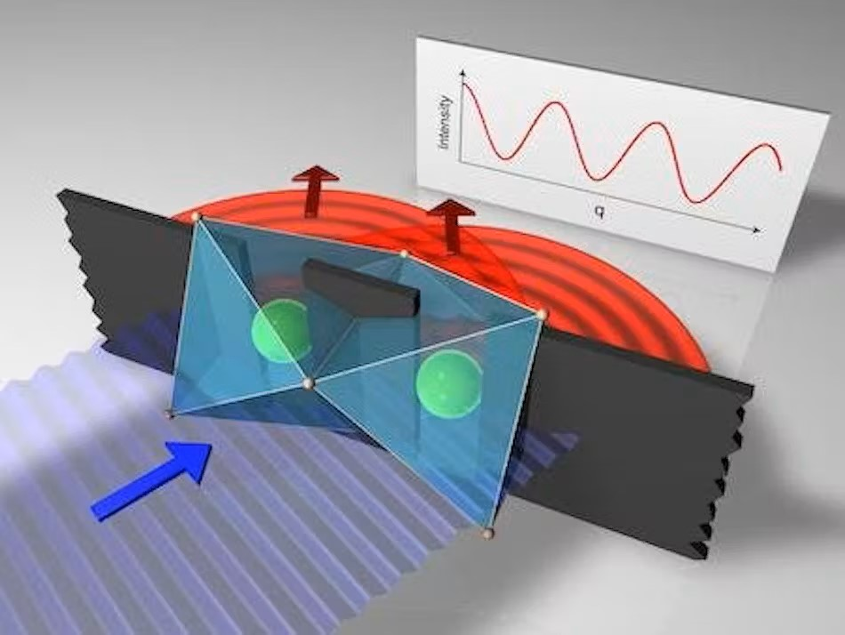
Double-Slit Experiments
Status: Classic but scaling up.
Focus: Interference of ever-larger particles.
Quantum Gravity Connection: Seeing whether interference disappears for large masses due to gravitational effects (e.g., spontaneous localization).
Example: Molecule interference up to ~10,000 amu; proposals for interferometry with nanoparticles.
https://www.laserfocusworld.com/test-measurement/test-measurement/article/16566907/classic-double-slit-experiment-redone-with-x-rays-and-two-adjacent-iridium-atoms

Slide 16
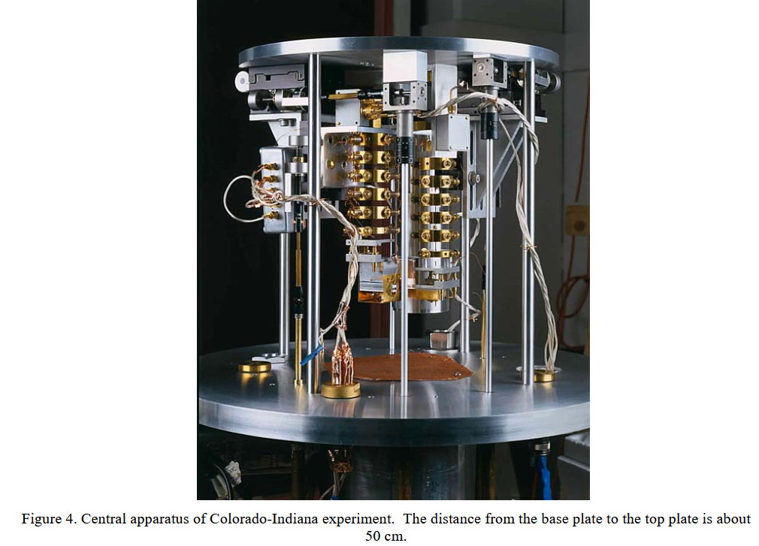
Torsion Balances
Status: Established.
Focus: Detecting tiny forces and torques.
Quantum Gravity Connection: Tests of inverse square law violations at short distances; probing extra dimensions.
Example: search of new forces down to micrometer scales.

Slide 17
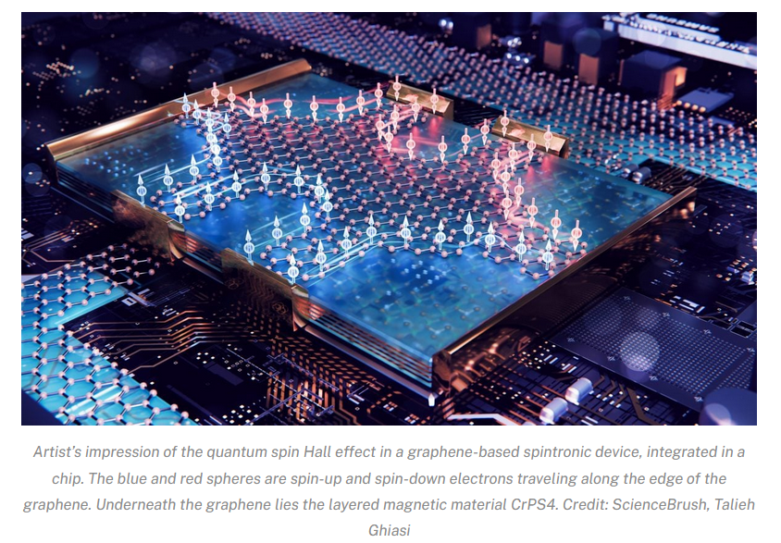
Solid-State Devices
Status: Growing.
Focus: Josephson junctions, SQUIDs, resonators.
Quantum Gravity Connection: Searching for quantum spacetime noise, minimal length effects, and decoherence.
Example: No conclusive detection; sensitivity improving.

Slide 18
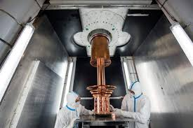
Underground Experiments
Status: Mature in dark matter and neutrino physics; beginning for quantum gravity.
Focus: Low-background environments.
Quantum Gravity Connection: Potential tests of Planck-scale effects, rare decays, and energy deposition from spacetime granularity.
Example: No signal yet; facilities like Gran Sasso provide ideal environments.
LNGS

Slide 19
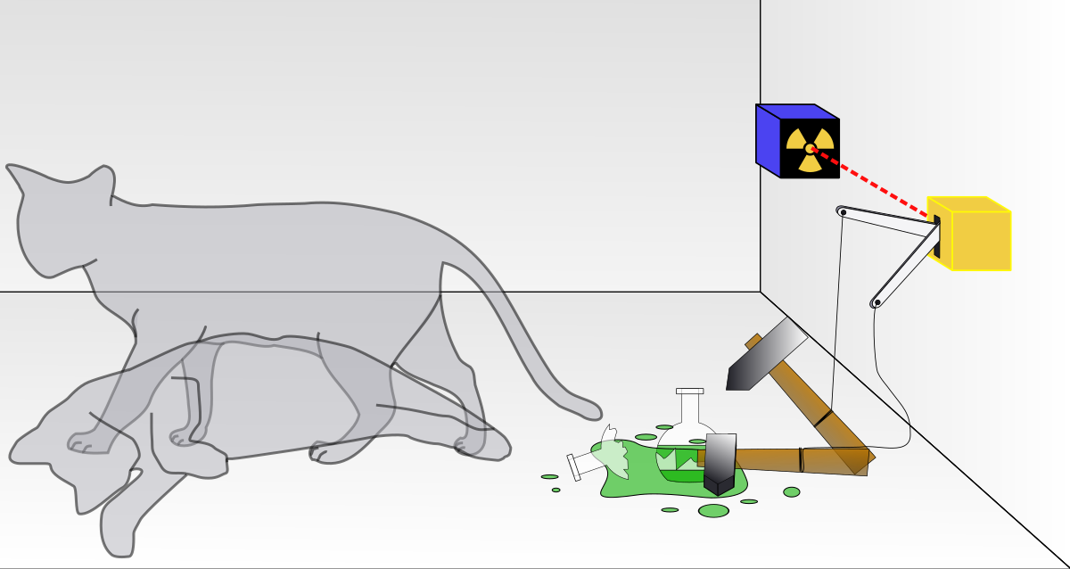
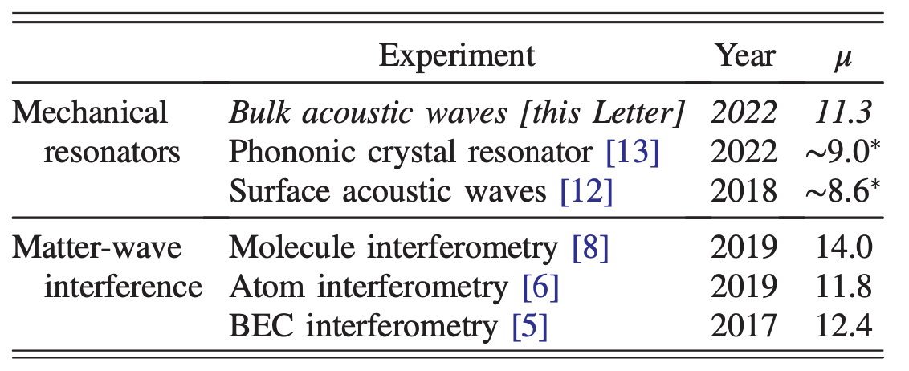
Challenges
    many atoms = large mass ☺
              = many degrees of freedom available ☺
    many atoms = many degrees of freedom to control ☹
                = many decoherence channels ☹
many atoms = macroscopic?
number of particles, mass, energy difference,
delocalization distance, coherence time, …
Schrinski et at. PRL 130, 133604 (2023)
Yadin and Fadel, arXiv:2503.08324 (2025)

Slide 20
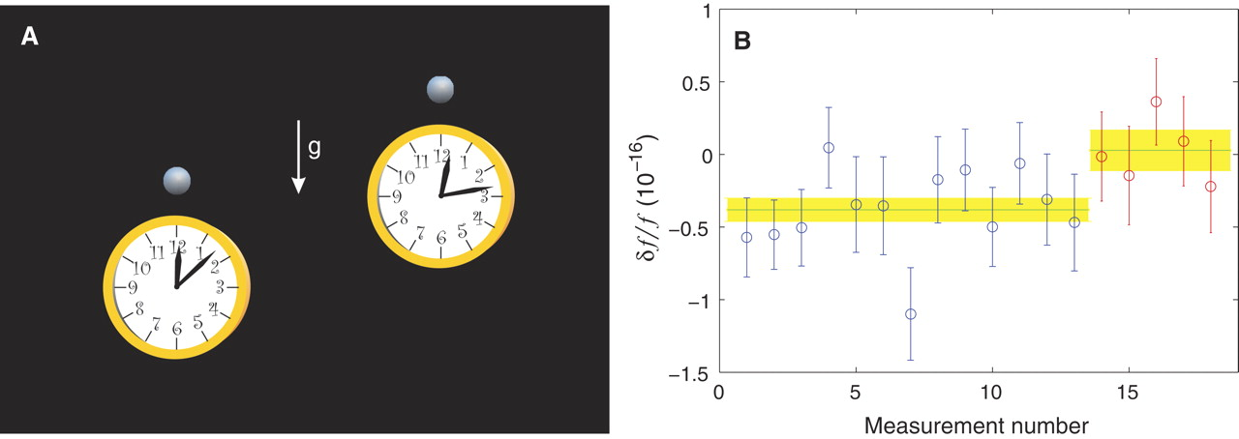
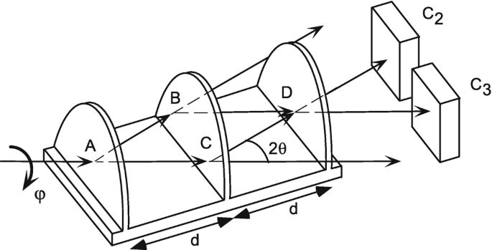
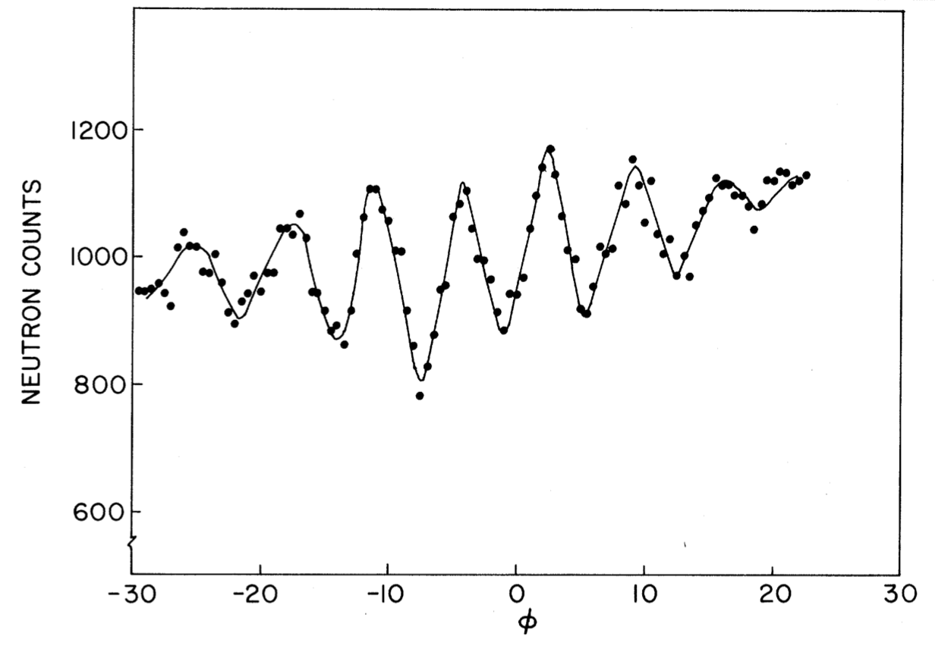
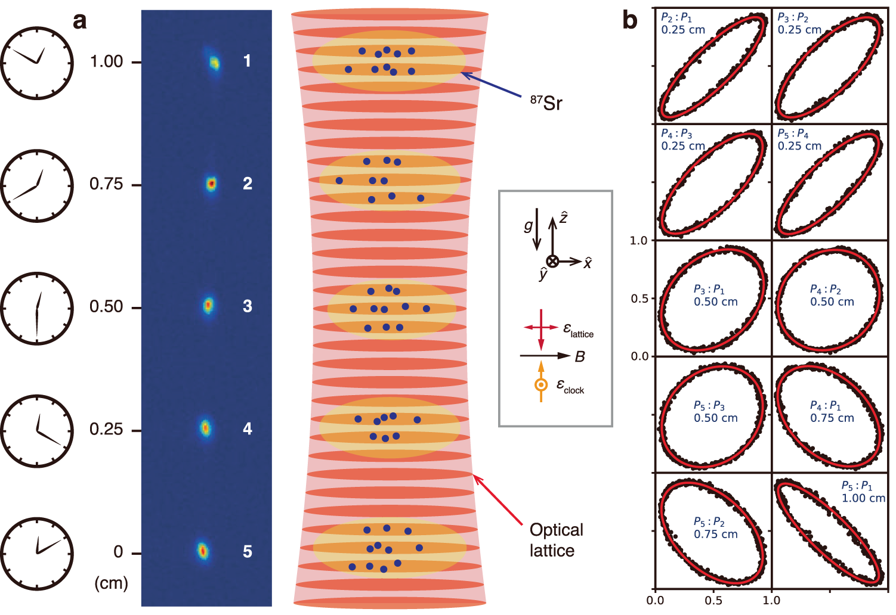
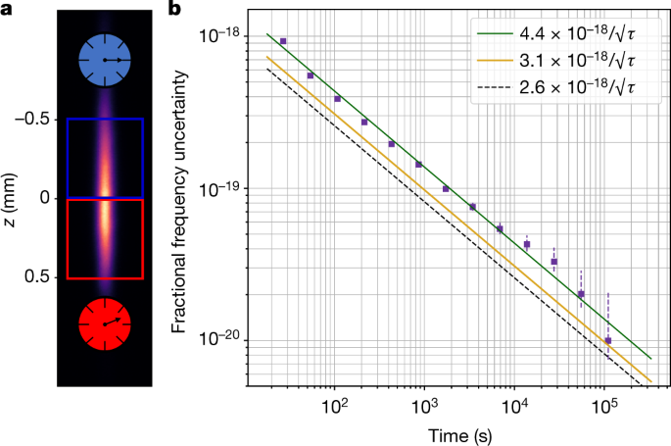
Interaction with gravity
~30 cm
Colella et al. Phys. Rev. Lett. 34, 1472 (1975)
Chou et al. Science 329, 1630 (2010)
Zheng et al. Nat. Comm. 14, 4886 (2023)
Bothwell et al. Nature 602, 420 (2022)

Slide 21
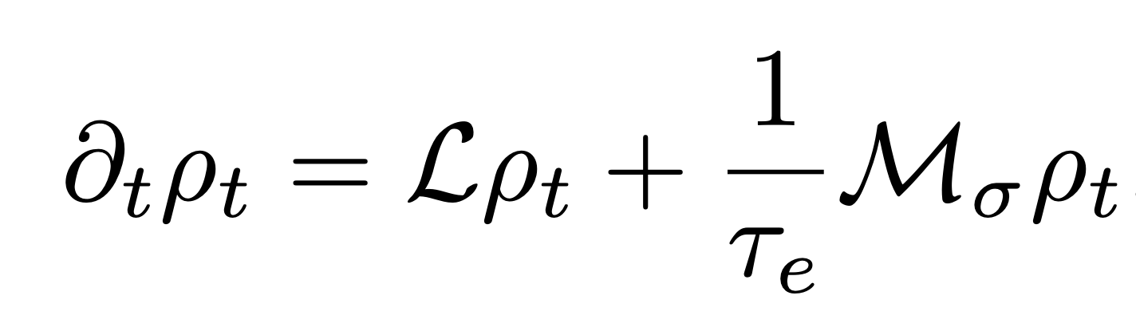
Testing modifications to QM
standard QM
modification

Slide 22
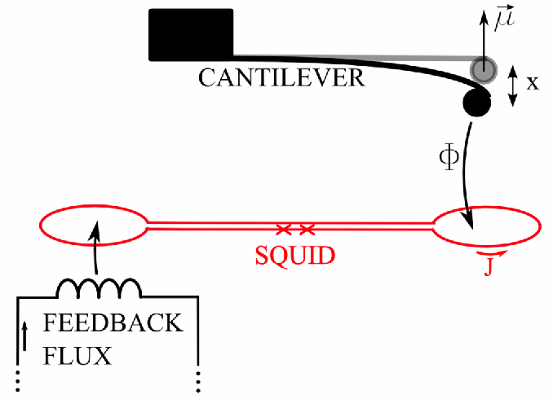
Testing modifications to QM
interferometric tests
non-interferometric tests
direct measurement of the decoherence of a quantum (superposition) state
indirect decoherence measurement through e.g. heating or emission effects
see also: precision spectroscopy, mechanical oscillators,
atom interferometers, …
see also: levitated particles, bulk matter, cold atoms, gravitational waves, …

Slide 23
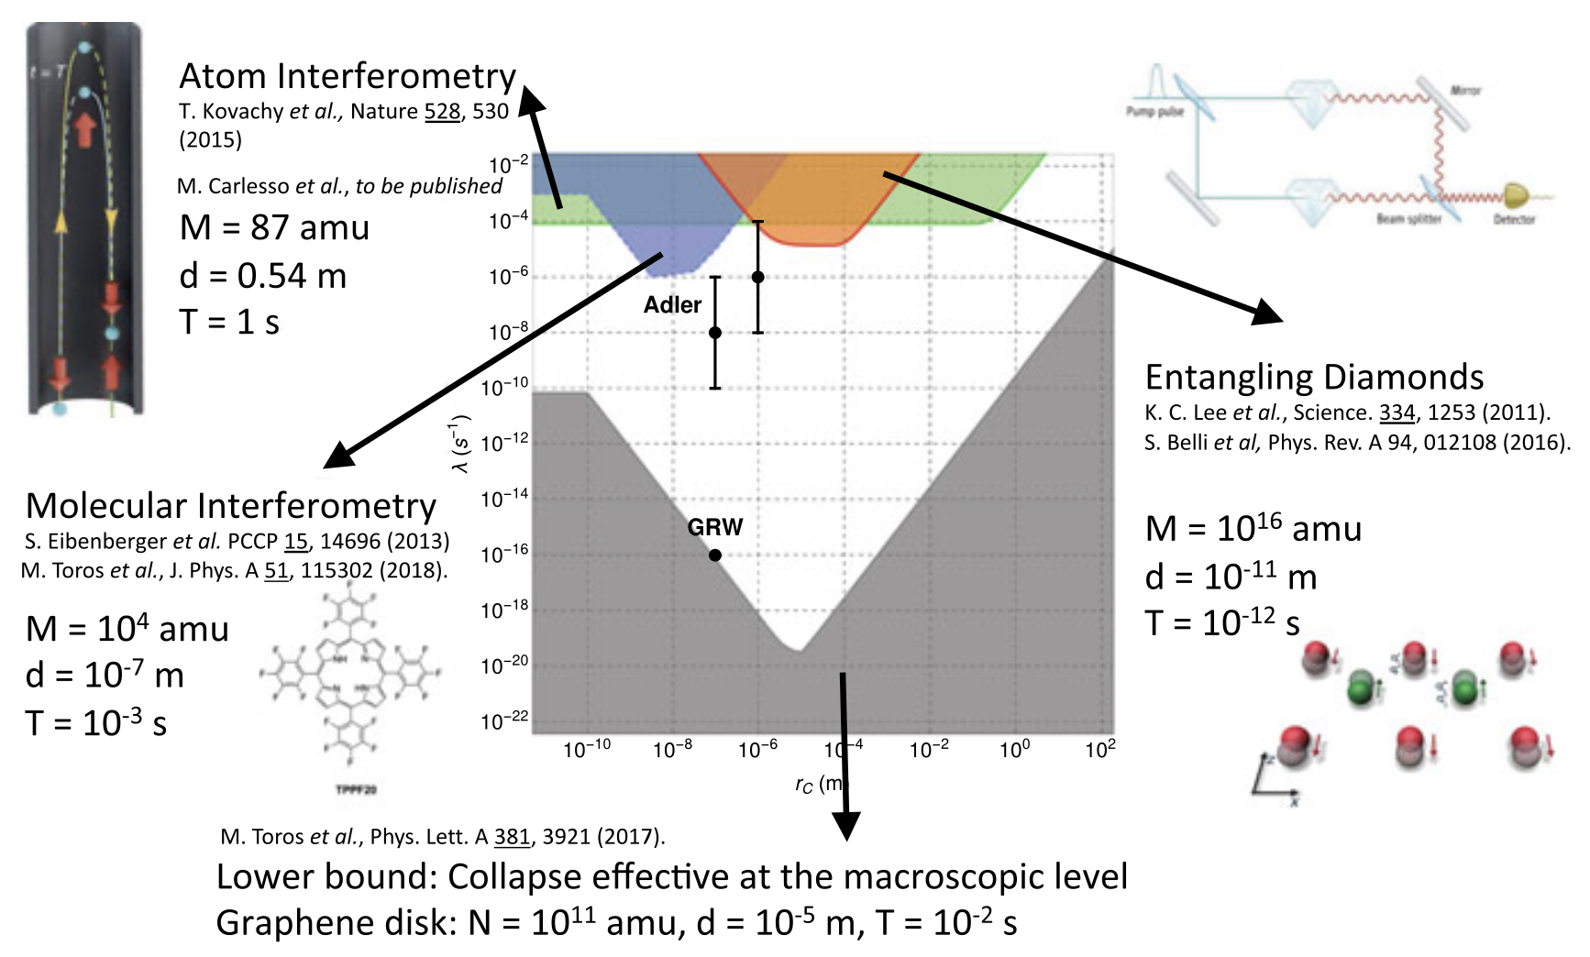
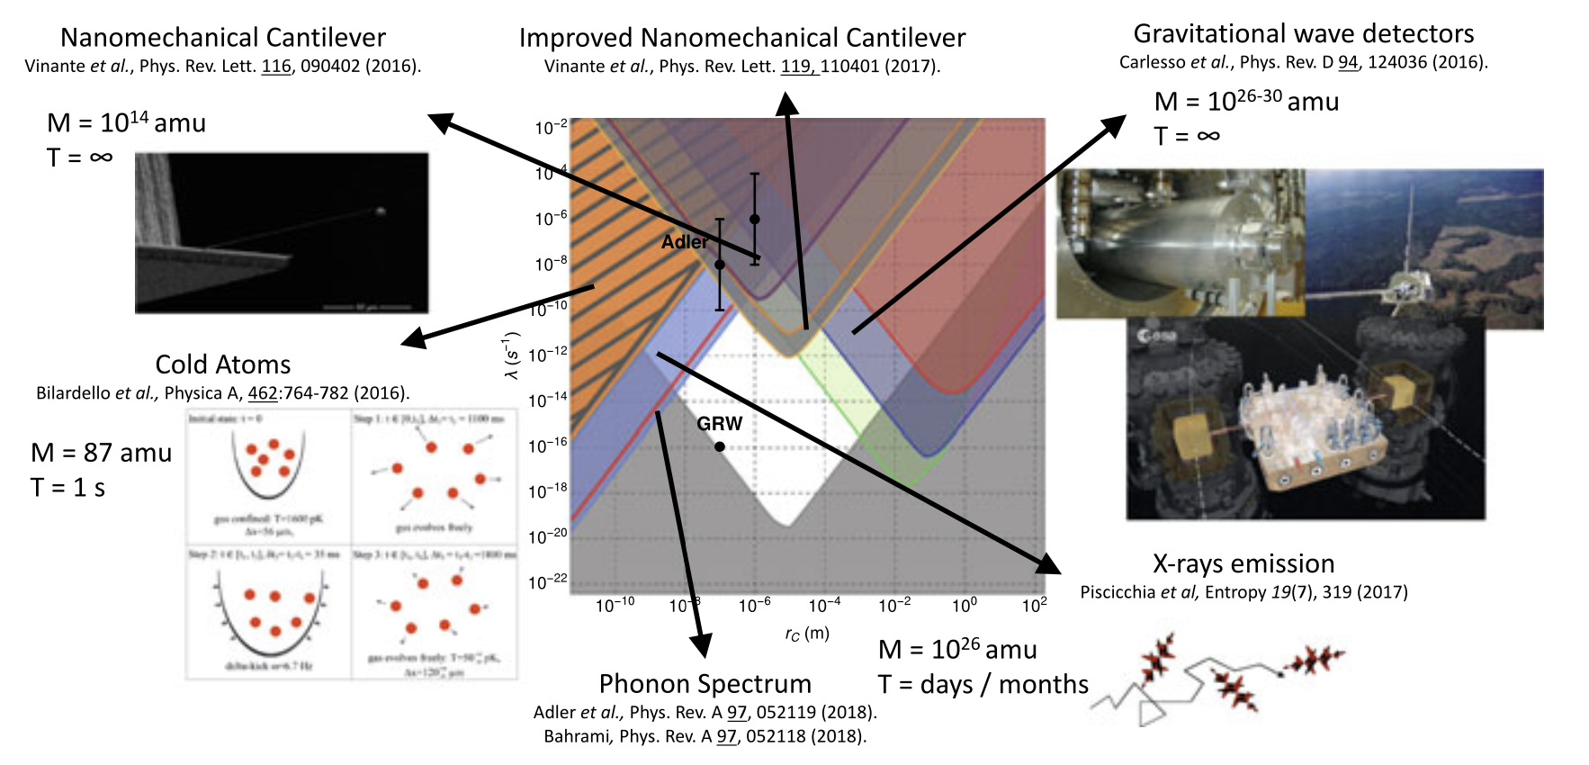
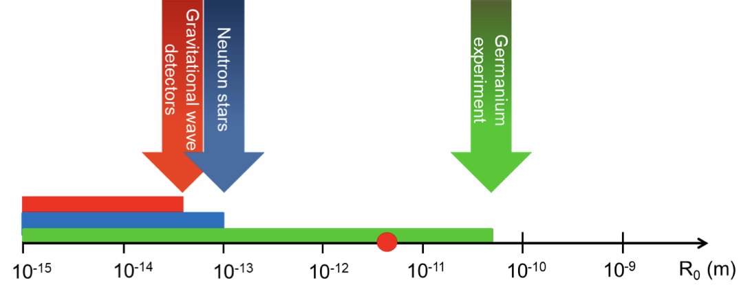
Testing modifications to QM
interferometric tests
non-interferometric tests
Diosi-Penrose
Carlesso and Donadi, Springer (2019)
Donadi et al. Nature Physics 17, 74 (2021)

Slide 24
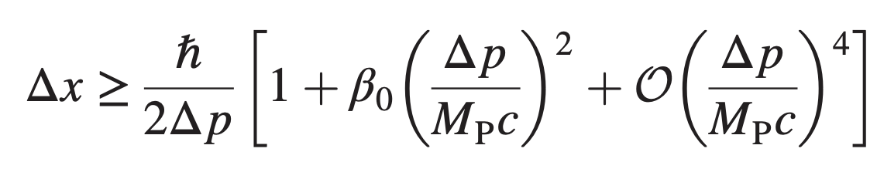
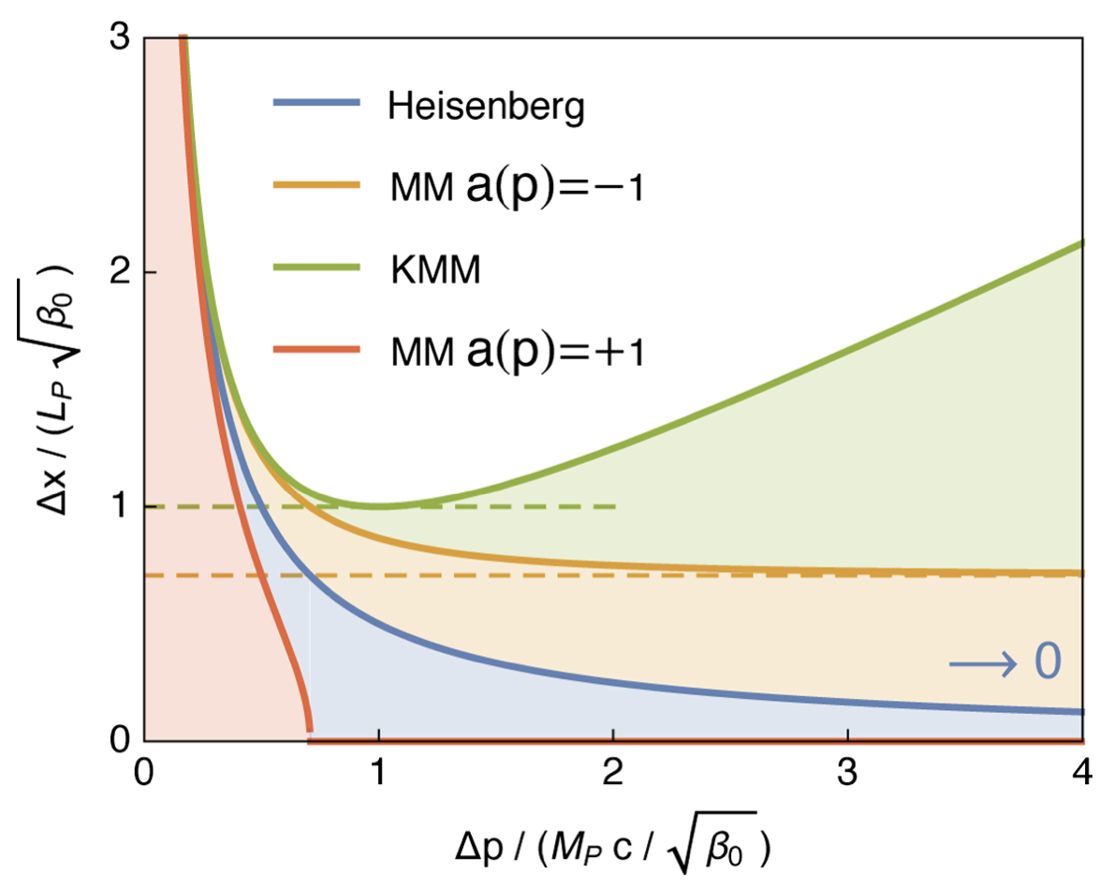
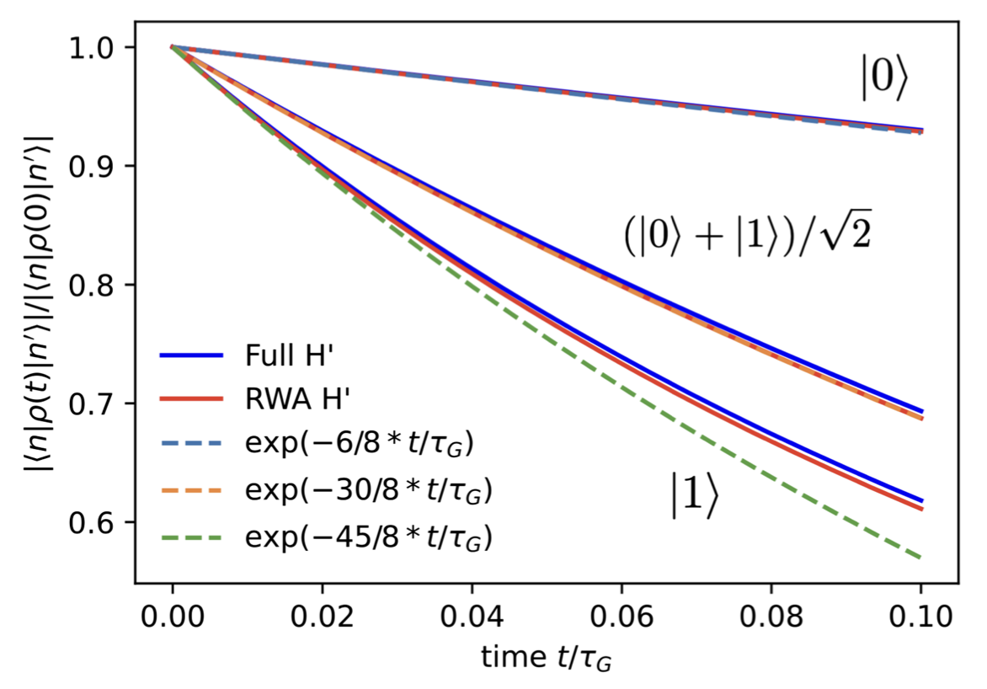
Spacetime structure tests
GUP
stochastic spacetime fluctuations
or foaminess
Breuer et al., Quant. Grav. 26, 105012 (2009).
Petruzziello and Illuminati, Nat. Comm. 12 (2021)
Arzano et al., Comm. Phys. 6 (2023)
Donadi and Fadel PRD 111, 026009 (2025)
Fadel and Maggiore PRD 105, 106017 (2022)
experiment

Slide 25
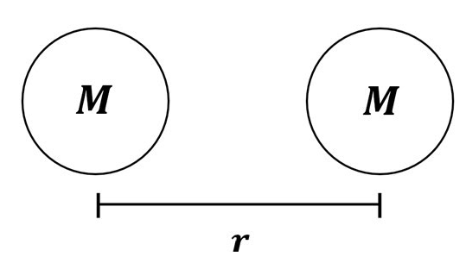
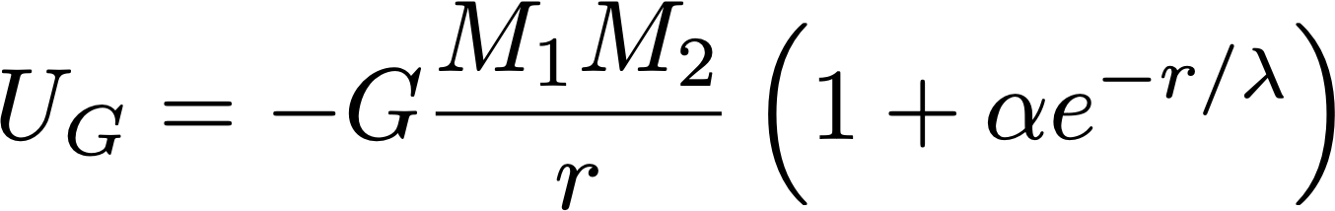
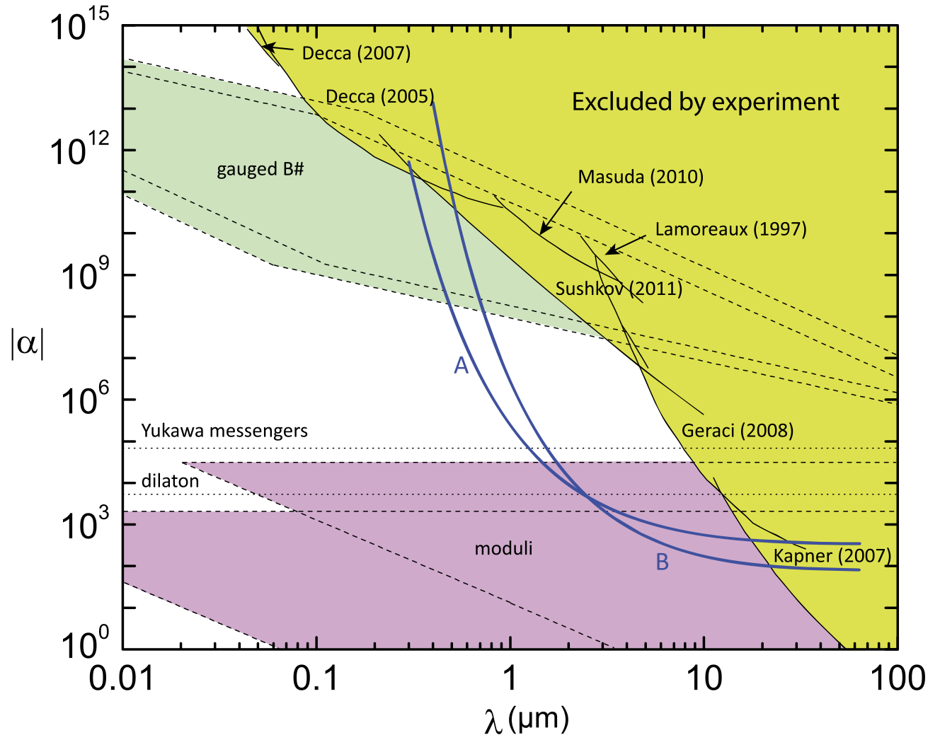
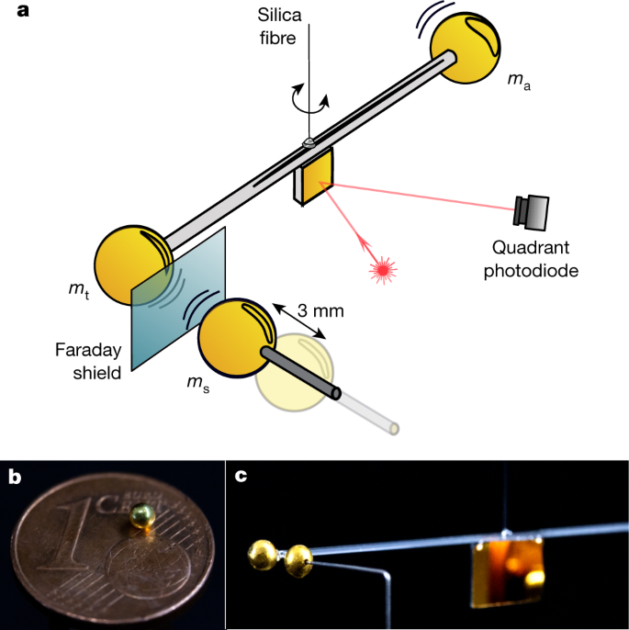
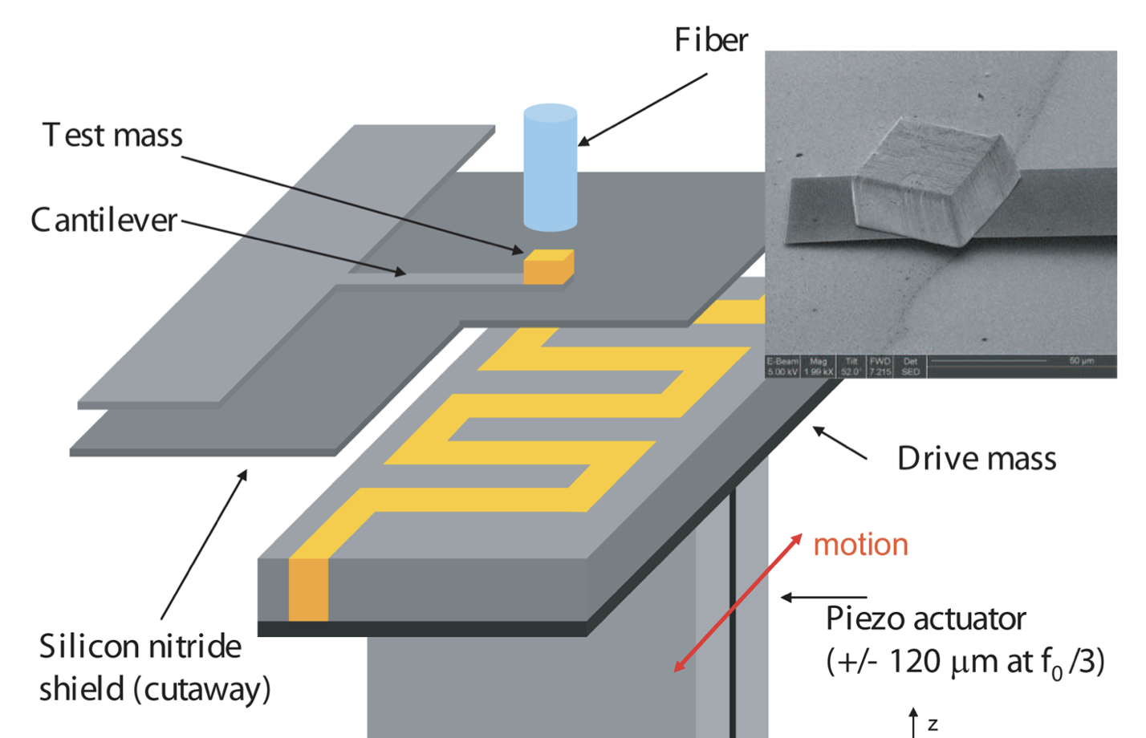
Gravity at short distances
Geraci and Goldman, PRD 92, 062002 (2015)
Westphal et al., Nature 591, 225 (2021)
Geraci et al., PRD 78, 022002 (2008)

Slide 26
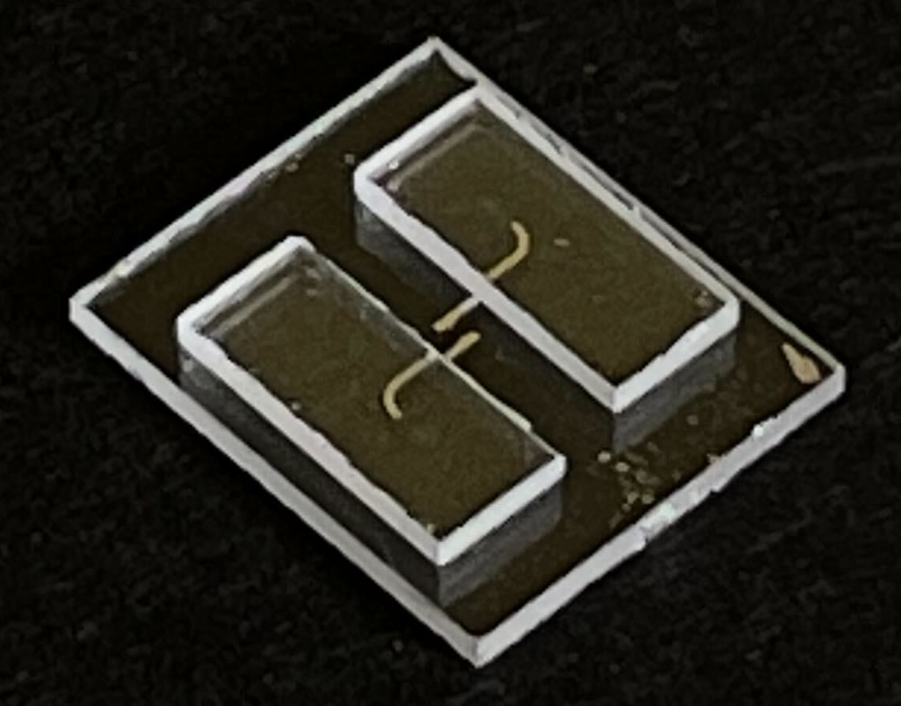
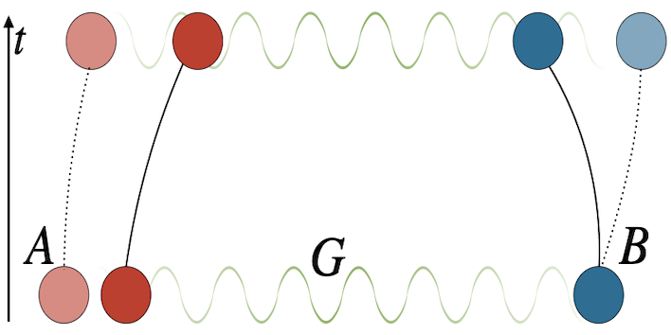
Long term goal
can gravity mediate entanglement?
i.e. is gravity quantum?
Galley et al.
Marletto ad Vedral PRL 119 (2017)
Bose et al. PRL 119 (2017)

Slide 27
Summary
No confirmed experimental evidence of quantum gravity yet.
Precision keeps improving by orders of magnitude every decade.
Next milestones:
Entanglement experiments with mesoscopic masses.
Interference of levitated particles >10⁹ amu.
Better torsion balance sensitivity below microns.
Clock comparisons over gravitational gradients
Underground experiments – more precision

Slide 28
