Slide 1



Exploring gravity with micro-mechanical oscillators
Francesco Marin
Dipartimento di Fisica e Astronomia
Università di Firenze
Paris, July 7-10, 2025

Slide 2

Outline
Upper limit to defomed canonic commutator using mechanical oscillators
Measuring gravity force between micro-oscillators
Quantum effects in the motion of levitated nanospheres
HUMOR
GRAFIQO

Slide 3

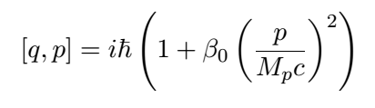

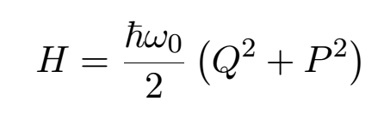
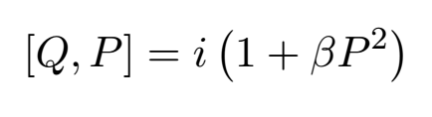
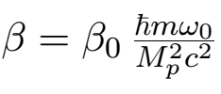
Modified commutator
HUMOR
1) Modified commutator
2) Keep Heisenberg evolution equations
3) Apply to an harmonic oscillator

Slide 4
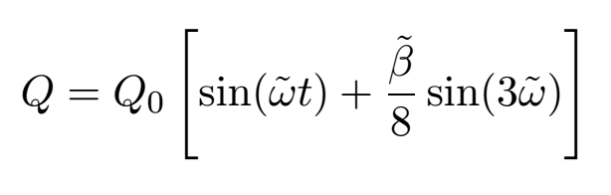
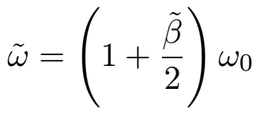

Solution
HUMOR
Third harmonic
Amplitude-dependent frequency shift
Idea: excite the oscillator and measure the frequency during the free decay

Slide 5
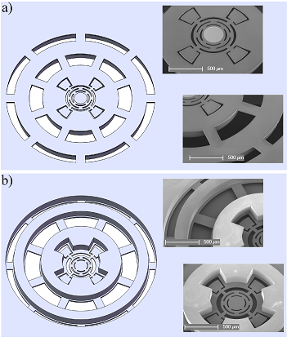
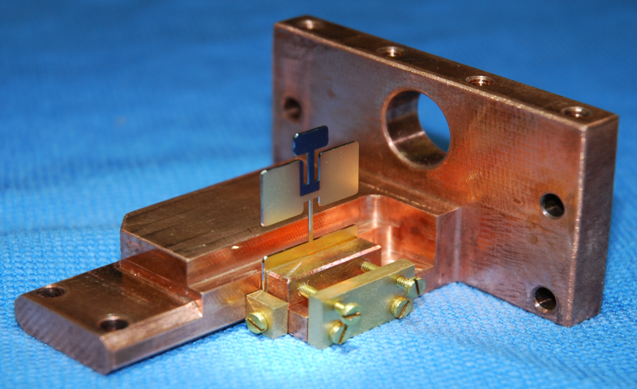
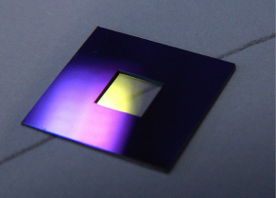
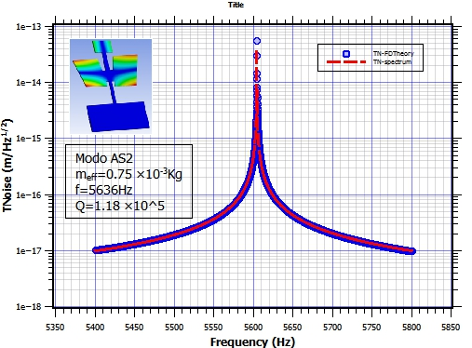
Three oscillators
HUMOR
m ≅ 1 g
m ≅ 100 μg
m ≅ 100 ng
SiN membrane
0.5 x 0.5 mm² x 50nm
mass = 135 ng
Q = 8.6x10⁵
mass = 20 μg
f_{m} = 141 KHz
Q = 1.2 x10⁶ T = 4.3 K

Slide 6
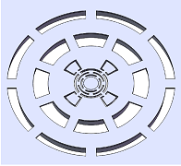
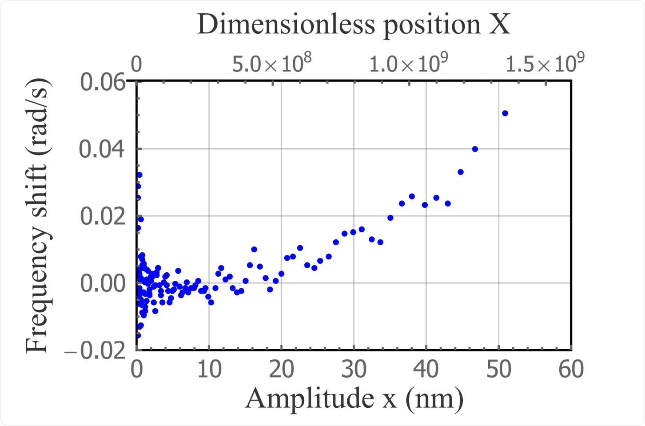
Results
HUMOR

Slide 7

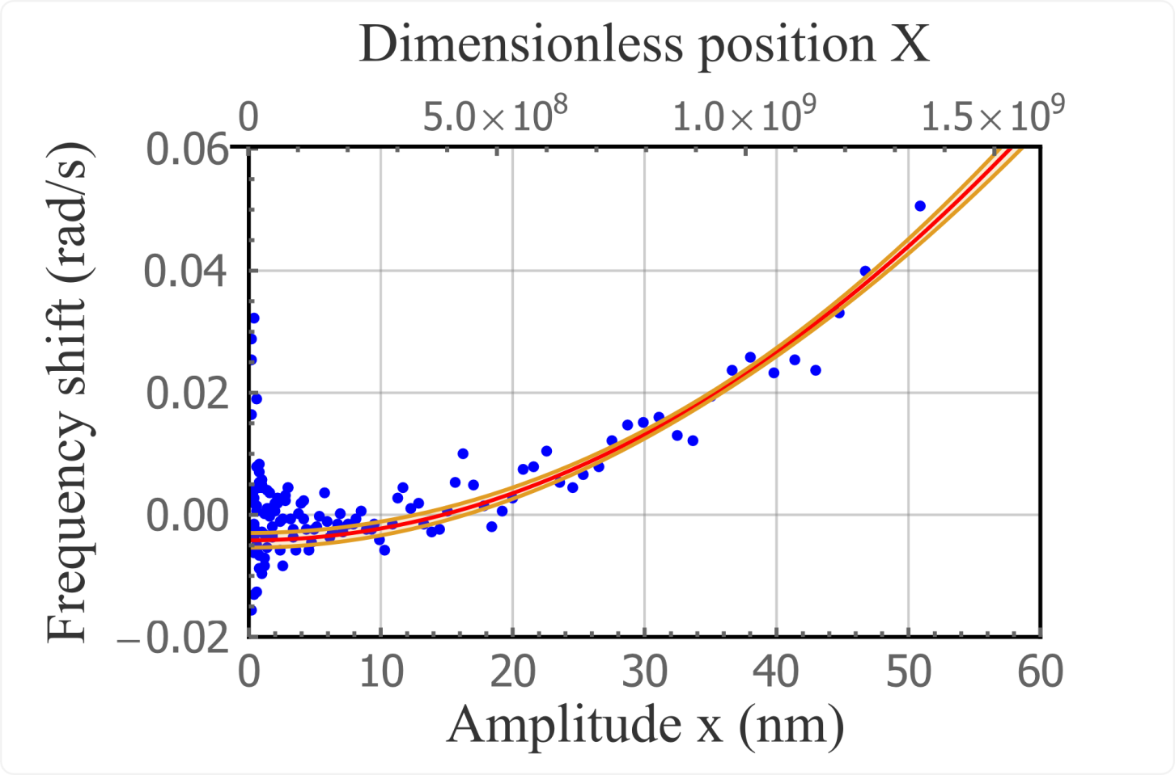
Results
HUMOR
Evidence of deformed commutator?
Structural non-linearity

Slide 8
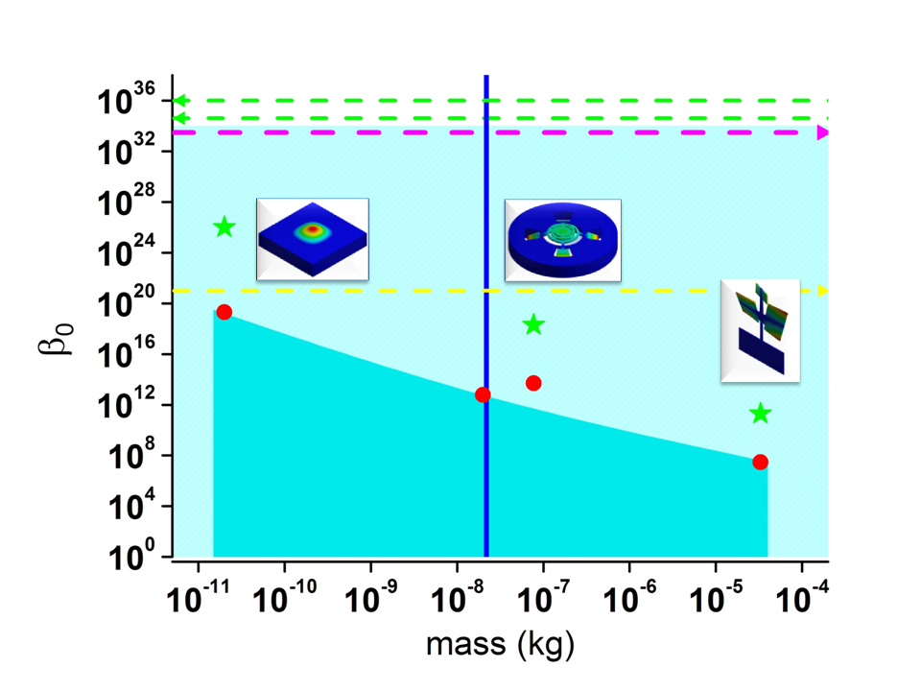
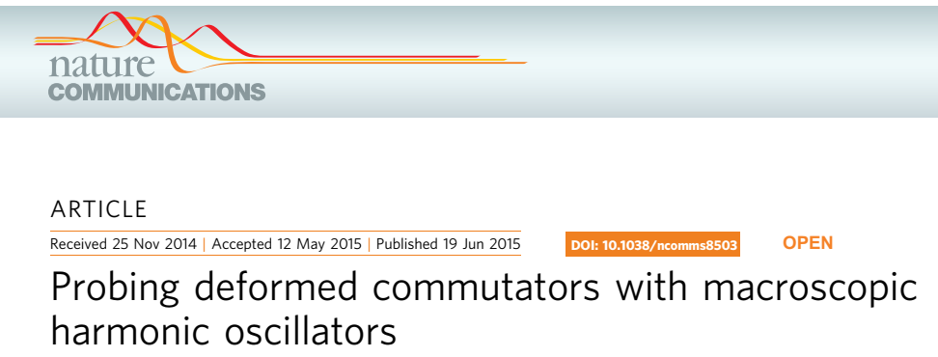
Upper limits
HUMOR
M_{P}
3° harmonic
δω vs q
See also: P. A. Bushev et al., Phys. Rev. D 100, 066020 (2019)

Slide 9
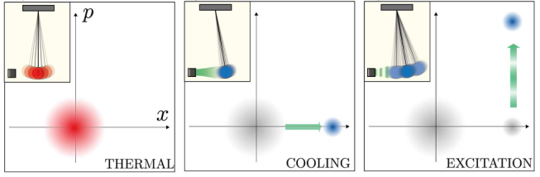
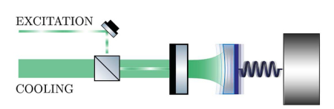
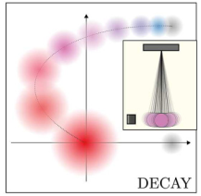
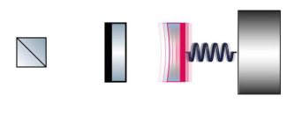
Measurements on a high purity state
W. Li. et al., . Quantum Sci. Technol. 10, 035055 (2025)

Slide 10
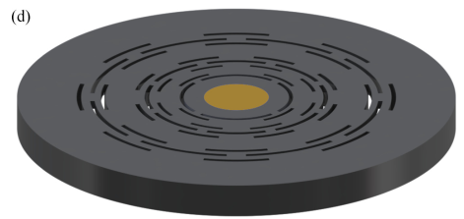
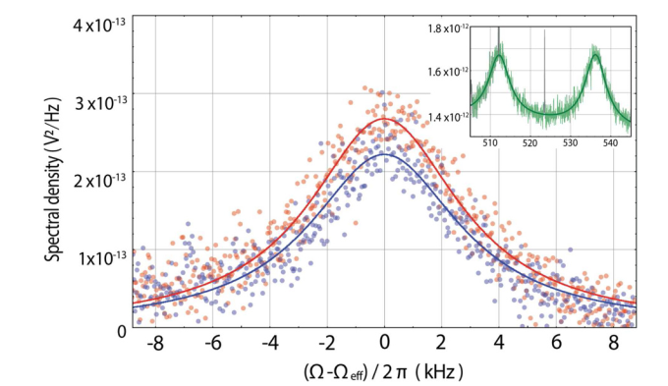
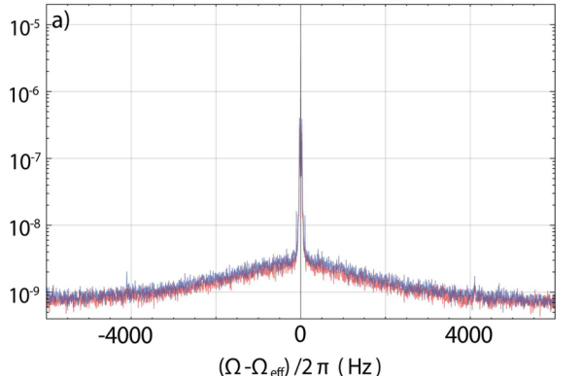
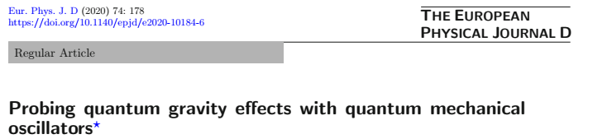
Thermal spectra
HUMOR
Thermal occupancy n = 5 (purity = 0.1)
Decoherence rate 1/5 μs⁻¹
Coherent displacement α = 6

Slide 11
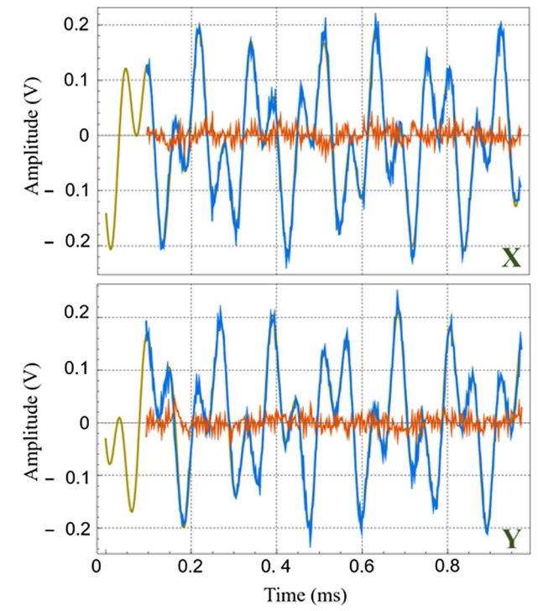
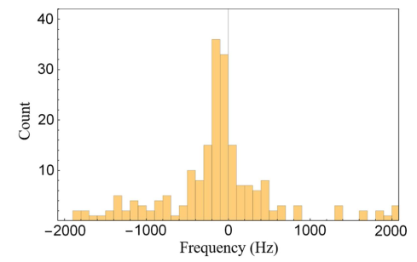
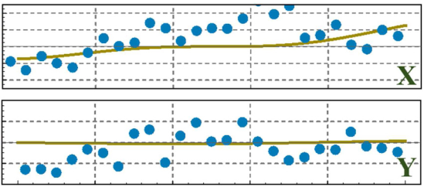
Frequency shift
HUMOR

Slide 12
Preliminary upper limit to β₀
HUMOR

Slide 13
Outline
Upper limit to defomed canonic commutator using mechanical oscillators
Measuring gravity force between micro-oscillators
Quantum effects in the motion of levitated nanospheres
HUMOR
GRAFIQO

Slide 14
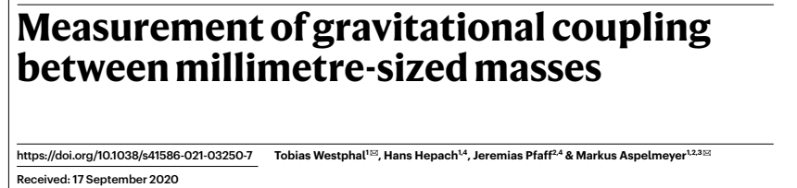
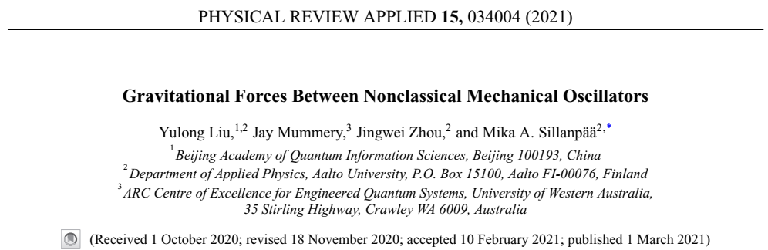
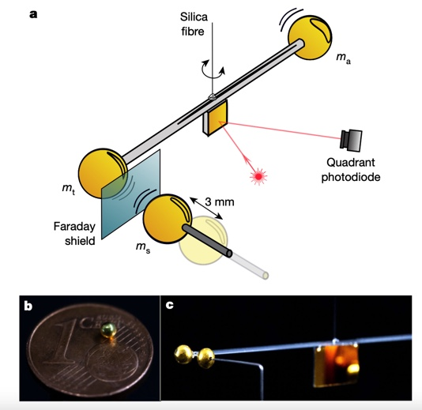
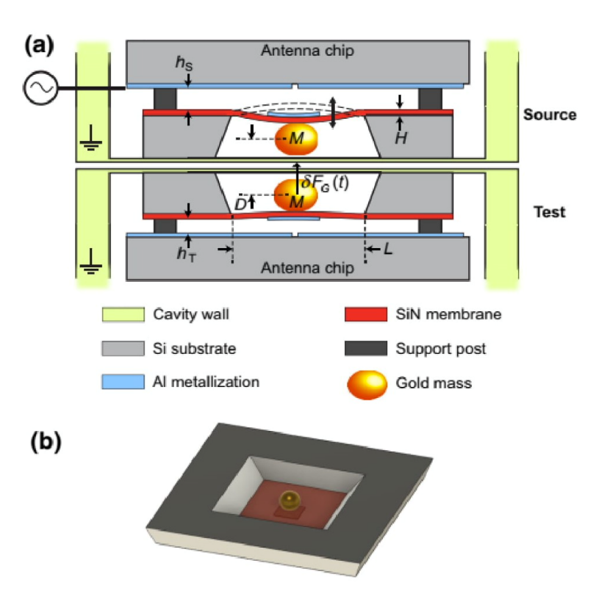
Introduction
GRAFIQO

Slide 15
Experimental scheme
GRAFIQO
Source oscillator
Probe oscillator
Electric shield
SiN membrane

Slide 16
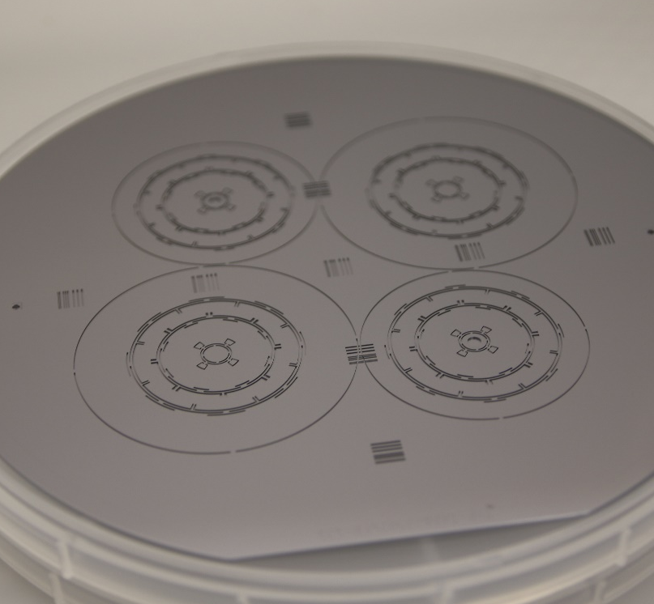
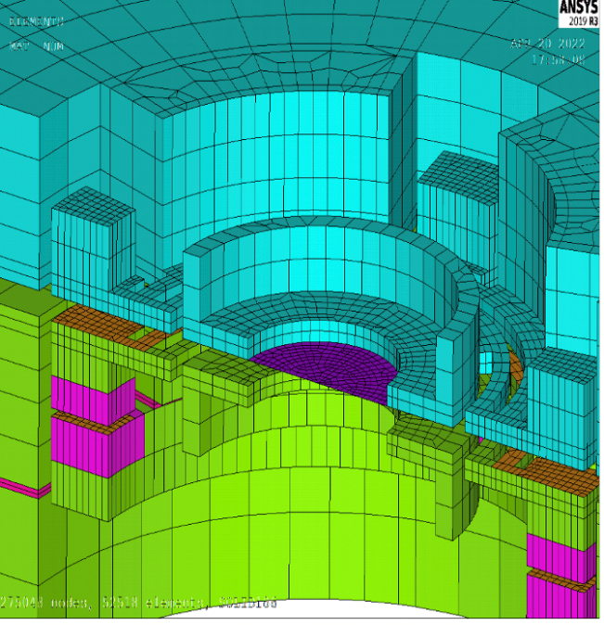
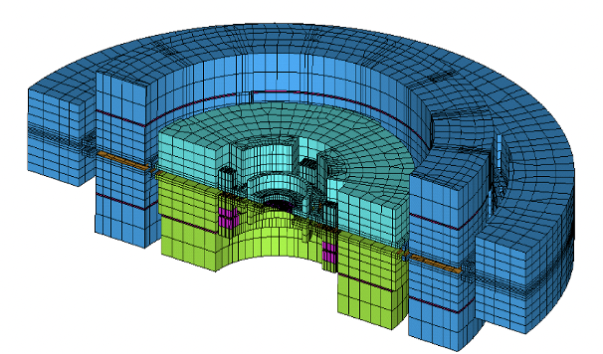
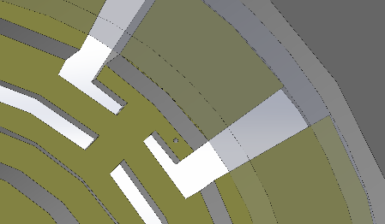
Source-Probe design
GRAFIQO
DC+AC
Metalized
Through Silicon Vias
Notes:
Abbiamo scelto l’eccitazione elettrostatica
WP1: Progettazione e realizzazione di dispositivi - si vuole eccitare il sistema dall’interno con risulatate forze nulla
Dobbiamo discriminare la componente gravitazionale dai rumori con una misura in risonanza. La membrana risuona a 200k Hz
Siamo passati all’attuazione elettrostatica osservado la forza

Slide 17
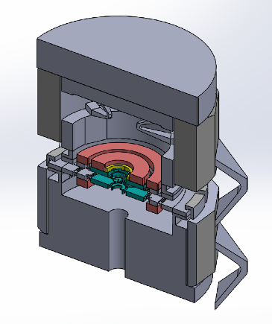
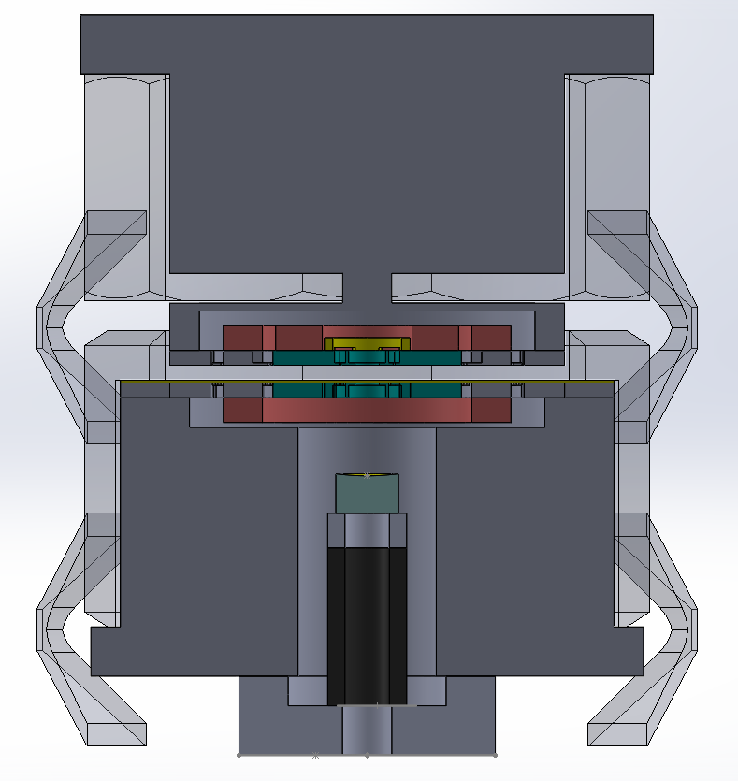
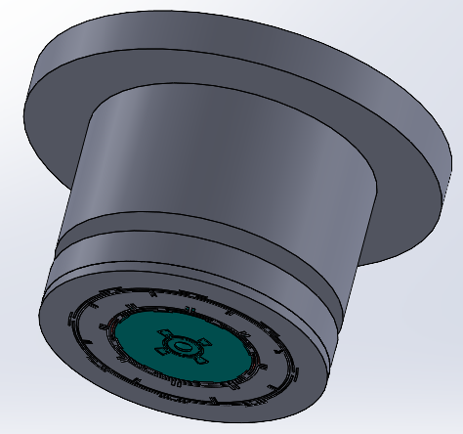
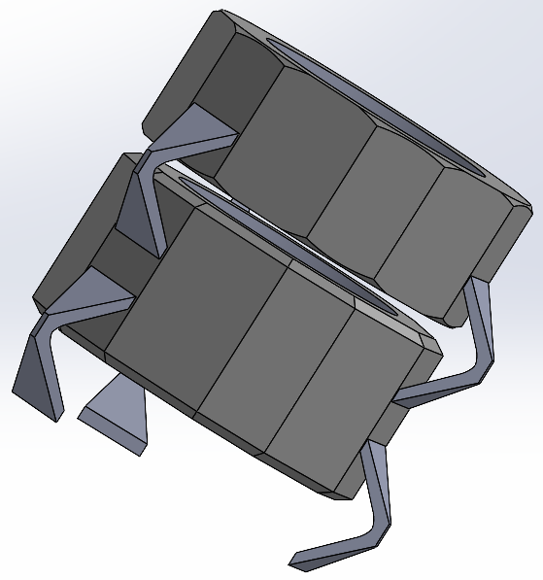
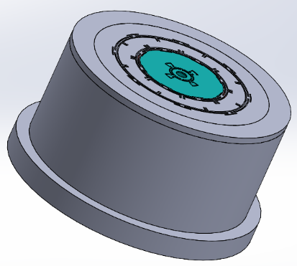
Cavity design
GRAFIQO
Source holder
Cavity body
Probe holder
Input mirror
Piezo

Slide 18
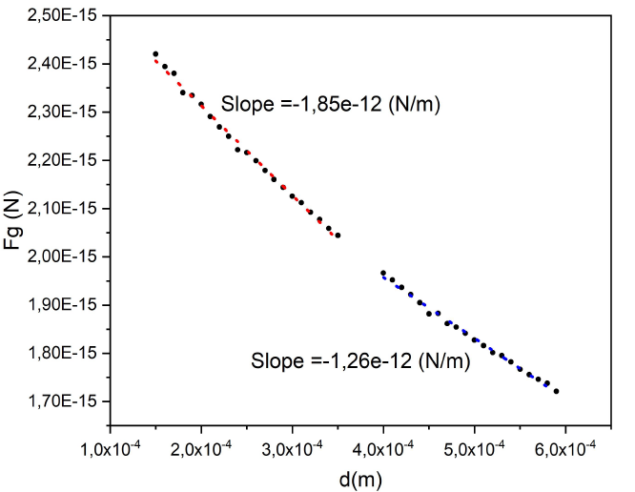
Design parameters
GRAFIQO
 | Source | Probe
Test mass (mg) | 15 | 15
Quality factor | 1 x 10⁶ | 50 x 10⁶
Resonance frequency (kHz) | 20 | 20
Temperature (mK) | 20 | 20
Source amplitude oscillation of
1 micron with 100 V bias and 10 V AC drive
FEM-evaluated gravitational force
The gravitational force is F_{g} = 1.8 x 10⁻¹⁸ N (source amplitude A = 1 micron)
probe displacement = 1.7 x 10⁻¹⁶ m
Thermal fluctuation peak at 20 mK
√S_{xx} = 3 x 10⁻¹⁴ m/√Hz
Integration time to get a unit SNR is 10⁴ s

Slide 19
Experimental steps
GRAFIQO
Measurement of gravity interaction between thermal oscillators
Cooling of the Probe oscillator down to n ≅ 1
Upper limit to β₀ using the Probe oscillator
Cooling of the Source oscillator

Slide 20
Experimental steps
GRAFIQO
Measurement of gravity interaction between thermal oscillators
Cooling of the Probe oscillator down to n ≅ 1
Upper limit to β₀ using the Probe oscillator
Cooling of the Source oscillator

Slide 21
Experimental steps
GRAFIQO
Measurement of gravity interaction between thermal oscillators
Cooling of the Probe oscillator down to n ≅ 1
Upper limit to β₀ using the Probe oscillator
Cooling of the Source oscillator

Slide 22
Outline
Upper limit to defomed canonic commutator using mechanical oscillators
Measuring gravity force between micro-oscillators
Quantum effects in the motion of levitated nanospheres
HUMOR
GRAFIQO

Slide 23
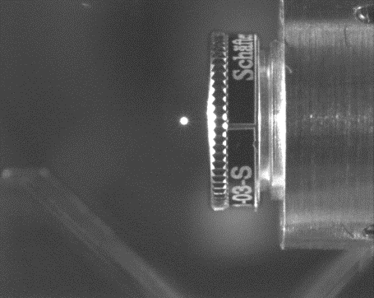
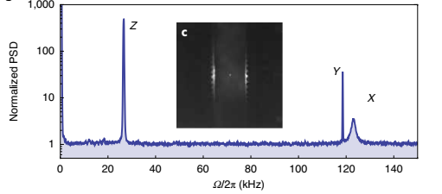
Asymmetry as a function of ‘s’
Levitated silica nanosphere
Y
E
Z
nanosphere Φ = 125 nm
P_{tweezer} = 300 mW
w_{x} = 0.9 μm
w_{y} = 1.0 μm ( // E )

Slide 24
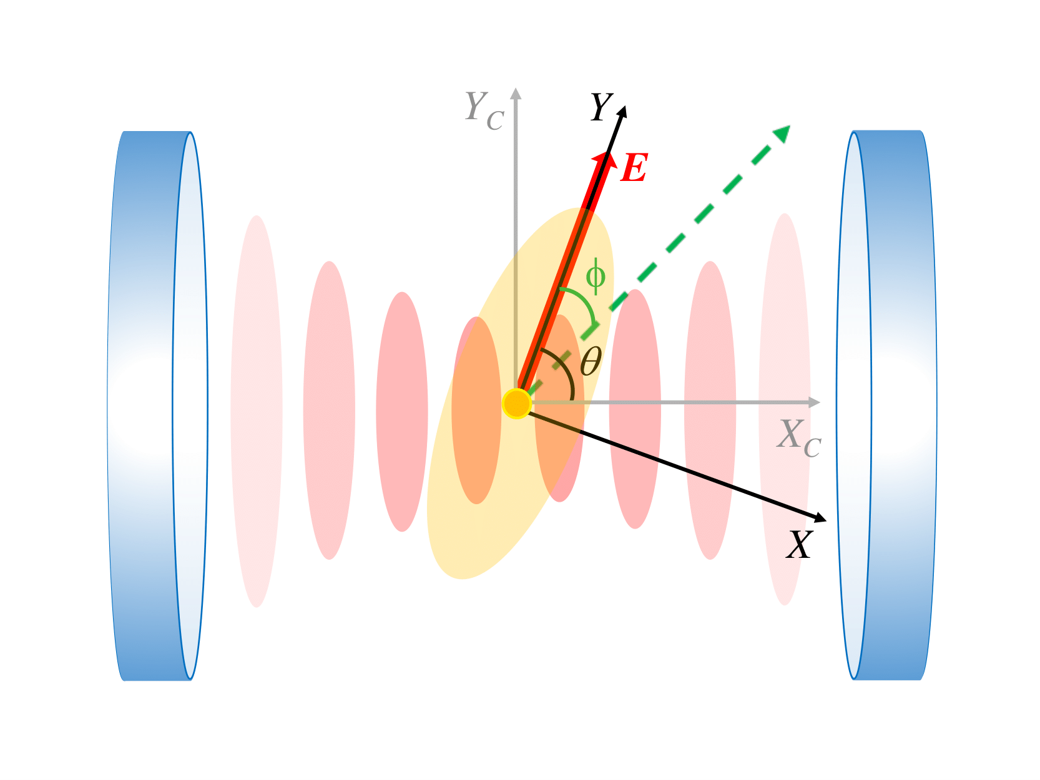
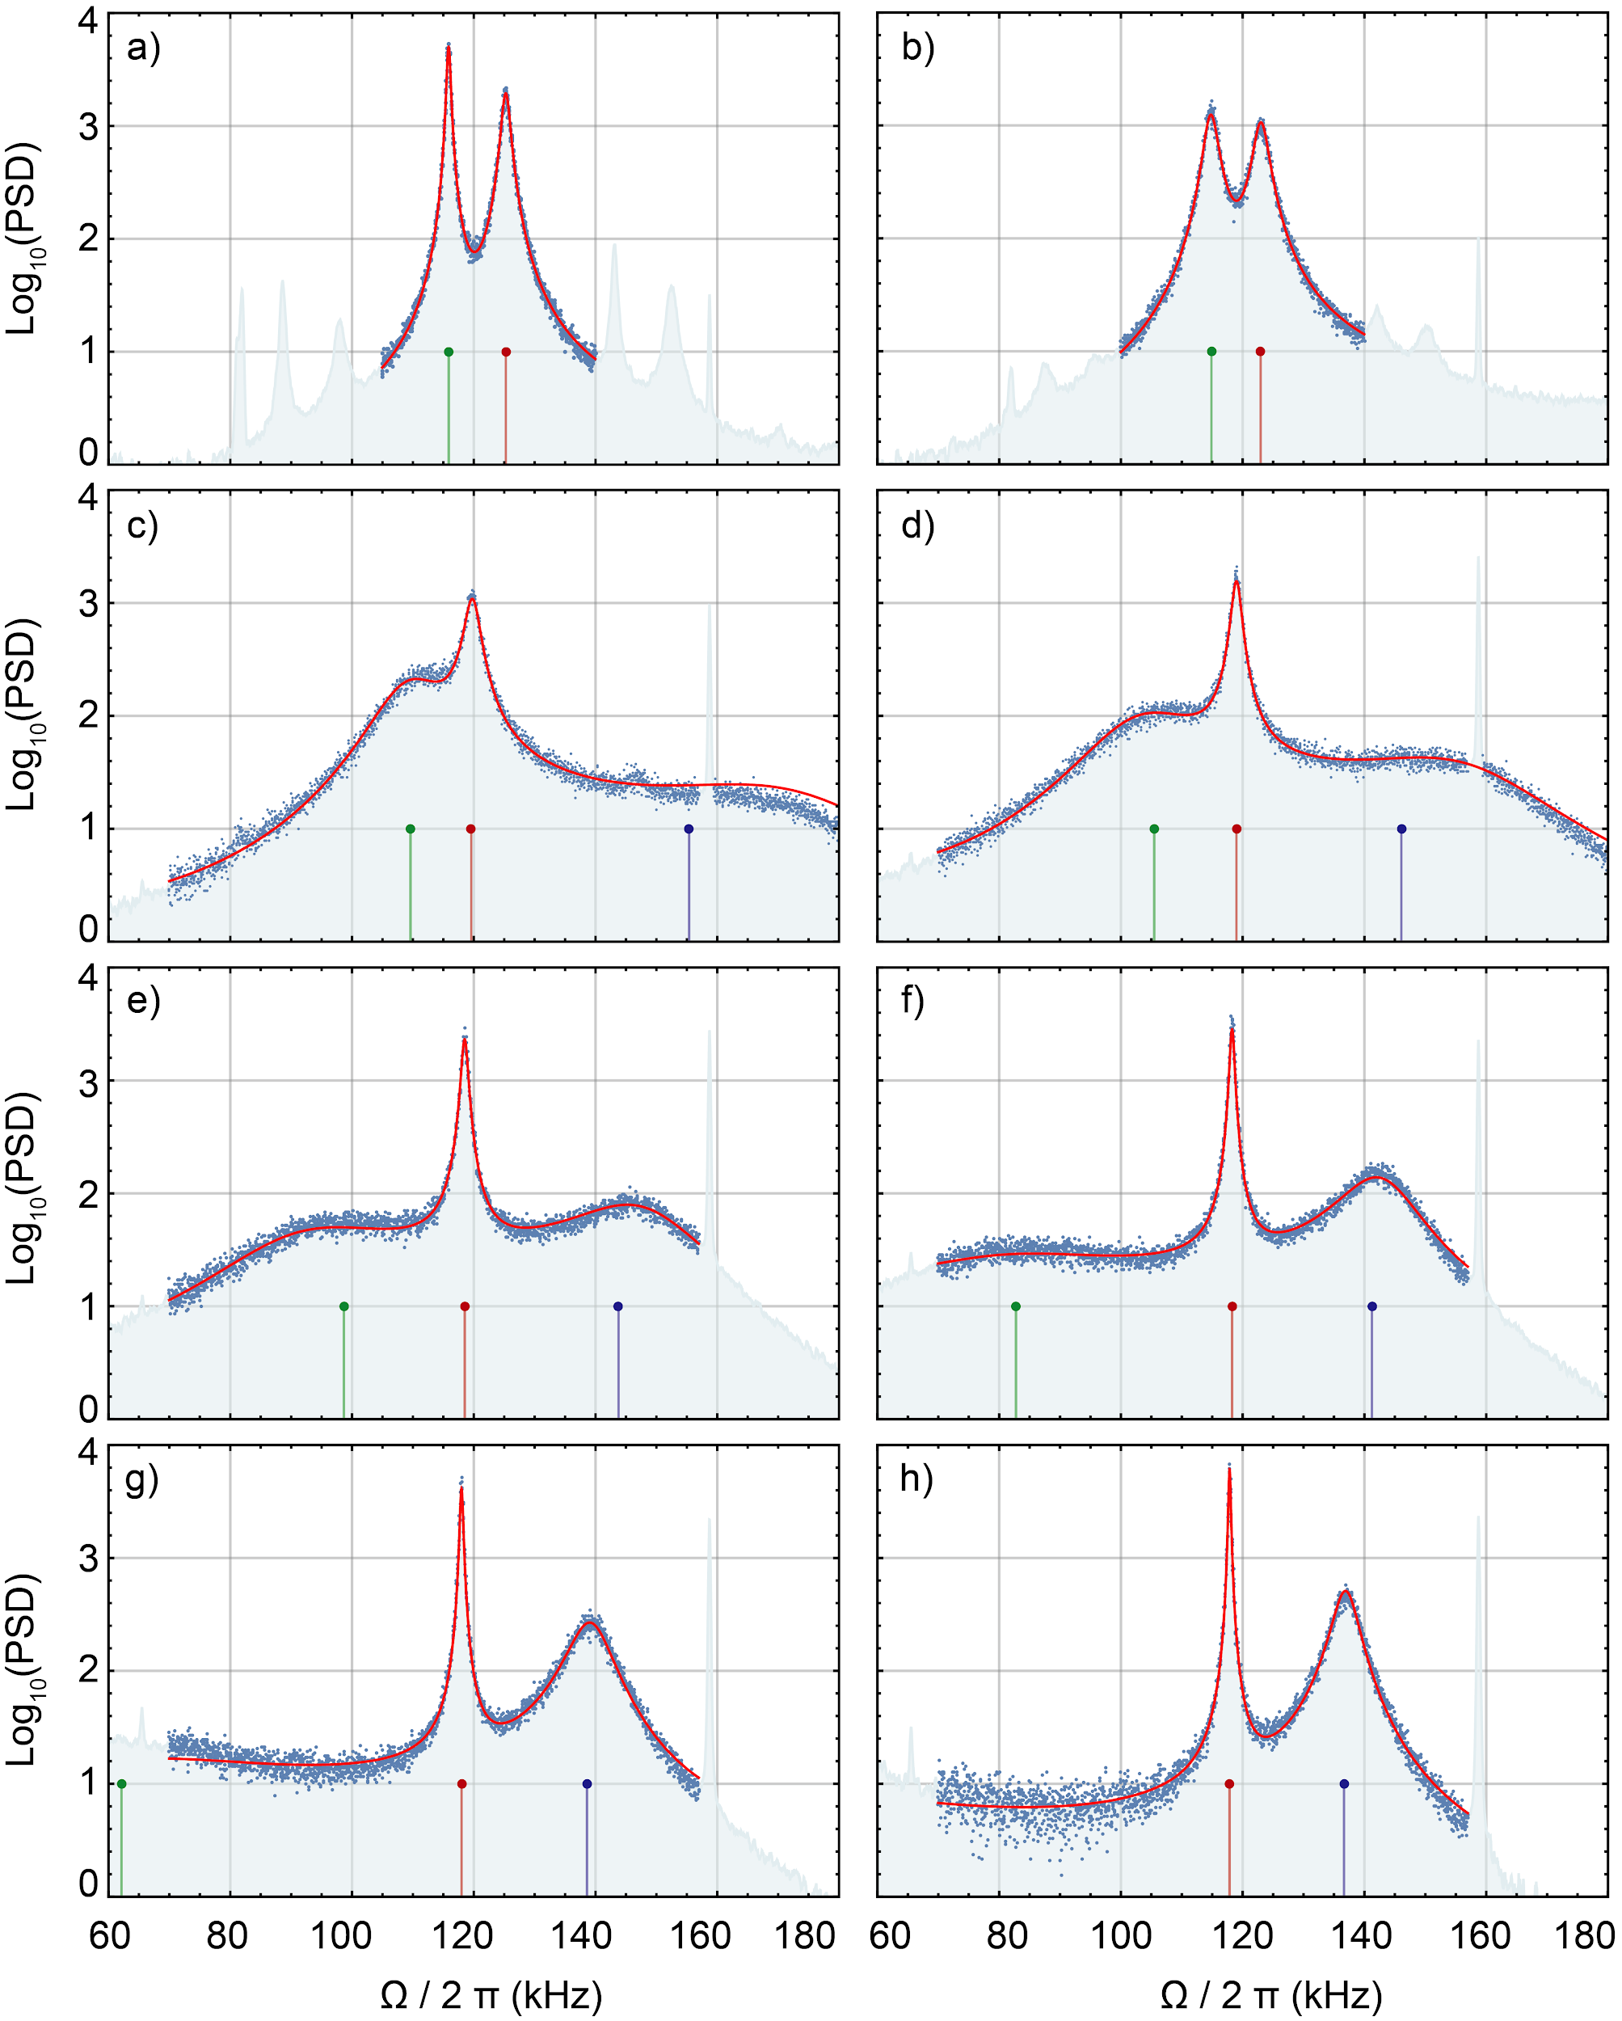
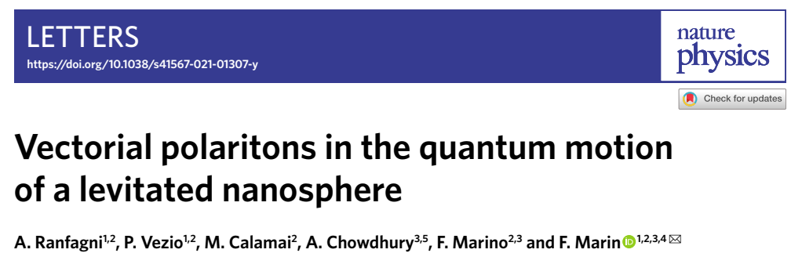
Asymmetry as a function of ‘s’
Vectorial polaritons
Spectra of the transmitted field
-260kHz
-210kHz
-160kHz
-140kHz
θ = 72º
g_{x} = 2π x 26.7 kHz
g_{y} = 2π x 9.4 kHz
-120kHz
-100kHz
-80kHz
-60kHz

Slide 25
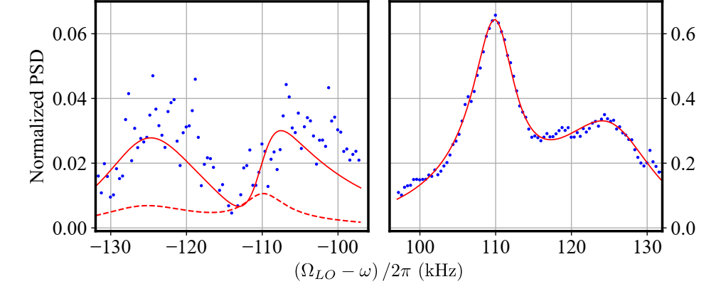


Different shapes of the motional sidebands
Anti-Stokes ($\overline{n}+1$)
Stokes ($\overline{n}$)
A. Ranfagni et al., Phys. Rev. Lett. 130, 193601 (2023)
Q. Deplano et al., Nat. Commun. 16, 4215 (2025)

Slide 26
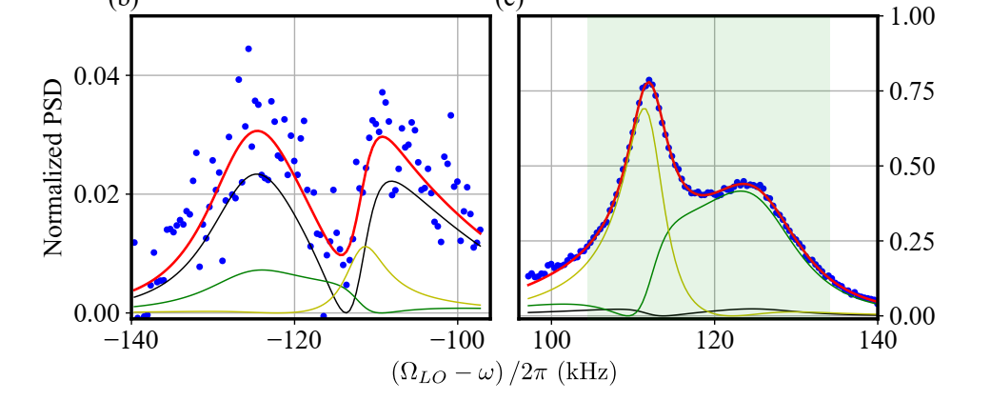


Noise contributions
Anti-Stokes ($\overline{n}+1$)
Stokes ($\overline{n}$)
Quantum noise (back-action)
Thermal Y
Thermal X
A. Ranfagni et al., Phys. Rev. Lett. 130, 193601 (2023)
Q. Deplano et al., Nat. Commun. 16, 4215 (2025)

Slide 27
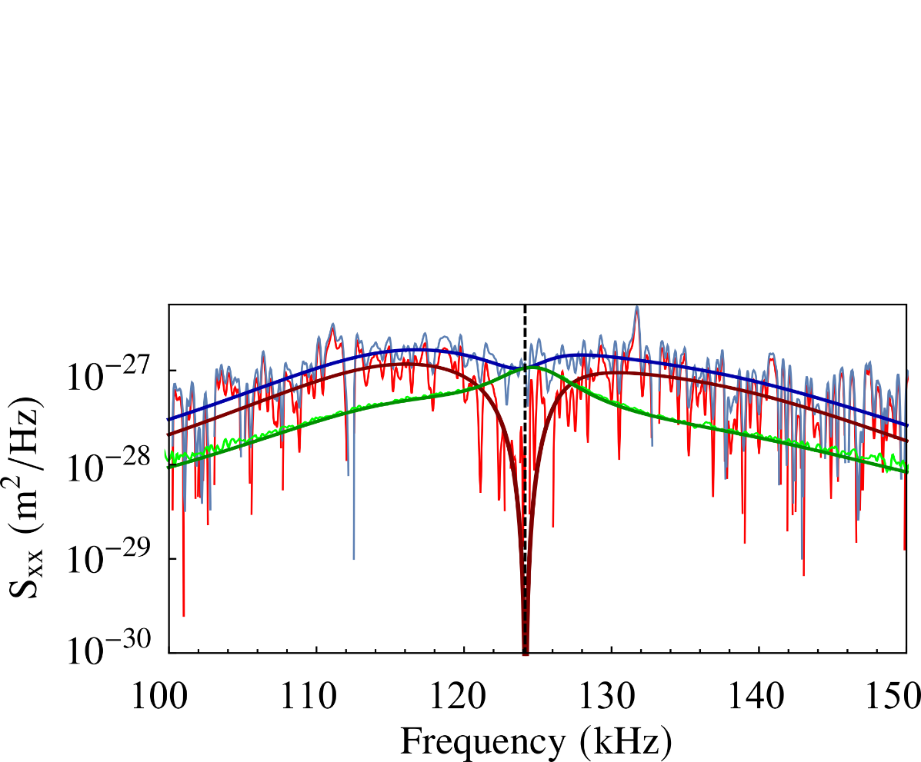
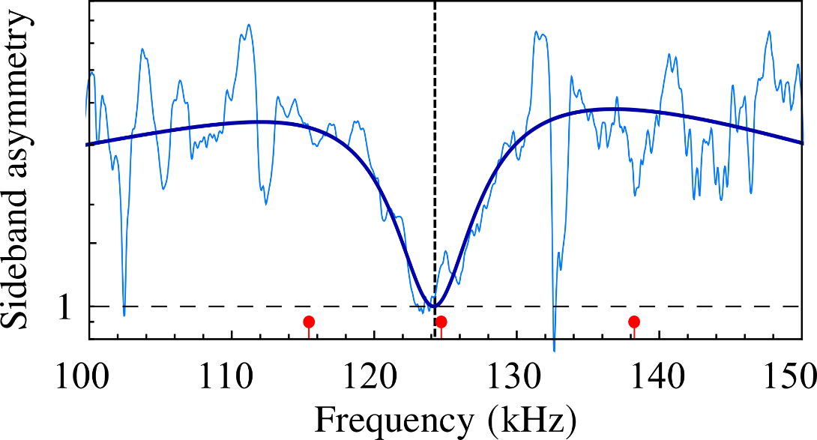
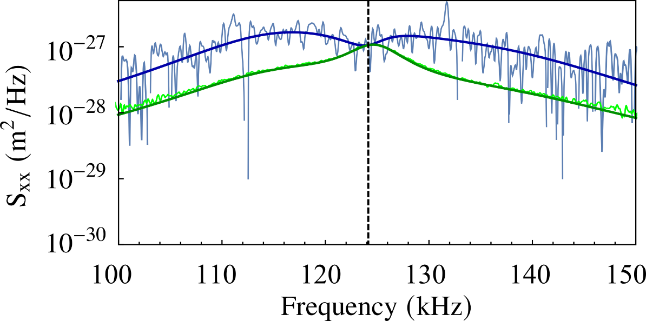



2D strong coupling regime: Quantum backaction cancellation
$\overline{n}+1$ sideband
difference
$\overline{n}$ sideband
A. Ranfagni et al., Phys. Rev. Lett. 130, 193601 (2023)

Slide 28



Asymmetry as a function of ‘s’
State purity + quantum discord
• A. Ranfagni et al., Phys. Rev. Res. 4, 033051 (2022)
A. Ranfagni et al., Phys. Rev. Lett. 130, 193601 (2023)
J. Piotrowski et al., Nature Phys. 19, 1009 (2023)
♦ Q. Deplano et al., Nat. Commun. 16, 4215 (2025)

Slide 29




Asymmetry as a function of ‘s’
Bi-chromatic tweezer
Sideband asymmetry
Chromatic tweezer
z₁
z₂
x₁
y₁
x₂
y₂
Chromatic aberration shifts the position of the focus

Slide 30






Asymmetry as a function of ‘s’
Coulomb coupling
Sideband asymmetry
Chromatic tweezer
1.5 mbar
y₂
1064 nm
976 nm
x₂
y₁
x₁
z₂
z₁
Measured
Reached strong coupling

Slide 31



Asymmetry as a function of ‘s’
Cavity-mediated coupling
Sideband asymmetry
Chromatic tweezer
Δ= - 400 kHz
5x10⁻⁶ mbar
A. Pontin et al., arXiv:2502.08563 (2025)

Slide 32















Michele Bonaldi
Enrico Serra
Antonio Borrielli
Giovanni A. Prodi
David Vitali
Gianni Di Giuseppe
Nicola Malossi
Francesco Marzioni
Riccardo Natali
Paolo Piergentili
Mateusz Bawaj
Ciro Biancofiore
Federica Bonfigli
Wenlin Li
Francesco Marin
Francesco Marino
Antonio Pontin
Quentin Deplano
Pasqualina M. Sarro
Bruno Morana
Gregory Pandraud

