Slide 1
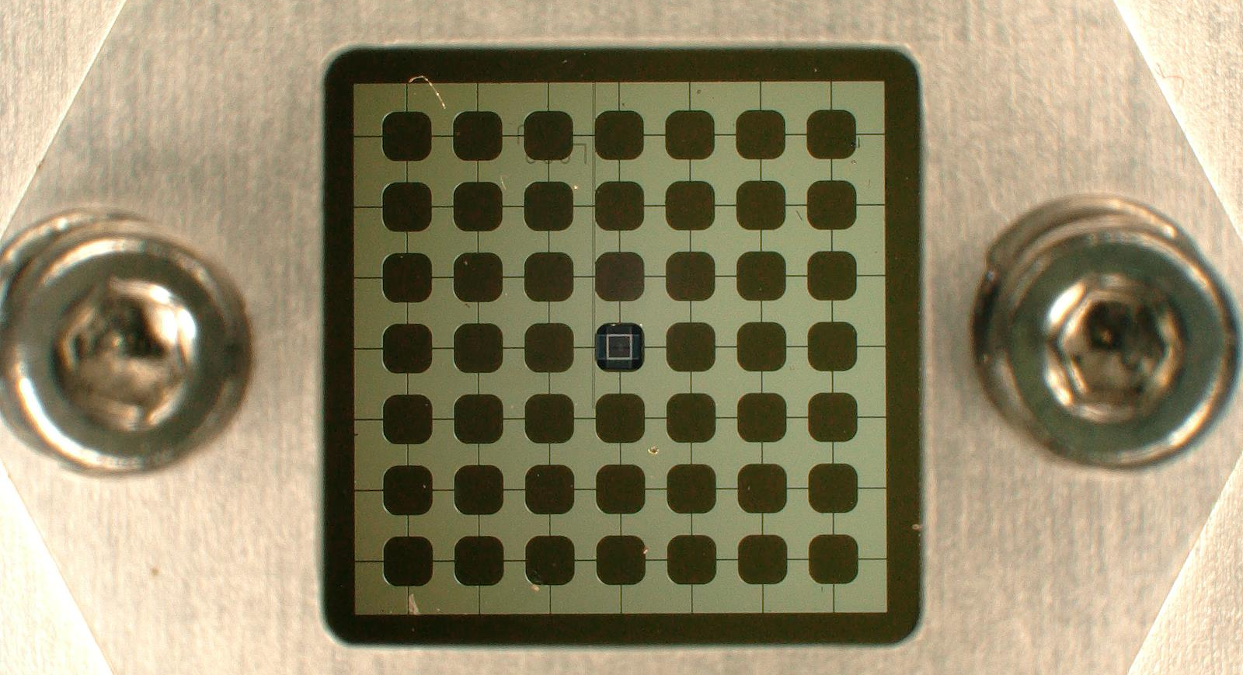
Superconducting Electromechanics
to explore the effects of general relativity in massive superpositions
Gary Steele, TU Delft
Notes:
I am here today to tell you about my proposal to use this device, based on superconducting electromechanics, to experimentally answer the following question:
What happens if we combine quantum mechanics and general relativity?

Slide 2
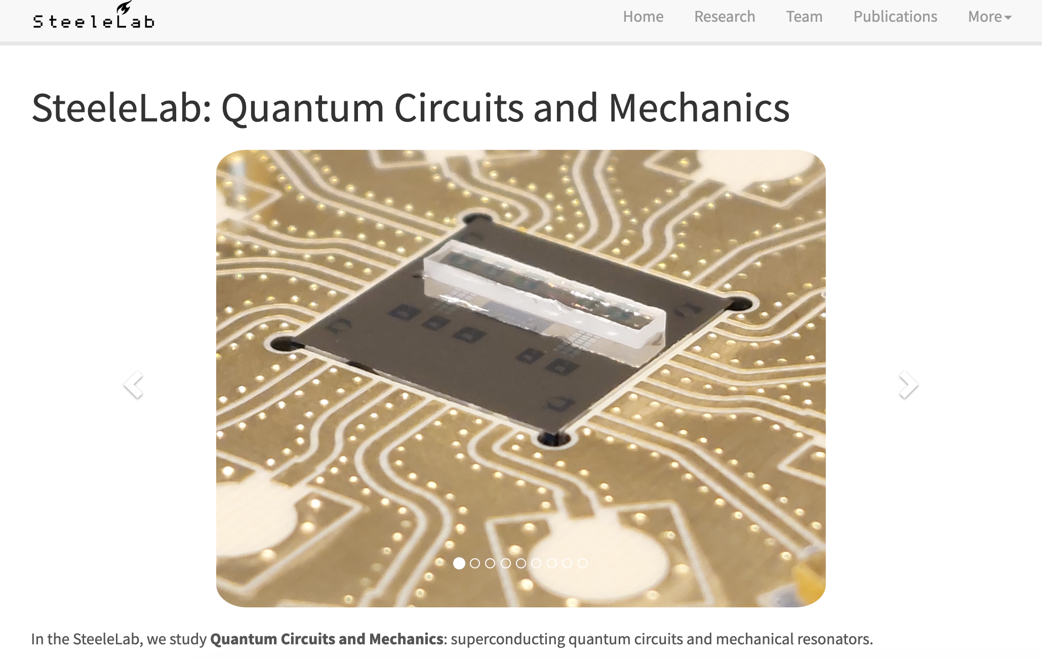
https://steelelab.tudelft.nl/

Slide 3
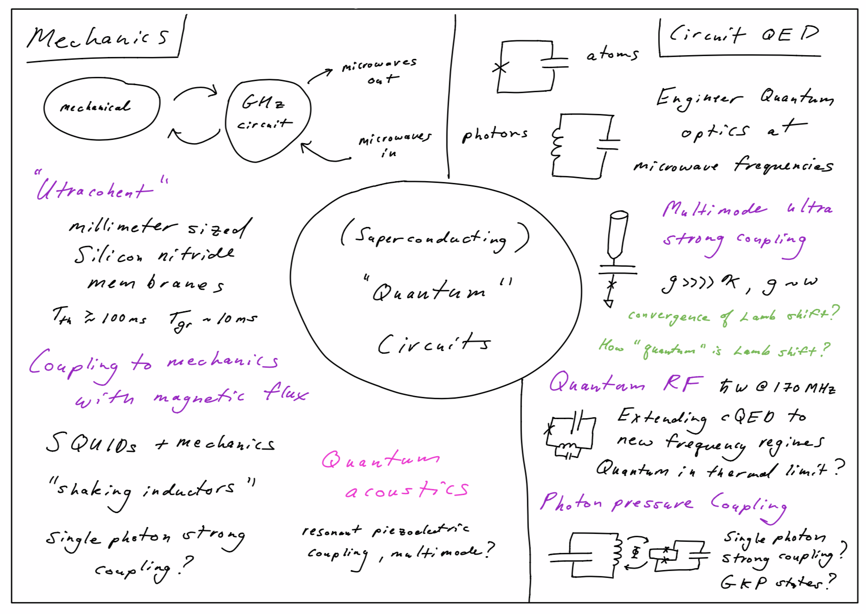

Slide 4
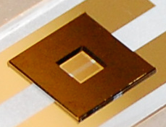
Our platform: Mechanical Resonators
Metallized Silicon Nitride Membrane

Slide 5
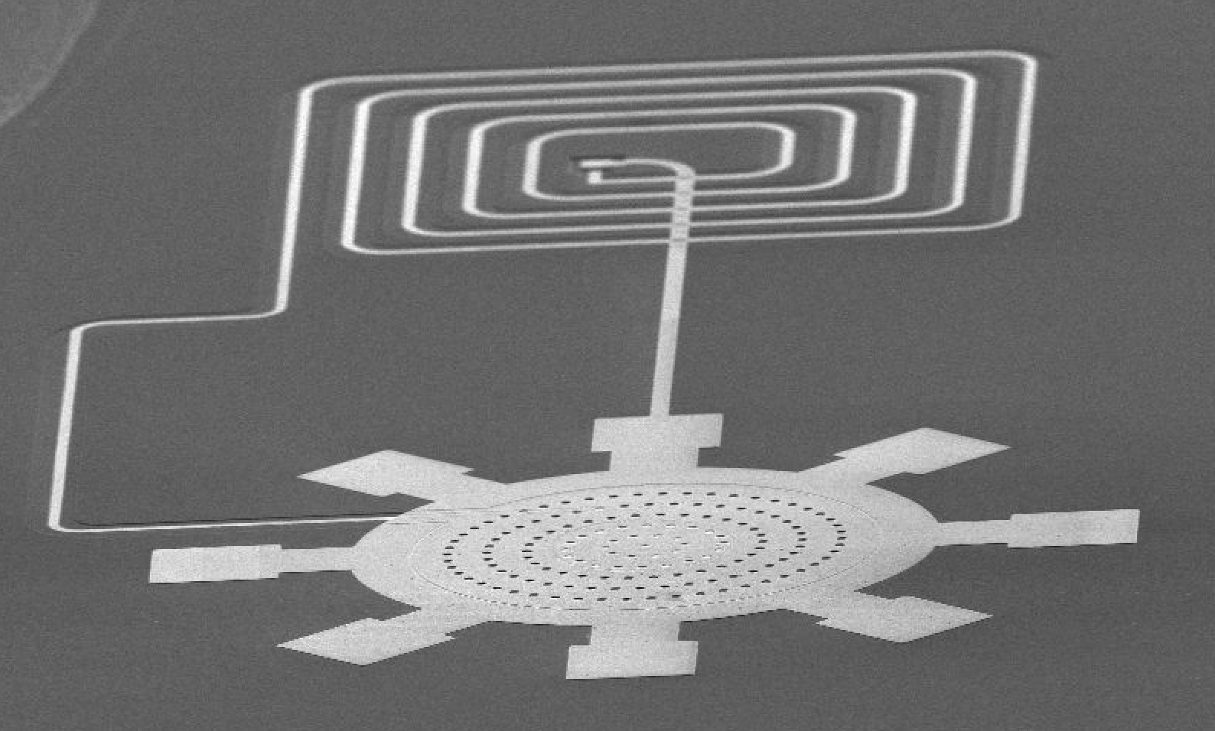
Our platform: Mechanical Resonators
Aluminum Plate Resonators

Slide 6
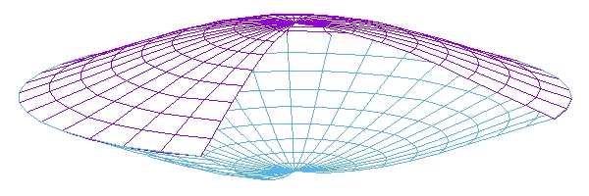
Goal: Quantum Superpositions
Make “mechanical” Schroedinger cat in membrane

Slide 7
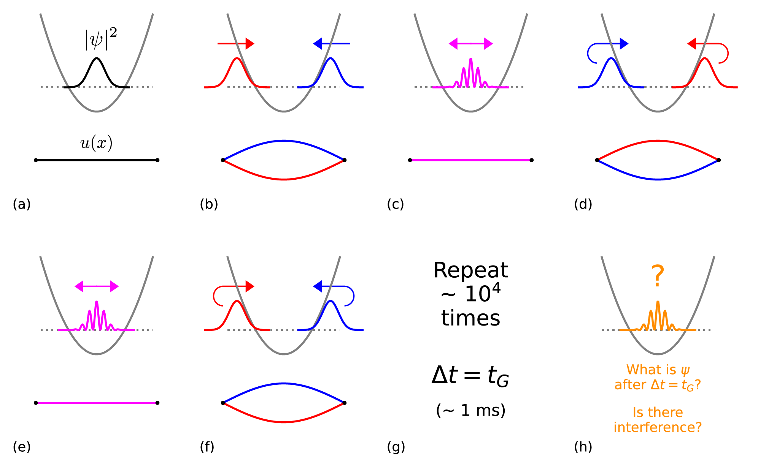
How? “Cat” Interferometry

Slide 8
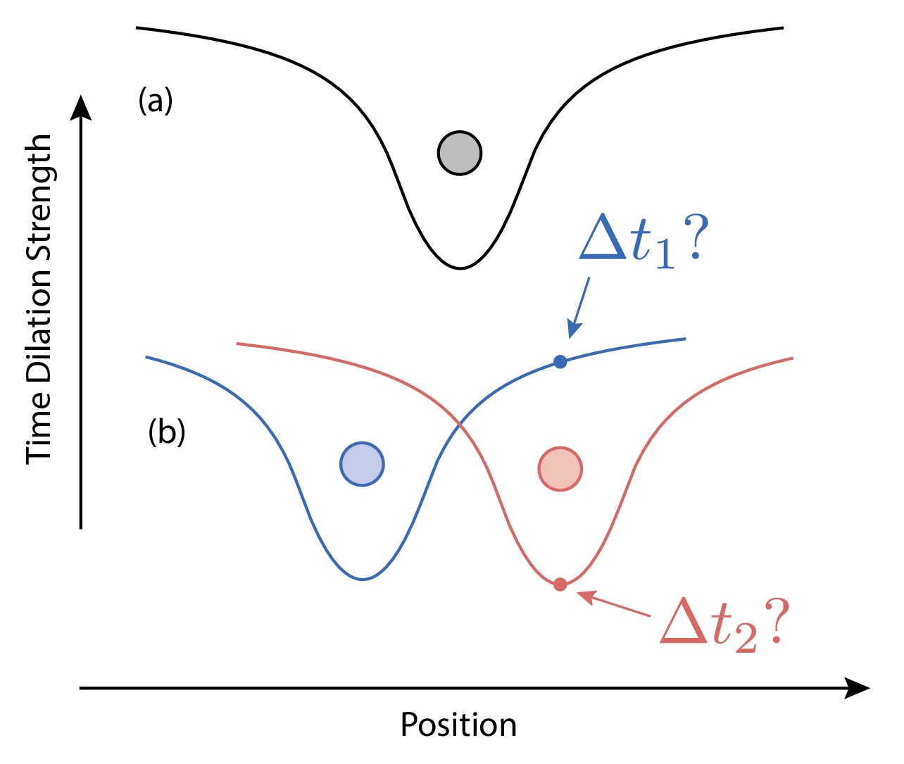
What can we test?
Diosi-Penrose timescale
Notes:
Why is this interesting?
Amazingly, General Relativity and Quantum Mechanics, two of the most tested theories of physics, are fundamentally incompatible with each other: both theories cannot be correct!
This has left us puzzled for a century: what do we do with this problem?

Slide 9
What do you need?
Large Mass
Large Superposition
High Coherence
Challenge:
How to make large enough superpositions of heavy and coherent enough objects?

Slide 10
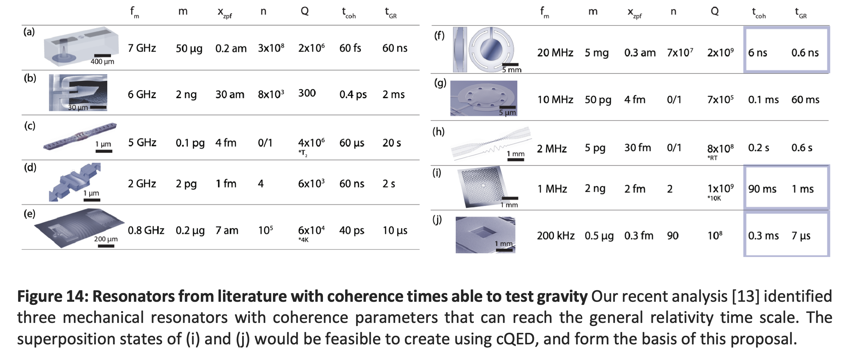
Do we have the coherence and mass?
No
No
No
No
No

Slide 11
Do we have the coherence and mass?
Hard…
No
No
Yes
Yes
M_{p} / 40!

Slide 12
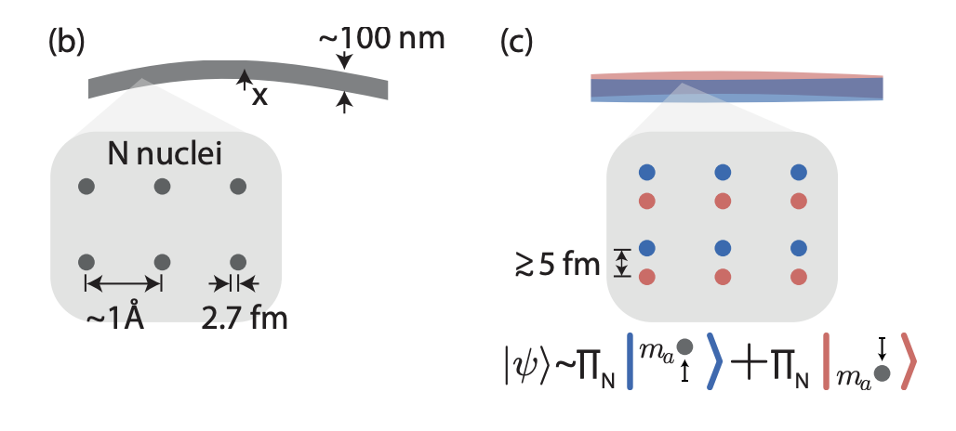
Caveat: Mass radius
Numbers based on R = 3 fm
Assume: superposition in reference frame of rigid reference frame is relevant
Nuclear Lattice ZPF? Justification?

Slide 13
Creating and measuring superpositions

Slide 14
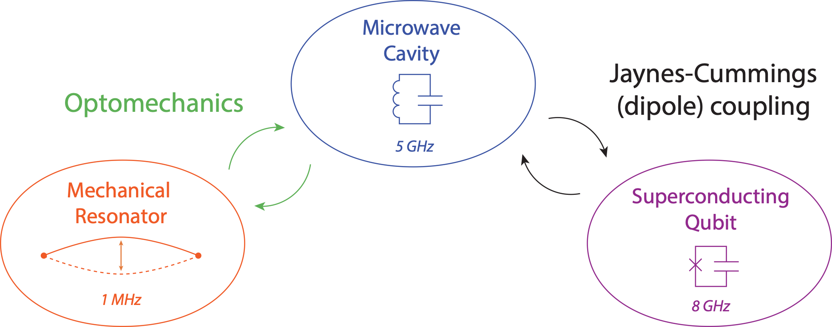
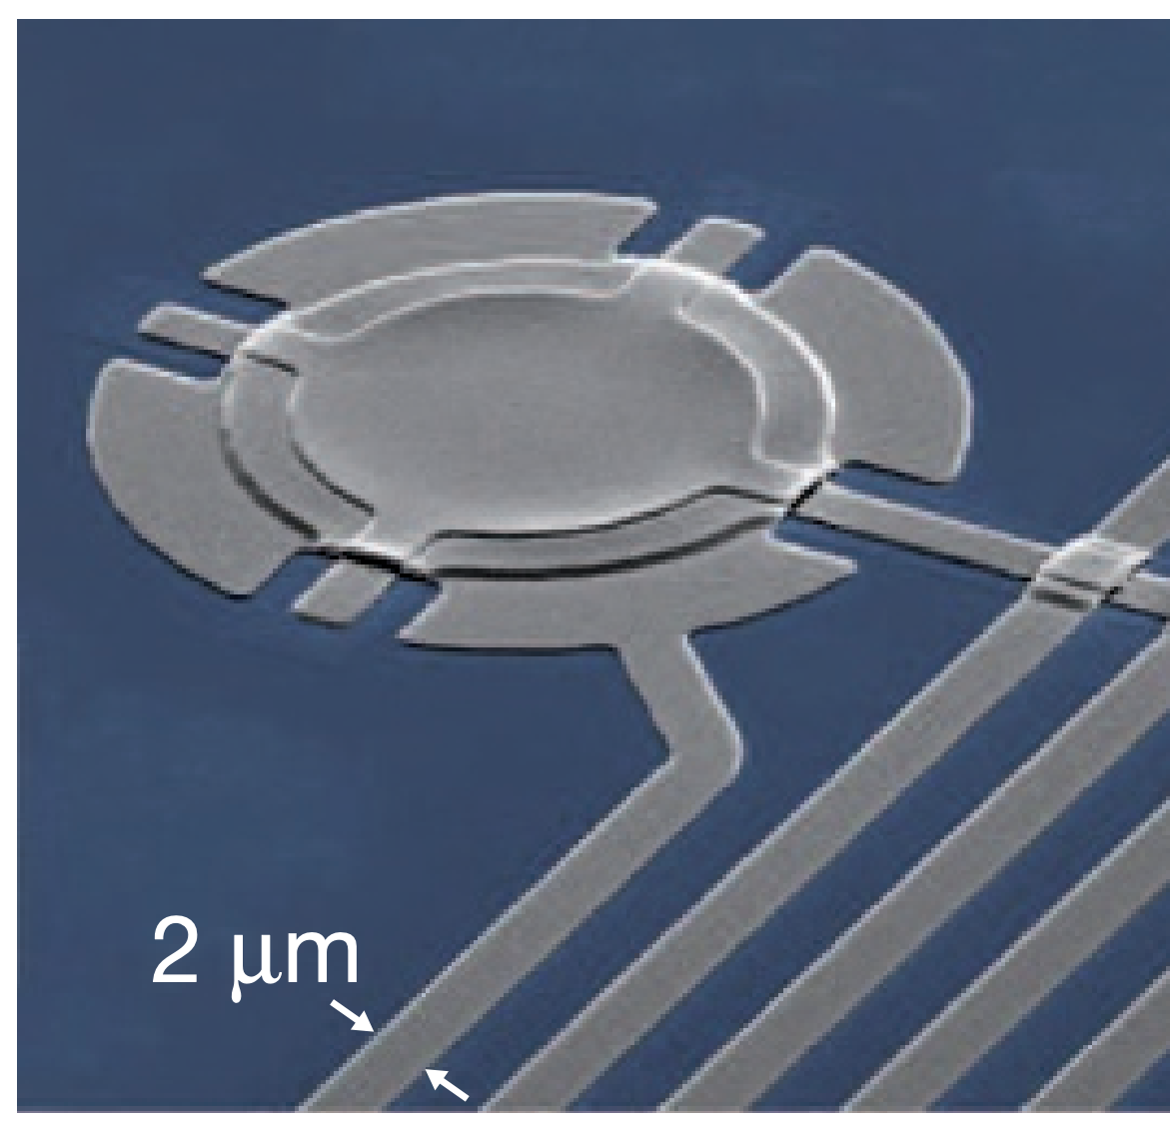

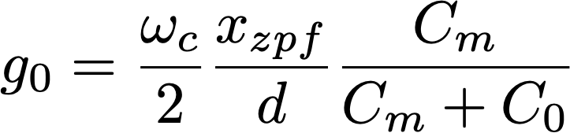




Cavity Optomechanics
Strong Driving:

Slide 15
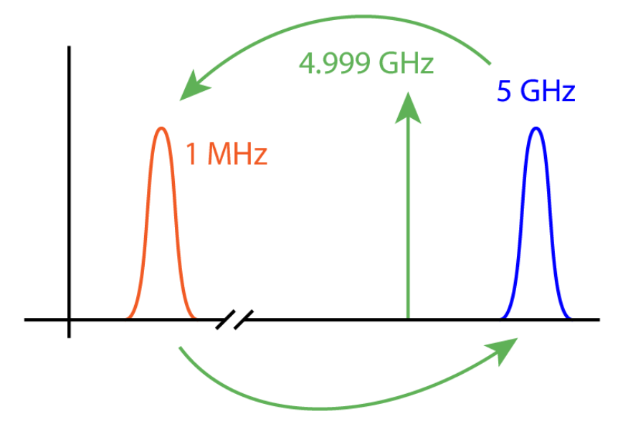
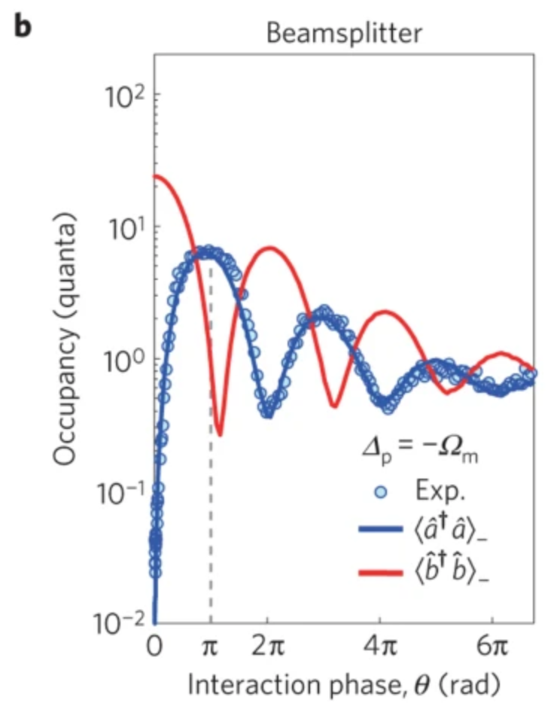
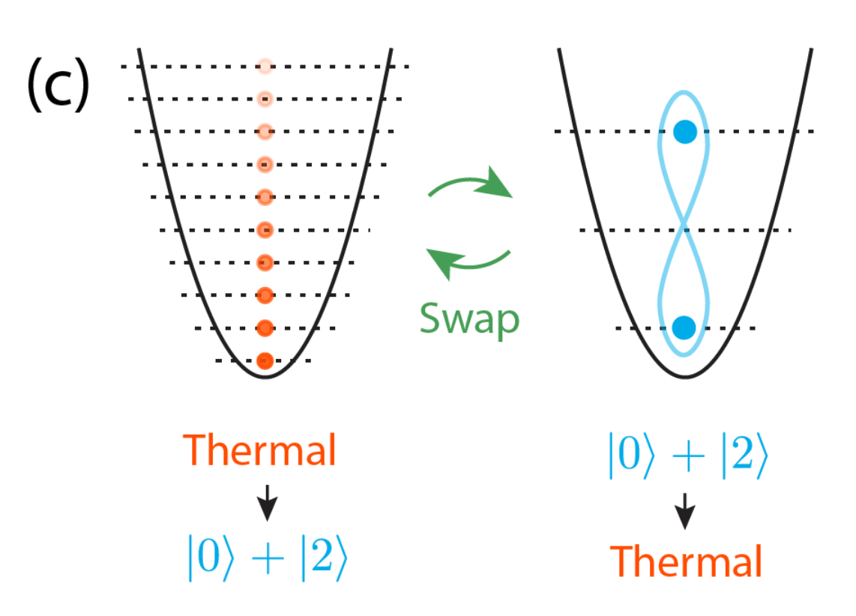
Optomechanical Swap + Cooling
Nature Physics 11, 635 (2015)
(NIST group)

Slide 16
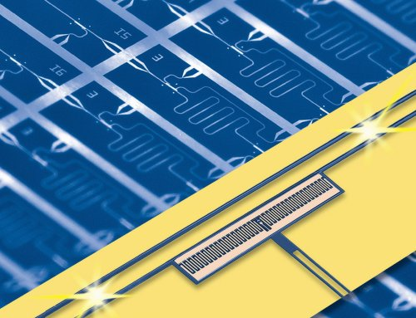

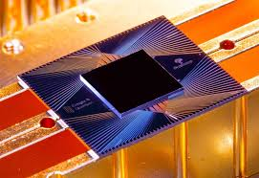
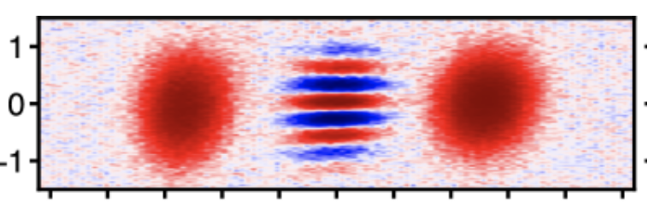
Circuit QED
Quantum Processor
Microwave Quantum State Engineering
https://arxiv.org/abs/2406.03389v1

Slide 17
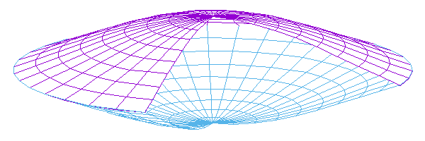
cQED for Mechanical Cats
Swap!
Make cavity cat

Slide 18
Challenge: cQED + Optomechanics

Slide 19
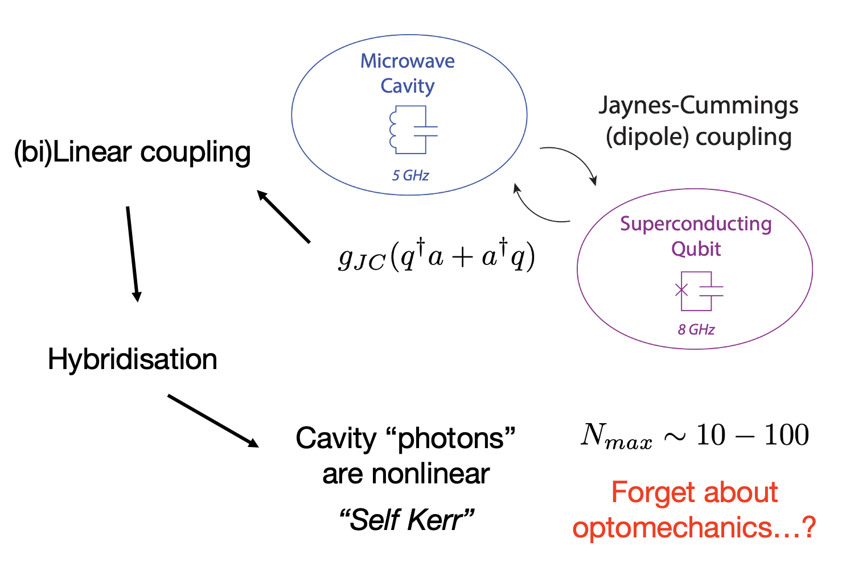
Snake in the grass…

Slide 20
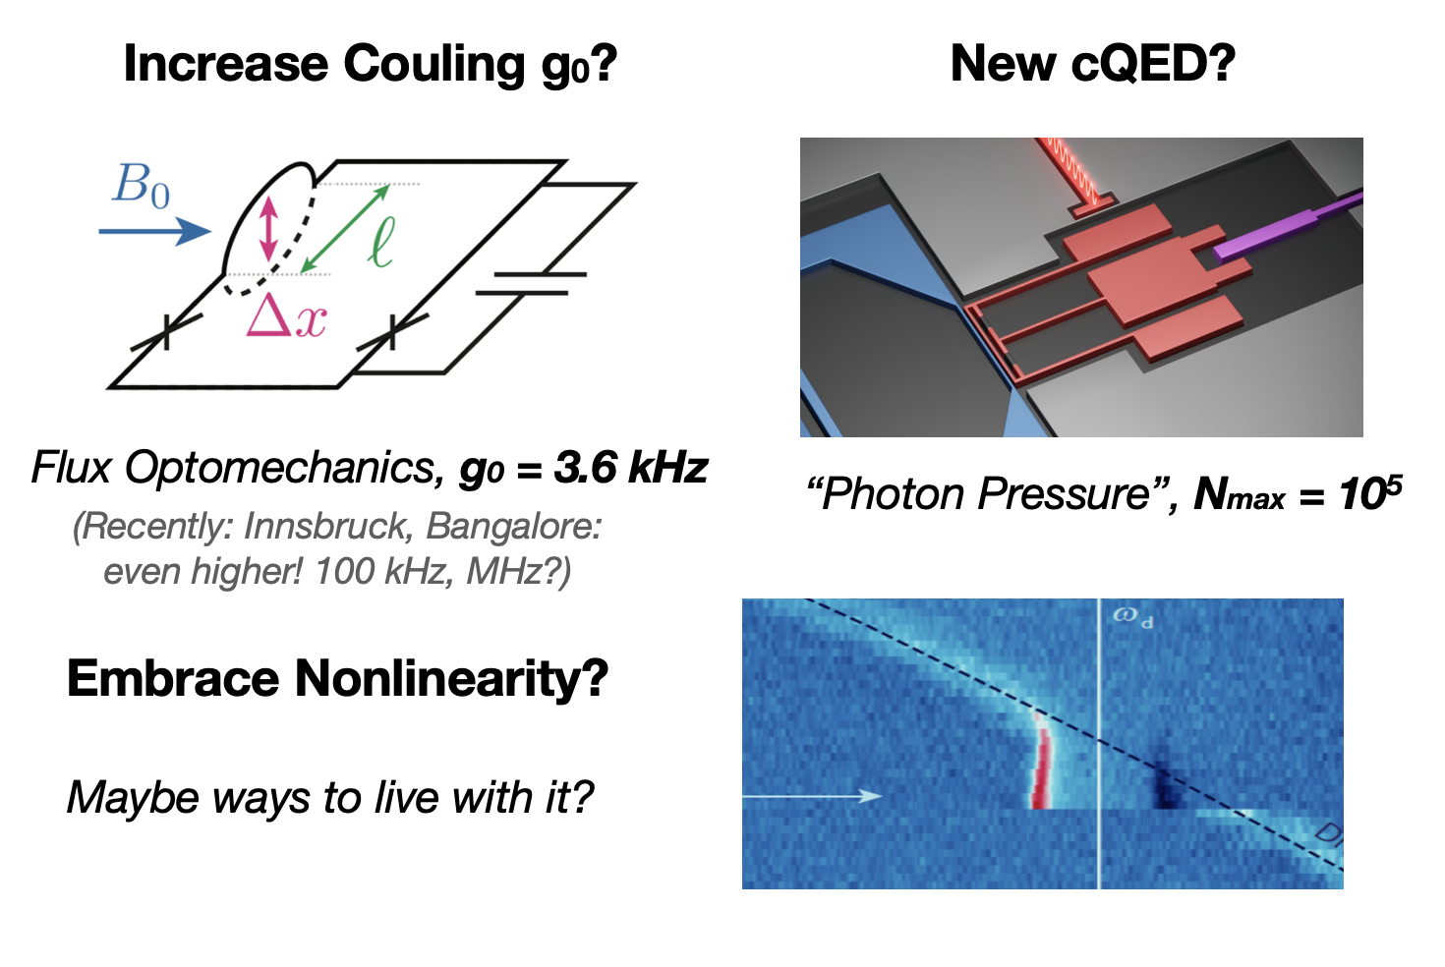
Solutions?

Slide 21
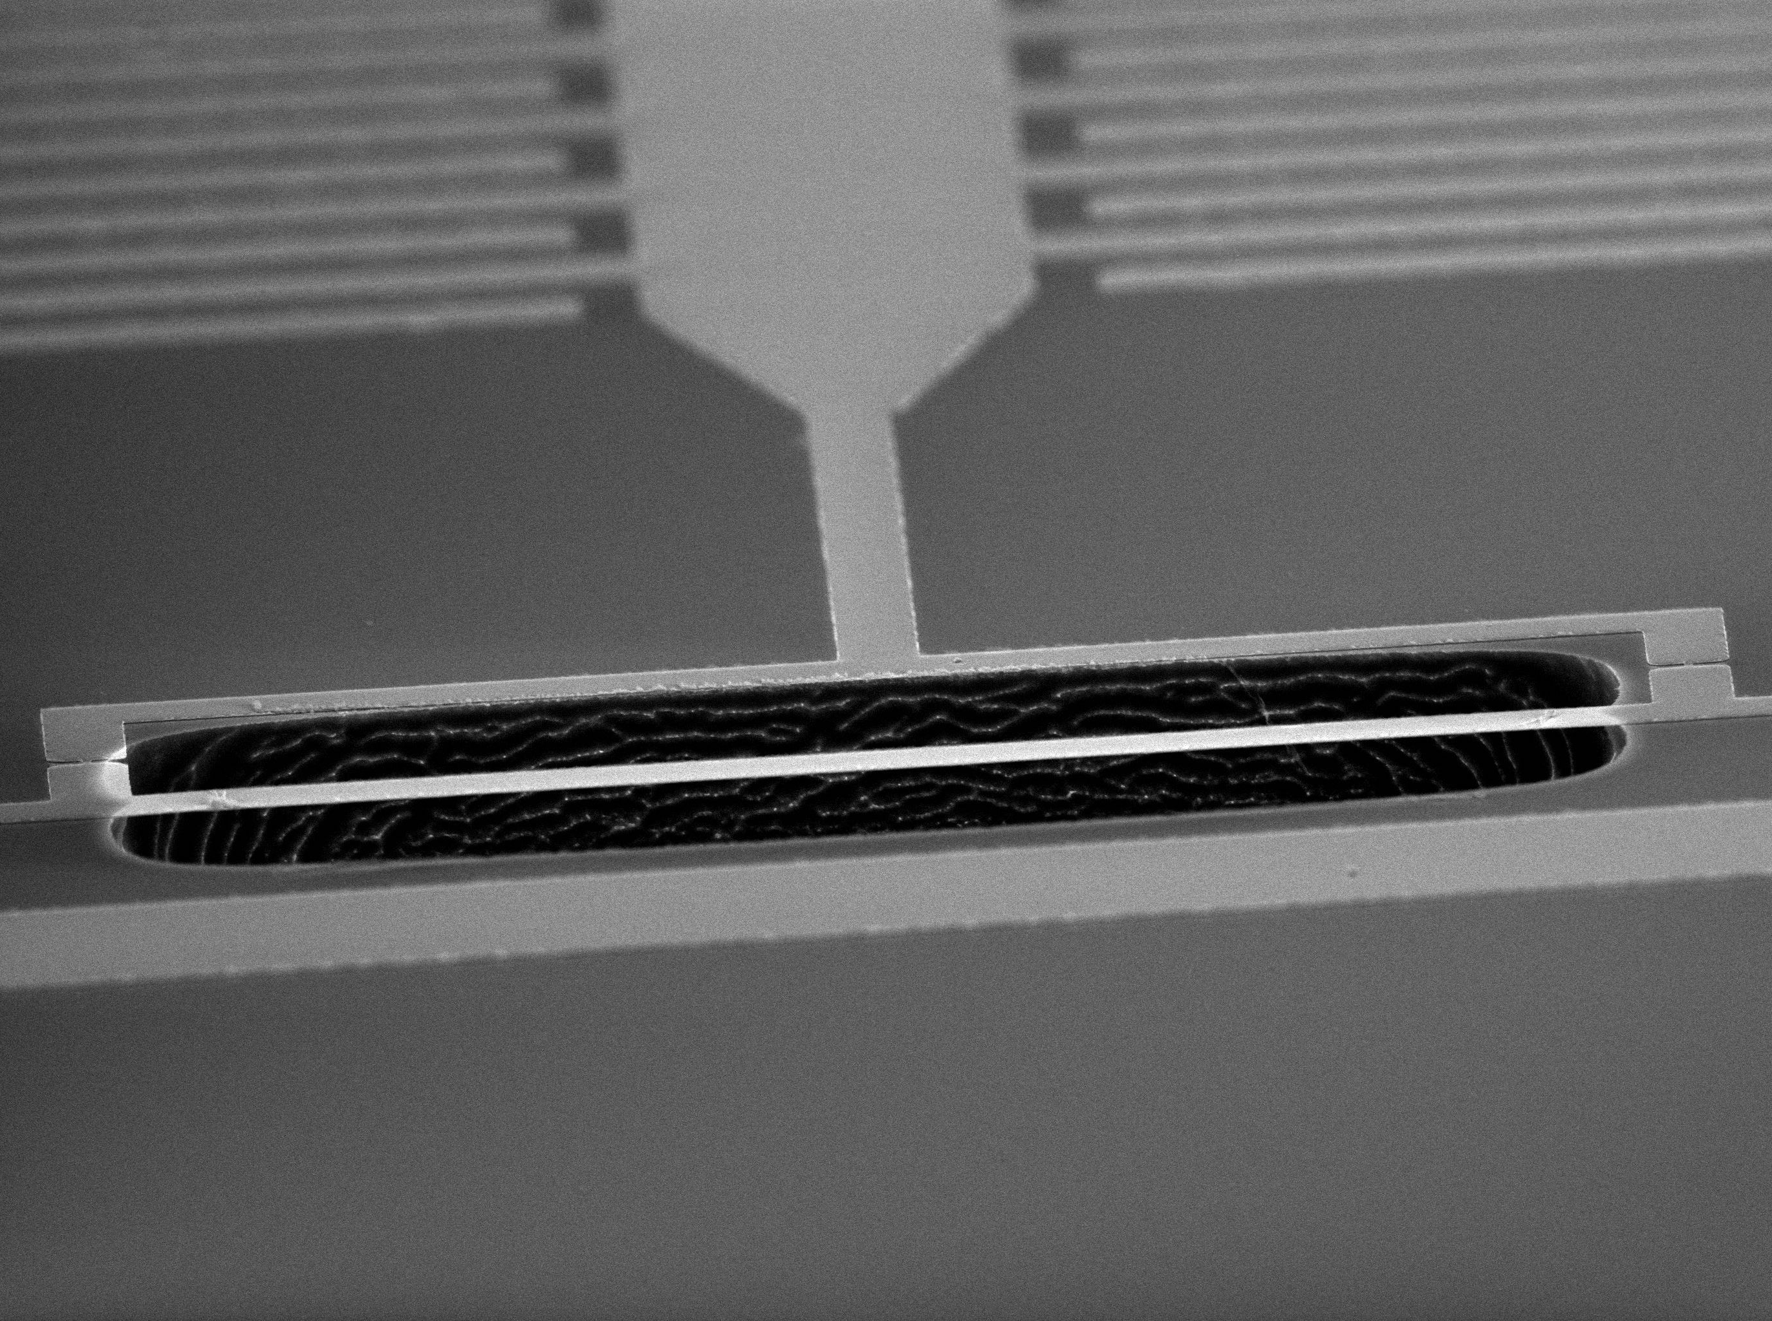
“Flux optomechanics” with SQUIDs

Slide 22
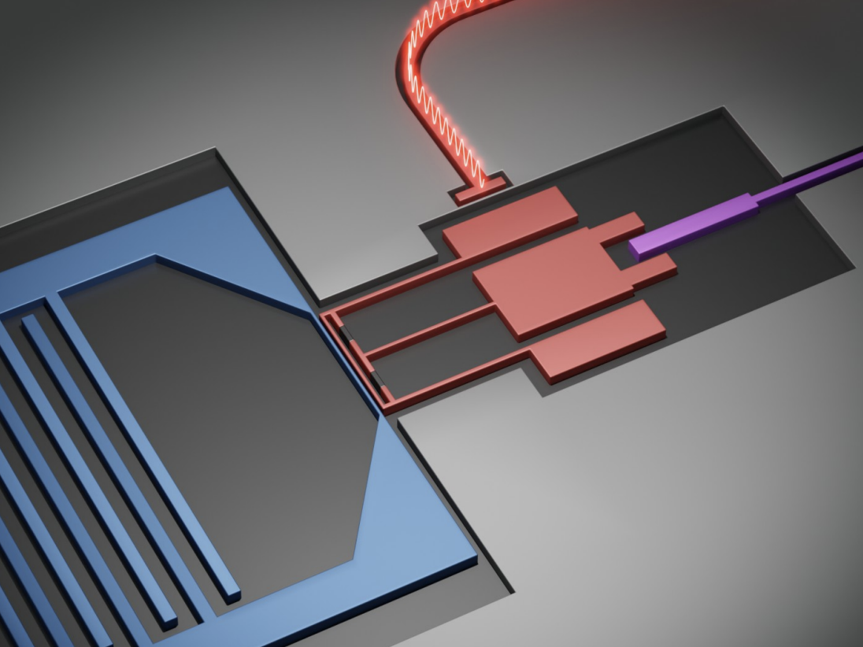
Longitudinal cQED
SQUID Transmon qubit with inductive parametric coupling

Slide 23
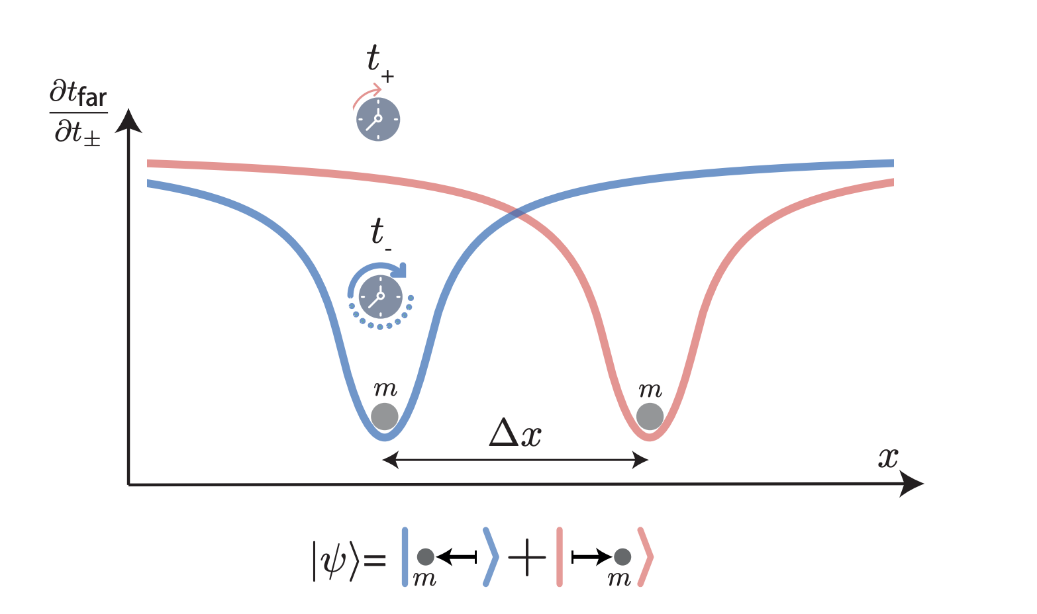


Superconducting Electromechanics
Optomechanics + cQED:
Control and detection of mechanical quantum states
High mass, High coherence, and large quantum fluctuations
Talent Program
(Vidi, Vici)
Superpositions of masses approaching Planck mass scale

