Slide 1
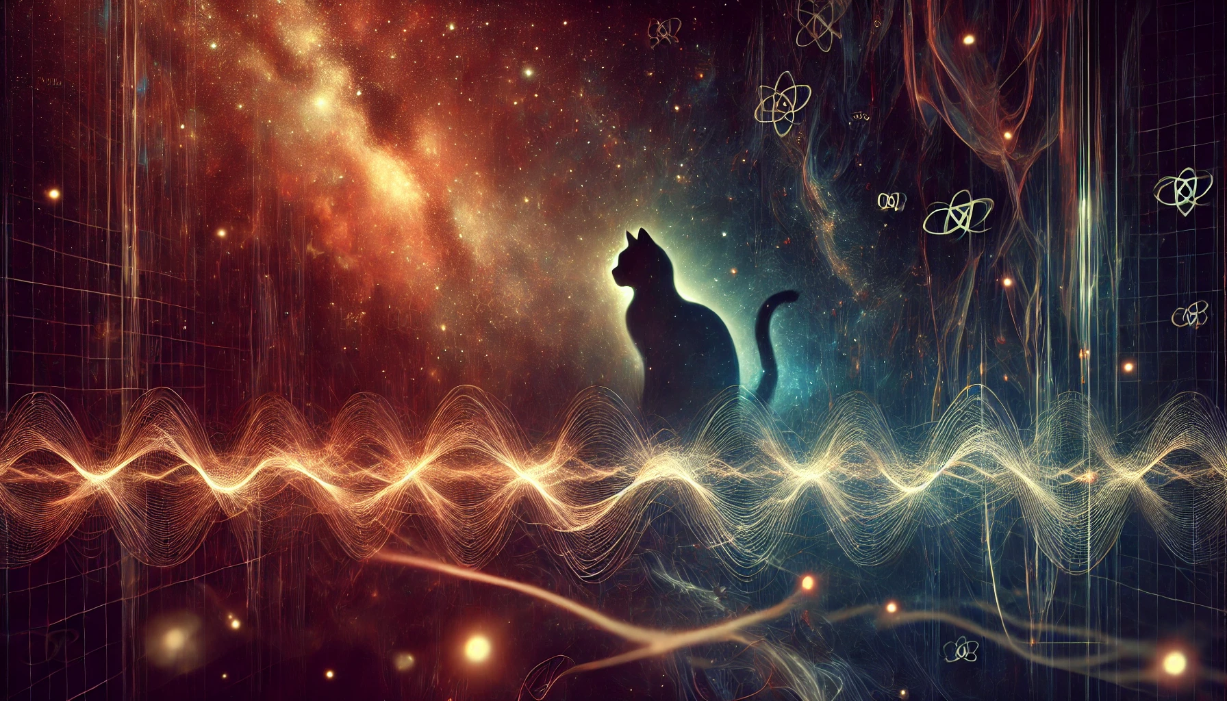
Testing Quantum Mechanics Underground: From Pauli Exclusion Principle Violations to Spontaneous Collapse
Catalina Curceanu, LNF-INFN, Frascati (Italy)
On behalf of the VIP Collaboration
Bridging high and low energies in search of quantum gravity Cost Action CA23130 First Annual Conference
Paris, 7 – 11 July 2025

Slide 2
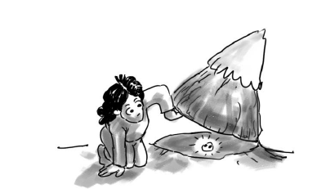
Quantum Mechanics tests:
Pauli Exclusion Principle Violation
Collapse Models
Bridging QM and Gravity WG4 COST Action
Notes:
E allora come scoprirlo? Io guido un gruppo che f aun esperimento che sta verificando proprio questo: ha la meccanica quantistica limiti di valabilita’? E’ una teoria che magari un giorno verra’ sostituita da un’altra teoria piu’ completa? (un po’ come la gravita’ di Newton e’ stata sostituita da quella di Einstein)?

Slide 3
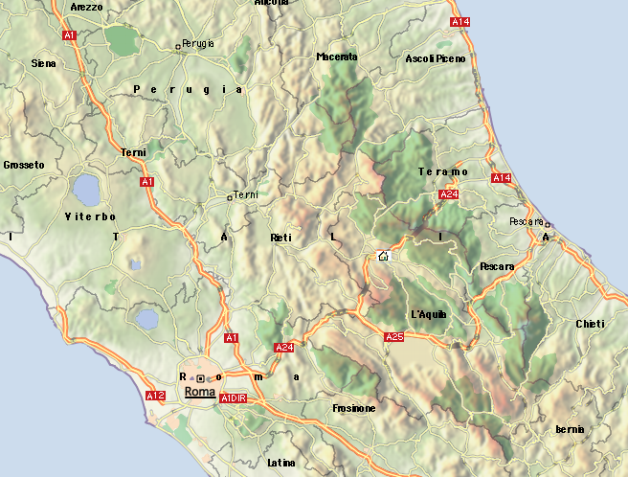
Laboratori Nazionali del Gran Sasso, Istituto Nazionale di Fisica Nucleare
LNGS

Slide 5
LNGS-INFN – cosmic silence
Evento raro
Notes:
Proprio con lo scopo di osservare il decadimento del protone, alla fine degli anni Settanta, s’inaugurò l’era dei laboratori sotterranei, con lo scopo di proteggere i rivelatori di particelle dalla pioggia dei raggi cosmici, creando le condizioni di quiete richieste dalla rarità delle osservazioni.

Slide 6
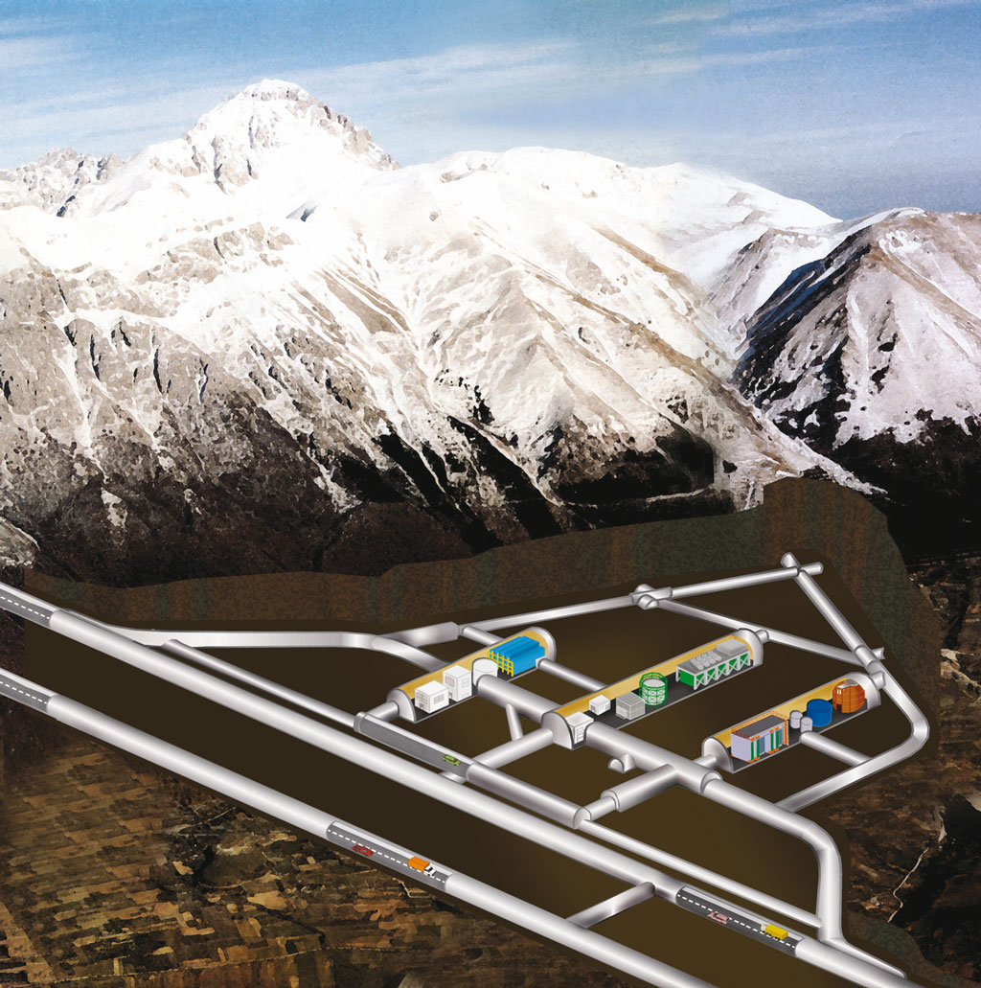

Slide 7
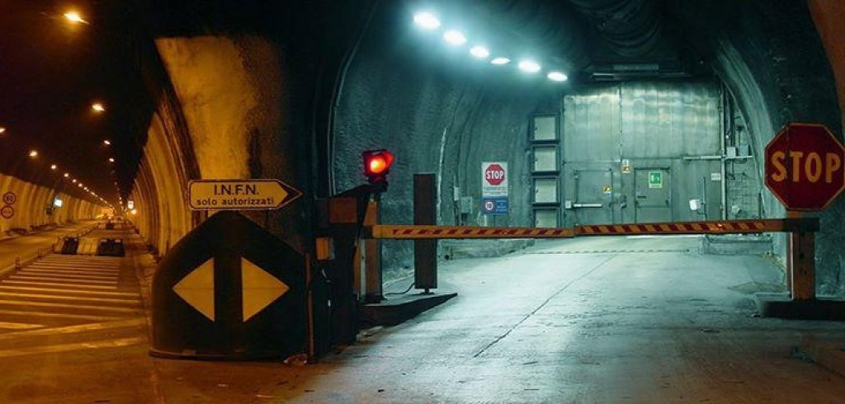

Slide 9
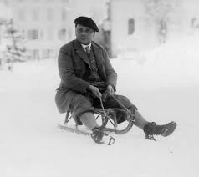
We search for the impossible atoms
An experiment to test the Pauli Exclusion Principle (PEP) for electrons in a clean environment (LNGS) using atomic physics methods – the VIP experiment

Slide 11
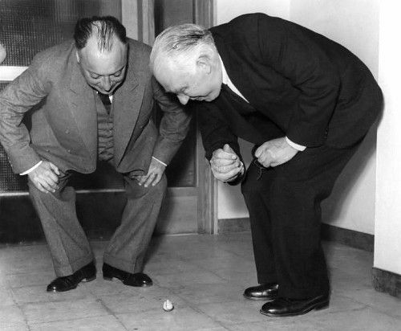
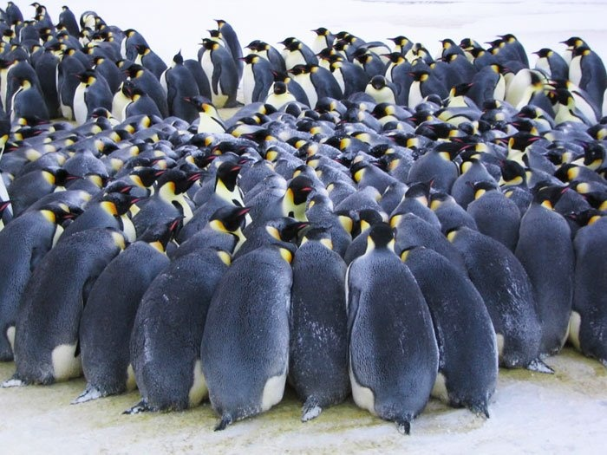
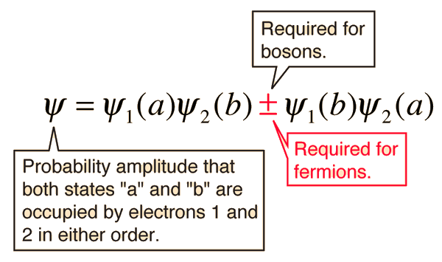
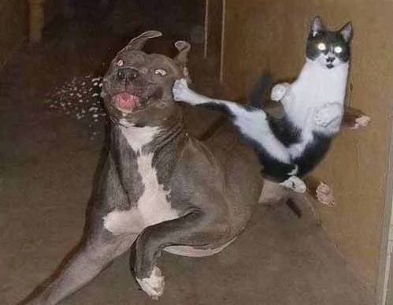

Slide 12
At the root of the Exclusion Principle:
proof of spin-statistics theorem by Lüders and Zumino
Postulates:
The theory is invariant with respect to the proper inhomogeneous Lorentz group (includes translations, does not include reflections)
Two operators of the same field at points separated by a spacelike interval either commute or anticommute (locality - microcausality)
The vacuum is the state of lowest energy
The metric of the Hilbert space is positive definite
The vacuum is not identically annihilated by a field
From these postulates it follows that (pseudo)scalar fields
commute and spinor fields anticommute.
(G. Lüders and B. Zumino, Phys. Rev. 110 (1958) 1450)

Slide 13
Theories of Violation of Statistics
O.W. Greenberg: AIP Conf.Proc.545:113-127,2004
“Possible external motivations for violation of statistics include: (a) violation of CPT, (b) violation of locality, (c) violation of Lorentz invariance, (d) extra space dimensions, (e) discrete space and/or time and (f) noncommutative spacetime. Of these (a) seems unlikely because the quon theory which obeys CPT allows violations, (b) seems likely because if locality is satisfied we can prove the spin-statistics connection and there will be no violations, (c), (d), (e) and (f) seem possible…………..
Hopefully either violation will be found experimentally or our theoretical efforts will lead to understanding of why only bose and fermi statistics occur in Nature.”

Slide 14
n=2
Experimental method:
Search for anomalous X-ray transitions
when bringing “new” electrons
n=2
n=1
n=1
2p –>1s transition violating
Pauli principle
Energy 7.7 keV
Normal 2p –>1s transition
Energy 8.04 keV
Messiah Greenberg superselection rule

Slide 19
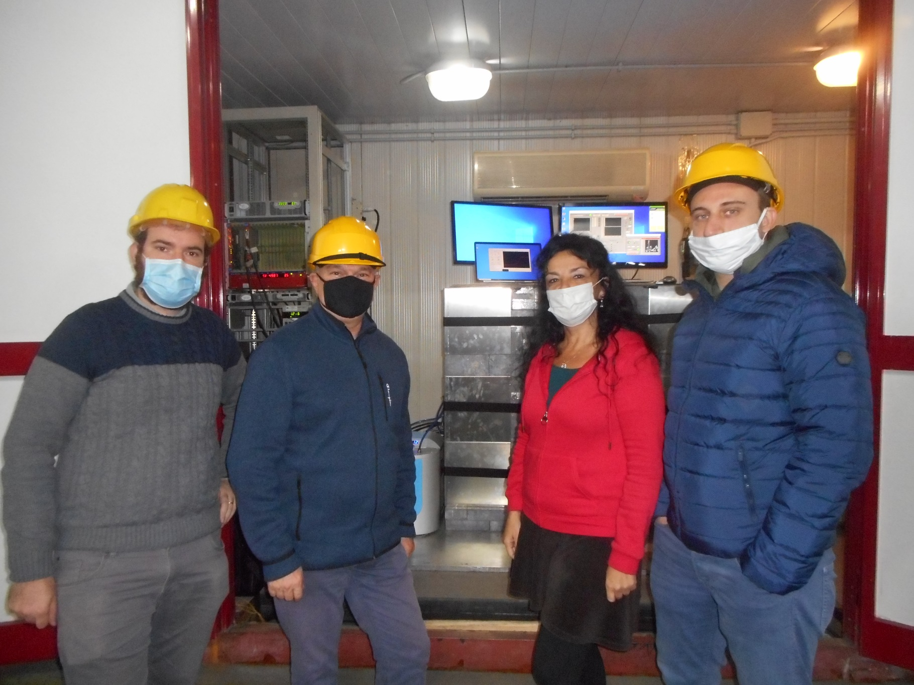
Nat. Phys. (2020). https://doi.org/10.1038/s41567-020-1008-4
Notes:
E se dovessimo trovarli sarebbe una prova che la MQ andrebbe modificata.

Slide 20
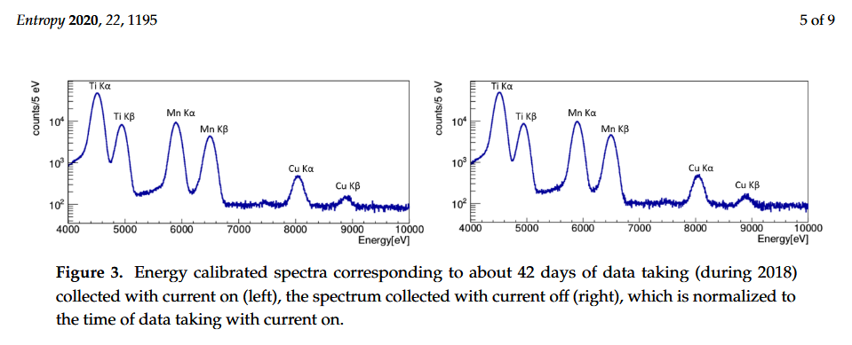
Entropy 2020, 22(11), 1195; https://doi.org/10.3390/e22111195

Slide 21
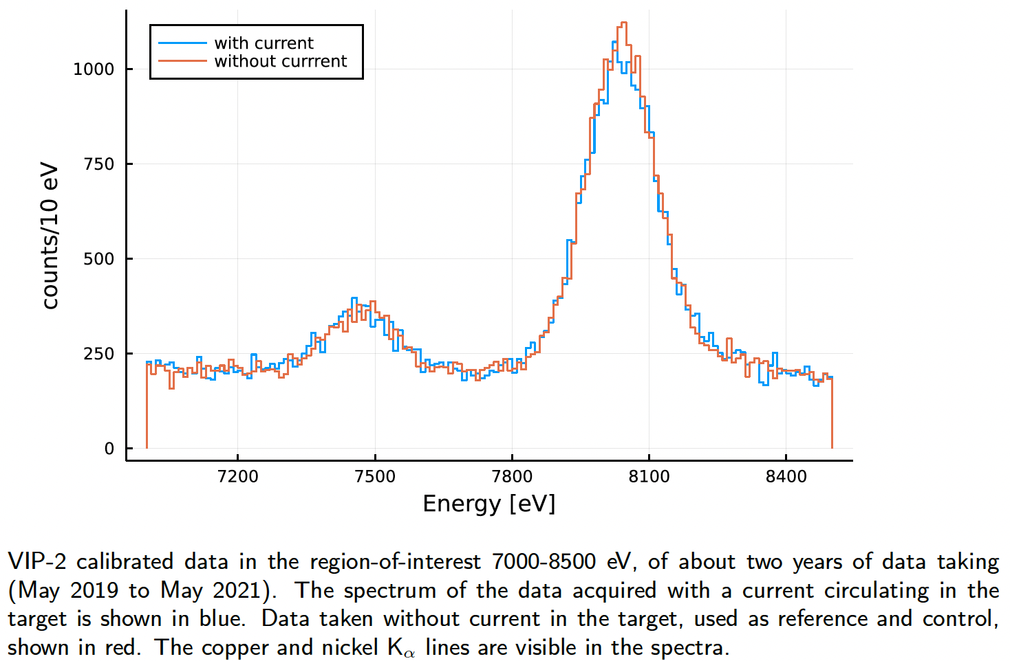
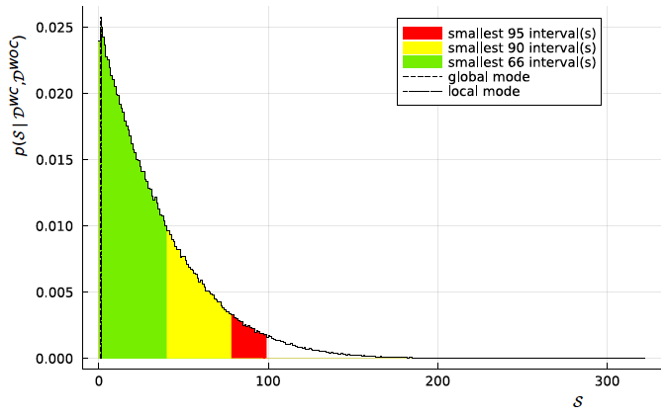
Symmetry 2022, 14(5), 893; https://doi.org/10.3390/sym1405089
Bayesian analysis result: stromgest limits on PEPV probablity for electrons:
β ²/2 < 6.8 · 10⁻⁴³

Slide 23
Future plans: test other QG models – with directionality (magnetic field) – interest in exp. Australia and Canada (MSCA NEXUS)!

Slide 24
First Experimental Survey of a Whole Class of Non-Commutative Quantum Gravity Models in the VIP-2 Lead Underground Experiment, Universe 2023, 9, 32
The case k = 3, introduces a deformation of the space-time and momentum
algebra that is appropriate for the “triply special relativity” model and involves a third invariant scale (other than the velocity of light and the Planck energy), associated to the cosmological constant by the authors.
As a consequence, the measurement is very sensitive to high orders in the
power series expansion of the Pauli violation probability, which allows to set the first constraint to the “triply special relativity” model proposed by Kowalski-Glikman and Smolin.
The characteristic energy scale of the model is bound to Λ > 5.6 · 10**−9 Planck scales
Future plans: test other QG models – with directionality (magnetic field) – interaction with theoreticians BridgeQG

Slide 25
Testing the Pauli Exclusion Principle across the Periodic Table with the VIP-3 Experiment
Entropy 26 (2024) 9, 752

Slide 28
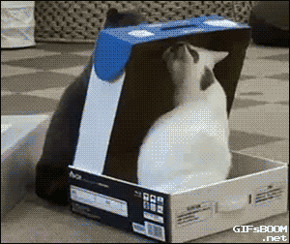

Slide 29
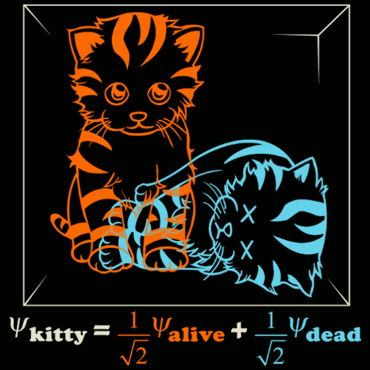

Slide 30
The measurement problem
Possible solutions:
De Broglie – Bohm
Many-World Interpretations
Collapse of the w.f.
.....

Slide 31
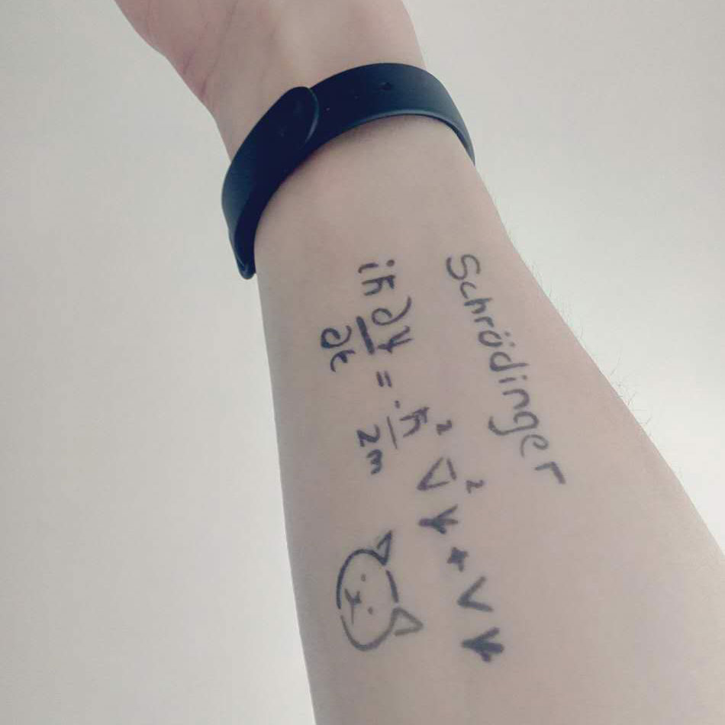
+…

Slide 32
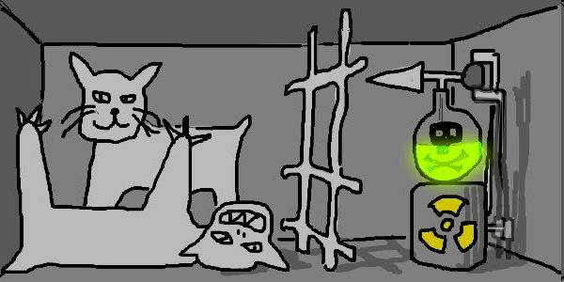
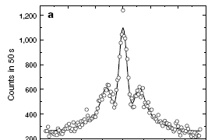
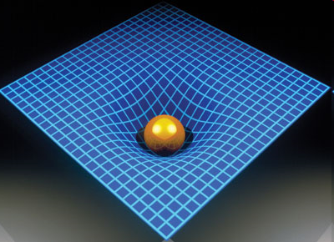
What are collapse models
Collapse models = solution of the measurement problem
Paradox-free description of the quantum world
Collapse models = rival theory of Quantum Mechanics
They are related to experiments testing quantum linearity
Collapse models as phenomenological models of an underlying pre-quantum theory
Can gravity causes the collapse?
Trieste: 5 luglio 2010
32

Slide 34
Gravity-related
the size of the particle’s mass density R0
Penrose – no radiation (but not yet dynamics?)

Slide 36
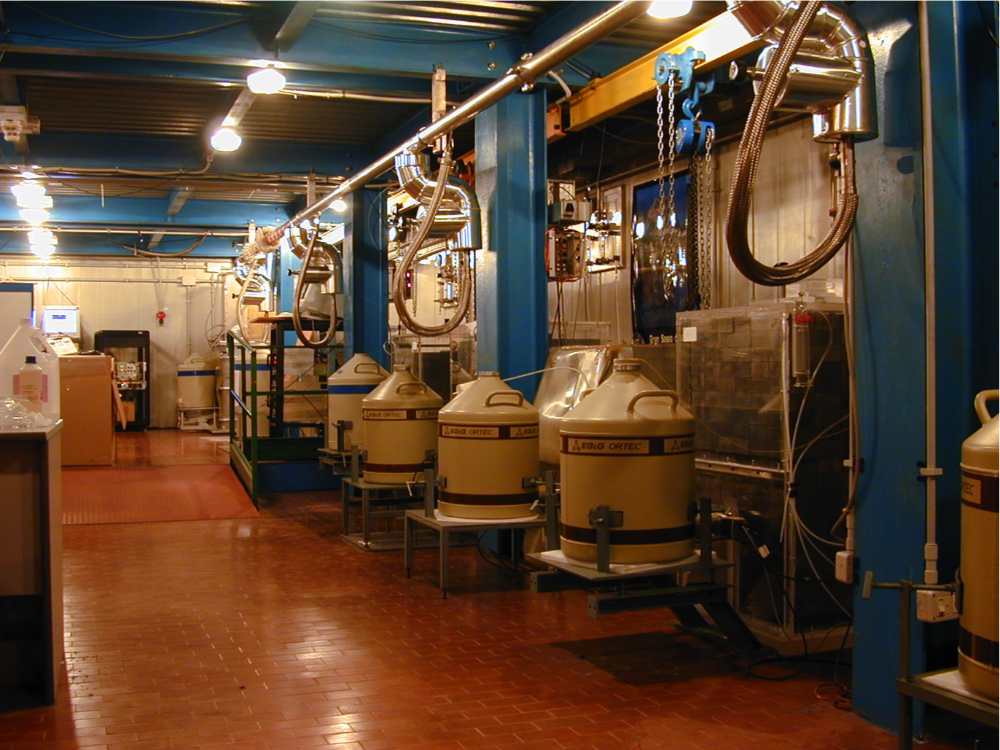
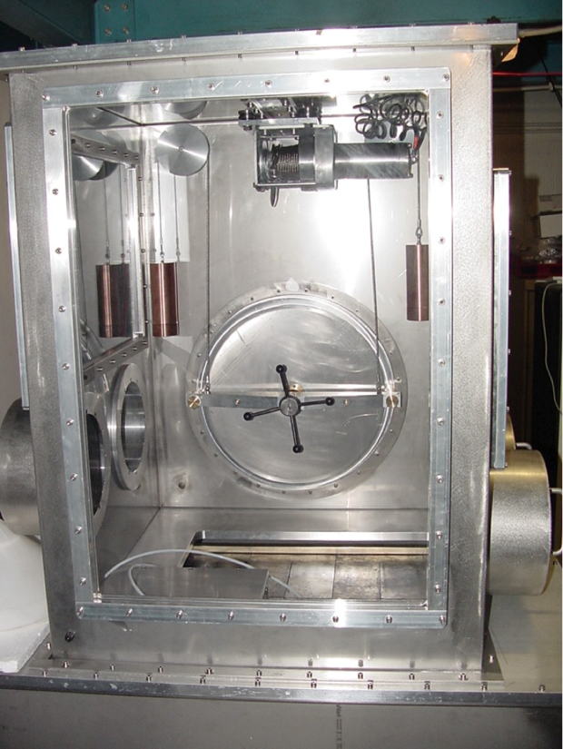
Spontaneous emission including nuclear protons – data taking at LNGS (ultrapure Ge; Matthias Laubenstein)!

Slide 37
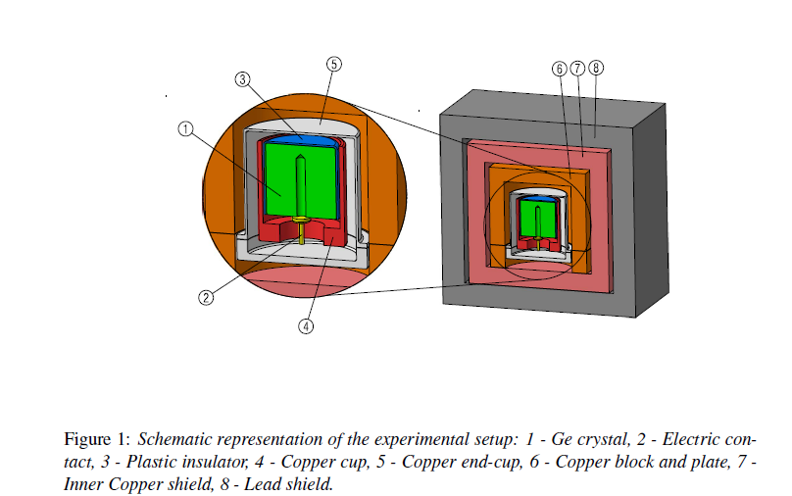

Slide 39
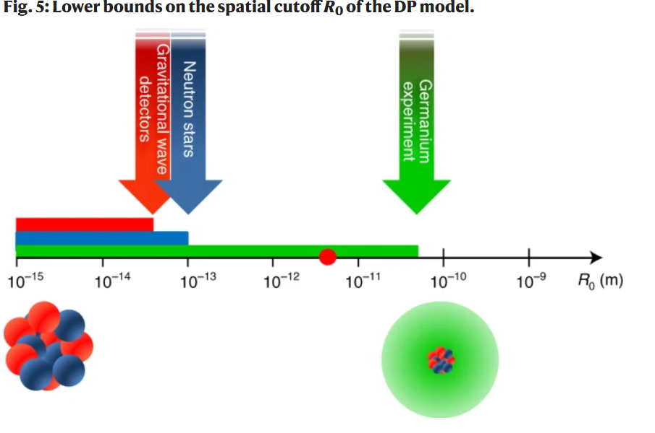

Slide 40
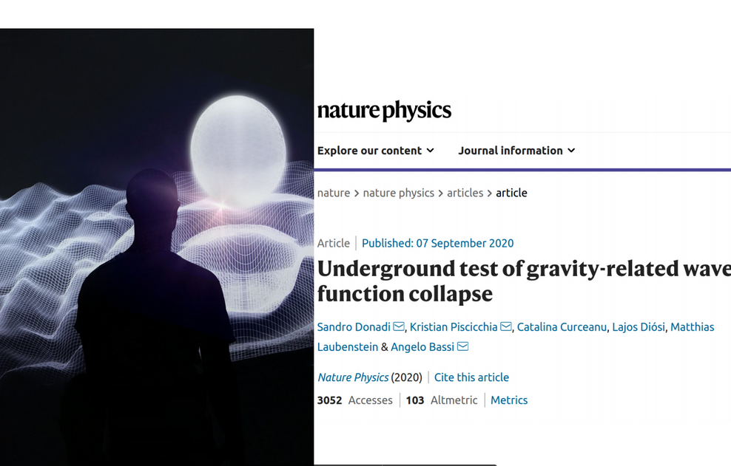

Slide 41
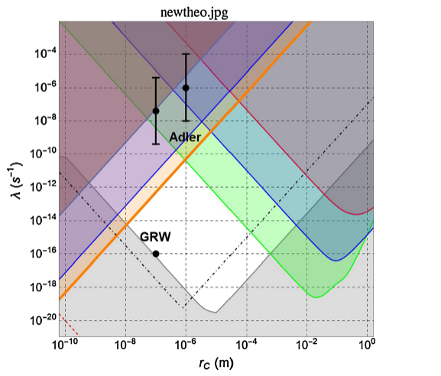
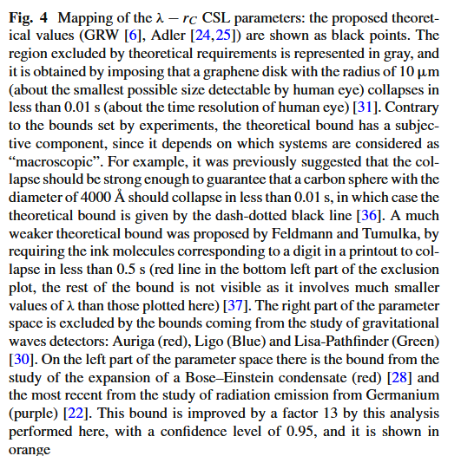

Slide 42
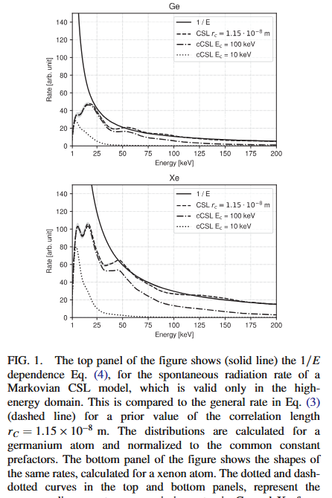
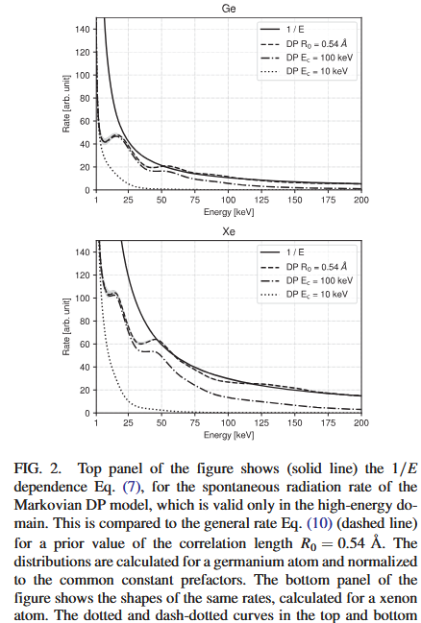

Slide 44
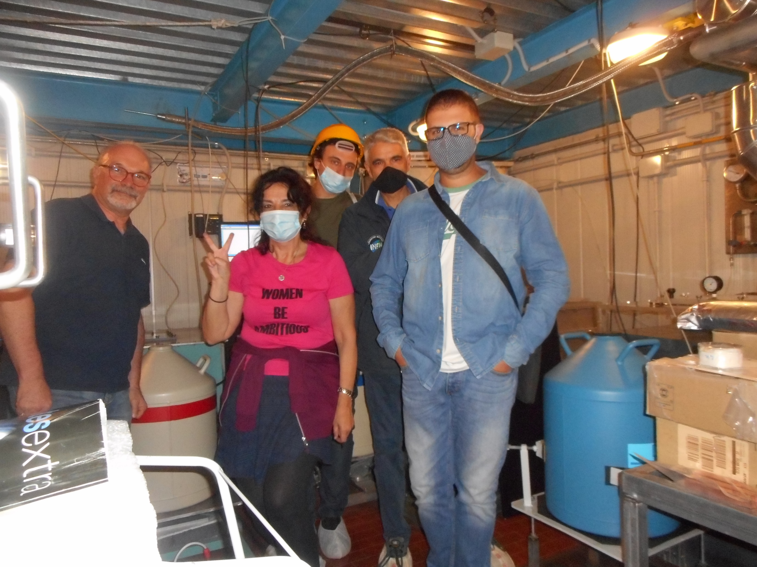
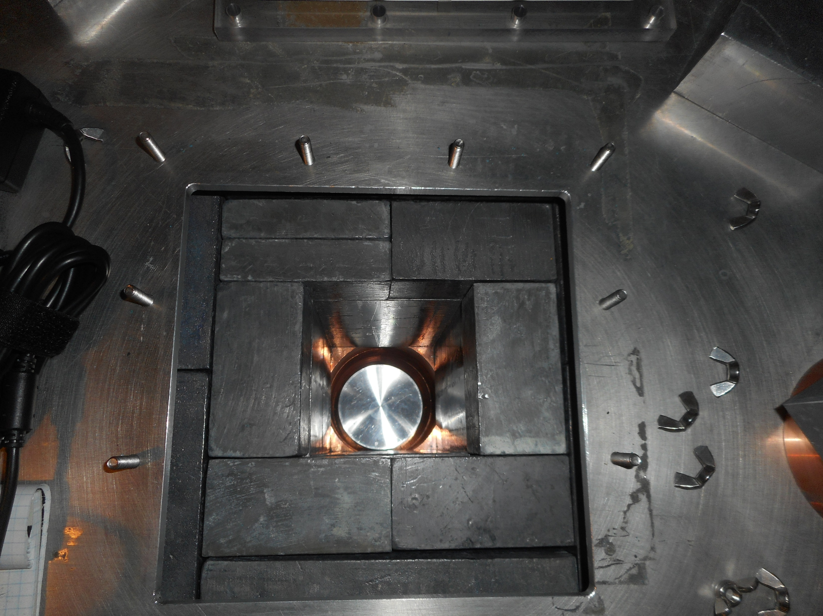
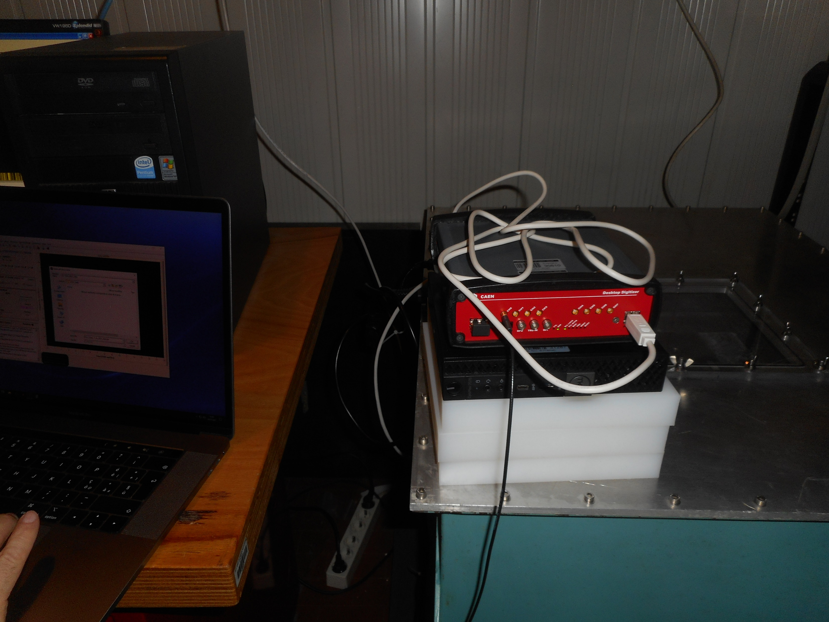
BEGe detector at LNGS – we are in run since early July

Slide 45
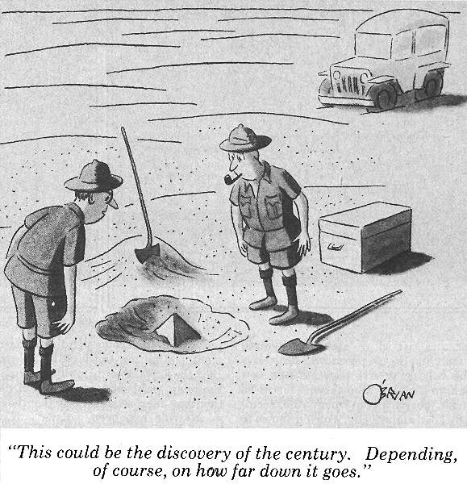
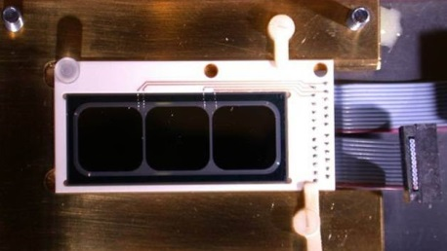
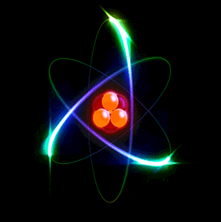
Testing Quantum Physics underground
Support from BridgeQG COST Action

Slide 46
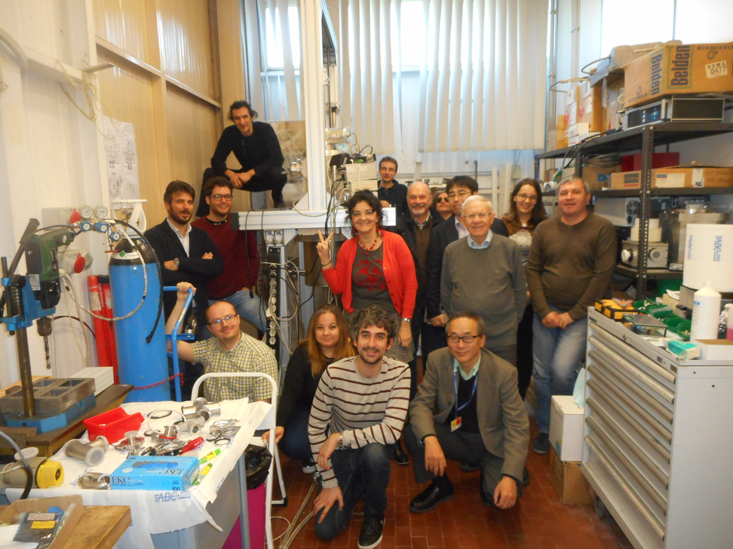
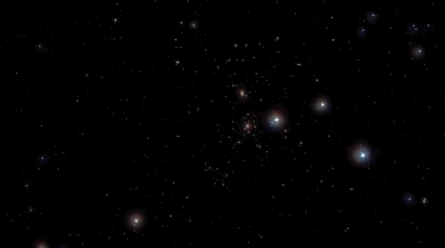
Acknowledgements

