Slide 1

Detectability of post-Newtonian classical and quantum gravity via quantum clock interferometry
arXiv:2506.15014
Eyuri Wakakuwa
Nagoya University

Slide 2
Background
Intersection b/w GR+QM is still unknown
Low-energy experiments have been proposed (“table-top”)
Quantum probe of
general relativistic proper time
Witnessing
quantumness of gravity
(Zych et al. Nat. Comm. 2, 505 (2011))
(Bose et al. PRL 119, 240401 (2017))
(Marletto&Vedral PRL 119, 240402 (2017))

Slide 3
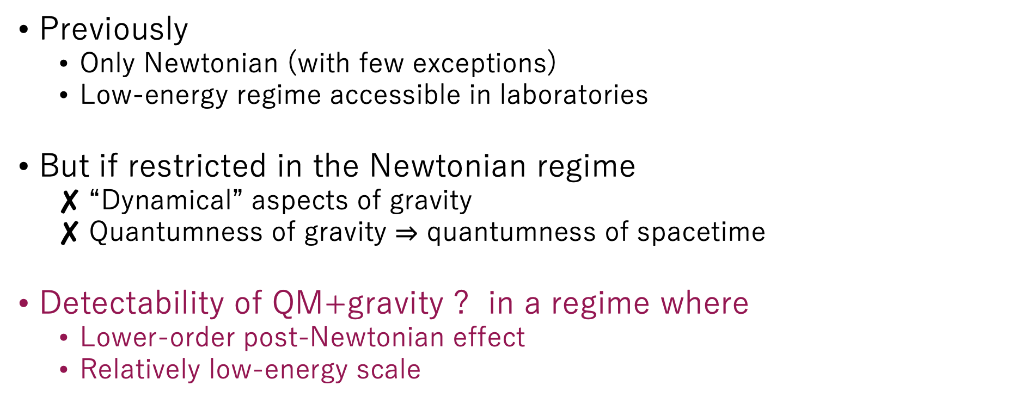
Post-Newtonian gravity + QM?
Previously
  Only Newtonian (with few exceptions)
  Low-energy regime accessible in laboratories
But if restricted in the Newtonian regime
  “Dynamical” aspects of gravity
  Quantumness of gravity $⇒$ quantumness of spacetime
Detectability of QM+gravity ? in a regime where
  Lower-order post-Newtonian effect
  Relatively low-energy scale
Notes:
Low energy limitの説明を練習する
It is not surprising, because the original motivation of these proposals is to detect the quantum and gravitational effects in the low energy regime that is accessible in laboratory experiments.

Slide 4
Outline of this research
Gravitomagnetic clock effect
(post-Newtonian)
Interferometric visibility
Gravity mediated entanglement
Quantum
Equivalence principle
Quantum clock interferometry

Slide 5

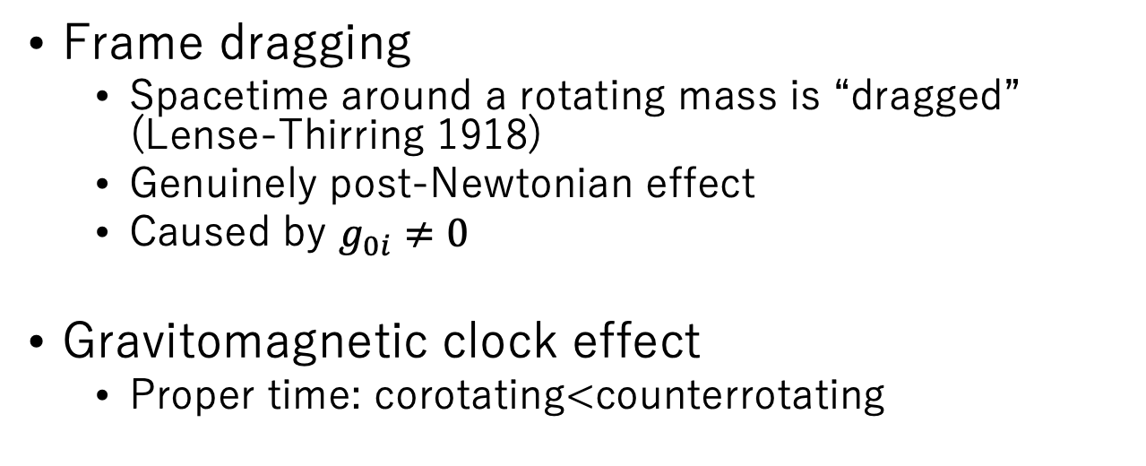



Gravitomagnetic clock effect
Frame dragging
  Spacetime around a rotating mass is “dragged” (Lense-Thirring 1918)
  Genuinely post-Newtonian effect
  Caused by $g_{0i}≠0$
Gravitomagnetic clock effect
  Proper time: corotating<counterrotating
$$τ_{L}$$
$$τ_{R}$$
$$J$$
Spacetime metric at a distance from the source:
$$−{\left(cdτ\right)}^{2}≈−\left(1−\frac{2GM}{c^{2}r}\right){\left(cdt\right)}^{2}+\left(1+\frac{2GM}{c^{2}r}\right){dr}^{2}+r^{2}\left({dθ}^{2}+{\sin{θ}}^{2}{dφ}^{2}\right)−\frac{4GJ}{c^{3}r}{\sin{θ}}^{2}\left(cdt\right)dφ$$
Schwarzschild components ($⊃$Newtonian)
Frame dragging
Notes:
GCEの説明を練習する
Gravitomagnetic clock effect is one of the phenomena that is caused by the frame dragging effect.
Suppose that there is a mass rotating along a fixed axis, and a clock passes nearby .
Then, the proper time that the clock ticks is shorter for the corotating orbit, and longer for the counterrotating orbit.

Slide 6



Interferometric visibility experiment
(An extension of IV experiment in homogeneous gravity by Zych et al. Nat. Comm. 2, 505 (2011) )
$$L′$$
$$R′$$
Setup:
  Mach-Zehnder type interferometry
  Quantum clock particle
  Source mass is rotating in a fixed direction

Slide 7
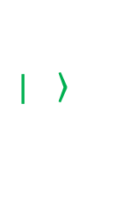
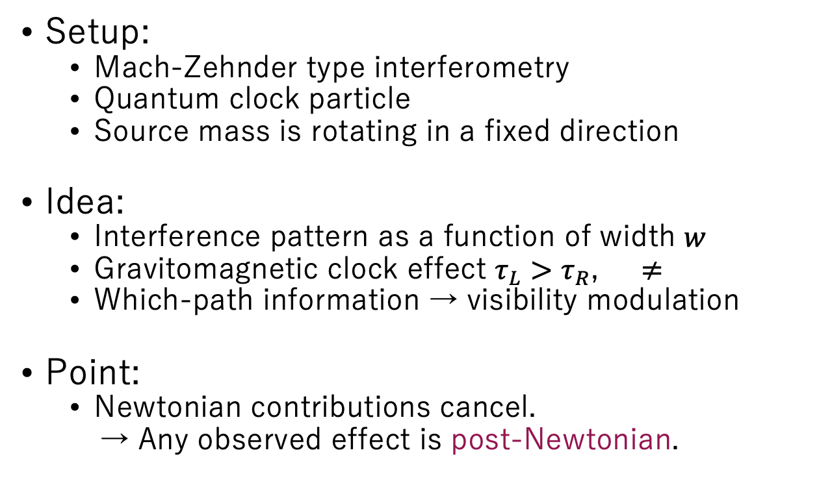

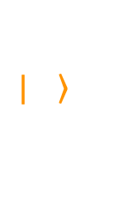




Interferometric visibility experiment
(An extension of IV experiment in homogeneous gravity by Zych et al. Nat. Comm. 2, 505 (2011) )
$$L′$$
$$R′$$
Setup:
  Mach-Zehnder type interferometry
  Quantum clock particle
  Source mass is rotating in a fixed direction
Idea:
  Interference pattern as a function of width $w$
  Gravitomagnetic clock effect $τ_{L}>τ_{R}$, $≠$
  Which-path information → visibility modulation
Point:
  Newtonian contributions cancel.
  → Any observed effect is post-Newtonian.
$$|\left.\right\rangle$$
$$|\left.\right\rangle$$
$$τ_{L}$$
$$τ_{R}$$
$$|\left.\right\rangle$$
$$|\left.\right\rangle$$
$$|\left.\right\rangle$$
$$|\left.\right\rangle$$
$$w$$

Slide 8

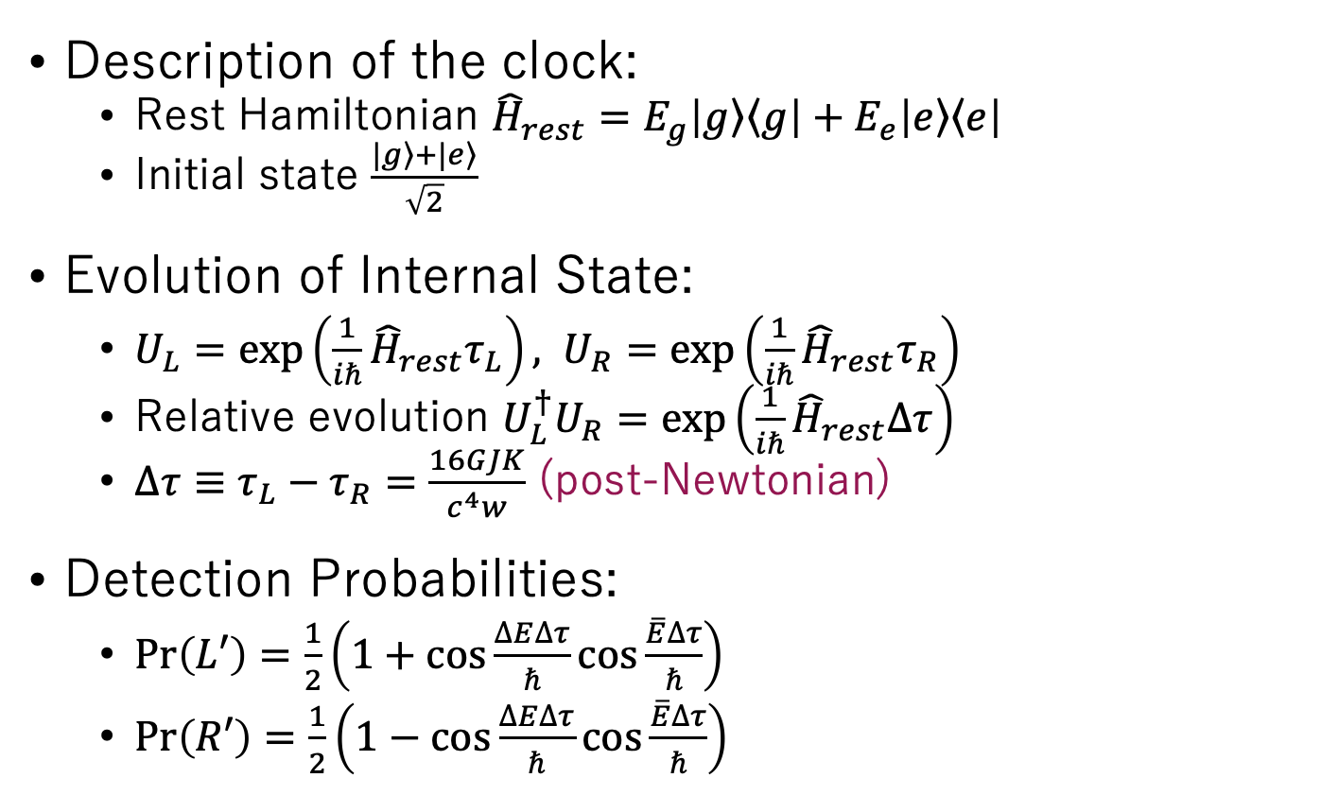

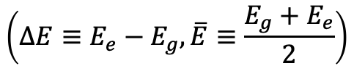

Interference pattern
Description of the clock:
  Rest Hamiltonian ${\hat{H}}_{rest}=E_{g}\left|\left.g\right\rangle \left\langle g\right.\right|+E_{e}\left|\left.e\right\rangle \left\langle e\right.\right|$
  Initial state $\frac{|\left.g\right\rangle +|\left.e\right\rangle }{\sqrt{2}}$
Evolution of Internal State:
  $U_{L}=exp\left(\frac{1}{iℏ}{\hat{H}}_{rest}τ_{L}\right), U_{R}=exp\left(\frac{1}{iℏ}{\hat{H}}_{rest}τ_{R}\right)$
  Relative evolution ${U_{L}^{†}U}_{R}=exp\left(\frac{1}{iℏ}{\hat{H}}_{rest}Δτ\right)$
  $Δτ≡τ_{L}−τ_{R}=\frac{16GJK}{c^{4}w}$ (post-Newtonian)
Detection Probabilities:
  $Pr\left(L′\right)=\frac{1}{2}\left(1+\cos{\frac{∆E∆τ}{ℏ}}\cos{\frac{\overline{E}∆τ}{ℏ}}\right)$
  $Pr\left(R′\right)=\frac{1}{2}\left(1−\cos{\frac{∆E∆τ}{ℏ}}\cos{\frac{\overline{E}∆τ}{ℏ}}\right)$
$$Pr\left(L′\right)$$
$$ΔE=0$$
$$ΔE=\overline{E}/24$$
$w′≡\frac{c^{4}w}{16GJK}$
$$\left(ΔE≡E_{e}−E_{g}, \overline{E}≡\frac{E_{g}+E_{e}}{2}\right)$$
Notes:
The detection probabilities are calculated in this way and are depicted in the graph.
The first cosine term represents the amplitude modulation and the second term represents the phase shift due to the proper time difference.
If delta E=0, there is no clock degree of freedom and no amplitude modulation, while if delta E is not zero there is an amplitude modulation.

Slide 9
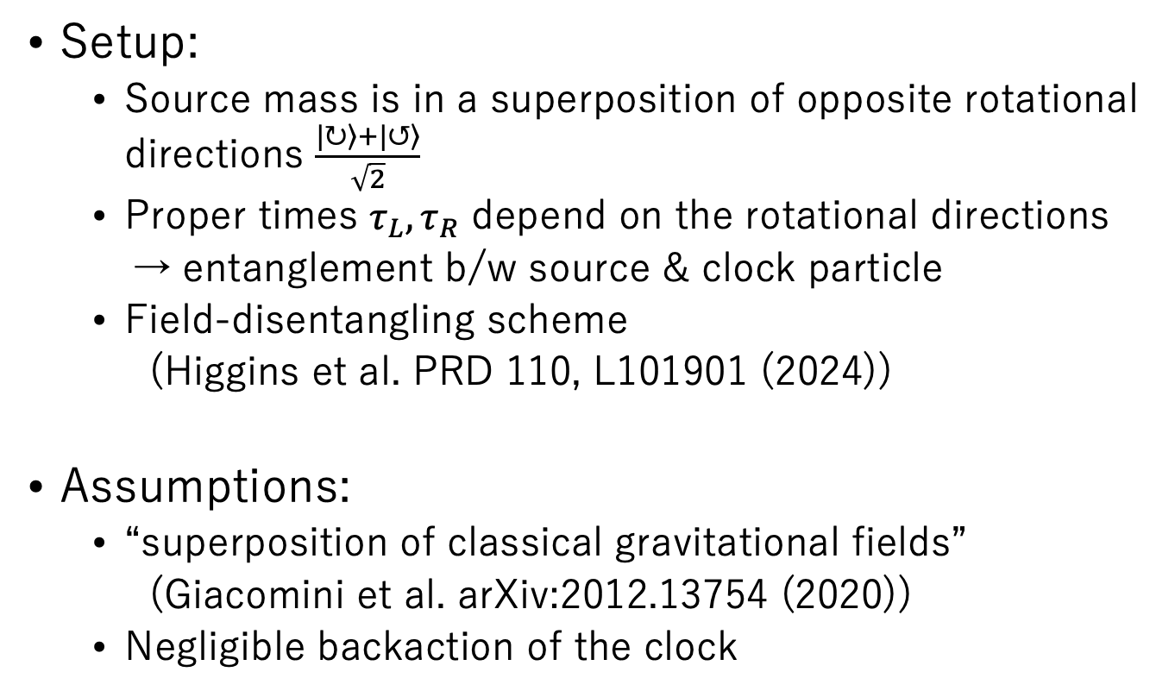
GME experiment
Setup:
  Source mass is in a superposition of opposite rotational directions $\frac{|\left.↻\right\rangle +|\left.↺\right\rangle }{\sqrt{2}}$
  Proper times $τ_{L},τ_{R}$ depend on the rotational directions
  → entanglement b/w source & clock particle
  Field-disentangling scheme
  (Higgins et al. PRD 110, L101901 (2024))
Assumptions:
  “superposition of classical gravitational fields”
  (Giacomini et al. arXiv:2012.13754 (2020))
  Negligible backaction of the clock
Notes:
Now we adapt the previous interferometry experiment to the GME experiment.
One is the assumption of “superposition of classical gravitational fields”.
This means that the state of the gravitational field is represented as superpositions of classical configurations of the field, and each configuration is described by general relativity.

Slide 10

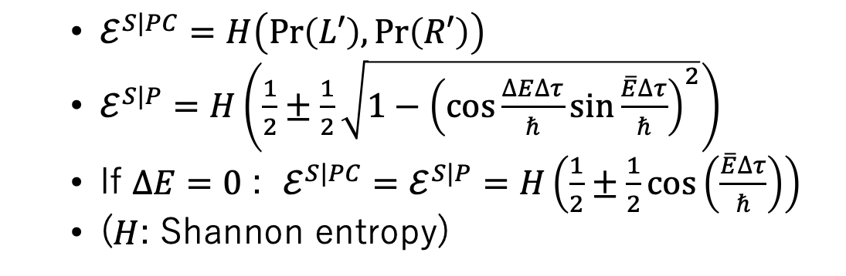
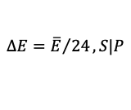
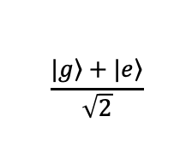
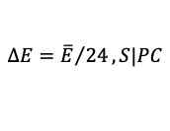
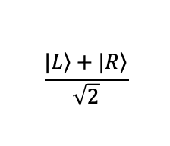
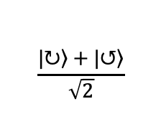

Entanglement generation
Source
$$\frac{|\left.↻\right\rangle +|\left.↺\right\rangle }{\sqrt{2}}$$
Path
$$\frac{|\left.L\right\rangle +|\left.R\right\rangle }{\sqrt{2}}$$
Clock
$$\frac{|\left.g\right\rangle +|\left.e\right\rangle }{\sqrt{2}}$$
phase
  $ℰ^{S|PC}=H\left(Pr\left(L′\right),Pr\left(R′\right)\right)$
  $ℰ^{S|P}=H\left(\frac{1}{2}±\frac{1}{2}\sqrt{1−{\left(\cos{\frac{∆E∆τ}{ℏ}}\sin{\frac{\overline{E}∆τ}{ℏ}}\right)}^{2}}\right)$
  If $ΔE=0$ : $ℰ^{S|PC}=ℰ^{S|P}=H\left(\frac{1}{2}±\frac{1}{2}\cos\left(\frac{\overline{E}∆τ}{ℏ}\right)\right)$
  ($H$: Shannon entropy)
$$ΔE=0$$
$$ℰ$$
$$ΔE={\overline{E}}/{24}, S|PC$$
$$ΔE={\overline{E}}/{24}, S|P$$
$w′≡\frac{c^{4}w}{16GJK}$
Notes:
In the circuit model, the situation is represented like this.
We have three qubits, which is the rotational direction of the source mass, the path and clock degrees of freedom of the particle.
The interaction is described as the controlled-controlled phase gate.
The entanglement between S and PC is just the Shannon entropy of the detection probability.
The entanglement between S and P is calculated in this way, and both are shown in the graph.
If delta E=0, the two entanglement coincide and there is no modulation, and if delta E is not zero, there is an amplitude modulation.

Slide 11
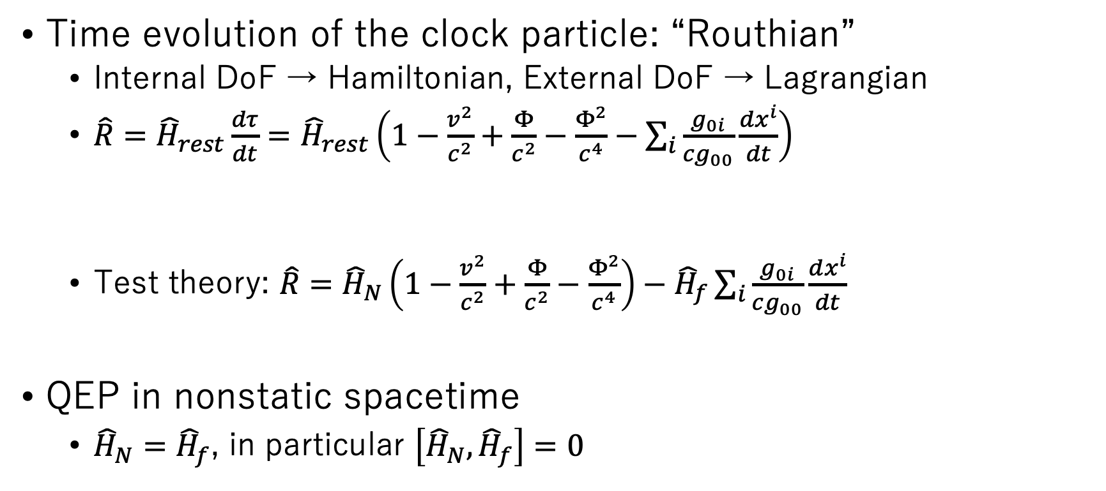
QEP in nonstatic spacetime
(An extension of QEP in static spacetime by Zych et al. Nat. Phys. 14, 1027 (2018))
Time evolution of the clock particle: “Routhian”
  Internal DoF → Hamiltonian, External DoF → Lagrangian
  $\hat{R}={\hat{H}}_{rest}\frac{dτ}{dt}={\hat{H}}_{rest}\left(1−\frac{v^{2}}{c^{2}}+\frac{Φ}{c^{2}}−\frac{Φ^{2}}{c^{4}}−\sum_{i}{\frac{g_{0i}}{cg_{00}}\frac{dx^{i}}{dt}}\right)$
  Test theory: $\hat{R}={\hat{H}}_{N}\left(1−\frac{v^{2}}{c^{2}}+\frac{Φ}{c^{2}}−\frac{Φ^{2}}{c^{4}}\right)−{\hat{H}}_{f}\sum_{i}{\frac{g_{0i}}{cg_{00}}\frac{dx^{i}}{dt}}$
QEP in nonstatic spacetime
  ${\hat{H}}_{N}={\hat{H}}_{f}$, in particular $\left[{\hat{H}}_{N},{\hat{H}}_{f}\right]=0$
Time
dilation
Gravitational
redshift
Frame
dragging
QEP holds in Newtonian limit
QEP ensures
geometric picture of
gravity

Slide 12

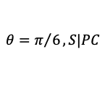
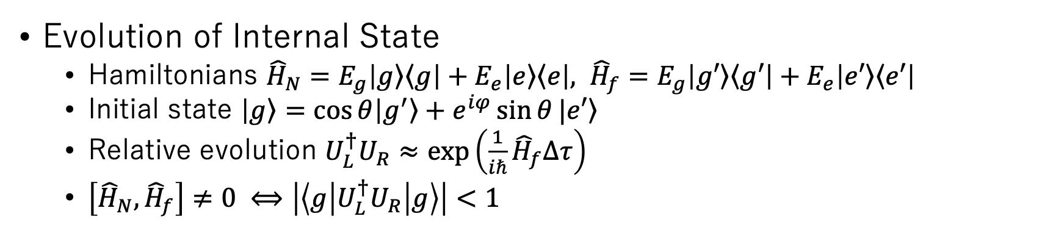




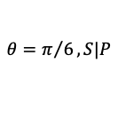
QEP violations in clock interferometry
Evolution of Internal State
  Hamiltonians ${\hat{H}}_{N}=E_{g}\left|\left.g\right\rangle \left\langle g\right.\right|+E_{e}\left|\left.e\right\rangle \left\langle e\right.\right|, {\hat{H}}_{f}=E_{g}\left|\left.g′\right\rangle \left\langle g′\right.\right|+E_{e}\left|\left.e′\right\rangle \left\langle e′\right.\right|$
  Initial state $\left|\left.g\right\rangle =\cos{θ}\right|\left.g^{′}\right\rangle +e^{iφ}\sin{θ}|\left.e′\right\rangle$
  Relative evolution ${U_{L}^{†}U}_{R}≈exp\left(\frac{1}{iℏ}{\hat{H}}_{f}Δτ\right)$
  $\left[{\hat{H}}_{N},{\hat{H}}_{f}\right]≠0 ⟺\left|\left\langle g | {U_{L}^{†}U}_{R} | g\right\rangle \right|<1$
Gravity is
quantum
spacetime geometry
Interferometric visibility
GME
$$Pr\left(L′\right)$$
$$θ=0$$
$$θ=0$$
$$ℰ$$
$$θ=π/6, S|PC$$
$$θ=π/6$$
$$θ=π/6, S|P$$
$w′≡\frac{c^{4}w}{16GJK}$
$w′≡\frac{c^{4}w}{16GJK}$

Slide 13

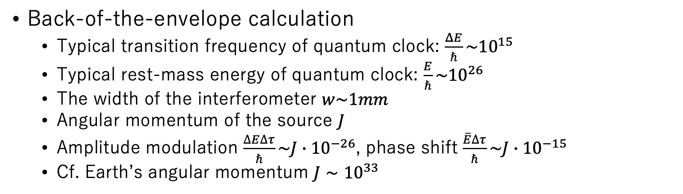
Feasibility?
Back-of-the-envelope calculation
  Typical transition frequency of quantum clock: $\frac{ΔE}{ℏ}\sim {10}^{15}$
  Typical rest-mass energy of quantum clock: $\frac{E}{ℏ}\sim {10}^{26}$
  The width of the interferometer $w\sim 1mm$
  Angular momentum of the source $J$
  Amplitude modulation $\frac{∆E∆τ}{ℏ}\sim J∙{10}^{−26}$, phase shift $\frac{\overline{E}∆τ}{ℏ}\sim J∙{10}^{−15}$
  Cf. Earth’s angular momentum $J∼{10}^{33}$
The effect is too small in any realistic parameter regions.
No more than gedankenexperiment!

Slide 14
What does the unfeasibility possibly mean?
Our scheme is not good.
→ Alternative experimental scheme would be necessary.
Quantum nature of post-Newtonian gravity cannot be detected at low energy (even if Newtonian gravity can be).
→ High-energy experiment is necessary.
Post-Newtonian gravity is classical (even if Newtonian gravity is quantum).
→ Quantumness of gravity is regime-dependent.

Slide 15


Summary
arXiv:2506.15014
What we have done:
  Proposed an experimental schemes to detect post-Newtonian gravitational effect in quantum clock interferometry
  Interferometric visibility / GME / quantum equivalence principle
  The effects are too small to be detected in realistic scenario
  Discussed possible interpretations of the unfeasibility
Related researches:
  Interferometric detection of QCE by spin ½ particle
  (Basso&Maziero GRG 53, 70 (2021))
  Gravitational interaction between angular momenta to mediate entanglement
  (Lantaño et al. arXiv:2409.01364)
  Post-Newtonian gravitational effects from delocalized quantum source
  (Chen&Giacomini arXiv:2402.10288)

Slide 16
GME Experiment: Assumptions
(Adaptation from Giacomini et al. arXiv:2012.13754 (2020))
  Distinguishable states of the gravitational field are assigned different quantum state vectors.
  Each well-defined gravitational field is described by general relativity.
  The superposition principle holds for such gravitational fields.

