Slide 1



Probing the nature of gravity via diffusion
Oliviero Angeli
8.7.25 – BridgeQG, Paris
OA, S Donadi, JL Gaona Reyes, G Di Bartolomeo, A Vinante and A Bassi
arXiv:2501.13030

Slide 2
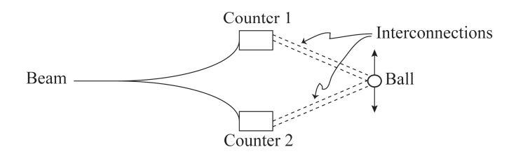
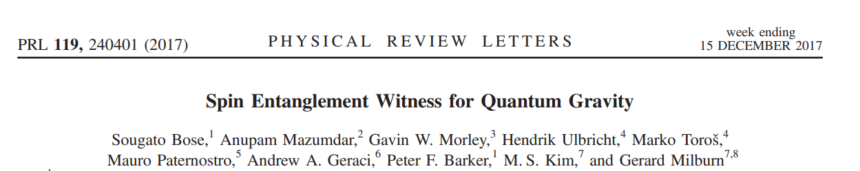
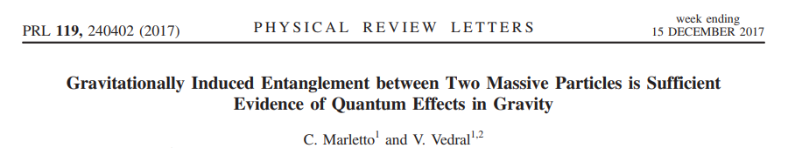
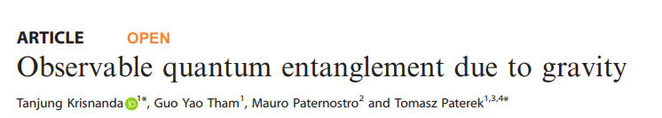
What is the gravitational field sourced by a superposition?
Feynman R, in Chapel Hill Conference Proceedings (1957)
…

Slide 3
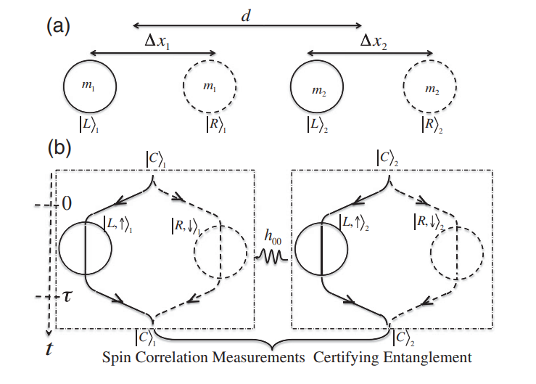
Entanglement generation
^{Non-classicality}
Creating and maintaining large mass superpositions is hard
Bose S et al. "Spin entanglement witness for quantum gravity." Physical review letters 119.24 (2017): 240401.

Slide 4
?
classicality

Slide 5
Diffusion in quantum matter
classicality

Slide 6



Diffusion in quantum matter
$$γ_{ij}$$
$$d$$
classicality
No superpositions required
Classical detection strategies

Slide 7

Feynman meets EPR
Assumptions
1. Matter is described by quantum mechanics
2. When matter is in a classical state then it follows Newton’s laws
3. The gravitational interaction is local and classical (LOCC)
-no superluminal signaling-
Feynman R, in Chapel Hill Conference Proceedings (1957)
Bohm D, & Aharonov Y (1957). Discussion of experimental proof for the paradox of Einstein, Rosen, and Podolsky. Physical Review, 108(4), 1070.

Slide 8

Feynman meets EPR
$$z$$
outcome
Matter here is everywhere semiclassical, so the probe must react according to Newton’s laws

Slide 9


Feynman meets EPR
$$z$$
$$±$$
Possible outcomes
To avoid signaling the statistics of Bob’s measurements must not change
The gravitional interaction must induce the collapse of the wavefunction!

Slide 10
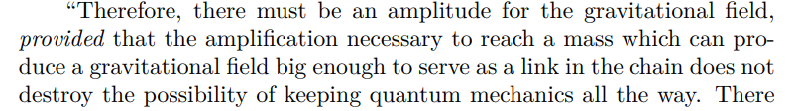
Feynman meets EPR
$$z$$
$$±$$
Possible outcomes
Feynman R, in Chapel Hill Conference Proceedings (1957)

Slide 11


Can the collapse be deterministic?
Then to each $|\left.B±\right\rangle$ state a particular outcome would be associated. The states $|\left.B±\right\rangle$ are entangled spin-position of a particle, but in principle, they can refer to far away systems
Charlie could then apply Z gates to switch the collapse superluminally
$$±$$
DIFFUSION
Thus a classical gravitational field must induce a stochastic collapse of the wavefunction of quantum matter in space. Any such dynamics [Sandro’s talk¹] necessarily induces
Brownian-like behavior
¹Donadi, S., Ferialdi, L., & Bassi, A. (2023). Collapse dynamics are diffusive. Physical Review Letters, 130(23), 230202.

Slide 12
Not a radically new idea
Kafri D, Taylor J M, & Milburn G J (2014). A classical channel model for gravitational decoherence. New Journal of Physics, 16(6), 065020
Tilloy A, & Diósi L (2016). Sourcing semiclassical gravity from spontaneously localized quantum matter. Physical Review D, 93(2), 024026
Gaona-Reyes J L, Carlesso M, & Bassi A (2021). Gravitational interaction through a feedback mechanism. Physical Review D, 103(5), 056011
Oppenheim J (2023). A postquantum theory of classical gravity?. Physical Review X, 13(4), 041040
.
.
.
DIFFUSION
But a model independent conclusion
Thus a classical gravitational field must induce a stochastic collapse of the wavefunction of quantum matter in space. Any such dynamics [Sandro’s talk¹] necessarily induces
Brownian-like behavior
¹Donadi, S., Ferialdi, L., & Bassi, A. (2023). Collapse dynamics are diffusive. Physical Review Letters, 130(23), 230202.

Slide 13

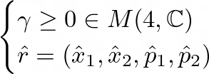
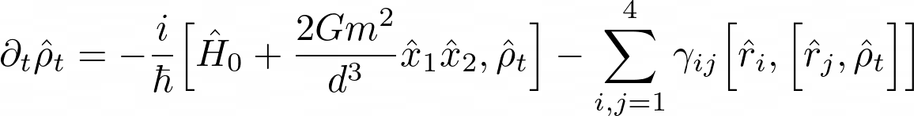
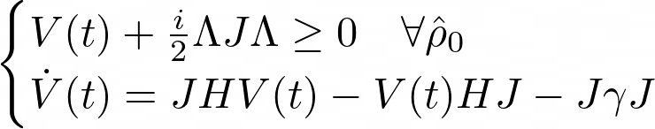
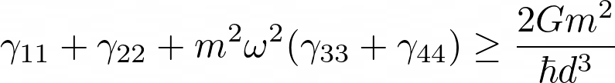




Modelling the setup
We assume we can model the dynamics of the setup via a master equation
1. Linear, Completely Positive, Diffusive
2. Markovian, Gaussian
$$γ_{ij}$$
$$d$$
$$Λ=diag[1,1,1,−1]$$
PPT $⟺$ (Gaussian)
Separability

Slide 14

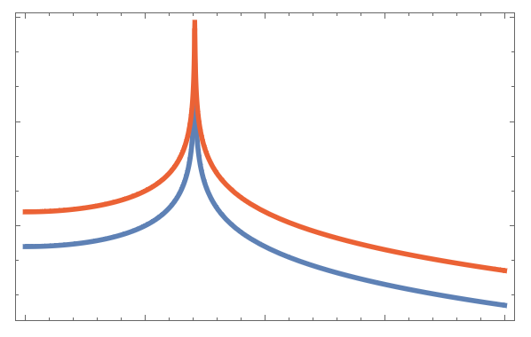
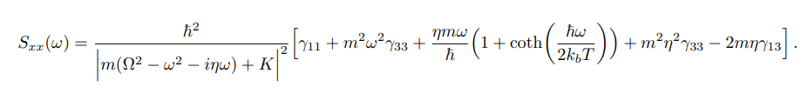

Detection strategies
$$Q/T\sim {10}^{14}K^{−1}$$
REHEATING – Transient
Cool the system and then let it evolve for a time t << relaxation time. Repeat N times to estimate the reheating rate
$$γ_{ij}$$
$$d$$
SPECTRUM – Stationary
Let the system equilibrate with the environment and estimate the DNS: gravitational noise appears as
an extra noise force

Slide 15
Thank you!

Slide 16


Quantum systems in fields generated by classical sources
COW experiments, $t^{3}$ phase, etc..
Quantum systems in fields generated by quantum sources
You are here
Levels of interplay between quantum theory and gravity
On-shell graviton effects
(tree level QFT)
Radiative corrections
(loops diagrams)
Exotic effects due to loops, strings etc.etc.

Slide 17
