Slide 1
Démonstrateur pour le portage HW automatisé
Dev SW:
Adaptation lib pour NN choisi
Prise en compte des param HW
Entrainement avec dynamique réelle
Evaluation perf et implémentatibilité
Dev passerelle SW/FW:
Lib hdl
Script transfo NN -> rtl
Simulation netlist -> validation perf
Synthèse -> valider estim resources
Dev FW fixe:
Choix cible & host architecture
DAQ drivers
Scientific Data
Topology and parameters definition
Software training
HDL Lib
Neural Network
Rtl generation
Host Architecture
Performance evaluation
Netlist Simulation
Synthesis & Implementation
FPGA
DAQ Drivers
Implementation feasibility
FPGA related software
Efficiency measurement

Slide 2
Library HDL - description des composants nécessaires
TensorFlow description
x=layers.Conv1D(filters=16, kernel_size=8)(input)
x=layers.MaxPool1D(pool_size=4)(x)
x=layers.Activation(activation='relu')(x)
x=layers.Conv1D(filters=32, kernel_size=2)(x)
x=layers.MaxPool1D(pool_size=4)(x)
x=layers.Activation(activation='relu')(x)
x=layers.Conv1D(filters=16, kernel_size=2)(x)
x=layers.MaxPool1D(pool_size=4)(x) x=layers.Activation(activation='relu')(x)
x=layers.Conv1D(filters=8, kernel_size=8)(x)
x=layers.MaxPool1D(pool_size=4)(x)
x=layers.Activation(activation='relu')(x)
x=layers.Flatten()(x)
output=layers.Dense(2)(x)
Conv1D_Layer: GENERIC -> N_FILTERS
Parallel generic instantiation
|
|
|
|
|
|
|
|
|
|
|
|
|
|
Conv1D_Filter: GENERIC -> N_INPUTS
Parallel generic instantiation
|
|
|
|
|
|
|
|
|
Kernel1D: GENERIC -> KER_SIZE
Chained generic instantiation
|
|
|
|
Clk, Rst,…
DSP
Param Bus
Param reg
Data IN Bus
Data OUT Bus
Generic layer interface

Slide 3
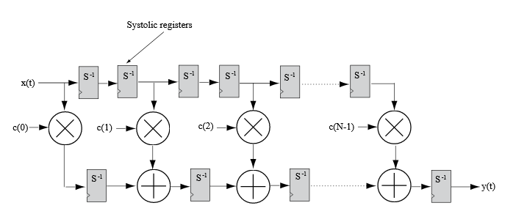
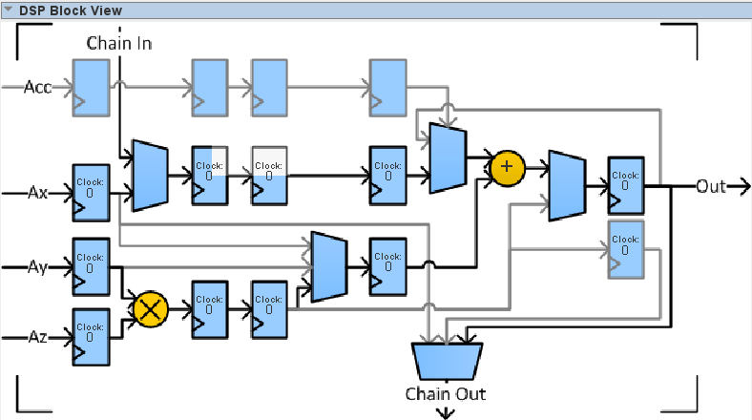
Library HDL - description des composants nécessaires
Conv1D_Layer (N_INPUTS => 3, N_FILTERS => 2)
Kernel 1D module = FIR filter
Kernel1D
+
Kernel1D
DATA OUT
Kernel1D
Bias
DATA IN
Kernel1D
+
Kernel1D
Kernel1D
Stratix 10 DSP
Native 32b floating point arithmetic
Up to 4000 units available
Bias

Slide 4
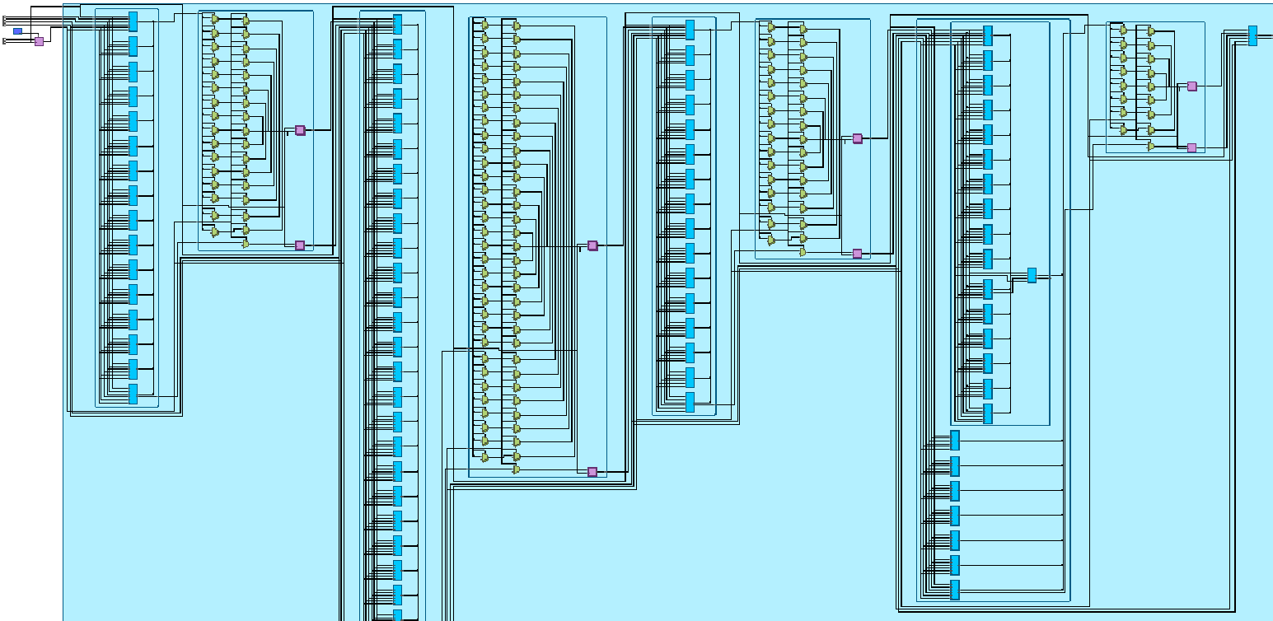
RTL Generation script
Conv Layer 0
Activation Layer 0
Conv Layer 1
Activation Layer 1
Conv Layer 2
Activation Layer 2
Conv Layer 3
Activation Layer 3
A python script generates the rtl top level architecture of the IP
Desired architecture is a parameter of the script
Synthesis allows to estimate the resource utilization
Fully unrolled architecture (no reusability) -> only small design can fit in FPGA

Slide 5
RTL Simulation
Param file
TestBench (vhdl)
Simulation script (Python)
Write
Read
Data IN file
TestBench Control
Quartus/Questa
Compilation Elaboration
Run
Generated IP (vhdl)
Read
Le script Python :
Fourni les entrées
Automatise les étapes nécessaires à la simulation
Récupère les résultats et les analyse (comparaison avec calcul soft)
Le TestBench :
Génère l’horloge
Instancie l’IP générée
Séquence le test
Fait des accès aux fichiers
Write
Data OUT file

Slide 6
How to fit the system in a FPGA
TradeOff entre différentes grandeurs :
Ressources disponibles (DSP, mémoire, routage …)
Latence
Précision
Consommation électrique
…
Dépends du FPGA et du système hôte
Contraintes extérieures
Latence
Latence
Possible
Lat max
Possible
Impossible
pour la cible HW
Design optimal
Points connus
Impossible
Impossible
Design attendu
Lat min
Ressources
Ressources
Ress min
Ress max
FPGA cible
= réutilisation maximale
= plus aucun gain de latence
Approche choisie pour converger vers le design cible : Partir du design minimal (latence max) et en itérer en dupliquant le module de calcul permettant le meilleur gain en latence (valeur facile à estimer).

Slide 7
Minimal design, highest resources reusability
Top module
Processing unit
Kernel 1D
IN Crossbar
Relu
OUT Crossbar
Flatten
Data OUT
Neuron
…
Bypass
Data Memory
Data IN
R/W pointers Read requests
Control unit
Parameter Memory
Memory manager
Switch manager
Param IN
Instruction Memory
Instructions
Instruction decoder
Instruction IN

Slide 8
Exemple d’instructions
Set CROSSBAR MODE -> KERNEL 1D (1 Dataflow)
Set PRP = K0 param Base addr
Read Param 8
Set DWP = res0 Base addr
Set DRP = In0 data Base addr
Read Data 2048
Set PRP = K1 param Base addr
Read Param 8
Set DWP = res1 Base addr
Set DRP = In1 data Base addr
Read Data 2048
Set PRP = K2 param Base addr
Read Param 8
Set DWP = res2 Base addr
Set DRP = In2 data Base addr
Read Data 2048
Set CROSSBAR MODE -> Reduction Adder (2 Dataflows)
Set DRP0 = res0 Base addr
Set DRP1 = res1 Base addr
Set DWP = res0+1 Base addr
Read Data 2048
Set DRP0 = res0+1 Base addr
Set DRP1 = res2 Base addr
Set DWP = res0+1+2 Base addr
Read Data 2048
Set CROSSBAR MODE -> Constant Adder (1 Dataflow)
Set PRP = Bias0 param Base addr
Read Param 1
Set DRP = res0+1+2 Base addr
Set DWP = res0+1+2 Base addr
Read Data 2048
DATA IN
Kernel1D
+
DATA OUT
Kernel1D
Kernel1D
Bias
Processing unit
Kernel1D
IN Crossbar
OUT Crossbar
+
+ Bias

Slide 9
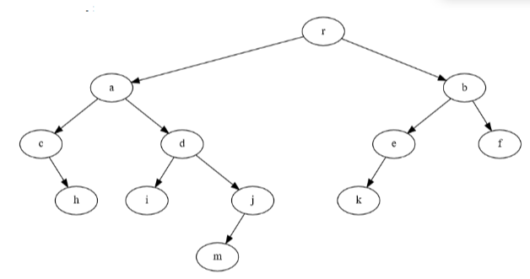
Evolution par itérations successives
Guidée par une recherche de « patterns » sur l’arbre de calcul
Les instructions sont regénérées pour chaque nouvelle architecture
Processing unit
Kernel1D
IN Crossbar
OUT Crossbar
+
+ Bias
Duplication de modules les plus utilisés
= verticale
Prolongement des blocs
= horizontal
Processing unit
Processing unit
Kernel1D
Kernel1D
Kernel1D
+
Kernel1D
IN Crossbar
OUT Crossbar
+
IN Crossbar
OUT Crossbar
+
+ Bias
+ Bias

