Slide 1
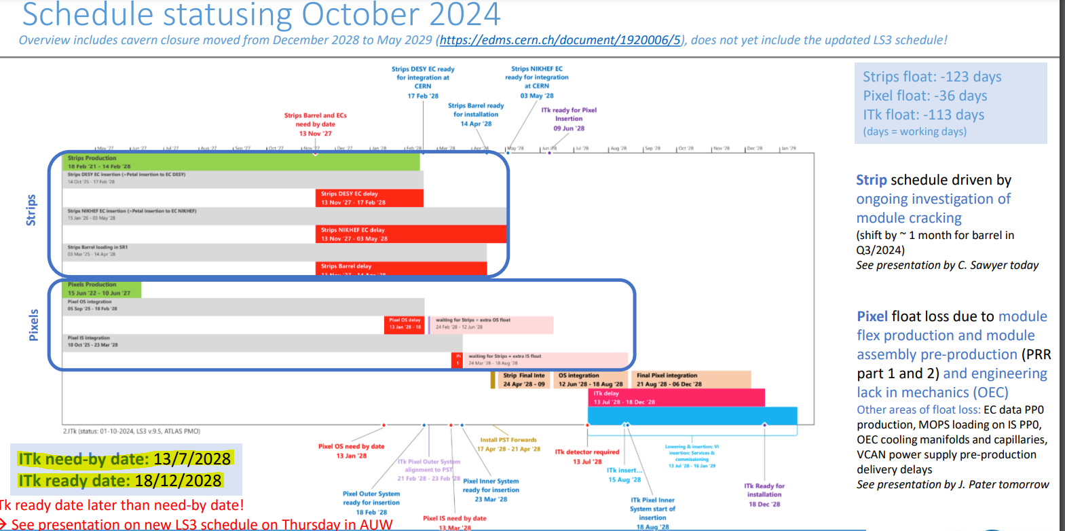
List of Updates taken from AUW:
Main theme:
Yahya Khwaira
1

Slide 2
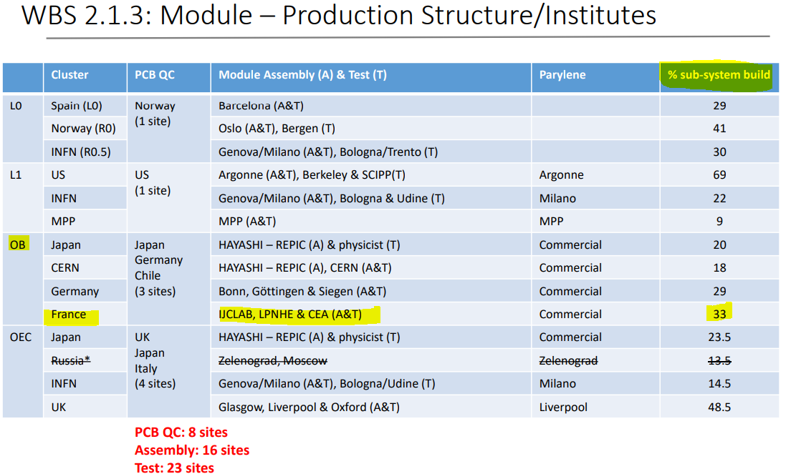
List of Updates taken from AUW:
Our share of OB Pixel:
Yahya Khwaira
1

Slide 3
List of Updates taken from AUW:
Current status:
Yahya Khwaira
1

Slide 4
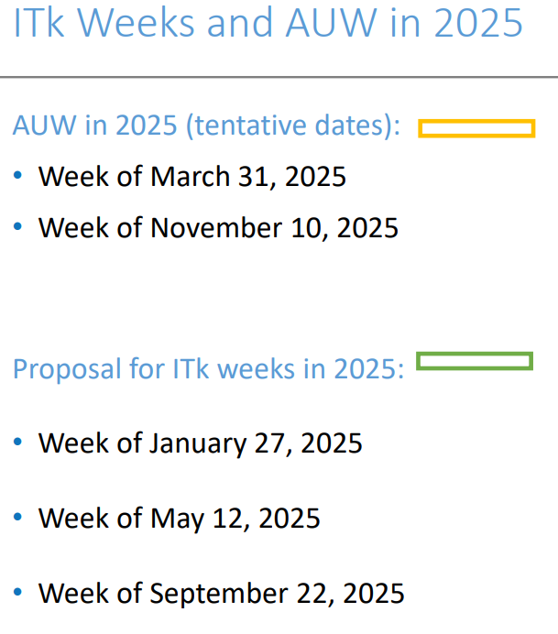
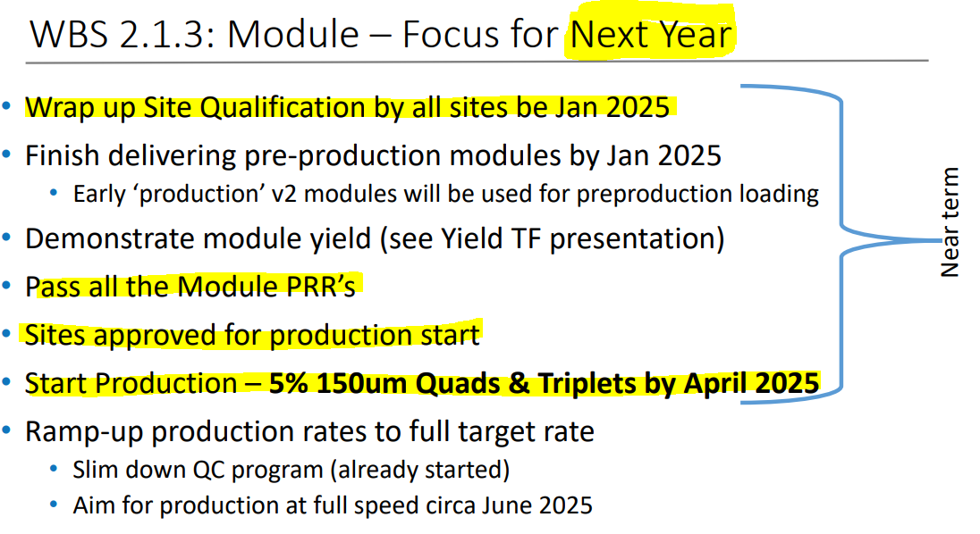
List of Updates taken from AUW:
Future and upcoming plans:
More in the AUW agenda:
SR1 Activities.
FELIX DAQ.
Pixel Integration and mechanics
Yahya Khwaira
1

