Slide 1
Polarized flares from Sagittarius A*: Modeling and beyond
Collaborators : F. Vincent, A. Dmytriiev, I. El Mellah, T. Paumard, G. Perrin, A. Zech, J. Luis Rosa, H. Liis Tamm, P. garcia
GRAVITY+ workshop,
Observatoire de Paris-Meudon
20 Novembre 2024
ndaimar@fe.up.pt
Nicolas Aimar
GRAVITY+ workshop

Slide 2
Table of content
Introduction
Magnetic reconnection in black holes environment
GRMHD simulations
(GR)PIC simulations
Hotspot model from magnetic reconnection
Model properties
Comparison with observations
Flares polarization as probe of space-time
Conclusion
Nicolas Aimar
GRAVITY+ workshop

Slide 3
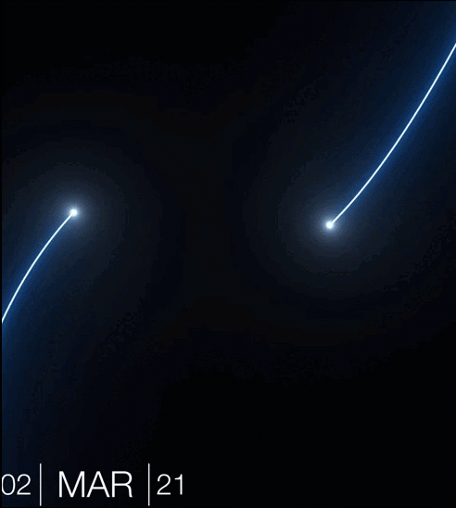
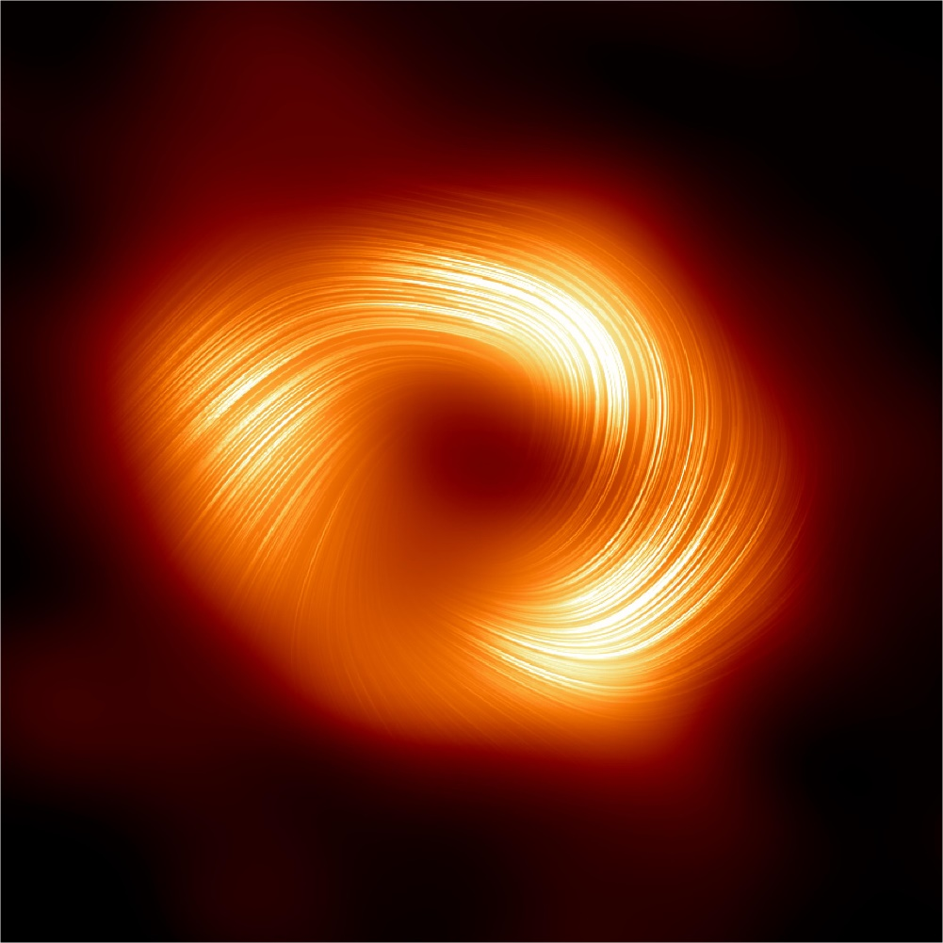
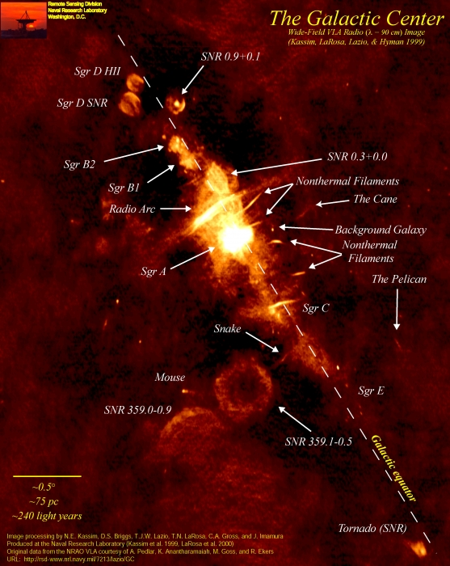
Introduction
Credits : Naval Research Laboratory & ESO/GRAVITY collaboration
Polarized reconstructed images of Sgr A*. Credits : EHT collaboration
Nicolas Aimar
GRAVITY+ workshop

Slide 4
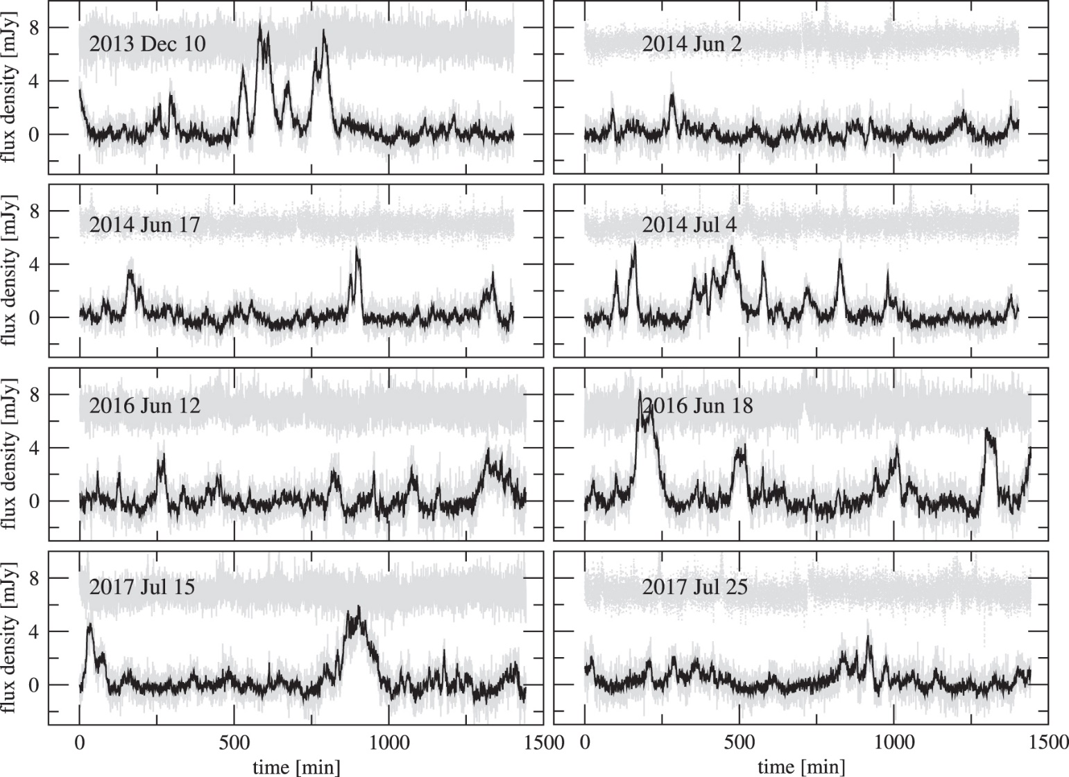
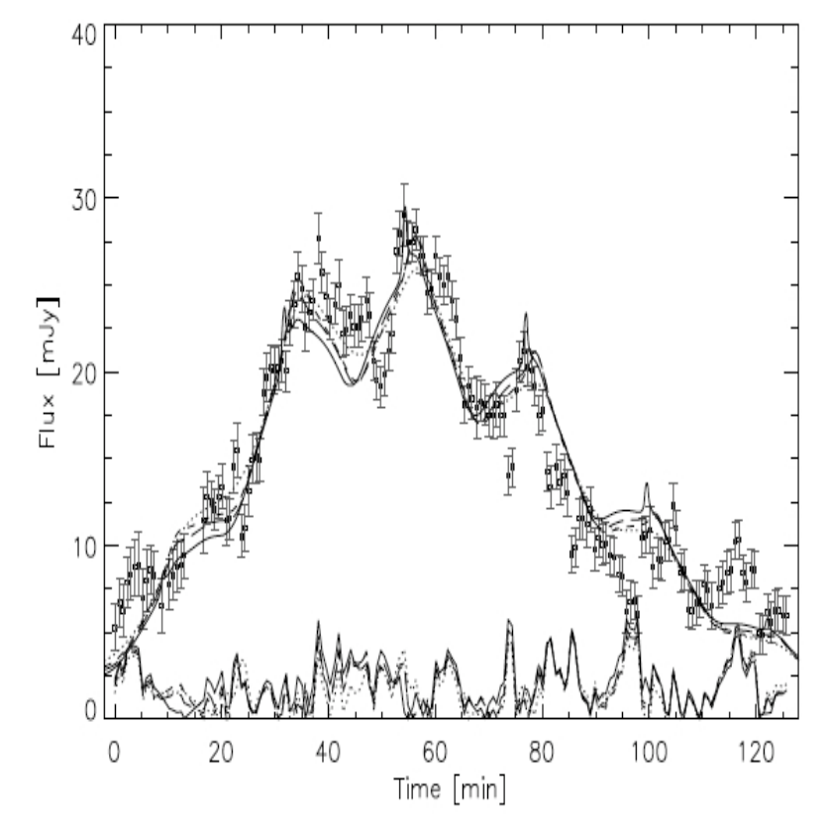
Introduction
Light curves of Sgr A* in NIR with Spitzer. Credit : Witzel et al., 2018
Light curve of Sgr A* in IR (bande-L). Credit : Hamaus et al., 2009
Nicolas Aimar
GRAVITY+ workshop

Slide 5
Introduction
Sgr A* flare fit from GRAVITY 2018
Simple hotspot model with a Keplerian circular orbit in the equatorial plane
Results :
Low inclination
Orbit at a few $R_{g}$
Possible super-keplerian velocity ?
Credit : GRAVITY Collaboration, 2018
Nicolas Aimar
GRAVITY+ workshop

Slide 6
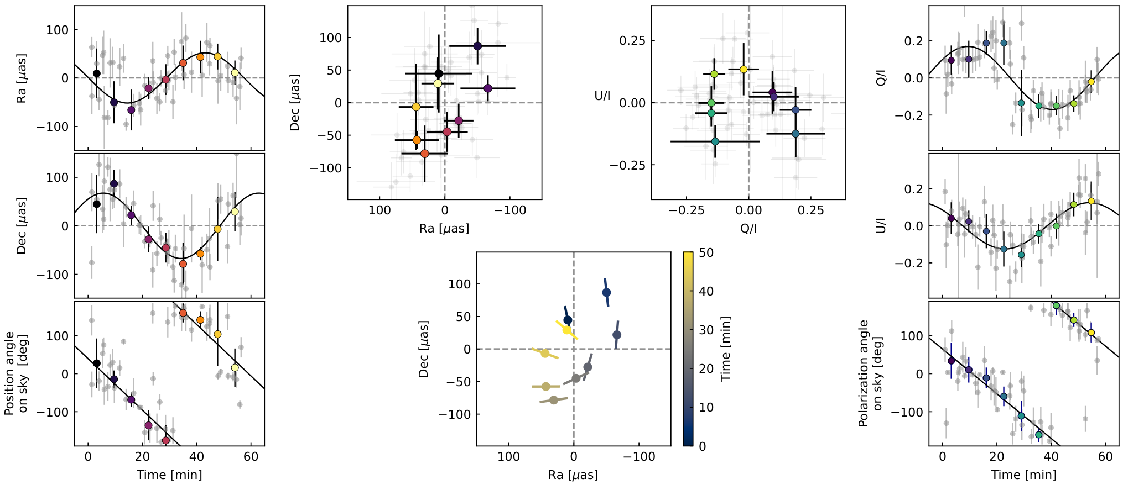
Introduction
Sgr A* flare in NIR
Time scale of 30min-1h
Average flare shows orbital motion at $r=9$M with $i≈157$°
Polarization angular velocity is only compatible with poloidal magnetic field configuration
Maybe super Keplerian velocity
Some double peak LC have been observed
Credit : GRAVITY Collaboration, 2023
Nicolas Aimar
GRAVITY+ workshop

Slide 7
Introduction
Sgr A* flare in radio
Time scale of ~70min
Polarization loops also hints toward an equatorial orbital motion of an hotspot at $r=10$M and $i=160$°
Radio polarization also constraint the magnetic field to be in a purely vertical configuration
Orbital velocity is Keplerian
Very low density plasma $n_{e}≈5×{10}^{5} {cm}^{−3}$
Credit : Wielgus et al., 2022
Nicolas Aimar
GRAVITY+ workshop

Slide 8
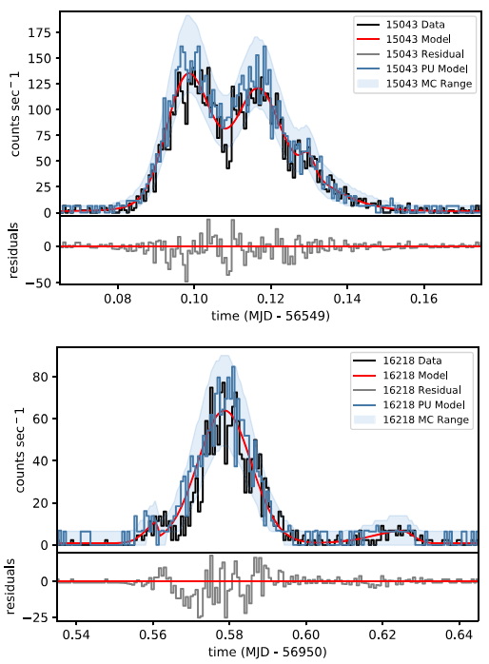
Introduction
Sgr A* flare in X-rays
Single and double peak light curve are observed
Time scale between ~10min and 1,5h
Hard spectral index $Γ≈2,0$
High energy photons could be generated by
High energy (non-thermal) electrons emitting synchrotron radiation
Low energy electrons emitting synchrotron self-Compton (SSC) radiation
Credit : Haggard et al., 2019
Nicolas Aimar
GRAVITY+ workshop

Slide 9
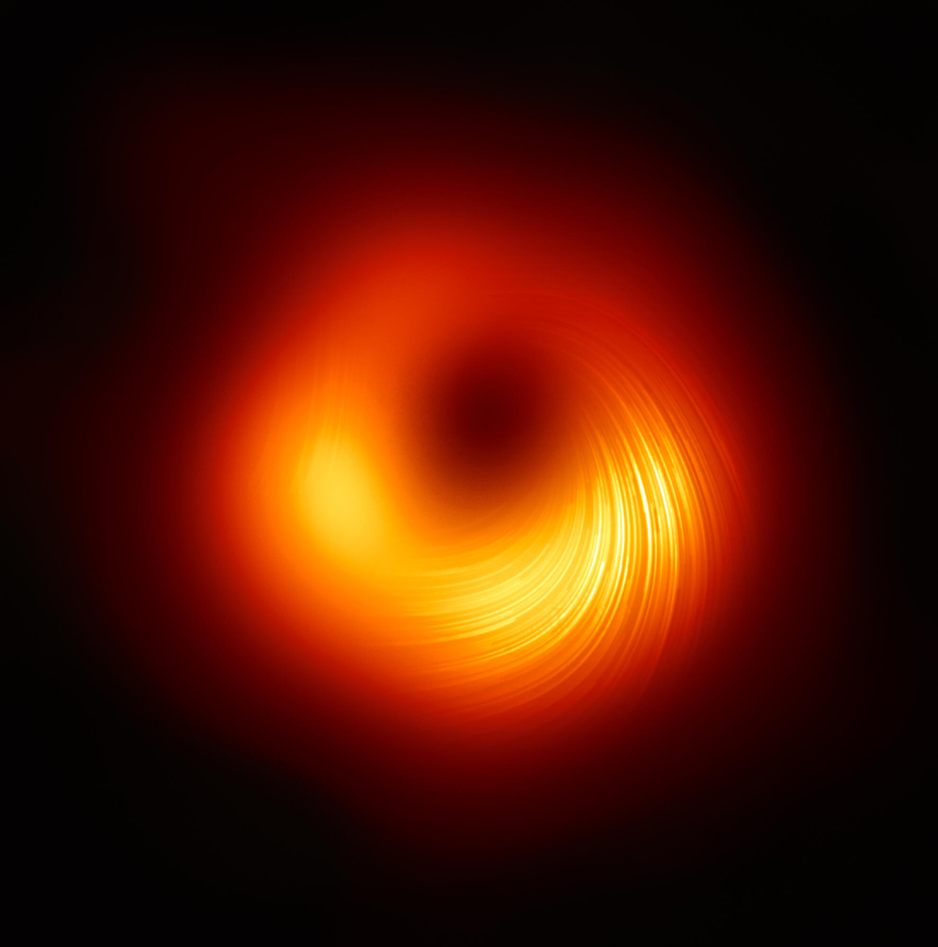
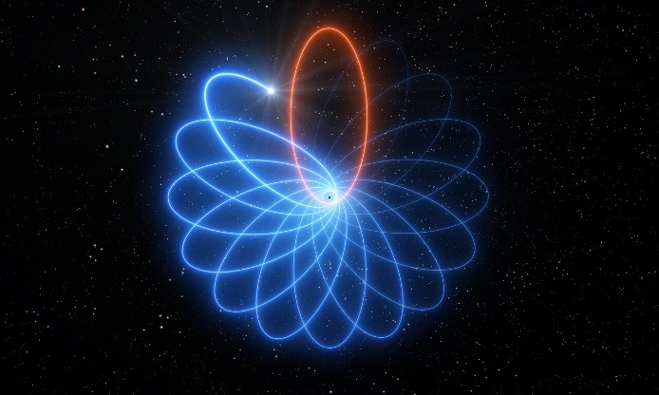
Introduction
Long terms objectives:
Test the “no hair” theorem of black holes
Find a limit of General relativity
Credit : EHT Collaboration
Credit : ESO/L. Calçada
Credit : ESO/Gravity Consortium
Nicolas Aimar
GRAVITY+ workshop

Slide 10
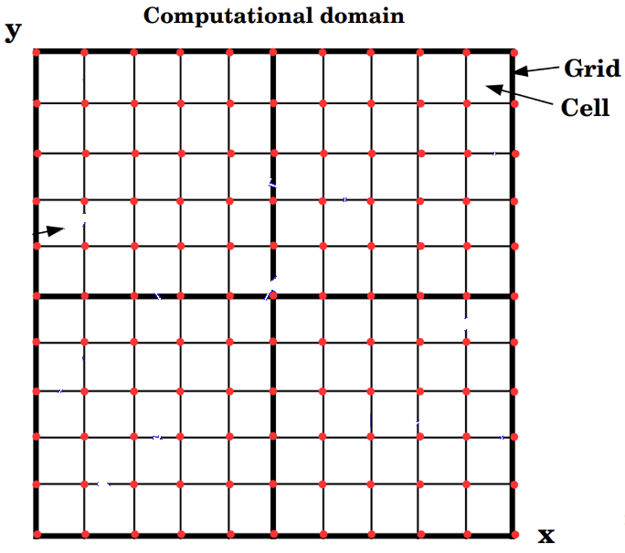
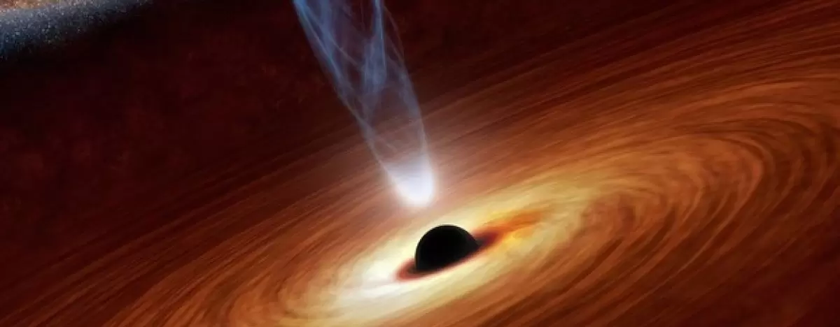
Introduction
Particles-in-Cells (PIC)
MagnetoHydroDynamic (MHD)
Credit : National Science Foundation
Credit : B. Cerutti
Credit : B. Ripperda, 2022
Short terms objectives :
Better constrain plasma physics in the strong gravity regime
Decipher the origin of Sgr A* flares
Create a model capable of explaining the astrometry, light curves and polarization observables of flares
Nicolas Aimar
GRAVITY+ workshop

Slide 11
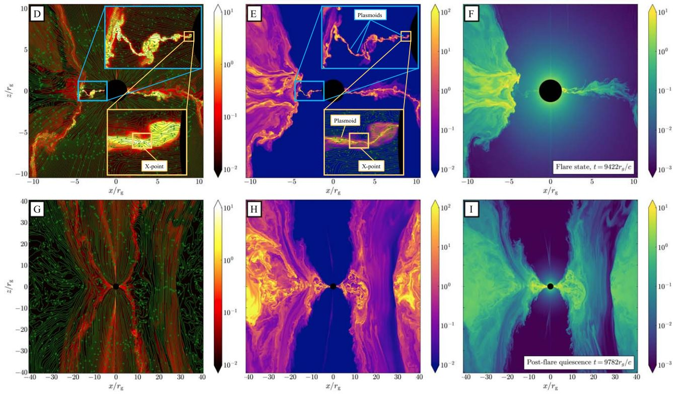
Magnetic reconnection in BH environments
GRMHD simulations
GRMHD simulations :
Pro :
Fluid approach -> reduced number of variables (density, velocity, energy, magnetic field)
Large-scale evolution
Long-term simulations
Cons :
Fluid approach-> non valid for collisionless plasma
No microphysics
Credit : Ripperda et al., 2022
Nicolas Aimar
GRAVITY+ workshop

Slide 12
Magnetic reconnection in BH environments
(GR)PIC simulations
GRPIC simulations :
Pro :
Capture all the microphysics
Evolution of the particles distribution function and of the electromagnetic field
Self-consistent pair production
Cons :
Computationally expensive: limited number of particles
Scale separation
No global kinetic evolution of the accretion disk
Credit : El Mellah et al., 2022
Nicolas Aimar
GRAVITY+ workshop

Slide 13
Hotspot model from MR
Model properties
How build a model from magnetic reconnection simulations?
Size, shape
Motion
Number density, temperature, magnetic field and their profiles (uniform or Gaussian)
Electron distribution function (thermal, power-law, kappa, …)
Magnetic field configuration (important for polarization)
Nicolas Aimar
GRAVITY+ workshop

Slide 14
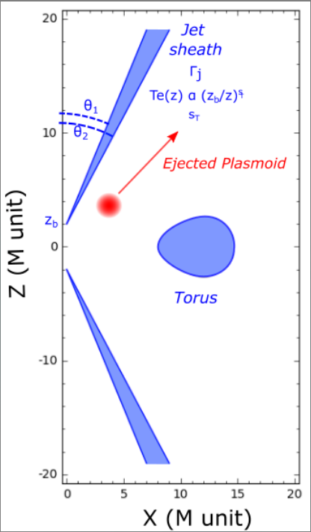
Hotspot model from MR
Model properties
Model composed of :
A jet $⟺$ quiescent state
A hotspot $⟺$ source of the flare
Hotspot in GYOTO:
Uniform sphere
Conical ejection, i.e. $v_{r}>0$, at $θ=cst$
$v_{φ}$ is a free parameter (not necessary Keplerian)
Time dependant electron energy distribution
Tangled magnetic field (work in progress for Vertical configuration)
Nicolas Aimar
GRAVITY+ workshop

Slide 15
Hotspot model from MR
Model properties
2 phases in a kinetic approach (A. Dmytriiev):
Growth phase : injection of accelerated e⁻ following a κ-distribution at a constant rate
Cooling phase : cooling through synchrotron radiation
$$γ$$
Aimar et al., 2023
Aimar et al., 2023
Nicolas Aimar
GRAVITY+ workshop

Slide 16
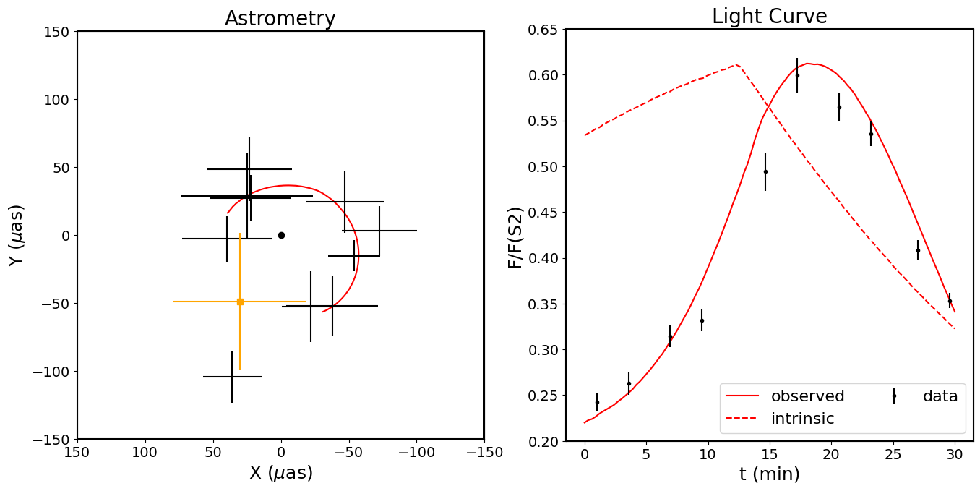
Hotspot model from MR
Comparison with observations
Total number parameters of the hotspot model : 13
22 July flare comparison :
Orbital velocity compatible with constrains from El Mellah et al., 2022
Strong influence of the beaming effect
Shows good agreement with the data (not a fit !)
Aimar et al., 2023
Nicolas Aimar
GRAVITY+ workshop

Slide 17
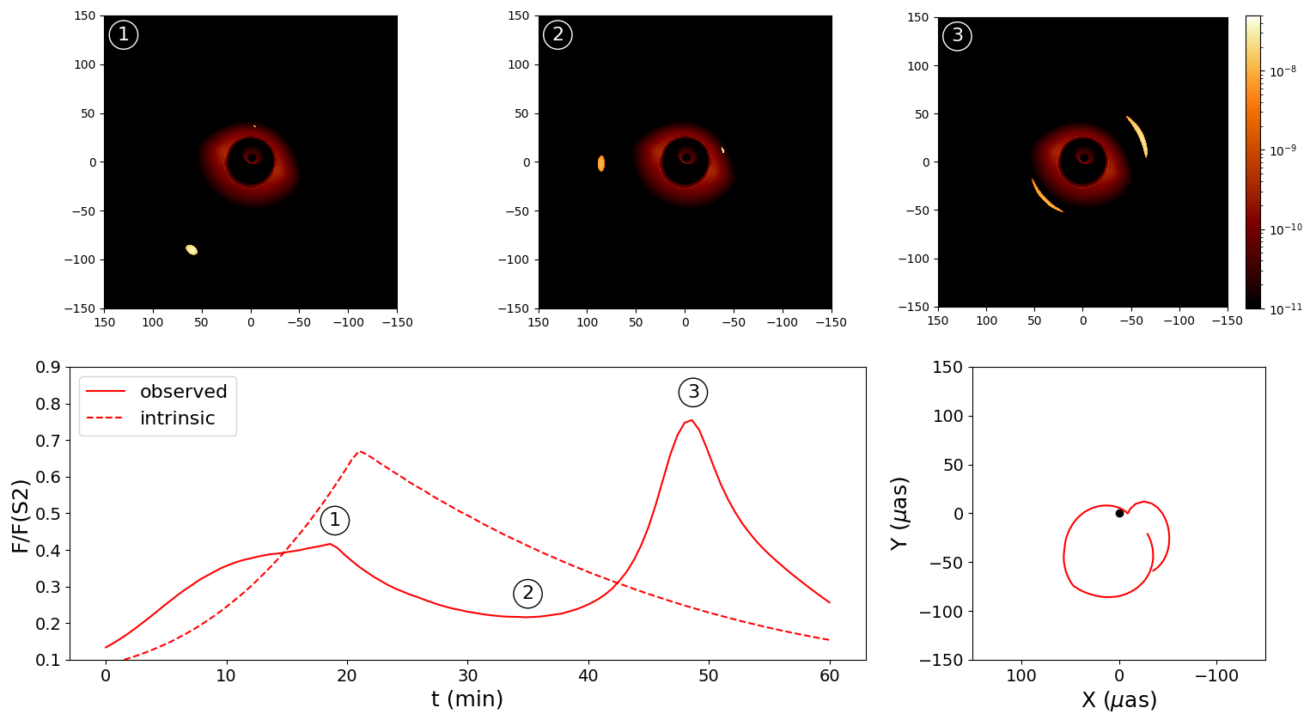
Hotspot model from MR
Comparison with observations
Double peak light curve :
1st peak : injection of accelerated electrons
2nd peak : beaming + lensing
$θ≈$ inclination
Plasmoïd is behind the black hole
The alignment constrains the maximum and shape of the second peak
Nicolas Aimar
GRAVITY+ workshop

Slide 18
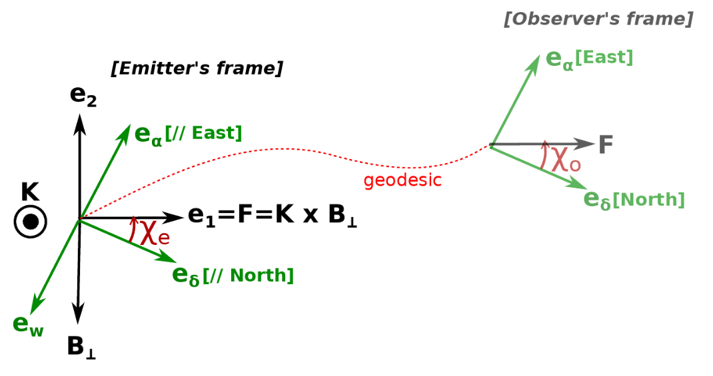
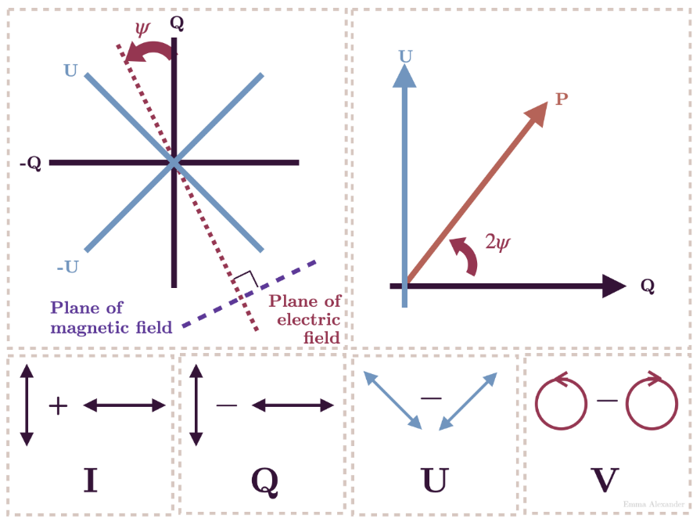
Flares polarization as probe of space-time
Vincent et al., 2024
Nicolas Aimar
GRAVITY+ workshop

Slide 19
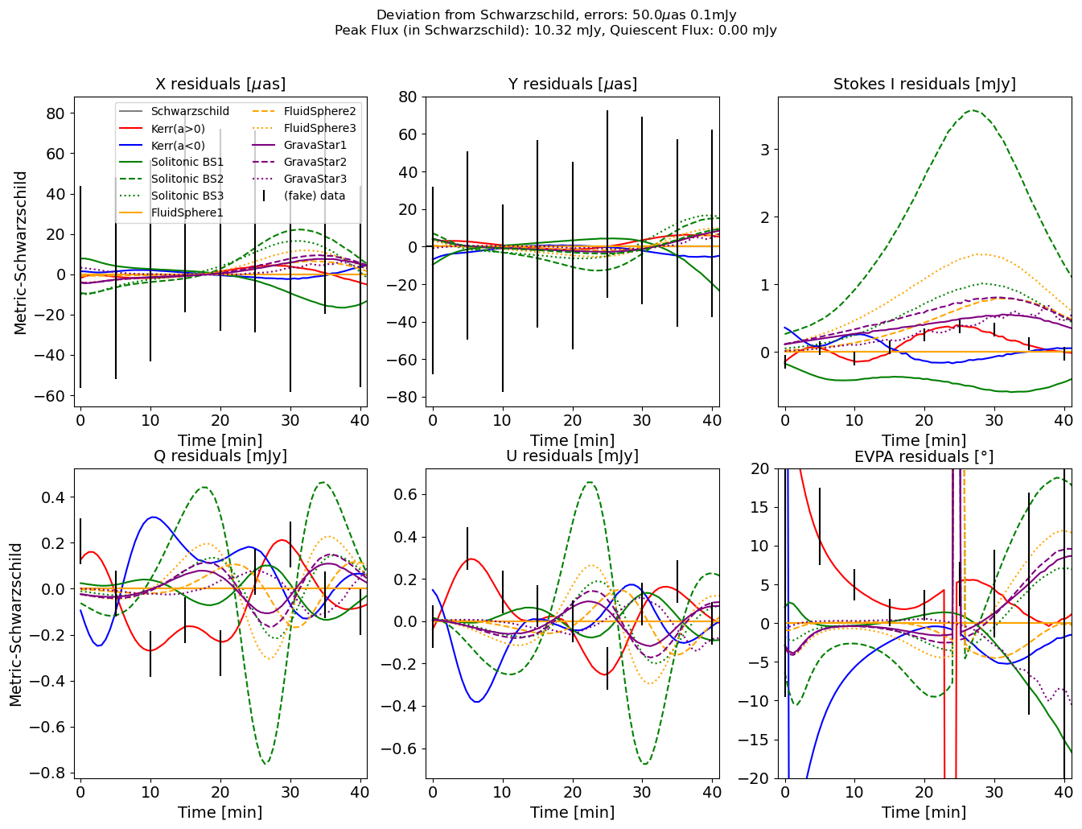
Flares polarization as probe of space-time
Can we detect exotic compact object (ECO) signatures in Sgr A* flares polarization ?
Deviation from Schwarzschild :
Fit the data in Schwarzschild
Subtract the model from the data
Search ECO signal in the residuals
3 ECOs families of models :
Solitonic Boson Stars
Grava Stars
Fluid Sphere
Fake data generated in Kerr (a=0.9)
Preliminary results
Nicolas Aimar
GRAVITY+ workshop

Slide 20
Future Prospects
Improve the model:
Better orbital motion prescription (work in progress)
Use well-defined magnetic field configuration (work in progress)
Compute polarized coefficients from non-well-defined EED (work in progress)
Study the multi-wavelength properties (future work)
Fit the model to data (future work)
Nicolas Aimar
GRAVITY+ workshop

Slide 21
Conclusion
Sagittarius A* flares is an ideal subject for testing general relativity and the black hole no hair theorem.
But the physical origin of flares is still under debate. Nevertheless, magnetic reconnection is very promising to explain Sgr A* flares origin.
We have developed a hotspot model using kinetic simulations mimicking magnetic reconnection based on GRMHD and (GR)PIC results. The hotspot model shows very promising results compared to data.
Polarization signal contains information about the space-time which can be detected
Next steps : fit the data, include the polarization and make a multi-wavelength analysis.
Nicolas Aimar
GRAVITY+ workshop

Slide 22
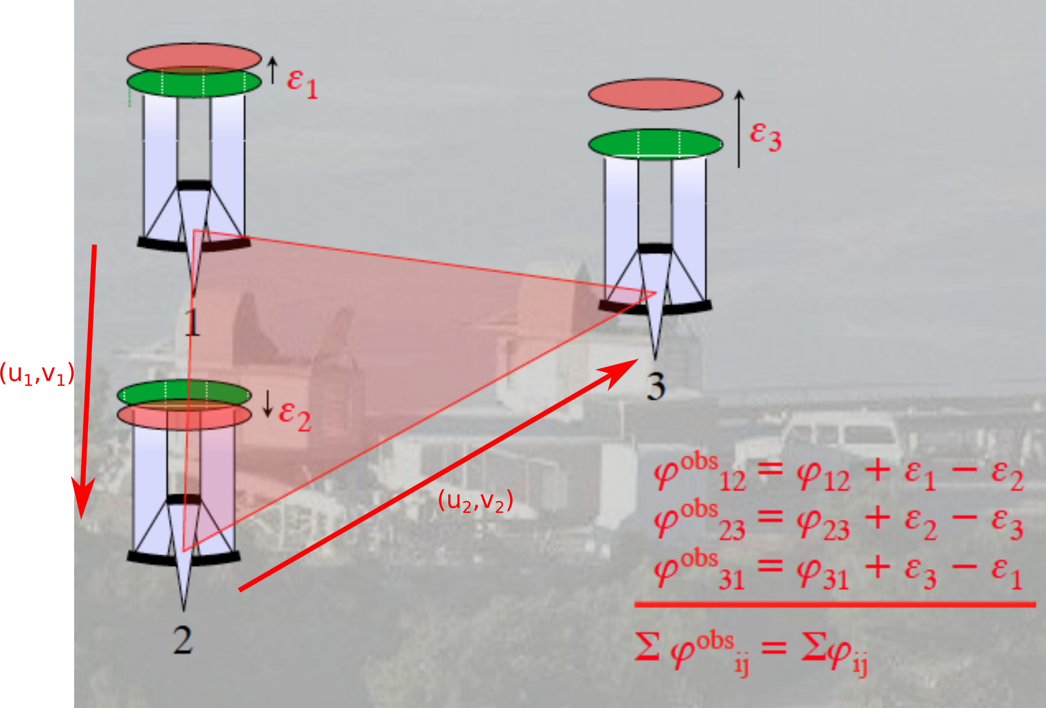
Appendix
Diagram illustrating the shift of the same wave plane due to the atmosphere between different telescopes. By summing the phases of three telescopes (combined two by two), these shifts cancel each other out. Credit: Guy Perrin
Nicolas Aimar
GRAVITY+ workshop
20/11/2024

Slide 23
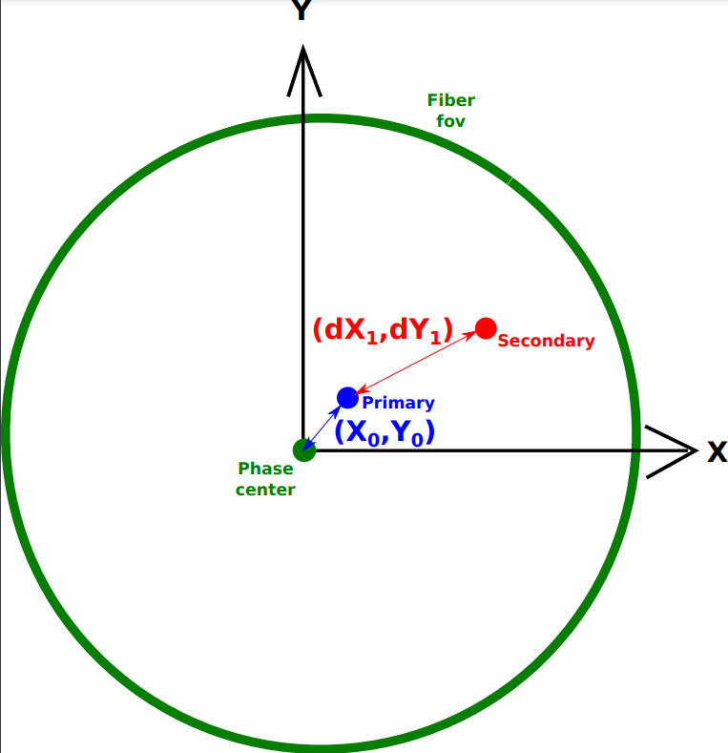
Appendix
Sgr A*
S-Star
Exemple d’ajustement de données GRAVITY du 05 Mai 2018 avec Sgr A* et S2.
Nicolas Aimar
GRAVITY+ workshop

Slide 24
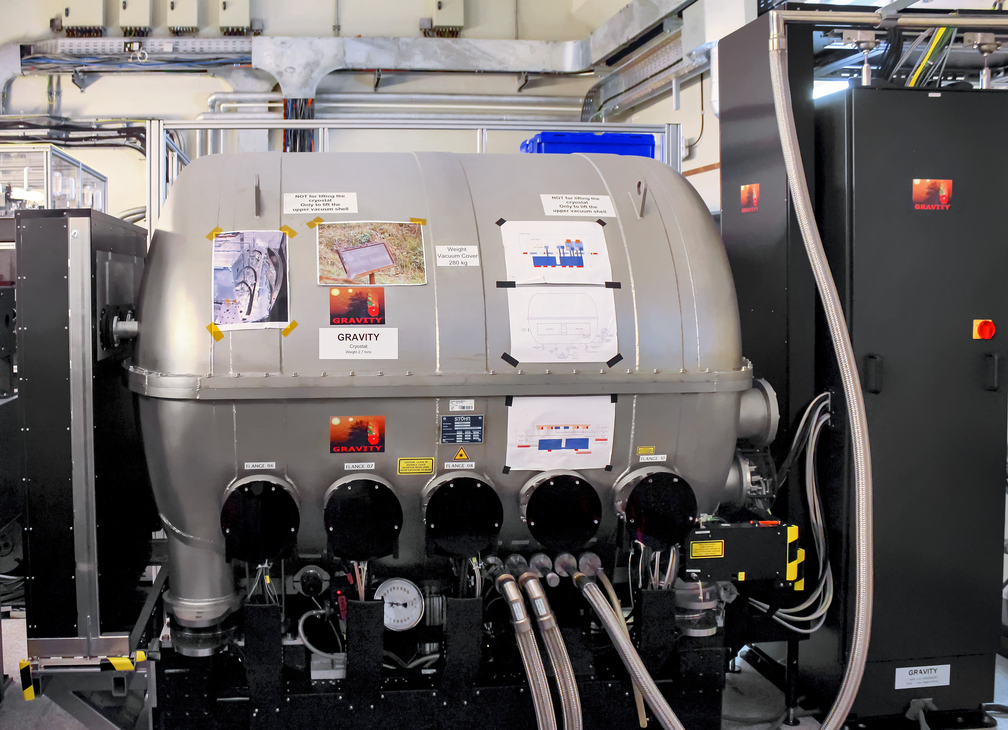
Appendix
Very Large Telescope Interferometer (VLTI) :
4 télescopes de 8.2m (UT)
Distance max : ~140 m
L’instrument GRAVITY :
Bande K (2.0-2.4 μm)
Résolution spatiale : ~3 mas
Précision Astrométrique : ~10 μas
Credit : G. Rojas/ESO
Nicolas Aimar
GRAVITY+ workshop

Slide 25
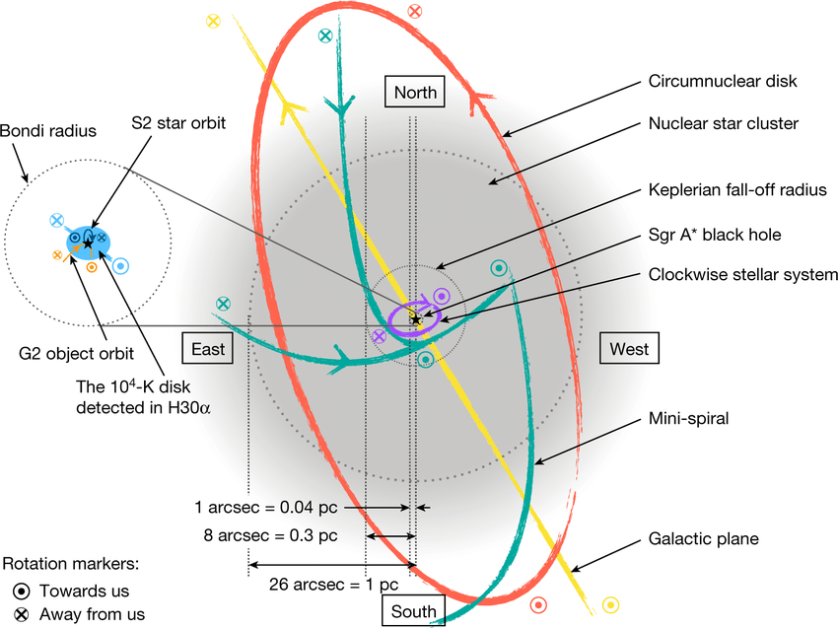
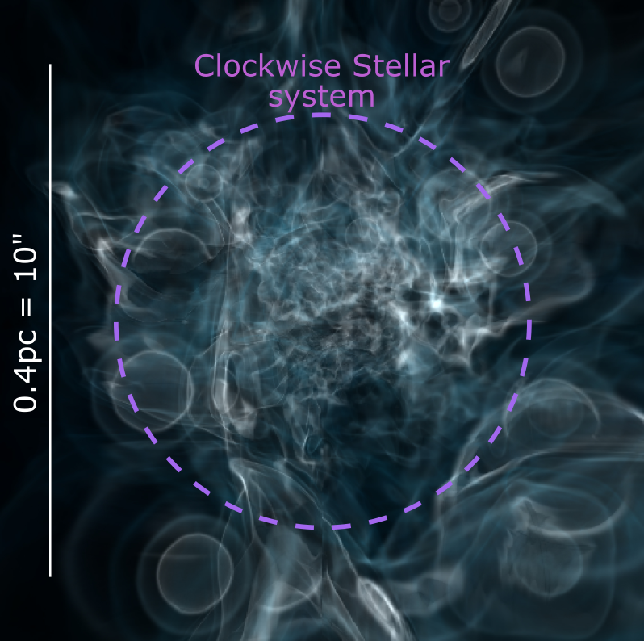
Appendix
Credit : Murchikova et al., 2019
Credit : Ressler et al., 2019
Nicolas Aimar
GRAVITY+ workshop

Slide 26
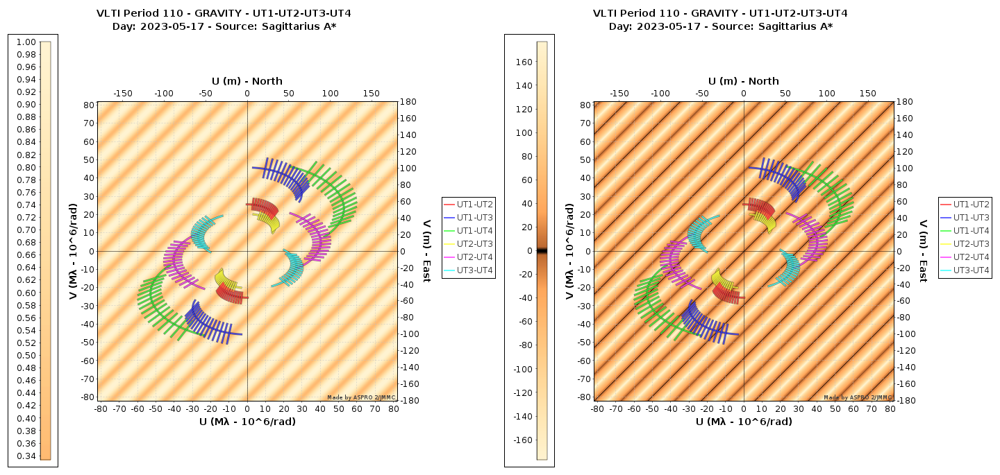
Appendix
Nicolas Aimar
GRAVITY+ workshop

Slide 27
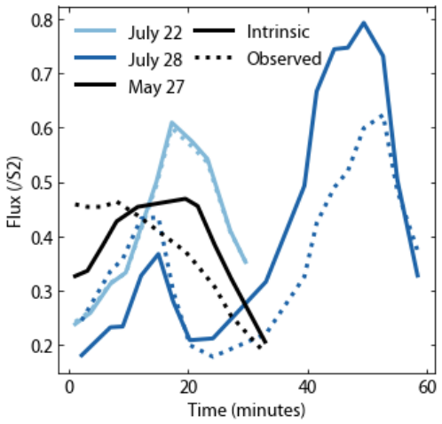
Appendix
GRAVITY observed 3 bright flares in 2018 showing orbital motion
Credit : GRAVITY Collaboration, 2020
Nicolas Aimar
GRAVITY+ workshop

Slide 28
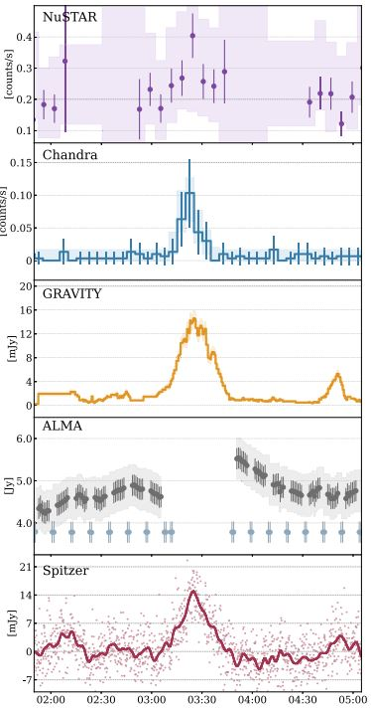
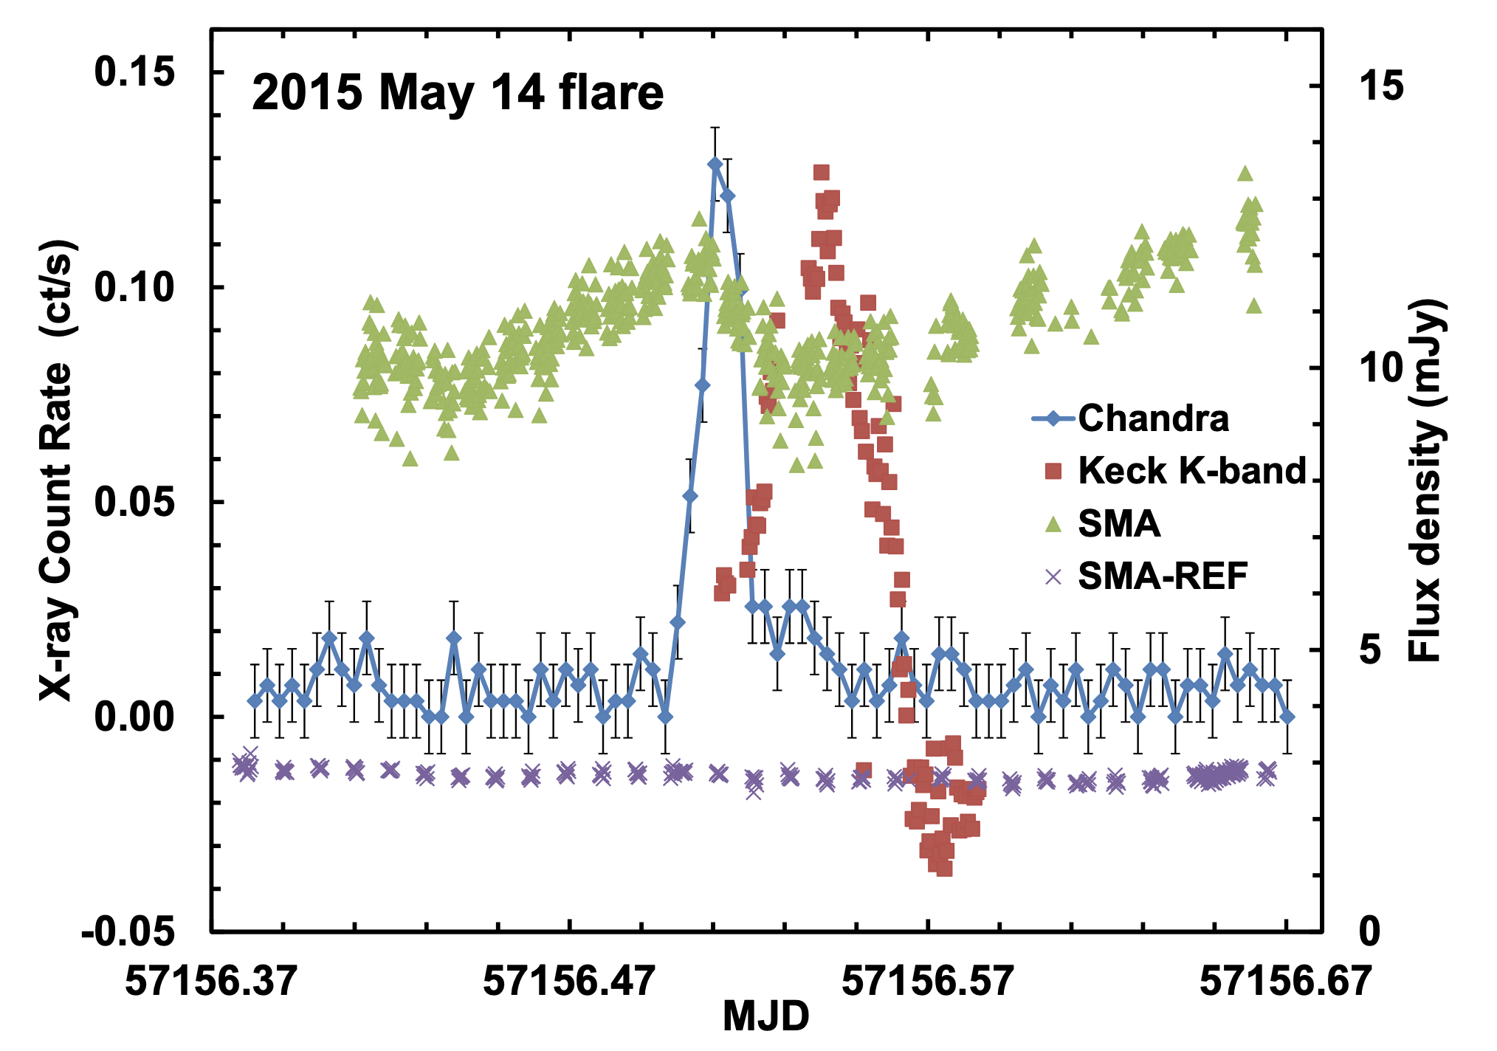
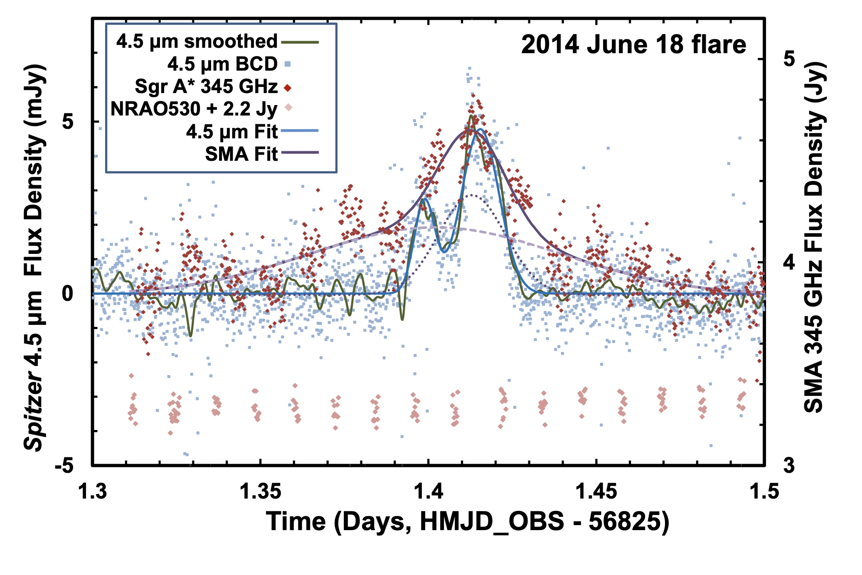
Introduction
Multi-wavelength Sgr A* flares observation show puzzling properties
Delayed flare in NIR
X-ray flare
Simultaneous radio and NIR flares
Radio dimming ?
Credit : Fazio et al., 2018
Credit : Boyce et al., 2022
Nicolas Aimar
GRAVITY+ workshop

Slide 29
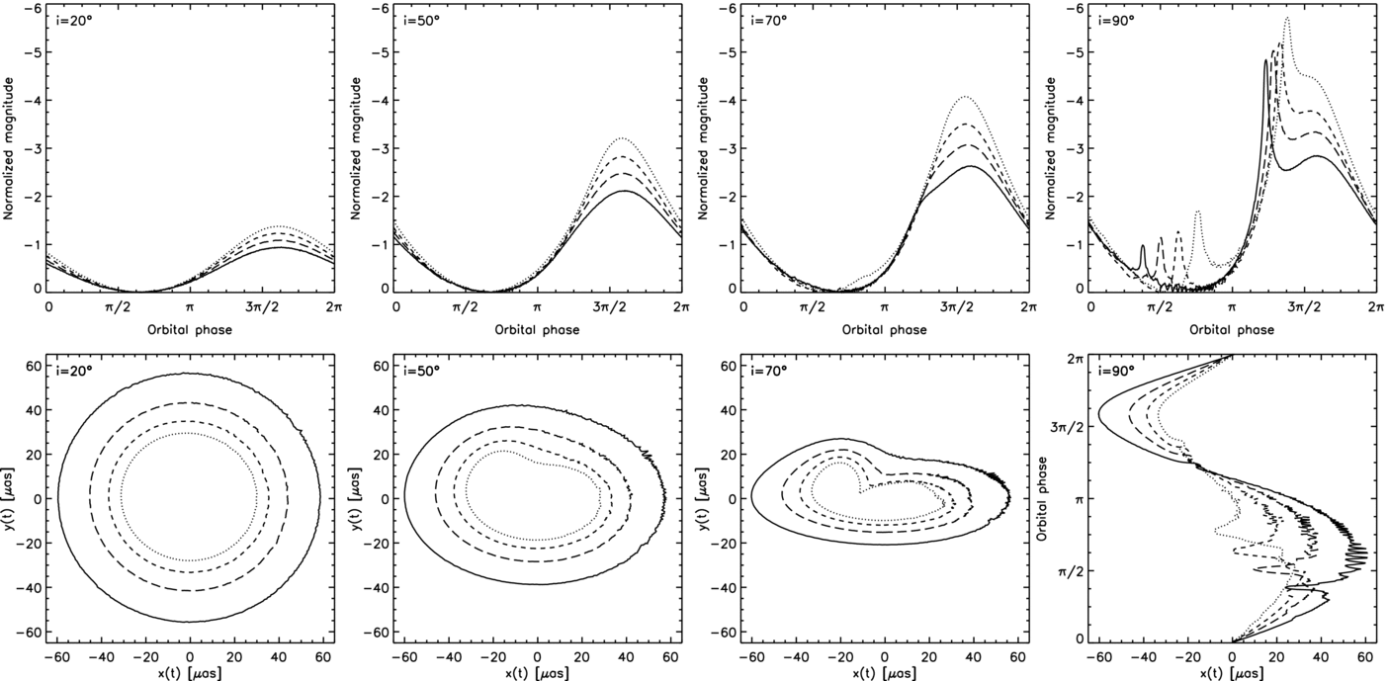
Appendix
Credit : Hamaus et al., 2009
Nicolas Aimar
GRAVITY+ workshop

Slide 30
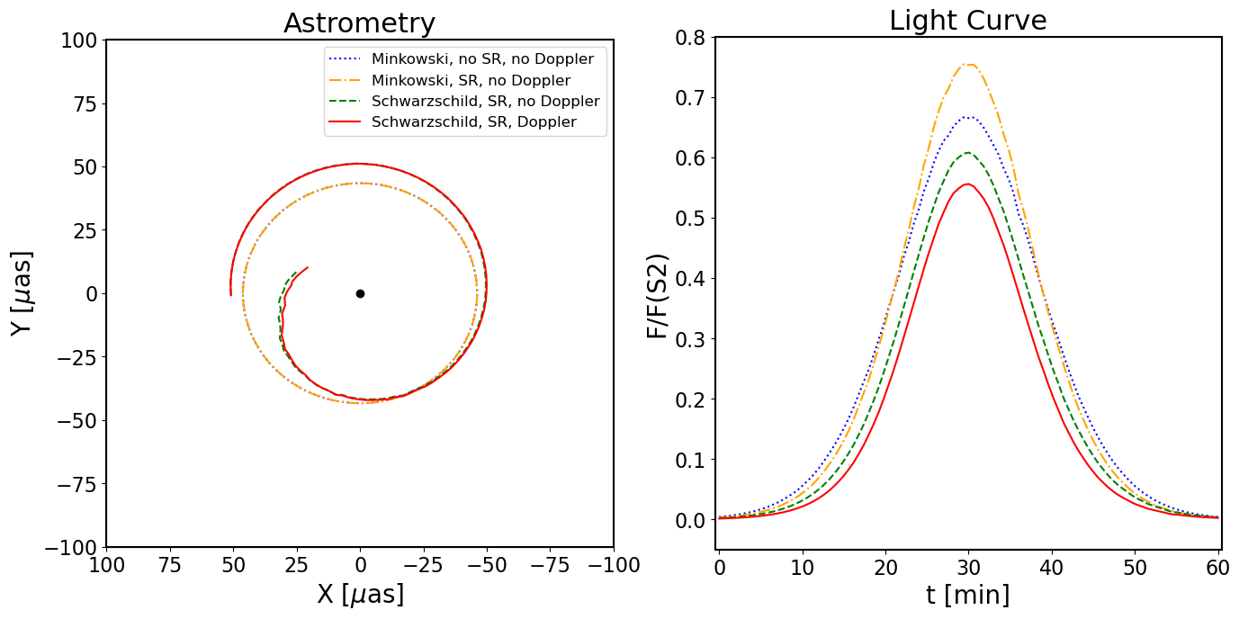
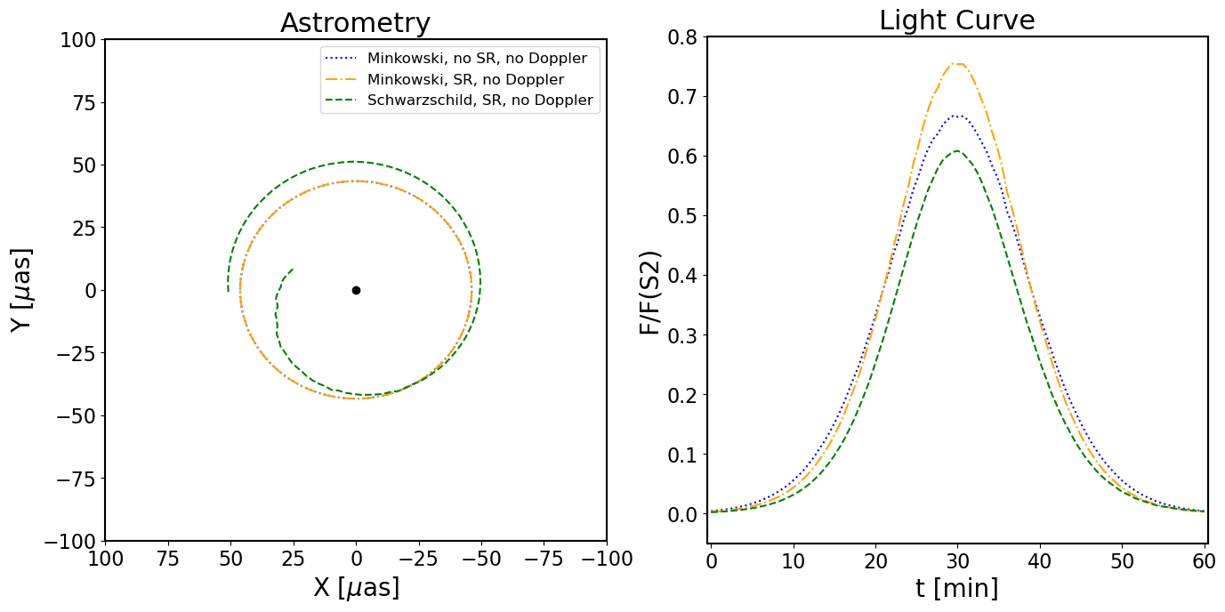
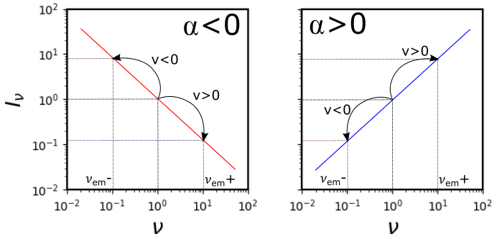
Appendix
Schwarzschild black hole
$α<0$
PhD. Thesis Aimar N. (2023)
Nicolas Aimar
GRAVITY+ workshop

Slide 31
Magnetic reconnection in BH environments
What could we learn from magnetic reconnection simulations ?
Creation of magnetic island called flux tubes (both GRMHD and GRPIC)
Flux tubes geometry (both GRMHD and GRPIC)
Dynamics of flux tubes (both GRMHD and GRPIC)
Magnetic field configuration (both GRMHD and GRPIC)
Timescales: duration of flares, delay between two events (GRMHD)
Electron Energy Distribution (EED) evolution inside the flux tubes (GRPIC)
Nicolas Aimar
GRAVITY+ workshop

Slide 32
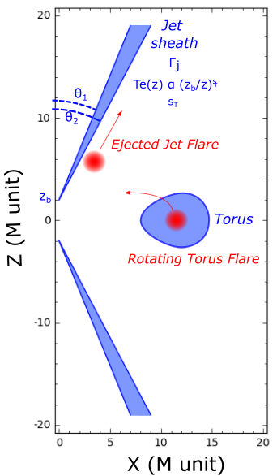
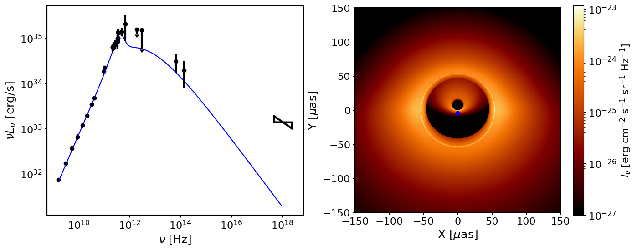
Appendix
Front jet
Photon ring
Black hole shadow
Back jet
Quiescent model:
Accreting torus (thermal synchrotron, dominates in radio)
Jets sheath (kappa synchrotron, dominates all other $λ$)
Nicolas Aimar
GRAVITY+ workshop

Slide 33
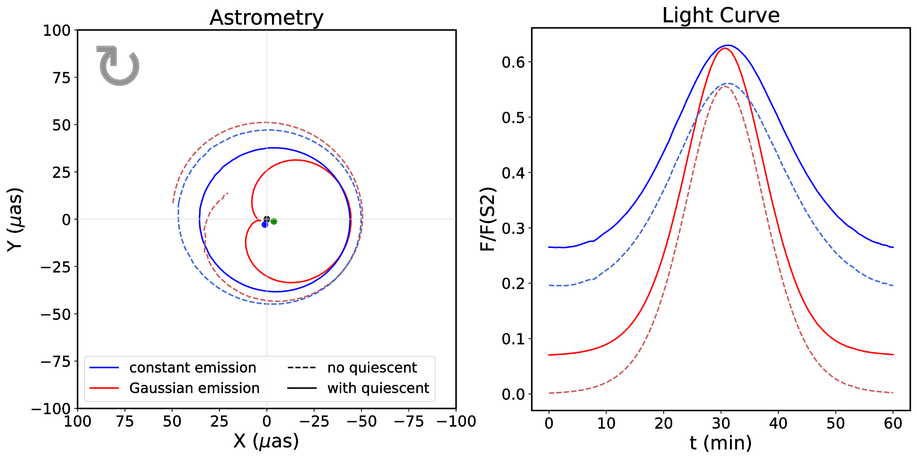
Appendix
Credit : Aimar et al., 2023
Nicolas Aimar
GRAVITY+ workshop

Slide 34
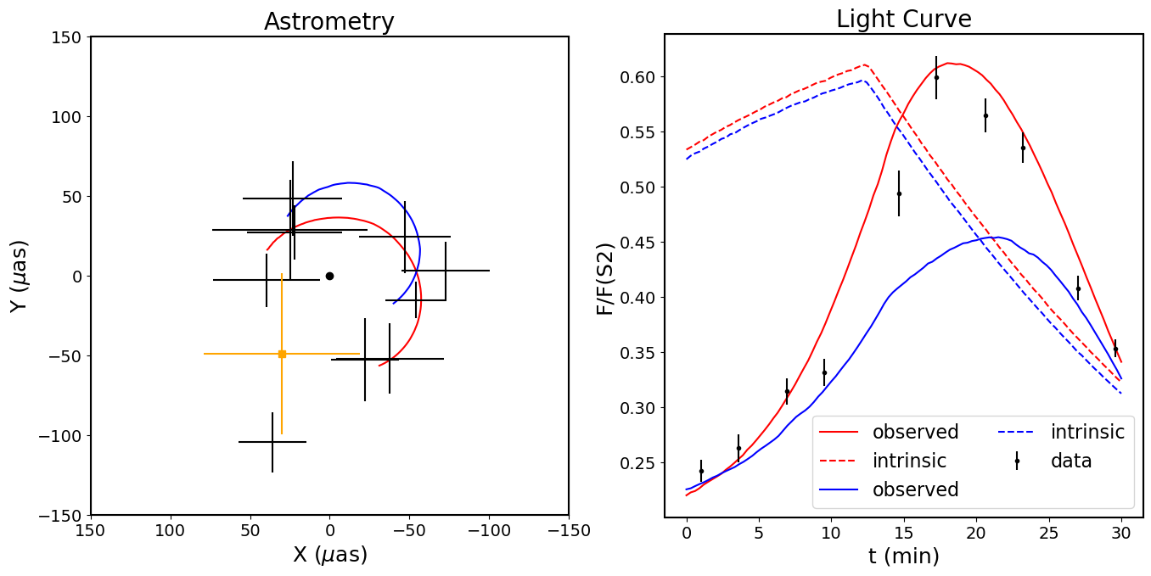
Appendix
PhD. Thesis Aimar N. (2023)
Nicolas Aimar
GRAVITY+ workshop

Slide 35
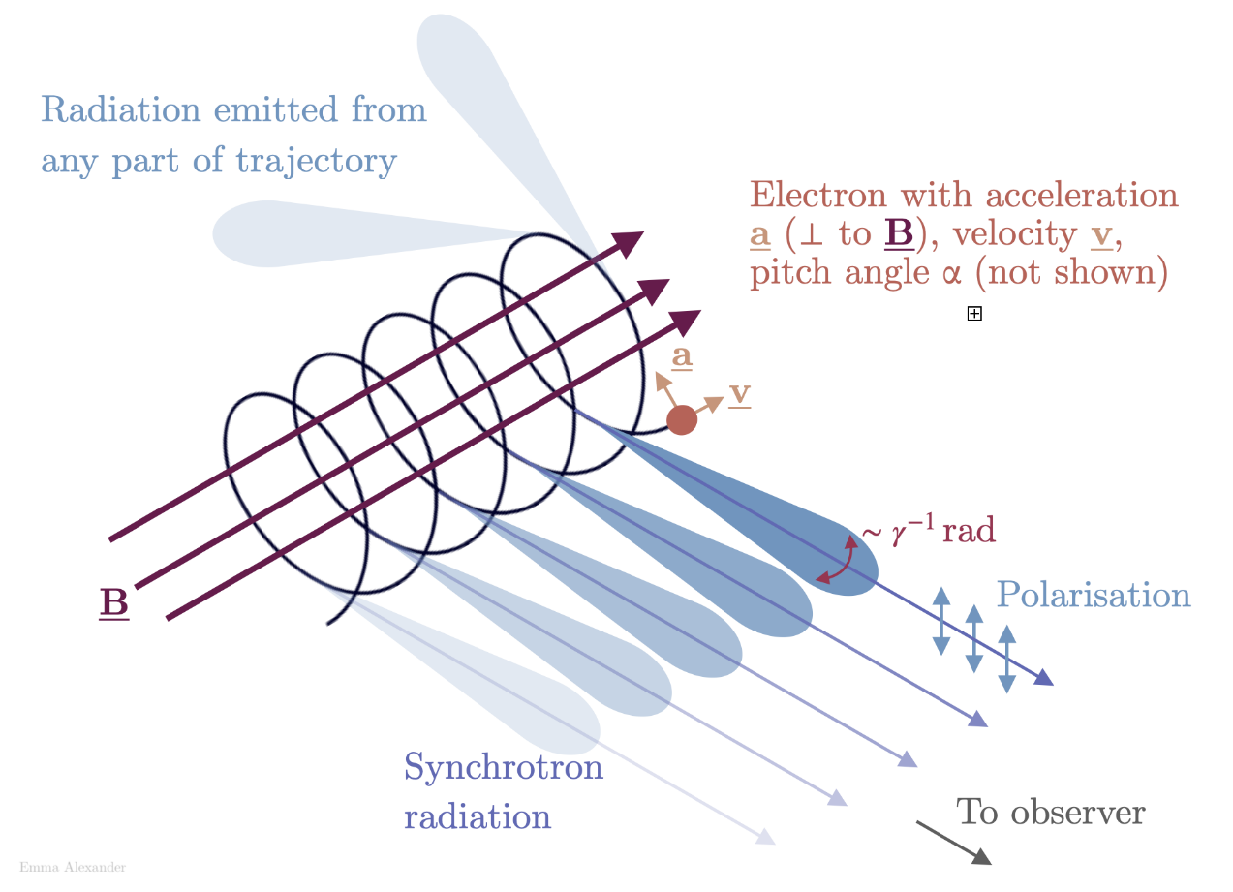
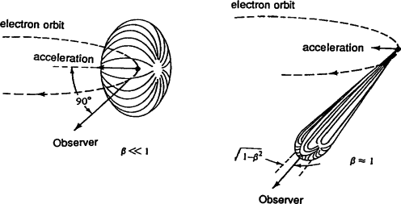
Appendix
Synchrotron radiation
Credit : Johnson P., 1997
Scheme of synchrotron radiation.
Credit : Emma Alexander
Nicolas Aimar
GRAVITY+ workshop

Slide 36
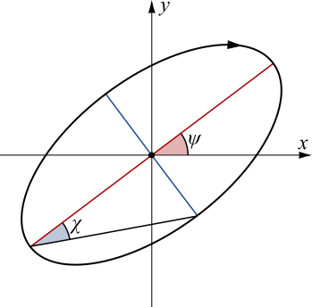
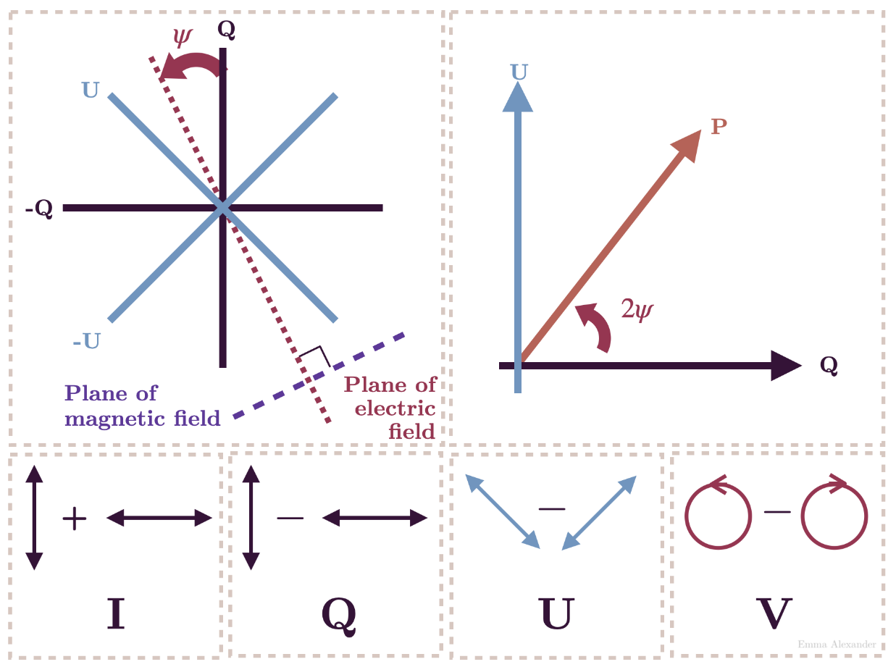
Appendix
$$I :total intensity$$
$$Q=Ip\cos{2ψ}\cos{2χ}$$
$$U=Ip\sin{2ψ}\cos{2χ}$$
$$V=Ip\sin{2χ}$$
Stokes parameters
$$I= {\left|E_{x}\right|}^{2}+{\left|E_{y}\right|}^{2}$$
$$Q= {\left|E_{x}\right|}^{2}−{\left|E_{y}\right|}^{2}$$
$$U=2Re(E_{x}E_{y}^{∗})$$
$$V=−Im(E_{x}E_{y}^{∗})$$
$$I^{2}≥Q^{2}+U^{2}+V²$$
Nicolas Aimar
GRAVITY+ workshop

Slide 37
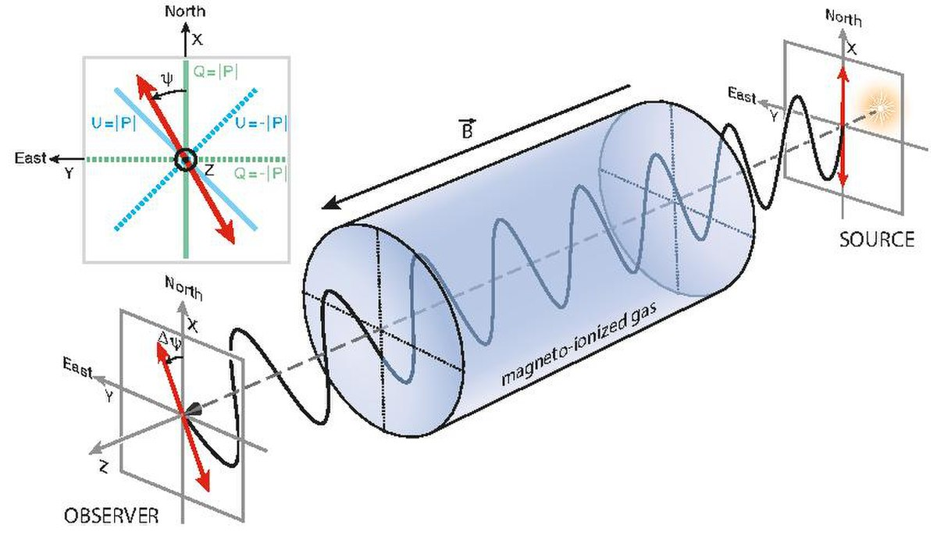
Appendix
Faraday rotation by an ionized plasma. Credit : Ferrière K. et al., 2021
Nicolas Aimar
GRAVITY+ workshop

Slide 38
Appendix
Polarization basis of the observer
Parallel transport
Projection in the emitter frame
k₀
n
u
k
$n^{′}=n+α k$, $α=−\frac{n⋅u}{k⋅u}$
$w^{′}=w+β k$, $β=−\frac{w⋅u}{k⋅u}$
$$\left(n,w,k \right)\underset{⊥u}{→}{ \left(n^{′},w^{′},K\right)}$$
$K=k+(k⋅u)u$
Nicolas Aimar
GRAVITY+ workshop

Slide 39
Appendix
Example :
Equatorial orbit
Toroïdal magnetic field
Face-on
Minkowski metric
$⇒$ Two Q-U loops
Credit : Vincent F. et al. (2023)
Nicolas Aimar
GRAVITY+ workshop

Slide 40
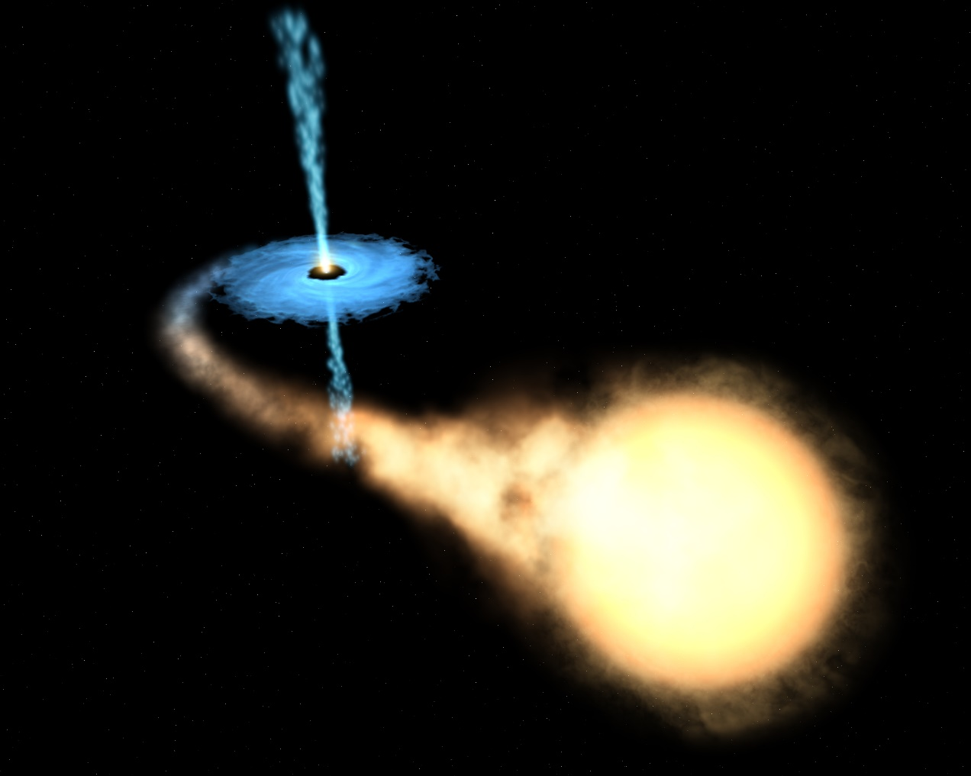
Appendix
Polarize image of M87*. Credit : EHT Collaboration
Artistic view of an X-ray binary. Credit : ESA/Hubble
Nicolas Aimar
GRAVITY+ workshop

Slide 41
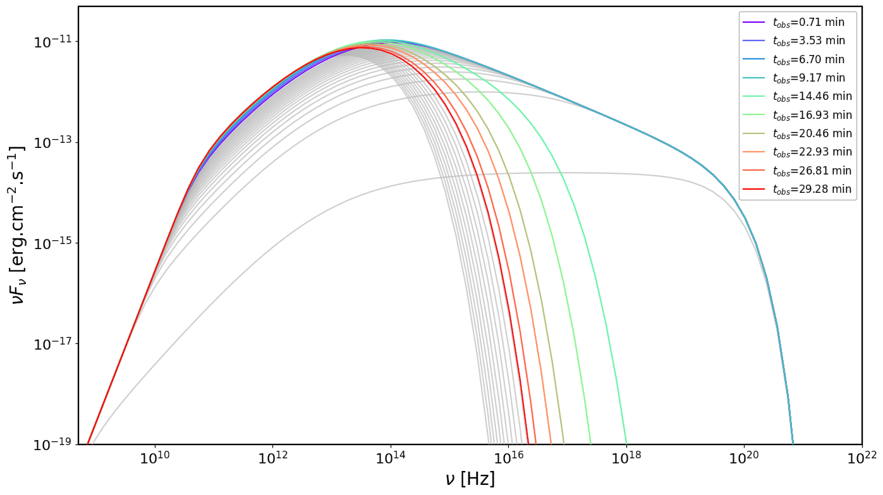
Appendix
SED evolution
X-ray data
Good evolution in NIR
Infinite rising of the flux in radio
Flux in X-rays too low
Flux evolution in X-rays too fast
Cut-off frequency depends on $γ_{max}$
ALMA
GRAVITY
Chandra
Credit : Aimar et al., 2023
Nicolas Aimar
GRAVITY+ workshop

Slide 42
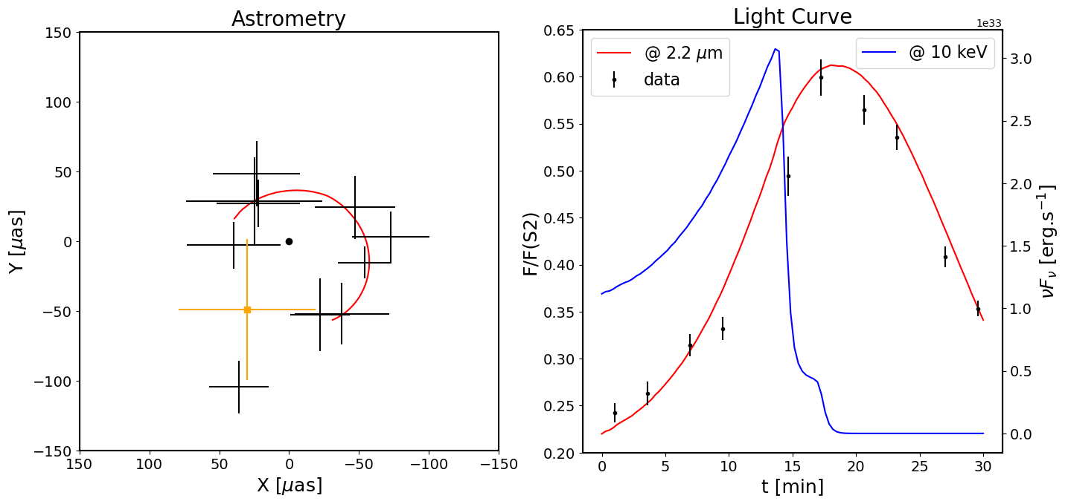
Appendix
X-rays cooling timescale too short:
Magnetic field too high ?
Bad modelling ?
Credit : PhD. Thesis Aimar N. (2023)
Nicolas Aimar
GRAVITY+ workshop

Slide 43
Appendix
Time delay between the difference wavelengths
Credit : Michail et al., 2021
Nicolas Aimar
GRAVITY+ workshop

