Slide 1
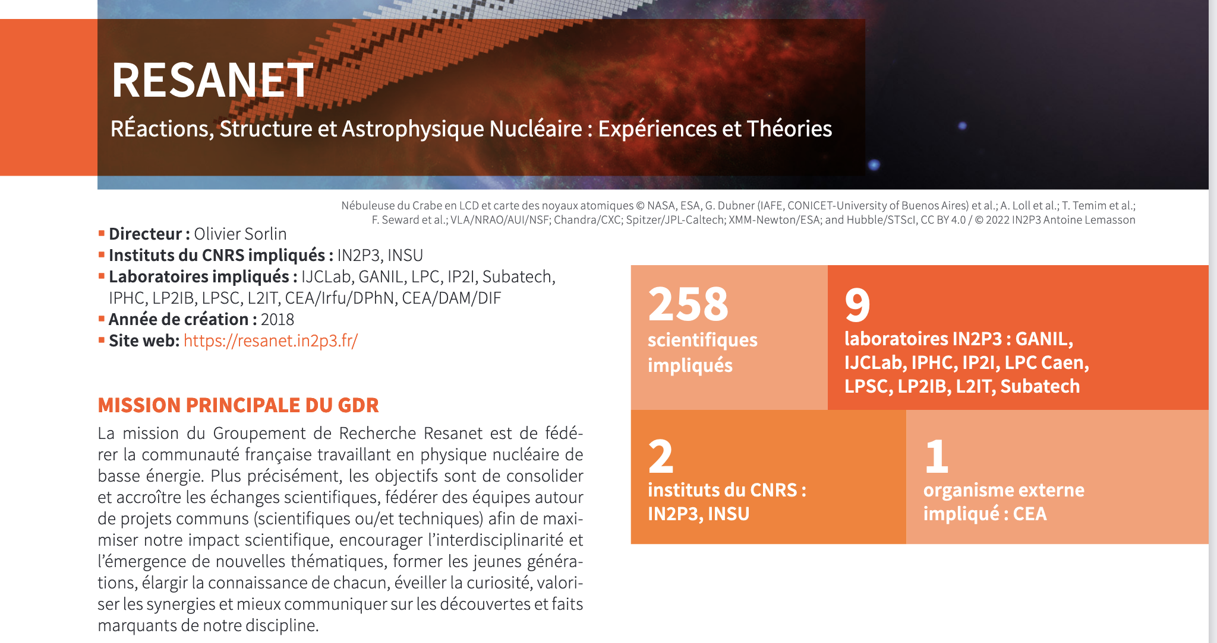
From 2023-2027
Finantial support about 15 kE /year

Slide 2
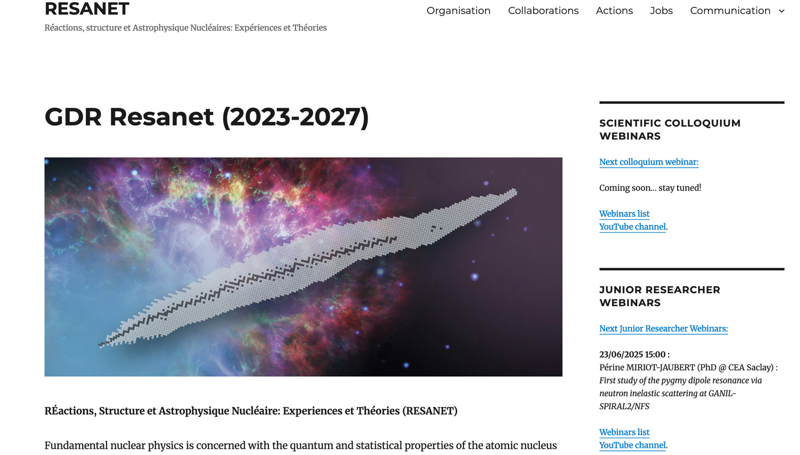
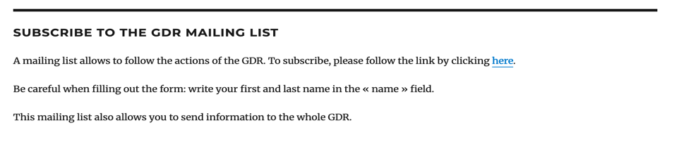
Who ?
IRN/ IRL
WS
schools
Webinars
Videos/ Blogs
MOOCS…
Website : https://resanet.in2p3.fr/
SUBSCRIBE HERE
(345 actually)

Slide 3
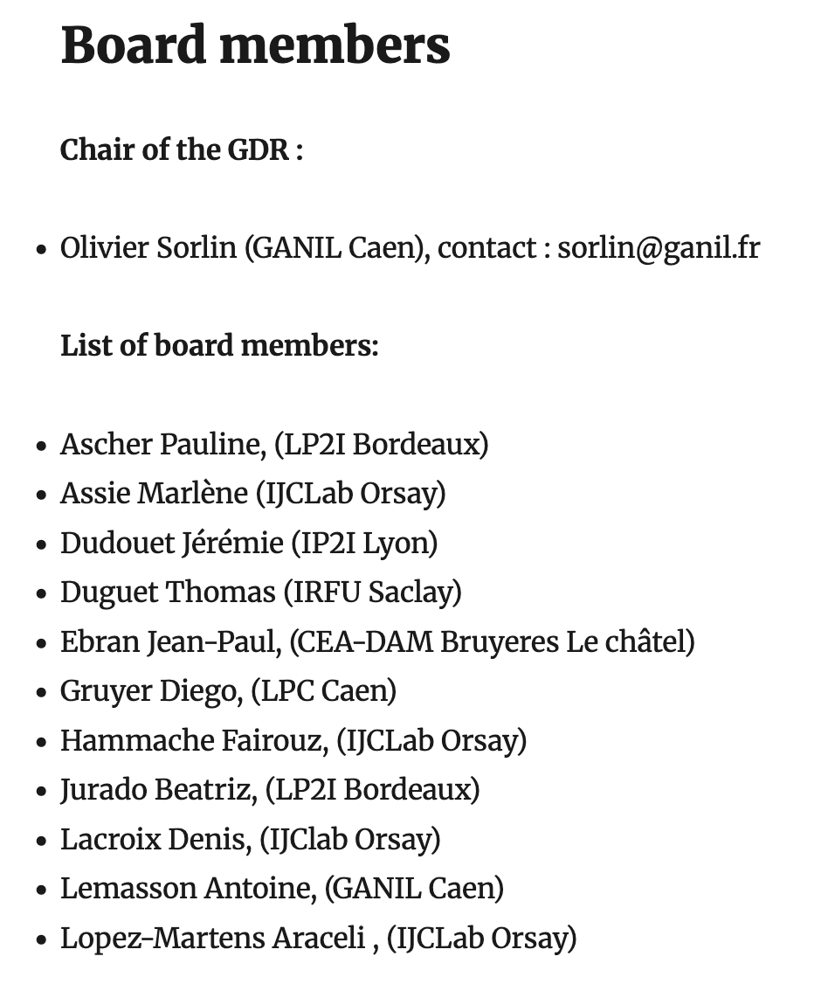
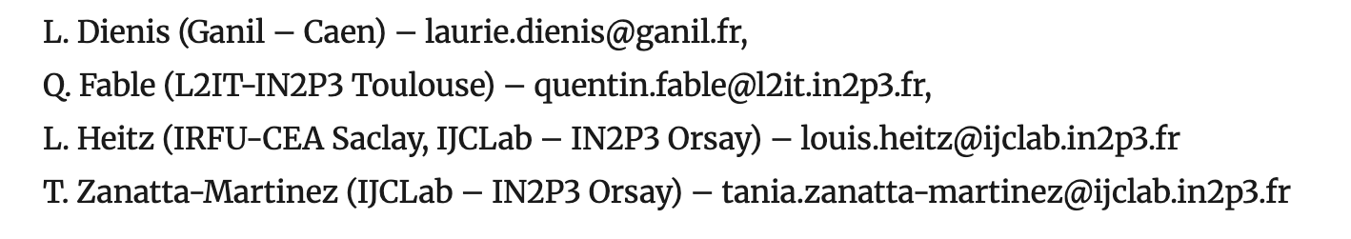
(12 in total)
Board of young researchers

Slide 4
GDR in actions
Organization of schools Phynube2, 3 and soon coming PhyNube4
Plenary meeting (present week)
Organization of webinars (senior, young researchers, technical)
Senior 600 views in 2025, junior 550 views in 2025, technical on NpTool 150 views
Youtube channel: 181 subscribers (26 new in 2025), 8000 views with 600h in total
Repository of many lectures including communication to public (especially from 2018– 2022)
Information to the whole community (workshops, conferences, job offers, IRN, IRL …)
75 messages in 2025
Support of workshop, schools and organization of events

Slide 5
Summary of sponsored events by Resanet
In-beam France community meetings juin 2023 (Lyon), Agata@GANIL mai 2024
ISOL-France community meetings 2023, 2024, 2025
WS on Target ion souce Sept 2023
WS on V_{ud} Nov. 2024
Ecole Joliot Curie 2024 & 2025
WS on advance quantum computing for many-body systems (Nov 2025)
PhyNuBe 2, PhyNeBe 3 and soon coming PhyNuBe4
Plenary meeting Resanet

Slide 6
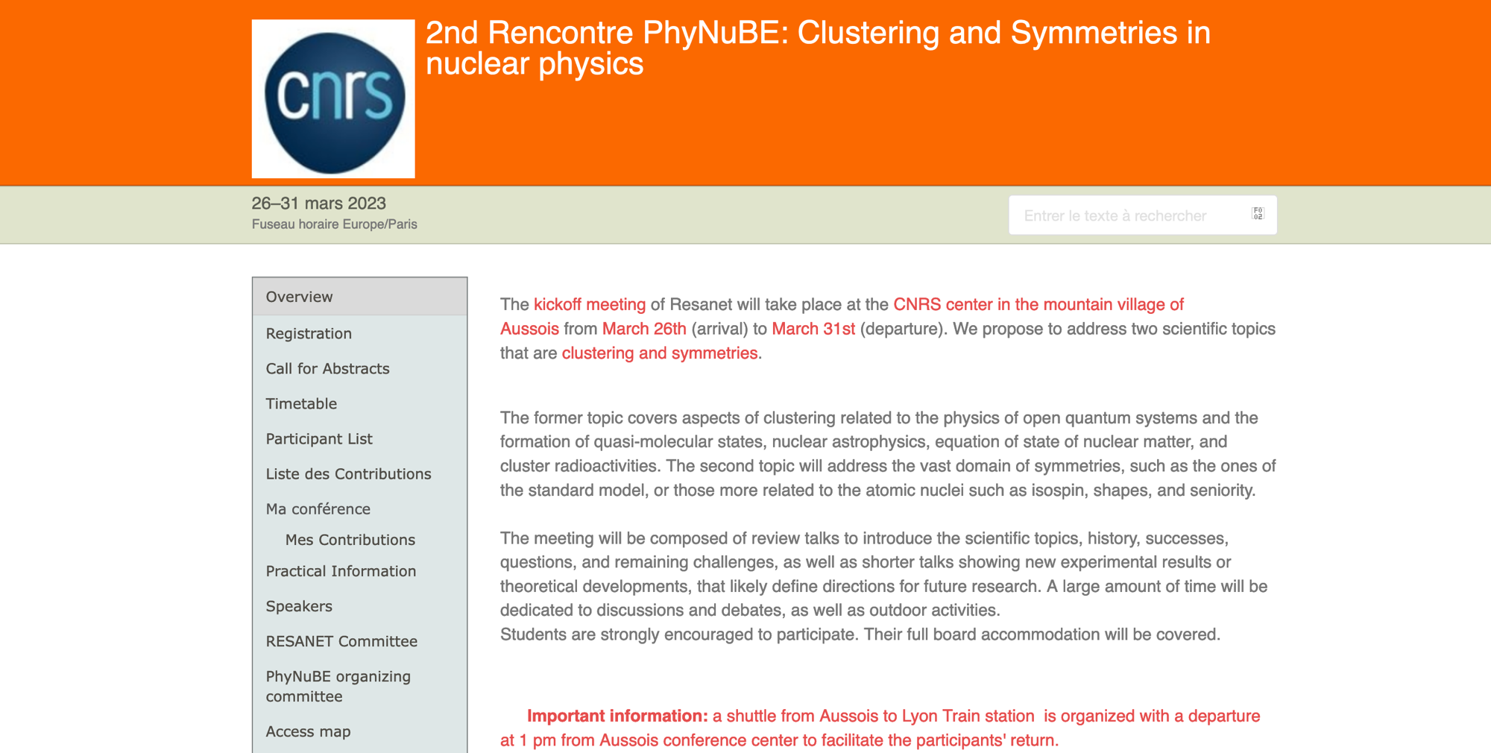

Slide 7
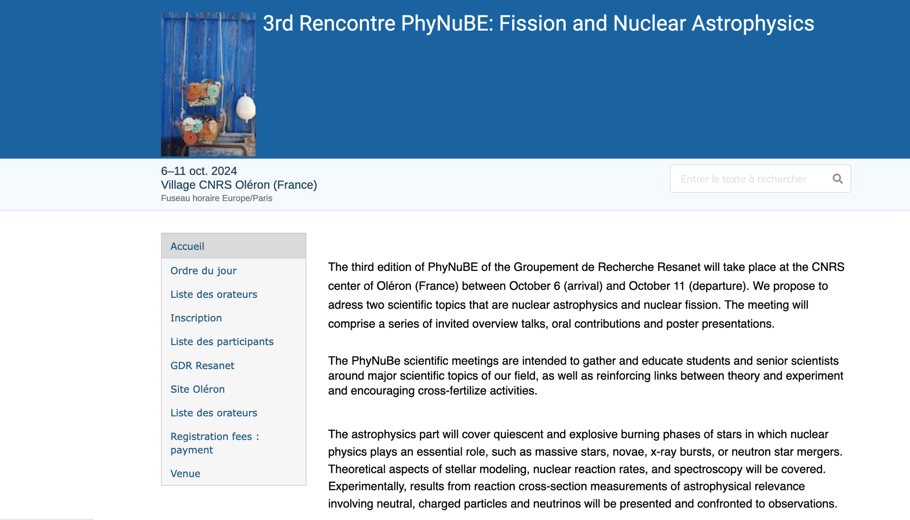

Slide 8

REGISTRATION OPEN: LIMITED NUMBER OF PARTICIPANTS

Slide 9
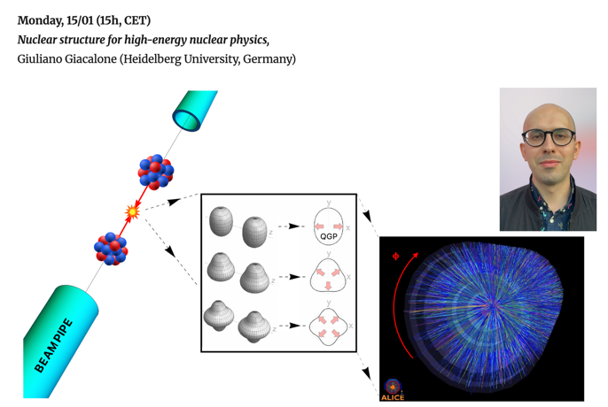
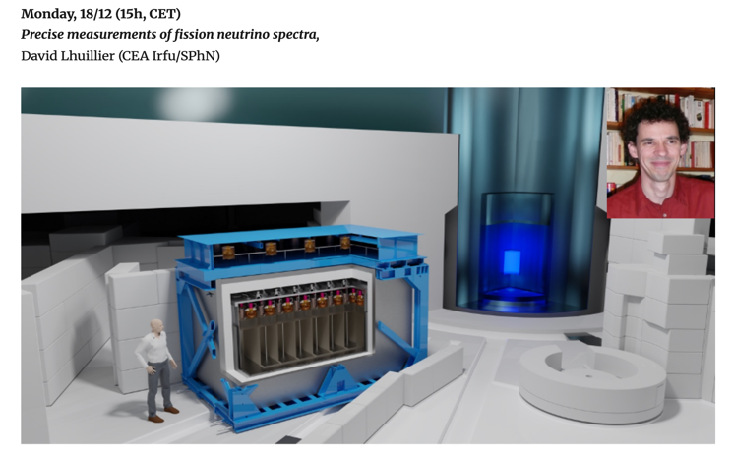
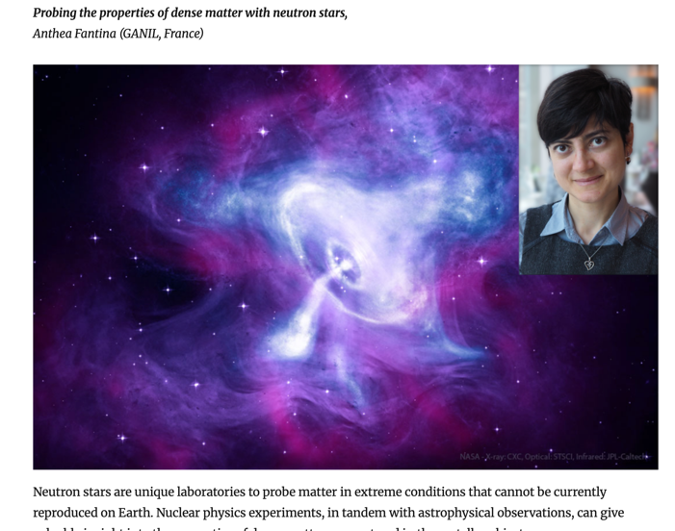
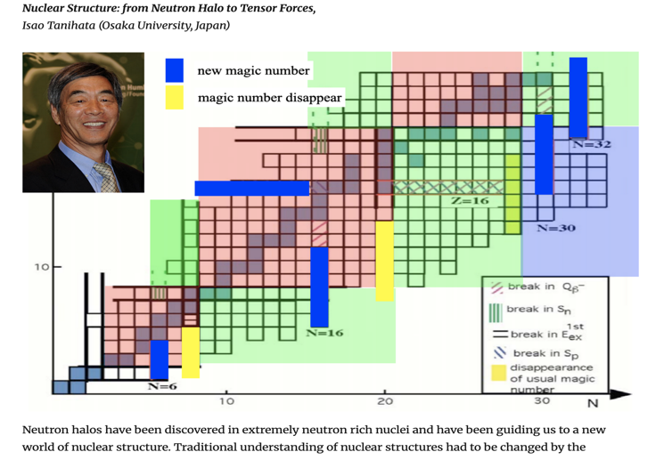
Some past webinars

Slide 10
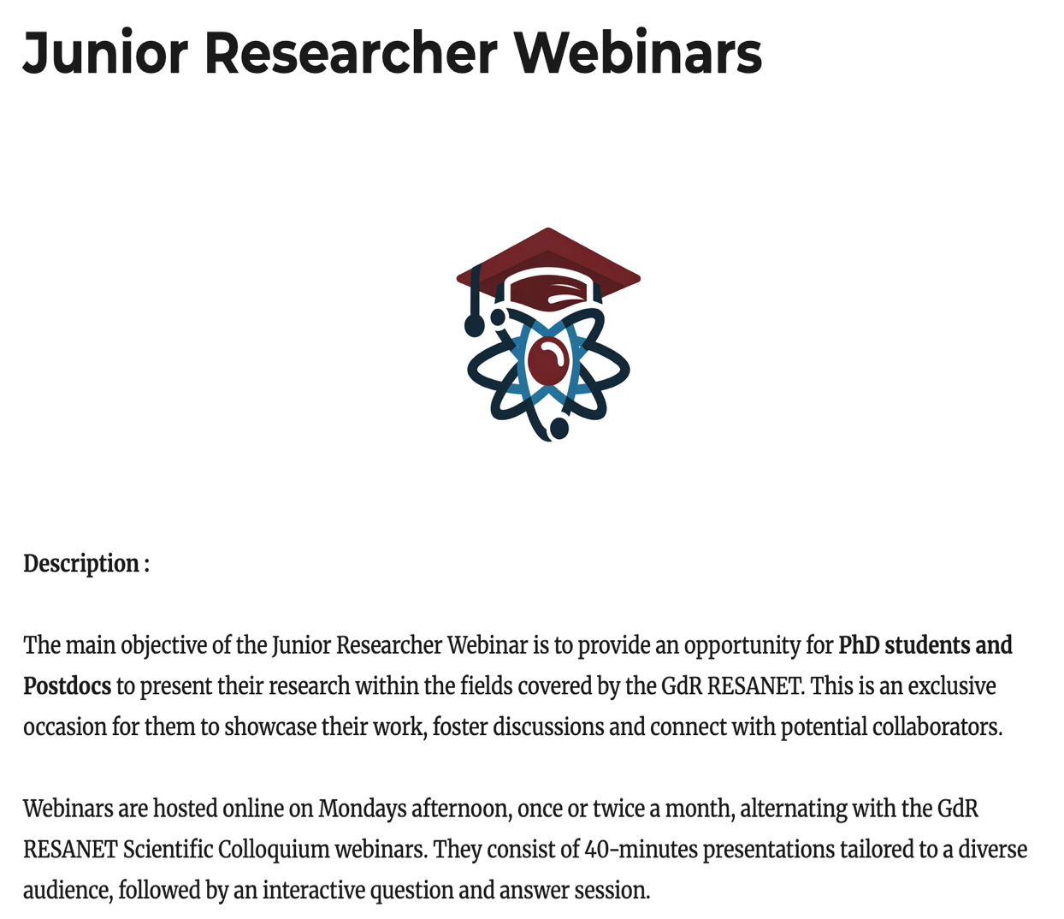
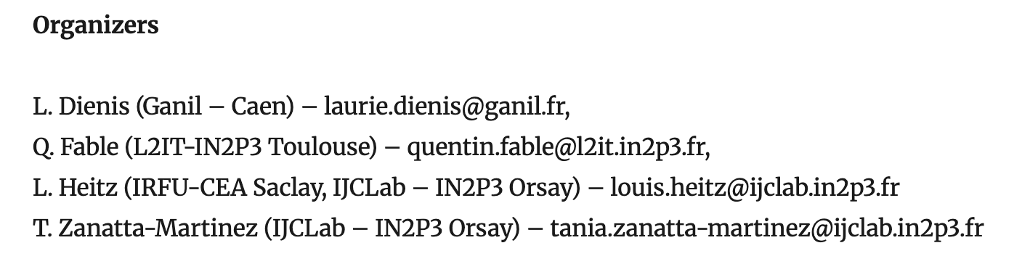

Slide 11
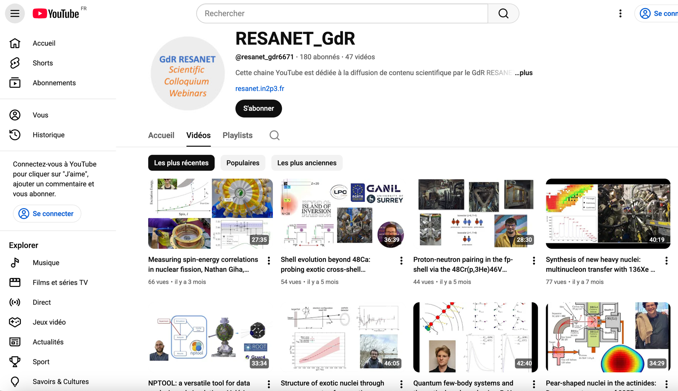

Slide 12
Who ?
IRN/ IRL
WS
schools
Webinars
Videos/ Blogs
MOOCS…
Website : https://resanet.in2p3.fr/
SUBSCRIBE HERE
(345 actually)

