Slide 1
International: tools and actions at CNRS-IN2P3
Focus on nuclear physics
Marcella Grasso
Scientific Director
Nuclear and Hadronic Physics
CNRS Nucléaire & Particules
IN2P3, France

Slide 2
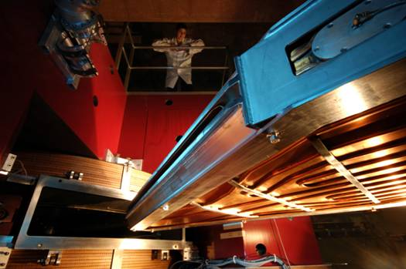
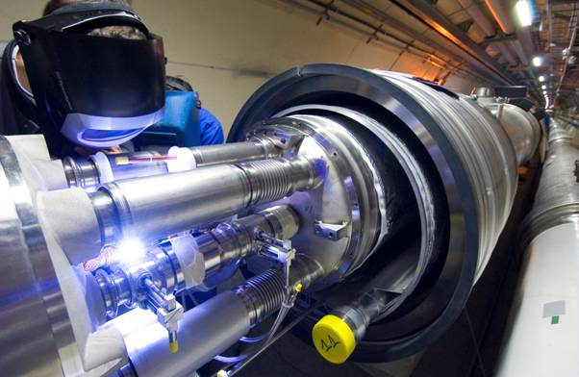
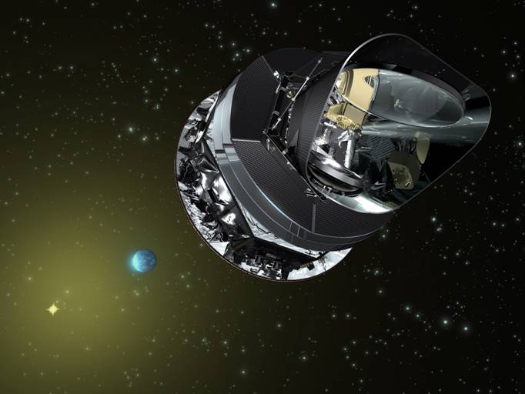
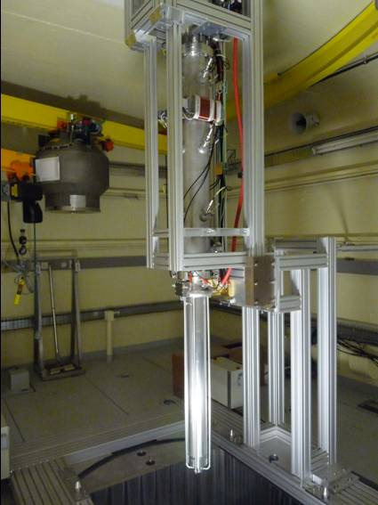
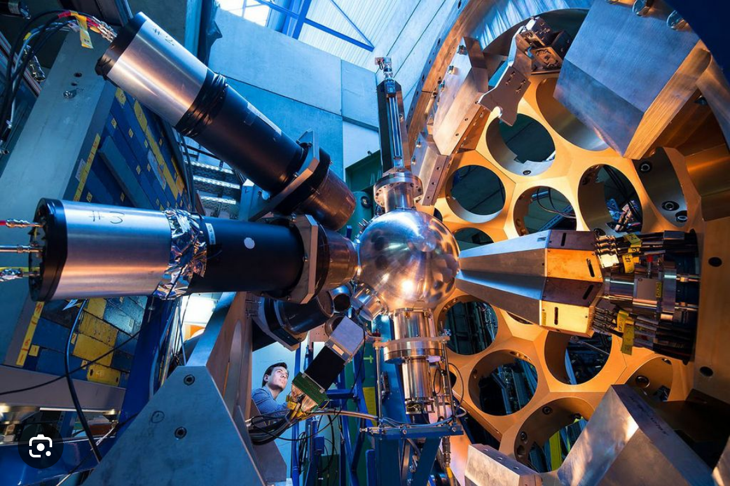
IN2P3 Organization Chart
Institute Director: C Roy
Deputy: J-L Biarrotte
Administrative Director :
S Pannetier
Technical Director:
R Cornat
Scientific Directors
Accelerators and
Technologies
A Lucotte
Astroparticle Physics and Cosmology
N Leroy
Nuclear and Hadronic Physics
M Grasso
Particle Physics
L Vacavant
Societal-impact activities (energy, health, environment)
J Marteau
15 laboratories (partnerships with local universities), GANIL (CNRS and CEA), 8 national science & technology platforms
About: 1000 physicists (half of them CNRS staff), 1400 engineers, technicians and administration staff (1200 CNRS staff)
About 300 post-doc, 500 PhD students, and 200 engineers, technicians and administration staff with fixed-term contracts
Almost all projects are carried out within international collaborations (exp and th) (about 40 MoUs ongoing)
Advisory Committee:
IN2P3 Scientific Council (3 sessions per year)

Slide 3

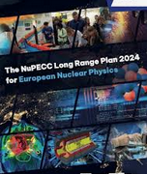
National road map: selected international facilities and projects
IN2P3 contributes to the overall French strategy for research infrastructures driven by the ministry : national road map.
An update is ongoing -> new road map is expected in 2026
European Long-Range Plan
IN2P3 scientists strongly contribute to NuPECC and have strongly contributed to its recent Long Range Plan

Slide 4
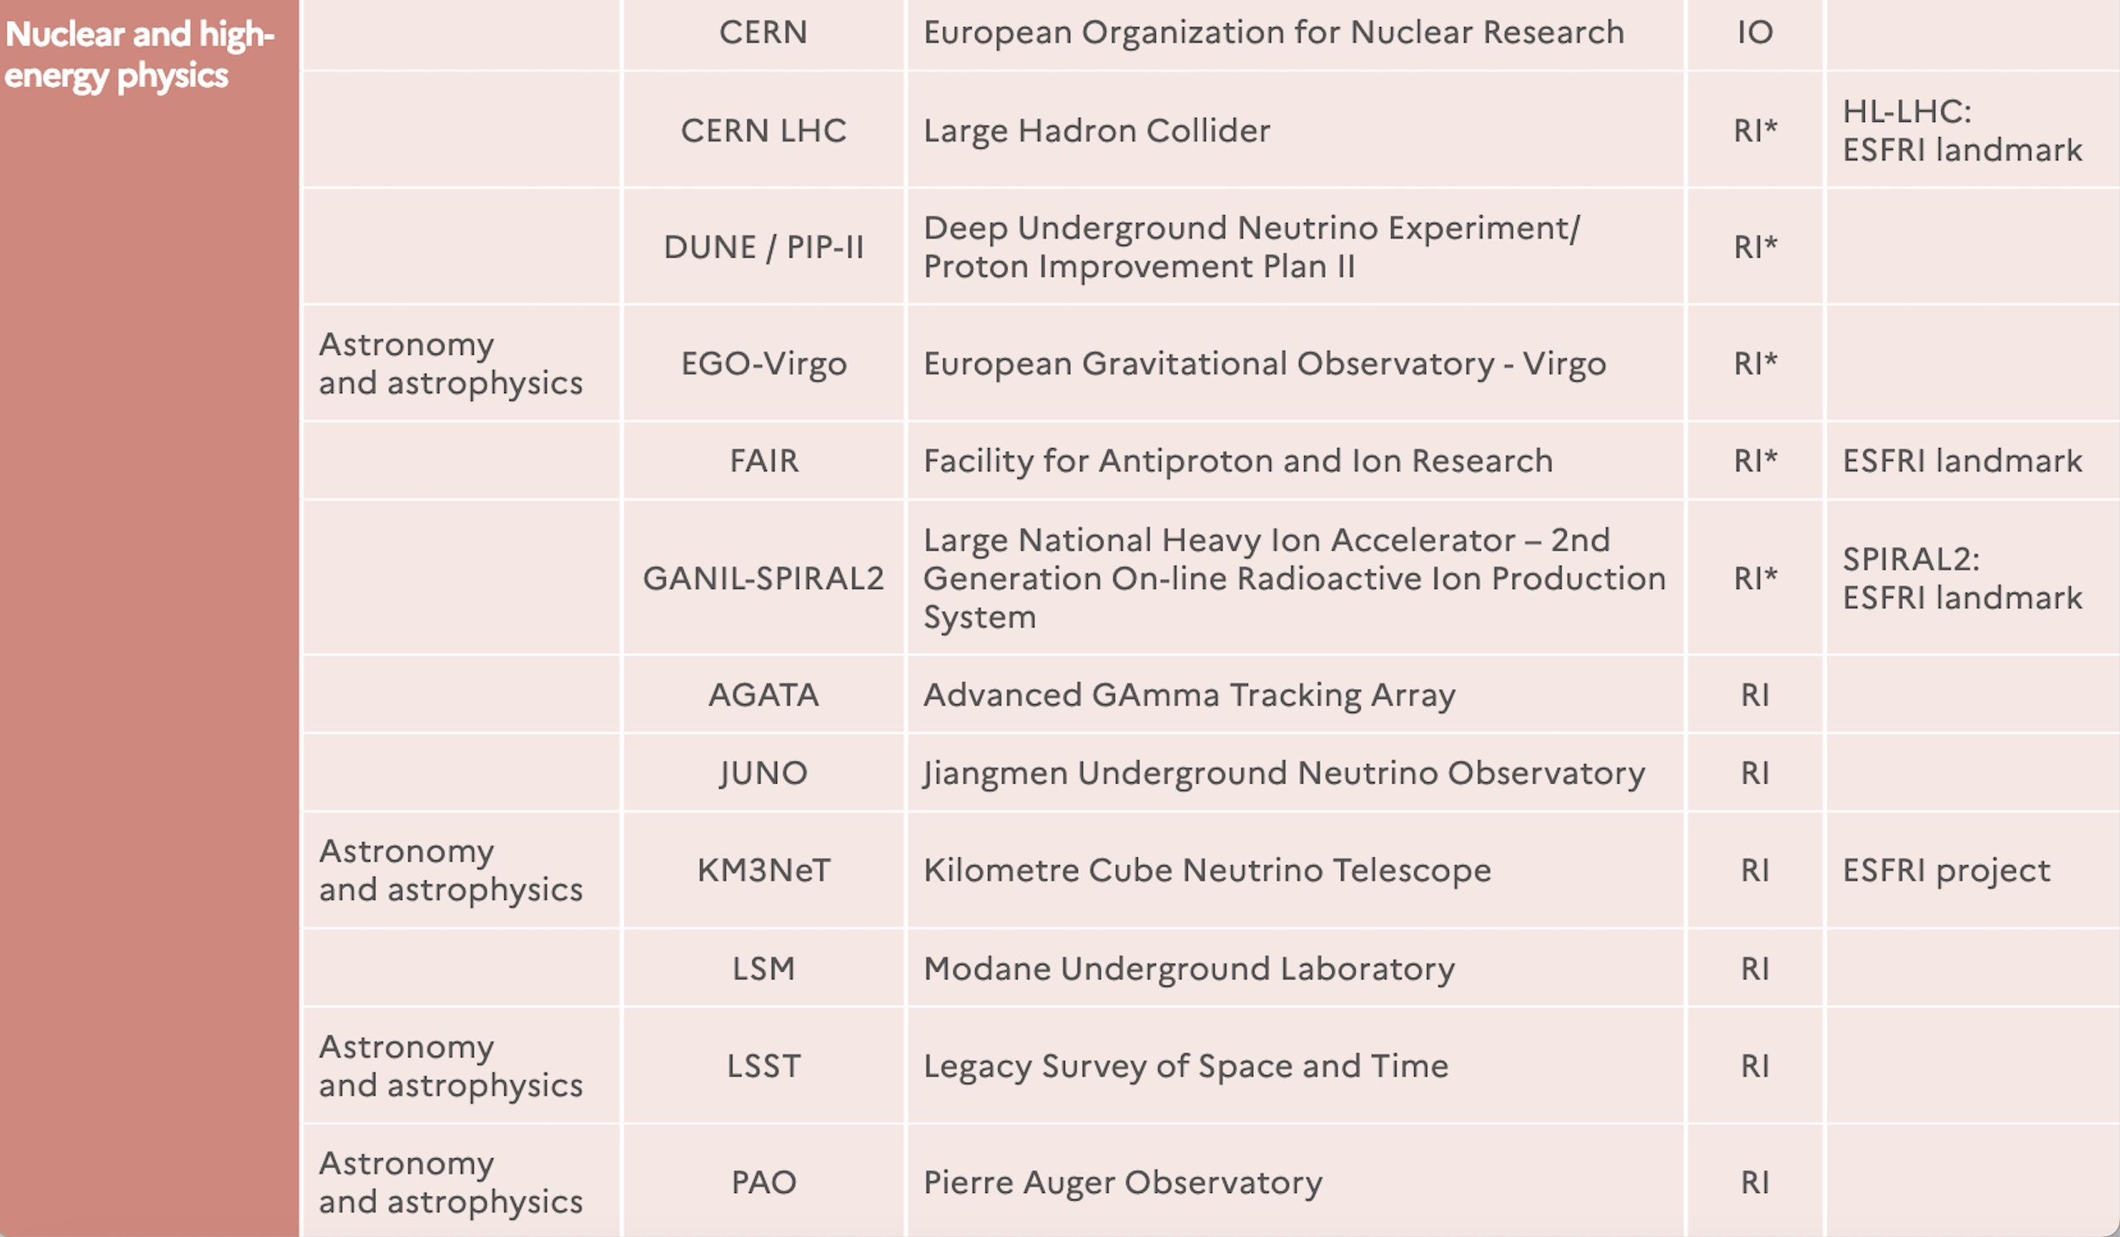
2021 Research Infrastructure French Road Map (Minister of Higher Education, Research and Innovation).
Dedicated funding from the Ministry for RI*
IO: International Organizations,
legally based on an intergovernmental
convention
RI*: (large) Research
Infrastructures, under
the scientific responsibility of research operators, subject to specific budgetary allocation by the Ministry
RI: Research infrastructures
whose scientific strategy and budgetary
monitoring are the responsibility
of research operators

Slide 5
IN2P3 regularly meets other funding agencies abroad: bilateral meeting every year with some of them, to discuss about common interests and projects
Some examples, for nuclear physics:
DOE Nuclear Physics -> GANIL (visit in 2023) and FRIB -> IRL NPA, IRN FANPEN (after FUSTIPEN, under discussion), isotope procurement for GANIL from Oak RIdge (for example, ⁴⁸Ca)---- double beta decay projects ---- Electron Ion Collider at BNL, ….
STFC (UK) -> visit of GANIL in 2023, UK participation in the MoU GRIT, projects for S3 and DESIR submitted to the ongoing update of the UK roadmap, contacts established for NFS ….
INFN -> GANIL, LNL, LNS, International Research Network FENMTO, double beta decay, …

Slide 6
International links and actions at CNRS-IN2P3. Some examples
9 International Research Networks (IRNs), to favor exchanges and links with other countries (scientific animation and common projects
7 International Research Laboratories (IRLs), where our scientists and engineers may spend periods of a few years (CNRS secondments and expatriation allowances), and students and post-doc may be co-trained
Canada:
-NPAT (Nuclear Physics, Nuclear Astrophysics and Accelerator Technologies), TRIUMF
Germany:
-DMLab (Dark Matter Laboratory), DESY
Japan:
-ILANCE (International Laboratory for Astrophysics, Neutrino and Cosmology Experiments),Tokyo Univ.
- TYL (Toshiko Yuasa Laboratory, particle physics), KEK
US
-CPB (Centre Pierre Binétruy, astroparticle physics), University of California, Berkeley
-NPA (Nuclear Physics and Nuclear Astrophysics), Michigan State University, FRIB
-PPC (Particle Physics and Cosmology), University of Chicago, Fermilab

Slide 7
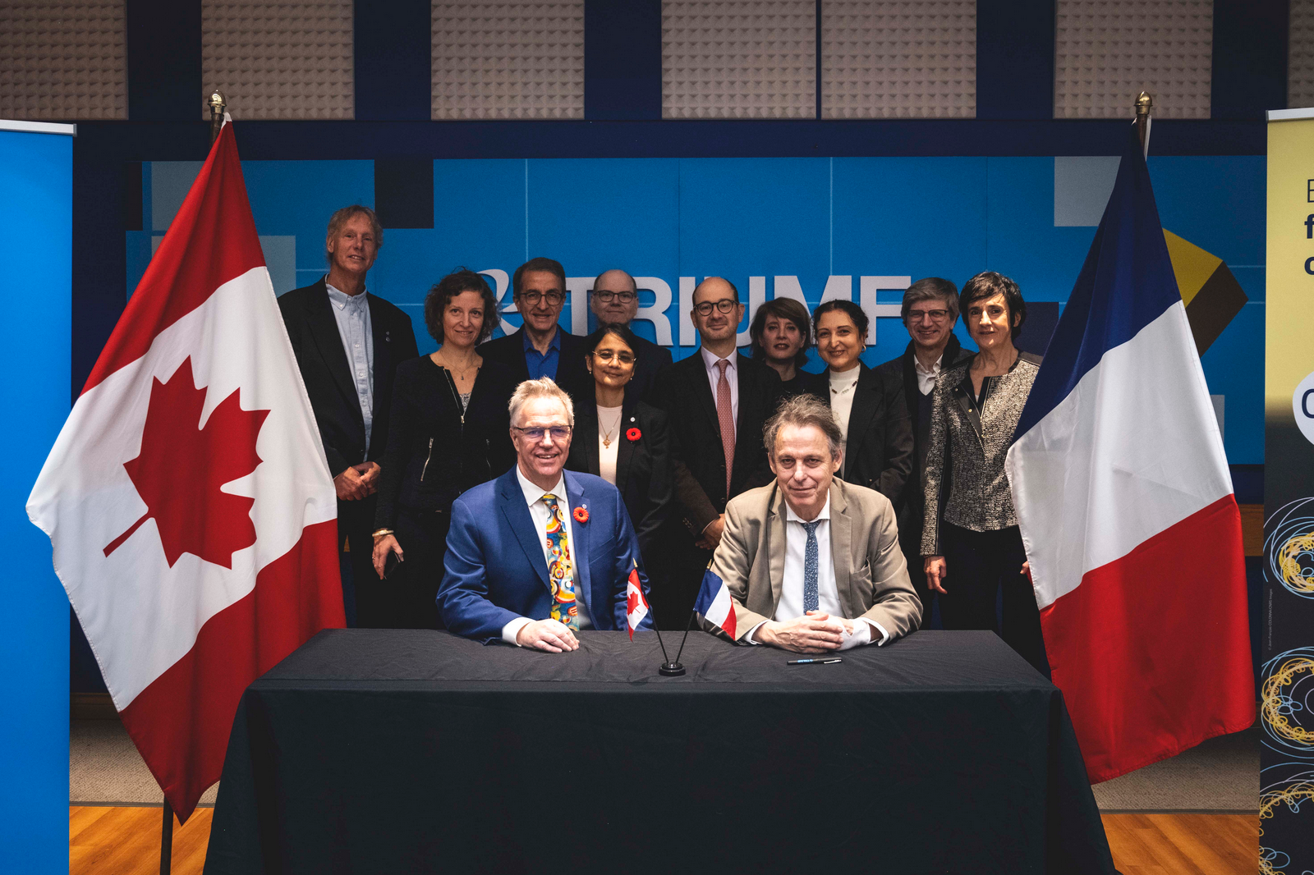
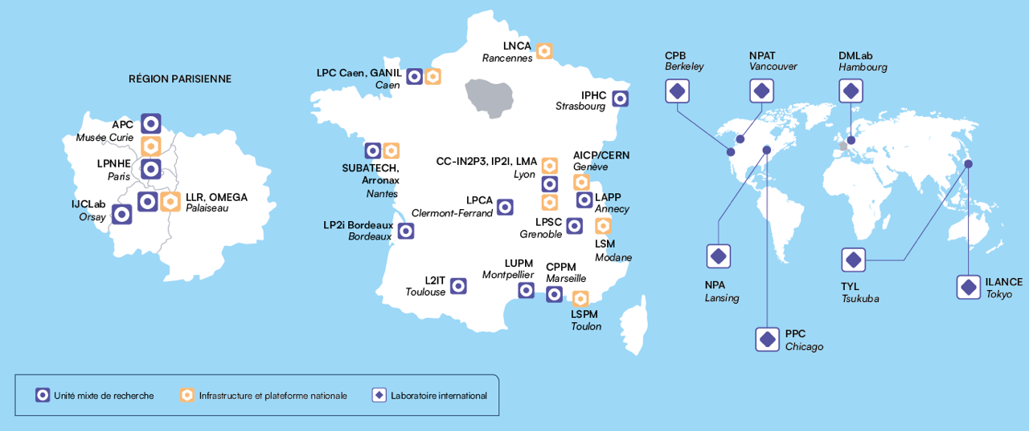
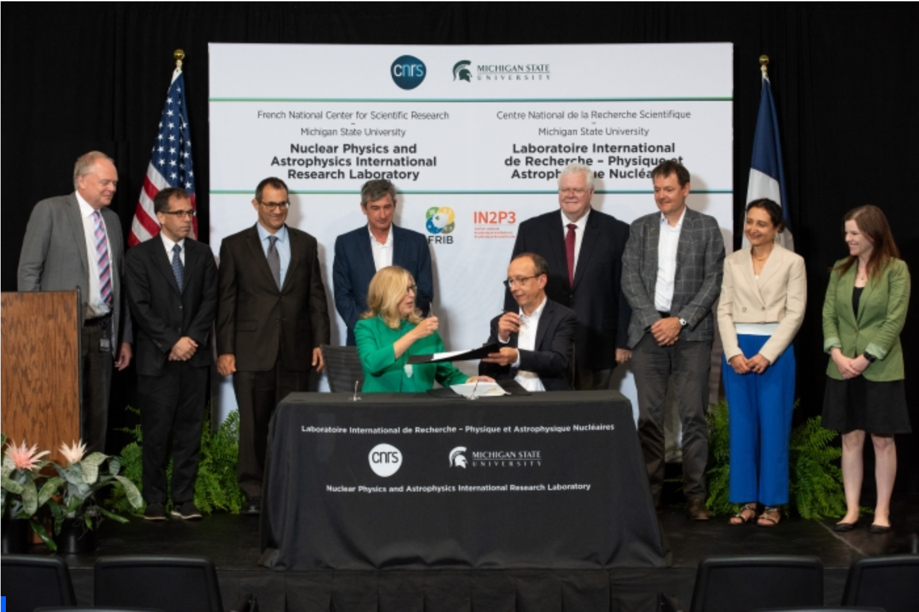
IN2P3 today, a distributed laboratory in France
Partnerships with Universities
GANIL is a CNRS-CEA laboratory
NPAT
Inauguration ceremony, November 2024
NPA
Inauguration ceremony,
July 2023
East

Slide 8
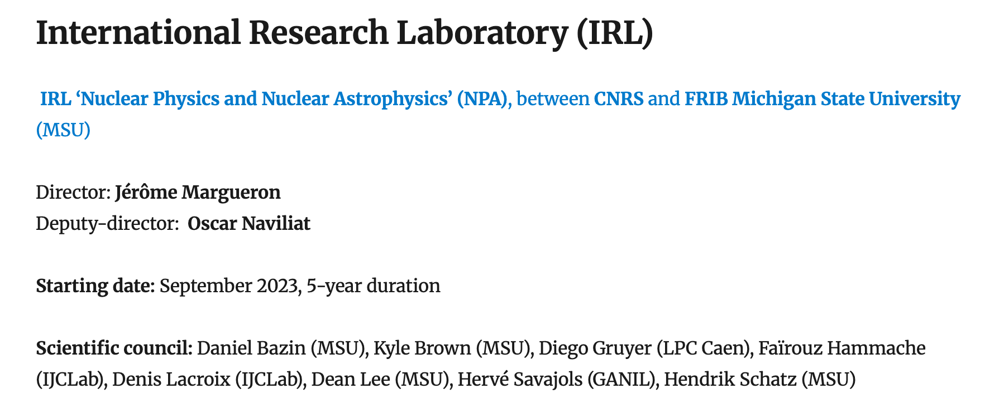
IRL ‘Nuclear Physics, Nuclear Astrophysics and Accelerator Technologies, between CNRS and TRIUMF
Director: David Lunney
Deputy: Ritu Kanungo
Scientific council: Martin Alcorta (TRIUMF), Maud Baylac (LPCS), Oliver Kester (TRIUMF), Thomas Roger (GANIL), Christopher Ruiz (TRIUMF), Nicolas de Serveville (IJCLab),

Slide 9
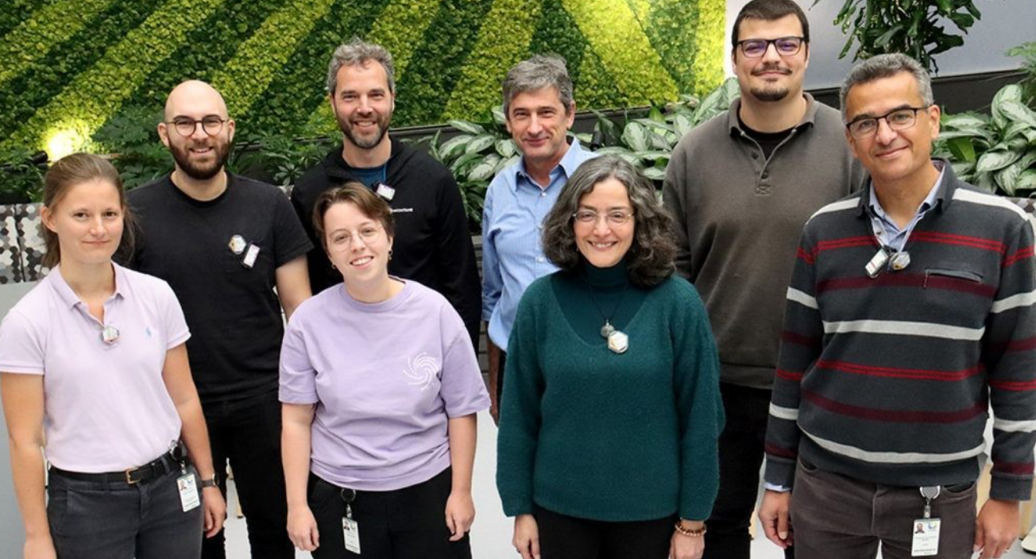
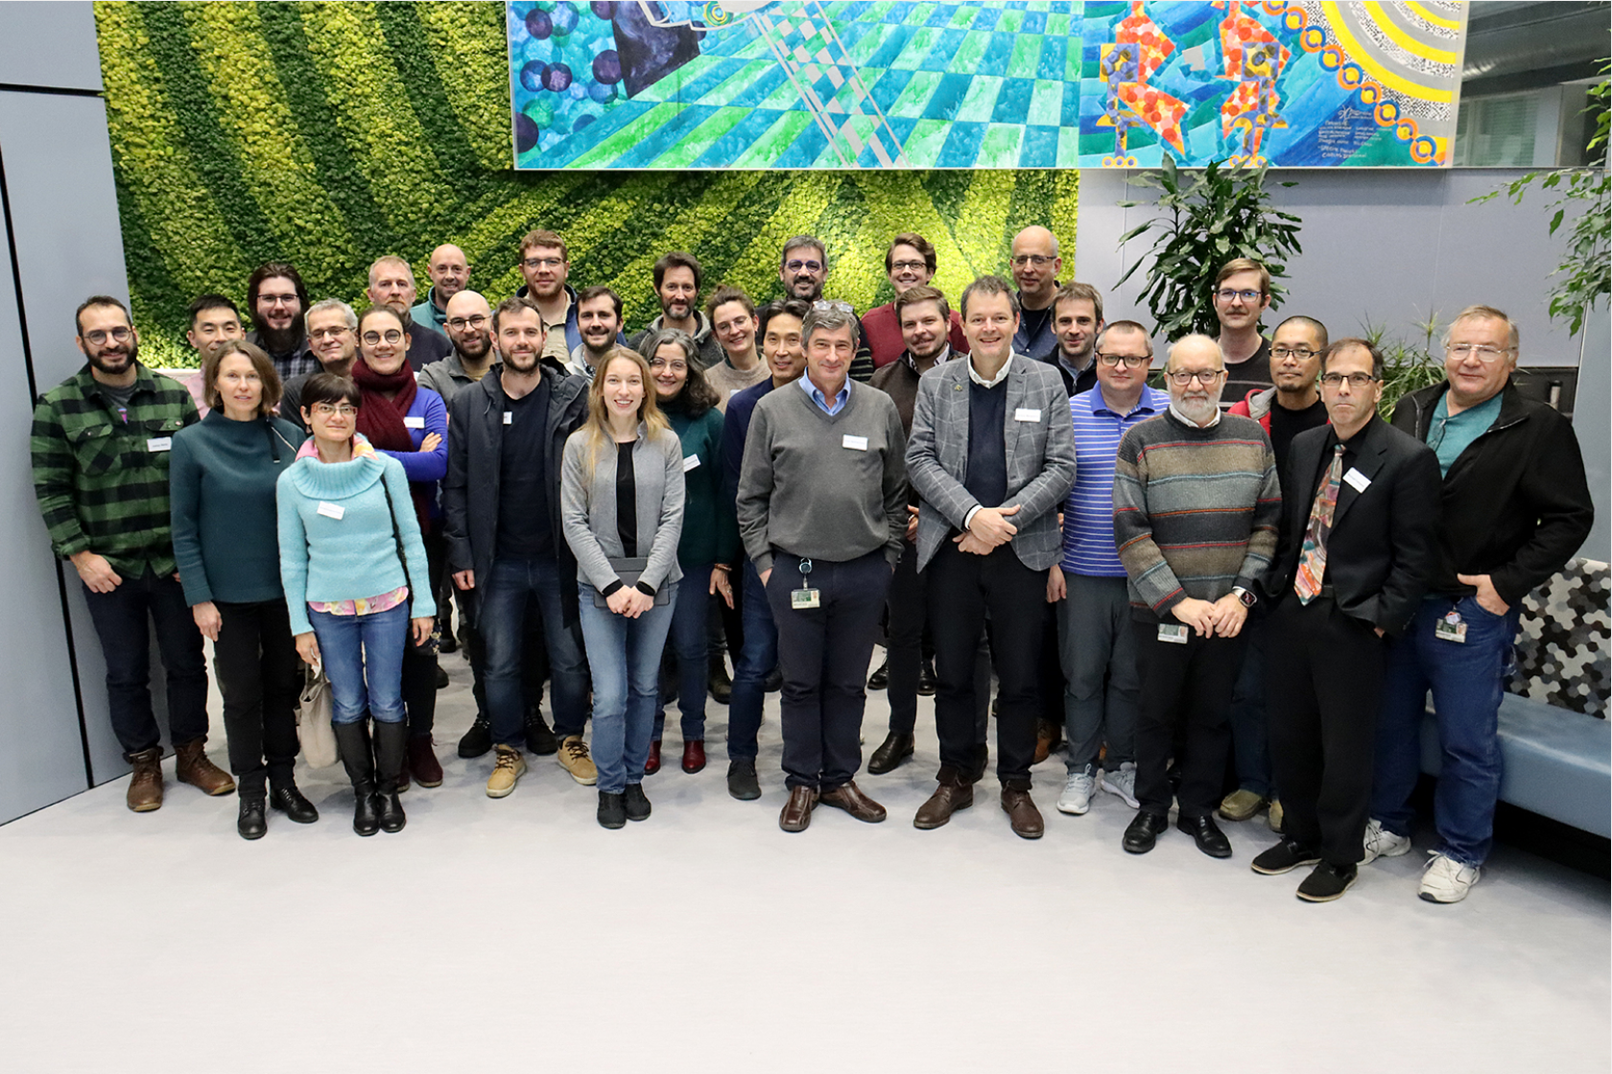

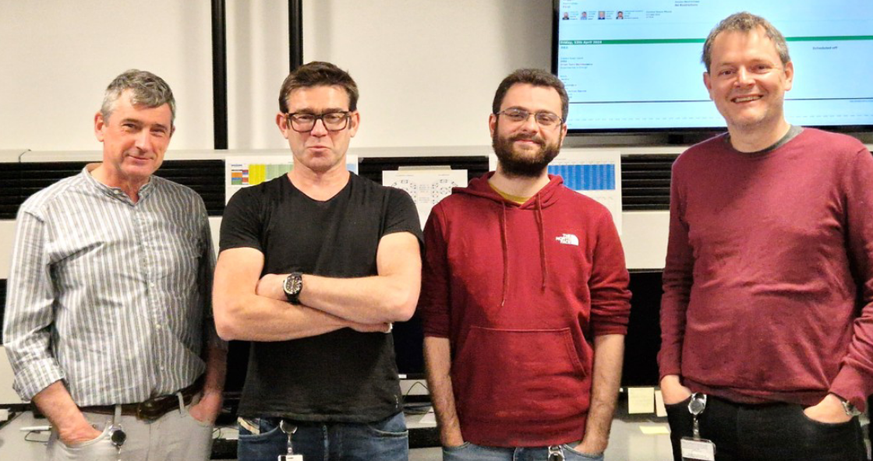
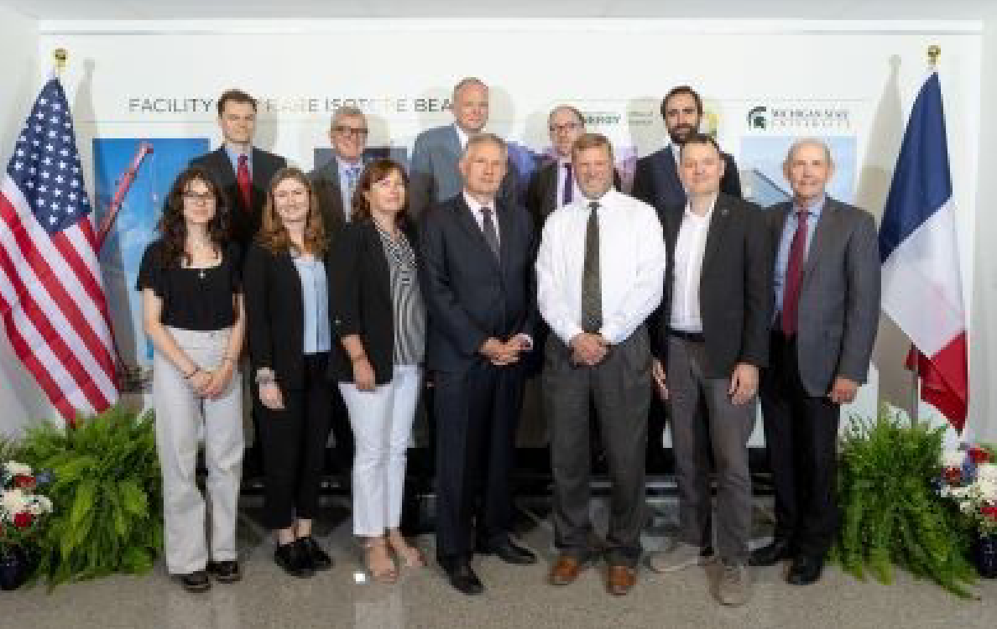
2023
Kickoff meeting end of 2023
French participation in 3 experiences at FRIB (2 nuclear astrophysics, 1 instrumentation)
1 French visitor (IJCLab Orsay)
1 workshop
2024
3 Master-2 French Students (Univ of Bordeaux, Caen, Strasbourg) have done 4-month internships at the IRL (MSU local supervisors: Paul Gueye, Aldric Revel, Xing Wu)
2 MSU students were selected by the French Embassy through the Chateaubriand fellowship program to spend a few months in French laboratories (Orsay and Toulouse)
3 French visitors (GANIL, IJCLab Orsay, LP2I Bordeaux)
French participation in 1 experience at FRIB (Near-barrier fusion of 18-22O + 12C)
2 workshops
The IRL is hiring a post-doc
Under discussion, for next year: summer training program, 1 international thesis
2025
Visit of the FR Ambassador, July 2024

Slide 10

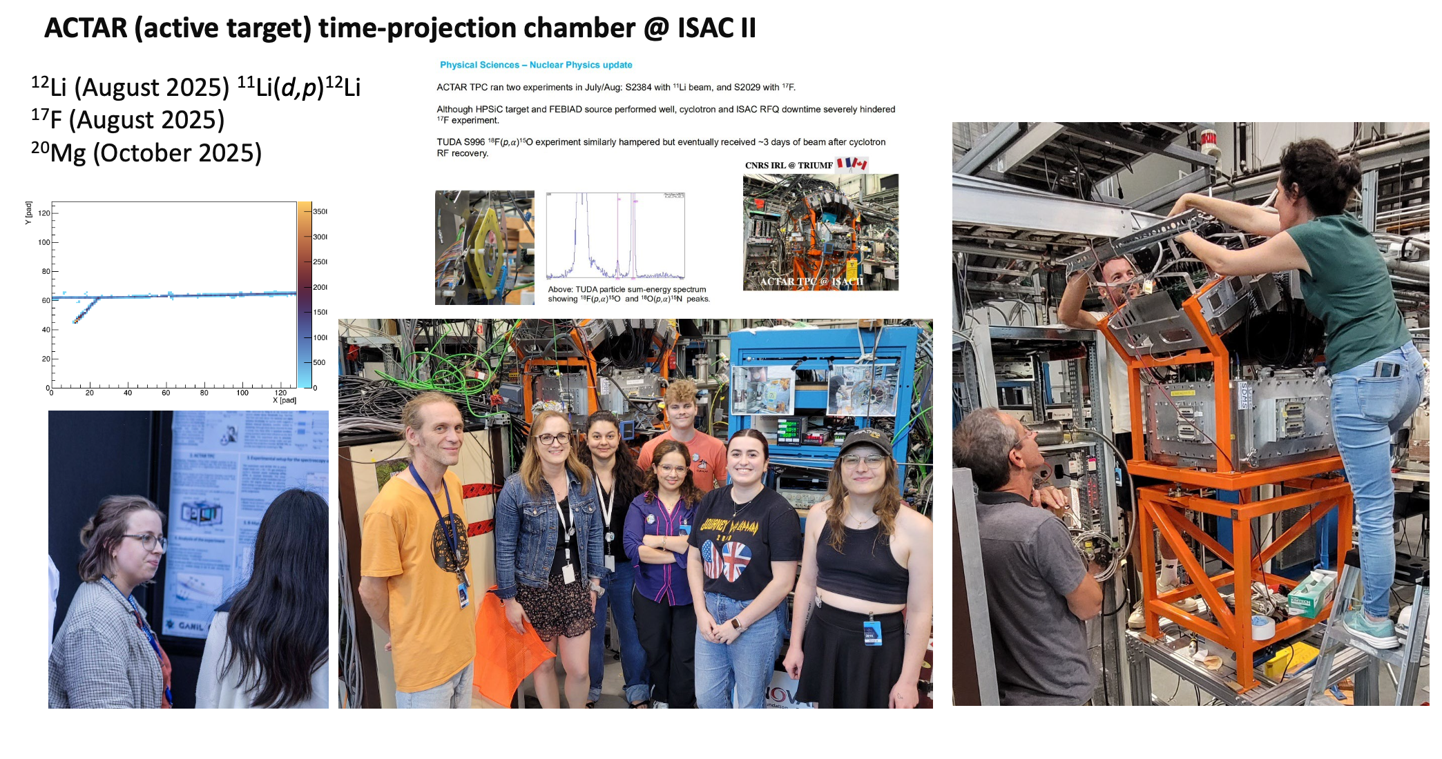
2025
4 visits (1 colloquium, 2 collaboration, 1 experiment)
ACTAR campaign
Under discussion for next year :
Hiring of 1 postdoc
Joint IRL-ARIEL workshop in April 2026
Courtesy of D. Lunney

Slide 11
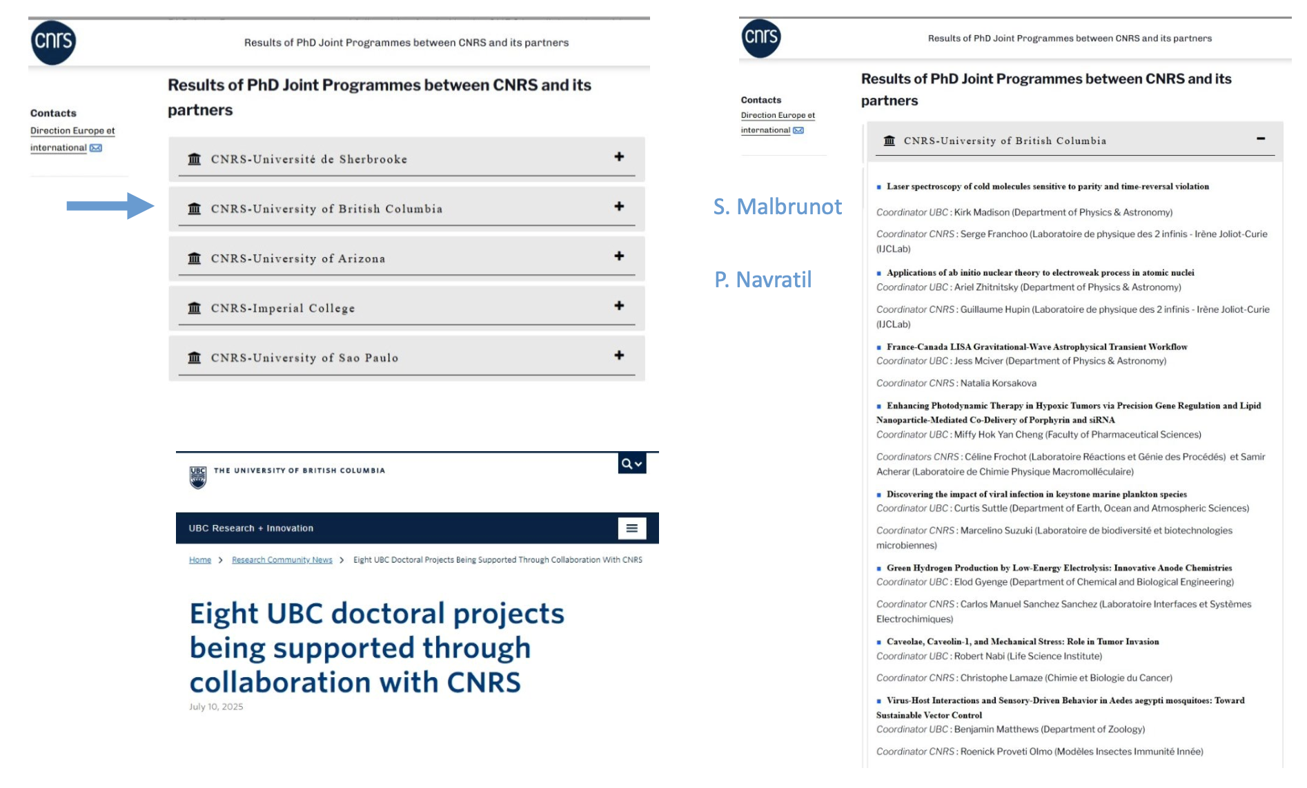
S. Franchoo, Laser spectroscopy of cold molecules sensitive to parity and time-reversal violations
G. Hupin, Applications of ab-initio nuclear theory to electroweak process in atomic nuclei

Slide 12
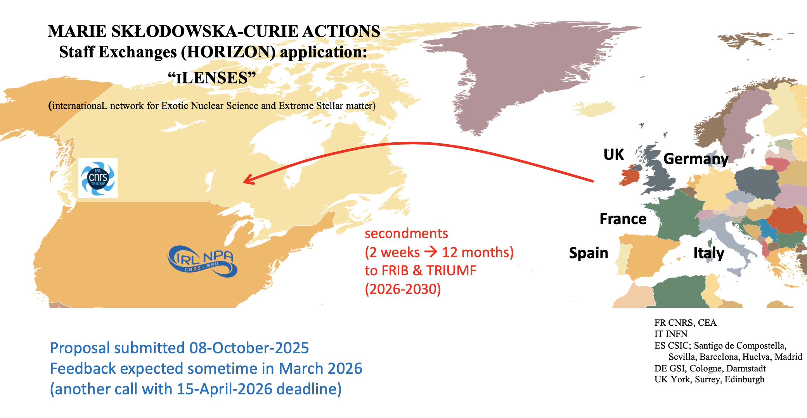
Courtesy of D. Lunney

Slide 13
Commitments (nuclear physics)
FAIR
France is shareholder (CNRS and CEA vote at FAIR Council and are represented at the NUSTAR Resources Review Board)
Contributions from the Ministry for the construction, commissioning, pre-operation and to operation (starting from 2028, First Science) (Agreements FAIR-GANIL have been discussed recently)
ISOLDE
France is member (CNRS and CEA). We contribute every year (ISOLDE fee) (Steering Committee, Resources Review Board)
ECT* Trento
IN2P3 contributes every year, with INFN, STFC, BMFTR, …
Ongoing Memorandum of Understanding for projects in nuclear physics
AGATA (CNRS-IN2P3, CEA, GANIL). IN2P3 : GANIL, IJCLab, IPHC, IP2I
Collaboration, 13 pays
Amendment MoU for 2026-2030 signed in 2025 (CNRS)
GRIT (CNRS-IN2P3, GANIL). IN2P3 : GANIL, IJCLab, LPCC
Collaboration : IN2P3, GANIL, INFN, Valencia, Santiago de Compostela, Huelva, STFC (Surrey), Ruder Boskovic Institute (Croatia)
New MOU under discussion to complete the construction and cover the first GRIT-AGATA campaign : 2026-2030
NUSTAR (CNRS-IN2P3, CEA, GANIL). IN2P3 : LP2I, IPHC, IJCLab, GANIL
Collaboration: more than 25 pays (a NUSTAR Council is being created (chair B. Rubio) and an operation-MoU starts to be discussed)
Construction ongoing (IN2P3: common funds and cost-matrix, gSPEC). Start of operation with HEB -> 2028
NA2STARS (CNRS-IN2P3, GANIL). IN2P3 : SUBATECH, GANIL, IP2I
Collaboration : IN2P3, GANIL, Spain (Madrid, Valencia, Huelva), STFC (Surrey), Turkey (Istanbul), Czech Republic (NPI CAS)
2024-2028
FAZIA (CNRS-IN2P3, GANIL). IN2P3 : GANIL, LPC Caen
Collaboration : IN2P3, GANIL, Italy, South Korea, Spain
2023-2027
PARIS (CNRS-IN2P3, GANIL). IN2P3 : IJCLab, GANIL, IPHC, IP2I
Collaboration : IN2P3, GANIL, Poland, INFN
Amendment for constructing the Paris Minicube geometry: 2022-2026

Slide 14
International – nuclear physics and nuclear astrophysics networks (IRNs)
International Research Network (France, Spain)
ASTRANUCAP: Astrophysics, STructure, Reactions, and Analysis with NUClear beams and Applications, January 2021, 5 years, ending in December 2025
Nicolas
International Research Network (France, Italy)
FENMTO: Frontiers in Exotic Nuclei, Multidisciplinary research and TheOry, January 2024, 5 years
International Research Network (France, US)
FANPEN: France North-America Network on the Physics of Exotic Nuclei, January 2024, 5 years

Slide 15
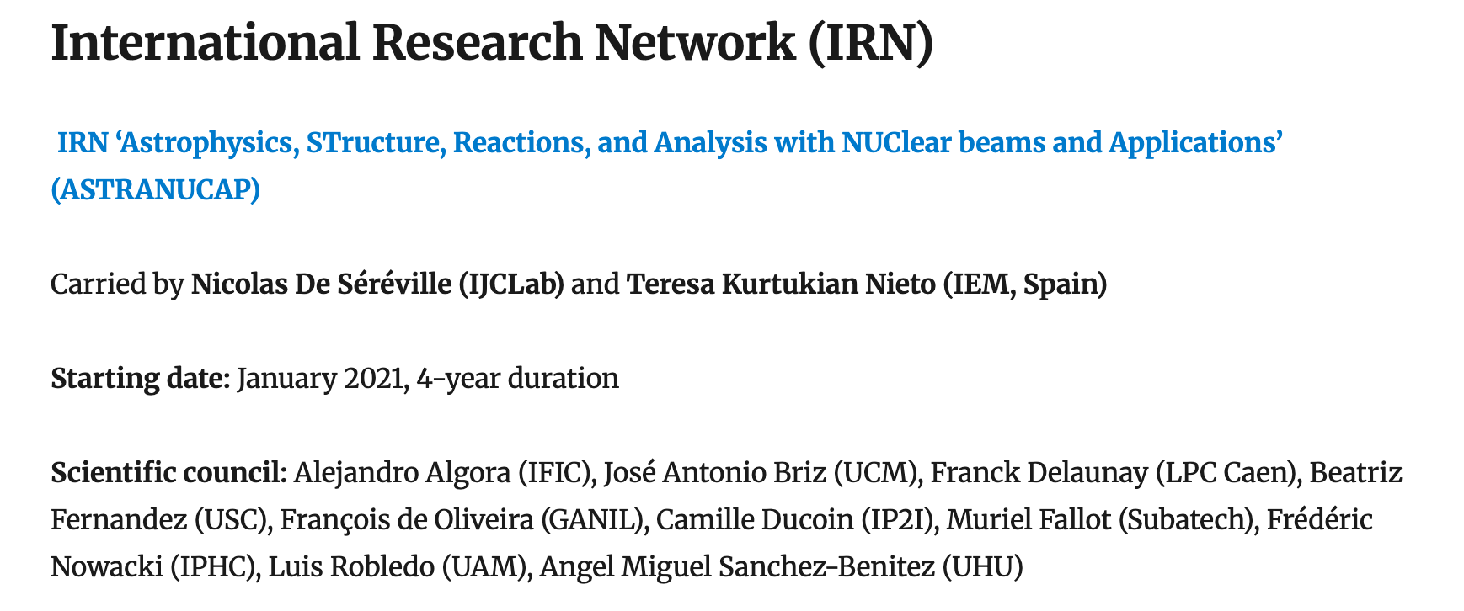
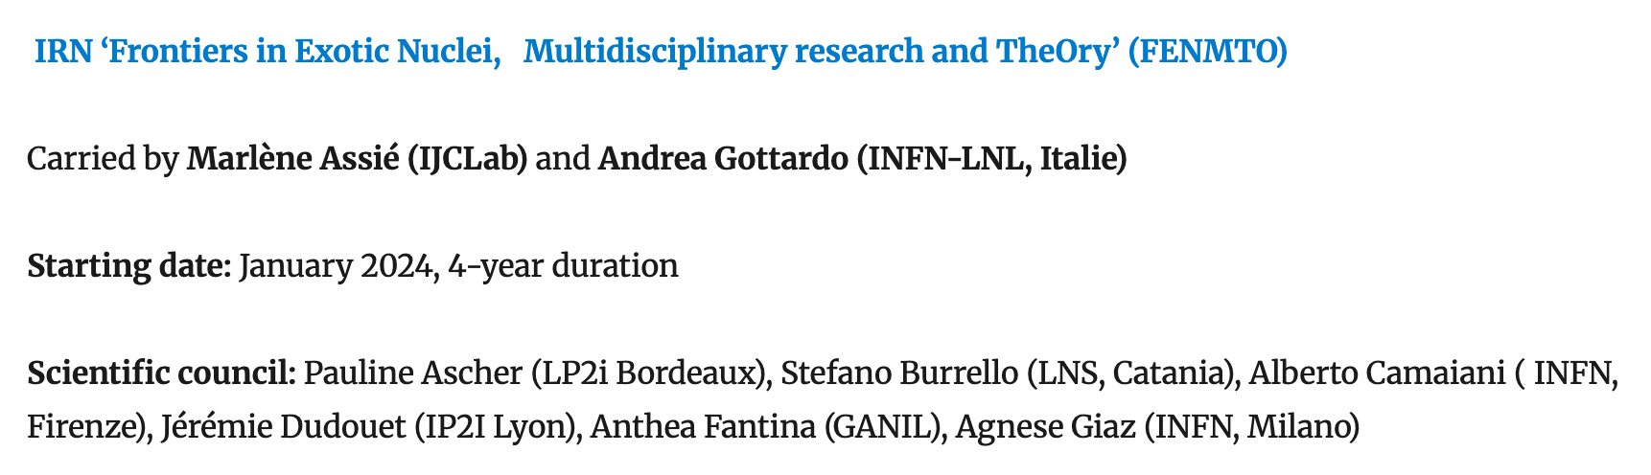
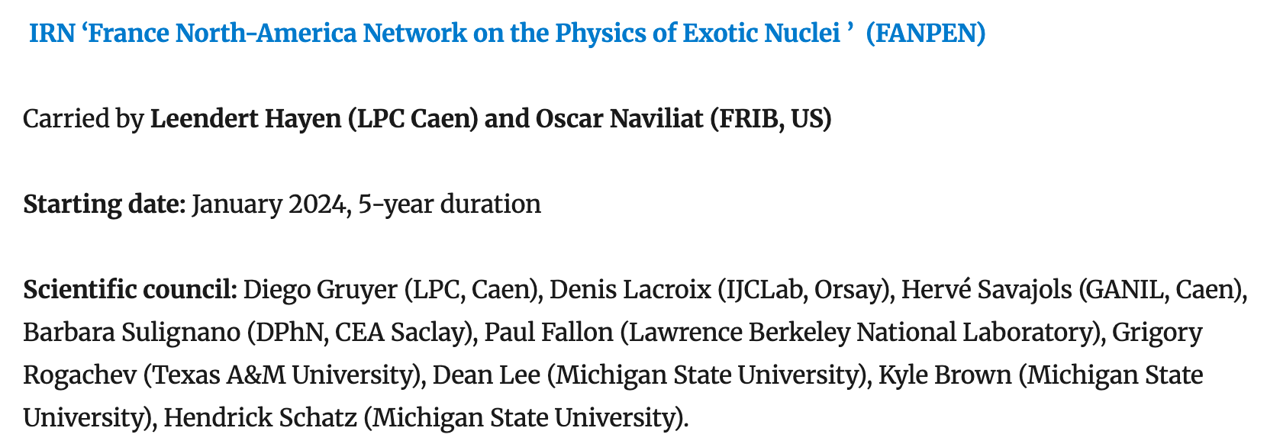
From RESANET web site

Slide 16
After the first 5-year period, ASTRANUCAP (N. De Séréville)
80 trips were undertaken representing an average of 20 trips per year, 55% from France to Spain, 45% were from Spain to France
Training of PhD students is a core priority of ASTRANUCAP (approximately half of all trips)
Several PhD projects have been jointly supervised between France and Spain, including LP2IB/University of Santiago de Compostela, GANIL/University of Santiago de Compostela and Subatech/University of Valencia. 3 PhD thesis defended, 4 ongoing
3 to 5 publications per year
Kickoff meeting (zoom, 24/03/2021, 42 participants): https://indico.in2p3.fr/event/23858/, First ASTRANUCAP workshop (Madrid, 18-19/11/2024, 30 participants): https://indico.in2p3.fr/event/33761/
In 2024, FENMTO (M. Assié)
14 scientists France to Italy
3 workshops, 1 data analysis, 3 exp + maintenance of AGATA clusters, 2 collaboration meetings (1 exp, 1 th)
IRN workshop planned in Spring 2026 in Italy

Slide 17
Other actions at IN2P3
IRPs, with Japan (J. Gibelin)
International theses and joint PhD
Agreements (Poland, GSI)

Slide 18
Participation of French scientists in projects and experiences done abroad. Why?
International scientific collaborations and emulation are fundamental for achievements and progress. IN2P3 direction strongly supports this.
Scientific solidarity at the international level is essential for promoting fundamental science (in general) and pushing for scientific progress, in all domains
Training of young generations (also) through international projects and in international facilities is beneficial for their future career
Obvious constraints to be taken into account: needs for the projects to be done at GANIL, manpower, financial constraints
Globally, a very reasonable balance exists

Slide 19
Scientific impact
Some high-impact publications are highlighted and illustrated every year at the annual IN2P3 meeting (journée projets) (NATURE and PRL, exp and th)
Exp, facilities outside France: highlighted publications at the annual ‘journée projets’
2022
1 Nature (exp at RIKEN), 1 PRL (exp at iThemba LABS)
2023
1 Nature (exp at RIKEN), 1 Nature Communications (exp at Yuväskylä), 3 PRL (exp at ISOLDE), 2 PRL (exp at RIKEN)
2024
1 Nature and 1 PRL (exp at Berkeley), 1 Nature (exp at GSI), 1 Nature Physics and 1 PRL (exp at ISOLDE), 2 PRL (exp at RIKEN)
2025
To be done

Slide 20
Thank you for your attention

