Slide 1

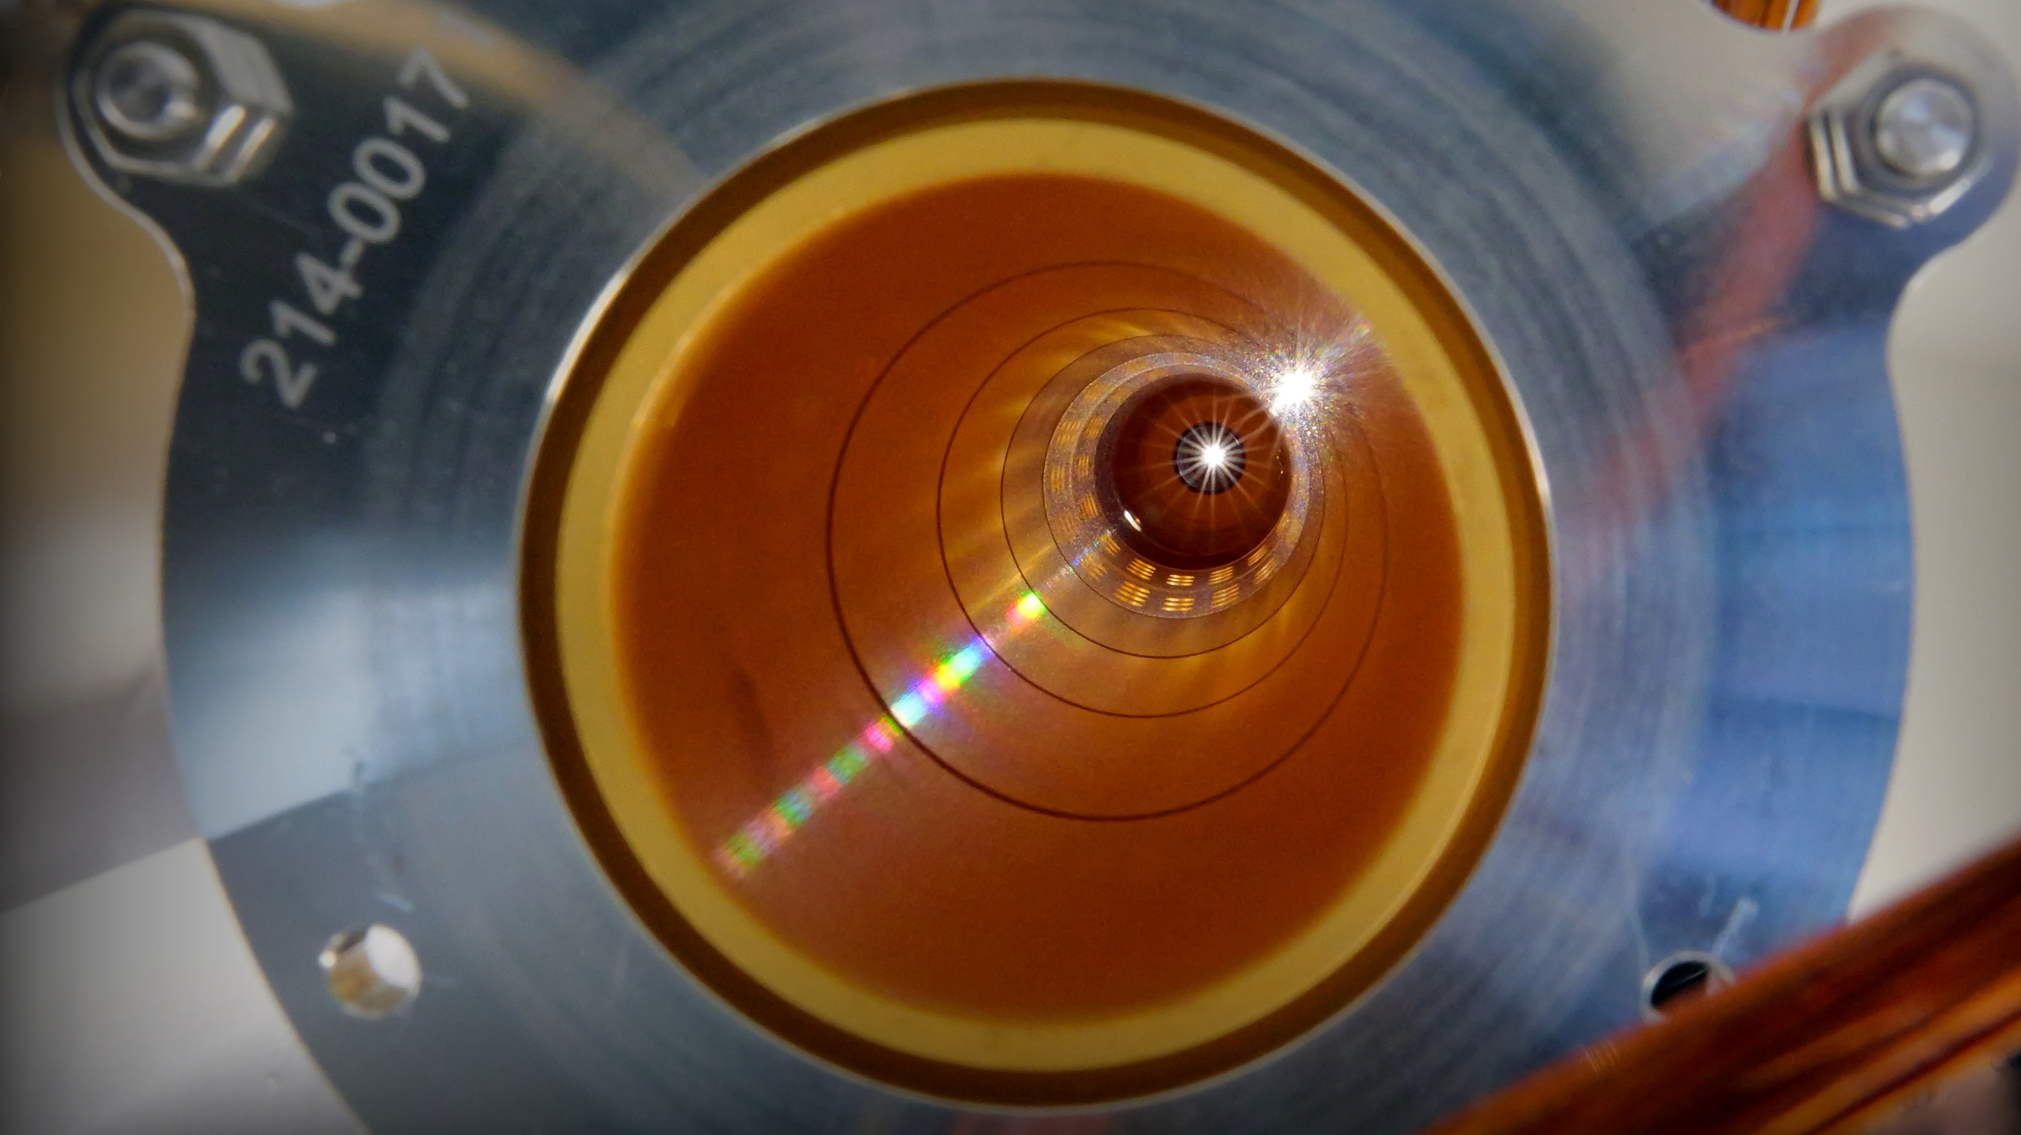
MASS MEASUREMENTS:
RECENT ACHIEVEMENTS AND PERSPECTIVES
Context of mass spectrometry
Recent highlights
Neutron-rich isotopes in the Zr-Rh region
Neutron-rich Co isotopes in the region of N=40
Future
PIPERADE developments
Perspectives of mass measurements
Pauline Ascher – RESANET Meeting – 3-7 November 2025

Slide 2
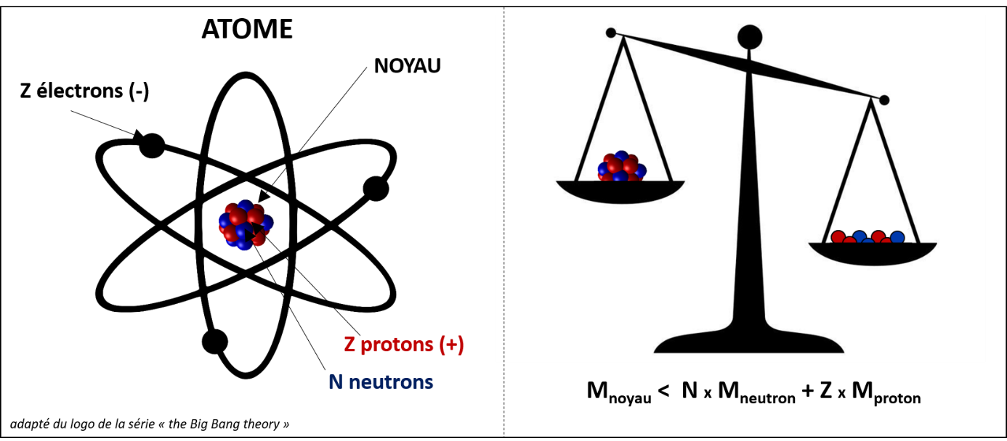
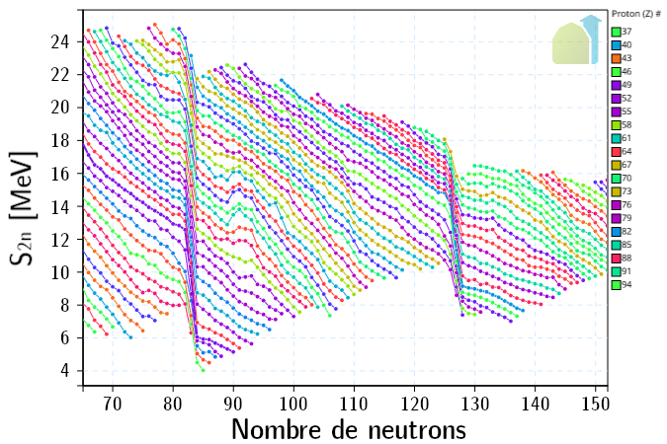
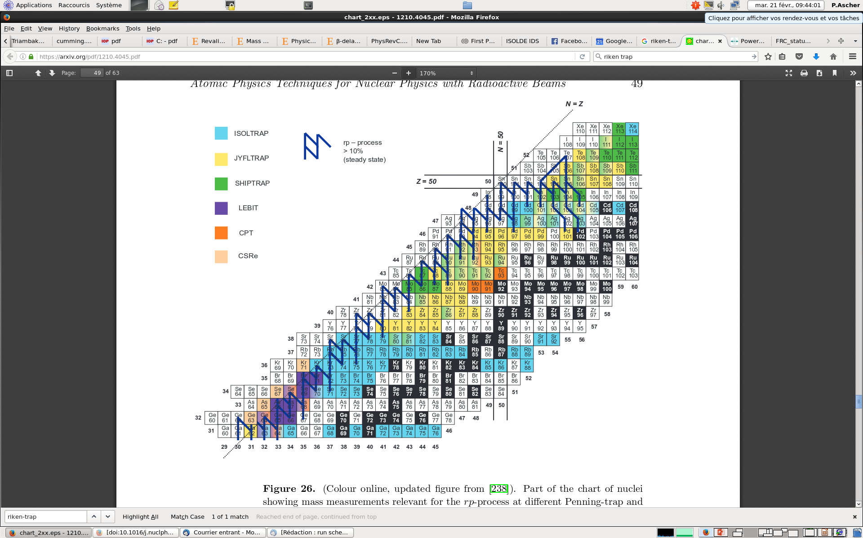
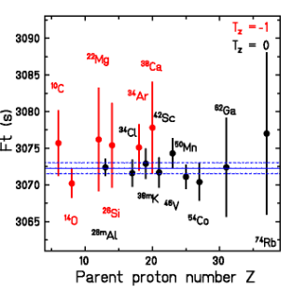

MASS SPECTROMETRY
$$M(Z,N)=Z∙Mp+N∙Mn−BE(Z,N)$$
NUCLEAR STRUCTURE
NUCLEAR ASTROPHYSICS
WEAK INTERACTION STUDIES
$$S_{2n}\left(Z,N\right)=BE\left(Z,N\right)−BE(Z,N−2)$$
Test of CVC hypothesis and determination of V_{ud}
ft-values depend on Q-values
Trends of « mass filters » (S_{n}, S_{2n} Δ_{3n}, …)
Spectrocopic information with isomers
Example: rp process (X-ray bursts)
Isotope & energy production, timescale, all depend on Q-values
See talk of M. Versteegen on Thursday
Pauline Ascher – RESANET Meeting – 3-7 November 2025

Slide 3
COMPLEMENTARY MS TECHNIQUES
Low-energy RIB facilities → best is to have both MR-ToF and PT due to complementarity (case by case) but also the possiblity to combine them
PTMS is the only technique suited to ft-values measurements (δm/m < 10⁻⁸)
Highest resolution means highest accuracy when there are isomeric states ! → PTMS
meas. time
M/ΔM
δM/M
rapidity
< 1 μs
~100 μs
~10 ms
100 ms - 1 s
ToF-Bρ
STORAGE RINGS
MR-ToF MS
PENNING TRAP
10⁴
10⁵
few 10⁵
10⁵ – 10⁷
(PI-ICR)
~10⁻⁵
~10⁻⁶
~10⁻⁷
< 10⁻⁸
resolution
precision
All of them are highly sensitive techniques !
Pauline Ascher – RESANET Meeting – 3-7 November 2025

Slide 4

HIGH-PRECISION MS MARKET
7 PTMS worldwide
JYFLTRAP (IGISOL)
TITAN (TRIUMF)
LEBIT (MSU)
SHIPTRAP (GSI)
CPT (ANL)
TRIGATRAP (IKC)
ISOLTRAP (CERN)
Pauline Ascher – RESANET Meeting – 3-7 November 2025

Slide 5
HIGH-PRECISION MS MARKET
MR-ToF
7 PTMS worldwide
MR-ToF developed in many places, and more to come….
JYFLTRAP (IGISOL)
MR-ToF
MR-ToF (FRS)
MR-ToF
TITAN (TRIUMF)
LEBIT (MSU)
SHIPTRAP (GSI)
CPT (ANL)
TRIGATRAP (IKC)
ISOLTRAP (CERN)
MR-ToF
MR-ToF
MR-ToF
MR-ToF
MR-ToF
Pauline Ascher – RESANET Meeting – 3-7 November 2025

Slide 6
HIGH-PRECISION MS MARKET
MR-ToF
7 PTMS worldwide
MR-ToF developed in many places, and more to come….
A new player in MS: France ! with 4 devices to come
JYFLTRAP (IGISOL)
MR-ToF
PIPERADE/DESIR
MR-ToF (FRS)
MR-ToF
TITAN (TRIUMF)
LEBIT (MSU)
SHIPTRAP (GSI)
MR-ToF/DESIR
TRIGATRAP (IKC)
CPT (ANL)
PILGRIM/S3-LEB
ISOLTRAP (CERN)
MR-ToF
MR-ToF
MR-ToF
MLLTRAP/ALTO
MR-ToF
MR-ToF
Pauline Ascher – RESANET Meeting – 3-7 November 2025

Slide 7
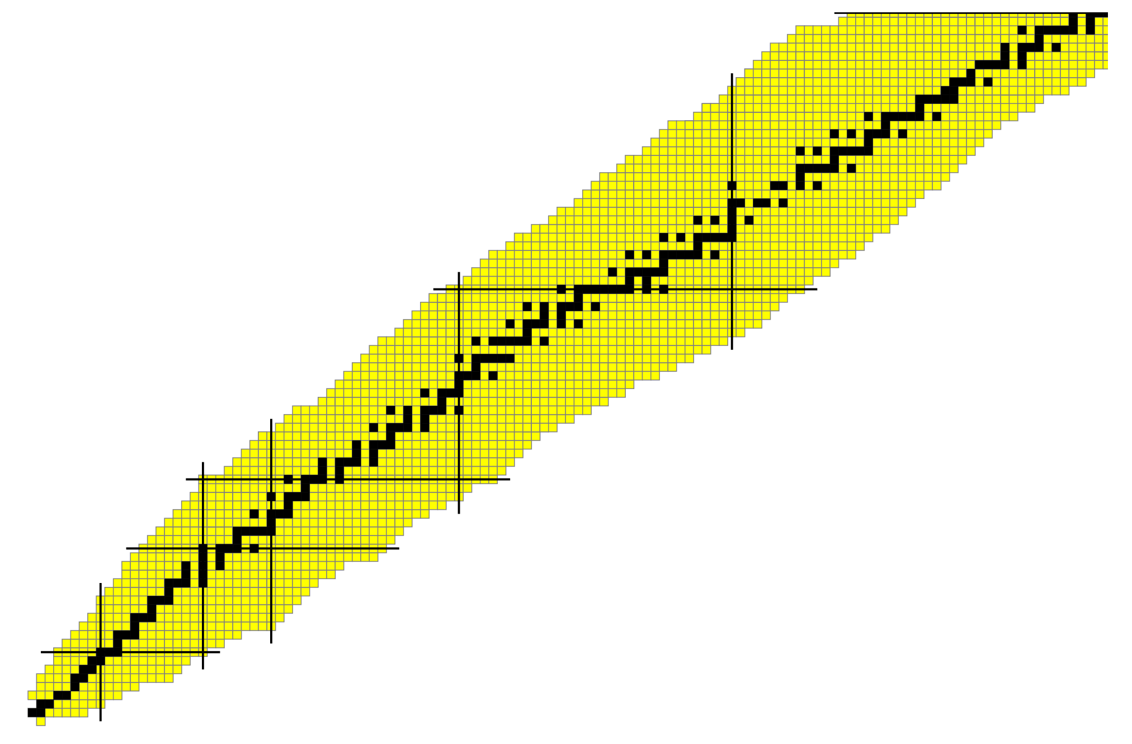
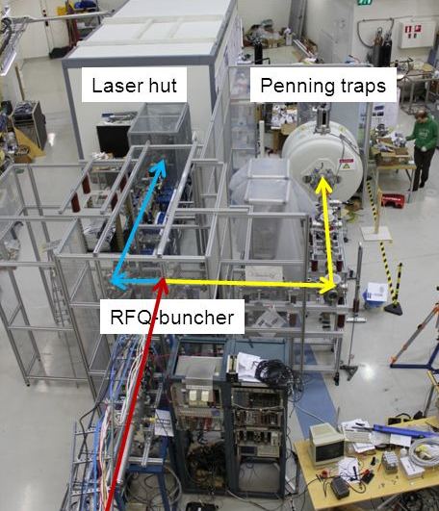
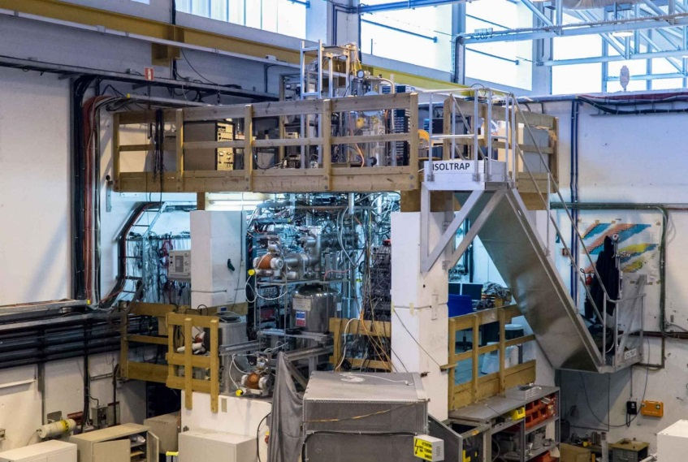
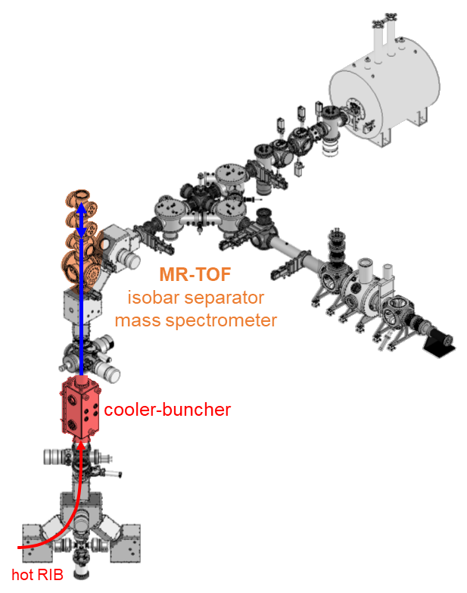
RECENT « FRENCH » HIGHLIGHTS
JYFLTRAP @IGISOL
(P. Ascher, S. Grévy, M. Gerbaux)
ISOLTRAP @ISOLDE/CERN
(D. Lunney, S. Naimi, M. Benhatchi, V. Manea)
¹⁰³Sn, ⁹⁹⁻¹⁰¹In,^{97,98}Cd
L. Nies et al., PRC 111, 014315 (2025)
L. Nies et al., PRL 131, 022502 (2023)
M. Benhatchi, in preparation
Y-Rh region
M. Hukkanen et al., PRC 107, 014306 (2023)
M. Hukkanen et al., PRC 108, 064315 (2023)
M. Hukkanen et al., PLB 856, 138916 (2024)
TITAN @TRIUMF
(D. Lunney)
⁹⁶⁻⁹⁸Kr
D. Lunney et al., PRC 112, 034307 (2025)
^{79m}Zn
L. Nies et al., PRL 131, 222503 (2023)
⁶⁸⁻⁷⁰Co
M. Flayol et al., in preparation
+ Collaborations with theoreticians from CEA (T. Duguet, J.-P. Ebran, …)
IPHC (F. Nowacki, K. Sieja, D.D. Dao)
IP2I (M. Bender)
⁴⁹Ar
M. Benhatchi, in preparation
³¹⁻³³Na, ³¹⁻³⁵Mg
E. M. Lkiardopoulou et al., PRL 134, 052503 (2025)
Pauline Ascher – RESANET Meeting – 3-7 November 2025

Slide 8
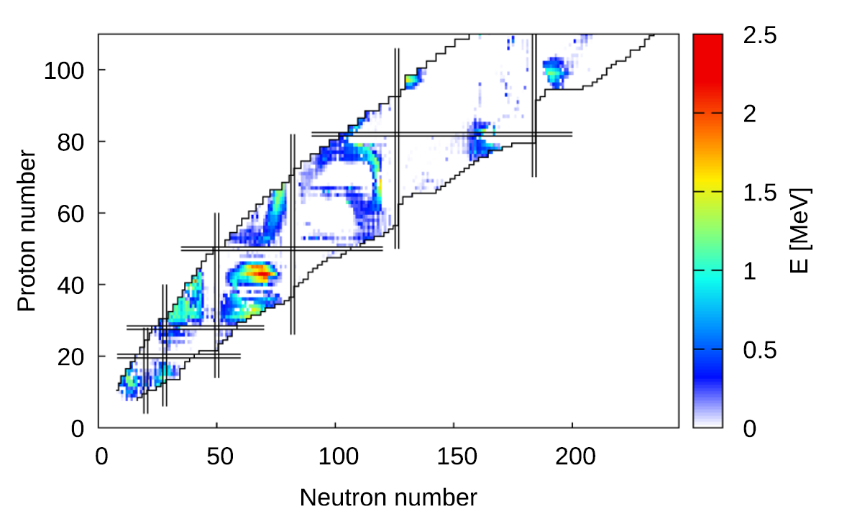
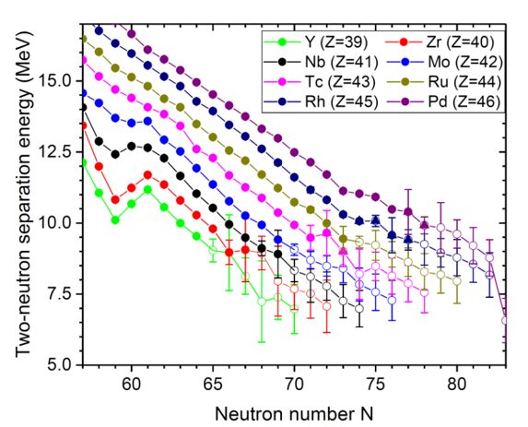
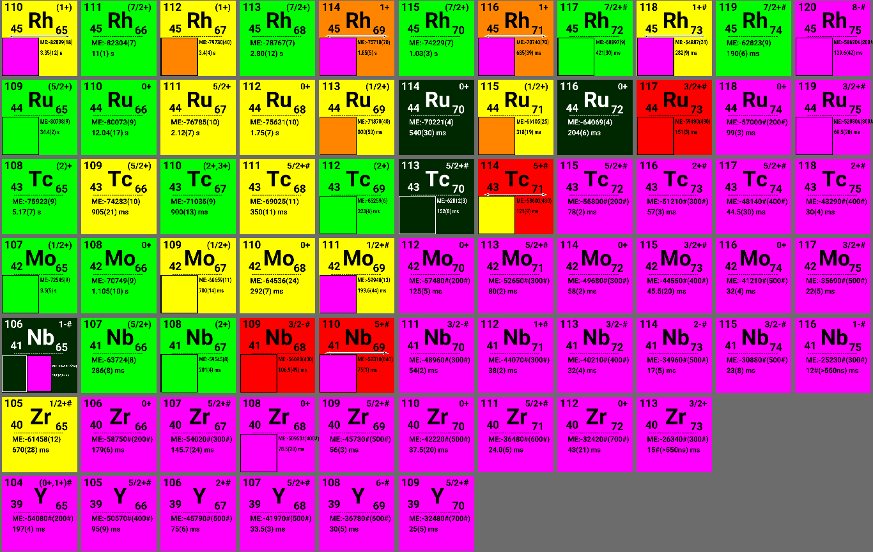
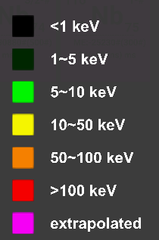
REGION OF N-RICH Y-Rh
Binding energy differences axial-triaxial
Region of triaxiality → BSKG predictions
Poorly known in terms of masses
From Y to Rh: refractory elements → non accessible at standard isol facilities
Many isomers → only ToF-ICR measurements
Some nuclei not produced by fission (low-spin states)
G. Scamps et al., EPJ A 48, 46 (2021)
Pauline Ascher – RESANET Meeting – 3-7 November 2025

Slide 9
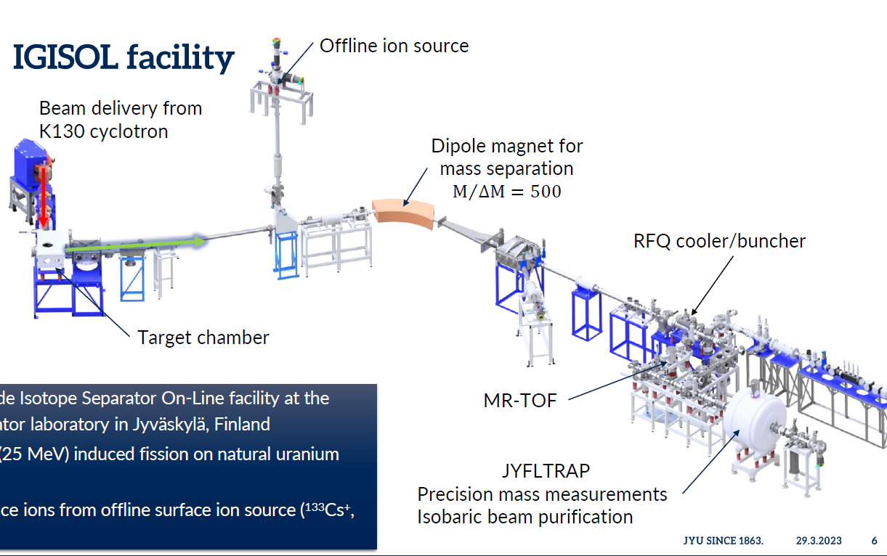
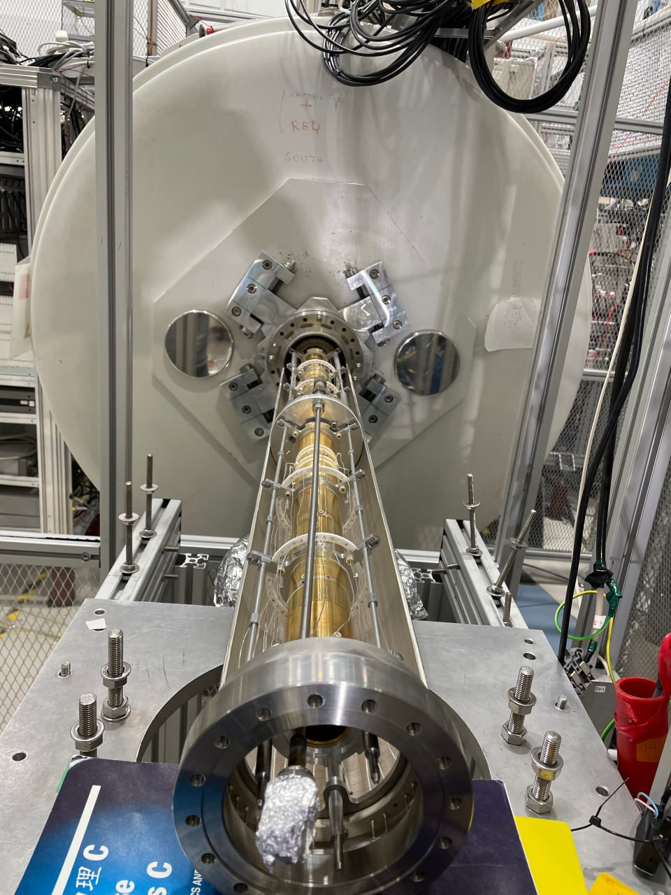
IGISOL FACILITY – JYFL ACCELERATOR LABORATORY
JYFLTRAP
Pauline Ascher – RESANET Meeting – 3-7 November 2025

Slide 10
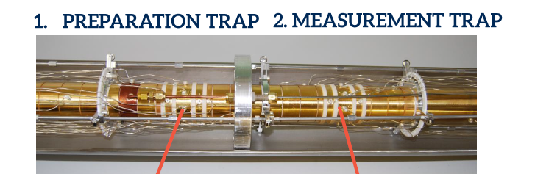
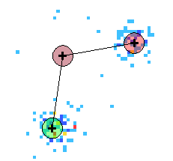
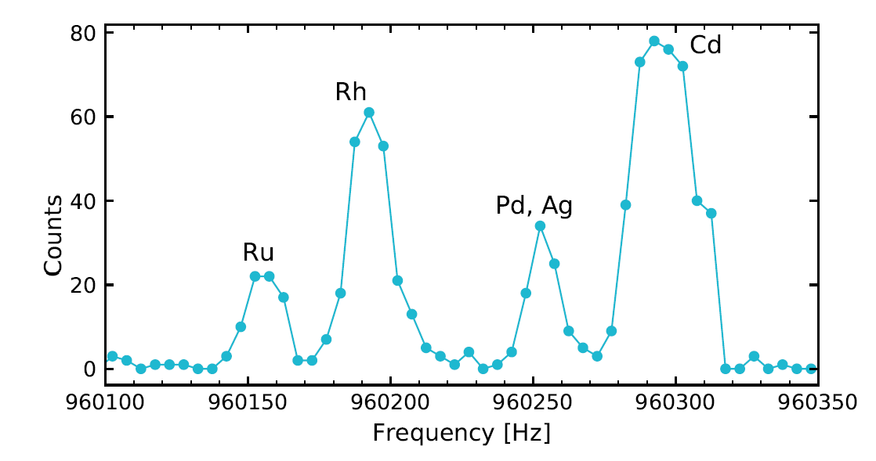
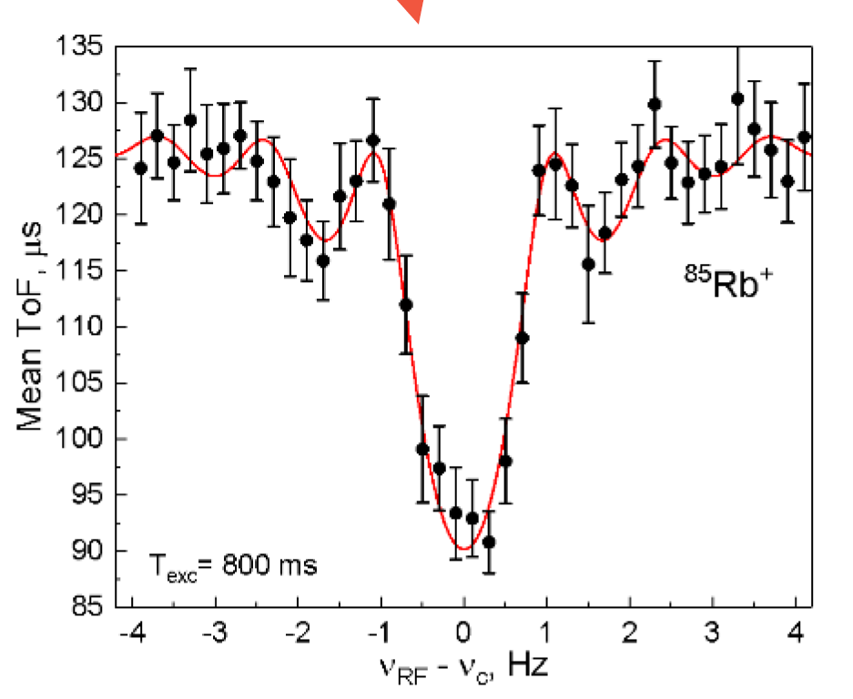
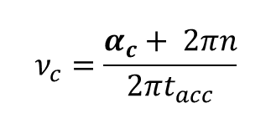

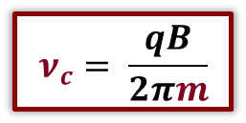
JYFLTRAP DOUBLE PENNING TRAP
PURIFICATION TRAP
MEASUREMENT TRAP
Position-sensitive MCP
Mass-selective buffer-gas cooling
ToF-ICR
(Time-of-Flight Ion–Cyclotron-Resonance)
PI-ICR
(Phase-Imaging Ion–Cyclotron-Resonance)
A = 112
y_{d}
reduced cyclotron
center
MCP counts
$$α_{c}$$
x_{d}
magnetron
$$ν_{c}=\frac{α_{c}+ 2πn}{2πt_{acc}}$$
Recentering frequency (Hz)
$$ν_{c}= \frac{qB}{2πm}$$
B measured via ν_{c} of a well-known mass
Pauline Ascher – RESANET Meeting – 3-7 November 2025

Slide 11
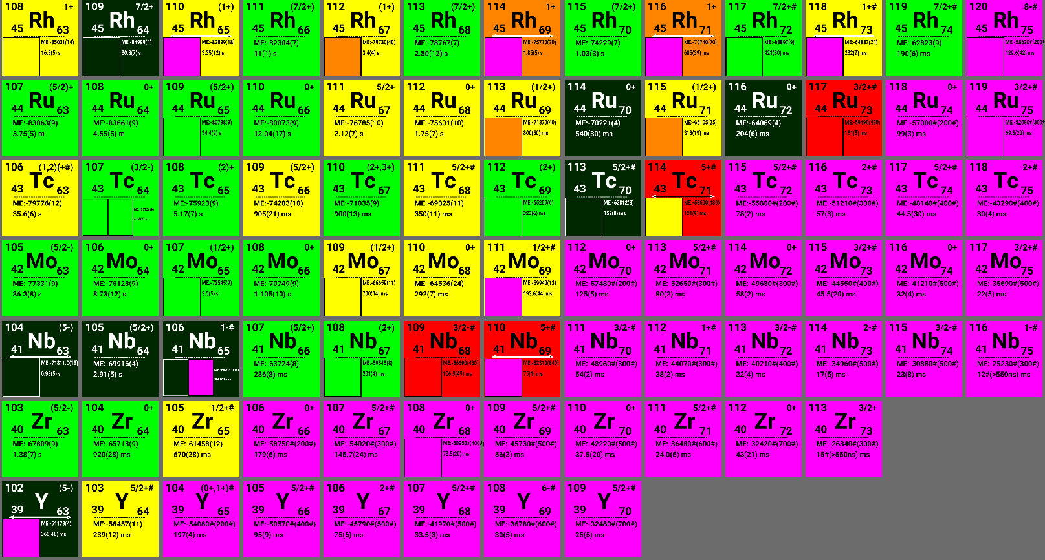
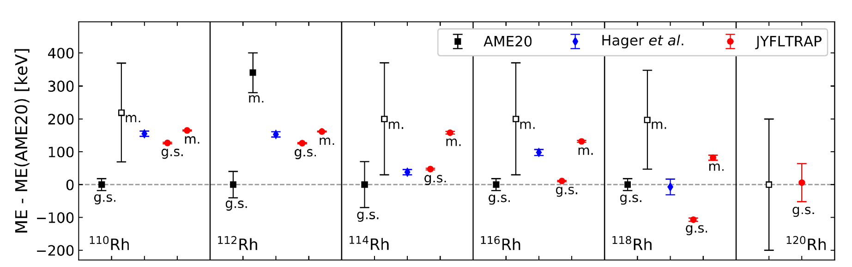
MASS MEASUREMENTS AT JYFLTRAP
15 ground-state masses and 8 isomeric states were measured (two one-week beam times)
Masses of ^{113,113m}Ru, ^{115,115m}Ru, ^{110,110m}Rh, ^{112,112m}Rh, ^{114,114m}Rh, ^{116,116m}Rh, ^{118,118m}Rh, ¹⁰⁴Y, ¹⁰⁶Zr, ^{104,104m}Nb,, ¹¹¹Mo measured with PI-ICR
→ Isomer excitation energies
Accurate ground-state masses (previous ToF-ICR measurements from Hager et al.: mixture of states)
Masses of ¹¹⁷Ru, ¹²⁰Rh, ¹⁰⁹Nb, ¹¹²Mo measured with ToF-ICR
JYFLTRAP ToF-ICR 2007
M. Hukkanen et al., PRC 107, 014306 (2023)
Pauline Ascher – RESANET Meeting – 3-7 November 2025

Slide 12
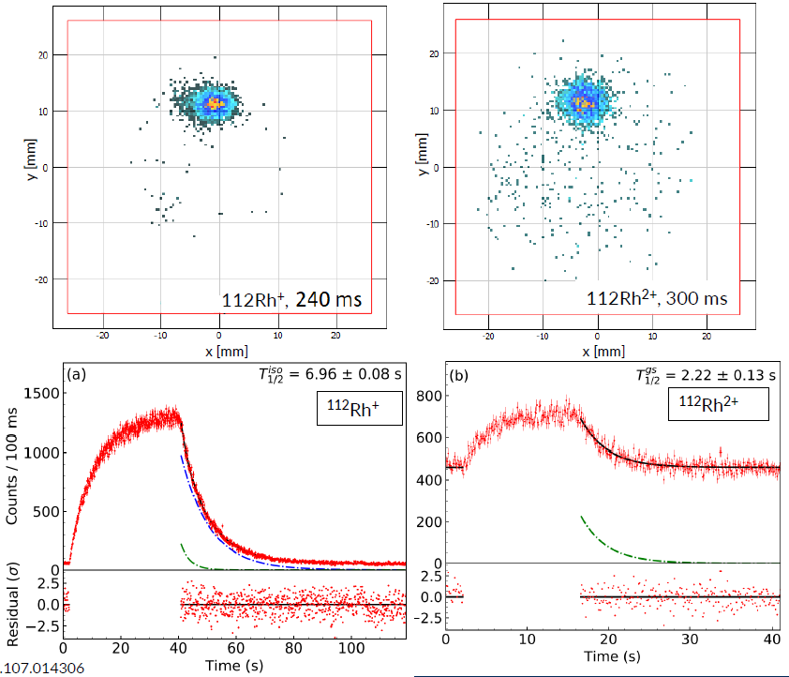
IN-TRAP DECAY – ASSISTED PTMS
Let the ions beta-decaying in the first trap (waiting time)
Capture the daughter ions (2+ charge state)
Send to MT for PI-ICR measurement (factor of 2 in precision due to charge state)
→ Allow to produce states or elements not produced
THE CASE OF ¹¹²Rh
Proton-induced fission at 25 MeV mainly produces the isomeric state
Ground state was produced by in-trap decay of ¹¹²Ru
Half-life measurements of both states with a Si detector downstream
→ assignment of states
Also a few low-spin states events in fission (30 keV excitation energy
In-trap decay assisted PTMS also used for ^{104, 104m}Nb (in-trap decay of ¹⁰⁴Zr) → 10 keV excitation energy !
Pauline Ascher – RESANET Meeting – 3-7 November 2025

Slide 13
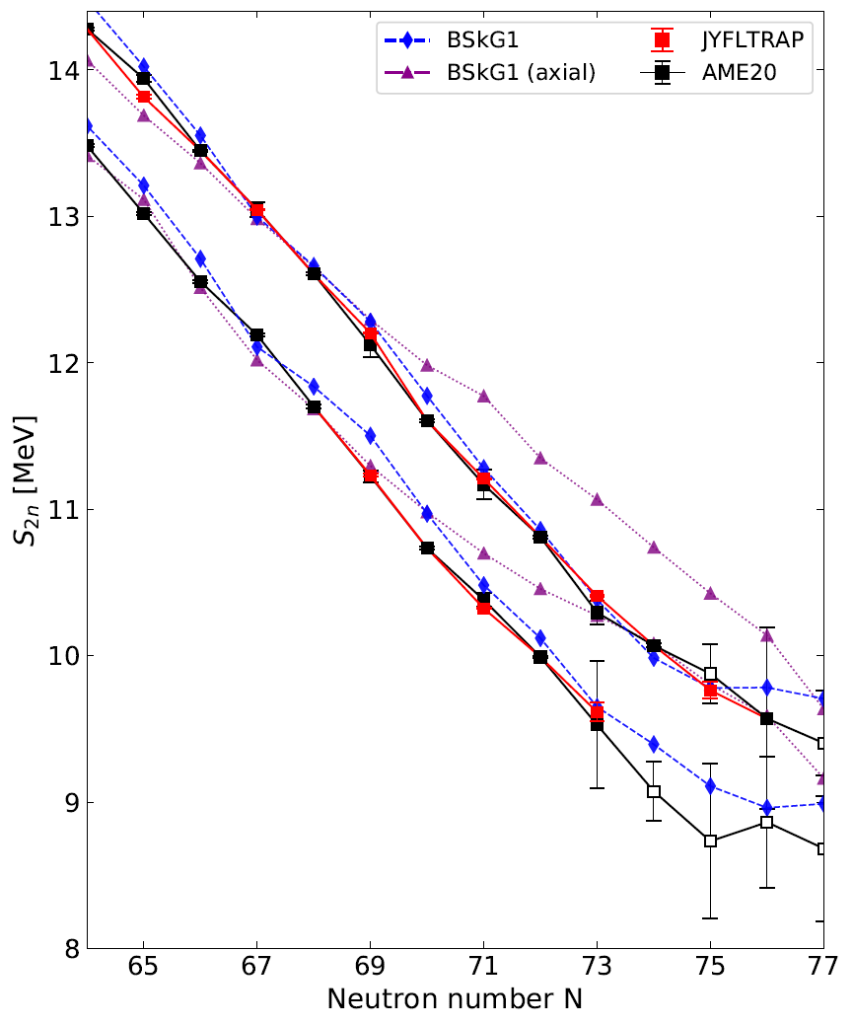
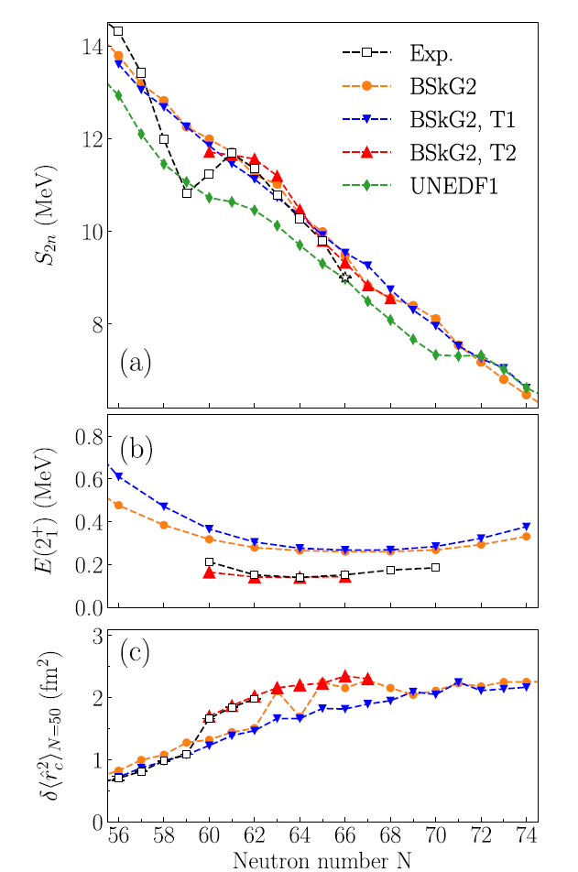
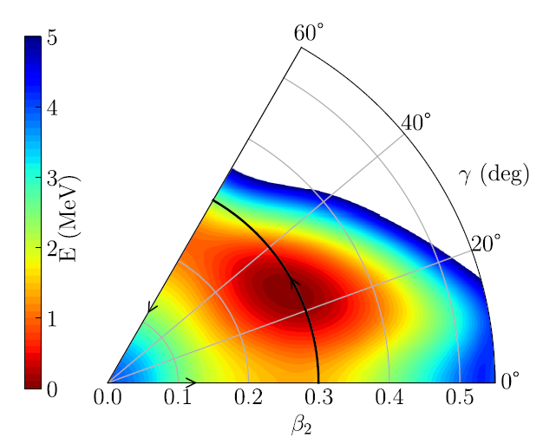
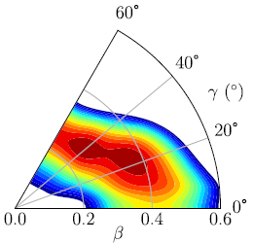
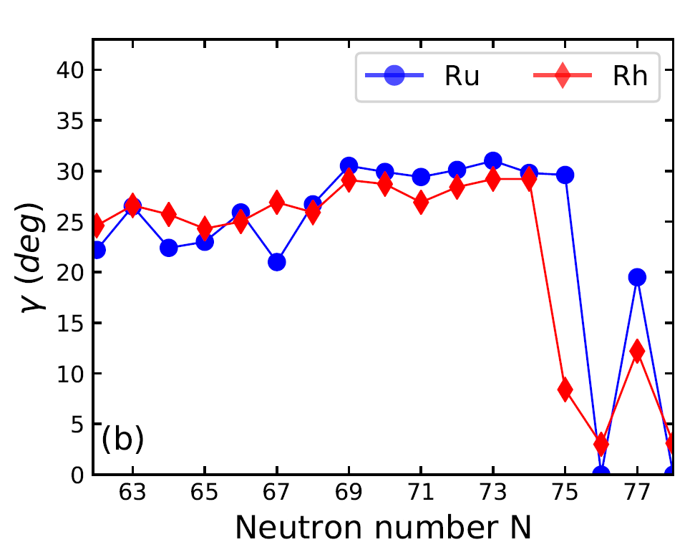
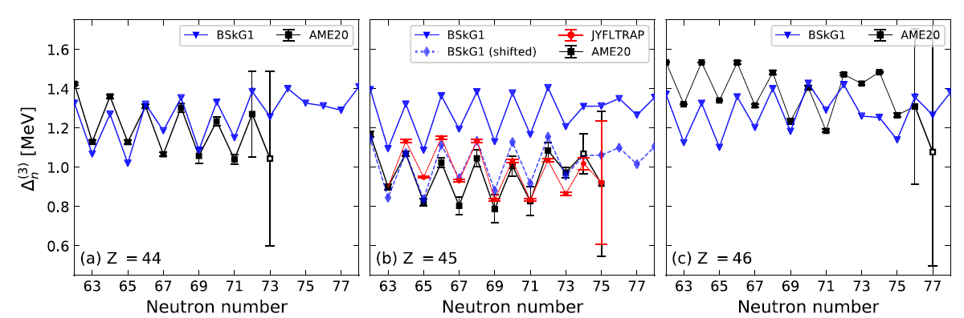
COMPARISON WITH BSKG CALCULATIONS
Rh
Zr
Collaboration with W. Ryssens (ULB) and M. Bender (IP2I)
→BSKG1: non-axial shapes (axial symmetry breaking) and odd-odd calculations
Comparisons experimental results with calculations
Importance of triaxiality in Rh et Ru
Tentative interpretation of isomers
Tentative reproduction of Zr isotopic chain
Δ_{3n}: defficiency to reproduce odd-odd masses
→ W. Ryssens et al, J. Phys.: Conf. Ser. 2586 012097 (2023)
…
¹¹²Rh
Ru
¹⁰⁶Zr
M. Hukkanen et al., PRC 107, 014306 (2023)
M. Hukkanen et al., PRC 108, 064315 (2023)
M. Hukkanen et al., PLB 856, 138916 (2024)
Pauline Ascher – RESANET Meeting – 3-7 November 2025

Slide 14
RECENT « FRENCH » HIGHLIGHTS
JYFLTRAP @IGISOL
(P. Ascher, S. Grévy, M. Gerbaux)
ISOLTRAP @ISOLDE/CERN
(D. Lunney, S. Naimi, M. Benhatchi, V. Manea)
¹⁰³Sn, ⁹⁹⁻¹⁰¹In,^{97,98}Cd
L. Nies et al., PRC 111, 014315 (2025)
L. Nies et al., PRL 131, 022502 (2023)
M. Benhatchi, in preparation
Y-Rh region
M. Hukkanen et al., PRC 107, 014306 (2023)
M. Hukkanen et al., PRC 108, 064315 (2023)
M. Hukkanen et al., PLB 856, 138916 (2024)
TITAN @TRIUMF
(D. Lunney)
⁹⁶⁻⁹⁸Kr
D. Lunney et al., PRC 112, 034307 (2025)
^{79m}Zn
L. Nies et al., PRL 131, 222503 (2023)
⁶⁸⁻⁷⁰Co
M. Flayol et al., in preparation
+ Collaborations with theoreticians from CEA (T. Duguet, J.-P. Ebran, …)
IPHC (F. Nowacki, K. Sieja, D.D. Dao)
IP2I (M. Bender)
⁴⁹Ar
M. Benhatchi, in preparation
³¹⁻³³Na, ³¹⁻³⁵Mg
E. M. Lkiardopoulou et al., PRL 134, 052503 (2025)
Pauline Ascher – RESANET Meeting – 3-7 November 2025

Slide 15
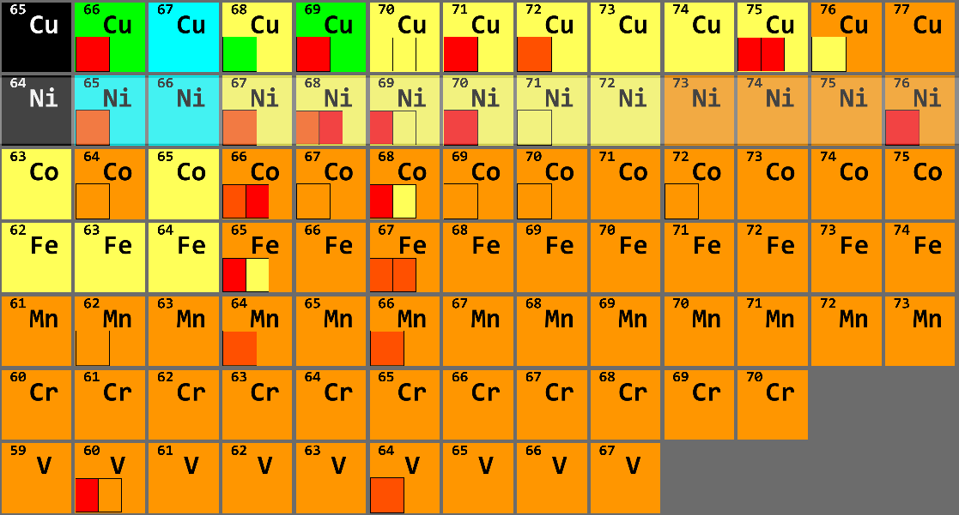
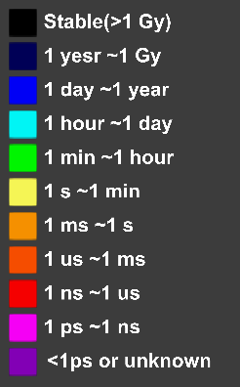
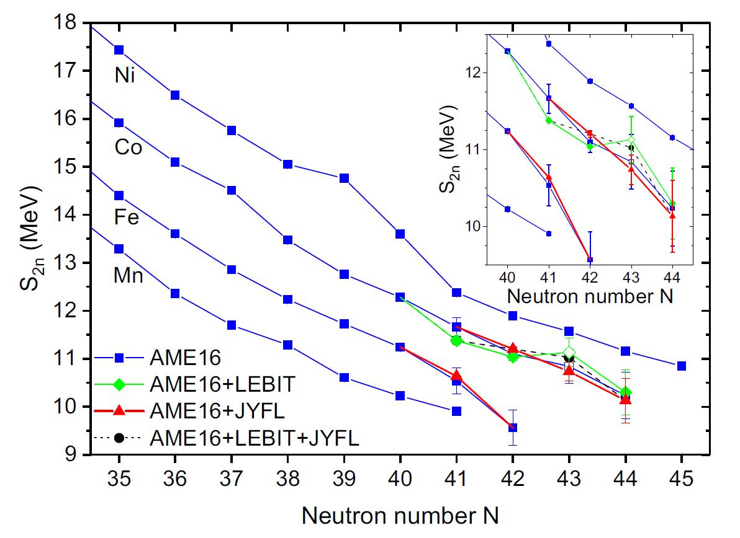
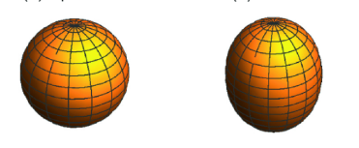
N=40 REGION
N=40
Previous PT measurements
2018 LEBIT → ^{68,69}Co
Izzo et al., PRC97 014309 (2018)
2020 JYFL → ^{69,69m, 70}Co
Canete et al., PRC 101 041304 (2020)
Lead to different trends
Isomer in ^{68,70}Co measured ? Gs masses of ^{68,70}Co unknown ?
Z=28
f_{7/2}
g_{9/2}
50
g_{9/2}
40
p_{1/2}
f_{5/2}
p_{3/2}
ν
28
f_{7/2}
« normal configuration »
« intruder configuration »
L. Canete et al, PRC 101, 041304(R) (2020)
π
Pauline Ascher – RESANET Meeting – 3-7 November 2025

Slide 16
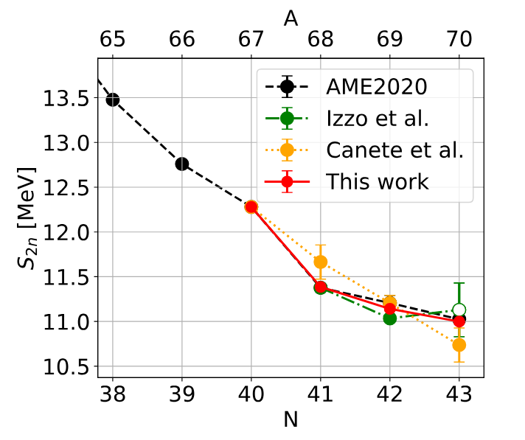
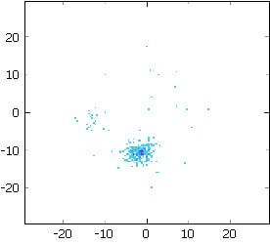
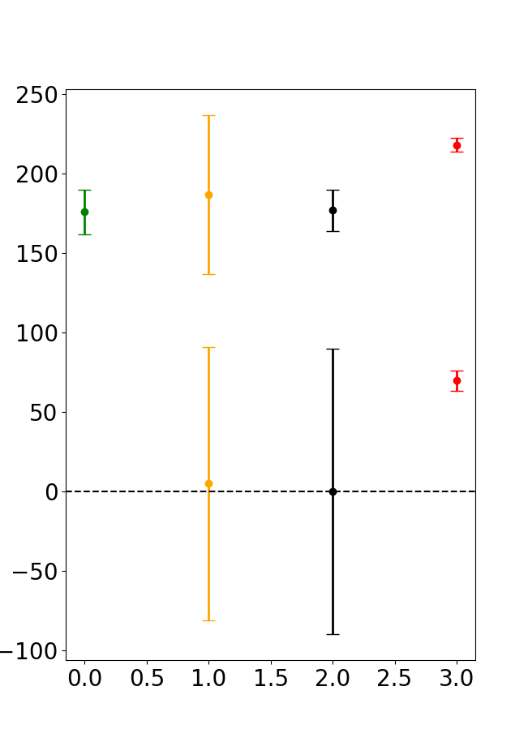
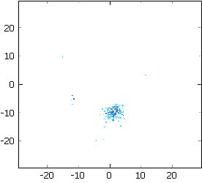




RESULTS: MASSES and STATE ASSIGNMENT
⁶⁸Co⁺
⁶⁹Co
AME2020
m
^{m}
m
m
Y$(mm)$
^{g.s.}
T_{acc} = 113 ms
^{ME - ME(AME20) (keV)}
g.s.
⁷⁰Co⁺
$$X(mm)$$
g.s.
g.s.
Y$(mm)$
^{m}
^{g.s.}
T_{acc} = 35 ms
LEBIT
JYFL 2020
AME
This work
$$X(mm)$$
PI-ICR allows individual state counting !
(→ half-life assignments)
Isomeric and ground states in ^{68,69,70}Co separated and BE individually measured
Clarified S_{2N} trend
Isomers exc. energy in ^{68,70}Co measured for the first time
State assignment with PI-ICR counting
(7-)
113(7) ms
(2-)
1.6(3) s
E* = 79.5(2) keV
E* = 268.4(50) keV
(7-)
200(20) ms
(1+)
508(7) ms
⁶⁸Co
⁷⁰Co
Pauline Ascher – RESANET Meeting – 3-7 November 2025

Slide 17

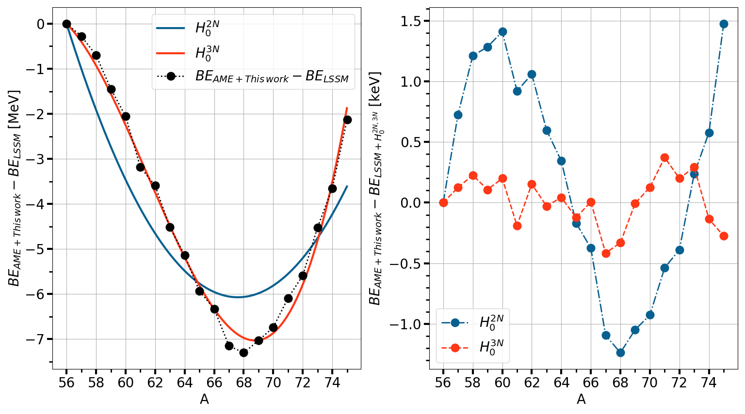
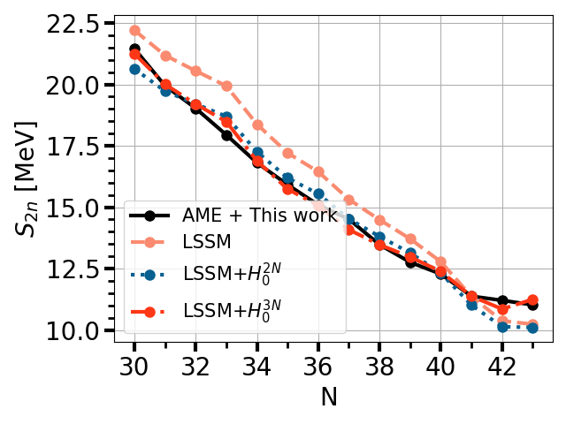
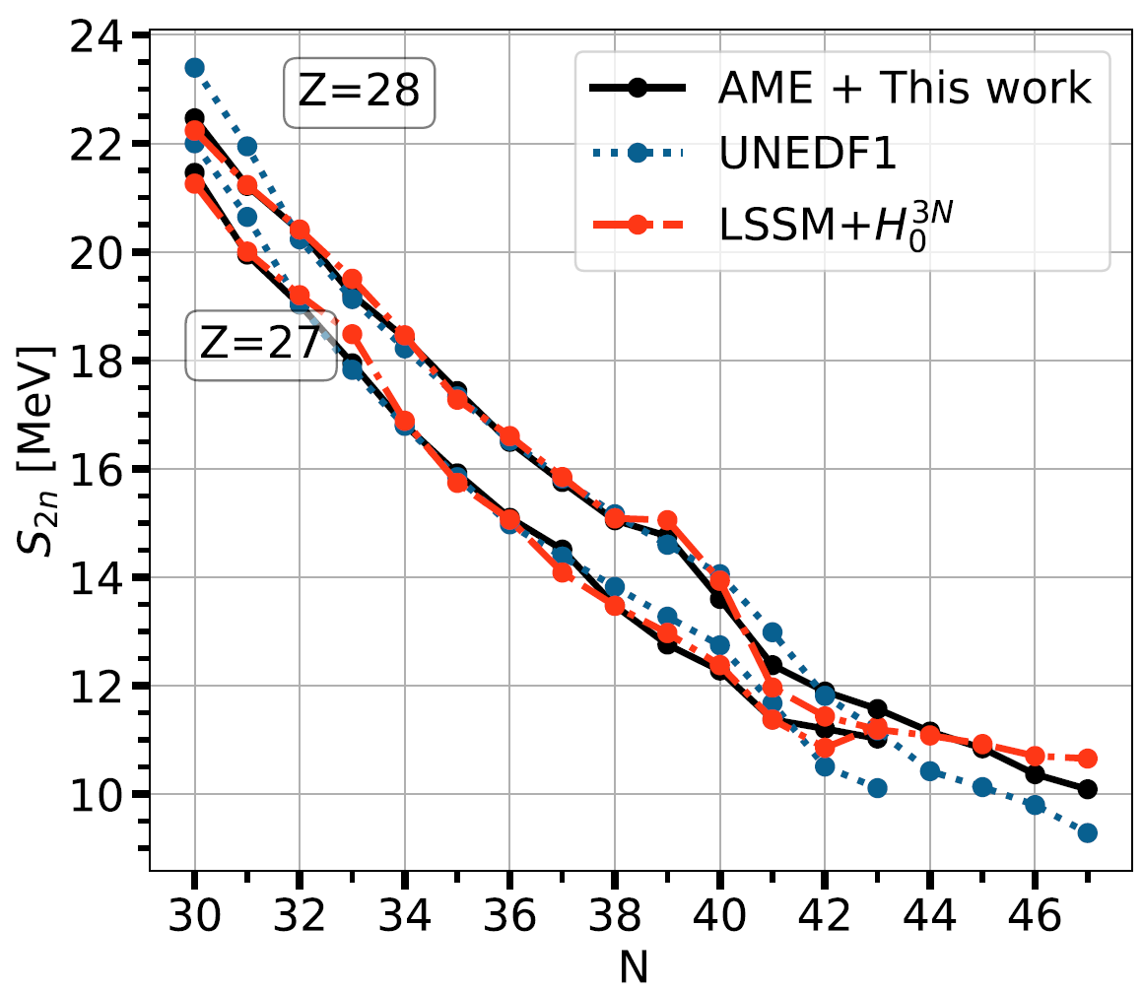
LARGE-SCALE SHELL-MODEL CALCULATIONS
F. Nowacki and D. D. Dao
LNPS Interaction, PRC 82 054301 (2010)
Phenomenological correction on master term of Duflo/Zucker mass formula Duflo, Zucker, PRC 52, R23 (1995)
→ Using only a 2-body term H^{2N} or a 3-body term H^{3N}
Final rms of 170 keV with 3-body term
Final rms of 513 keV with only 2-body term
Nickel isotopes
Final rms of 207 keV with 3-body term
Final rms of 893keV with only 2-body term
Work in progress, aim is to fit Ni, Co, Fe together
Pauline Ascher – RESANET Meeting – 3-7 November 2025

Slide 18
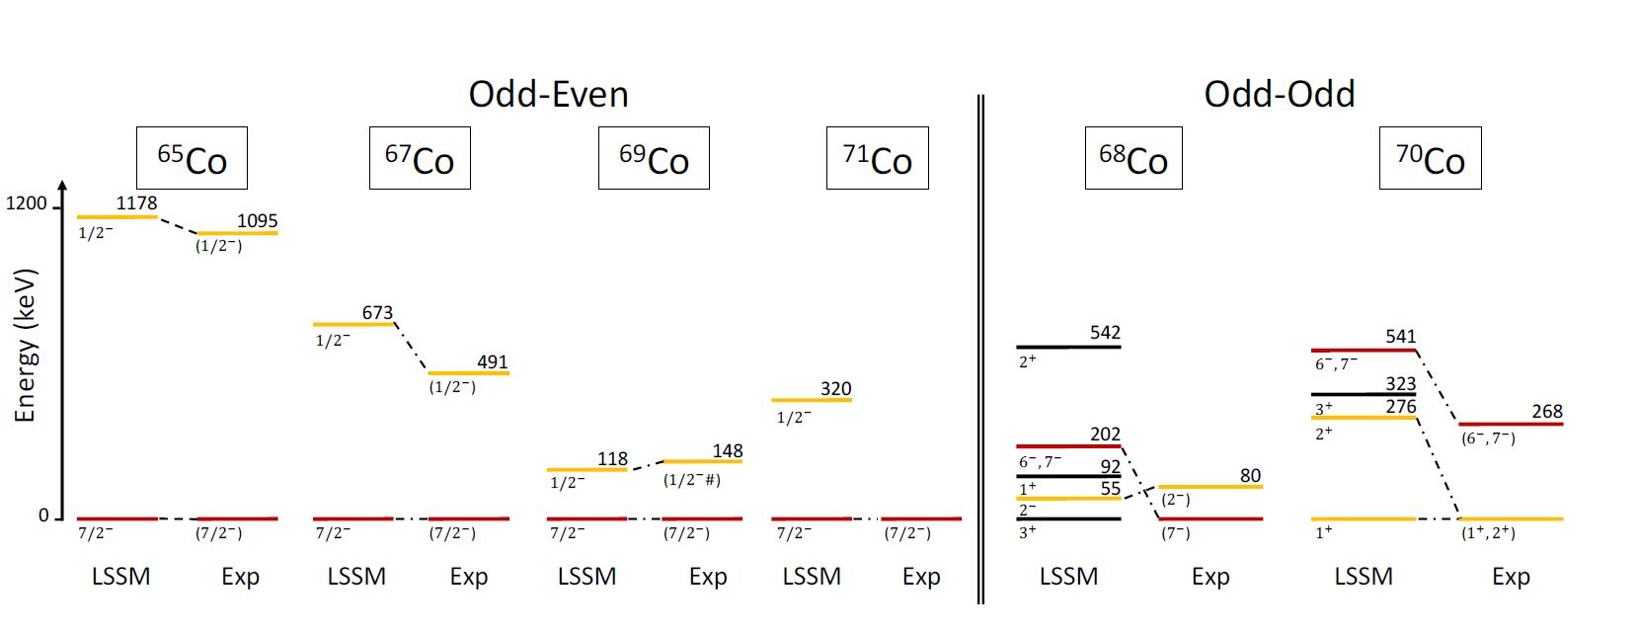
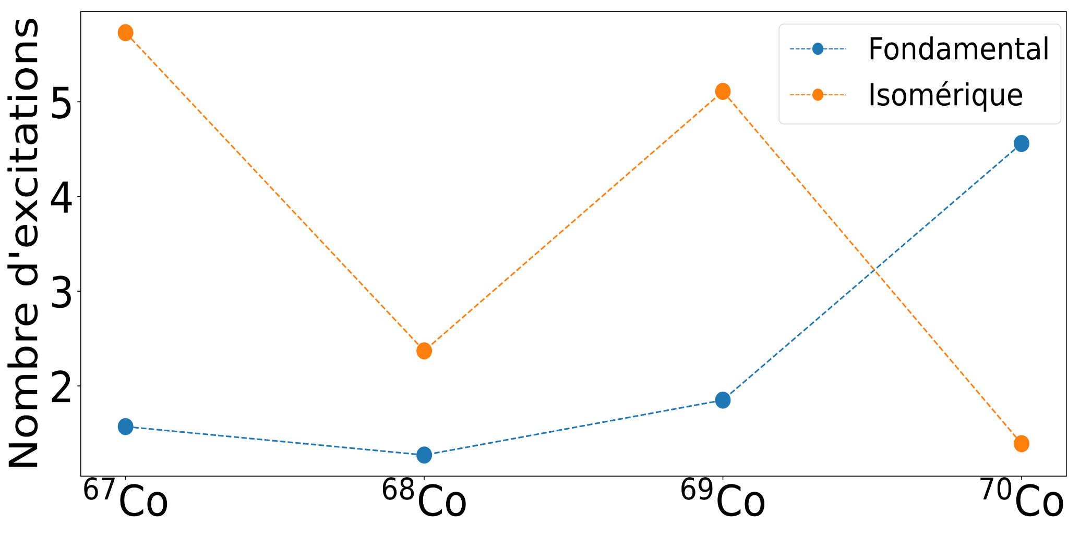
LSSM CALCULATIONS
F. Nowacki, D. D. Dao
LNPS interaction
Ground state
Isomeric state
Overall good agreement between experiment and theory
Inversion of intruder and « normal » configuration from N=43 and ½- state is predicted to increase again for ⁷¹Co
Northern border of IOI: transitional regime between Ni and Fe
Number of ph excitations
Pauline Ascher – RESANET Meeting – 3-7 November 2025

Slide 19
MASS MEASUREMENTS:
RECENT ACHIEVEMENTS AND PERSPECTIVES
Context of mass spectrometry
Recent highlights
Neutron-rich isotopes in the Zr-Rh region
Neutron-rich Co isotopes in the region of N=40
Future
PIPERADE developments
Perspectives of mass measurements
Pauline Ascher – RESANET Meeting – 3-7 November 2025

Slide 20
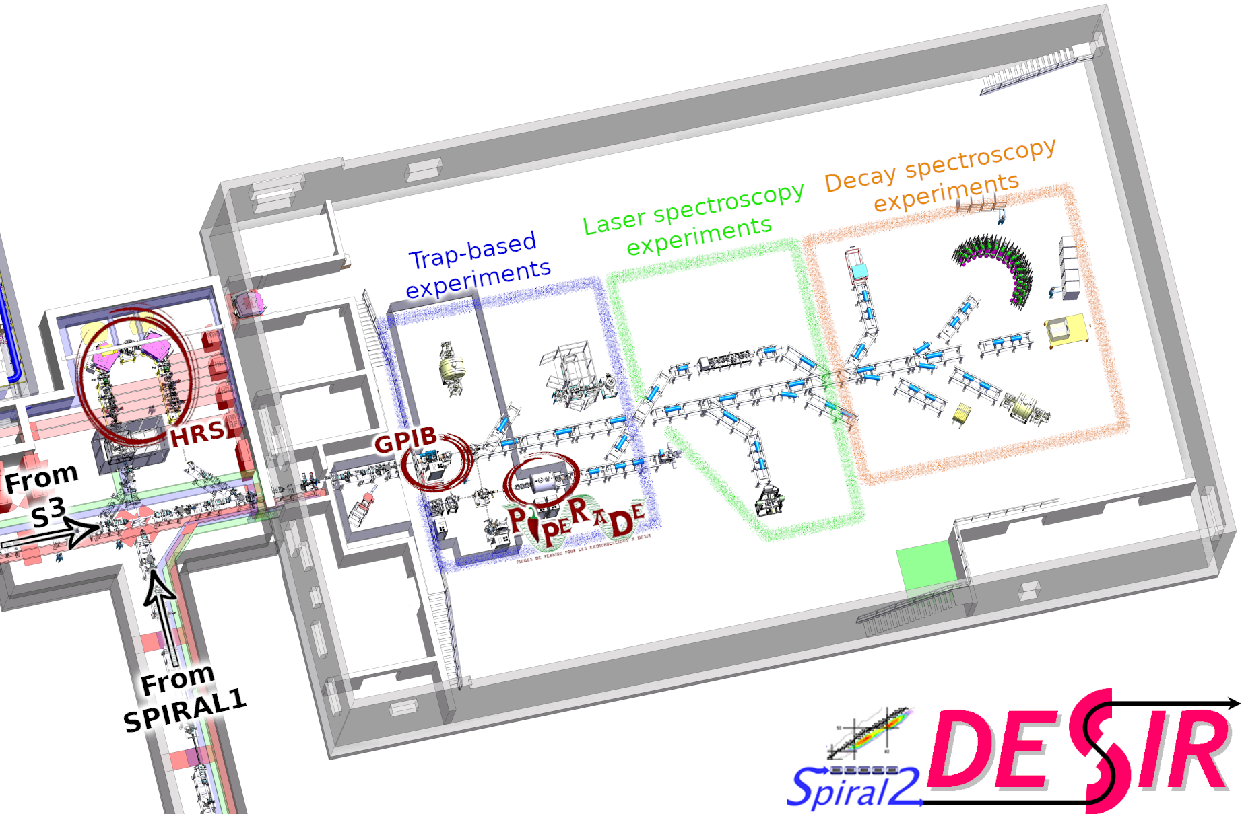
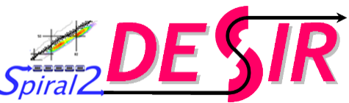
PIPERADE @DESIR and @LP2iB
PIPERADE for mass spectrometry but also for mass purification
→ Only PT installed at the entrance of a low-energy facility
time
M/ΔM
rapidity
selectivity
few 10 µs
HRS
MR-ToF MS
Penning Trap
~2.10⁴
~10-20 ms
few 10⁵
100 ms – 1 s
10⁵ - 10⁷
MR-ToF
Pauline Ascher – RESANET Meeting – 3-7 November 2025

Slide 21
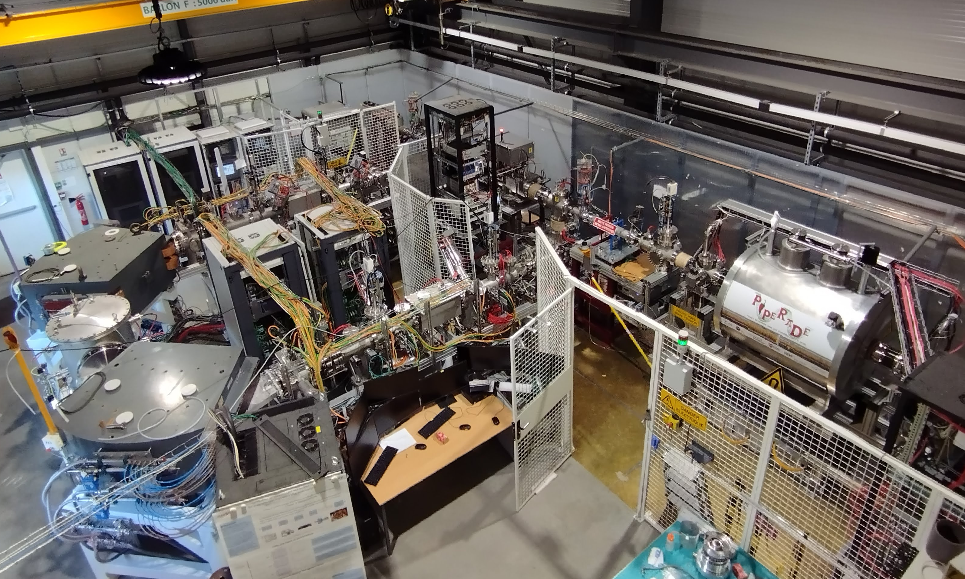
PIPERADE @DESIR and @LP2iB
GPIB
PIPERADE
HRS
DESIR building delivered a few days ago !
→ Transfer HRS/GPIB/PIPERADE in about 1 year
Pauline Ascher – RESANET Meeting – 3-7 November 2025

Slide 22
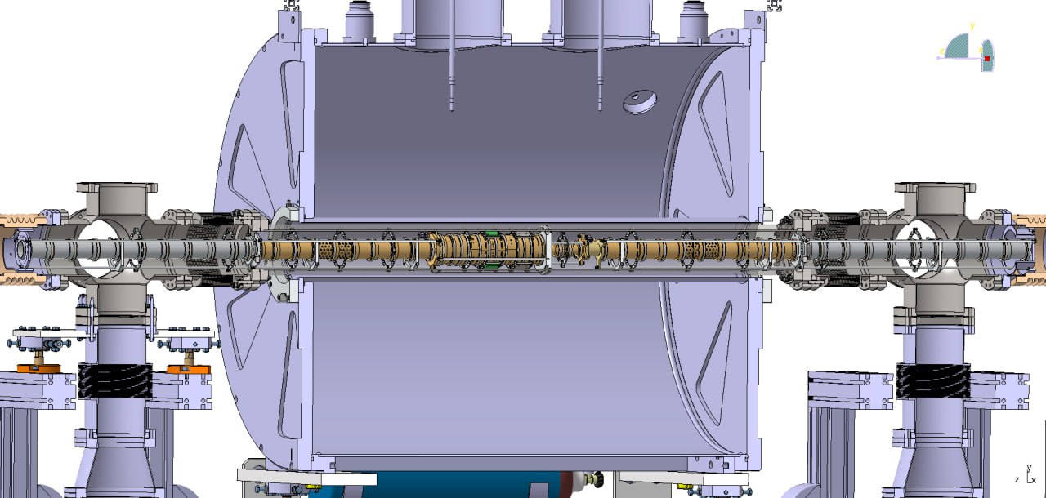
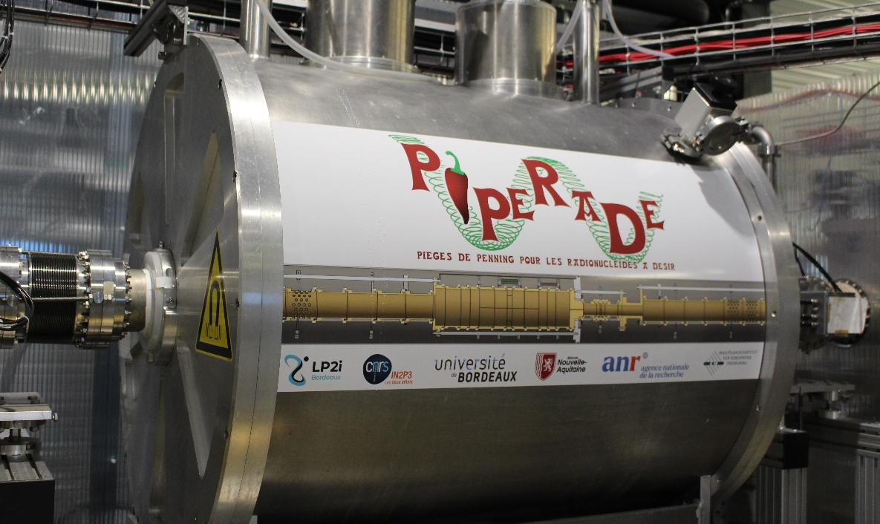
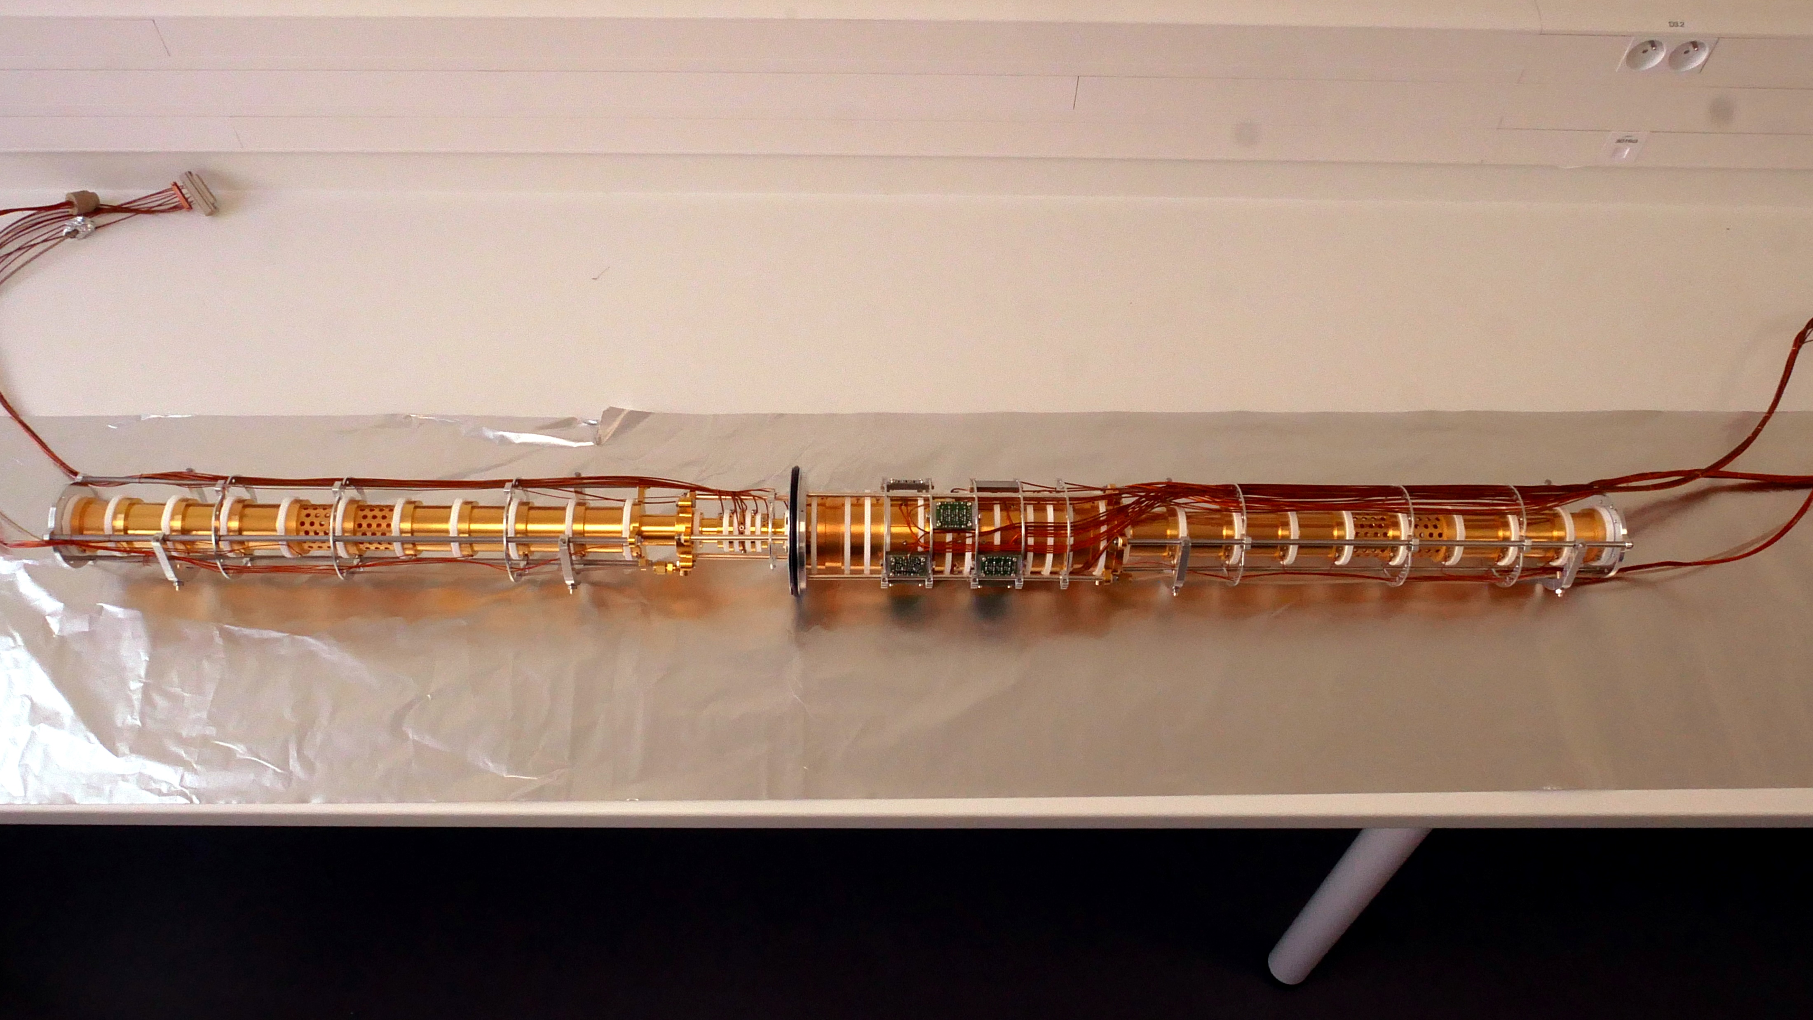

PIPERADE
Designed and machined at MPIK Heidelberg
Diaphragm
From
GPIB
MCP
Counting
ToF
Position
Injection optics
Purification trap
Measurement trap
Extraction optics
P. Ascher et al., NIM A 1019, 165857 (2021)
Pauline Ascher – RESANET Meeting – 3-7 November 2025

Slide 23
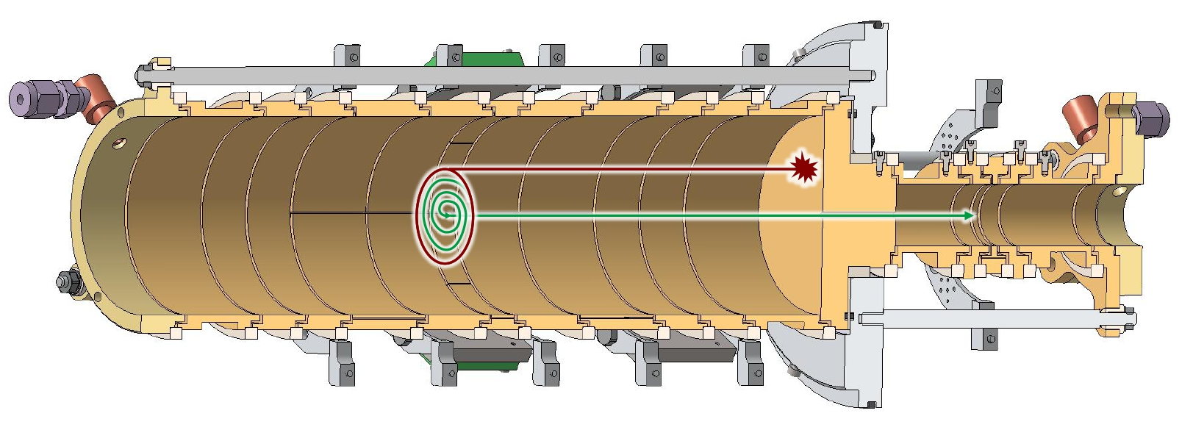




PIPERADE double Penning trap
Measurement Trap (MT)
Purification Trap (PT)
$$39K^{+}$$
Helium buffer-gas cooling
Separate ions of interest from the contaminants
→ Resolving power R$=\frac{ν_{c}}{Δν_{c}}= \frac{m}{Δm}≈2.{10}^{5}$
ν_{rf} – 2745648 (Hz)
Pauline Ascher – RESANET Meeting – 3-7 November 2025

Slide 24


PIPERADE double Penning trap
Measurement Trap
Measurement Trap (MT)
Purification Trap (PT)
High-precision mass measurements
→ Determine $ν_{c}= \frac{qB}{2πm}$
Time-of-Flight Ion-Cyclotron-Resonance (ToF-ICR)
Phase-Imaging Ion-Cyclotron-Resonance (PI-ICR)
High-resolution separation
(phase-dependent cleaning, dipole cleaning)
Ion stacking
Helium buffer-gas cooling
Separate ions of interest from the contaminants
Pauline Ascher – RESANET Meeting – 3-7 November 2025

Slide 25

TOF-ICR MEASUREMENTS
Results in agreement with AME and reproducible
Relative mass precision ~ 2.10⁻⁹
Studies of field imperfections (E-field anharmonicities, B-field inhomogeneities/fluctuations, ….)
Pauline Ascher – RESANET Meeting – 3-7 November 2025

Slide 26





PI-ICR at PIPERADE
initial conditions
magnetron damping
ν₊ excitation & conversion
angle measurement
α_{c}
t_{acc} = 100 ms
$$ν_{c}=\frac{α_{c}+ 2πn}{2πt_{acc}}$$
Pauline Ascher – RESANET Meeting – 3-7 November 2025

Slide 27


PI-ICR MEASUREMENTS
${}_{}^{41}K$ vs ${}_{}^{39}K$ with 100 ms of accumulation time
07/08/2025
Mass excess – AME [keV]
Time
Relative mass precision ~ 2.10⁻⁹, but systematics still to investigate, deviations of a few 10⁻⁹
Studies of field imperfections ongoing
Impact of the image distortion on the relative mass precision
Issues with long accumulation times…. in progress
Iris diaphragm for phase-dependent cleaning
(trap-assisted spectro)
Pauline Ascher – RESANET Meeting – 3-7 November 2025

Slide 28

PERSPECTIVES FOR MS
data from AME2020
Pauline Ascher – RESANET Meeting – 3-7 November 2025

Slide 29

PERSPECTIVES FOR MS AT GANIL
data from AME2020
Pauline Ascher – RESANET Meeting – 3-7 November 2025

Slide 30
PERSPECTIVES FOR MS AT GANIL (AND ALTO)
SHN
SP1 fragmentation: few interesting cases (Cl, P, O, F, …)
SP1 TULIP: region around ¹⁰⁰Sn
(beam tests Spring 2026) and ⁷⁴Rb
S3-LEB: refractory Zr-Rh, ¹⁰⁰Sn region, heavier n-deficient nuclei and SHN
(Fission fragments would be great…)
p-drip line
p-emitters
cluster radioactivity
shell evolution
rp-process
n-rich Ag at ALTO (day-one)
Wigner energy
ft-values
IMME
shell evolution
+ trap-assisted spectroscopy
Ideas welcome !
CALL FOR LOI@DESIR
WS MARCH 16-20 AT GANIL
N=16, 20, 28, 32
Pauline Ascher – RESANET Meeting – 3-7 November 2025

Slide 31






JYFL
T. Eronen, Z. Ge, M. Hukkanen, A. Jaries, A. Kankainen, I. D. Moore, M. Mougeot, M. Stryjczyk, J. Ruotsalainen, V. Virtanen
Mathieu Flayol
THEORY
D. D. Dao and F. Nowacki (IPHC)
M. Bender (IP2I) and W. Ryssens (ULB)
LP2iB PIPERADE / GPIB / DESIR
P. Alfaurt, P. Ascher, D. Atanasov, B. Blank, L. Daudin, M. Flayol, M. Gerbaux, S. Grévy, G. Guignard, M. Hukkanen, A. Husson, B. Lachacinski, S. Lechner, E. Rey-herme, M. Roche, A. de Roubin, C. Roumegou
Marjut Hukkanen
THANK YOU FOR YOUR ATTENTION !
Pauline Ascher – RESANET Meeting – 3-7 November 2025

Slide 32



B-field linear drift
Linear drift is compensated by a superconducting shield coil (down to 5.10⁻⁸/hour)
→ warm active coil (about +30 nA/sec)
First measurements via NMR probe
Warm compensating coil reduces the field drift by two orders of magnitude allowing longer measurements
without warm coil
Compensation limited to 20 days
Δ𝜈_{c} ~ 38 Hz
with warm coil
T₀+ 20 days
T₀
DETRAP Workshop 2025 – Pauline Ascher LP2iB

Slide 33



B-field fluctuations
There are also non-linear fluctuations due to environmental instabilities
𝛥T = 28
𝛥T = 56
³⁹K
Time / min
3.1e-11 min⁻¹ → Already OK for many cases
To be done again with new data and later with PI-ICR
T & p stabilization at DESIR will improve a lot the situation
M. Flayol, PhD Thesis (2024)
DETRAP Workshop 2025 – Pauline Ascher LP2iB
Notes:
Shiptrap 2e-10/min sans stab et avec stab 1e-12/min
Jyfltrap 2e-12/min sans stab

Slide 34





E-field anharmonicities
Two correction electrodes to tune the trap harmonicity
E-Field anharmonicities lead to frequency shifts
These shifts depend on the motion amplitudes
ME1
MR
ME2
MC1
MC2
OV
OV
-8OV
Trap closure time (µs)
($\sim$ axial motion amplitude R_{z})
DETRAP Workshop 2025 – Pauline Ascher LP2iB

Slide 35



Interface for PIPERADE Analysis (IPA)
Software dedicated to ToF-ICR and PI-ICR fitting and mass determination
E. Rey-herme & G. Guignard
DETRAP Workshop 2025 – Pauline Ascher LP2iB

Slide 36


Python Trap Scanner for DESIR (PTSD)
Scan all EPICS variables
Control trapping sequence
Signal acquisition
Position reconstruction
Data gating and fitting
End goal : Adaptable to any DESIR detector type
D. Atanasov, M. Flayol, G. Guignard, E. Rey-herme, C. Roumegou
DETRAP Workshop 2025 – Pauline Ascher LP2iB

Slide 37













Mass measurement techniques
ToF-ICR
PI-ICR
$$υ_{c}$$
Center
$φ_{c}={2ν}_{C}πt_{acc}$- $2π$n
$$Φ_{c}$$
Reduced cyclotron
Magnetron
$$ν_{c}= \frac{qB}{2πm}$$
$$m_{{}_{}^{41}K}=\frac{ν_{c}({}_{}^{39}{K^{+}})}{ν_{c}({}_{}^{41}{K^{+}} )}\left(m_{{}_{}^{39}K}−m_{e}\right)+m_{e}$$
$${}_{}^{39}{K^{+}}$$
$${}_{}^{41}{K^{+}}$$
$${}_{}^{39}{K^{+}}$$
M. Flayol, PhD Thesis (2024)
Notes:
-> ToF-ICR : see a resonance around nu_c (value in the center) -> find m with this equation -> with multiple ToF-ICR measurement -> mass plot (longer excitation time give smaller error bar) -> we routinely use it
-> PI-ICR: this method use position of 3 spot : center {reduced cyclotron and magnetron} which constitute the cyclotron motion in the traps -> extract the angle between the two -> obtain nu_c with this equation -> same as ToF-ICR after that multiple Pi-ICR -> mass plot -> need more development for the moment
-> both need systematics studies -> I will add a little more explanation on the ToF-ICR analysis

Slide 38








SIMULATIONS EXTRACTION PI-ICR
Position on the detector
Ideal magnetron star template
Optimized extraction
K. Ronxin, M1 Internship (2025)
Pauline Ascher – RESANET Meeting – 3-7 November 2025

Slide 39



Slide 40

⁶⁹Co MASS EXCESS
⁶⁹Co
m
m
m
^{ME - ME(AME20) (keV)}
g.s.
g.s.
g.s.
E* = 148.3(76) keV
Precision on E* improved by a factor >10
Izzo et al.
2018
Canete et al.
2020
AME2020
This work
Pauline Ascher – RESANET Meeting – 3-7 November 2025

Slide 41


⁶⁸Co AND ⁷⁰Co MASS EXCESSES
m
^{ME - ME(AME20) (keV)}
m
m
m
g.s.
g.s.
g.s.
g.s.
→ CLARIFIED SCENARIO !
Izzo et al.
AME2020
This work
Canete et al.
AME2020
This work
Pauline Ascher – RESANET Meeting – 3-7 November 2025

Slide 42






PI-ICR MASS MEASUREMENT
y_{d}
$$\frac{δB}{Bδt}=2,01\left(25\right).{10}^{−12}min^{−1}$$
reduced cyclotron
$$ν_{c}=\frac{α_{c}+ 2πn}{2πt_{acc}}$$
$$=\frac{qB}{2πm}$$
center
$$α_{c}$$
x_{d}
$$m_{ioi}=\frac{ν_{c}(ref)}{ν_{c}(ioi )}\left(m_{ref}−m_{e}\right)+m_{e}$$
magnétron
Reference
Reference
Reference
Reference
Ion of Interest
Ion of Interest
Ion of Interest
0
Time
1h
Precision for mos of the cases in this work → $\frac{δm}{m}∼$ few 10⁻⁸
Pauline Ascher – RESANET Meeting – 3-7 November 2025

Slide 43

⁶⁸Co AND ⁷⁰Co STATE ASSIGNMENT
(7-)
113(7) ms
PI-ICR allows individual state counting !
E* = 268.4(50) keV
(1+)
508(7) ms
⁷⁰Co
→ long-lived low-spin state corresponds to the ground state
(2-)
1.6(3) s
E* = 79.5(2) keV
(7-)
200(20) ms
⁶⁸Co
→ short-lived high-spin state corresponds to the ground state
Pauline Ascher – RESANET Meeting – 3-7 November 2025

Slide 44
PERSPECTIVES FOR MS AT GANIL
Pauline Ascher – RESANET Meeting – 3-7 November 2025

Slide 45


