Slide 1
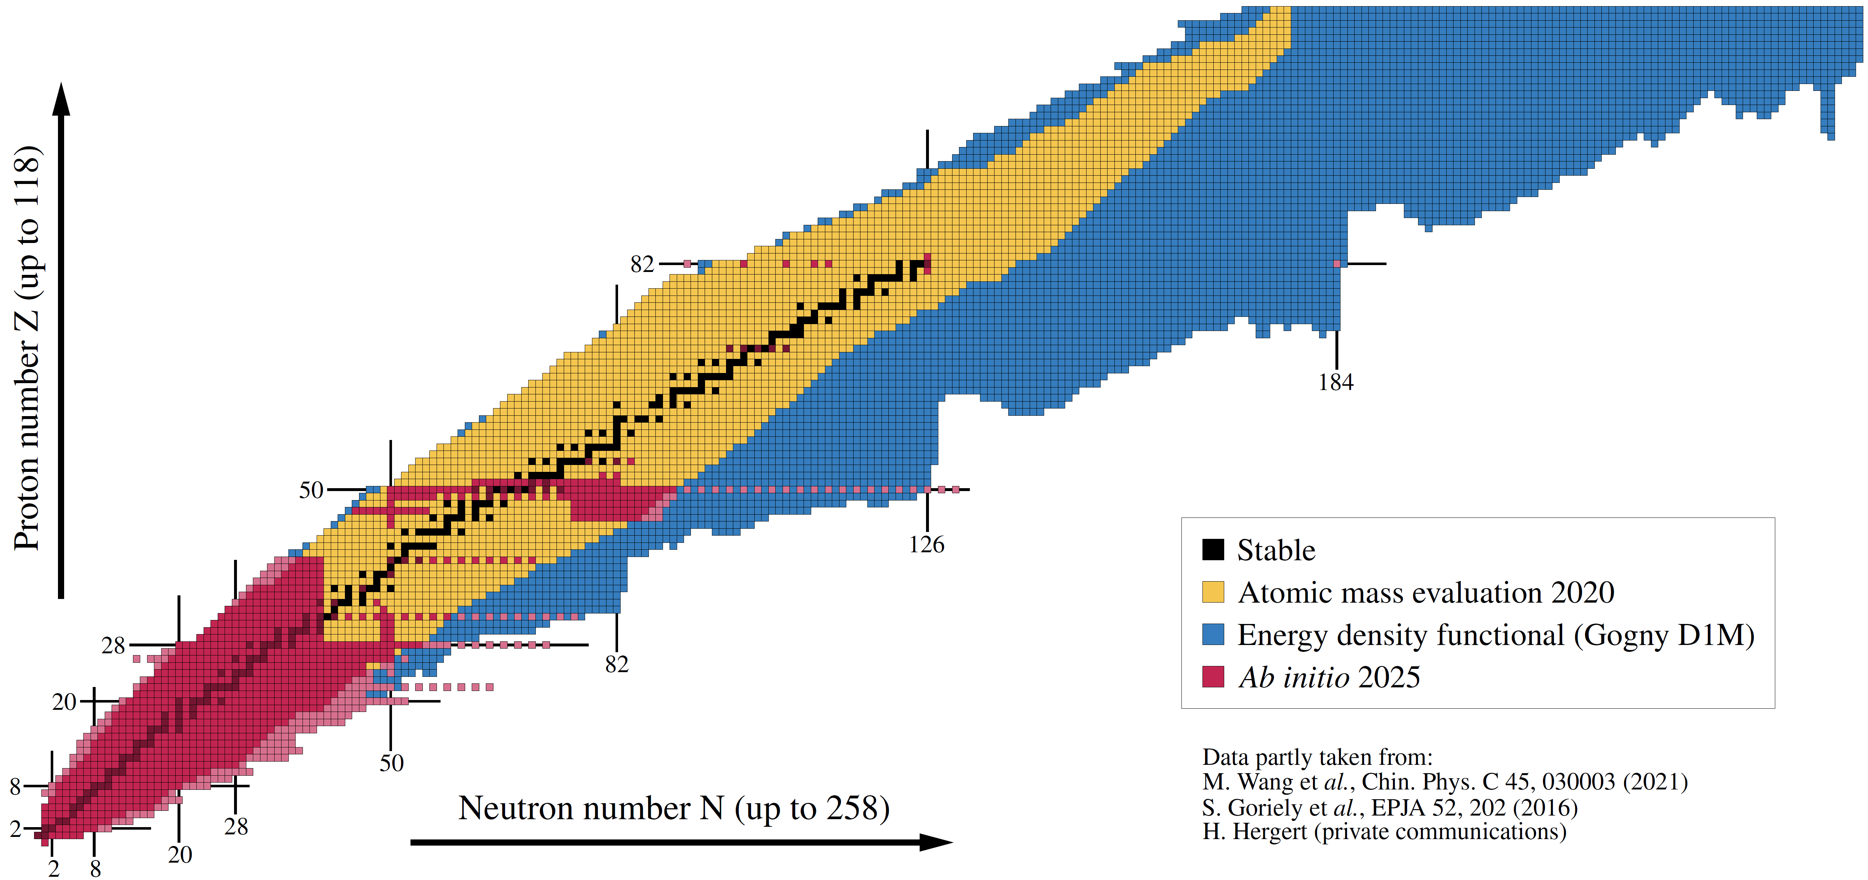

Highlights of nuclear ab initio calculations
Recent progress and challenges using polynomially-scaling expansion many-body methods
²⁰⁸Pb
2025
Figure: B. Bally
GDR RESANET, Plenary meeting, November 3-7 2025, Strasbourg
Thomas DUGUET
DPhN, CEA-Saclay, France

Slide 2
Contents
⦿ The ab initio nuclear many-body problem and many-body expansion methods
⦿ Personal selection of highlights and frontiers
⦿ Evaluating and propagating systematic interaction uncertainties
⦿ From ab initio nuclear structure to the Quark Gluon Plasma
⦿ Charge radius through ¹³²Sn
⦿ Charge radius through ⁵⁸Cr
⦿ Two-body corrections to magnetic dipole moments
⦿ Frugal many-body calculations from tensor factorization techniques
⦿ Giant resonances in doubly open-shell nuclei
⦿ Ab-initio (transition) optical potentials
⁞

Slide 3
Contents
⦿ The ab initio nuclear many-body problem and many-body expansion methods
⦿ Personal selection of highlights and frontiers
⦿ Evaluating and propagating systematic interaction uncertainties
⦿ From ab initio nuclear structure to the Quark Gluon Plasma
⦿ Charge radius through ¹³²Sn
⦿ Charge radius through ⁵⁸Cr
⦿ Two-body corrections to magnetic dipole moments
⦿ Frugal many-body calculations from tensor factorization techniques
⦿ Giant resonances in doubly open-shell nuclei
⦿ Ab-initio (transition) optical potentials
⁞

Slide 4
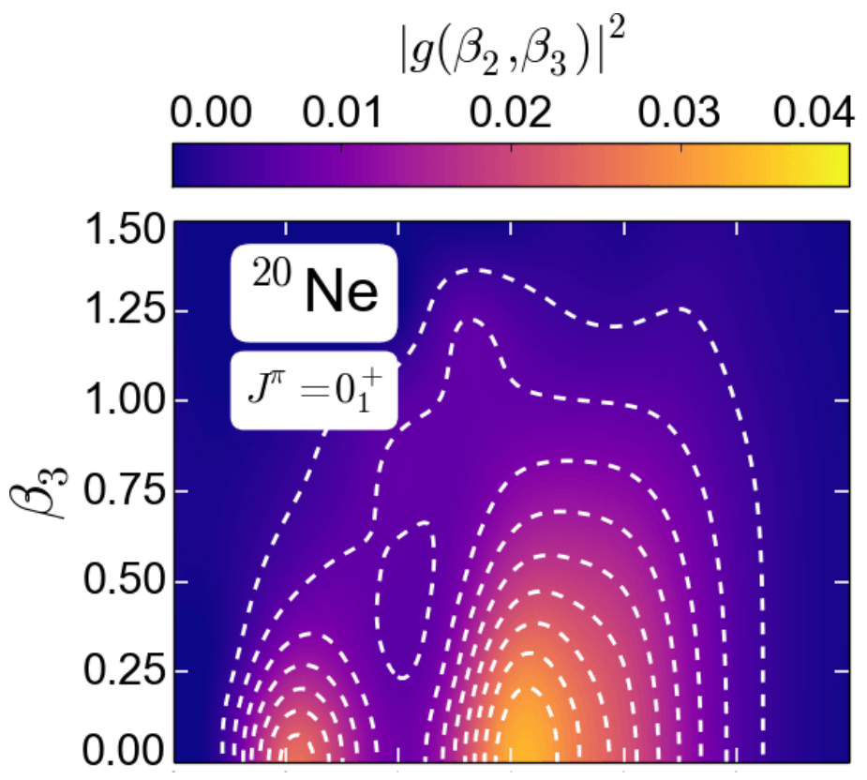
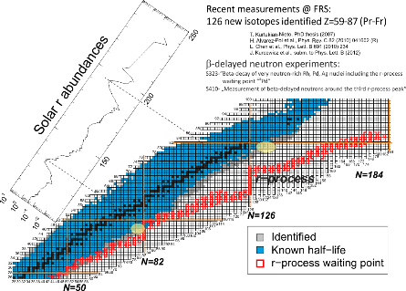
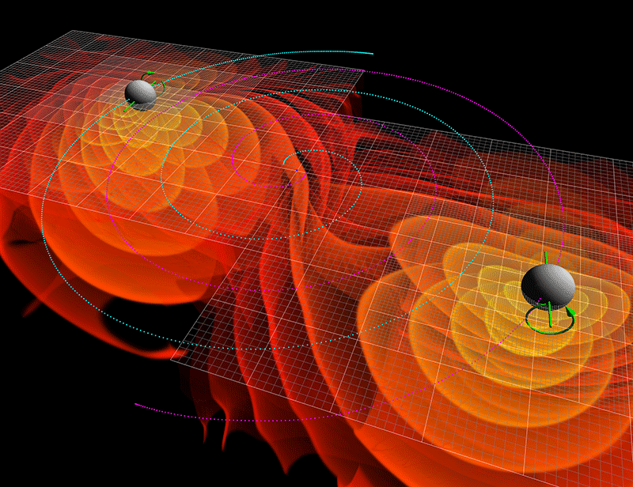
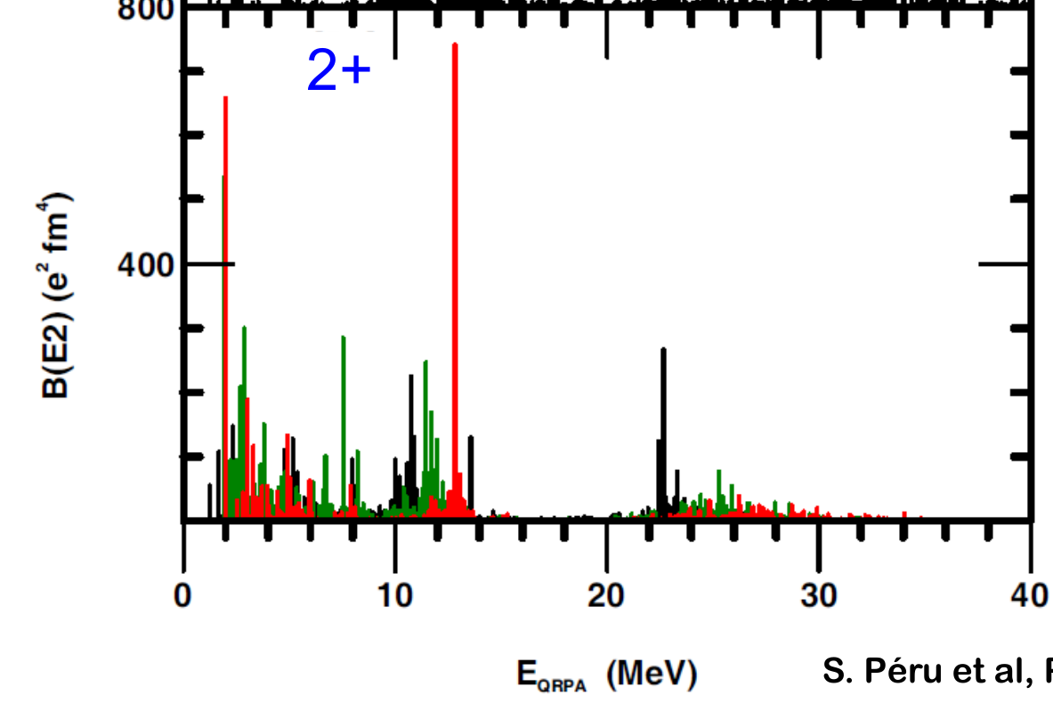
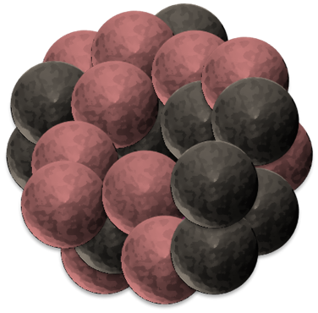
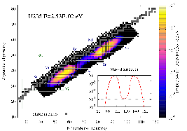
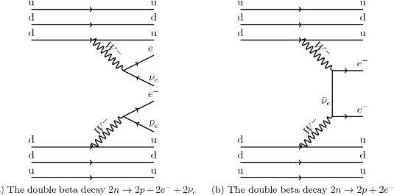

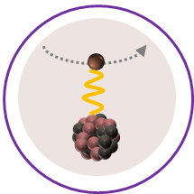
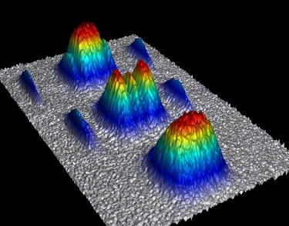
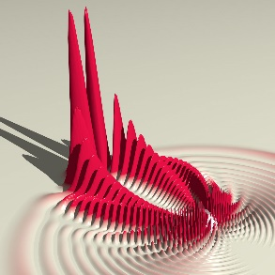
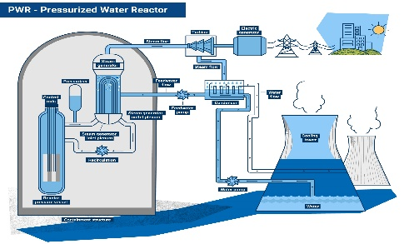
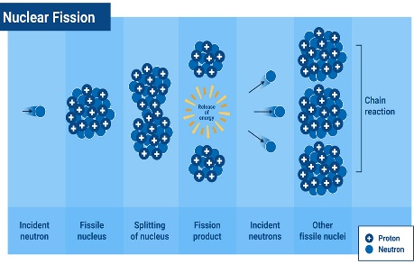
The atomic nucleus as a 4-components quantum mesoscopic system
An extremely rich and diverse phenomenology
Nucleus: bound (or resonant) state of Z protons and N neutrons
“Ab initio” (= In medias res) long-term endeavor
Can nuclear systems be convincingly described
From structure-less nucleons and their interactions: right balance of reductionism vs emergence?
Rooted into QCD in a systematically improvable way: sound connection via EFT(s)?
Systematically: complete phenomenology up to (super) heavy nuclei?
Accurately enough: relevant to experimental investigations/applications?
Astrophysics
Neutron star, supernovae, nucleo-synthesis…
Ground-state
masses, radii, density distributions …
Excitation spectra
energies, transition probabilities, response function to electroweak probes, …
Standard model of particle physics
0ν2β, unitarity of CKM matrix, PT
Ab Initio
Practical benefit = work in progress… yet to be proven
Decay modes
lifetime, yields, …
Nuclear observables can be
Described consistently
With (small enough) uncertainties
Extrapolated in a controlled fashion
Reactions
cross sections, …
Mesoscopic many-body systems
Molecules, atoms, cold atom gases…
Nuclear data applications
Nuclear energy, nuclear defense…

Slide 5

Ab initio theoretical scheme
In this talk “Ab initio” theoretical scheme
=
Chiral effective field theory (χEFT) based on Weinberg Power Counting (WPC)
Exponential curse with A
Systematic expansion of H
Full solution | Ψ_{k} >
Limited to A ~ 16

Slide 6



Ab initio theoretical scheme
In this talk “Ab initio” theoretical scheme
=
Chiral effective field theory (χEFT) based on Weinberg Power Counting (WPC)
Exponential → Polynomial cost
Systematic expansion of H
Systematic expansion of | Ψ_{k} >
Double expansion systematically improvable towards well-defined limit
H
| Ψ_{k} >
Uncertainties evaluation
Chiral EFT truncation
LECs adjustement
Rank reduction of V^{3N}
Basis truncation
Expansion truncation

Slide 7
Ab initio theoretical scheme : 1) expansion of H
Ab initio = Chiral EFT = low-energy realization of QCD
Effective degrees of freedom
Nucleons
Hadronic Physics
QCD
Pions
m_{π} = 150MeV
800MeV
Manifestation of chiral symmetry breaking at low energy
[Weinberg, Gasser, Leutwyler, van Kolck, ..]
150MeV
+ …
High-energy via contact interactions
Physics of nuclei
χEFT
N
N
∞ # operators compatible with symmetries of QCD
𝜋
+ …
Pion-driven interactions explicit
N
N
1) Organize via expected importance in (Q/Λ_{χ})^{ν} = Power Counting

Slide 8
Ab initio theoretical scheme : 1) expansion of H

Slide 9
Ab initio theoretical scheme : 1) expansion of H
Ab initio = Chiral EFT = low-energy realization of QCD
Effective degrees of freedom
Nucleons
Hadronic Physics
QCD
Pions
m_{π} = 150MeV
800MeV
Manifestation of chiral symmetry breaking at low energy
[Weinberg, Gasser, Leutwyler, van Kolck, ..]
150MeV
+ …
High-energy via contact interactions
Physics of nuclei
χEFT
N
N
∞ # operators compatible with symmetries of QCD
𝜋
+ …
Pion-driven interactions explicit
N
N
1) Organize via expected importance in (Q/Λ_{χ})^{ν} = Power Counting
2) Truncate at working order k → Systematic uncertainty (1)
3) Adjust Low Energy Couplings → Statistical uncertainty (2)
∼(15−30) LECS to be inferred from data

Slide 10
Ab initio theoretical scheme : 1) expansion of H
Ab initio = Chiral EFT = low-energy realization of QCD
Effective degrees of freedom
Nucleons
Hadronic Physics
QCD
Pions
m_{π} = 150MeV
800MeV
Manifestation of chiral symmetry breaking at low energy
[Weinberg, Gasser, Leutwyler, van Kolck, ..]
150MeV
+ …
High-energy via contact interactions
Physics of nuclei
χEFT
N
N
∞ # operators compatible with symmetries of QCD
𝜋
+ …
Major challenges
Pion-driven interactions explicit
►Can k-body, k>3, be omitted in A>>3?
→Few calc. with 4-body in light nuclei
►N^{3/4}LO 2N for high precision; 3N? 4N?
→Under development; scarcely used
►Non-renormalizability of WPC
→RG-invariant variants exist but not used
►Error estimation&propagation
►Two body currents and S≠0 sector
N
N
1) Organize via expected importance in (Q/Λ_{χ})^{ν} = Power Counting
2) Truncate at working order k → Systematic uncertainty (1)
3) Adjust Low Energy Couplings → Statistical uncertainty (2)

Slide 11
Ab initio theoretical scheme : 2) expansion of |Ψ >
with
One-body Hilbert space
A-body Hilbert space
with
Symmetry group: U(1)_{N}xU_{Z}(1)xSU(2)_{J}xI_{Π}
One-body basis size
« The curse of dimensionality »
Expansion many-body methods = polynomially scaling methods
Hamiltonian partitioning
Unperturbed state
Fully correlated state
« Easy »
to solve
Expansion series
Wave operator
Mean-field-like =
Symmetry
Nature of the state
Nature of the expansion
Symm. conserving: closed shell
Symm. breaking (+ restoration): open shell(s)
Spherical HF
Deformed HF(B)
Pert.: MBPT
Non pert.: CC, SCGF, IM-SRG
Many more nuclei (2012→)
More accurate/expensive
Truncate at working order n → Systematic uncertainty (3)
[Arthuis, Barbieri, Binder, Bogner, Demol, Duguet, Frosini, Hagen, Heinz, Hergert, Roth, Papenbrock, Somà, Schwenk, Tichai…]

Slide 12









Ab initio theoretical scheme : 2) expansion of |Ψ >
with
One-body Hilbert space
A-body Hilbert space
with
Symmetry group: U(1)_{N}xU_{Z}(1)xSU(2)_{J}xI_{Π}
Expansion many-body methods = polynomially scaling methods
Hamiltonian partitioning
Unperturbed state
Fully correlated state
« Easy »
to solve
Expansion series
$${\sim ndim}^{4}$$
$${\sim ndim}^{5}$$
$${\sim ndim}^{6}$$
$${\sim ndim}^{7}$$
$${\sim ndim}^{8}$$
$${\sim ndim}^{9}$$
$\sim ndim$^{A}
(B)MBPT(2)
(B)MBPT(3)
(B)MBPT(4)
…
Diag.
CI
HF(B)
(B)CCSD
(B)CCSDT
IMSRG(2)
IMSRG(3)
(G)SCGF(2)
(G)SCGF(3)
Few 10% errors
Work-horse = few % error
n_{dim} is x10 in doubly open shell nuclei versus closed shell nuclei → 10⁵⁻⁷ more expensive!
Several % errors
State-of-the-art (approx. n_{dim}⁷) = sub% error
More complete but greater computational cost

Slide 13
Contents
⦿ The ab initio nuclear many-body problem and many-body expansion methods
⦿ Personal selection of highlights and frontiers
⦿ Evaluating and propagating systematic interaction uncertainties
⦿ From ab initio nuclear structure to the Quark Gluon Plasma
⦿ Charge radius through ¹³²Sn
⦿ Charge radius through ⁵⁸Cr
⦿ Two-body corrections to magnetic dipole moments
⦿ Frugal many-body calculations from tensor factorization techniques
⦿ Giant resonances in doubly open-shell nuclei
⦿ Ab-initio (transition) optical potentials
⁞

Slide 14
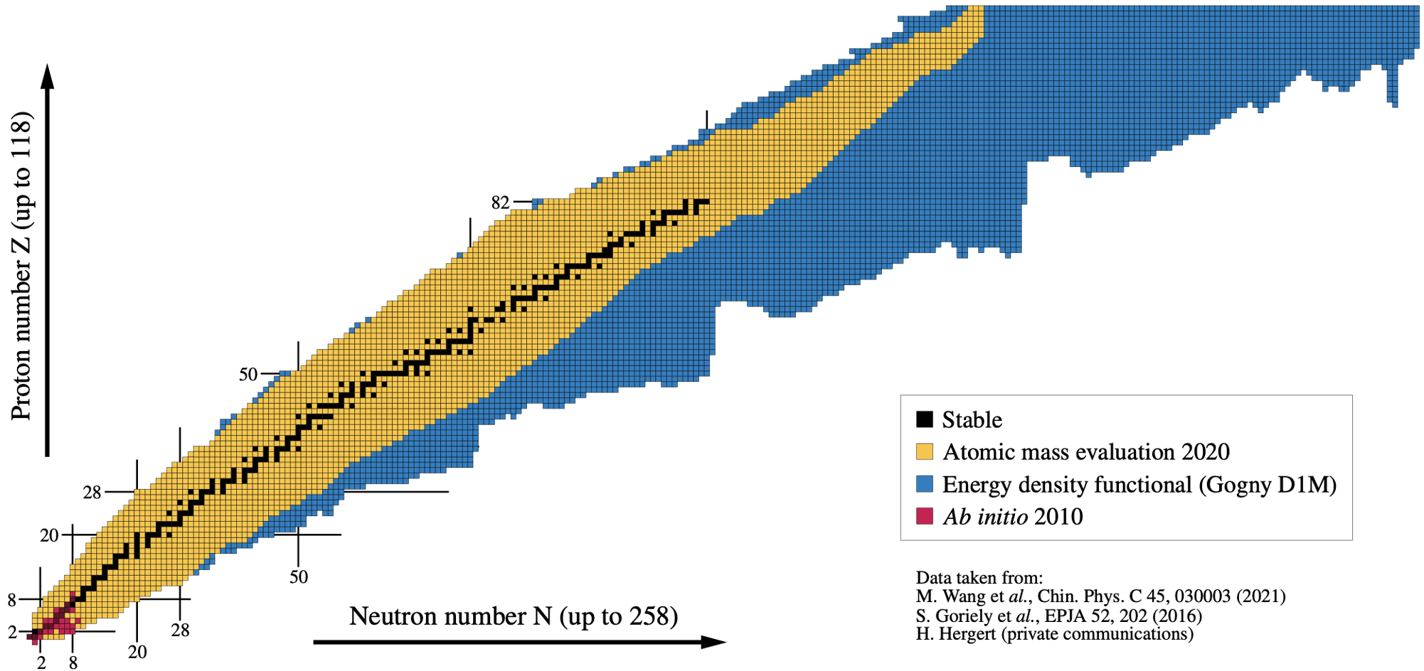
Ab initio theoretical scheme : 3) the current reach
2010
Courtesy of B. Bally

Slide 15
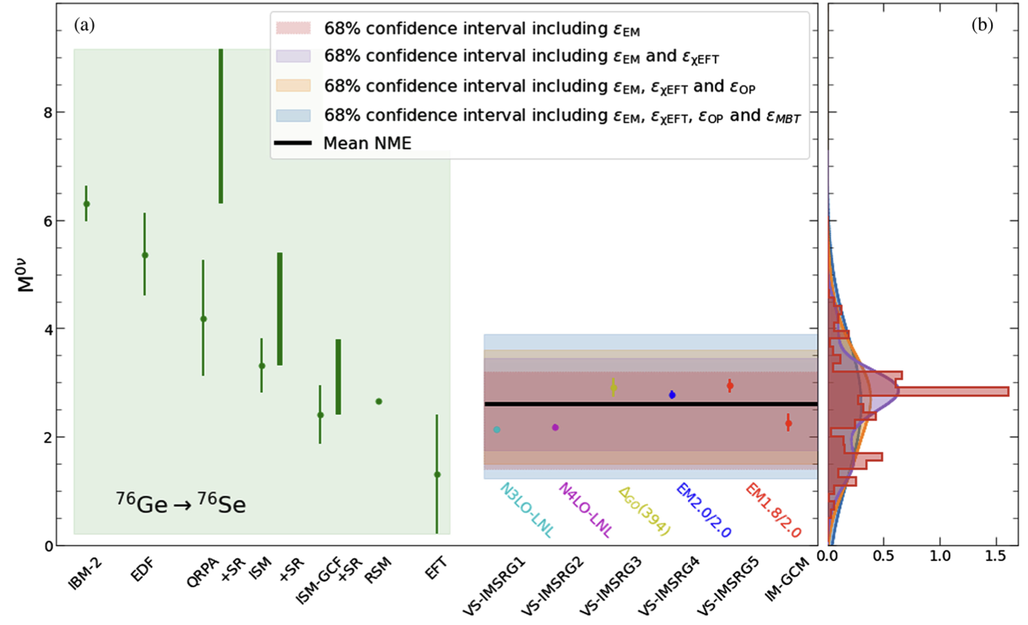
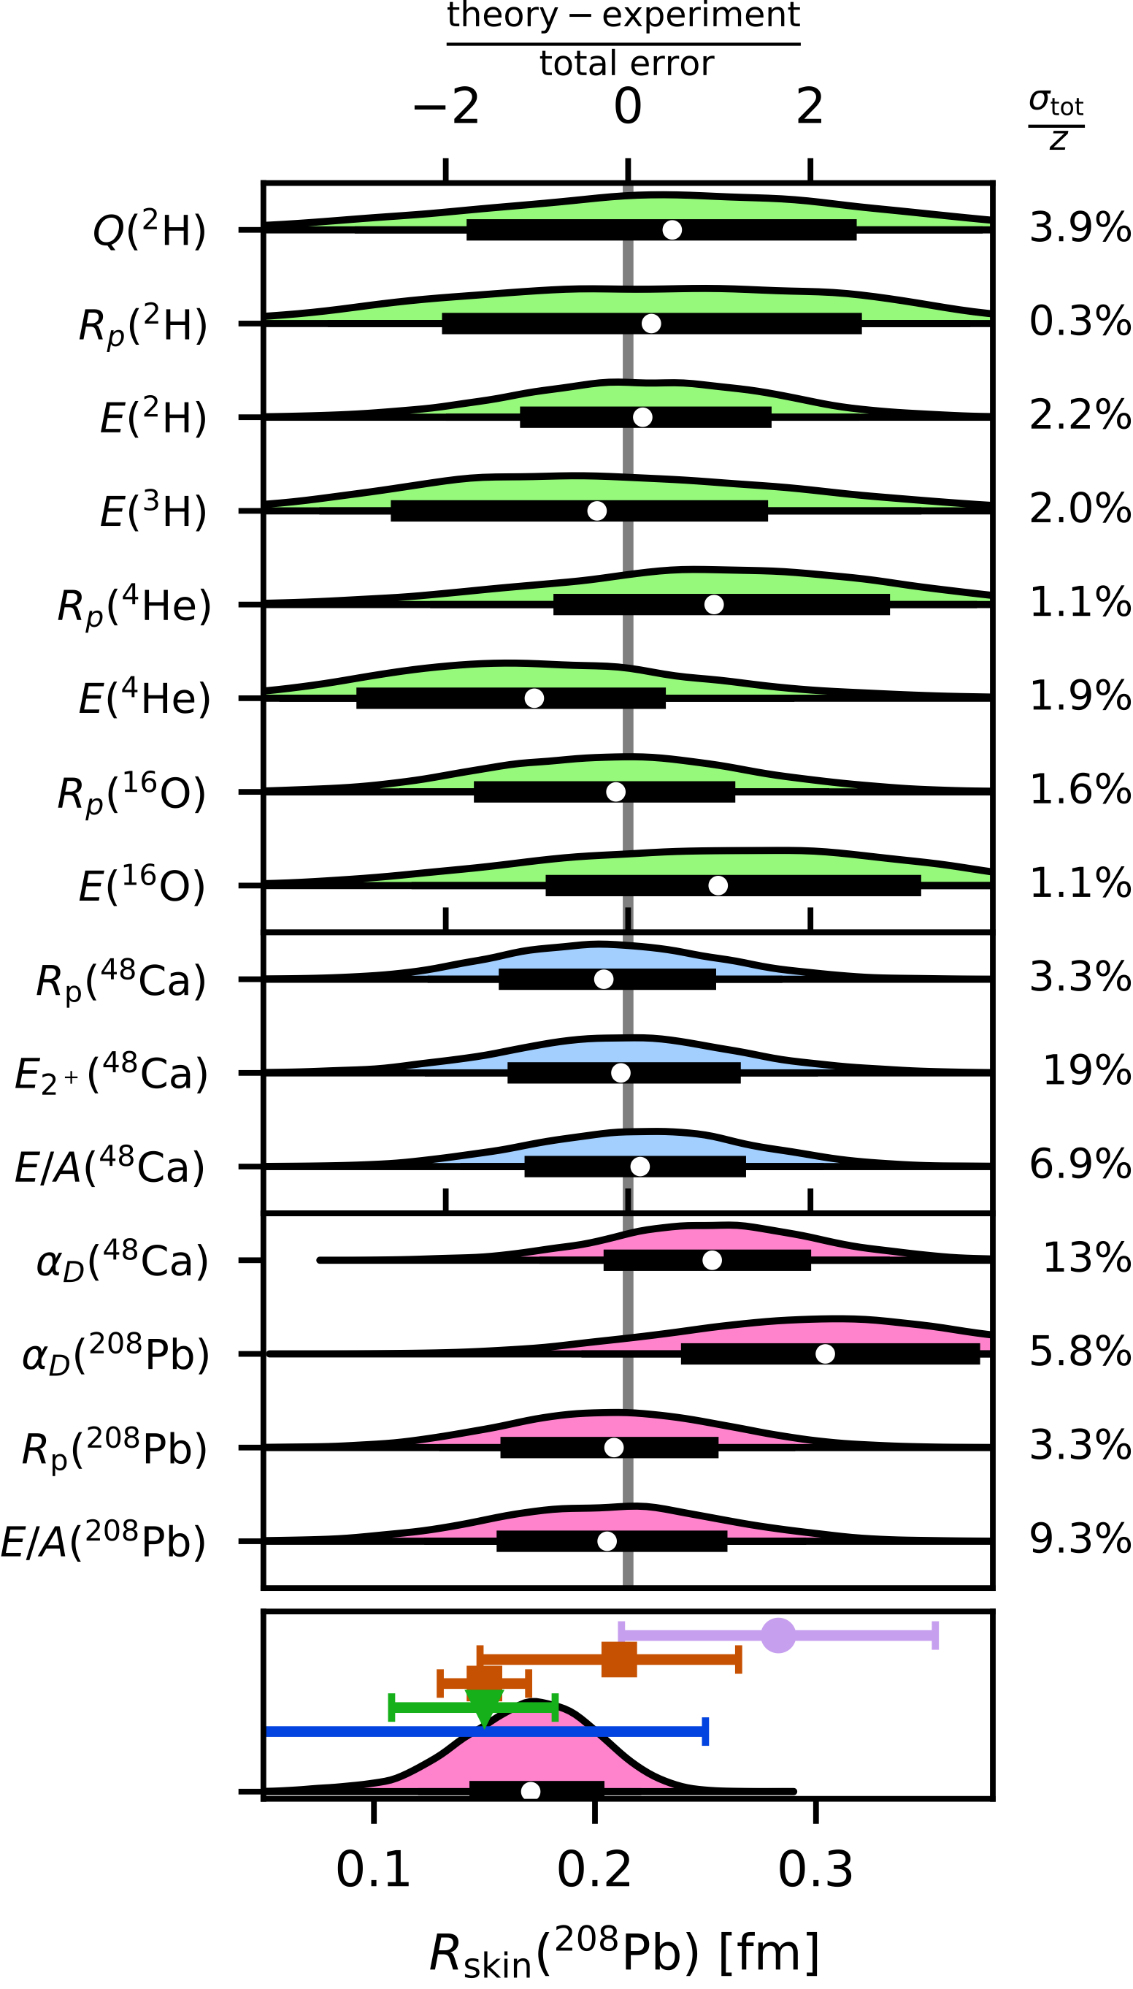
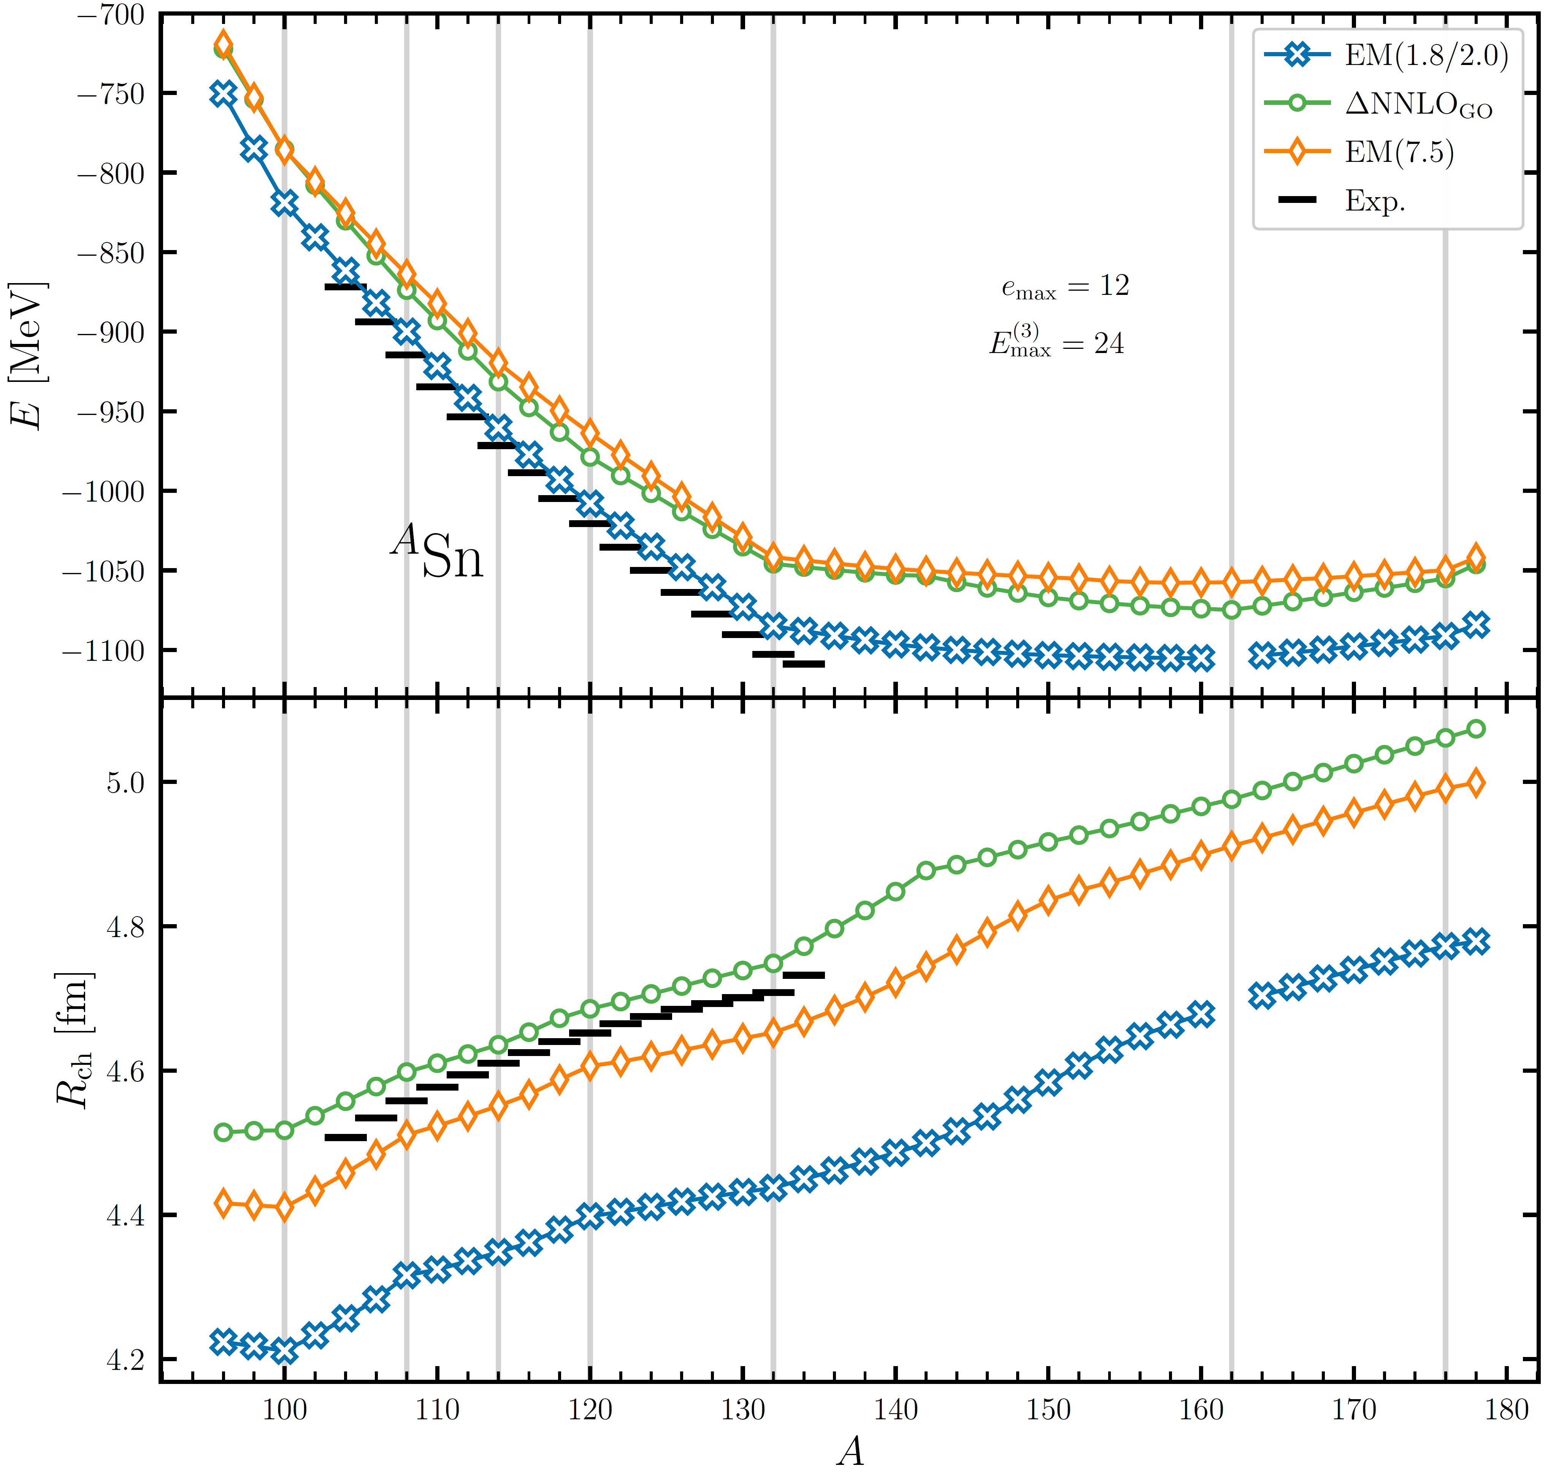
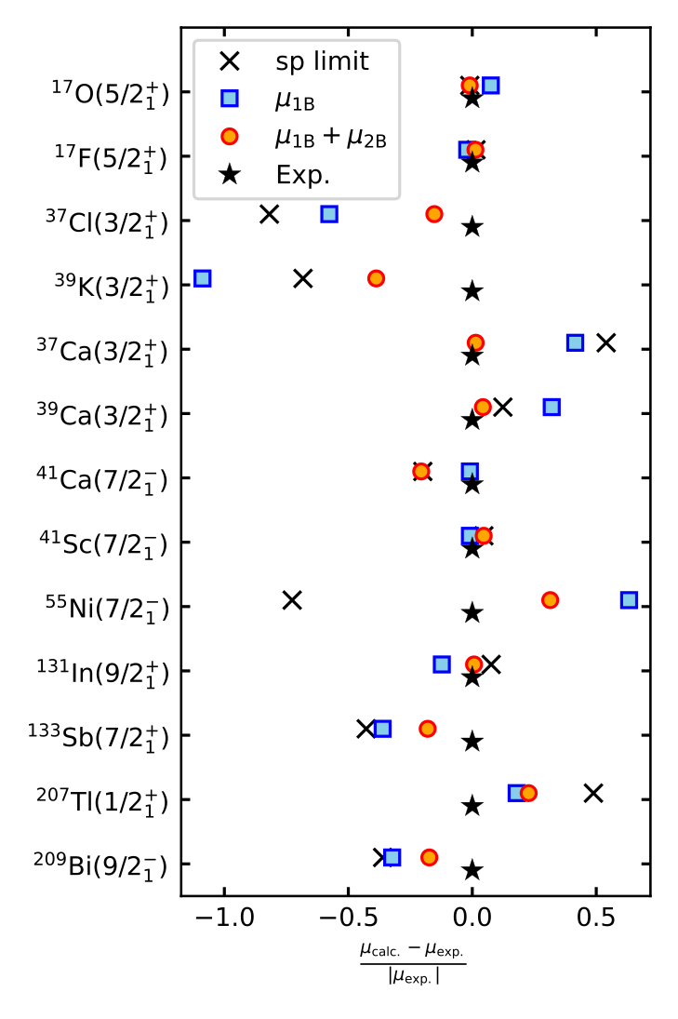
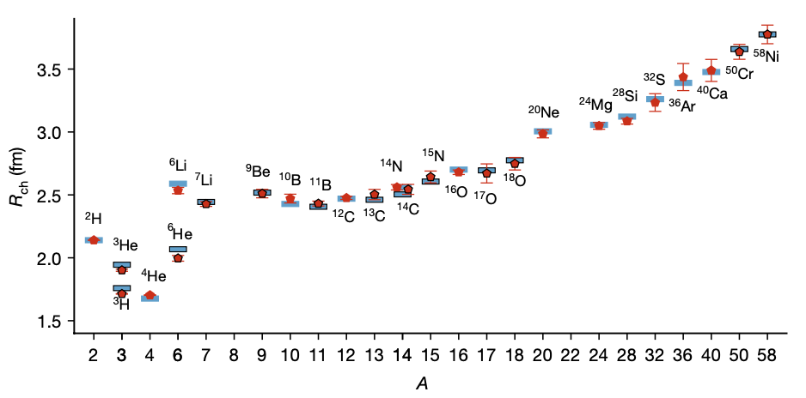
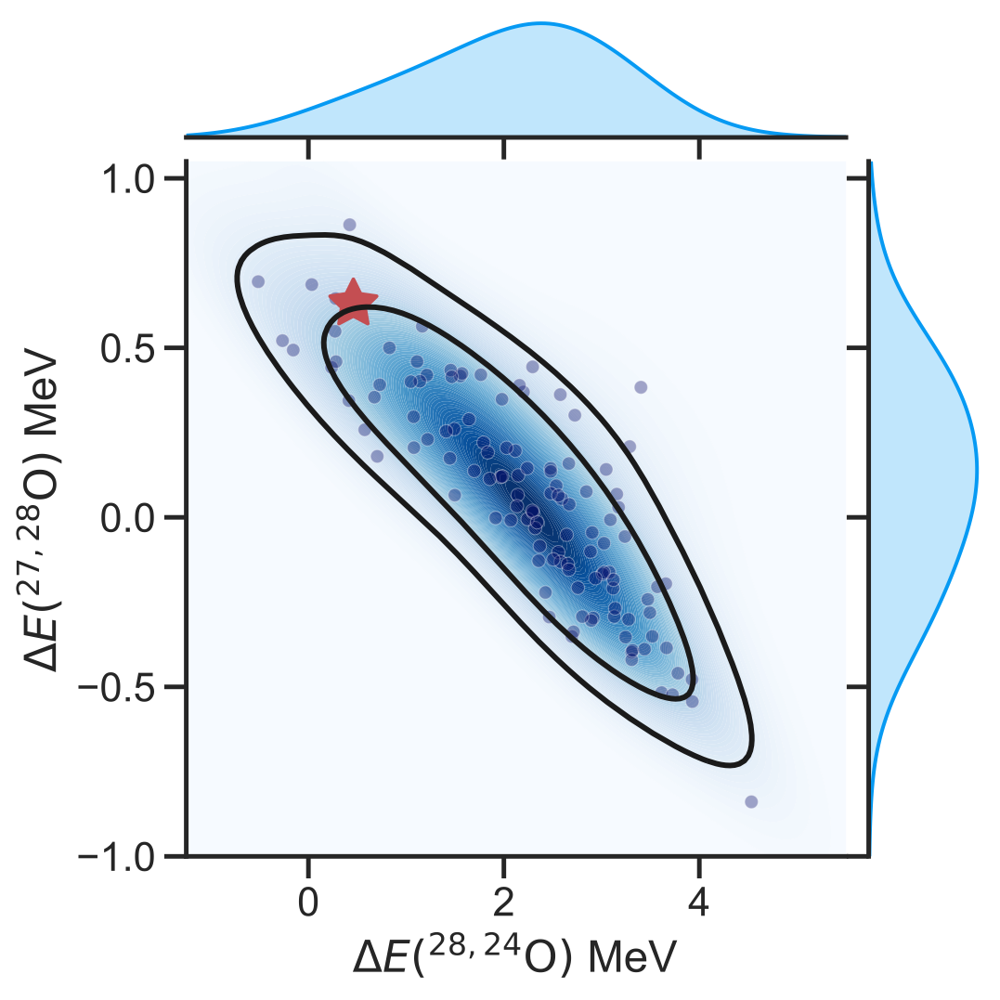
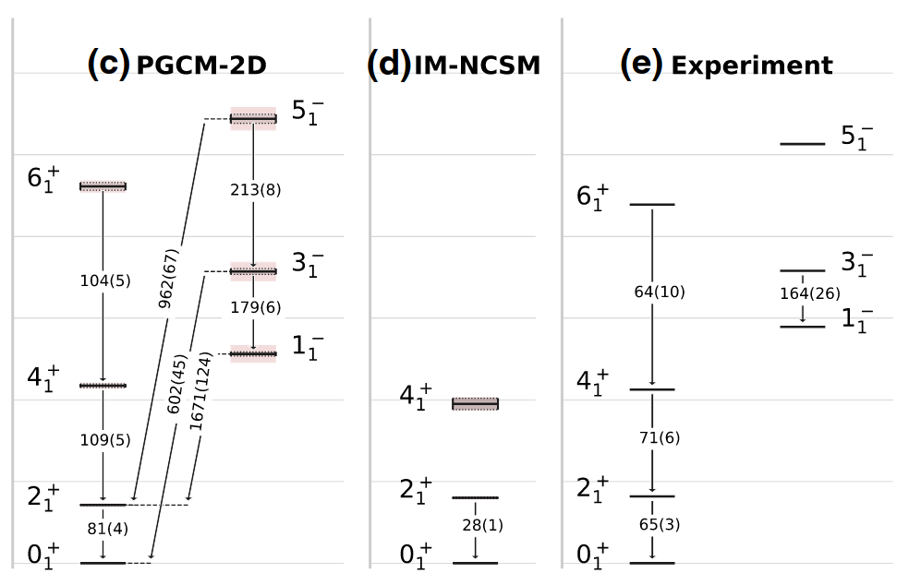
Ab initio theoretical scheme : 3) the current reach
UQ for 0νββ in ⁷⁶Ge
Skin thickness in ²⁰⁸Pb
Infinite matter EOS
Electroweak
Hadronic
Electromagnetic
Gravitational waves
Heavy ion collisions
Shape coexistence in ⁸⁰Zr
Hu et al. (2022)
Magicity of ²⁶⁶Pb
Belley et al. (2024)
E and R_{ch} in ¹⁰⁰⁻¹⁸⁰Sn
r-process with N=82 masses
Hu et al. (2025)
Optical potential
Hu et al. (2024)
³⁴Si bubble nucleus
Bonaiti et al. (2025)
2-body current for μ
Tichai et al. (2024,2025)
Vorabbi et al. (2024)
Kuske et al. (2025)
2⁺₁ through ¹³²Sn
Duguet et al. (2017)
Systematic ~700 nuclei
²H → ⁵⁸Ni R_{ch}
Clustering ¹⁶O&²⁰Ne
Miyagi et al. (2022)
Miyagi et al. (2024)
Stroberg et al. (2021)
Elhatisari et al. (2024)
Giacalone et al. (2025)
Stability of ²⁸O
Giant resonances
Rotational bands in ²⁰Ne
Courtesy of B. Bally
2025
²⁰Ne
Kondo et al. (2023)
Porro et al. (2024)
Frosini et al. (2022)

Slide 16
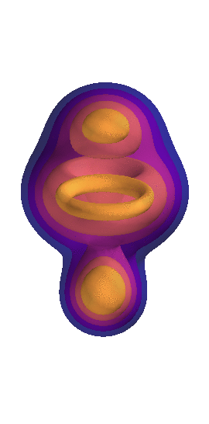
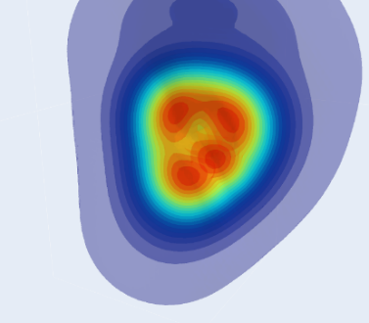


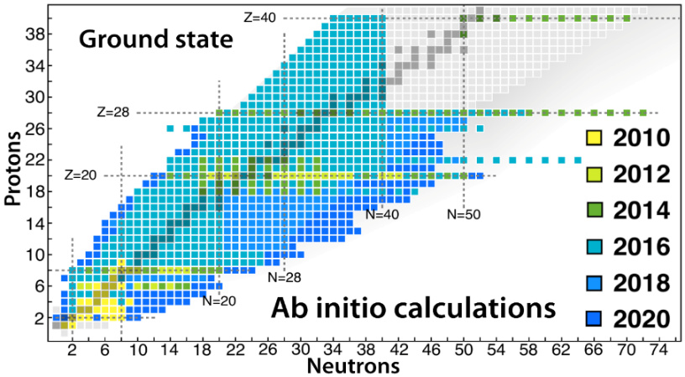
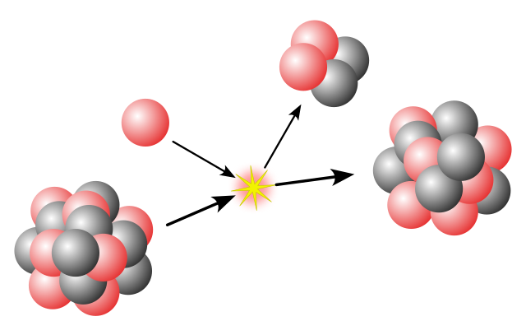
Frontiers in ab initio nuclear theory
SPECTROSCOPY
UNCERTAINTIES
Systematic
Single-particle excitations
Collective excitations
Clustering
Hamiltonian EFT truncation
¹⁶O
²⁰Ne
Tetrahedral
ground state
intrinsic density
[Bally et al., 2023]
A-body expansion method truncation
[Frosini et al., 2023]
1⁻/3⁻ vibration (¹⁶O+α ↔ ¹²C + 2α) at 7.2 MeV
OPEN-SHELL
Basis representation truncation
Novel many-body methods
Memory&CPU ⸕: Ñ^{p} → N^{q} (Ñ<<N)
Statistical
[Hergert, 2020]
MANY-BODY
METHODS
fit
ACCURACY
Algebra cost ⸕
Difficult manually
Numerical cost ⸕
Memory&CPU: N^{p} → N^{q} (q>p)
MASS
Memory&CPU ⸕: N^{p} with N ⸕
Importance of AN forces?
HAMILTONIAN
REACTIONS
[Hu et al, 2022]
S=0/S≠0 interactions
Power counting
Currents
Fit
Light nuclei
Optical potential
Transition densities

Slide 17
Contents
⦿ The ab initio nuclear many-body problem and many-body expansion methods
⦿ Personal selection of highlights and frontiers
⦿ Evaluating and propagating systematic interaction uncertainties
⦿ From ab initio nuclear structure to the Quark Gluon Plasma
⦿ Charge radius through ¹³²Sn
⦿ Charge radius through ⁵⁸Cr
⦿ Two-body corrections to magnetic dipole moments
⦿ Frugal many-body calculations from tensor factorization techniques
⦿ Giant resonances in doubly open-shell nuclei
⦿ Ab-initio (transition) optical potentials
⁞

Slide 18
Ab initio frontiers
SPECTROSCOPY
UNCERTAINTIES
Systematic
Single-particle excitations
Collective excitations
Clustering
Hamiltonian
¹⁶O
²⁰Ne
Tetrahedral
ground state
intrinsic density
A-body solution
[Frosini et al., 2023]
[Bally et al., 2023]
1⁻/3⁻ vibration (¹⁶O+α ↔ ¹²C + 2α) at 7.2 MeV
OPEN-SHELL
Basis representation
Novel many-body methods
Memory&CPU ⸕: Ñ^{p} → N^{q} (Ñ<<N)
Statistical
[Hergert, 2020]
MANY-BODY
METHODS
fit
ACCURACY
Algebra cost ⸕
Difficult manually
Numerical cost ⸕
Memory&CPU: N^{p} → N^{q} (q>p)
MASS
Memory&CPU ⸕: N^{p} with N ⸕
Importance of AN forces?
HAMILTONIAN
REACTIONS
[Hu et al, 2022]
S=0/S≠0 interactions
Power counting
Currents
Fit
Light nuclei
Optical potential
Transition densities

Slide 19

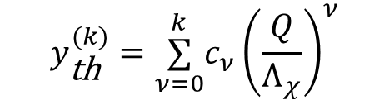
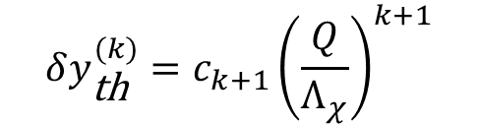
Propagating systematic EFT uncertainties
Plies, Heinz, Schwenk, arXiv:2509.24671
Hamiltonian χEFT truncation
Predicted observable at order k
$$y_{\text{th}}^{(k)}=\overset{k}{\underset{ν=0}{∑}}c_{ν}{\left(\frac{Q}{Λ_{χ}}\right)}^{ν}$$
1
2
Parameters to be inferred
fit
Error at order k
Exp.
$$δy_{\text{th}}^{(k)}=c_{k+1}{\left(\frac{Q}{Λ_{χ}}\right)}^{k+1}$$
3
Bayesian inferrence
4
Posterior distribution
Theor. error dominates
Model for c_{k+1} at N³LO
D = δ_{NN}, E(³H), T_{1/2}(³H)
Epelbaum, Krebs, Meissner, EPJA (2015)
5
Linear dependence on parameters
6
5.10⁵ samples via Markov Chain Monte Carlo
7
8
Many-body calculations
= 5.10⁵ many-body calculations!? Undoable…
9
Posterior predictive distribution (PDD) of observables
Frame, et al. PRL (2018)
Duguet et al., RMP (2025)
10
Emulator of many-body solver via Eigenvector Continuation (EC)
Training via a few tens of many-body calculations
5.10⁵ many-body calculations emulated in few minutes (<1% error)

Slide 20
Propagating systematic EFT uncertainties
Plies, Heinz, Schwenk, arXiv:2509.24671
PDD of E(³H), T_{1/2}(³H)
1
⦿ Truncation uncertainty of EM(1.8/2.0) Hamiltonian
Hebeler et al., PRC (2011)
2
1) Check consistency with input model error in, e.g. 3N sector
NCSM-EC
3
Consistent with input EFT error model
→Not as convincing in 2N sector for δ_{NN}(E) wrt E
Observables uncorrelated
→Good choice to fit C_{E} and C_{D} (=λ₁^{3N} and λ₂^{3N})
4
5
2) Many-body observables with EFT truncation error
6
PDD of E(²⁸O)- E(²⁴O)
Robust prediction of unbound ²⁸O but
→Significant dependence on likelihood employed for inference
→Tension with experimental value
→Continuum and many-body truncation errors missing
7
8
9
Doable for any accessible many-body observable
10
IMSRG(2)

Slide 21
Contents
⦿ The ab initio nuclear many-body problem and many-body expansion methods
⦿ Personal selection of highlights and frontiers
⦿ Evaluating and propagating systematic interaction uncertainties
⦿ From ab initio nuclear structure to the Quark Gluon Plasma
⦿ Charge radius through ¹³²Sn
⦿ Charge radius through ⁵⁸Cr
⦿ Two-body corrections to magnetic dipole moments
⦿ Frugal many-body calculations from tensor factorization techniques
⦿ Giant resonances in doubly open-shell nuclei
⦿ Ab-initio (transition) optical potentials
⁞

Slide 22
Ab initio frontiers
SPECTROSCOPY
UNCERTAINTIES
Systematic
Single-particle excitations
Collective excitations
Clustering
Hamiltonian
¹⁶O
²⁰Ne
Tetrahedral
ground state
intrinsic density
A-body solution
[Frosini et al., 2023]
[Bally et al., 2023]
1⁻/3⁻ vibration (¹⁶O+α ↔ ¹²C + 2α) at 7.2 MeV
OPEN-SHELL
Basis representation
Novel many-body methods
Memory&CPU ⸕: Ñ^{p} → N^{q} (Ñ<<N)
Statistical
[Hergert, 2020]
MANY-BODY
METHODS
fit
ACCURACY
Algebra cost ⸕
Difficult manually
Numerical cost ⸕
Memory&CPU: N^{p} → N^{q} (q>p)
MASS
Memory&CPU ⸕: N^{p} with N ⸕
Importance of AN forces?
HAMILTONIAN
REACTIONS
[Hu et al, 2022]
S=0/S≠0 interactions
Power counting
Currents
Fit
Light nuclei
Optical potential
Transition densities

Slide 23
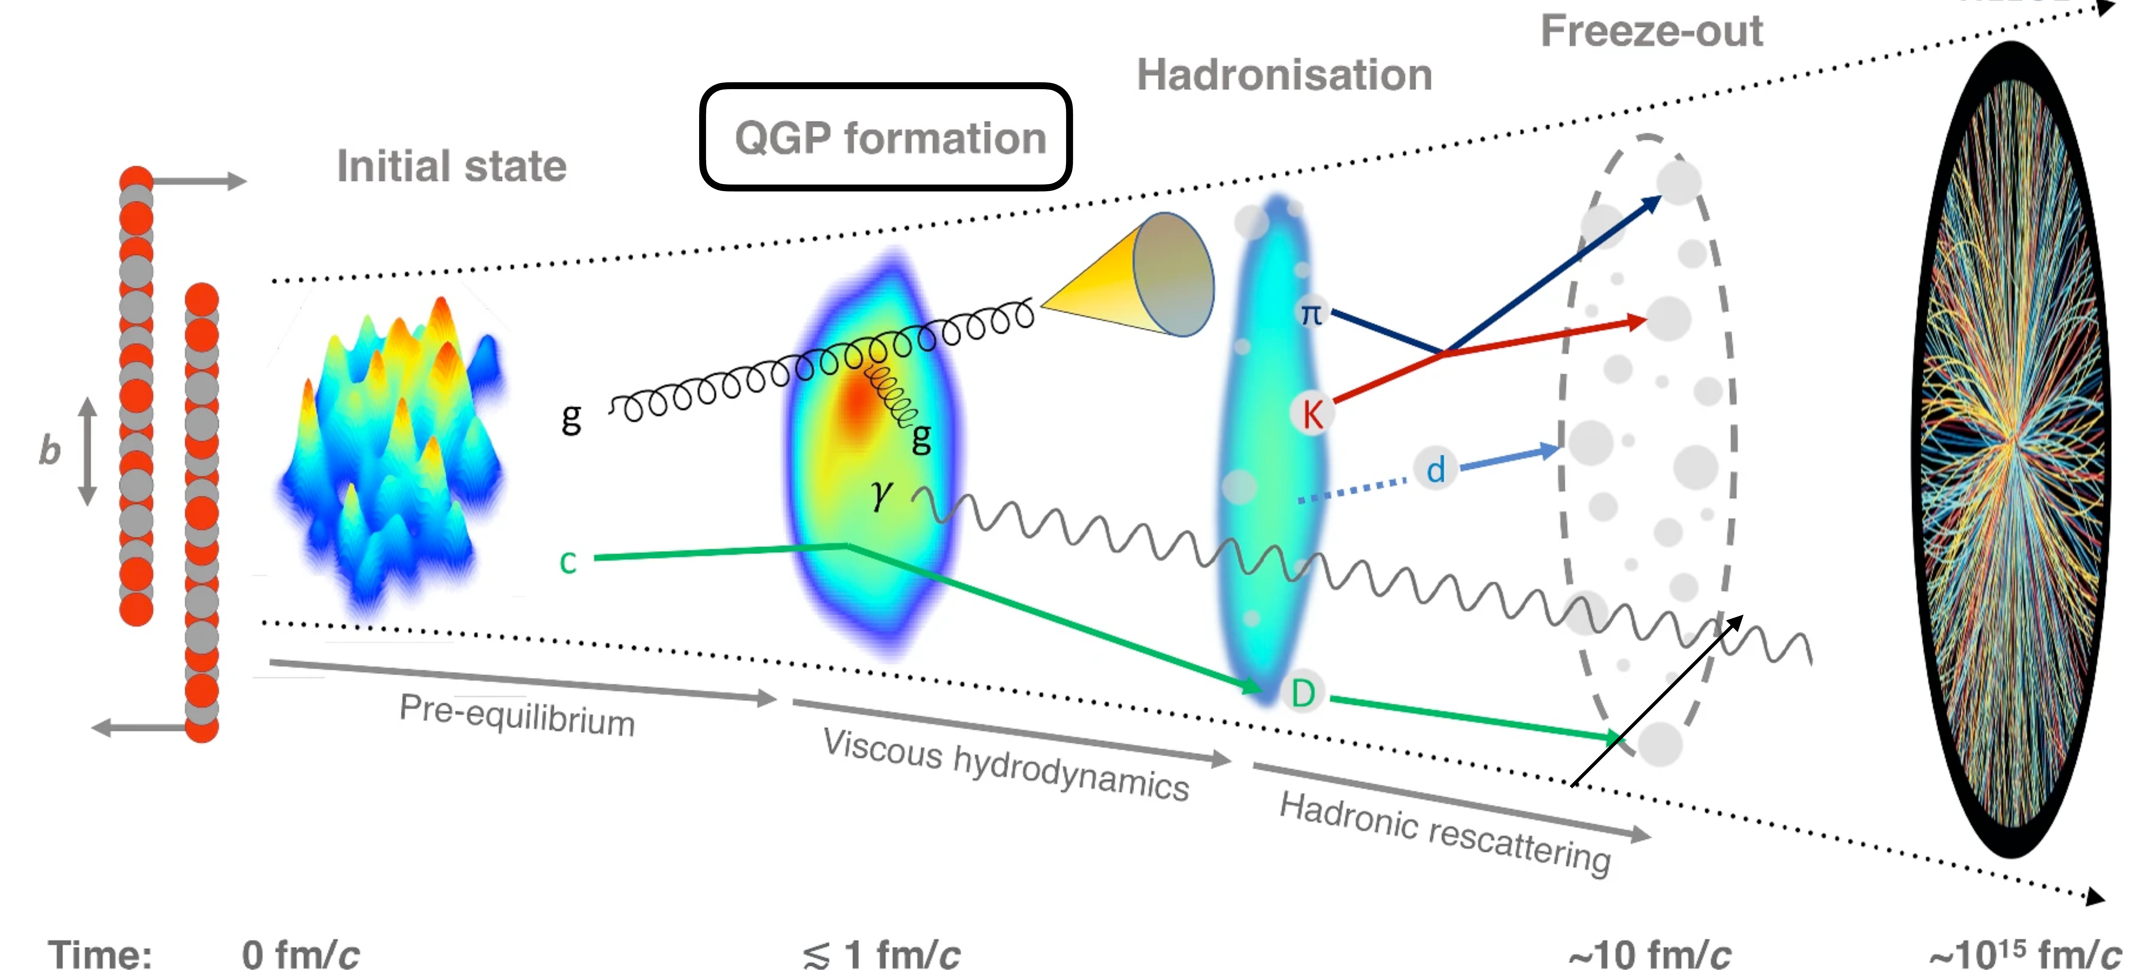
When ab initio nuclear structure impacts the LHC
Giacalone et al., PRL 2025
Initial geometry of the overlap
Anisotropy of particle flow
1
Ultra-relativistic ion collisions leading to QGP
2
Fourier components
« Flow harmonics »
Azimuthal angle
3
v₂ = elliptic flow
→Quadrupolar correl./def.
v₃ = triangular flow
→Octupolar correl./def.
4
5
Traditionally ↔ impact parameter
Ultra central ↔ nuclear « deformation »
6
Giacalone, PRL (2020)
7
Jiang et al., NCT (2024)
Present work
→Symmetric collision of light ¹⁶O and ²⁰Ne with ~A
→Analysis based on ab initio calculations of ¹⁶O and ²⁰Ne
8
²³⁸U (β₂₀, β₂₂, β_{30,} β₄₀) deformation
STAR collab., Nature (2024)
9
STAR collab., arXiv:2506.17785
Ryssens et al., PRL (2023)
10
The shape of gold
Bally, Giacalone, Bender, EPJA (2023)
²⁰⁸Pb and ⁴⁸Ca neutron skins
Giacalone, Nijs, van der Schee, PRL (2023)
Liu et al., PRC (2024)
Zhang et al., arXiv:2510.07816

Slide 24
When ab initio nuclear structure impacts the LHC
Giacalone et al., PRL 2025
Initial geometry of the overlap
Anisotropy of particle flow
1
Ultra-relativistic ion collisions leading to QGP
2
Fourier components
« Flow harmonics »
Azimuthal angle
3
v₂ = elliptic flow
→Quadrupolar correl./def.
v₃ = triangular flow
→Octupolar correl./def.
4
5
Traditionally ↔ impact parameter
Ultra central ↔ nuclear « deformation »
6
7
Present work
→Symmetric collision of light ¹⁶O and ²⁰Ne with ~A
→Analysis based on ab initio calculations of ¹⁶O and ²⁰Ne
8
9
Questions of interest addressed via particle flow analysis
10
Perfect fluid QGP formed in collisions of small systems!?
→Symmetric collisions such as OO and NeNe better than pp or pA because less sensitive to proton structure
To which extent collectivity is driven by initial geometry?
→NeNe/OO elliptic flow (v2) predicted to be sensitive to ²⁰Ne exotic deformation
→Ratio with ~A suppresses hydro uncertainties: direct test of nuclear structure predictions
Giacalone et al., PRL 2025

Slide 25
When ab initio nuclear structure impacts the LHC
Giacalone et al., PRL 2025
Hydrodynamic simulation
1
(Largest ever) PGCM calculations (10⁷ CPUh)
PGCM
2
--- OO
--- NeNe
3
NLEFT
4
¹⁶O
²⁰Ne
--- PGCM
--- NLEFT
5
6
Tetrahedron α clustering
Bowling-pin ¹⁶O+α cluster
7
Enhancement in ultra central collisions
8
9
Consistent ab initio predictions
10
1-day ²⁰Ne+²⁰Ne@CERN – July 8th 2025

Slide 26
When ab initio nuclear structure impacts the LHC
ALICE collaboration, arXiv:2509.06428
ATLAS collaboration, arXiv:2509.05171
CMS collaboration, arXiv:2510.02580
1
2
v₂ rises and decrease towards centrality
→Hydrodynamic response to initial geometry
→Consistent with droplet of QGP
PGCM and NEFT v₂&v₃ consistent with data
3
v₂
v₂
4
OO
NeNe
v₃
v₃
5
6
7
NeNe/OO takes out systematic hydro error
→Strong rise of v₂ towards ultra centrality →Probe of strong quad. correl. in ²⁰Ne
→PGCM prediction in outstanding agreement!
NeNe/OO
v₃
8
v₂
9
10
Room for improvement
→PGCM and NLEFT predictions for ²²Ne needed (10% of natural Neon beam used at LHC)
→Sample 2-body PGCM density matrix and evaluate 2-body correlation v₂ operator
Duguet et al., PRL (2025)

Slide 27
Contents
⦿ The ab initio nuclear many-body problem and many-body expansion methods
⦿ Personal selection of highlights and frontiers
⦿ Evaluating and propagating systematic interaction uncertainties
⦿ From ab initio nuclear structure to the Quark Gluon Plasma
⦿ Charge radius through ¹³²Sn
⦿ Charge radius through ⁵⁸Cr
⦿ Two-body corrections to magnetic dipole moments
⦿ Frugal many-body calculations from tensor factorization techniques
⦿ Giant resonances in doubly open-shell nuclei
⦿ Ab-initio (transition) optical potentials
⁞

Slide 28
Ab initio frontiers
SPECTROSCOPY
UNCERTAINTIES
Systematic
Single-particle excitations
Collective excitations
Clustering
Hamiltonian
¹⁶O
²⁰Ne
Tetrahedral
ground state
intrinsic density
A-body solution
[Frosini et al., 2023]
[Bally et al., 2023]
1⁻/3⁻ vibration (¹⁶O+α ↔ ¹²C + 2α) at 7.2 MeV
OPEN-SHELL
Basis representation
Novel many-body methods
Memory&CPU ⸕: Ñ^{p} → N^{q} (Ñ<<N)
Statistical
[Hergert, 2020]
MANY-BODY
METHODS
fit
ACCURACY
Algebra cost ⸕
Difficult manually
Numerical cost ⸕
Memory&CPU: N^{p} → N^{q} (q>p)
MASS
Memory&CPU ⸕: N^{p} with N ⸕
Importance of AN forces?
HAMILTONIAN
REACTIONS
[Hu et al, 2022]
S=0/S≠0 interactions
Power counting
Currents
Fit
Light nuclei
Optical potential
Transition densities

Slide 29
Heaviest open-shell nuclei computed ab initio
Heaviest doubly closed-shell nuclei
Spherical CC
Skin thickness in ²⁰⁸Pb
Magicity of ²⁶⁶Pb
Hagen et al., RPP (2014)
Electroweak
Hadronic
Electromagnetic
Gravitational waves
Heavy ion collisions
Heaviest (singly) open-shell nuclei
E and R_{ch} in ¹⁰⁰⁻¹⁸⁰Sn
Bonaiti et al. (2025)
Hu et al. (2022)
Spherical Bogoliubov CC
Signoracci et al., PRC (2015)
2025
Tichai, Demol, Duguet (2024)
Demol et al. (2025)
R_{ch} in doubly magic
Isotopic shift through ⁴⁸Ca
Arthuis et al., arXiv:2401.06675
Arthuis et al., priv. Comm.
What about the Sn playgound?
⦿ χEFT based Hamiltonian EM (1.8/2.0)
⦿ χEFT based Hamiltonian EM (7.5)
⦿ Δ-full χEFT ΔN²LO_{GO} Hamiltonian
Hebeler et al., PRC (2011)
→Optimal binding energies and spectro. in mid-mass nuclei
Arthuis et al., arXiv:2401.06675
→Same with improved charge radii
Jiang et al., PRC (2020)
→Good saturation properties of SNM

Slide 30






Heaviest open-shell nuclei computed ab initio
Spherical Bogoliubov CC at BCCSD and BCCSDT levels
1
2
with
3
High accuracy
4
5
6
7
8
Unbearable
9
$${\sim ndim}^{4}$$
$${\sim ndim}^{5}$$
$${\sim ndim}^{6}$$
$${\sim ndim}^{7}$$
$${\sim ndim}^{8}$$
$$\sim ndim!$$
10
HFB
BMBPT(2)
BMBPT(3)
BMBPT(4)
…
Diag.
CI
BCCSD
BCCSDT
More complete
Greater computational cost

Slide 31






Heaviest open-shell nuclei computed ab initio
Demol et al., unpublished (2025)
Spherical Bogoliubov CC at BCCSD and BCCSDT levels
1
2
with
3
4
5
6
7
8
9
$${\sim ndim}^{4}$$
$${\sim ndim}^{5}$$
$${\sim ndim}^{6}$$
$${\sim ndim}^{7}$$
$${\sim ndim}^{8}$$
$$\sim ndim!$$
10
HFB
BMBPT(2)
BMBPT(3)
BMBPT(4)
. . .
CI
Diag.
BCCSD
BCCSD[T ]
BCCSD(T)
BCCSD{T }
BCCSDT
BCCSD[T ]
Perturbative triple approximations
More complete
Greater computational cost

Slide 32
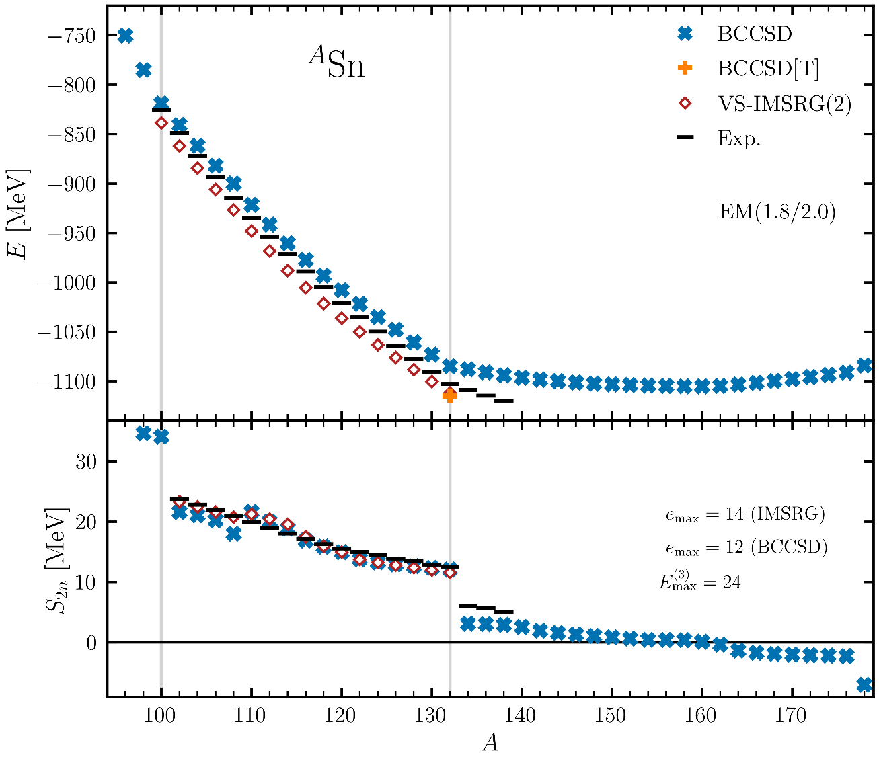
Binding energy of Sn isotopes
Demol et al., unpublished (2025)
Spherical Bogoliubov CC at BCCSD and BCCSD[T] levels
1
2
Complete chain accessible
with
3
BCCSD g.s. energy rms error vs Exp ~ 1.6%
BCCSD[T] vs VS-IMSRG(2) in ¹³²Sn = 2.4% (-0.3%)
Exaggerated N=82 magicity not corrected by triples
→Outside many-body uncertainty estimate
→Test successful χEFT interactions in new regime
Predicted drip-line location [¹⁴⁰Sn,¹⁶²Sn] fine tuned
→Subject to all sources of uncertainties
4
5
6
7
?
8
9
VS-IMSRG(2) results
Gustafsson et al., PRL (2025)
10

Slide 33
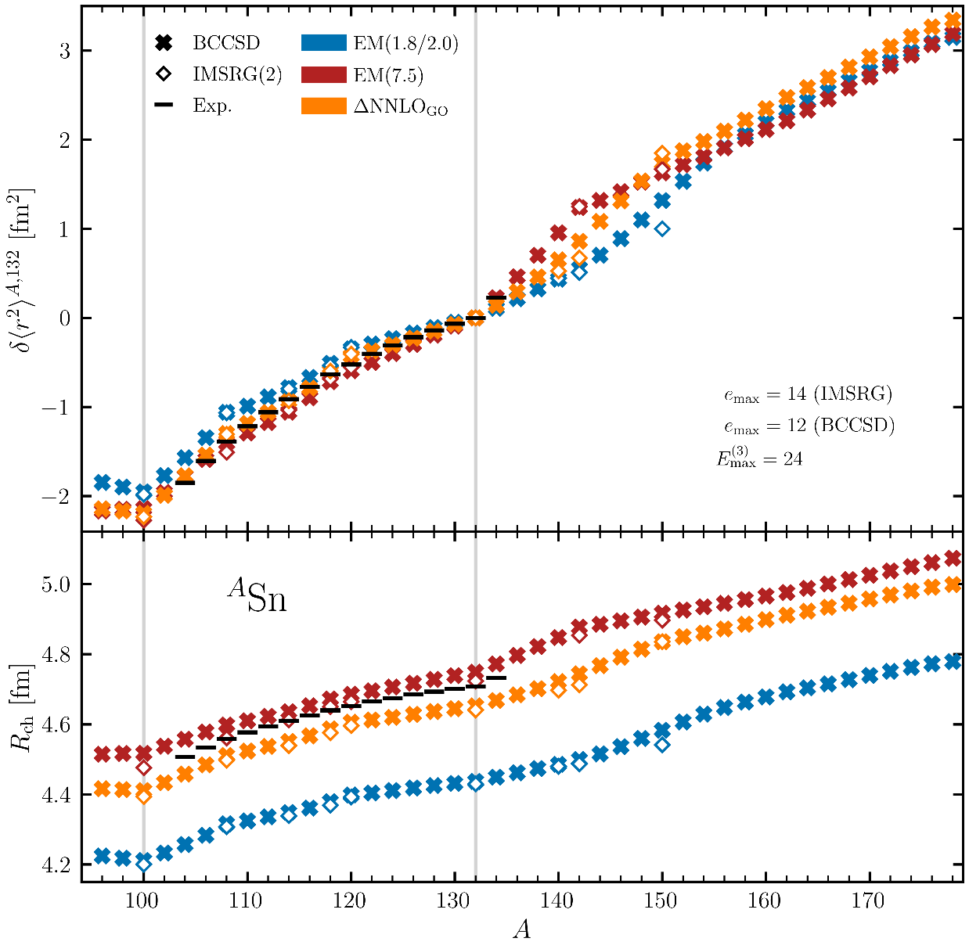
Charge radius of Sn isotopes
Demol et al., unpublished (2025)
Spherical Bogoliubov CC at BCCSD and BCCSD[T] levels
1
2
with
3
BCCSD g.s. energy rms error vs Exp ~ 1.6%
BCCSD[T] vs VS-IMSRG(2) in ¹³²Sn = 2.4% (-0.3%)
Exaggerated N=82 magicity not corrected by triples
→Outside many-body uncertainty estimate
→Test successful χEFT interactions in new regime
Predicted drip-line location [¹⁴⁰Sn,¹⁶²Sn] fine tuned
→Subject to all sources of uncertainties
4
5
Complete chain accessible
6
7
BCCSD rms error on absolute charge radii
→EM(1.8/2.0)/ΔNNLOgo/EM(7.5) = 5.6%/1.8%/0.8%
→Good agreement with IMSRG(2) for three χEFT H
→Triples correction+1-body basis error soon (~1-2%)
8
9
IMSRG(2) results
Arthuis., Priv. Comm.
Isotopic shift
→Kink through ¹³²Sn (Exp = 0.017fm)
10
Measurement of R_{ch}(¹⁰⁴⁻¹⁰⁷Sn) at CRIS@ISOLDE
Gustafsson et al., arXiv:2504.17060v1
Measurement of R_{ch}(¹³⁴Sn) at COLLAPS@ISOLDE
Gorges et al., PRL (2019)

Slide 34
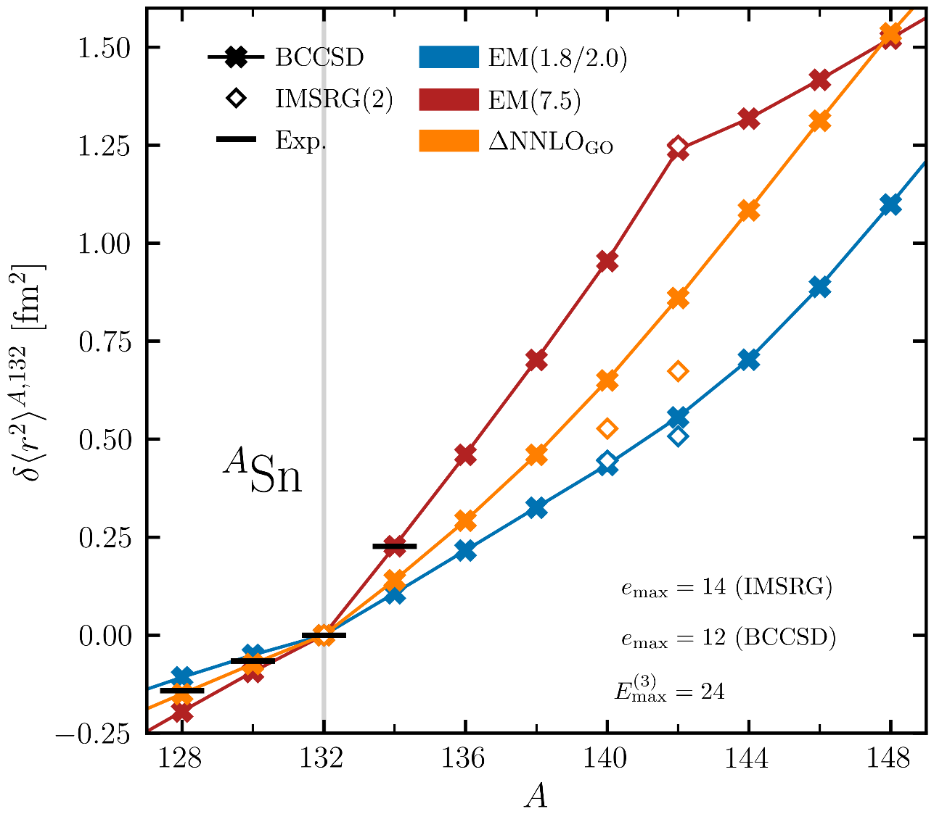
Charge radius through ¹³²Sn
Demol et al., unpublished (2025)
1
2
with
3
BCCSD g.s. energy rms error vs Exp ~ 1.6%
BCCSD[T] vs VS-IMSRG(2) in ¹³²Sn = 2.4% (-0.3%)
Exaggerated N=82 magicity not corrected by triples
→Outside many-body uncertainty estimate
→Test successful χEFT interactions in new regime
Predicted drip-line location [¹⁴⁰Sn,¹⁶²Sn] fine tuned
→Subject to all sources of uncertainties
4
5
6
7
BCCSD rms error on absolute charge radii →EM(1.8/2.0)/ΔNNLOgo/EM(7.5) = 5.6%/1.8%/0.8%
→Good agreement with IMSRG(2) for three χEFT H
→Triples correction+1-body basis error soon (~1-2%)
8
9
IMSRG(2) results
Arthuis., Priv. Comm.
Isotopic shift
→Kink through ¹³²Sn (Exp = 0.017fm)
EM(1.8/2.0)/ΔNNLOgo/EM(7.5) = 0.006/0.007/0.014fm
More difference than through ⁴⁸Ca
→Inverted kink predicted at ¹⁴²Sn for EM(7.5)
Same prediction at ⁶⁰Ca for three H
→Mechanism behind kinks being analyzed
10
Measurement of R_{ch}(¹⁰⁴⁻¹⁰⁷Sn) at CRIS@ISOLDE
Gustafsson et al., arXiv:2504.17060v1
Measurement of R_{ch}(¹³⁴Sn) at COLLAPS@ISOLDE
Arthuis et al., Priv. Comm.
Gorges et al., PRL (2019)
Neutron skin evolution
→To be reported on soon
Arthuis et al., Priv. Comm.

Slide 35
Contents
⦿ The ab initio nuclear many-body problem and many-body expansion methods
⦿ Personal selection of highlights and frontiers
⦿ Evaluating and propagating systematic interaction uncertainties
⦿ From ab initio nuclear structure to the Quark Gluon Plasma
⦿ Charge radius through ¹³²Sn
⦿ Charge radius through ⁵⁸Cr
⦿ Two-body corrections to magnetic dipole moments
⦿ Frugal many-body calculations from tensor factorization techniques
⦿ Giant resonances in doubly open-shell nuclei
⦿ Ab-initio (transition) optical potentials
⁞

Slide 36
Ab initio frontiers
SPECTROSCOPY
UNCERTAINTIES
Systematic
Single-particle excitations
Collective excitations
Clustering
Hamiltonian
¹⁶O
²⁰Ne
Tetrahedral
ground state
intrinsic density
A-body solution
[Frosini et al., 2023]
[Bally et al., 2023]
1⁻/3⁻ vibration (¹⁶O+α ↔ ¹²C + 2α) at 7.2 MeV
OPEN-SHELL
Basis representation
Novel many-body methods
Memory&CPU ⸕: Ñ^{p} → N^{q} (Ñ<<N)
Statistical
[Hergert, 2020]
MANY-BODY
METHODS
fit
ACCURACY
Algebra cost ⸕
Difficult manually
Numerical cost ⸕
Memory&CPU: N^{p} → N^{q} (q>p)
MASS
Memory&CPU ⸕: N^{p} with N ⸕
Importance of AN forces?
HAMILTONIAN
REACTIONS
[Hu et al, 2022]
S=0/S≠0 interactions
Power counting
Currents
Fit
Light nuclei
Optical potential
Transition densities

Slide 37
Mid-mass doubly open-shell nuclei…
MR-IMSRG+PGCM(-PT)
Yao et al., PRL (2020)
Frosini et al., EPJA (2022)
dCC
Hagen et al., PRC (2022)
dDSCGF
Scalesi, Duguet, Somà, unpublished
2025
^{A}Sn
What about going to mid-mass doubly open-shell?
Figure: B. Bally
Courtesy of B. Bally

Slide 38
Isotopic shift through ⁵⁸Cr
dCC
Hagen et al., PRC (2022)
dDSCGF
Scalesi, Duguet, Somà, unpublished
2025
Island of invertion south of ⁶⁸Ni
Increasing collectivity towards ⁶⁴Cr
^{A}Cr
Figure: B. Bally
N=28
N=32
N=34
N=40
Courtesy of B. Bally
Measurement of R_{ch}(⁵⁰⁻⁶²Cr) at CRIS@ISOLDE: 6 novel neutron-rich isotopes
Lalanne et al., unpublished (2025)

Slide 39
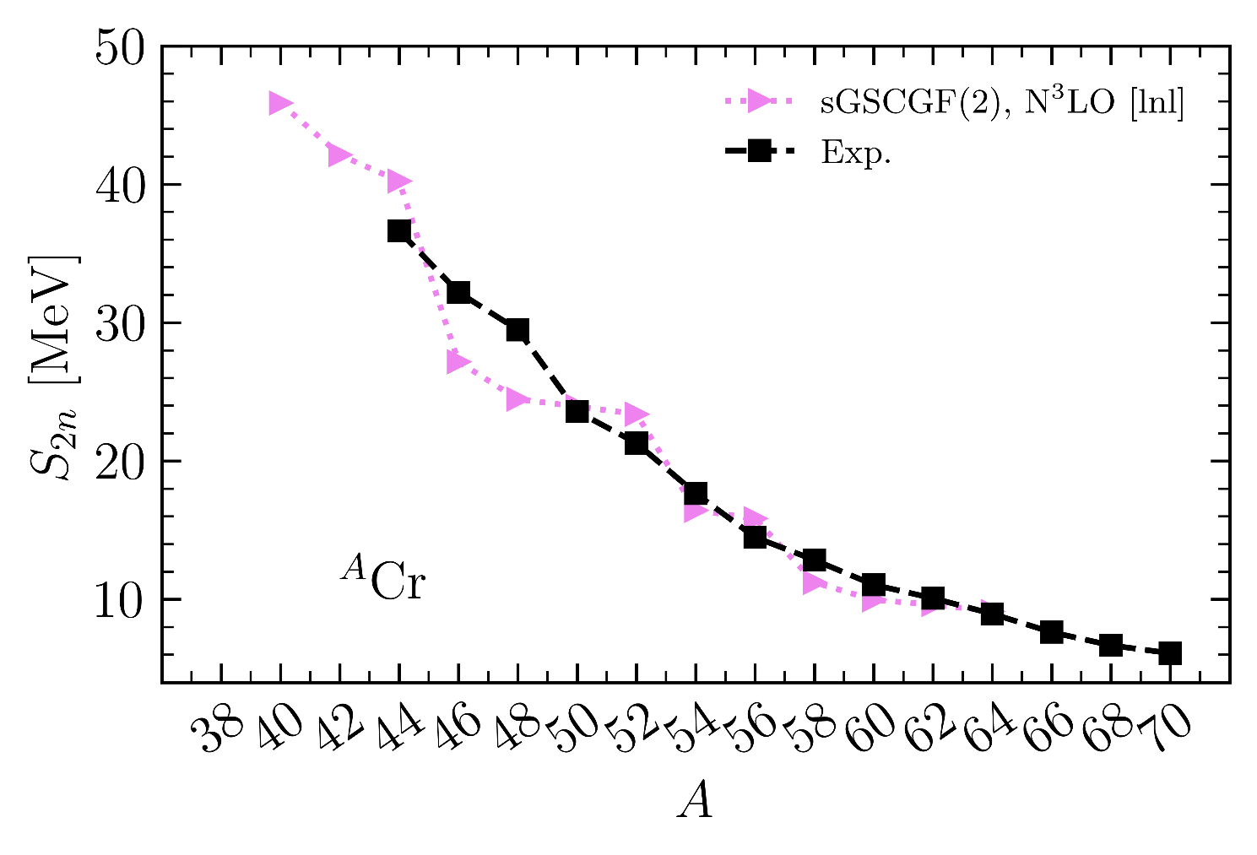
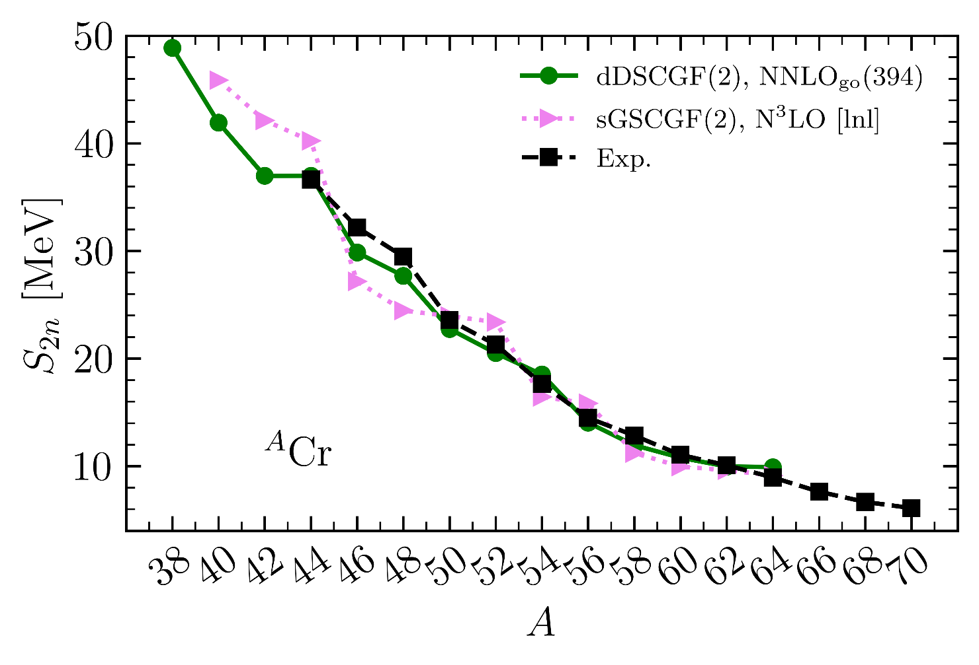
Two-neutron separation energy in Cr
Scalesi, Duguet, Somà, unpublished (2025)
Deformed Dyson Self consistent Green’s function theory
1
Full
dHF
2
1d_{3/2}
3
1f_{7/2}
ADC(2,3)
Preliminary
4
2p_{3/2}
1f_{5/2}
5
6
7
8
sGSCGF(2) results: based on a spherical HFB state
→Wrong fingerprints of neutron spherical shells
→Quadrupole correlations (very) hard to grasp via many-body expansion
dDSCGF(2): based on a deformed HF state
→Trend corrected: memory of spherical shells gone
→Quantitative reproduction achieved
→Dominant quadrupole correlations accounted for at mean-field level
9
10

Slide 40
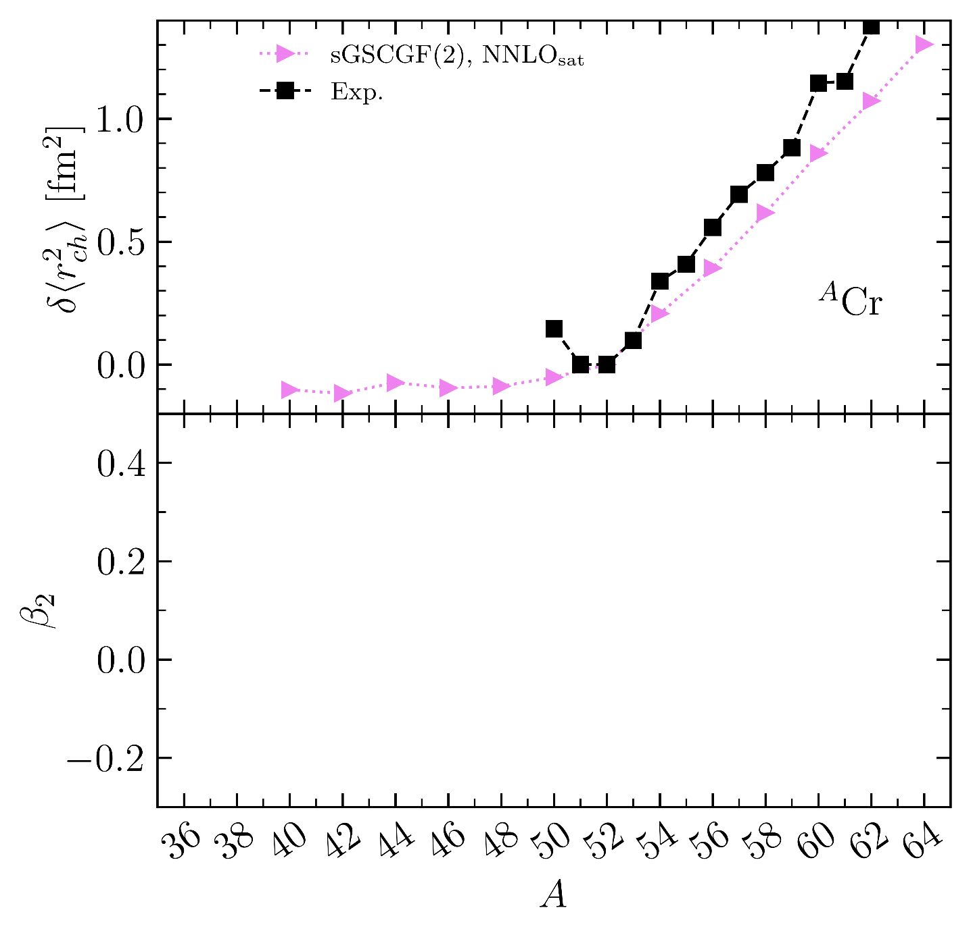
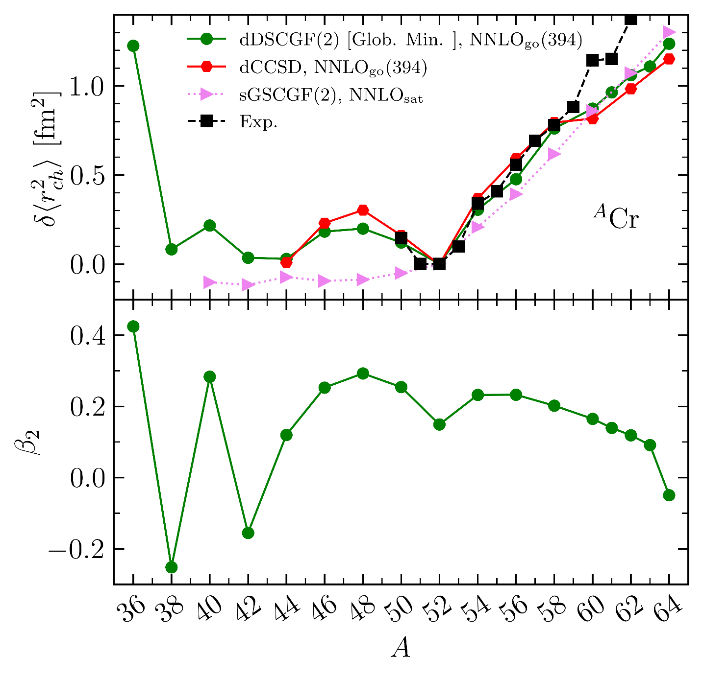
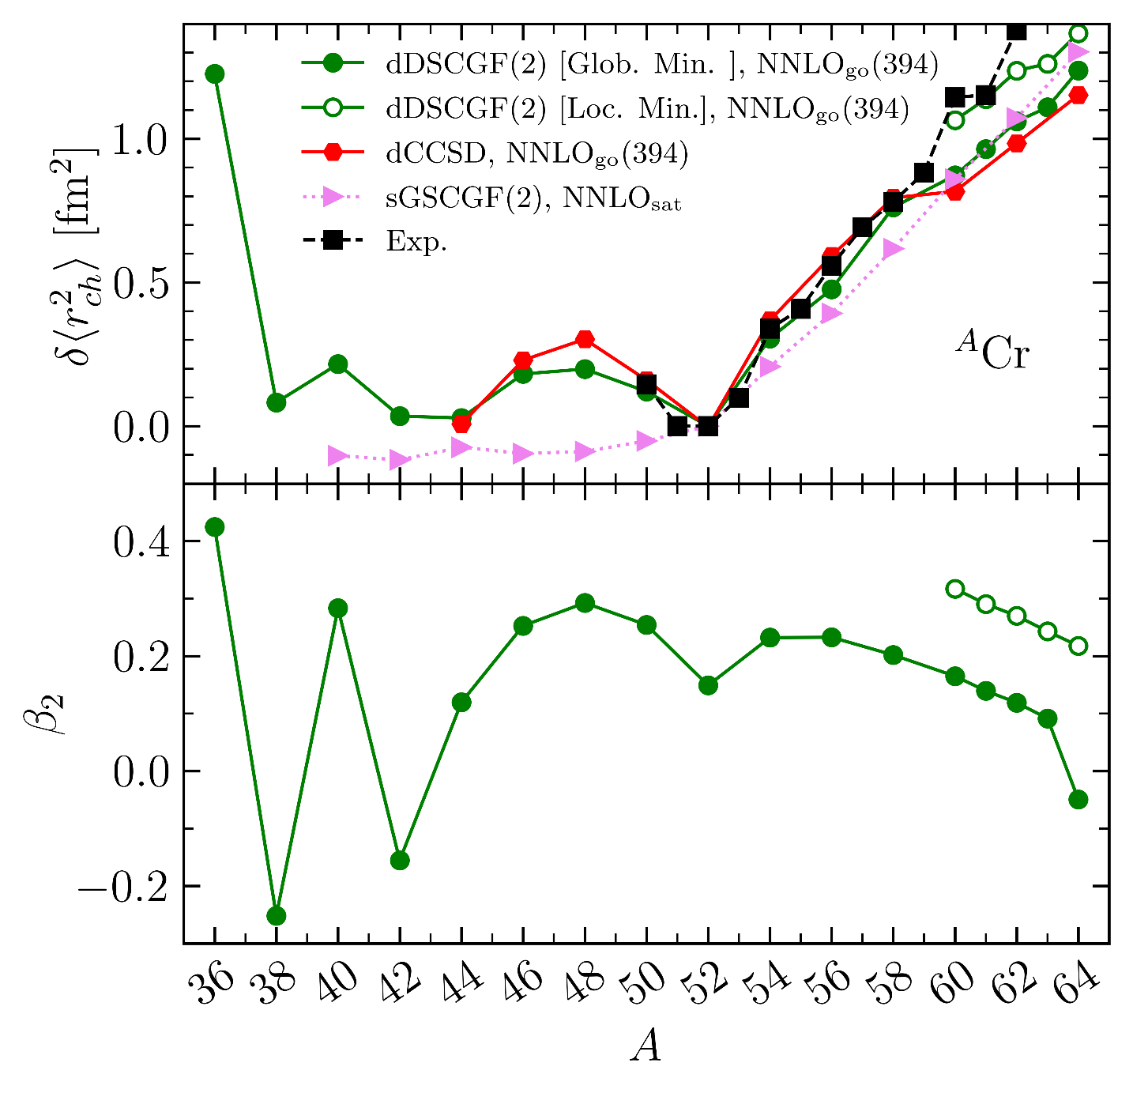
Charge radius through 58Cr
Scalesi, Duguet, Somà, unpublished (2025)
Deformed Dyson Self consistent Green’s function theory
1
2
3
4
Experimental data
→Strong kink at N=28
→Steep increase between N=28 and N=34
→Sizable jumps at N=36 and 38
5
HF defomation
6
Ab initio results
sGSCGF(2): based on a spherical HFB state
→Miss the kink at N=28
→Increase from N=28 not N=34 not steep enough
→Jump at N=36 entirely missed
dDSCGF(2): based on a deformed HF state
→Kink at N=28 reproduced + arch through f_{7/2}
→Steep increase from N=28 to N=34 reproduced
→Jump at N=36 missed
…the state becomes more spherical towards ⁶⁴Cr…
→…but not if using the more deformed shape isomer
2.6MeV too high in ⁶⁰Cr with ΔNNLOgo to be the g.s.
→Current χEFT Hamiltonians fail to reproduce IoI
7
Preliminary
8
9
10
Measurement of R_{ch}(⁵⁰⁻⁶²Cr) at CRIS@ISOLDE
Lalanne et al., unpublished (2025)
dCCSD calculations
Kortalainen et al., PRC (2022)

Slide 41
Contents
⦿ The ab initio nuclear many-body problem and many-body expansion methods
⦿ Personal selection of highlights and frontiers
⦿ Evaluating and propagating systematic interaction uncertainties
⦿ From ab initio nuclear structure to the Quark Gluon Plasma
⦿ Charge radius through ¹³²Sn
⦿ Charge radius through ⁵⁸Cr
⦿ Two-body corrections to magnetic dipole moments
⦿ Frugal many-body calculations from tensor factorization techniques
⦿ Giant resonances in doubly open-shell nuclei
⦿ Ab-initio (transition) optical potentials
⁞

Slide 42
Ab initio frontiers
SPECTROSCOPY
UNCERTAINTIES
Systematic
Single-particle excitations
Collective excitations
Clustering
Hamiltonian
¹⁶O
²⁰Ne
Tetrahedral
ground state
intrinsic density
A-body solution
[Frosini et al., 2023]
[Bally et al., 2023]
1⁻/3⁻ vibration (¹⁶O+α ↔ ¹²C + 2α) at 7.2 MeV
OPEN-SHELL
Basis representation
Novel many-body methods
Memory&CPU ⸕: Ñ^{p} → N^{q} (Ñ<<N)
Statistical
[Hergert, 2020]
MANY-BODY
METHODS
fit
ACCURACY
Algebra cost ⸕
Difficult manually
Numerical cost ⸕
Memory&CPU: N^{p} → N^{q} (q>p)
MASS
Memory&CPU ⸕: N^{p} with N ⸕
Importance of AN forces?
HAMILTONIAN
REACTIONS
[Hu et al, 2022]
S=0/S≠0 interactions
Power counting
Currents
Fit
Light nuclei
Optical potential
Transition densities

Slide 43
Two-body current corrections to magnetic dipole moment
►Electroweak properties are measured through the coupling of the nucleus with an external field
►χEFT expansion of charge and current operators through continuity equation
⦿ One-body (i.e. standard) operator
⦿ Two-body meson-exchange currents (MECs)
Magnetic dipole moment operator
= momentum transfer from external field
EM current
Current EM operator
Charge EM operator
One-body j^{LO} one factor of Q lower than ρ^{LO}
Two-body OPE enter j/ρ at NLO/N³LO
LO
LO
No new parameter
NLO
N²LO
Likely to correct LO one-body contribution to μ
N²LO
N³LO
N³LO
N⁴LO
Kolling et al., PRC (2009) BFS (2019)
Pastore et al., PRC (2008,2009,2011)

Slide 44
Two-body current corrections to magnetic dipole moment
Numerical setting
⦿ N⁰⁻³LO Norfolk interactions and currents
⦿ 2B currents up to N³LO
Piarulli et al., PRC (2015)
2025
VMC&GFMC calculations
Carlson et al., RMP (2015)
►Quasi-exact method
Courtesy of B. Bally
Light sp-shell nuclei

Slide 45
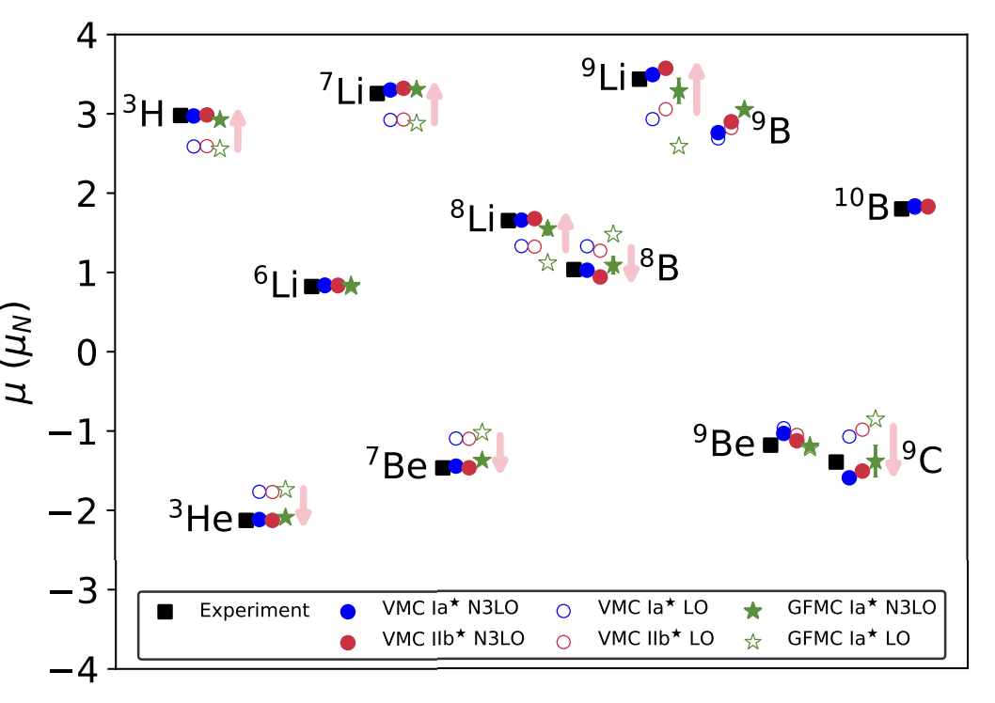
Two-body current corrections to magnetic dipole moment
►Light sp-shell nuclei
Chambers-Wall et al., PRC (2024)
Significant contribution from 2B MECs (up to 35%)
→ Improve systematically agreement with data
→ Positive (negative) for neutron (proton) rich nuclei
→ Understood from cluster and universal short-range
→ Fit LECs at N³LO spoil order-by-order
What about in heavier systems?

Slide 46
Two-body current corrections to magnetic dipole moment
Numerical setting
⦿ Chiral-based Hamiltonian EM 1.8/2.0
⦿ 2B currents at NLO
⦿ e_{max} = 14 and e_{3max} = 28 (1% uncertainty)
Hebeler et al., PRC (2011)
2025
²⁰⁷Tl, ²⁰⁹Bi
sVS-IMSRG(2) calculations
Stroberg et al., ARNPS (2019)
►Non-polynomial method
¹³¹In, ¹³³Sb
³⁷C^{, 39}K,^{37,39,41}Ca, ⁴¹Sc
Figure: B. Bally
¹⁷O,¹⁷F
Courtesy of B. Bally
Doubly closed shell +\-1 with A=17-209

Slide 47
Two-body current corrections to magnetic dipole moment
►Light sp-shell nuclei
Chambers-Wall et al., PRC (2024)
Significant contribution from 2B MECs (up to 35%)
→ Improve systematically agreement with data
→ Positive (negative) for neutron (proton) rich nuclei
→ Understood from cluster and universal short-range
→ Fit LECs at N³LO spoil order-by-order
What about in heavier systems?
Myiagi et al., PRL (2024)
►Doubly-closed shell +\-1 medium-heavy nuclei
►One-body (Schmidt) value does not explain data
→ Many-body correlations and 2-body currents are key
→ Cross-shell excitations can be crucial (e.g. ⁴¹Ca)
→ Improvement less systematic in mid-shell nuclei
►Small interaction uncertainty
→ More pronounced in mid-shell nuclei
►2BC increases with mass due to Sachs’ contribution
Consistent with dCCSD results in ^{39,41*,47,49,51}Ca
Acharya et al., PRL (2024)
→ 2BC must also be added to compute B(M1) transitions!

Slide 48
Contents
⦿ The ab initio nuclear many-body problem and many-body expansion methods
⦿ Personal selection of highlights and frontiers
⦿ Evaluating and propagating systematic interaction uncertainties
⦿ From ab initio nuclear structure to the Quark Gluon Plasma
⦿ Charge radius through ¹³²Sn
⦿ Charge radius through ⁵⁸Cr
⦿ Two-body corrections to magnetic dipole moments
⦿ Frugal many-body calculations from tensor factorization techniques
⦿ Giant resonances in doubly open-shell nuclei
⦿ Ab-initio (transition) optical potentials
⁞

Slide 49
Ab initio frontiers
SPECTROSCOPY
UNCERTAINTIES
Systematic
Single-particle excitations
Collective excitations
Clustering
Hamiltonian
¹⁶O
²⁰Ne
Tetrahedral
ground state
intrinsic density
A-body solution
[Frosini et al., 2023]
[Bally et al., 2023]
1⁻/3⁻ vibration (¹⁶O+α ↔ ¹²C + 2α) at 7.2 MeV
OPEN-SHELL
Basis representation
Novel many-body methods
Memory&CPU ⸕: Ñ^{p} → N^{q} (Ñ<<N)
Statistical
[Hergert, 2020]
MANY-BODY
METHODS
fit
ACCURACY
Algebra cost ⸕
Difficult manually
Numerical cost ⸕
Memory&CPU: N^{p} → N^{q} (q>p)
MASS
Memory&CPU ⸕: N^{p} with N ⸕
Importance of AN forces?
HAMILTONIAN
REACTIONS
[Hu et al, 2022]
S=0/S≠0 interactions
Power counting
Currents
Fit
Light nuclei
Optical potential
Transition densities

Slide 50
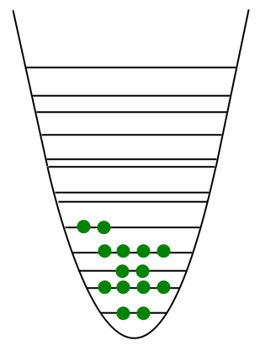
Tensor factorization techniques
HO single-particle basis
⦿ Expansion many-body methods formulated in terms of tensors and tensor networks
1) Input tensors: the Hamiltonian
k-body force
↕
2k-index tensor
a = (n_{a},l_{a},j_{a},m_{a},t_{a})
e_{1max}
↕
n_{dim}
ã = (n_{a},l_{a},j_{a})
ň_{dim} << n_{dim}
Naive storage cost n_{dim}^{2k}
►Grows polynomially with n_{dim}
►Grows exponentially with interaction rank k
ħω
►JT-coupled matrix elements (decoupling on-the-fly)
► Rank-reduction of V^{3N}

Slide 51
Tensor factorization techniques
⦿ Many-body calculations employ tensors and compute tensor networks
1) Input tensors: the Hamiltonian
HFB
Wick
theorem
n_{dim}⁵ cost
2) Output tensors: the wave function
Ex1: BMBPT(2)
Unknown mode-4 tensor
BMBPT(2)
J-sheme for sBMBPT up to A~200 ►OK
M-scheme for _{t}dBMBPT ►too expensive to compute and store
Storage n_{dim}⁴ cost
Tensor network of n_{dim}⁴ cost

Slide 52
Going 1) heavier 2) doubly open-shell 3) greater accuracy
⦿ Many-body calculations employ tensors and compute tensor networks
Elster et al., PRC (1997)
1) Input tensors: the Hamiltonian
2) Output tensors: the wave function
Ex2: PGCM unperturbed state for PGCM-PT
HFB states
Off-diagonal one-body density matrices
n_{gcm}²n_{proj} mode-2 tensors of size n_{dim}xn_{dim}
GCM mixing
Symmetry restoration
→Quickly redundant for large scale PGCM
►HFB (PNP), triaxial (3d AMP), octuple (PP), several GC
n_{gcm}²n_{proj} kernels quadratic in density matrices costing n_{dim}⁴
→Makes (very) large-scale PGCM (very) expensive

Slide 53
Tensor factorization of many-body tensor in _{t}BMBPT(2)
⦿ Triaxial BMBPT(2) up to ⁷²Kr in large bases
►Undoable full fledged
Frosini, Duguet, Tamagno, EPJA (2024)
Tensor factorize via randomize (truncated) SVD without ever constructing
Laplace transform
Matrix-less rSVD
TF for 1% error
_{a,t}BMBPT(2)
HFB PES
rSVD
n_{dim}
Gain becomes very significant for large e_{max}
Compression by 10⁴ for 1% error on ΔE⁽²⁾₀ at e_{max}=16 (n_{dim}=4000) ↔ Effective e_{max} = 7 calculations
To be extended to 1) _{a,t}BMBPT(3) for greater accuracy
2) non-perturbative methods such as BCC
Zurek, Duguet, Ebran, Frosini, unp. (2024)
Much greater gain expected for initially much costlier approaches

Slide 54
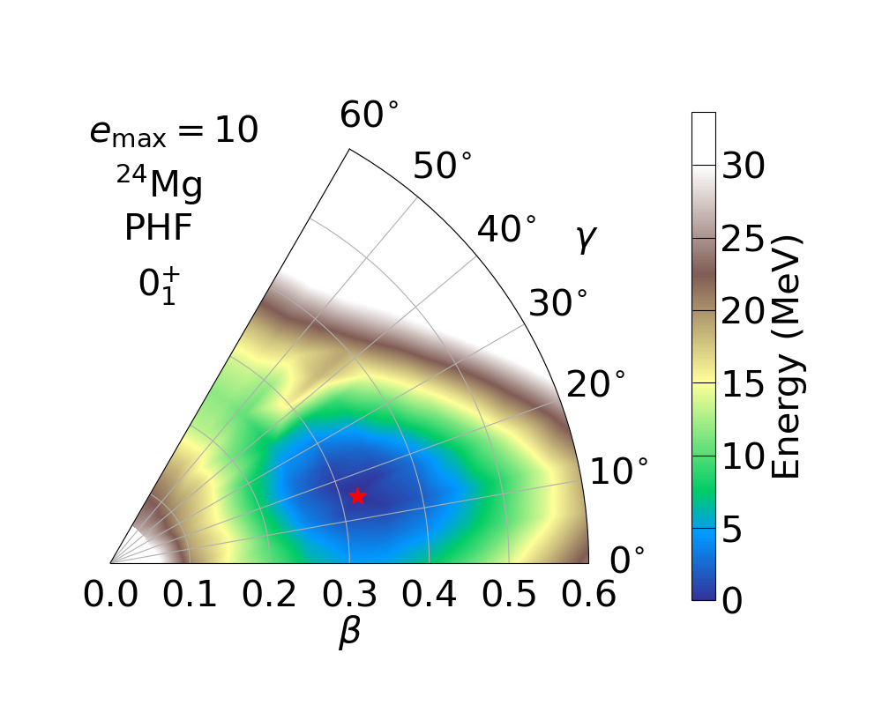
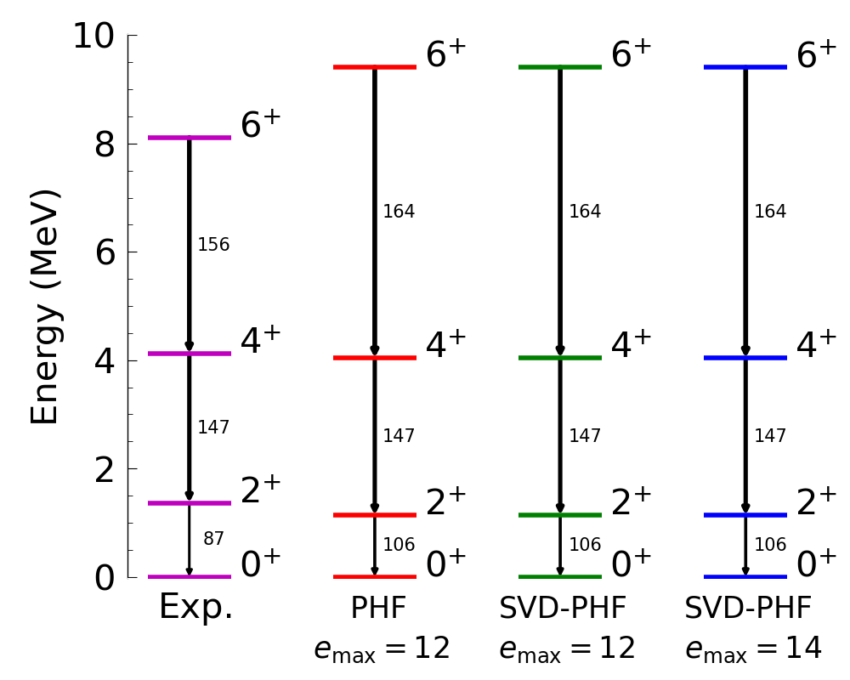
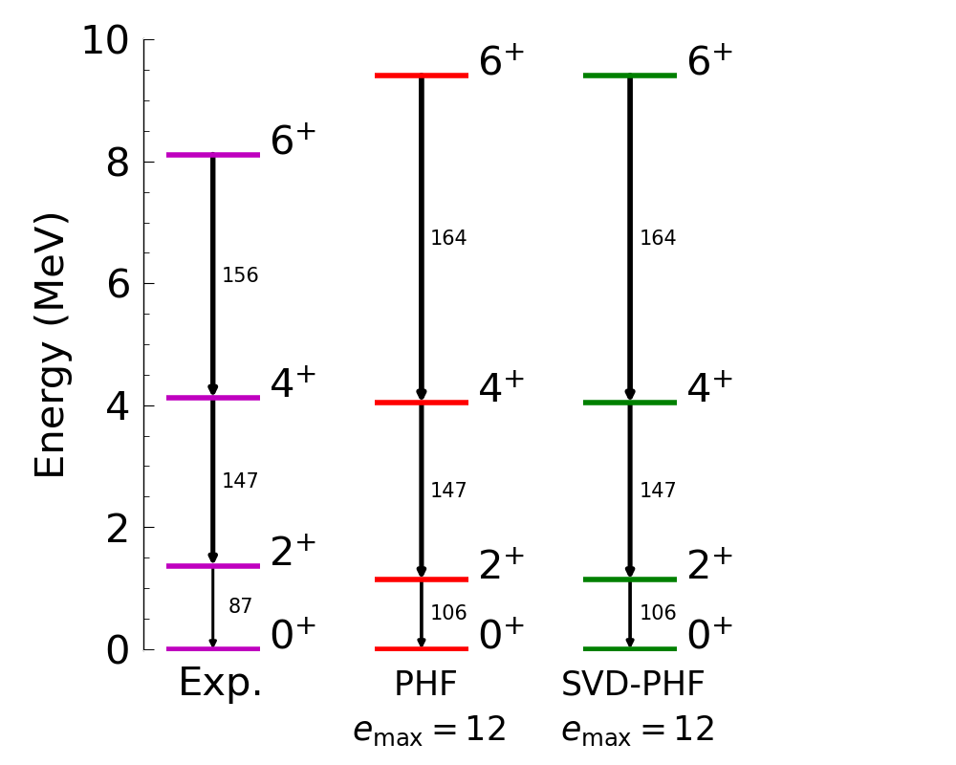
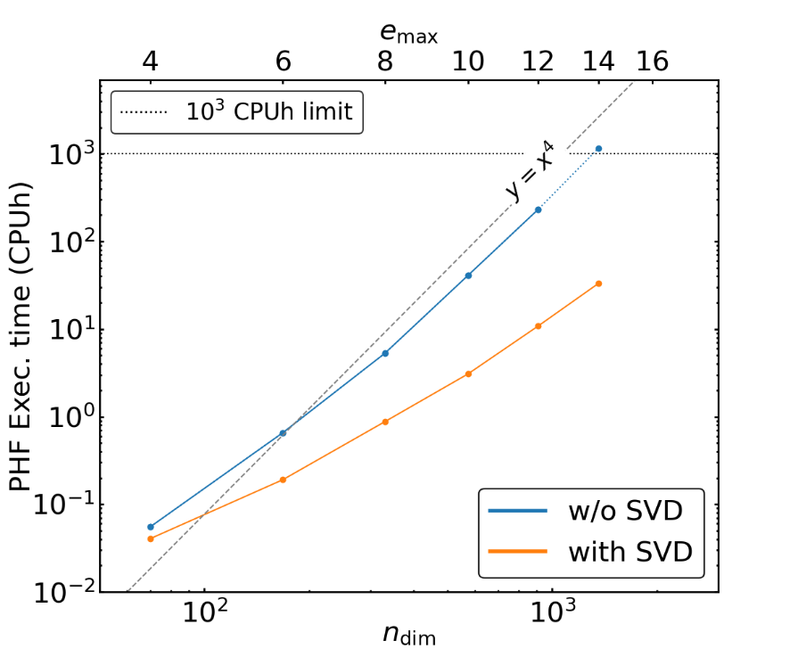

Dimensionality reduction of PGCM calculations
⦿ PHF triaxial ²⁴Mg in large bases
►Undoable full fledged
Bofos, Bally, Duguet, Frosini, unp. (2024)
Compress via randomize SVD
$rm≪$ $n_{proj}n_{gcm}^{2}$
N³LO V^{2N} Hüther et al., PLB (2020)
_{t}PHF
n_{proj}=1.510⁴
²⁴Mg
n_{gcm}=1
rSVD
r_{m}=400
Range of SVD r_{m} converges for large n_{dim} at 2-3% of n_{proj} → Excellent agreement with exact _{t}PHF
Exact _{t}PHF at e_{max}=14 undoable becomes now doable
►scaling n_{proj}n_{gcm}²n_{dim}⁴ → r_{m}n_{dim}⁴
Extension to actual PGCM calculations (n_{gcm} >>1) under way
Large scale PGCM(-PT) applications + algorithm to search for optimal set of generator coordinates

Slide 55
Contents
⦿ The ab initio nuclear many-body problem and many-body expansion methods
⦿ Personal selection of highlights and frontiers
⦿ Evaluating and propagating systematic interaction uncertainties
⦿ From ab initio nuclear structure to the Quark Gluon Plasma
⦿ Charge radius through ¹³²Sn
⦿ Charge radius through ⁵⁸Cr
⦿ Two-body corrections to magnetic dipole moments
⦿ Frugal many-body calculations from tensor factorization techniques
⦿ Giant resonances in doubly open-shell nuclei
⦿ Ab-initio (transition) optical potentials
⁞

Slide 56
Ab initio frontiers
SPECTROSCOPY
UNCERTAINTIES
Systematic
Single-particle excitations
Collective excitations
Clustering
Hamiltonian
¹⁶O
²⁰Ne
Tetrahedral
ground state
intrinsic density
A-body solution
[Frosini et al., 2023]
[Bally et al., 2023]
1⁻/3⁻ vibration (¹⁶O+α ↔ ¹²C + 2α) at 7.2 MeV
OPEN-SHELL
Basis representation
Novel many-body methods
Memory&CPU ⸕: Ñ^{p} → N^{q} (Ñ<<N)
Statistical
[Hergert, 2020]
MANY-BODY
METHODS
fit
ACCURACY
Algebra cost ⸕
Difficult manually
Numerical cost ⸕
Memory&CPU: N^{p} → N^{q} (q>p)
MASS
Memory&CPU ⸕: N^{p} with N ⸕
Importance of AN forces?
HAMILTONIAN
REACTIONS
[Hu et al, 2022]
S=0/S≠0 interactions
Power counting
Currents
Fit
Light nuclei
Optical potential
Transition densities

Slide 57
Collective excitations in doubly open-shell nuclei
2025
PGCM-PT calculations
Frosini et al., EPJA (2022)
²⁴Mg
²⁰Ne
Courtesy of B. Bally

Slide 58
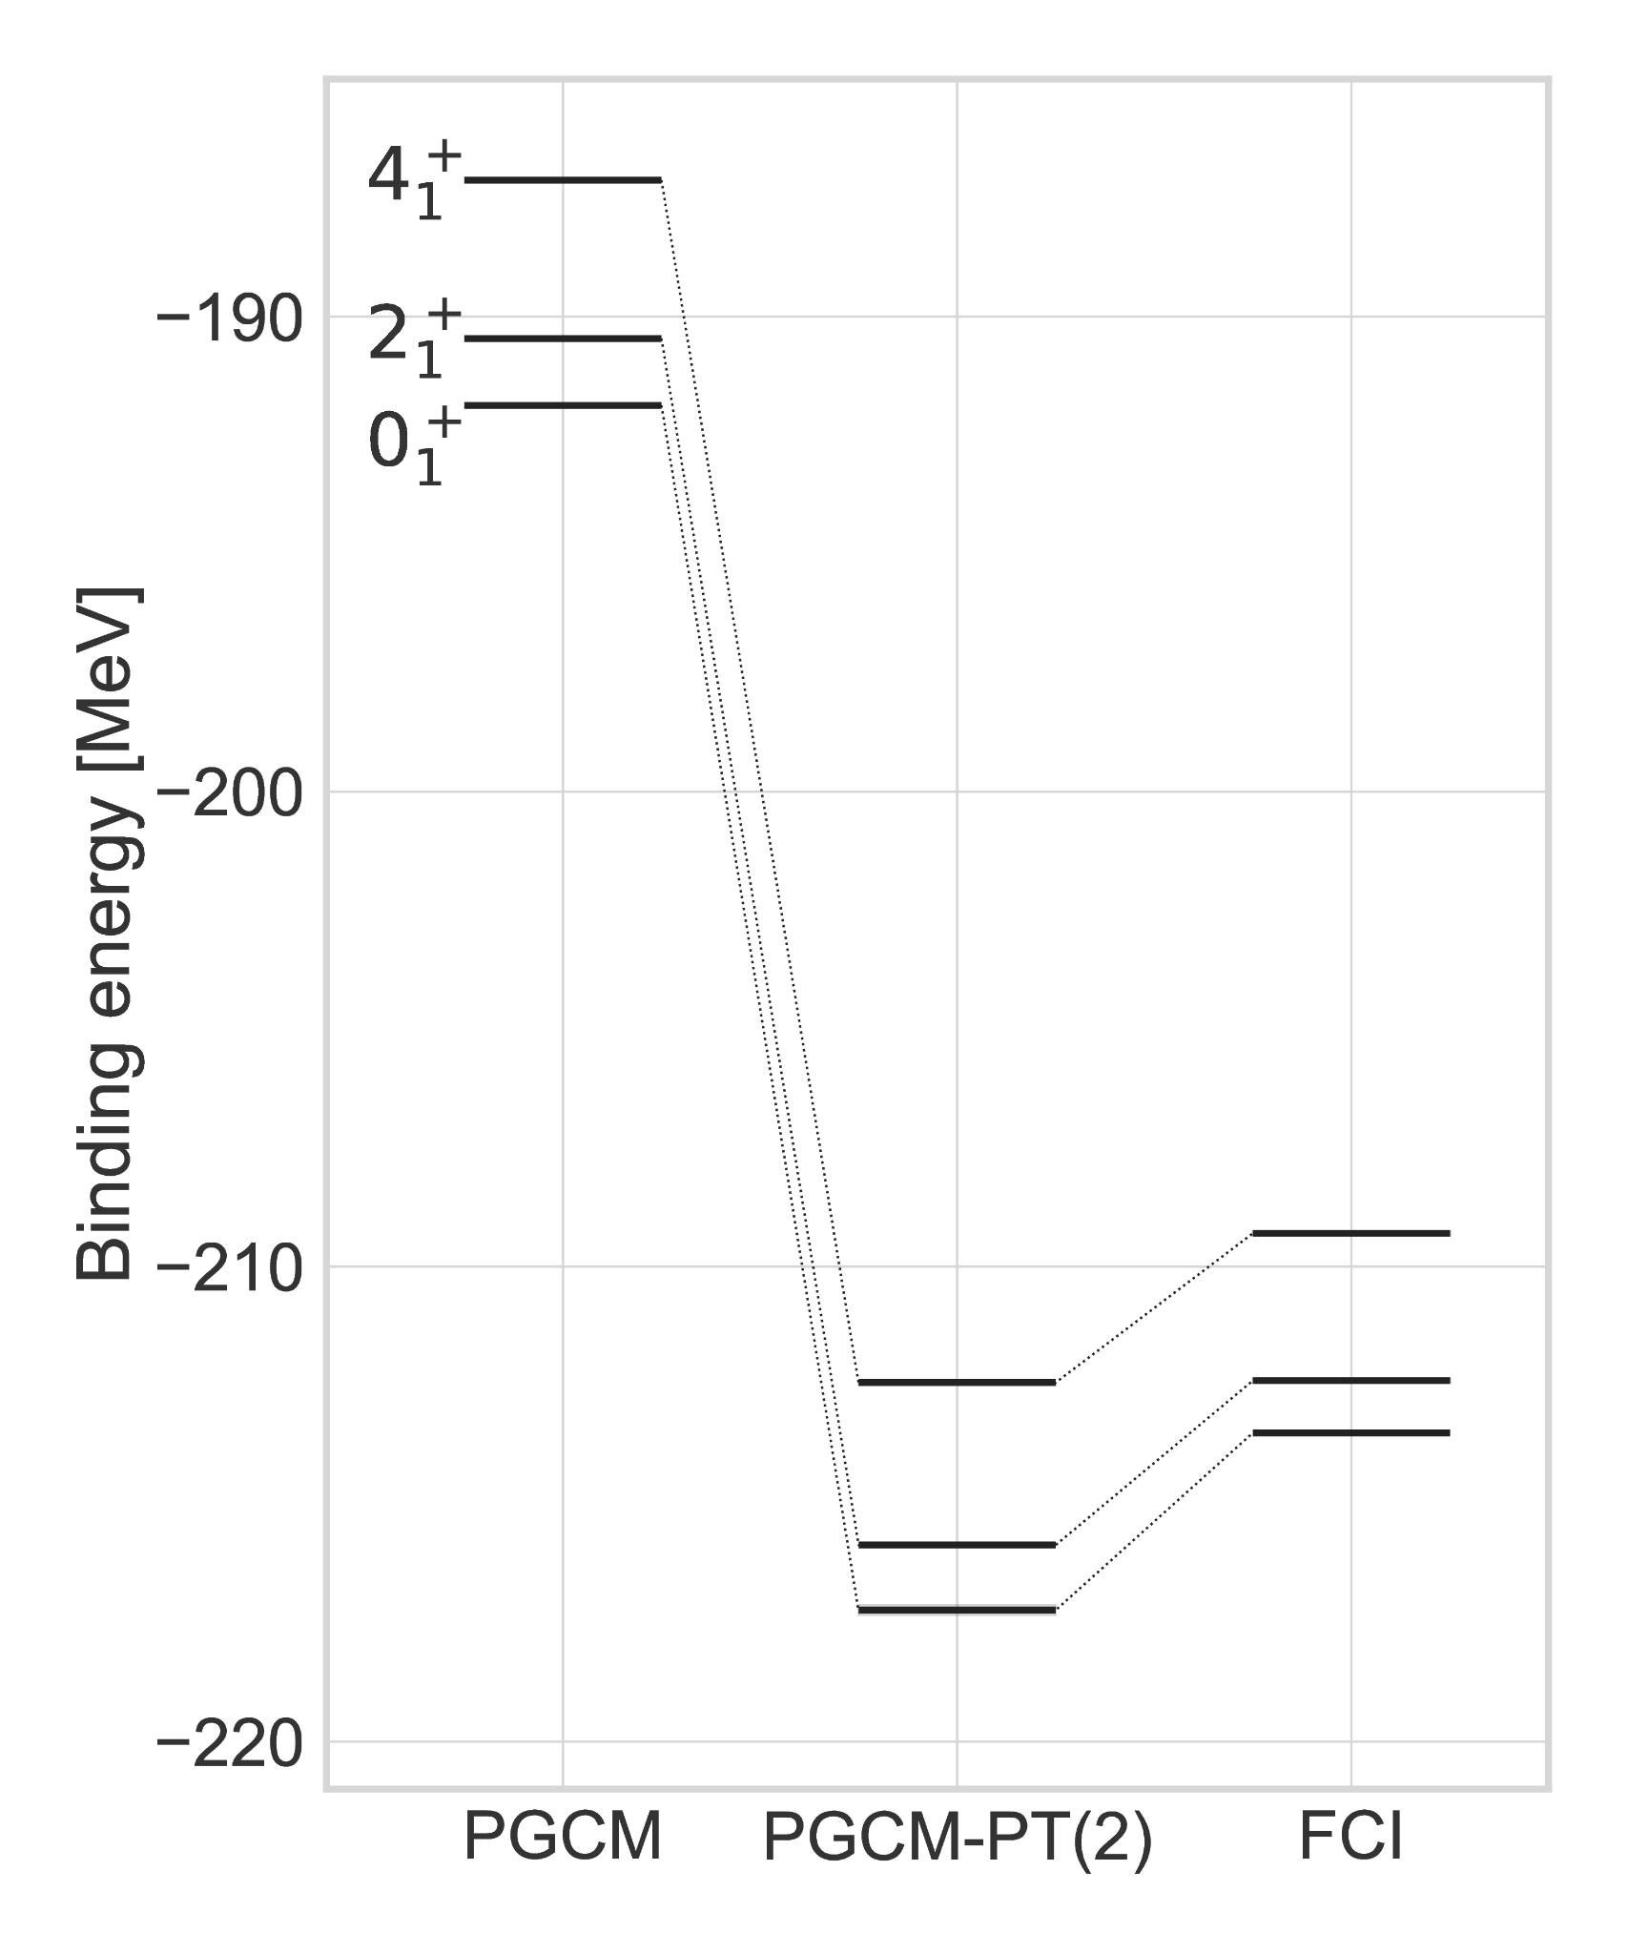
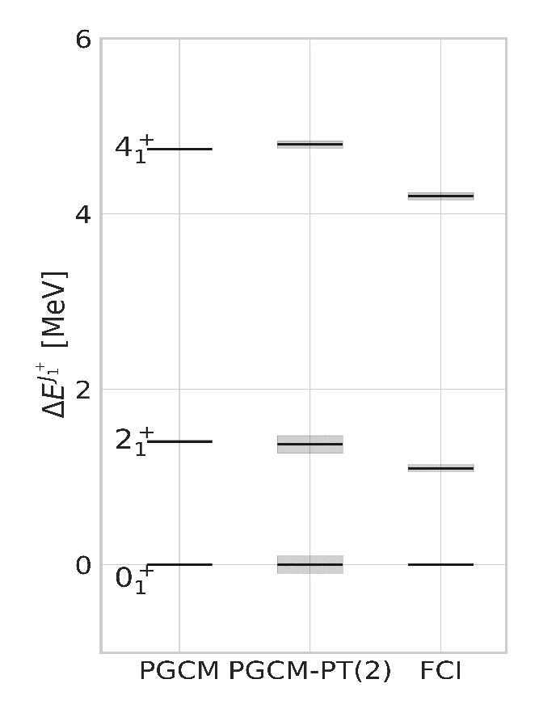
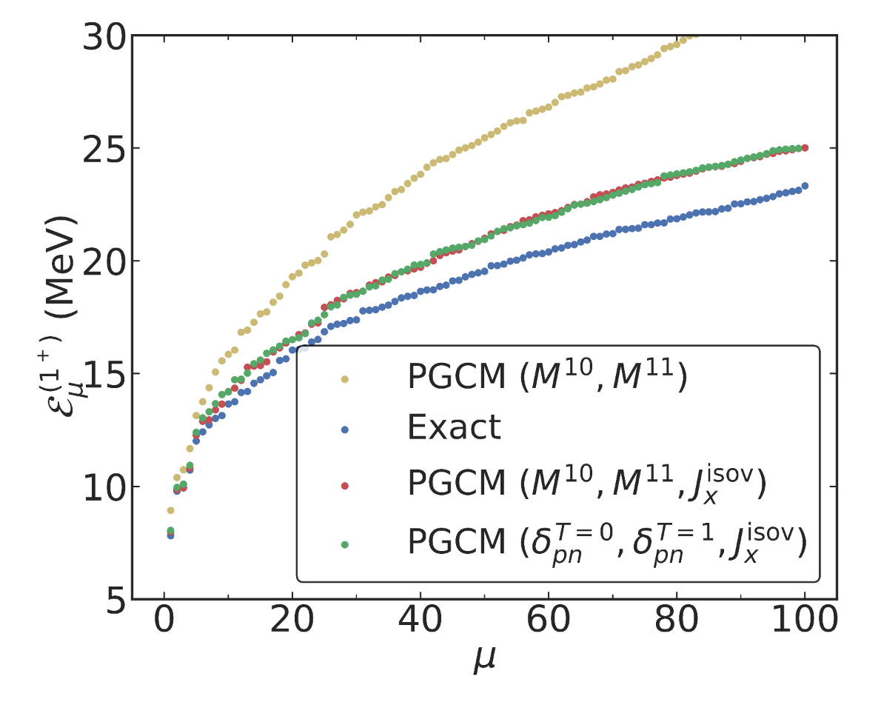

Static versus dynamical correlations in collective excitations
PGCM-PT(2)
Yrast states
Ground-state rotational band
PGCM
Frosini et al., EPJA (2022)
2N χEFT
²⁰Ne
Static correlations = long-range collective correlations
²⁰Ne
Dynamical correlations = short range
Numerical setting
►e_{max} = 4, hω = 20 MeV
►N³LO V^{2N} Hüther et al., PLB (2020)
►λ_{srg} = 1.88 fm-1
Frosini et al., EPJA (2022)
PAN@CEA
1⁺ unnatural parity states
²⁴Mg
$$𝓔_{μ}^{\left(1^{+}\right)}\text{=} E_{μ}^{(1^{+})}−E_{1}^{(0^{+})}$$
Dynamical correlations vs FCI
→ Essential for absolute energies
→ Cancel out in low-lying members of GS rotational band
sd valence space
1⁺ excitations (IVM1 GR at 9.9-10.7 MeV) vs VS-CI
[0,12]/[12,18]/[18,25] MeV → Best rms error = 100/820/1700 keV
→ Cancellation of dynamical correlations validated
→ Deteriorates with excitation energy (1→7% for 10→25MeV)
→ Depends on generator coordinates used (non-adiabatic?)
CI
Bofos et al., unp. (2024)
►Standalone ab initio PGCM = good first approximation to collective spectroscopy

Slide 59
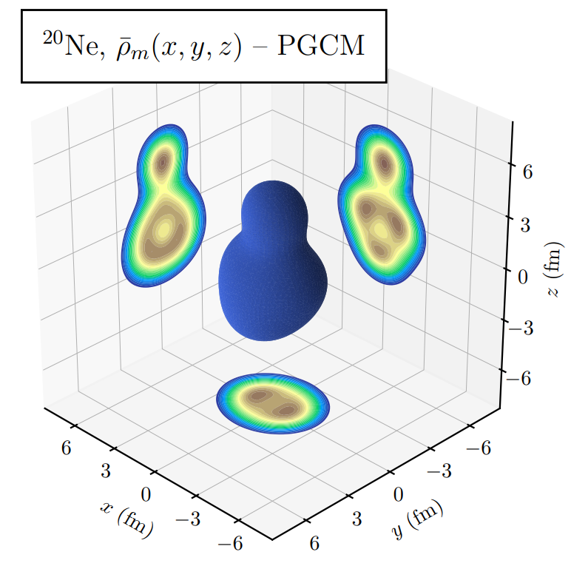
Rotational bands in ²⁰Ne from 2D PGCM
PGCM
Clustering in ²⁰Ne
PGCM
Numerical setting
►e_{max} = 10, e_{3max} = 14
►N³LO V^{2N} + V^{3N} Hüther et al., PLB (2020)
►λ_{srg} = 1.88 fm-1
Giacalone et al., unp. (2024)
Ground-state and first negative parity bands
TAURUS
Bally, Rodriguez., EPJA. (2024)
β₂, β₃
²⁰Ne
Rotational bands in ²⁰Ne
→ 2₁⁺ and 4₁⁺ validated against IM-NCSM
→ Good agreement with data (ΔE and B(E2))
→ Chiral expansion uncertainty negligible
Evolution with N less convincing
→ Deterioration towards highland of inversion
→ Better coordinates (&better Hamiltonian?)
Frosini et al., EPJA (2022)
PAN@CEA

Slide 60
Giant resonances in doubly open-shell nuclei
2025
PGCM + QRPA calculations
All mid-mass nuclei
Courtesy of B. Bally

Slide 61
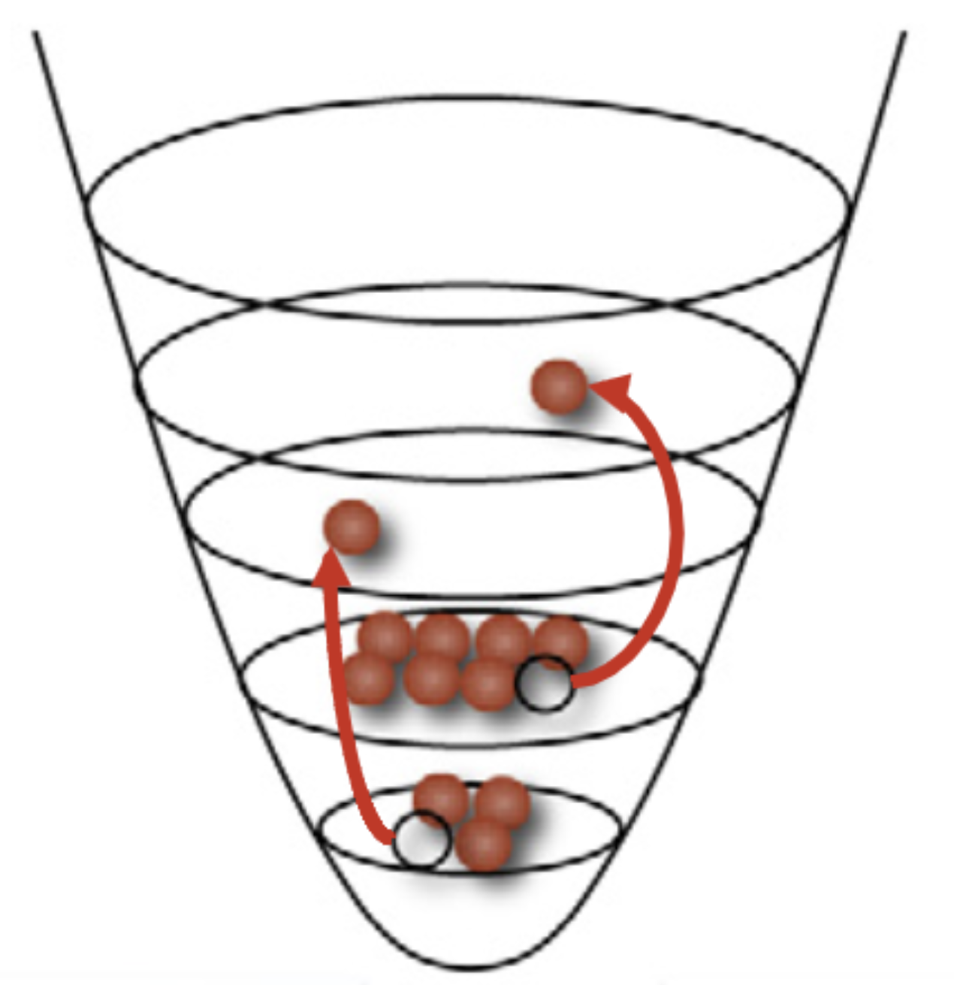

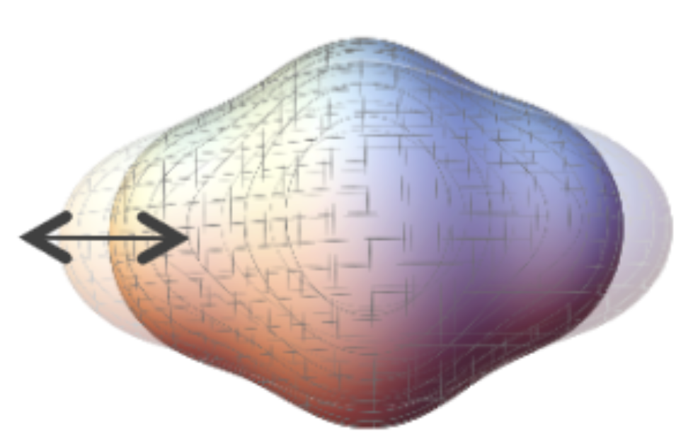
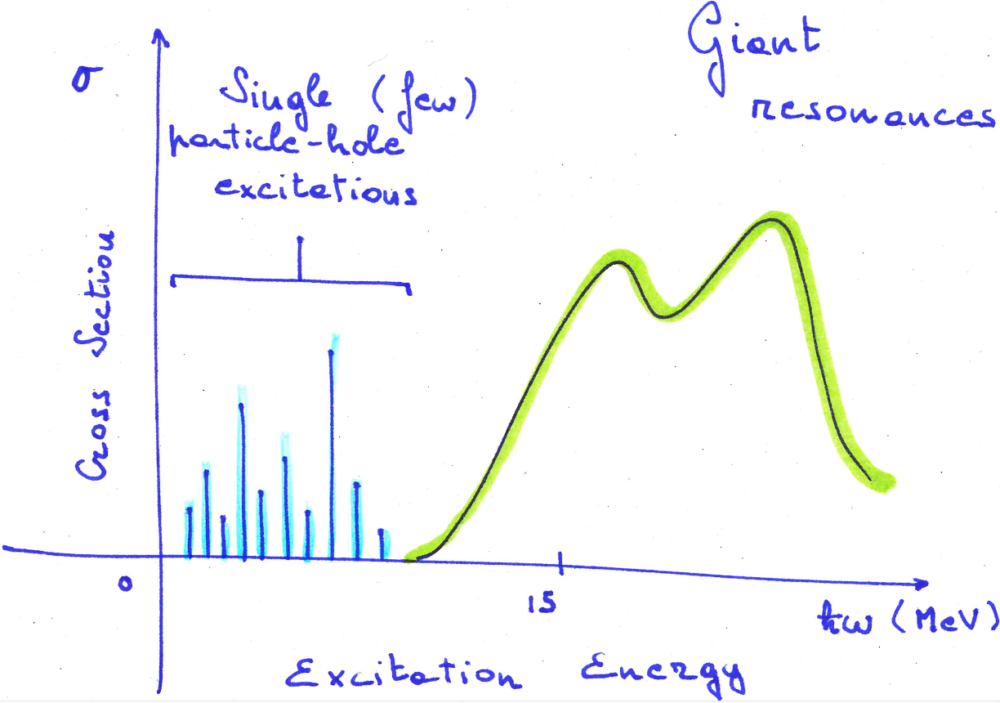
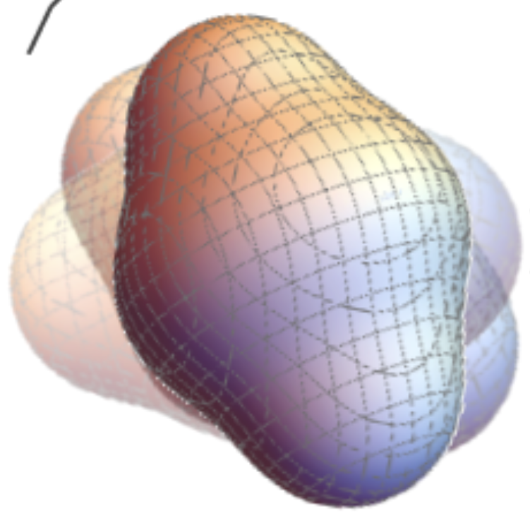



Giant resonances in doubly open-shell nuclei
$$σ$$
Single (few)
Particle-hole
excitations
Giant Resonances
►Nuclear structure
►Constrain equation of state
►Nuclear applications
Cross Section
6⁺
8⁺
2⁺
4⁺
PGCM + Harmonic limit of GCM = QRPA
Rotations
Liquid drop picture
vibrations, oscillations
Numerical setting
►e_{max} = 12, e_{3max} = 14
►N^{k}LO V^{2N} + V^{3N} Hüther et al., PLB (2020)
►λ_{srg} = 1.88 fm-1
I
0
15
$ℏω$ [MeV]
PAN@CEA
Excitation Energy
ISGMR (L=0) on shape isomer
Double ISGQR
Systematic IVGDR up to A=56
PGCM 2D (r²,β₂)
Porro et al., unp. (2024)
Porro et al., EPJA (2024)
González-Miret et al., unp. (2024)
PGCM 1D (β₂)
Triaxial QRPA
Ground-state vs exp: Ok (compressibility)
Shape-isomer: defies Brink-Axel Hypothesis
►Would be a first experimentally
Few exp cases 20y back
Novel ab initio predictions
►Experimental revival?
(n,γ) rates
PDR ↔ E1 polarizability ↔ neutron skin
►systematic: Astro&Nuclear data

Slide 62
Contents
⦿ The ab initio nuclear many-body problem and many-body expansion methods
⦿ Personal selection of highlights and frontiers
⦿ Evaluating and propagating systematic interaction uncertainties
⦿ From ab initio nuclear structure to the Quark Gluon Plasma
⦿ Charge radius through ¹³²Sn
⦿ Charge radius through ⁵⁸Cr
⦿ Two-body corrections to magnetic dipole moments
⦿ Frugal many-body calculations from tensor factorization techniques
⦿ Giant resonances in doubly open-shell nuclei
⦿ Ab-initio (transition) optical potentials
⁞

Slide 63
Ab initio frontiers
SPECTROSCOPY
UNCERTAINTIES
Systematic
Single-particle excitations
Collective excitations
Clustering
Hamiltonian
¹⁶O
²⁰Ne
Tetrahedral
ground state
intrinsic density
A-body solution
[Frosini et al., 2023]
[Bally et al., 2023]
1⁻/3⁻ vibration (¹⁶O+α ↔ ¹²C + 2α) at 7.2 MeV
OPEN-SHELL
Basis representation
Novel many-body methods
Memory&CPU ⸕: Ñ^{p} → N^{q} (Ñ<<N)
Statistical
[Hergert, 2020]
MANY-BODY
METHODS
fit
ACCURACY
Algebra cost ⸕
Difficult manually
Numerical cost ⸕
Memory&CPU: N^{p} → N^{q} (q>p)
MASS
Memory&CPU ⸕: N^{p} with N ⸕
Importance of AN forces?
HAMILTONIAN
REACTIONS
[Hu et al, 2022]
S=0/S≠0 interactions
Power counting
Currents
Fit
Light nuclei
Optical potential
Transition densities

Slide 64


Ab initio(-based) optical potential
Optical potential
Phenomenological OP
Accurate elastic scattering of known nuclei
Used to analyze multiple variety of nuclear reactions
Lack predictive power away from known data
Nucleon-nucleus elastic scattering
Extension to inelastic scattering
Input to a wide variety of nuclear reactions

Slide 65
Ab initio(-based) optical potential
Optical potential
Microscopic OP
Expected to be less accurate in low-order approximations
Promise of consistency
Expected to better extrapolate (with uncertainty)
Can constrain/inform phenomenological potentials
Nucleon-nucleus elastic scattering
Extension to inelastic scattering
Input to a wide variety of nuclear reactions
Basic OP formalism
Recent developments following different routes
Kerman, McManus, Thaler, AoP (1959)
SCGF irreducible self-energy
CC-based Green’s function inversion
NCSM-based Green’s function inversion
Chiral-symmetry inspired OP
Double-folding OP from chiral EFT
G-matrix based OP
Microscopically-inspired dispersive OP
SA-NCSM-based multiple scattering theory
SCGF-based multiple scattering theory
Feshbach, AoP (1962)
Idini, Barbieri, Navrátil, PRL (2019).
Picklesimer et al., PRC (1984)
Rotureau, FiP.(2020)
Watson, PR (1957)
Baker et al., FiP (2023)
Whitehead, Lim, Holt, PRL (2021)
Durant, Capel, PRC (2022)
Arellano, Brieva, Love, PRC (1995); Kohno, PRC (2020)
Atkinson et al., PRC (2020)
Baker et al., PRC (2024)
Vorabbi et al., PRC (2024)

Slide 66
Ab initio(-based) optical potential
Numerical setting
Optimal for radii → Key to diffraction minima in dσ/dΩ
⦿ Chiral-based Hamiltonian NNLO_{sat}
⦿ e_{max} = 13 (300 for T) and e_{3max} = 16 (small uncertainty in dσ/dΩ)
Ekström et al., PRC (2015)
2025
Watson MST calculations
Chinn et al., PRC (1995)
based on
sGSCGF-ADC(2) calculations
Somà et al., PRC (2011)
^{A}Ni
^{A}Ca
Semi-magic mid-mass nuclei
Courtesy of B. Bally

Slide 67
Ab initio(-based) optical potential
Watson potential multiple scattering theory
Phenomenological
Elster et al., PRC (1997)
Watson, PR (1957)
Ab initio
Vorabbi et al., PRC (2024) [Baker et al., PRC (2024)]
Chinn et al., PRC (1995)
Consistent structure and reaction components
sGSCGF → mid-mass singly open-shell nuclei Complementary to SCGF self-energy at lower energies
Approximations
First-order in the spectator expansion
Impulse Approximation (intermediate energies)
Schematically
Elastic transition amplitude
Optical potential
Free-space NN t-matrix between projectile and target nucleons
Target one-body density matrix from sGSCGF-ADC(2) (well converged)
Remarkable agreement down to 65 MeV (unexpected)
Minima pushed to smaller θ_{cm} with increasing N-Z
Computed consistently from same Chiral EFT Hamiltonian (sole input!)

Slide 68
Ab initio(-based) optical potential
Watson potential multiple scattering theory
Phenomenological
Elster et al., PRC (1997)
Watson, PR (1957)
Ab initio
Vorabbi et al., PRC (2024) [Baker et al., PRC (2024)]
Chinn et al., PRC (1995)
Consistent structure and reaction components
sGSCGF → mid-mass singly open-shell nuclei Complementary to SCGF self-energy at lower energies
Approximations
First-order in the spectator expansion
Impulse Approximation (intermediate energies)
Schematically
in NN t-matrix
Elastic transition amplitude
Optical potential
Free-space NN t-matrix between projectile and target nucleons
Target one-body density matrix from sGSCGF-ADC(2) (well converged)
Significant dependence on V^{2N} entering t_{pt}
A_{y} very well described with NNLO_{sat}
Computed consistently from same Chiral EFT Hamiltonian (sole input!)

Slide 69
Ab initio(-based) optical potential
Watson potential multiple scattering theory
Phenomenological
Elster et al., PRC (1997)
Watson, PR (1957)
Ab initio
Vorabbi et al., PRC (2024) [Baker et al., PRC (2024)]
Chinn et al., PRC (1995)
Consistent structure and reaction components
sGSCGF → mid-mass singly open-shell nuclei Complementary to SCGF self-energy at lower energies
Approximations
First-order in the spectator expansion
Impulse Approximation (intermediate energies)
Future plan 1
Schematically
Two-body density matrix for second order in SE
Develop SCGF self energy for OP below 100 MeV
Doubly open-shell nuclei via deformed SCGF
Elastic transition amplitude
PAN@CEA
Scalesi et al., unp. (2024)
Optical potential
Future plan 2
(In)elastic scattering below ~30MeV
→ PGCM one-body (transition) density matrices
→ OP&transition potentials coupled channel (DWBA)
Free-space NN t-matrix between projectile and target nucleons
Target one-body density matrix from sGSCGF-ADC(2) (well converged)
PAN@CEA
Da Costa, Dupuis, et al., unp. (2024)
Computed consistently from same Chiral EFT Hamiltonian (sole input!)

Slide 70
Conclusions
►Ask me if not clear

