Slide 1




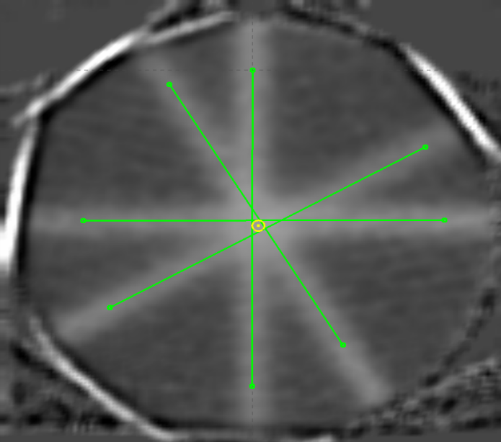
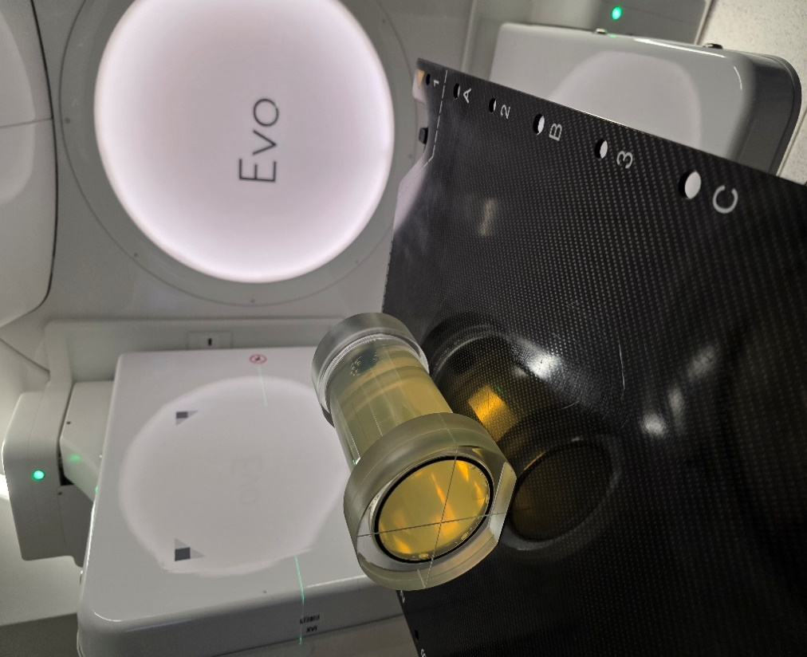
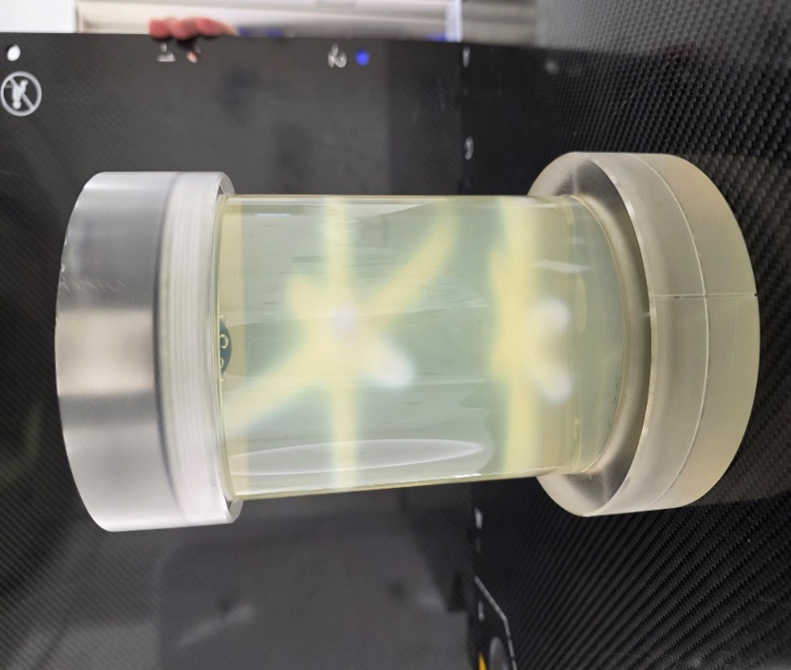

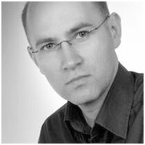
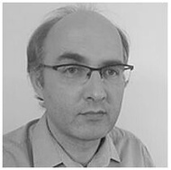
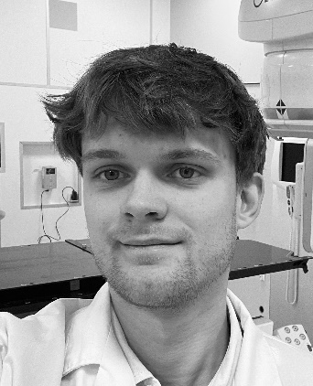
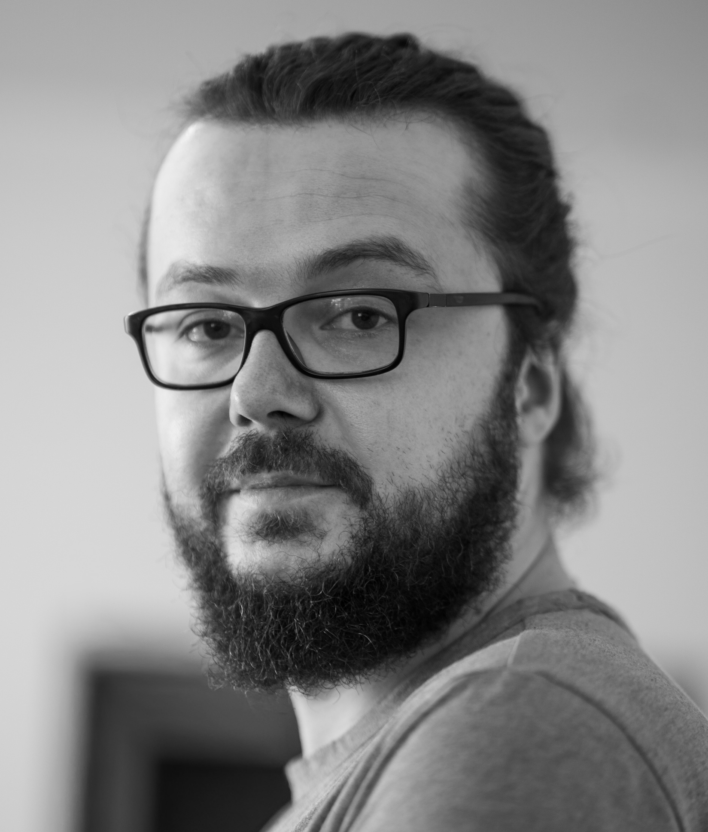
FEASIBILITY OF 3D GEL DOSIMETRY FOR CBCT-BASED ISOCENTER VERIFICATION ON ELEKTA SYSTEMS
INTERNATIONAL CONFERENCE ON 3D DOSIMETRY (IC3DDOSE), CAEN, FRANCE, 15-17 JUNE 2026
Oskar Madetko^{1,2}, Piotr Maras^{3,4}, Bartłomiej Jasiak², and Marek Kozicki^{4,5}
¹University of Applied Sciences in Tarnow, Tarnow, Poland
²St. Lucas Hospital, Tarnow, Poland
³Copernicus Hospital, Lodz, Poland
⁴GeVero Co., Lodz, Poland
⁵Lodz University of Technology, Lodz, Poland
A
B
C
Objectives
Isocenter 3D check: volumetric verification and 3D coincidence of mechanical, imaging, and radiation geometries.
Elekta CBCT feasibility: evaluation of standard on-board imaging protocols for dosimetry.
Reconstruction algorithm analysis: assessment of FDK vs. Iris HD performance in polymer gels.
Methodology
Gel dosimeter application: usage of a 3D polymer gel optimized for CBCT.
Star-shot beam delivery: 2D and 3D patterns on Evo and Versa HD.
Readout: CBCT and MRI for gel dosimetry; EBT4 film for reference.
Calculation: polyGeVero-CT v. 1.3 software.
Figure 1. Experimental setup (A), irradiated polymer gel dosimeter: 2D and 3D star-shot (B) and 2D star-shot irradiation pattern measured with CBCT (C).
Table 1. Radiation isocenter analysis using 3D polymer gel dosimetry: coincidence with mechanical and imaging isocenters,
and radiation isocenter size. All values: [mm].
Key Conclusions
FDK protocol advantage: significantly lower reconstruction noise (∼1.5 HU) vs. Iris HD.
Iris HD limitations: systematic artifacts in homogeneous gels due to DNN scatter estimation.
Readout method agreement: high spatial correspondence (≤ 0.15 mm) between CBCT and MRI.
High spatial accuracy: sub-millimeter correlation (< 0.25 mm) against reference film dosimetry.
Processing procedure efficiency: SNR enhancement via scan averaging and background subtraction.
Algorithm | Starshot Type | Evo |  |  | Versa HD
 |  | Rad. vs. Mech. | Rad. vs. Img | Rad. Size | Rad. vs. Mech. | Rad. vs. Img | Rad. Size
M20-Pelvis-HD | 2D | 0.56 | 0.36 | 1.07
M20-High_Res |  | 0.53 | 0.33 | 1.11 | 1.57 | 1.25 | 0.12
M20-Med_Res |  | 0.49 | 0.29 | 1.07 | 1.42 | 1.14 | 0.12
M20-Pelvis-HD | 3D | 1.69 | 1.21 | 1.30
M20-High_Res |  | 1.02 | 0.75 | 1.19 | 2.80 | 1.19 | 0.63
M20-Med_Res |  | 1.51 | 1.1 | 1.2 | 2.73 | 1.42 | 0.55
Our Department
Our Research Group
Professor, DSc, PhD Marek Kozicki, Head
PhD Piotr Maras
MSc Bartłomiej Jasiak
MSc Oskar Madetko

