Slide 1




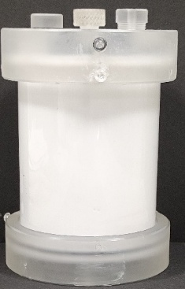
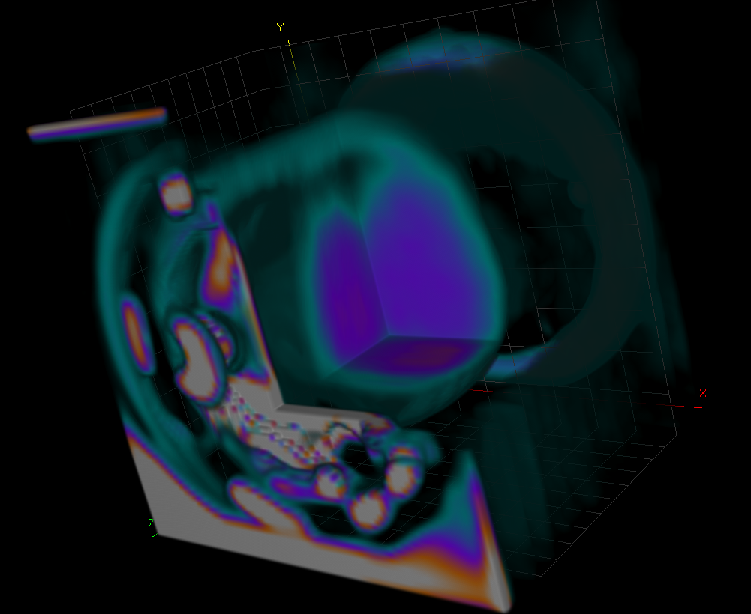
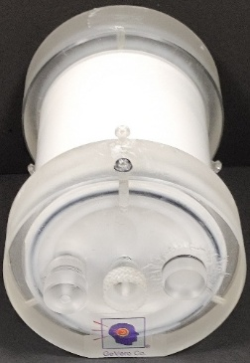


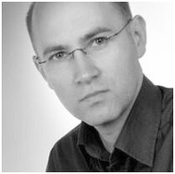
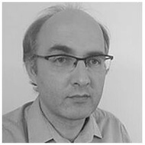


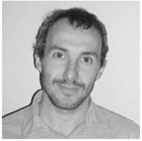
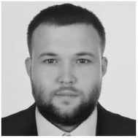
INTERNATIONAL CONFERENCE ON 3D DOSIMETRY (IC3DDOSE), Caen, France, June 15-17, 2026
CT-Based Dose Measurements with an Enhanced Bone-Mimicking 3D Dosimeter
Marek Kozicki^{1,3} Malwina Jaszczak-Kuligowska¹, Piotr Maras^{2,3}
¹Lodz University of Technology, Lodz, Poland
²Copernicus Hospital, Lodz, Poland
³GeVero Co., Lodz, Poland
AIM:
To investigate the dose response of the PAGAT2–Pluronic F-127 trabecular bone dosimeter containing magnesium chloride and using computed tomography (CT) as the readout method.
RESULTS
A
B
C
MATERIALS AND METHODS
PAGAT2–Pluronic F–127 hydroxyapatite-based (BoneGel) dosimeter:
25% Pluronic F–127
3% (w/w) N,N′-methylenebisacrylamide (MBA)
3% (w/w) acrylamide (AA)
18% (w/w) hydroxyapatite
10 mM tetrakis(hydroxymethyl)phosphonium chloride (THPC)
0.05 M magnesium chloride (MgCl₂)
In ~600 mL container (PH-6-DD2, GeVero Co., Poland) for HU–dose calibration
Irradiation
TrueBeam linear accelerator (Varian, USA); 6 MV photon beam (600 MU·min⁻¹, 0.0769 Gy/s)
A water phantom at ~21 °C
A cross-beam arrangement of twelve 3 × 3 cm² fields (gantry angles: 0°, 90°, 180°, 270°; 100–1000 MU) generated eight dose regions (2–30.2 Gy)
Eclipse TPS (v. 16.1, AAA algorithm)
CT measurements
Somatom Sensation Open scanner (Siemens, Germany)
Water phantom
120 kV, 250 eff. mAs, pitch 0.5, slice thickness 2 mm, FOV 250 mm, and H30s reconstruction. Each sample was scanned 20 times pre- and post-irradiation
Calculations
polyGeVero®-CT. Background-correction, mean filtering (Kernal size=3 mm, Kernel mode: 3D, Iterations=1 and Nutall window processing: 25 iterations)
Figure 1. Dosimeter after preparation and irradiation (A,B). C: CT 3D image of the dosimeter after irradiation.
A
B
CT signal [HU]
CONCLUSIONS
PAGAT2–Pluronic F–127 with hydroxyapatite and magnesium chloride is suitable for 3D radiotherapy dosimetry with CT reading.
Figure 2. Dose response of the dosimeter: calibration (A) and dose resolution (B) vs. absorbed dose.
Our Department
Our Research Group
Professor, DSc, PhD Marek Kozicki, Head
PhD Piotr Maras
PhD Elżbieta
Sąsiadek-Andrzejczak
PhD Malwina
Jaszczak-Kuligowska
Associate Professor,
DSc, PhD Mariusz Dudek
PhD Michał Piotrowski

