Slide 1




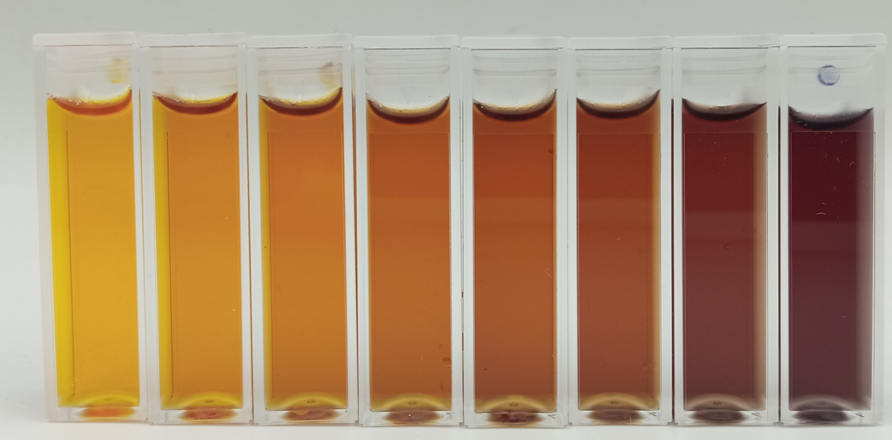
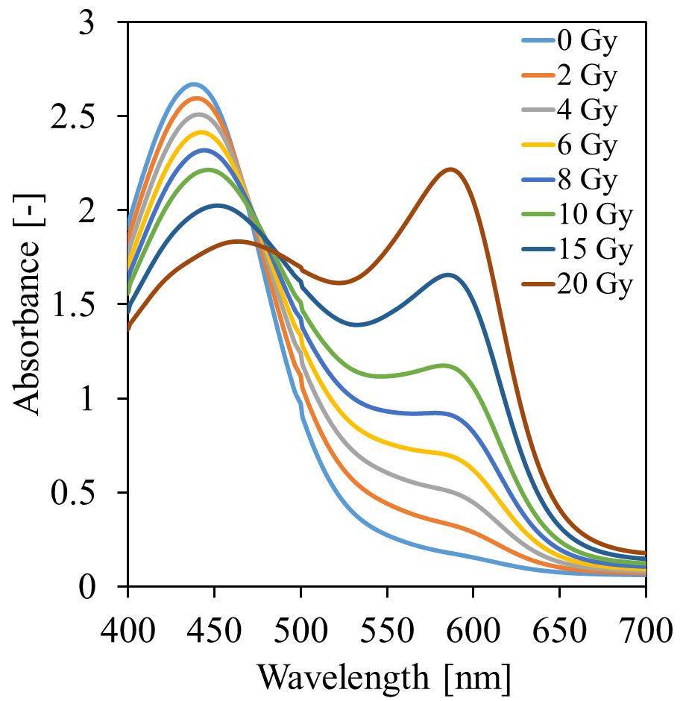
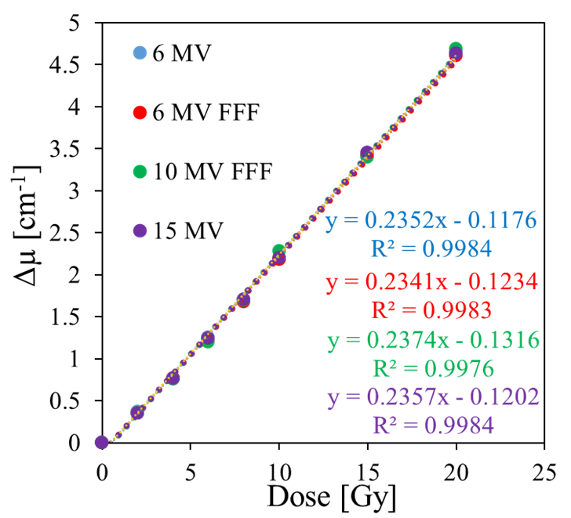







INTERNATIONAL CONFERENCE ON 3D DOSIMETRY (IC3DDOSE), Caen, France, June 15-17, 2026
Impact of photon beam quality on the radiation response of Fricke-XO-Gelatin with sorbitol
Michał Piotrowski¹, Piotr Maras², and Marek Kozicki^{1,3}
¹Lodz University of Technology, Lodz, Poland
² Copernicus Hospital, Lodz, Poland
³GeVero Co., Lodz, Poland
Dose: 0→20 Gy
AIM:
Impact of beam quality on the radiation response
Impact of dose rate on the radiation response
Reproducibility of the radiation response
Conclusions:
Radiation response is linear in dose range 0-20 Gy
The radiation response does not depend on the beam quality or dose rate
The volume of the samples may affect the reproducibility of the dose measurements.
Figure 1. Fricke-XO-Gelatin with sorbitol irradiated to doses 0-20 Gy.
A
B
Figure 2. Fricke-XO-Gelatin with sorbitol irradiated to doses 0-20 Gy. Absorbance spectra (A) and optical density vs. dose relations (B).
Our Department
Our Research Group
Professor, DSc, PhD Marek Kozicki, Head
PhD Piotr Maras
PhD Elżbieta
Sąsiadek-Andrzejczak
PhD Malwina
Jaszczak-Kuligowska
Associate Professor,
DSc, PhD Mariusz Dudek
PhD Michał Piotrowski

