Slide 1

Development of double-clad QDot-based microstrip detector for Spatially Fractionated Radiotherapy dosimetry
Josue Esteves, Pierre Everaere, Thu Nhi Tran Caliste, Benjamin Fornacciari and Patrick Pittet
14th International Conference on 3D Dosimetry (IC3DDose)
Caen, France, June 15-17, 2026

Slide 2
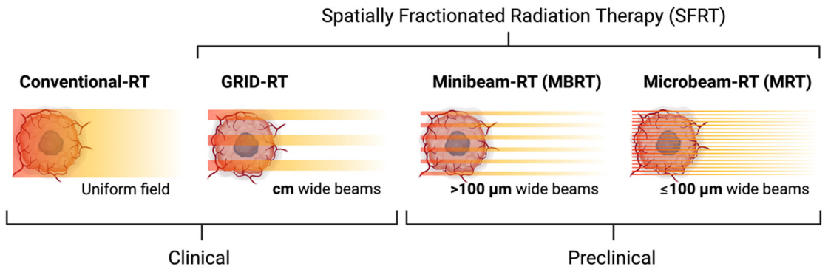
Introduction: Spatially Fractionated Radiotherapy
According to Prezado et al. [1], Spatially Fractionnated Radiation Therapy (SFRT):
improve local tumor control (dose increase to radioresistant regions while sparing nearby critical structures)
can overcome the limitations of tumor heterogeneity (specific region targeting)
☞ SFRT requires high-resolution tissue-equivalent detectors for QA and dosimetry
[2]
[1] Prezado et al., Phys. Med. Biol., vol. 69, 2024
[2] Fernandez-Palomo et al., Cancers, vol. 14(362), 2022

Slide 3
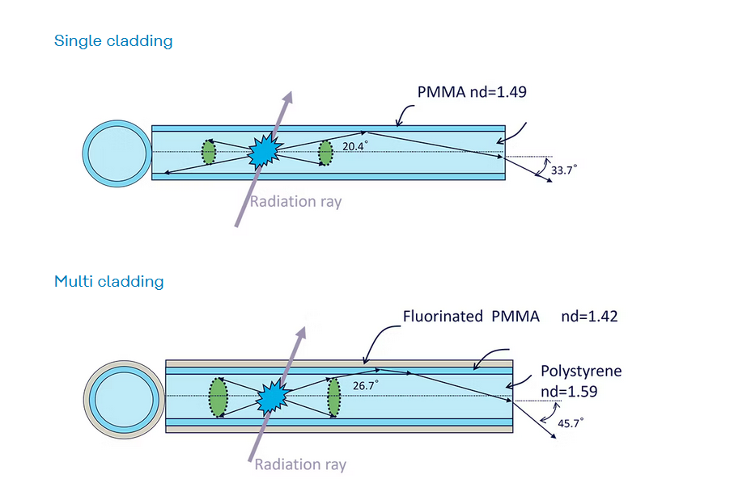

Introduction: Pros and Cons of Scintillation fiber for SFRT
Current sizes range from
- 0.5 mm to 3 mm (Bicron/St Gobain/Luxium)
- 0.2 mm to 2 mm (Kuraray)
“Multicladding increases confinement efficiency by increasing the refractive index difference, resulting in higher light collection efficiency than single cladding”
https://methacrylate.kuraray.com/en/products/psf/

Slide 4
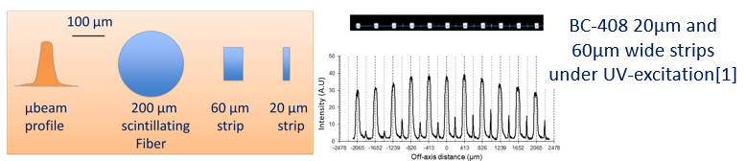
Introduction: Pros and Cons of Scintillation fiber for SFRT
Current sizes range from
- 0.5 mm to 3 mm (Bicron/St Gobain/Luxium)
- 0.2 mm to 2 mm (Kuraray)
“Multicladding increases confinement efficiency by increasing the refractive index difference, resulting in higher light collection efficiency than single cladding”
https://methacrylate.kuraray.com/en/products/psf/
A proven technology whose response shows low energy dependence (within the range used in conventional radiotherapy)
The current dimensions of the scintillation fibres are not suitable for Minibeam-RT and Microbeam-RT QA
(volume averaging effect)

Slide 5
Material and Methods: Double-clad QDot-based microstrip detector for SFRT
In this study, we developed QDot-based microstrip detector implementing heterogeneous cavities[3] with:
CdSe QDots as nano-scintillators[4]
Organic tissue-equivalent surrounding material (Photoresist and Cyclic Olefin Copolymer COC)
[3] F. Thevenet et al., J. Phys.: Conf. Ser. 2799 012012, 2024
[4] C. Dujardin et al., Adv. Optical Mater., 13, 2402739, 2025
Notes:
Hot carriers energy relaxation: Penetration range of hot carriers exceeds
the Qdot size → primary electrons and their secondary electrons deposit
significant energy outside the Qdot cavity
Thermalization: Significant electron escape can occur
Quantum confinement & Multi-Exciton Generation: ultra-fast multi-excitonic emission in direct-gap CdSe Qdots

Slide 6
Material and Methods: QDot nanoscintillator, a Bragg-Gray cavity ?
BG C1 : QDot size ( < 100 nm) is much smaller than the range of charged particles
☞ no perturbation of the fluence of charged particles in the medium
BG C2 : The energy absorbed in the QDot comes exclusively from charged particles passing through the cavity
☞ very low QDot concentration
ESTAR - NIST
Electron range
QD
Each Qdot can be considered as a Bragg-Gray cavity
Photon interactions only
outside the QDot
Notes:
Hot carriers energy relaxation: Penetration range of hot carriers exceeds
the Qdot size → primary electrons and their secondary electrons deposit
significant energy outside the Qdot cavity
Thermalization: Significant electron escape can occur
Quantum confinement & Multi-Exciton Generation: ultra-fast multi-excitonic emission in direct-gap CdSe Qdots

Slide 7
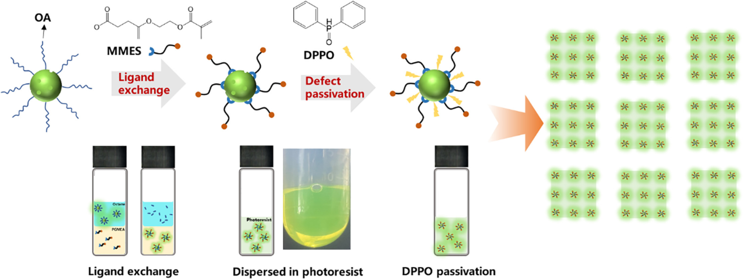
Material and Methods: QDot ligant Engineering
Native Oleic-Acid QDot ligands:
High stability and dispersity in Toluene without aggregation
High hydrophobicity
Incompatibility with photoresist dispersion
[5] Y. Wang et al., Giant, Vol. 16, 2023
Notes:
Hot carriers energy relaxation: Penetration range of hot carriers exceeds
the Qdot size → primary electrons and their secondary electrons deposit
significant energy outside the Qdot cavity
Thermalization: Significant electron escape can occur
Quantum confinement & Multi-Exciton Generation: ultra-fast multi-excitonic emission in direct-gap CdSe Qdots

Slide 8
Material and Methods: QDot ligant Engineering
Native Oleic-Acid QDot ligands:
High stability and dispersity in Toluene without aggregation
High hydrophobicity
Incompatibility with photoresist dispersion
QDot ligand exchange process[5]:
MMES ligants for high dispersity in PGMEA, the most common photoresists solvent
Defect passivation with DPPO was critical to preserve the luminescent properties of the QDot-Photoresist strip
Adapted from [5]
[5] Y. Wang et al., Giant, Vol. 16, 2023
Notes:
Hot carriers energy relaxation: Penetration range of hot carriers exceeds
the Qdot size → primary electrons and their secondary electrons deposit
significant energy outside the Qdot cavity
Thermalization: Significant electron escape can occur
Quantum confinement & Multi-Exciton Generation: ultra-fast multi-excitonic emission in direct-gap CdSe Qdots

Slide 9
Material and Methods: Double-clad QDot-based microstrip
Refractive index management for implementation of multimode double-clad waveguides
QDot Loaded photoresist (scintillating microstrip)
https://phydemo.app/rayoptics/simulator/
Refractive index of the photoresist ~1.60 (core)
Refractive index of cyclo-olefin copolymer (COC) ~ 1.53 (1st clad)
Refractive index of air = 1 (2nd clad)
QDot luminescence
Notes:
Hot carriers energy relaxation: Penetration range of hot carriers exceeds
the Qdot size → primary electrons and their secondary electrons deposit
significant energy outside the Qdot cavity
Thermalization: Significant electron escape can occur
Quantum confinement & Multi-Exciton Generation: ultra-fast multi-excitonic emission in direct-gap CdSe Qdots

Slide 10
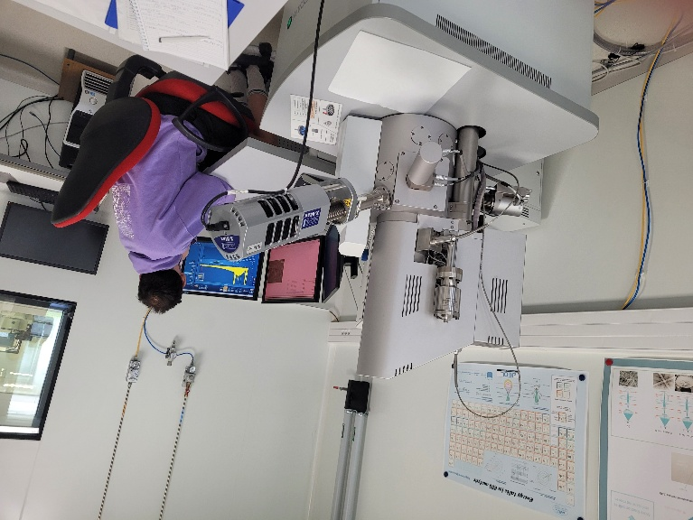
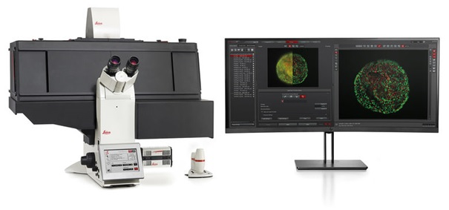
Material and Methods: Characterization setups
Lab characterization:
- scanning electron microscopy with energy-dispersive X-ray spectroscopy and cathodoluminescence imaging
- camera-based UV fluorescence microscope with stitching capability
Notes:
Hot carriers energy relaxation: Penetration range of hot carriers exceeds
the Qdot size → primary electrons and their secondary electrons deposit
significant energy outside the Qdot cavity
Thermalization: Significant electron escape can occur
Quantum confinement & Multi-Exciton Generation: ultra-fast multi-excitonic emission in direct-gap CdSe Qdots

Slide 11
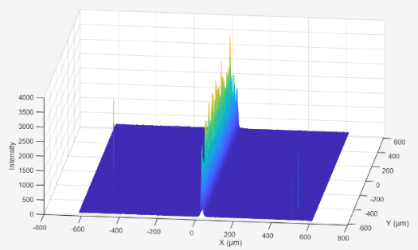
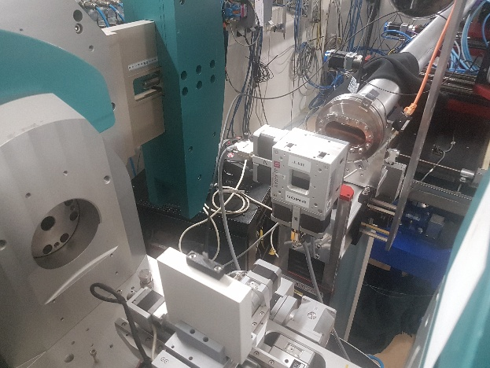
Material and Methods: Characterization setups
Synchrotron characterization:
- ESRF (BM05): 40keV monochromatic X-ray microbeam with 10¹⁰ph/s in 2x2mm² radiation field upstream the focusing lens
- ANSTO (IMBL): Mean beam energy 52 keV to 123 keV – Dose rate up to 4750 G/s
Notes:
Hot carriers energy relaxation: Penetration range of hot carriers exceeds
the Qdot size → primary electrons and their secondary electrons deposit
significant energy outside the Qdot cavity
Thermalization: Significant electron escape can occur
Quantum confinement & Multi-Exciton Generation: ultra-fast multi-excitonic emission in direct-gap CdSe Qdots

Slide 12
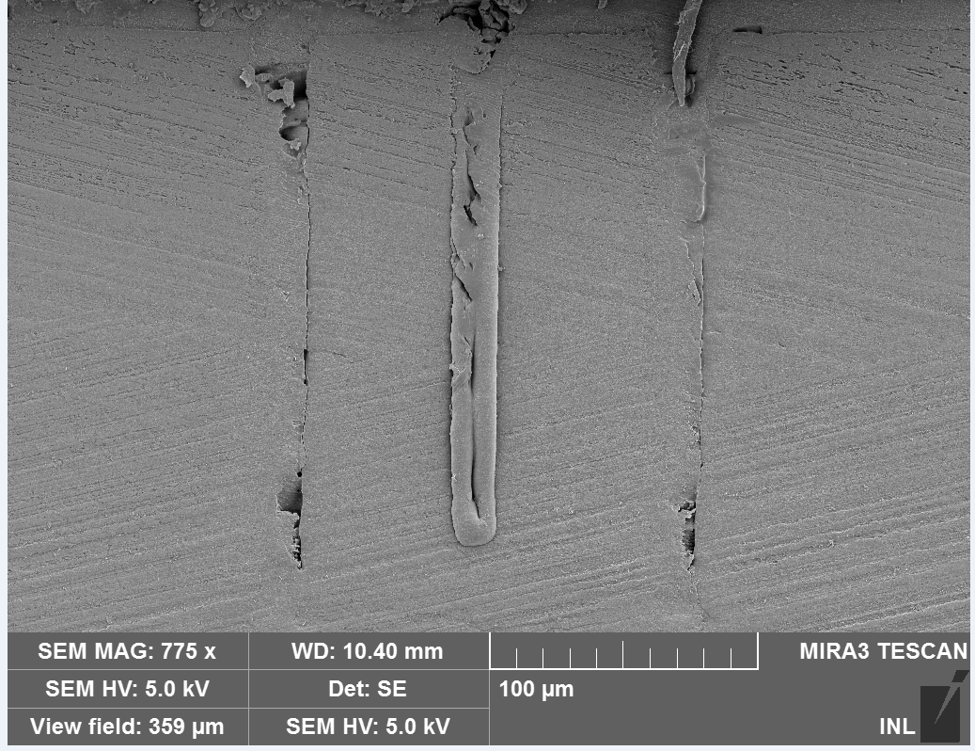
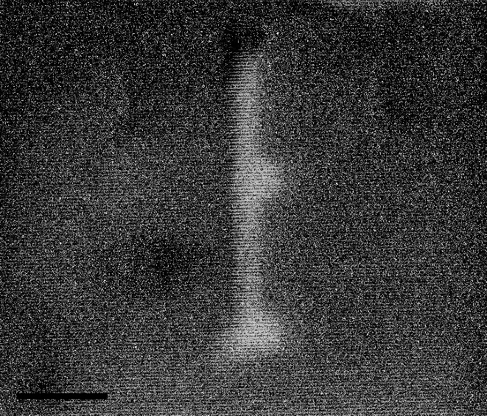
Results: SEM and Cathodoluminescence microstrip characterization
Cathodoluminescence
Microstrip
Zoom
QDot size (aggregates)
[80 nm – 110 nm]
Notes:
Hot carriers energy relaxation: Penetration range of hot carriers exceeds
the Qdot size → primary electrons and their secondary electrons deposit
significant energy outside the Qdot cavity
Thermalization: Significant electron escape can occur
Quantum confinement & Multi-Exciton Generation: ultra-fast multi-excitonic emission in direct-gap CdSe Qdots

Slide 13
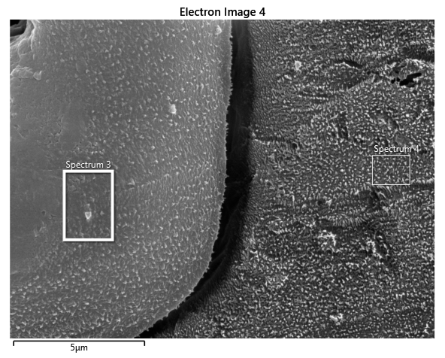
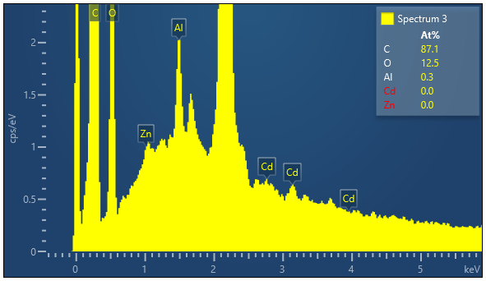
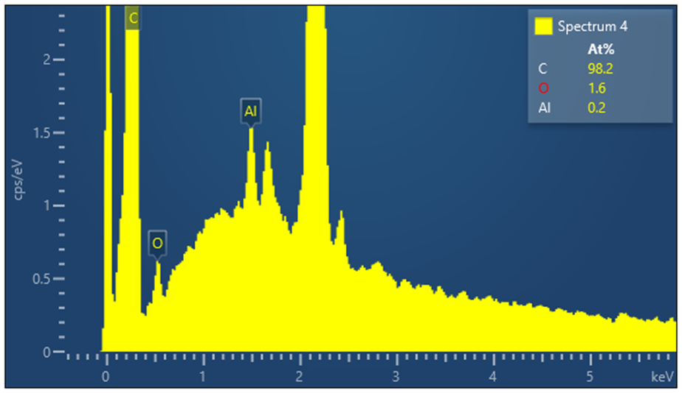
Results: SEM and EDS microstrip characterization
SEM Image
Elemental composition of the surrounding medium (photoresist)
Elemental composition of the strip
Microstrip
Surrounding medium (photoresist)
5 µm
☞ Scanning electron microscopy with energy-dispersive X-ray spectroscopy (SEM/EDS) confirms low CdSe QD concentration in the strip
Notes:
Hot carriers energy relaxation: Penetration range of hot carriers exceeds
the Qdot size → primary electrons and their secondary electrons deposit
significant energy outside the Qdot cavity
Thermalization: Significant electron escape can occur
Quantum confinement & Multi-Exciton Generation: ultra-fast multi-excitonic emission in direct-gap CdSe Qdots

Slide 14
Results: UV-microscope images of the detector
Bright UV-Fluorescence of each microstrip
☞ good dispersion and passivation of the CdSe Qdots
☞ the waveguide core shows the 20 µm x 150 µm microstrip cross-section
The double-clads guide the fluorescence
Notes:
Hot carriers energy relaxation: Penetration range of hot carriers exceeds
the Qdot size → primary electrons and their secondary electrons deposit
significant energy outside the Qdot cavity
Thermalization: Significant electron escape can occur
Quantum confinement & Multi-Exciton Generation: ultra-fast multi-excitonic emission in direct-gap CdSe Qdots

Slide 15
Results: ESRF measurements
UV fluorescence image
X-ray µbeam scan (20 µm steps)
X-ray µbeam scan (2.5 µm steps)
Detectable luminescence for each microstrip
Notes:
Hot carriers energy relaxation: Penetration range of hot carriers exceeds
the Qdot size → primary electrons and their secondary electrons deposit
significant energy outside the Qdot cavity
Thermalization: Significant electron escape can occur
Quantum confinement & Multi-Exciton Generation: ultra-fast multi-excitonic emission in direct-gap CdSe Qdots

Slide 16
Results: ESRF measurements
UV fluorescence image
Stem effect of COC clad ?
X-ray µbeam scan (20 µm steps)
X-ray µbeam scan (2.5 µm steps)
Detectable luminescence for each microstrip
Peak broadening (volume averaging effect) with COC Clad stem effect
Notes:
Hot carriers energy relaxation: Penetration range of hot carriers exceeds
the Qdot size → primary electrons and their secondary electrons deposit
significant energy outside the Qdot cavity
Thermalization: Significant electron escape can occur
Quantum confinement & Multi-Exciton Generation: ultra-fast multi-excitonic emission in direct-gap CdSe Qdots

Slide 17
Results: ANSTO IMBL measurements
4750 Gy/s – 52 keV
Notes:
Hot carriers energy relaxation: Penetration range of hot carriers exceeds
the Qdot size → primary electrons and their secondary electrons deposit
significant energy outside the Qdot cavity
Thermalization: Significant electron escape can occur
Quantum confinement & Multi-Exciton Generation: ultra-fast multi-excitonic emission in direct-gap CdSe Qdots

Slide 18
Results: ANSTO IMBL measurements
SNR was much lower than with BC408 strips (-20 dB)
Energy dependence seems to be much lower than with BC408 (to be confirmed)
Notes:
Hot carriers energy relaxation: Penetration range of hot carriers exceeds
the Qdot size → primary electrons and their secondary electrons deposit
significant energy outside the Qdot cavity
Thermalization: Significant electron escape can occur
Quantum confinement & Multi-Exciton Generation: ultra-fast multi-excitonic emission in direct-gap CdSe Qdots

Slide 19
Discussion
Double-Clad Qdot-based microstrips has been fabricated and tested
Ligand engineering allows good dispersity of QDots in photoresist
Luminescence guidance has been confirmed by UV-fluorescence measurements
☞ under X-ray irradiation, a stem effect was attributed to the width of the 2nd Clad
CdSe quantum dot microstrips have produced measurable signals
encouraging preliminary results during irradiation with high dose rate µbeam (remained to be confirmed)
SNR was 20 dB lower than with BC-408 microstrips
☞ Qdot concentration should be optimized for SNR increase while maintaining strip density ~1, low self-absorption and aggregation
All tests where carried out with static fields while MRT implements dynamic fields
☞ Stem effect issues need to be addressed (2nd Clad + Readout clear fiber bundle)

Slide 20


Acknowledgment
Thank you for your attention !
The authors acknowledge for their support:
InCa and Inserm (PCSI / 2023 / IODA-Master / 23CP088)
ANSTO (in-kind grant AS251/IMBL/23184) with special thanks to Chris Hall and Mathew Cameron
labex primes (ANR-11-LABX-0063)
Nanolyon platform from the French national network CNRS-RENATECH+
Michael Lerch, John Paul Ortiz Bustillo and Enbang Li from CRMP – Univ- Wollongong

