Slide 1


Quantification of Internal Radioactivity to Measure the Arterial Input Function In Dynamic Positron Emission Tomography: A Simulation Study
Marc-Antoine Leclerc^{1,3}
Supervisor: Shirin Abbasinejad Enger^{1,2,3}
IC3DDose 2026
June 17th, 2026
¹ Medical Physics Unit, Department of Oncology, Faculty of Medicine, McGill University, Montreal, Quebec, Canada
²Research Institute of the McGill University Health Centre, Montreal, Quebec, Canada
³Lady Davis Institute for Medical Research, Jewish General Hospital, Montreal, Quebec, Canada

Slide 2
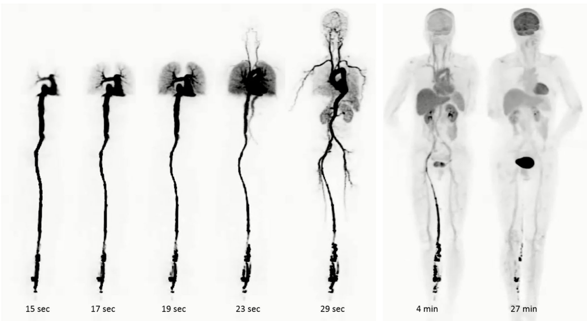
Dynamic PET and the AIF
Dynamic PET can recover quantitative information about radiotracer kinetics (metabolic rate of glucose instead of SUV for FDG)
Require the Arterial Input Function (AIF): radiotracer concentration in arterial blood over time
Gold standard: blood sampling via radial artery catheterization
This is invasive, requires anesthesiologist, radiation exposure
Introduction​ | Objectives​ | Methods​ | Results​ | Discussion | Conclusions​

Slide 3
Image-Derived Input Function
Main non-invasive alternative: Extract the AIF from a large artery in the PET image.
Limitations: limited temporal resolution and partial volume effects for small arteries
Is there another way of quantifying in vivo radioactivity to measure the AIF?
What about planar imaging?
Carotid arteries are too small
Aorta is large enough
Introduction​ | Objectives​ | Methods​ | Results​ | Discussion | Conclusions​

Slide 4
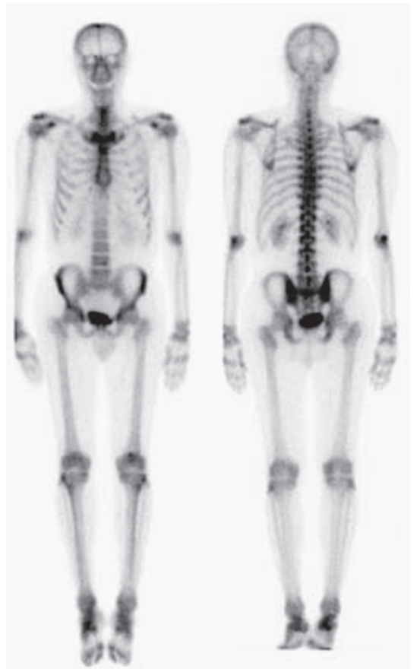
Planar Imaging
Advantage:
Geometric flexibility in the placement of the camera
Improve sensitivity and spatial resolution
Limitation:
  2D projection:
  Loss of depth information
  Organ overlap
Cherry (2012)
Introduction​ | Objectives​ | Methods​ | Results​ | Discussion | Conclusions​

Slide 5
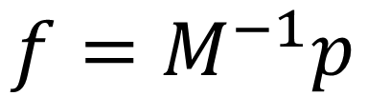
ROI Image Reconstruction
Planar imaging can be used for 3D radioactivity quantification using a region-of-interest (ROI) “image” reconstruction
$$f=M^{−1}p$$
f: “image” (intensity of each ROI)
M: system matrix
p: measured projection (pixel intensity)
ROI 1
ROI n
…
ROI 2
Gamma Camera
Introduction​ | Objectives​ | Methods​ | Results​ | Discussion | Conclusions​

Slide 6
Challenges with ROI approaches
Trade-off between number of ROIs (accuracy) and precision
Have been mainly applied to the torso anatomy for radionuclide dosimetry:
  Many high uptake structures and organs
  Breathing and cardiac motion leads to motion artefacts
  Large thickness
This method is potentially better suited for geometrically simpler, superficial, and motionless radioactivity distributions.
Introduction​ | Objectives​ | Methods​ | Results​ | Discussion | Conclusions​

Slide 7
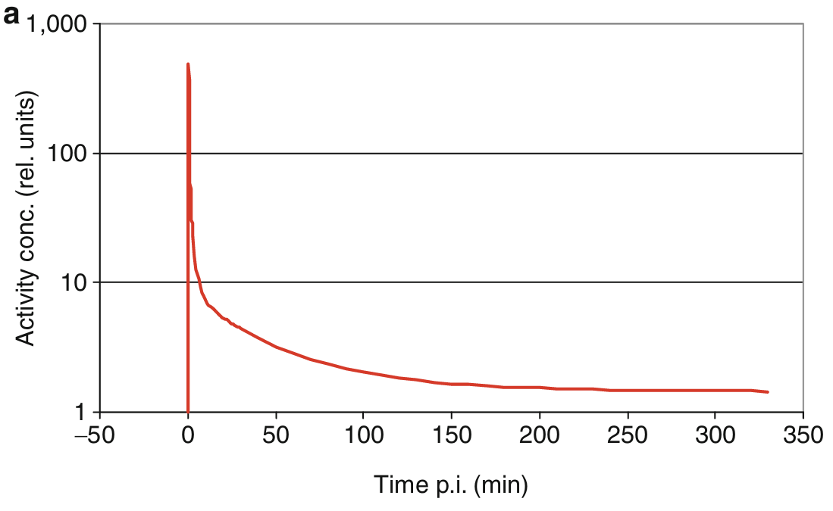
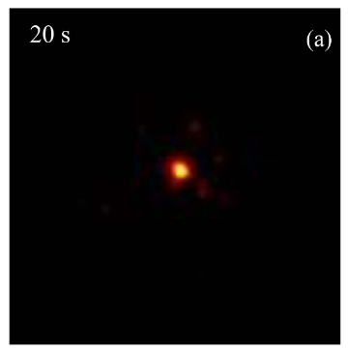
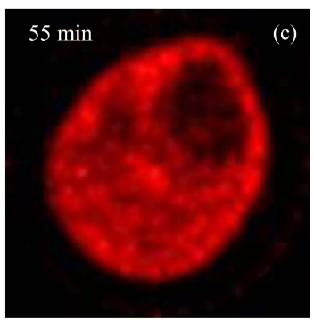
Dynamic PET and the AIF
Arterial input function (AIF):
¹⁸F-FDG dynamic PET images of the leg
Erlandsson (2021)
Wei et al (2022)
Introduction​ | Objectives​ | Methods​ | Results​ | Discussion | Conclusions​

Slide 8
Objectives
Objective: Develop a planar detector and ROI-based radioactivity reconstruction framework to measure the AIF of the radial artery for dynamic PET
Hypotheses:
Radial artery is superficial –> Improved sensitivity and spatial resolution
Imaged with ultrasound –> Guide the ROI delineation
Readily immobilized -> mitigate motion artefacts
Introduction | ​Objectives | Methods​ | Results​ | Discussion | Conclusions​

Slide 9
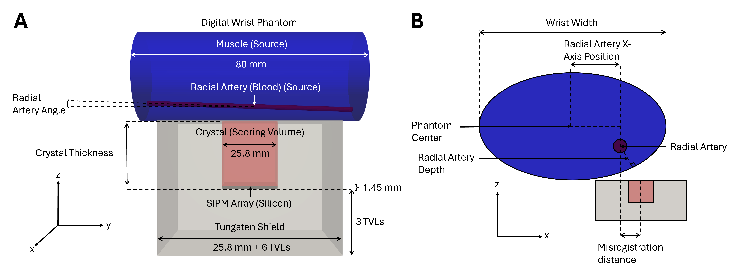
Simulation Geometry
ROIs: Radial artery (ultrasound imaging) and muscle (anthropometric datasets)
Introduction​ | Objectives​ | Methods​ | Results​ | Discussion | Conclusions​

Slide 10


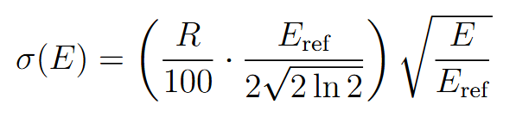

Source, Scoring and Reconstruction
Simulated accurate radionuclide ([¹⁸F]FDG) uptake
Scored 2D radiation detection position (x,y), energy and time
(E₁, t₁, x₁, y₁), (E₂, t₂, x₂, y₂), (E₃, t₃, x₃, y₃), …
Applied gaussian energy blurring
Introduction​ | Objectives​ | Methods​ | Results​ | Discussion | Conclusions​

Slide 11

ROI-Based Reconstruction
Reconstructed the AIF using a ROI-based reconstruction for each time frame
Compared the area under the curve with the simulated ground-truth
Vector of scored counts in each projection (energy window/pixel combination)
Vector of true count in each ROI (“image”)
Probability that an emission from a specific ROI be detected in a specific projection (system matrix)
Introduction​ | Objectives​ | Methods​ | Results​ | Discussion | Conclusions​

Slide 12
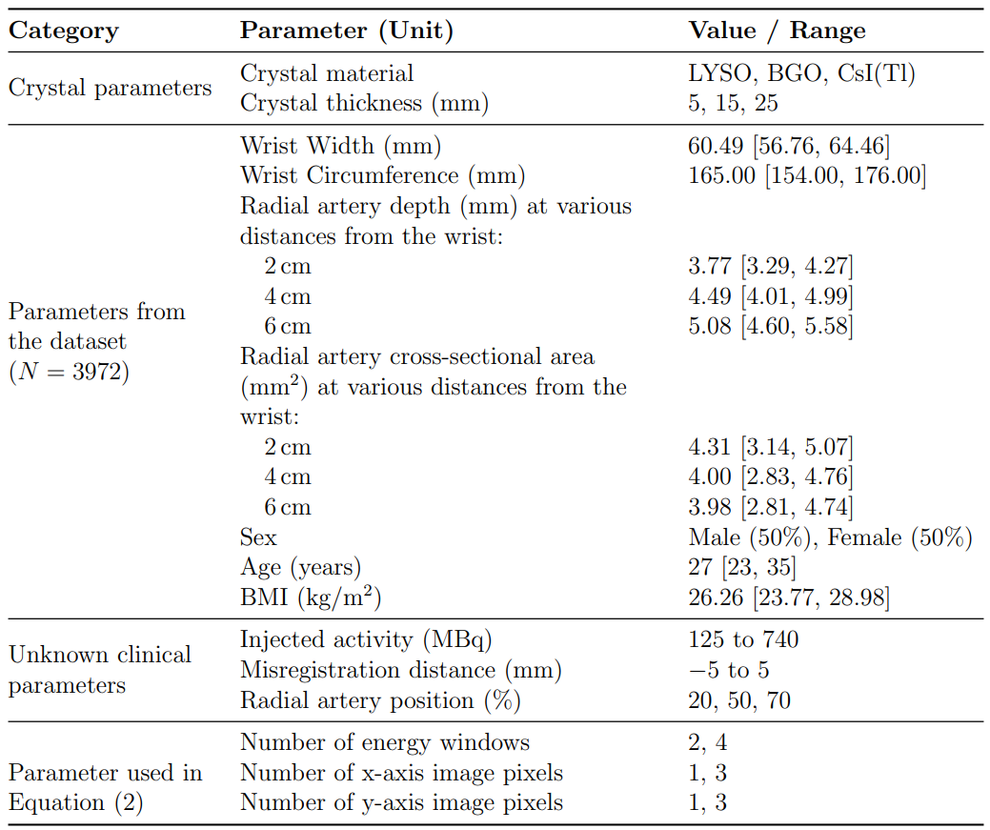
Parameter Space Exploration
999 simulations
Reconstructed 8 times with different parameters
Total: 7,992 simulation results
Crystal parameters
Phantom dimensions
Practical uncertainties
Reconstruction parameters
Introduction​ | Objectives​ | Methods​ | Results​ | Discussion | Conclusions​

Slide 13
Results
Optimal detector: 25 mm thick LYSO, 1 image pixel, 4 energy windows.
Why 1 pixel? Larger pixel sizes compared to the misregistration magnitude mitigate the effect
Uses differences in ROI spectral sensitivities to solve ROI radioactivity
Mean error in AUC difference of 8.2 ± 0.4% across the parameter exploration, 95th percentile of 15 ± 1%
Introduction​ | Objectives​ | Methods​ | Results​ | Discussion | Conclusions​

Slide 14
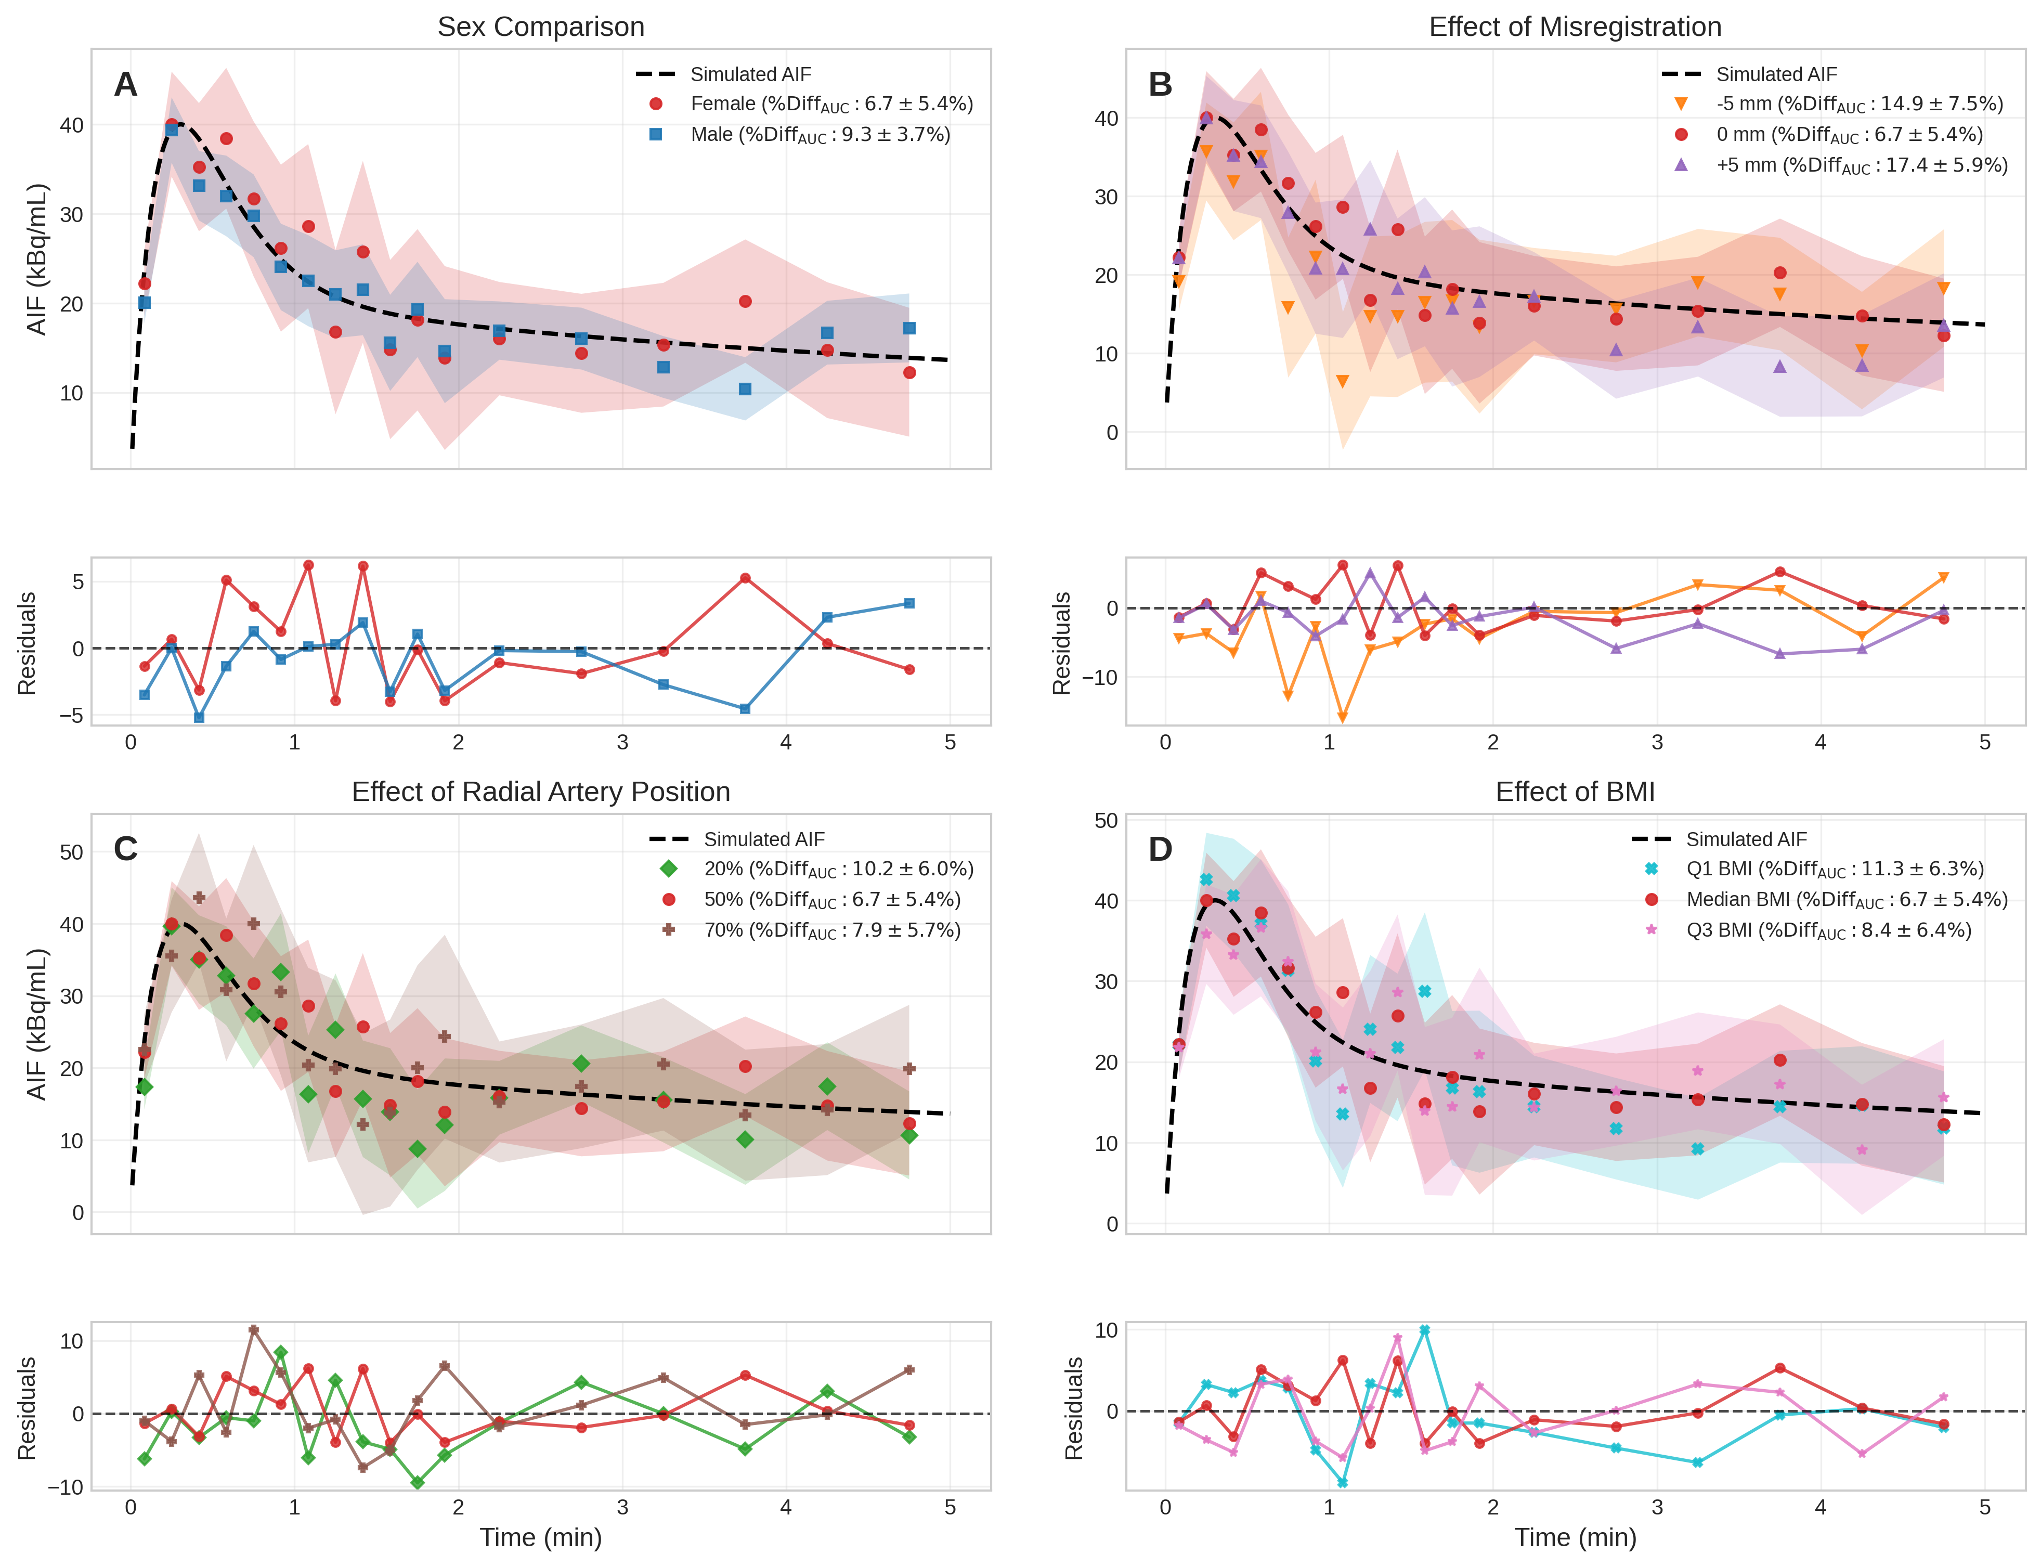
Simulation Results
Time (min)
Time (min)
Introduction​ | Objectives​ | Methods​ | Results​ | Discussion | Conclusions​

Slide 15
Discussion
Advantages:
ROI-based reconstruction can mitigate partial volume effects and are less sensitive to noise (Vanzi et al., 2006)
We use scattered photons in the reconstruction instead of discarding them
MC simulations to calculate the system matrix
Limitations:
Simplified phantom composition (missing bones and other vasculature)
Accuracy is most sensitive to misregistration
Rely on prior radionuclide uptake knowledge for ROI determination
Introduction​ | Objectives​ | Methods​ | Results​ | Discussion | Conclusions​

Slide 16
Conclusion
Quantifying radioactivity in vivo is essential for radionuclide dosimetry and quantitative imaging
Anatomy-guided, ROI-based image reconstruction can be performed with gamma camera (2D) imaging
We are applying a similar technique to measure the AIF for dynamic PET
Future work will focus on improving the phantom composition and experimental validation
Introduction​ | Objectives​ | Methods​ | ​Results | Discussion | Conclusions

Slide 17
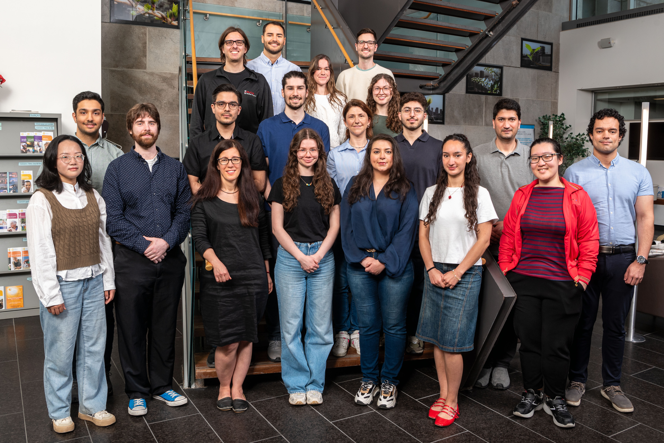




Acknowledgements
Supervisor: Shirin A. Enger
Co-supervisor: Roger Lecomte
Jacob G. Johansen
Lia Carroll
All EngerLab members

Slide 18
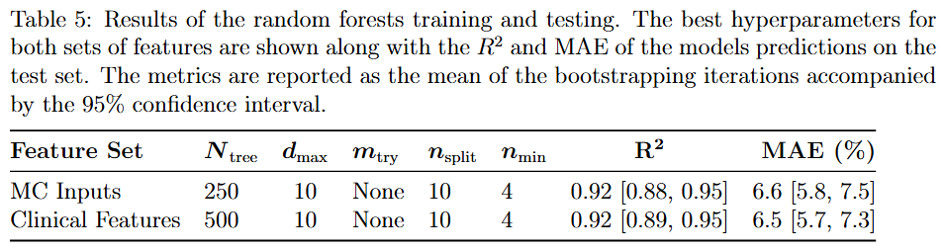
Random Forest Regressor
Introduction​ | Objectives​ | Methods​ | Results​ | Discussion | Conclusions​

Slide 19
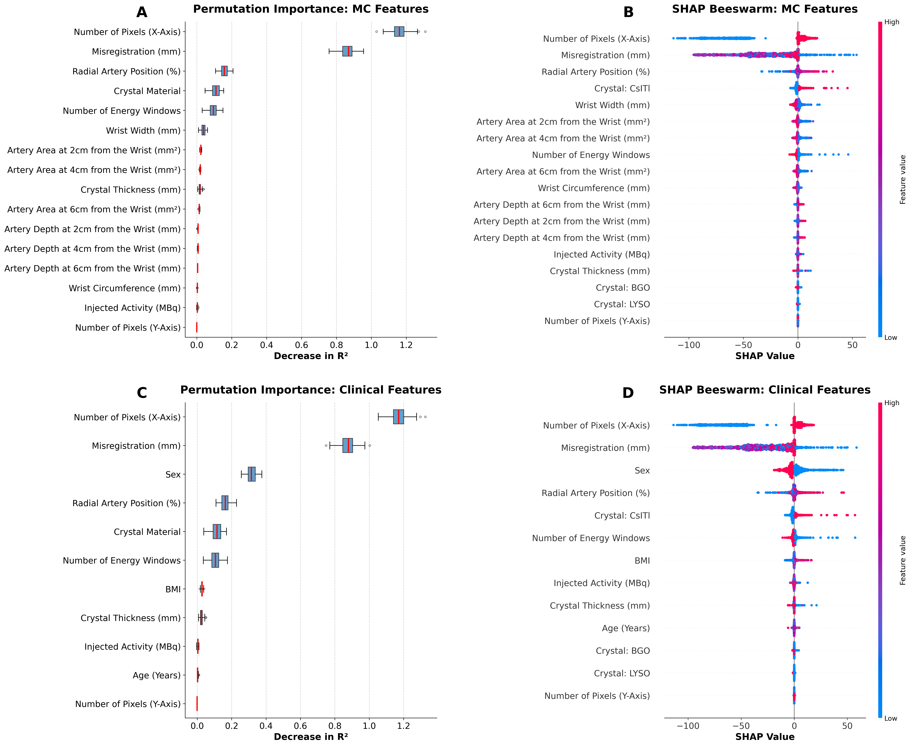
Feature Importance
Introduction​ | Objectives​ | Methods​ | Results​ | Discussion | Conclusions​

Slide 20
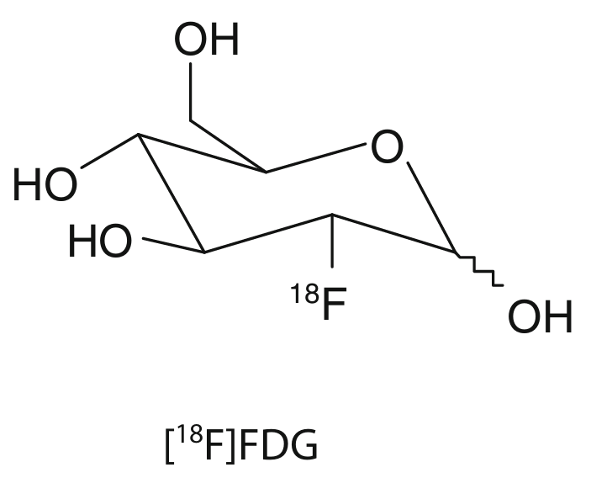
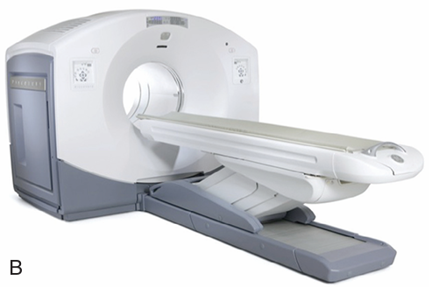
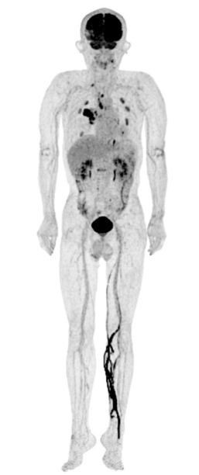
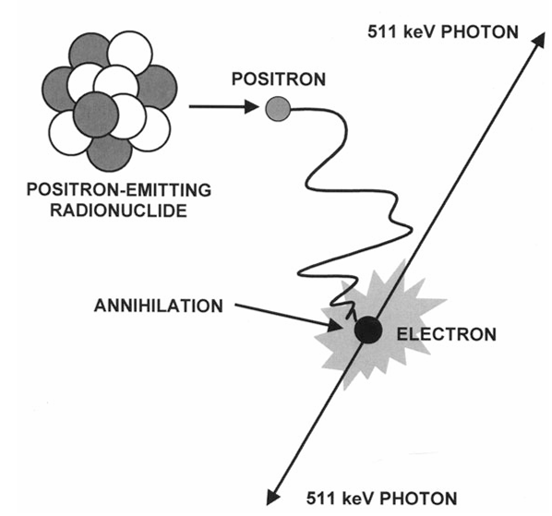
Positron Emission Tomography (PET)
Intra-venous injection
Radiation detection
Image reconstruction
Introduction​ | Objectives​ | Methods​ | Results​ | Discussion | Conclusions​

Slide 21

Arterial Input Function (AIF)
Radiotracer concentration in arterial blood or plasma (kBq/mL).
Gold standard method: arterial blood sampling.
Detector
Detector
Waste container
Introduction​ | Objectives​ | Methods​ | Results​ | Discussion | Conclusions​

Slide 22
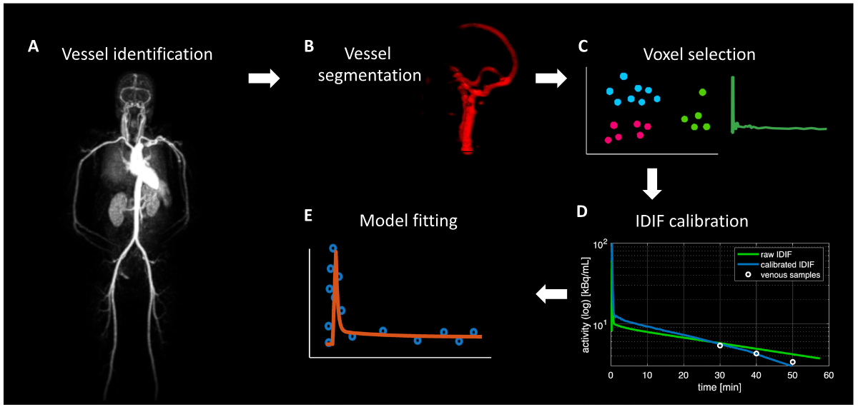
Image-Derived Input Function
The pipeline is complex, user dependent and no commercial software are available:
Correction factors can be applied to recover the AIF.
Estimating the AIF for brain studies is still an evolving field.
Introduction​ | Objectives​ | Methods​ | Results​ | Discussion | Conclusions​

Slide 23
Static vs Dynamic Acquisition
Inject tracer intravenously
Wait for tracer accumulation
Acquire one image
Static PET
Inject tracer intravenously
Acquire multiple images immediately
Dynamic PET
Introduction​ | Objectives​ | Methods​ | Results​ | Discussion | Conclusions​

Slide 24
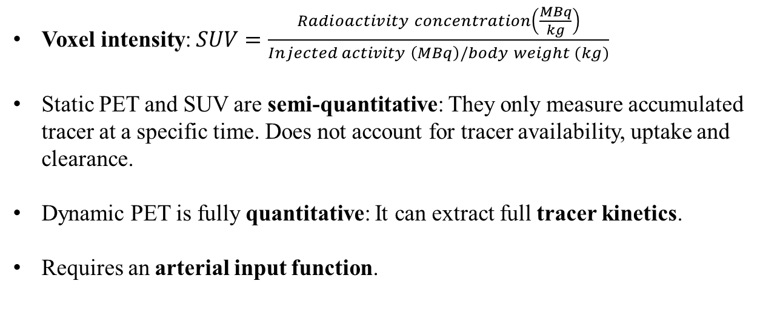
Problems with Static PET
Voxel intensity: $SUV=\frac{Radioactivity concentration\left(\frac{MBq}{kg}\right)}{Injected activity \left(MBq\right)/body weight (kg)}$
Static PET and SUV are semi-quantitative: They only measure accumulated tracer at a specific time. Does not account for tracer availability, uptake and clearance.
Dynamic PET is fully quantitative: It can extract full tracer kinetics.
Requires an arterial input function.
Introduction​ | Objectives​ | Methods​ | Results​ | Discussion | Conclusions​

Slide 25

Example: [¹⁸F]-FDG
Steady state plasma glucose concentration
K₁
k₂
k₃
k₄
Metabolic rate of glucose $=\frac{C_{glucose}}{LC}\left(\frac{K_{1}k_{3}}{k_{2}+k_{3}}\right)$
Constant to relate FDG metabolism to glucose metabolism ~ 0.42 - 0.52 in brain
Static PET measures accumulated FDG activity while dynamic PET can measure the metabolic rate of glucose
Introduction​ | Objectives​ | Methods​ | Results​ | Discussion | Conclusions​

Slide 26
Example: [¹⁸F]-FDG
C_{PET}(t): Radioactivity the
PET scanner measures
K₁
k₃
FDG in plasma
(AIF)
FDG in tissue
FDG-6-P
in tissue
K₁: perfusion
k₂: reverse capillary membrane transport
k₃: phosphorylation
k₄: dephosphorylation (small, which is why FDG accumulates in tissue)
k₂
k₄
Capillary membrane
Phosphorylation
Solving the system:
Least-squares fit
K₁
k₂
k₃
k₄
$$C_{PET}(t)=\frac{K_{1}}{α_{2}−α_{1}}\left[ \left(k_{3}+k_{4}−α_{1}\right)e^{−α_{1}t}+\left(α_{2}−k_{3}−k_{4}\right)e^{−α_{2}t}\right]∗AIF\left(t\right)+k_{5}AIF(t)$$
Introduction​ | Objectives​ | Methods​ | Results​ | Discussion | Conclusions​

Slide 27
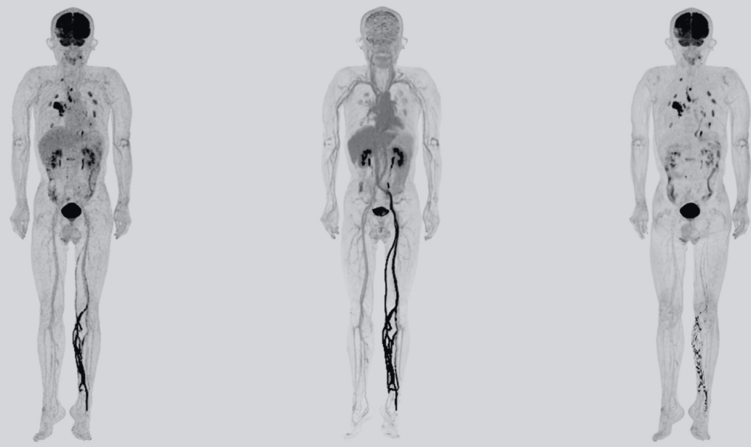
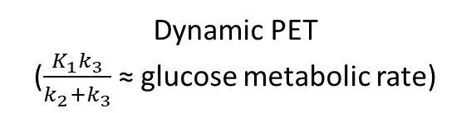
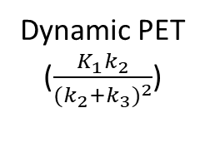
[¹⁸F]-FDG Parametric Imaging
Static PET
(SUV)
Dynamic PET
($\frac{K_{1}k_{2}}{{{(k}_{2}+k_{3})}^{2}}$)
Dynamic PET
($\frac{K_{1}k_{3}}{k_{2}+k_{3}}$≈ glucose metabolic rate)
Dimitrakopoulou-Strauss et al 2021
Introduction​ | Objectives​ | Methods​ | Results​ | Discussion | Conclusions​

Slide 28
Radiation Detector
Annihilation Photons
Measure radiation energy, x-y position and time
The measured radiation counts are binned into energy windows , x-y image pixels and time frame
Scintillation crystal
x
Scintillation light
y
Photodetector array
Introduction​ | Objectives​ | Methods​ | Results​ | Discussion | Conclusions​

Slide 29
Simulation Results
Introduction​ | Objectives​ | Methods​ | Results​ | Discussion | Conclusions​

Slide 30
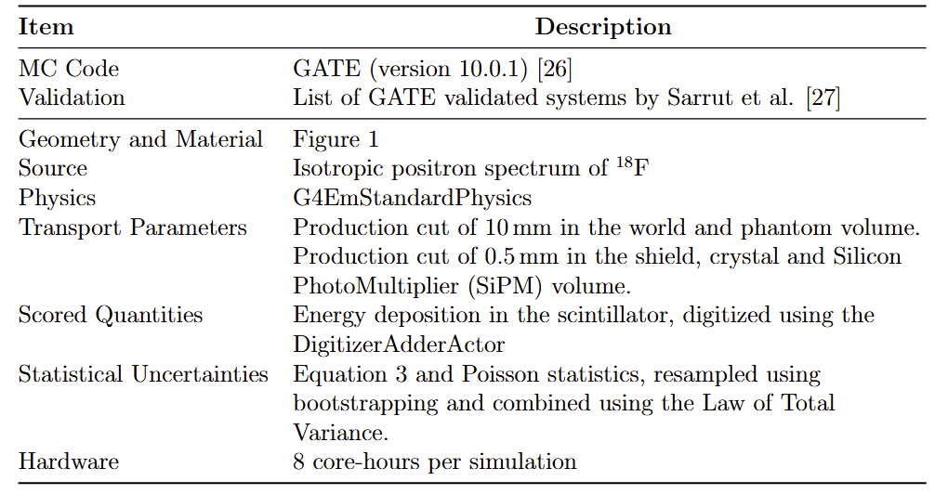
Simulation Parameters
Introduction​ | Objectives​ | Methods​ | Results​ | Discussion | Conclusions​

Slide 31
Anthropometric Dataset
Claire C. Gordon et al. 2012 Anthropometric Survey of U.S. Army Personnel: Methods and Summary Statistics. Tech. rep. NATICK/TR-15/007. Natick, MA: U.S. Army Natick Soldier Research, Development and Engineering Center, 2014.
  Publicly available database consisting of 4,082 males and 1,986 females anthropometric data for weight, height, age, hand length, and hand breadth, …
Thomas M. Greiner. Hand Anthropometry of U.S Army Personnel. Tech. rep. NATICK/TR-92/011. Natick, MA: U.S. Army Natick Research, Development and Engineering Center, Dec. 1991. url: https://apps.dtic.mil/sti/citations/ADA244533.
  Anthropometric measurements of the wrist and hand from working databases of 1,774 males and 2,208 females.
Introduction​ | Objectives​ | Methods​ | Results​ | Discussion | Conclusions​

Slide 32

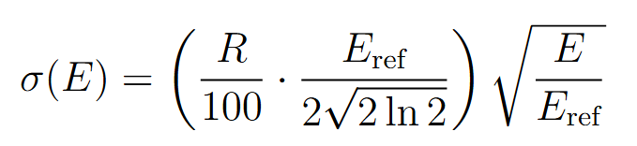
Statistical Uncertainties
Bootstrapping approach: Event re-sampling with replacement
Energy Blur:
Introduction​ | Objectives​ | Methods​ | Results​ | Discussion | Conclusions​

Slide 33
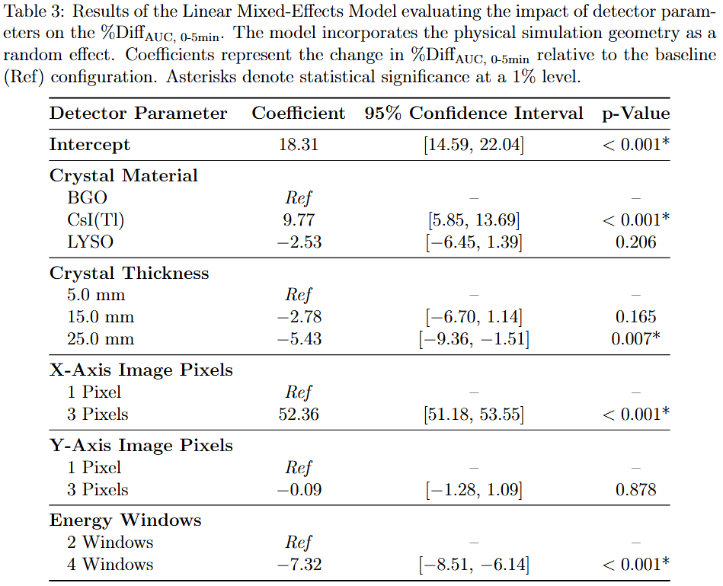
LMEM
Introduction​ | Objectives​ | Methods​ | Results​ | Discussion | Conclusions​

Slide 34
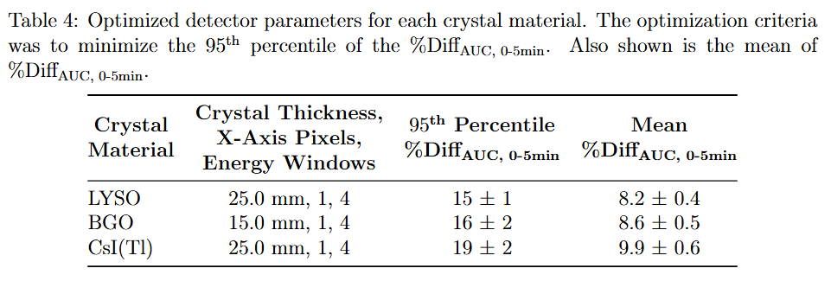
Optimized Detector
Introduction​ | Objectives​ | Methods​ | Results​ | Discussion | Conclusions​

Slide 35
Permutation Feature Importance
Introduction​ | Objectives​ | Methods​ | Results​ | Discussion | Conclusions​

Slide 36
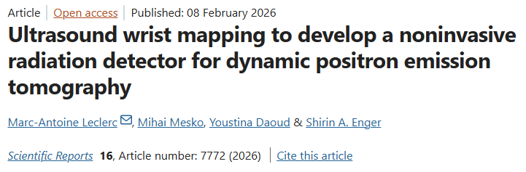
Radial Artery
We imaged the radial artery using ultrasound imaging on 154 healthy participants.
We developed a statistical model to predict the depth and cross-sectional area of the radial artery at various distances from the wrist.
Introduction​ | Objectives​ | Methods​ | Results​ | Discussion | Conclusions​

Slide 37
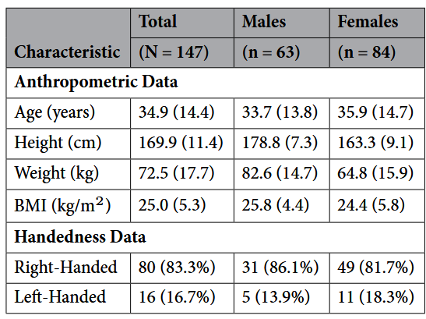
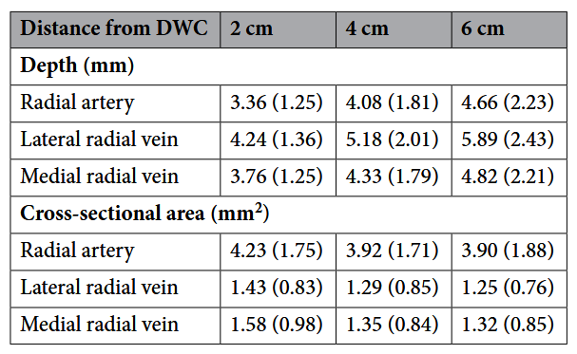
Radial Artery Ultrasound Study
Introduction​ | Objectives​ | Methods​ | Results​ | Discussion | Conclusions​

Slide 38
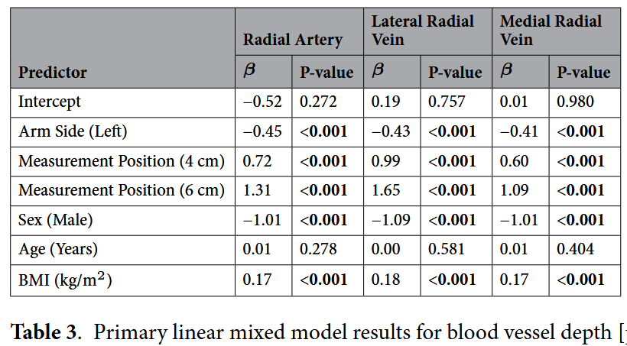
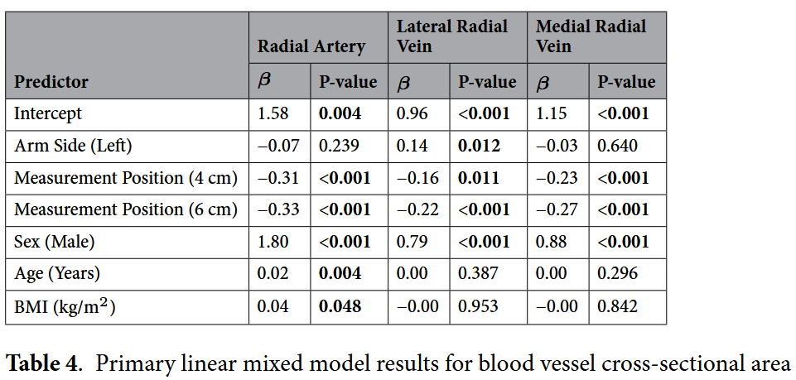
Radial Artery Ultrasound Study
Introduction​ | Objectives​ | Methods​ | Results​ | Discussion | Conclusions​

Slide 39
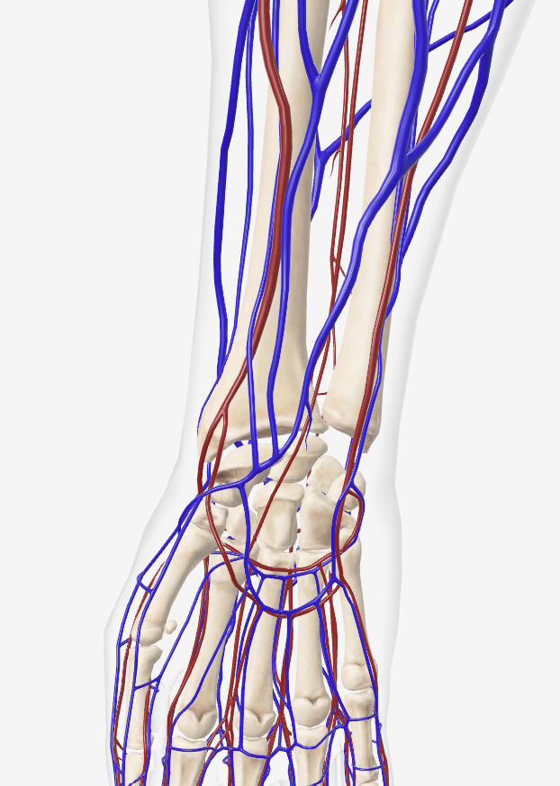
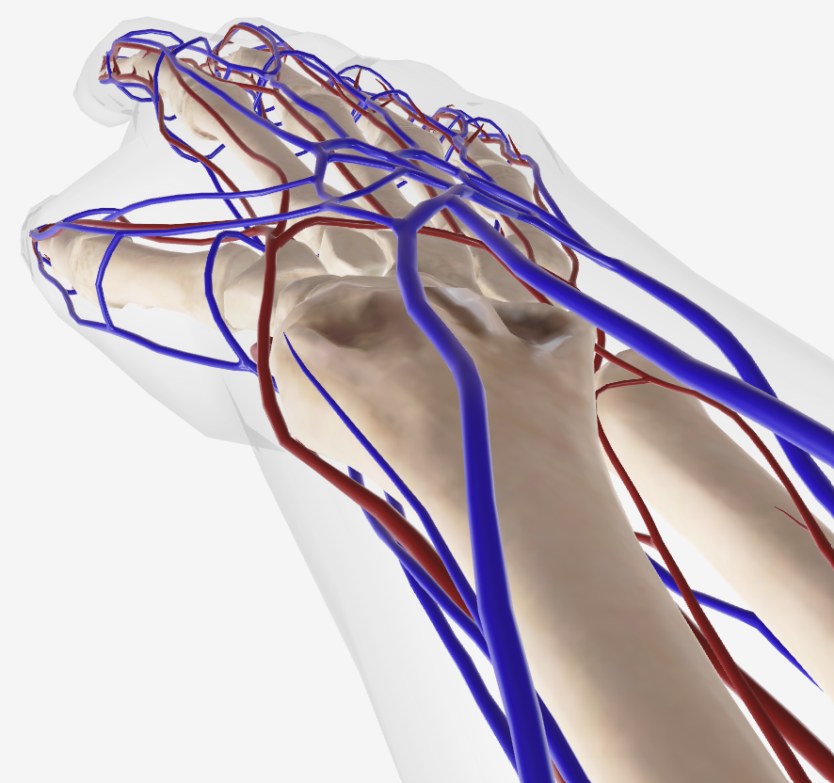
Wrist Vascular Anatomy
Radius
Radial artery
Ulnar artery
Radius
Ulna
Radial artery
Human Biodigital
Introduction​ | Objectives​ | Methods​ | Results​ | Discussion | Conclusions​

Slide 40
Tracer kinetics: Compartment modelling
Design a model for the tracer kinetics inside the body:
  where does the tracer go?
  How long does it stay there?
  What chemical reactions occur?
Derive a mathematical relation between what the PET scanner measures and how much tracer is available as supply for the tissues over time (arterial input function).
Fit this equation with the PET scanner and arterial input function measurements to extract quantitative information about the tracer.
Introduction​ | Objectives​ | Methods​ | Results​ | Discussion | Conclusions​

Slide 41
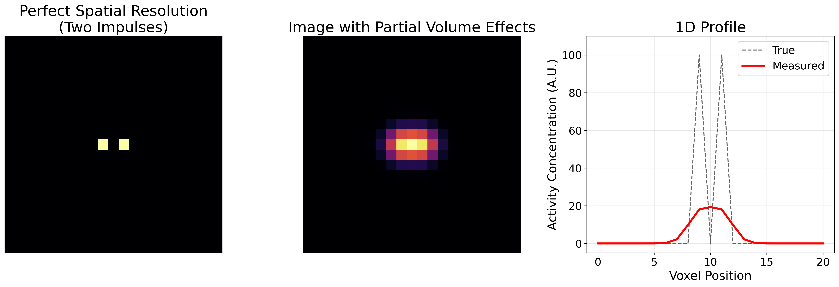
Partial Volume Effects
Introduction​ | Objectives​ | Methods​ | Results​ | Discussion | Conclusions​

