Slide 1



JUNE 17, 2026
THIBAULT BERNELIN, PhD STUDENT
Monte-Carlo simulations of Cherenkov fluence for FLASH radiotherapy dosimetry
Thibault Bernelin^{1,2}, Arthur Lalonde^{2,3}, Louis Archambault¹
1 - Université Laval, Quebec, QC, Canada
2 - Centre de Recherche du Centre Hospitalier de l’Université de Montreal (CRCHUM), Montreal, QC, Canada
3 - Université de Montréal, Montreal, QC, Canada
Notes:
Good morning everyone. My name is Thibault Bernelin and I am a PhD student at Université Laval and the CRCHUM.
Today I will present our work on Monte Carlo simulations of Cherenkov fluence for FLASH radiotherapy dosimetry.
More specifically, we investigated the relationship between absorbed dose, Cherenkov photon production, and the optical signal that would ultimately be detected by a camera.

Slide 2
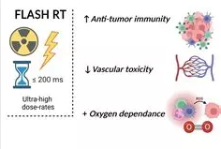
INTRODUCTION – FLASH DOSIMETRY CHALLENGES
Flash radiotherapy is a promising technology advancement that delivers ultra-high doses rates, rather than the traditional approach of delivering the dose over several minutes.
Accurate dose reporting is a critical tool for radiobiological studies, pre-clinical evaluations, and clinical.
DOSE RATE > 100 Gy/s
REDUCED NORMAL TISSUE TOXICITY
CONVENTIONAL DETECTORS SUFFER FROM :
SATURATION
TEMPORAL LIMITATIONS
SIGNAL INSTABILITY
Figure 1: Representation of the advantages of FLASH radiotherapy [1]
PAGE 2
THIBAULT BERNELIN
[1] Combining FLASH and spatially fractionated radiation therapy: The best of both worlds, Schneider et al, 2024
Notes:
FLASH radiotherapy have a considerable interest because it can deliver radiation at ultra-high dose rates, which reduce normal tissue toxicity.
Although the biological mechanisms are still under investigation, the potential clinical impact is significant.
However, one major challenge remains : dosimetry.
At these dose rates, conventional detectors may suffer from saturation, temporal limitations, or signal instabilities.
Therefore, alternative approaches for real-time dose monitoring are actively investigated.

Slide 3
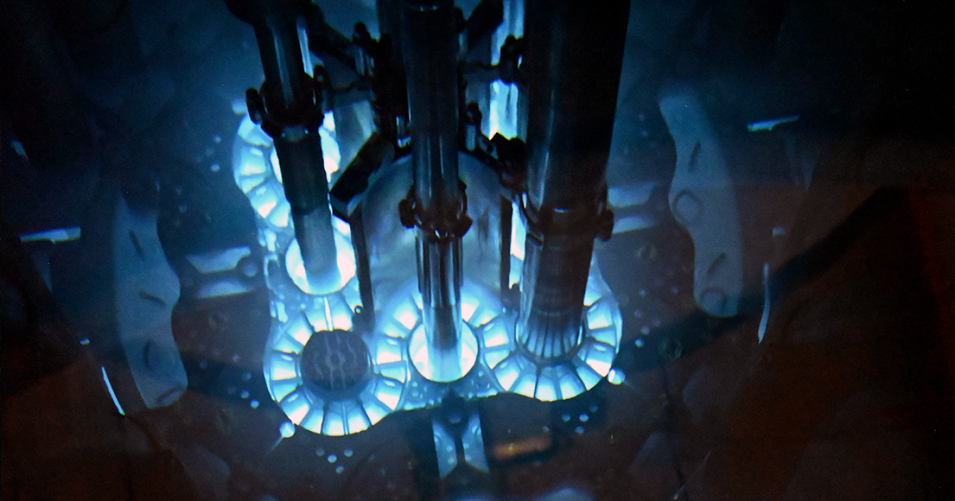
WHY CHERENKOV IMAGING ?
NON-INVASIVE
REAL-TIME IMAGING
NATURALLY PRODUCED
ALREADY INVESTIGATED FOR CONVENTIONAL RT
Figure 2 : Cherenkov Radiation captured inside the Advanced Test Reactor at Idaho National Laboratory
PAGE 3
THIBAULT BERNELIN
Notes:
One promising alternative is Cherenkov imaging.
Cherenkov light is naturally produced during irradiation whenever charged particles, here électrons, travel faster than the speed of light in the medium.
It can be detected without perturbing the beam, provides high spatial resolution, and can potentially be acquired in real time.
These characteristics make it particularly attractive for FLASH dosimetry applications.

Slide 4
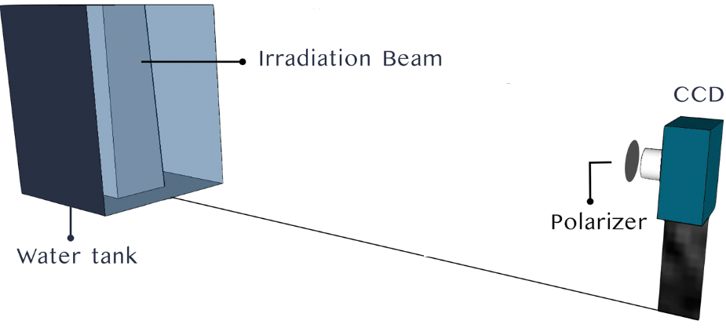
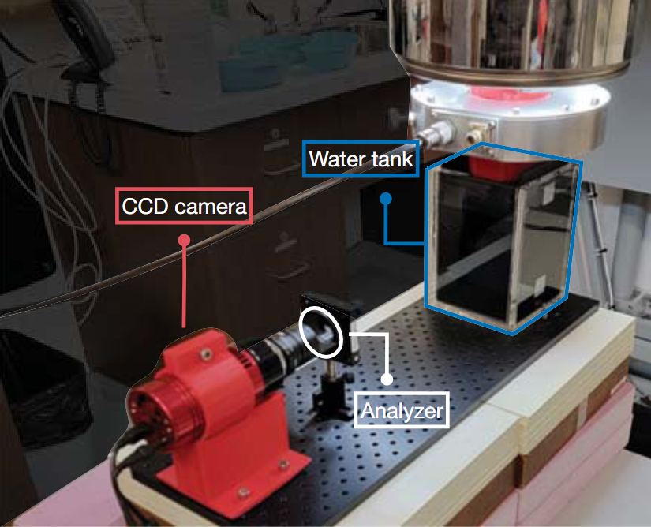
Objective of this work
Investigating Cherenkov light as a potential dosimetric surrogate for FLASH radiotherapy, instead of regular dosimetry system
This work aims to use Monte Carlo simulations to:
Model the production of Cherenkov photons by ultra-high dose rate electron beams;
Simulate the transport of optical photons inside a water phantom;
Compare the spatial distributions of:
  absorbed dose,
  Cherenkov photon production,
  detected optical fluence
How closely does the simulated Cherenkov signal represent the underlying dose distribution ?
Figure 3 (top) : Representation of the measurement setup together with the irradiation conditions for PPDD and profile measurements [2]
Figure 4 (left) : Measurement setup comprising a CCD camera coupled to a rotating analyzer imaging a water tank [3]
PAGE 4
THIBAULT BERNELIN
[2] E. Cloutier, L. Beaulieu, and L. Archambault, “Direct in-water radiation dose measure-ments using Cherenkov emission corrected signals from polarization imaging for a clinicalradiotherapy application,” Sci Rep, vol. 12, p. 9608, June 2022.
[3] E. Cloutier, A. Lalonde, K. Zerouali, L. Beaulieu, and L. Archambault, “Applications of Po-larization Imaging for Conventional and FLASH Radiotherapy Dosimetry,” J. Phys.: Conf.Ser., vol. 2799, p. 012015, July 2024.
Notes:
The objective of this work was to investigate whether Cherenkov light could be used as a surrogate for absorbed dose in FLASH electron beams.
To do so, we used Monte Carlo simulations to model Cherenkov photon generation and optical transport inside a water phantom.
We, then, compared three quantities:
absorbed dose, Cherenkov photon production, and detected optical fluence.
The central question of our work was:
How closely does the simulated Cherenkov signal represent the underlying dose distribution?

Slide 5
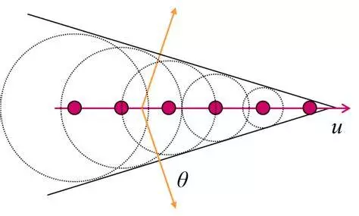


I – CHERENKOV PHYSICS
Cherenkov radiation :
emitted when a charged particle travels through a dielectric medium
Occurs only above a threshold energy
​
which depends on the refractive index of the material.
The emitted photons form a characteristic cone whose opening angle is given by
where n is the refractive index and β=v/c.
As a result, Cherenkov emission is inherently directional and depends on both particle energy and medium properties.
$$E_{min}=m_{0}c^{2}{[\sqrt{1−\frac{1}{n^{2}}}]}^{−1}$$
$$\cos\left(θ\right)=c∙{[vn]}^{−1} =\frac{1}{nβ}$$
Figure 5 : Representation of the Cherenkov cone [4]
PAGE 5
THIBAULT BERNELIN
[4] http://large.stanford.edu/courses/2014/ph241/alaeian2/
Notes:
Before discussing the simulations, I would like to briefly review the physics behind Cherenkov radiation.
Cherenkov light is emitted when a charged particle travels faster than the phase velocity of light in a dielectric medium.
This only occurs above a threshold energy, shown here, which dépend on the refractive index of the medium.
The emitted photons form a characteristic cone whose opening angle theta is determined by the particle velocity and the refractive index of the medium.
An important consequence is that Cherenkov emission is directional.
Therefore, the detected signal does not necessarily correspond directly to the deposited dose.

Slide 6
II – FLASH PHASE SPACE GENERATION
Why Monte-Carlo input matters ?
Cherenkov light production depends directly on the characteristics of the incident electron beam :
Electron energy spectrum
Angular distribution
Spatial distribution
Field size and collimation
Therefore, realistic optical simulations require realistic beam modeling.
PAGE 6
THIBAULT BERNELIN
[5] Audet S, Beaulieu W, Zerouali K, Guillet D, Bouchard H, Lalonde A. Physics-based energy spectrum optimization (PESO): a new method to model the energy spectrum of a compact ultra-high dose rate electron linac for Monte Carlo dose calculation. Phys Med Biol. 2025 Apr 4;70(8). doi: 10.1088/1361-6560/adc4b9. PMID: 40127540.
Notes:
Before studying Cherenkov emission, it was necessary to ensure that the incident electron beam was modeled accurately. Since Cherenkov production strongly depends on the beam characteristics, we relied on previously validated Mobetron phase-space files. These phase spaces were generated from experimental measurements, reconstructed using the PESO beam-modeling approach, and then used as the input source for our TOPAS optical simulations.

Slide 7
II – FLASH PHASE SPACE GENERATION
Challenges
The Mobetron has no bending magnet:
broad energy spectrum
low-energy electron tail
difficult to model accurately
Solution
Physics-Based Energy Spectrum Optimization (PESO)
(Audet et al., 2025)
PAGE 7
THIBAULT BERNELIN
[5] Audet S, Beaulieu W, Zerouali K, Guillet D, Bouchard H, Lalonde A. Physics-based energy spectrum optimization (PESO): a new method to model the energy spectrum of a compact ultra-high dose rate electron linac for Monte Carlo dose calculation. Phys Med Biol. 2025 Apr 4;70(8). doi: 10.1088/1361-6560/adc4b9. PMID: 40127540.
[6] Chiasson J, Audet S, Zerouali K, Guillet D, Renaud J, Muir B, Lalonde A. Design, optimization, and validation of a novel applicator integrating real-time dose monitoring for ultra-high dose rate (FLASH) electron radiotherapy. Phys Med Biol. 2026 Jun 10;71(11). doi: 10.1088/1361-6560/ae6d6e. PMID: 42128006.
Notes:
The Mobetron presents an additional challenge because it does not contain a bending magnet.
As a result, the beam spectrum is broader and includes low-energy components that are difficult to model accurately.
To address this issue, Audet et al. developed the Physics-Based Energy Spectrum Optimization method, or PESO.
This approach reconstructs physically realistic electron spectra that can subsequently be used for Monte Carlo beam modelling.

Slide 8
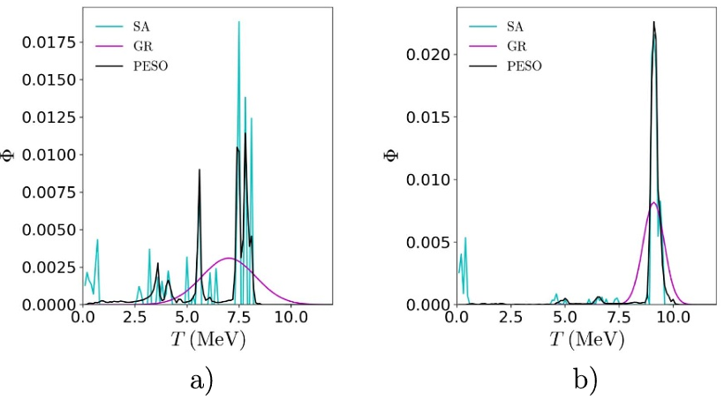
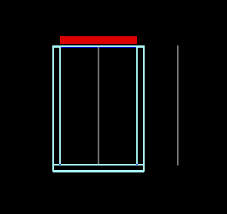
II – FLASH PHASE SPACE GENERATION
Monte-Carlo beam model
Using EGSnrc:
complete Mobetron head geometry
applicators
collimators
Output
The phase space was scored at the applicator exit and then used as the source in TOPAS
Figure 6 : Reconstructed spectra for the 6 MeV (UHDR) (a) and 9 MeV (UHDR) beams using the three reconstruction methods [5]
PAGE 8
THIBAULT BERNELIN
[5] Audet S, Beaulieu W, Zerouali K, Guillet D, Bouchard H, Lalonde A. Physics-based energy spectrum optimization (PESO): a new method to model the energy spectrum of a compact ultra-high dose rate electron linac for Monte Carlo dose calculation. Phys Med Biol. 2025 Apr 4;70(8). doi: 10.1088/1361-6560/adc4b9. PMID: 40127540.
[6] Chiasson J, Audet S, Zerouali K, Guillet D, Renaud J, Muir B, Lalonde A. Design, optimization, and validation of a novel applicator integrating real-time dose monitoring for ultra-high dose rate (FLASH) electron radiotherapy. Phys Med Biol. 2026 Jun 10;71(11). doi: 10.1088/1361-6560/ae6d6e. PMID: 42128006.
Notes:
Once the energy spectrum had been reconstructed, the complete Mobetron geometry was modeled using EGSnrc.
The applicators and collimation system were included in the simulations.
Phase-space files were then recorded at the applicator exit and these phase spaces served as the source term for all subsequent TOPAS optical simulations.

Slide 9
II – FLASH PHASE SPACE GENERATION
Validation of the phase spaces – Experimental validation
Comparison with:
EBT films
BCT measurements
Agreement within approximately 2%
The generated phase spaces accurately reproduce measured dose distributions
Figure 7 : Illustration of setup for measurements in solid water [5]
Illustration of setup for measurements in solid water.
Beam energy (MeV) | Collimation (mm) | Measured dose (cGy) | Predicted dose (cGy) | Difference (%)
6 | 30 | 771 | 784 | + 1,68
6 | 50 | 832 | 828 | - 0,54
9 | 30 | 727 | 726 | - 0,16
9 | 50 | 754 | 741 | - 1,67
Comparison between Monte Carlo simulated and experimentally
measured mean doses.
Figure 8 : Comparison between Monte-Carlo simulated and experimentally measured beam doses [6]
PAGE 9
THIBAULT BERNELIN
[5] Audet S, Beaulieu W, Zerouali K, Guillet D, Bouchard H, Lalonde A. Physics-based energy spectrum optimization (PESO): a new method to model the energy spectrum of a compact ultra-high dose rate electron linac for Monte Carlo dose calculation. Phys Med Biol. 2025 Apr 4;70(8). doi: 10.1088/1361-6560/adc4b9. PMID: 40127540.
[6] Chiasson J, Audet S, Zerouali K, Guillet D, Renaud J, Muir B, Lalonde A. Design, optimization, and validation of a novel applicator integrating real-time dose monitoring for ultra-high dose rate (FLASH) electron radiotherapy. Phys Med Biol. 2026 Jun 10;71(11). doi: 10.1088/1361-6560/ae6d6e. PMID: 42128006.
Notes:
Before using these phase spaces for Cherenkov simulations, they were experimentally validated.
Predicted doses were compared against measurements performed using EBT films and beam current transformer readings.
The agreement was excellent, with differences below approximately two percent in all tested configurations.
This validation provides confidence that the incident beams used in our optical simulations are realistic.

Slide 10
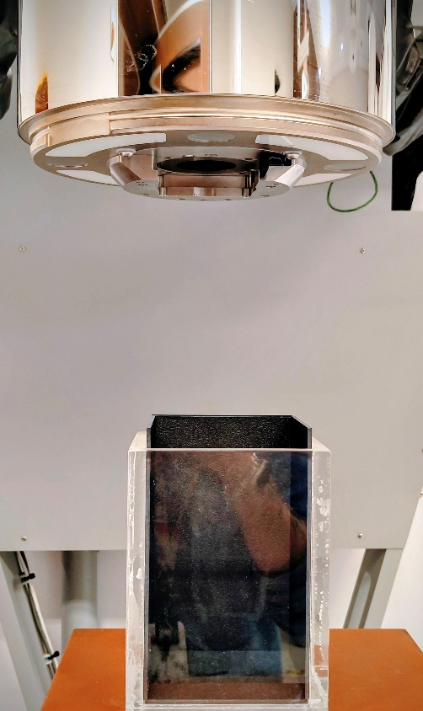
III – TOPAS SIMULATION SETUP
Input
Validated phase spaces
Geometry
Water phantom : 11,5 x 11,5 x 17,5 cm
PMMA walls : 1cm thick
Detection plans
Simulation
electron transport
Cherenkov production
optical transport
Outputs
Dose : energy deposition
Cherenkov production : generated photons
Optical fluence : detected photons
This separation allows us to isolate transport effects
Figure 9 : (a) Representation of the simulated geometry used in the TOPAS simulations, (b) Experimental Cherenkov imaging setup showing the water tank positioned under the Mobetron
PAGE 10
THIBAULT BERNELIN
Notes:
Using these validated phase spaces, we built an optical simulation in TOPAS.
The geometry consisted of a water phantom surrounded by PMMA walls and an external detection plane.
The simulation included electron transport, Cherenkov photon generation, and optical photon transport.
Three independent quantities were scored: absorbed dose, Cherenkov photon production, and optical fluence reaching the detector.
This allows us to separate generation effects from transport effects.

Slide 11
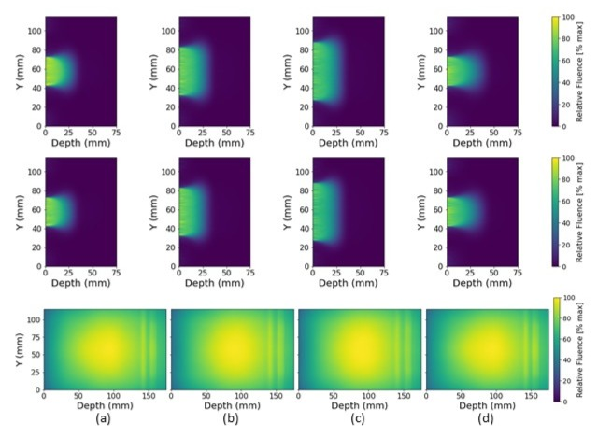
IV – RESULTS
2D DISTRIBUTIONS
Figure 10 : Simulated relative absorbed dose distribution (top), Cherenkov photon relative production (middle), and Cherenkov photon relative fluence reaching the external detection plane (bottom) for the
2.5 cm, 6 MeV,
(b) 5 cm, 6 MeV,
(c) 6 cm, 6 MeV, (d) 2.5 cm, 9 MeV electron beams
Observations
Strong agreement between dose and Cherenkov production
Optical transport introduces reflections and spatial distortions
Directional Cherenkov emission affects the detected signal.
Take-home message
TOPAS reproduces the expected transport of optical photons
PAGE 11
THIBAULT BERNELIN
Notes:
Here we compare the two-dimensional distributions obtained for several beam configurations.
The absorbed dose is shown on the top row. Cherenkov photon production is shown in the middle row. Optical fluence reaching the detector is shown on the bottom row.
The first observation is that Cherenkov production closely follows the dose distribution inside the water tank.
The detected fluence exhibits the optical effects expected from Cherenkov photon transport, including reflections at interfaces and a displacement of the main emission region.
These observations suggest that TOPAS properly models the production and transport of optical photons.

Slide 12
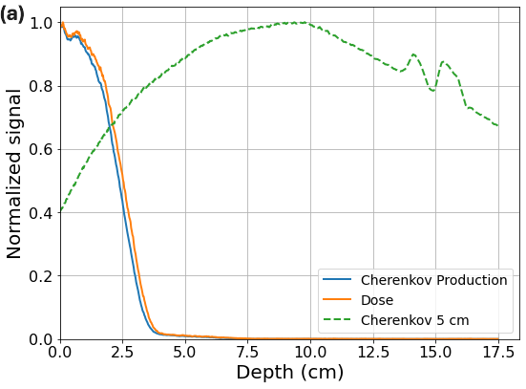


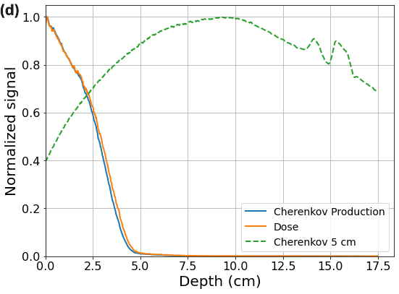
IV – RESULTS
DEPTH PROFILES
Observations
Strong correlation between dose and production.
Detected fluence exhibits:
  Shifts
  Distortions
  Secondary peaks
Figure 11 : Comparison of longitudinal profiles of absorbed dose (orange), Cherenkov photon production (blue), and Cherenkov photon fluence at 5 cm (green) for the (a) 2.5cm - 6 MeV, (b) 5cm - 6 MeV, (c) 6 cm - 6 MeV, and (d) 2.5cm - 9 MeV electron beams
PAGE 12
THIBAULT BERNELIN
Notes:
To better quantify these differences, we extracted longitudinal profiles.
Once again, we observe a very strong agreement between absorbed dose and Cherenkov production.
In contrast, the detected fluence exhibits shifts, distortions, and secondary peaks.
These features appear consistently across all investigated beam configurations.
Therefore, while Cherenkov production is closely related to dose deposition, the detected optical signal contains additional transport-related information.

Slide 13
V – DISCUSSIONS
Why does the signal shift ?
Cherenkov photons are :
emitted at a specific angle
anisotropic
refracted at interfaces
reflected by boundaries
Therefore : Camera signal is influenced by optical transport phenomena
Implication for FLASH dosimetry
Strong dose-production correlation
Predictable transport effects
Monte Carlo can characterize corrections
Potential for quantitative Cherenkov dosimetry in FLASH beams.
PAGE 13
THIBAULT BERNELIN
Notes:
Why do these shifts occur?
Several optical phenomena contribute.
First, Cherenkov photons are emitted anisotropically along a characteristic cone. They then undergo refraction at material interfaces. Some photons are reflected by phantom boundaries. Finally, the detection geometry itself introduces additional bias.
Consequently, the signal observed by a camera cannot be interpreted as a direct image of the absorbed dose.
Nevertheless, these effects are deterministic and can be modeled using Monte Carlo simulations.

Slide 14
CONCLUSIONS
Realistic phase spaces were generated using validated Mobetron beam models
PESO enabled physically consistent spectrum reconstruction
TOPAS successfully modeled Cherenkov generation and transport
Optical transport significantly modifies the detected signal, but in a predictable manner
These effects must be considered before quantitative dose estimation
Future work
Experimental validation
Polarization studies
Correction algorithms
Real-time FLASH dosimetry
PAGE 14
THIBAULT BERNELIN
Notes:
To conclude:
We used validated Mobetron phase spaces to perform optical Monte Carlo simulations in TOPAS.
The simulations demonstrated a strong correlation between absorbed dose and Cherenkov photon production.
However, optical transport significantly modifies the detected signal.
These transport effects must therefore be accounted for before quantitative dose estimation becomes possible.
Future work will focus on experimental validation, polarization studies, and correction algorithms for real-time FLASH dosimetry.

Slide 15
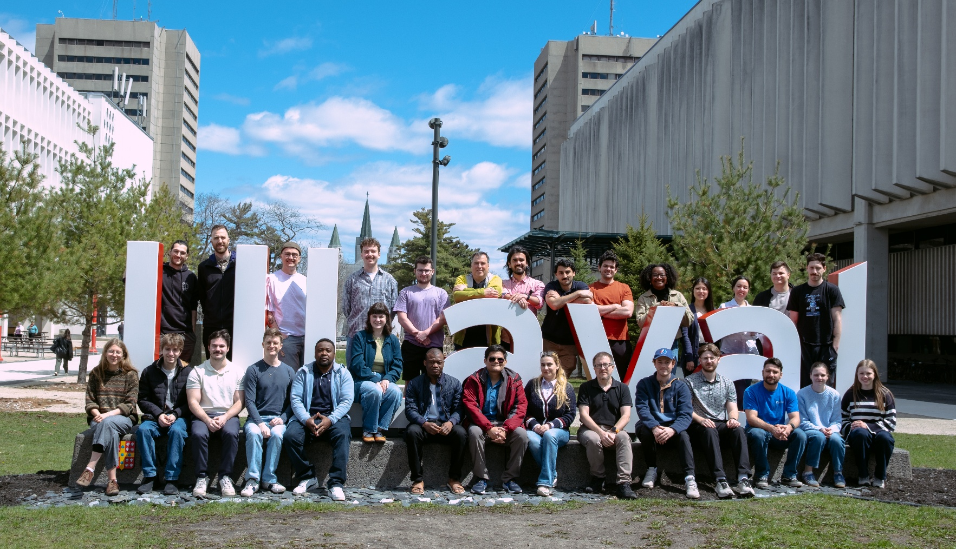
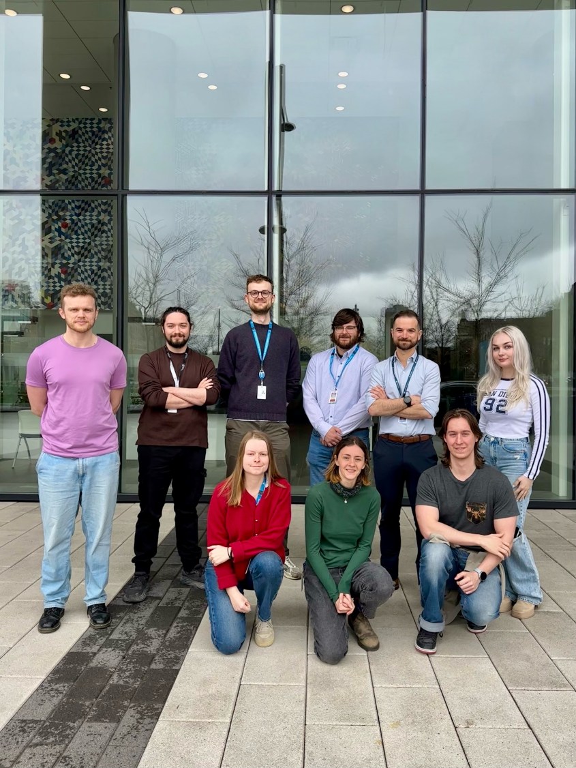
THANKS FOR YOUR ATTENTION
Any questions ?

