Slide 1
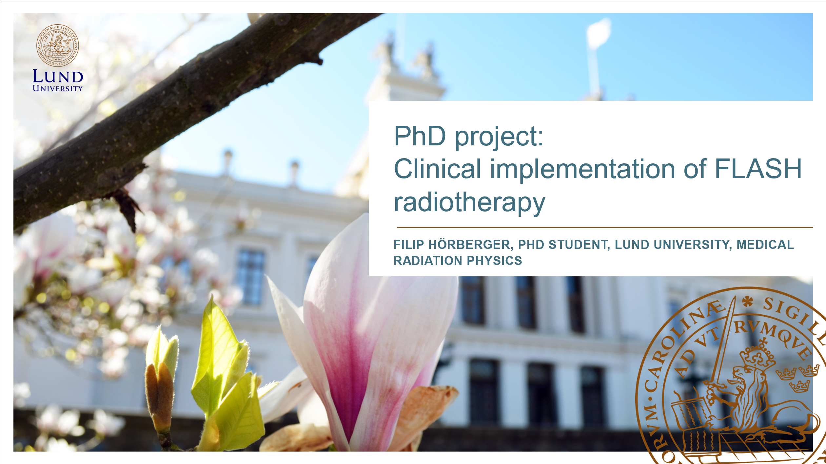

Clinical Implementation of FLASH Radiotherapy
Half time presentation:
IC3Ddose 2026 Caen, France
A scintillator-based approach to spatial and temporal dosimetry in UHDR electron irradiation:
A complementary tool for preclinical research
Filip Hörberger, PhD Student, Lund University, Medical Radiation Physics, Lund, Sweden
Filip Hörberger

Slide 2




The rationality
FLASH program in Lund since 2019
- Preclinical research
- Veterinary trials
Desirable dosimetry under UHDR conditions still lacking (especially one with both spatial and temporal properties)
Our main goal: The “(pre)clinical” application of a scintillator-based dosimetry system → “Bridging the gap”

Slide 3
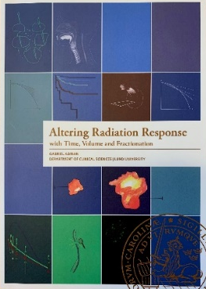
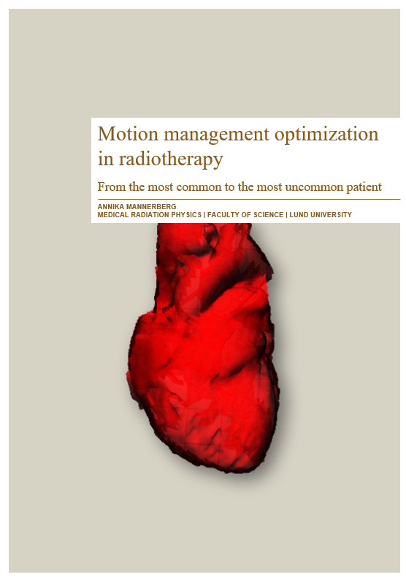
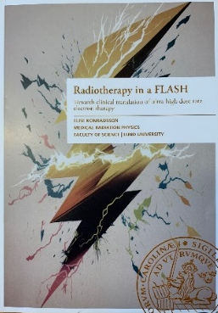

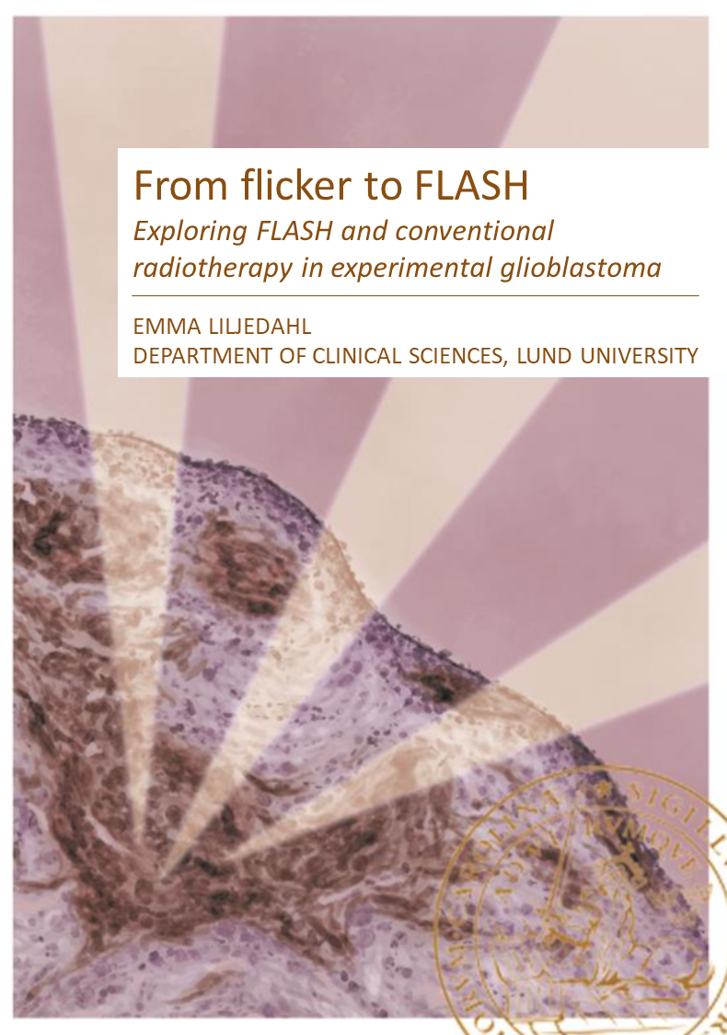

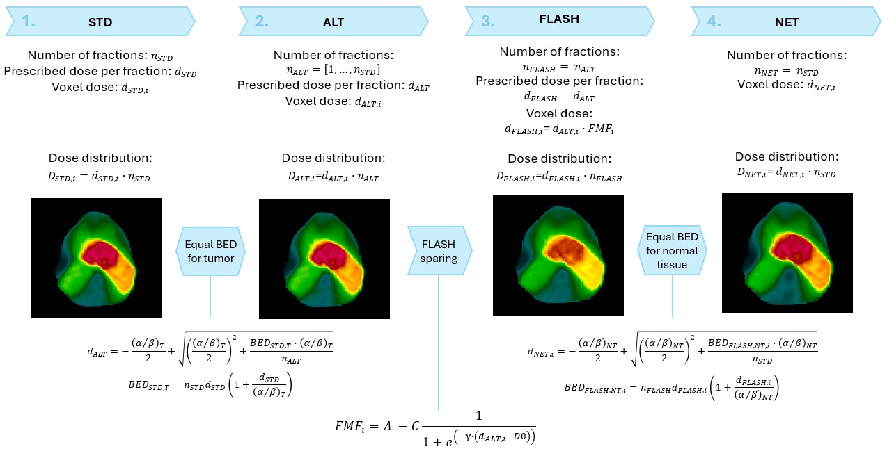

Our FLASH Publications
(2019-2025)
Lempart M, Blad B, Adrian G, Bäck S, Knöös T, Ceberg C, Petersson K. Modifying a clinical linear accelerator for delivery of ultra-high dose rate irradiation. Radiother Oncol DOI:10.1016/j.radonc.2019.01.031, 2019.
Konradsson E, Ceberg C, Lempart M, Blad B, Bäck S, Knöös T, Petersson K. Correction for ion recombination in a built-in monitor chamber of a clinical linear accelerator at ultra-high dose rates. Radiat Res 194:580-586, 2020.
Konradsson E, Petersson K, Adrian G, Lempart M, Blad B, Ceberg S, Knöös T, Bäck SÅJ, Ceberg C. Development of dosimetric procedures for experimental ultra-high dose rate irradiation at a clinical accelerator. J Phys Conf Ser 2167:012003, 2022.
Ceberg S, Mannerberg A, Konradsson E, Blomstedt M, Kügele M, Kadhim M, Edvardsson A, Bäck SÅJ, Petersson K, Jamtheim Gustafsson C, Ceberg C. FLASH radiotherapy and the associated dosimetric challenges. J Phys Conf Ser 2630:012010, 2023.
Mannerberg A, Konradsson E, Kügele M, Edvardsson A, Kadhim M, Ceberg C, Petersson K, Thomasson HM, Arendt ML, Børresen B, Bastholm Jensen K, Ceberg S. Surface guided electron FLASH radiotherapy for canine cancer patients. Med Phys doi:10.1002/mp.16453, 2023.
Konradsson E, Ericsson Szecsenyi R, Adrian G, Coskun M, Børresen B, Arendt ML, Erhart K, Bäck SÅJ, Petersson K, Ceberg C. Konradsson E, Evaluation of intensity-modulated electron FLASH radiotherapy in a clinical setting using veterinary cases. Med Phys 50:6569–6579, 2023.
Konradsson E, Wahlqvist P, Thoft A, Blad B, Bäck S, Ceberg C, Petersson K. Beam control system and output ﬁne-tuning for safe and precise delivery of FLASH radiotherapy at a clinical linear accelerator. Font Oncol 14:1342488, 2024.
Konradsson E, Ericsson Szecsenyi R, Wahlqvist P, Thoft A, Blad B, Bäck S, Ceberg C, Petersson K. Reconfiguring a plane-parallel transmission ionization chamber to extend the operating range into the ultra-high dose-per-pulse regime. Radiat Res doi.org/10.1667/RADE-23-00177.1, 2024.
Hörberger F, Petersson K, Ceberg S, Bäck S, Adrian G, Ceberg C. Investigating the therapeutic potential of FLASH radiotherapy – a treatment planning study. Radiother Oncol 21:209:110947, 2025.
Adrian G, Konradsson E, Lempart M, Bäck S, Ceberg C, Petersson K. The FLASH effect depends on oxygen concentration. Br J Radiol 93:20190702, 2020.
Petersson K, Adrian G, Butterworth K, McMahon SJ. A quantitative analysis of the role of oxygen tension in FLASH radiation therapy. Int J Radiat Oncol Biol Phys, 2020.
Adrian G, Konradsson E, Beyer S, Wittrup A, Butterworth KT, McMahon SJ, Ghita M, Petersson K, Ceberg C. Cancer cells can exhibit a sparing FLASH effect at low doses under normoxic in vitro-conditions. Front Oncol doi:10.3389/fonc.2021.686142, 2021.
Konradsson E, Liljedahl E, Gustafsson E, Adrian G, Beyer S, Ehsaan Ilaahi S, Petersson K, Ceberg C, Nittby Redebrandt H. Comparable long-term tumor control for hypofractionated FLASH vs. conventional radiation therapy in an immunocompetent rat glioma model. Adv Radiat Oncol doi.org/10.1016/j.adro.2022.101011, 2022.
Liljedahl E, Konradsson E, Gustafsson E, Förnvik Jonson K, Olofsson JK, Ceberg C, Nittby Redebrandt H. Long-term anti-tumor effects following both conventional radiotherapy and FLASH in fully immunocompetent animals with glioblastoma. Sci Rep 19:12285, 2022.
Böhlen T, Germond JF, Petersson K, Ozsahin EM, Herrera FG, Bailat C, Bochud F, Bourhis J, Moeckli R, Adrian G. Effect of conventional and ultrahigh dose rate FLASH irradiations on preclinical tumo models: a systematic analysis. Int J Radiat Oncol Biol Phys 117:1007-1017, 2023.
Liljedahl E, Konradsson E, Linderfalk K, Gustafsson E, Petersson K, Ceberg C, Nittby Redebrandt H. Comparable survival in rats with intracranial glioblastoma irradiated with single-fraction conventional radiotherapy or FLASH radiotherapy. Front Oncol 13:1309174, 2024.
Dela R, Lemos da Silva L, Beyer S, Singers Sörensen B, Poulsen P, Konradsson E, Hörberger F, Petersson K, Ceberg C, Adrian G. Not all tumors are alike: varying efficacy of FLASH across tumor types and oxygenation status in spheroid models. Br J Radiol doi.org/10.1093/bjr/tqaf219, 2025.
Konradsson E, Arendt ML, Bastholm Jensen K, Børresen B, Hansen AE, Bäck S, Kristensen AT, Munck af Rosenschöld P, Ceberg C, Petersson K. Establishment and initial experience of clinical FLASH radiotherapy in canine cancer patients. Front Oncol 11:658004, 2021.
Børresen B, Arendt M, Konradsson E, Bastholm Jensen K, Bäck SÅ, Munck af Rosenschöld P, Ceberg C, Petersson K. Evaluation of single-fraction high dose FLASH radiotherapy in a cohort of canine oral cancer patients. Radiat Oncol doi:10.3389/fonc.2023.1256760, 2023.
Gjaldbaek B, Arendt ML, Konradsson E, Bastholm Jensen K, Bäck SÅJ, Munck af Rosenschöld P, Ceberg C, Petersson K, Børresen B. Long-term toxicity and efficacy of FLASH radiotherapy in dogs with superficial malignant tumors. Front Oncol 14:1425240, 2024.
MED
PHYS
PRE
CLIN
Clinical implementation of FLASH radiotherapy
+ PhD theses
VET
Notes:
FLASH-publications from Lund 2019 - 2025

Slide 4







Overview
Go FLASH!
The Rationality
Background:
UHDR and the FLASH effect
The FLASH program in Lund
A scintillator-based approach…
Closing Remarks
Notes:
I will then introduce the FLASH program in Lund, which will set stage for why we are exploring a scintillator-based dosimetry system.

Slide 5
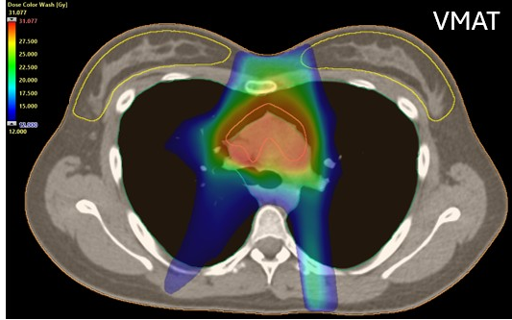
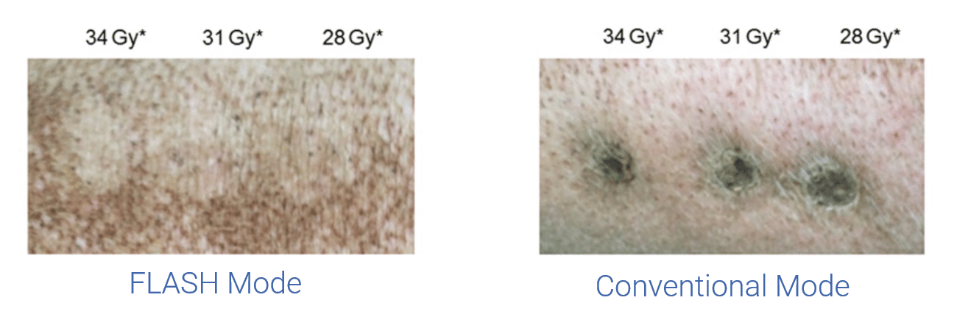
Background
Radiotherapy: A cornerstone of modern cancer treatment
Fractionation & geometric sparing
RT with ultra-high dose rates
- The FLASH effect
Large fraction doses (>5 Gy)
Dose rates > 40 Gy/s
Short irradiation times
*Vozenin MC et al. The Advantage of FLASH Radiotherapy Confirmed in Mini-pig and Cat-cancer Patients. Clin Cancer Res. 2019
Notes:
The goal, and challenge, of RT is to deliver a high enough radiation dose to the tumor, killing it, while minimizing the exposure to healthy tissue.
Modern RT primarily reduces damage to normal tissue (NT) through two key methods: dose fractionation and geometric sparing.
Helped us balanced tumor control and normal tissue complications.
Despite these improvements, adverse effects still remains a problem and ongoing research seeks novel.
One such novel approach…which has been shown to induce the so-called “FLASH effect”. The FLASH effect, characterized by a differential normal tissue (NT) response with irradiation at UHDR compared to conventional dose-rates, has been demonstrated in multiple preclinical studies.

Slide 6
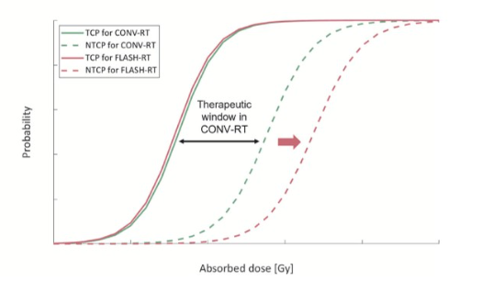
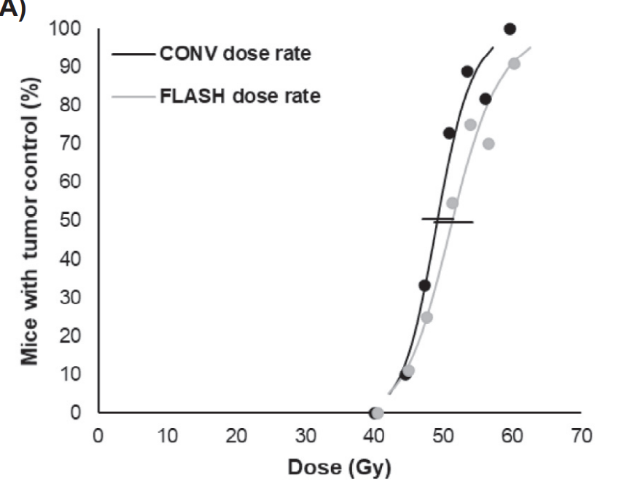
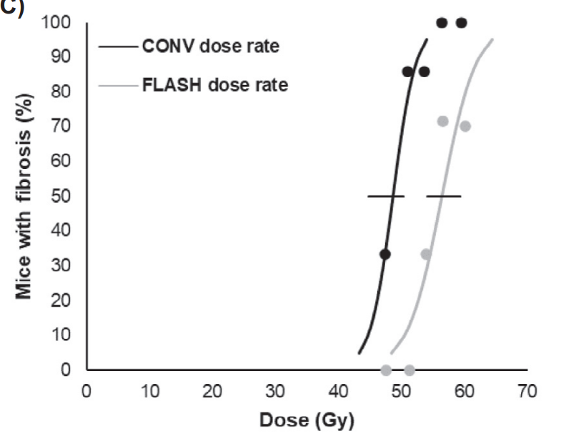
The FLASH Effect – Improved Therapeutic Window
Comparable treatment efficacy
Normal tissue sparing
*
CONV
FLASH
CONV
FLASH
Mice with subcutaneous
C3H breast cancer
Increased tolerance
in the skin
Therapeutic window in FLASH-RT
*CONV = conventional dose rate
Singers Sørensen et al., Radiother Oncol 2022

Slide 7
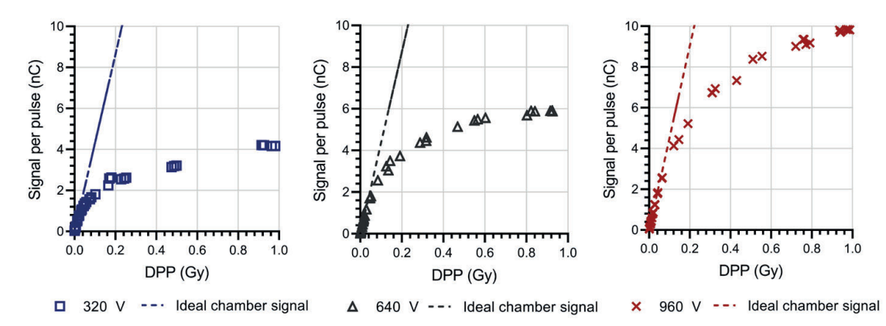
Background
Practical consideration of UHDR-RT
    - Short irradiation time
Intra-fraction motion would be insignificant
Dosimetry challenges
Konradsson, E. (2023). Radiotherapy in a FLASH: Towards clinical translation of ultra-high dose rate electron therapy. [Doctoral Thesis (compilation), Faculty of Science]. Lund University.
Notes:
However, the FLASH effect is only one aspect, that being the biological part, of UHDR, the very short and fast dose-delivery constitutes another important part.
In essence, the uncertainty from intra-fraction motion would in practice disappear. However, at the same time

Slide 8
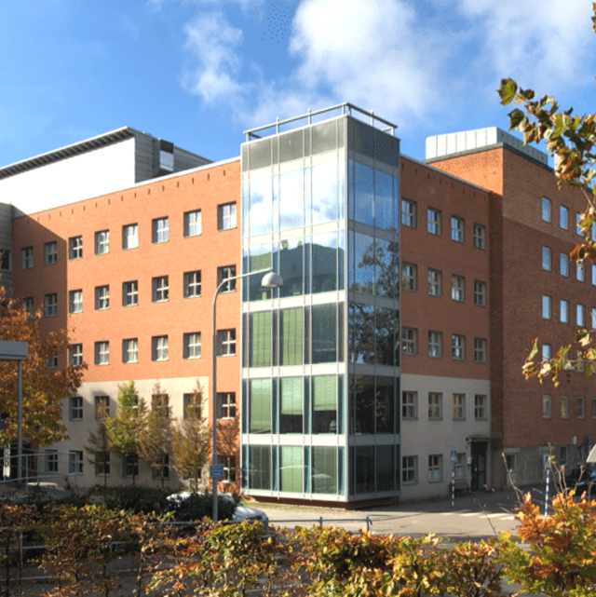
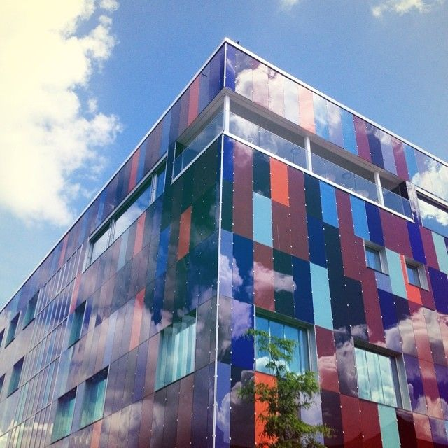
The FLASH Program in Lund
MEDICAL RADIATION PHYSICS, LU
Lund University
Medical Radiation Physics
Oncology
Neurosurgery
RADIATION PHYSICS, SUS
Skåne University Hospital
Oncology, Hematology, Radiation Physics
Department of Radiotherapy
Notes:
With UHDR and FLASH introduced I would like to talk about the FLASH program in Lund which I mentioned earlier, and this is a collaboration between Lund University and Skåne university hospital.

Slide 9
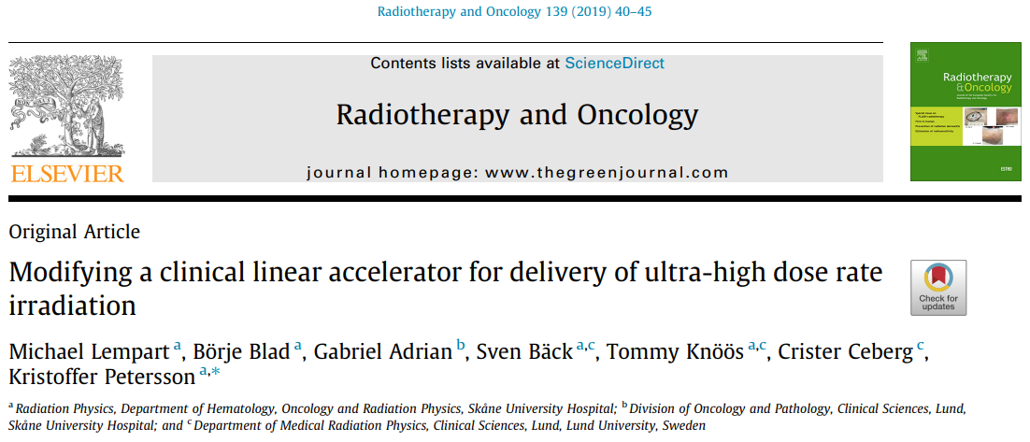
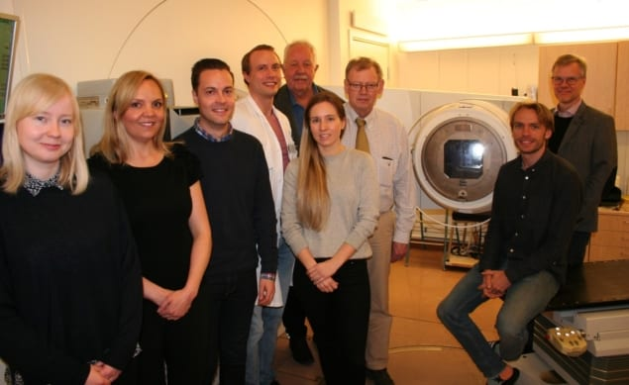
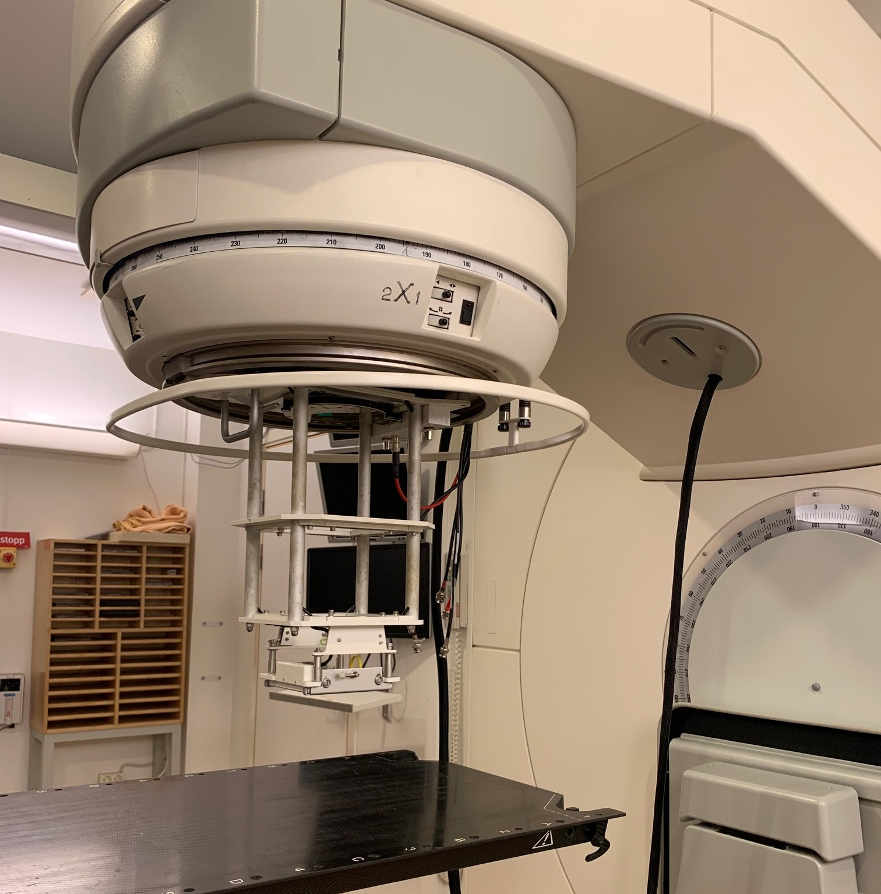
FLASH Radiotherapy on a Medical Linac
In 2019 a clinical LINAC (Elekta Precise, from 2003) was modified to enable UHDR-delivery
Increased electron current to 100 μA
(normally 0.1 μA)
Custom built external dosimetry system (pulse-by-pulse control)
Notes:
The whole program started in 2019 when a group of very curious people converted a clinical linac, an Elekta Precise, to enable UHDR-delivery. And to my understanding the conversion was, and is, very simple, coming down to increasing the electron current at the Linacs gun, as well as removing the scattering foils.

Slide 10
LINAC beam parameters
Beam parameters
Energy | 10 MeV (6, 12, 15 MeV)
Dose per pulse | 1.08 Gy (at isocenter, in water)
Average dose rate | 216 Gy/s (at isocenter, in water)
Pulse repetition frequency | 200 Hz
Time between each pulse | 5 ms
Pulse width | 3.5 μs
5 ms
3.5 μs
Dose rate
Time
Notes:
Some quick beam parameters: Our reference energy is 10 MeV but we have the option

Slide 11
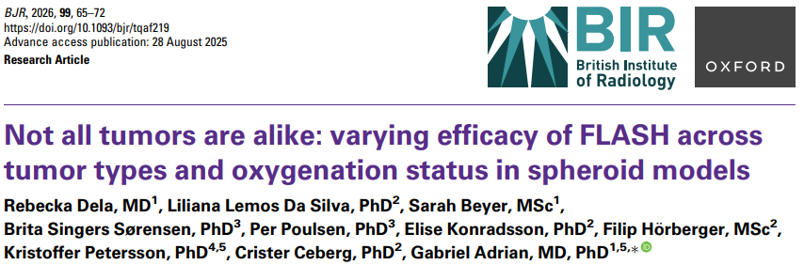
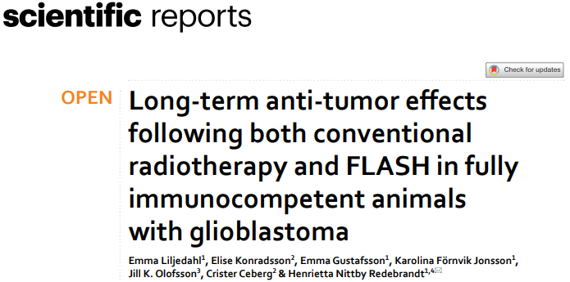
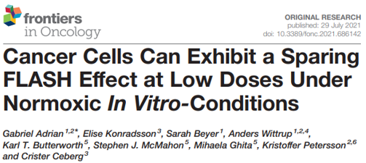
Preclinical research
Notes:
Now using this machine we have performed a lot of work on dosimetry in UHDR, but also a lot of preclinical research both in-vitro and in-vivo.

Slide 12
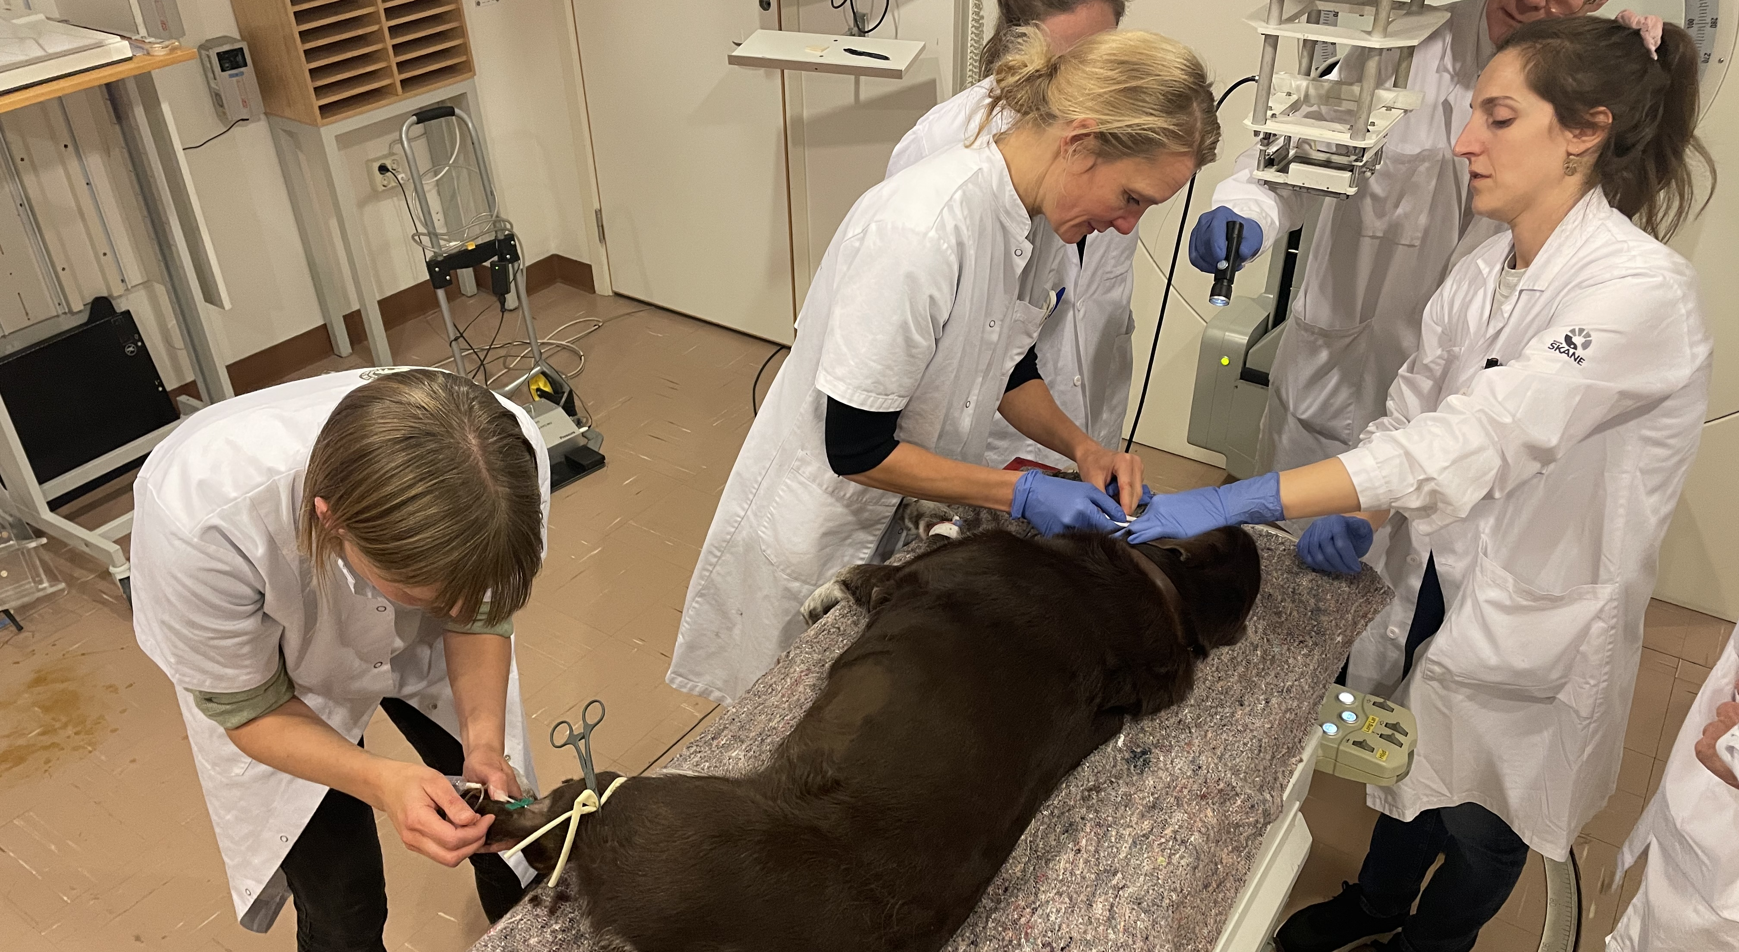
Veterinary clinical trials in Lund
Collaboration with Copenhagen University Hospital for Companion Animals
Notes:
But today I liked to focus on our ongoing clinical trials with veterinary patients, which are in collaboration with our veterinary colleagues from Copenhagen university

Slide 13
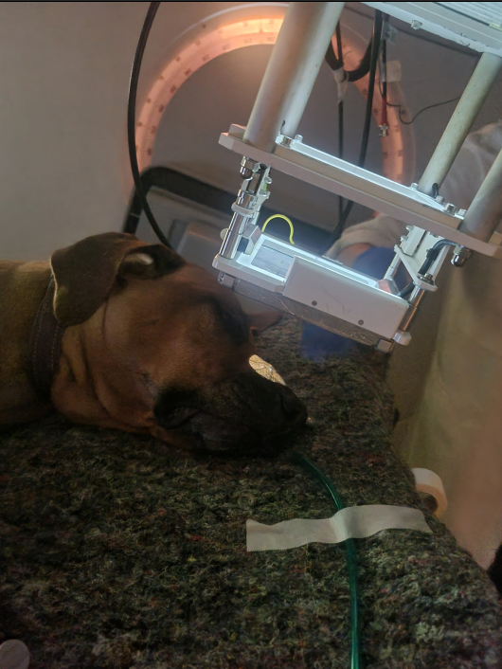
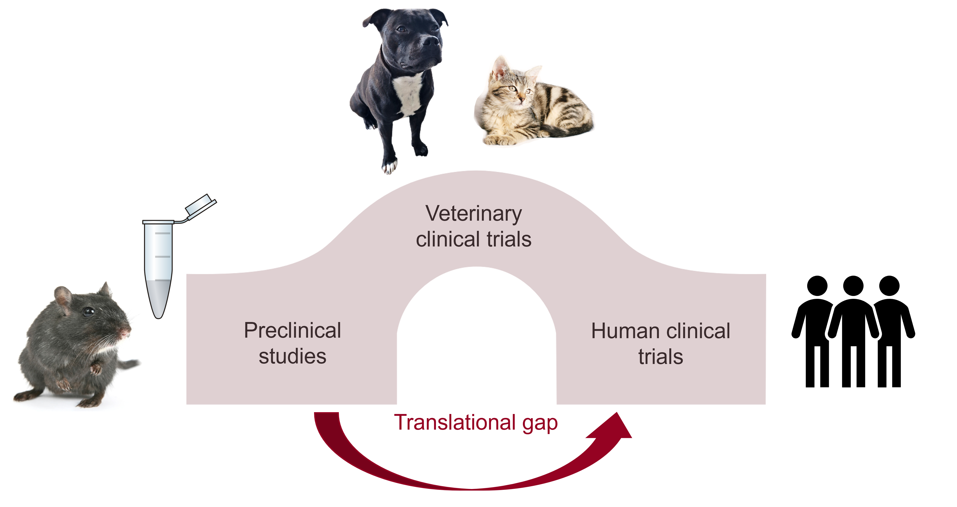
The translational gap
The translational gap
  Few preclinical results are translated to human clinical trials
Veterinary trials can help brigding the translational gap
  Demonstrate efficacy
  Decide on dose prescription
  Optimize treatment schedule
Notes:
So these are real patients diagnosed with various cancers, but they can help us bridge the translation gap between the preclinical results and a real clinical implementation.

Slide 14
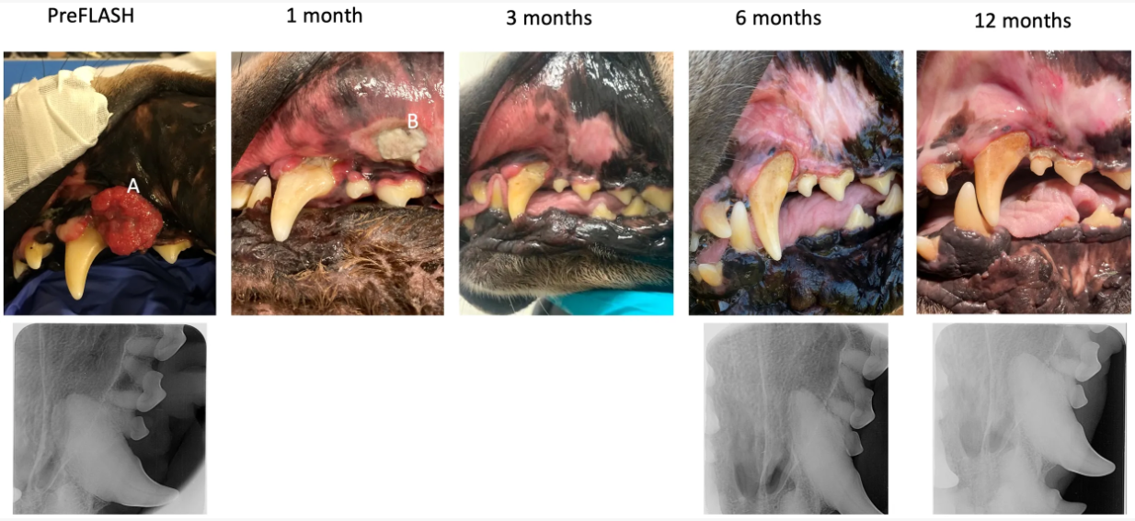
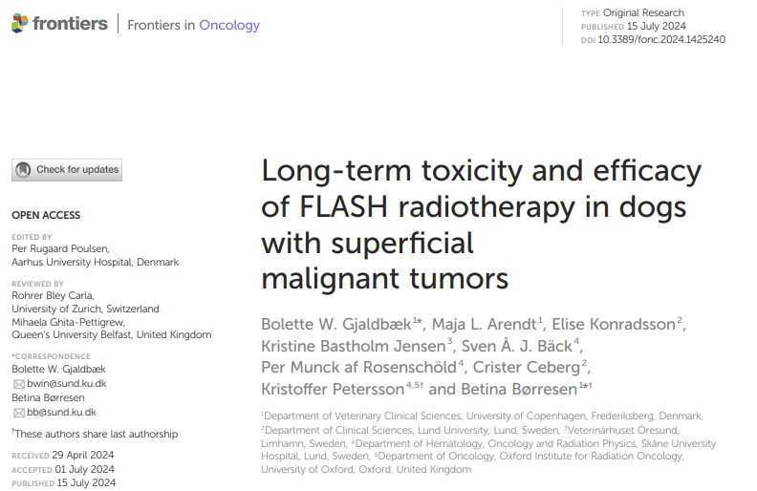

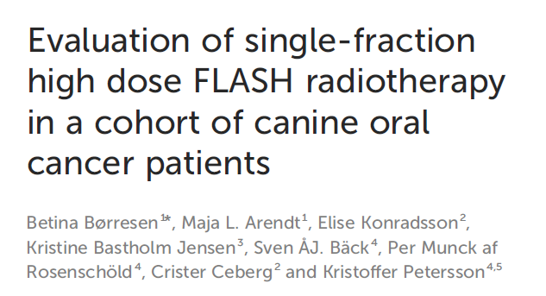
Single-arm study on oral malignant tumors
Single fraction UHDR 30 Gy – 42 Gy
Primary endpoint: safety
Secondary endpoint: efficacy
Completed and published
  11 dogs included
  12 months follow-up
Børresen et al., Front Oncol, 2023
Notes:
Initially we did a dose-escalation study starting from 15 Gy going up to 35 Gy, and only very mild acute side effects were seen. That initial experience translated into this single-arm study on oral malignant tumors, which included a long-term follow-up.
But our intuition was still that fractionation will play an important part.

Slide 15
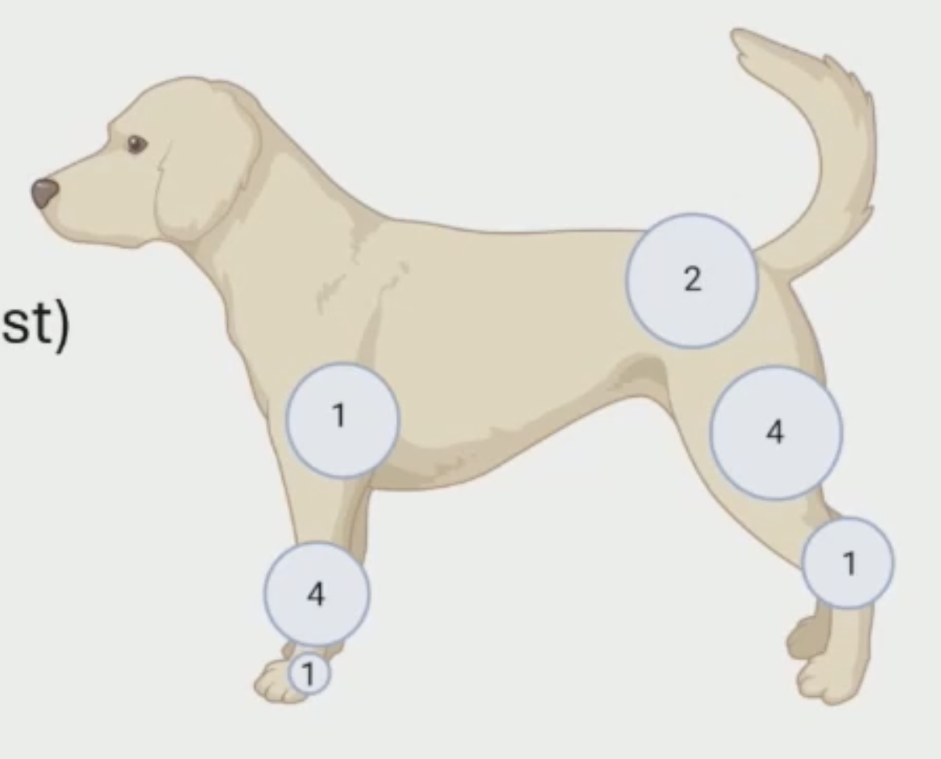
Two-armed randomized study
Hypofractionated treatment 4x8 Gy
  UHDR vs. conventional RT
  2 fractions per week
Inclusion
  Post-operative microscopic disease
  20 animals
  Primary endpoint: acute and late skin toxicity
Follow-up 10d, 40d, 3m, 6m, 12m and 24mo
Notes:
So, in essence using 30 Gy single fraction, resulted in side effects that were much less frequent than what one would expect with conventional dose-rates. And here the key word is expect, as we had no way of truly comparing it with conventional RT. So that was the next step.

Slide 16
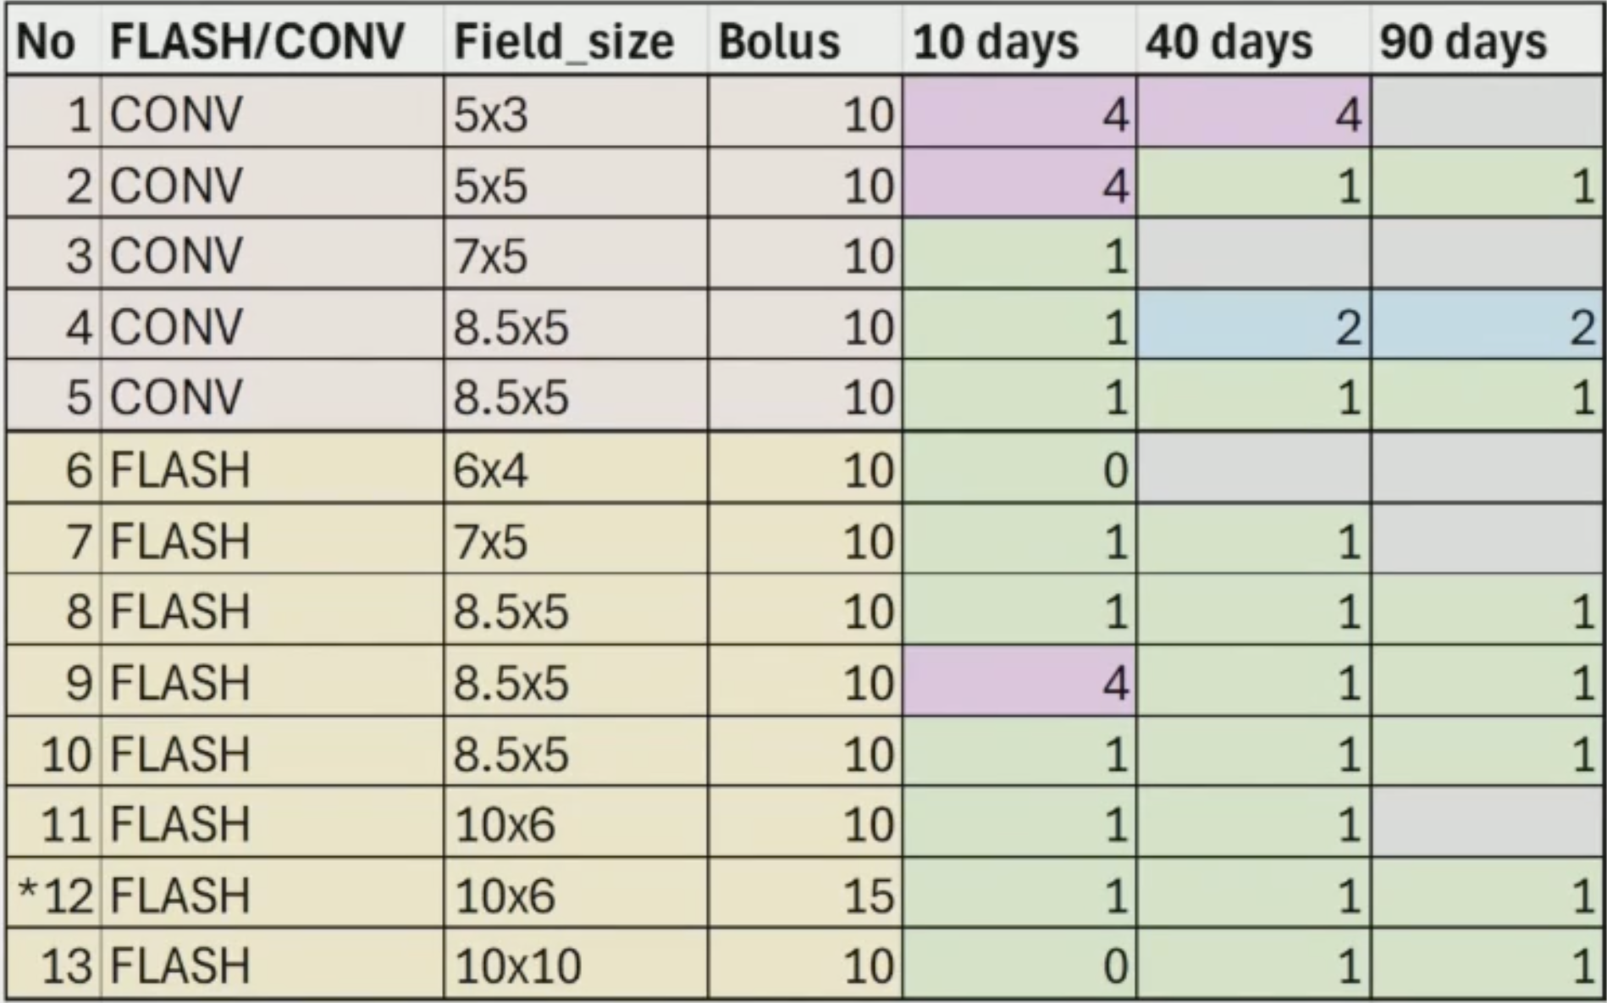
Two-armed randomized study
Only preliminary results so far
At 3 months there is overall low skin toxicity
Slight tendency towards UHDR having less acute skin toxicity
Still awaiting results for long-term toxicity
preliminary data
Notes:
And although there are only preliminary results so far, there seems to be a slight tendency towards less acute skin toxicity with UHDR. But this is an ongoing study, and we will continue to add more cases.

Slide 17
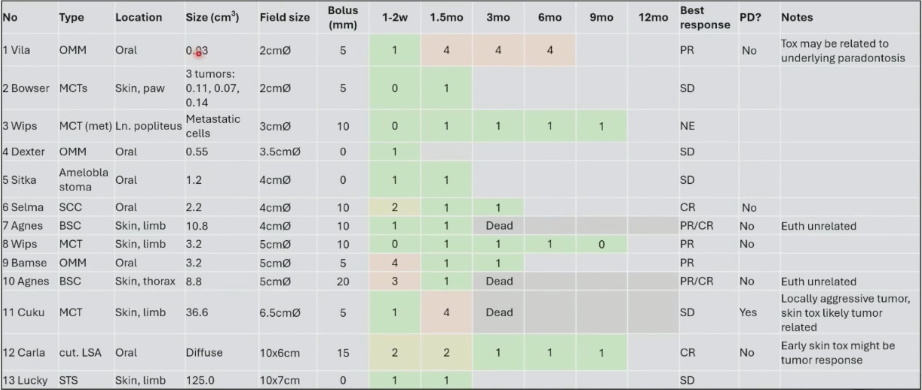

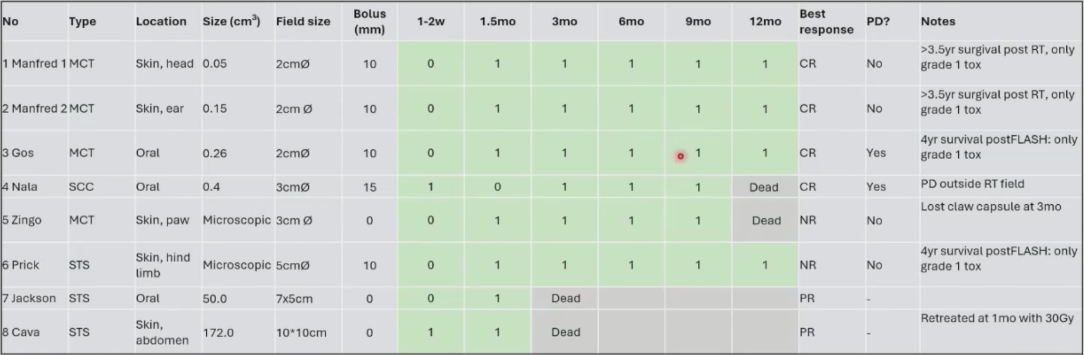
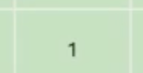
Two-armed fractionation study
3x10 Gy
1x30 Gy
Notes:
In parallel to that study, we also treated solid tumors with 4x8Gy, but that did not produce an effective treatment response, so we changed to 3x10 Gy. And this also provided a good opportunity to compare fractionated with single fraction UHDR-RT.

Slide 18
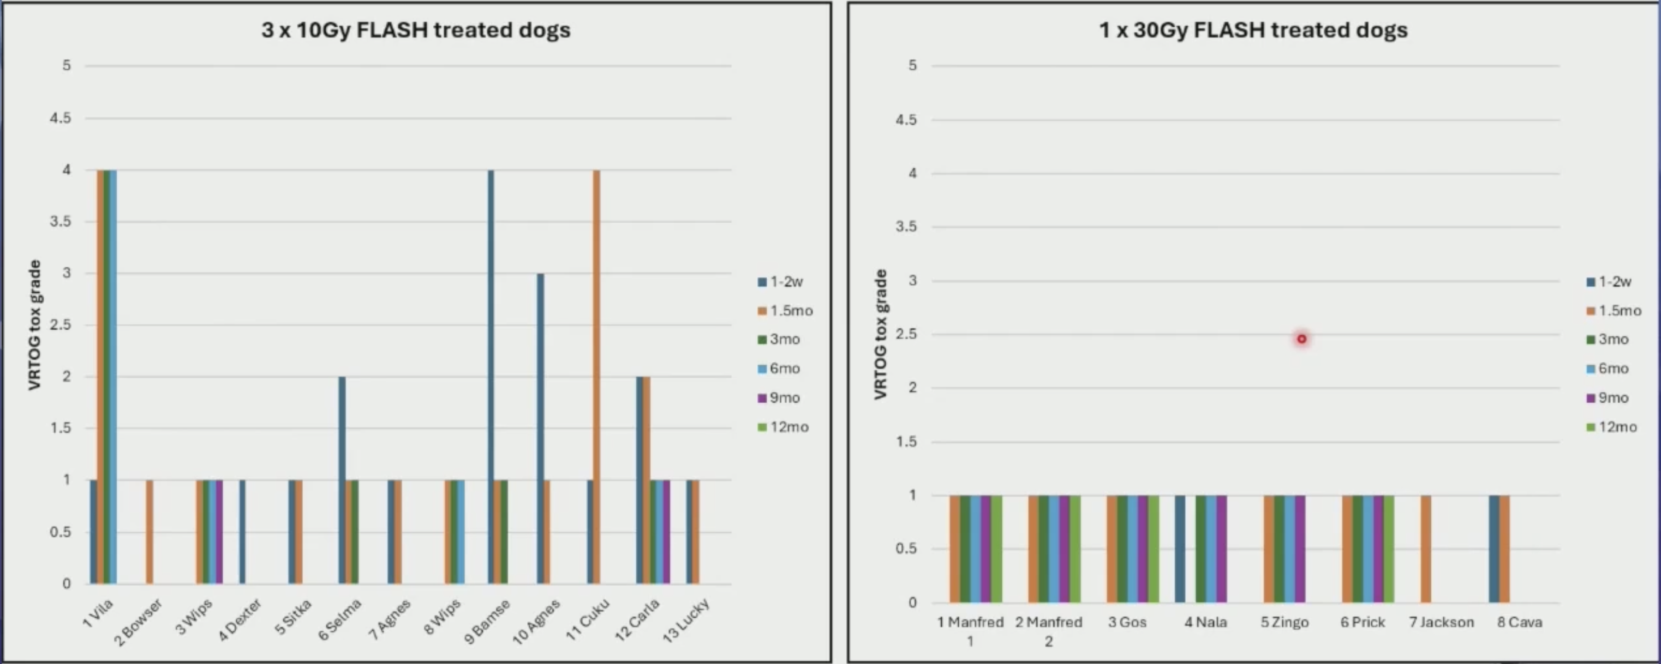

Two-armed fractionation study
There was more NT toxicity at 3x10 Gy than at 1x30 Gy
This is in contrast to all conventional experience of fractionation (the BED-model)
Interpretation:
  - The FLASH-effect is determined by the fraction dose, not the total dose
  - There is a substantially larger FLASH-effect at 30 Gy than at 10 Gy (larger than the BED-effect)
preliminary data
Notes:
And surprisingly what we are seeing is that there seems to be more normal tissue toxicity as 3x10 Gy than at 1x30 Gy. And this is in contrast to all conventional experience of fractionation where we do expect less side effects when we split up the total dose.
But this disparity in results and interpretation also highlights the challenges we have with these experiments, which is dosimetry. Maybe, we are lacking the tools to properly distinguish the beam parameters that actually describe these results. So, you know, coming back to the rationality of the scintillator project that I will now present.

Slide 19
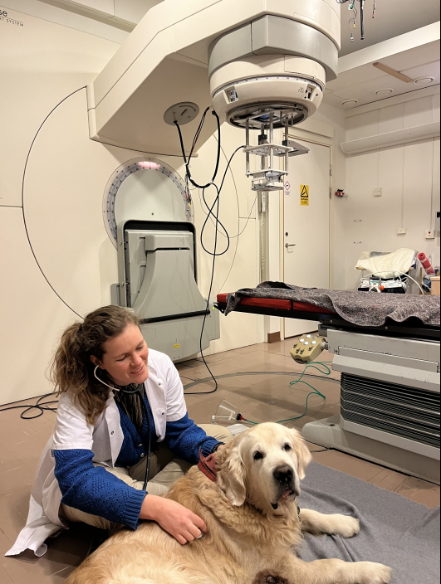
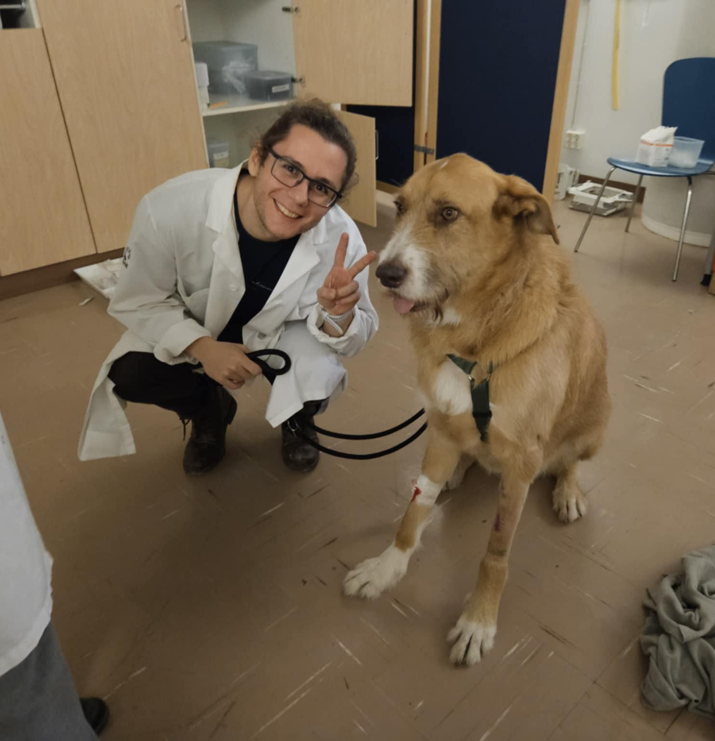

Slide 20

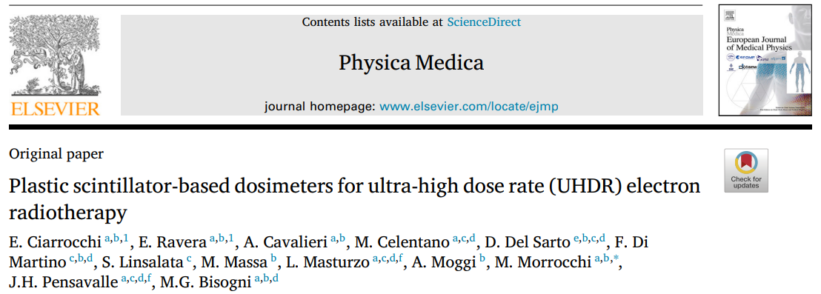
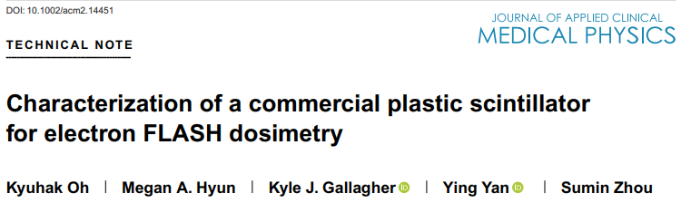
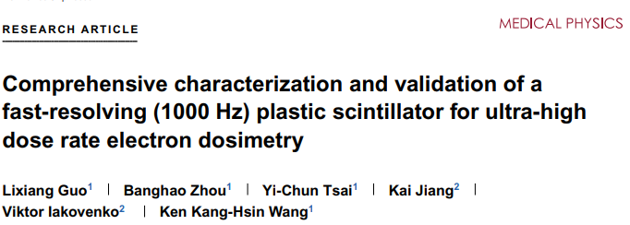
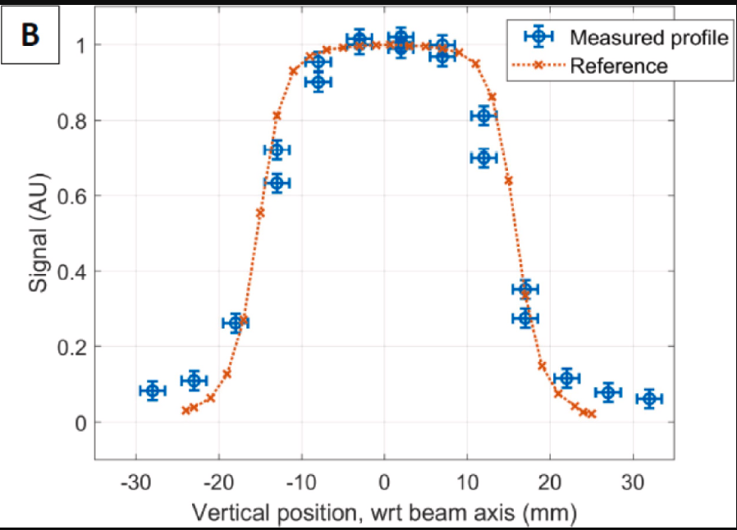
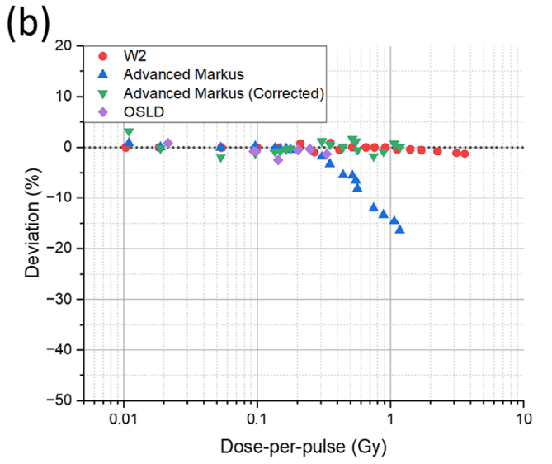

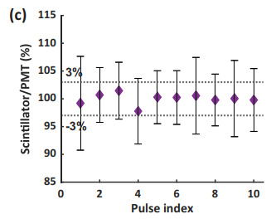
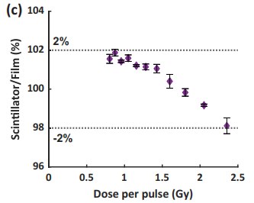
Why the need for a scintillator-based approach to spatial and temporal dosimetry in UHDR electron irradiation
Clinical reference dosimetry tools for conventional RT exhibit strong dose rate dependence
Maybe the explanation is hidden behind beam parameters we currently cannot resolve?
Notes:
So hopefully I have established the stage of why there is a need for a scintillator-based approach to spatial and temporal dosimetry in UHDR electron irradiation. But is important to say that naturally we are not the first ones who have thought of this
First paper: Sep 2025, 6 & 18 MeV, 0.8-2.3 Gy per pulse.
2nd paper: June 2024, 16 MeV, 180 Gy/s at isocenter.
Third: May 2024, Dosimeter array proof-of-concept.

Slide 21
Why the need for a scintillator-based approach to spatial and temporal dosimetry in UHDR electron irradiation
Clinical reference dosimetry tools for conventional RT exhibit strong dose rate dependence
Resolving spatial properties will be important for a successful safe clinical translation
Maybe the explanation is hidden behind beam parameters we currently cannot resolve?
The aim:
Establish a scintillation-based dosimetry system capable of achieving both fast temporal and spatial information
Explore the system in a preclinical environment (application)
Notes:
In the light of these, and to our knowledge, the community is still lacking a reliable and easy to use system to resolve some of the spatial properties that must be quantified for safe clinical implementation.

Slide 22
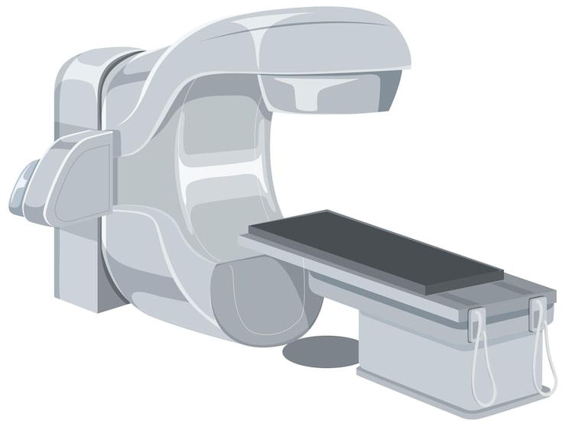
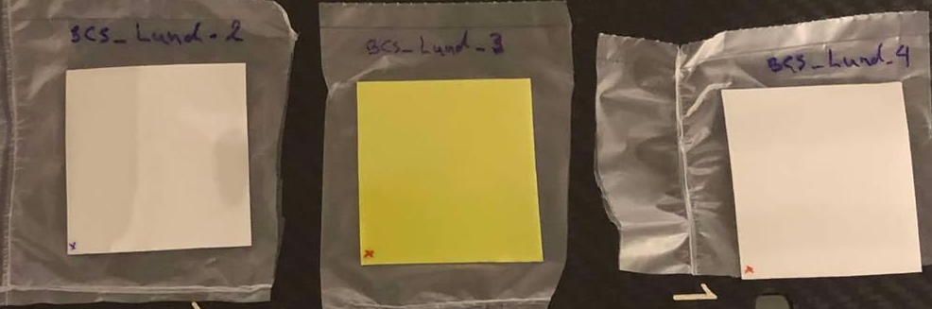
Method & Material
Elekta Precise Linac
Beam parameters
Energy | 10 MeV (6, 12, 15 MeV)
Average dose rate | 216 Gy/s (at isocenter, in water)
Pulse repetition frequency | 200 Hz
Time between each pulse | 5 ms
Pulse width | 3.5 μs
Conflict of interest:
Research agreement with BrightComSol, the provider of the scintillator film.
In general: 5×5 cm² and 565 µm thick
Notes:
Methodology-wise we had our trusty Elekta Precise linac, and just a quick reiteration of beam parameters. Important for us is the pulse-repetition frequency resulting in 5ms between each pulse, and a 3.5 us pulse width.

Slide 23
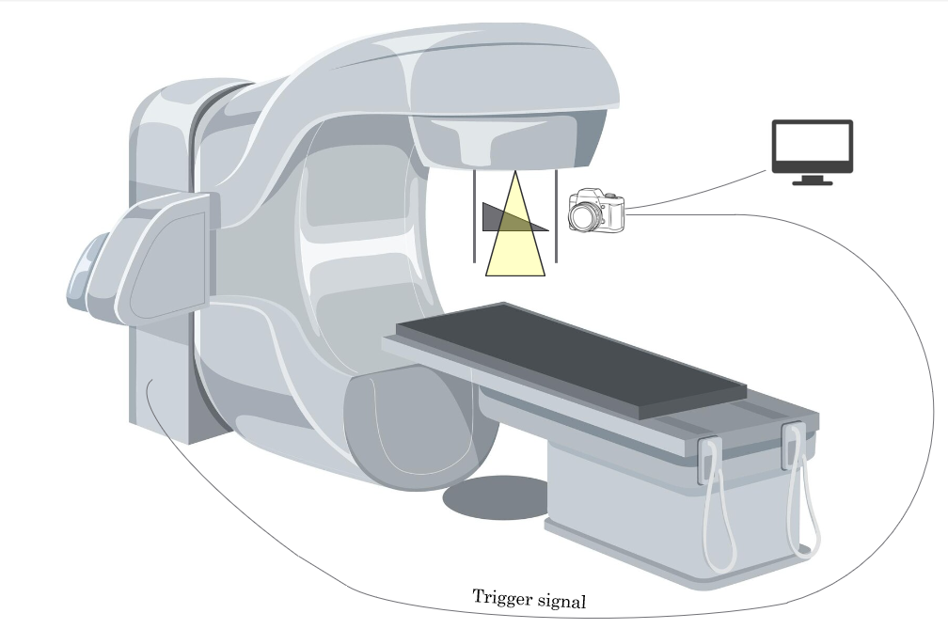
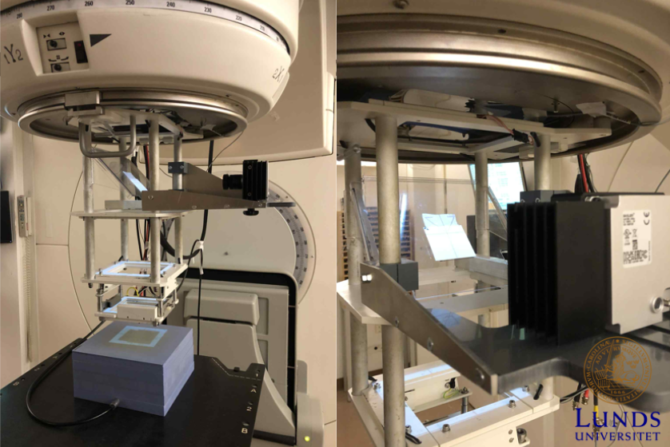


Experimental set-up
Pylon Viewer software
Thin-film scintillator
Scintillator mounted at a 45°, roughly at a SSD ≈ 65 cm
Basler boost (boA1936-400cca) high-speed camera
Camera-to-scint ≈ 25 cm, 90° relative beam axis
Image acquisition triggered by the linac’s PFV-V signal
Camera settings:
- Gain 20 dB
- 1024×1024 pixels
- 8-bit monochrome depth (maximum pixel value 254)
45°
CXP cable
Notes:
The scintillator was mounted at a 45 degree angle, at an SSD of 65 cm. We then had a high-speed camera directed towards the scintillator in order to capture an image of each pulse delivery. The distance from the camera to the scintillator was around 25 cm. The camera was connected to a computer via a CXP cable and image acquisition was triggered by the linac’s PFV-V signal which sends an electrical signal before each radiation pulse. This allowed individual pulses to be captured in real time with the scintillator.

Slide 24
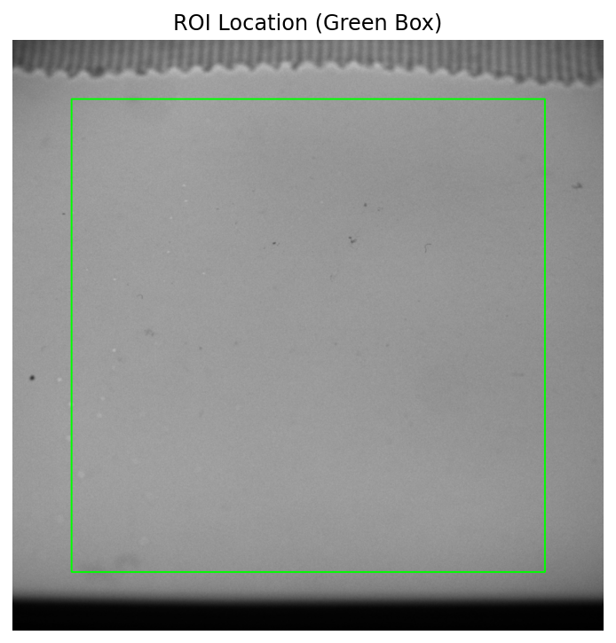
Method
Scintillation light-intensity was quantified as pixel value
All images were processed and analyzed in Spyder, Python
Radiochromic film (EBT-XD) used for reference dosimetry (when necessary)
- Following established protocol
- A dose uncertainty of 4% was applied

Slide 25
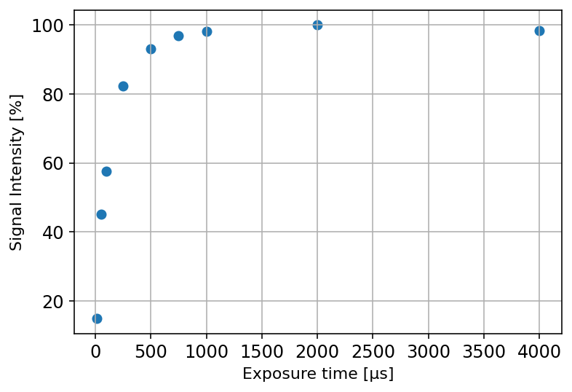

Task 1
Question 1: Afterglow
The scintillator’s afterglow < 5 ms (time between two pulses)?
Method:
Repeated measurements (10 pulses) with varying exposure time 10-4000 μs
Results:
Afterglow around 1 ms
Notes:
Our first task was to determine the scintillators afterglow, and given the fixed PRF of 200 Hz, the scintillator’s afterglow must be sufficiently short to avoid signal contamination from subsequent pulses. To verify this, repeated measurements were performed in which the same number of pulses and the same delivered dose were acquired at varying camera exposure times, ranging from 10 to 4000 µs.

Slide 26
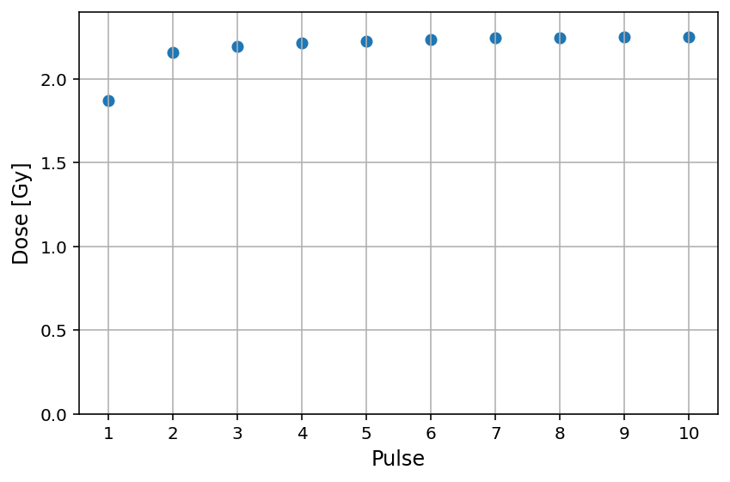
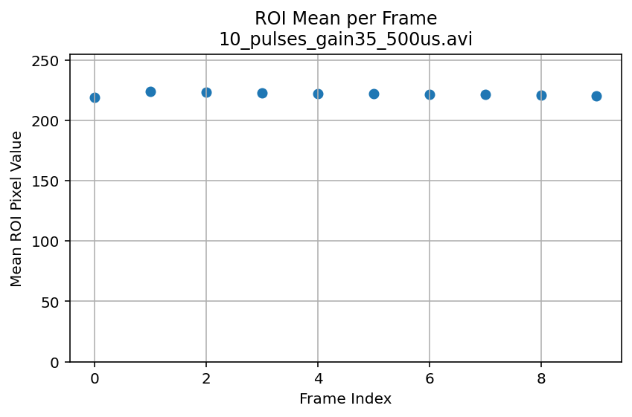
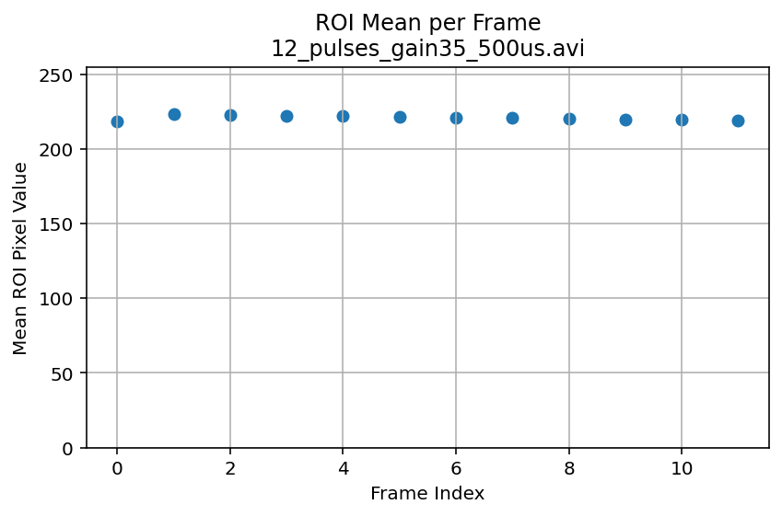

Task 1.5
Question 1.5:
Using 1 ms exposure time, do we get sufficient temporal resolution for resolving pulses?
10 pulses
12 pulses
20 pulses
Notes:
And indeed the system was fast enough to resolve each pulse without any signal contamination, seen here for a train of 10 pulses. The lower intensity observed for the first pulse in is a known characteristic of our linac, where the dose in the first pulse is consistently lower than subsequent pulses.

Slide 27

Task 2
Question 2:
How is the dose response as a function of dose-per-pulse under UHDR irradiation?
Method:
Pulse trains of 10–110 pulses, varying the linac’s gun setting → different DPP
Delivered doses 6-21 Gy, DPP range 0.06-2.1 Gy
Radiochromic adjacent to the scintillator.
Average scintillator intensity for each pulse train
Results:
Good linearity over the measured DPP interval
Saturation threshold ≈ 3.13 Gy/pulse (for the given settings)
Notes:
Moving on, we wanted to quantify the dose response of the system as a function of dose-per-pulse under UHDR irradiation. The dose linearity of the system readout (pixel intensity) was evaluated by delivering pulse sequences with varying DPP, achieved by adjusting the linac gun settings.

Slide 28






Notes:
So, what happens is that during our “normal” UHDR irradiation we have the gun setting set to produce maximum output and, in that case, if you push the machine, you lose power. But in these cases, with lower gun settings, we believe that the machine heats up during delivery thus producing a higher output.

Slide 29


Task 3:
Question 3: Can we get pulsed resolved spatial information?
information
Symmetry & Flatness
(A must for clinical implementation)
Notes:
But moving on to the next questions, can we get pulsed resolved spatial information? So, this heat map illustrates the spatial distribution of the signal…
So yes, it is possible to reliable get pulsed resolved spatial information, and although not quantified here we believe this demonstrates that it is practically possible to measure symmetry and flastness of the field which is a must for a beam delivery in the clinic.

Slide 30

Off center
Central axis

Slide 31


Film flipped 180°

Slide 32

Other potentially valuable feedback
Varying the pulse forming network (PFN) affects the intensity of the first pulse
More accurate dose delivery closer to the prescribed dose
Notes:
I mentioned before that the first pulse was always weaker than the rest and that the strength of that first pulse was something we could control. We can do this by varying the pulse forming network time, “the ramp up time”. In this figure…

Slide 33

Closing remarks
Notes:
By providing online information on the DPP, the present method offers sufficient temporal resolution to enable “pulse‑train”-level control of dose delivery, thereby shifting the paradigm from simply counting delivered pulses to actively, in real time, measuring the delivered dose. As efforts toward clinical implementation of UHDR radiotherapy accelerate, reliable tools capable of characterizing both dose and beam structure are essential, and the presented approach represents one possible solution.

Slide 34














The FLASH Program in Lund
  Medical Radiation Physics, LU
    Filip Hörberger
    Liliana Lemos da Silva
    Elise Konradsson
    Rebecka Ericsson Szecsenyi
    Annika Mannerberg
    Sofie Ceberg
    Mizgin Coskun
    Crister Ceberg
  Oncology, LU
    Gabriel Adrian
    Sarah Beyer
    Anders Wittrup
    Rebecka Dela
  Neurosurgery, Rausing Laboratory, LU
    Henrietta Nittby Redebrandt
    Emma Liljedahl
    Emma Gustafsson
    Suhayb Ehsaan Ilaahi
  Integrative Neurophysiology, LU
    Per Petersson
    Sebastian Barrientos
  Skåne University Hospital, Lund
    Pontus Wahlstedt
    Andreas Thoft
    Michael Lempart
    Börje Blad
    Hannamaria Thomasson
    Malin Kügele
    Annelie Edvardsson
    Tommy Knöös
    Sven Bäck
    Per Munck af Rosenschöld
    Silke Engelholm
  Oxford University
    Kristoffer Petersson
  University of Copenhagen
    Betina Børresen
    Maja L Arendt
    Bolette Gjaldbaek
    Emilie Strange Wisman
    Annemarie T Kristensen
  Veterinärhuset Öresund
    Kristine Bastholm Jensen
  Denmark Technical University
    Anders E Hansen
    Anja Brus
  Queens University Belfast
    Karl T Butterworth
    Stephen J McMahon
    Michaela Ghita
Kristoffer Petersson
Liliana Lemos da Silva
Betina Börresen
Crister Ceberg
Maja Arendt
Emilie Strange Wisman
Gabriel Adrian
Sarah Beyer

Slide 35

Thank you for your attention

