Slide 1
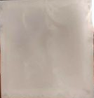
High-resolution 2.5D dosimetry of proton therapy using optically stimulated luminescence films in an anthropomorphic neck phantom
Sarah Clausen
Clausen@phys.au.dk
Notes:
HUSK AT ”AKTIVERE INDHOLD” I DIALOGBOKSEN DER KOMMER NÅR PRÆSENTATIONEN STARTER (GUL BJÆLKE)

Slide 2
Motivation
Stereotactic surgery
Modern radiation therapy
VMAT
SFPT
IMRT
Notes:
Many modern radiotherapies involves techniques that create dose distributions with steep gradients and highly localized features. If we want to validate those dose distributions, it is very beneficial to have a dosimetric geometry more complex than just a two-dimensional plane.

Slide 3
Motivation
VMAT
SFPT
Modern radiation therapy
IMRT
Stereotactic surgery
Notes:
Many modern radiotherapy involves techniques that create dose distributions with steep gradients and highly localized features. If we want to validate those dose distributions, it is very beneficial to have a dosimetric geometry more complex than just a two-dimensional plane.

Slide 4
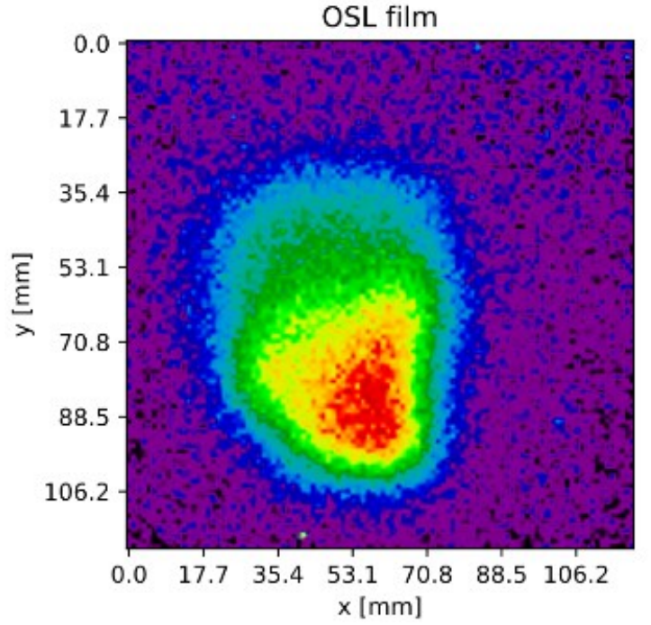
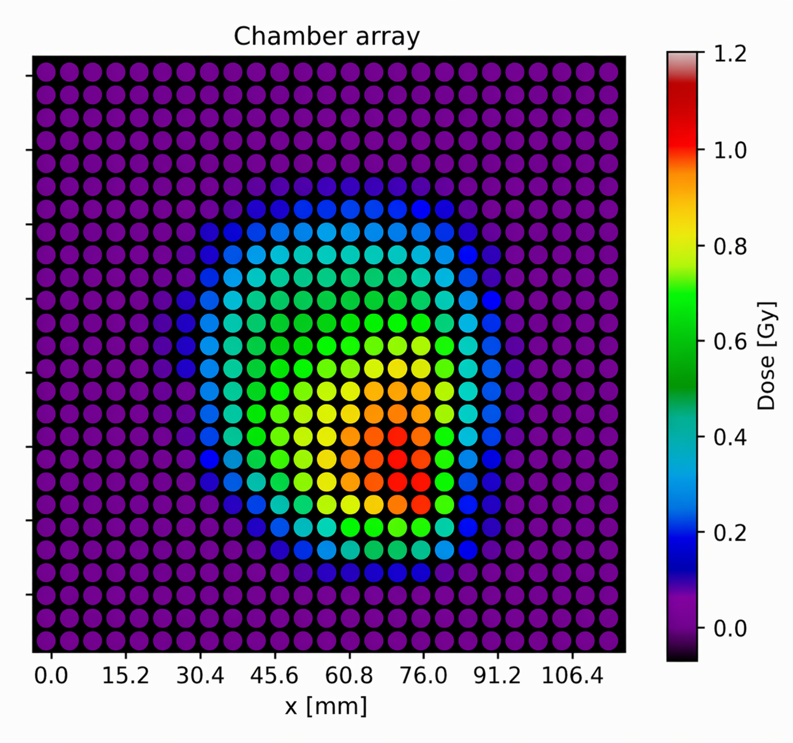
Motivation
SFPT
Stereotactic surgery
Needs 2(and more)D dose verifications!
VMAT
IMRT
Aim: To investigate the potential for our in-house-made OSL films for 2.5D high resolution (0.6x0.6)mm² dosimetry
Notes:
Many modern radiotherapy involves techniques that create dose distributions with steep gradients and highly localized features. If we want to validate those dose distributions, it is very beneficial to have a dosimetric geometry more complex than just a two-dimensional plane.

Slide 5
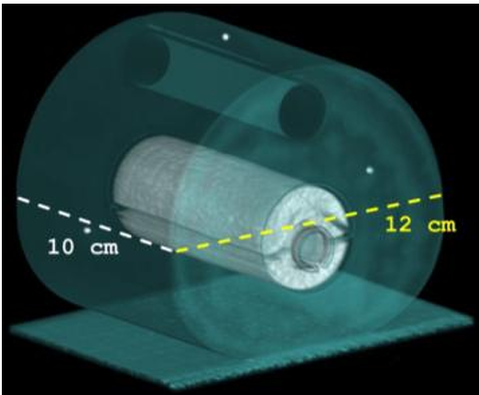
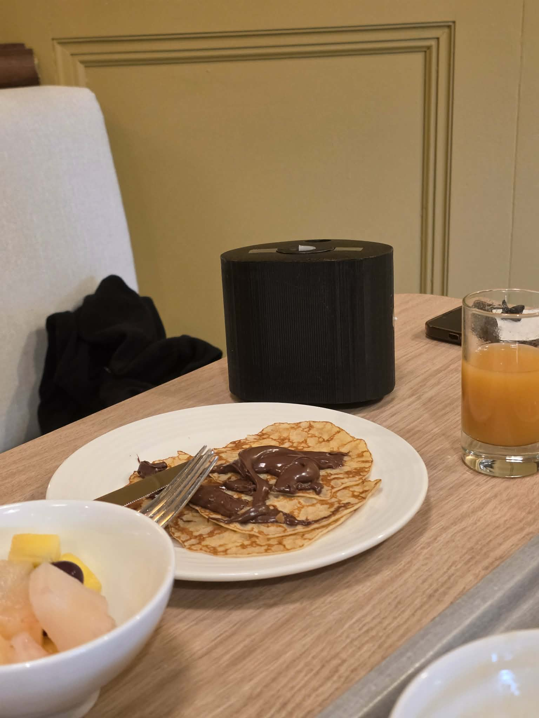
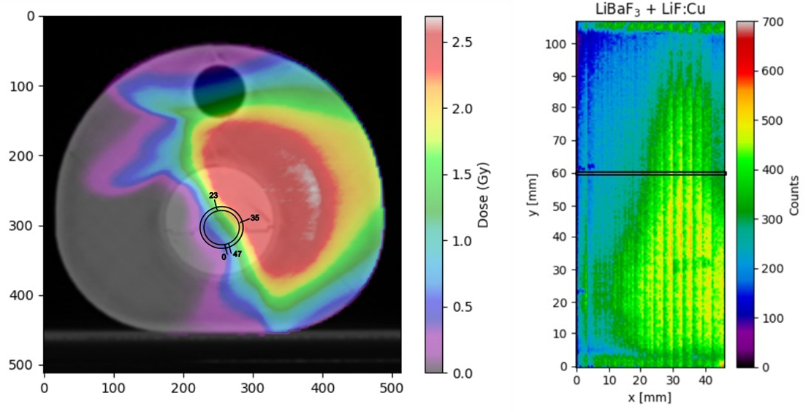

Investigation case: Target and phantom
Notes:
As an investigation case, we 3D printed a (1st degree approximation to) anthropomorphic neck phantom consisting of… In the phantom, a target was created, and a treatment plan consisting of two fields with high dose gradients in the dosimeter area was designed.

Slide 6
Investigation case: Target and phantom
Pineckhio
Notes:
As an investigation case, we 3D printed a (1st degree approximation to) anthropomorphic neck phantom consisting of… In the phantom, a target was created, and a treatment plan consisting of two fields with high dose gradients in the dosimeter area was designed.

Slide 7
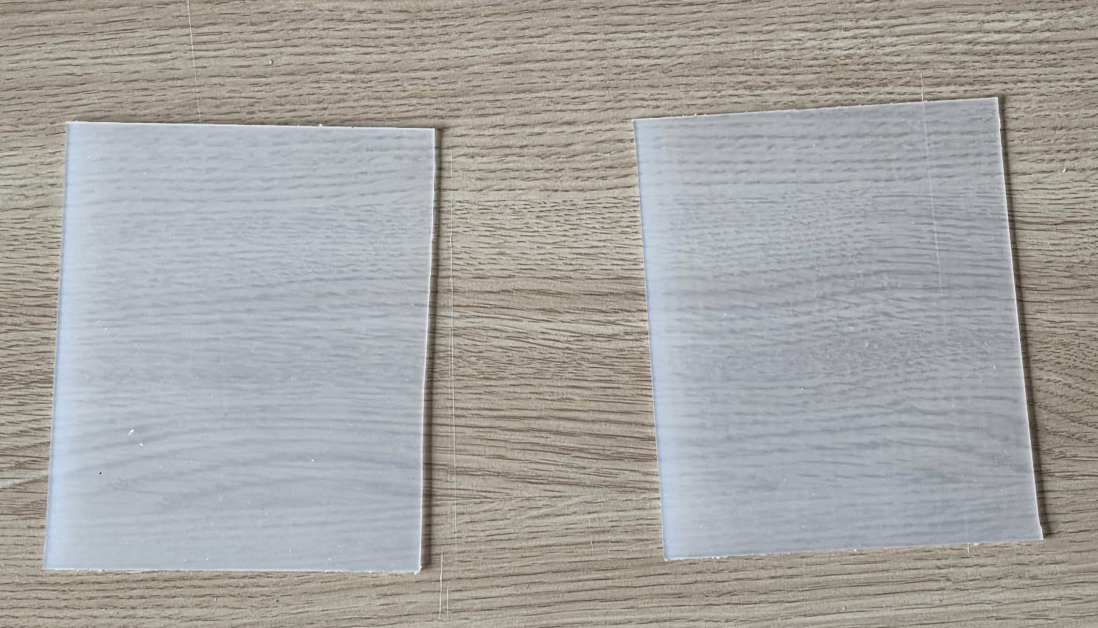
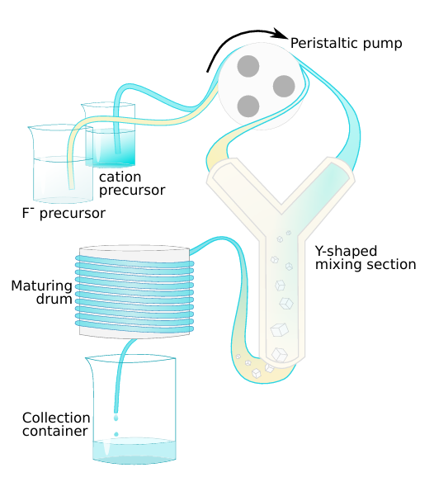
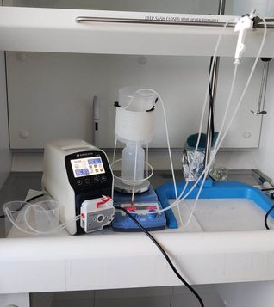
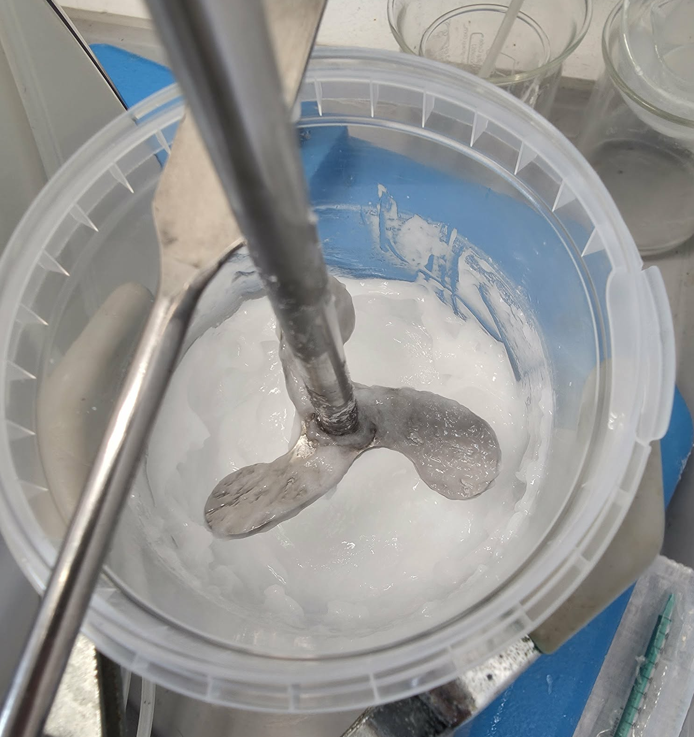
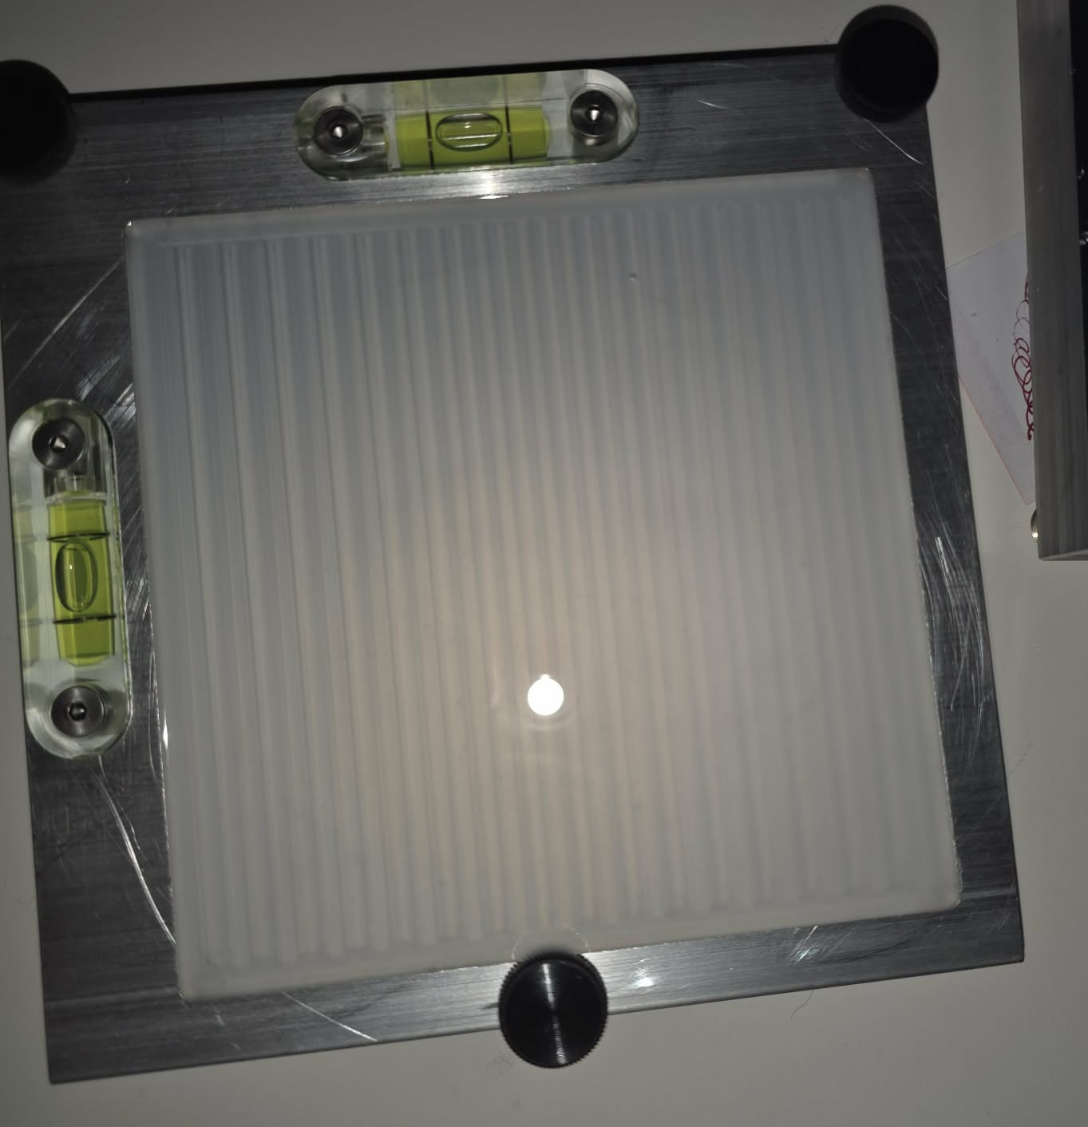
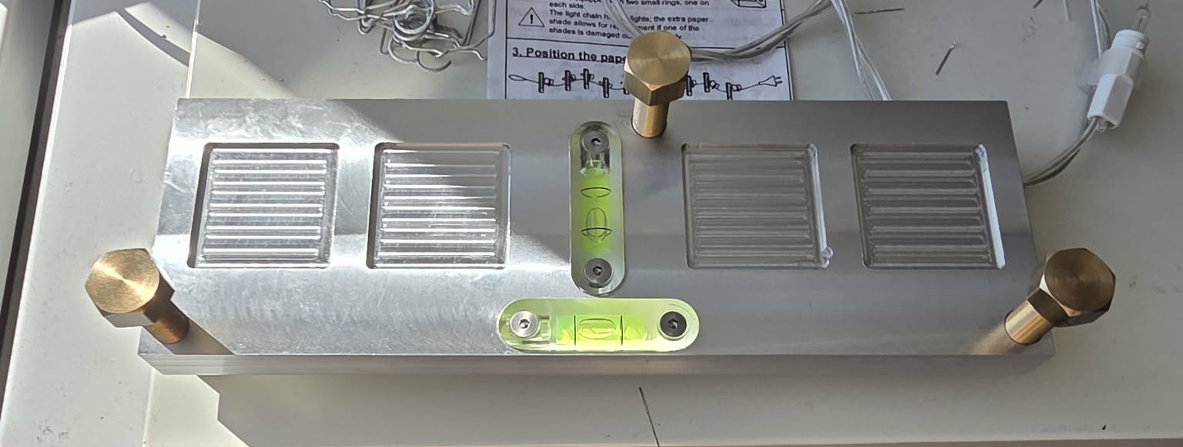
Our dosimeters
LiBaF₃
Size: ~300 nm
Emission: ~400nm
LiF:Cu
Size: 52 ± 22 nm
Emission: ~325nm
LET
Notes:
Our dosimeters consists of the OSL active nano particles LiBaF3 and LiF:Cu dispersed in a silicone matrix. The two particles emit light at different wavelengths, and their signals quench at different LET-values, and hence by tracking their signal ratio, we expect to be able to measure LET. We synthesize the particles ourselves In our lab using a flow synthesis, and mix them with silicone, from where they can be poured into moulds with the wanted sizes and be left to cure. It takes around 2 days to make a batch of powder, and 3 days from there to make a dosimeter.

Slide 8
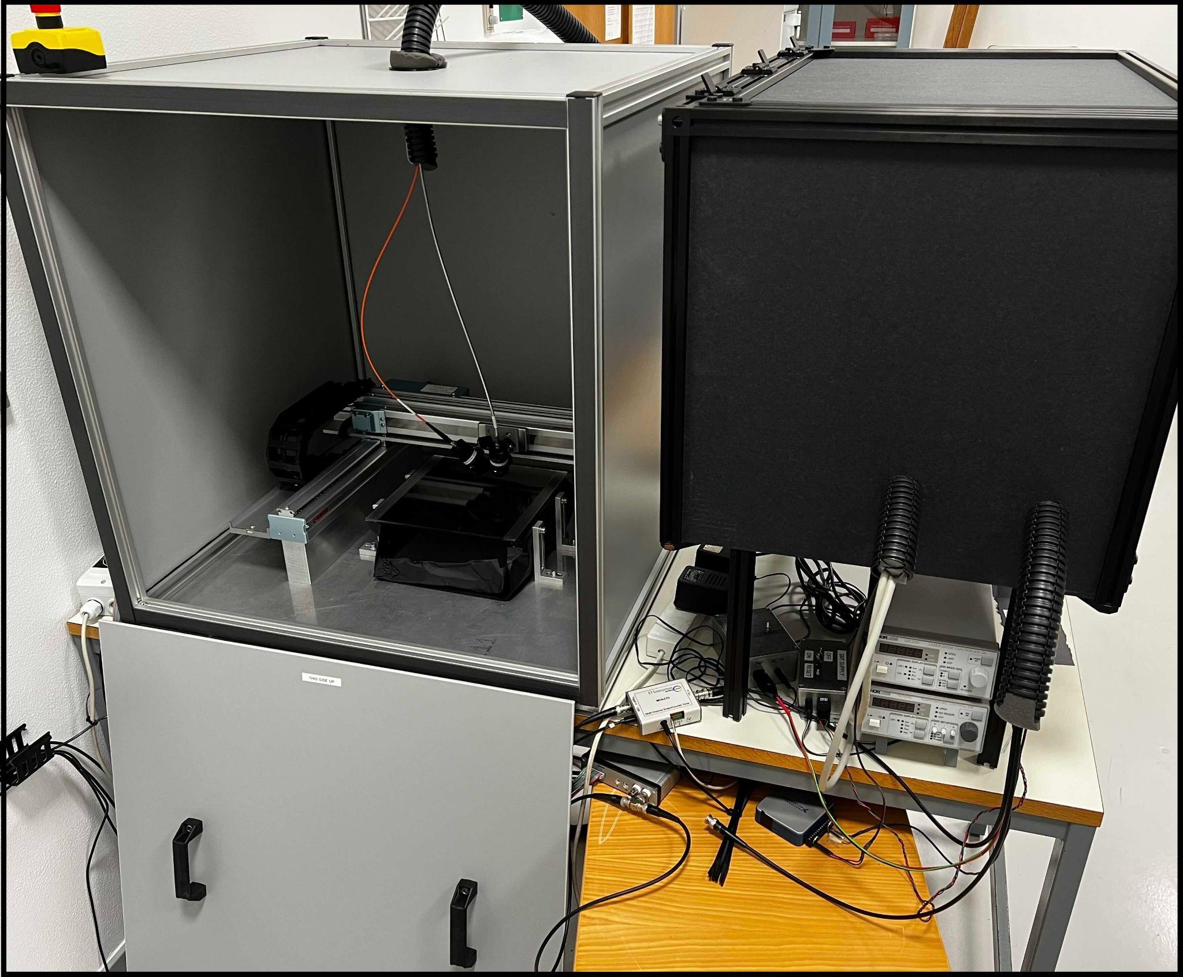
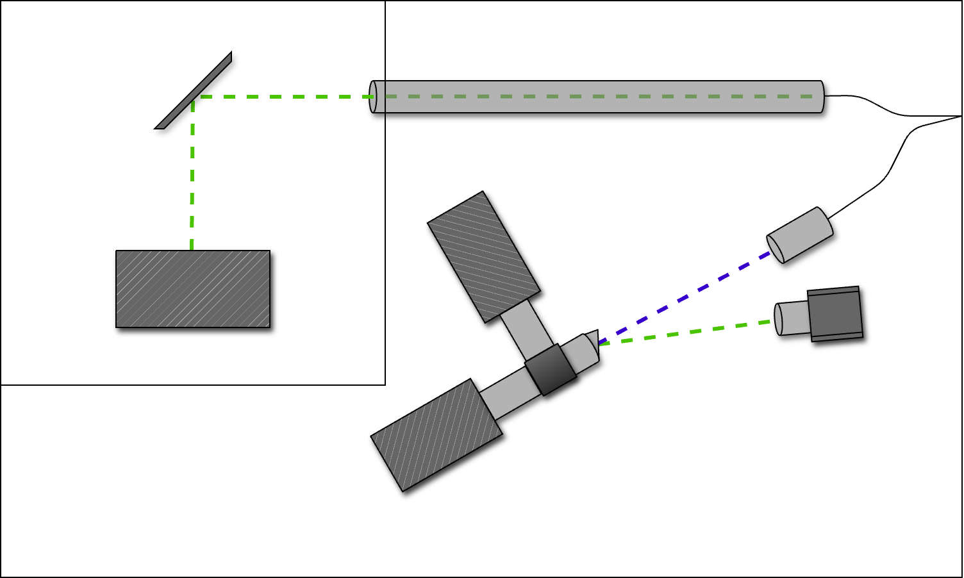


The scanning setup
LiF:Cu
LiBaF₃
LiF:Cu
LiBaF
Green Laser
For more details :
Notes:
Once irradiated, we use a home-build scanning setup placed at IFA to read out the dosimeters. It consists of a robotic arm on where two fibers are placed, that are coupled to a green laser and a lense respectively. The laser reads out a small area of the dosimeter, and the lense catches the emitted light from the OSL particles in the area. From here, the signal is transported through the fiber, from where it is separated into the different wavelengths from the two OSL particle types. The scanner moves the fibers from side to side all over the dosimeter.

Slide 9
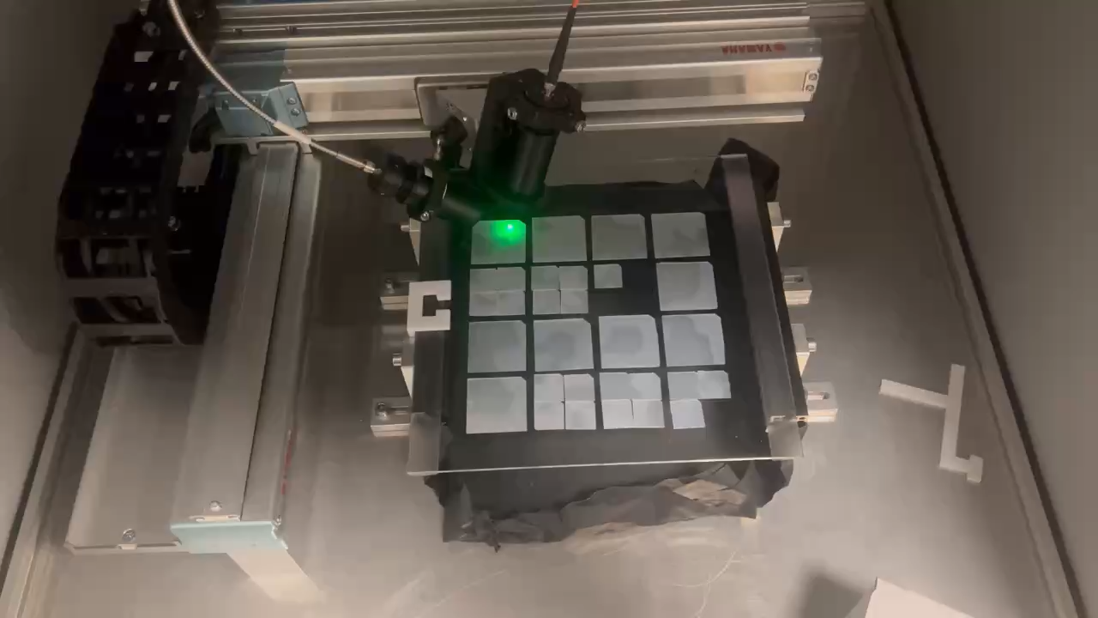
User flow
irradiated
Read out
Bleached and background is collected

Slide 10
Calibrations
Energy dependence
Dose linearity and calibration
(LET calibration)
Notes:
Two be able to use the dosimeters, we needed to ensure that they were energy-dependent, had dose linearity and we have also started looking at the possibility for calibrating them towards measuring LET.

Slide 11
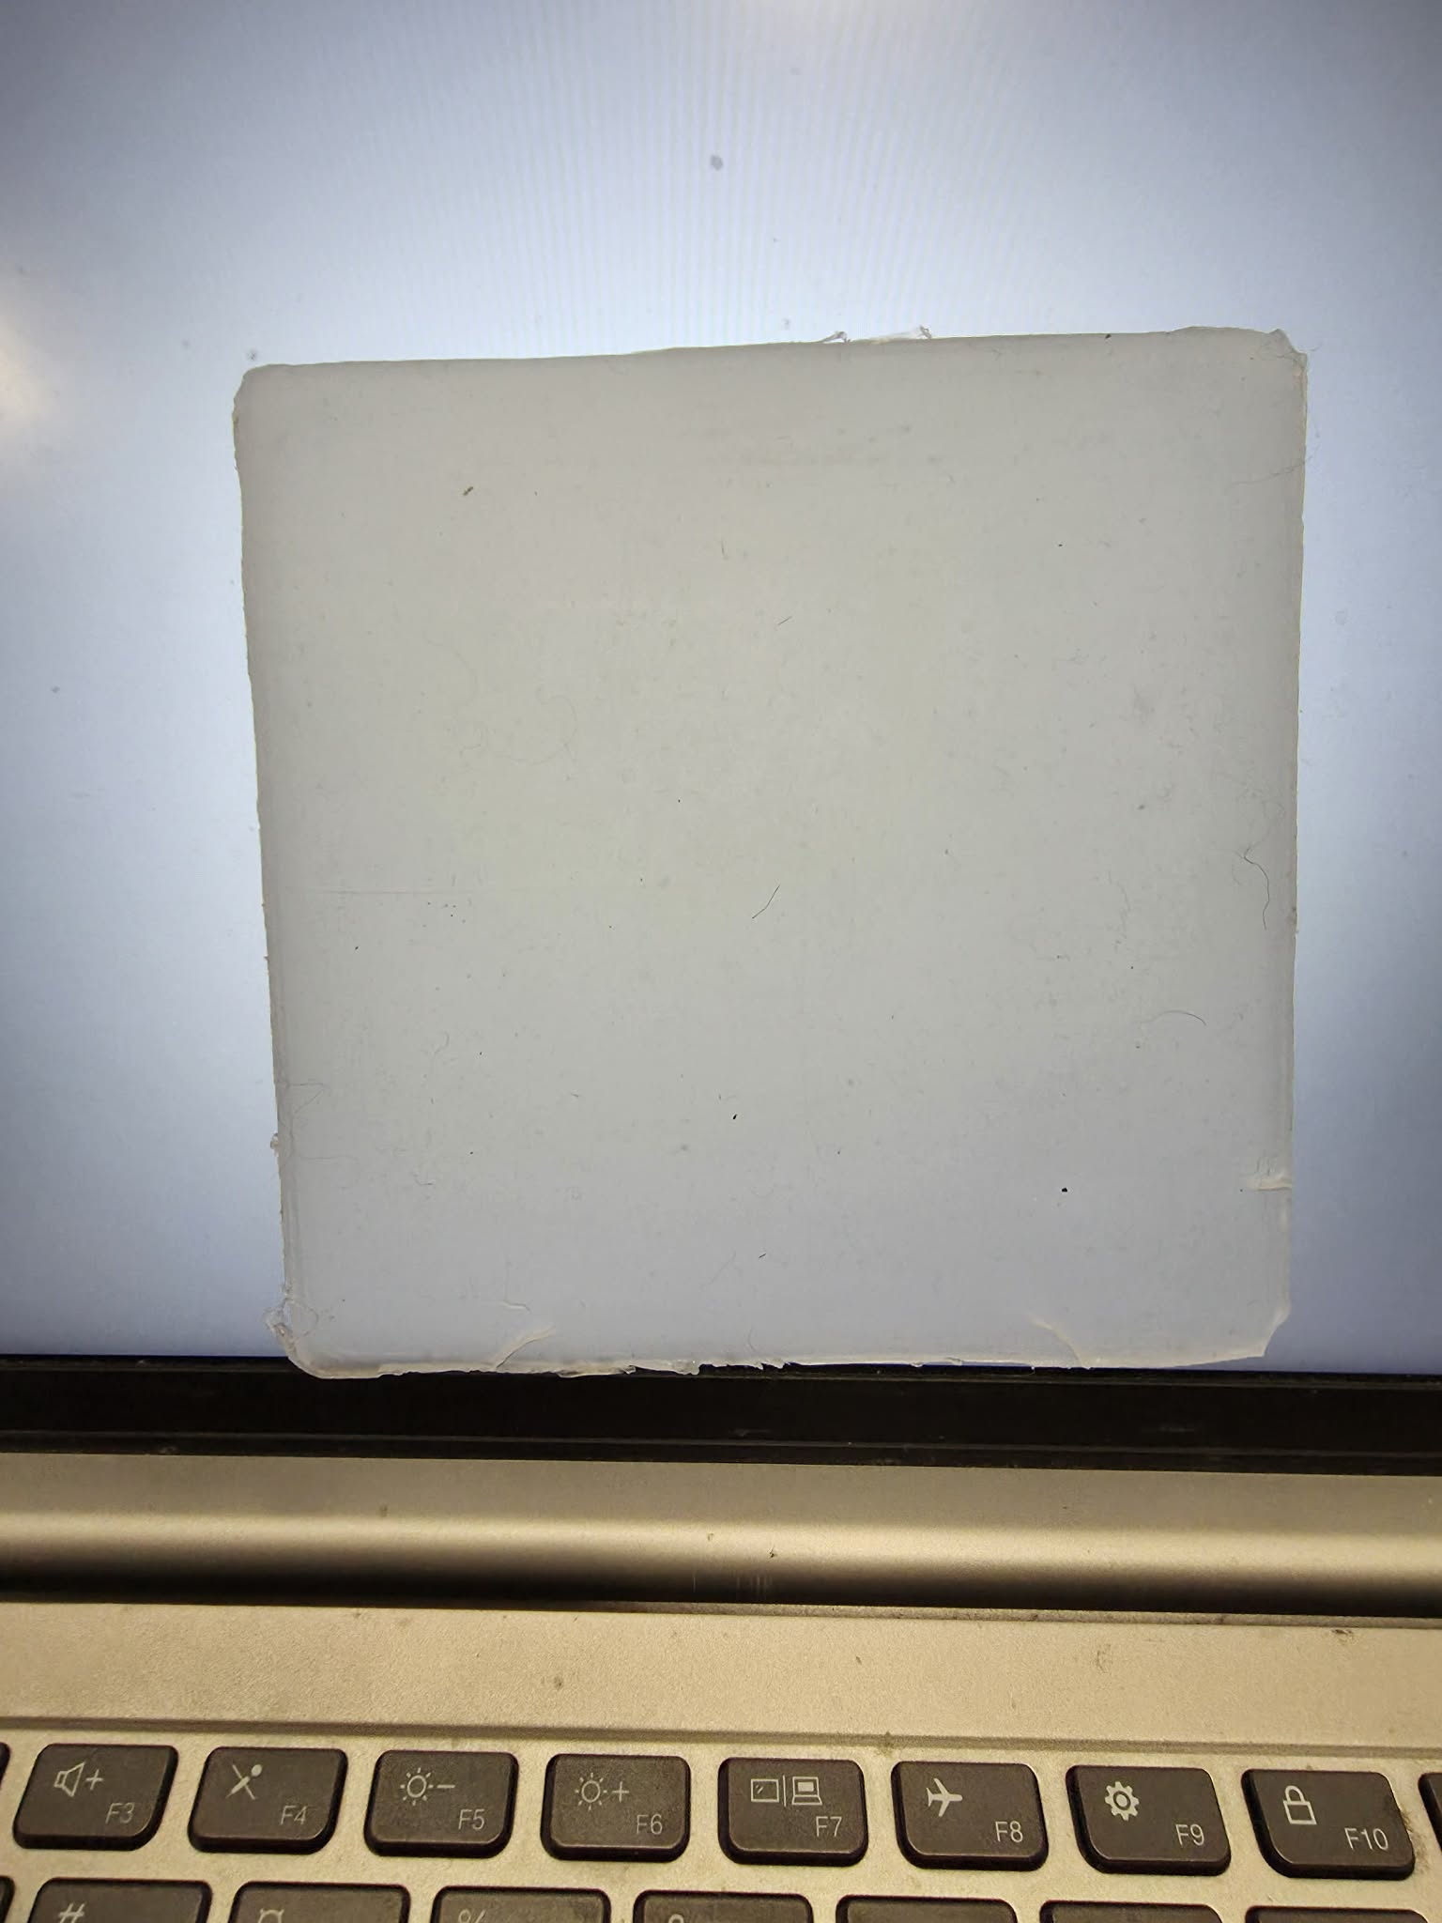
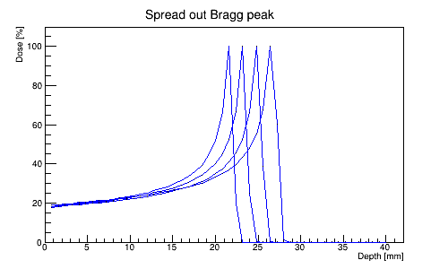
Energy dependence
12 x 12 cm^2 dosimeters cut into 4 x 4 cm^2 from different batches
Dosimeters placed 2 and 2 (to take batch-variations into account) near beam entrance of a mono energetic field.
5 different entrance energies in the clinical range (100-220 MeV)
  Placed near beam entrance to ensure low LET.
Water-equivalent dose measured at dosimeter placement using Marcus IC chamber
Notes:
For all the investigations, we will use 2 dosimeters that are 12 by 12 cm which will each be cut into 9 4 x 4 dosimeters. For the energy dependence, we will …

Slide 12
Energy dependence
12 x 12 cm^2 dosimeters cut into 4 x 4 cm^2 from different batches
Dosimeters placed 2 and 2 (to take batch-variations into account) near beam entrance of a mono energetic field.
5 different entrance energies in the clinical range (100-220 MeV)
  Placed near beam entrance to ensure low LET.
Water-equivalent dose measured at dosimeter placement using Marcus IC chamber
Notes:
For all the investigations, we will use 2 dosimeters that are 12 by 12 cm which will each be cut into 9 4 x 4 dosimeters. For the energy dependence, we will …

Slide 13
Energy dependence
12 x 12 cm^2 dosimeters cut into 4 x 4 cm^2 from different batches
Dosimeters placed 2 and 2 (to take batch-variations into account) near beam entrance of a mono energetic field.
5 different entrance energies in the clinical range (100-220 MeV)
  Placed near beam entrance to ensure low LET.
Water-equivalent dose measured at dosimeter placement using Marcus IC chamber

Slide 14
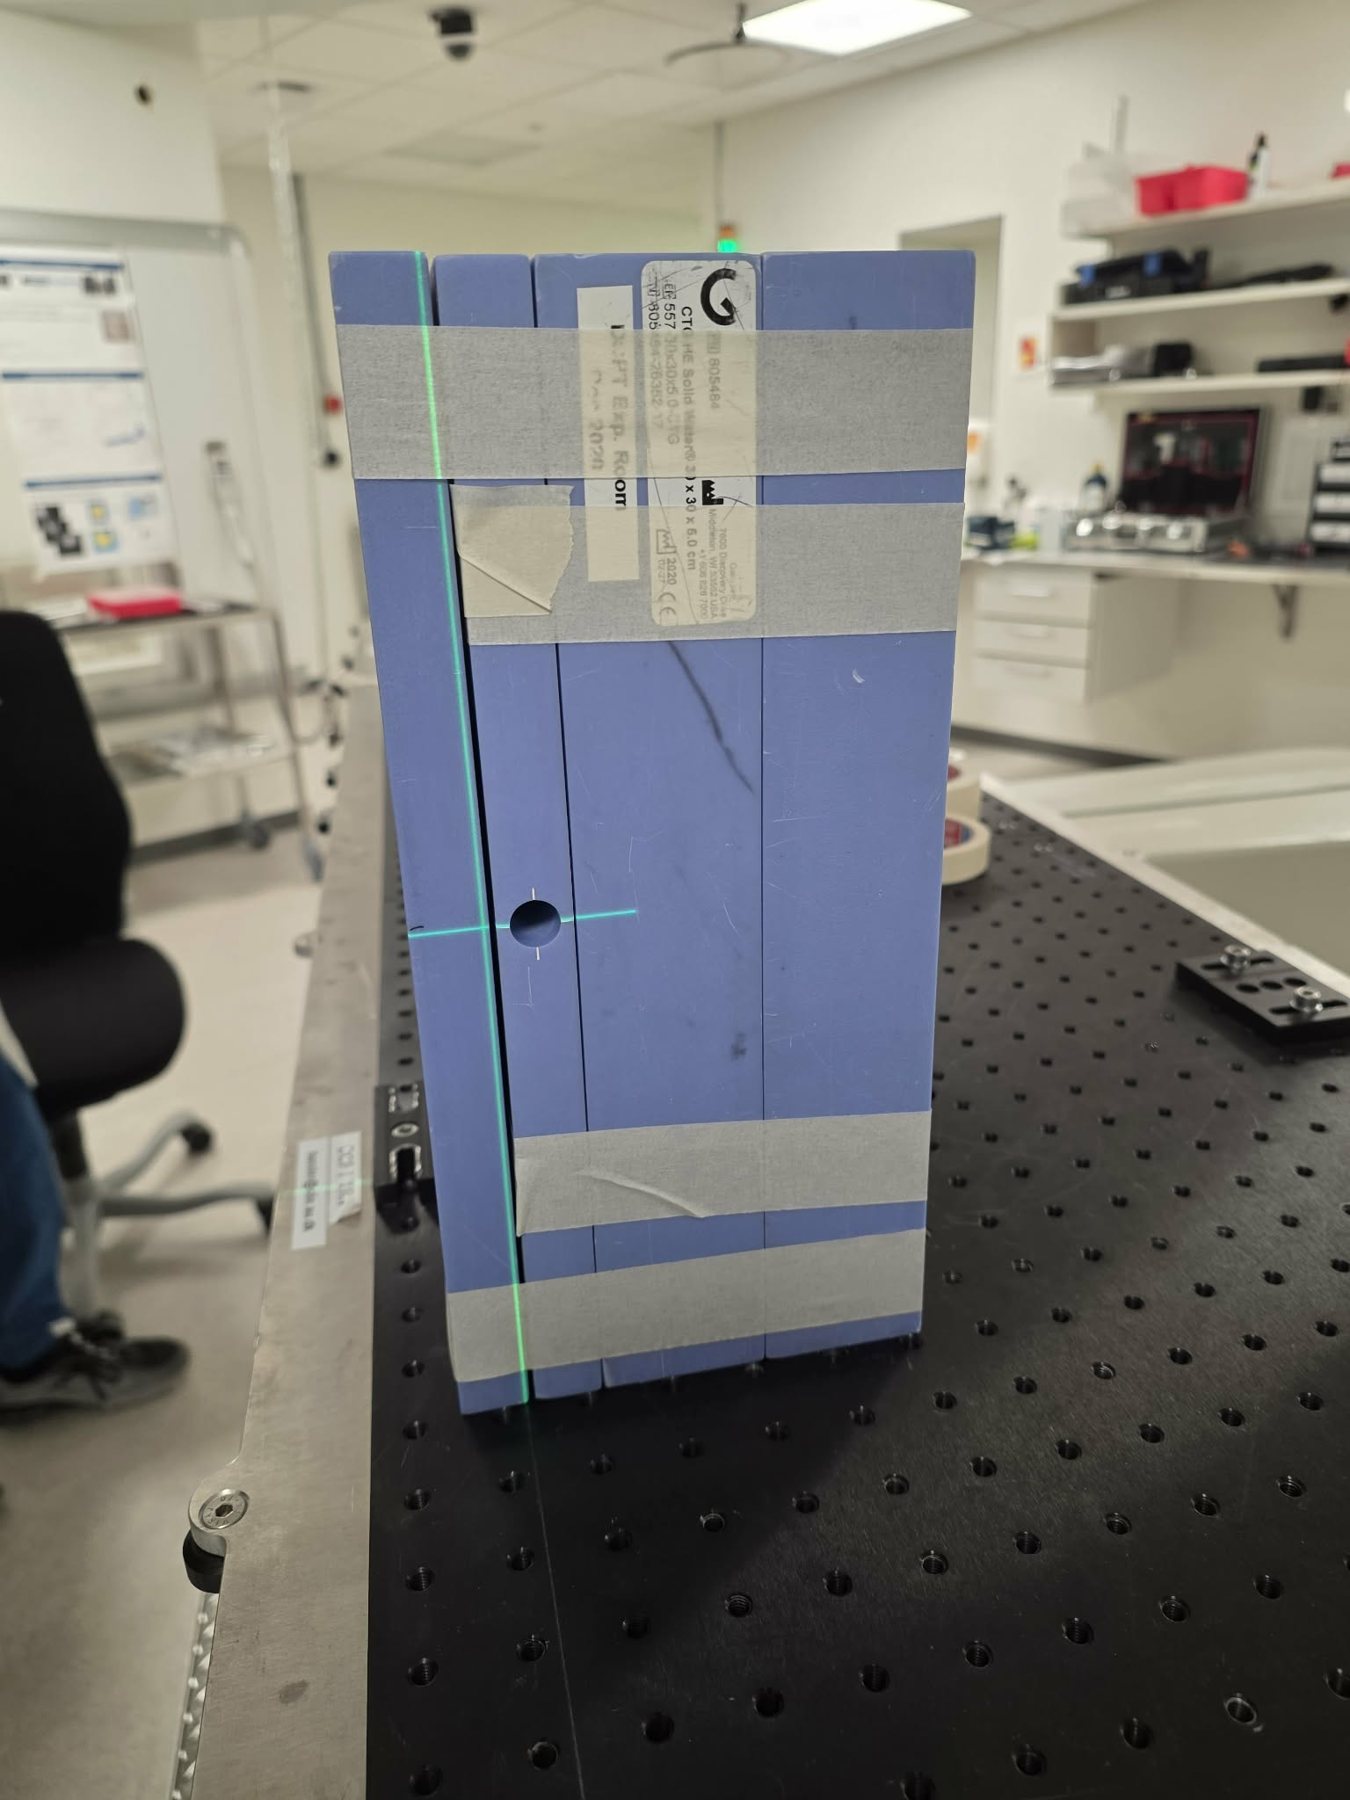
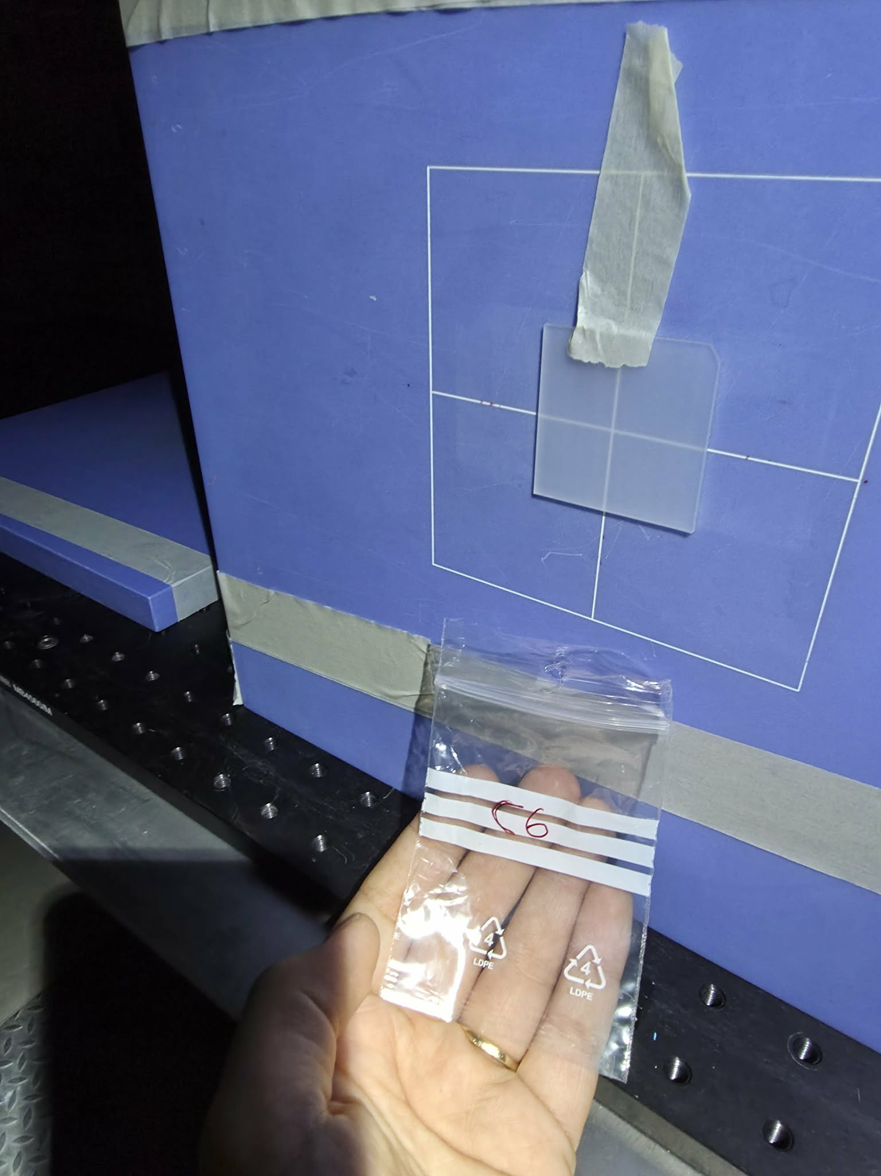
Dose linearity and dose calibration
8 dosimeters placed near beam entrance (low LET). For each time, dose is varied, but energy kept constant (160 MeV)
8 different doses between 100 mGy and 10 Gy.
Dose confirmation using IC.
Notes:
A visual demonstration of the setup can be seen here. The same physical setup was used for our dose calibration.

Slide 15
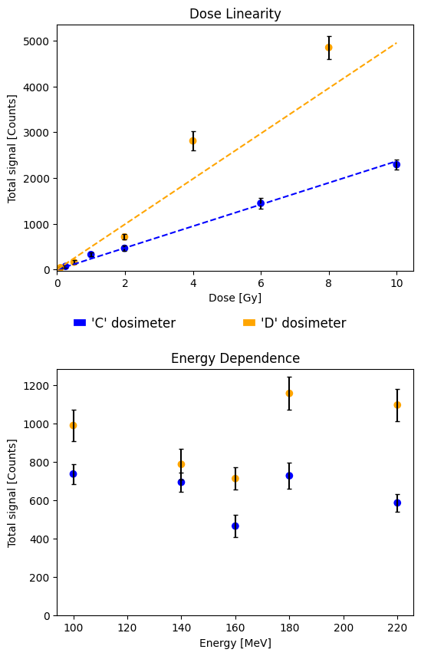
Results

Slide 16
Now: back to the neck
Notes:
I have brought two of the previous experiments the dosimeters have been a part of

Slide 17
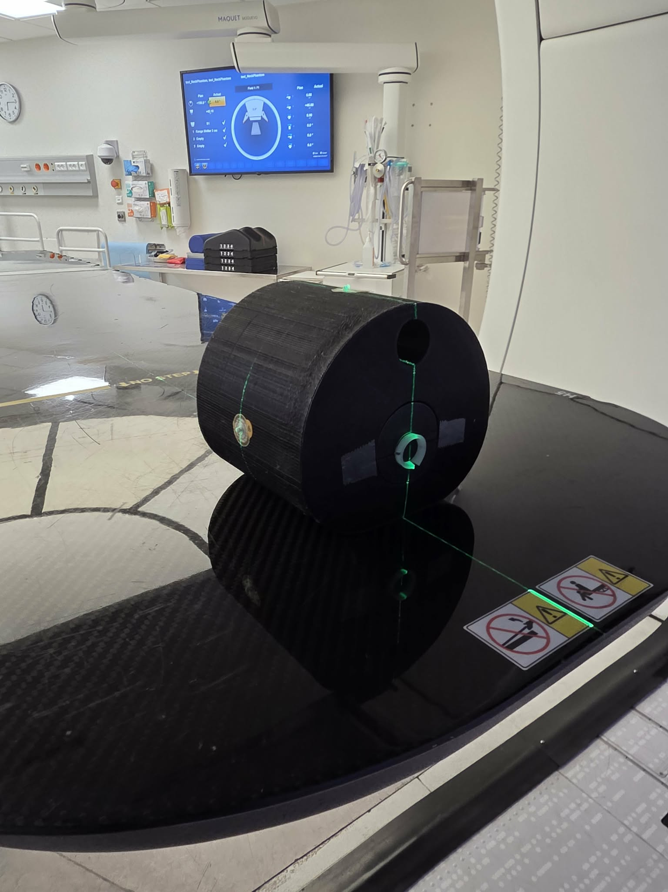
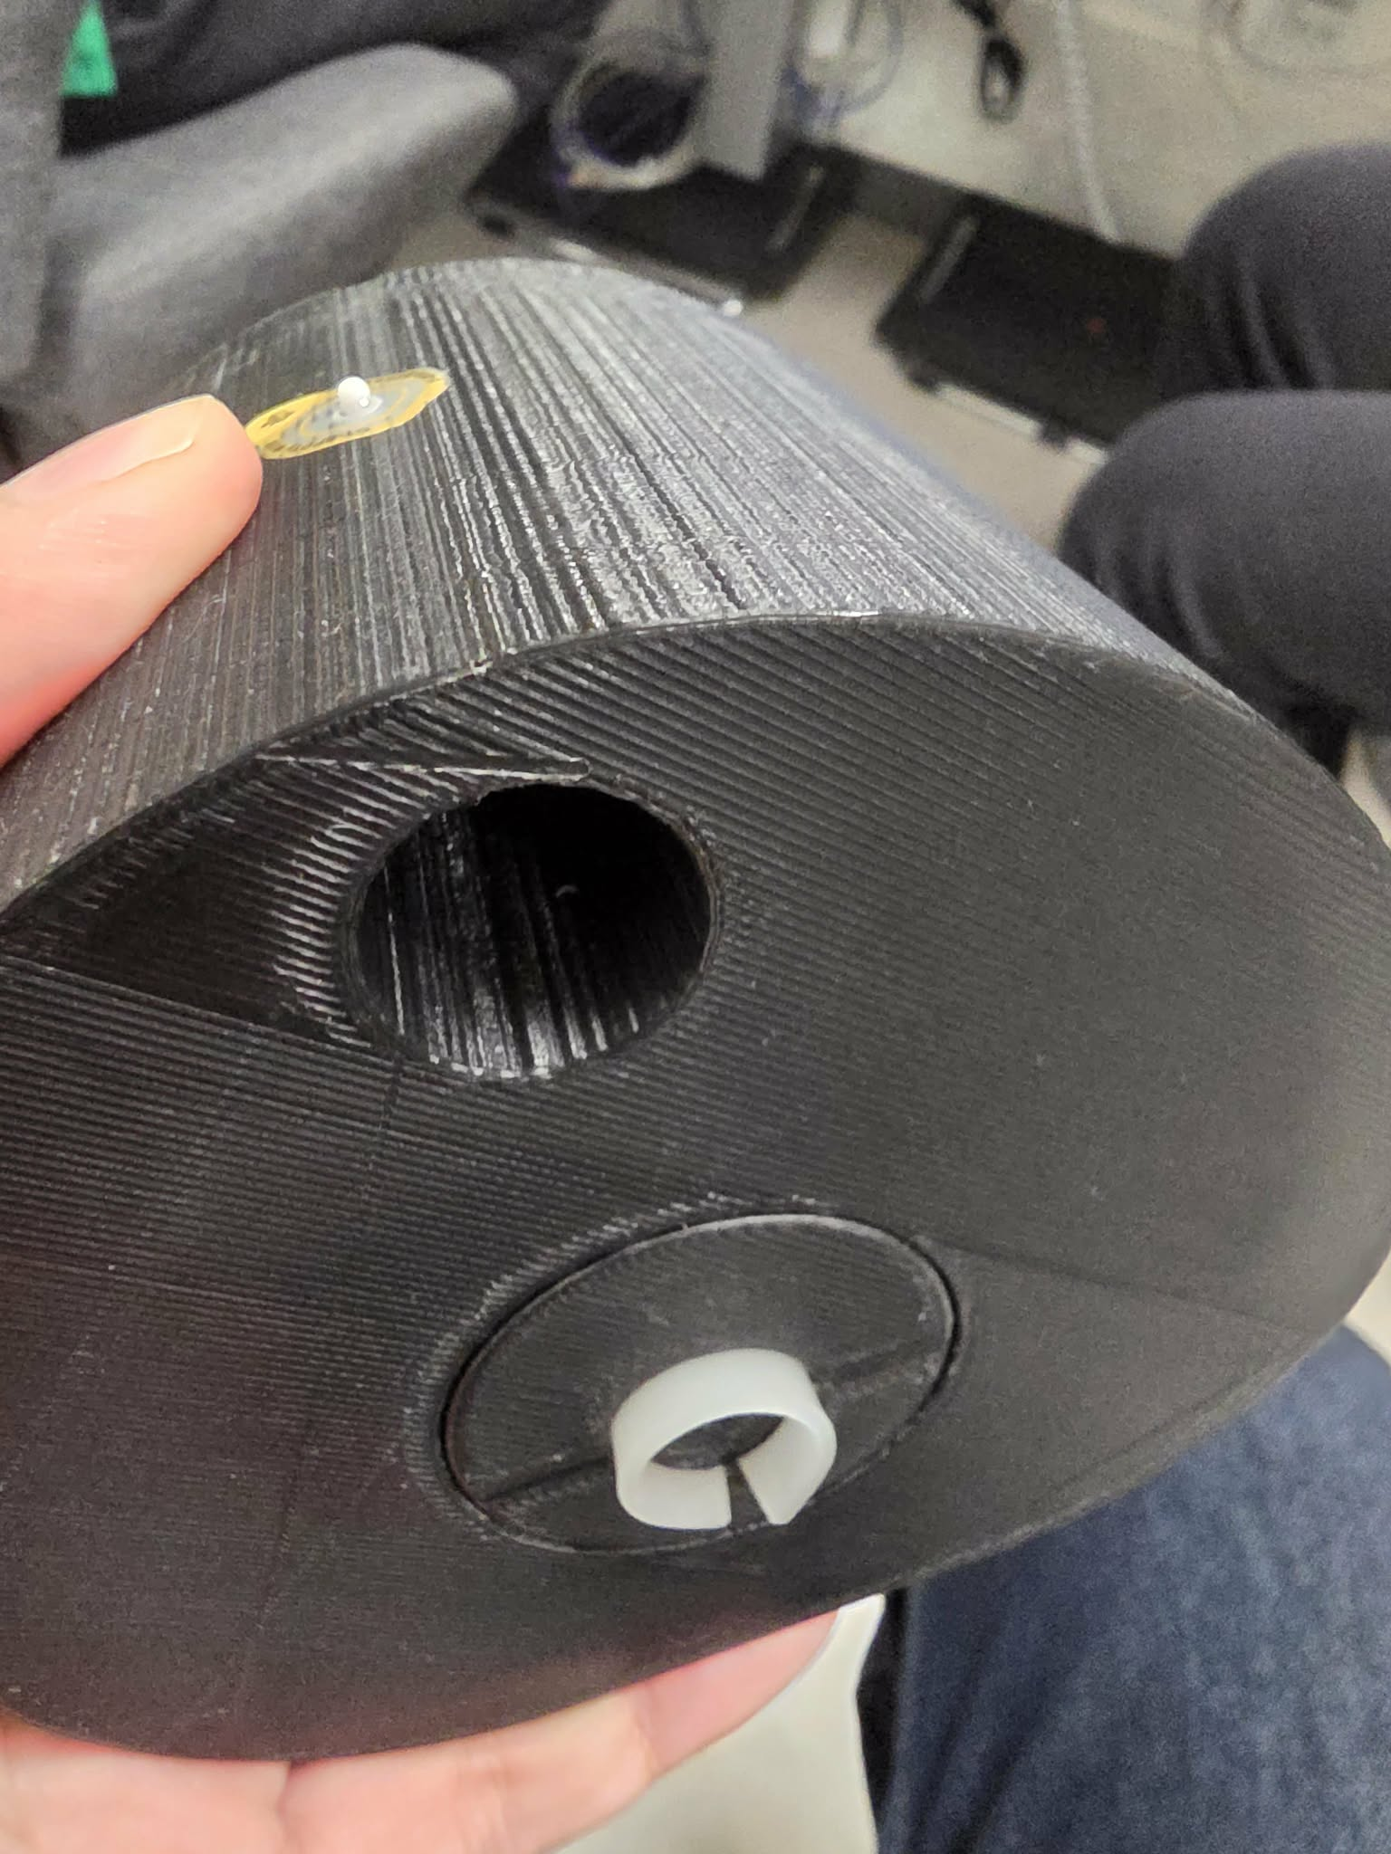
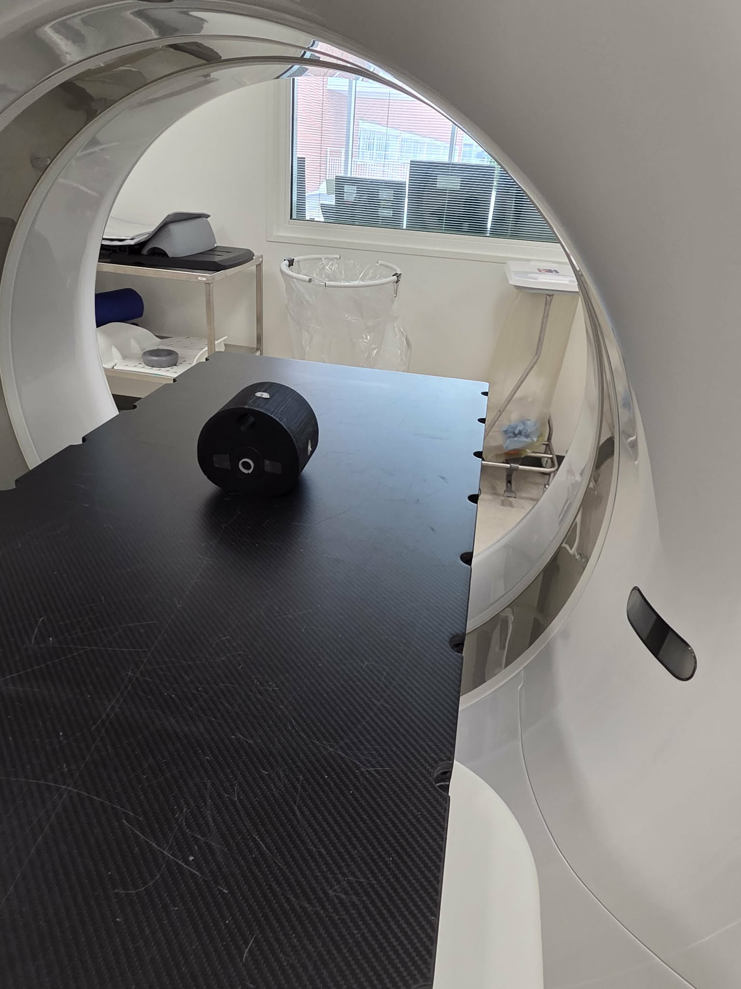
Now: back to the neck
Notes:
The neck phantom had our dosimeter wrapped tightly around its spine. From here, it was first CT-scanned with metal beads to help for better alignment later,

Slide 18
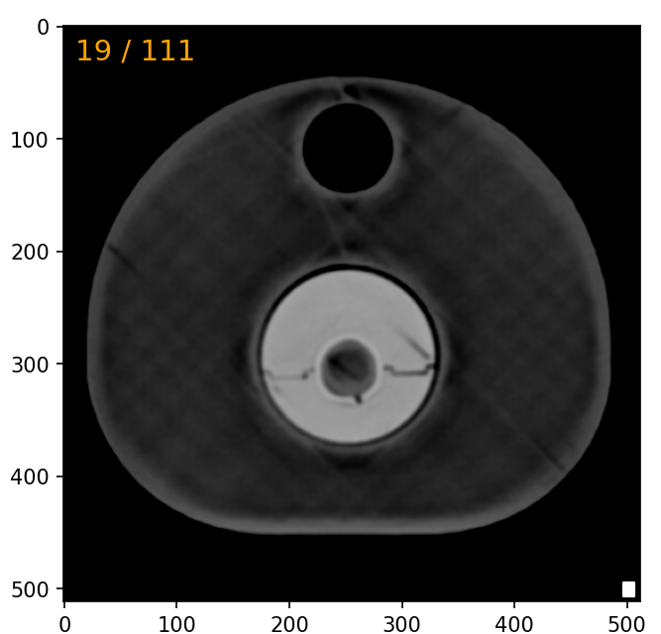
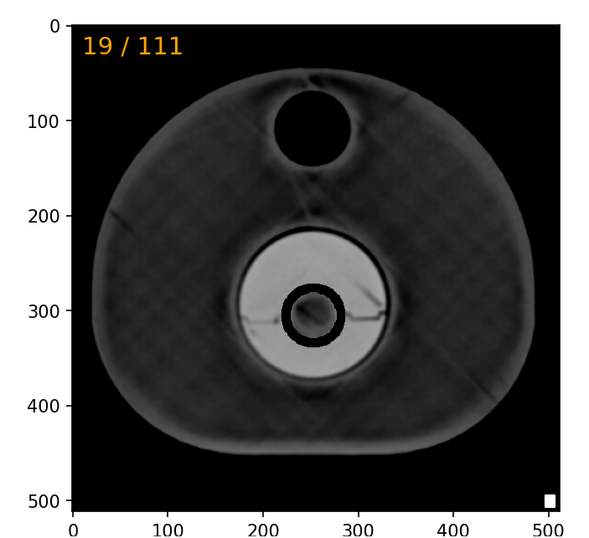
Workflow for irradiation

Slide 19
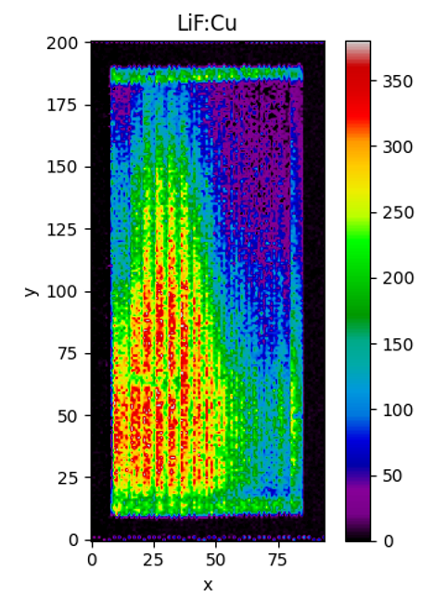
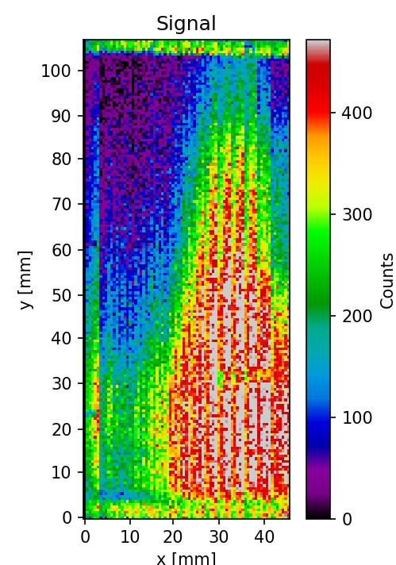
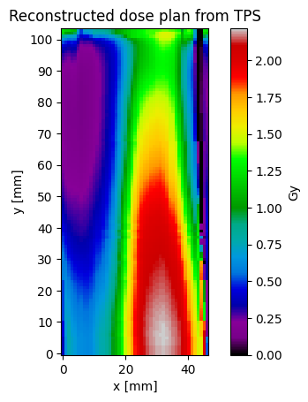
Result: Comparison of measurement and reconstructed plan

Slide 20
Calibrations
Energy dependence
Dose linearity and calibration
(LET calibration)
Notes:
I have brought two of the previous experiments the dosimeters have been a part of

Slide 21
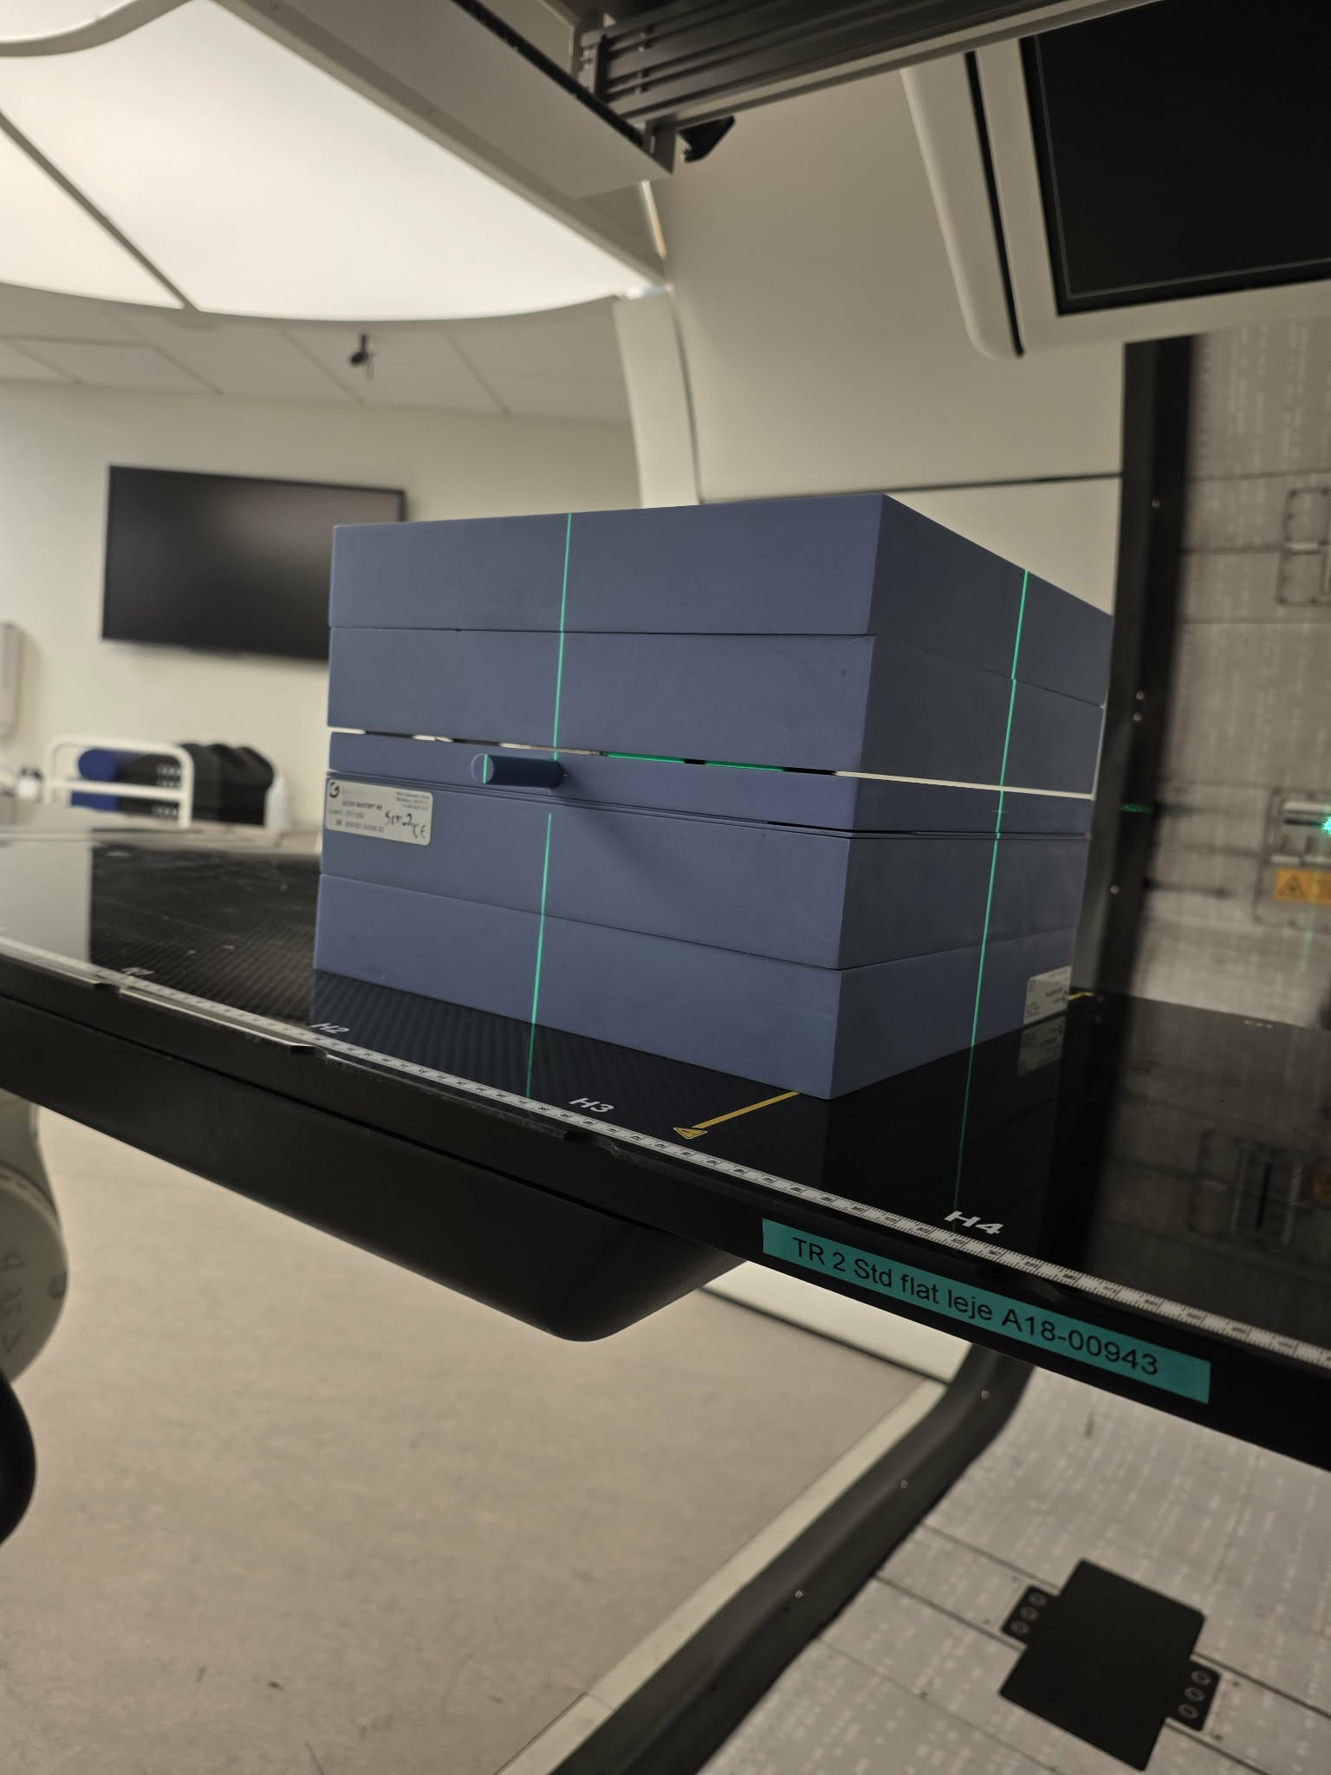
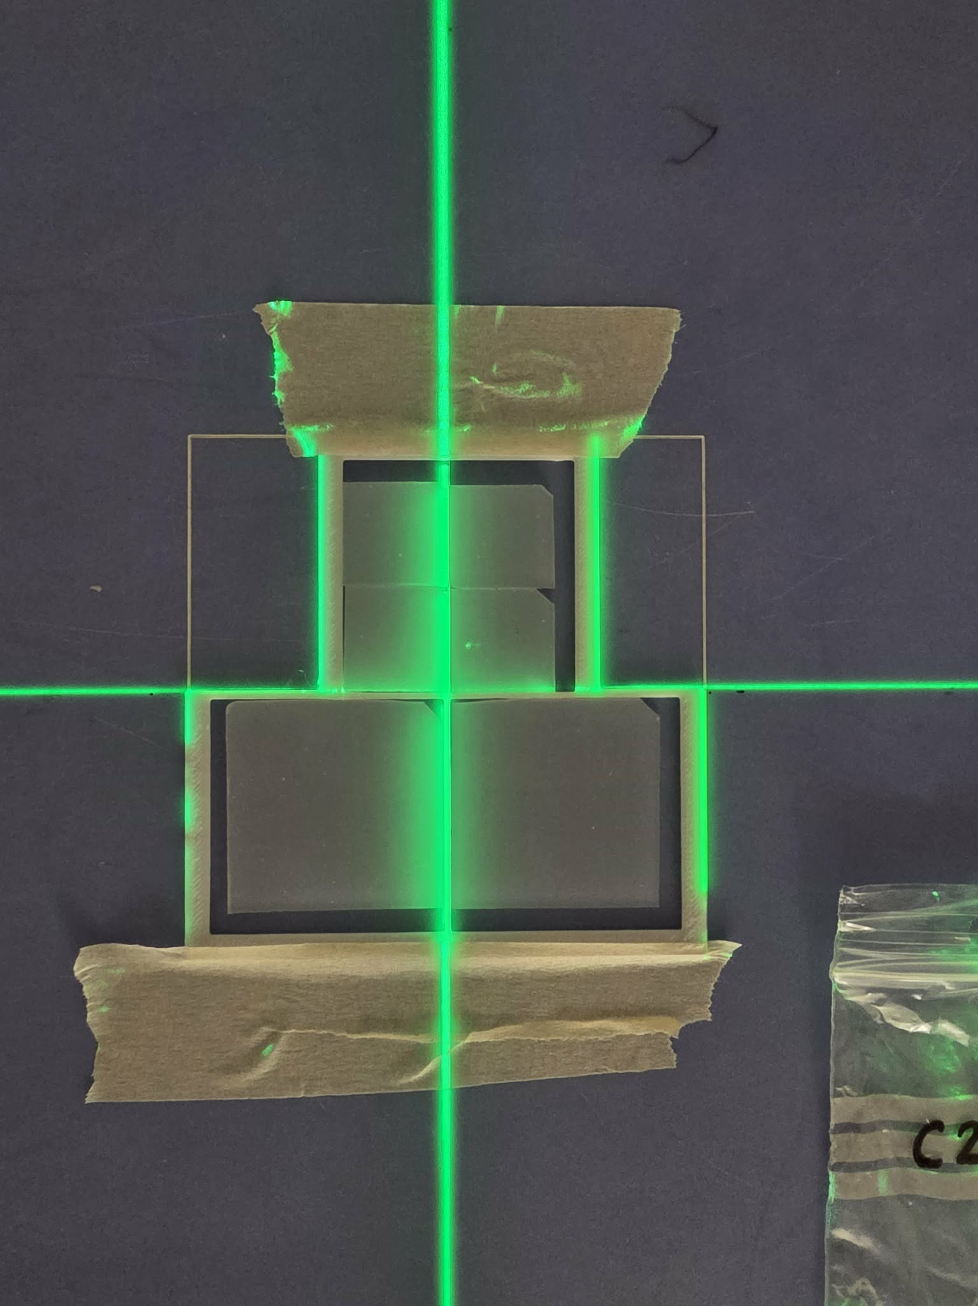
LetD calibration
Aim: Investigate LETD dependence of signal ratio and how dose response curves changes as a function of LETD
5 points in SOBP, 4 of them in the distal edge.
For each LET-value, 3 different doses to investigate LET-dependent quenching effects’ influence on dose levels.

Slide 22
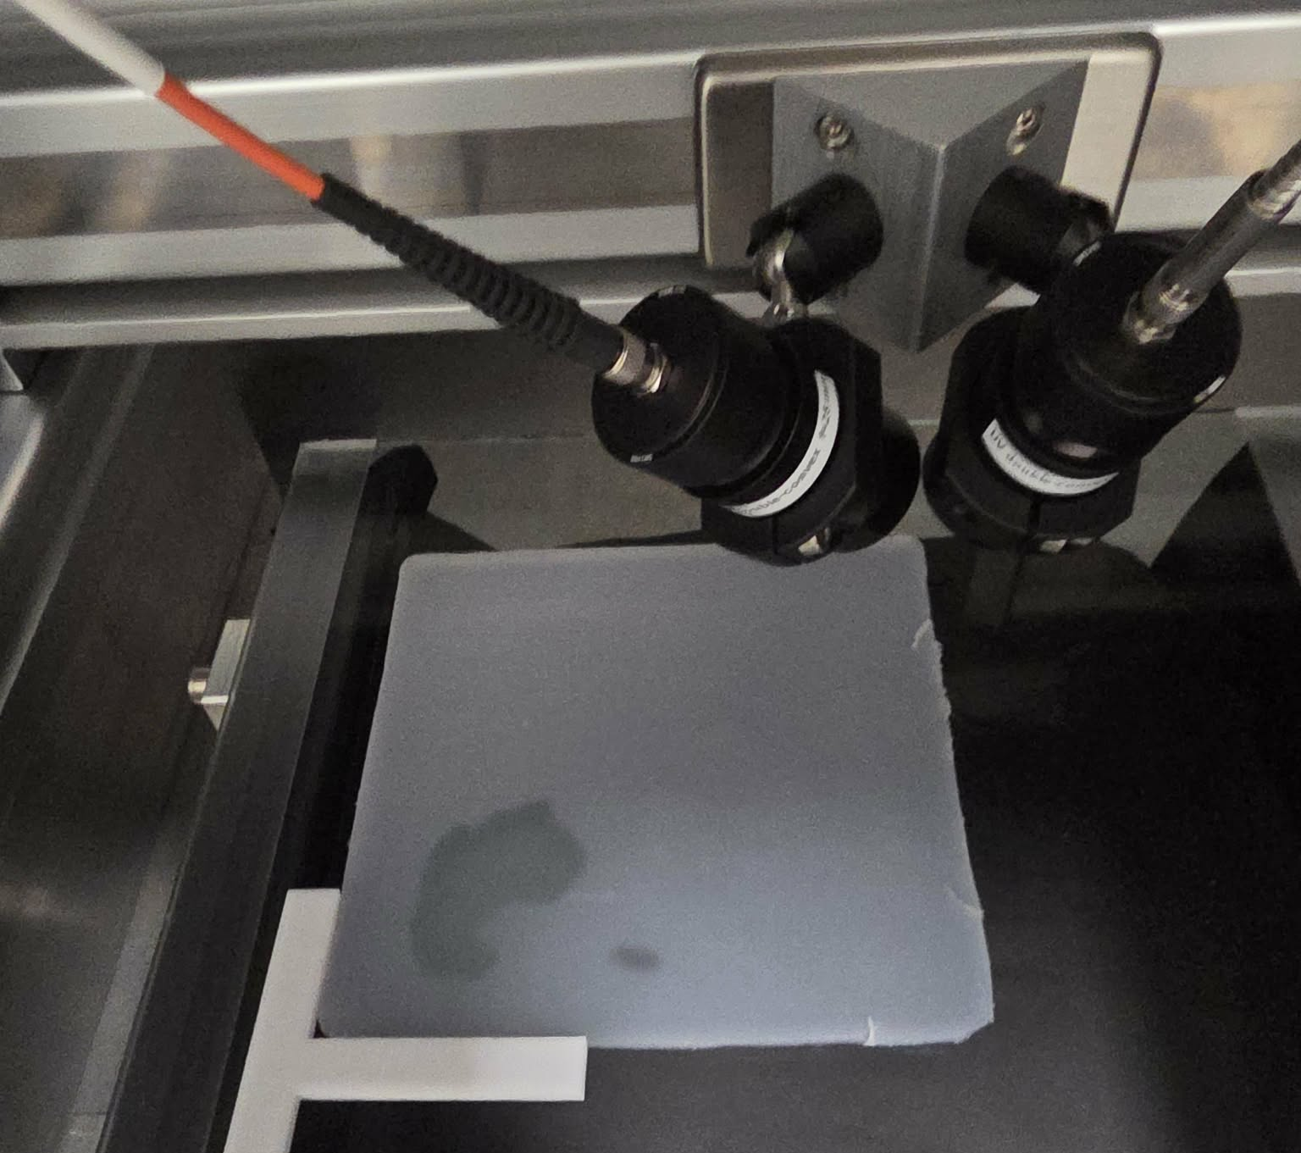
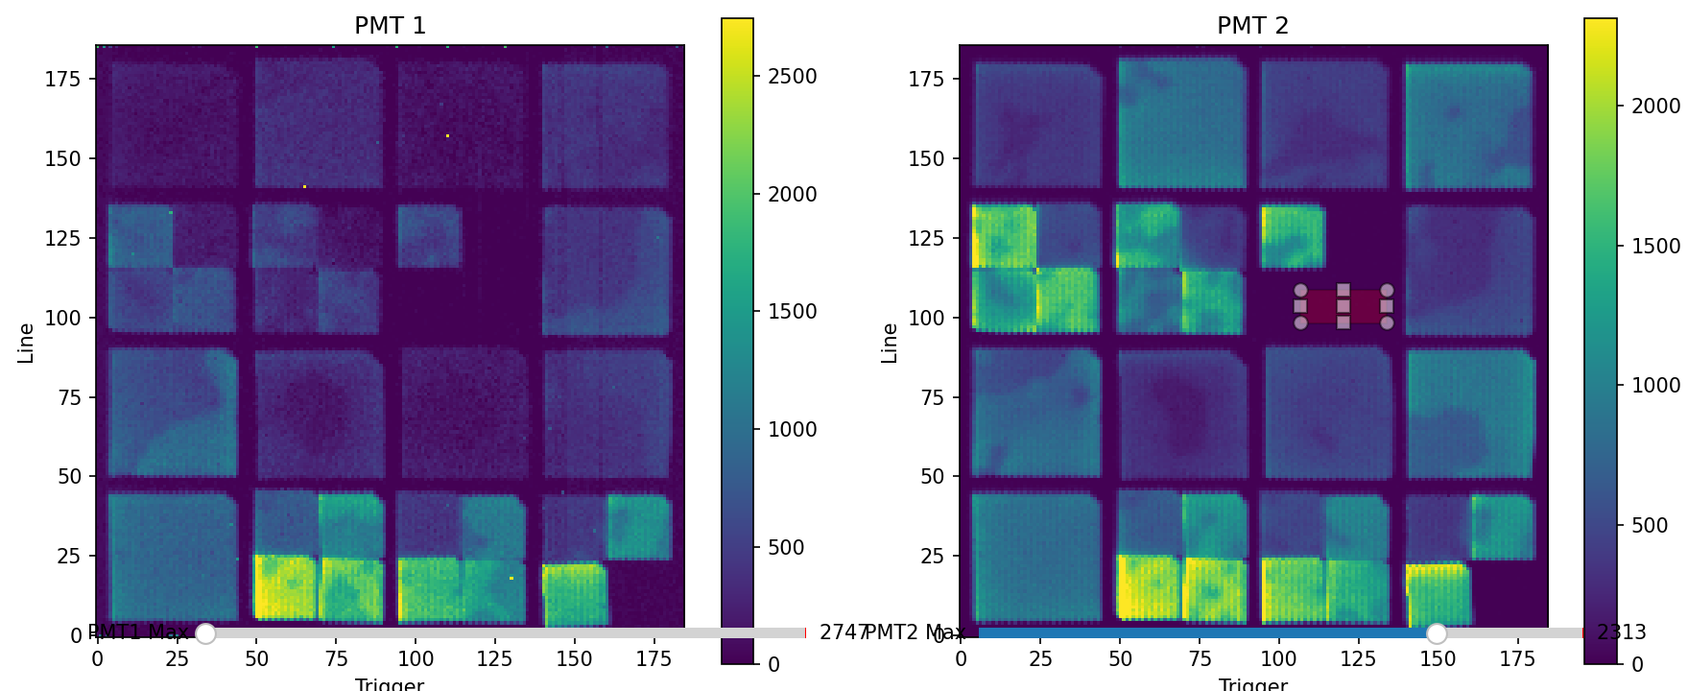
LetD calibration

Slide 23
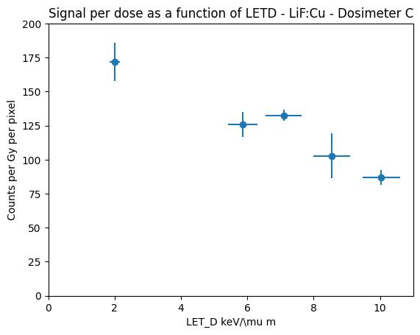
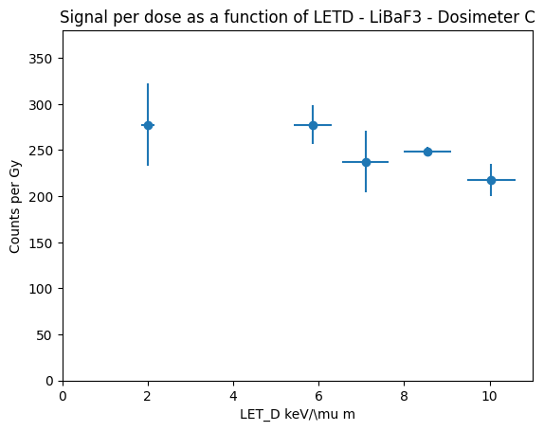
LetD ?
…Still ongoing

Slide 24

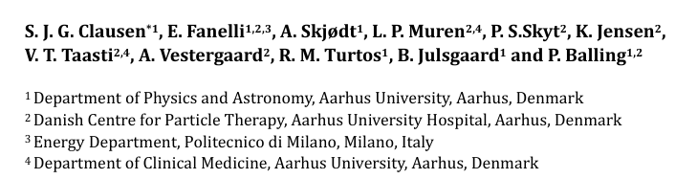


To sum up
Future improvements:
Better SNR
Optimize reconstruction algorithm for TPS
Batch-to-batch calibration
System consisting of 2D scanner and dosimeters with dose linearity and no apparent energy dependence in proton beams.
Developed a neck-phantom to explore the usability of the dosimeter in higher spatial resolution.
To some degree we qualitatively see a match between readout and TP.
Energy dependence
Dose linearity and calibration
(LET calibration)
THANK YOU!
Sarah Clausen
Clausen@phys.au.dk

Slide 26
Notes:
In one of them, the dosimeter was used to measure dose and LET delivered to the border of the spine of a 3D-printed neck-phantom. It was curved around a tissue-equivalent spine-cylinder and souronded by a bone-equivalent cylinder. The dosimeter was readout with a 0.6 mm^2 pixel resolution. It is still a WIP, since currently, we have the signal levels from our nano particles from the irradiation, and their signal ratio for each pixel.

