Slide 1

Evaluation of a detector design to measure the superficial 2D dose distribution for skin cancer treated by Protontherapy
DeCuPro project
Giulia Tosetti¹
tosetti@lpccaen.in2p3.fr
Jean-Marc Fontbonne¹, Dorothée Lebhertz², Cyril Moignier² and Rémi Lafaye¹
¹Université de Caen Normandie, ENSICAEN, CNRS/IN2P3, LPC Caen UMR6534, F-14000 Caen, France
² Centre François Baclesse, service de radiophysique, Caen, France

Slide 2
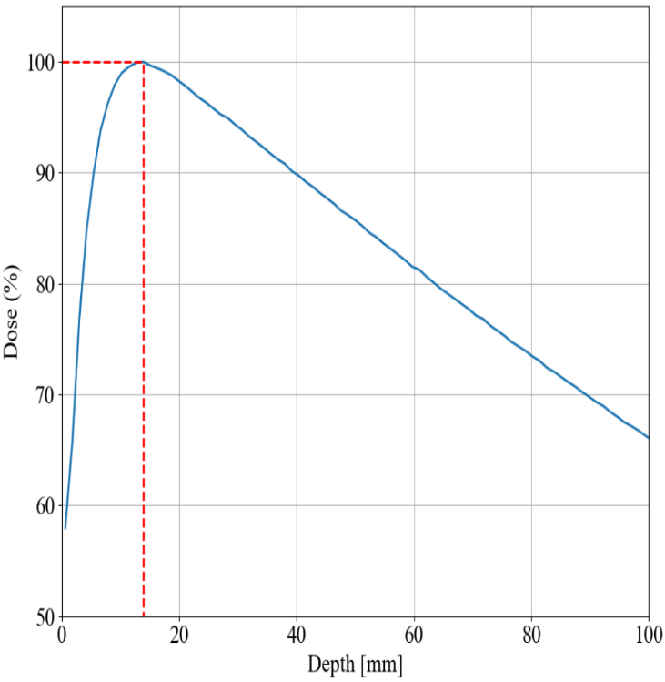
Introduction
I
Photon percentage depth dose (PDD) curve without (a) and with bolus (b)
Without Bolus
With Bolus
Conventional radiotherapy is an available treatment option for NMSC.
The maximum dose deposited by the photon beam is achieved thanks to a tissue equivalent material: the bolus.
The shrinking of the tumor will lead to air gaps between the bolus and the tumor volume, that could impact the total dose given at the tumor [1,2].
Patient’s surface
Tumor
Bolus
Tumor
Patient’s surface
(a)
(b)

Slide 3
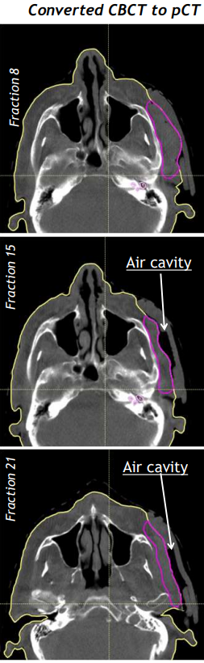
Introduction
I
Variation of the CTV dose coverage with daily fraction – (a) beginning of treatment (b) middle of treatment (c) end of treatment
Bolus
Tumor
(a)
(b)
(c)
In the case presented at PTCOG 2023 [3], the patient has been treated with a photon VMAT plan treatment using 3 Gy/fr with a total of 21 fractions (PD=63Gy) but a relapse occurred.
Tumor has evolved during the treatment, creating some air cavities up to 1.2 cm between the skin and bolus.

Slide 4
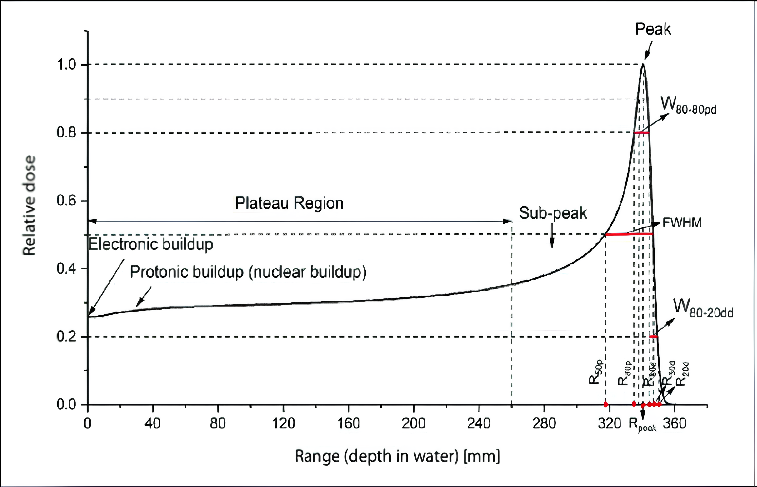
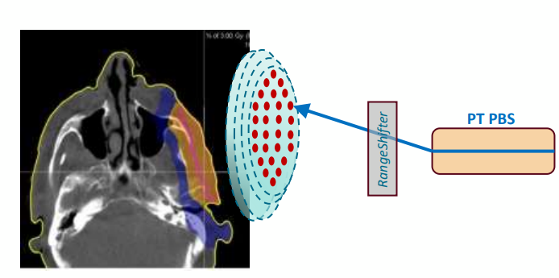
Motivation
I
In hadron-therapy, particles like protons or ions, deposits most of its energy at the Bragg peak: the dose is delivered precisely at the tumor site. The need for a bolus is eliminated.
Proton percentage depth dose (PDD) curve
Schematics of the patient treatment (TPS) + clinical proton beams from a ProteusOne (IBA)
Tumor
Proton pencil beam
Treatment simulation with TPS
Pencil beam spot

Slide 5
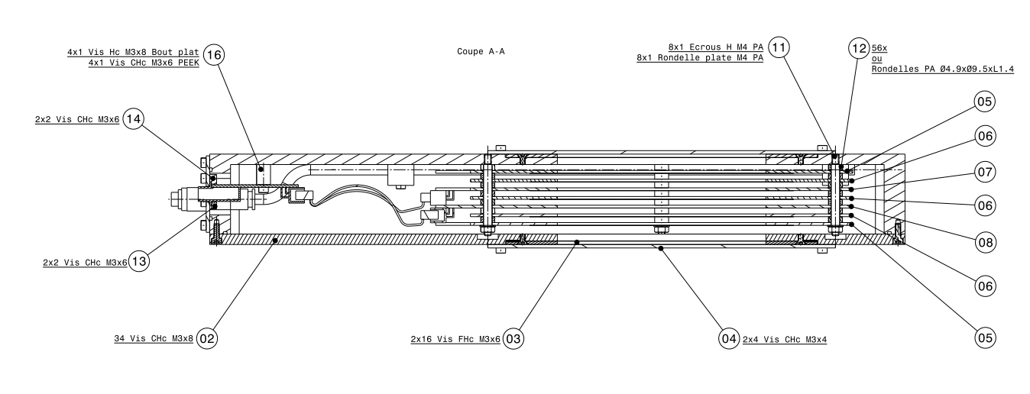
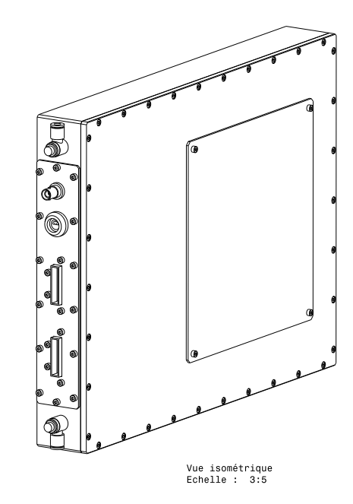
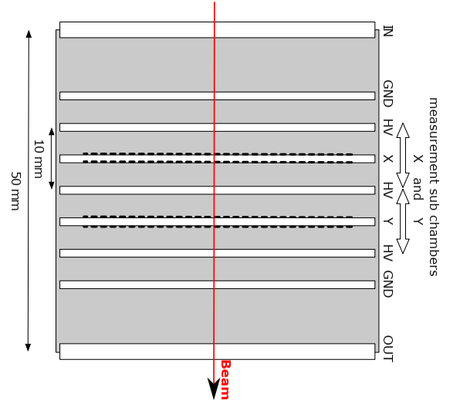
DOSION
II
Schematics of DOSION
DOSION [4] is a parallel plate air ionization chambers consisted in two sub-chambers measuring the beam intensity and two stripped sub-chambers measuring the position and the size of the beam along X and Y axes.
Signal measurement were conducted using the in-house build acquisition system FASTER [5] with a two daughter cards setup for a total of 64 electrometer channels.
9cm

Slide 6
Experimental set up
II
DOSION under the ProteusOne at Cyclhad, Caen, France
DOSION is position at the center of the gantry aperture and each stripped chamber is connected to an electrometer unit.
Different experiments are carried out:
Linearity
Patient Specific Quality Assurance (PSQA)

Slide 7
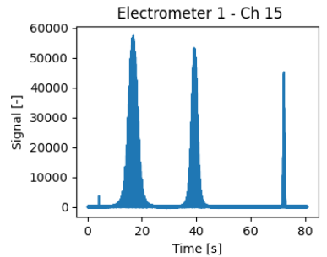
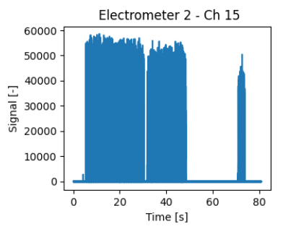
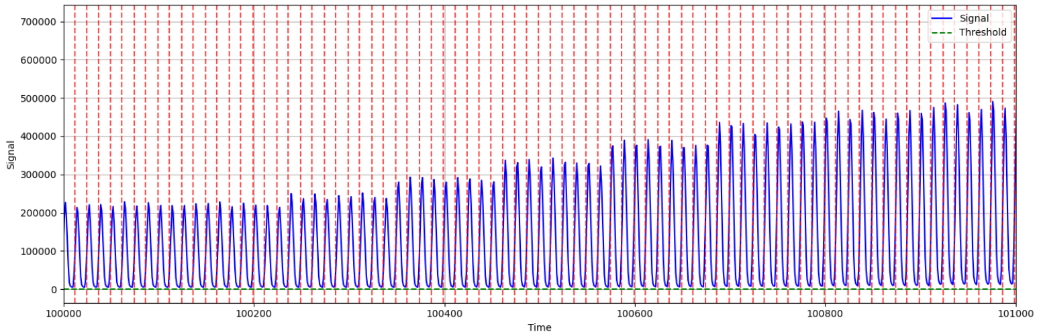
Data Analysis
II
Signal processing – Signal minus background noise detected by the 15th stripe in (a) X chamber (b) Y chamber, (c) signal filtered in space and time with peak detection
To detect each peak, the signal is analyzed using the following steps:
    Background subtraction
Temporal filtering
Spatial filtering
Threshold identification
Peaks detection
Signal [au]
Signal [au]
(a)
(b)
Signal [au]
Counts
(c)

Slide 8
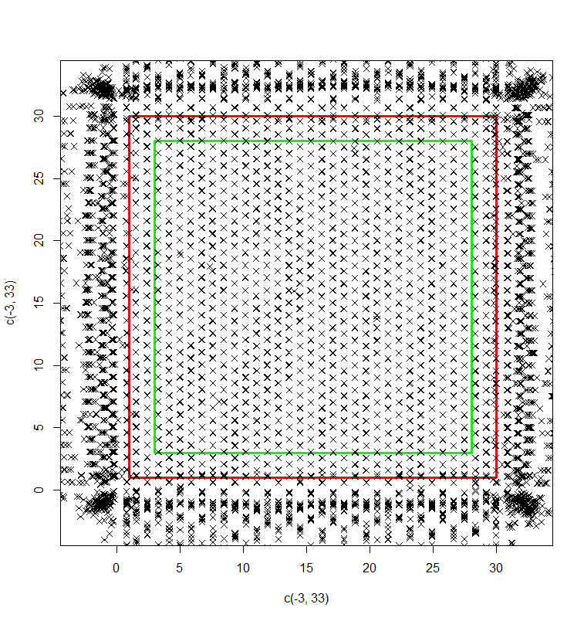
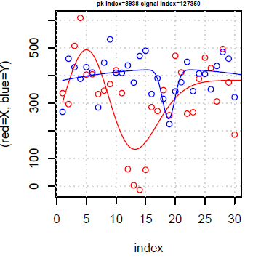
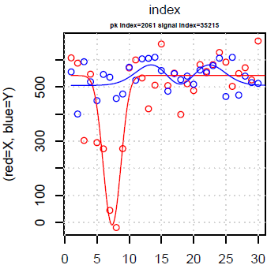
Recontruction of the dose maps
II
Gaussian fitting of the time-filtered signals
Quality-control steps applied for peak rejection
Peak rejection criteria - (a) peaks outside the selected area (b) peaks with non-convergent fitting (c) peaks with negative fitted peak height
Signal [au]
Signal [au]
O X data
O Y data
X fit
Y fit
O X data
O Y data
X fit
Y fit
Channel
Channel
(a)
(b)
(c)

Slide 9
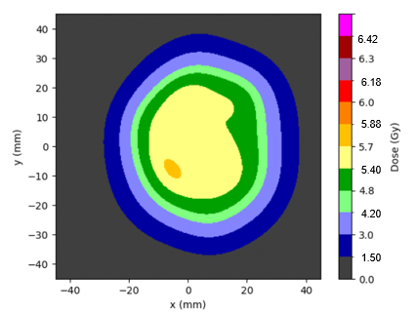
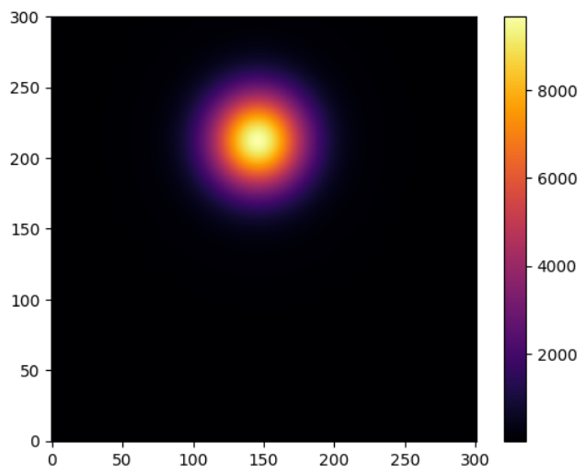
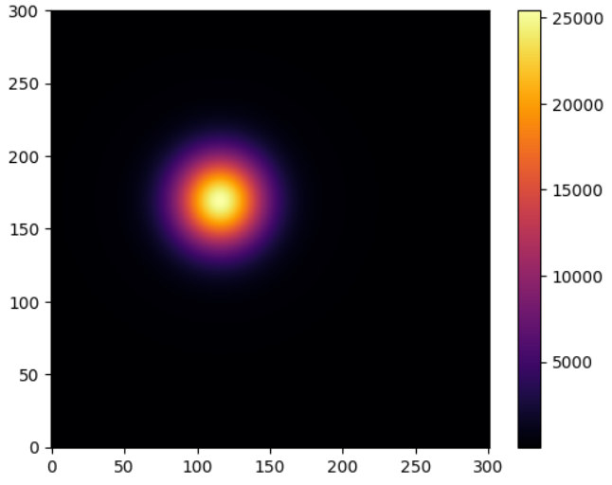
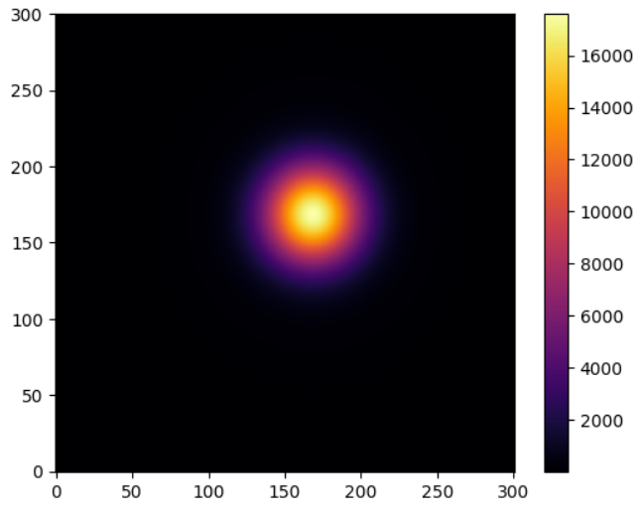
Recontruction of the dose maps
II
Reconstruction of a single pencil-beam image
Reconstruction of two-dimensional dose maps
Different single pencil beam shoot
2D dose map reconstruction with DOSION

Slide 10
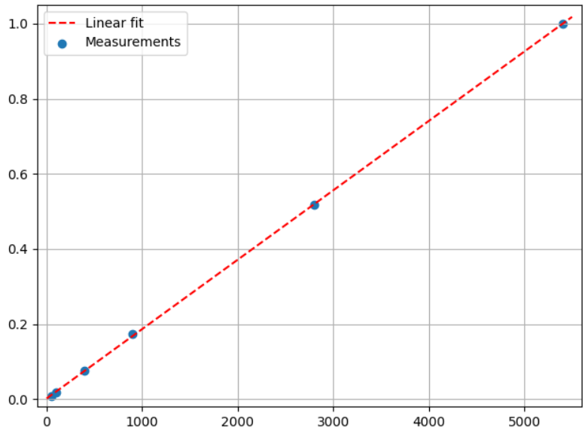
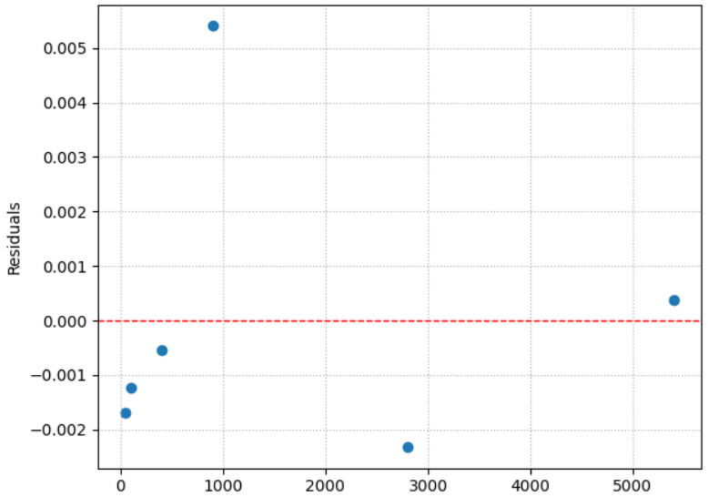
Linearity
II
Linear Regression - Fit (a) and Residuals (b)
To demonstrate the linearity the beam is deliver with different monitor units, ranging from 50 to 5400 MU.
The linear fit residuals have a standard deviation of 0.0025
Signal [au/au.max]
Residuals
Monitor Units
Monitor Units
(a)
(b)

Slide 11
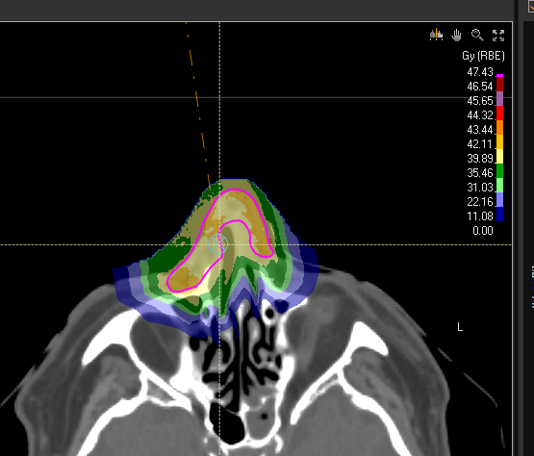
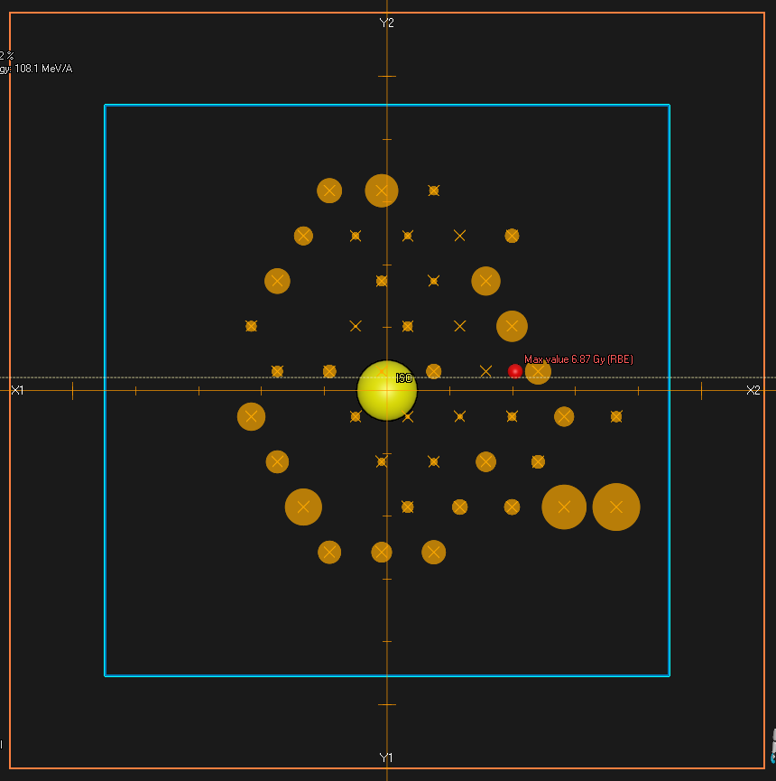
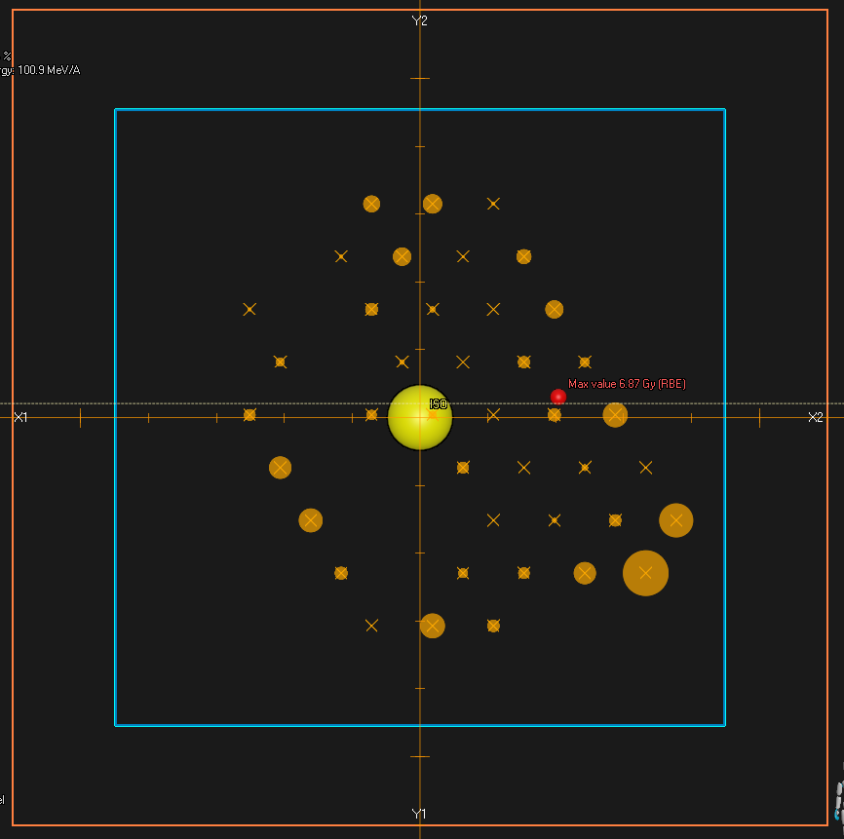
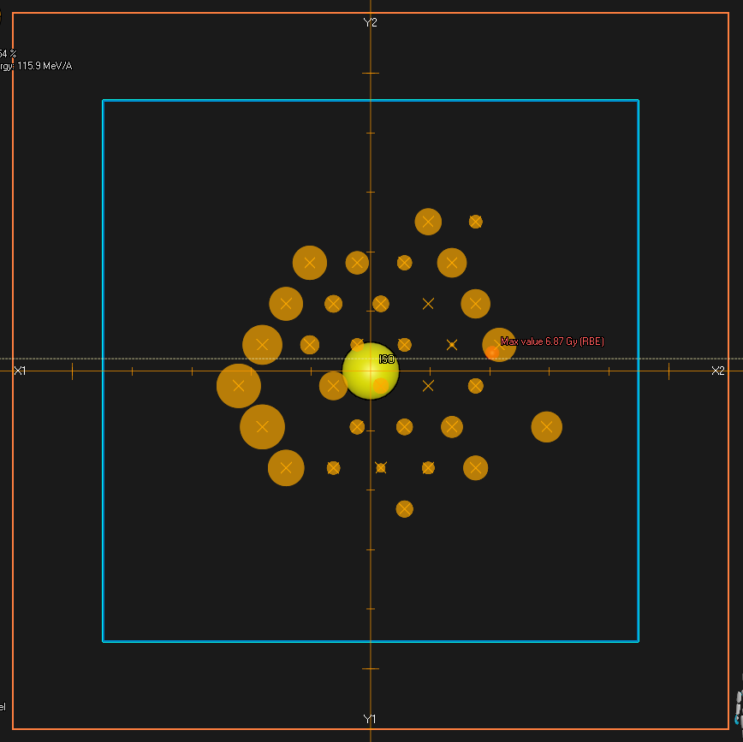
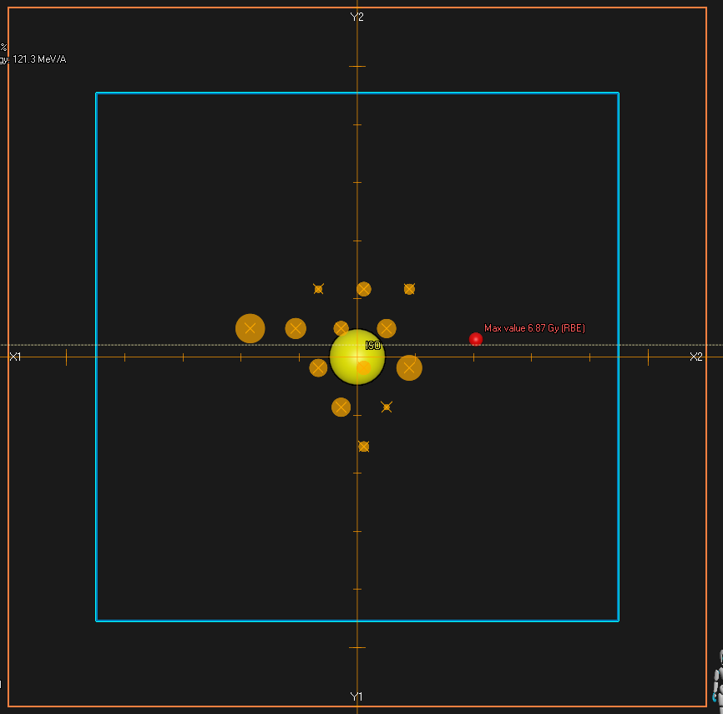
Patient Specific Quality Assurance
II
Patient treatment plan on TPS
To compare TPS dose calculations with DOSION measurements, the treatment plan was evaluated using both computational and experimental methods.

Slide 12
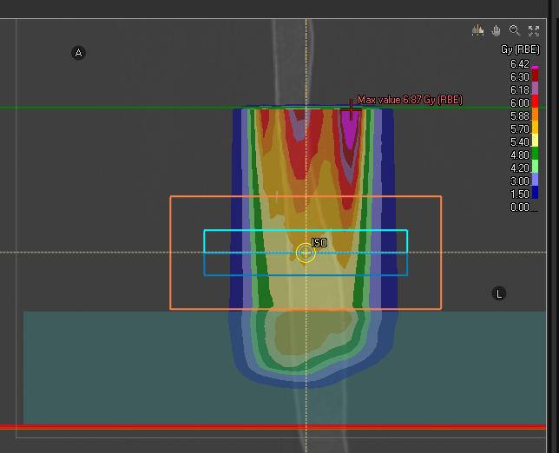
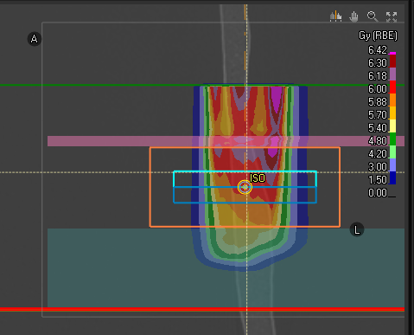
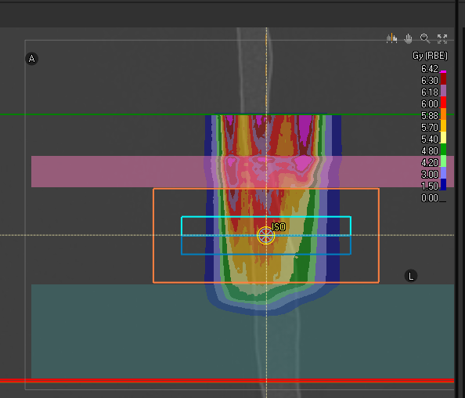
Patient Specific Quality Assurance
II
TPS dose calculation lateral view
X chamber
Y chamber
DOSION
Water equivalent material
X chamber
Y chamber
DOSION
Water equivalent material
X chamber
Y chamber
DOSION
1cm
5cm
12cm
9cm
(a)
(b)
(c)
Dose assessments were performed at three patient depths: (a) at the surface , (b) 7 mm depth and (c) 17 mm depth.

Slide 13
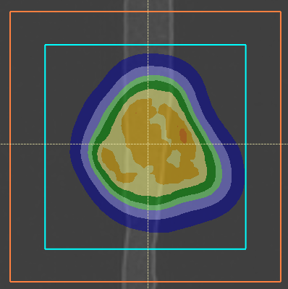

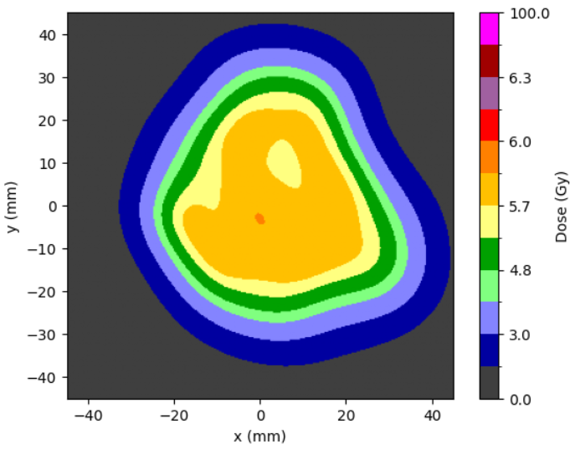
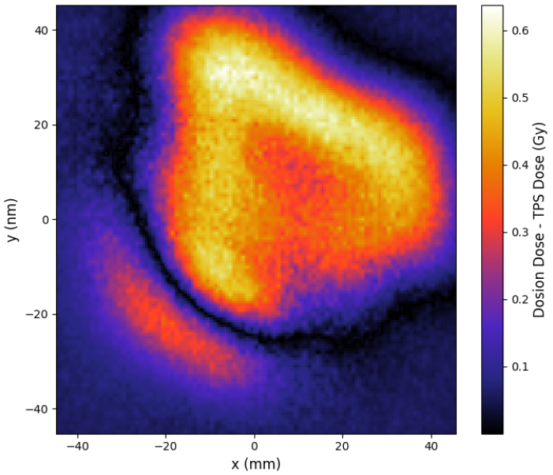
PSQA at 0 mm
a
TPS dose calculation top view
2D dose map reconstruction with DOSION
TPS – DOSION dose map
6.42
6.18
5.88
5.40
4.20
1.50

Slide 14
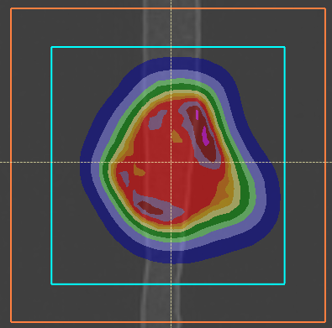
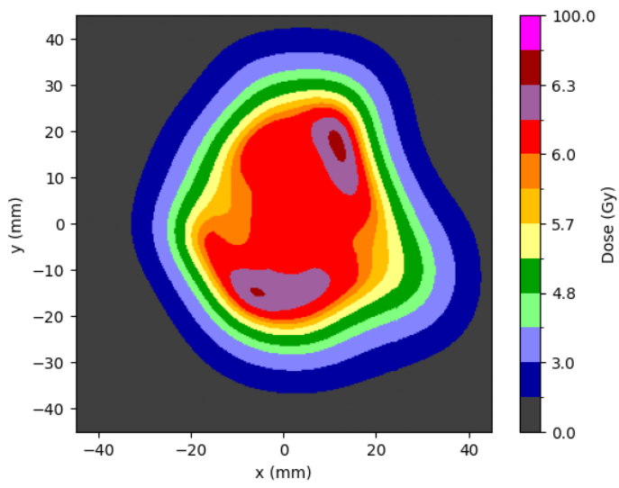
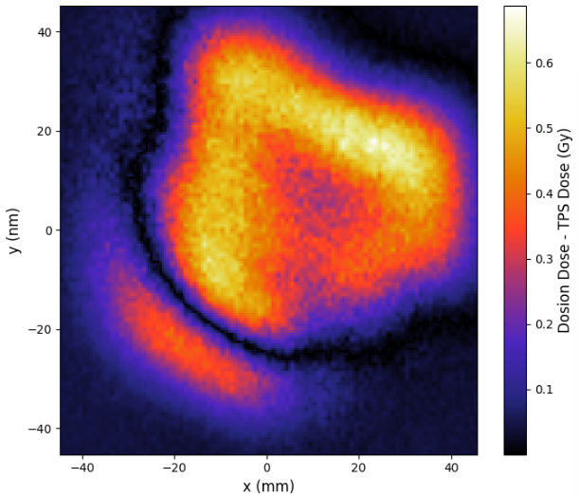
PSQA at 7 mm
b
TPS dose calculation top view
2D dose map reconstruction with DOSION
TPS – DOSION dose map
6.42
6.18
5.88
5.40
4.20
1.50

Slide 15
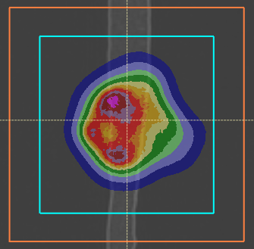
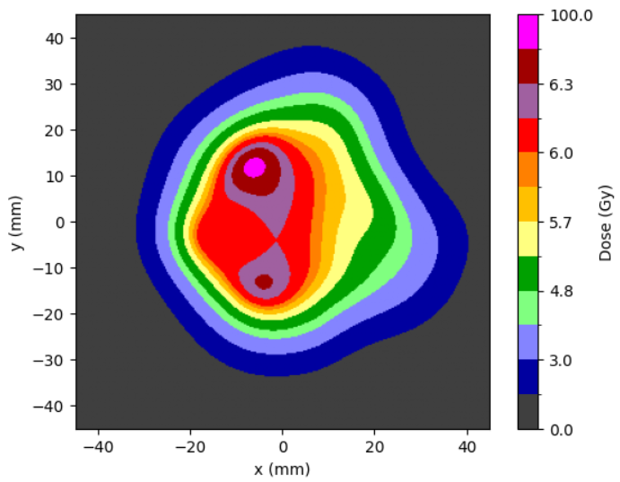
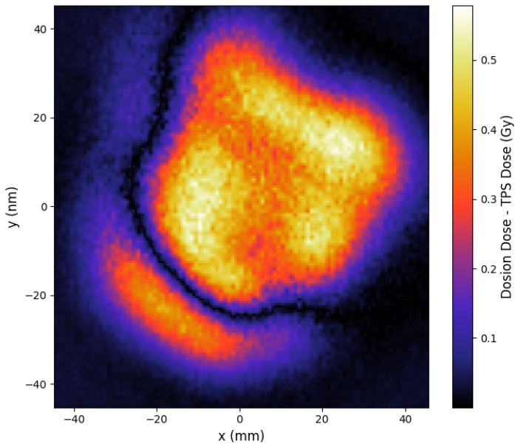
PSQA at 17 mm
c
TPS dose calculation top view
2D dose map reconstruction with DOSION
TPS – DOSION dose map
6.42
6.18
5.88
5.40
4.20
1.50

Slide 16
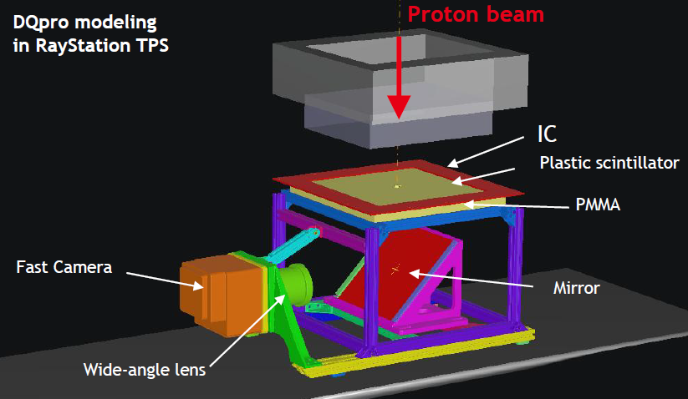
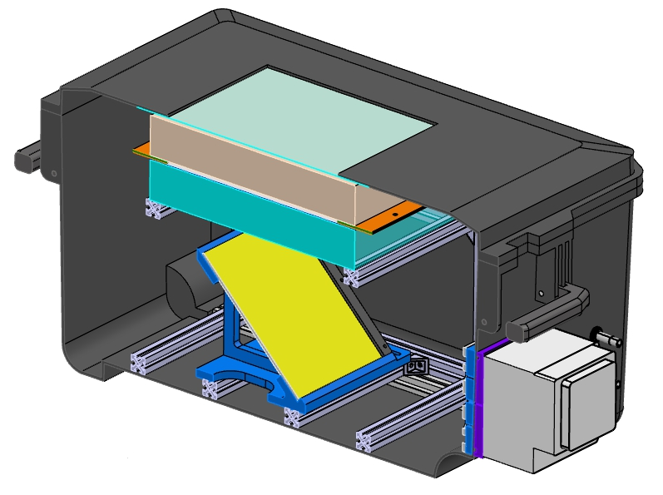
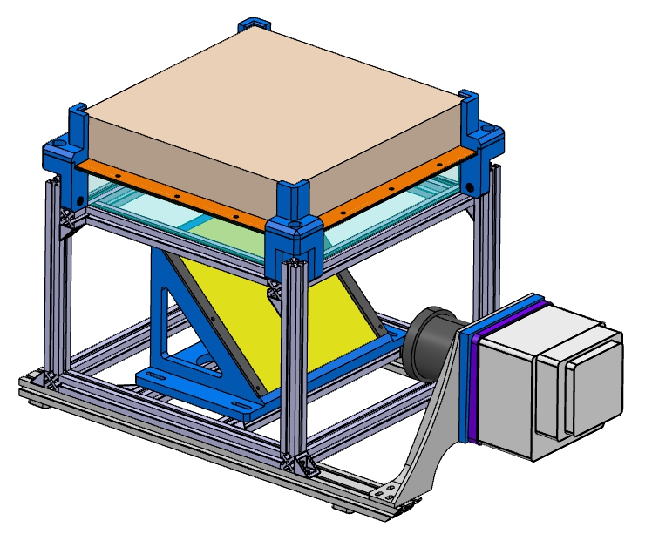
Conclusions and Overlooks
III
Future prototype design
From the experiment:
The device response is linear with respect to MU
Ionization chambers provide reliable measurements for PSQA
Future prototype:
An integral ionization chamber will be developed
A camera system couple with a plastic scintillator and a mirror
The chamber will have a larger window

Slide 17
THANK YOU VERY MUCH!
Giulia Tosetti¹
tosetti@lpccaen.in2p3.fr
Jean-Marc Fontbonne¹, Dorothée Lebhertz², Cyril Moignier² and Rémi Lafaye¹
¹Université de Caen Normandie, ENSICAEN, CNRS/IN2P3, LPC Caen UMR6534, F-14000 Caen, France
² Centre François Baclesse, service de radiophysique, Caen, France

Slide 18
Bibliography
III
[1] E. Boman, J. Ojala, M. Rossi, and M. Kapanen, “Monte Carlo investigation on the effect of air gap under bolus in post-mastectomy radiotherapy,” vol. 55, pp. 82–87
[2] M. J. Butson, T. Cheung, P. Yu, and P. Metcalfe, “Effects on skin dose from unwanted air gaps under bolus in photon beam radiotherapy,” Radiation Measurements, vol. 32, no. 3, pp. 201–204, 2000.
[Online]. Available: https://www.sciencedirect.com/science/article/pii/S1350448799002760
[3] Cyril Moigner, et al., “Protontherapy for superficial tumors: validation of the tps dose calculation and comparison to high energy photon techniques”, PTCOG, 2023.
[4] Guillaume Boissonnat, "Chambres d'ionisation en protonthérapie et hadronthérapie", thèse 2015, https://theses.fr/2015CAEN2018
[5] https://faster.in2p3.fr/

Slide 19
Outline
Part I
  Introduction
    Motivation
    Part II
    DOSION
    Experimental set up
    Data Analysis + Experiments
    Part III
    Conclusions & Outlooks
    Bibliography

