Slide 1
Development of a 3D Slicer Extension for MR-Based Gel Dosimetry Analysis
G S Lee¹, K M Alexander^{1,2,3}, and JD Jutras^{1,4}
¹ Department of Physics and Astronomy, University of Calgary, Calgary, Alberta, Canada
² Department of Oncology, Queen’s University, Kingston, Ontario, Canada
³ Medical Physics Department, Cancer Centre of Southeastern Ontario at Kingston Health Sciences Centre, Kingston, Ontario, Canada
⁴ Department of Medical Physics, Arthur JE Child Comprehensive Cancer Centre, Calgary, Alberta, Canada

Slide 2

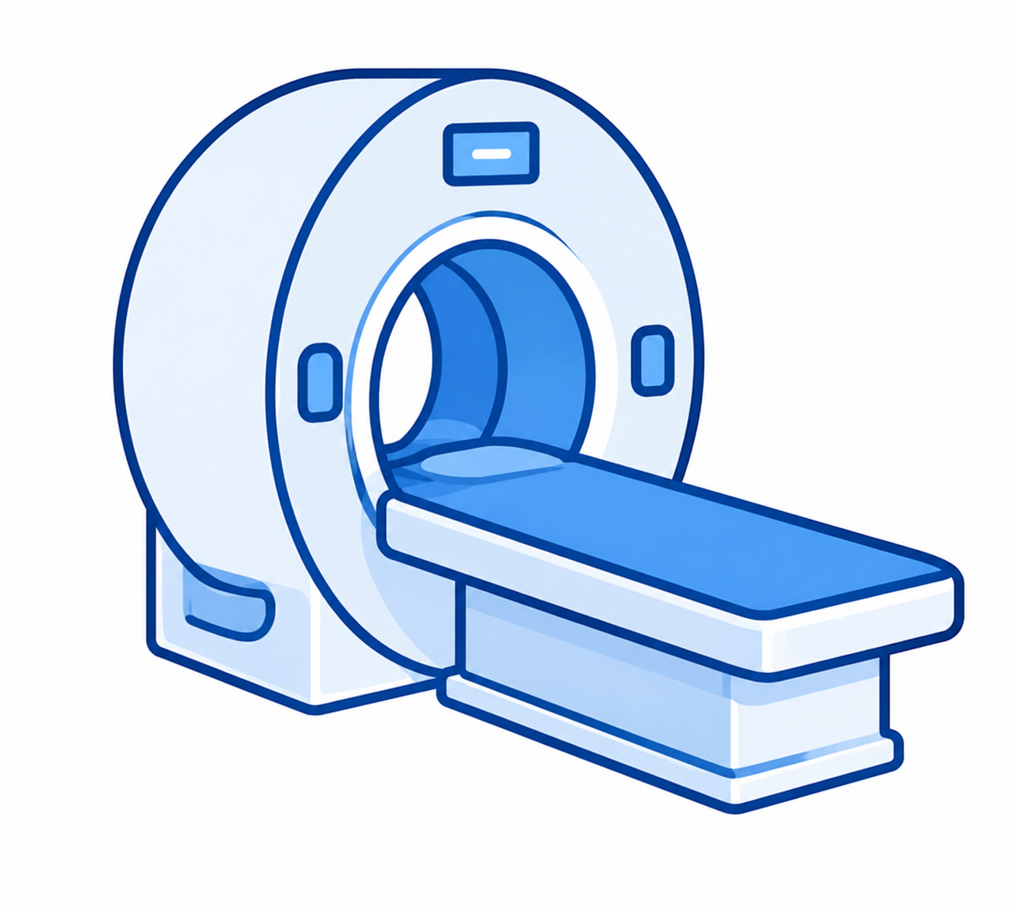
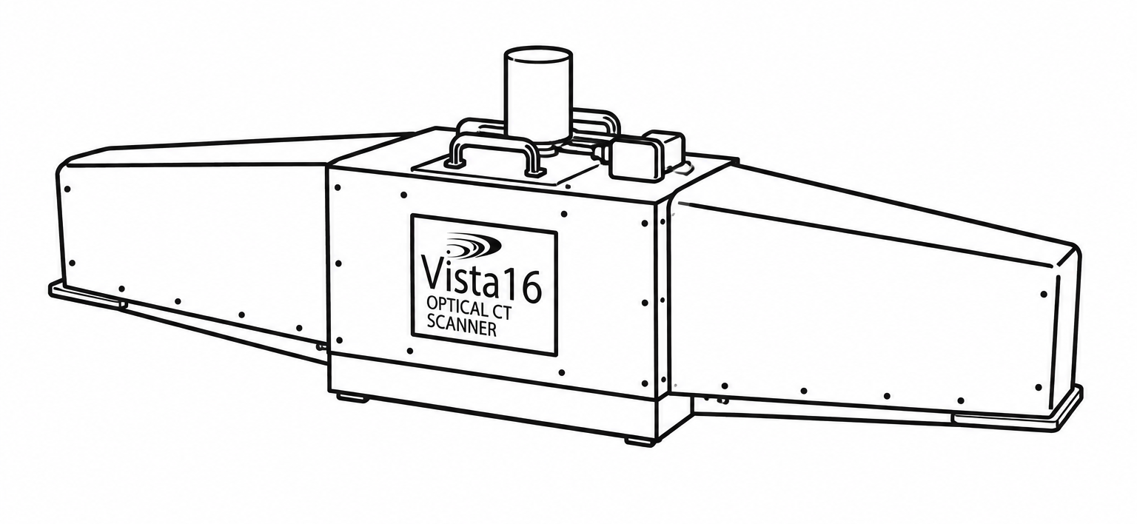

The Return of MRI in Gel Dosimetry
1. Development of
Fricke Dosimetry
2. MR Readout of
Fricke Dosimetry
3. Adoption of
Optical CT Readout
4. Renewed Interest
in MR Readout
Chemical dosimetry based on the oxidation of Fe²⁺ to Fe³⁺ by ionizing radiation.
MRI was the preferred readout method for dose quantification.
Optical CT became more accessible and practical, leading to widespread adoption and extensive Fricke gel studies.
Advances in MRI technology and MR-guided radiation therapy have renewed interest in MR-based Fricke gel dosimetry.
No open-source software exists for MR gel dosimetry analysis!
1

Slide 3
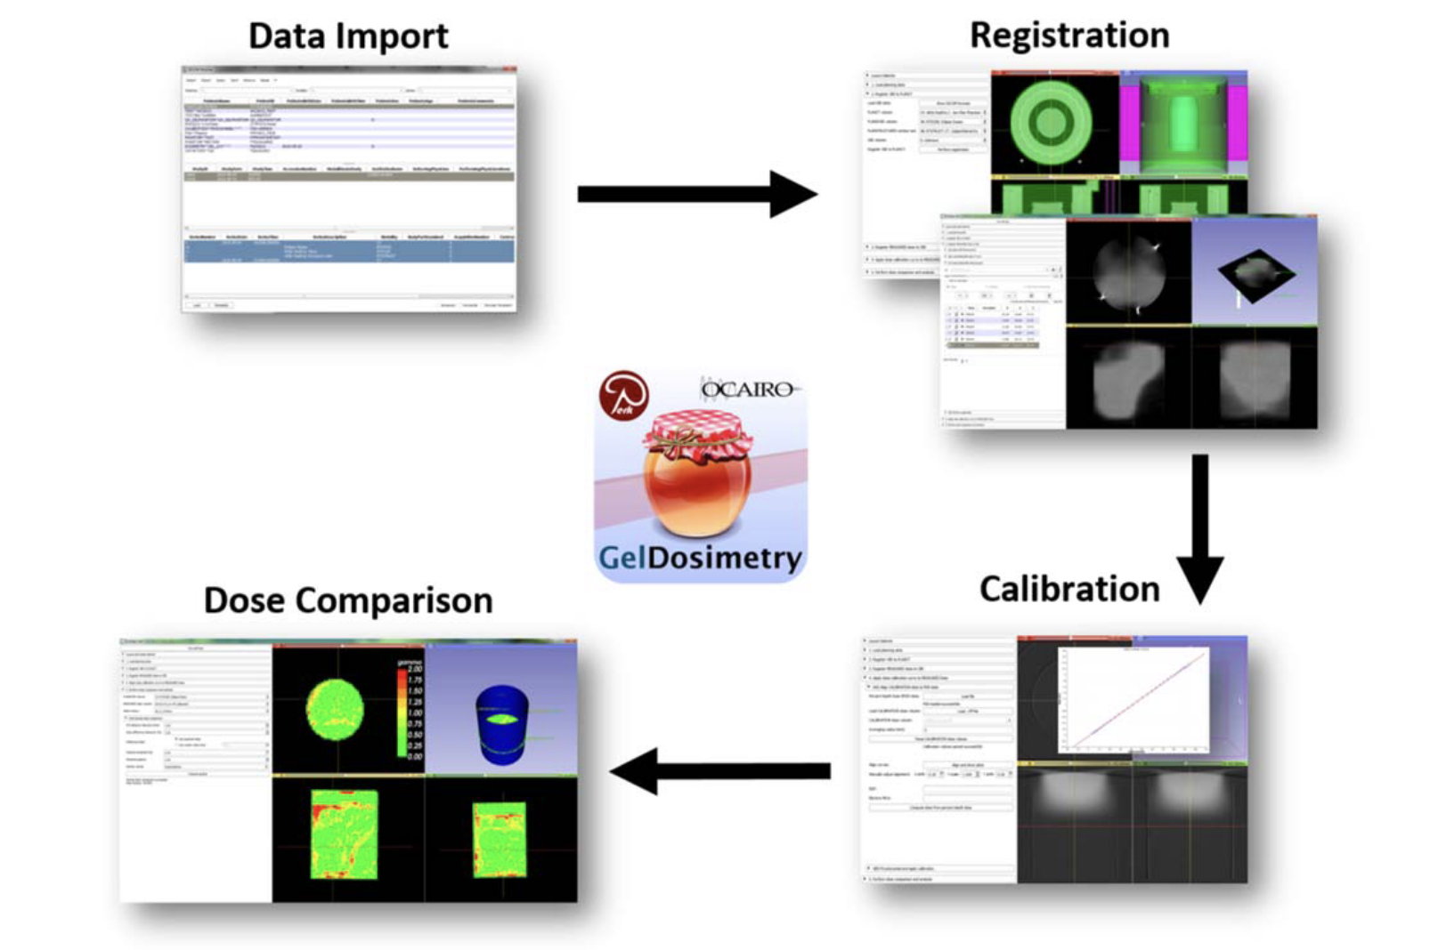
Existing Optical CT Workflow in 3D Slicer
Alexander KM, et al. Streamlined open-source gel dosimetry analysis in 3D slicer. Biomed Phys Eng Express. 2018;4(4). doi: 10.1088/2057-1976/aad0cf.
2

Slide 4
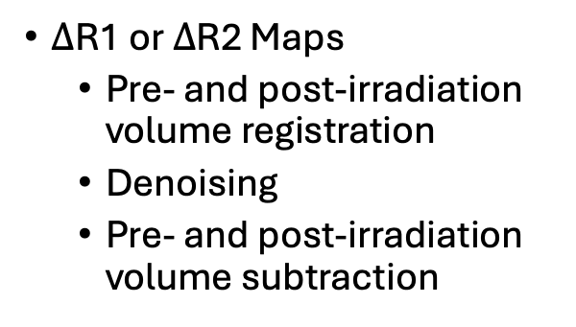
What’s New in MR Workflow?
$Δ$R1 or $Δ$R2 Maps
  Pre- and post-irradiation volume registration
  Denoising
  Pre- and post-irradiation volume subtraction
MR Dose Calibration
  User defined sampling axis
  Adjustable averaging radius
3

Slide 5
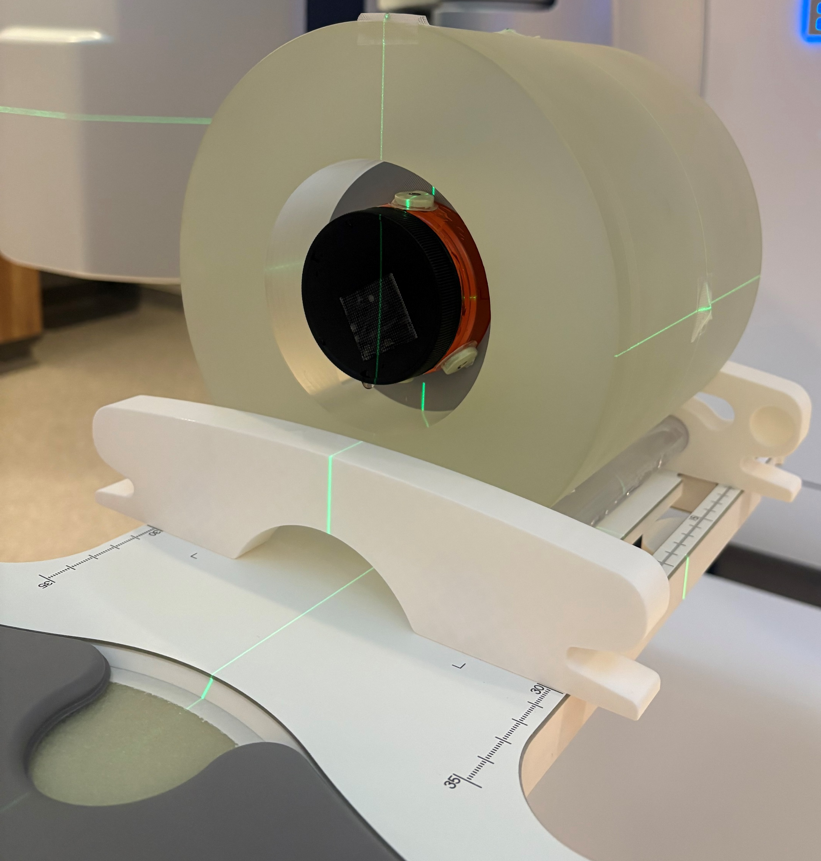
Experimental Case Study
Fricke Gel Formulation
Clinical Plan
Gelatin: 6 wt%
Sulfuric acid: 65 mM
Ferrous ammonium sulfate: 0.42 mM
Xylenol Orange: 0.05 mM
Two gel jars prepared:
  Measured
  Calibration
Liver SBRT
Varian TrueBeam linac
10 MV FFF beam
3 Gy scaled down prescription dose
Cylindrical phantom
4

Slide 6
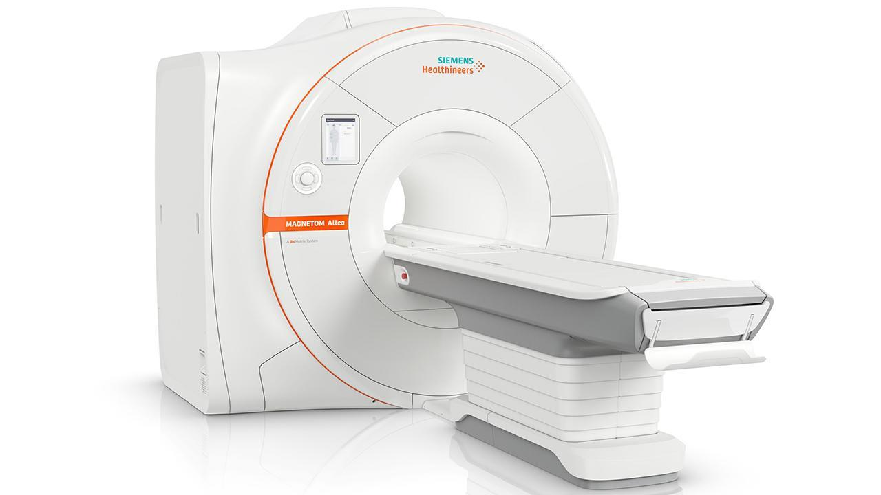
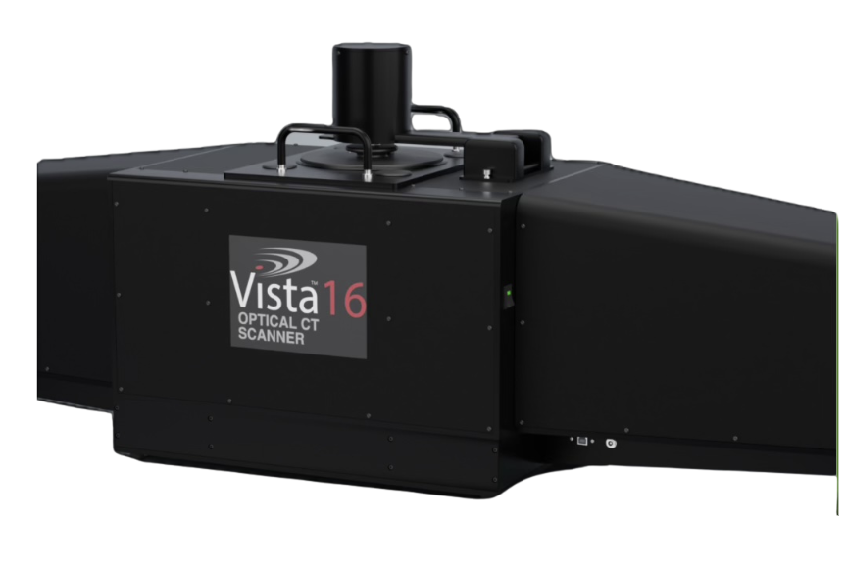
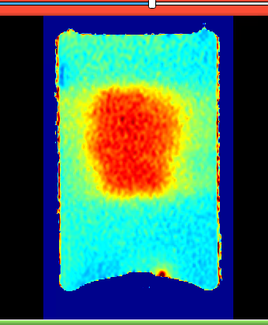
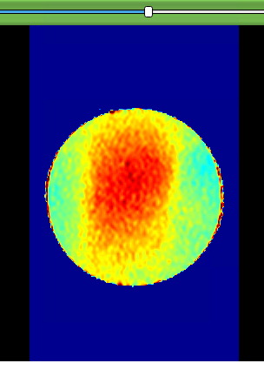
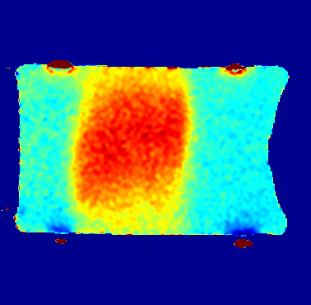
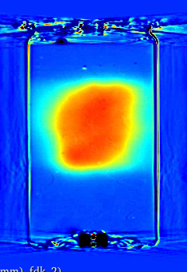
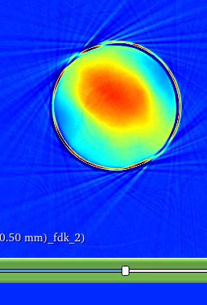
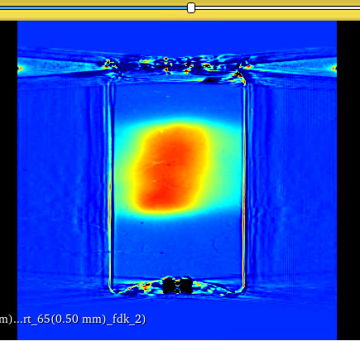
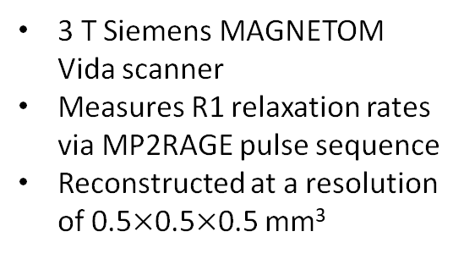
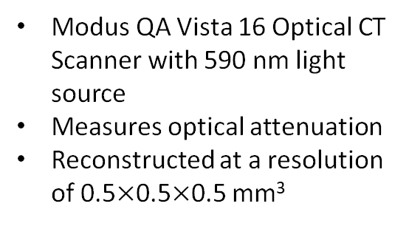
Imaging Readout Methods for FXO Gel
Magnetic Resonance Imaging (MRI)
Optical Computed Tomography (Optical CT)
3 T Siemens MAGNETOM Vida scanner
Measures R1 relaxation rates via MP2RAGE pulse sequence
Reconstructed at a resolution of 0.5$×$0.5$×$0.5 mm³
Modus QA Vista 16 Optical CT Scanner with 590 nm light source
Measures optical attenuation
Reconstructed at a resolution of 0.5$×$0.5$×$0.5 mm³
5

Slide 7
MR Workflow Demonstration
Load data
ΔR1 mapping: registration, denoising, subtraction
2. Registration
Planning → IGRT & Measured gel volume → IGRT
3. Dose calibration
PDD-based calibration: ΔR1 → dose
4. Dose comparison
Gamma analysis & line profiles
6

Slide 8
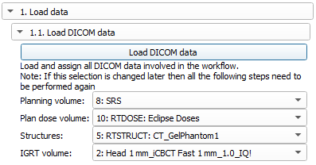
1.1 Load DICOM Data
7

Slide 9
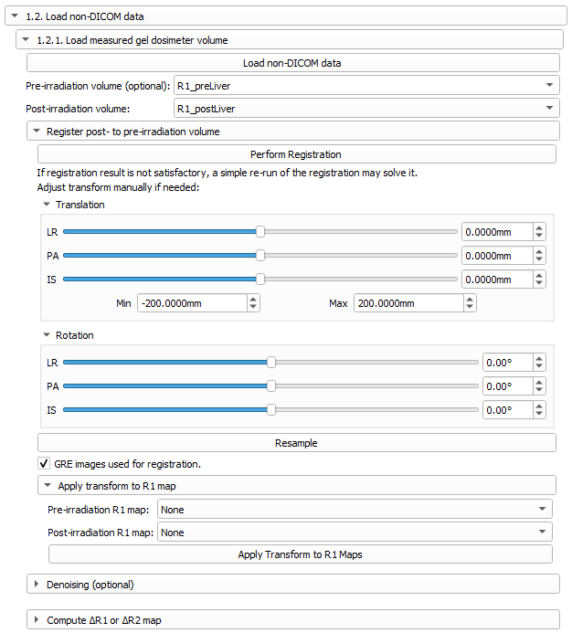
1.2 Load non-DICOM Data
8

Slide 10
ΔR1 Mapping Workflow
Registration
9

Slide 11
ΔR1 Mapping Workflow
A. Registration – Manual Transformation & Resampling
10

Slide 12
ΔR1 Mapping Workflow
A. Registration – Apply Transform to R1 Map
11

Slide 13
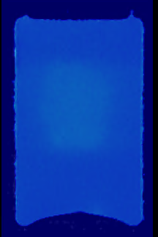
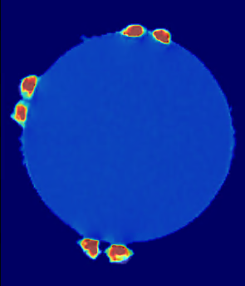
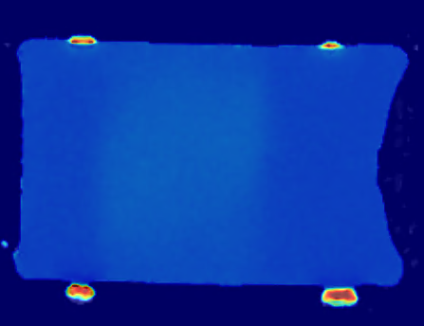
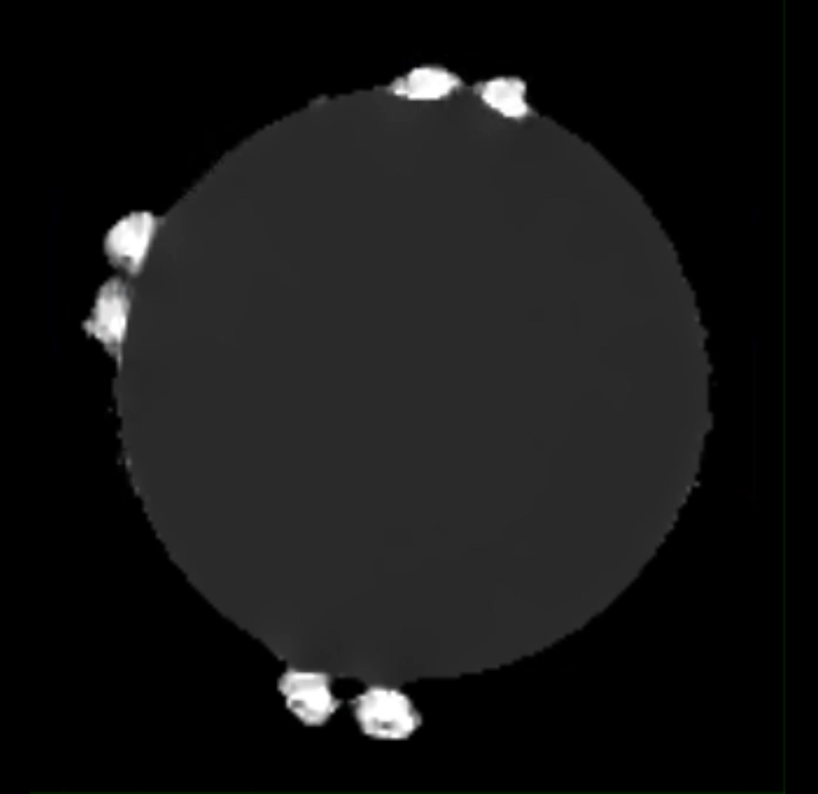
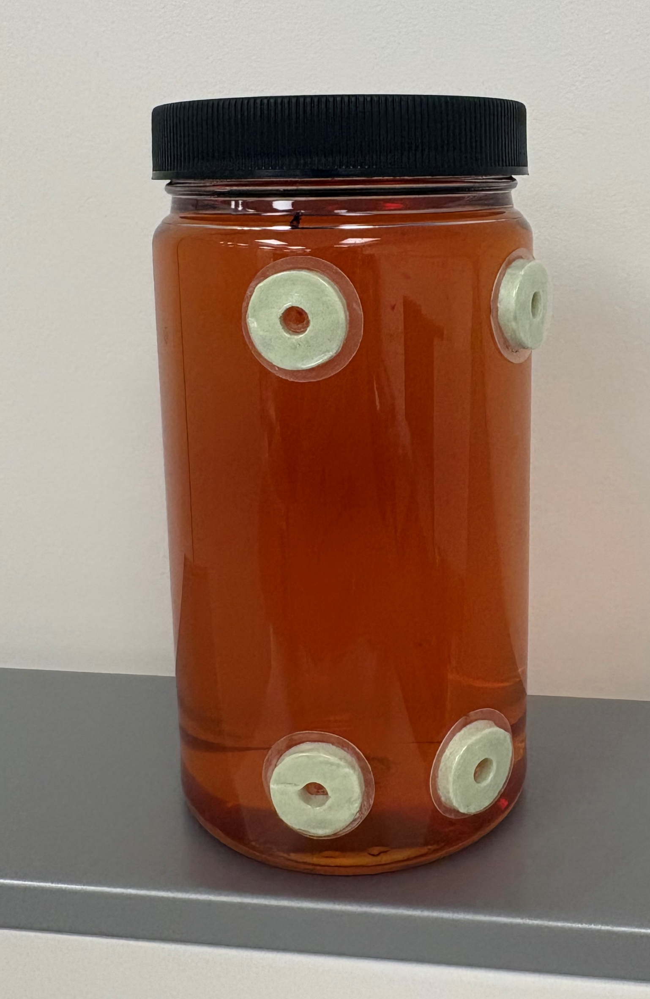
ΔR1 Mapping Workflow
Registration
12

Slide 14
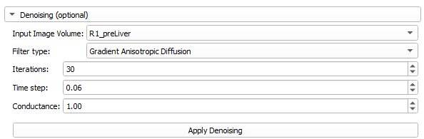
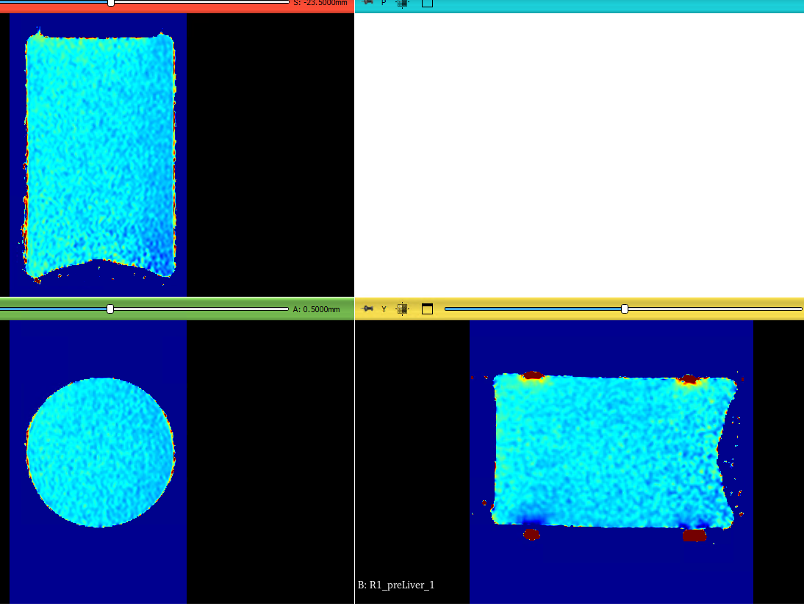
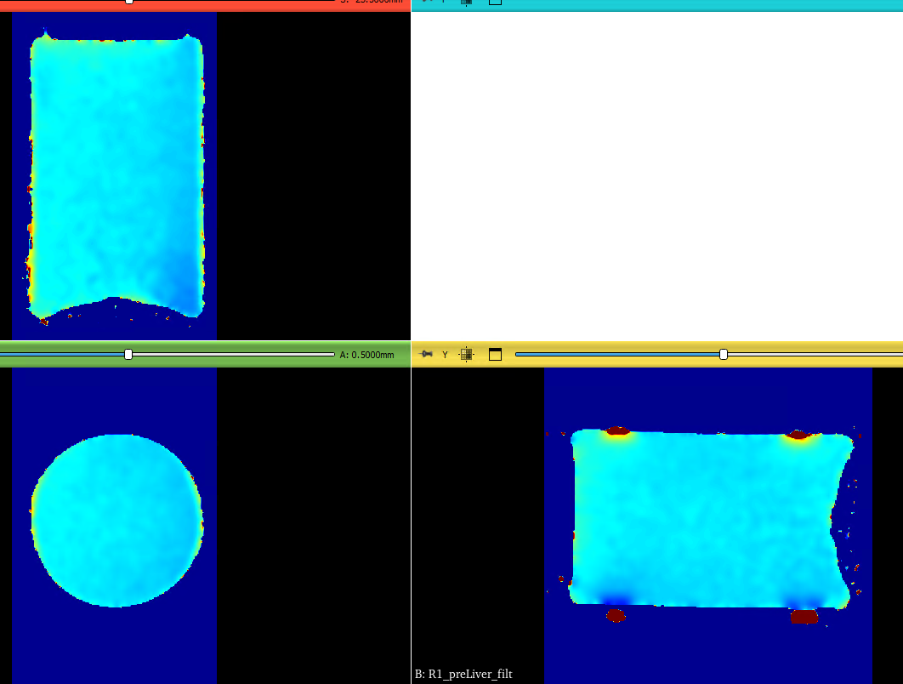
ΔR1 Mapping Workflow
B. Denoising
Before Denoising
After Denoising
13

Slide 15
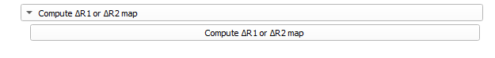
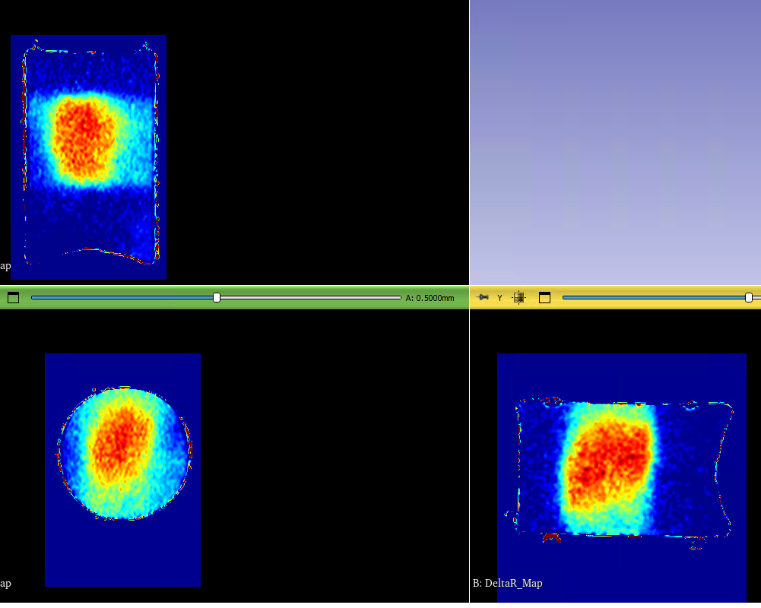
ΔR1 Mapping Workflow
C. Volume Subtraction
ΔR1 mapping is performed for both measured and calibration gel volumes!
14

Slide 16
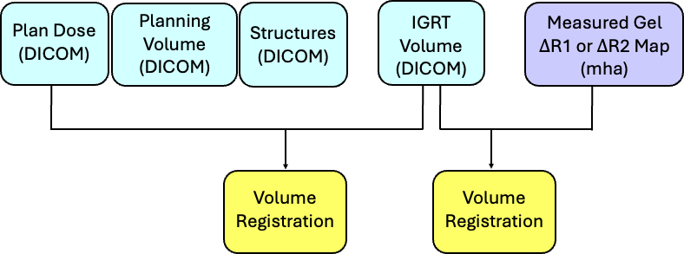
2. Registration
15

Slide 17
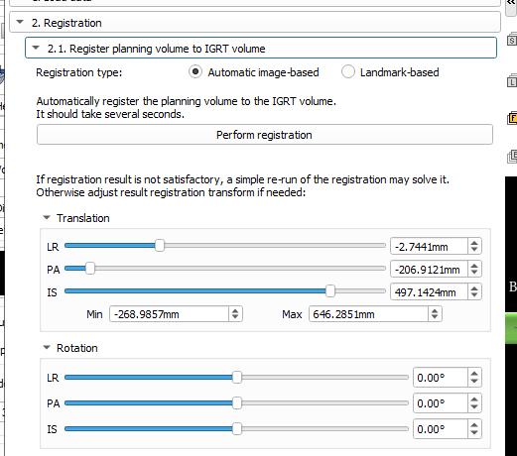
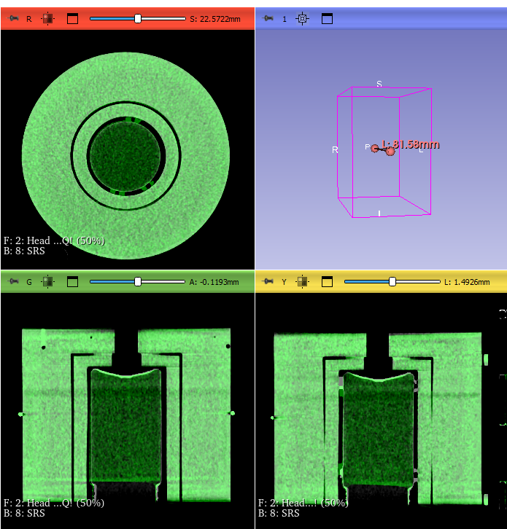
2.1 Registration
16

Slide 18
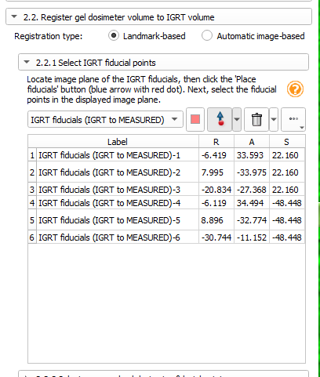
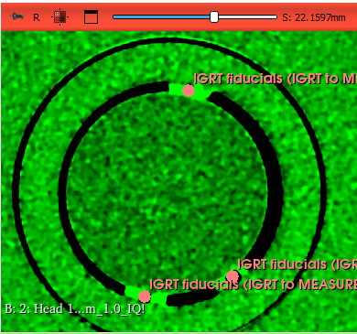
2.2 Registration
17

Slide 19
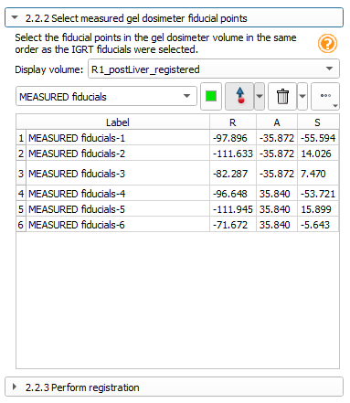
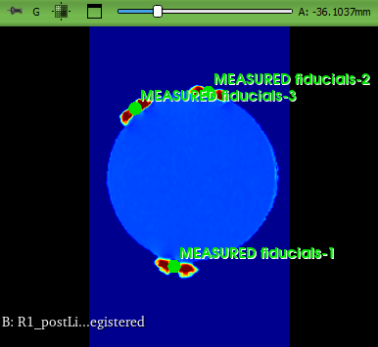
2.2 Registration
18

Slide 20
2.2 Registration
18

Slide 21
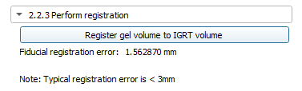
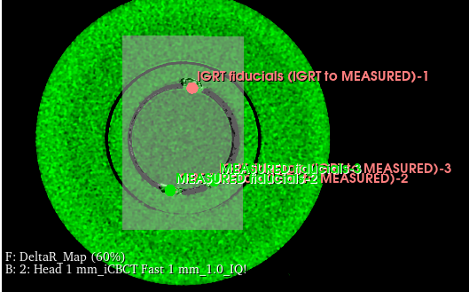
2.2 Registration
19

Slide 22
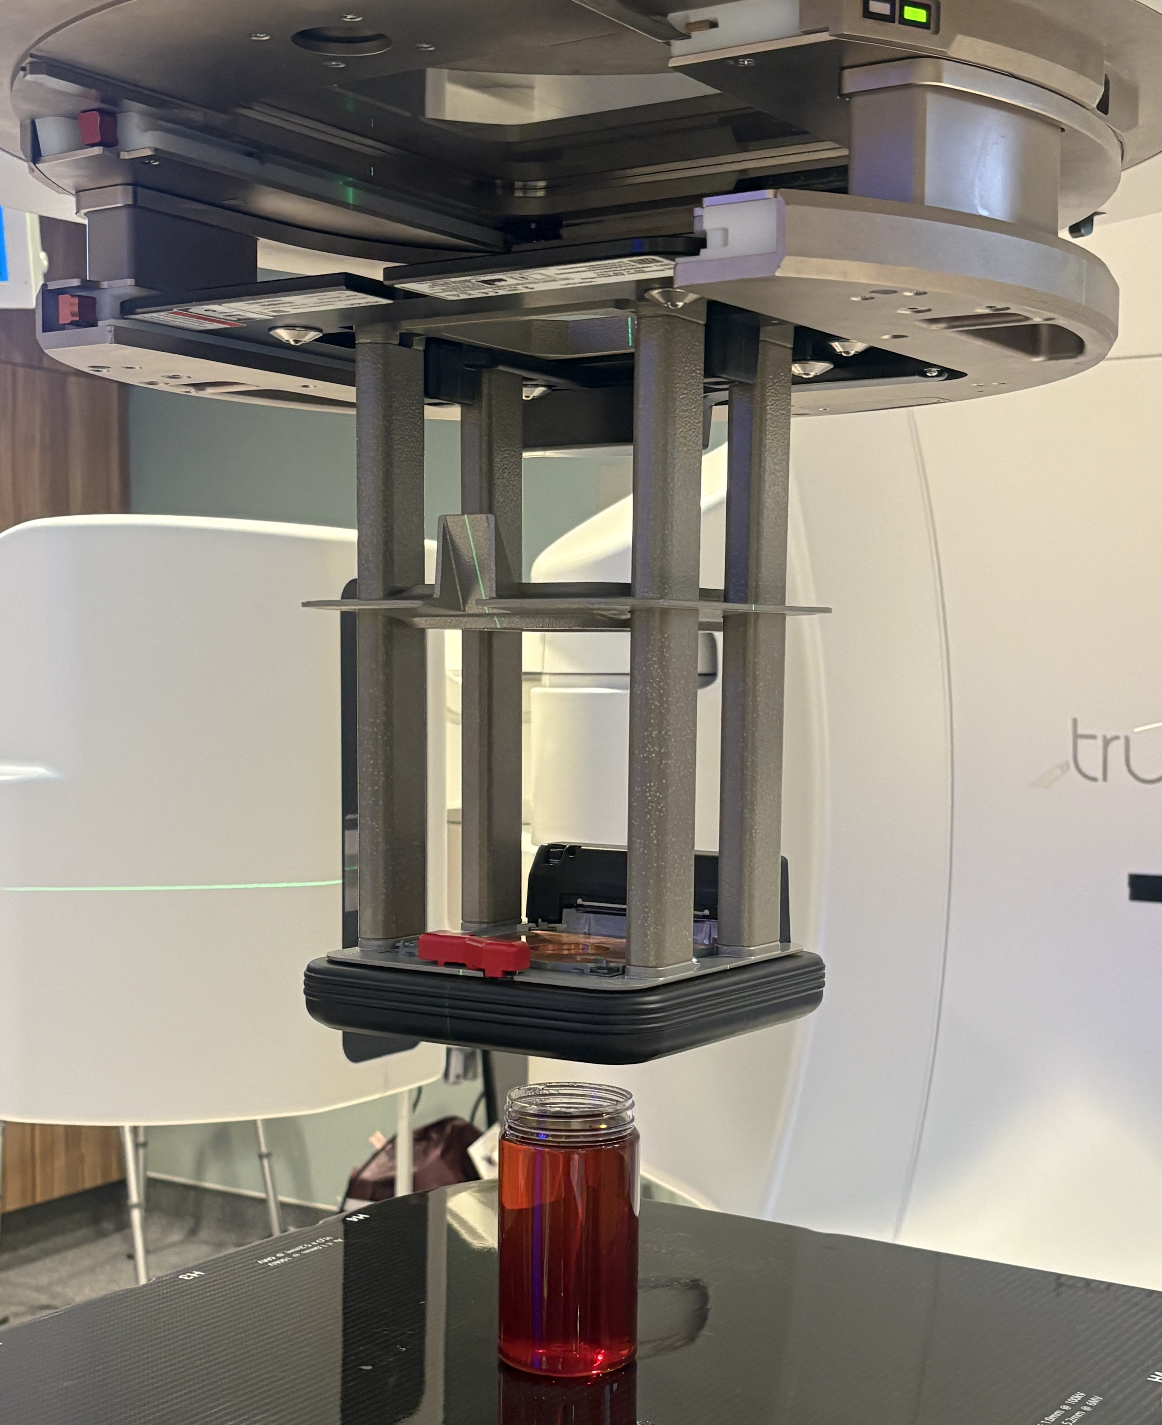
3. Dose Calibration
Determines the relationship between ΔR1 and dose
Uses a PDD-based calibration method along a user-defined axis
Aligns the ΔR1 depth profile with commissioning PDD data
20

Slide 23
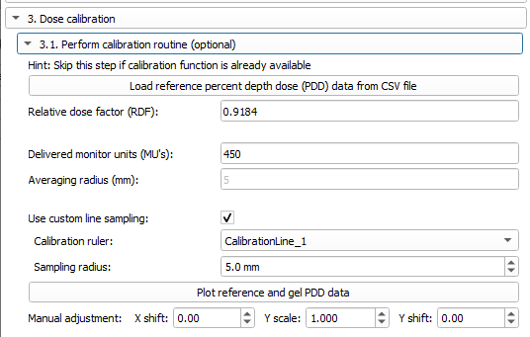
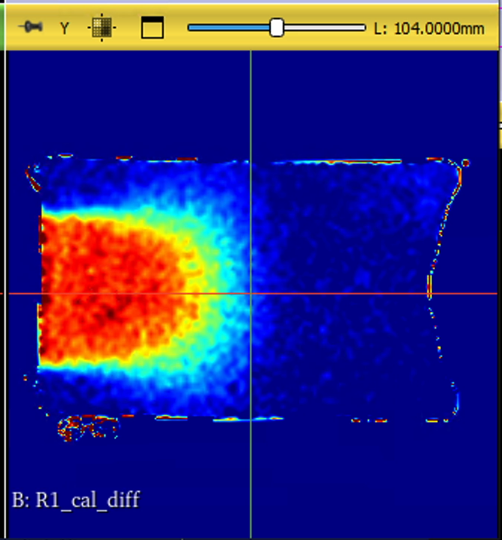
3.1 Dose Calibration
21

Slide 24
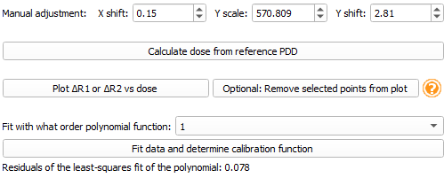
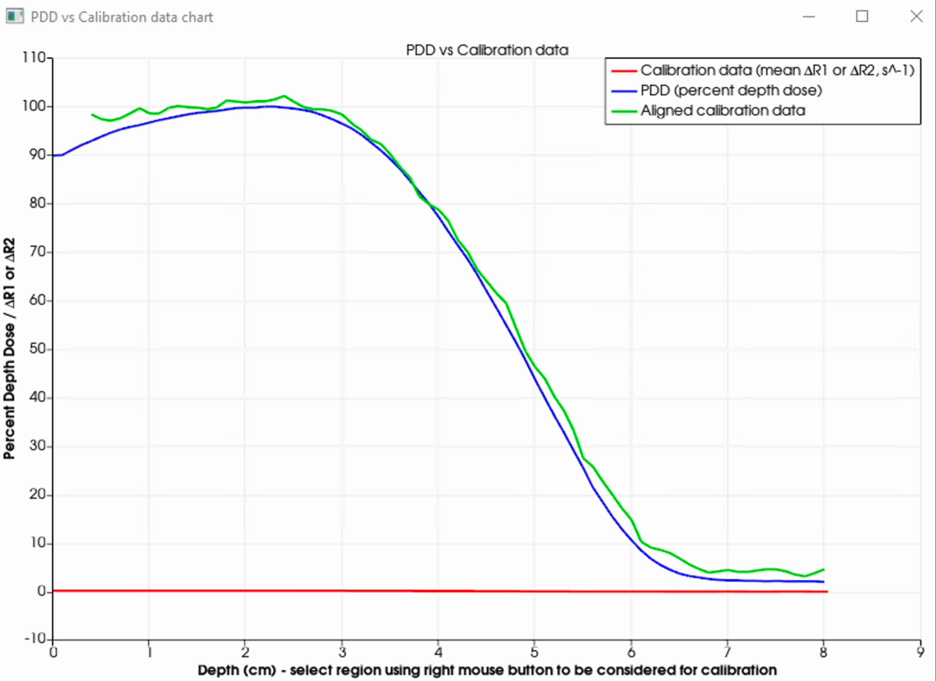
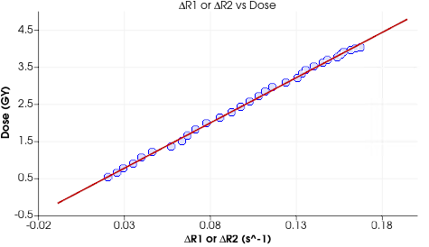
3.1 Dose Calibration
22

Slide 25
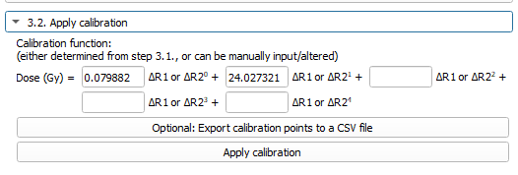
3.2 Apply Calibration
23

Slide 26
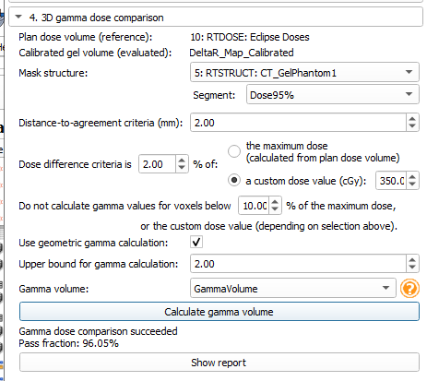
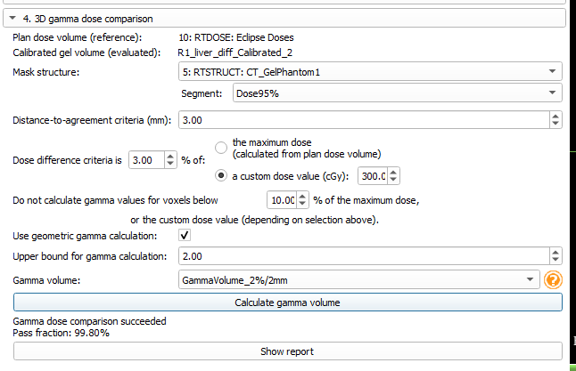
4. Dose Comparison
24

Slide 27
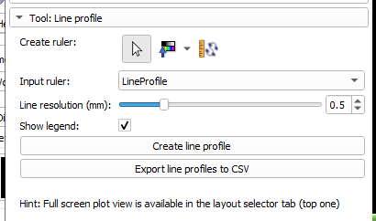
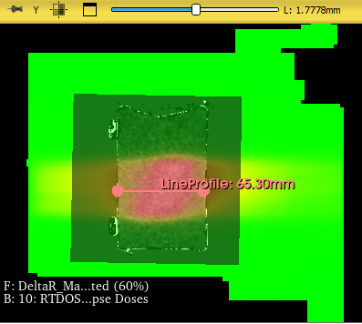
Line Profile
25

Slide 28
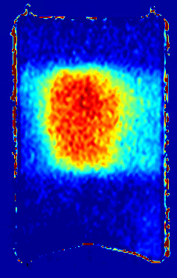
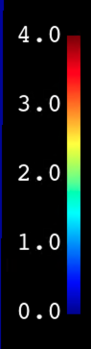
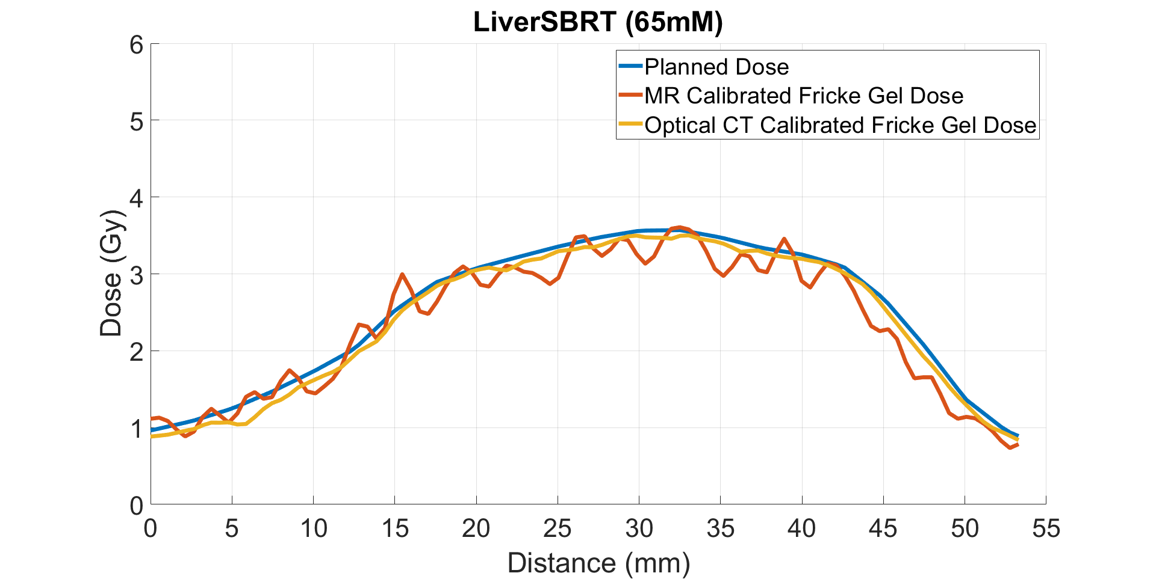


Results
Gamma Volume
MR Dose Map
Line Profile
Imaging Modality | Mean Dose inside 95% Isodose Line |  |  | Gamma Analysis at 2%/2mm (%)
 | Planned Dose (Gy) | Measured Volume (Gy) | % Difference (%)
MR | 3.22 | 3.13 | 2.8 | 96.05
oCT | 3.22 | 3.16 | 1.9 | 97.88
26

Slide 29
Conclusion
Developed an MR-based gel dosimetry workflow in 3D Slicer
MR measurements showed good agreement with planned dose and optical CT
Accessible through an open-source platform
Supports MR-guided radiation therapy applications
27

Slide 30



Acknowledgements
School of Computing, Queen’s University
  Andras Lasso
  Kyle Sunderland
  Gabor Fichtinger
Design Lab
  Adam Yarschenko
  William Gill
28

