Slide 1




IC3DDose 2026
Characterization and 3D printing of a tissue-equivalent anthropomorphic neck phantom for 2.5D dosimetric verification in proton therapy
Elena Fanelli, S.J.G. Clausen, A.M. Skjødt, L. Muren, V.T. Taasti,
K. Fotiou, P.S. Skyt, R.M. Turtos, P. Balling

Slide 2
BACKGROUND
The Clinical Challenge
Standard QA Phantoms
Homogeneous water/plastic slabs: miss the geometric complexity of real patient anatomy
→ FDM 3D printing for cost-effective custom phantoms
Dosimetric Pass Rates Drop
In heterogeneous H&N geometries, TPS errors may not be detected in flat phantoms
Spinal Cord at Risk
Steep dose gradients near the cord (critical OAR) require precise measurement
Taylor P A et al. 2016, Int J Radiat Oncol Biol Phys, 95(1), 242–248.
2 / 12

Slide 3
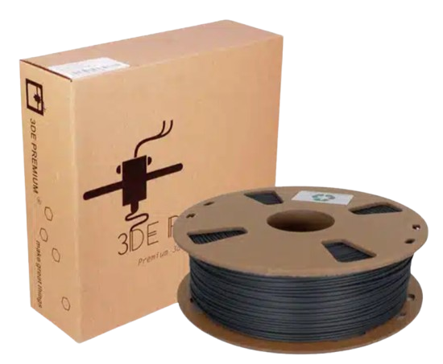
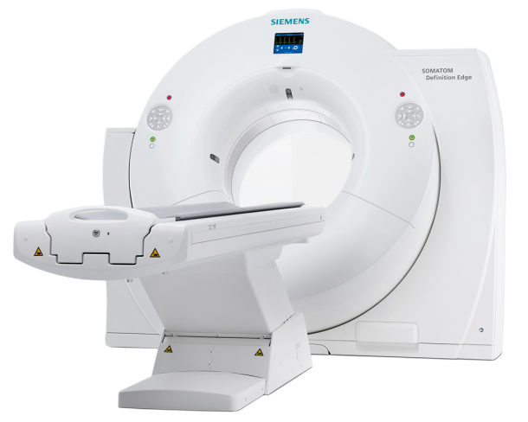
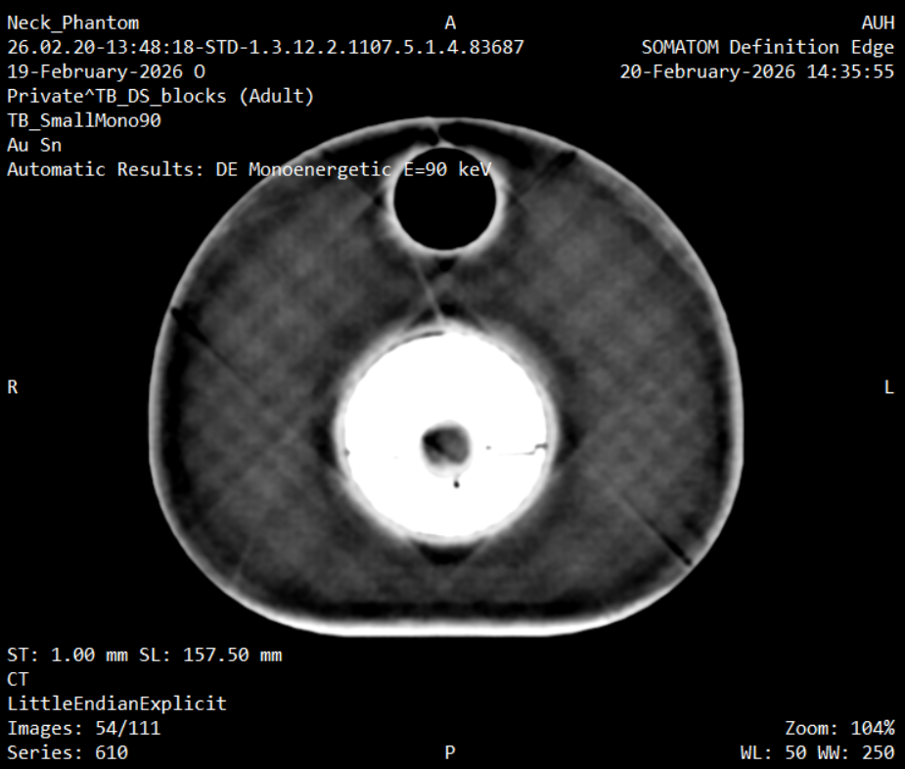
STUDY AIMS
Three parts
01
02
03
Selection of FDM filaments
Characterization for tissue equivalency
Design, 3D print and verification of the neck phantom
3 / 12

Slide 4
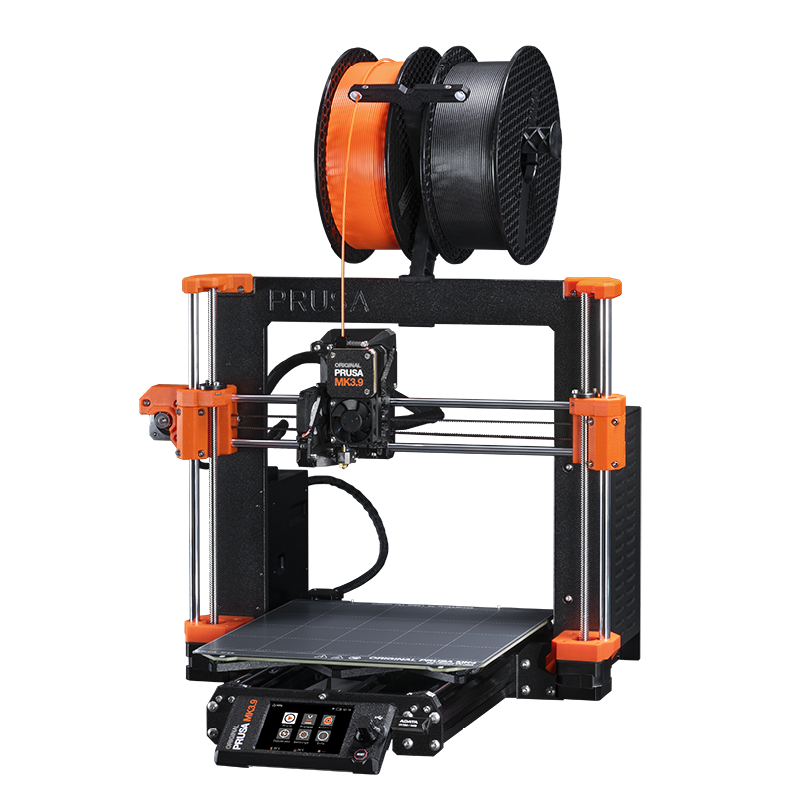
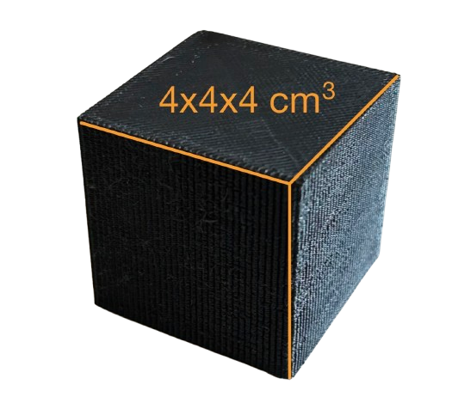
SELECTION
Filament selection
→ Cost-effectiveness
→ Long-term stability
→ Information from previous studies
→ No high-Z elements
PLA
PETG
Polylactic Acid
→ Soft Tissue Surrogate
→ Infill: 85%, 82%, 80%, 78%, 75%
Polyethylene Terephthalate Glycol
→ Bone Surrogate
→ Infill: 100%, 95%, 90%, 85%, 75%
→ Color Black
→ Lines pattern
Lustermans D et al. Phys Imaging Radiat Oncol 2024;32:100656 · Hariyanto AP et al. Jurnal ILMU DASAR 2022;23(2):87–92
4 / 12

Slide 5

CHARACTERIZATION
How to assess tissue equivalency
PLA
PETG
→
Radiochemical Equivalence
CT Char.
RED & Zeff
→ from CT imaging protocol
Macroscopic Attenuation:
RED and Zeff must align with the
tissue trendline in the RED–Zeff plane
CT number & SPR within
of reference tissue values
5% tolerance
Proton SPR
→ from SPR measurement
→
Tissue-Equivalent phantom
Bento M et al. Biomed. Phys. Eng. Express 2024;10:065005
5 / 12

Slide 6
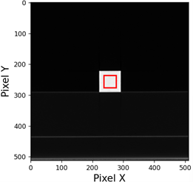
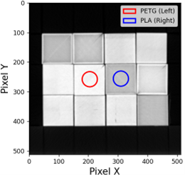
CT CHARACTERIZATION
CT Imaging protocol
Initial Screening
Optimised Acquisition
›
SECT (120kVp) + DECT dual-spiral (80 kVp and 140 kVp)
All infill % scanned
Maps: RED · Zeff · VMI 90 keV
→ Selected: PLA 75% & PETG 95%
DECT TwinBeam mode (120 kVp)
3×4 stacked cube configuration
Simulates neck scattering & beam hardening
→ Final tissue equivalency evaluation
Scanner: Siemens Somatom Edge CT (Siemens Healthineers)
6 / 12
6 / 12

Slide 7
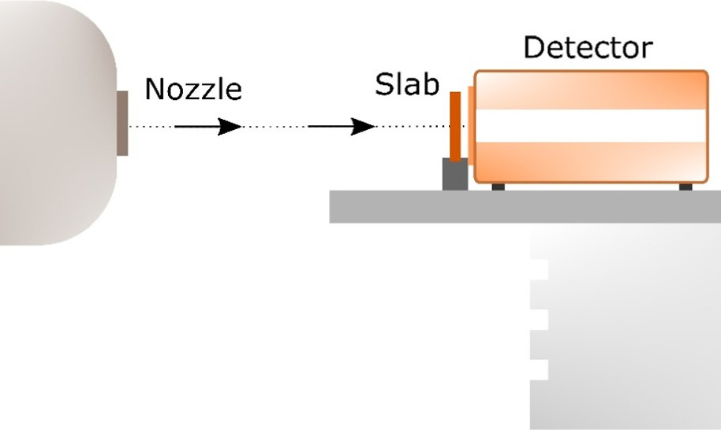
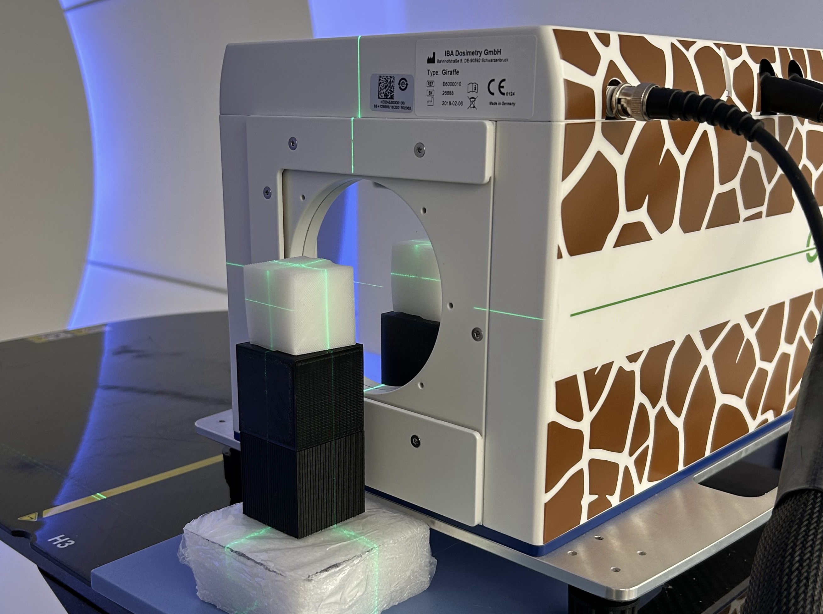
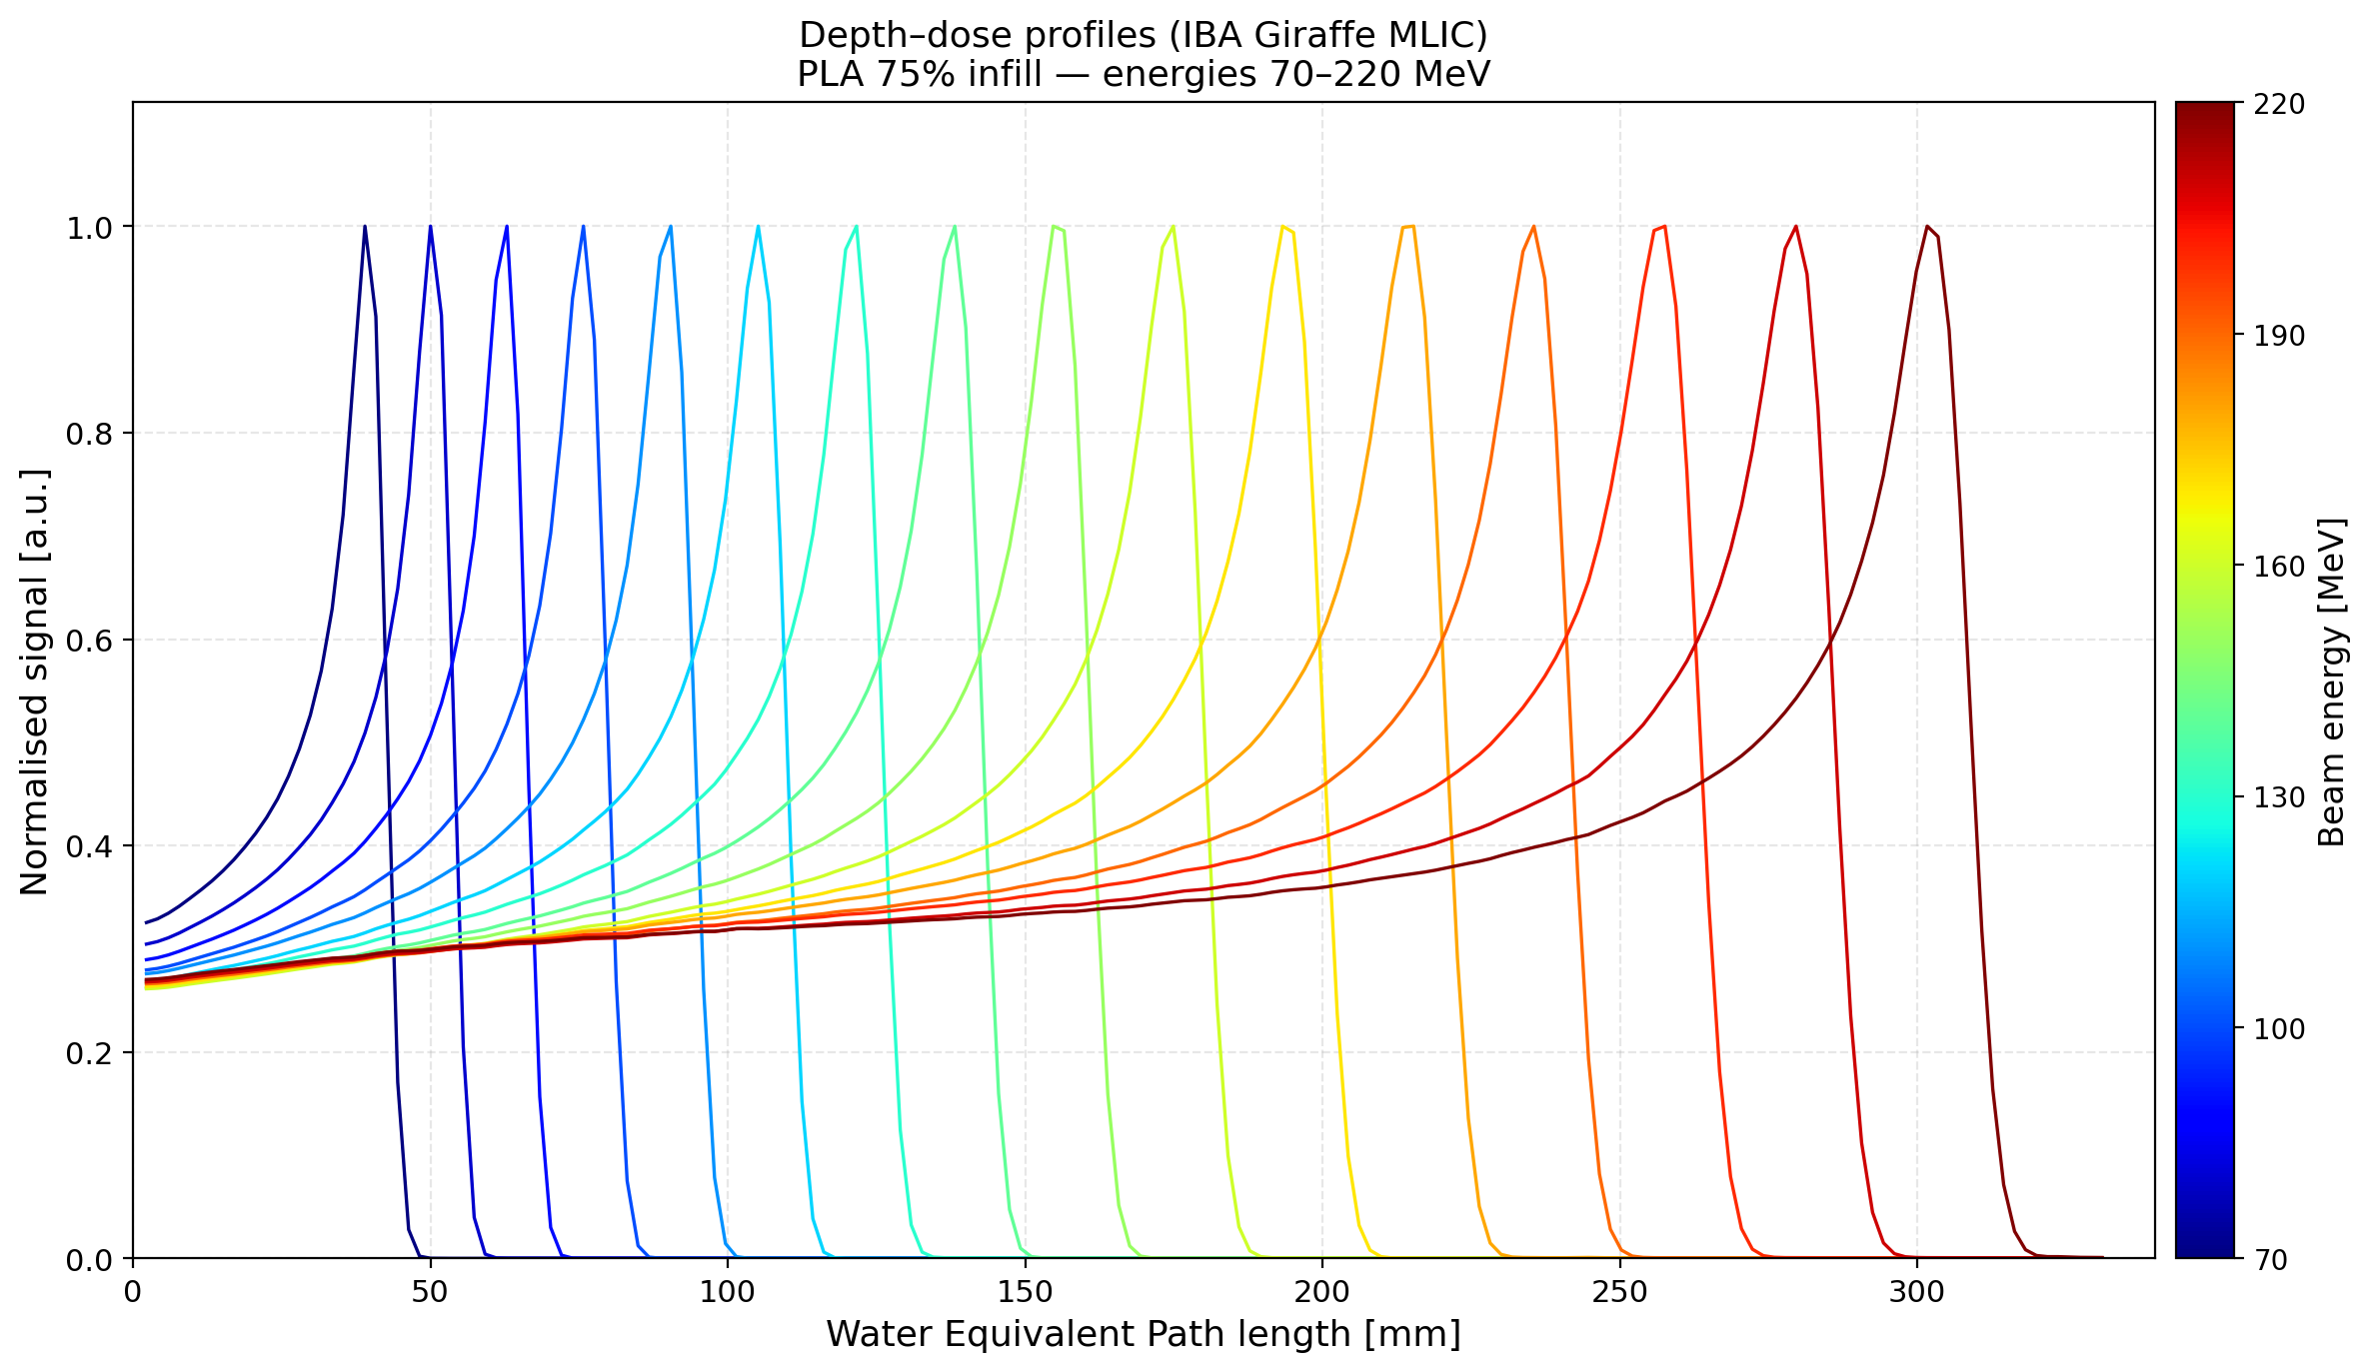
PROTON SPR
Stopping Power Ratio measurement
*
Facility:
Danish Centre for Particle Therapy, Aarhus
Instrument:
Giraffe MLIC (IBA Dosimetry)
Beam:
Monoenergetic proton pencil beams (from 70 MeV to 220 MeV)
Method:
Depth-dose profiles → Water Equivalent Thickness (WET)
SPR = WET / sample thickness
averaged over multiple beam energies
* Adapted from Bento M et al. Biomed. Phys. Eng. Express 2024;10:065005
7 / 12

Slide 8
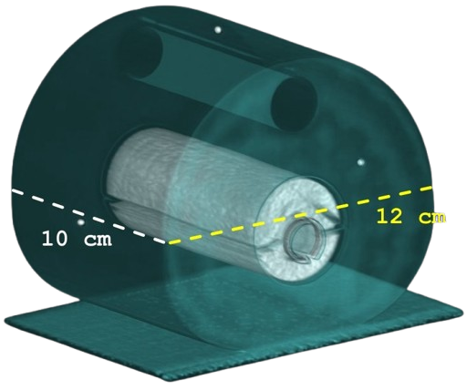

PHANTOM DESIGN
Neck phantom design
Key Design Features
Three interlocking components
Easy blind-extraction for OSL film
Film wraps around spinal cord geometry → 2.5D dose + possible future LET map
PLA 75% Soft Tissue
PETG 95% Bone
Spinal Cord
Trachea (air)
Pineckhio
OSL Film Slot
8 / 12

Slide 9
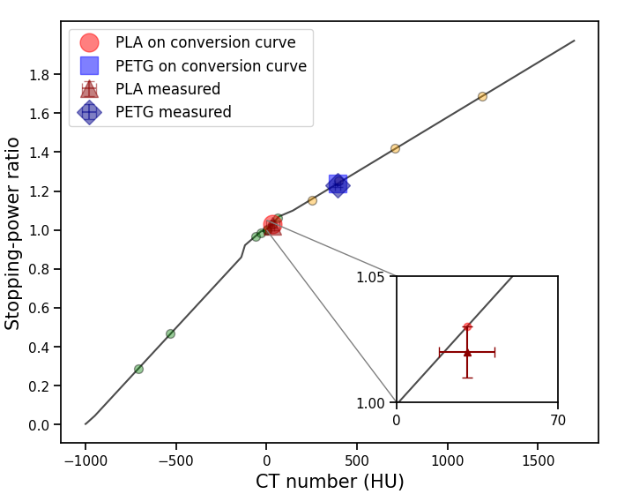
RESULTS: CT & SPR
Material characterization results
30 HU
PLA 75% CT Number
1.02
PLA 75% SPR
✓ Both materials within 5% tolerance: compatible with proton therapy TPS workflows
392 HU
PETG 95% CT Number
1.23
PETG 95% SPR
9 / 12

Slide 10
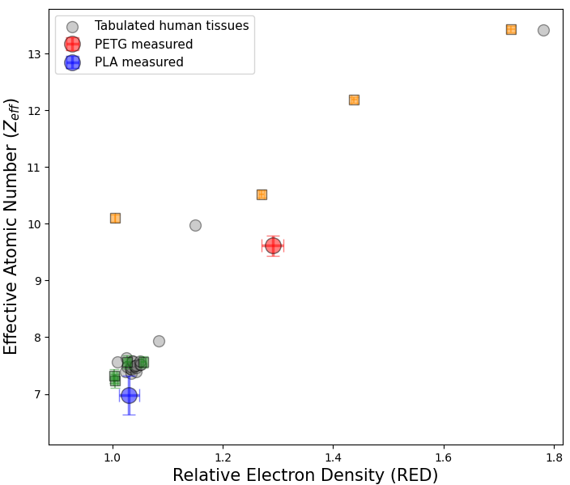
RESULTS: ZEFF & RED
Radiochemical equivalency analysis
✓ RED Values
Good agreement with reference tissue values: physical density well reproduced.
⚠ Zeff Values
Noticeable deviations: PLA/PETG do not replicate biological elemental composition exactly.
Known limitation of this study.
Woodard HQ, White DR. Brit J Radiol 1986;59(708):1209–1218
10 / 12

Slide 11
RESULTS: ASSEMBLED PHANTOM
Full phantom CT numbers
CT Numbers: Cubes → Phantom
PLA
Test cubes: 30 HU
Phantom: −9 HU
PETG
Test cubes: 392 HU
Phantom: 374 HU
Rastogi P et al. 3D Print Biomed Eng 2020, pp. 43–68
11 / 12

Slide 12

Conclusions
1
FDM 3D printing is a cost-effective route to anthropomorphic QA phantoms, no special equipment needed
2
PLA 75% and PETG 95% meet the 5% SPR tolerance → directly compatible with proton TPS workflows
3
Phantom designed for OSL-based 2.5D dose verification around the spinal cord
-
Zeff deviations
-
Phantom CT values ≠ test cubes CT values
Future Directions
Our Pinocchio
is not yet a real boy.
But he's getting very close.
→ Phantom application for patient-specific measurements
→ Novel filaments to improve Zeff equivalency
→ LET measurements with OSL film
Thank you · elena.fanelli@mail.polimi.it
12 / 12

