Slide 1

Development of a 3D Electronic Array for Radiotherapy Quality Assurance
Dante E. Roa, PhD

Slide 2
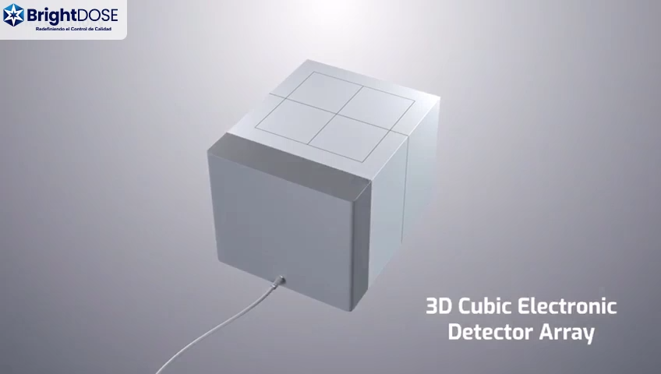

Slide 3
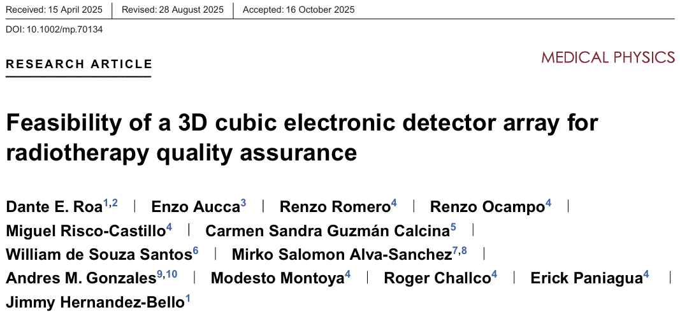

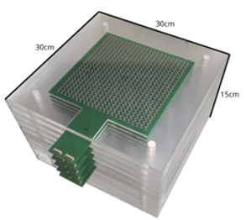
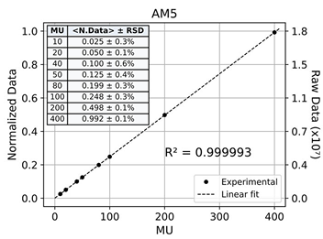
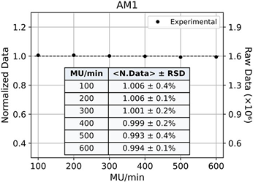
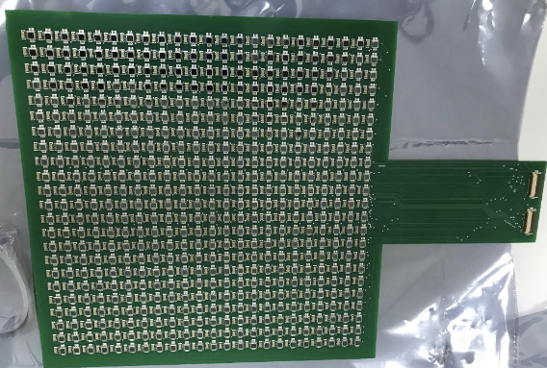
Prototype v.3.0
QR-Code
Linearity
Dose Rate

Slide 4
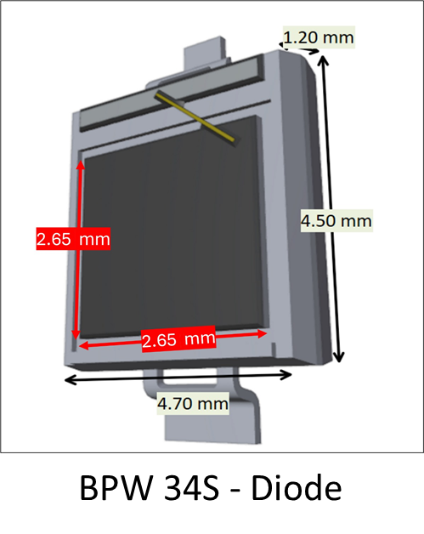
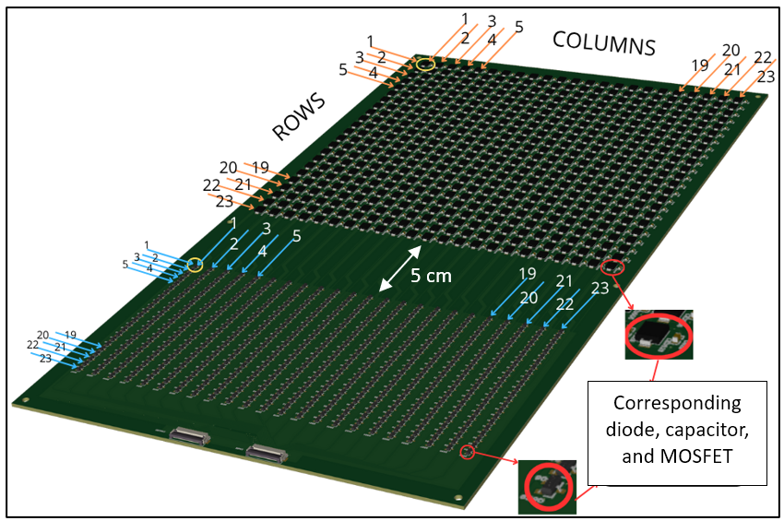
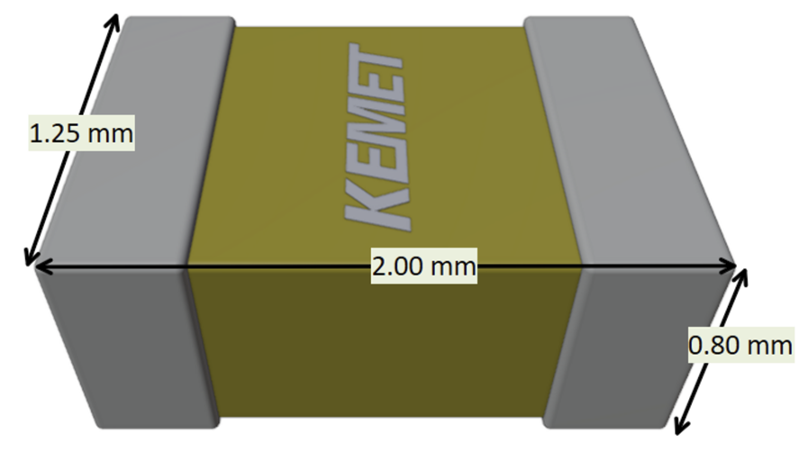
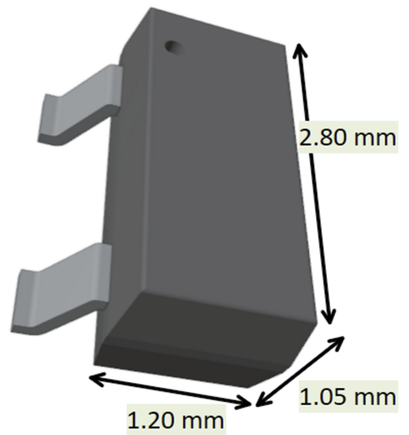
Prototype v.4.5 – Active Matrix (AM) Design
Sensitive Area – 18 x 18 cm²
KEMET Capacitor
Pixel = Diode+Capacitor+MOSFET
MOSFET

Slide 5
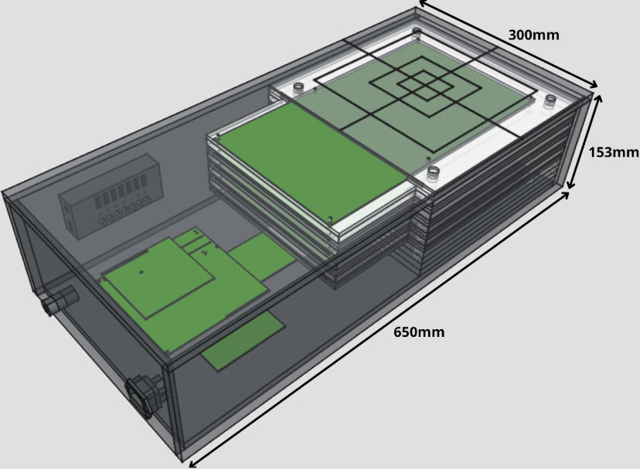
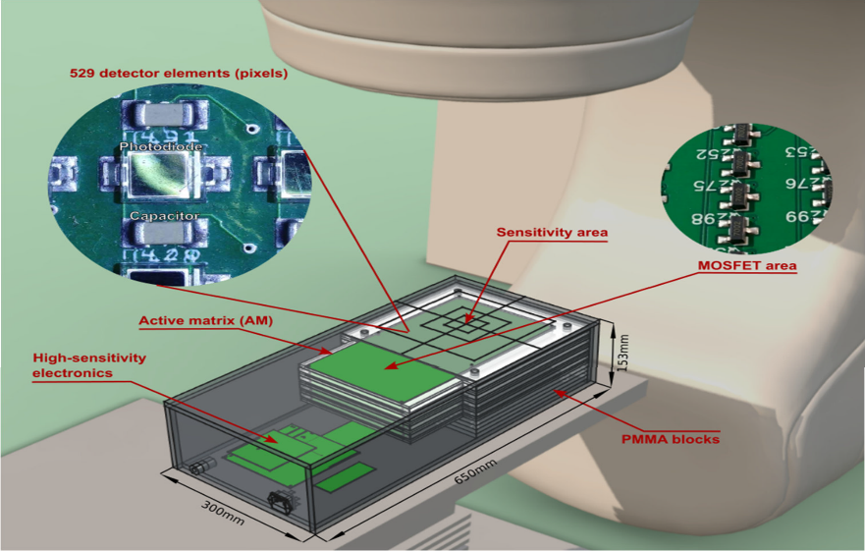
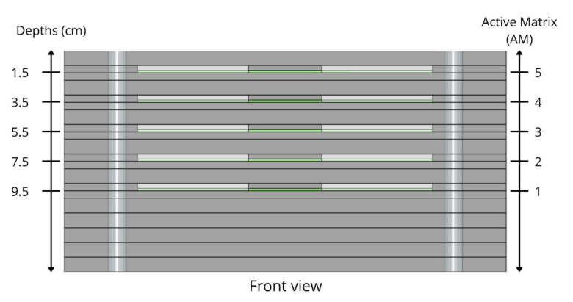
Prototype v.4.5

Slide 6
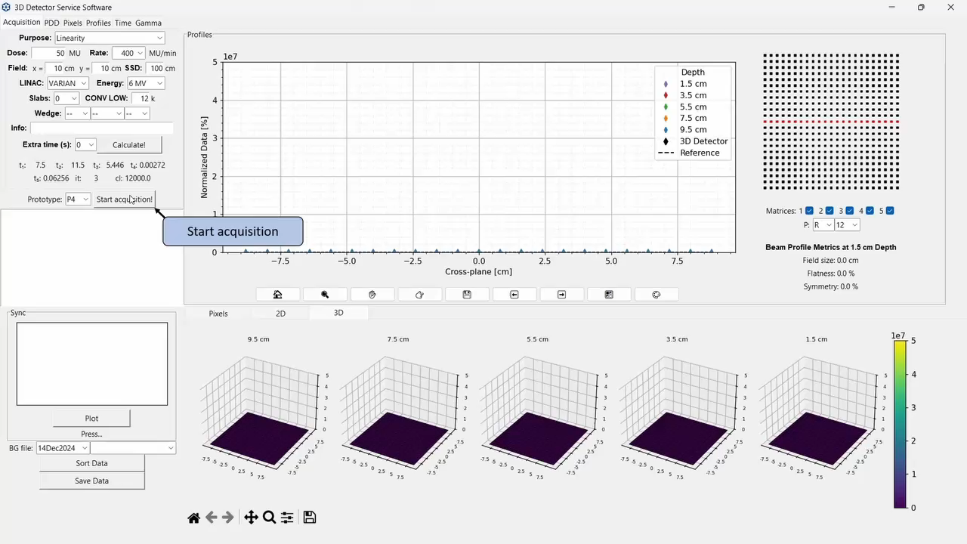
Prototype v.4.5 – Service (Diagnostics) Software
Configurable data acquisition
Horizontal and vertical profile visualization (off-axis)
Pixel signal analysis
Visualization as a function of time (instantaneous and cumulative)

Slide 7
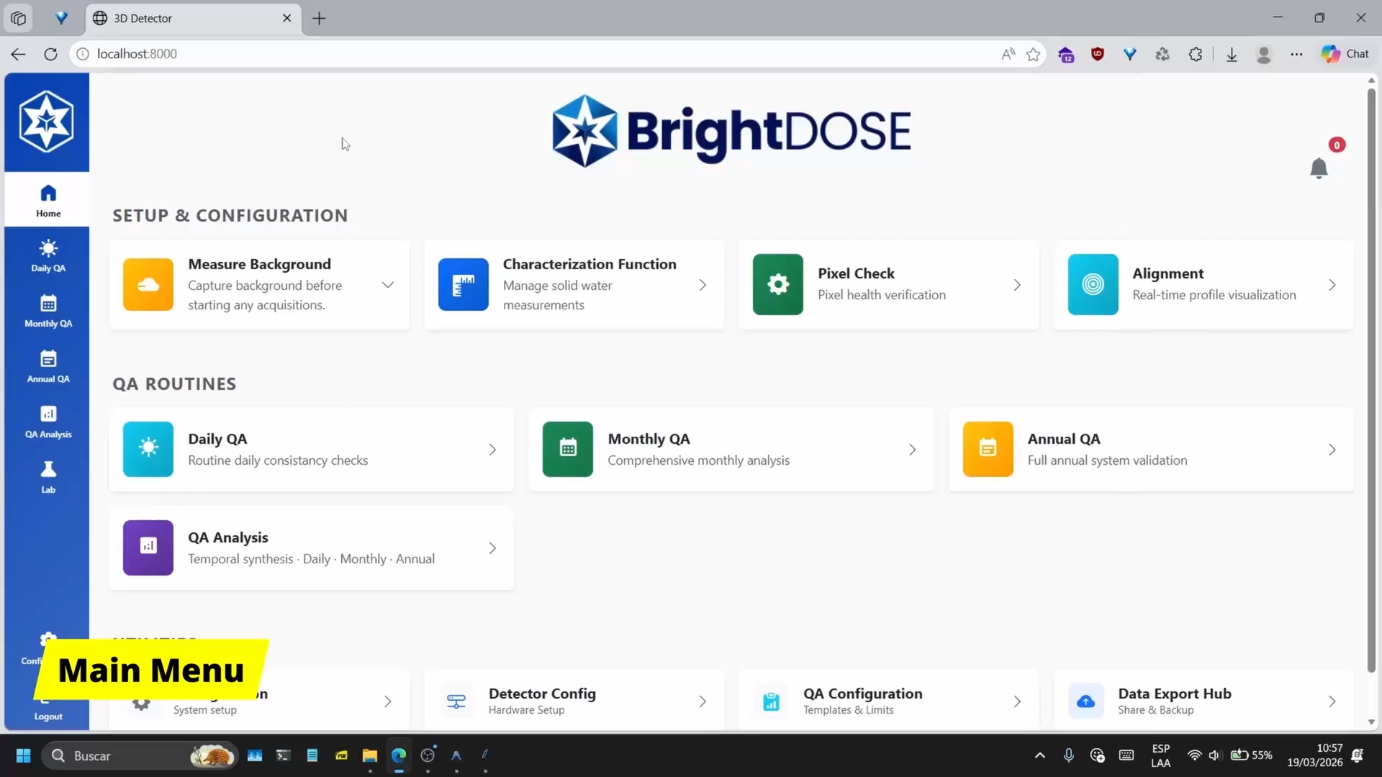
Prototype v.4.5 – Web-based User Software

Slide 8
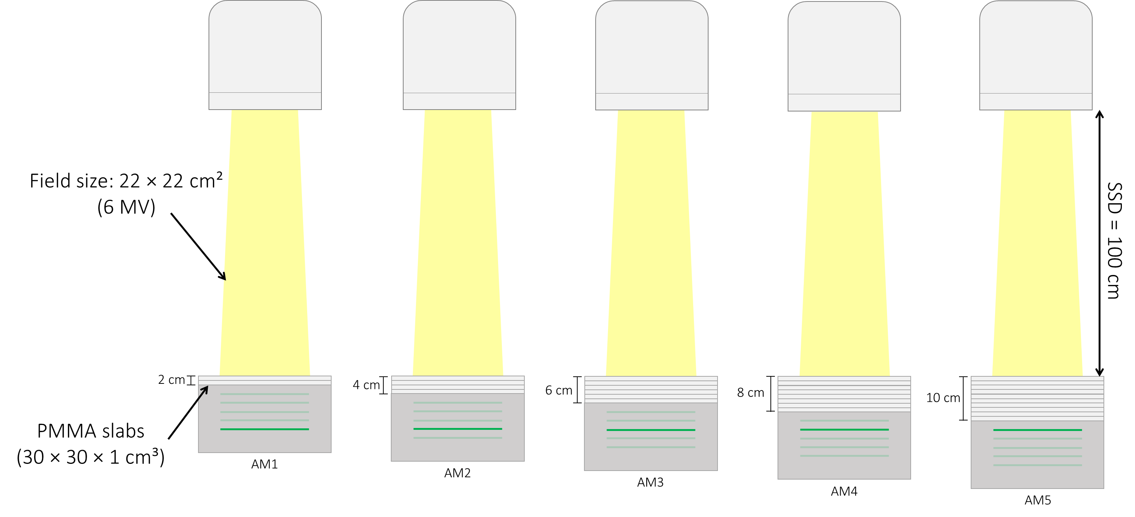
Prototype v.4.5 – Characterization Factor - SETUP
Linac
SDD = 111.5 cm
Each setup is designed to determine the correction factors for each pixel in the active matrix, thereby homogenizing the detector response.

Slide 9
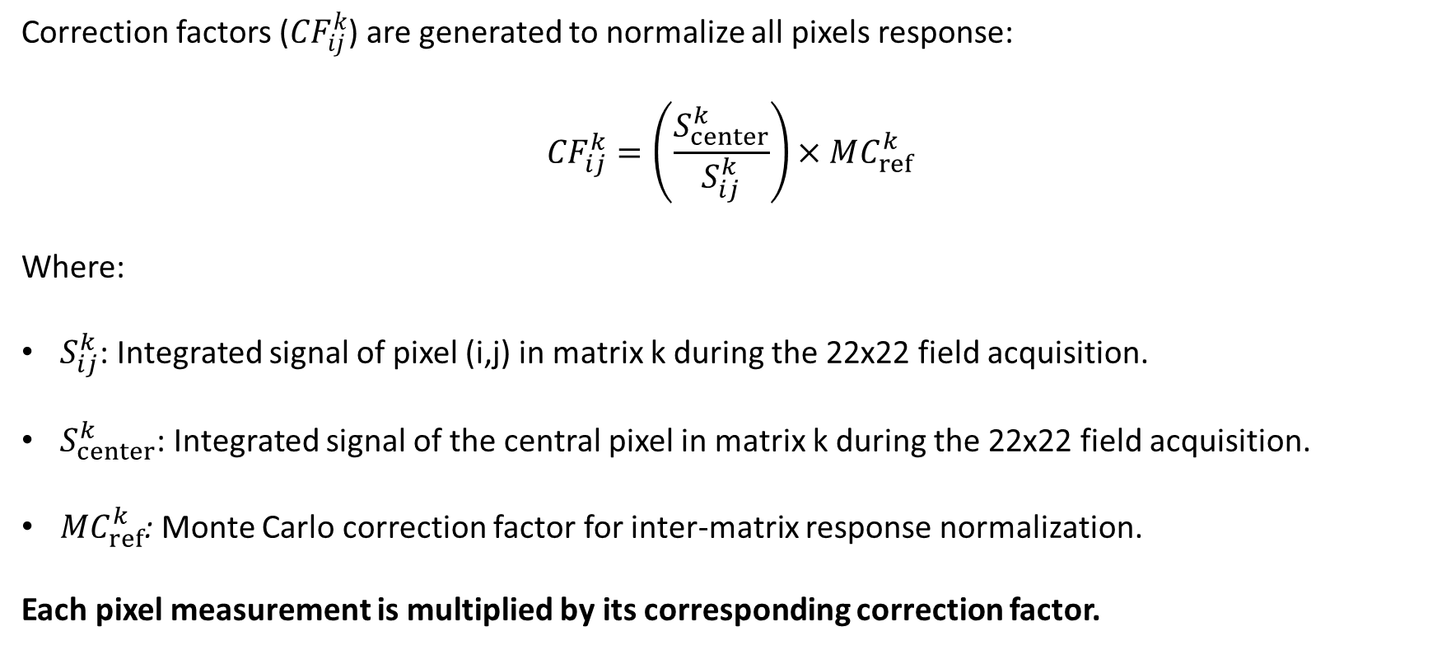
Prototype v.4.5 – Characterization Factor
Correction factors (${CF}_{ij}^{k}$) are generated to normalize all pixels response:
$${CF}_{ij}^{k}=\left(\frac{S_{center}^{k}}{S_{ij}^{k}}\right)×MC_{ref}^{k}$$
Where:
$S_{ij}^{k}$: Integrated signal of pixel (i,j) in matrix k during the 22x22 field acquisition.
$S_{center}^{k}$: Integrated signal of the central pixel in matrix k during the 22x22 field acquisition.
$MC_{ref}^{k}$: Monte Carlo correction factor for inter-matrix response normalization.
Each pixel measurement is multiplied by its corresponding correction factor.
Greer PB, Popescu CC. Amorphous silicon EPID calibration for dosimetric applications: comparison of a method based on Monte Carlo prediction of response with existing techniques. Medical Physics, 2006.

Slide 10
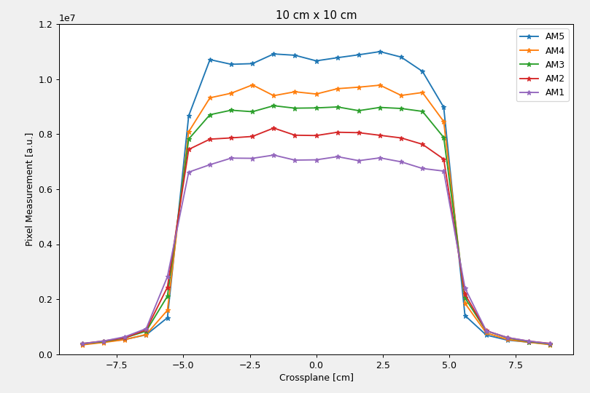
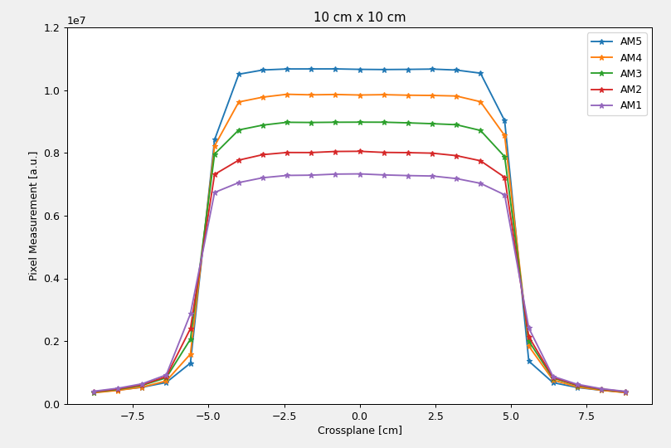
Prototype v.4.5 – Characterization Factor – DATA/RESULTS
Application of correction factors
Elekta Infinity 10×10 cm² 50 MU 300 MU/min 6 MV

Slide 11
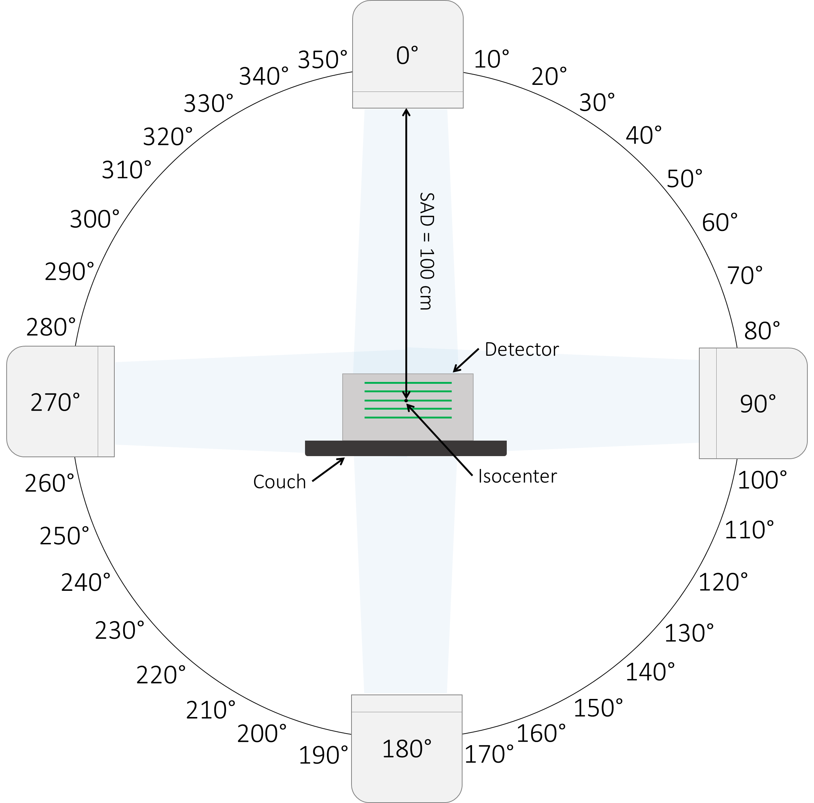
Prototype v.4.5 – Angular Dependence – SETUP Measurements
Elekta Infinity:
6 MV,
22×22 cm²,
50 MU,
300 MU/min

Slide 12
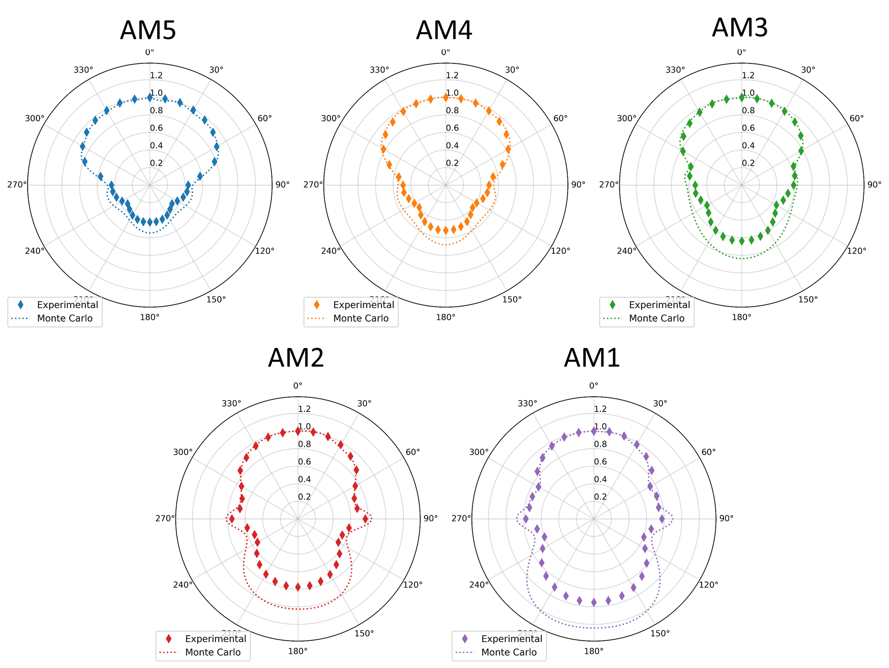
Prototype v.4.5 – Angular Dependence – DATA/RESULTS

Slide 13
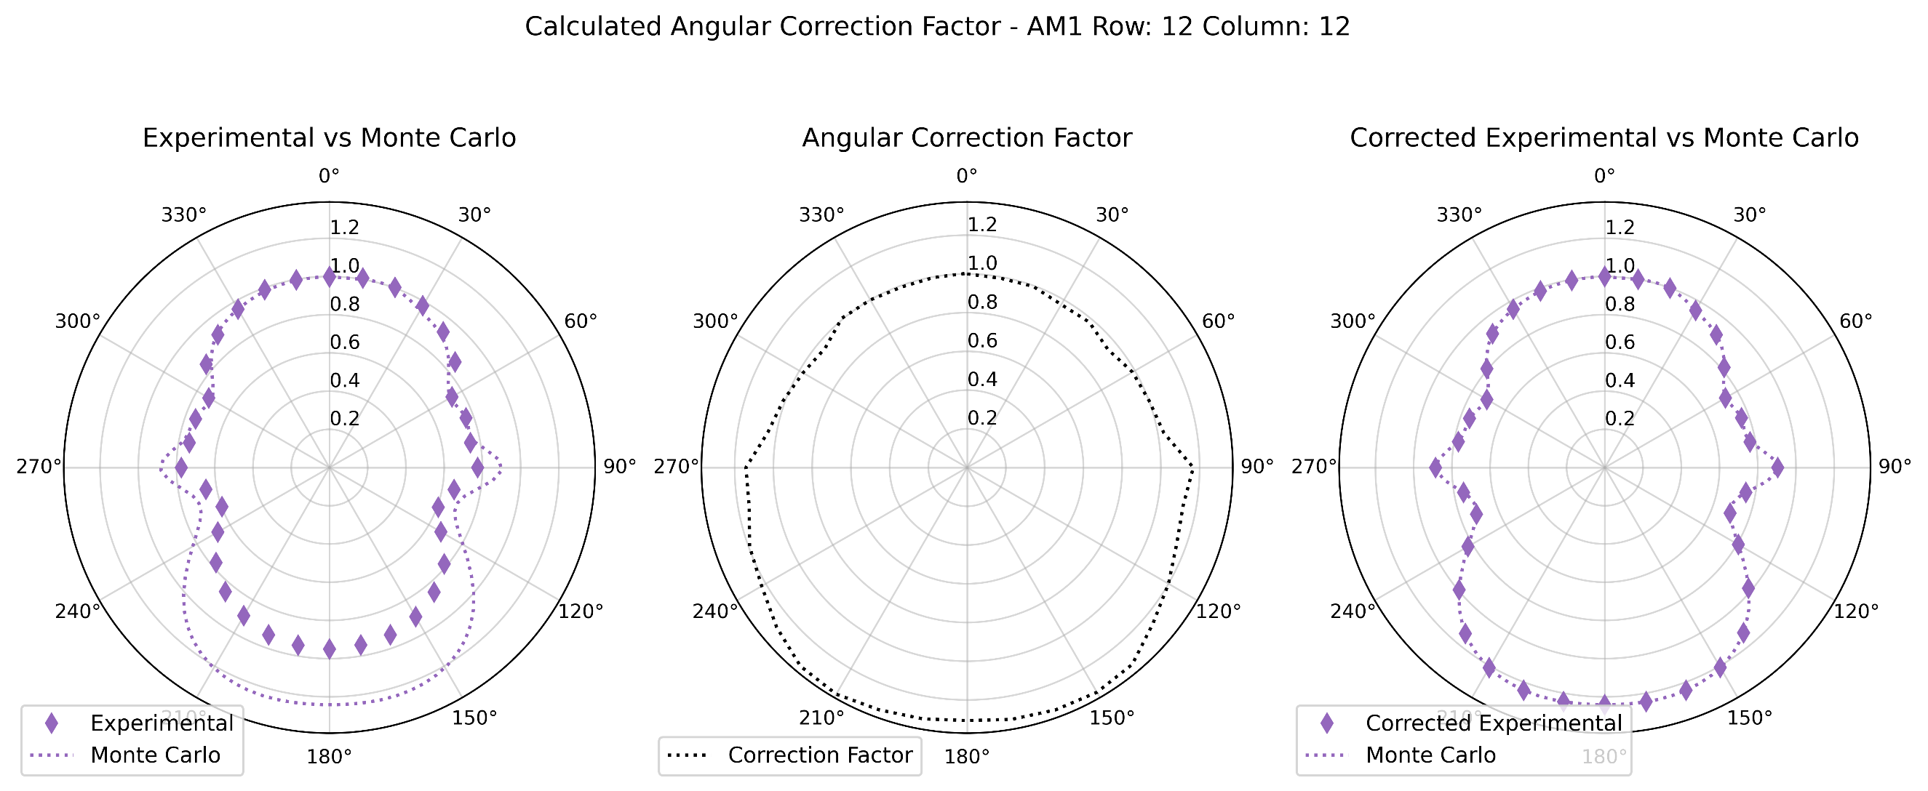
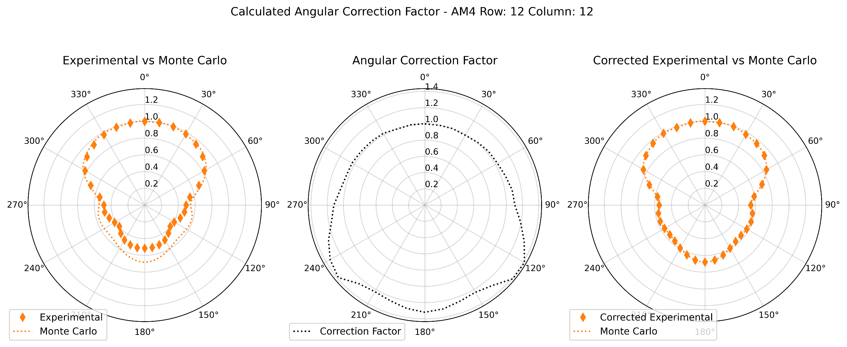
Prototype v.4.5 – Angular Dependence – continues

Slide 14
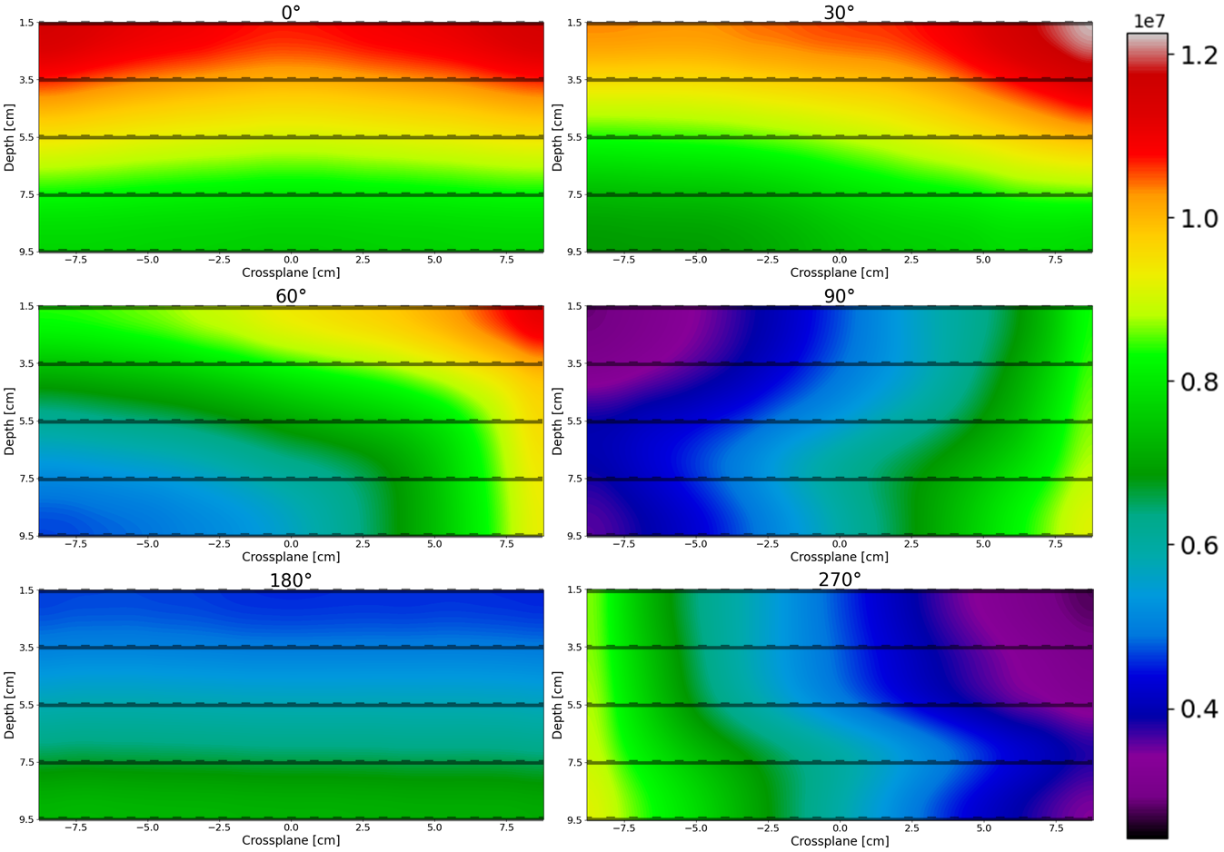
Prototype v.4.5 – Angular Dependence – DATA/RESULTS
Elekta Infinity:
6 MV,
22×22 cm²,
50 MU,
300 MU/min

Slide 15
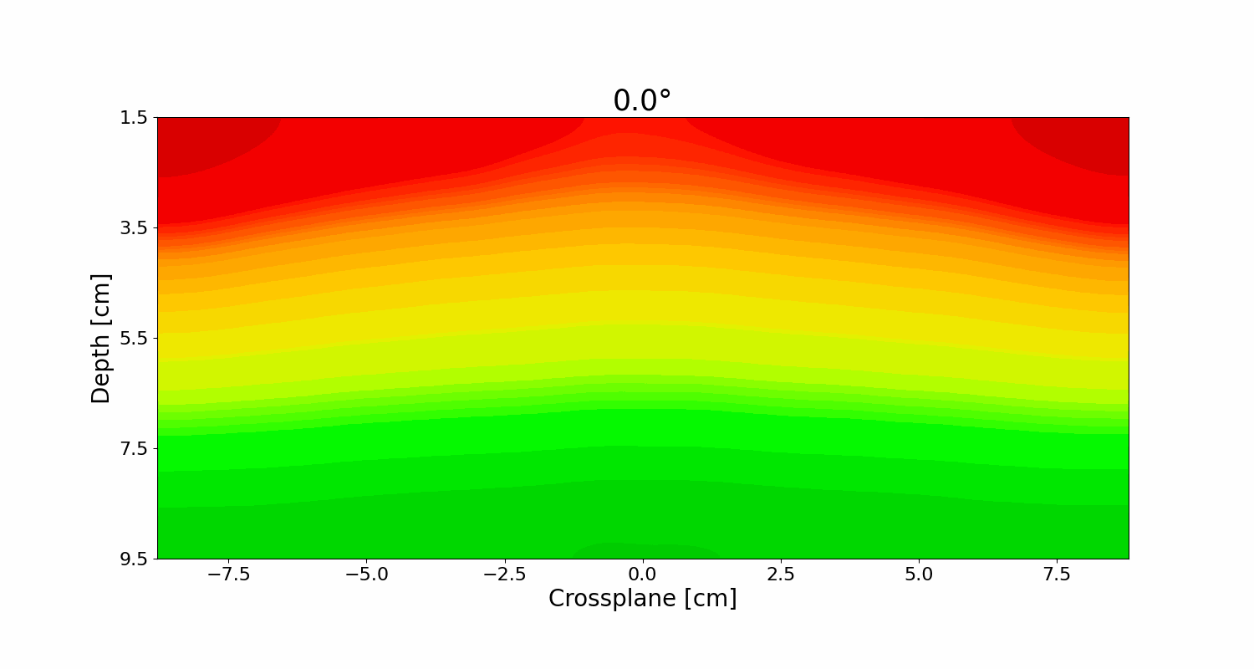
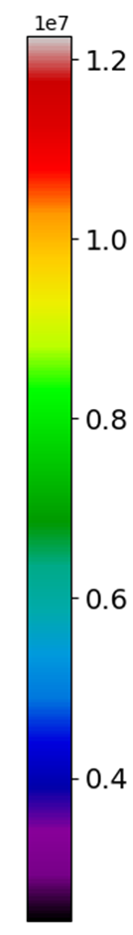

Prototype v.4.5 – Angular Dependence – DATA/RESULTS
Elekta Infinity:
6 MV,
22×22 cm²,
50 MU,
300 MU/min

Slide 16
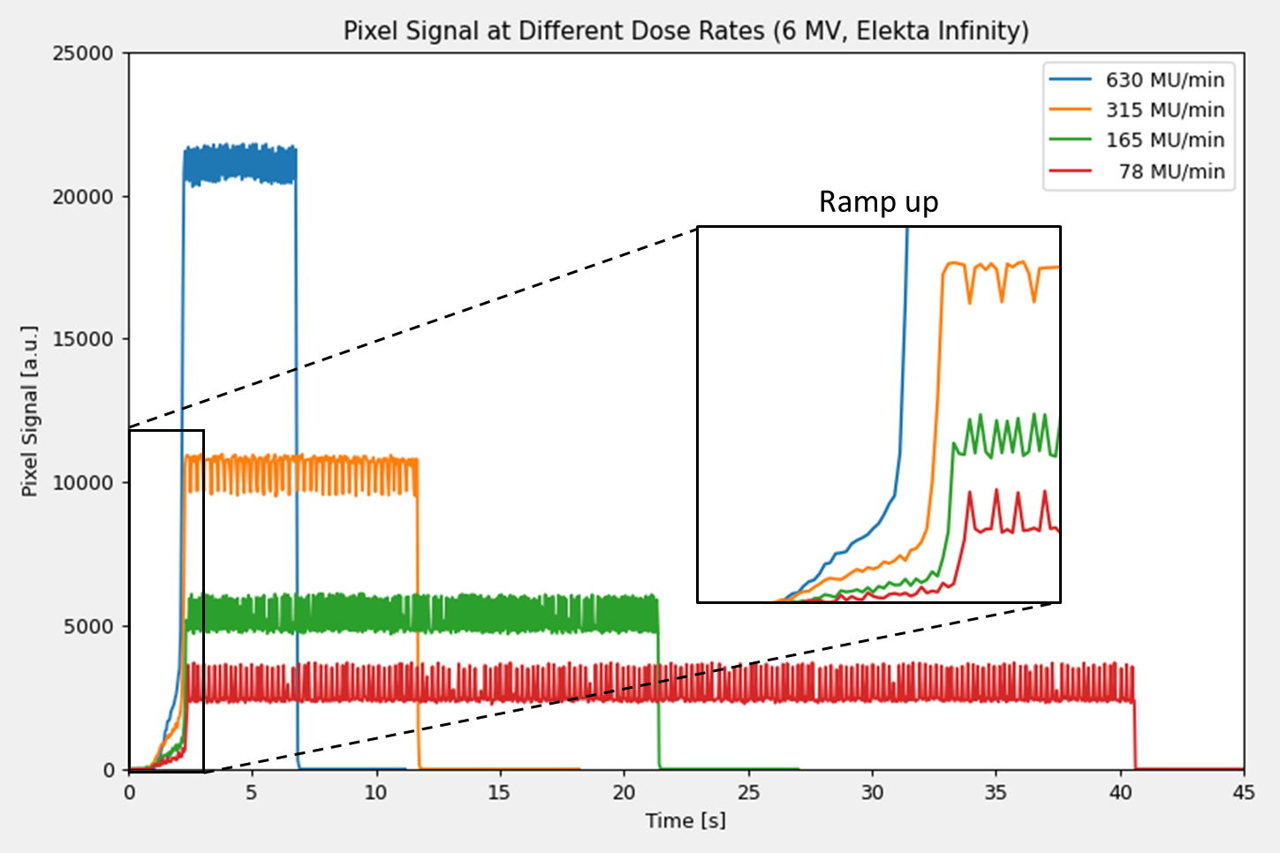
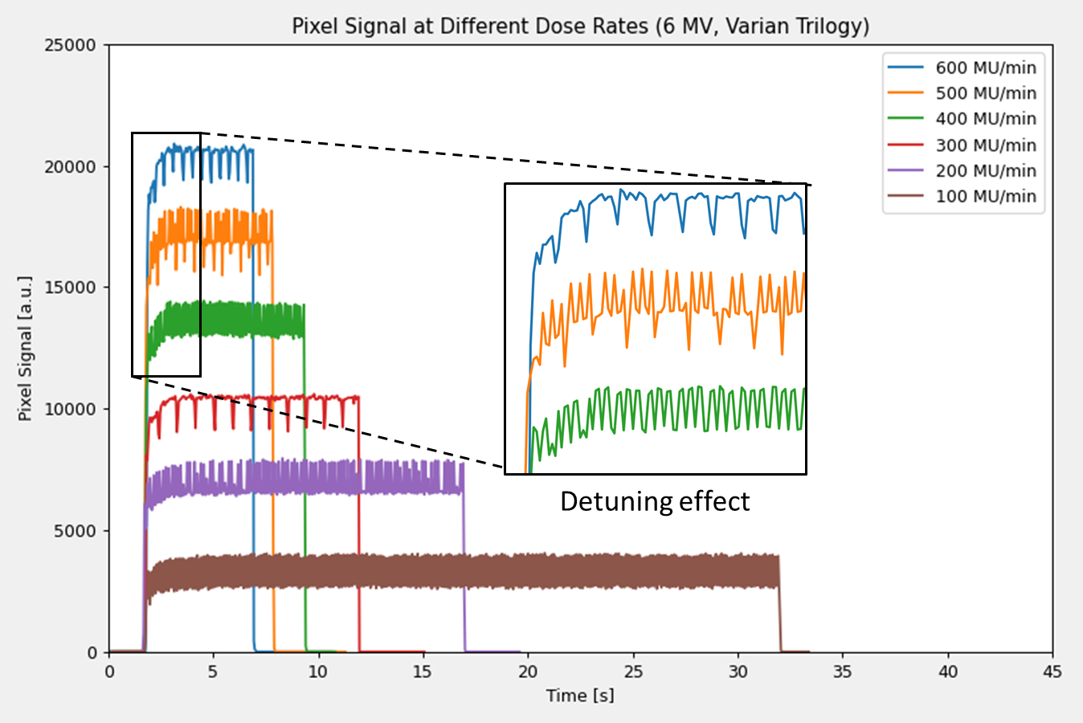
Prototype v.4.5 – Beam Pulse Quality – DATA/RESULTS
Elekta Infinity
Varian Trilogy
Pixel signal increases with higher dose rate.
Specific beam pulse patterns can be identified.
Beam ramp-up and de-tuning can be measured.

Slide 17
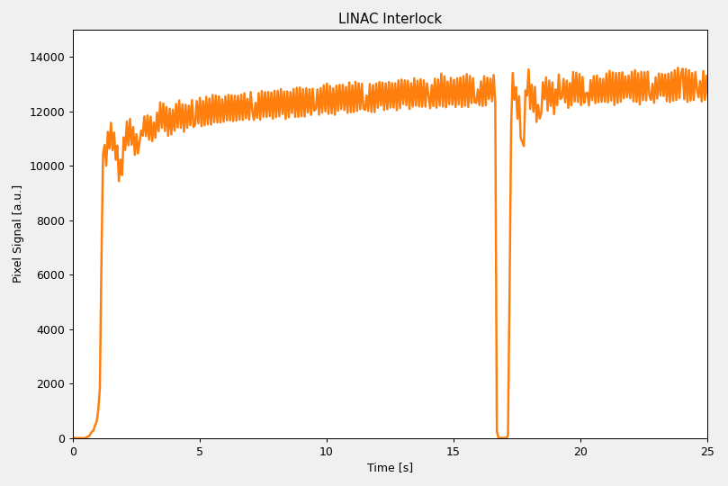
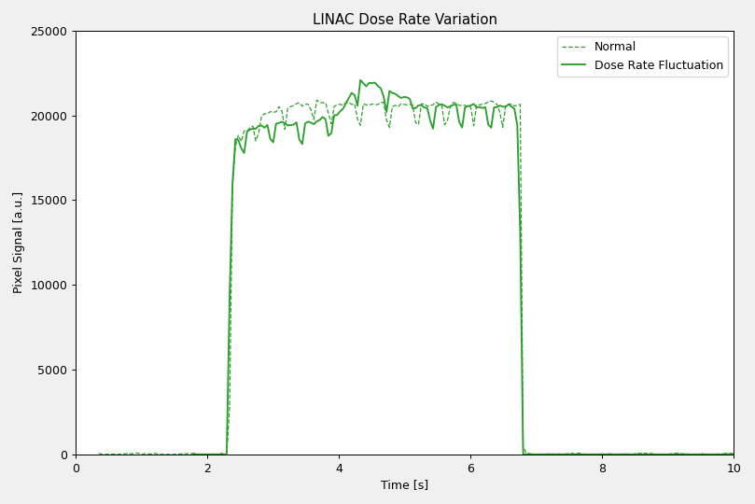
Prototype v.4.5 – Beam Pulse Quality – DATA/RESULTS #2
Interlock
Interlocks, slight dose rate differences, and other anomalies can be detected.

Slide 18
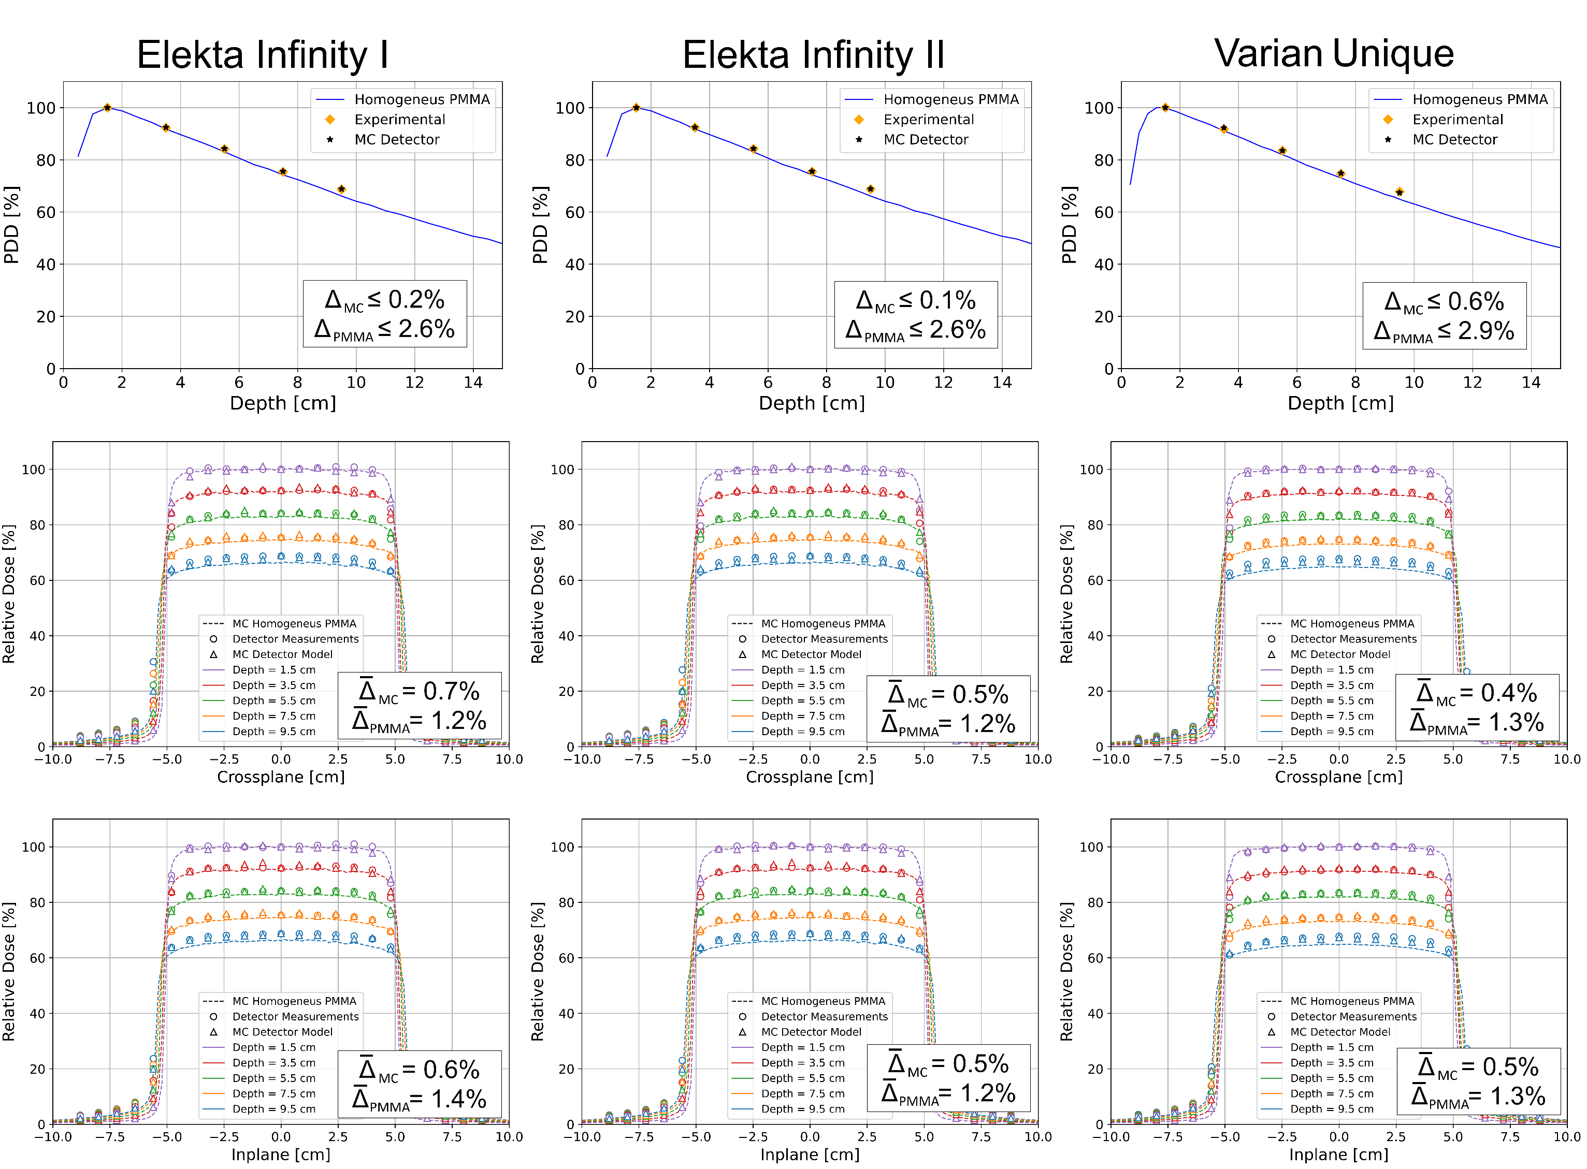
Prototype v.4.5 – PDD & Profile Results
E = 6 MV,
FS = 10 x 10 cm

Slide 19
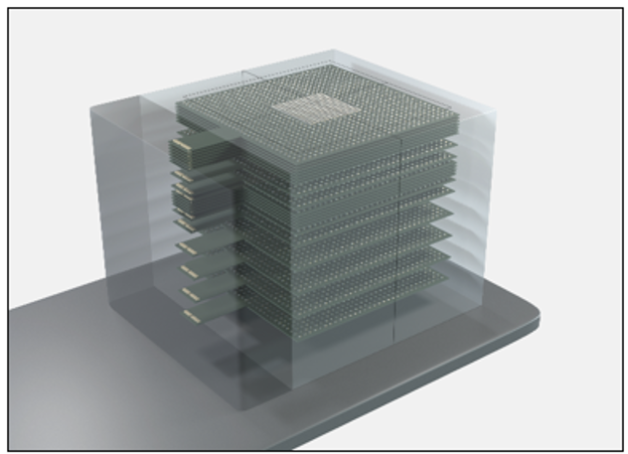
Prototype v.X.X – Towards an Advanced Clinical Model

Slide 20
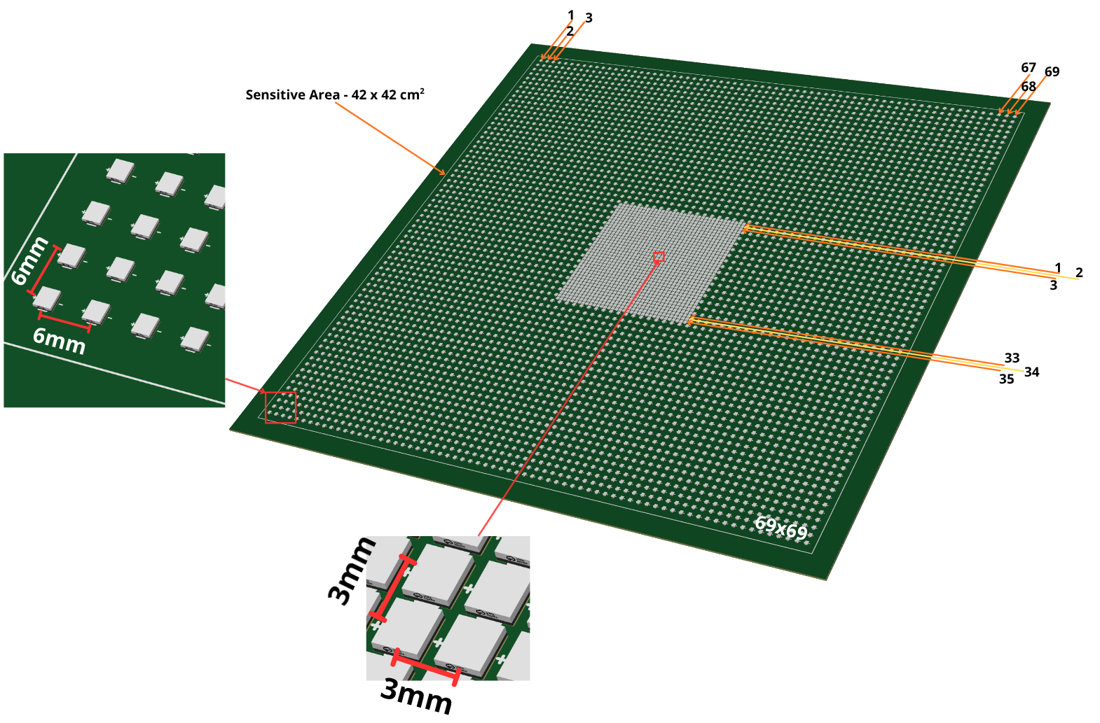
Prototype v.X.X – High Spatial Resolution AM Schematic
Sensitive Area – 42 x 42 cm²

Slide 21
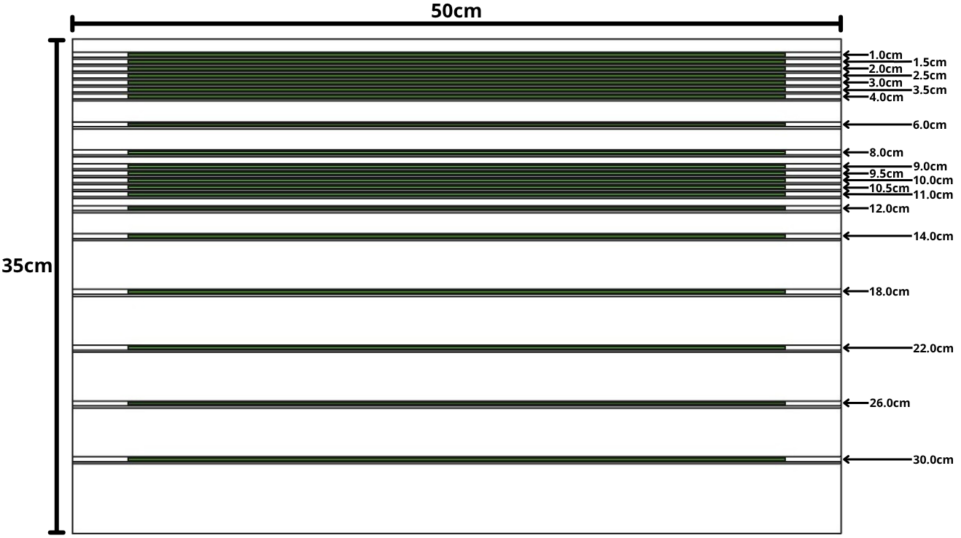
Prototype v.X.X – Vertical High Spatial Resolution AM Schematic
5 mm spatial resolution
5 mm spatial resolution

Slide 22
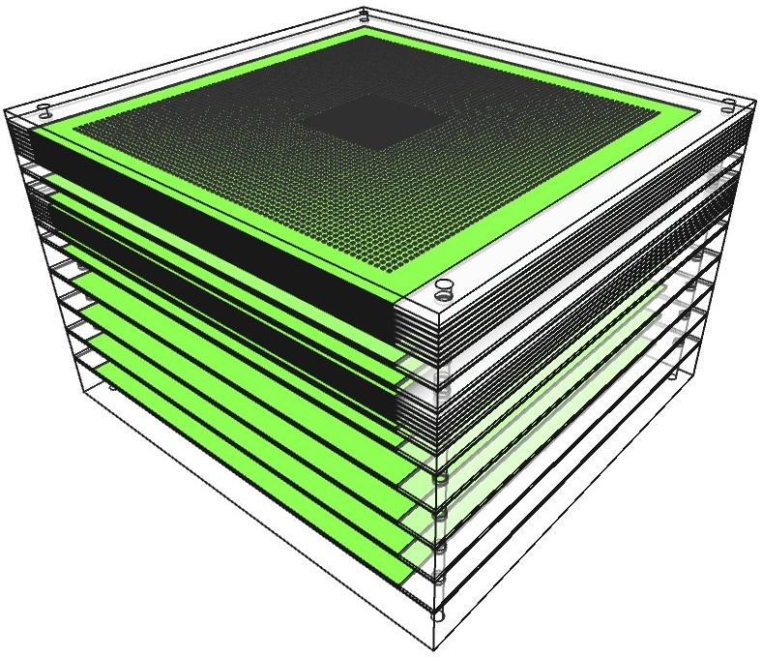
Prototype v.X.X – High Spatial Resolution AM Schematic

Slide 23
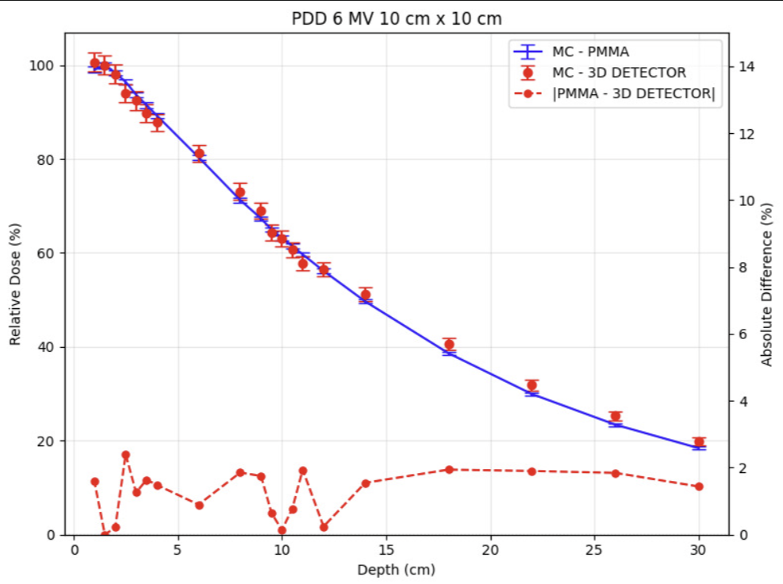
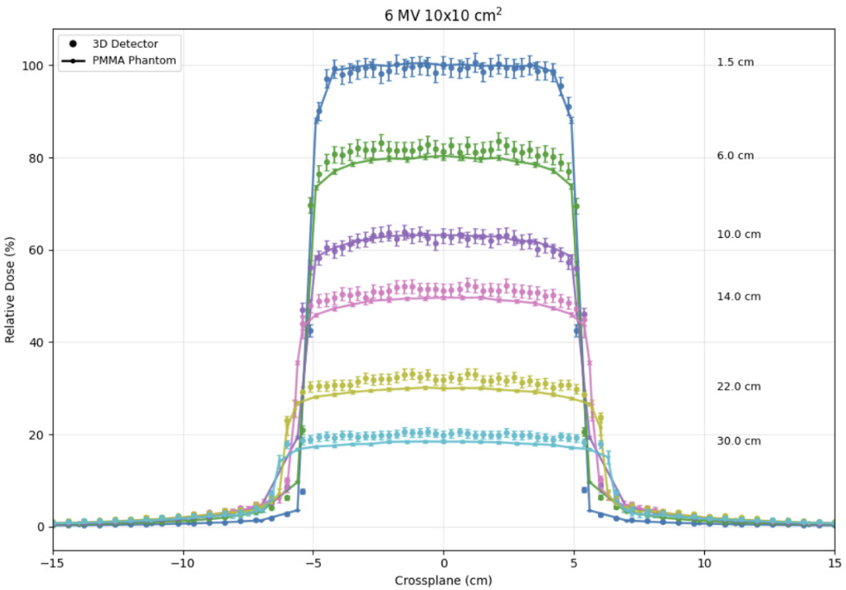
Prototype v.X.X – MC Data
1.5 cm - 1.8% diff
6.0 cm – 3.6% diff
10.0 cm – 1.7% diff
14.0 cm – 3.3% diff
22.0 cm – 3.1% diff
30.0 cm – 2.3% diff

Slide 24
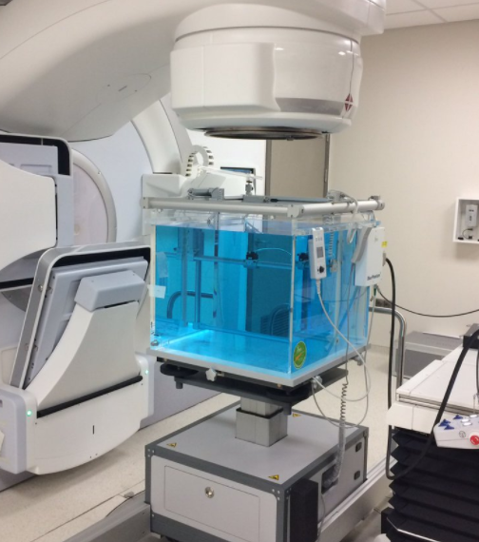
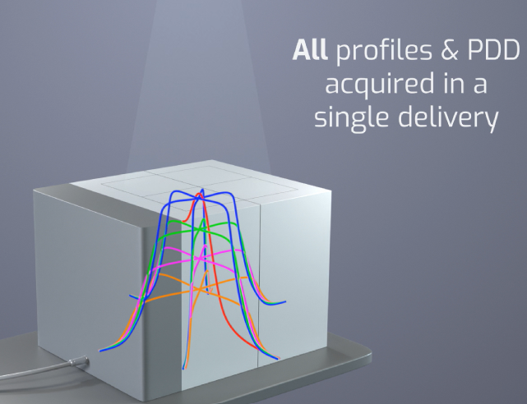
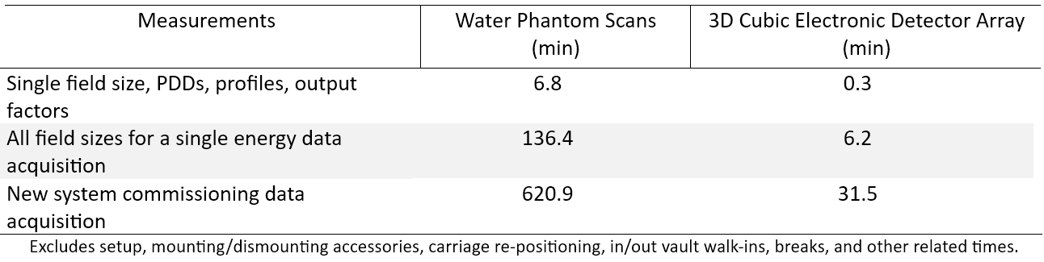
Water Scans versus 3D Detector Commissioning Data Acquisition Times
All Commissioning Data could be acquired in days

Slide 25
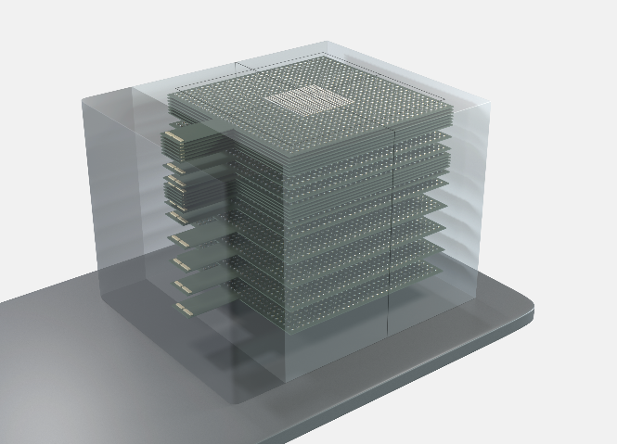
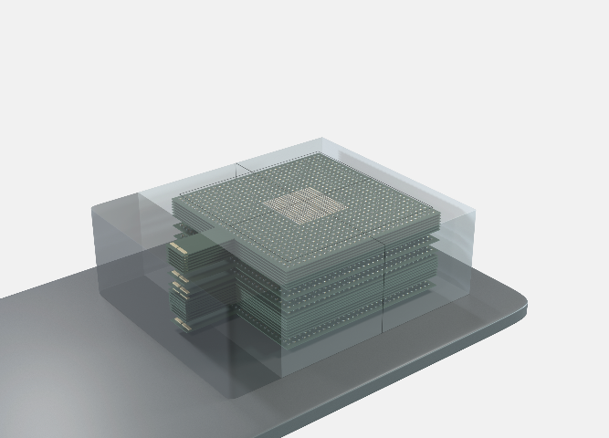
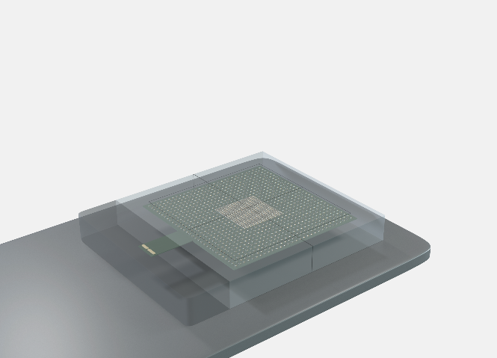
3D Electronic Detector Array Modular Design – Three different applications in ONE
Full Assembly – 20 layers
Linac commissioning
Monthly QA
Patient-specific plan QA, if needed
Partial Assembly – 14 layers
Patient-specific plan QA with 3D data acquisition
Basic Assembly – 1 layer
Daily linac QA
~ 188 lbs (85 Kg)
~ 74 lbs (34 Kg)
~ 32 lbs (15 Kg)

Slide 26
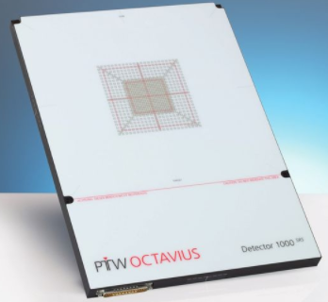
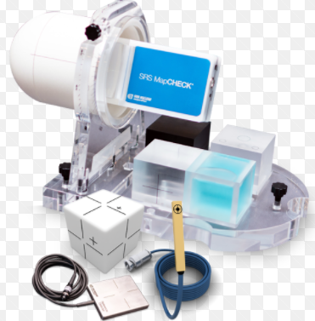
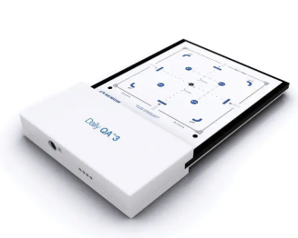
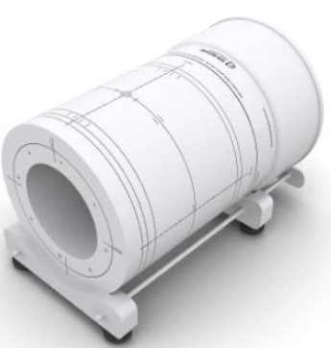
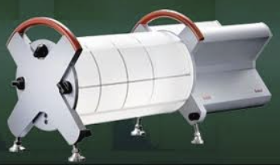
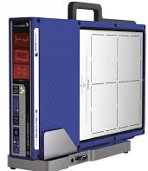
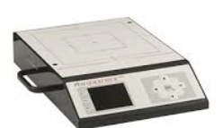

$70K - $100K
Commissioning & Monthly
Patient Specific QA
Daily Linac QA
$50K - $70K*
$10K - $20K*
$100K - $120K*
~$43K*
*Separate purchase

Slide 27
Conclusion
Measured and reliable 3D dosimetric data with an electronic detector array is possible.
Linearity, dose rate, PDD, and profile results support this statement
The detector has sufficient temporal resolution to evaluate beam pulse quality from different linac vendors. Useful in beam diagnostics and an alert to the user.
Can provide 3D dose distribution of patient-specific treatment plan QA minutes after irradiation.
Full implementation of this technology could lead to significant time-savings in linac commissioning and monthly QA and cost savings in PSQA and Daily Linac QA.

Slide 28


The Team
Dante E. Roa, PhD ^{1,2*}, Miguel Risco-Castillo^{1,4}, Renzo Romero^{1,4}. Enzo Aucca^{1,3}, Renzo Ocampo^{1,4}, William de Souza Santos, PhD⁶, Mirko Salomón Alva Sánchez, PhD⁷, Carmen Sandra Guzmán Calcina, PhD^{1,5}, Modesto Montoya, PhD⁴, Roger Challco, EE^{1,4}, Gabriel López^{1,3}, Erick Paniagua, EE^{4,8}
1 BrightDOSE USA LLC, Mission Viejo, CA, USA
2 Leonard Cancer Institute, Mission Viejo, CA, USA
3 Ponti icia Universidad Católica del Perú , Electronic Engineering Department, Lima, Perú
4 Universidad Nacional de Ingenierı́a, Facultad de Ciencias, Lima, Perú
5 Instituto de Investigaciones en Ciencias Biomédicas, Universidad Ricardo Palma, Lima, Perú
6 Departamento de Fı́sica, Universidade Federal de Sergipe, São Cristóvão, Brasil
7 Federal University of Health Sciences of Porto Alegre, Porto Alegre, Brazil
8 Universidad Nacional de San Antonio Abad del Cusco, Electronic Engineering Department, Cusco, Perú
*E-mail: danteeroa@gmail.com

Slide 29


Questions?
Visible Light Tests with model v.4.5

