Slide 1

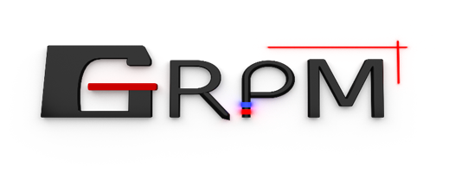



Study of Attenuation Correction
in Sparse-View Tomographic
Dose Reconstruction with a Static Multi-Stack Scintillating Fiber Detector
IC3DDose 2026
14th International Conference
on 3D Dosimetry
Caen, France · 15–17 June 2026
Sajjad Ahmad Khan
Supervisors: Luc Beaulieu and Louis Archambault
Département de physique, Université Laval, Québec, Canada
Centre de recherche du CHU de Québec–Université Laval
Notes:
Good morning everyone. I am Sajjad Ahmad Khan from Université Laval. Today I will present our work on attenuation correction for sparse-view tomographic dose reconstruction using a static multi-stack scintillating fiber detector. This is joint work with Professors Luc Beaulieu and Louis Archambault, carried out within the GRPM group and the CHU de Québec research centre.

Slide 2
BACKGROUND
Motivation
🎯
Clinical Need
Modern radiotherapy (IMRT / VMAT) delivers complex, highly modulated dose distributions that must be verified before treatment. High-resolution 2D dosimetry confirms the delivered dose matches the plan — but radiochromic film is offline (needs post-irradiation scanning + calibration) and ion-chamber / diode arrays have coarse spatial resolution.
⚡
Fiber Advantage
Scintillating fibers offer near water-equivalence, real-time response, and fine spatial sampling — making them well-suited for tomographic dose reconstruction.
🔬
Our Goal
Eliminate mechanical rotation using a static multi-stack detector. The challenge: stacks sit at different depths, so depth-dependent attenuation must be corrected before reconstruction.
2
Notes:
Three points motivate this work. First, the clinical need: modern radiotherapy uses IMRT and VMAT to deliver complex, highly shaped dose distributions, and these must be verified before treatment to ensure they match the plan. High-resolution 2D dosimetry does this, but the standard tools fall short — radiochromic film is not real time and needs scanning after 24 hours of irradiation, while ion-chamber or diode arrays are real-time but have coarse spatial resolution. [click] Second, scintillating fibers are attractive: they are nearly water-equivalent, give real-time response, and sample finely — good for tomography. [click] Third, our goal is to remove mechanical rotation with a static multi-stack design, but because the stacks sit at different depths, depth-dependent attenuation must be corrected.

Slide 3
METHODS OVERVIEW
Study Workflow
1
2
3
4
TOPAS MC
Simulation
Fiber Dose
Scoring
Projection
Matrix
SIRT+TV
Reconstruction
ROTATING ACQUISITION
STATIC ACQUISITION
Single stack at d_max rotated
19 proj (10°) or 10 proj (20°)
Same depth → direct reconstruction
10 stacks at fixed angles (0°–180°)
Each at a different depth (0–18 cm)
Needs attenuation correction first
Evaluation: γ (3%/3mm) · MAE · RMSE · F₅₀
Correction: PDD · Beer–Lambert · Robust
3
Notes:
Here is the overall workflow. We run TOPAS Monte Carlo, score dose in each fiber, build projection matrices, and reconstruct with SIRT plus total variation. [click] First, the rotating path: a single stack rotates and all projections are at the same depth, so we reconstruct directly. [click] Second, the static path: 10 stacks at different depths and angles, which needs attenuation correction first. [click] Everything is evaluated with gamma analysis, MAE, RMSE, and field width.

Slide 4
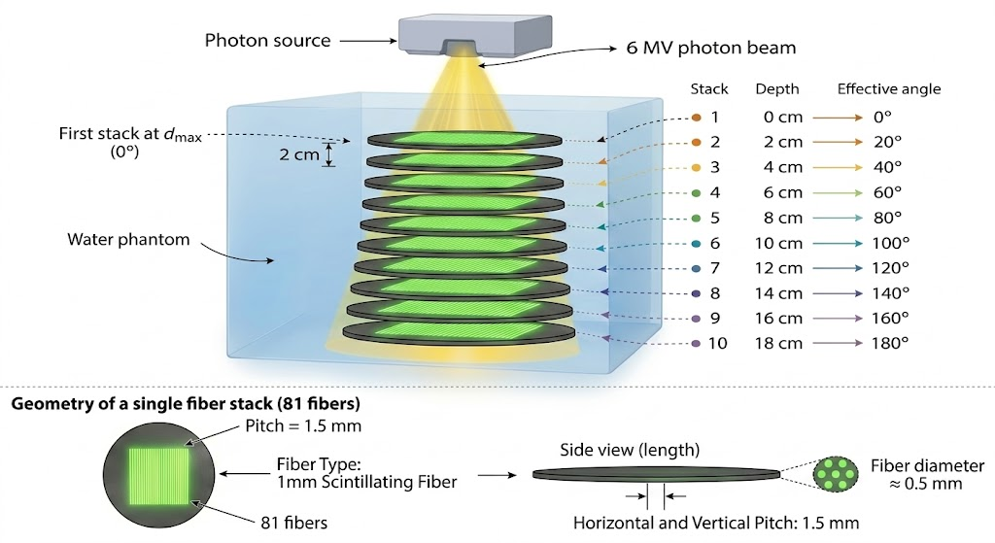
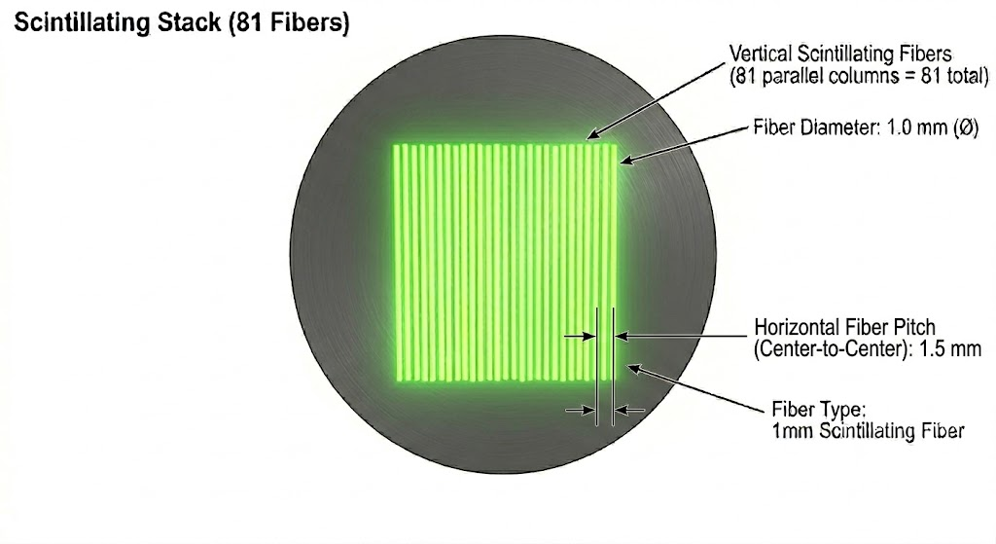
METHODS
Detector Geometry & Simulation
DETECTOR
• 81 polystyrene scintillating fibers / stack
• 1 mm Diameter, PMMA cladding, 150 mm active length
• 10 stacks · 2 cm depth spacing (0–18 cm)
• Angles 0°–180° (20° steps); pitch 1.50→1.83 mm
MONTE CARLO SIMULATION
• TOPAS v3.9 (Geant4-based)
• 6 MV photon, Varian TrueBeam (IAEA phase-space)
• SAD 100 cm · water phantom 330×315×272.5 mm³
• Physics list: g4em-standard_opt4
• 10¹¹ histories (100 runs × 10⁹) per configuration
• Reference: 2D dose-to-water at d_max ≈ 1.5 cm
Figure 1: Ten scintillating fiber stacks at increasing depths in a water phantom.
Each stack provides one projection angle; pitch scales with beam divergence.
4
Notes:
This slide covers both the detector and the simulation setup. [click] The detector: each stack has 81 polystyrene scintillating fibers, 1 mm diameter, with PMMA cladding and 75 mm active length. There are 10 stacks spaced 2 cm apart in depth, covering 0 to 18 cm, at angles from 0 to 180 degrees in 20-degree steps. The pitch increases from 1.5 to 1.83 mm to follow the beam divergence. [click] The simulation: we used TOPAS version 3.9, based on Geant4, with a 6 MV Varian TrueBeam photon beam from an IAEA phase-space source. The source-to-axis distance was 100 cm, in a water phantom of 330 by 315 by 272.5 mm. We used the g4em-standard-opt4 physics list and 100 billion histories per configuration, run as 100 independent batches of one billion. The reference dose is a 2D dose-to-water plane scored at the depth of maximum dose, about 1.5 cm.

Slide 5
METHODS
Rotating vs Static Configuration
ROTATING
vs
STATIC
Single stack rotates
Detector motion
10 fixed stacks
19 (10°) or 10 (20°)
Projections
10 at fixed angles
Same depth (d_max)
Depth
Varies 0 → 18 cm
No mismatch ✓
Attenuation
Increases with depth ✗
Direct reconstruction
Raw result
Fails (γ = 55.5%)
5
Notes:
Let me compare the two configurations row by row. [click] Detector motion: rotating uses a single stack that rotates; static uses 10 fixed stacks. [click] Projections: rotating gives 19 or 10; static has 10 at fixed angles. [click] Depth: rotating keeps the same depth at d-max; static varies from 0 to 18 cm. [click] Attenuation: rotating has no mismatch, but static attenuation increases with depth. [click] Raw result: rotating reconstructs directly, while static fails at 55.5 percent without correction.

Slide 6
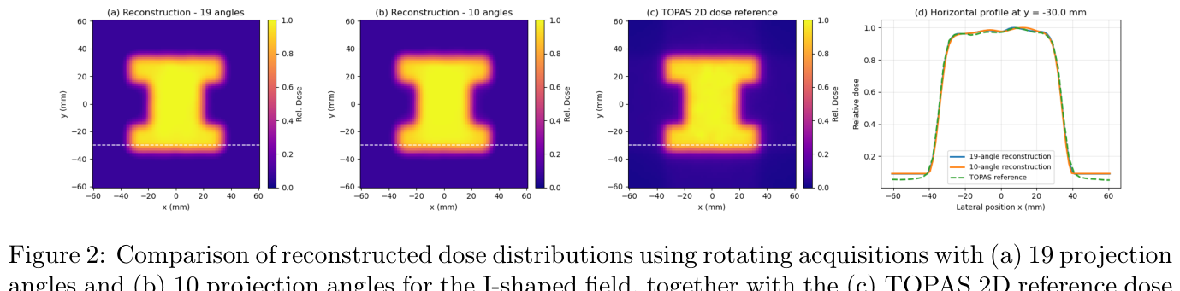
RESULTS
Rotating Acquisition — Baseline
Figure 2: (a) 19-projection and (b) 10-projection reconstructions vs (c) TOPAS reference. (d) Horizontal profiles at y = −30 mm.
Colour scale: relative dose (0–1); axes x and y in mm; profile y-axis = relative dose, x-axis = lateral position (mm).
19 Projections
γ = 99%
10 Projections
γ = 95%
MAE 0.013 · RMSE 0.015 · F₅₀ 69.86 mm
MAE 0.018 · RMSE 0.022 · F₅₀ 69.86 mm
Reference F₅₀: 69.86 mm
6
Notes:
These are our baseline rotating results; the figure shows excellent agreement with the TOPAS reference. [click] With 19 projections, gamma is 99 percent and the field width matches exactly at 69.86 mm. [click] With only 10 projections, it is still 95 percent with the same field width. So 10 projections are enough, and we use that sampling for the static detector.

Slide 7
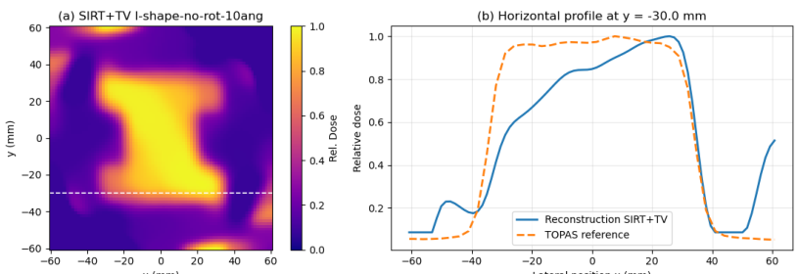
RESULTS
Static — Without Correction
Without Correction
γ pass rate
55.5%
MAE
0.078
RMSE
0.104
F₅₀
63.8 mm
Figure 3: (a) Uncorrected 2D dose map (colour = relative dose). (b) Profile at y = −30 mm:
blue = reconstruction, dashed orange = TOPAS reference. x-axis = lateral position (mm), y-axis = relative dose.
Reference F₅₀
69.9 mm
⚠ Depth-dependent attenuation → asymmetry, distorted plateau, underestimated field width
7
Notes:
The static configuration without correction. The dose map and profile show clear distortion. [click] Reveal the numbers one at a time: [click] gamma pass rate only 55.5 percent; [click] MAE 0.078; [click] RMSE 0.104; [click] field width underestimated at 63.8 mm; [click] versus the reference of 69.9 mm. [click] In short, depth-dependent attenuation causes asymmetry, a distorted plateau, and an underestimated field — correction is essential.
You can still see the I-shape is recognizable. But the reconstruction is clearly distorted.
Looking at the profile on the right — the central plateau is asymmetric, the boundaries are in the wrong place, and the field is visibly narrower than it should be

Slide 8
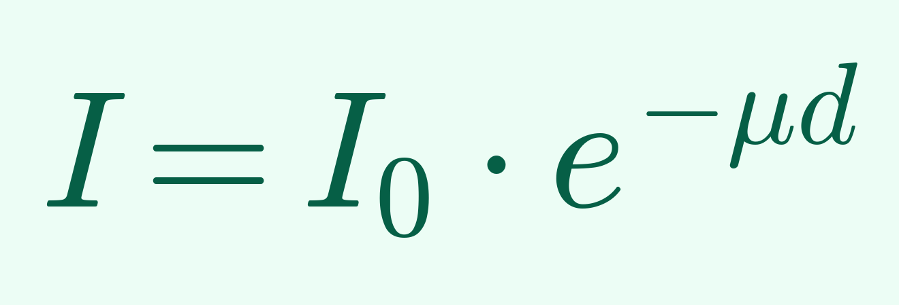
METHODS
Three Correction Strategies
Pre-processing: 70% background subtraction from edge fibers → suppress scatter, preserve penumbra
1 PDD Scaling
2 Beer–Lambert
3 Robust Adaptive
Known PDD curve
(from TOPAS)
Central signal
per stack
Average 3 shallowest
stacks as reference
↓
↓
↓
Interpolate at
each stack depth
Fit exponential
I = I₀·e^(−μd)
Gaussian-weighted
central matching
↓
↓
↓
Scale each projection
to d_max level
Rescale each
projection to stack 1
Weighted least-squares
scaling per stack
8
Notes:
Three correction methods. [click] First, pre-processing: subtract 70 percent of the background from edge fibers to remove scatter. [click] Method 1, PDD scaling: take the known depth-dose curve from TOPAS, interpolate at each stack depth, and rescale every projection to the d-max level. [click] Method 2, Beer-Lambert: compute a central signal per stack, fit an exponential attenuation curve, rescale. [click] Method 3, robust adaptive: average the shallowest stacks as reference, do Gaussian-weighted matching, and compute least-squares scaling per stack.
We use the central-axis percent-depth-dose curve from a separate TOPAS simulation of the same beam in water. We interpolate that curve at each of the 10 stack depths, compute the dose ratio relative to d_max, and use it as the scaling factor for that stack. This is the most physics-complete method — the PDD curve captures primary attenuation, scatter buildup, and beam hardening all at once.
[click] Method 2 is Beer-Lambert fitting. Instead of using a pre-known PDD, we fit the data itself to a simple exponential — I equals I-naught times exp minus mu d. We extract a central signal from each stack, fit those ten points to find an effective attenuation coefficient, and use the fitted exponential to rescale each projection. The advantage over PDD is that no external reference is needed — the correction is self-contained in the measured data.
[click] Method 3 is robust adaptive normalization. This one uses no physics at all. We average the three shallowest stacks to make a reference profile, then for each deeper stack we find the single scaling number that best matches that stack to the reference, with Gaussian weighting that emphasizes the bright central region. It's a purely empirical fallback — the "no-physics baseline."
[click] So we have three methods spanning a spectrum: from physics-complete with prior knowledge required, to physics-approximate and self-contained, to no-physics and purely empirical. The next slide will tell us what the physics is worth."

Slide 9
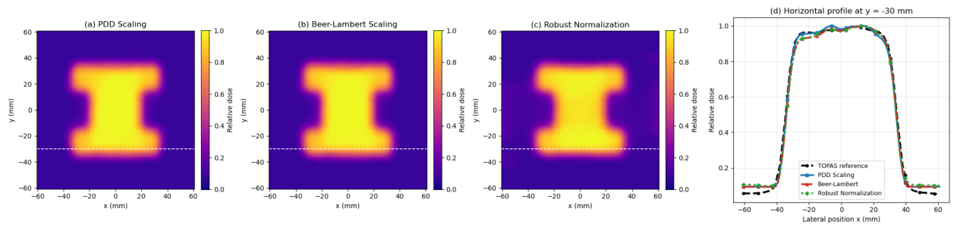
RESULTS
Corrected Reconstruction
Figure 4: (a) PDD scaling, (b) Beer–Lambert, (c) Robust normalization (colour = relative dose, axes x/y in mm).
(d) Profiles at y = −30 mm; x-axis = lateral position (mm), y-axis = relative dose; TOPAS reference = black dashed line.
✓ PDD scaling and Beer–Lambert closely match the reference in plateau and penumbra
! Robust normalization deviates more and yields a slightly narrower field
9
Notes:
After correction, results improve dramatically; all three methods restore the I-shaped field. [click] PDD scaling and Beer-Lambert closely match the reference across plateau and penumbra. [click] Robust normalization deviates more and gives a slightly narrower field.

Slide 10
RESULTS
Quantitative Comparison
Reference F₅₀: 69.86 mm
Gamma analysis: 3%/3 mm, global normalization, 10% threshold
Configuration | γ Pass Rate | MAE | RMSE | F₅₀ (mm)
Rotating — 19 proj. | 99.0% | 0.013 | 0.015 | 69.86
Rotating — 10 proj. | 95.0% | 0.018 | 0.022 | 69.86
Static — No correction | 55.5% | 0.078 | 0.104 | 63.79
Static — PDD Scaling | 93.1% | 0.017 | 0.022 | 69.86
Static — Beer–Lambert | 92.6% | 0.017 | 0.023 | 69.86
Static — Robust Adaptive | 81.2% | 0.028 | 0.034 | 68.34
Gamma Pass Rate Comparison
19 rot.
99%
10 rot.
95%
No corr.
55.5%
PDD
93.1%
Beer-L.
92.6%
10
Robust
81.2%
Notes:
This table gathers all results. [click] Reading down: 19 rotating projections give 99 percent, 10 give 95 percent. Without correction the static drops to 55.5 percent, in red. PDD scaling recovers to 93.1 percent, Beer-Lambert to 92.6 percent — both restore the correct field width. Robust normalization gives 81.2 percent. [click] The bar chart makes it visual: PDD and Beer-Lambert nearly reach the rotating baseline, while no-correction is far below.

Slide 11
COMPARISON WITH PRIOR WORK
What Makes Our Approach Different
1
No Mechanical Rotation
2
Shape-Agnostic Reconstruction
All 10 stacks acquire projections simultaneously — no moving parts during irradiation.
Unlike Goulet et al. (2012), which sequentially rotates a single fiber stack.
SIRT+TV recovers arbitrary, non-convex field shapes (e.g., the I-shape used here) with no field-shape prior.
Unlike Pivot et al. (2023), which parameterizes by MLC leaf positions.
3
Beyond Single-Depth Fields
4
Quasi-3D Capability
Multi-depth architecture across 0–18 cm captures larger, non-convex fields rather than only the central overlap region.
Unlike Esteves et al. (2023), constrained to small convex fields at d_max.
Depth-resolved stacks open a path toward 3D dose reconstruction beyond a single 2D slice.
Not possible with any prior single-depth scintillating-fiber design.
11
Notes:
Comparison with prior work. Four key differentiators of this work. [click] First — no mechanical rotation; all 10 stacks acquire projections at the same time, unlike Goulet 2012. [click] Second — SIRT+TV is shape-agnostic; we don't need to know the field shape beforehand, unlike Pivot 2023 which parameterizes by MLC leaf positions. [click] Third — we span 0 to 18 cm depth so we can handle larger and non-convex fields, unlike Esteves 2023 which is limited to small convex fields at d_max. [click] Fourth — and most importantly for future work — the depth-resolved architecture opens a route to quasi-3D dosimetry, which none of the prior single-depth designs can offer.

Slide 12
Summary
THE NEED
Current 2D dosimetry tools fall short for IMRT/VMAT QA:
• Radiochromic film — offline; requires post-irradiation scanning + calibration
• EPIDs — non-water-equivalent; energy-response issues from high-Z layers
• Diode arrays — coarse spatial resolution; silicon, not tissue-equivalent
We propose scintillating fibers (near water-equivalent, real-time, fine sampling) — but existing fiber-based systems require mechanical rotation, depend on prior knowledge of field shape, or are limited to small fields at a single depth.
OUR APPROACH
Static multi-stack scintillating fiber detector with SIRT+TV tomographic reconstruction — 10 stacks at different depths, simultaneous projections, no moving parts.
CHALLENGES → SOLUTIONS
• Beam divergence across 0–18 cm depth → depth-scaled pitch (1.50 → 1.83 mm)
• Depth-dependent attenuation → PDD scaling correction
KEY RESULT
γ = 93.1% with 10 stacks · rotation-free · shape-agnostic · quasi-3D potential
12
Notes:
To summarize. [click] The need: current 2D dosimetry tools fall short for IMRT and VMAT QA. Radiochromic film is offline. EPIDs are non-water-equivalent. Diode arrays are coarse and silicon-based. Scintillating fibers solve most of these problems but existing fiber systems still have limitations — rotation, prior knowledge of field shape, or restriction to small fields at one depth. [click] Our approach addresses these: a static multi-stack scintillating fiber detector with SIRT+TV reconstruction, ten stacks at different depths, simultaneous projections, no moving parts. [click] The architecture introduced two challenges, which we solved: beam divergence over 0 to 18 cm depth handled by depth-scaled pitch; depth-dependent attenuation handled by PDD scaling correction. [click] Result: 93.1 percent gamma pass rate with 10 stacks, rotation-free, shape-agnostic, and with quasi-3D potential.

Slide 13
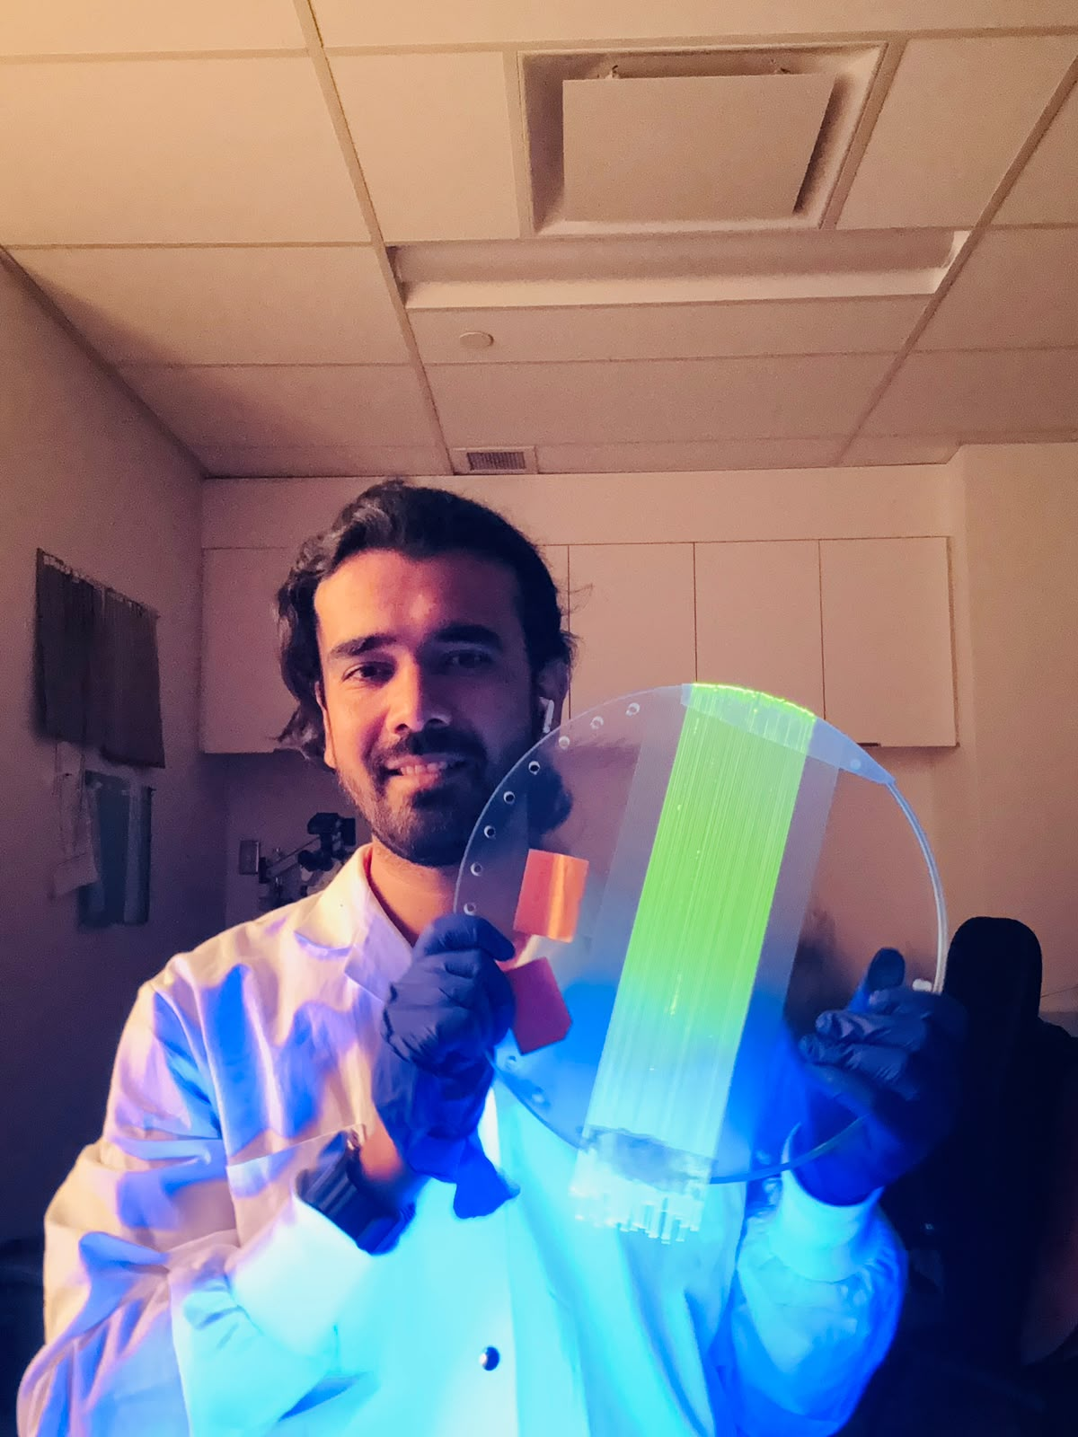
FUTURE WORK
Future Directions
🔬
Experimental Validation
Real fiber measurements under clinical 6 MV irradiation
📐
Complex Fields
MLC-shaped fields beyond the I-shaped test case
🔀
Randomized Angle–Depth
Decorrelate attenuation from angular sampling
📊
Quasi-3D Dosimetry
Exploit depth-resolved data for 3D dose reconstruction
13
Notes:
Four future directions. [click] First, experimental validation with real fibers under clinical irradiation. [click] Second, testing complex MLC-shaped fields. [click] Third, randomizing the angle-to-depth mapping to further decorrelate attenuation effects. [click] And fourth, developing quasi-3D dosimetry using the depth-resolved information.

Slide 14


ICCR 2027 - XXIth International Conference on the use of Computers in Radiation Therapy
Quebec Congress Centre • July 4-8, 2027
Join us in Quebec City, July 2027
ICCR is one of the longest-running conferences in radiation therapy. Held only every three years, it attracts medical physicists, clinicians, and academic scientists from across the globe who are using computers to drive advances in radiation therapy. Many important innovations have been unveiled at ICCR and the conference enjoys a very high standing in the international radiation oncology community.
We look forward to welcoming you in Québec in July 2027!

Slide 15
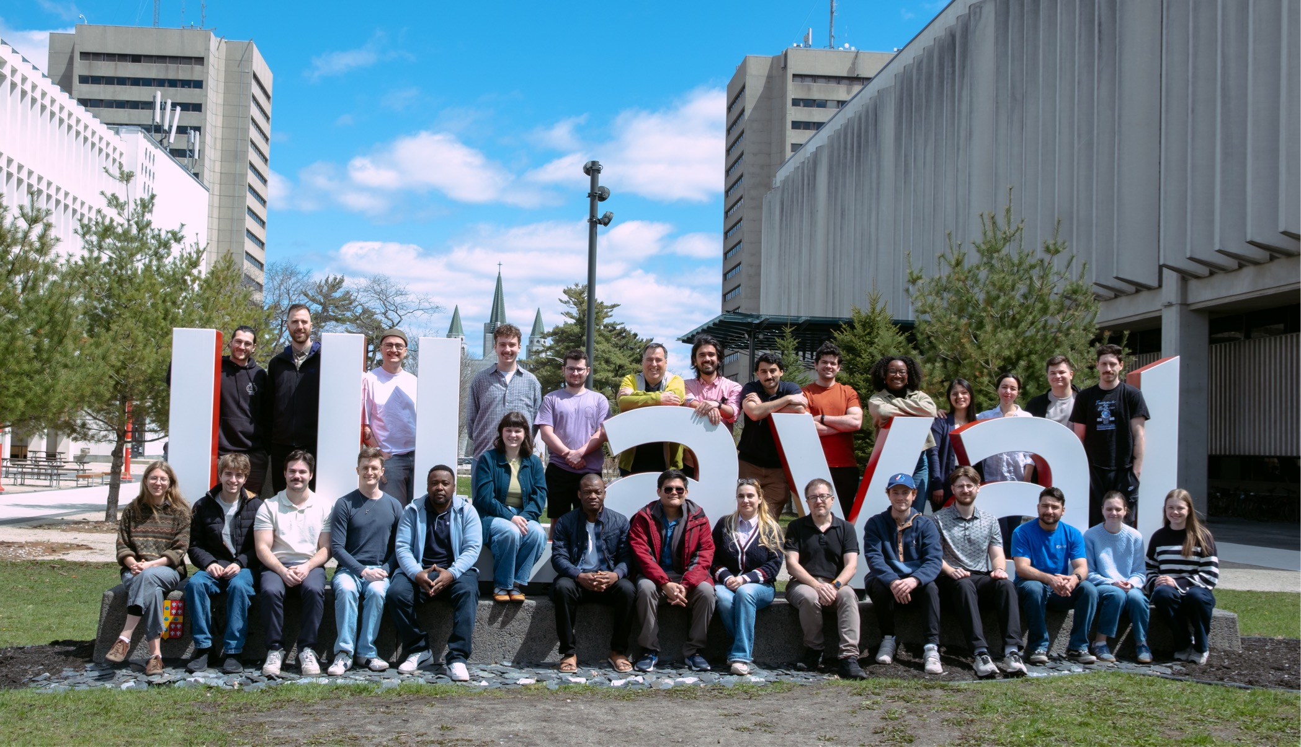

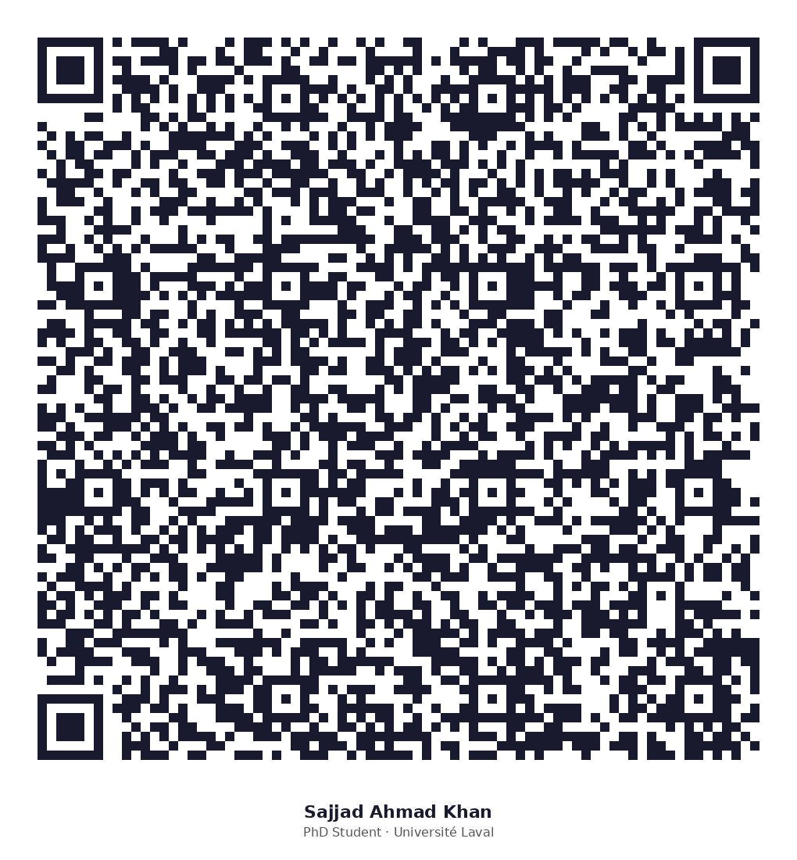
Thank You!
Key References
Questions?
[1] Devic S, Phys. Med. 27 (2011)
[2] Goulet M et al., Med. Phys. 39 (2012)
[3] Esteves J et al., Med. Phys. 50 (2023)
[4] Pivot O et al., Phys. Med. Biol. 68 (2023)
[5] Martinez-Lopez E, Rad. Meas. 193 (2026)
[6] Perl J et al., Med. Phys. 39 (2012)
Notes:
Thank you for your attention. I acknowledge the GRPM, the CHU de Québec research centre, Mitacs, NSERC, and the Digital Research Alliance of Canada for computing resources. I am happy to take any questions.

