Slide 1
Measuring Small Collimated Proton Fields with a Volumetric Scintillation Detector
A history of innovation leading to a practical application
Abram Bell, Jason Holmes, Sam Beddar, Daniel Robertson
IC3DDose 2026
15 June 2026

Slide 2
Volumetric scintillation dosimetry
Notes:
I coined this term during my PhD to describe a 3D detector that is read in a way that produces <3D data (e.g. 2D projections). Might also call it “2.5-D dosimetry”.
Let’s look at the history and development of this idea over the years that led to the current work.

Slide 3
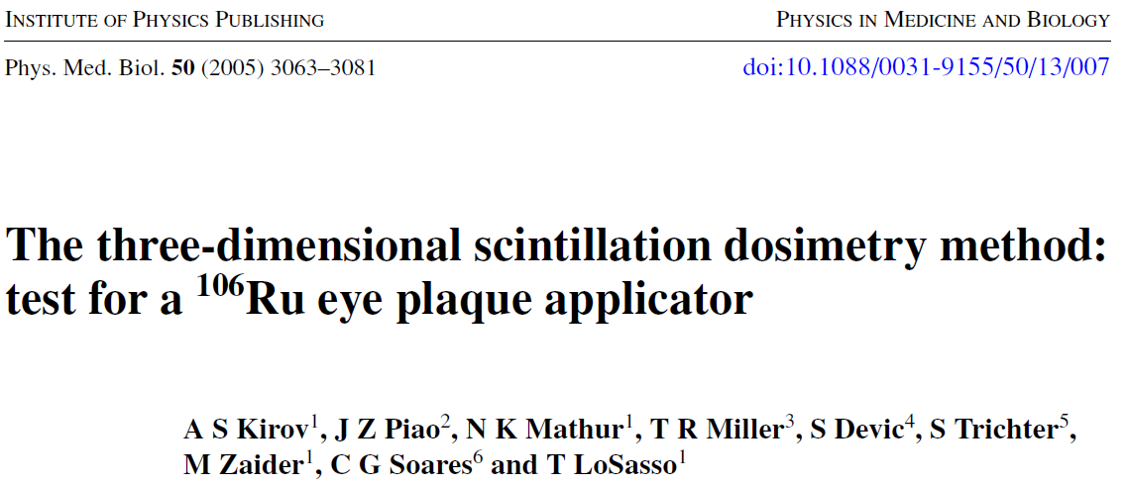
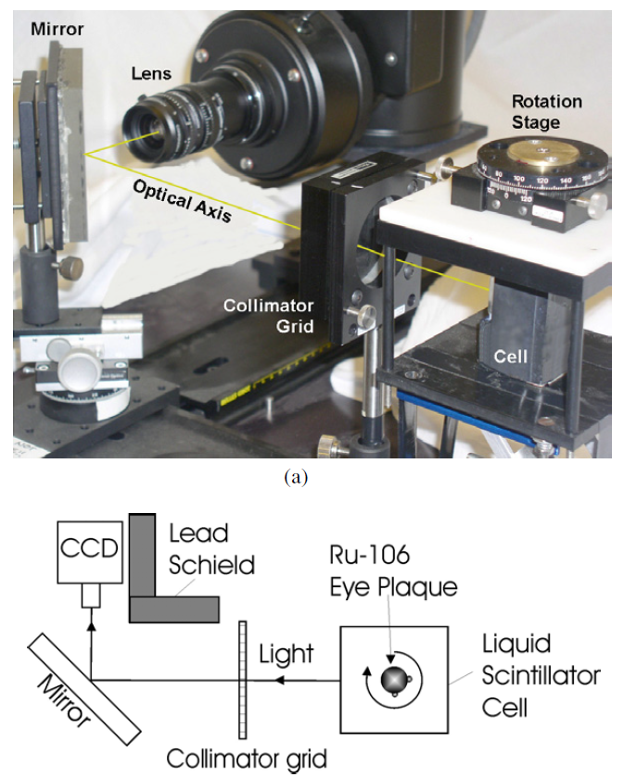
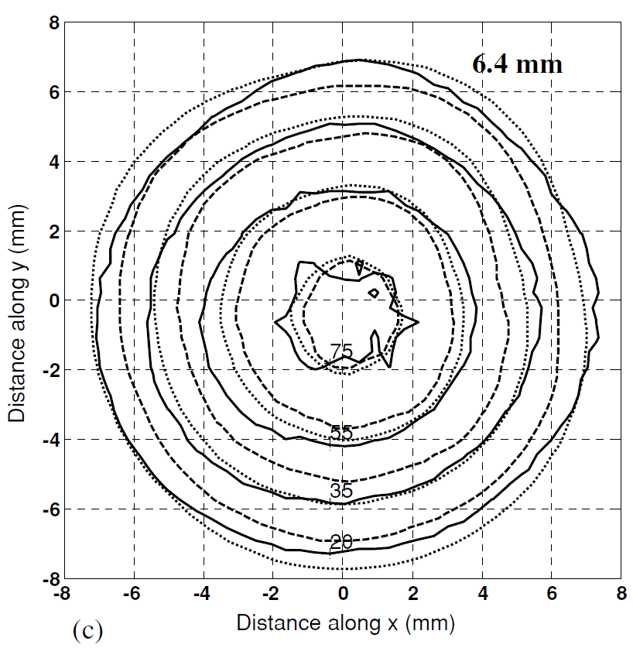
Notes:
Initial concept of 3D scintillation dosimetry
Eye plaques (effectively infinite time scale of brachytherapy source)
Rotating stage and single camera

Slide 4
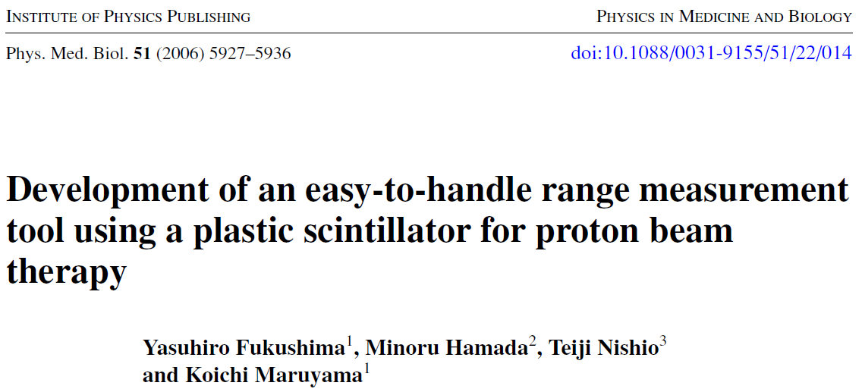
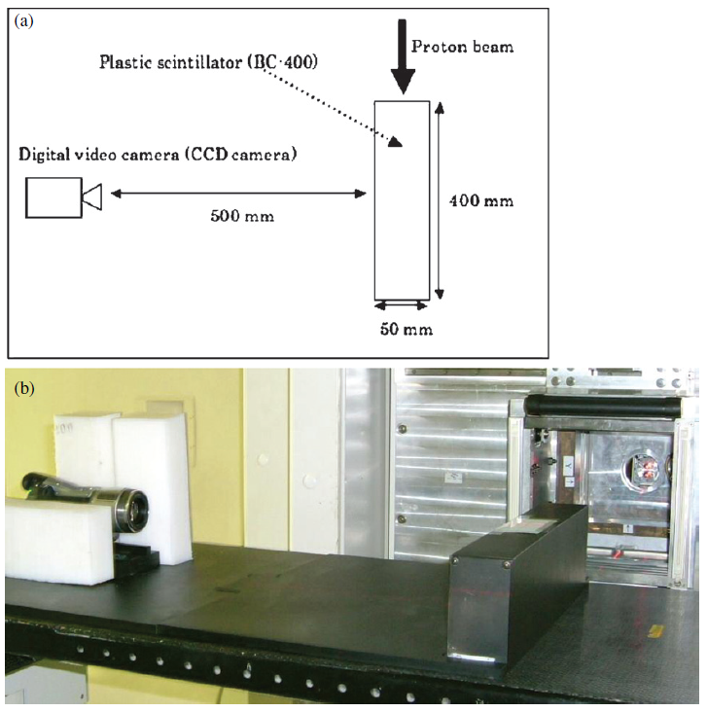
Notes:
First application of scintillator volumes to proton beams
Range measurement application

Slide 5
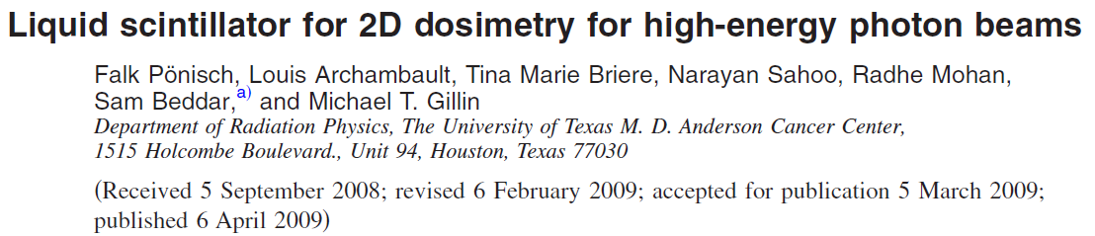
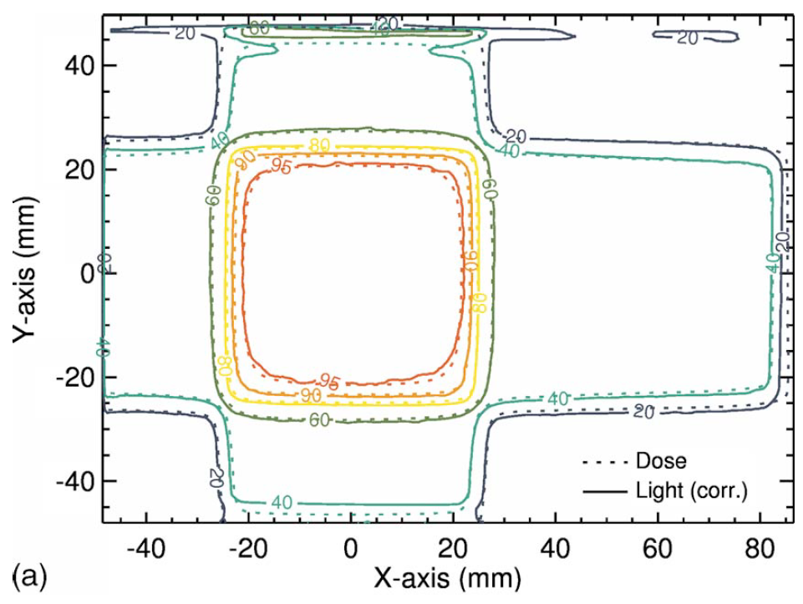
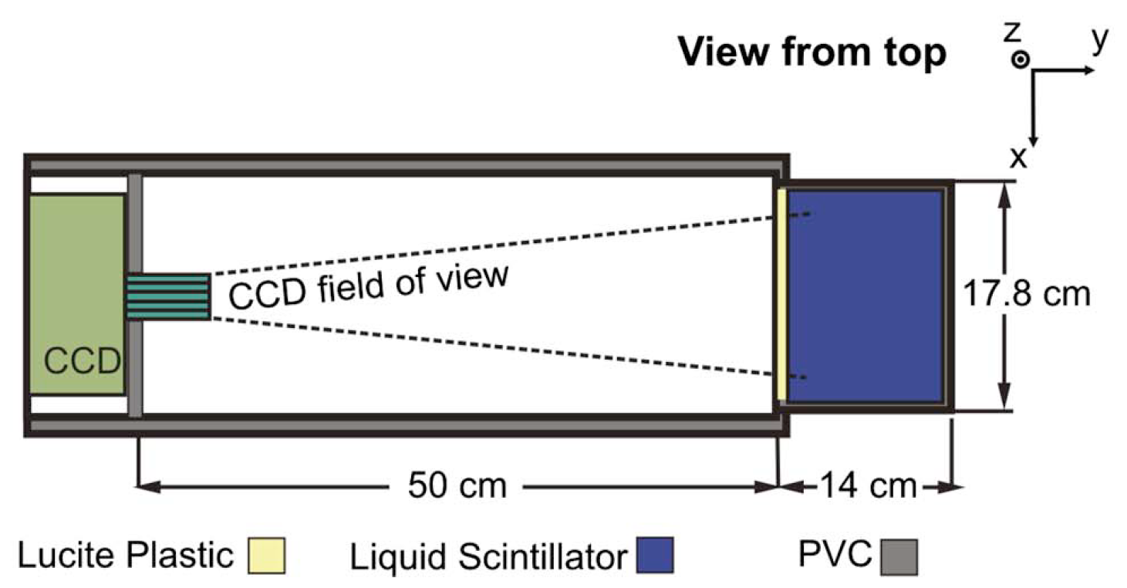
Notes:
First application of volumetric scintillation dosimetry in external beam therapy
Compared dose to TPS

Slide 6
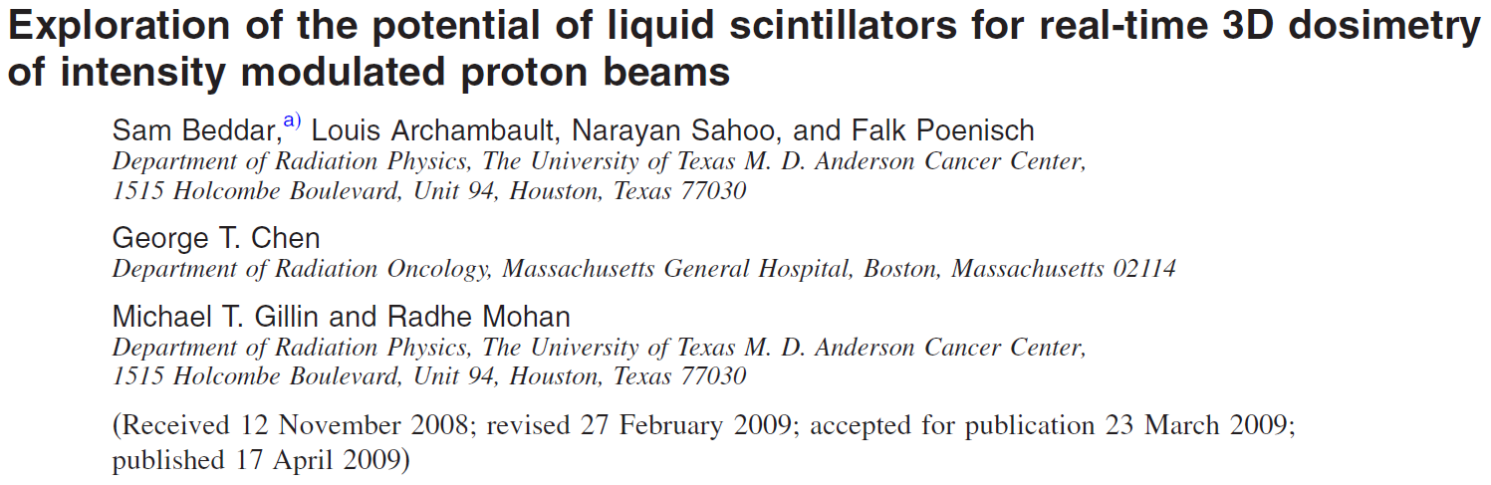
Notes:
Concept of quenching addressed
Quenching modeled, potential to correct for quenching raised

Slide 7
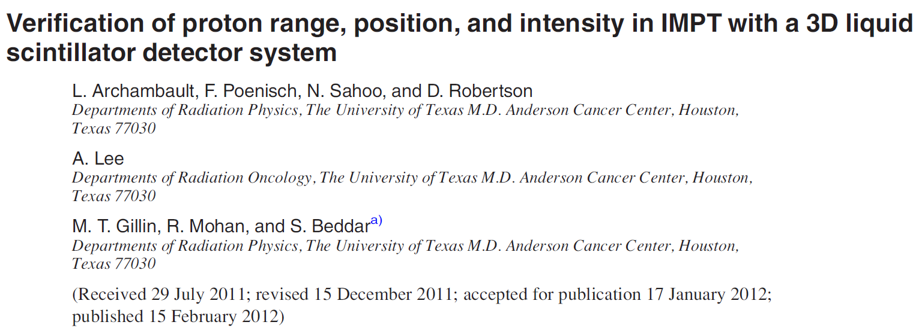
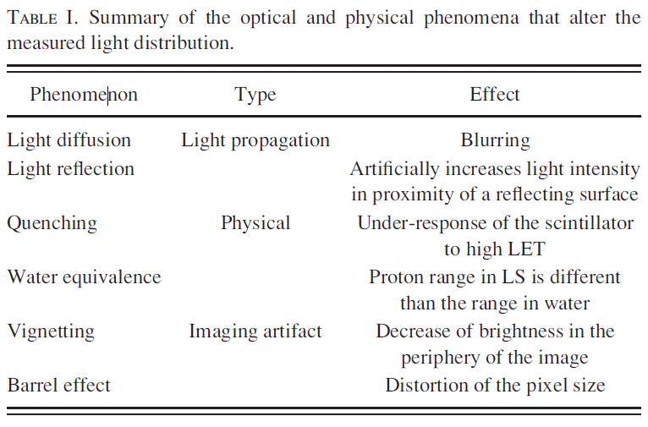
Notes:
Machine QA
Range
Spot position
Relative intensity

Slide 8
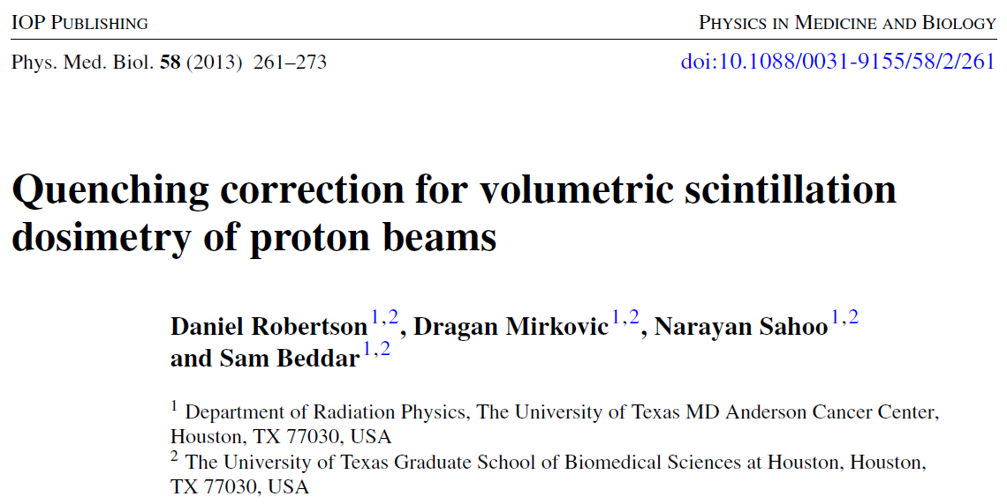
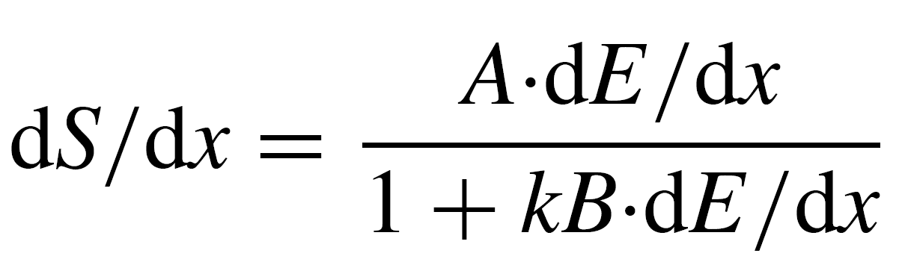
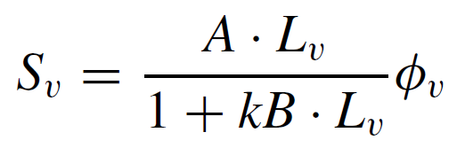
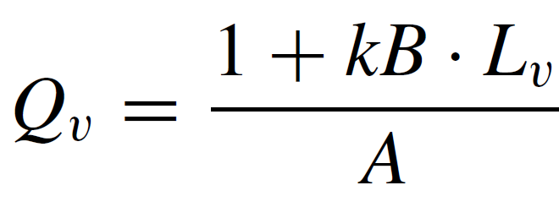
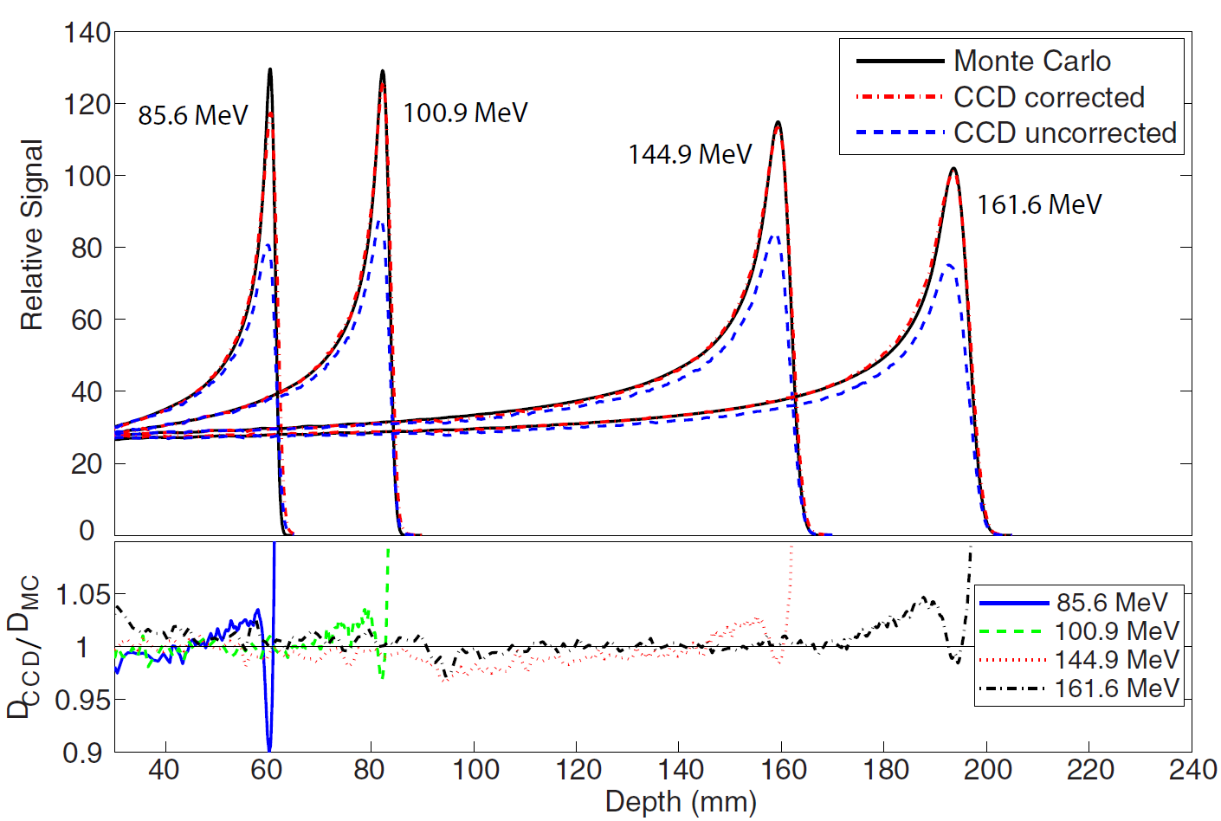
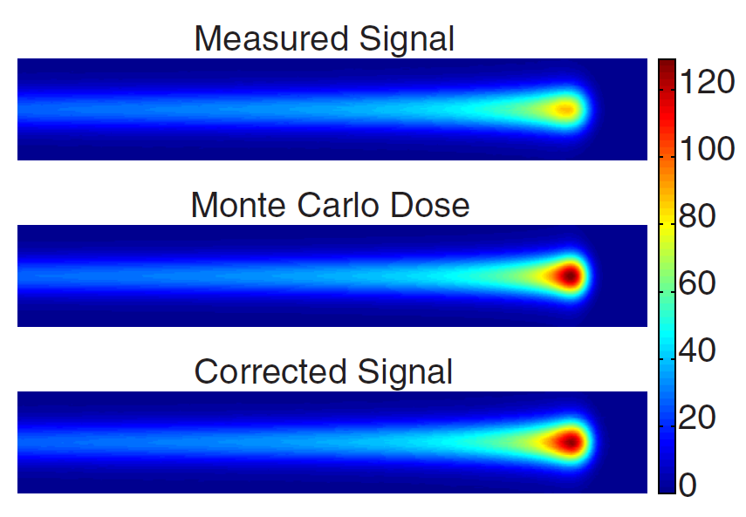

Slide 9
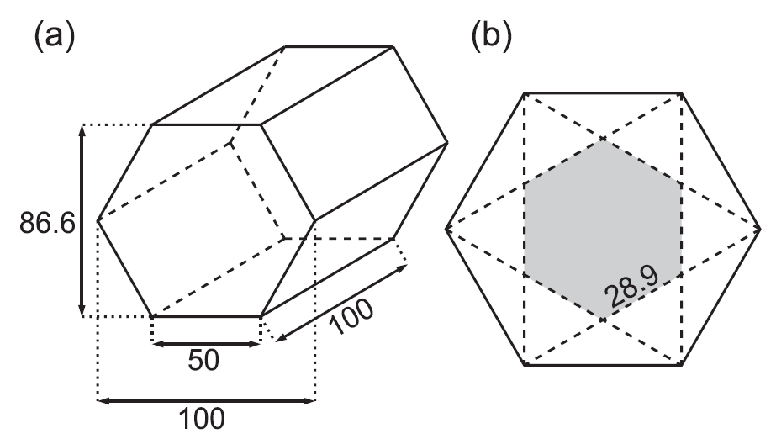
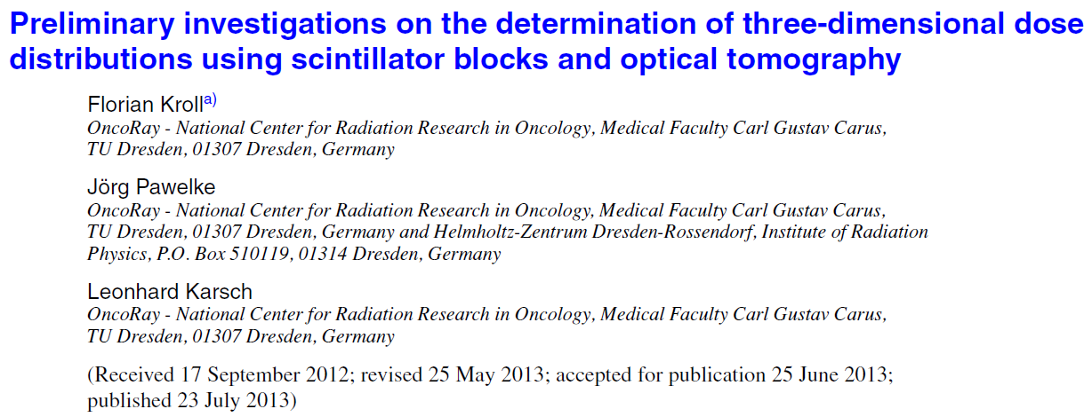
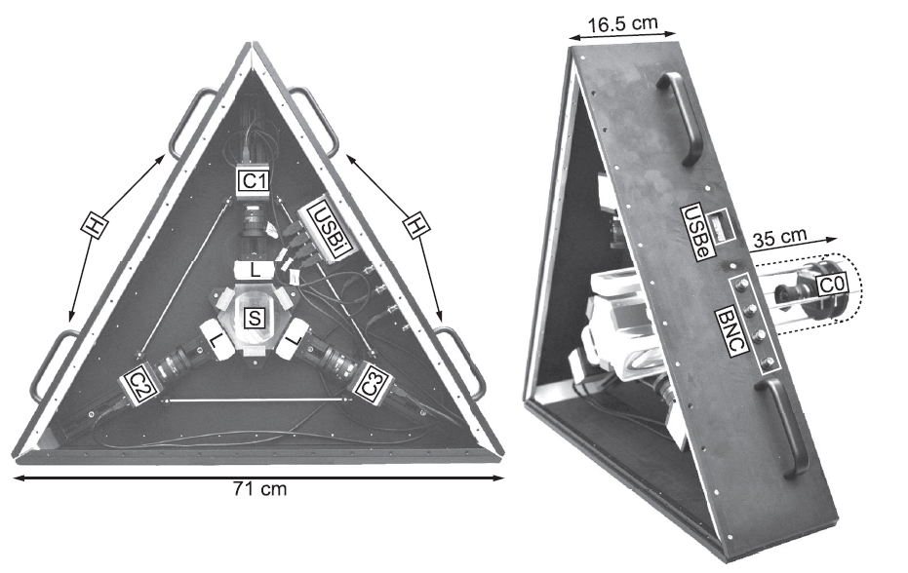
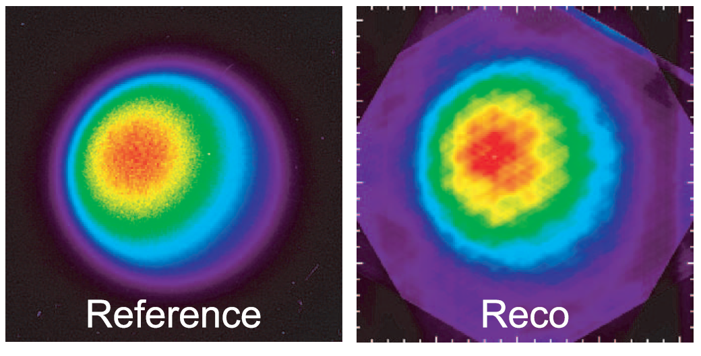
Notes:
First scintillator 3D reconstruction of a radiation beam (ELBE electron accelerator)
Also measured a proton Bragg peak, but didn’t apply quenching correction

Slide 10
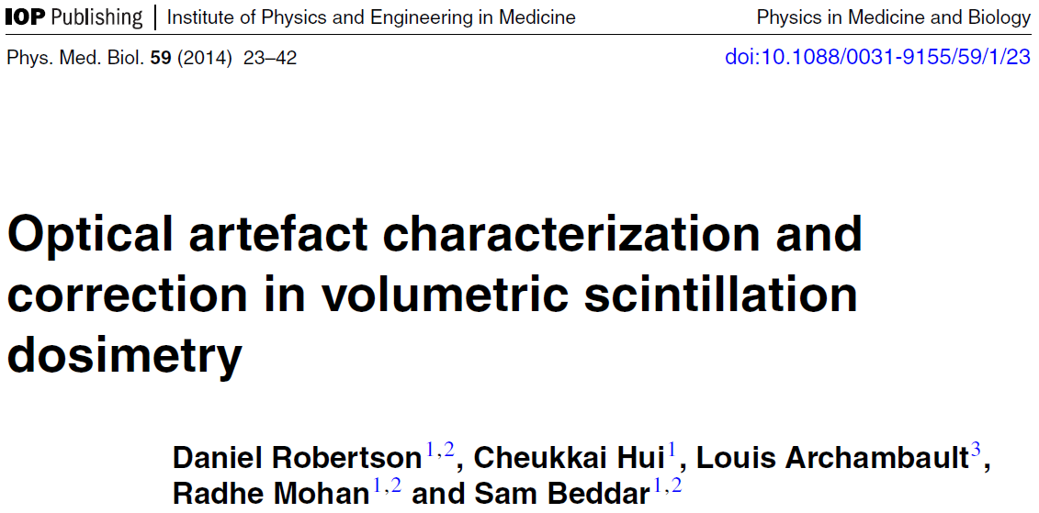
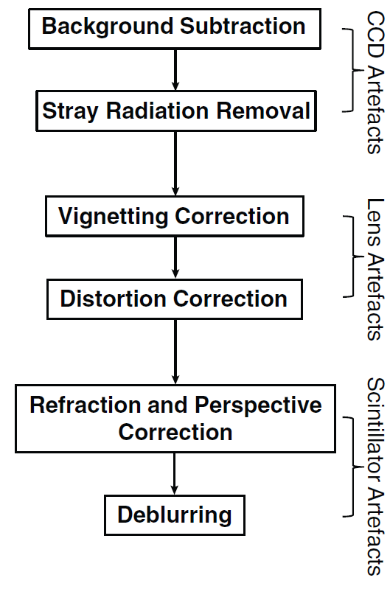
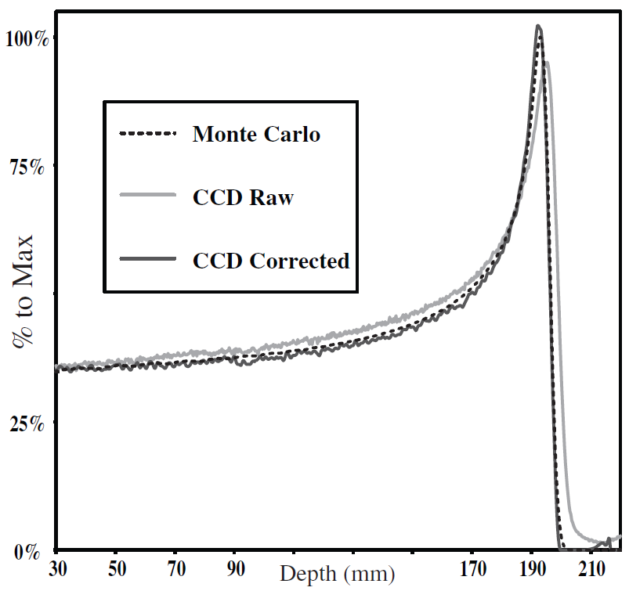
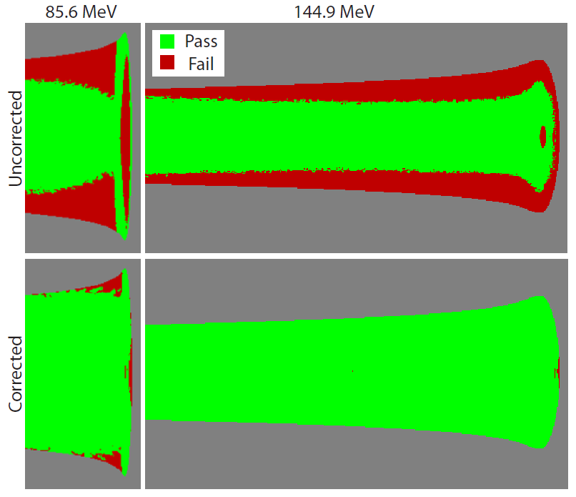
Notes:
Detailed analysis of optical artifacts for volumetric scintillation dosimetry
Their effects
How to correct for them
2%,2mm Gamma comparison

Slide 11
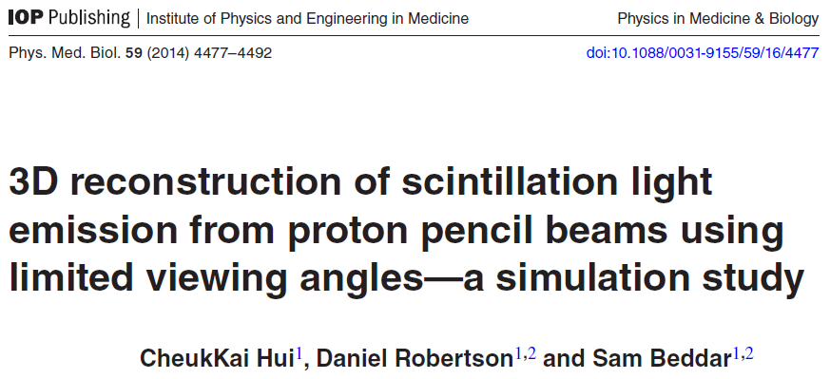
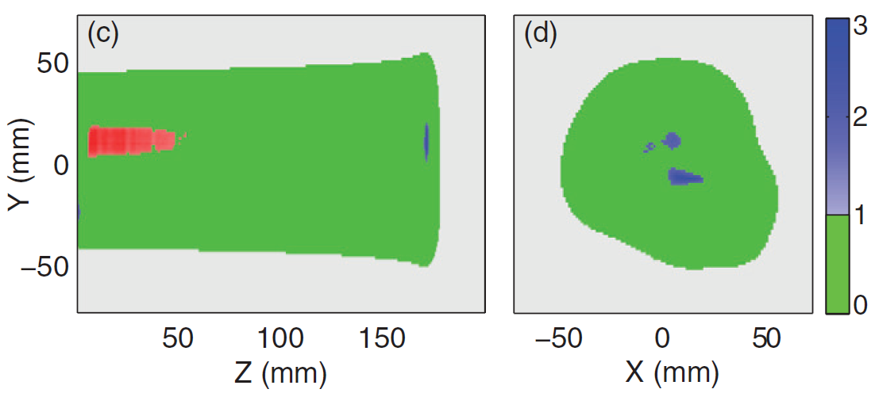
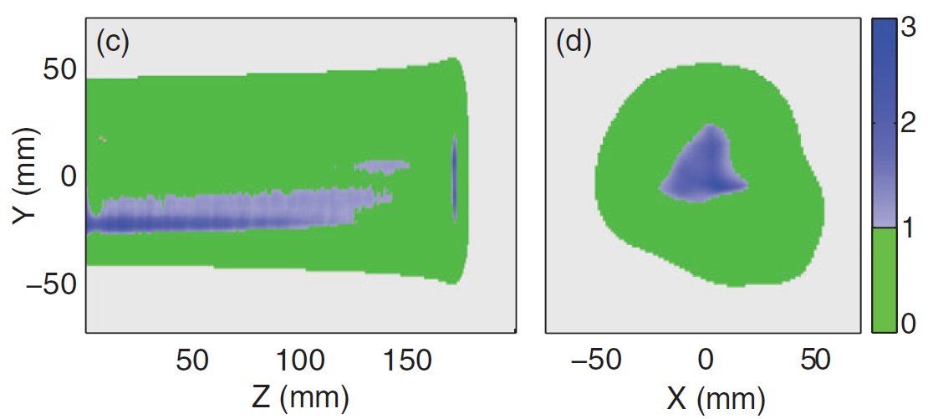
Notes:
Limited-angle reconstruction of proton pencil beams is possible with only 3 views if one of them is a beam’s-eye view
Individual beams can be summed to image patient treatment plans
Single energy layer of an IMPT plan
Nominal plan
Isocenter shifted by 1 mm in X and Y

Slide 12
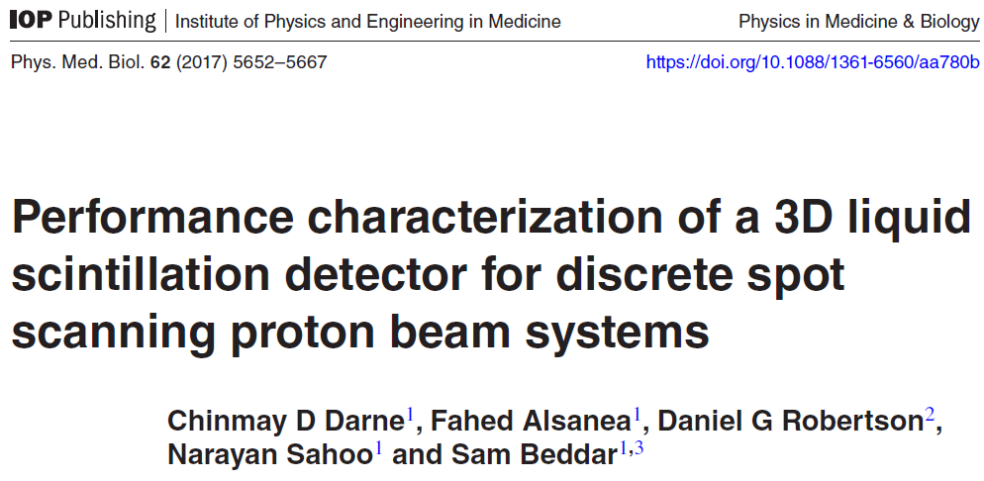
Notes:
Built the 3-camera system
Range
Spot position
Lateral profile

Slide 13
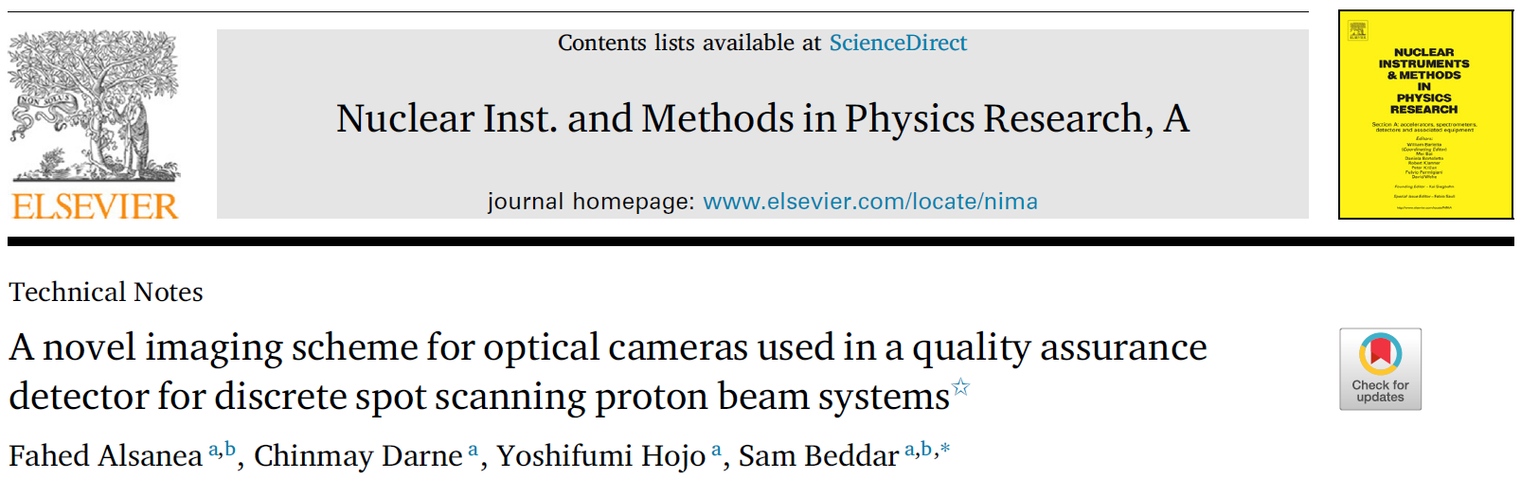
Notes:
Triggering scheme to align camera acquisitions with beam pulses

Slide 14
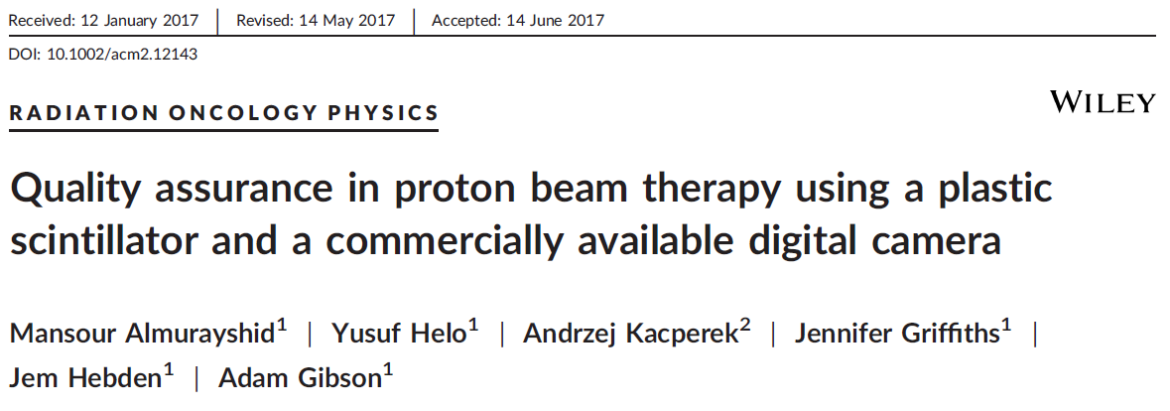
Notes:
Important contribution
LET curve and Bragg peak are sharp – it is hard to accurately align them
Use computed Bragg peak and LET curve to calculate quenching correction factor – this has a less steep gradient
Small misalignments don’t cause such problematic impact on corrected light distribution

Slide 15
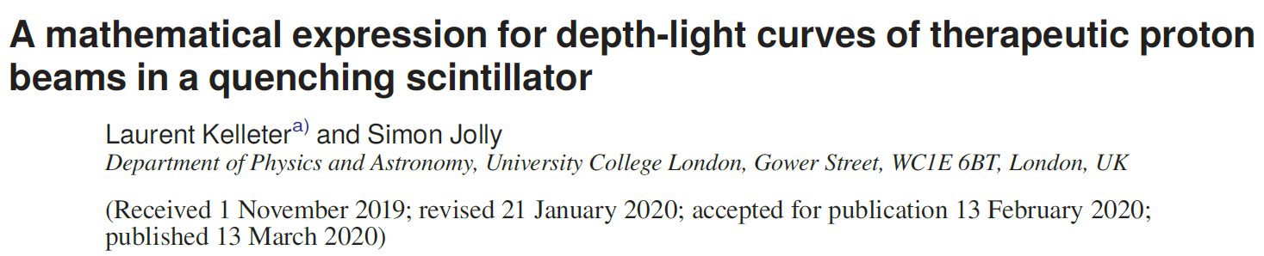
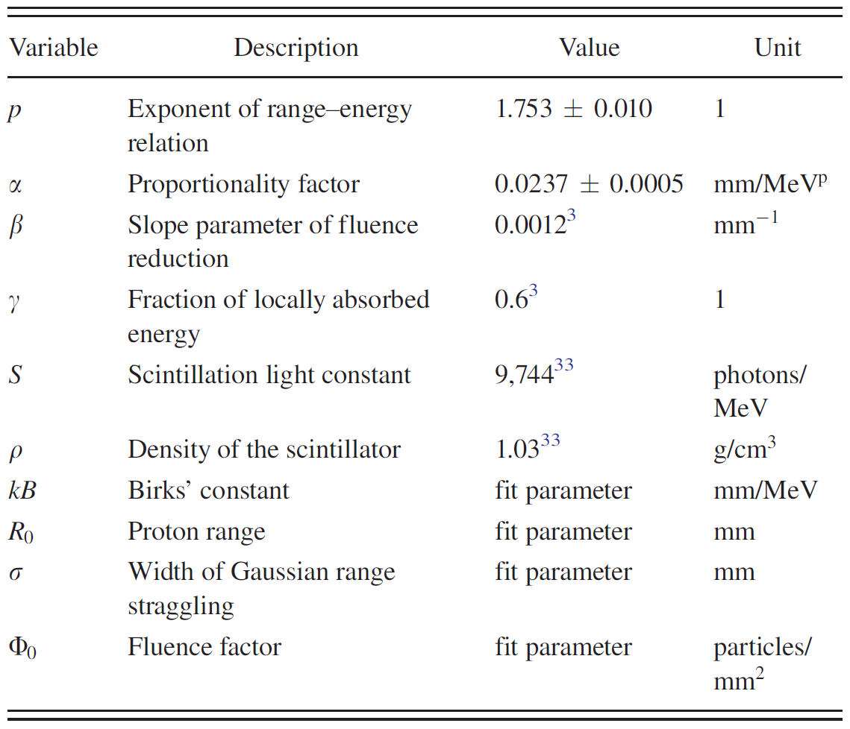
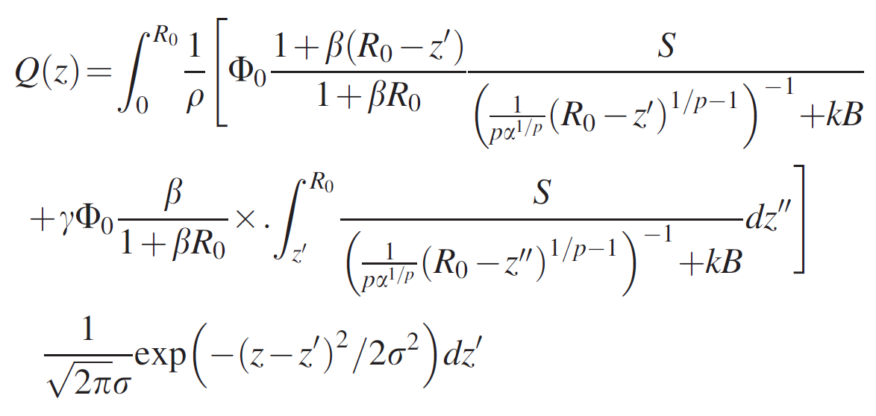

Slide 16
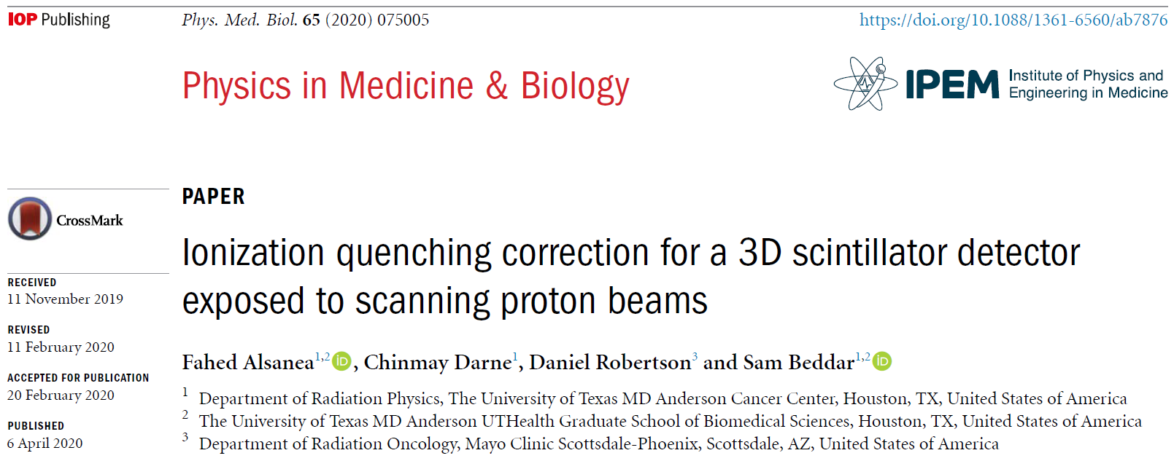
Notes:
improved the application of Birks’ model quenching corrections
in 3D scintillators by numerically projecting the dose and LET 3D grid to camera projections

Slide 17
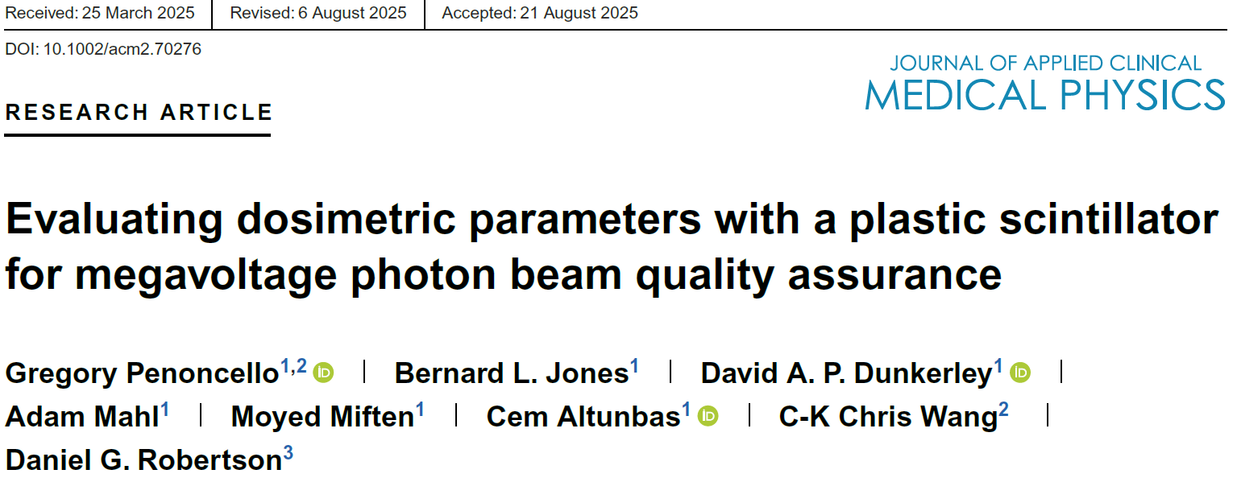
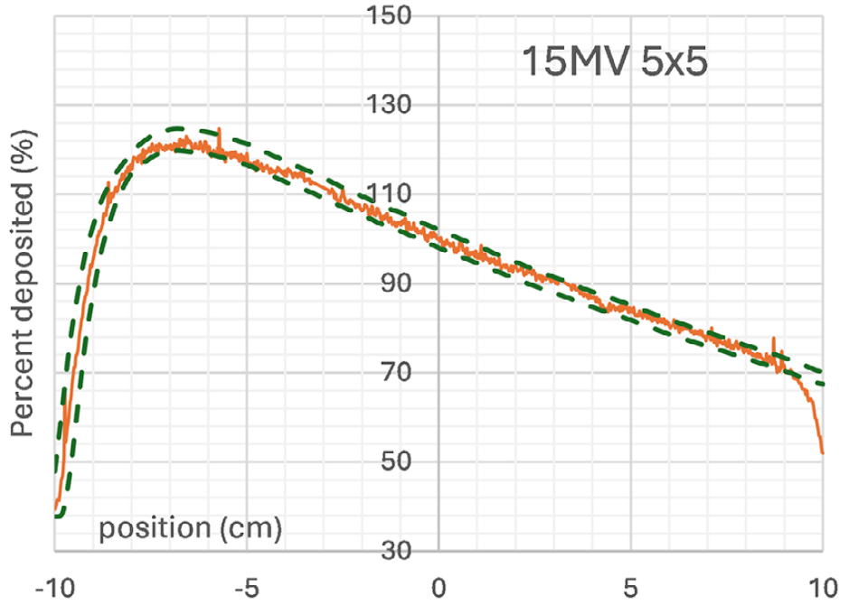
Notes:
Recent work of a colleague I mentored during his PhD – applying VSD to photon beams
Work on photon SRS multi-met fields for his PhD

Slide 18
Proton stereotactic radiosurgery (srs)

Slide 19
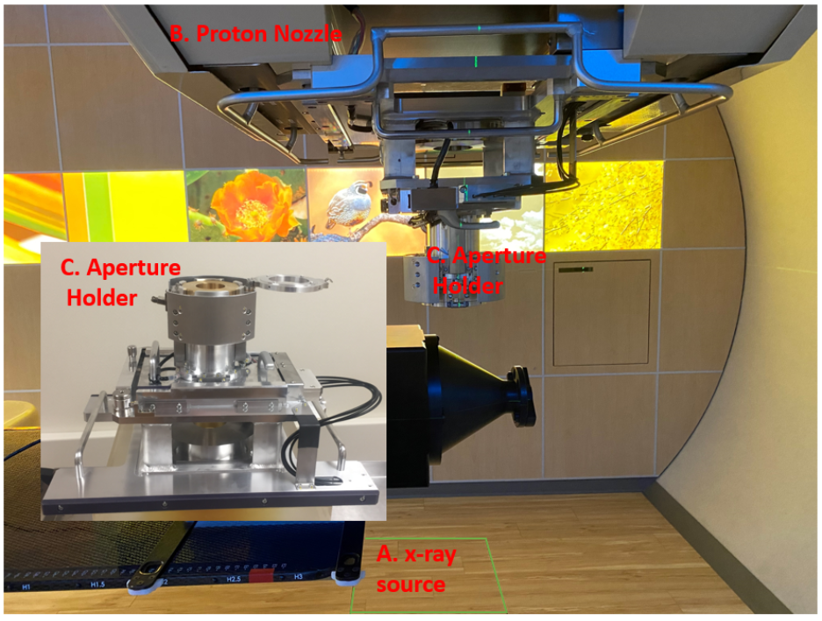
Proton Stereotactic Radiosurgery (SRS)
Overview
High dose (10-20 Gy)
Field-specific brass aperture
Small target volume
Optional range shifter

Slide 20
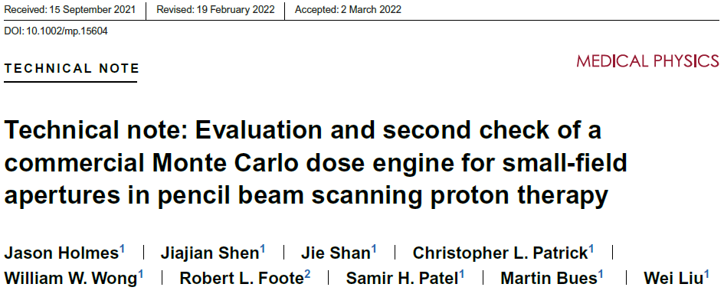
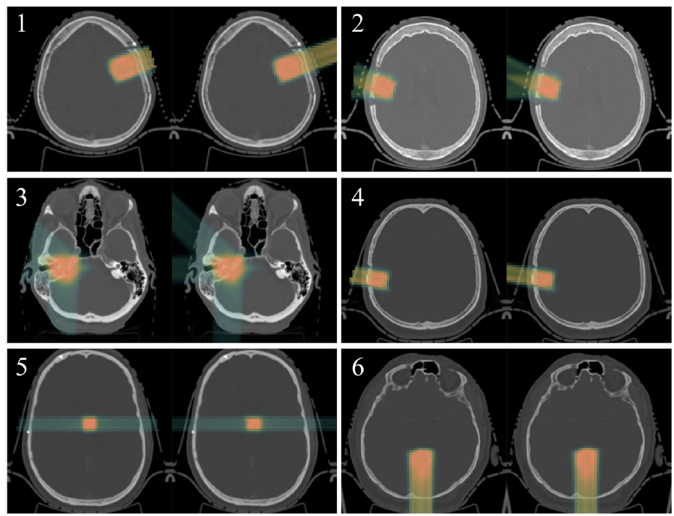
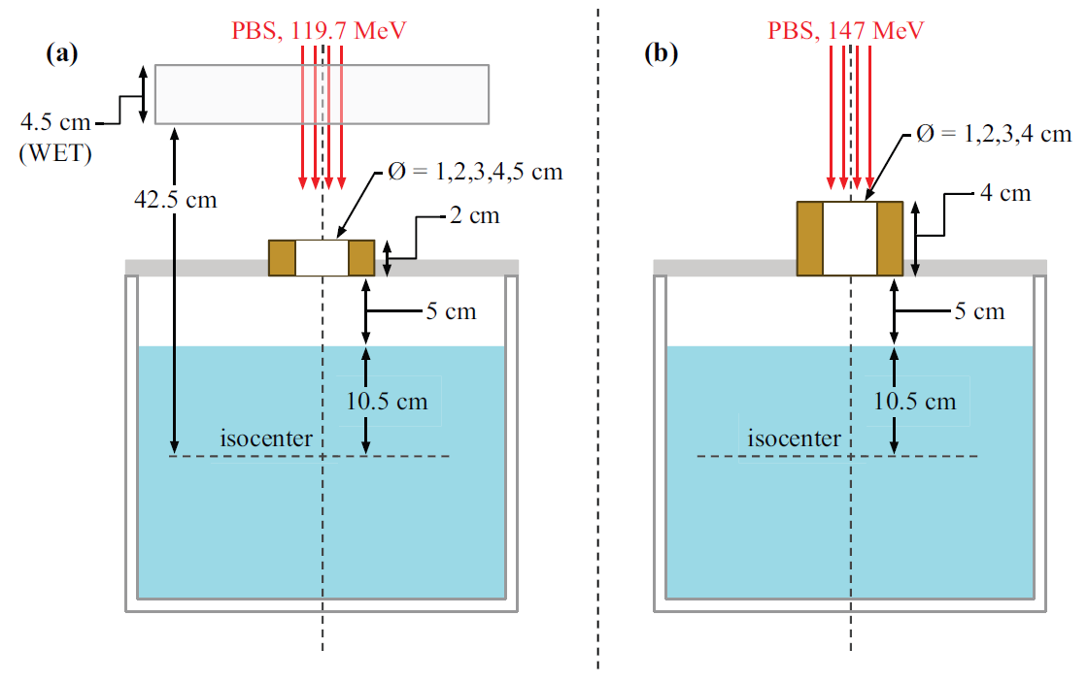
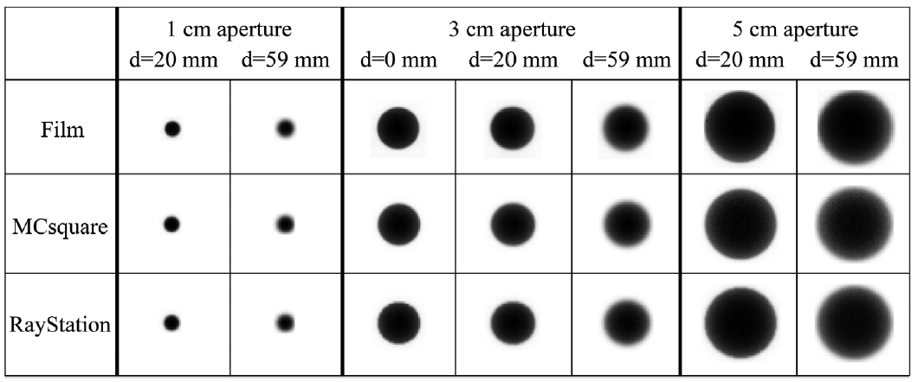

Slide 21
Proton Stereotactic Radiosurgery (SRS)
Patient-Specific Quality Assurance
Demands high spatial resolution
Steep dose gradients, possible non-homogeneity

Slide 22
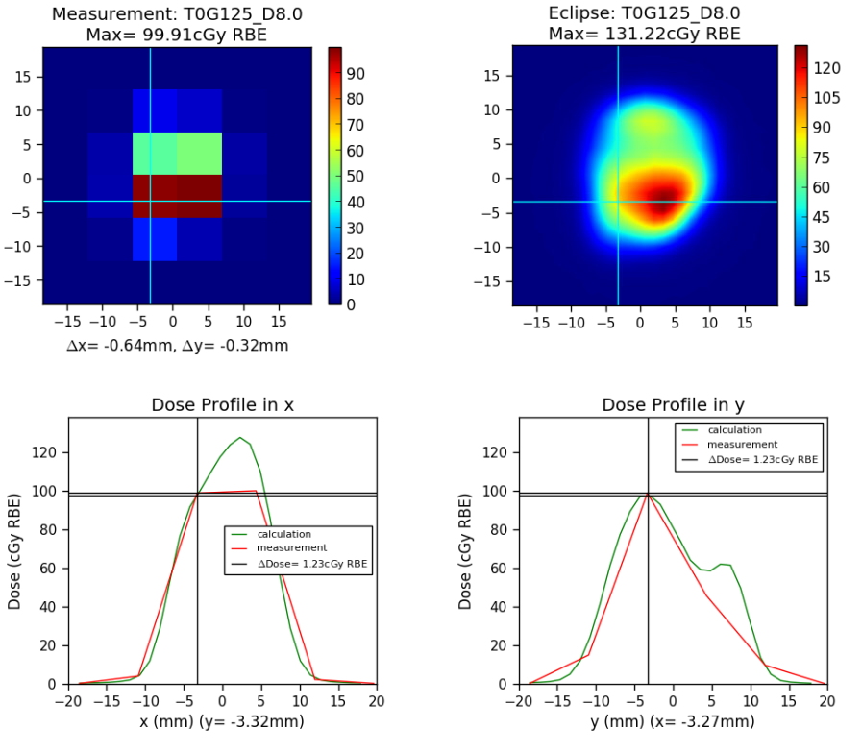
Patient-specific qa for proton srs
2D lateral profile
MatriXX ionization chamber array
  7.5 mm chamber spacing
  4.5 mm diameter chambers
  32x32 grid

Slide 23
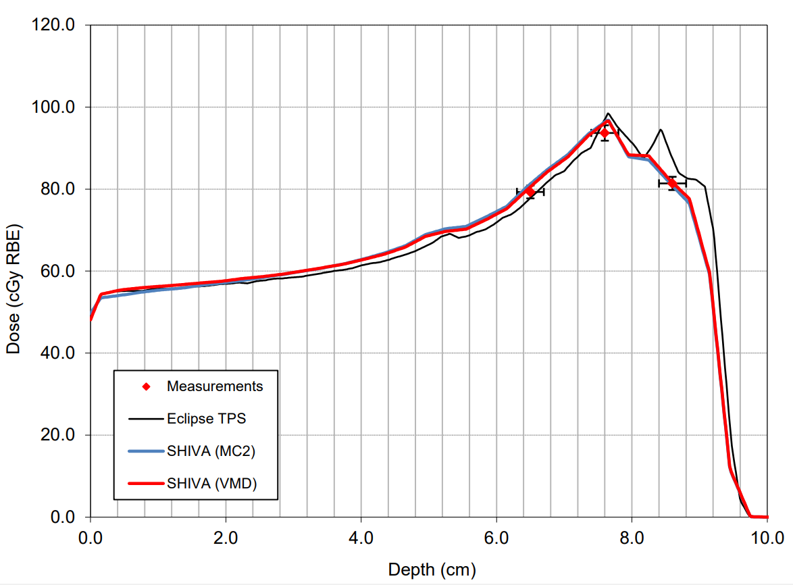
Patient-specific qa for proton srs
PDD/Absolute Dose
PTW microdiamond detector
  0.004 mm³ sensitive volume
  Minimal direction/energy dependence
1D scanning water tank
  Limited number of depths/measurements

Slide 24
Volumetric scintillation dosimetry for Proton srs

Slide 25
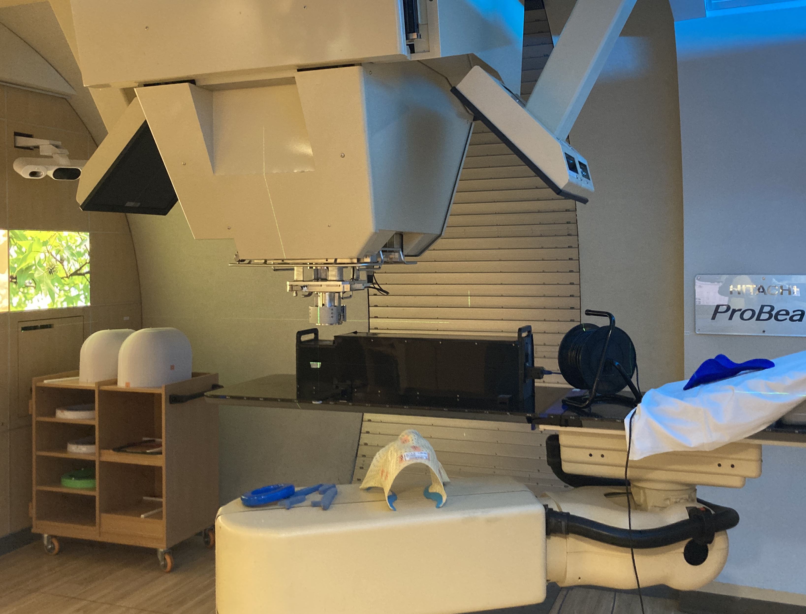
Volumetric Scintillator Detector
Overview
Single lateral projection
~0.1 mm spatial resolution
15 cm x 15cm x 15cm cube
Projection correction omitted due to small field size
PICTURE HERE
Notes:
Normally we would need to correct every pencil beam to apply the correct pixel size at its distance from the camera. This was omitted because of the small field size, which makes this correction small.

Slide 26
Experimental Setup
Exploring Detector Viability in Performing SRS PSQA
Phase 1 – Determine optimal quenching model
Implement optical corrections
Birk's model – use Monte-Carlo (MC) dose and linear energy transfer (LET) to predict light
Kelleter's model – use scintillation light to predict total dose

Slide 27
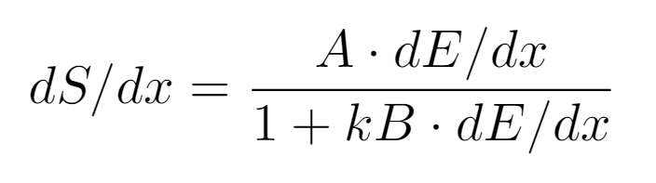
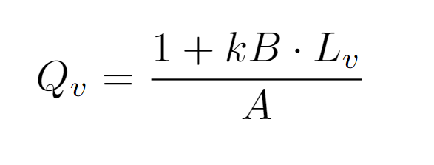
Birks Model
Predicting Quenched light from Dose
Empirical model proposed in 1951 Utilizes track-average LET, A, kB to calculate scintillation light
Variables
  A: Scaling factor
  dE / dx: Localized energy lost, or LET
  kB: Quenching parameter
Voxelized form derived by Dr. Robertson
Volumetric Scintillation Dosimetry for Scanned Proton Beams Robertson, 2014

Slide 28
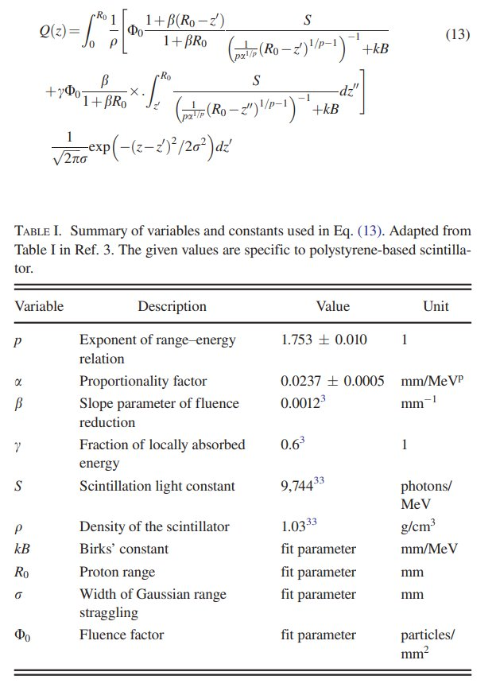
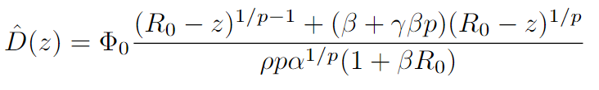
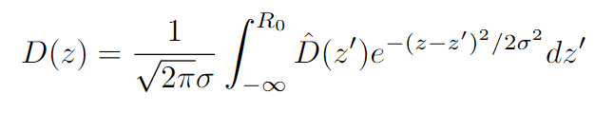
Kelleter's Method
Predicting Dose from light data
Combines Birk's empirical model and Bortfeld's analytical approximation
Predicts integrated depth dose from light data
  Limited to IDD, rather than voxel data
Quenched Bragg curve for proton therapy Kelleter et. al., 2014

Slide 29
Phase 1 – Determine optimal Data processing method
Birks Method
Kelleter Method
MC Dose
MC LET
Measured Light
Birks' Formula
Kelleter's Formula
Quenched Light
Measured Light
Predicted Dose
MC Dose
Gamma Analysis
Gamma Analysis

Slide 30

Model Comparison
Notes:
Caution that this was early work, Kelleter could still be potentially useful

Slide 31
Quenching correction method
Birks Method
Kelleter Method
MC Dose
MC LET
Measured Light
Birks' Formula
Kelleter's Formula
Quenched Light
Measured Light
Predicted Dose
MC Dose
Gamma Analysis
Gamma Analysis
Notes:
Note that Kelleter limited to 1D correction. Birks chosen. Show change to dose comparison instead of light

Slide 32
Quenching correction method
Birks Method
Birks Quenching Correction
MC Dose
MC LET
MC Dose
MC LET
Birks' Formula
Birks' Formula
Quenched Light
Quenched Light
Measured Light
Quenching Correction Factors
Gamma Analysis
Measured Light
Measured Dose
Notes:
Note that Kelleter limited to 1D correction. Birks chosen. Show change to dose comparison instead of light

Slide 33
Testing Detector PSQA performance
Introduce errors in patient plan beam deliveries
Compare Measured and Calculated Dose
Range shift (1, 3 mm)
No aperture
90 Percent MU
Deleted Spot
Gamma analysis (2% 2mm)

Slide 34
Proton srs patient field
Five-field SRS treatment of an arteriovenous malformation
Patient-specific brass apertures mounted on the SRS nozzle
Dose distribution within the aperture was modulated laterally and in depth
Maximum lateral extent of the aperture < 2 cm

Slide 35


T0G125 – Control

Slide 36
T0G125 – Control

Slide 37


T180G153 – Control

Slide 38


T270G90 – Control

Slide 39


T180G60 – Control

Slide 40


T331G95 – Control

Slide 41


T0G125 – 1mm range shift

Slide 42


T331G95 – 1mm range shift

Slide 43


T0G125 – 3mm range shift

Slide 44


T331G95 – 3mm range shift

Slide 45


T0G125 – 90% MU

Slide 46


T331G95 – 90% MU

Slide 47


T0G125 – no aperture

Slide 48


T331G95 – no aperture

Slide 49
Meningioma Plan - 2%2mm Gamma Analysis
Field | Control | 1mm RS | 3mm RS | No Aperture | 90% MU
T331 G95 | 99.8 | 96.5 | 80.7 | 19.9 | 81.5
T0 G125 | 98.3 | 90.1 | 82.6 | 12.4 | 81.0
T180 G153 | 99.0
T180 G60 | 91.3
T270 G90 | 99.1

Slide 50
Conclusion
Volumetric scintillation dosimetry shows promise for PSQA of small, collimated proton fields
  High spatial resolution
  Entire field measured in a single delivery
  Ability to detect plan/delivery errors
Some further optimization required before clinical use

Slide 51
acknowledgments
Colleagues
Students
MD Anderson Cancer Center
Sam Beddar
Beckett Hui
Chinmay Darne
Fahed Alsanea
Mayo Clinic
Jason Holmes
Jason Shen
Abram Bell
Kyle Durrant

Slide 52


Notes:
A group we collaborate with developed this system based on plenoptic camera and flat panel imager
3D reconstruction

Slide 53




