Slide 1








Uncertainty-Aware Deep Learning Reconstruction for 3D Scintillation Dosimetry
Alexis Horik^{1,2,3}, Raphaël Brodeur^{1,3}, Nicolas Drouin^{1,3}, Simon Thibault^{1,2}, and Louis Archambault^{1,2,3}
¹Département de physique, de génie physique et d’optique, Université Laval, Québec, Canada
²Centre d’optique, photonique et laser, Université Laval, Québec, Canada
³Centre de recherche du CHU de Québec-Université Laval et Centre de recherche sur le cancer de l’Université Laval, Université Laval, Québec, Canada
International Conference on 3D Dosimetry 2026

Slide 2
Presentation outline
Motivation and proposed approach
Overview of the 3D dosimeter
  Experimental setup;
  Deep learning reconstruction model.
Bayesian formulation
  Motivation and introduction;
  Bayesian neural network for tomographic reconstruction.
Results
  Uncertainty analysis;
  Bayesian vs deterministic models.
Discussion and conclusion

Slide 3
Toward real-time, uncertainty-aware 3D dosimetry
3D dose measurements are needed for satisfactory linac QA.
Real-time dosimetry is desirable
The reliability of dose measurements is crucial.
Dynamic treatments benefit from temporal information
Technicians’ and physicists’ time is valuable
Objective
Develop a novel dosimeter that can (i) measure the dose in 3D and in real-time, and (ii) estimate the reliability of its measurement.
Motivation and Context

Slide 4
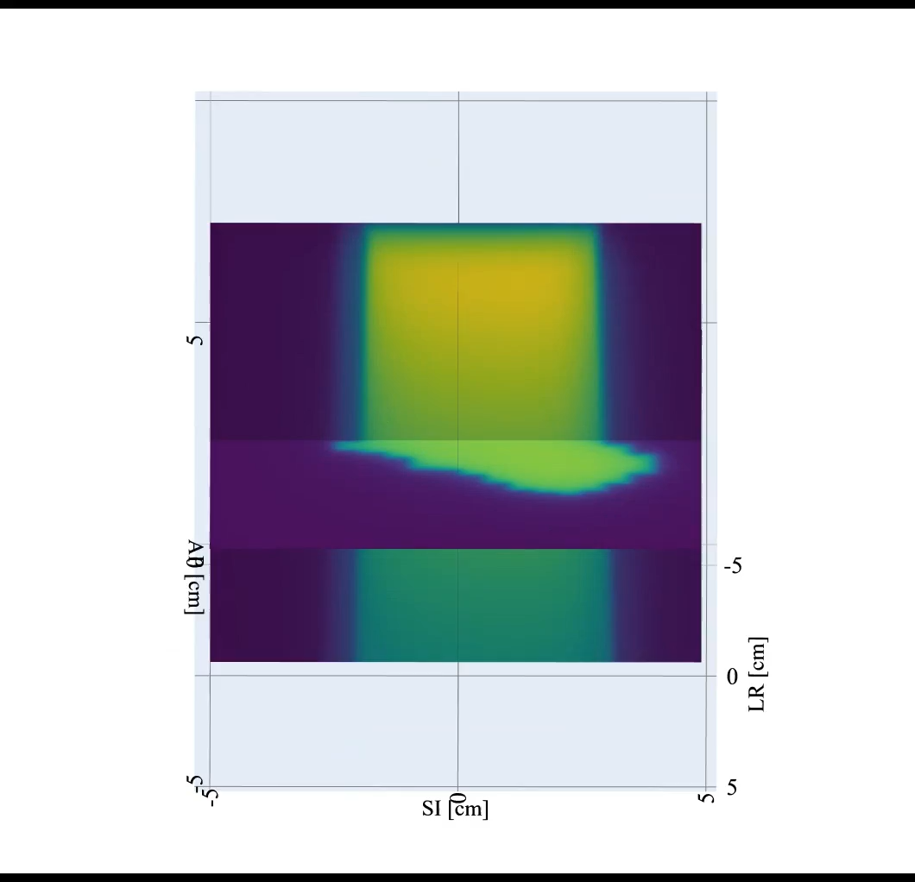
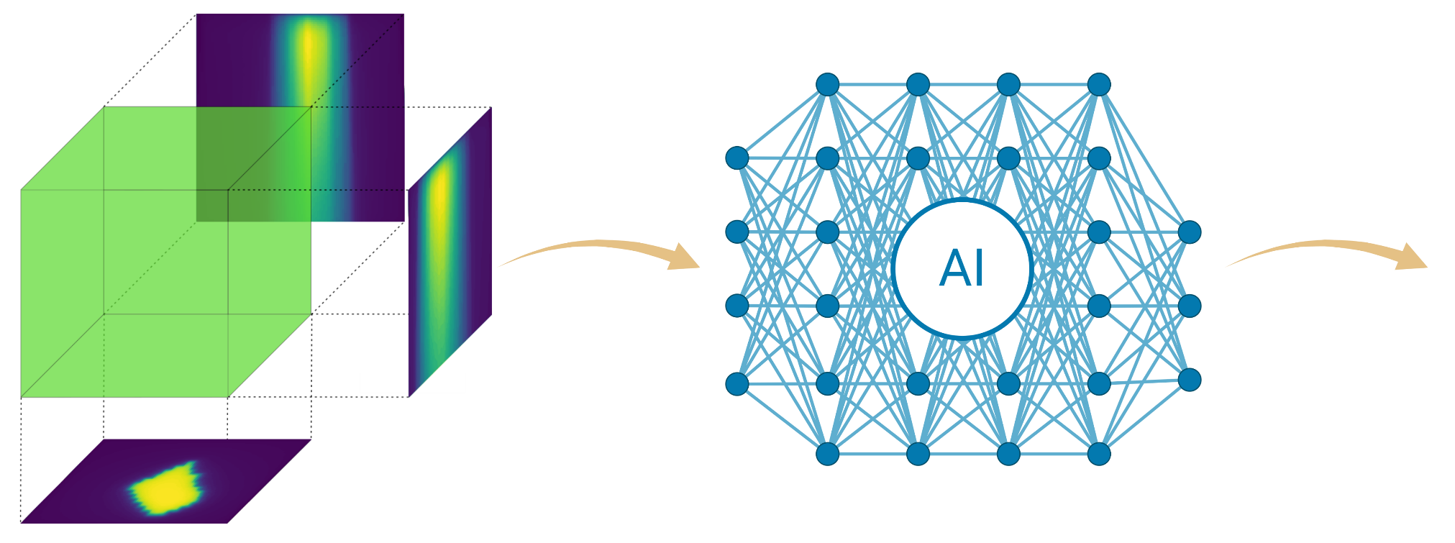
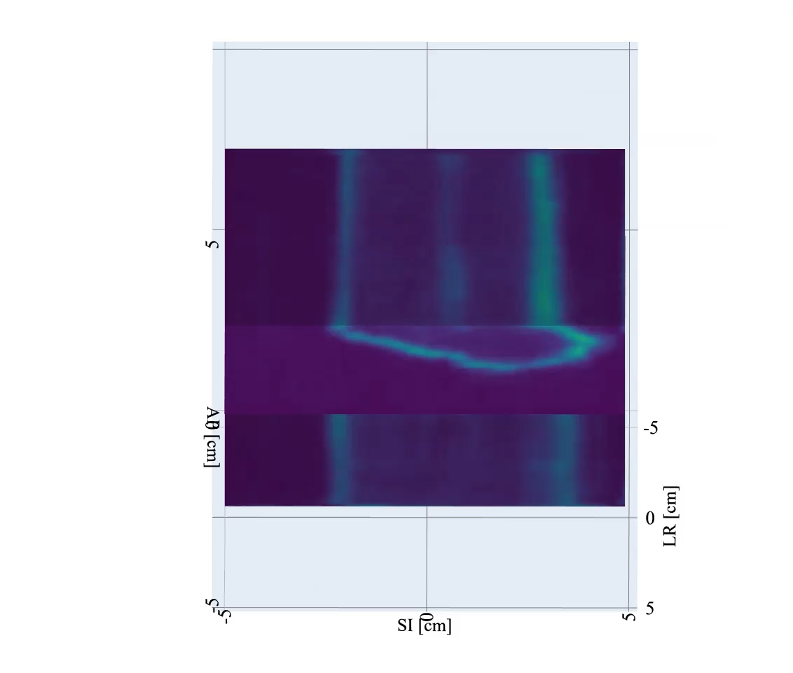
Proposed approach
1
Dose measurement
Tomographic reconstruction
3D dose distribution estimation
QA metrics and decision-making
2
3
4
Reconstructed dose
Dose deposition in scintillator
Input: Projection data
Example use:
3D voxelized dose map.
Development of acceptance criteria.
Thresholding on uncertainty to determine if:
  The reconstruction is reliable.
If the reconstruction is reliable:
  Flag high-error regions;
  Guide targeted review of profiles or PDDs;
  Global acceptance criteria.
Tomographic reconstruction algorithm
Scintillation light emitted
Uncertainty estimation of the reconstruction.
Spatial information on the errors.
Optical system records projections
Output: 3D distribution
Flagging of reconstruction errors.
Uncertainty map
Motivation and Context

Slide 5
Dose Measurement

Slide 6
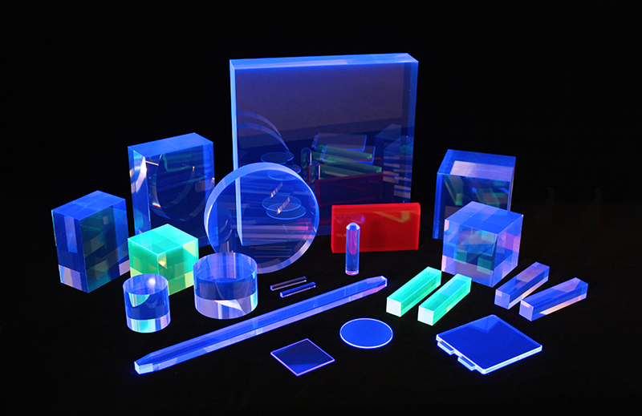

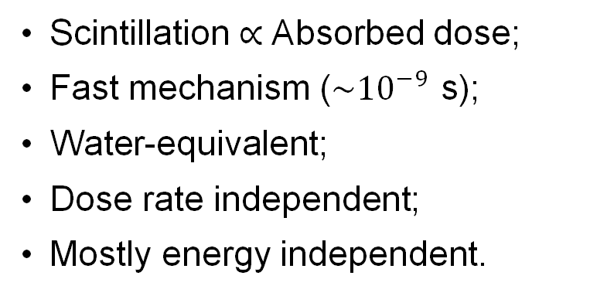
Volumetric scintillation dosimetry
Source: Eljen Technology
Dosimetric Characteristics
Scintillation $∝$ Absorbed dose;
Fast mechanism ($\sim {10}^{−9}$ s);
Water-equivalent;
Dose rate independent;
Mostly energy independent.
The problem becomes…
Imaging of the scintillation light;
Tomographic reconstruction.
Motivation and Context

Slide 7
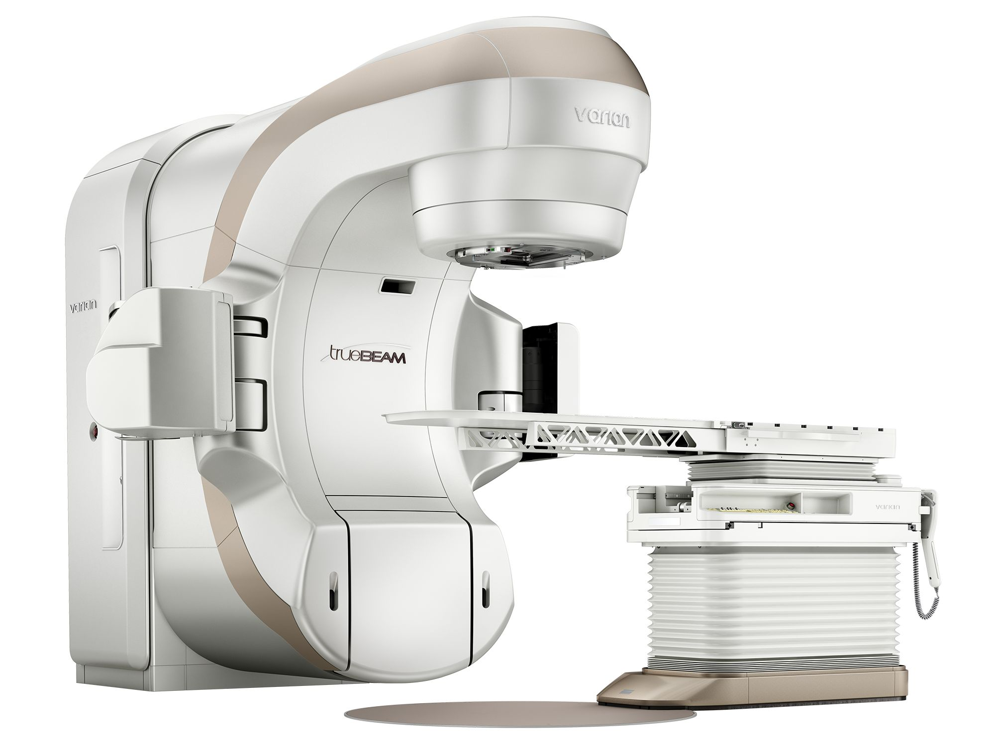
Experimental constraints
Geometric constraints – Restricted space around the treatment isocenter.
Camera placement considerations – Radiation can damage cameras and gantry motion can obstruct optical paths.
Time – Physicists have limited time to perform measurements.
Setup complexity – Intricate setups can suffer from reproducibility problems.
Cost – Multiple cameras or recent technology (ex. plenoptic cameras) can bump up the cost of the device.
Source: Siemens Healthineers
Motivation and Context

Slide 8
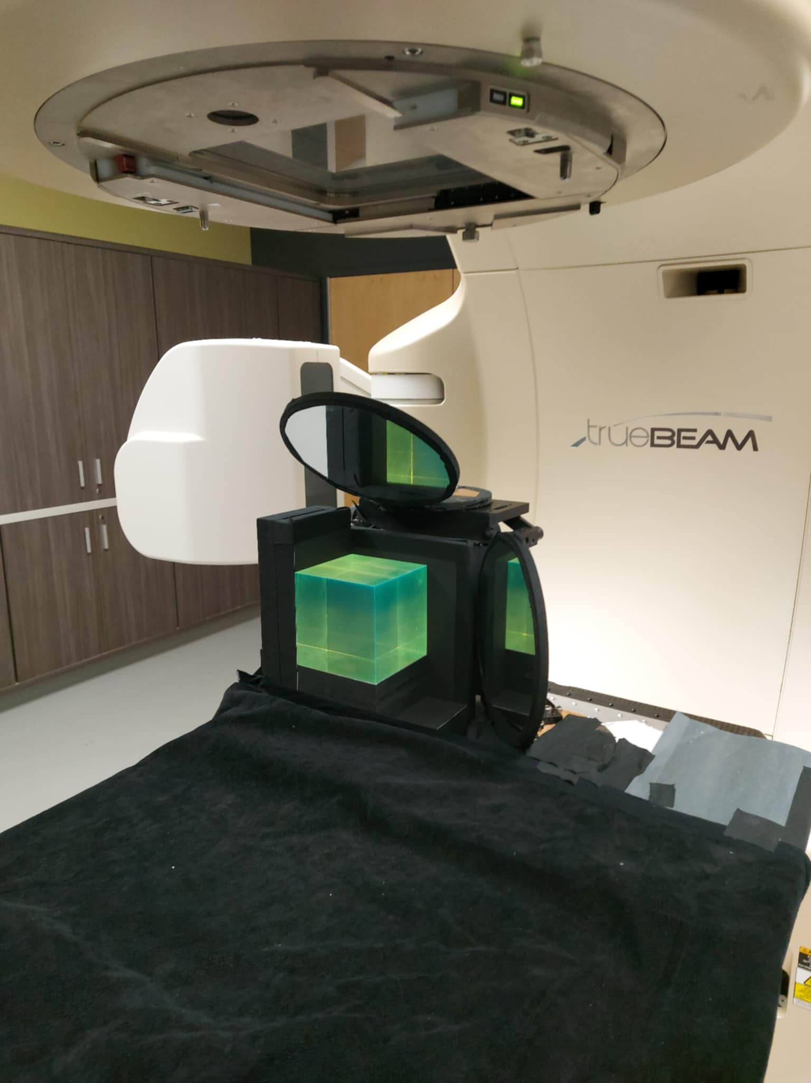
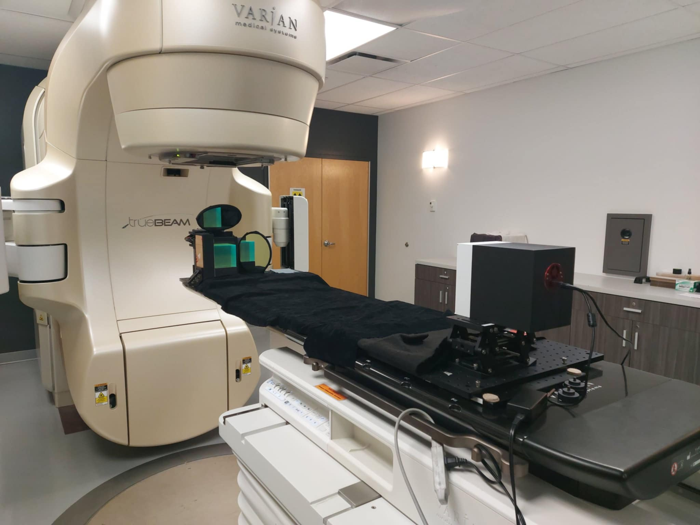

Experimental setup
CCD
Camera
Scintillating
Cube
Plane
Mirrors
Polyvinyltoluene
$$(10×10×10 {cm}^{3})$$
Proposed 3D dosimeter – Experimental data

Slide 9
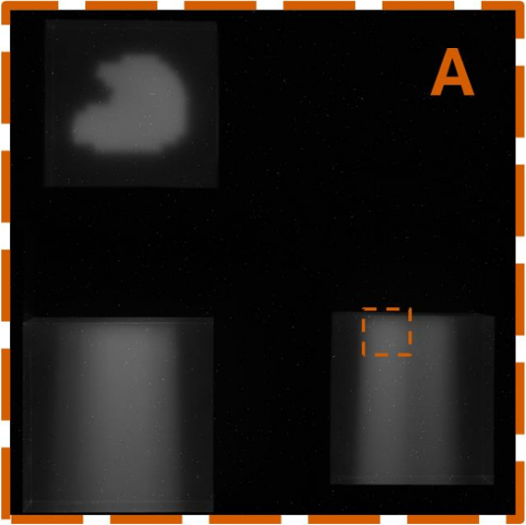
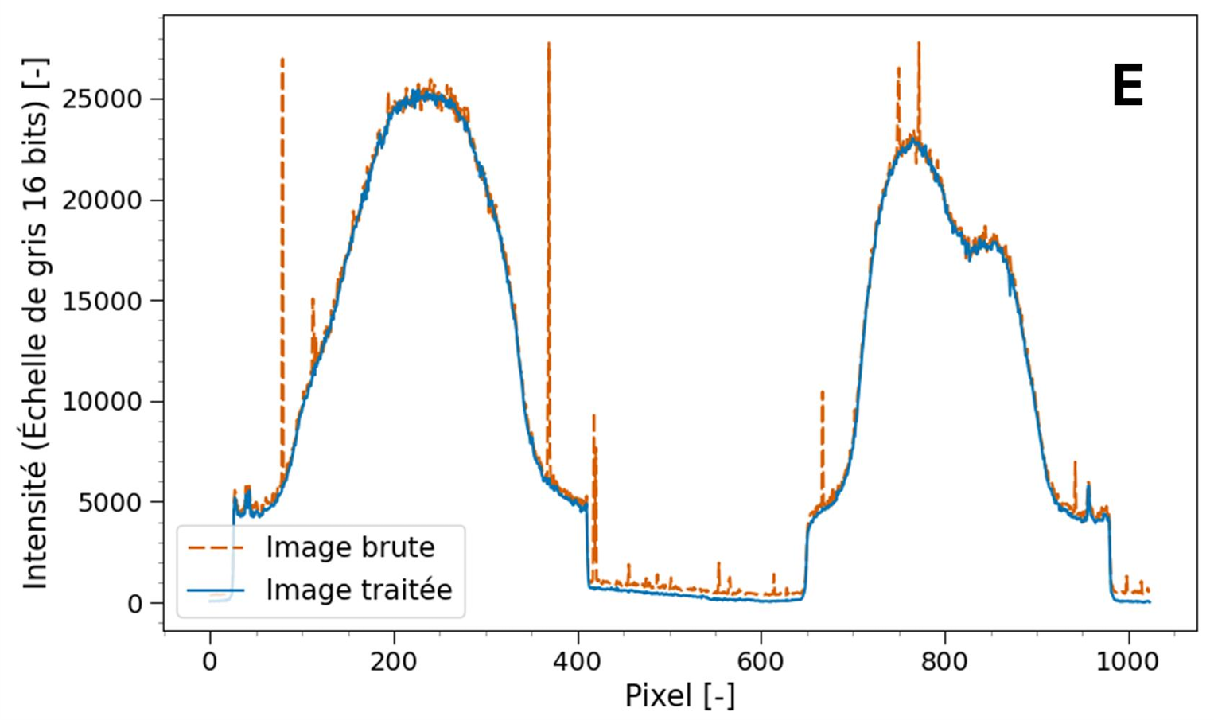
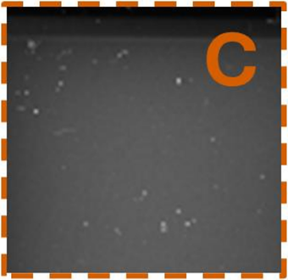
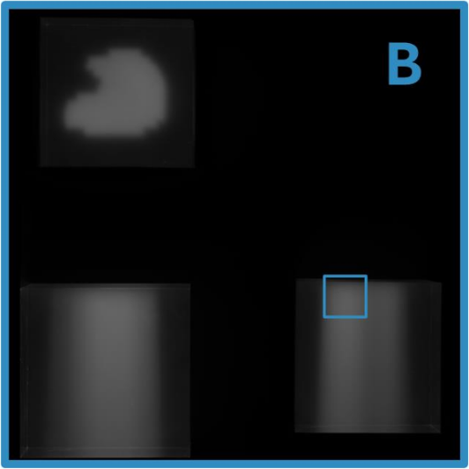

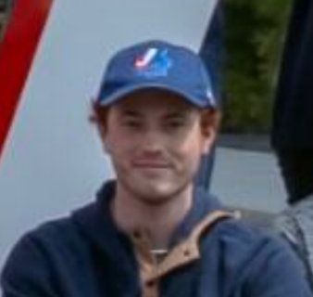
Experimental data collection and curation
Background noise substraction ;
Temporal median filter.
Intensity (16-bit scale) [ - ]
Raw image
Processed image
Pixel [ - ]
Collect of 249 experimental data of the form:
Nicolas Drouin
$$\left(Projection data\text{ ; Associated computed dose distribution}\right)$$
Proposed 3D dosimeter – Experimental data

Slide 10
Tomographic Reconstruction

Slide 11
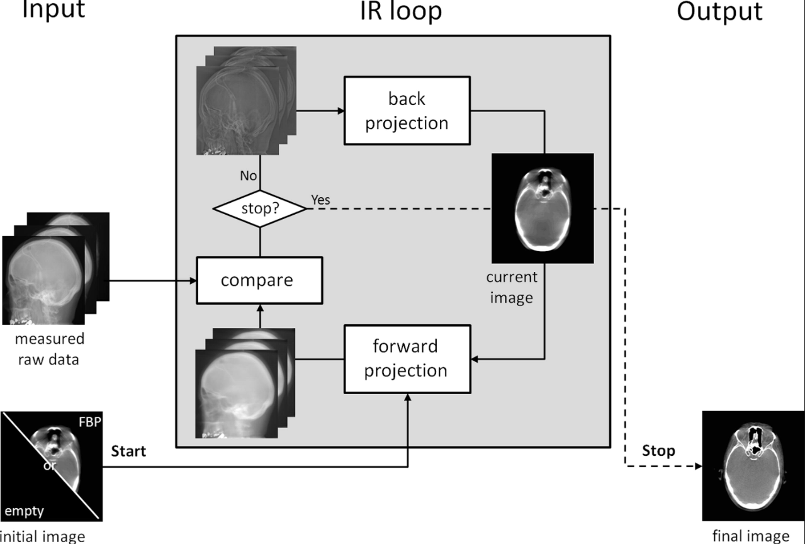
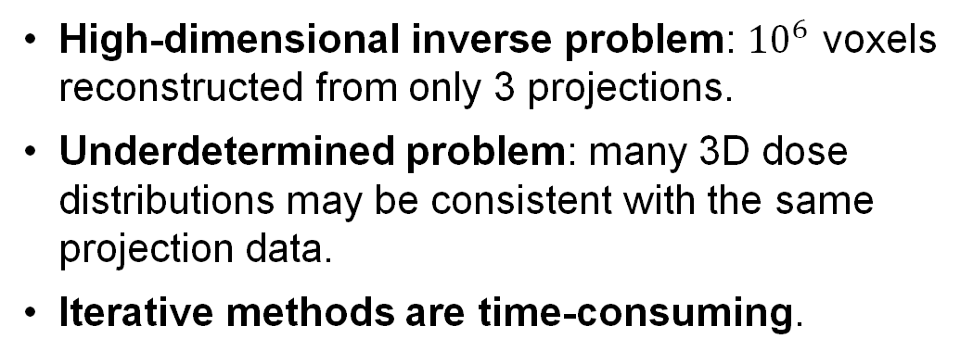
Tomographic reconstruction of scintillation light
In our case, the problem is not simple…
High-dimensional inverse problem: ${10}^{6}$ voxels reconstructed from only 3 projections.
Underdetermined problem: many 3D dose distributions may be consistent with the same projection data.
Iterative methods are time-consuming.
Deep learning reconstruction
High representation capacity
Fast reconstruction after training
Reconstruction from raw light signal.
Beister et al. Physica Medica. 2012
Proposed 3D dosimeter – Reconstruction

Slide 12
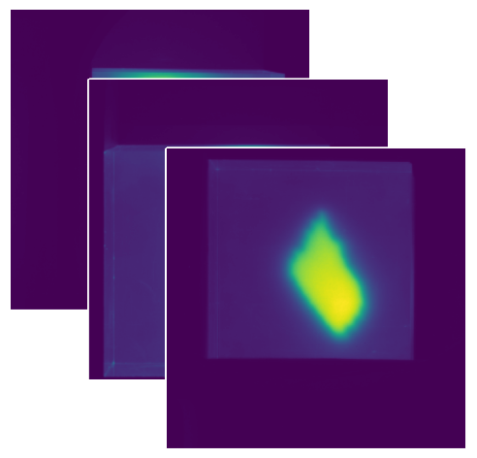
Deep learning reconstruction model
Input
projections
Output
distribution
Encoder-Decoder framework
CNN
Embedding
Transformer
Encoder
3D CNN
Decoder
Latent
Representation
Proposed 3D dosimeter – Reconstruction

Slide 13
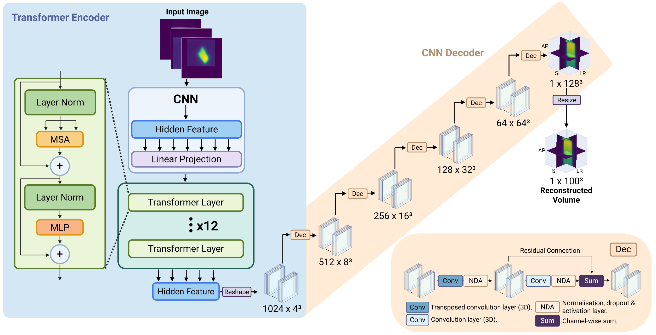
Architecture
Proposed 3D dosimeter – Reconstruction

Slide 14

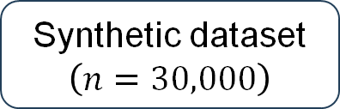

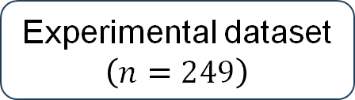



Training data
Synthetic data
Experimental data
Synthetic dataset
$$\left(n=30,000\right)$$
Experimental dataset
$$\left(n=249\right)$$
75%
25%
~70%
~18%
~12%
Training set
$$\left(n=22,500\right)$$
Validation set
$$\left(n=7,500\right)$$
Training set
$$\left(n=175\right)$$
Validation set
$$\left(n=44\right)$$
Test set
$$\left(n=30\right)$$
Data generated by ray-tracing in python.
Gaussian filter to approximate lateral dose falloff.
Empirical equation for depth dose deposition.
Data acquired using the experimental setup.
Proposed 3D dosimeter – Training data

Slide 15
Bayesian Formulation

Slide 16
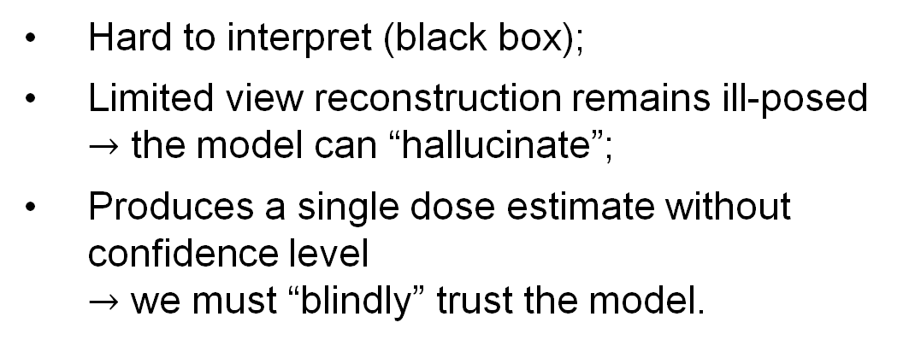
Limitations of DL – Prediction without confidence
Limitations
Hard to interpret (black box);
Limited view reconstruction remains ill-posed $→$ the model can “hallucinate”;
Produces a single dose estimate without confidence level
$→$ we must “blindly” trust the model.
?
Bayesian neural network
Predicts both dose and uncertainty;
Identifies regions with lower reconstruction confidence.
Bayesian formulation – Motivation and Introduction

Slide 17
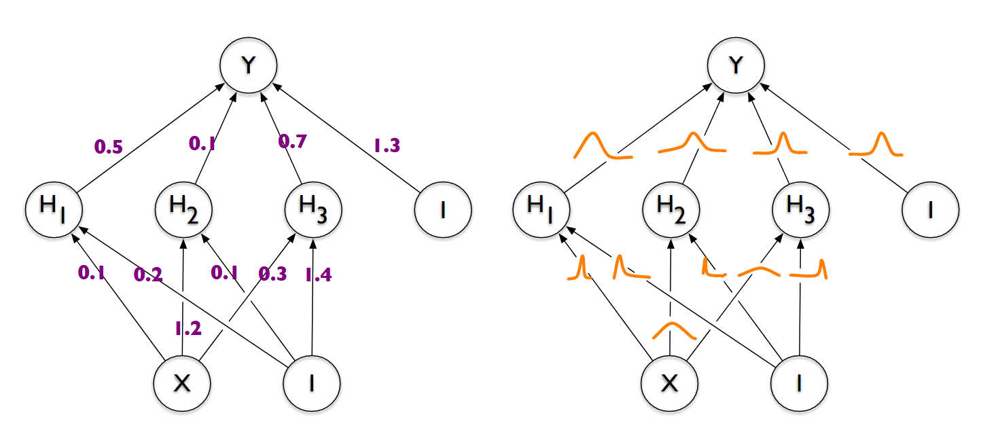
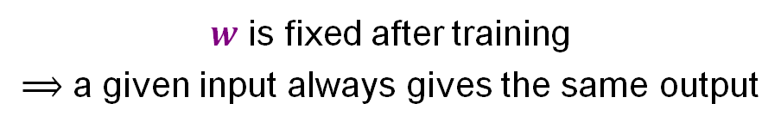

Bayesian Neural Network (BNN)
Deterministic model
$$\boxed{y=f(x;w)}$$
$w$ is fixed after training
$⟹$ a given input always gives the same output
Blundell et al. Int conf on machine learning. 2015
Bayesian formulation – Motivation and Introduction

Slide 18


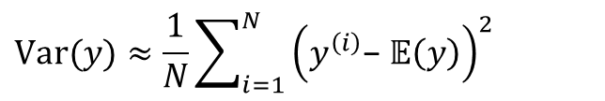
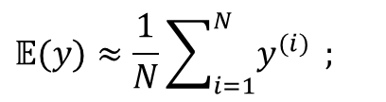
Bayesian Neural Network (BNN)
Deterministic model
Bayesian model
$$\boxed{y=f(x;w)}$$
$$p\left(y\right|x,D)=∫f\left(x;w\right)p\left(w | D\right) dw$$
$w$ is fixed after training
$⟹$ a given input always gives the same output
In practice:
$$w^{(i)} \sim p\left(w | D\right)$$
$$y^{(i)}=f\left(x | w^{(i)}\right)$$
$$𝔼(y)≈\frac{1}{N}\sum_{i=1}^{N}{y^{(i)}} ;$$
$$Var(y)≈\frac{1}{N}\sum_{i=1}^{N}{{\left(y^{\left(i\right)}\text{−} 𝔼\left(y\right)\right)}^{2} }$$
Blundell et al. Int conf on machine learning. 2015
Bayesian formulation – Motivation and Introduction

Slide 19
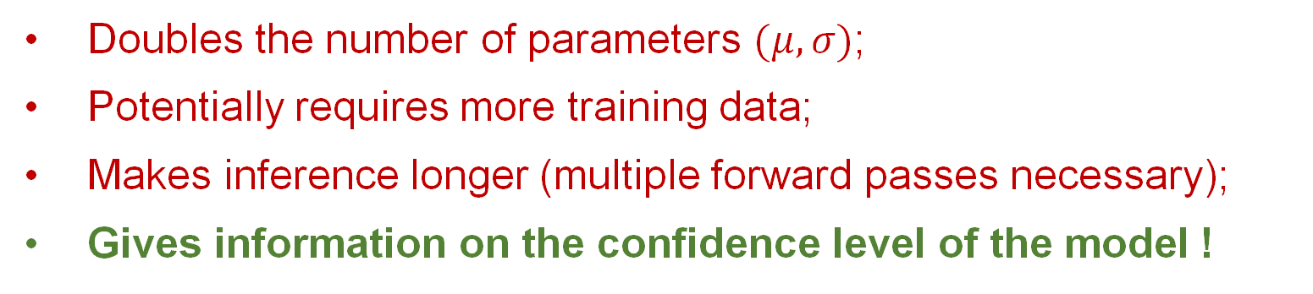

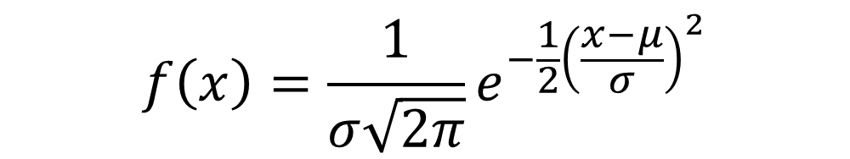
Bayesian Neural Network (BNN)
Generally, distributions on weights are approximated by gaussian distributions
$$f\left(x\right)=\frac{1}{σ\sqrt{2π}}e^{−\frac{1}{2}{\left(\frac{x−μ}{σ}\right)}^{2}}$$
$$w∼𝒩\left(μ,σ\right)$$
Doubles the number of parameters $(μ, σ)$;
Potentially requires more training data;
Makes inference longer (multiple forward passes necessary);
Gives information on the confidence level of the model !
Bayesian formulation – Motivation and Introduction

Slide 20


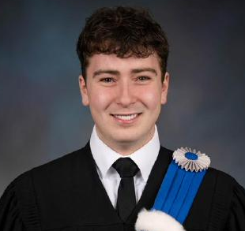
BNN implementation
GitHub repository
https://github.com/torchbayesian/torchbayesian
Deterministic-to-Bayesian conversion of any existing model.
Compatible with any nn.Module – Each weight is reparameterized as a variational distribution.
Direct KL divergence access using analytic computation when available and Monte Carlo estimation otherwise.
PyTorch-native design – Preserves existing workflows and is fully compatible with other PyTorch-based tools such as MONAI.
Raphaël Brodeur
Bayesian formulation – Experimentation

Slide 21
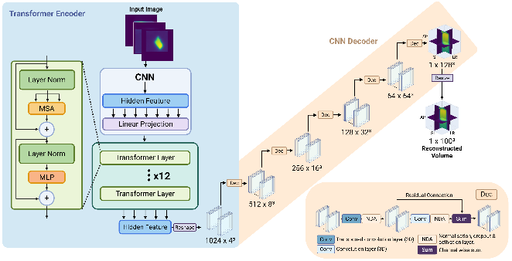
Deterministic vs Bayesian Training
Deterministic formulation
Bayesian formulation
Pre-training
Training
Synthetic dataset
Training set
Validation set
Training
Pre-trained model
Pre-trained model
Fine-tuning
Training
Experimental dataset
Training set
Validation set
Training
Evaluation
Test set
Evaluation
Model analysis and comparison
Uncertainty analysis
Bayesian formulation – Experimentation

Slide 22
Results

Slide 23
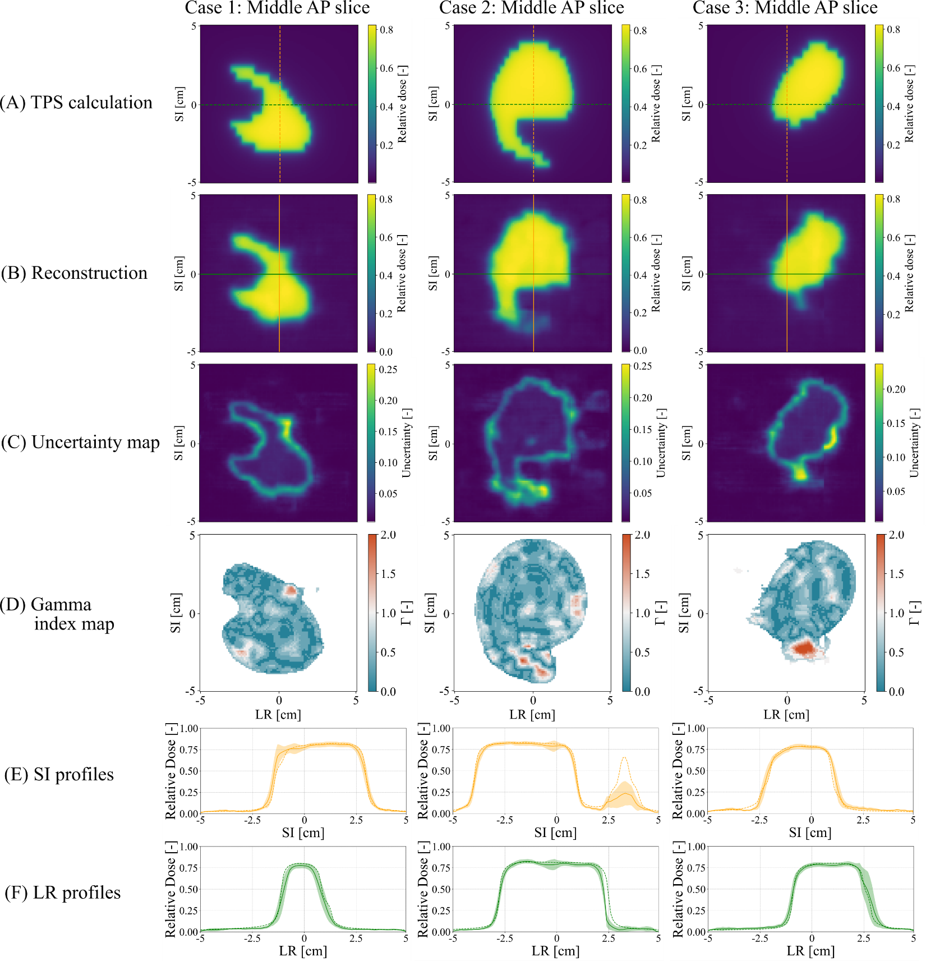
Qualitative correlation
Results – Uncertainty Analysis

Slide 24
Qualitative correlation
Results – Uncertainty Analysis

Slide 25
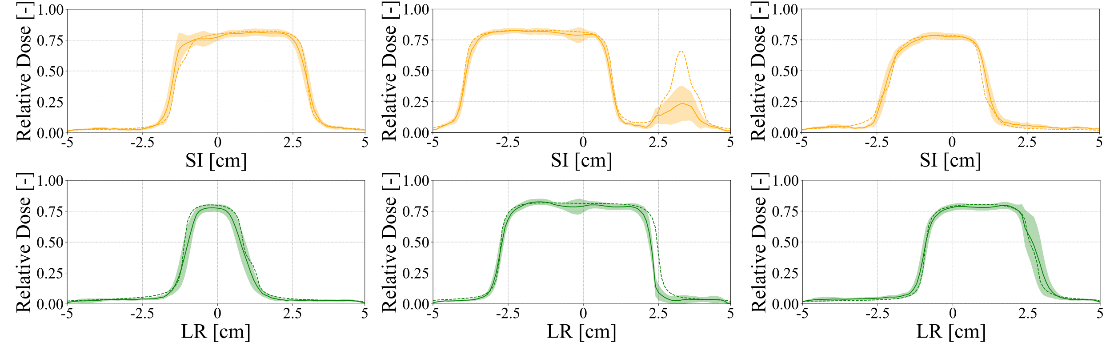
Transverse profiles
?
?
Results – Uncertainty Analysis

Slide 26
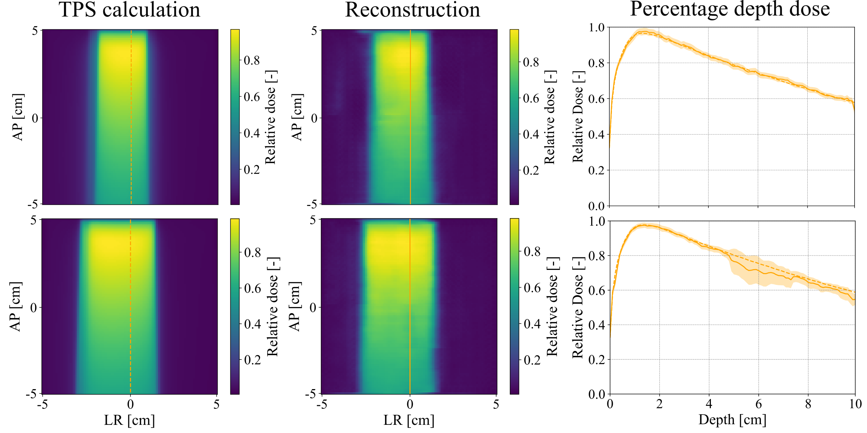
Depth dose curves
Results – Uncertainty Analysis

Slide 27
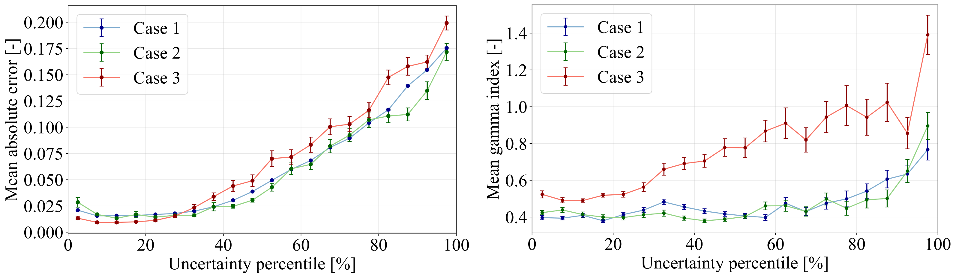




Quantitative correlation
Pearson $(r)$ and Spearman $(ρ)$correlation coefficients on the complete test dataset
$$r=0.94±0.01$$
$$r=0.61±0.06$$
$$ρ=0.96±0.03$$
$$ρ=0.67±0.09$$
Results – Uncertainty Analysis

Slide 28
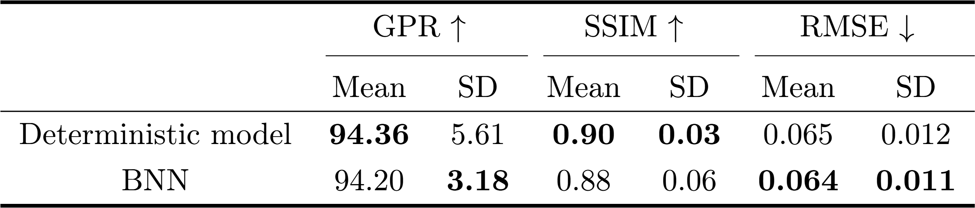
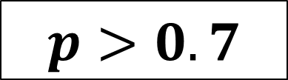
Deterministic model vs BNN performance
$$p>0.7$$
$⟹$ Performance difference not statistically significant !
Results – Deterministic vs Bayesian models

Slide 29
Discussion and Conclusion

Slide 30


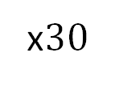











Reconstruction time
Deterministic formulation
Bayesian formulation
$$15.5±0.9 ms$$
(single pass)
$$28.5±0.8 ms$$
(single pass)
$$×number of passes$$
(multiple passes)
$$855±24 ms$$
(in our case)
$$y_{1}$$
$$y_{2}$$
x$30$
$$y_{3}$$
$$\text{mean}\left(y\right)$$
$$x$$
$$y$$
$$x$$
$$\text{s}\text{td}\left(y\right)$$
. . .
$$y_{30}$$
Discussion and limitations

Slide 31
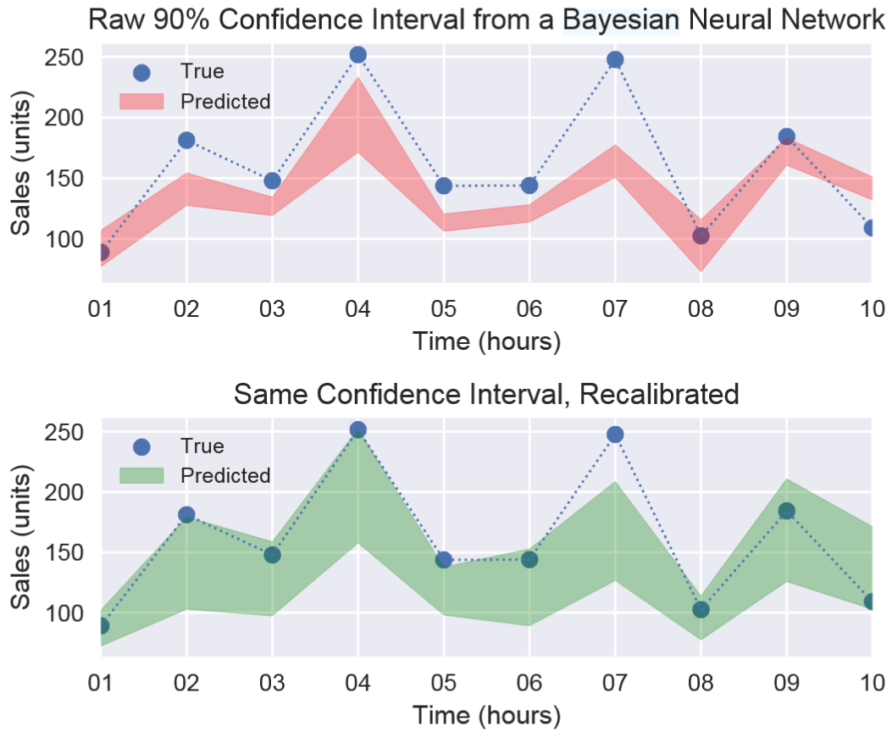
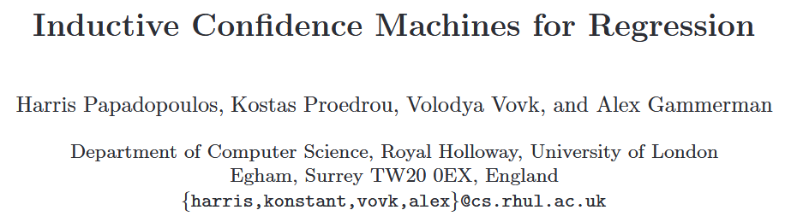
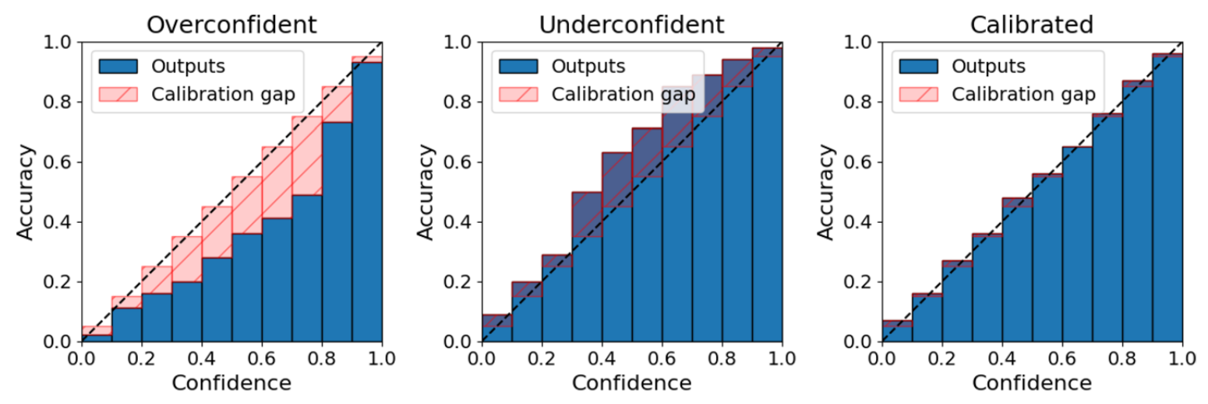
Uncertainty calibration
Calibration is needed to ensure that the derived predictive confidence represents a good approximation of the actual probability of correctness.
Kuleshov et al. Int conf on machine learning. 2018
Gawlikowski et al. Artif Intell Rev 56. 2013
Discussion and limitations

Slide 32
Conclusion
Deep learning reconstruction of a scintillation volume was shown to be a promising approach for real-time 3D dosimetry.
However, classical DL gives prediction without confidence level.
Bayesian neural networks can help provide uncertainty information on the predictions.
Take-home message
The BNN reconstruction framework showed that uncertainty correlates with error.
BNNs allow for confidence prediction without trade-off on performance.
Conclusion

Slide 33
Next steps
Uncertainty calibration and use:
  How can the uncertainty be used ?
Optimize learning methods:
  Test other architectures;
  Add physics priors in the training (gradients, spatial continuity).
Improve training data:
  Implement a new experimental setup providing more information;
  Use of optical design software for synthetic data generation.
Conclusion

Slide 34
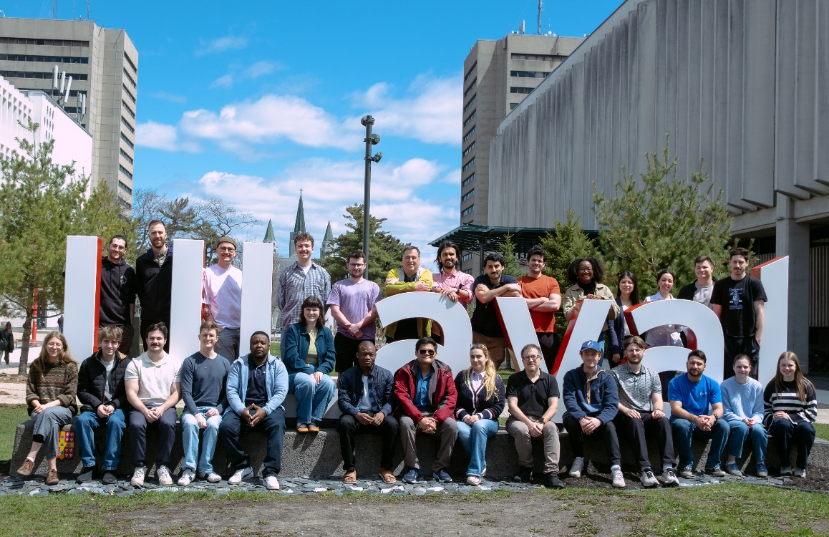

Uncertainty-Aware Deep Learning Reconstruction for 3D Scintillation Dosimetry
Medical Physics Research Group, Université Laval, 2026
Alexis Horik^{1,2,3}, Raphaël Brodeur^{1,3}, Nicolas Drouin^{1,3}, Simon Thibault^{1,2}, and Louis Archambault^{1,2,3}
¹Département de physique, de génie physique et d’optique, Université Laval, Québec, Canada
²Centre d’optique, photonique et laser, Université Laval, Québec, Canada
³Centre de recherche du CHU de Québec-Université Laval et Centre de recherche sur le cancer de l’Université Laval, Université Laval, Québec, Canada
alexis.horik.1@ulaval.ca

