Slide 1
Optimising the yield of optically stimulated luminescence in BaF₂
1/14

Slide 2
Main result
2/14

Slide 3
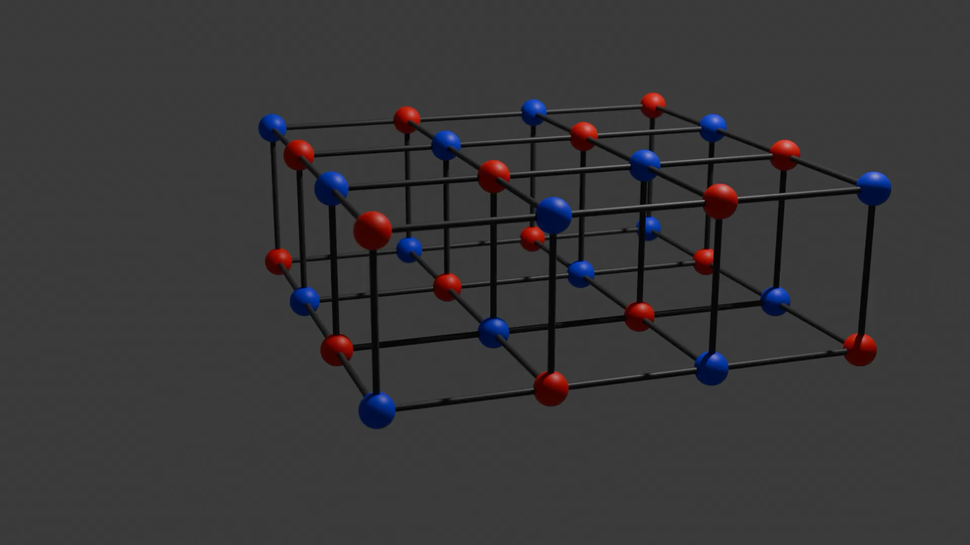
Luminescence via self-trapped excitons
3/14

Slide 4
Luminescence via self-trapped excitons
4/14

Slide 5

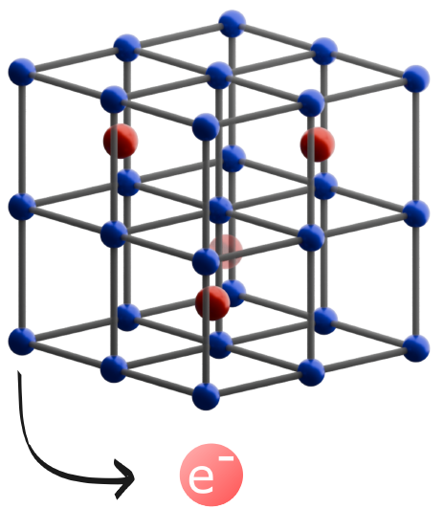
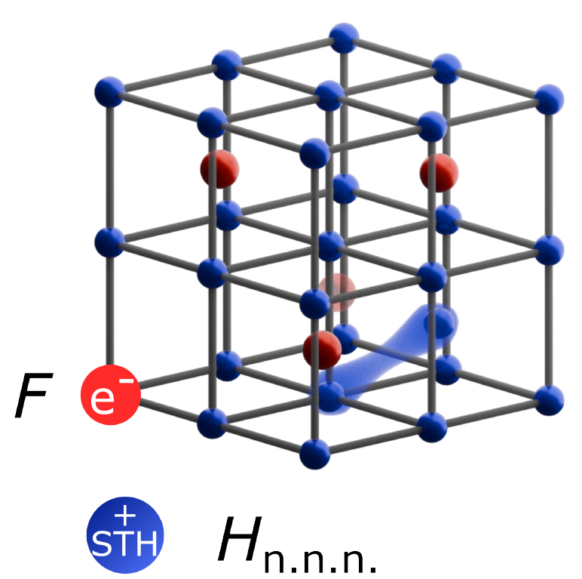
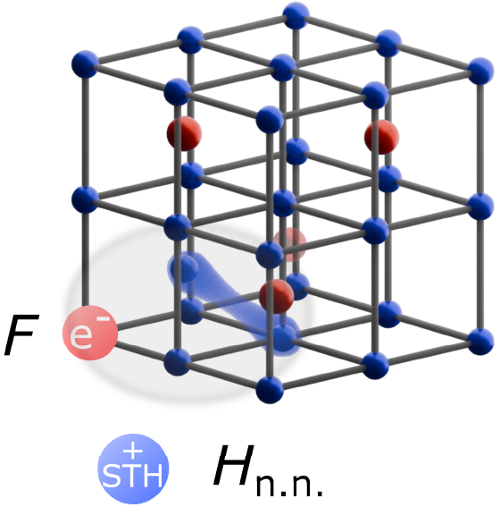
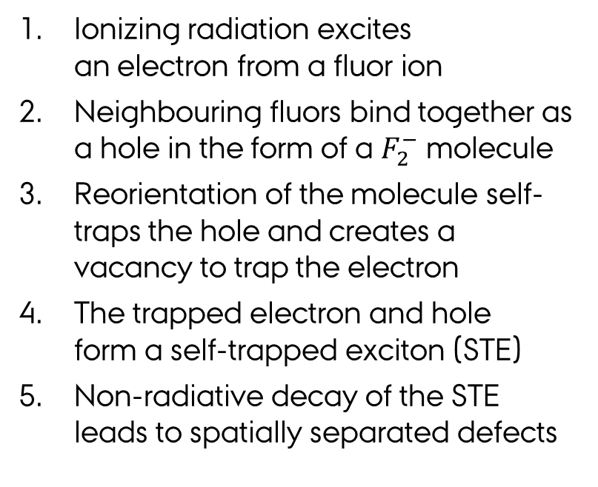
Luminescence process in baf₂
5/14
Ionizing radiation excites
an electron from a fluor ion
Neighbouring fluors bind together as a hole in the form of a $F_{2}^{−}$ molecule
Reorientation of the molecule self-traps the hole and creates a vacancy to trap the electron
The trapped electron and hole
form a self-trapped exciton (STE)
Non-radiative decay of the STE leads to spatially separated defects
J.C. Warming et al., Nature Photonics (in review)

Slide 6
Optical absorption
6/14

Slide 7
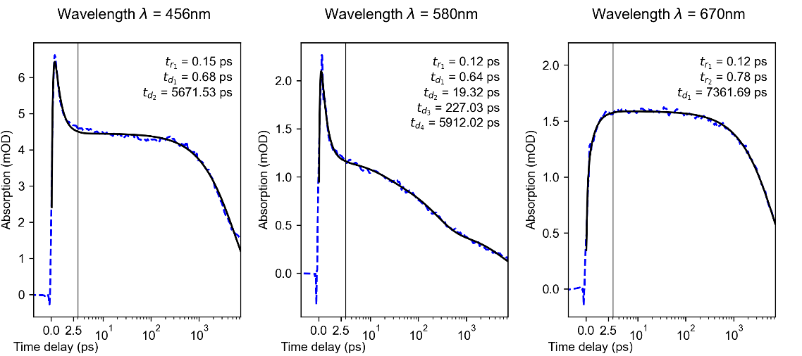
Optical absorption – transient
6/14
Two main bands dominate
Charges are trapped immediately
A fast component couples the bands

Slide 8
Optical absorption – stable
7/14
The two main bands
persist over a long time.
Spectral separation
and difference in shapes indicates distinct traps.
Optical bleaching suggests
these to be responsible for OSL.

Slide 9
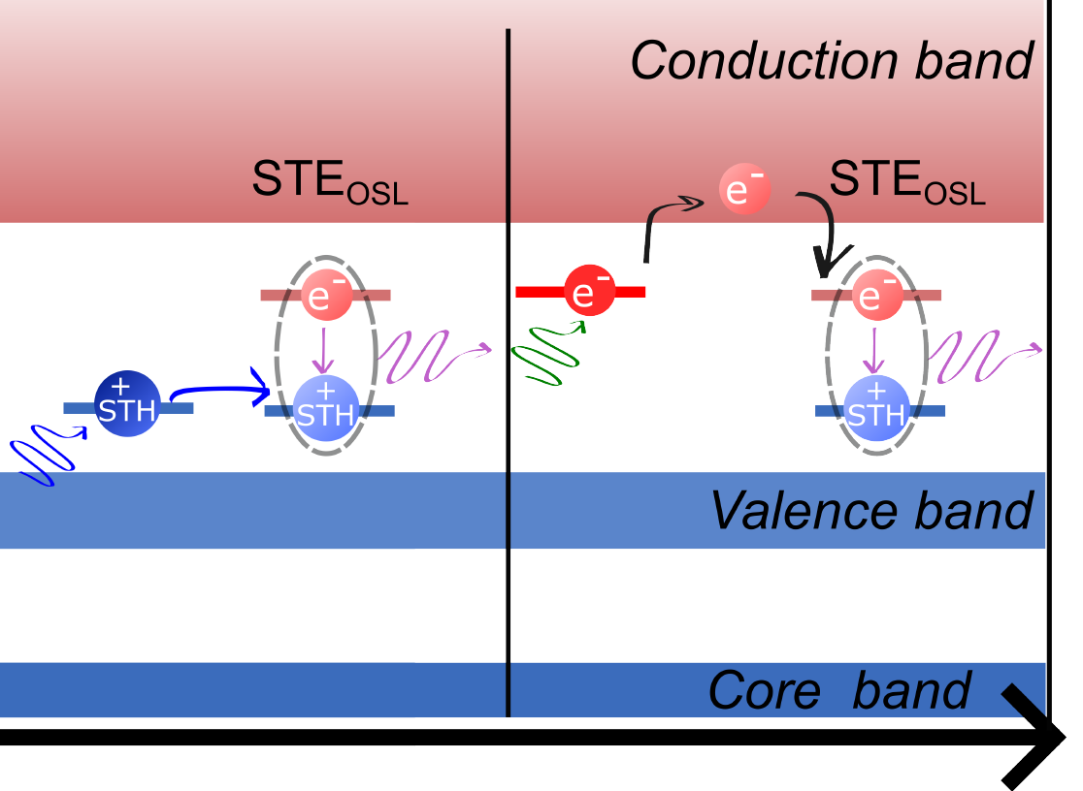
Lattice configurations
8/14
Spectral separation of traps
  Allows for selective liberation
Hole liberation
  F center + H center (scintillation STE)
Electron liberation
  Free electron + H center

Slide 10
Yield increase
9/14
Electron stimulation increases the OSL yield for the following measurement
Hole liberation/bleaching seems to reset the effect

Slide 11
Emission spectra
10/14
OSL emission spectrum is
very similar to scintillation
  Possibly due to STE configurations
Scintillation can be induced by two-photon absorption (2PA)
  Not limited to ionizing radiation
200
250
300
350
400
450

Slide 12
optical excitation and osl
11/14
Scintillation
OSL
Decay times are similar between scintillation and OSL, although OSL rise is slow
OSL from ionizing radiation and optical excitation decay equivalently

Slide 13
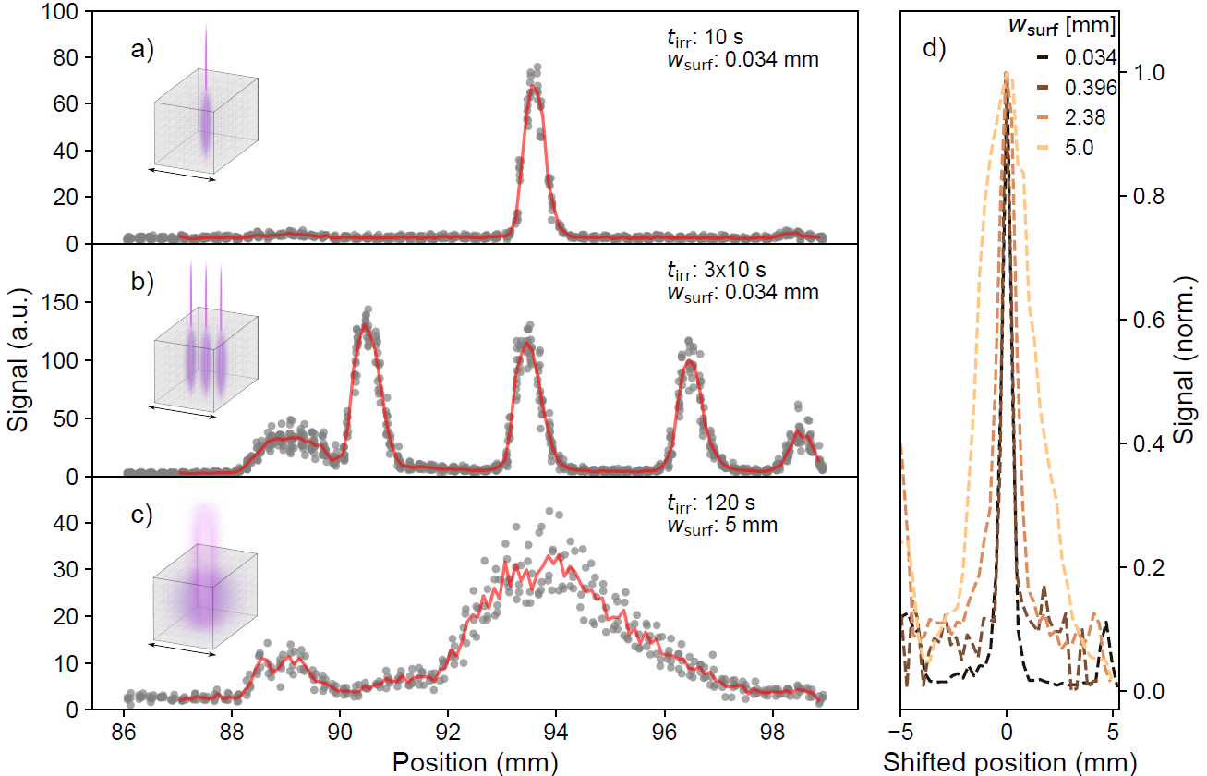
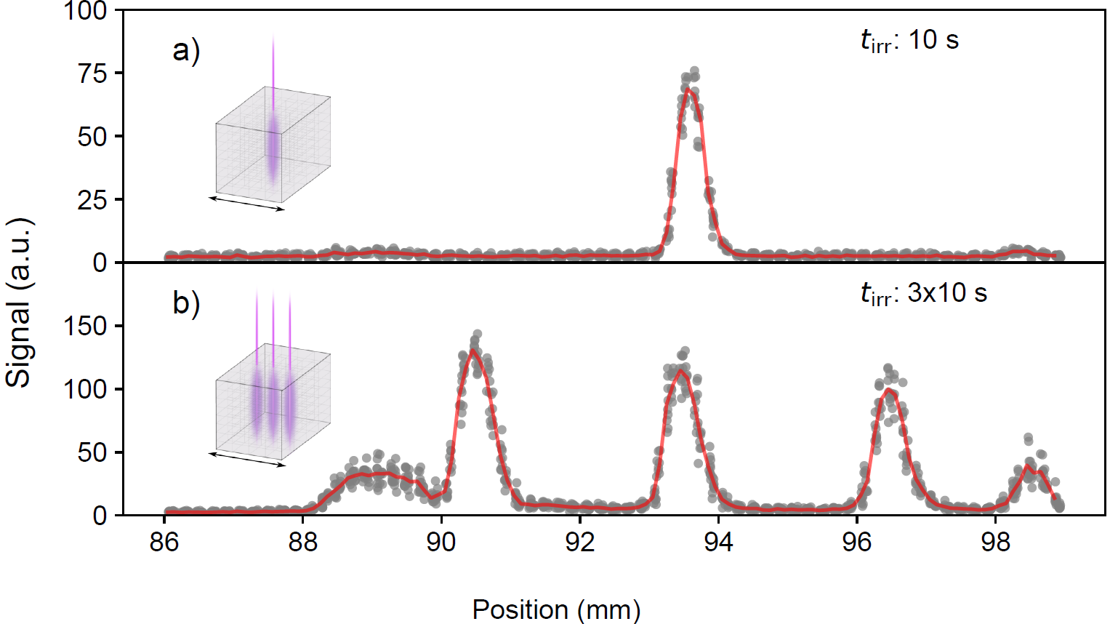
Spatial readout
12/14
Imaging of OSL after ”irradiation”
from 2PA with fs-laser pulses (~50 µJ)
Moving the irradiation position
creates spatially separated signals
Solid spatial resolution (~500µm)
limited by readout beam width.

Slide 14
Conclusion and outlook
13/14
Charge trapping in BaF₂ results
from non-radiative STE decay
The OSL yield can be increased
by selective liberation of electrons
Scintillation and OSL are both
independent of excitation source
Can we homogeneously increase the OSL yield?
How do we determine the
optimal stimulation wavelength?
Can the spatial readout be used to gain
information about non-linear processes?

Slide 15
Thank you for your attention
14/14
Questions?
Funding:
Contact: jcwarming@phys.au.dk
Supervision: Rosana M. Turtos & Peter Balling

