Slide 1






Cherenkov imaging dosimetry for heterogeneous phantom in the context of a MR-Linac
Audran Poher^{1, 2, 3}, Janelle Morrier³, Tigran Galstian¹, Louis Archambault^{1, 2, 3} and Luc Beaulieu^{1, 2, 3}
¹Département de physique, de génie physique et d’optique, Université Laval
²Centre de recherche sur le cancer, Université Laval
³Service de physique médicale et de radioprotection, Centre Intégré de Cancérologie et CRCHU de Québec, CHU de Québec

Slide 2
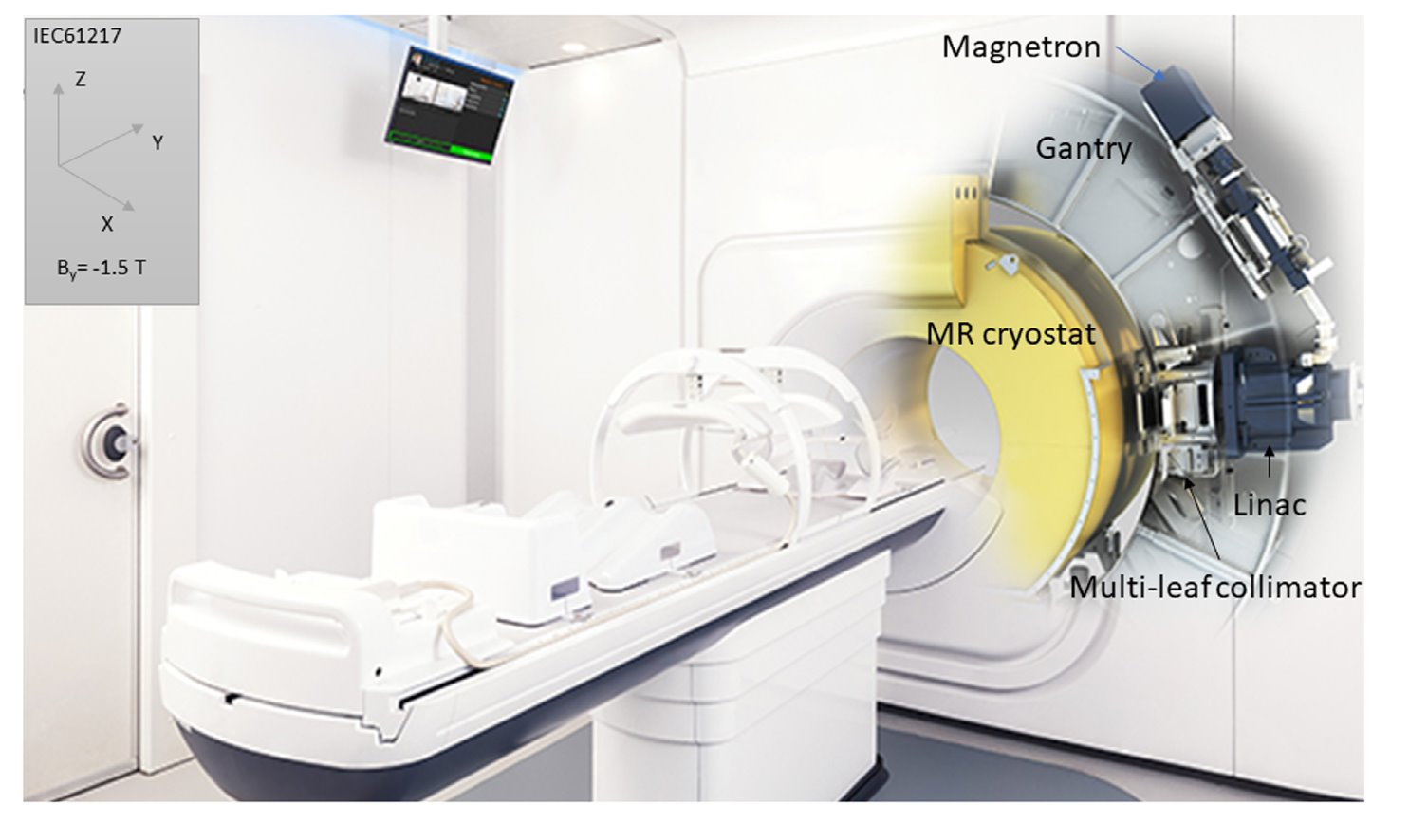
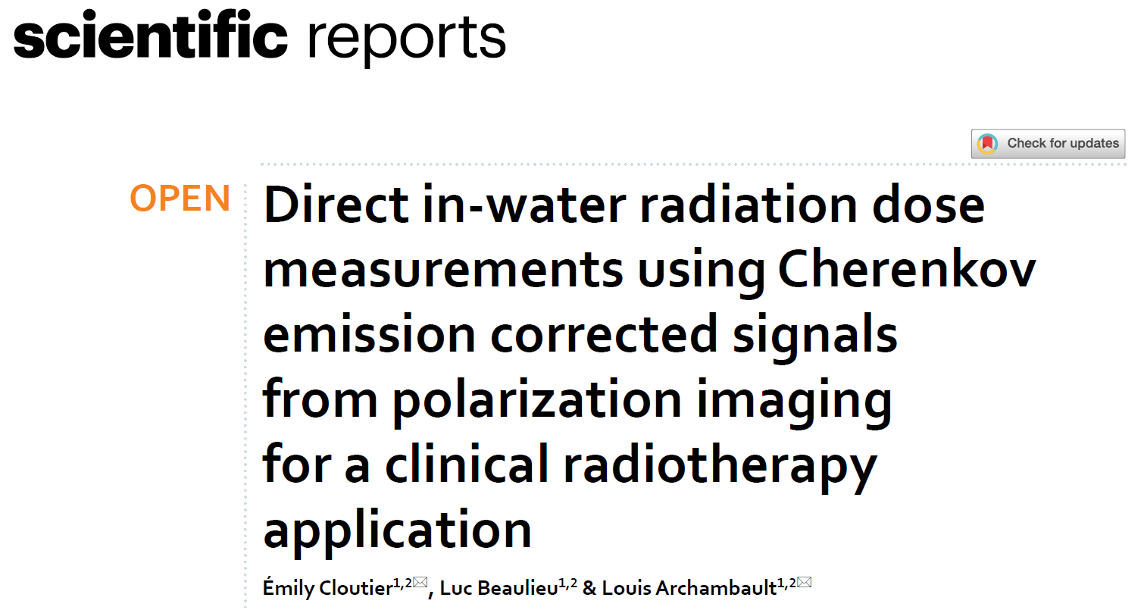
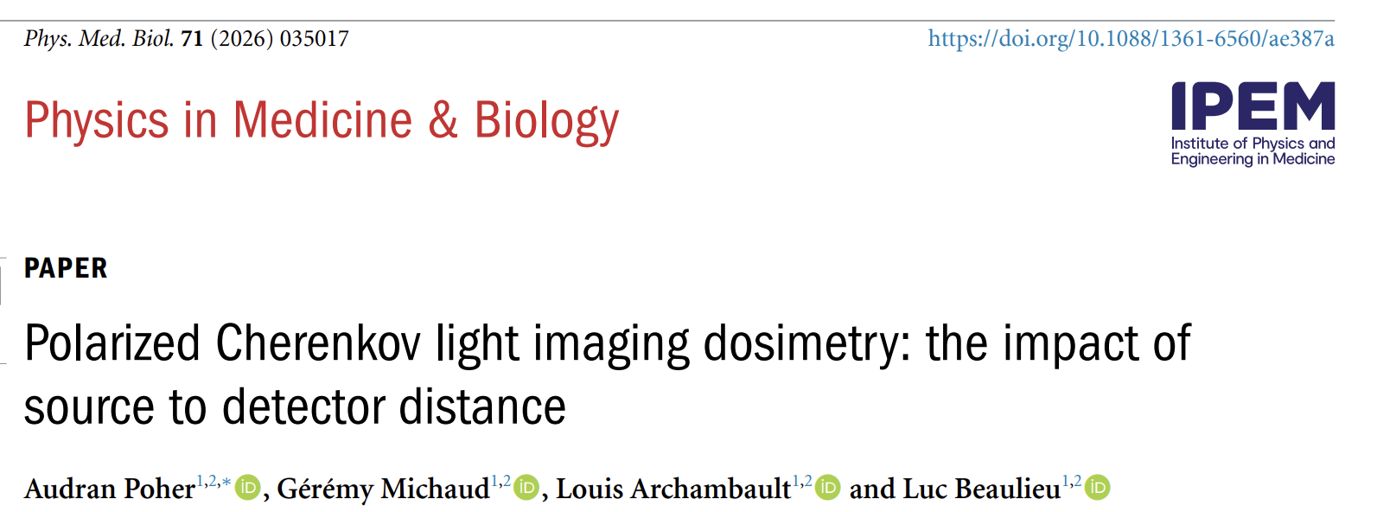
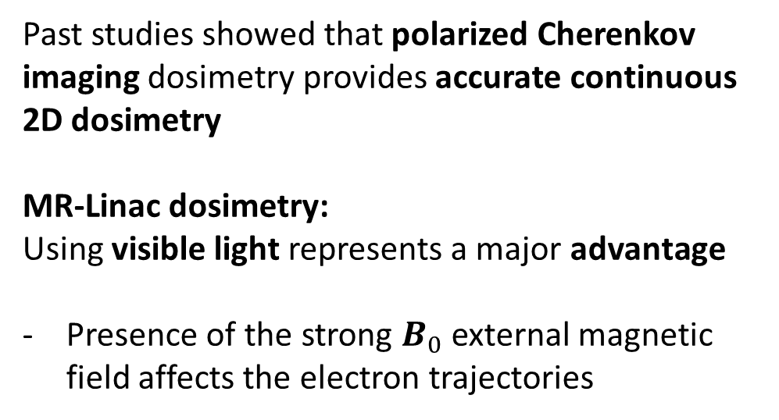
Introduction
Past studies showed that polarized Cherenkov imaging dosimetry provides accurate continuous 2D dosimetry
MR-Linac dosimetry:
Using visible light represents a major advantage
Presence of the strong $B_{0}$external magnetic field affects the electron trajectories

Slide 3
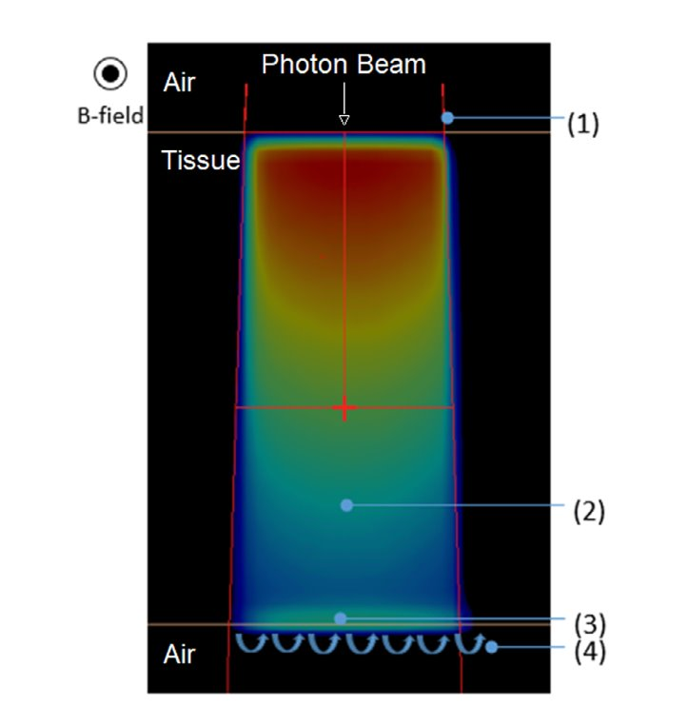
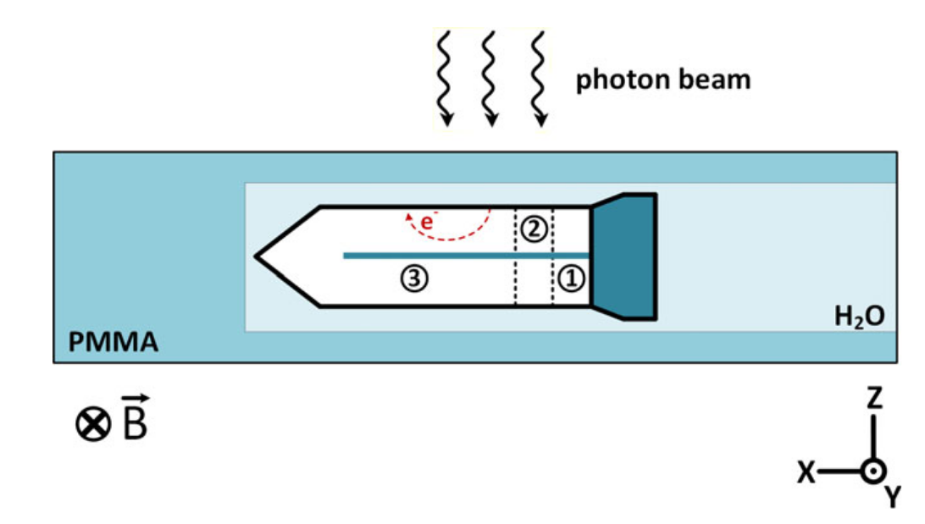
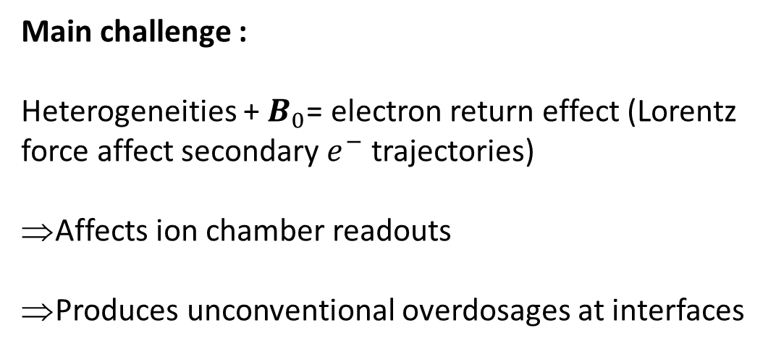
The electron return effect
Main challenge :
Heterogeneities + $B_{0}$= electron return effect (Lorentz force affect secondary $e^{−}$ trajectories)
Affects ion chamber readouts
Produces unconventional overdosages at interfaces
Use luminescence-based dosimetry
Electron return effect (ERE)
Roberts et al. (2021)
Malkov and Rogers (2017)
Notes:
Main challenge comes from the combination of hereto + B_0, resulting in the electron return effect

Slide 4
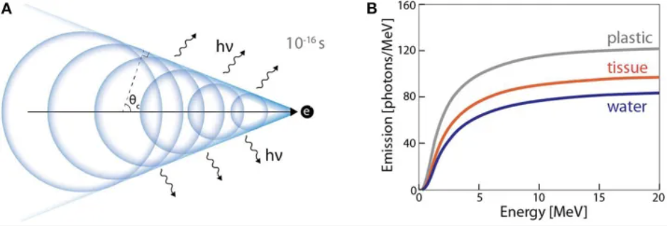
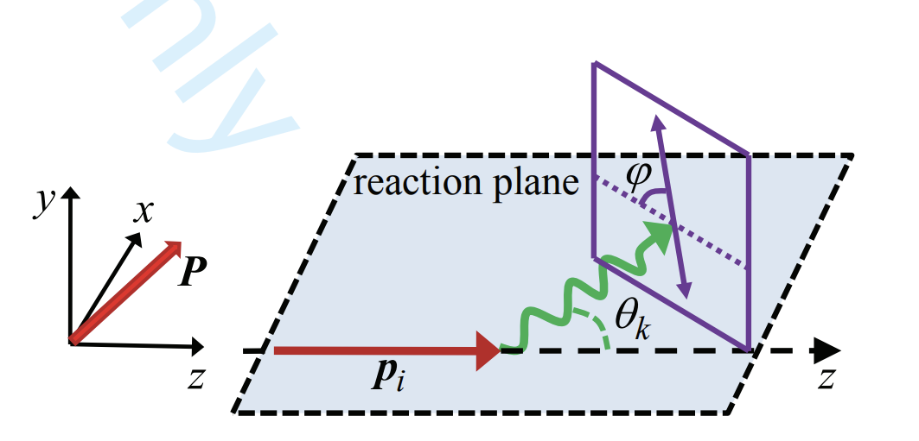
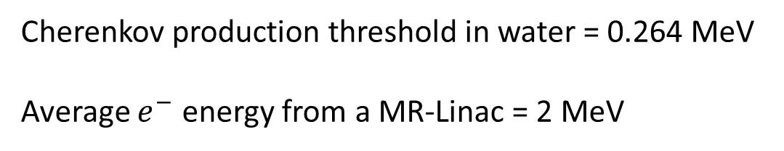
Cherenkov light emission
Cherenkov production :
Charged particle faster than light in medium
Constructive interferences of the electromagnetic wave = photon emission
Ashraf et al. (2020)
Cherenkov production threshold in water = 0.264 MeV
Average $e^{−}$ energy from a MR-Linac = 2 MeV
Cherenkov light can be used for luminescence-based dosimetry
Cherenkov is partly polarized due to conical emission
Peshkov (2019)

Slide 5
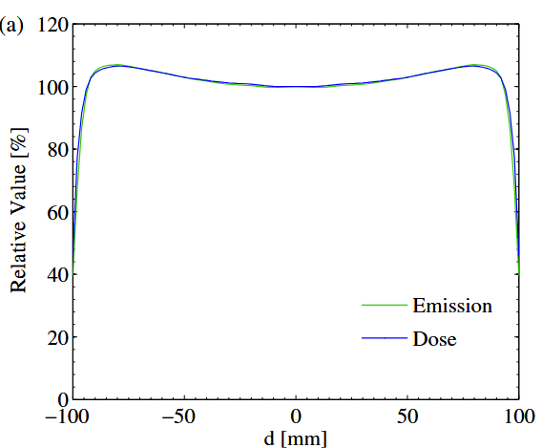

Our study
Cherenkov polarimetry:
Heterogeneities:
Field combination
Malus law:
Characterize the electron return effect with Cherenkov
Fluence energy spectrum averaging with AP-PA (Glaser et al. 2014)
- 1% / 1 mm agreement
$$I= I_{pol}{(\cos{(α_{0}−α)})}^{2}+I_{rand pol}$$
Deposited dose [Gy]
(Cloutier et al. 2022, Poher et al. 2026)
$$I_{pol}$$
Objective: characterize polarized Cherenkov imaging dosimetry in a heterogeneous phantom irradiated by a combination of fields from an MR-Linac
Glaser et al. (2014)

Slide 6
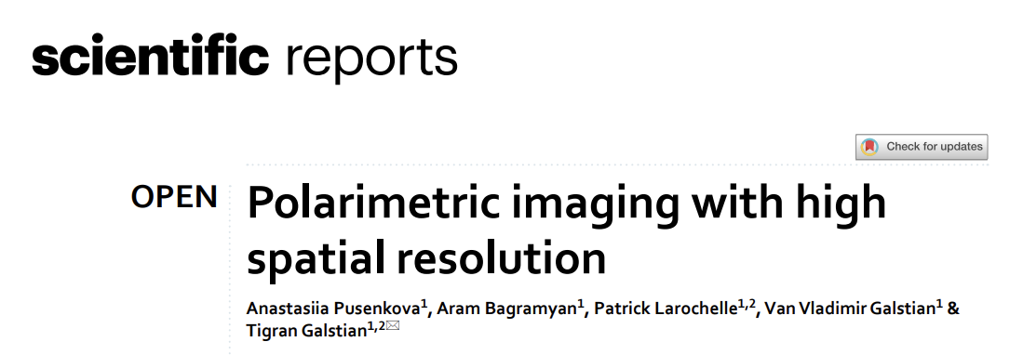
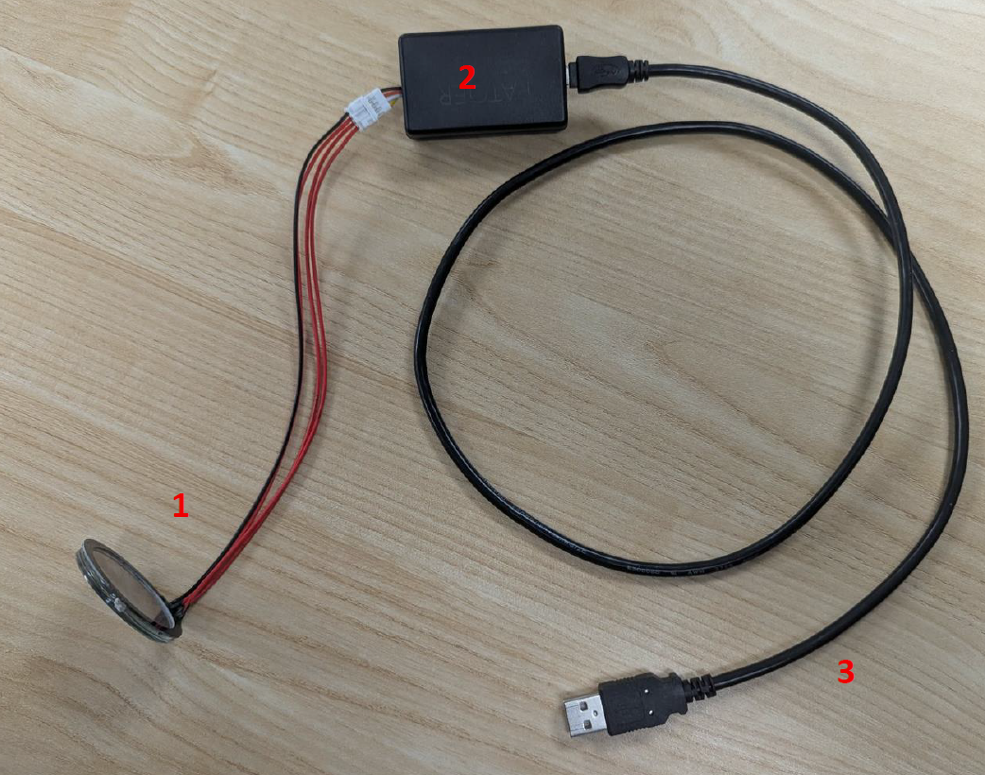
Predator filter
Predator V2 system (PATQER Photonique Inc.) (Pusenkova et al., 2025):
Polarizer-free electro-optic device
Nematic liquid crystal windows:
  positive dielectric anisotropy (electronically tunable)
  doped by a mixture of dichroic azobenzene molecules (Disperse Red 1)
Advantage: perform polarimetry and keep spatial resolution (no pixels in the filter)
Polarization Imaging User manual, PATQER Photonique Inc (2026).
Notes:
- nematic: radomly disposed in the medium
-Doping allows for : dichroic macroscopic light absorption (parallel and perpendicular components are attenuated differently)
- Positive dielectric anisotropy allows for the filter to be electronically tunable

Slide 7
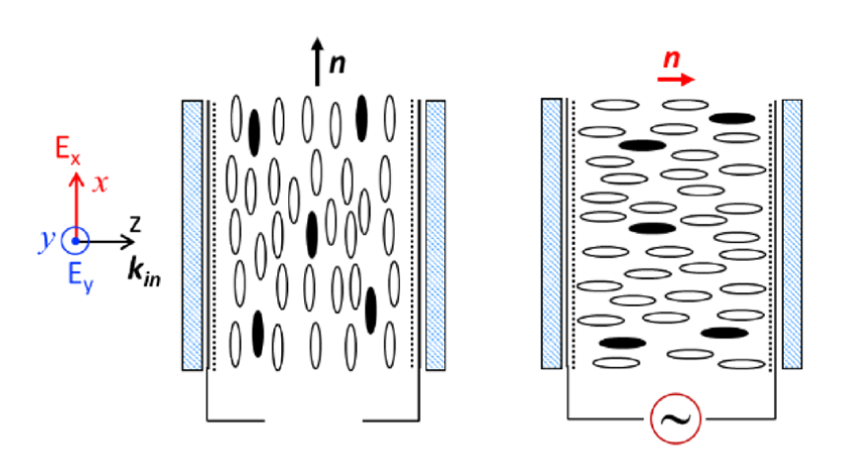
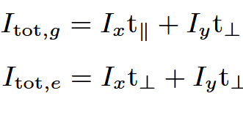


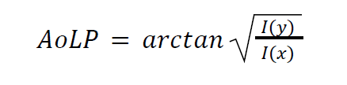
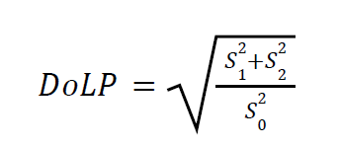
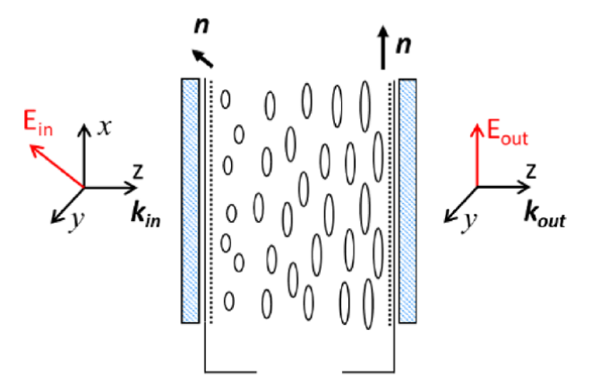



Predator filter: working principles
80%
Layer 1 ground state
40%
Layer 1:
Dichroic attenuation
Layer 1 (and 2) excited
Layer 1 and 2 ground state
Layer 2:
Adiabatic rotation 45°
Layer 1 and 2 excited
Notes:
Layer 1: straight liquid crystals
Layer 2: twisted liquid cristals, in ground state: adiabatic rotation at 45 deg
Combination of ground and excited states applied on layer 1 and 2

Slide 8
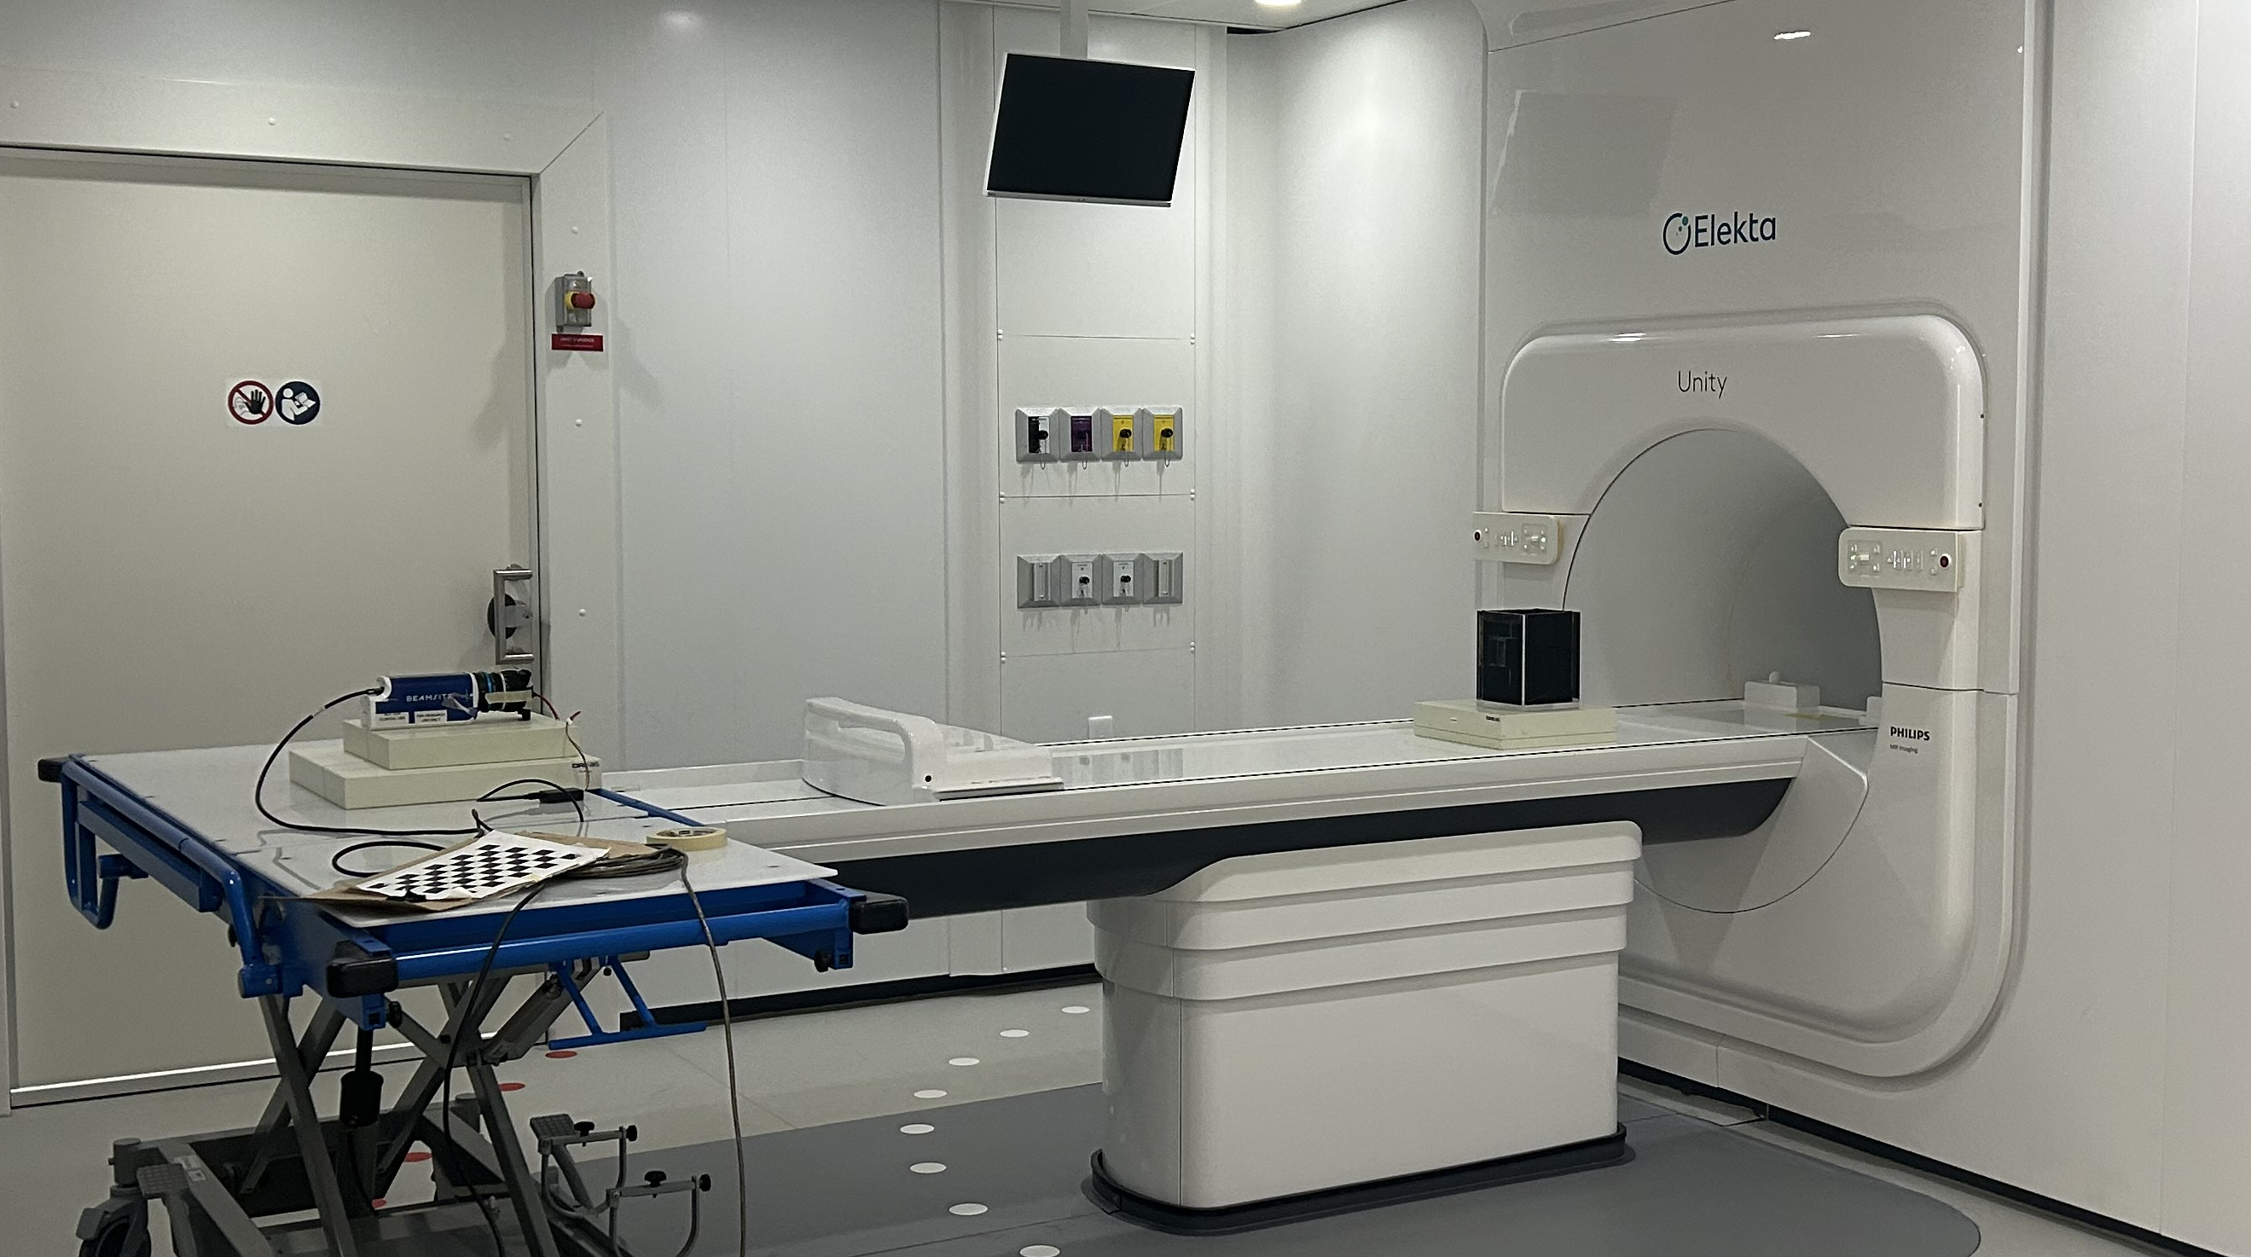




Experimental setup
Camera’s point of view
$$x$$
$$y$$
Beam 0°
Beam 45°
MR-Linac
$$z$$
3 cm
Acrylic walls
Camera + Predator V2
ROI 1
2 cm
Air cavity
20 cm
ROI 2
Water
17 cm
Phantom
Isocenter
1.7 cm
ROI 3
6.7 cm
2.5 cm
15 cm
Beam 115°
ROI 1: upper horizontal (UH) interface
Beam characteristics:
7 MV
600 MU at 425 MU/min
Phantom limitations prevented directly symmetrical opposed beams
ROI 2: right vertical (RV) interface
ROI 3: isocenter region

Slide 9
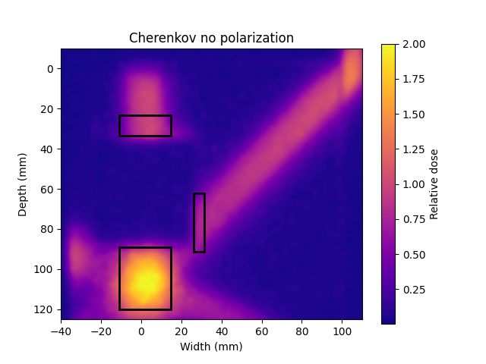
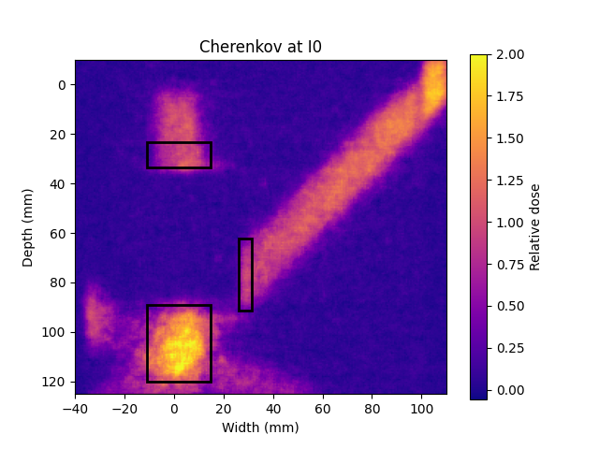
Polarimetric and dosimetric analysis
Polarimetric analysis (using the Predator software):
Image intensities at 0°, 45°, 90° and 135° polarization angles
AoP + DoLP map
Dosimetric analysis:
Projected percent depth dose
Gamma index maps with a 3% / 3 mm criteria
ROI 1: UH interface
ROI 2: RV interface
ROI 3: isocenter region
ROI 1: UH interface
ROI 2: RV interface
ROI 3: isocenter region
Notes:
Image ressampling with RegularGridInterpolator from scipy.interpolate

Slide 10
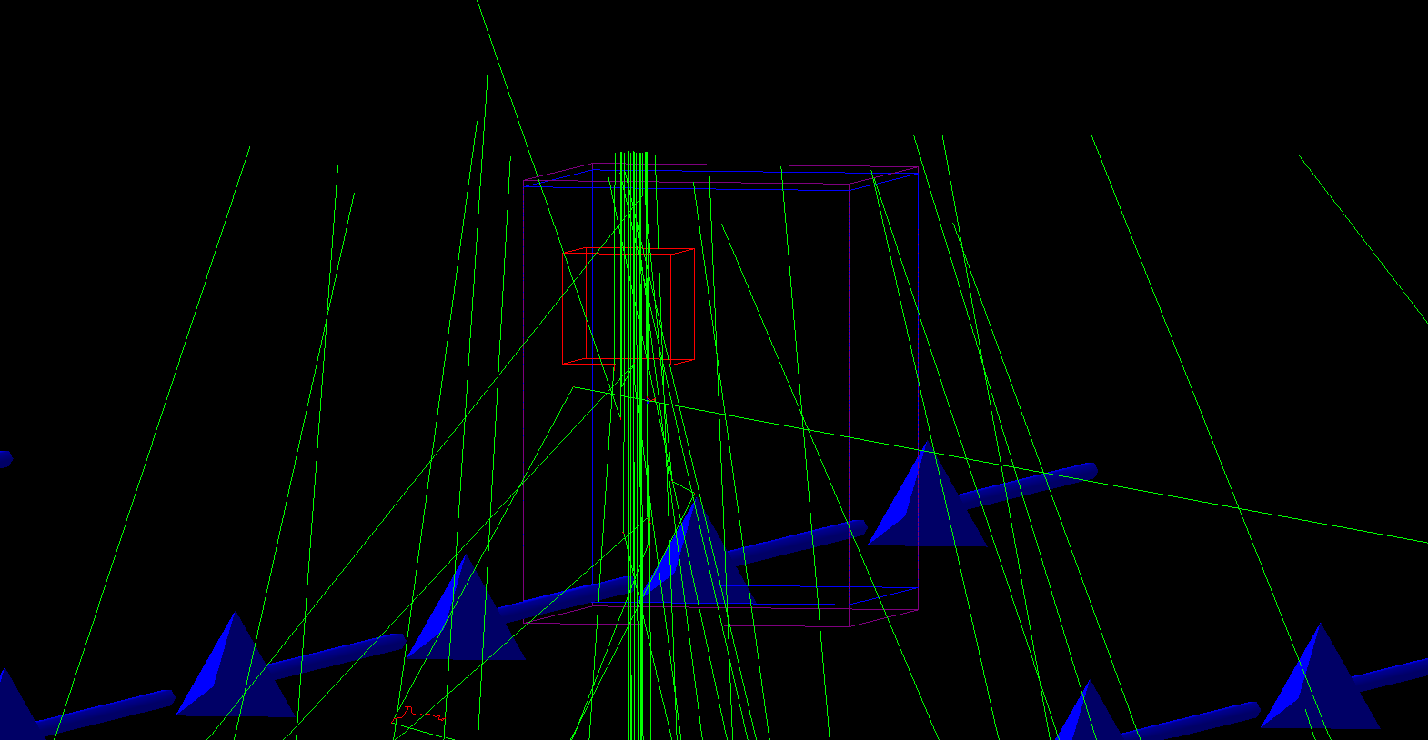
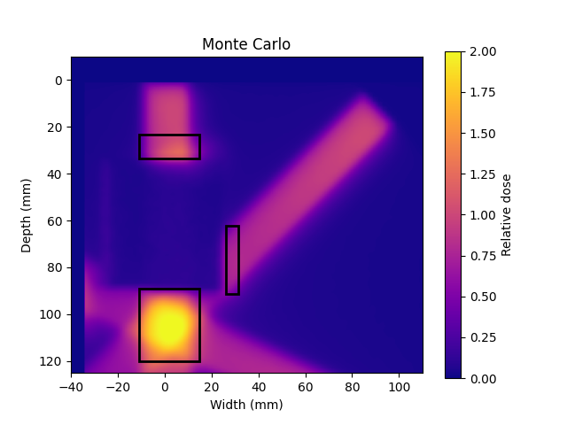


Reference Monte Carlo dose map
Gantry at 0°
10⁸ histories per beam
Beam simulated using phase space provided by Elekta (scored 129 cm from the source)
2 mm × 2 mm × 2 mm voxels
Modeled phantom geometry
TOPAS Monte Carlo toolkit version 3.9
  Geant4 version 10.7
ROI 1: UH interface
ROI 2: RV interface
ROI 3: isocenter region
Perl et al. (2012), Faddegon et al. (2020)
Agostinelli et al. (2003)

Slide 11
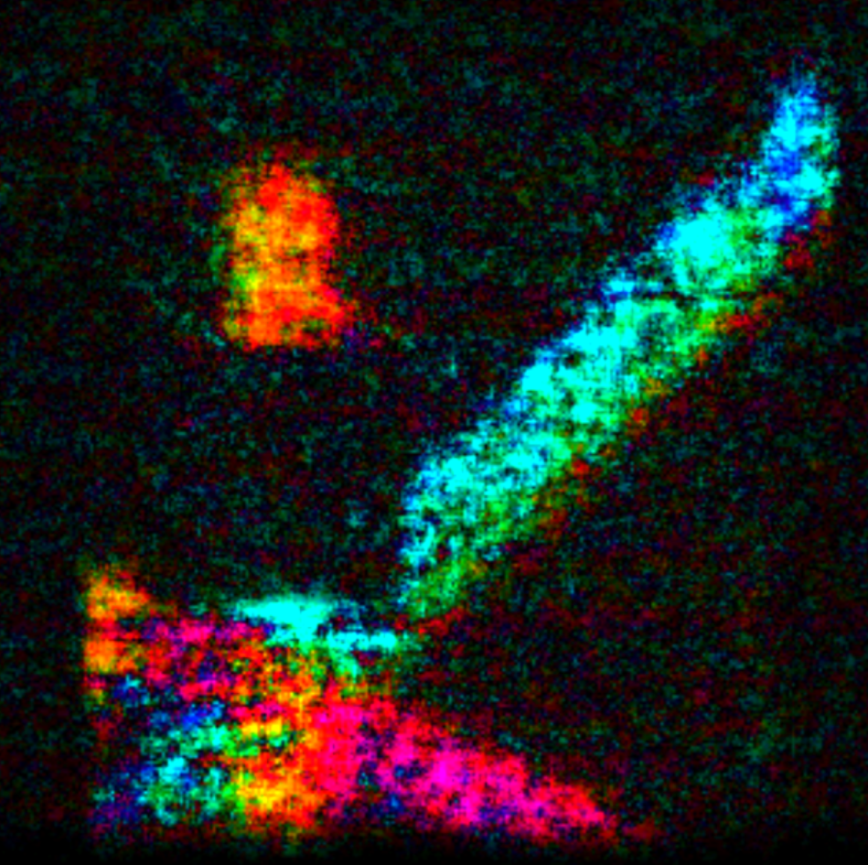
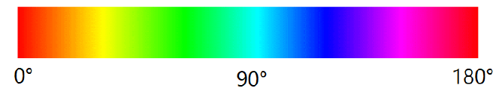
Angle and degree of linear polarization
AoP + DoLP
UH ROI
Variation of the AoP (5° → 81° → 164°) with the gantry angle (0° → 45° → 115°)
Angle of polarization relatively stable above the air cavity:
  Increase in Cherenkov signal at UH ROI not due to reflections
Noisy image
Increase irradiation time
Notes:
Approx 5 deg +/- 5 deg angle variation in the UH ROI (ERE region) , relatively stable compared to other gantry orientations resulting in vastly different angle of polarization

Slide 12
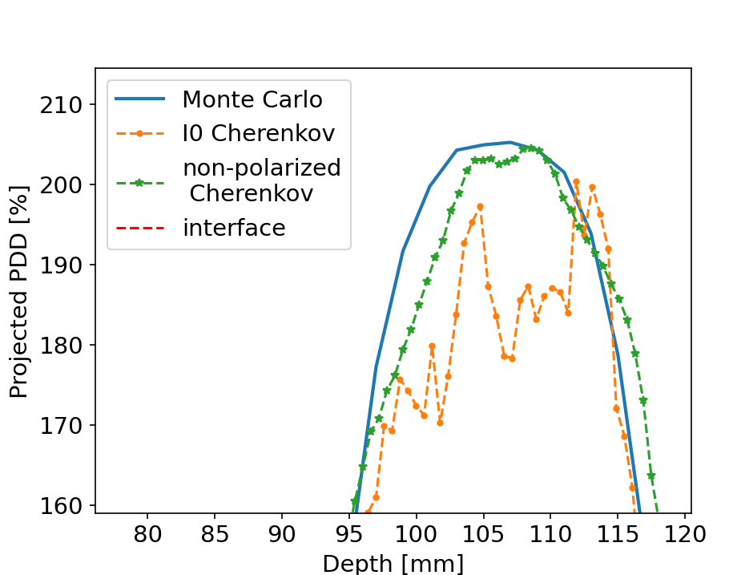
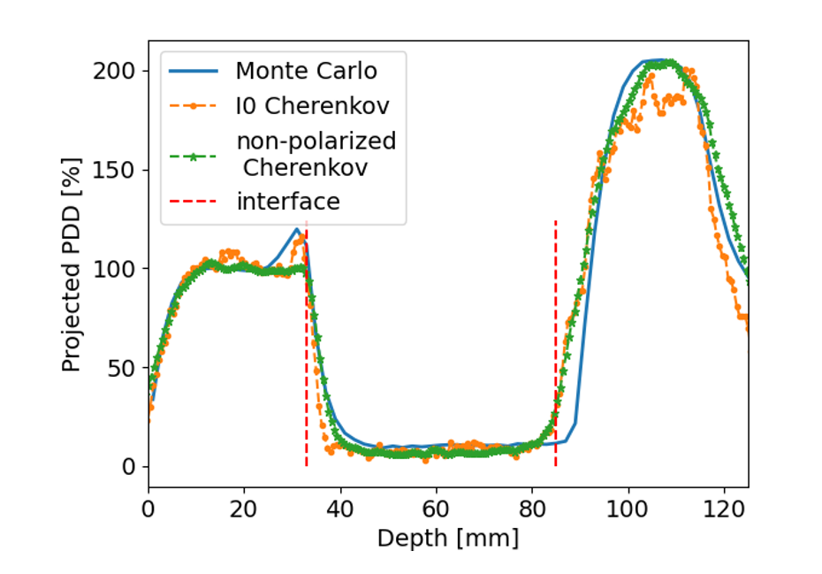
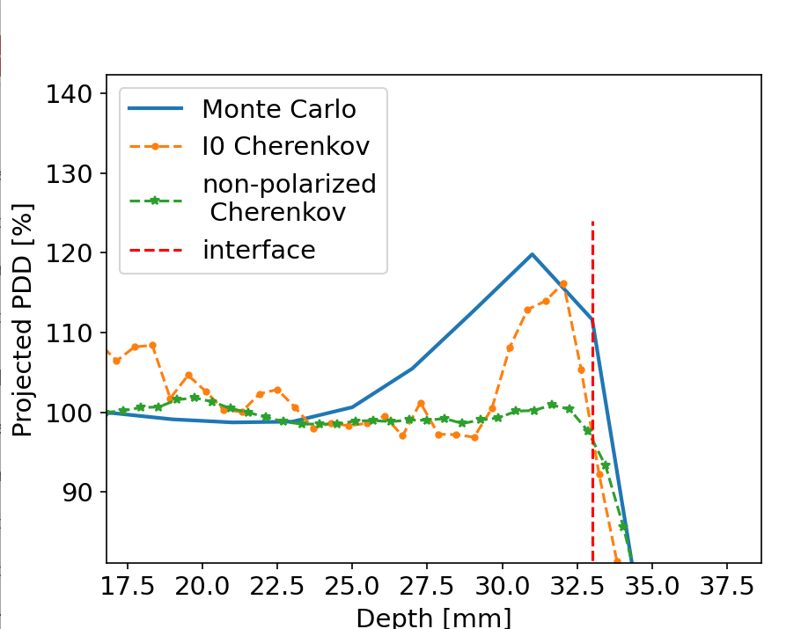
Projected percent depth dose
Monte Carlo: 120% ERE peak
Cherenkov I0: 117% ERE peak
Averaging a 0.5 cm wide strip
Noisy I0 signal (av. 8% rel diff to MC)
Non-pol. Che. av. rel diff to MC = 1.4%
ROI 1: UH interface
No ERE peak!
ROI 3: isocenter region
ROI 2: RV interface
ROI 1: UH interface
Air cavity
ROI 3: isocenter region

Slide 13
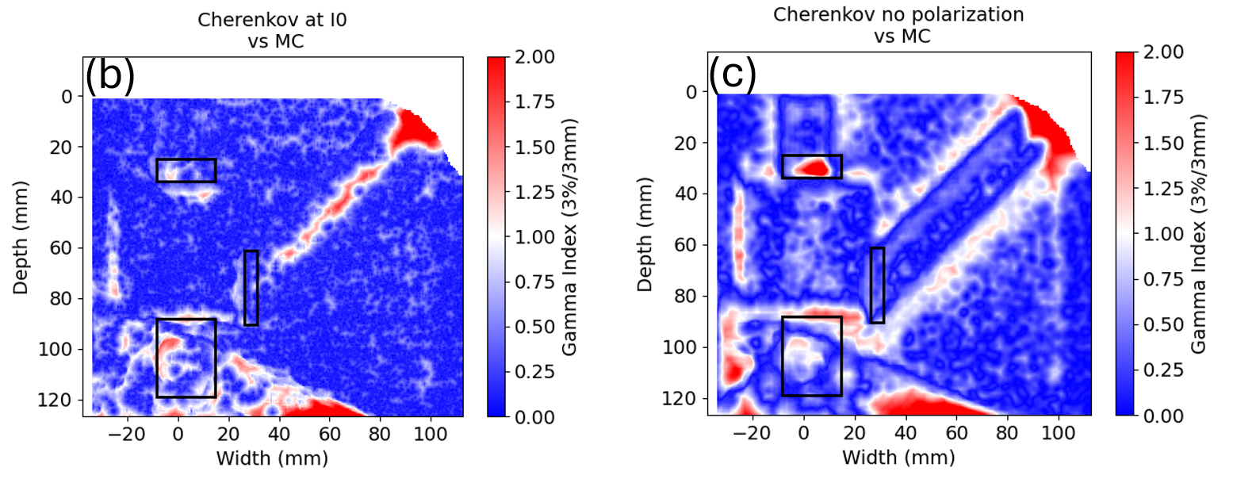


Gamma index maps
AoP + DoLP
Criteria: 3% / 3 mm
94% of pix, $γ≤1$
61% of pix, $γ≤1$
ROI 1: UH interface
ROI 1: UH interface
ERE minimal
ERE minimal
ROI 2: RV interface
ROI 2: RV interface
Better agreement to MC
ROI 3: isocenter region
ROI 3: isocenter region
Notes:
Greater non-polarized intensity vs $I_{0}$ polarized intensity in isocenter region

Slide 14
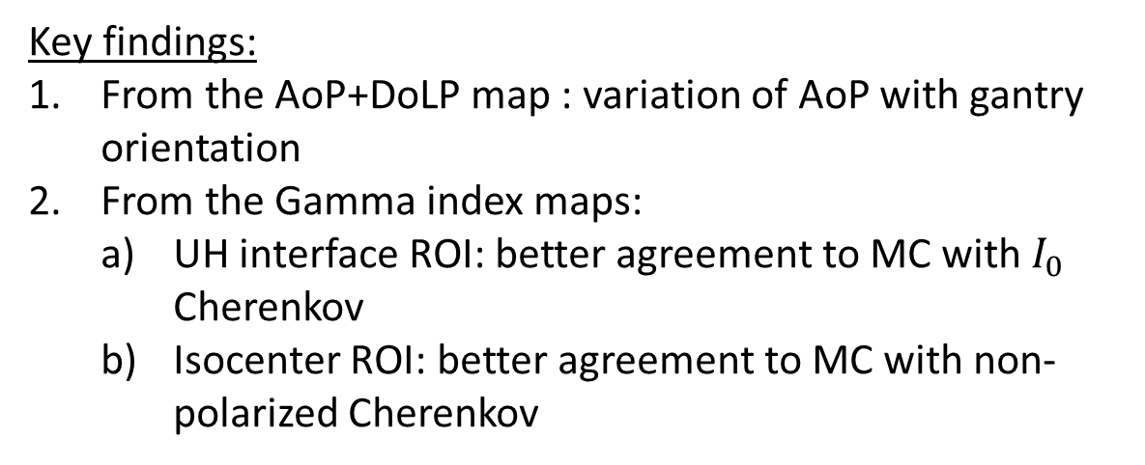
Conclusion
Summary:
A heterogenous phantom was irradiated at 3 gantry orientations by the Unity MR-Linac producing Cherenkov emissions.
Using the Predator filter, polarization characteristics of the Cherenkov emissions were extracted.
Polarized and non-polarized images of the Cherenkov emissions were compared to Monte Carlo dose distributions
Key findings:
From the AoP+DoLP map : variation of AoP with gantry orientation
From the Gamma index maps:
  UH interface ROI: better agreement to MC with $I_{0}$ Cherenkov
  Isocenter ROI: better agreement to MC with non-polarized Cherenkov
Notes:
No ERE peak is present in the UH ROI in the non-polarized Cherenkov map
Greater non-polarized intensity vs $I_{0}$ polarized intensity in isocenter region

Slide 15
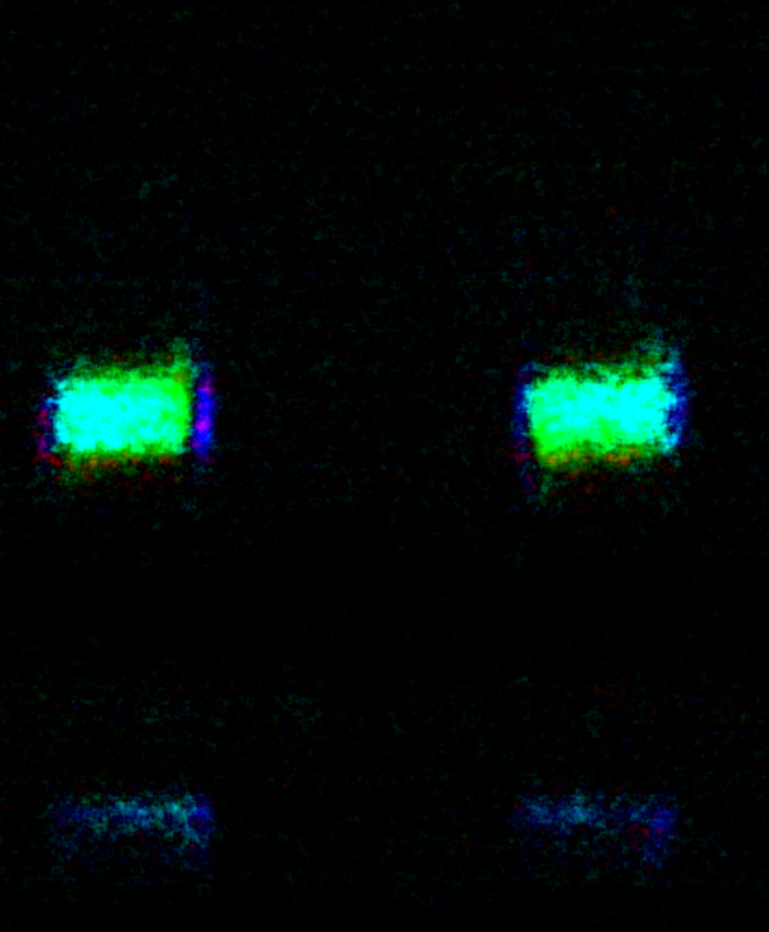
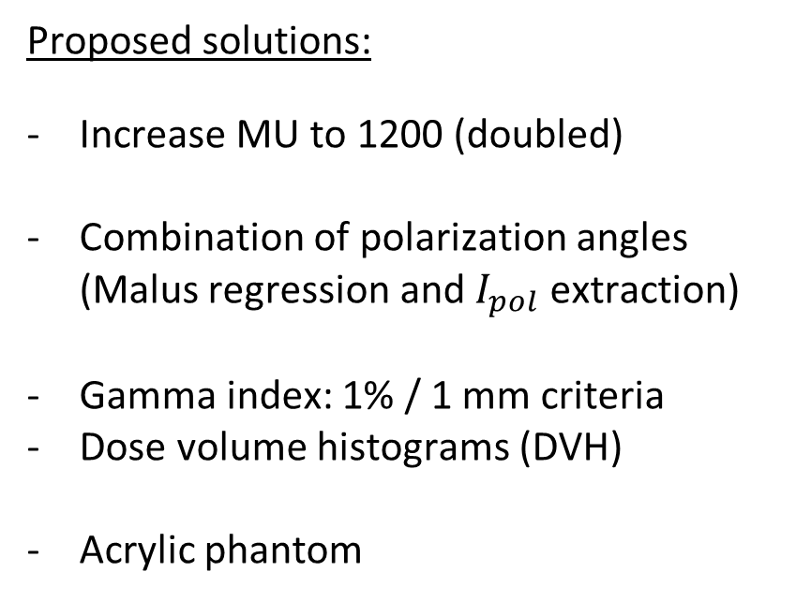
Future work
Encountered limitations:
Noisy AoP + DoLP image
1 polarization angle used
Gamma index: 3% / 3 mm criteria
No directly opposed beams
Proposed solutions:
Increase MU to 1200 (doubled)
Combination of polarization angles (Malus regression and $I_{pol}$ extraction)
Gamma index: 1% / 1 mm criteria
Dose volume histograms (DVH)
Acrylic phantom

Slide 16
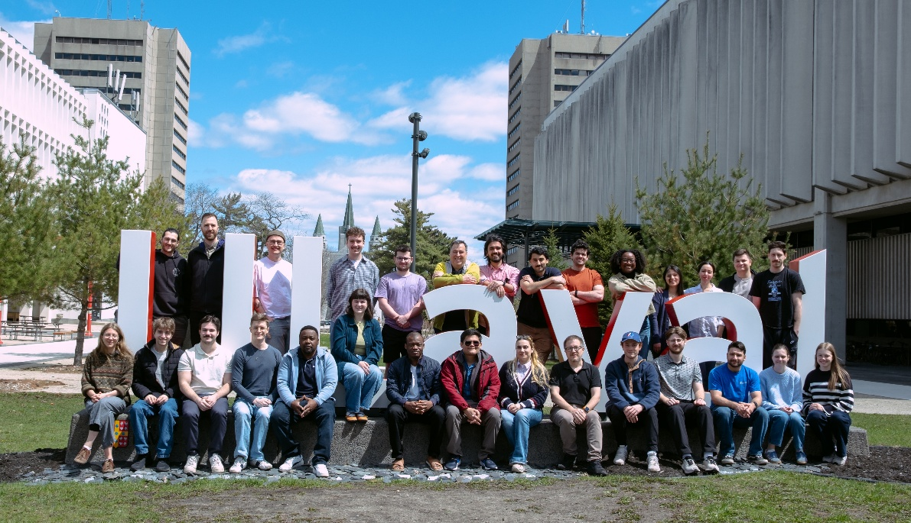



Cherenkov imaging dosimetry for heterogeneous phantom in the context of a MR-Linac
Medical Physics Research Group, Université Laval, 2026
Audran Poher^{1, 2, 3}, Janelle Morrier³, Tigran Galstian¹, Louis Archambault^{1, 2, 3} and Luc Beaulieu^{1, 2, 3}
¹Département de physique, de génie physique et d’optique, Université Laval
²Centre de recherche sur le cancer, Université Laval
³Service de physique médicale et de radioprotection, Centre Intégré de Cancérologie et CRCHU de Québec, CHU de Québec
Acknowledgments

Slide 17
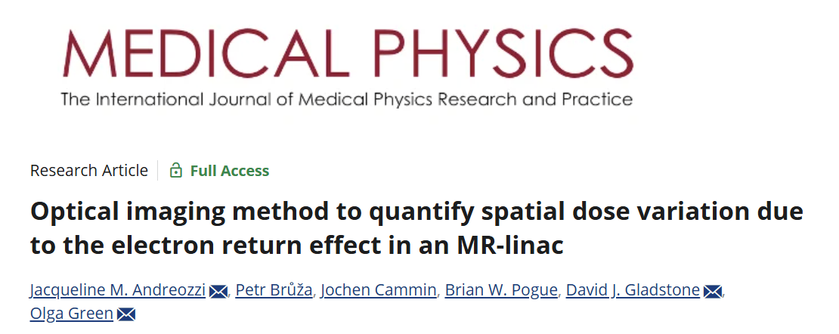
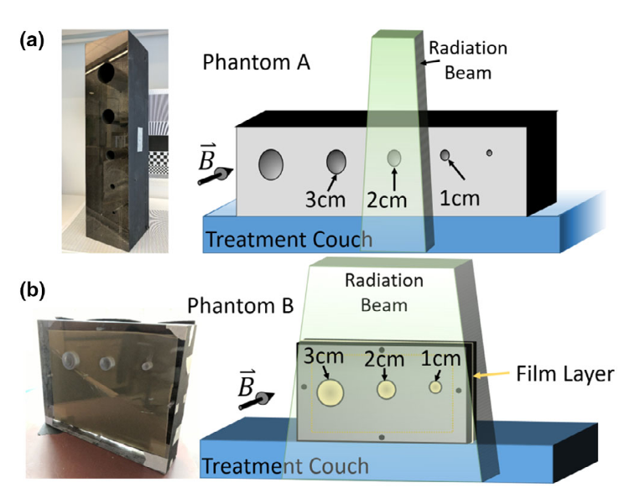
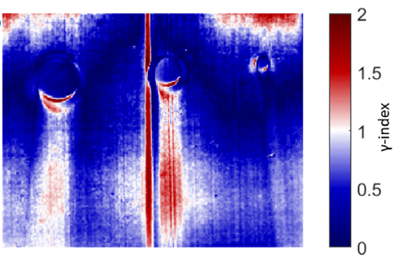
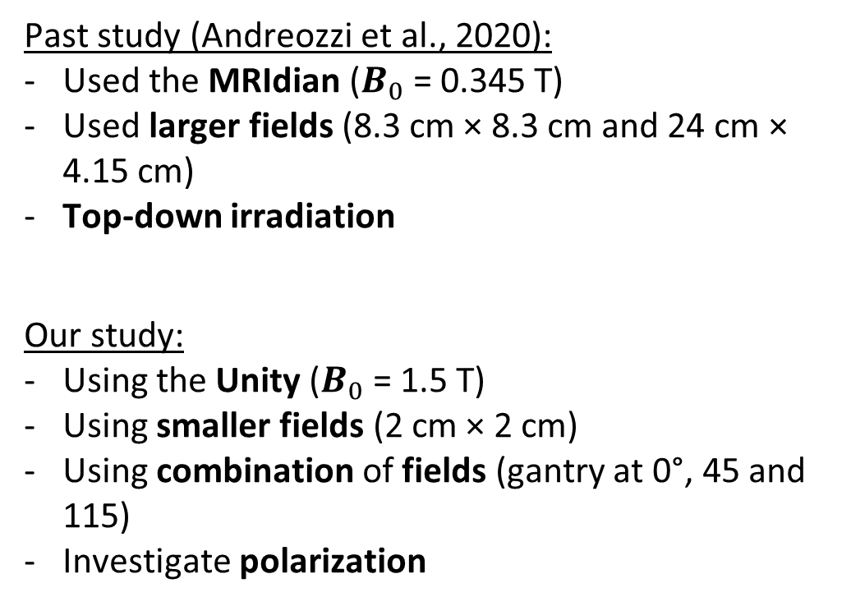
Past study using Cherenkov
Past study (Andreozzi et al., 2020):
Used the MRIdian ($B_{0}$= 0.345 T)
Used larger fields (8.3 cm × 8.3 cm and 24 cm × 4.15 cm)
Top-down irradiation
Our study:
Using the Unity ($B_{0}$= 1.5 T)
Using smaller fields (2 cm × 2 cm)
Using combination of fields (gantry at 0°, 45 and 115)
Investigate polarization
Phantom B:
Criteria: 3% / 3 mm
Andreozzi et al. (2020)
Notes:
I would like to start here by mentionning the past study by Andreozzi et al.
This study investigated similar factors

Slide 18
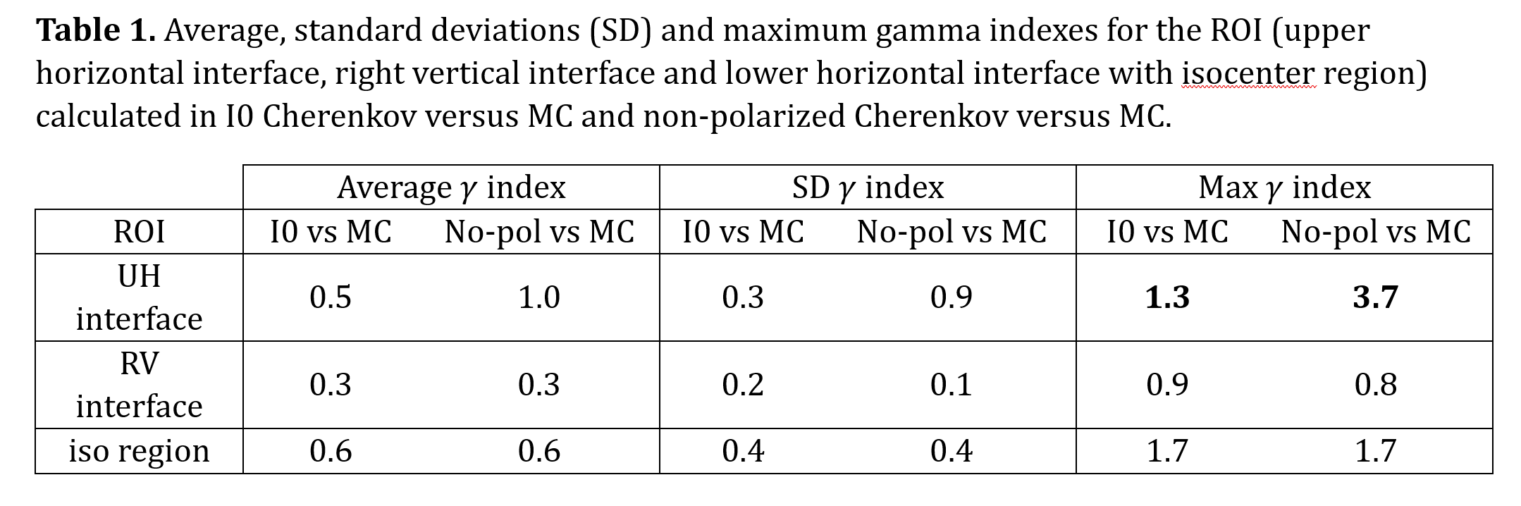
Discussion

Slide 19
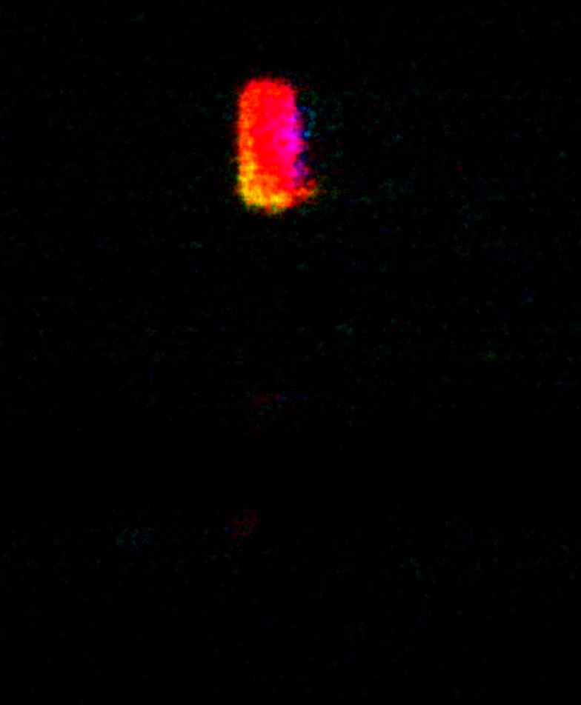
Acrylic phantom: AoP + DoLP
Reflections

