Slide 1
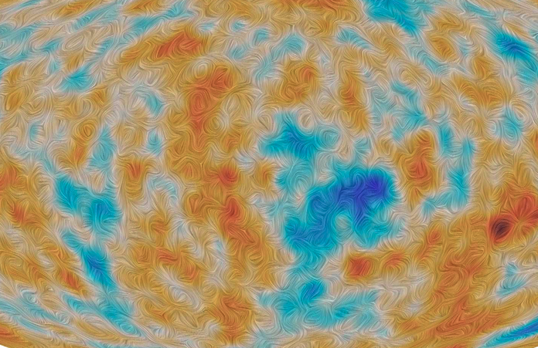




CMB B-mode – NEXT
@KEK, Tsukuba – Seminar Hall Building 3
January 27-29, 2025
Scientific Organizing Committee:
Masaya Hasegawa (KEK-IPNS & QUP), Guillaume Patanchon (APC), Hirokazu Ishino (U Okayama), Hiroki Akamatsu (QUP & SRON), Yuji Chinone (QUP) Tijmen de Haan (KEK-IPNS & QUP), Tommaso Ghigna (QUP & IPMU)
The goals of this workshop are:
Review the latest results in CMB science
Define synergies between space-based and ground-based CMB measurements, data analysis, component separation and instrument development and modeling.
Following the core principles of the CMB-Inflate and Core-to-core programs, create strong international bonds between researchers and promote younger generations.
Workshop Webpage: https://indico.in2p3.fr/event/34780/overview

