Slide 1
test bench 28nm

Slide 2
outline
28nm chip layout
1st results on pixels matrix chip
DAQ board
Pixel configuration
Transistors setup

Slide 3
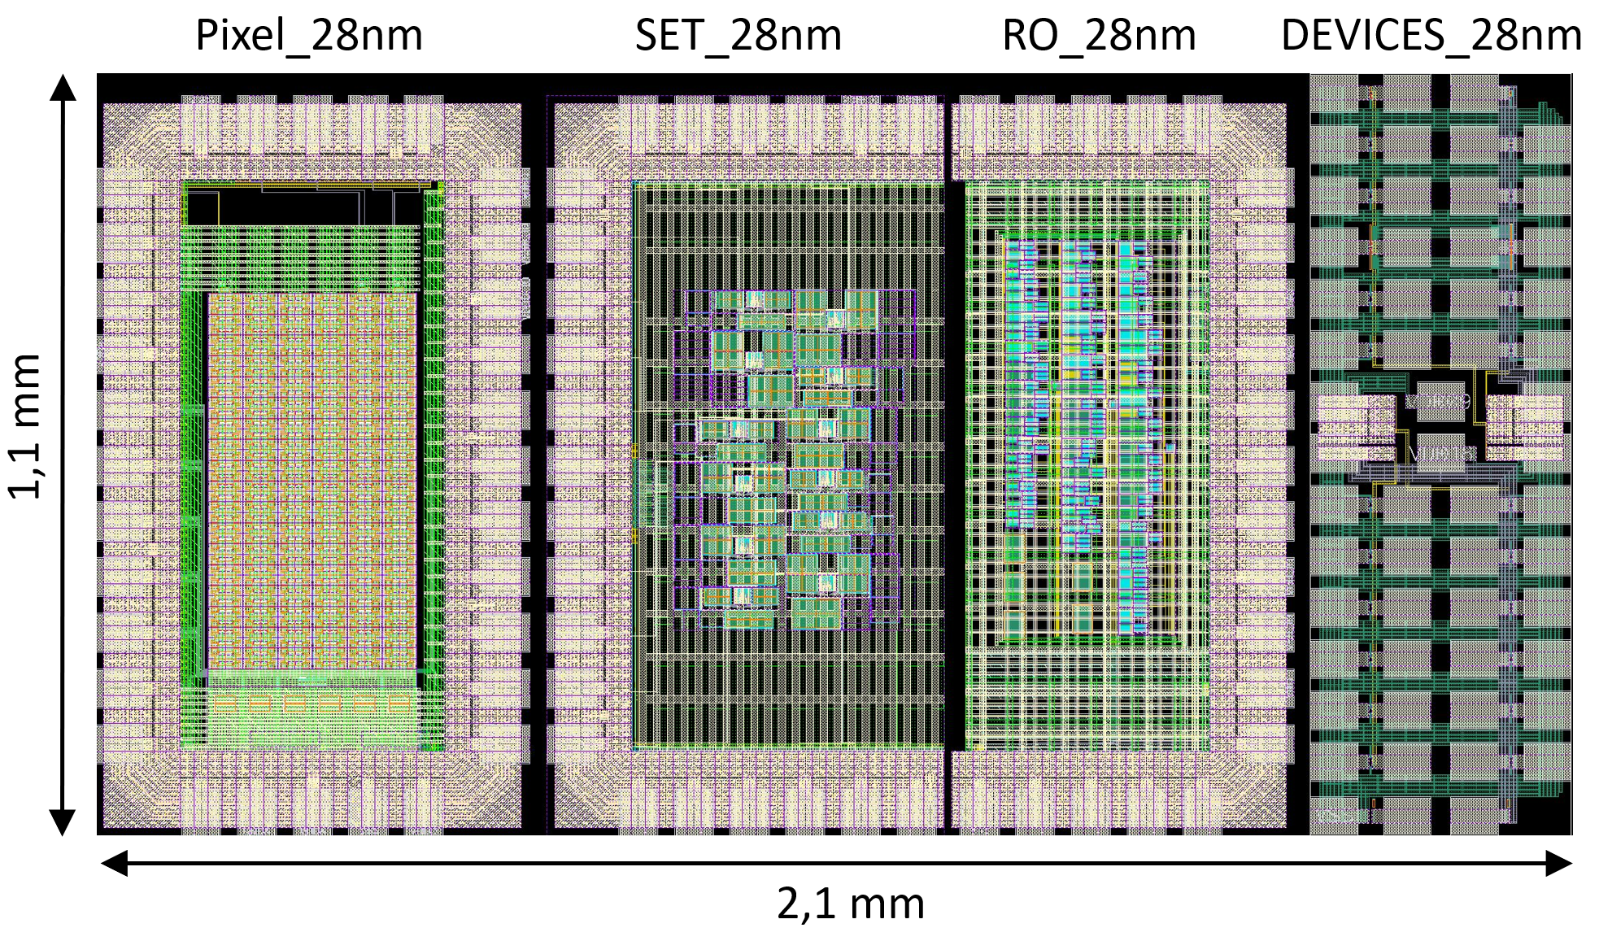
28nm chip Layout
4 independents sub-chips
Matrix of 432 pixels – « Pixel_28nm »
Bank of ring oscillators – « RO_28nm »
Transient signal detection – « SET_28nm »
Bank of transistors – « DEVICES_28nm »
N&PMOS in 0.9V & 1,8V
Each chip is bonded on boards
Sortie CSA ouput (pixel 36)

Slide 4
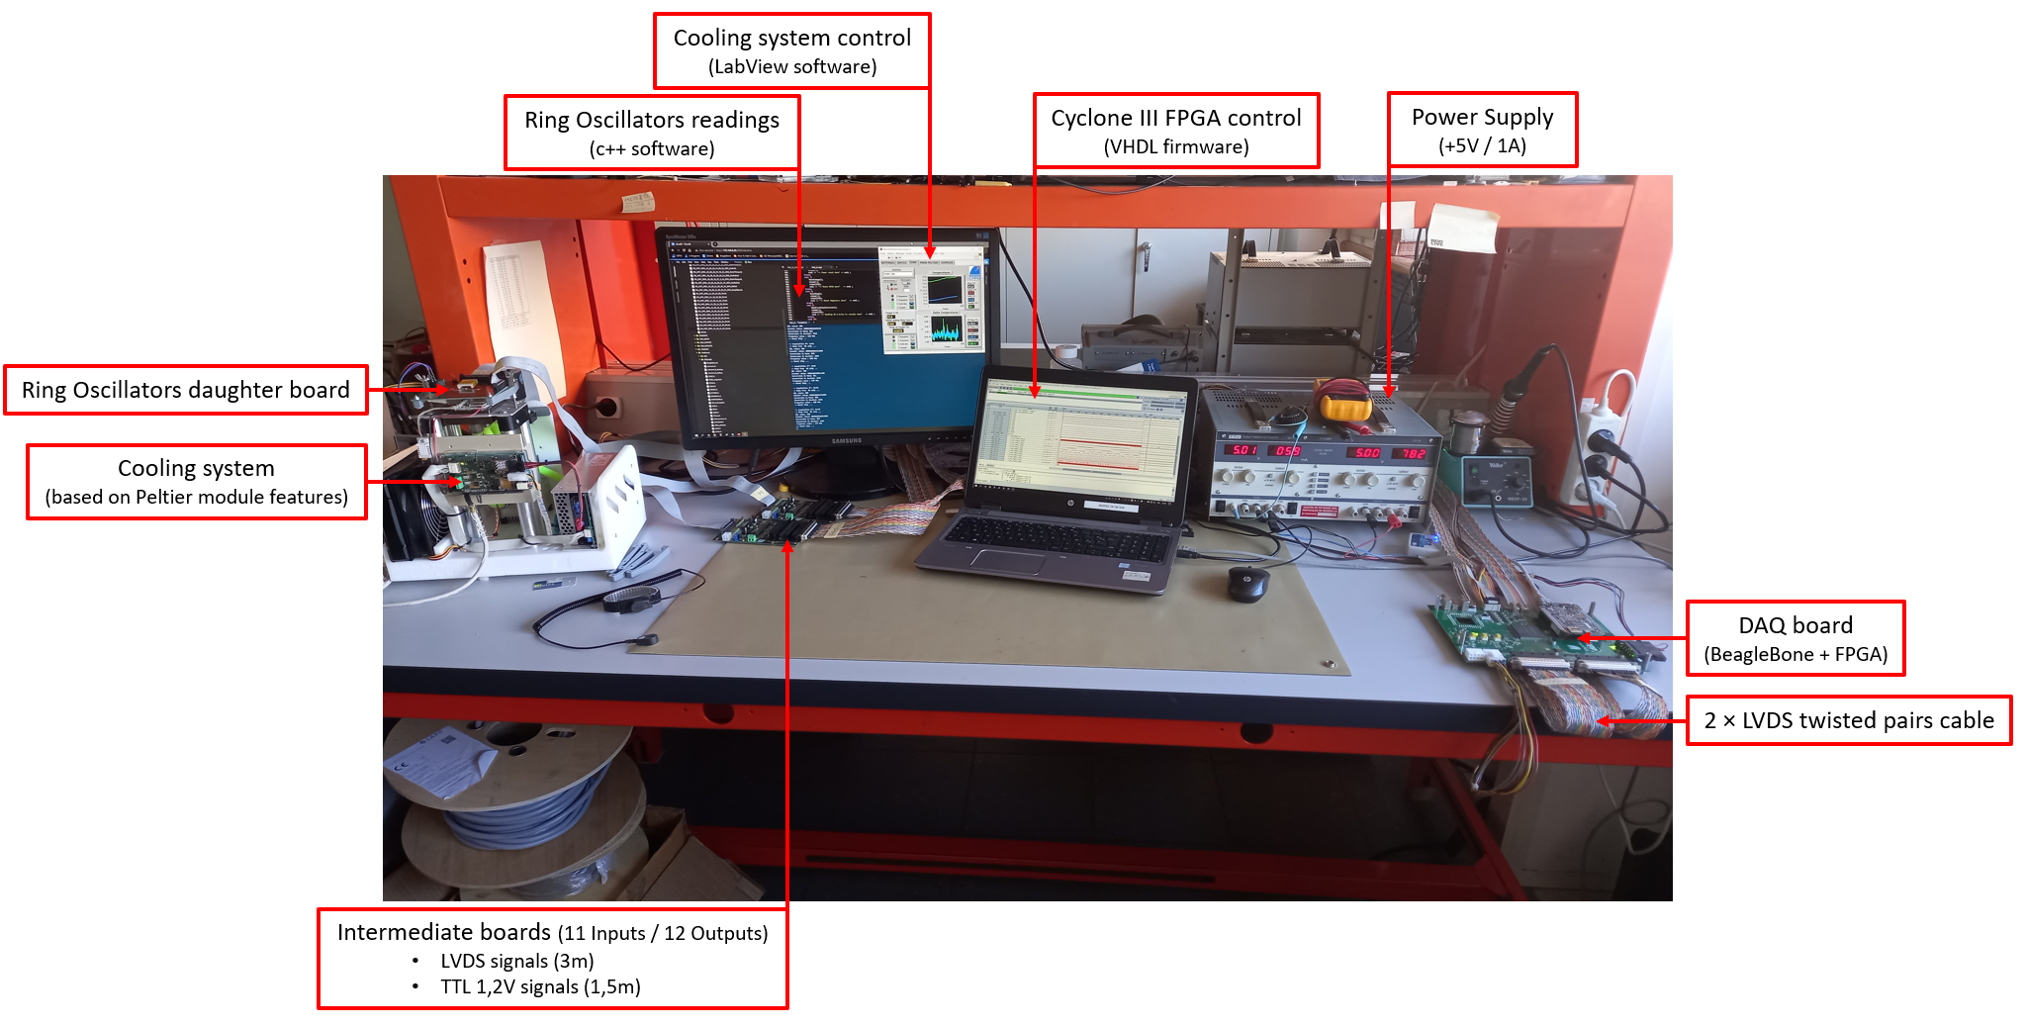
Test bench for 28nm chips
Test benches are ongoing
Firmware not fixed
Still big work for the C++ software
…
Test setup for a ring oscillators chip in TJ65nm

Slide 5
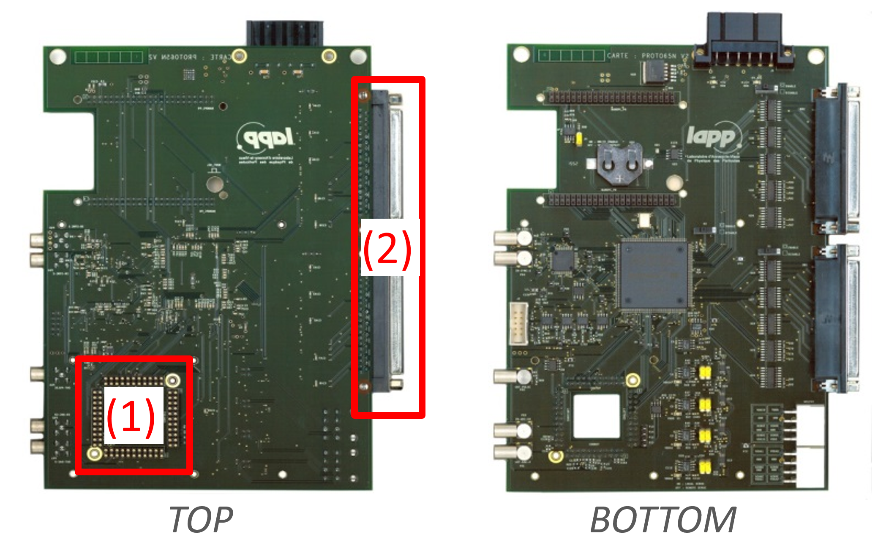
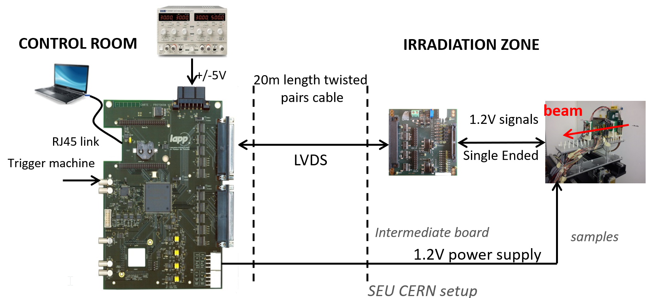
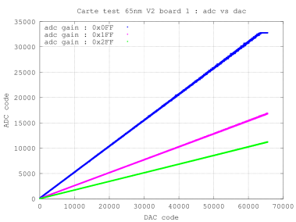
DAQ board
Mother board V3 – V4
Features:
nanoPC BeagleBone card (RJ45 linlk)
RJ45 link
Linux Debian OS integrated in a SDCard
Connected as a local network on a PC
FPGA (Cyclone III – Quartus 13.1)
Digital signals availables
40 TTL signals (local tests (1)-HE10 connectors)
32 LVDS signals (irradiation tests (2)- DB37 connectors)
Analog channels available
4 SAR ADC’s 16 bits
4-10 DAC (16 bits)
Monitoring (°C, current supply)
Charge injector
Lab tests
Compatible with irradiation tests
ADCout vs Gain

Slide 6
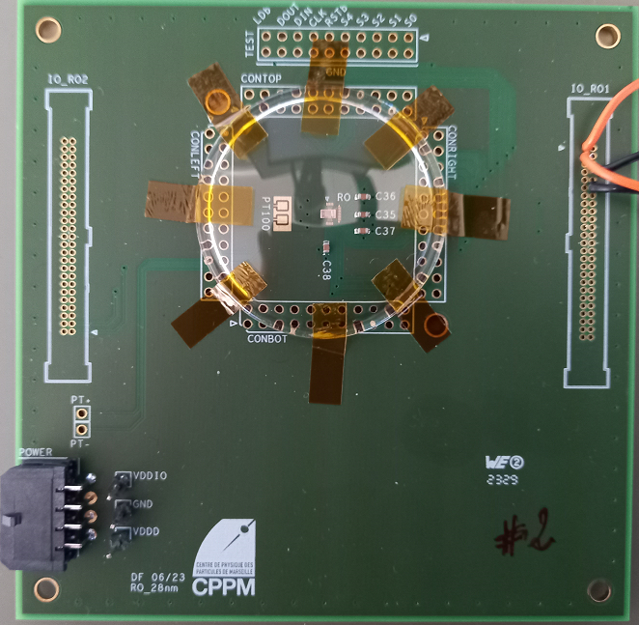
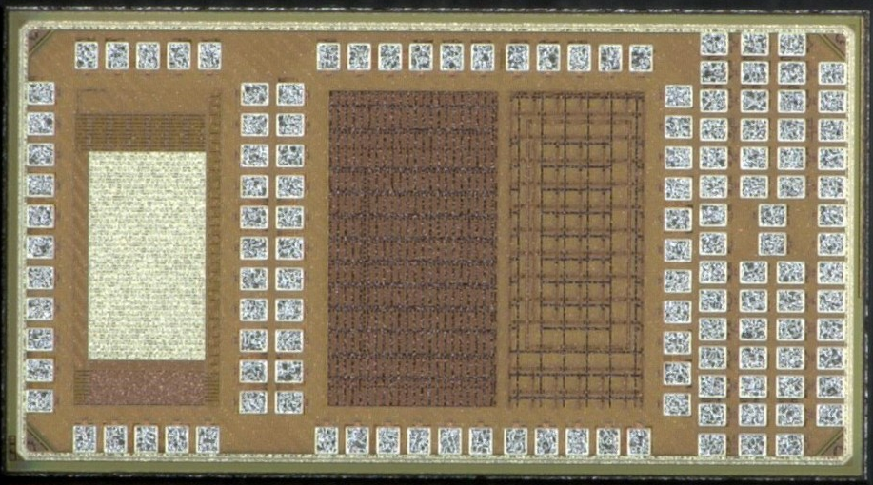
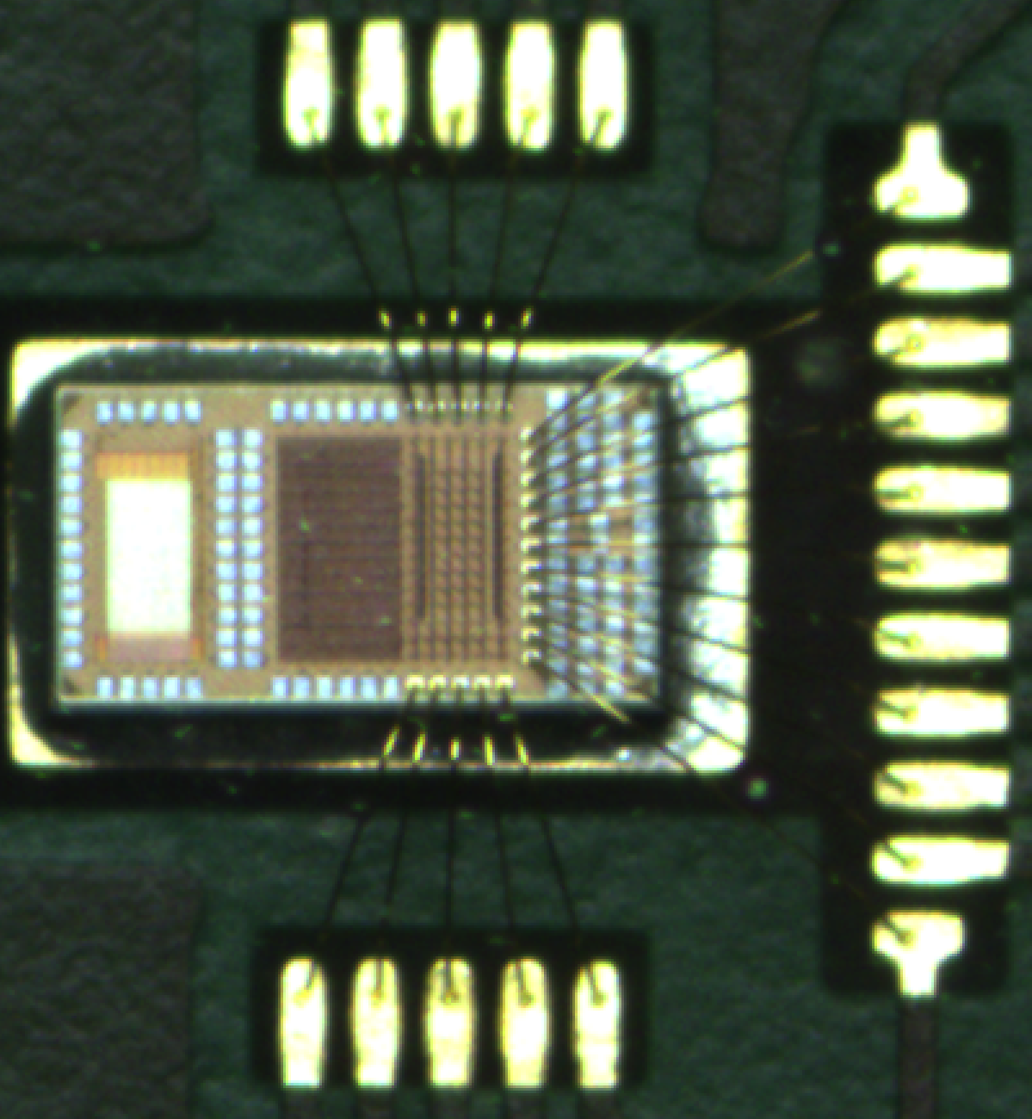
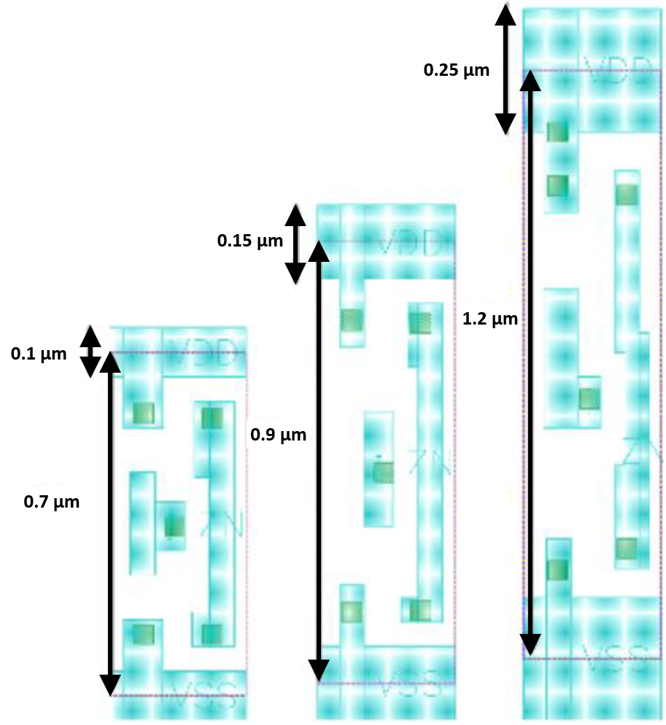
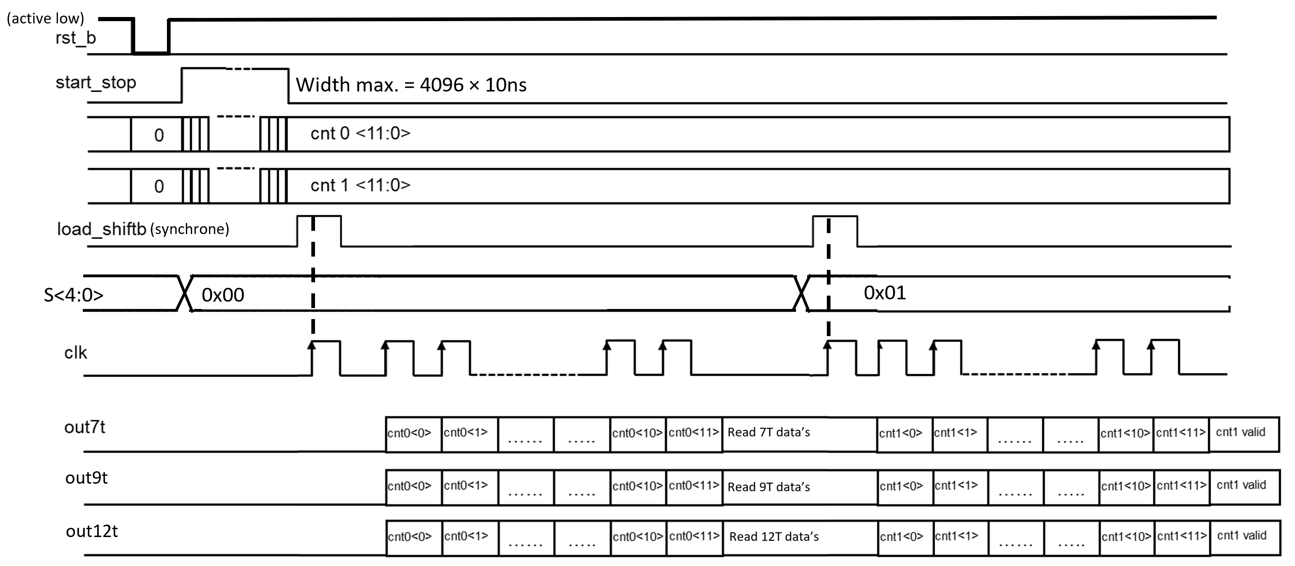
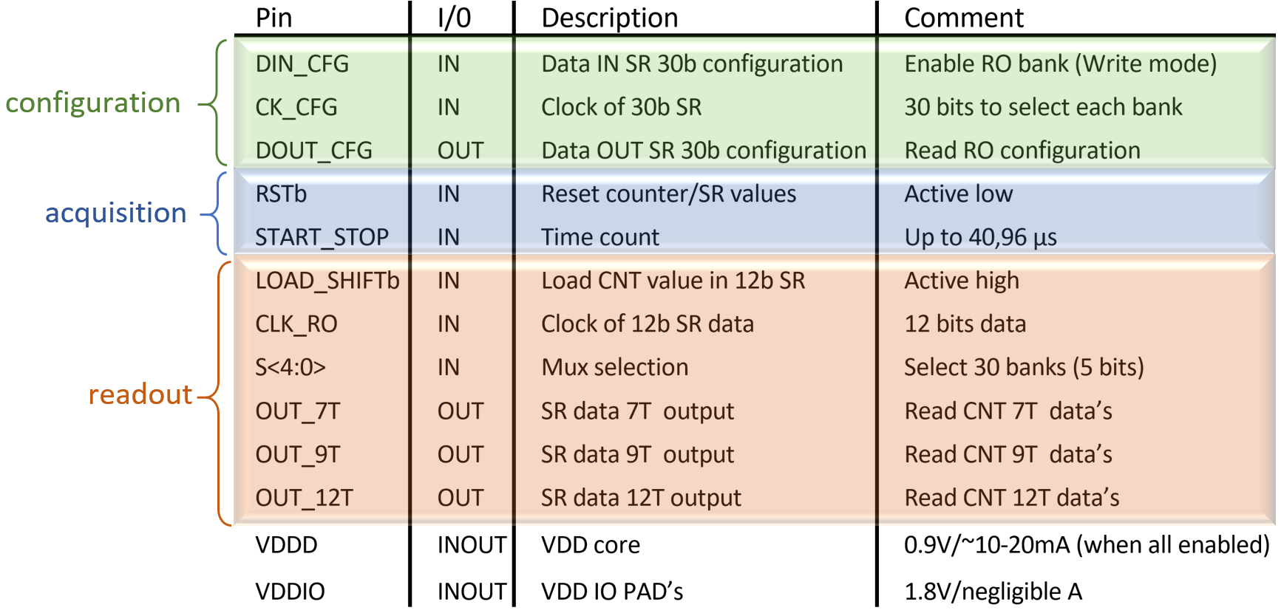
RO28nm
30 RO’s per size (7T, 9T, 12T)
Power supply:
VDD_{IO} (1,8 V),
VDD_{D} (0,9 V - ~10-20 mA)
Configuration through a shift register
It doesn’t work but implemented in the firmware
10 inputs/ 4 outputs:
Sizes 7T, 9T, 12T
Readout chronogram
Pinout ASIC RO 28nm

Slide 7
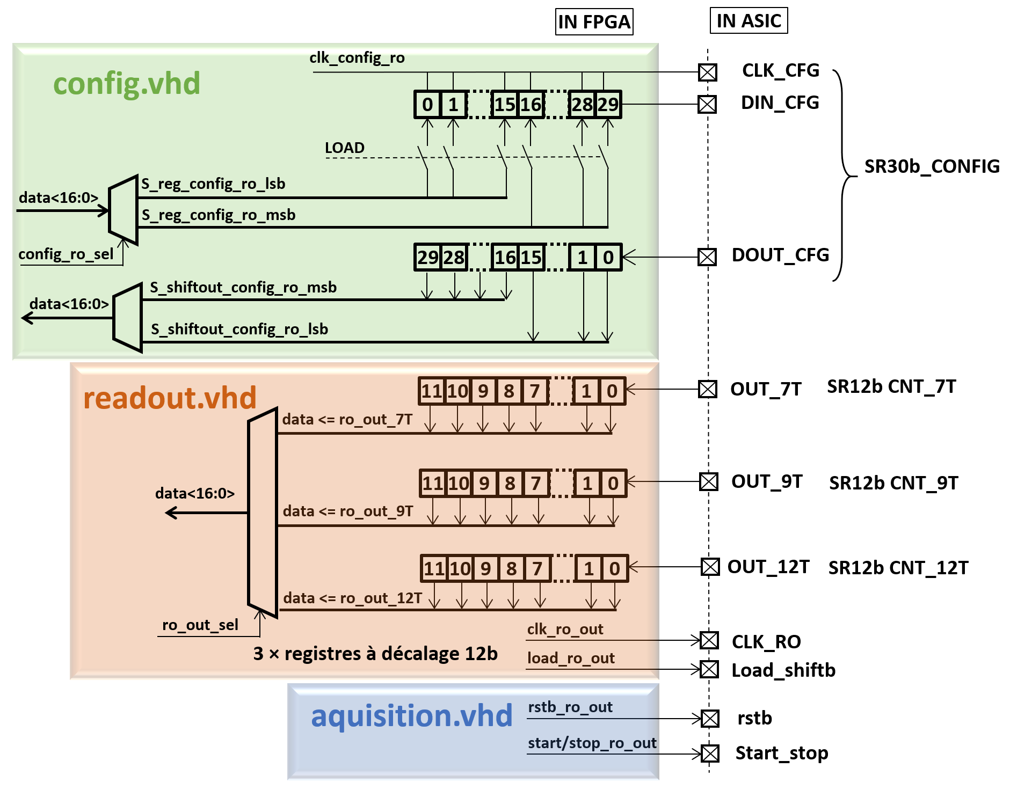
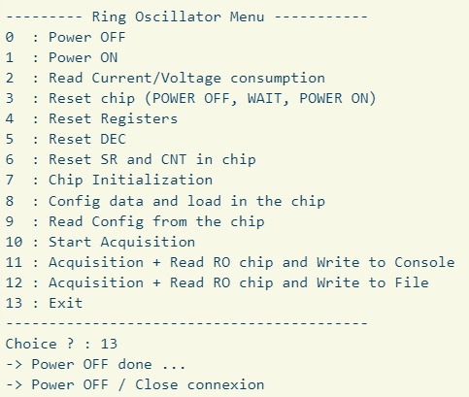
Firmware/software RO 28nm
Start/stop as a parameter
Tunable in the C++ file
Software side:
Power supply management
Each sequence can be tested
Counters readings in a console or in a file
Main menu RO 28nm
Cell vs code mux.
firmware RO 28nm synoptic

Slide 8
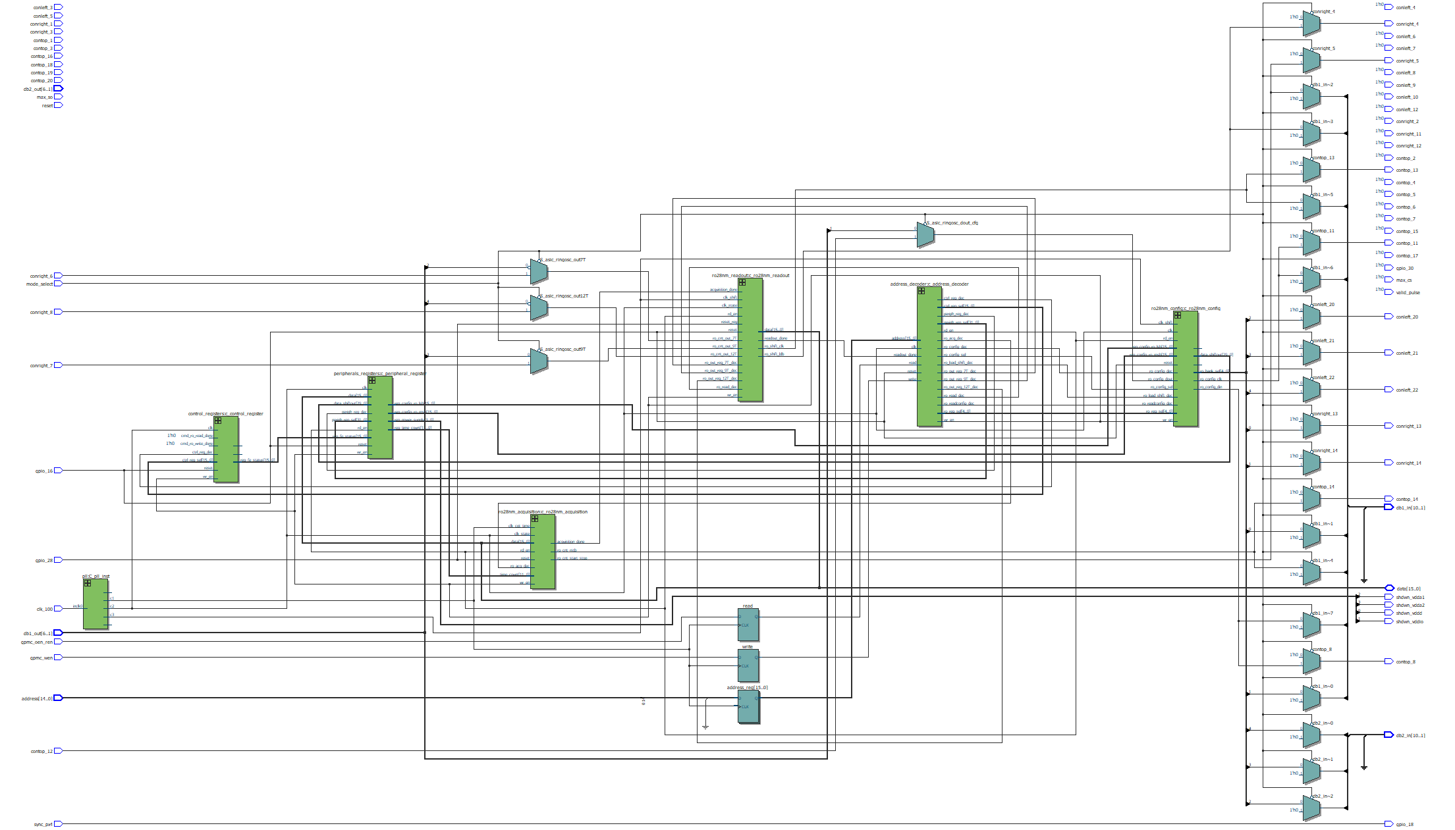
VHDL example: RO28nm
ro28nm_readout
1
address decoder
Commands from BeagleBone management
ro28nm config
Management of 30 configuration bits
ro28nm readout
Reading of 3 output (7T, 9T, 12T)
- store counters values in a shift register
- Read values in BeagleBone through data bus
1
3
2
Peripheral registers
registers to store parameters from data
Regulators enable
DAC’s data
Width counting
…
ro28nm acquisition
Management of 2 signals:
rstb: reste active low
start/stop: width of pulse count tunable
2
1
Control registers
Normally use to control the status of a command
Can help to synchronize read/write sequences and know their status
Can avoid also sleep, wait.. in a sequence
1
3
1
1
3
PLL’s
Clkin = 100 MHz
Clkout (4 max.)
200 MHz for SIGNAL TAP
100 MHz for clk_state
10 MHz
1 MHz
…
2
2
3
4
Multiplexors
IN/OUT locally
- CONxx
IN/OUT remotely
- LDVS drivers
carte_test_28nm.vhd (top view)
4

Slide 9
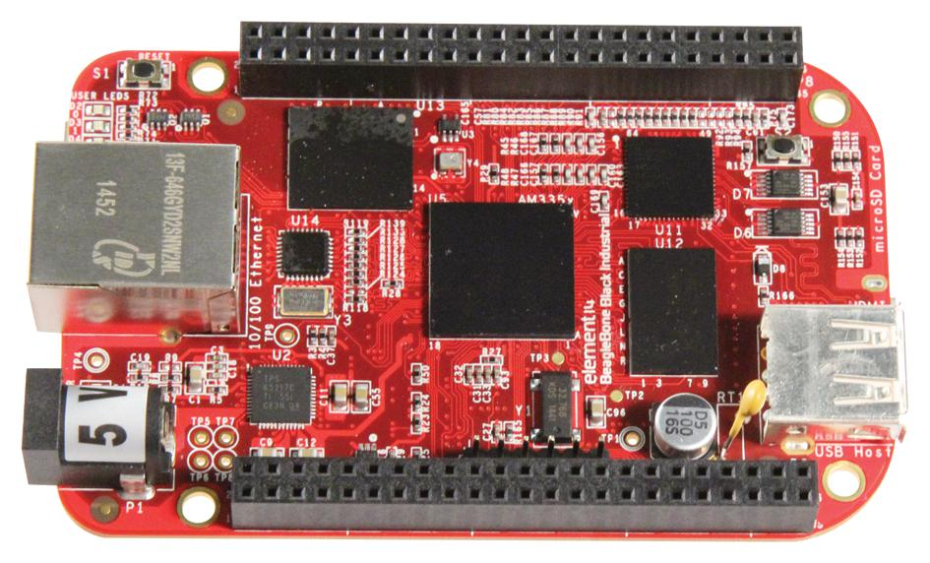
Synoptic firmware (simplified)
firmware FPGA Cyclone III -> Quartus 13.1
address_decoder.vhd
address building
DAC’s : 0x3000
periph.: 0x4000
config.: 0x2000
…
adc.vhd
periph_reg_sel (32b)
peripherals_registers.vhd
data registers
parameters registers
sck
to/from ADC
sdi
BeagleBone Black
address (15b)
dac.vhd
sdi<15..0>
sck
to 10 DAC’s
data (16b)
cs_dac<4..0>
DEVICE TREE:
GPIO-> bus GPMC
- address (15b)
data (16b)
I2C (2bus 1&2)
- power supply adjustment
- readings I/V
- RTC
- …
SPI
- Pt100
gpmc_oen_ren
cmd_start/stop
gpmc_wen
synchro
read
ctrl_reg_sel (16b)
control_registers.vhd
reset
write
reset
config.vhd
(ro chip)
data config
s_data
ro_config_sel
s_ck
s_mux<5..0>
200 MHz
(SIGNAL TAP)
ro_acq_dec
acquisition.vhd
(ro chip)
- launch counting in Ro chip
clk_in : crystal 100MHz
PLL
100 MHz
rstb
start/stop^{(*)}
RO chip
10 MHz
1 MHz
locked
ro_readout_dec
readout.vhd
(ro chip)
- launch counting in Ro chip
s_ck_readout
s_ld_readout
data 7T, 9T, 12T
^{(*)}: pulse width tunable

Slide 10
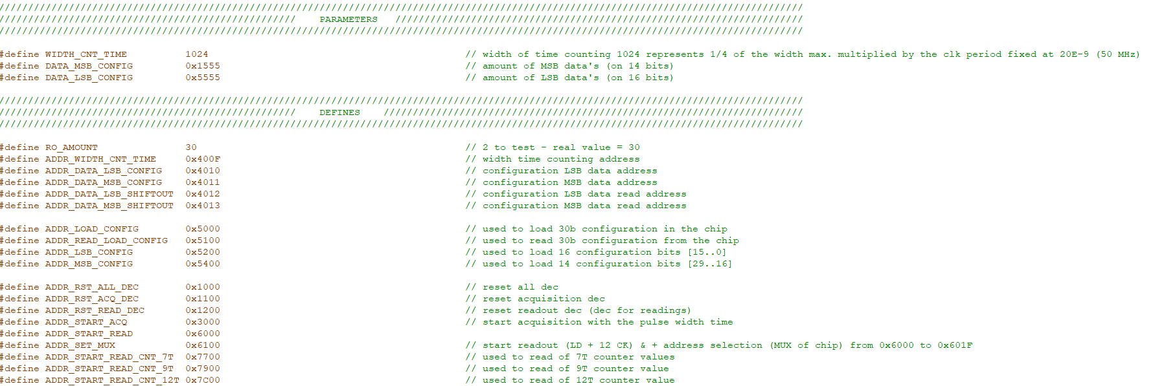
Address declaration in the software RO28nm
C++ files used address/data previously defined in the address_decoder .vhd

Slide 11
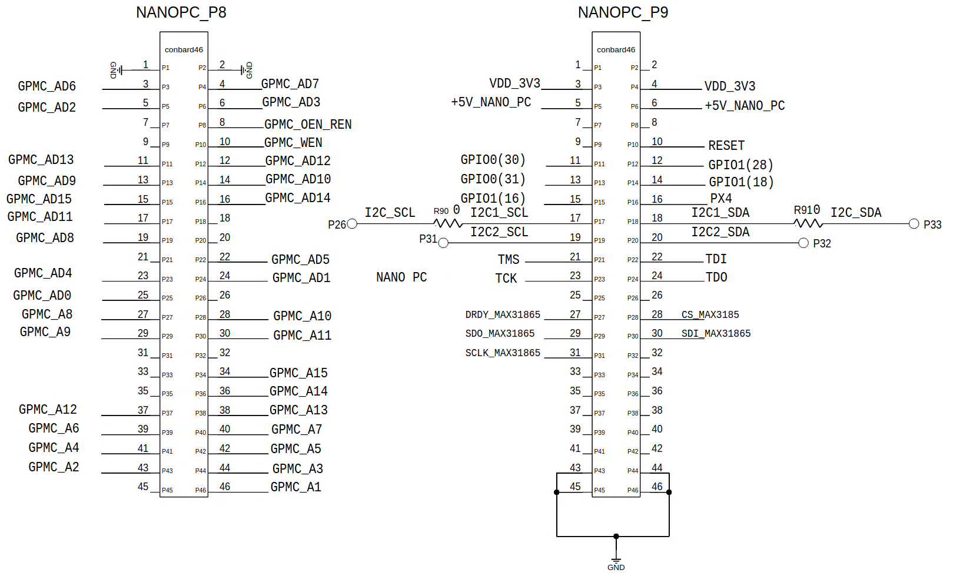
Pinout BeagleBone
Bus GPMC
Power supplies
GPIO
I2C
JTAG
SPI (Pt100)
Slow control

Slide 12
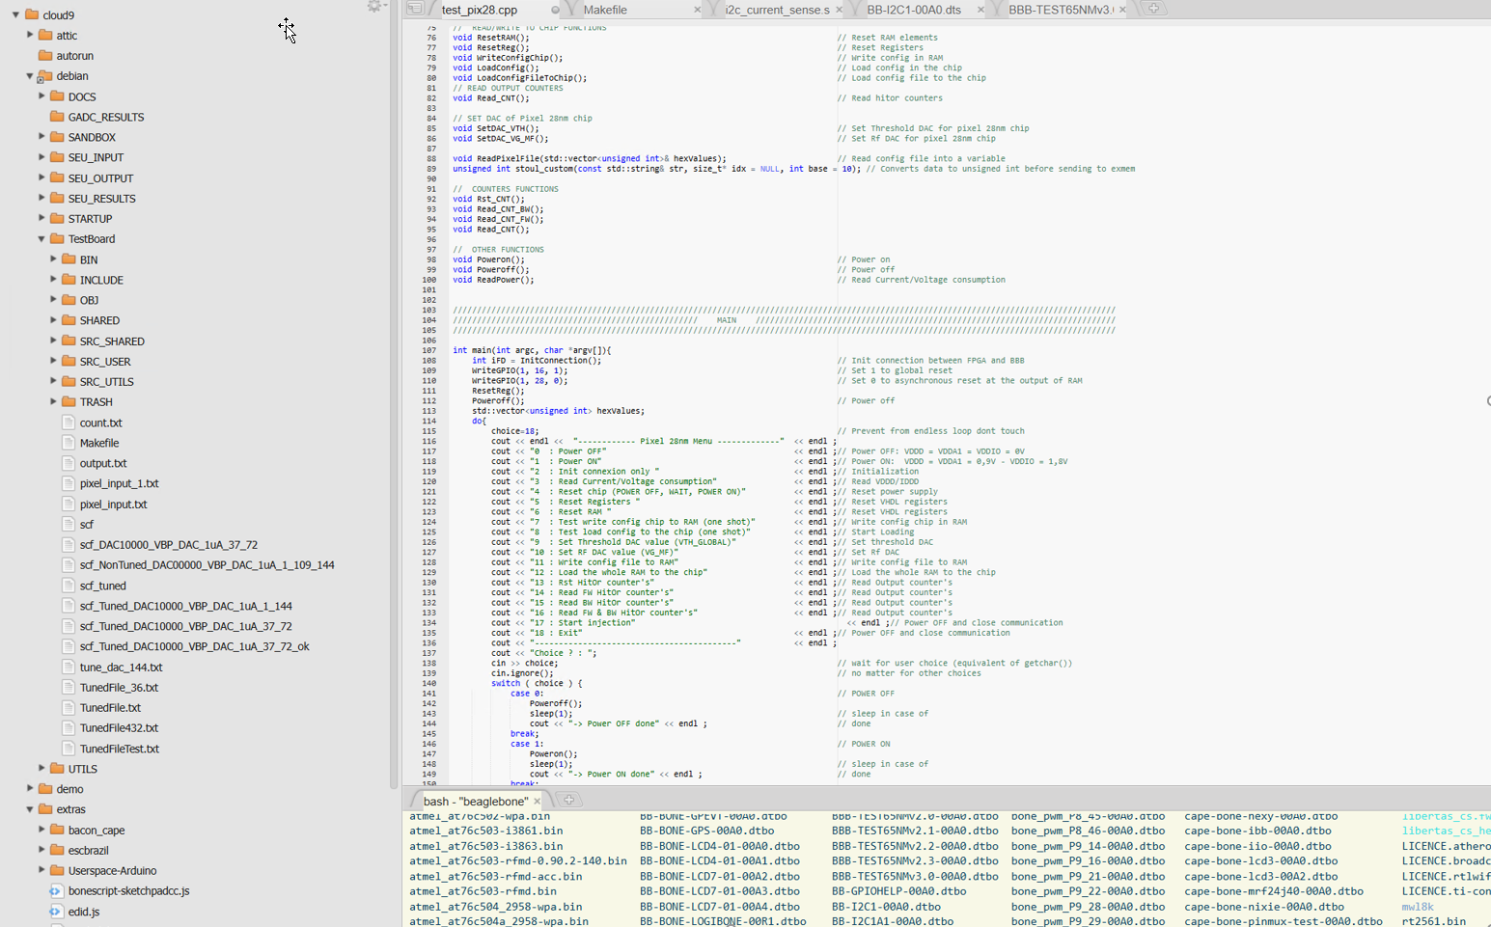
BeagleBone environment
OS embedded Linux Debian
C++ environment
All project files are in the TestBoard folder
Library folder
DAC, ADC, temp. in SRC_SHARED
c++ project files in SRC_USER
GPIO,… in SRC_UTILS
Makefile: allow to compile cpp file and generate .o output binary file
Critical file, syntax very important

Slide 13
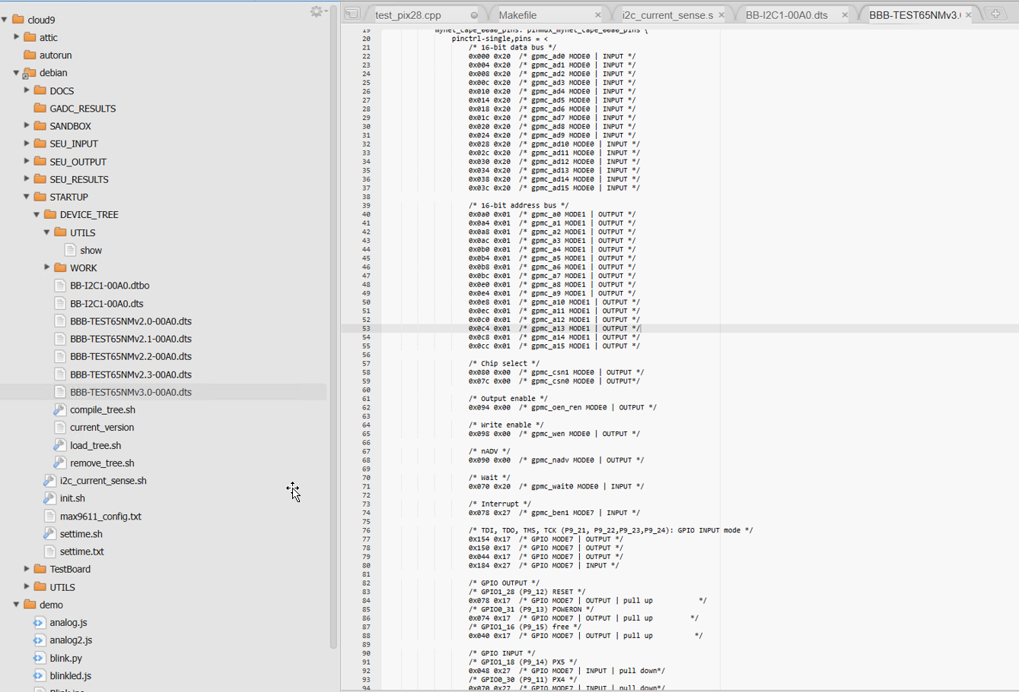
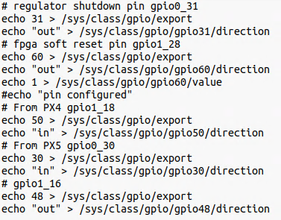
START UP
GPMC bus and GPIO must be configured and certainly specified inside the boot of the beaglebone
DEVICE_TREE in debian/STARTUP folder
.dts file compiled to a .dtbo and move in /lib/firmware/
Normally follow the sequence inside the init.sh file
GPMC configuration in a .dts file
config_pin

Slide 14
Slow control
I2C
Chip power supply
4 I/V monitoring (MAX9611)
0xE0
0xE6
0xF8
0xFE
4 programmable resistors (tpl102)
0x51
0x52
RTC (ds1307)
W: 0xD0
R: 0xD1
EEPROM (cat24c256)
W: 0xA0
R: 0xA1
I2C bus – MAX9611
MAX9611
3.3V
LT3021
0.1
to chip
100k
I2C bus – tpl102-100
20k
Synoptic per regulator ^{(*)}
^{(*)}: modified on V4 DAQ board
on V3:
- 4 × LT3021 (500mA max.)
on V4:
- 2 × LT3021 (500mA max.)
- 2 × LTC3026 (1.5A max.)
- need to integrate this modification in the software

Slide 15
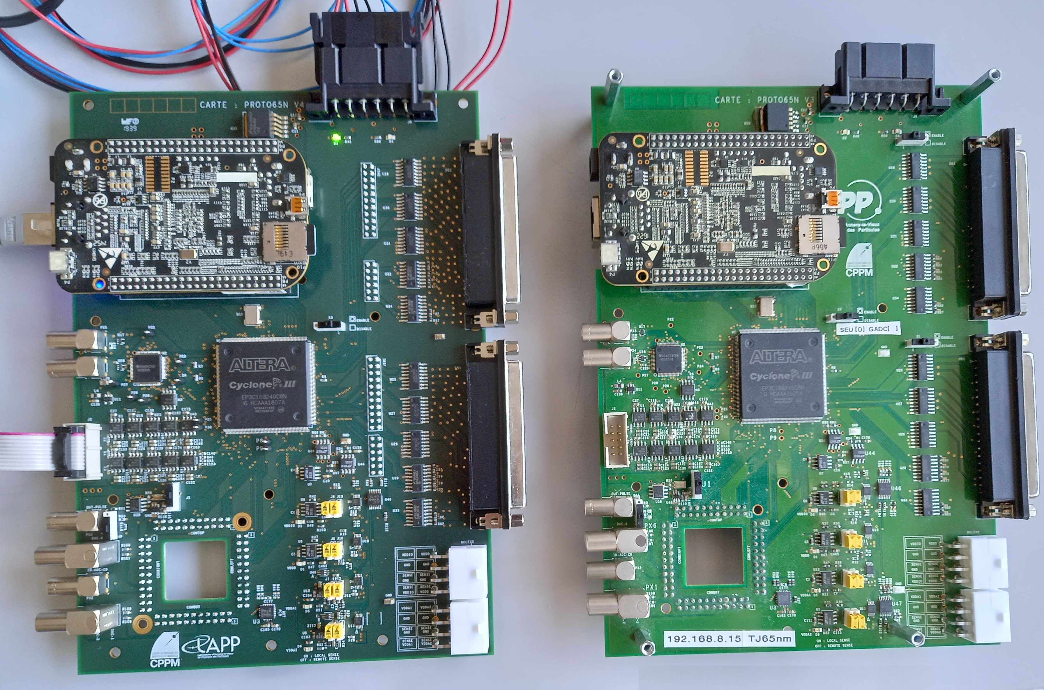
DAQ V3 V4
V4
V3
V3 ≠ V4
^{- regulators}
^{- swap pins}
^{- add connectors for debug}
^{-…}

