Slide 1
Discussion sur les sujets transverses: Instrumentation et R&D
Symposium national - Préparation de la contribution de la communauté française à ESPPU
Campus P&M Curie, Jussieu, Paris 20-21/01/2025
D. Contardo, P. Schwemling
64 contributions at https://esppu.in2p3.fr/contribution
  25 include ”detector R&D” keyword:
    rather generic identification of R&D areas, aspirations toward given projects (experiments)
    and/or within institutes, some EoI for FCC-ee systems

Slide 2
Introduction to French instrumentation activities (1)
French R&D activities mostly embedded in CERN DRDs (source below, not exhaustive)
  Most contributions are related to collider projects:
    Alice-3, LHCb-II, Belle-3, ATLAS, ePIC, time scale 2034-35, matched to a 1st R&D period of 3-4 years
    FCC-ee 2045-2048 (and other e-e 2040) can allow further technology steps
      5 labs involved/interested in Gas Detectors: MicroMegas, RPC, LGVD
      8 labs involved/interested in Solid States detectors: MCMOS, LGAD, Diamond
      3 labs involved/interested in Photon & PID detectors: PMT, Cerenkov radiator & PD coupling, SciFi
      8 labs involved/interested in calorimetry: ECAL Si, LNG, Crystals; HCal TMRPC
      7 labs involved/interested in on/off-detector electronics: data transmission, 4(5)D IP blocs, radiation tolerance, intelligence on-detector, Backend/non Backend, complex imaging ASIC
      3 labs involved/interested in Mechanics and integration of tracking systems: design and integration, material and manufacturing techniques, cooling
DRD1
DRD3
DRD4
DRD6
DRD7
DRD8

Slide 3
Introduction to French instrumentation activities (2)
French R&D activities mostly embedded in CERN DRDs (source below, not exhaustive)
  Most contributions are related to collider projects:
    Alice-3, LHCb-II, Belle-3, ATLAS, ePIC, time scale 2034-35, matched to a 1st R&D period of 3-4 yeas
    FCC-ee 2045-2048 (and other e-e 2040) can allow further technology steps
      5 labs involved/interested in Gas Detectors: MicroMegas, RPC, LGVD
      8 labs involved/interested in Solid States detectors: MCMOS, LGAD, Diamond
      3 labs involved/interested in Photon & PID detectors: PMT, Cerenkov radiator & PD coupling, SciFi
      8 labs involved/interested in calorimetry: ECAL Si, LNG, Crystals; HCal TMRPC
      7 labs involved/interested in on/off-detector electronics: data transmission, 4(5)D IP blocs, radiation tolerance, intelligence on-detector, Backend/non Backend, complex imaging ASIC
      3 labs involved/interested in Mechanics and integration of tracking systems: design and integration, material and manufacturing techniques, cooling
DRD1
Covering the ESPP GT goals and all FCC-ee collider concepts
Some R&D are applicable to different sub-systems
Three mainstream R&D areas at this stage
  High Granularity and Noble Liquid Calorimetry; Tracking with MCMOS technologies
    5 systems EoIs to be submitted to ESPP
Flavor (& some searches) physics program enhanced with homogenous crystal ECAL energy resolution
DRD3
DRD4
DRD6
DRD7
DRD8

Slide 4
Introduction to French instrumentation activities (3)
French R&D activities mostly embedded in CERN DRDs (source below, not exhaustive)
  Neutrino, DM, 0𝜈2β and rare decays
    link to projects and boundaries between on-going generation of experiments in preparation by end of the decade and next “scaled” generation in 2030-2040 not fully defined
    6 labs involved/interested in Liquid Detectors: TPC charge readout, target properties Opaque Scintillator and NLG, radiopurity, large area readout
    bolometers linked to quantum sensor no identified involvement in DRD5
DRD2
DRD5

Slide 5
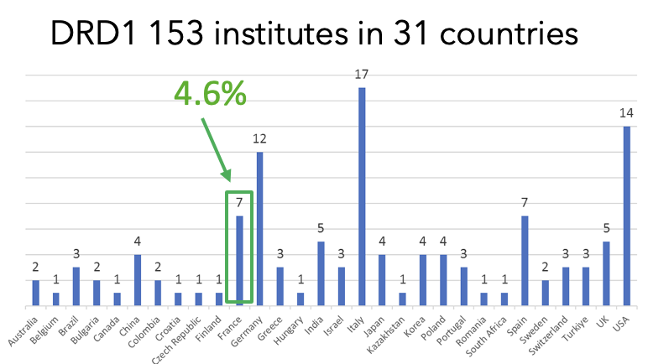
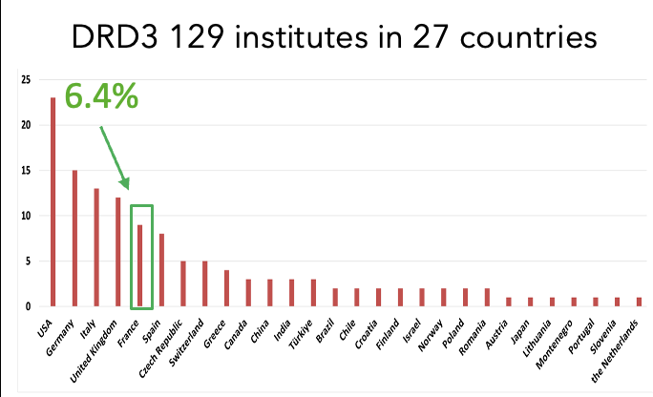
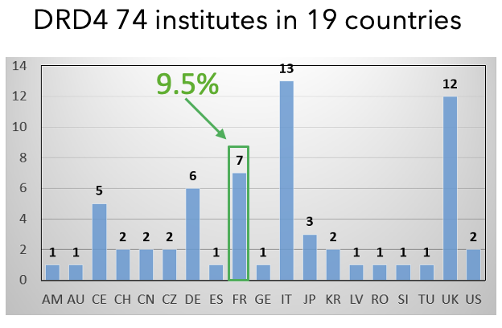
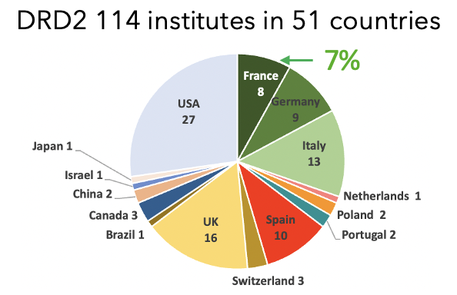
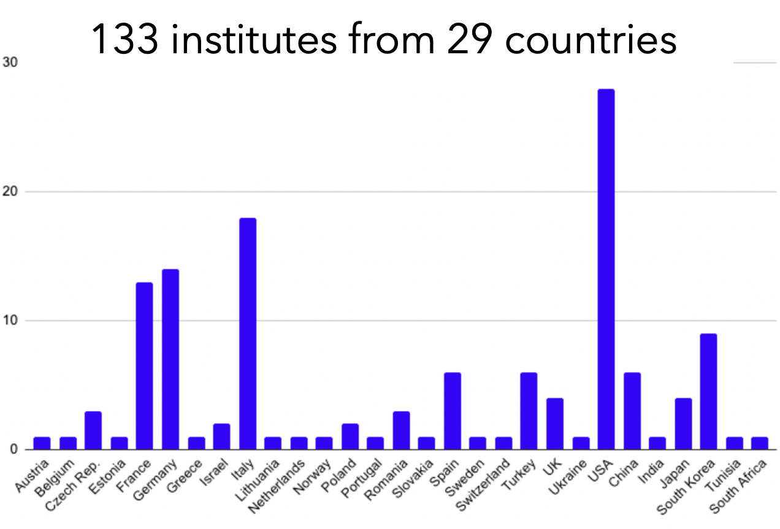
French contributions to DRDs
DRD6
9%
To be consolidated in MoUs, in preparation: deliverables with attached personnel and funding

Slide 6
Instrumentation in ESPP process
Planned inputs
  ECFA Detector Panel input – generic DRD collaborations status and prospect toward execution of the ECFA Detector Development roadmap
  Some DRD inputs (DRD5, DRD6 +?)
Detector instrumentation group of the ESSP PPG
  ”Detector instrumentation: will look at requirements from projects and whether they are covered by the R&D activities” (K. Jakobs at FCC workshop last week)
Global topics for discussion:
  Organisation of DRDs, management of cross-cut activities, adequation of resources
  1st phase (3-4 years) DRD goals versus project concept groups planning
  Transitions to less iterative second phase - focus on FCC-ee and 2nd generation Neutrino, DM, Rare Decays - evolution to new technologies - ramp-up of resources
  Availability of beam test and infrastructure facilities
  Training and Early Career (providing direct input to ESPPU)

Slide 7
Instrumentation in ESPP process
Discussion
French views on the global topics
  External (DRD) organisation, fit of programs/planning with French activities
  Internal organisation, synergies and priorities (not emerging from this exercise but not the goal, more relevant of a prospective exercise)
  Community building national/international (starting with discussions of common FCC EoI inputs to ESSP-2025, including 3 EoIs of detector concepts)
Global topics for discussion:
  Organisation of DRDs, management of cross-cut activities, adequation of resources
  1st phase (3-4 years) DRD goals versus project concept groups planning
  Transitions to less iterative second phase - focus on FCC-ee and 2nd generation Neutrino, DM, Rare Decays - evolution to new technologies - ramp-up of resources
  Availability of beam test and infrastructure facilities
  Training and Early Career (providing direct input to ESPPU)

Slide 8
Further Information
DRD framework, links of French activities to projects
DRDs main challenges, organisations and French contributions

Slide 9
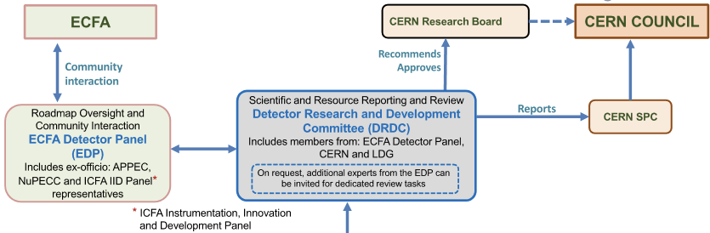
International instrumentation framework
French interest embedded in the (new) CERN DRD programs
consolidation on-going in preparation of MoUs (by mid-2025?): deliverables and resources
EDP will submit an input to the ESPP
The DRDC chair is the ESPP PPG instrumentation WG chair
DRD1
Gaseous Detector
M. Titov
E. Oliveri
DRD2
Liquid Detector
R. Guenette
J. Monroe
DRD3
Solid State Detector
G. Kramberger
G. Pellegrini
DRD4
Photon det.
and PID
M.Fiorini
G. Wilkinson
DRD5
Quantum,
emerging
techno.
M. Demarteau
M. Doser
DRD6
Calorimetry
R. Poeschl
R. Ferrari
DRD7
Electronics
on-detector
processing
F. Simon
F. Vasey
DRD8
Mechanics and
Integration
B. Schmidt
A. Mussgiller
DRDs cover Technology Readiness Levels between “blue sky” ≃ 3 & “experiment specific engineering” ≃ 6
some DRDs plan to submit an input to the ESPP

Slide 10
Overall DRD planning for collider projects
French interests largely driven by future e-e collider, but also intermediate programs
technology choices for specific engineering
FCC-ee
End of LHC upgrades LS4
will steer community contributions
10 – 12 years
periods & projects covered
by the CERN DRDs
ILC
decision on accelerator will steer DRD directions
HL-LHC*, Belle-3 CEPC
initial DRD programs focus on 3-4 years
consistent with earlier projects as stepping stones, technologies could change by FCC-ee
EPIC/EIC
* The programs considered for LS4 R&D are: ALICE-3, LHCb-II, replacement of ATLAS and CMS inner VD layer(s), and ATLAS inner HGTD ring(s)

Slide 11
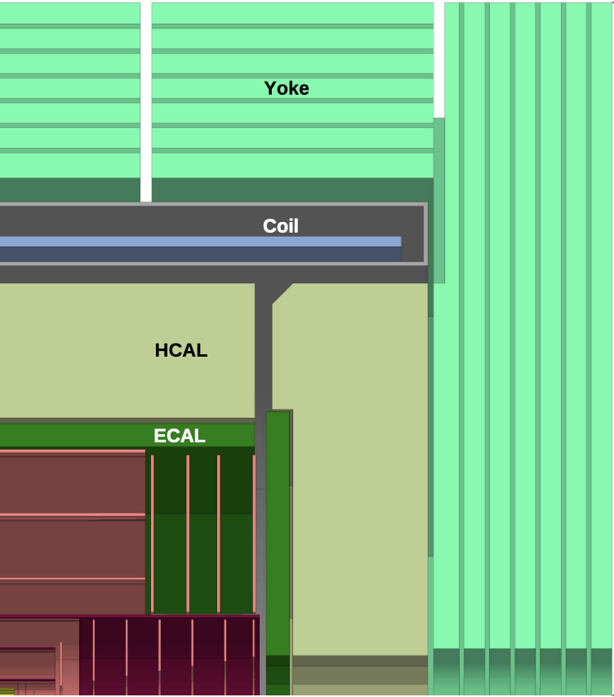
French instrumentation interests
applications in CLD-like concept
DRD1 WP1: Muon hodoscope
IRFU: MicroMegas
Sub-systems ESPP EoIs
DRD6 WP1: Sampling calorimetry w/ embedded electronics
IP2I, LPC-CF, OMEGA: T-SDHCAL
IJCLab, LLR, LPNHE, OMEGA: Si/W ECAL*
DRD3: SSD tracking
Tracking/Timing layers
IP2I, IRFU: MCMOS
IJCLab, CPPM, LPNHE: LGAD
Array of Rich Cells for PID
WP1
WP2
Full Si Tracker
WP1
Tracking IP2I, IRFU: MCMOS
Vertex Detector APC, CPPM, IPHC, IP2I, LPNHE: MCMOS
* MCMOS tracking sensors could be used in Si/W calorimetry layers

Slide 12
French instrumentation interests
applications in ILD-like concept
DRD1 WP1: Muon hodoscope
IRFU: MicroMegas
Sub-systems ESPP EoIs
DRD6 WP1: Sampling calorimetry w/ embedded electronics
IP2I, LPC-CF, OMEGA: T-SDHCAL
IJCLab, LLR, LPNHE, OMEGA: Si/W ECAL*
DRD3: SSD tracking
Tracking/Timing layers
IP2I, IRFU: MCMOS
IJCLab, CPPM, LPNHE: LGAD
Array of Rich Cells for PID
WP1
WP2
Full Si Tracker
TPC
DRD1 WP4
Tracking IRFU: TPC
TPC
DRD3 WP1
Vertex Detector APC, CPPM, IPHC, IP2I, LPNHE: MCMOS
* MCMOS tracking sensors could be used in Si/W calorimetry layers

Slide 13
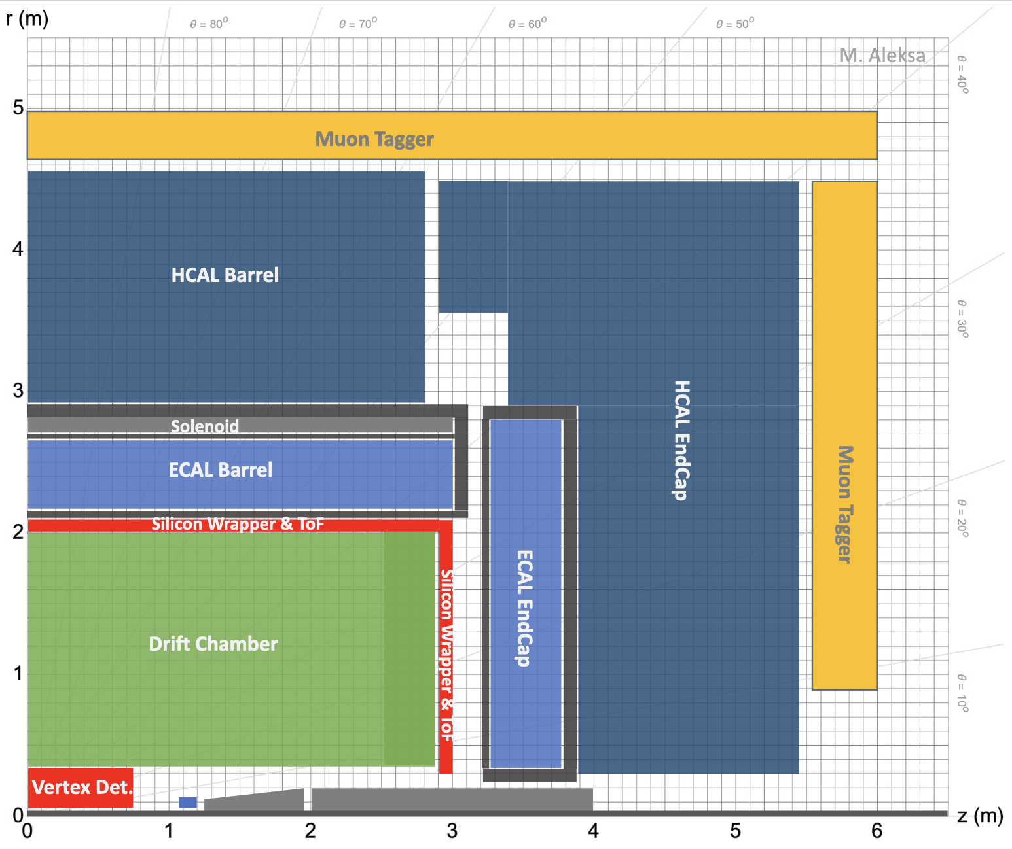
French instrumentation interests
applications in ALLEGRO-like concept
DRD1 WP1: Muon hodoscope
IRFU: MicroMegas
Sub-systems ESPP EoIs
DRD6 WP2: Liquified Noble Gas
ECAL
APC, CPPM, IJCLab, LAPP, LPNHE, LPSC, Omega
DRD3: SSD tracking
Tracking/Timing layers
IP2I, IRFU: MCMOS
IJCLab, CPPM, LPNHE: LGAD
WP1
WP2
DCH (TPC-DT)
DRD1 WP2/4
IRFU: TPC, IJCLAB, GANIL, LPHC: DCH
DRD3 WP1
Vertex Detector APC, CPPM, IPHC, IP2I, LPNHE: MCMOS

Slide 14
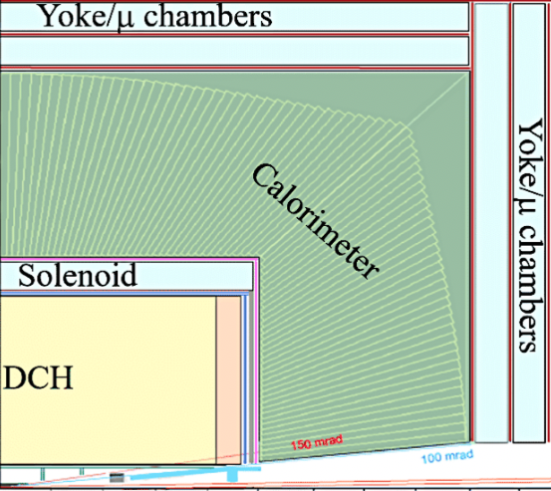
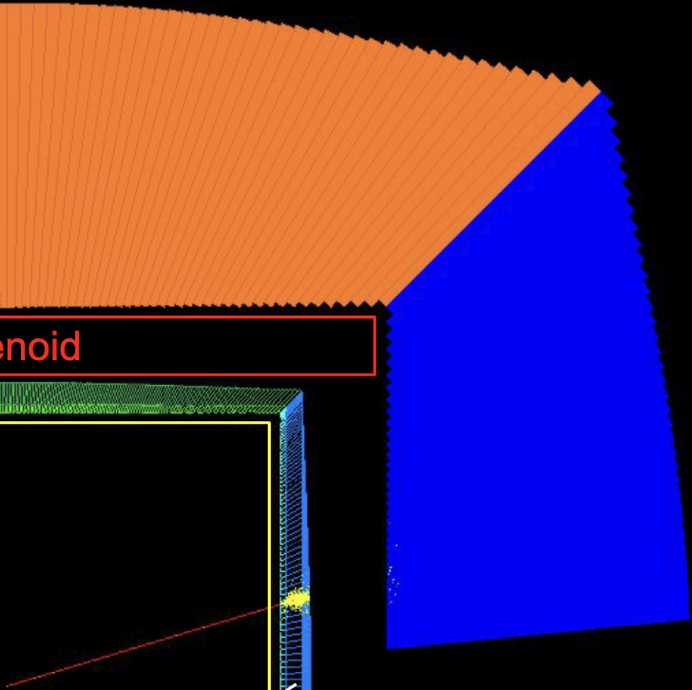
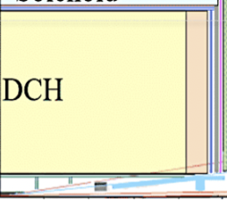
French instrumentation interests
applications in IDEA-like concept
DRD1 WP1: Muon hodoscope
IRFU: MicroMegas
Sub-systems ESPP EoIs
DRCAL
DRD6 WP3: Optical Calorimeters
ECAL
IJCLAB, LPC-CF: Crystal grains GRAiNITA
IP2I: Crystal bars
ECAL
DRD3: SSD tracking
Tracking/Timing layers
IP2I, IRFU: MCMOS
IJCLab, CPPM, LPNHE: LGAD
WP1
WP2
DRD1 WP2
IJCLAB, GANIL, LPHC: DCH
DCH
DRD3 WP1
Vertex Detector APC, CPPM, IPHC, IP2I, LPNHE: MCMOS

Slide 15
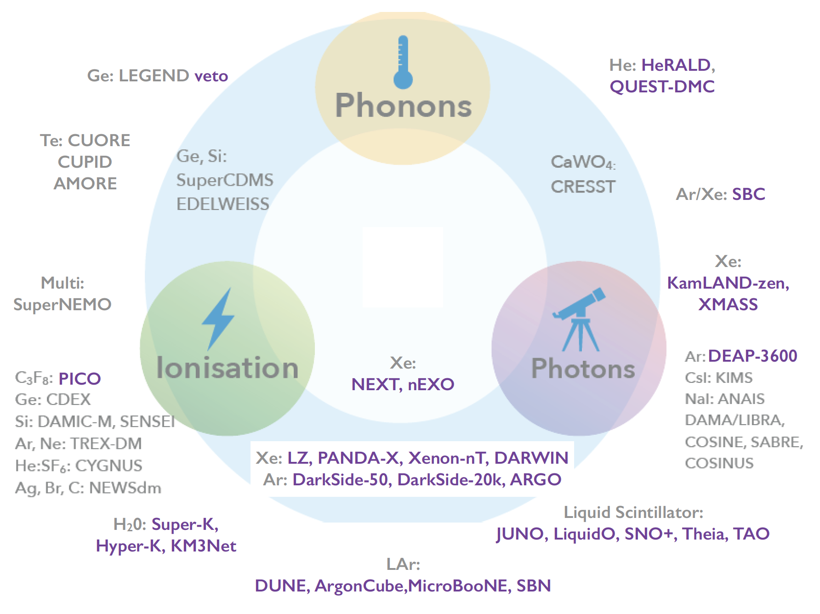
Neutrino, Dark Matter, 0𝜈ββ decay detectors (from ECFA roadmap)
goal to measure the different signals in same multi-purpose detectors of increasing volumes
shorter time scale than colliders: 1st generation 2025-2030, 2nd generation 2035-2040
Bolometers
Low energy thresholds small detectors crystals with quantum sensors
DRD5
Neutrino
Dark Matter
0𝜈ββ
Large detector volumes
different readout schemes
DRD2
Water Cherenkov
O(10²) 𝛾/MeV
visible range
Liquid Scintillators
O(10⁴) 𝛾/MeV
visible range
Liquified Noble Gas TPC
Ionization and O(4x10⁴) 𝛾/MeV VUV 128(178) nm for LAr(Xe)

Slide 16
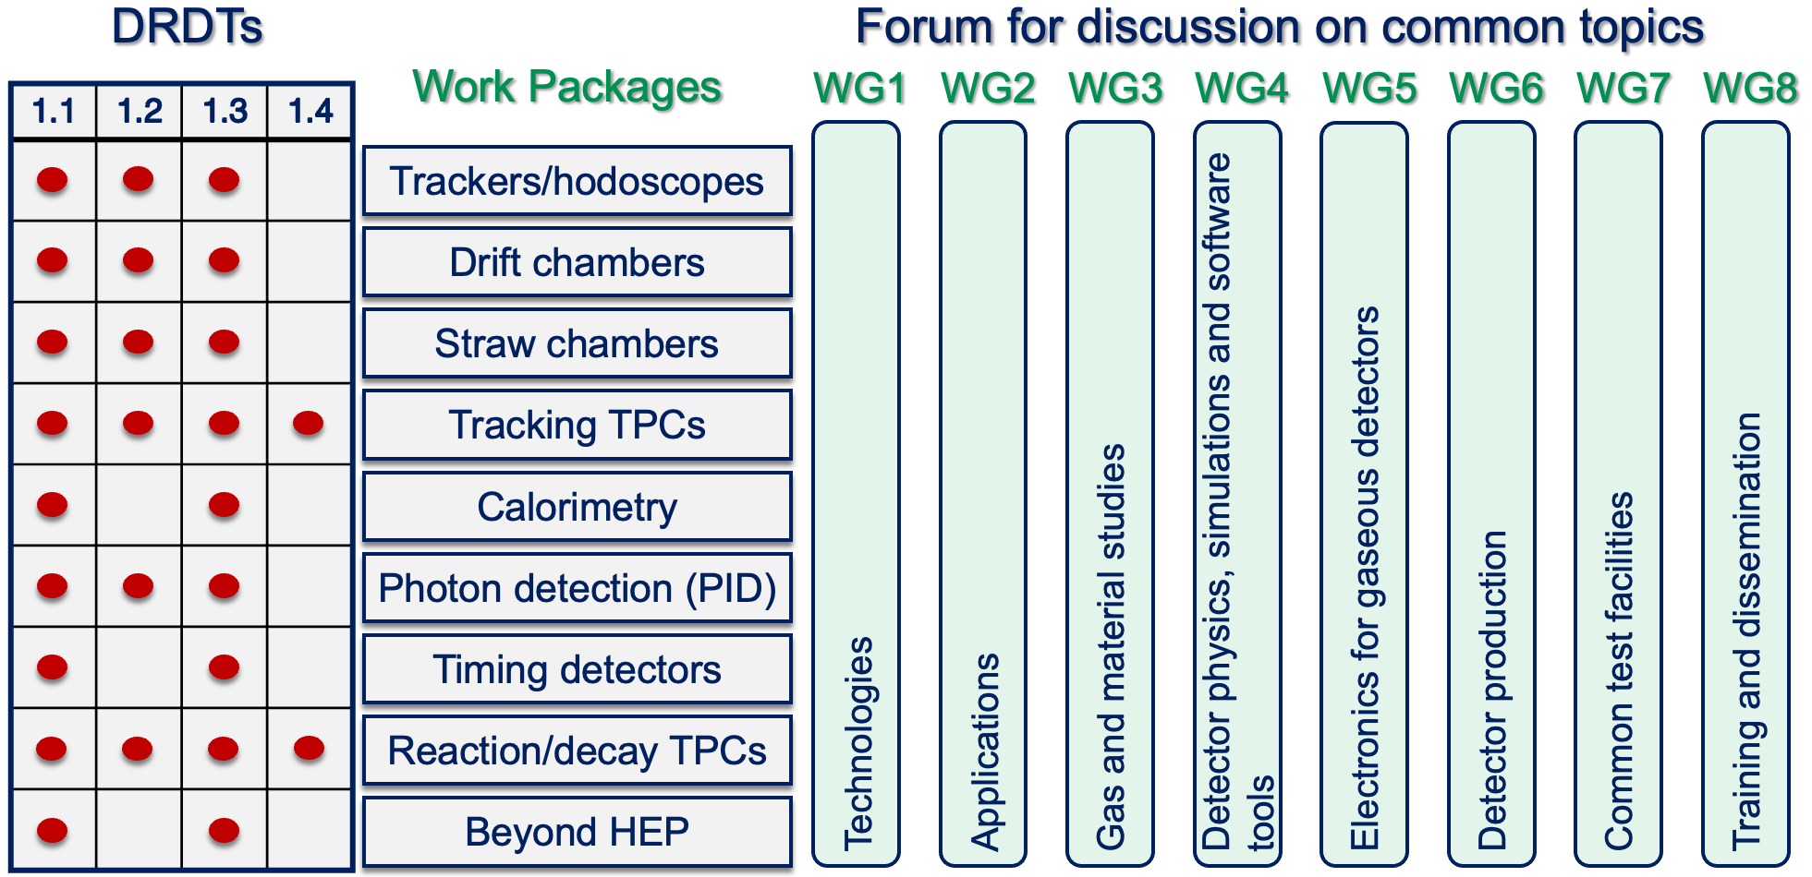
DRD1 Gaseous Detectors: structure
M. Titov²⁾ co-spokesperson
*
Work Packages
system applications
Working Groups
common forums
I. Laktineh ¹⁾
I. Laktineh ¹⁾
Detector R&D Themes (DRDT) identified in the ECFA roadmap
P. Colas²⁾
G. Charles¹⁾,
I. Laktineh ¹⁾
F. Jeanneau ²⁾
M. Gouzevitch¹⁾
¹⁾ IN2P3 and ²⁾ CEA/IRFU contributions to management positions, WG (multi-)convenership and WP (multi-)coodination
* can contain insitutes outside IN2P3 and CEA/IRFU

Slide 17
DRD1 Gaseous Detectors: French contribution proposals
relation to FCC-ee detector concepts
Muon systems all
Central Tracking with PID
MicroMegas - IRFU
IDEA - ALLEGRO
wires, cell, weaving - IJCLab, GANIL, LPSC
ILD’ (ALLEGRO)
IBF studies, MicroMegas readout - IRFU
MPGD/RPC for DRD6 ILD’, CLD
RICH readout for DRD4
readout components for DRD2
RPC ≲ 100 ps precision - IP2I, LPC-CF OMEGA
MicroMegas Picosec - IRFU
Major challenges (FCC-ee)
DC engineering - new: pulse sampling for dN/dx
TPC Ion Back Flow - new: MPGD readout for dN/dx
RPC eco-friendly gas mixture - new thin multigap design for Time of Flight

Slide 18
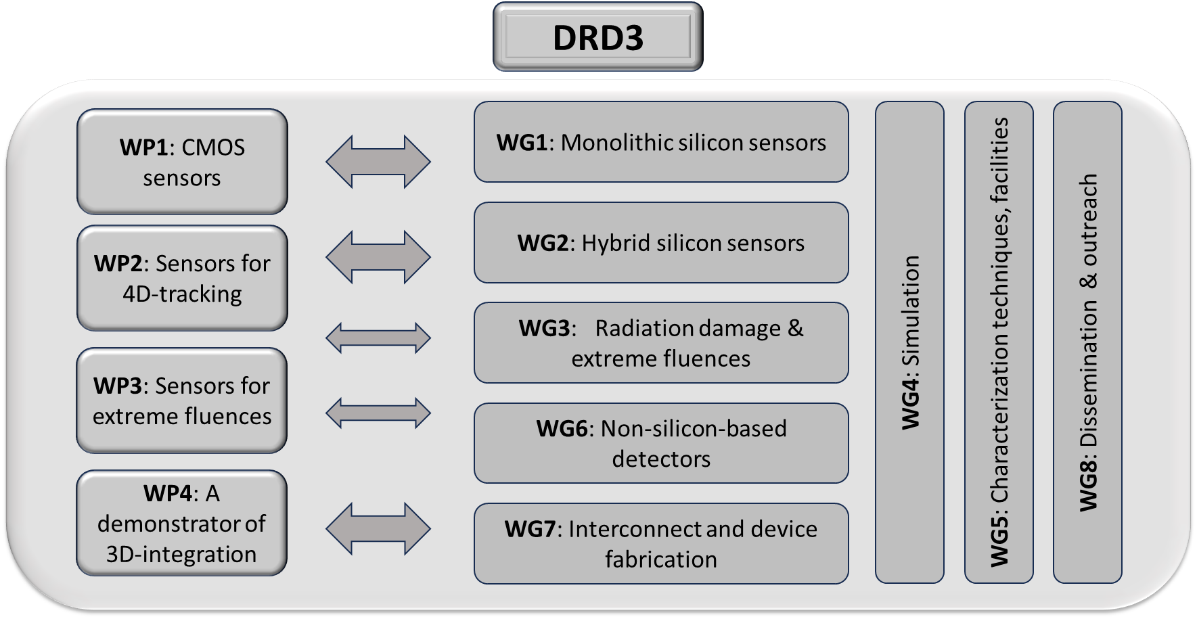
**
DRD3 Solid State Detectors*: structure
Work Packages
technologies
Working Groups
technology & common activities
J. Baudot¹⁾
G. Calderini¹⁾
matched to DRDTs
identified in the ECFA roadmap
* DRD3 proposal conditional approval, aiming at full approval at the next DRDC and RB sessions in June
¹⁾ IN2P3 contributions to WG/WP co-convenership, ** can contain insitutes outside IN2P3 and CEA/IRFU

Slide 19
DRD3 Solid State Detectors: French contribution proposals
relation to FCC-ee detector concepts
Monolithic CMOS VD/CT all, HGC ILD’ & CLD
TJ/TPSCo 180/65 nm - APC, CPPM, IPHC, IP2I, LPNHE
LFoundry 150 nm - IRFU
LGAD TL all and 3D sensors
LGAD - IJCLab , Omega, LPNHE
radiation tolerance
ATLAS/CMS/LHCb long term FCC-hh
WBG - LPSC, Diamond and Silicon - LPSC, IJCLab Silicon - APC, IRFU, LPNHE
in house interconnect - CPPM, IJCLab
wafer to wafer for MCMOS - IP2I
all techniques - LPNHE
mechanics & cooling - CPPM, LPNHE
VD/CT/HGC all - HGC
Major challenges (FCC-ee)
MCMOS granularity in large size at low power consumption - new: precise timing, on detector processing…
LGAD improve fill factor (for high pixel granularity)
collapse LGAD & MCMOS (spatial/time precisions) in single monolithic device, extend use to CT & HGC
sustain foundry interest (so far ≠ process privileged for ≠ applications to VD, CT, HGC, TL)
new finer nodes and/or 3D interconnection (analog - digital features) to gain space and for low power
Vertex Detector, Central Tracking, High Granularity Calorimetry, Time of Flight Layers

Slide 20
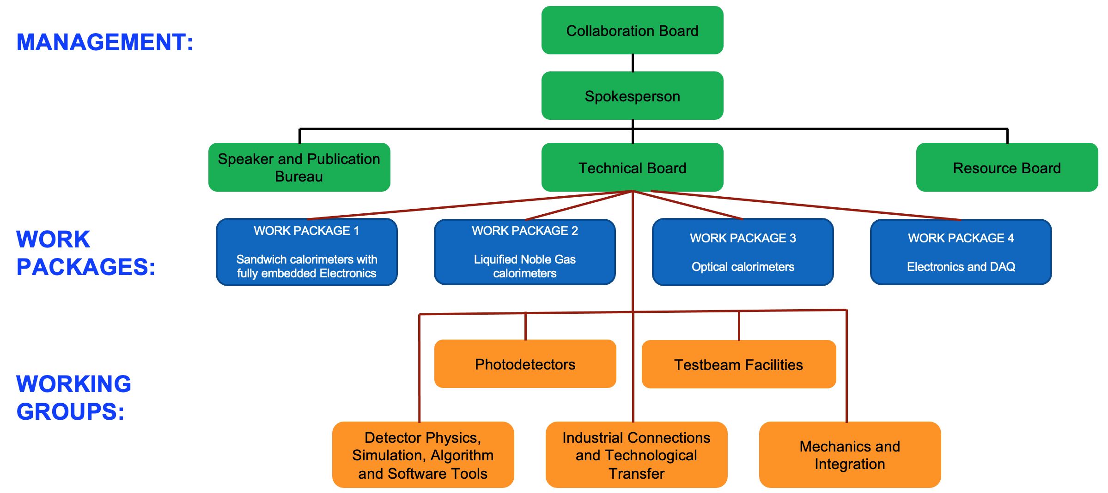
9%
DRD6 Calorimetry organization: structure
R. Poeschl¹⁾ spokesperson
*
Work Packages : 3 main classes of calorimeters + electronics (transverse)
N. Morange¹⁾
C. De la Taille¹⁾
DRD1/DRD3/WP3
for sensitive elements
link to DRD2 for
WP2 cold electronics
R&D scintillating & Cerenkov materials
link to DRD5 (quantum), DRD4 (ToF)
Working Groups
common activities
link to DRD2/DRD4 for SiPMs
¹⁾ IN2P3 contributions to management positions and WP convenership (C. De la Taille tbc), * can contain insitutes outside IN2P3 and CEA/IRFU

Slide 21
DRD6 Calorimetry: French contribution proposals
relation to FCC-ee detector concepts
ILD’, CLD
ALLEGRO
IDEA
All
APC, CPPM, IJCLab, LPNHE
WP1- WP2 - OMEGA, IRFU
SiW-ECAL - IJCLab, LLR, LPNHE
T-SDHCAL - IP2I, LPC-CF
GRAiNITA - IJCLAB, LPC-CF
MAXICC - IP2I, CPPM
SpaCal (LHCB-2) - IJCLAB, LPC-CAEN, LPC-CF
Major challenges (FCC-ee)
HGC ECAL sampling fraction - new: particle counting, precise timing
LNGCal dual readout - new: depth segmentation, cold electronics, light cryostat
OptiCal depth segmentation - new: dual readout materials, precise timing
Electronics fast and low power consumption
All systems engineering uniformity, no cracks, mechanical precision

Slide 22
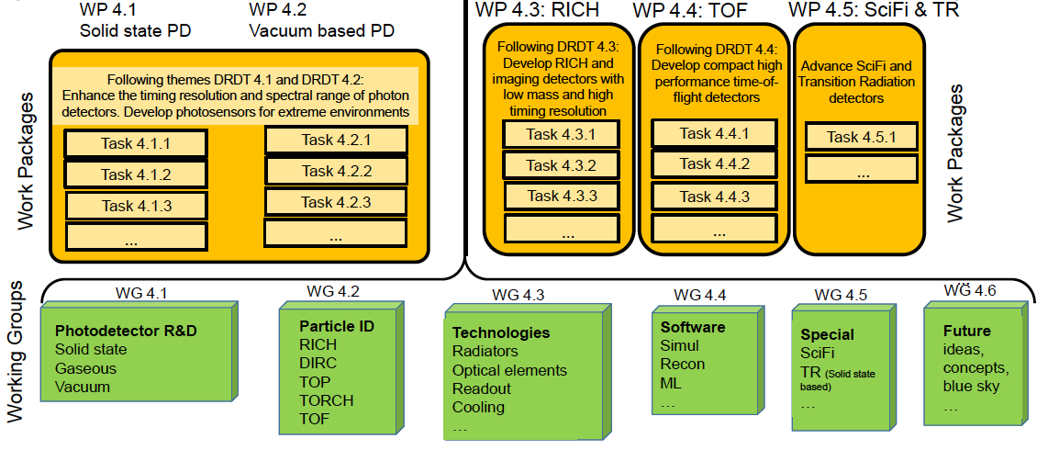
*
DRD4 Photon and PID: structure
Work Packages: matching the DRDTs of the ECFA roadmap
mix of technology and systems
I. Laktineh ¹⁾
Working Groups common forums and activities
¹⁾ IN2P3 WP convenership, * can contain insitutes outside IN2P3 and CEA/IRFU

Slide 23
DRD4 Photon and PID: French contribution proposals
relation to FCC-ee detector concepts
IDEA, ILD’, CLD
CLD
IDEA
Work Packages
radiation tolerant fibers
LPC-CF
nano-PMT - IP2I
New materials/PD for ToF - CPPM
Major challenges (FCC-ee)
PD spectral range, radiation tolerance – monolithic digital w/ high fill factor
radiators and photocathodes new materials, radiation tolerant (photocathodes)
RICH thin/light large momentum coverage – new; heterogenous concept
ToF single photon time resolution

Slide 24
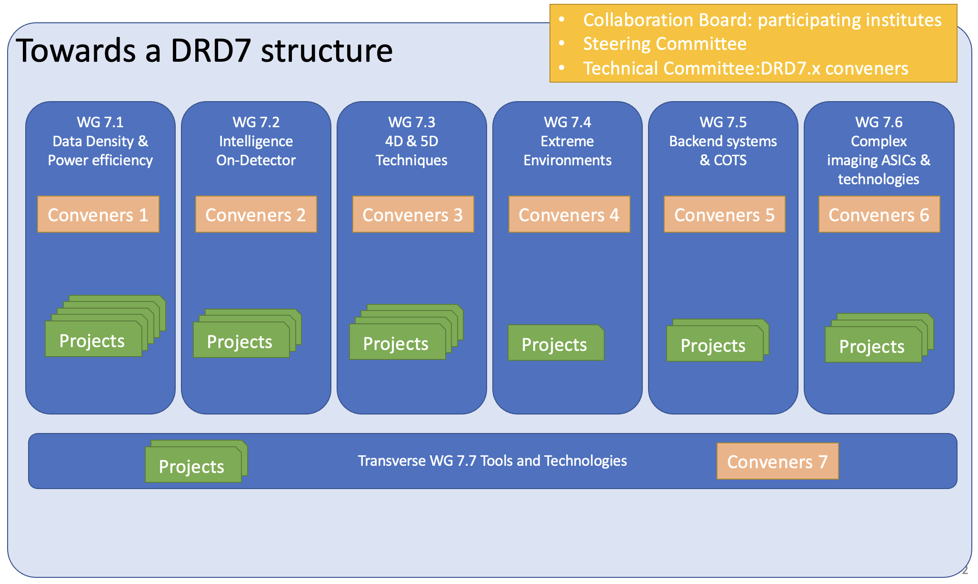
DRD7 Electronics & on-detector processing: structure
proposal submitted to DRDC aiming approval at June 2024 CERN RB meeting
68 institutes from 19 countries -12 French 18%*
J. Baudot¹⁾ steering committee member
F.Crescioli ¹⁾
M.Barbero¹⁾
Work Packages
16 projects
transverse Working Group
to propose regional hub/platform organization to provide support to the entire community
for common standards, methodologies, IP, technology access and tools
¹⁾ IN2P3 contribution to interim management team and WG convenership, * can contain insitutes outside IN2P3 and CEA/IRFU

Slide 25
DRD7 Electronics & on-detector processing
French contribution proposals
Wireless Allowing Data
and Power Transmission CEA-Leti, LPSC
MCMOS submissions
CPPM, IPHC, IP2I, LPNHE
3D & advanced integration IP2I
high level modelling IPHC
Processor & SoC in FE
(100 GbE-based links)
CPPM
TDC and ADC - CPPM, IP2I, IRFU, OMEGA
time calibration - LPC-CF
timing system strategy & characterisation - CPPM, IJCLab
CMOS process radiation tolerance - CPPM
cooling - CPPM, LAPP, LPNHE, LPSC
Major challenge
enabling 5D devices at high channel density low power dissipation (ultimately with extreme radiation tolerance)
introduce new technologies: finer foundry nodes, data transmission, 3D integration

Slide 26
DRD8 Mechanics & Cooling of future Vertex and Tracking systems
LoI submitted to DRDC in March 2023, targeting proposal in autumn 2024
Proposed Work Packages
Global/System Design and Integration - IPHC
  structures, services, environmental aspects, MDI, sclability, robotics
Low Mass Mechanics and thermal management - CPPM, LPNHE
  materials, advanced manufacturing techniques, embedded cooling
Detector Cooling - CPPM, LPNHE
  evaporative and liquid, gas, connexions and instrumentation
Design and Qualification Tools
  open-source software, ML assisted topology optimization, virtual reality, methods for complex 3D integration, connection of CAD tools to Geant
DRD8 has a strong link to DRD3 but institutes involved in other DRDs expressed interets
community building on-going (22 institutes so far)*
* contacts Andreas Mussgiller, Burckard Schmidt meeting to discuss proposal May 29-31, 2024 in Purdue

Slide 27
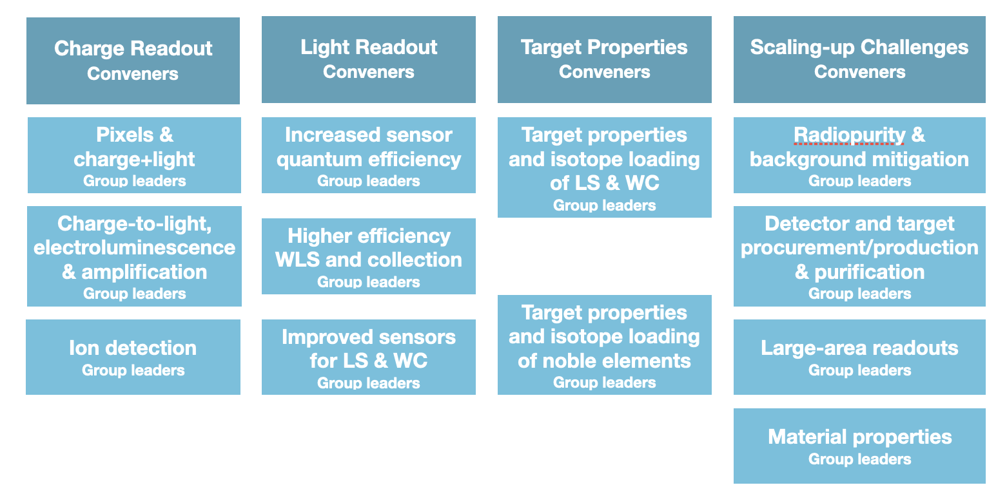
*
DRD2 Liquid Detectors : structure
Water Cerenkov, Noble Liquids, Liquid Scintillators
for DM, Neutrino, 0𝜈ββ, rare decays
Work Packages matched to DRDTs of the ECFA roadmap
M. Bongrand¹⁾
C. Franco¹⁾
¹⁾ IN2P3 contributions to interim convenership, * can contain insitutes outside IN2P3 and CEA/IRFU

Slide 28
DRD2 Liquid Detectors : structure
Water Cerenkov, Noble Liquids, Liquid Scintillators for DM, Neutrino, 0𝜈ββ, rare decays
Work Packages matched to DRDTs of the ECFA roadmap
low noise & power,
multimodal readout
LPNHE
CPPM
LLR, OMEGA, CEA/IRFU
opaque liquid scintillator - IJClab
LNG target properties APC, LPNHE + CTP, ICB, ICPJLab
Major challenges
readout low threshold, energy and spatial resolution (pixels, QE, WLS, photocathodes…)
material sensitivity, heterogenous Cerenkov & scintillation, new scintillators ex. opaque
systems scaling x 10 -100

Slide 29
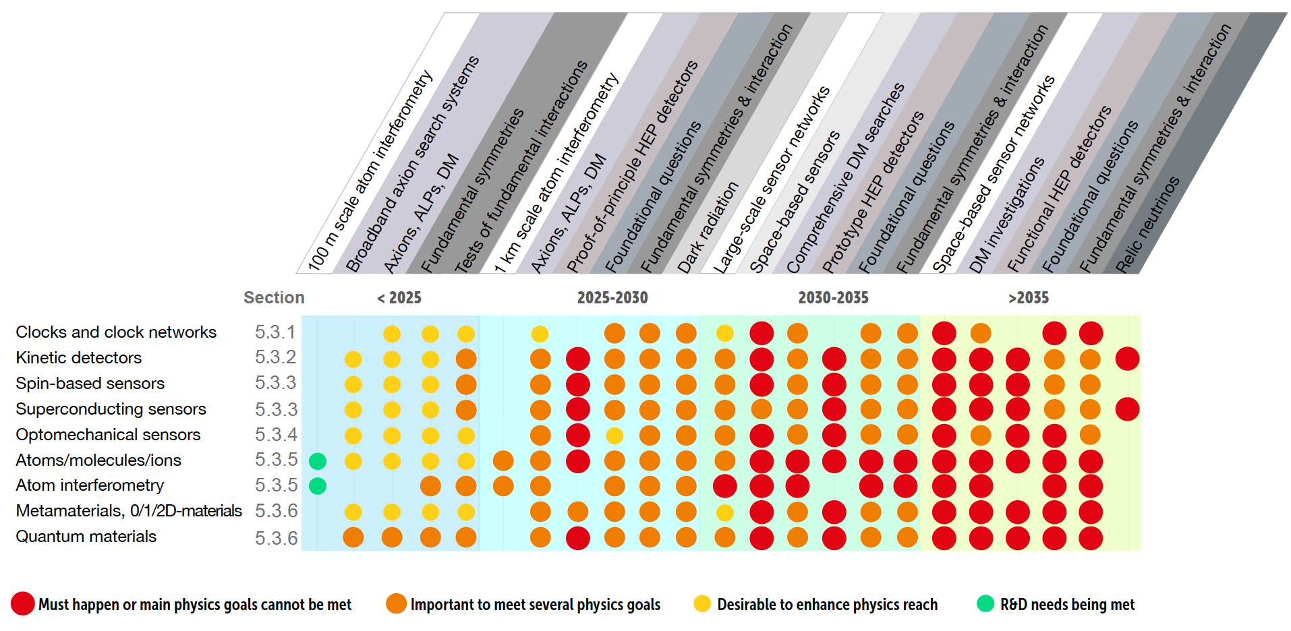
DRD5 Quantum Sensors
high sensitivity sensors, nano/meta/heterogenous materials
so far applications in EDM, DM, neutrino, 0𝜈ββ searches, fundamental forces
proposal submitted to DRDC aiming approval at June 2024 CERN RB meeting
76 groups in 15 countries*, 25 proposed contributions - no IN2P3, CEA/IRFU contributions so far
Work Packages (defined considering and HEP collaborative model)
  atomic, nuclear & molecular systems in traps & beams
  quantum materials
  cryogenic materials, device and systems
  scaled-up quantum
  quantum techniques for sensing
      networking, training, shared expertise and infrastructure
Technology areas
window for new detector concepts at FCC-ee ?
considering community building possibly through platform/hub organization
promoting developments and investigating application to collider projects
* including several contributions outside of HEP community

Slide 30
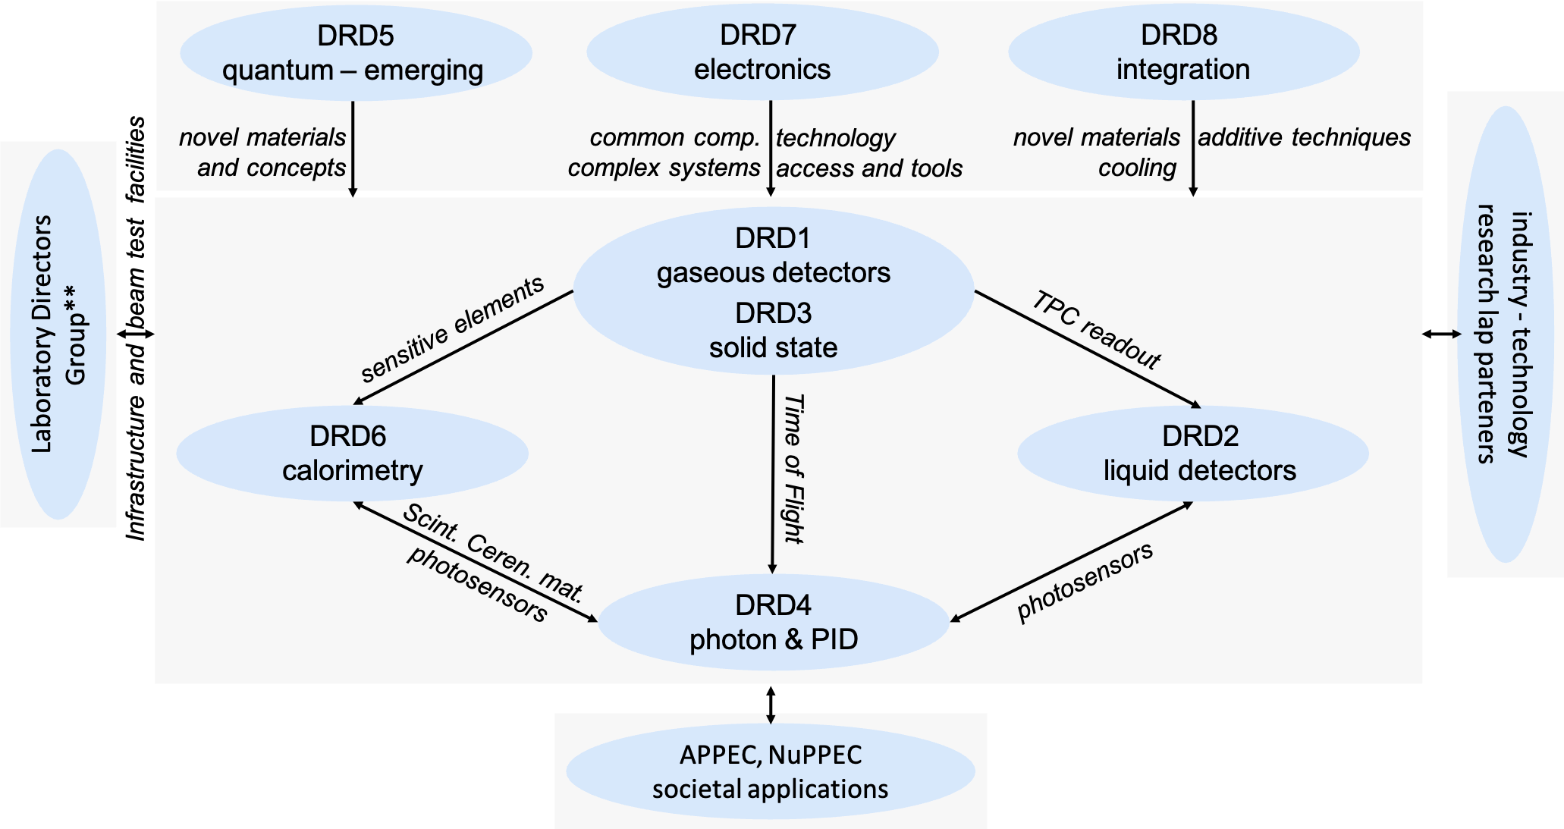
Links across DRDs and to external partners
need to synchronise programs and understand sharing of resources in common areas
** CEA/IRFU-France, CERN-EU, CIEMAT-Spain, DESY-Germany, IJCLab-France, LNF-Italy, LNGS-Italy, Nikhef-Netherlands, PSI-Switzerland, STFC/Daresbury-UK, STFC/RAL-UK

