Slide 1
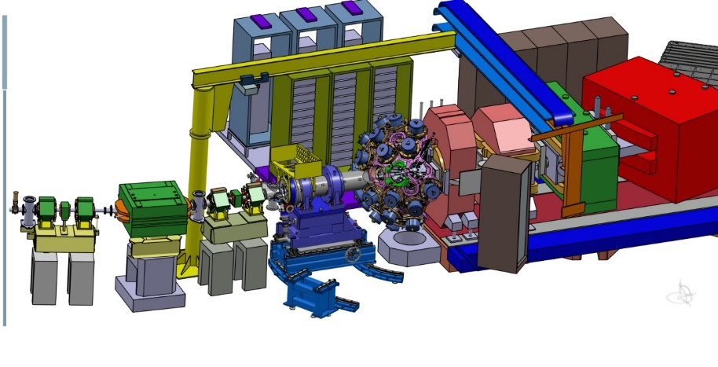
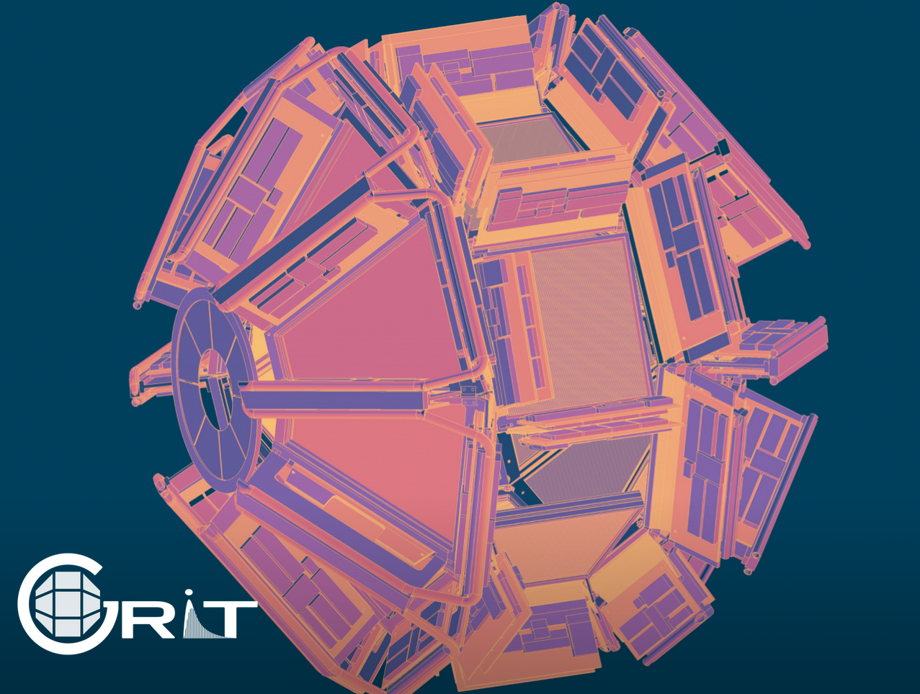
WELCOME

Slide 3
The goal of the workshop is to start the preparation of the 2029-2030 campaign
From the science drivers : the final configurations of the setup ? The clear needs guiding the developpments (beams, electronics, geometries)c
Start or continue the collaborative effort on : Mechanics, Front End Electronics, Data Flow, Data Analysis, Post-experiment efforts, publications policy

