Slide 1
Possibilities offered by (³He,n) reactions with AGATA and NEDA
Jose Javier Valiente Dobón
IFIC-CSIC, Valencia

Slide 2
Overview
Introduction
  What is NEDA
  NEDA detectors
  NEDA electronics
  General properties
Some possible physics cases (³He, n) for NEDA+AGATA
What about ³He targets?
Summary

Slide 3
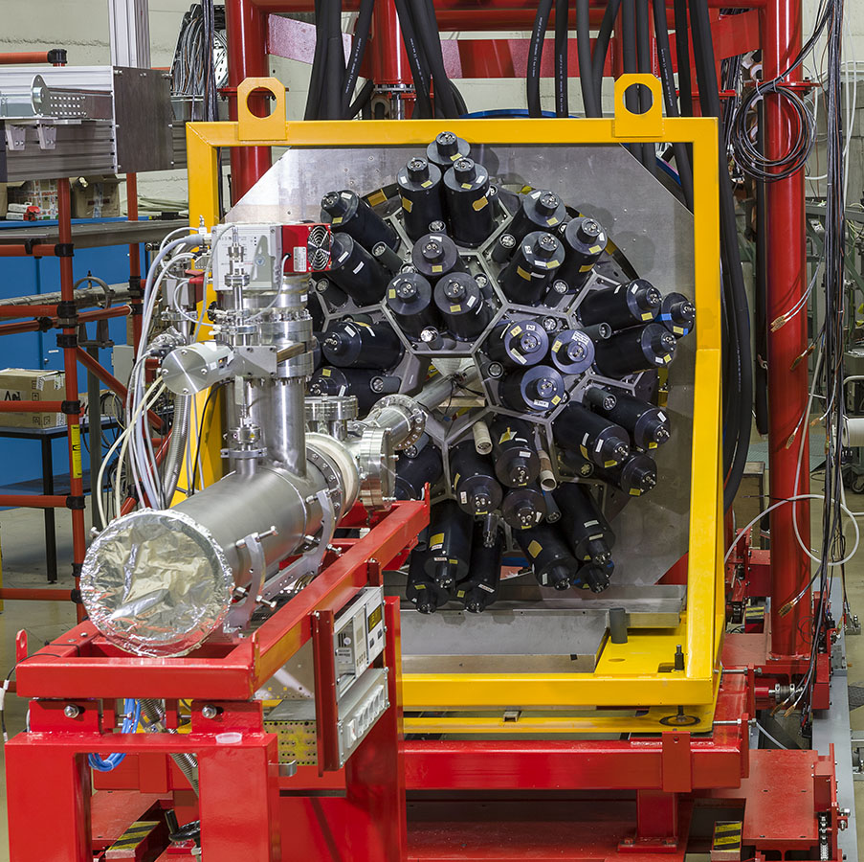
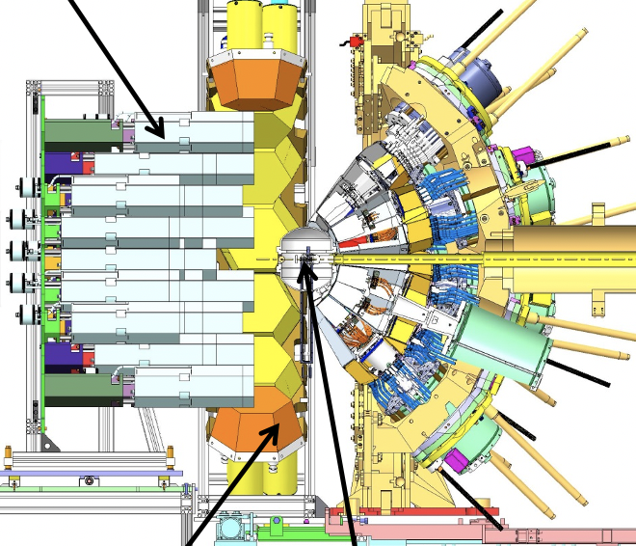
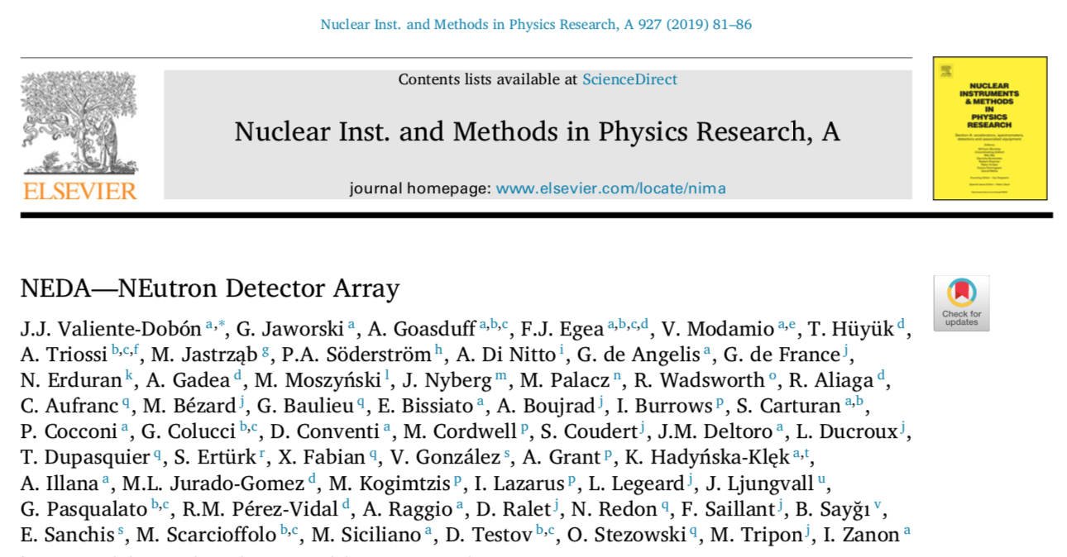
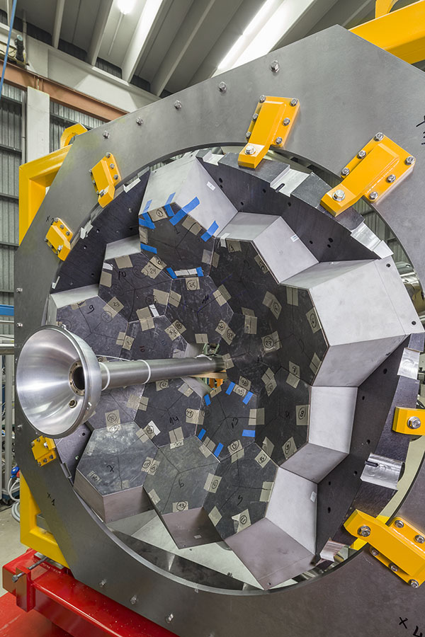
What is NEDA?
Versatile neutron detector designed to be coupled to gamma-ray arrays
Neutron detection is based on the liquid scintillator EJ301 with good neutron-gamma discrimination capabilities.
FEE fully digital system:
  200 MHz and ENOB 11,3
  Global Trigger System - GTS
Predecessor Neutron Wall
NEDA
AGATA

Slide 4
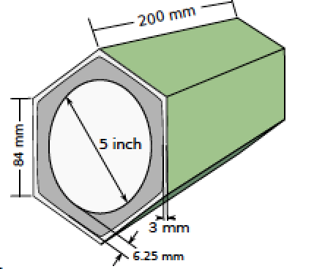
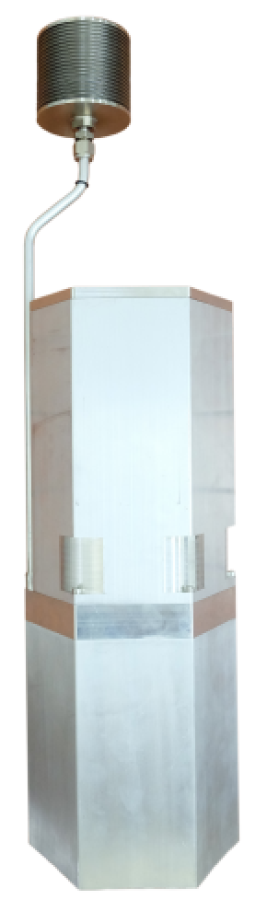
NEDA detectors
Regular hexagon to tile up a surface
20 cm depth detector
5” PM Hamamatsu R11833-100HA QE 33%
PSA liquid EJ301 → 3 liters
TiO₂ Reflexion paint
Expasion chamber ΔT =10-50 degrees
Voltage divider transistorized for large counting rates
Single to differential converter
1mm mu-metal shielding
Self produced
Expansion chamber

Slide 5
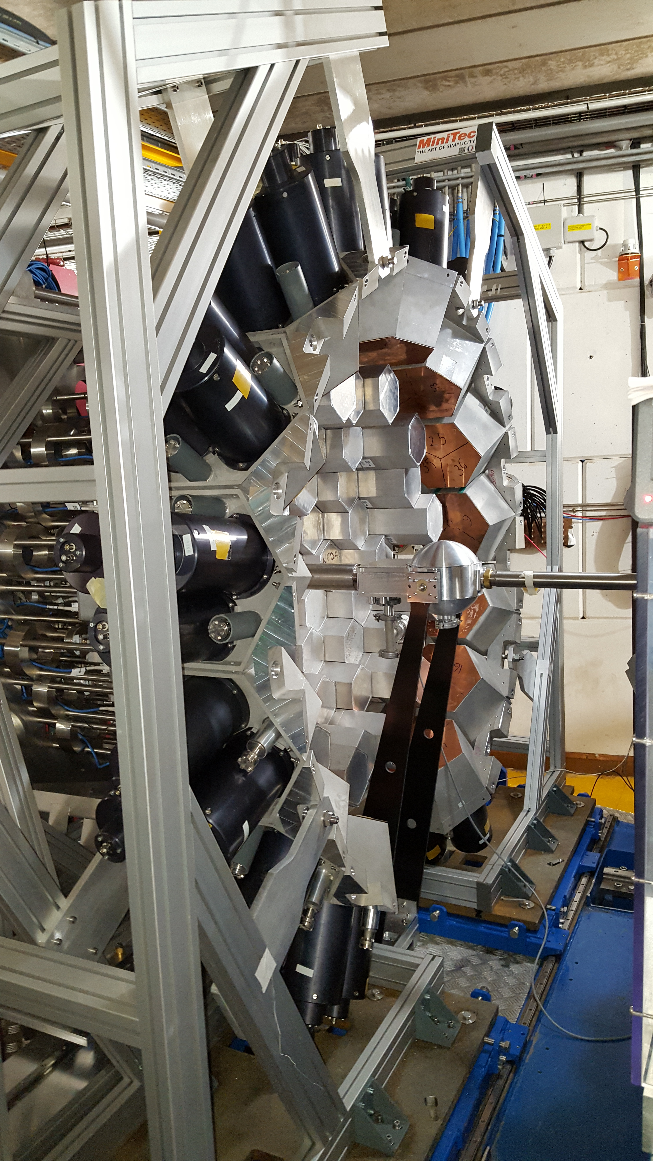
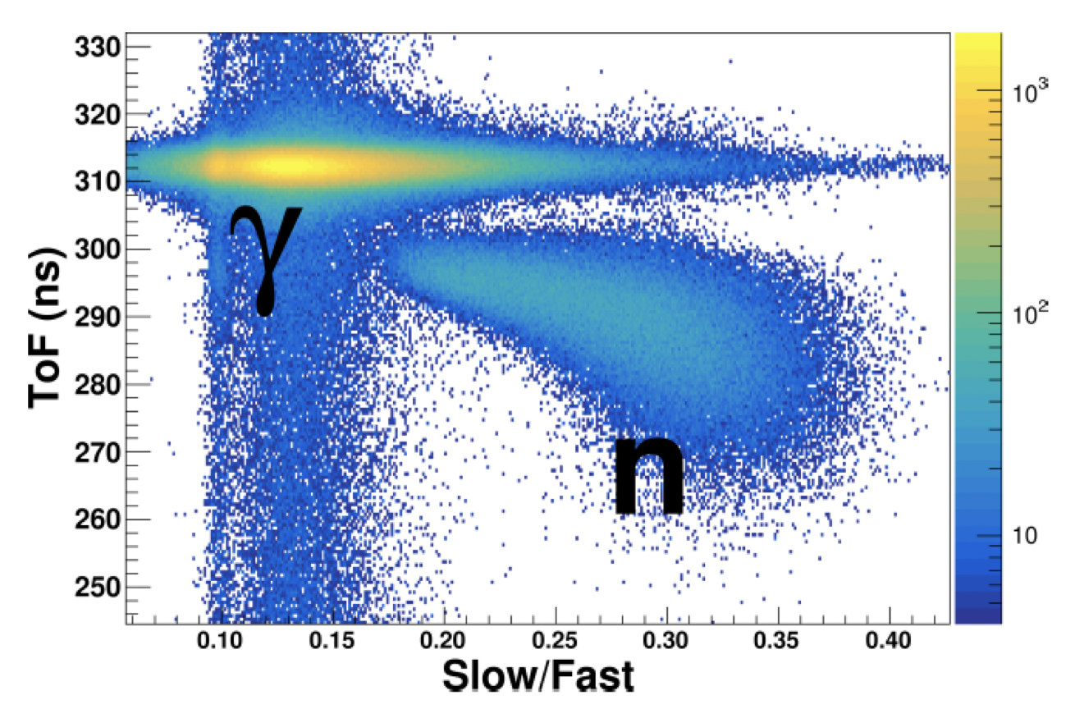

Slide 6
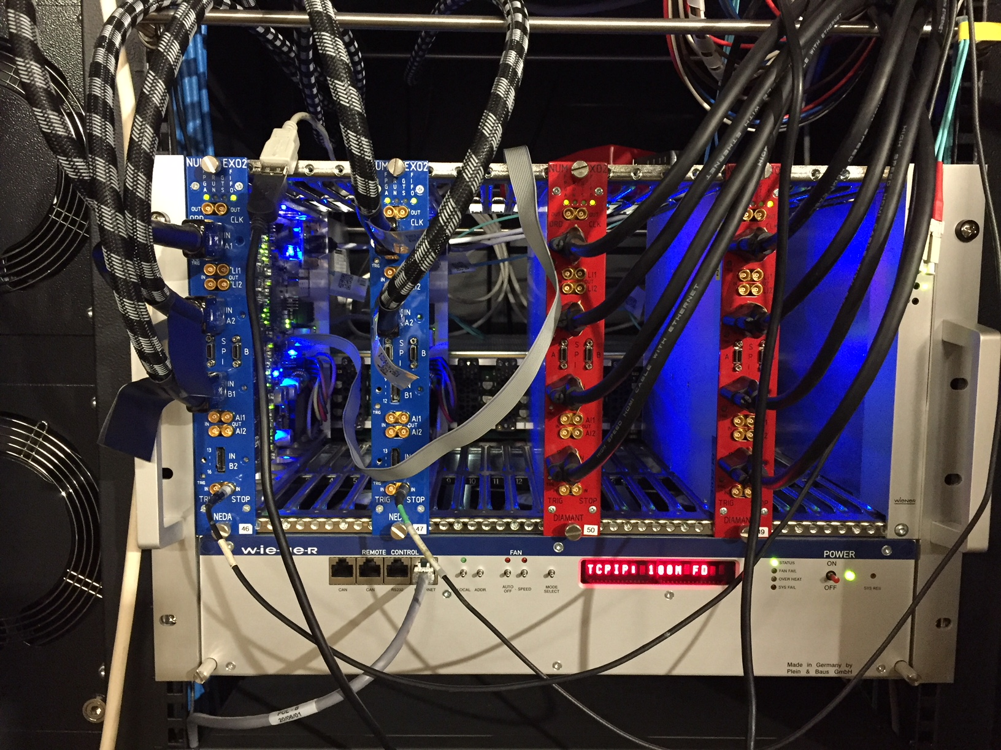

Slide 7
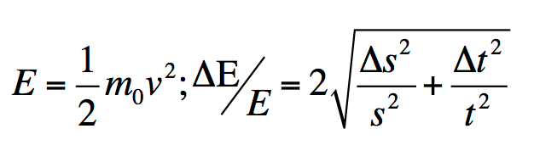
General properties of NEDA
Flexible array – variability of focal positions (experiment dependent) or configurations (mechanics to be done)
  Various campaigns of physics depending on the configuration
Neutron multiplicity filter. Efficiency 1n 30%
Pulse shape discrimination – online trigger selectivity
Off-line implementation of traditional algorithms and/or Neural Networks
Angular resolution: Δθ(0.5 m) = ±7° - Δθ(1 m) = ±4°
Timing better than 1 ns. Same performance digital/analog.
Energy resolution ΔE/E: NEDA 1m – 40%, NEDA 7m – 5%

Slide 8
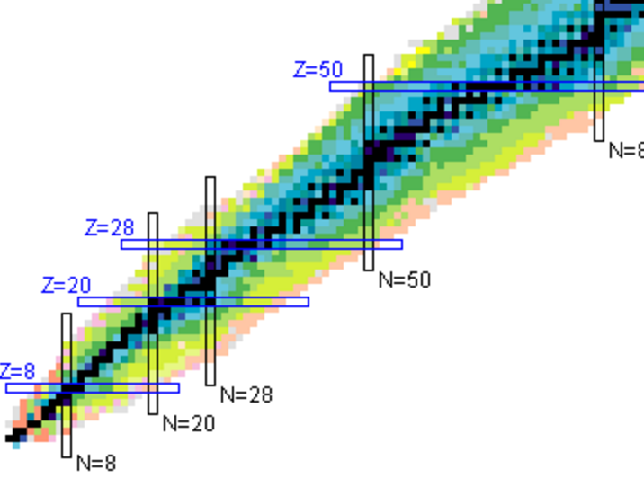
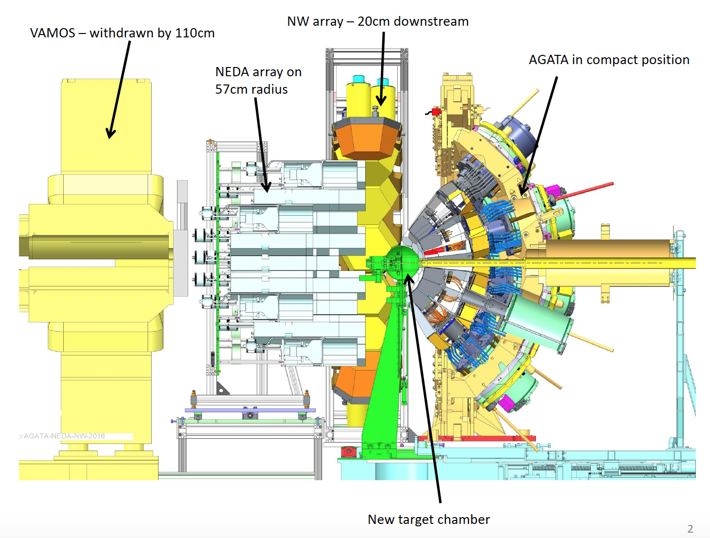
First physics campaign with NEDA
18th of april until 29th of July 2018
~ 44 beam days
E. Clement/J.J. Valiente-Dobon
Octupoles N=Z region Ba
J.. Nyberg
^{102,103}Sn excited levels
M. Palacz/M. Gorska
Pd high spin
N. Redon
Sm, Pm deformations
B. Cederwall
T=0 lifetimesPd-Ru
D. Ralet
⁸⁴Mo T=0 pairing
B. Cederwall
T=0 pairing ⁸⁸Ru
S. Lenzi
Iso. Symmetry Breaking A~63
Boso
⁷¹Kr-⁷¹Br – isospin symmetry
M. Bentley
⁶⁵As – isospin symmetry
D. Mengoni
Shape coexistance ⁶⁰Zn
B.S. Nara Singh
A=50 – isospin symmetry
Fusion-evaporation reactions involving 1 or 2 neutrons tagging.
N=Z
S. Leoni/B. Fornal
Gamma decay near threshold ¹⁴C
TO BE DONE

Slide 9
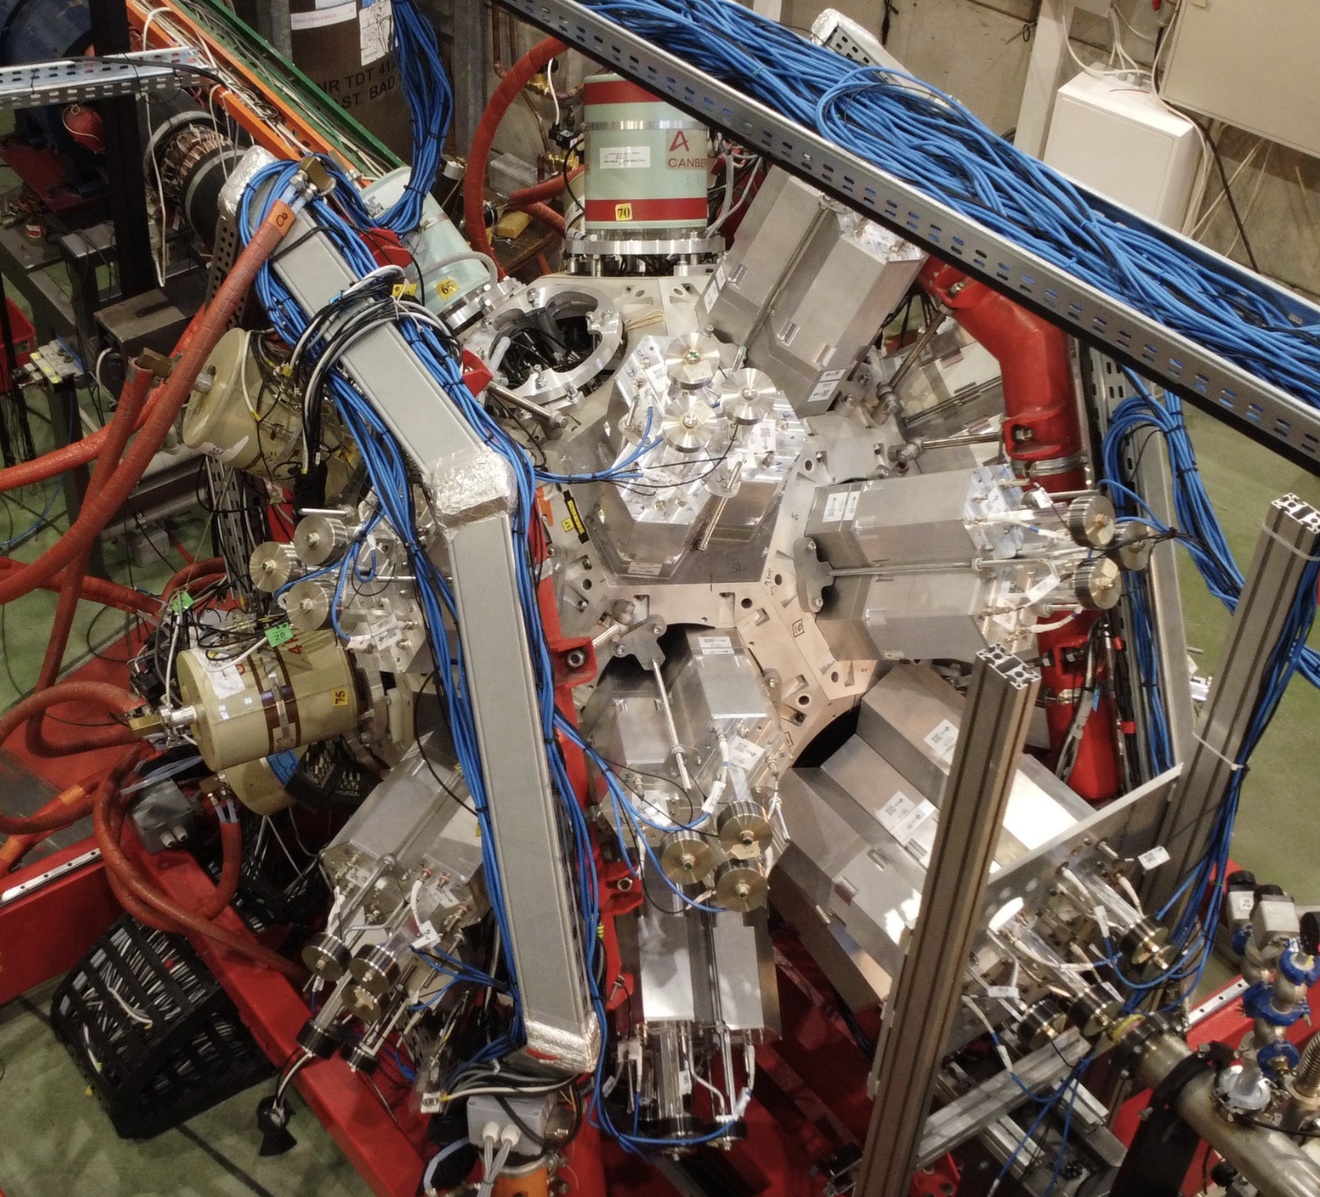
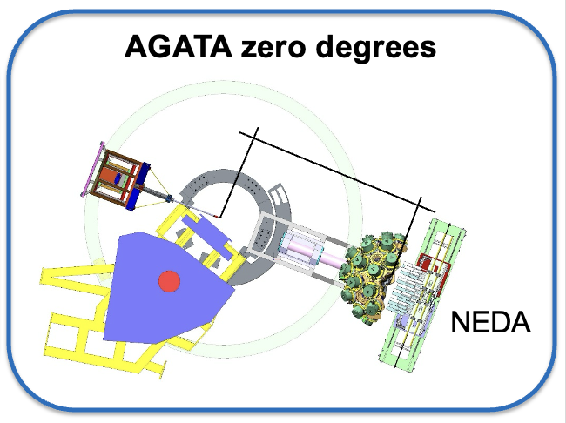
The NEDA time line
?
2017-2019
NEDA@GANIL
2021-2025
NEDA@HIL
2026-2028
NEDA@LNL

Slide 10
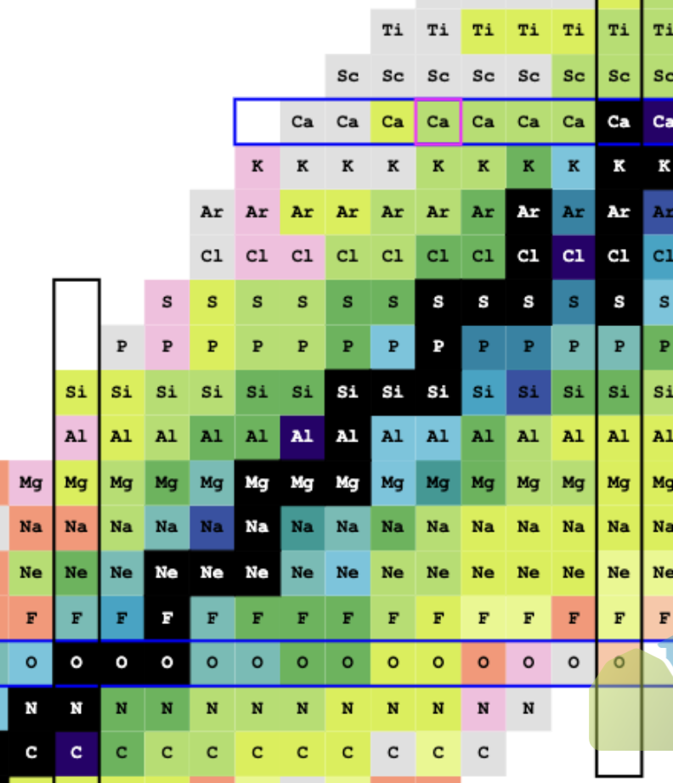
2p
(³He,n) reactions
2p transfer → large exoticity of final neutron deficient nucleus

Slide 11
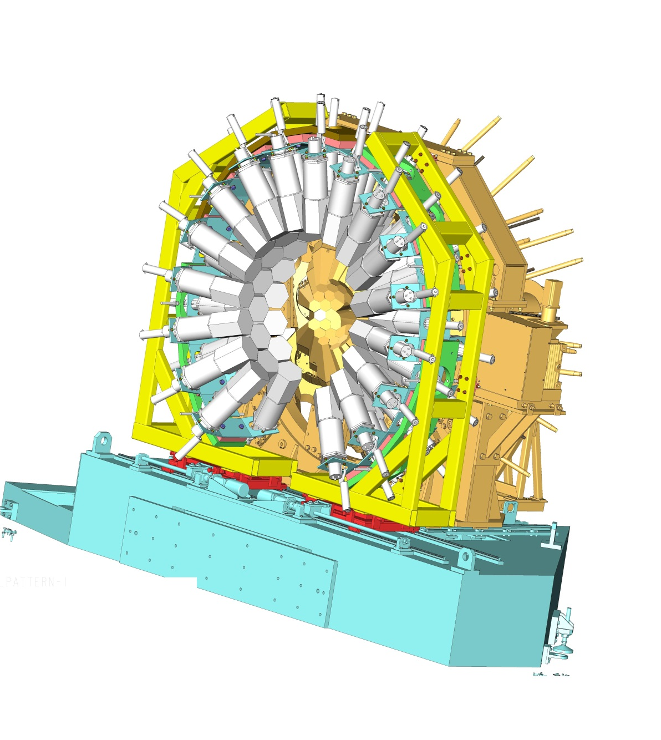
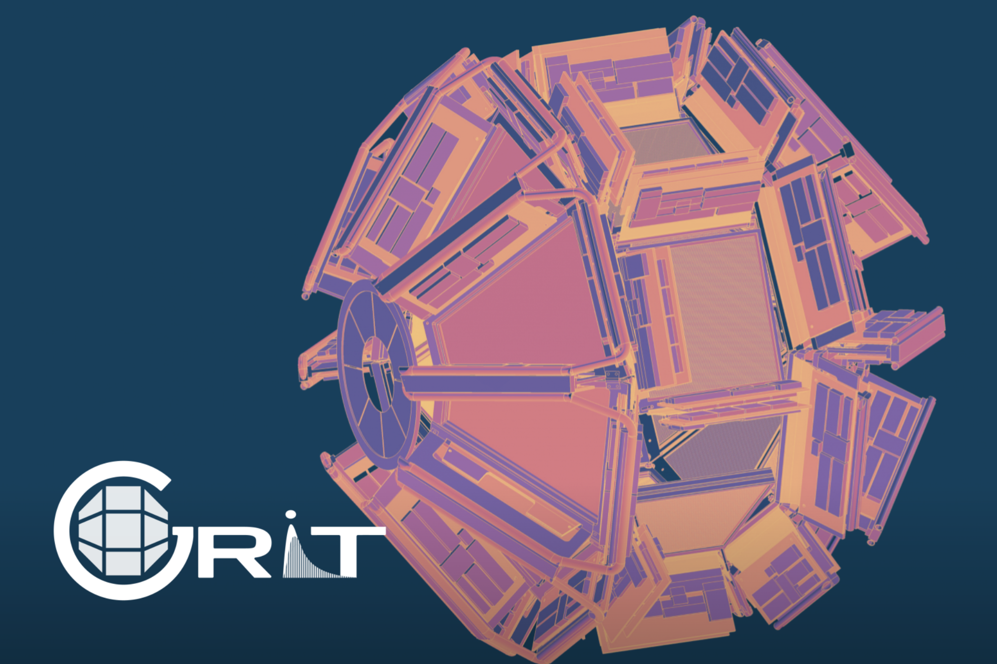
Coupling GRIT-NEDA-AGATA
One could imagine it as a campaign dedicated NEDA+AGATA+VAMOS or a unique configuration NEDA+AGATA+GRIT+VAMOS
Mechanical integration
Electroncis integration
…

Slide 12
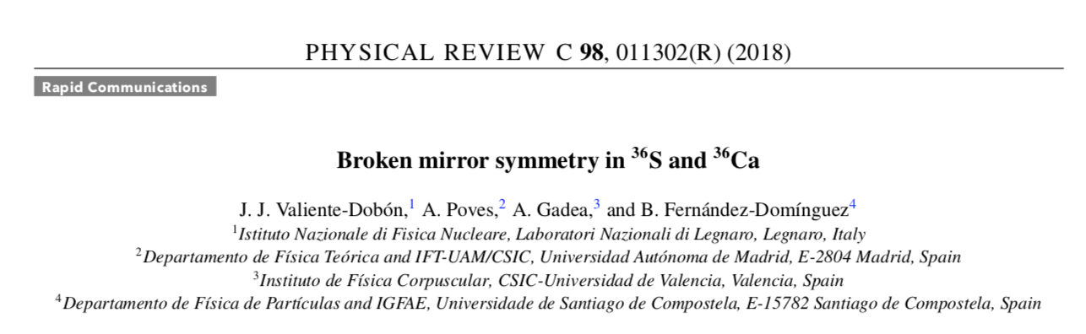
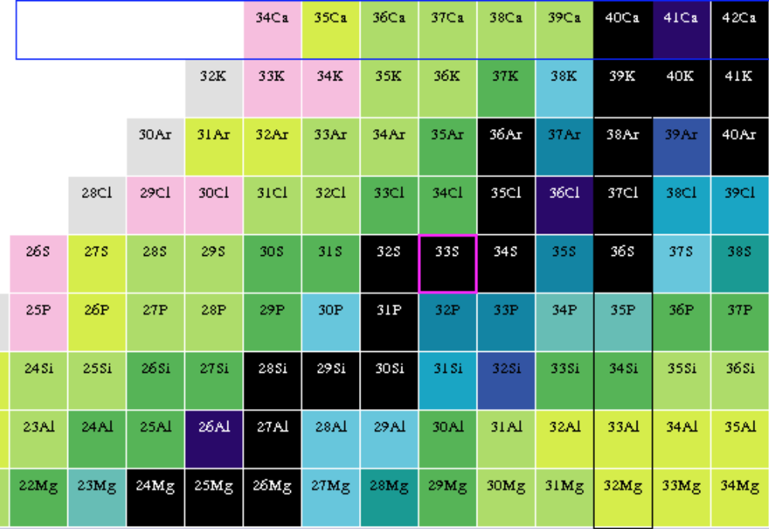
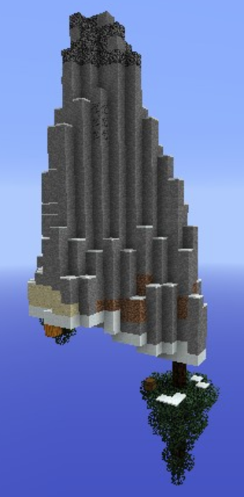
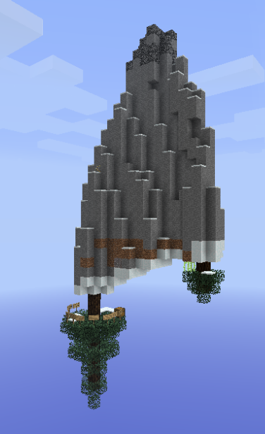
Broken mirrors: the ³⁶Ca-³⁶S case
Isospin symmetry Island of inversion
Mirror Energy Differences
MED_{J} = E_{J,Z>} - E_{J,Z<}
³²Ca
³³Ca
Z
N=Z
N
Island of inversion
N=Z

Slide 13
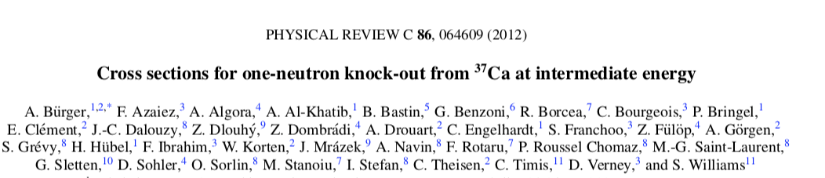
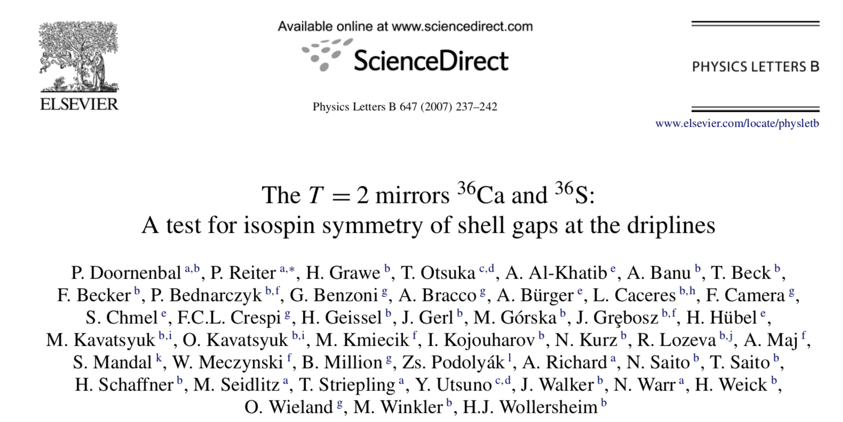
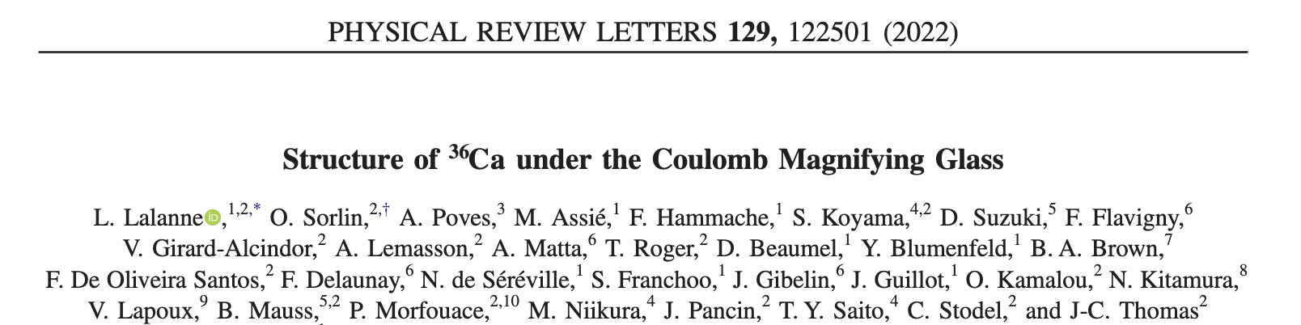
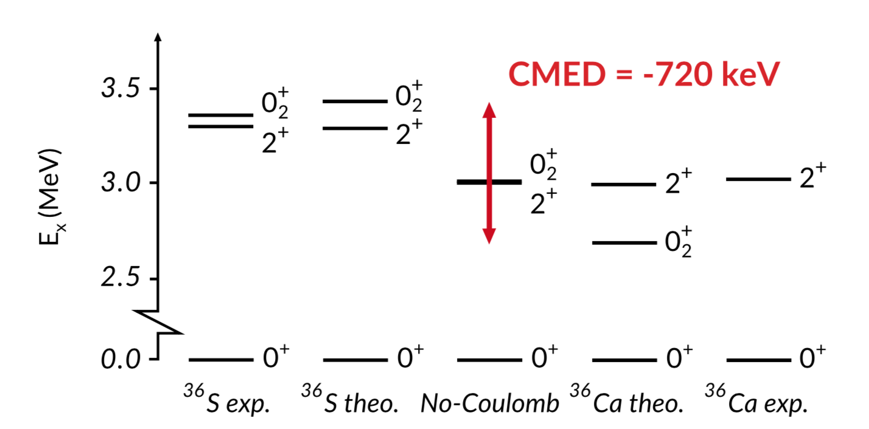
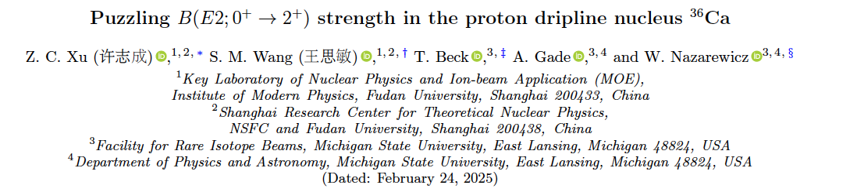
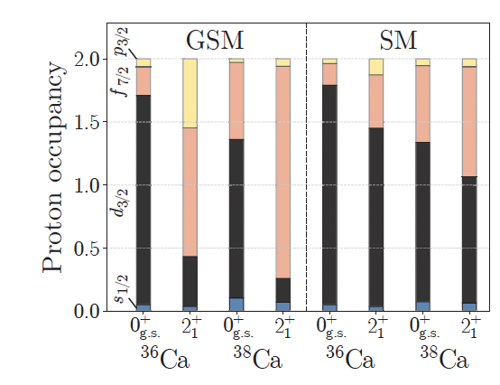
LSSM calculations for ³⁶Ca-³⁶S
The proton being further away feels less the Coulomb repulsion and therefore is more bound
d_{3/2}
s_{1/2}
π
d_{5/2}
π
³⁶Ca
υ
(sd)¹²
d_{5/2}⁶s_{1/2}¹d_{3/2}¹
8 ns
d_{5/2}⁶s_{1/2}²d_{3/2}² (pf)²
d_{5/2}⁶s_{1/2}¹d_{3/2}¹
(sd)¹²
d_{5/2}⁶s_{1/2}²
Sdpfu-mix interaction: model space (sdpf)πν and (sd) πν
two-body matrix elements of the Coulomb potential

Slide 14
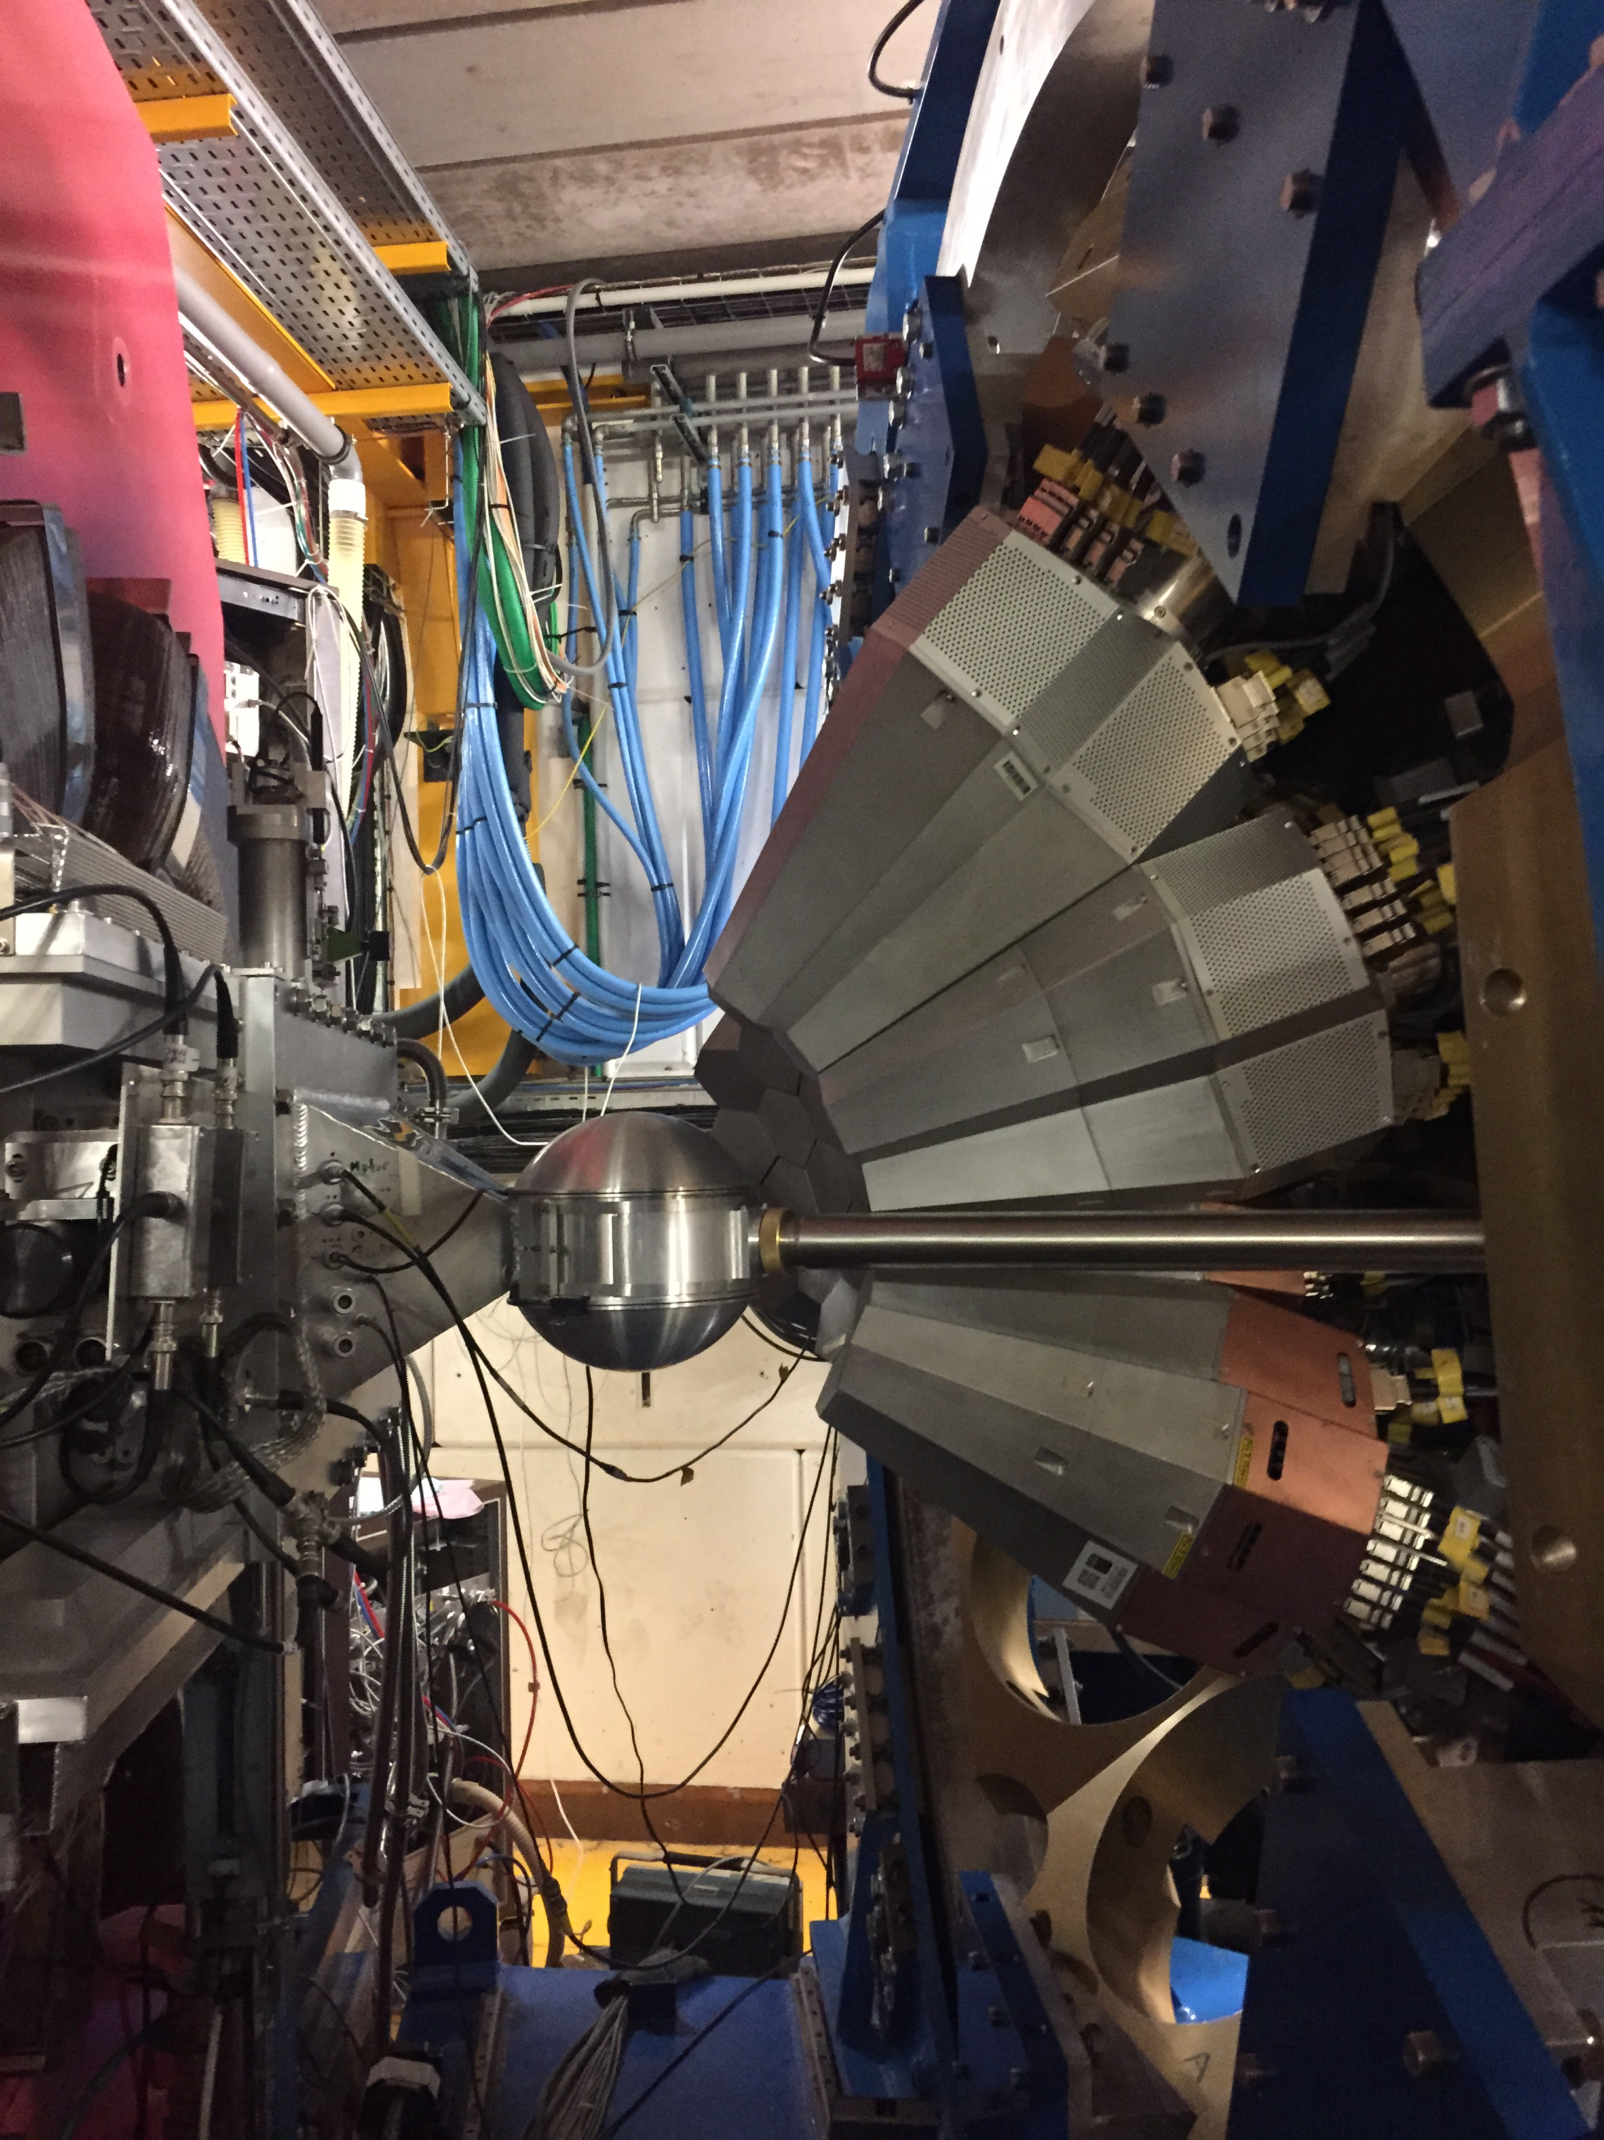
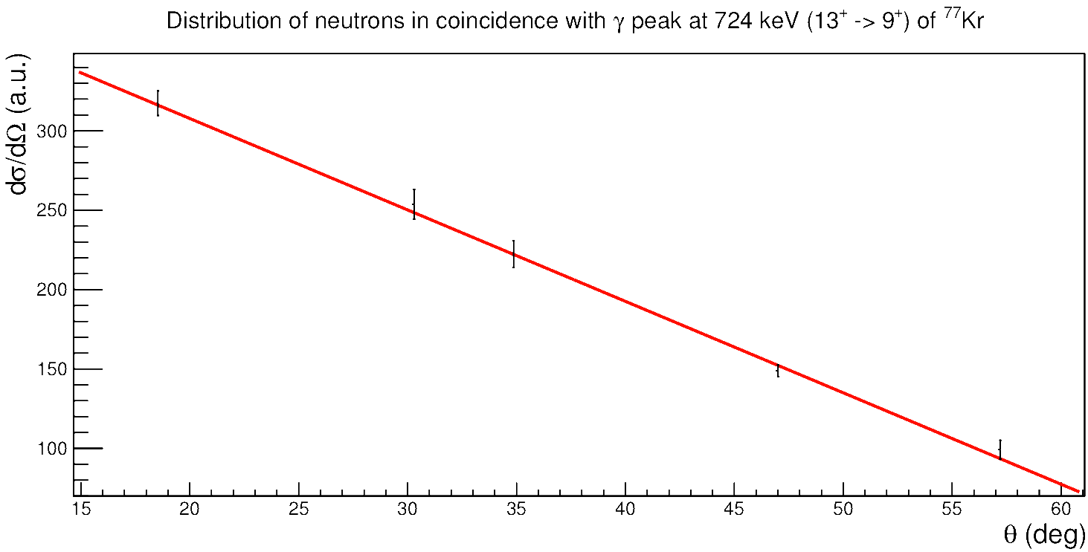
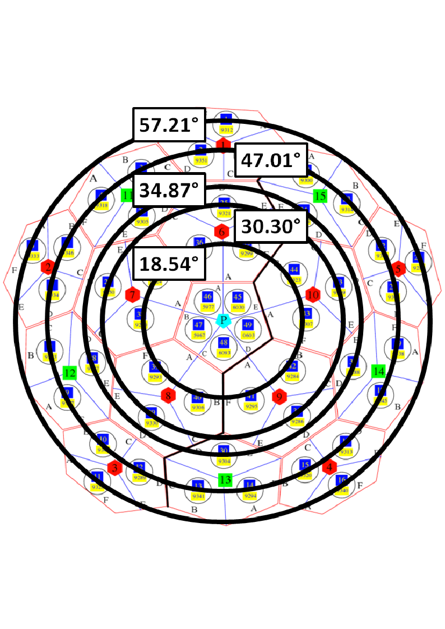
Experimentally CMED in ³⁶Ca-³⁶S
³⁶Ar (³He,n)³⁶Ca
Populate the 2⁺/0₂⁺ via ³⁴Ar (³He,n) ³⁶Ca
Proton nature of the 2⁺ in ³⁶Ca?
Measure the 0⁺→ 0⁺ transition internal pair production e⁺e⁻ The e+e- pair production branch in the 0+ → 0+ transition is 50 more intense than the EC branch. Lifetime?
³He target
Neutron detector NEDA 2π
Angular distributions with NW
DWBA calculations (Twofnr) – One step process → Potel more realistic calculations
Optical potential: C.T. Liang et al. JPG 36 (2009) 085104

Slide 15
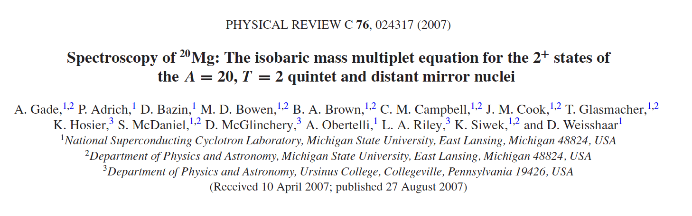
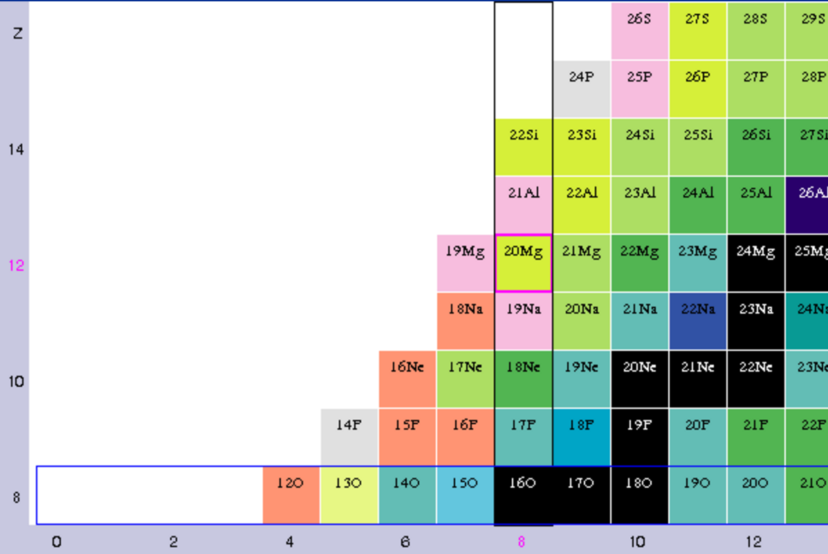
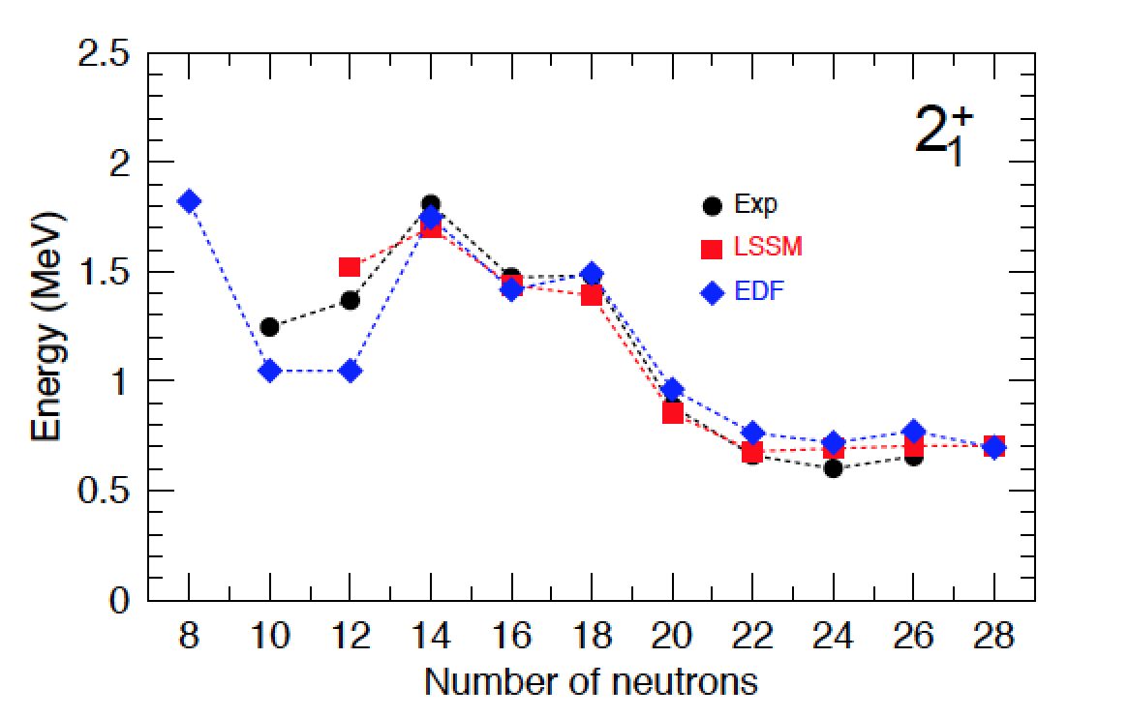
Spectroscopy of ²⁰Mg
¹⁸Ne (³He,n) ²⁰Mg
M. Borrajo, T.R.Rodriguez, J.L. Egido, PLB 746, 341 (2015)

Slide 16
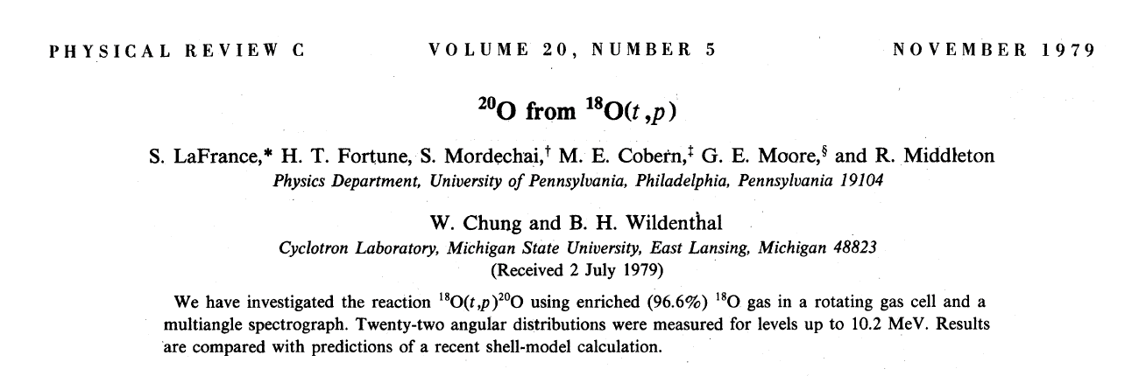
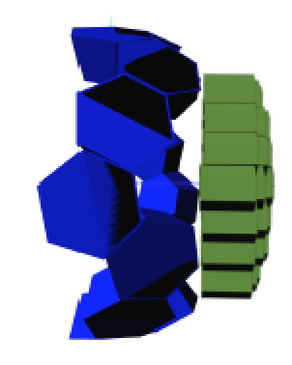
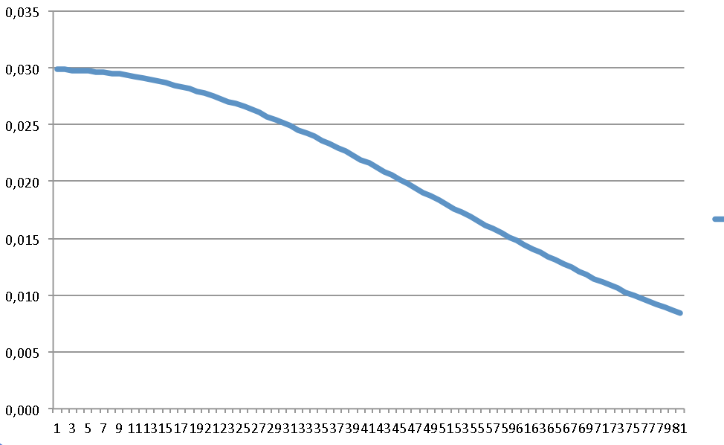
Transfer ¹⁸Ne (³He,n) ²⁰Mg
DWBA calculations (Twofnr) – One step process
17
Energy (MeV)
0⁺ (6p2h)
3
SF x
θ_{Lab}(degrees)
Energy of the neutrons emitted in the laboratory reference frame
Optical potential: C.T. Liang et al. JPG 36 (2009) 085104

Slide 17
Wealth of transfer reactions
F. Galtarossa, A. Gadea, A. Goasduff, A. Gottardo, S. Bottoni, D. Mengoni, M. Rocchini, …
¹⁴O (³He,n) ¹⁶Ne → 2.7 10⁵ ions
¹⁸Ne (³He,n) ²⁰Mg → 7.7 10⁶ ions
²²Mg (³He,n) ²⁴Si → 1 10⁵ ions
³⁴Ar (³He,n) ³⁶Ca → 9 10⁵ ions
⁵²Fe (³He,n) ⁵⁴Ni → 3 10⁴ ions
⁵⁴Fe (³He,n) ⁵⁶Ni → stable
…

Slide 18
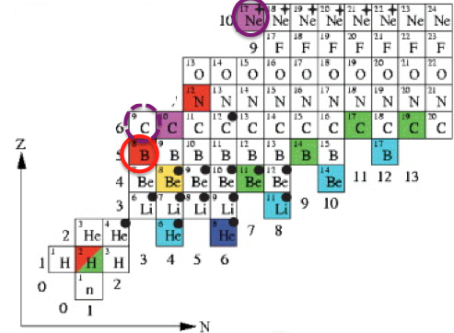
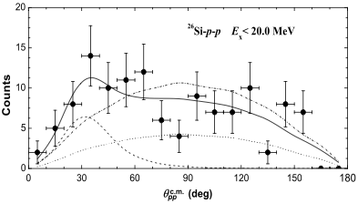
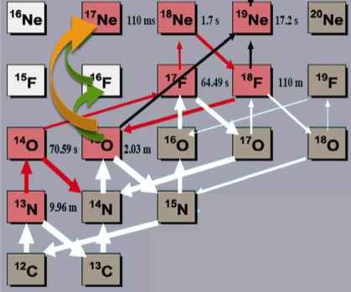
Study of two-proton structures
Marlene Assie
Case of ⁷Be(³He,n)⁹C
Case of ¹⁵O(³He,n)¹⁷Ne
Case of ²⁶Si(³He,n)²⁸S
⁸B = 1p halo nucleus
⁹C = good candidate for 2-proton halo and 2p structure
N. Furutachi et al, Prog. Theor. Phys., 122,2009
. 1st excited state : two proton halo
. Higher levels : 2 proton structure observed
T. Zerguerras et al, Eur. Phys. J. A 20, 389–396 (2004)
J.D. Ovejas PLB 843 (2023) 138007
. Waiting in CNO cycle : direct 2p capture rate
on ¹⁵O
²⁸S → correlation between 2p emitted from high lying states
X. Xu, Physics Letters B 727 (2013) 126–129
3-body decay
pure 2p emission
CNO cycle

Slide 19
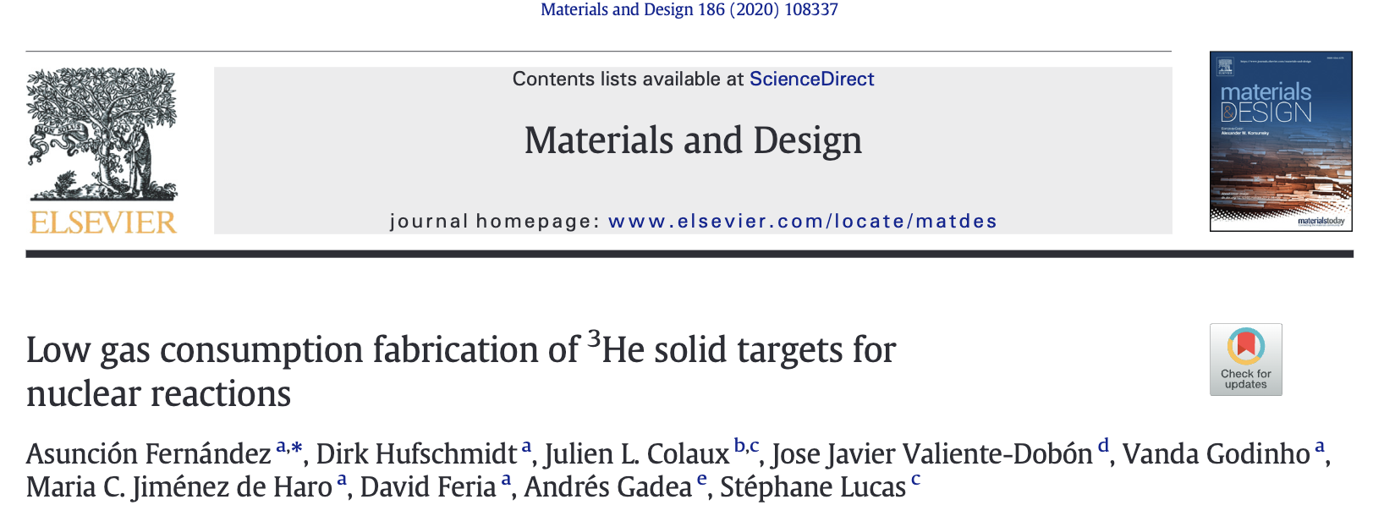
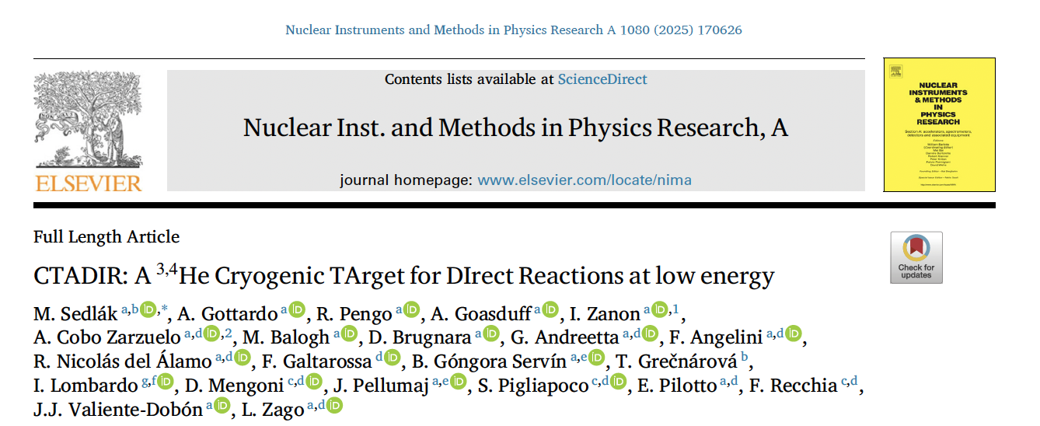
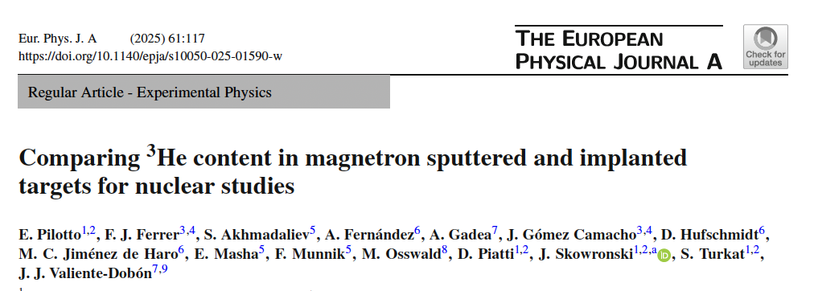
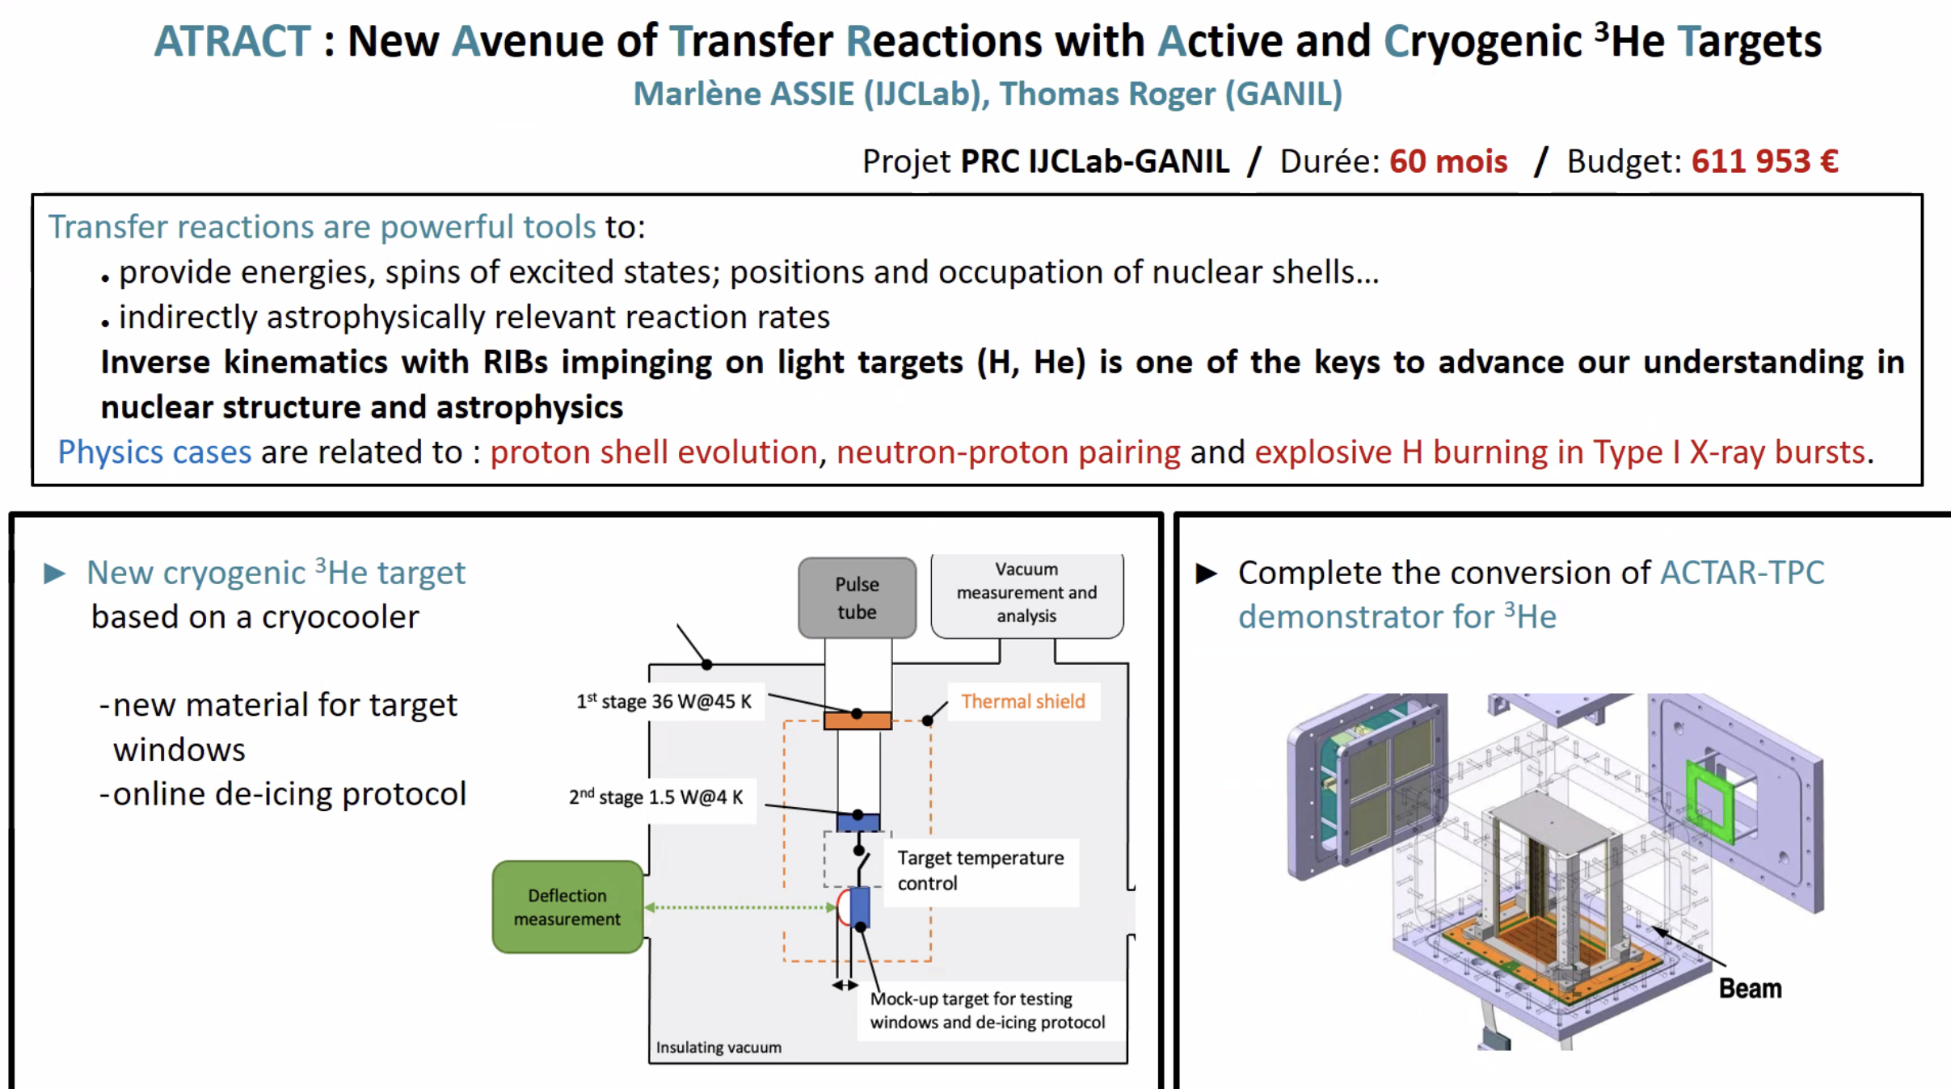
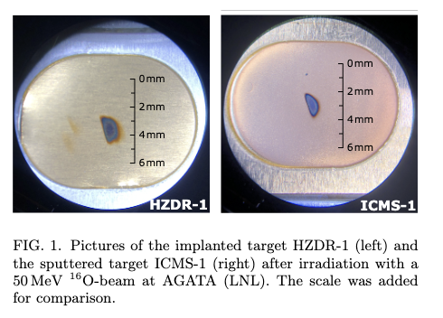
³He target possibilities
Solid target
Cryogenic target
Density: 10¹⁸ - 10¹⁹ at/cm²
Cost: 100 euros
Density: 10²⁰ − 10²¹ at/cm²
Cost:?

Slide 20
Summary
Versatile neutron detector to be coupled to gamma-ray arrays and charged particle detectors.
High efficiency neutron detector based on the liquid scintillator EJ301 with good neutron-gamma discrimination capabilities.
NEDA can be used in:
  Fusion evaporation reactions
  Transfer reaction, such as (³He,n), (d,n), etc.
  …
A discussion on compatibility with GRIT and AGATA—both in terms of mechanics and electronics—is necessary; however, I believe the possible anticipated physics outcomes fully justify the effort.
One could also imagine a campaign only NEDA+AGATA …
Collaboration G. Pottel (Uni. Sevilla) for the 2p transfer crossection calculations

Slide 21
END

Slide 22
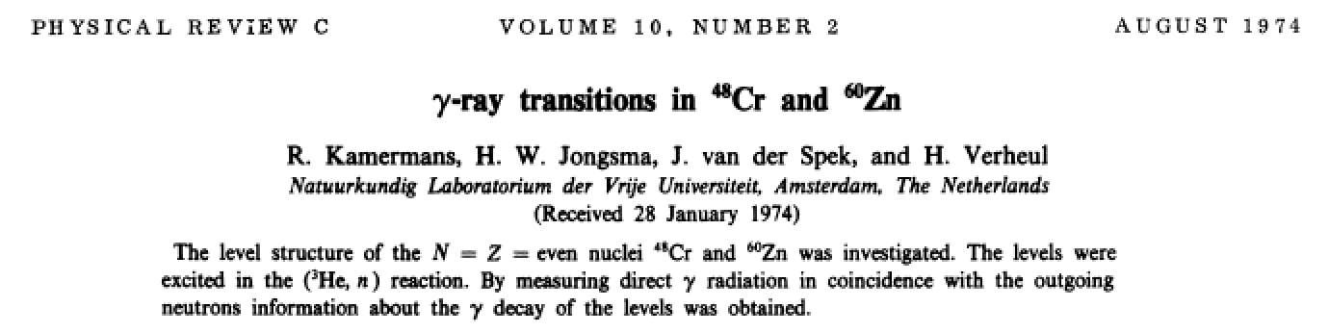
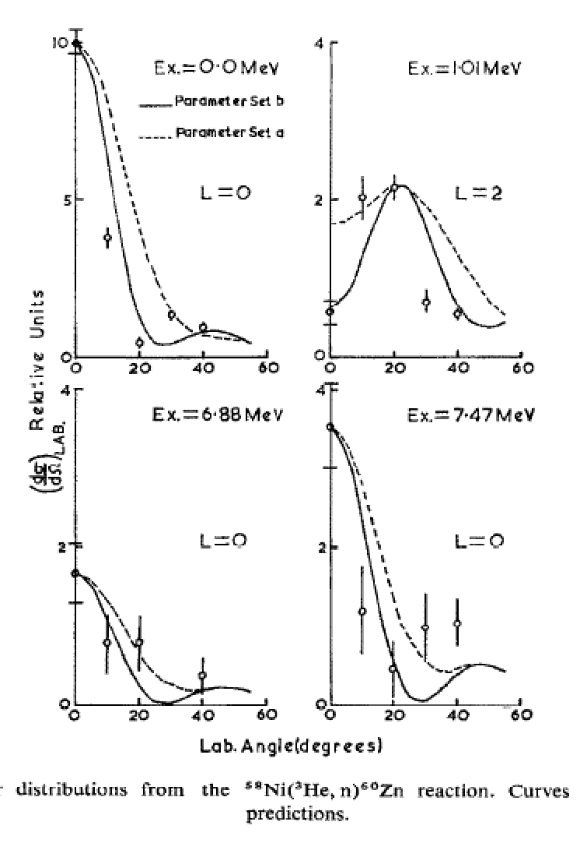
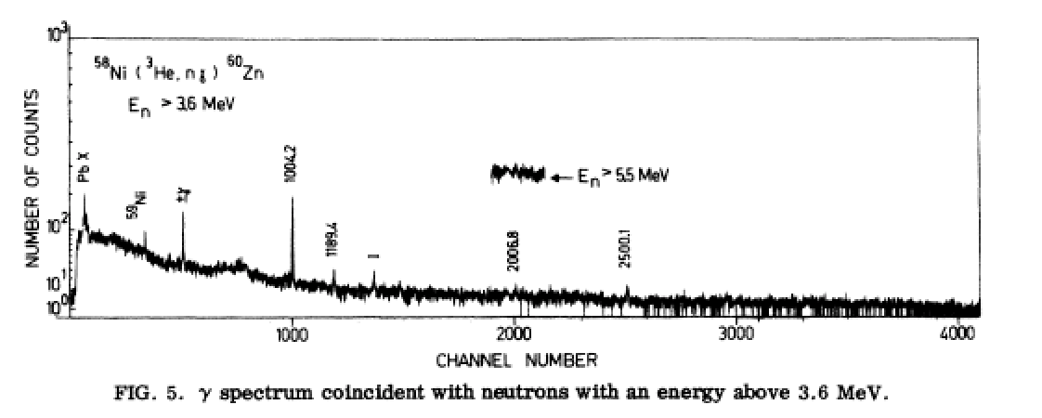
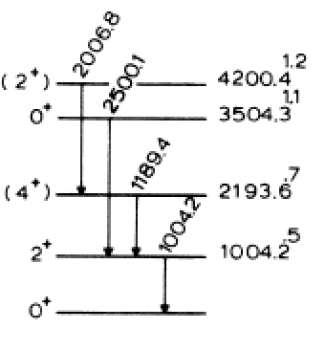
Transfer reactions ³He,n
Let’s look at one example: ⁶⁰Zn
Angular distribution
⁵⁸Ni (³He,n) ⁶⁰Zn
One neutron detector NE213 n/γ discrimination and one HPGe detector

Slide 23
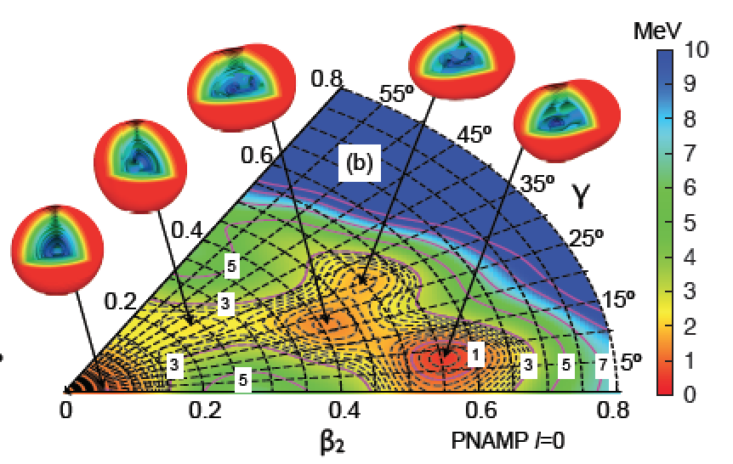
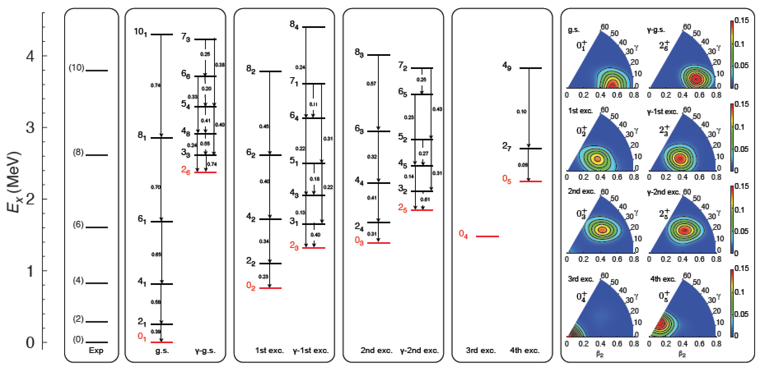

Shape coexistence in ⁸⁰Zr
Five 0+ states below 2.25 MeV that correspond to different minima in the triaxial potential energy landscape which constitutes a unique example of multiple shape coexistence in the nuclear chart.
Fusion-evaporation reaction ²⁴Mg (⁵⁸Ni,2n)
S.M. Fisher et al., PRL87, 132501 (2001)
T. Rodriguez and J.L. Egido, Physics Letters B 705 (2011) 255–259

Slide 24
Shape coexistence in ⁸⁰Zr
DWBA calculations (Twofnr) – One step process
4.0 MeV/u
NEDA 2π
⁷⁸Sr (³He,n) ⁸⁰Zr
⁷⁸Sr (source – 2.2 10⁶ ions/μA) considering 1.4 μA of protons and 5% charge/acc. efficiency → 1.5 10⁵ ions/s
SF x
Optical potential: C.T. Liang et al. JPG 36 (2009) 085104

Slide 25



NEDA test setup at LNL
The tests are being performed at LNL with the following instrumentation:
2 x BC501A (5” x 5” cylindrical prototype detector)
2 x BC537 (5” x 5” cylindrical prototype detector)
SIS3302 100 MS/s, 16 bits 8 ch. digitizer (analog setup)
SIS3350 500 MS/s, 12 bits 4 ch. digitizer
Digital PSA
VD tests
Prototype tests
Relative efficiency performance
Cross-talk between the detectors
Timing
BC501A
BC537
BaF2
25

Slide 26


Simulations: Single cell unit
Detailed study of GEANT4 simulations for a single detector of NEDA.

Slide 27


PSA measurements for NEDA
Algorithm for digital PSA for various Photomultipliers (fast to slow HQE 5’’)
FOM for various PM
PM tests for best PSA NEDA capabilities

Slide 28



Timing measurements for NEDA
Algorithm for digital timing for various Photomultipliers (fast to slow HQE 5’’)
PM tests for best timing NEDA capabilities
The time resolution is obtained with a ⁶⁰Co source and for two frequencies 500 MHz (the nominal) and 200 MHz (final NEDA one)

Slide 29



NEDA test: PSA Neural Network
Pulse shape discrimination for NEDA
Traditional
NN
P.A. Soderstrom et al., to be submitted NIM A

